Slide 1
Microcalorimeter for PTOLEMY
M. Rajteri

Slide 2
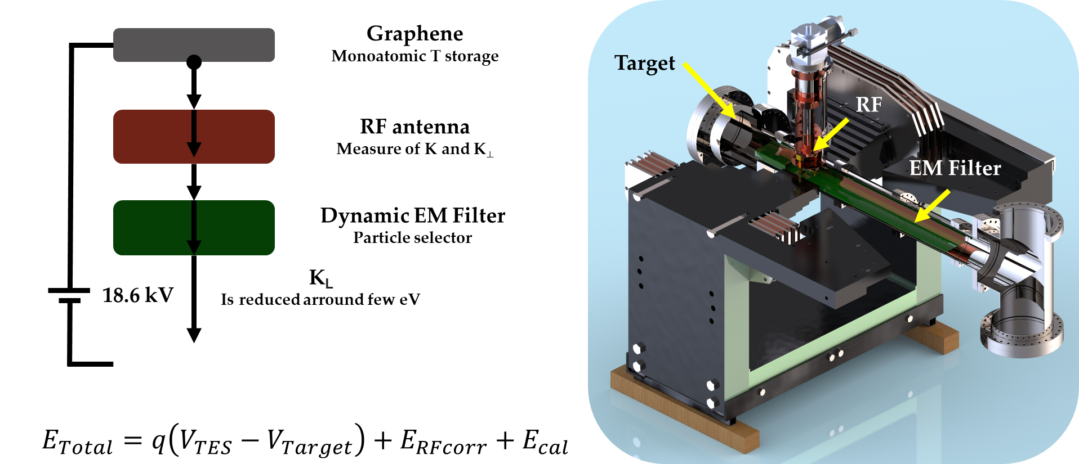
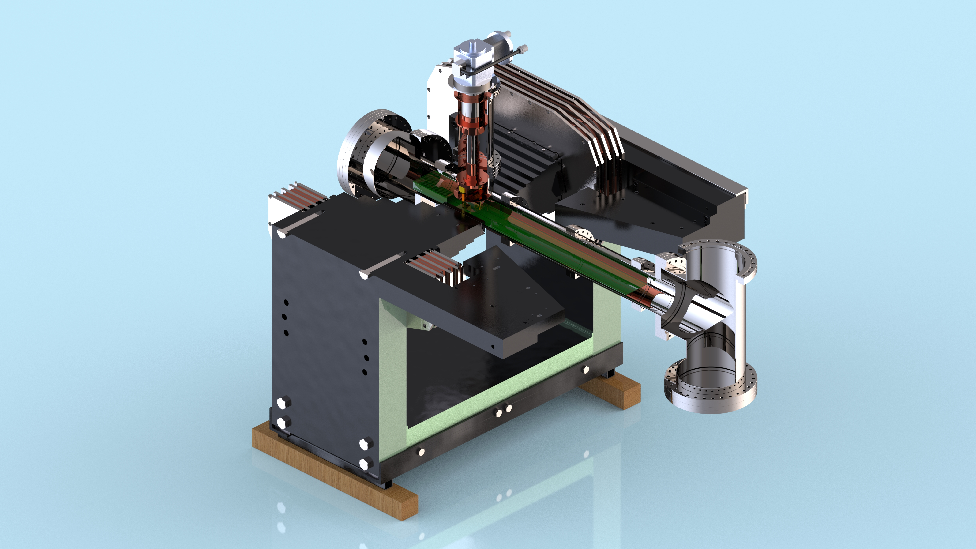
Microcalorimeter for PTOLEMY
Andi Tan
(Princeton)
Graphene
Monoatomic T storage
Target
RF
RF antenna
Measure of K and K⟂
EM Filter
Dynamic EM Filter
Particle selector
K_{L}
Is reduced arround few eV
18.6 kV
Calorimeter
TES provide a differential E measurement
Calorimeter
TES provide a differential E measurement
Microcalorimeter
Microcalorimeter
$$E_{Total}=q\left(V_{TES}−V_{Target}\right)+E_{RFcorr}+E_{cal}$$
Goal for electron resolution  ΔE_{e} = 50 meV @10 eV
Notes:
Più preciso su cosa lo rende un detector nelle varie applicazioni

Slide 3
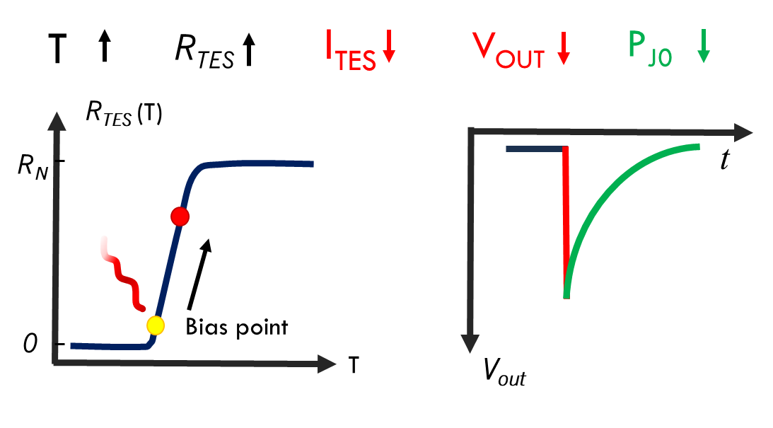
Superconducting single photon detectors
STJ (1991)
Superconducting Tunnel Junction
TES (1995)
Transition-edge Sensor
Q ~ E_{ph}/Δ_{SC}
SC
I
SC
SNSPD (2001)
(Superconductive Nanowire Single Photon Detector )
MKID (2008)
(Microwave Kinetic Inductance Detecor)
light
F₀
|S₂₁| [dB]
dark
δf
Frequency [GHz]
Notes:
Pochi al mondo hanno ottenuto buoni risultati con STJ. Difficili gli array,

Slide 4
Superconducting single photon detectors
 | STJ | MKID | SNSPD | TES
Temperature | 0.4 K | 0.1-0.4 K | 1.5-3 K | 0.01-0.4 K
Detection efficency | 70% | 17% | 99.5% | 98%
Max count rate | 10 kHz | 2 kHz | 1.5 GHz | 500 kHz
Energy resolution | Very Good | Good | SOME | Very good
Number of Pixel | 100 | 20k | 400k | 1k
Dark count rate | ? | ? | <0.01 Hz | <10⁻⁴ Hz
Ceccarelli, Francesco, et al. "Recent advances and future perspectives of single‐photon avalanche diodes for quantum photonics applications." Advanced Quantum Technologies 4.2 (2021): 2000102.
Lita, Adriana E., et al. "Development of superconducting single-photon and photon-number resolving detectors for quantum applications." Journal of Lightwave Technology 40.23 (2022): 7578-7597.

Slide 5
Superconducting single photon detectors
 | STJ | MKID | SNSPD | TES
Temperature | 0.4 K | 0.1-0.4 K | 1.5-3 K | 0.01-0.4 K
Detection efficency | 70% | 17% | 99.5% | 98%
Max count rate | 10 kHz | 2 kHz | 1.5 GHz | 500 kHz
Energy resolution | Very Good | Good | SOME | Very good
Number of Pixel | 100 | 20k | 400k | 1k
Dark count rate | ? | ? | <0.01 Hz | <10⁻⁴ Hz
Ceccarelli, Francesco, et al. "Recent advances and future perspectives of single‐photon avalanche diodes for quantum photonics applications." Advanced Quantum Technologies 4.2 (2021): 2000102.
Lita, Adriana E., et al. "Development of superconducting single-photon and photon-number resolving detectors for quantum applications." Journal of Lightwave Technology 40.23 (2022): 7578-7597.

Slide 6
Transition-Edge Sensors
Transition-Edge Sensors (TESs): detectors that exploit the strongly temperature-dependent resistance of the superconducting phase transition
~1 keV ~1 eV ~ 1meV
Calorimeter: energy detection
NIR, Visible, UV, x-ray, gamma ray
alpha particles
Near future….electrons
Bolometer: power detection
far-infrared (FIR)
÷
microwaves (THz-GHz)

Slide 7
TES calorimeter
A Calorimeter is a device used to measure the absorbed energy
E_{γ}
T
C = heat capacity
G = Thermal conductance
ΔT=E/C
C
ΔT
Energy resolution
τ = C/G
G
$$∆E≈{\text{(}\text{k}\text{B}\text{T} \text{2 }\text{C} \text{B}\text{)}}^{\frac{1}{2}}$$
T_{bath}
t
Performs better at low temperature and with small C
Notes:
Più preciso su cosa lo rende un detector nelle varie applicazioni

Slide 8
TES calorimeter
Microcalorimeters based on the steep superconductive transition of a metallic film.
Excelent energy resolution:
Energy of a single particle
Number of particles
Low dark count rates
Near unit quantum efficiency
Applications:
X-rays detection
Telecommunications
Quantum technologies
Metrology
Astrophysics
Particle experiments
10 µm
Notes:
Più preciso su cosa lo rende un detector nelle varie applicazioni

Slide 9
TES calorimeter
R_{TES} (T)
T_{bath} < T_{C} /2
V_{out}
I_{TES}
R_{N}
R_{fb}
R_{bias}
L_{in}
SQUID
L_{fb}
I_{bias}
R_{TES}
Bias point
R_{TES}
R_{TES}
Bias point
0
T
T_{TES}
R_{TES}
I_{TES}
V_{OUT}
P_{J0}
t
V_{out}
Notes:
Voltage bias perché Rbias molto piccola. Irwing nel 95 ha introdotto ETF

Slide 10
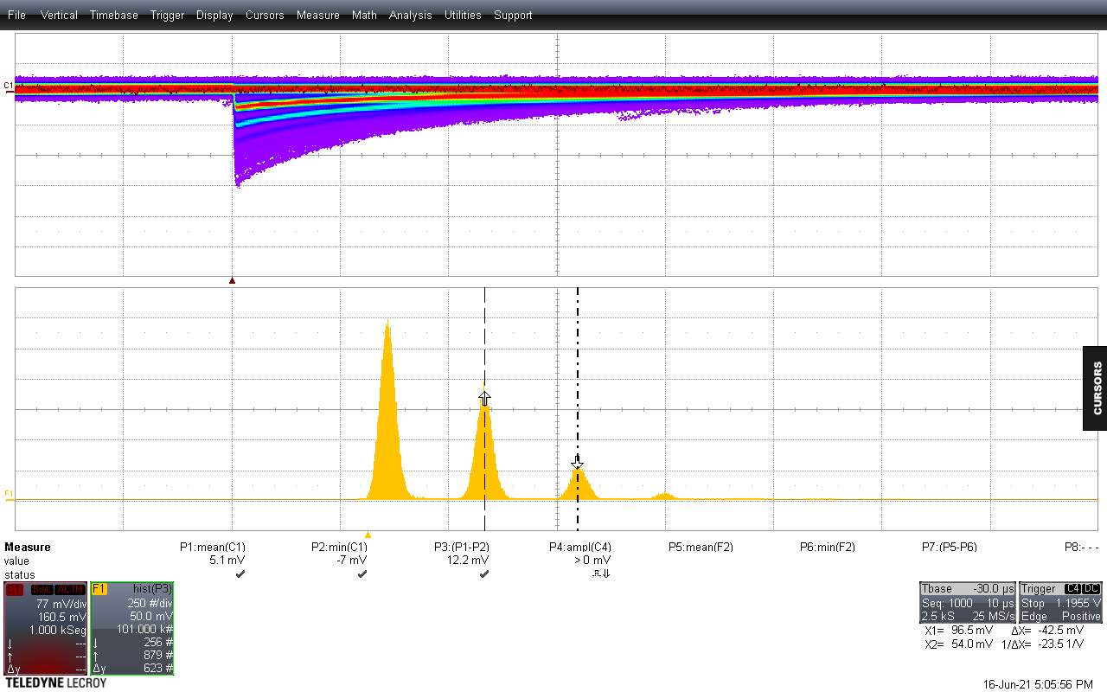
Photon counting characterization
Amplitude
λ= 1540 nm
0 ph
Counts
1 ph
2 ph
3 ph

Slide 11
TES: Performances
Transition sharpness

Effective response time
□
Trade-off between response time and energy resolution
$$ΔE_{FWHM}≃2.36\sqrt{4kT_{c}^{2}\frac{C_{e}}{α}\sqrt{n/2}}∝T_{c}^{3/2}$$
Energy resolution
□
Trade-off between energy resolution and saturation energy
Saturation Energy
$$E_{max}=10 eV T_{c}=50 mK n=5$$
$ΔE_{FWHM}≃$ 39 meV

Slide 12
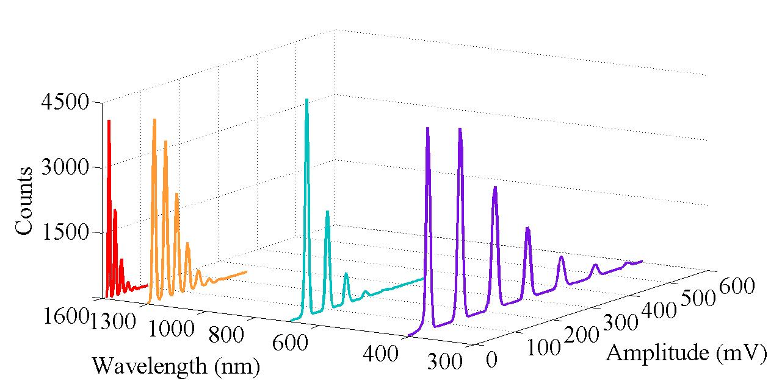
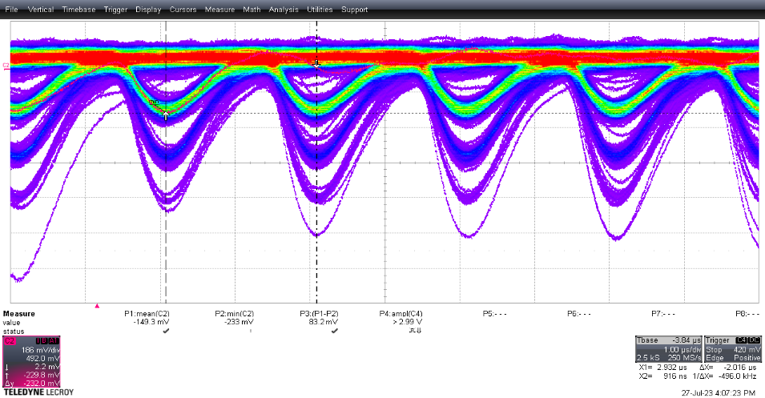
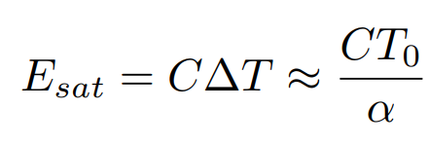
TES @INRiM
4500
Counts
T_{bath}= 40 mK
λ = 1540 nm (0.8 eV)
3000
20x20 µm
1500
600
1600
400
Amplitude (mV)
800
200
400
0
λ (nm)
Saturation energy
Repetition rate 500 kHz

Slide 13
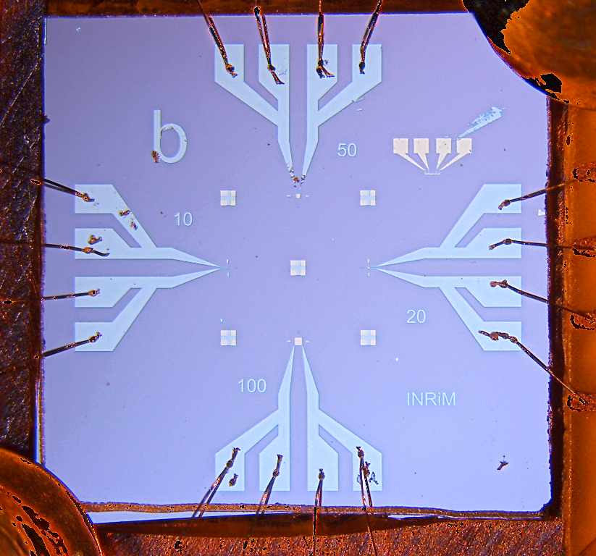
TES structure: Lito1 and Lito2
Au 30 nm
Nb
wiring
Ti 12 nm
SiN_{X} 500 nm
Si
SiN_{X} 500 nm
Thermal bath

Slide 14
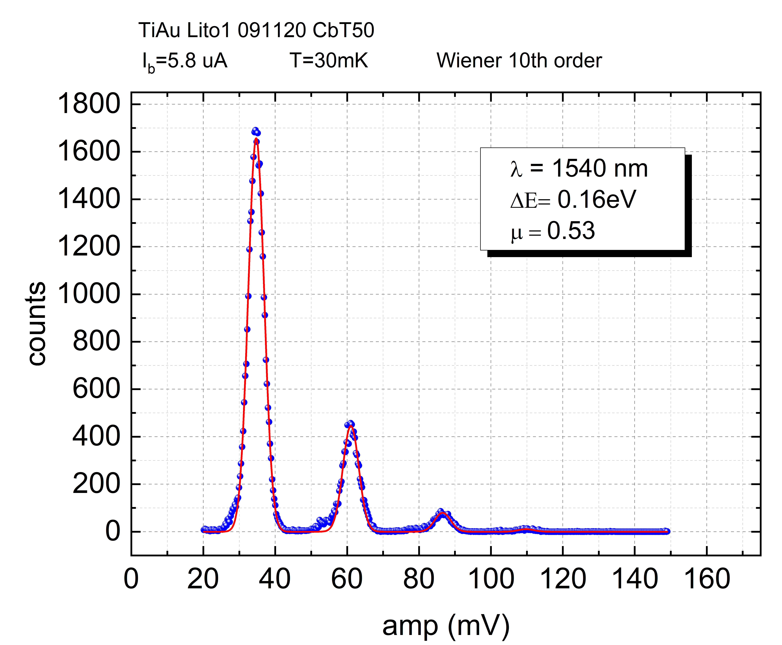
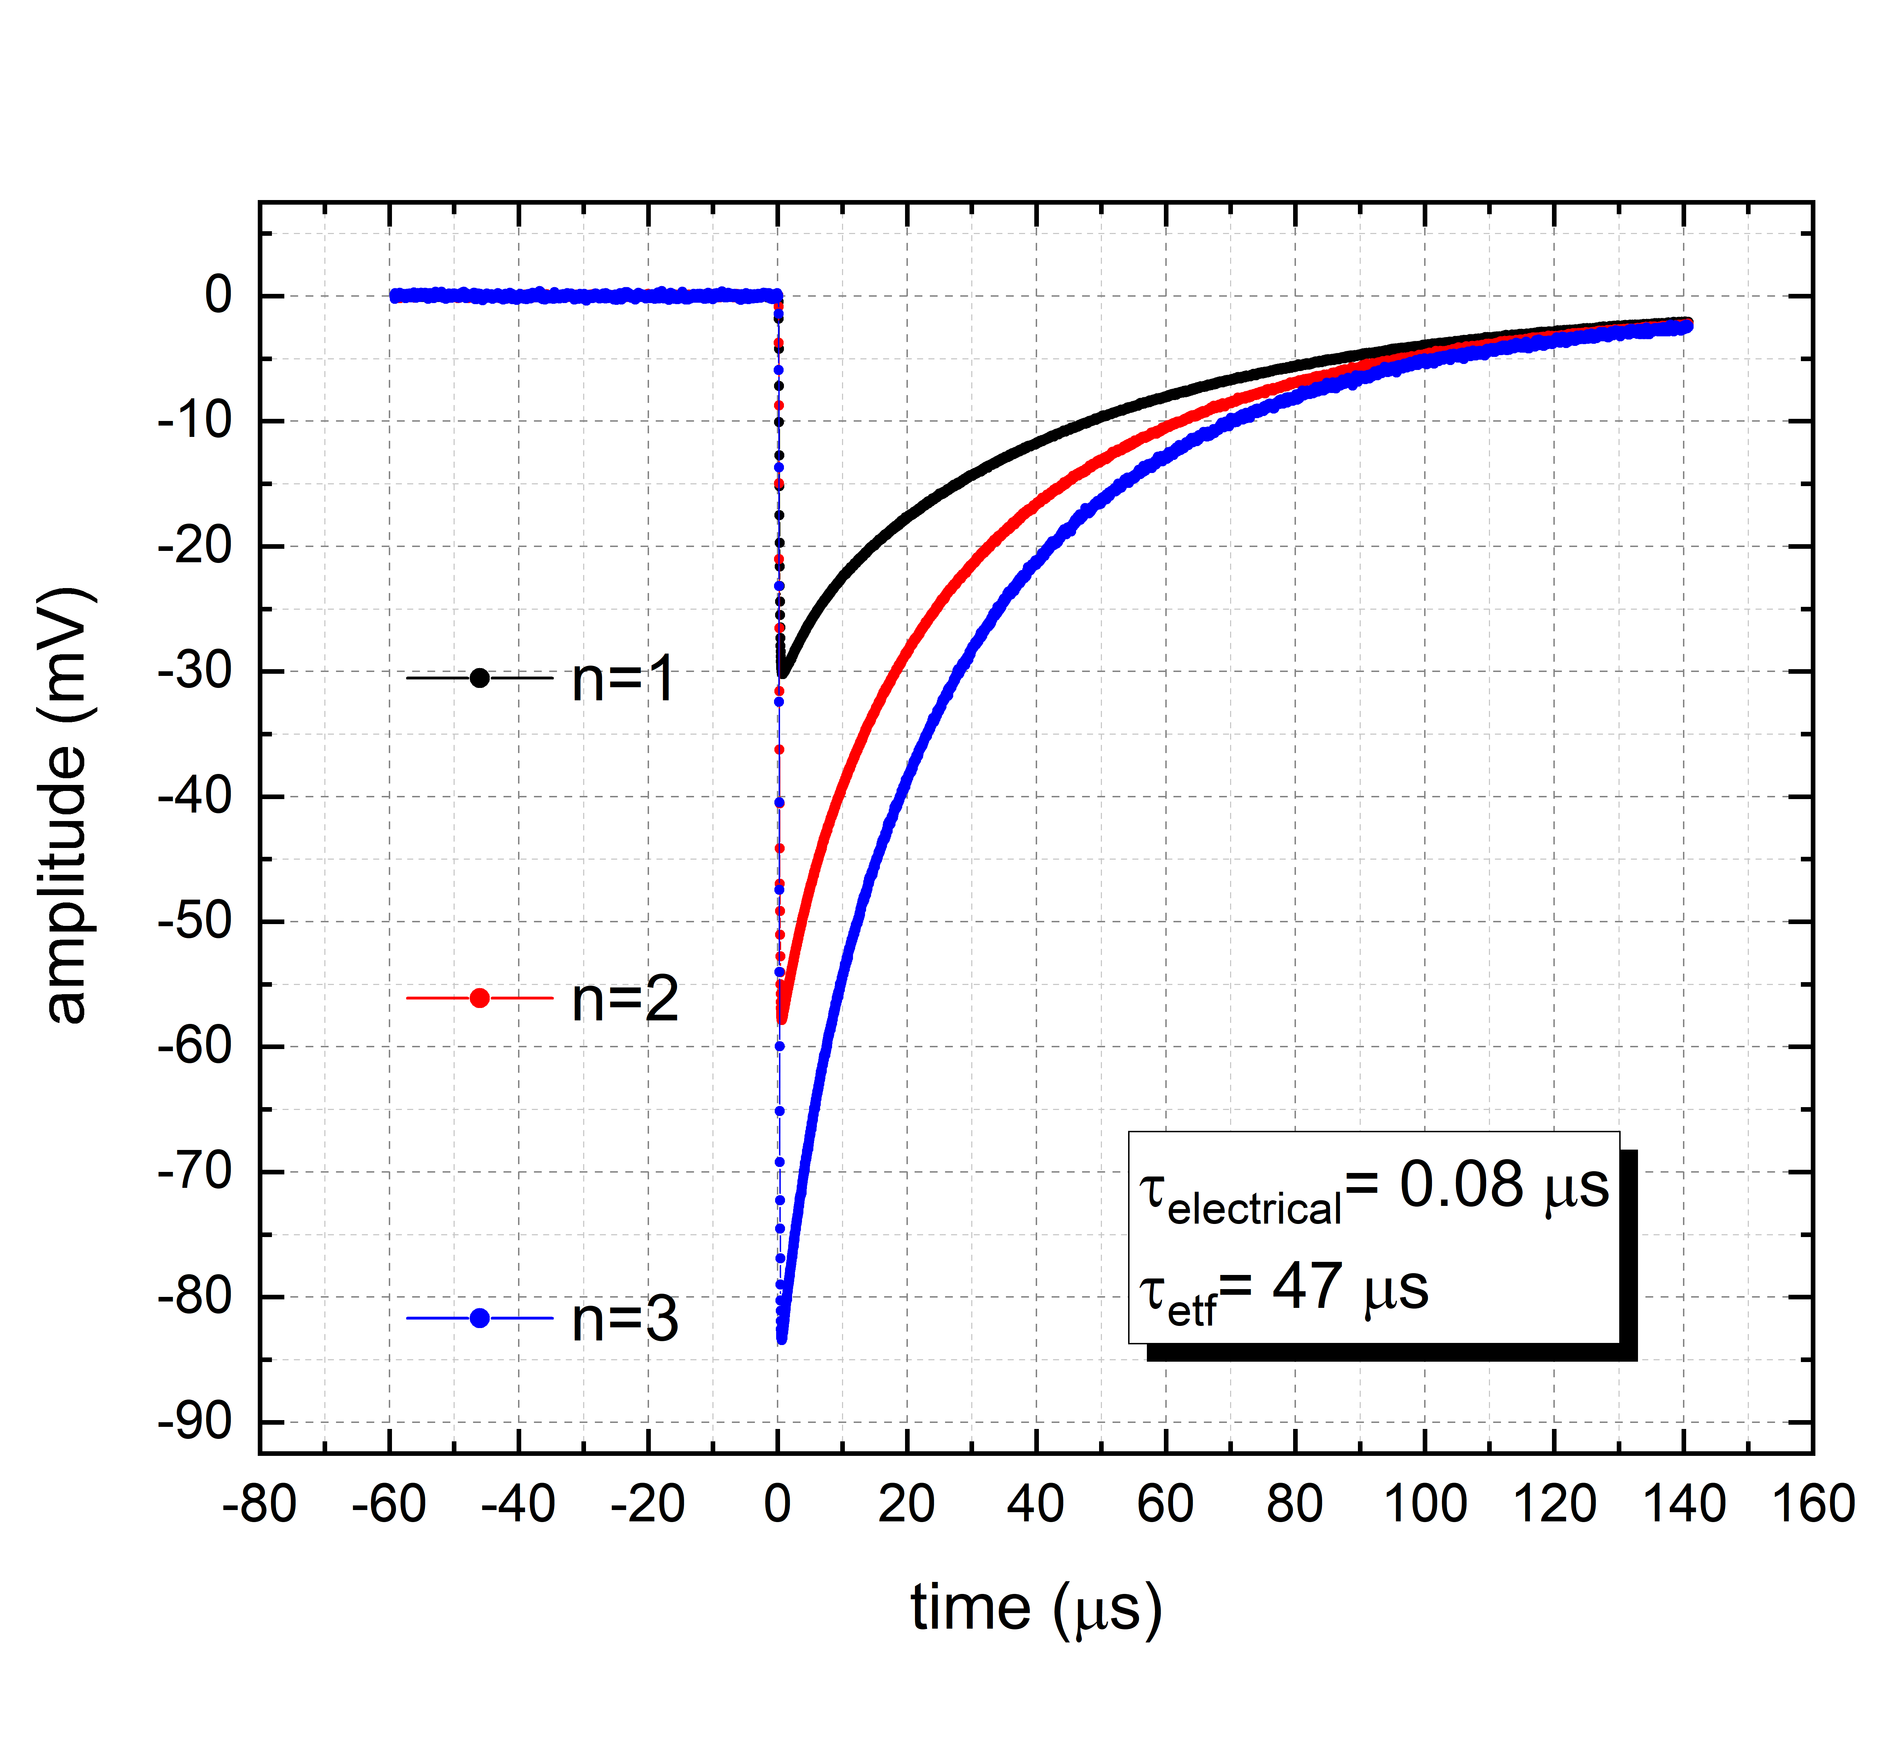
Lito1: T50
Histogram of pulses amplitude for fixed photon energy
50x50 µm (T50)
T_{C}= 47 mK
1
2
3

Slide 15
Lito2: T20
20x20 µm (T20)
R_{TES}= 20% R_{N}
T_{bath}= 40 mK
λ = 1540 nm (0.8 eV)
same result our APL13
but with an area
4 times greater

Slide 16
Conclusion
PTOLEMY requirements for electron detection are very demanding
ΔE = 50 meV @10 eV
TESs are good candidate to reach this goal
Best results up to now
ΔE_{fwhm} = 114 meV (σ =48 meV) (@ Tc~ 90 mK T20
Study of the materials and shape of devices are in progress
Cryogenic e-gun under development
……close to the first test on electron detection

