Slide 1
DRD3 Status
Sono stati mandati:
Il documento che delinea la struttura del DRD3
Un questionario per raccoglie gli interessi di ogni istituto
Un questionaro che raccoglie le risorse, attuali e “sperate”, di ogni istituto
Deadline: 20 Agosto 2023

Slide 2
DRD3: organizzazione e working groups

Slide 3
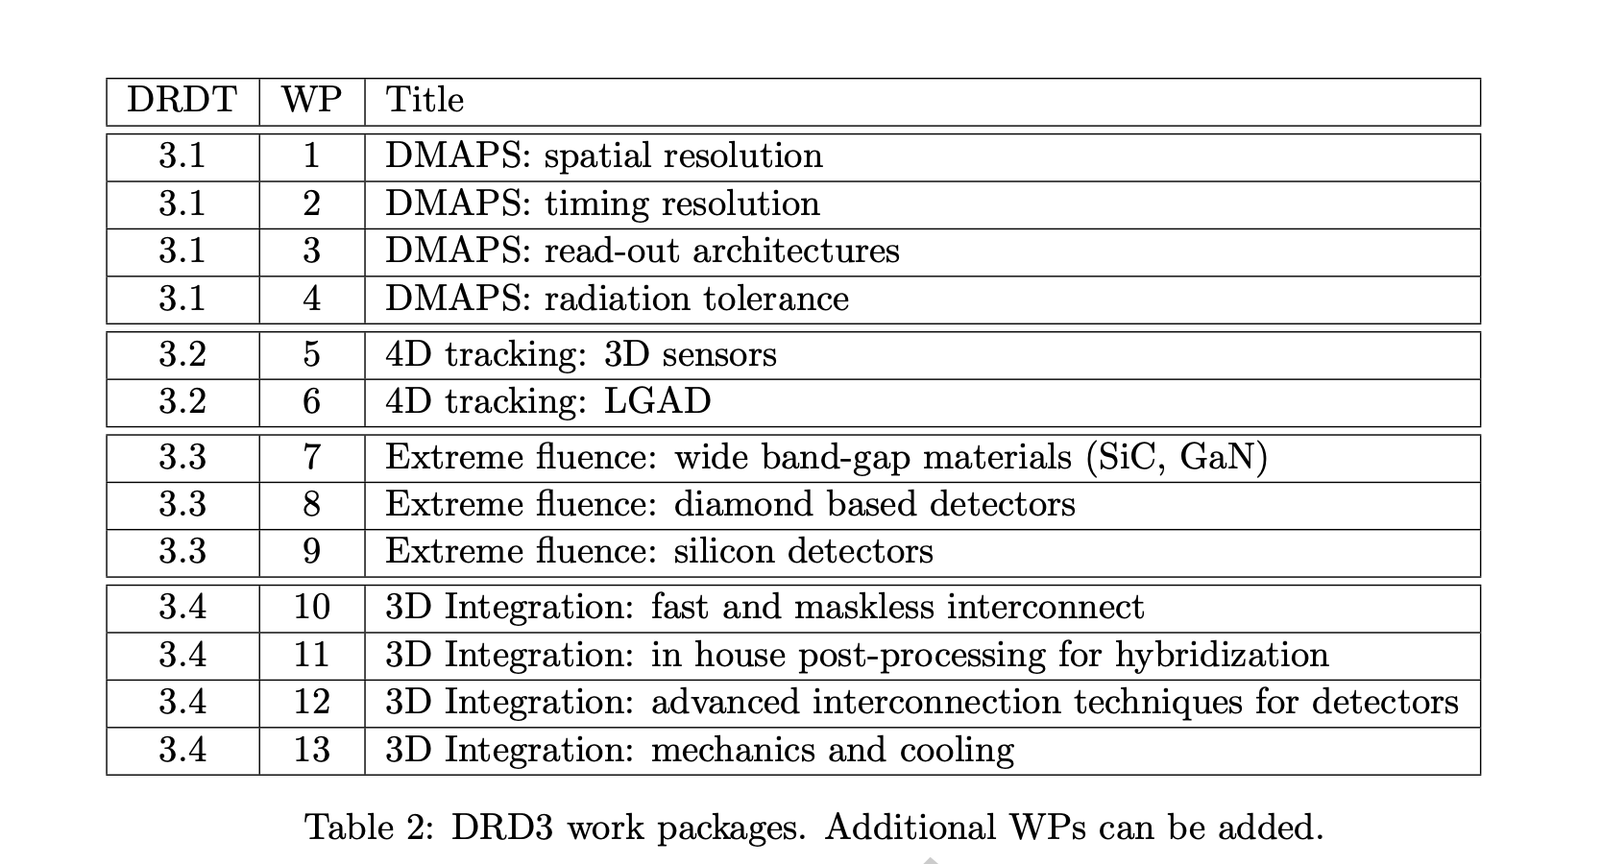
DRD3: work packages

Slide 4
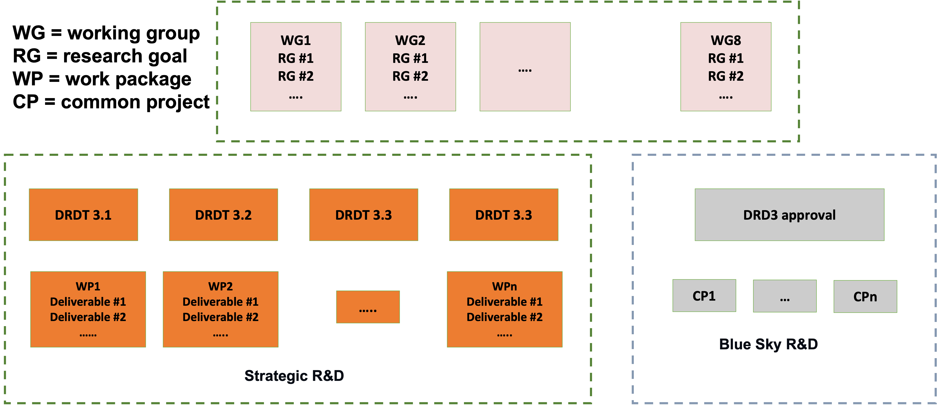
Schema finale

Slide 5
DRD3 funding
12.1 Funding for DRD3 strategic R&D
Funds for the strategic R&D should come from national funding agencies and will be assigned to their respective institutes. The strategic R&D will be the focus of the DRDC reviews.
12.2 Funding for DRD3 blue-sky R&D
Each institute will contribute to the DRD3 Blue-sky common fund. The amount of this levy is set to 2,000 CHF per year. The rules for the funding scheme will be defined by the new DRD3 management.
12.3 Funding for DRD3 operation
Each institute will contribute to the cost of the DRD3 collaboration. The amount of
this levy will be defined by the new DRD3 management.

Slide 6
Steps per la formazione del DRD3
The institutes participating in the proposal must designate a contact person who will serve as a member of the provisional institution board at the time of the submission of the proposal.
Following the submission of the proposal and before its final approval by the DRDC, the DRD3 proposal team will act as a search committee for the collaboration board chair.
The election of the collaboration board chair, utilizing the CERN e-voting system, will occur immediately after the proposal’s approval.
The DRD3 proposal team will collaboratively prepare the agenda and program for the inaugural meeting in collaboration with the collaboration board chair, expected to occur in the first quarter of 2024. This marks the conclusion of the DRD3 proposal team’s mandate.
The collaboration board chair will then assemble a search committee responsible for selecting a candidate pool for the role of spokesperson. These candidates will present their vision for the DRD3 collaboration at the kickoff meeting, including proposals for working group conveners.
The spokespersons’ elections will take place during the kickoff meeting of the collaboration, thereby establishing the operational functionality of the collaboration.
The spokespersons and the collaboration board chair will formulate a Memorandum of Understanding (MoU) for the collaboration and guide its formation by overseeing the establishment of all collaboration bodies.

