Slide 1
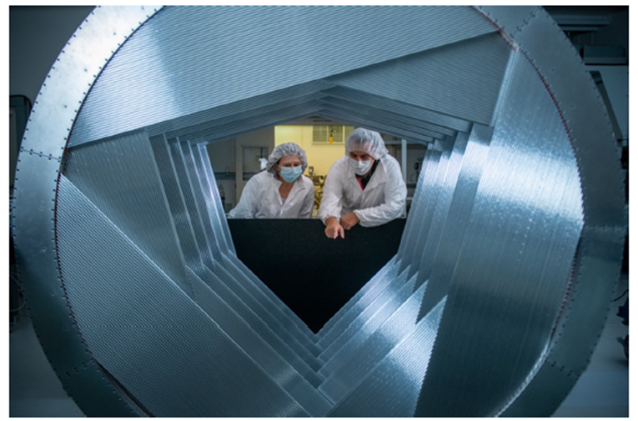
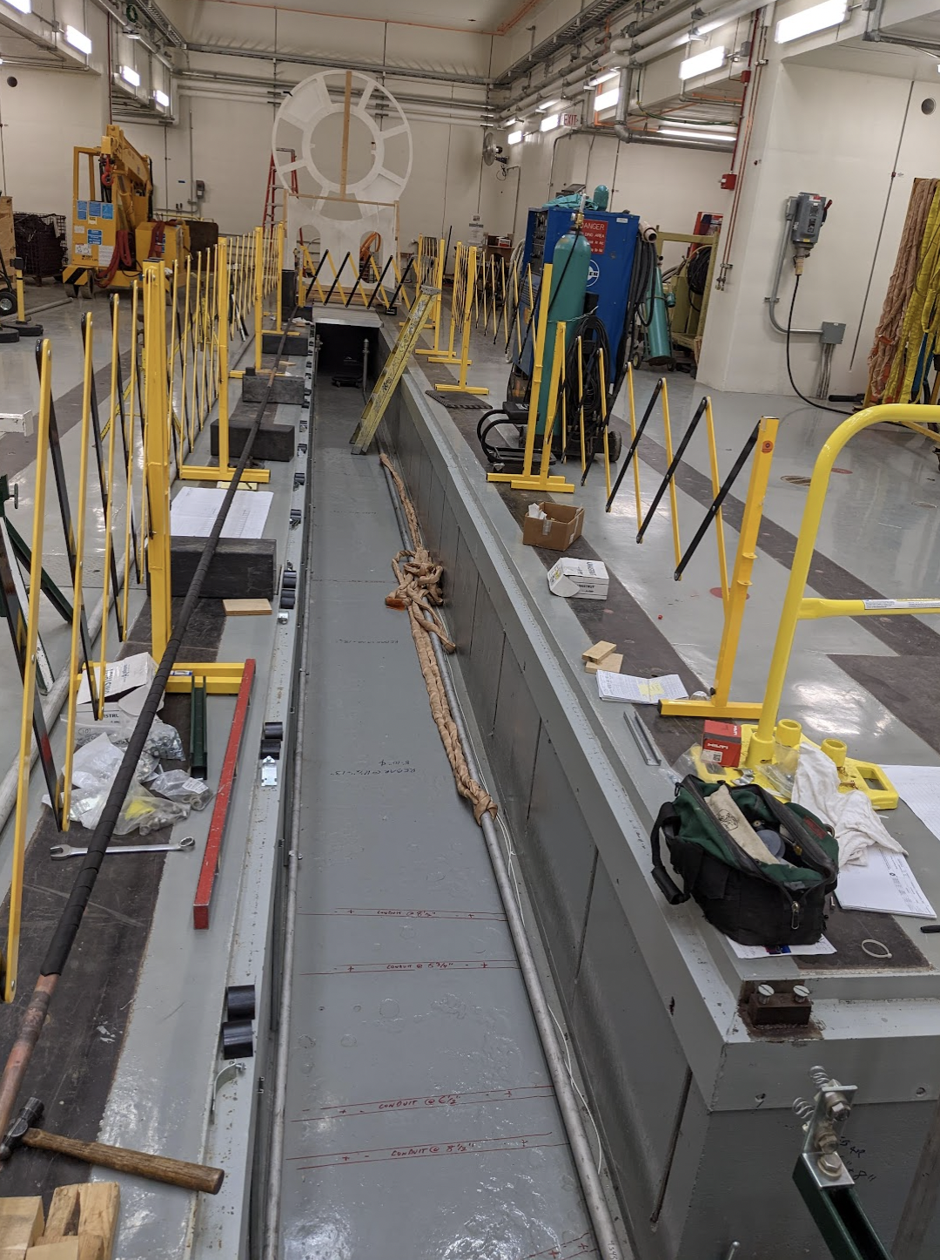
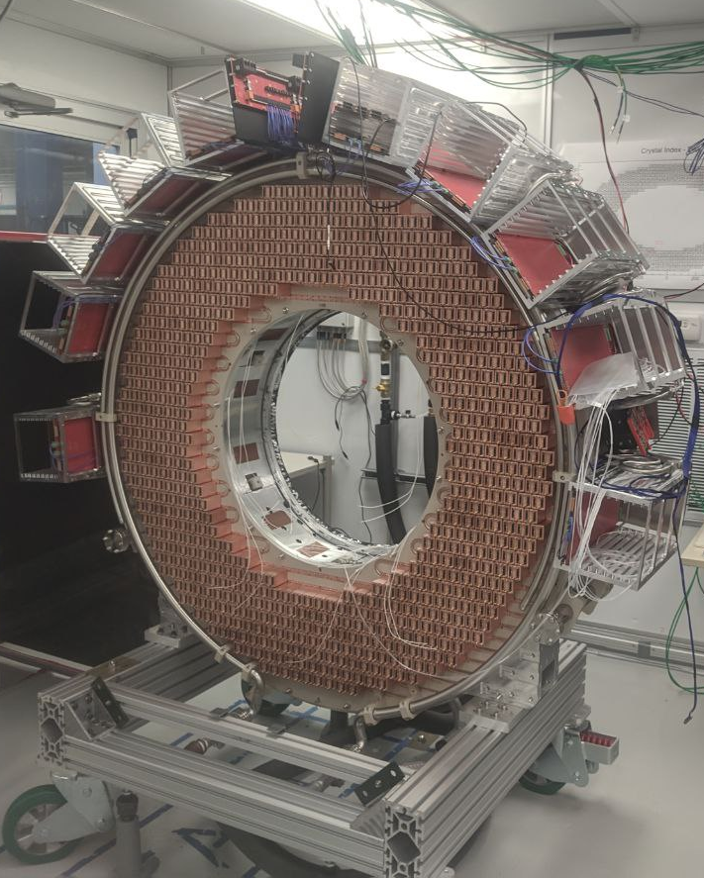
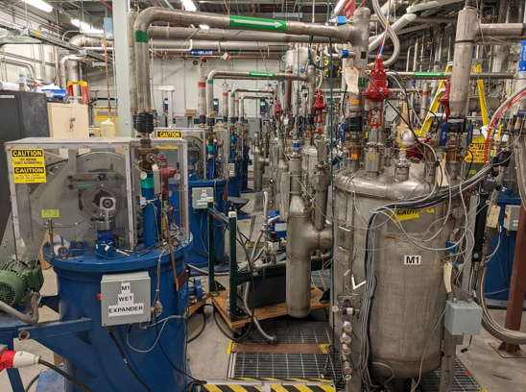
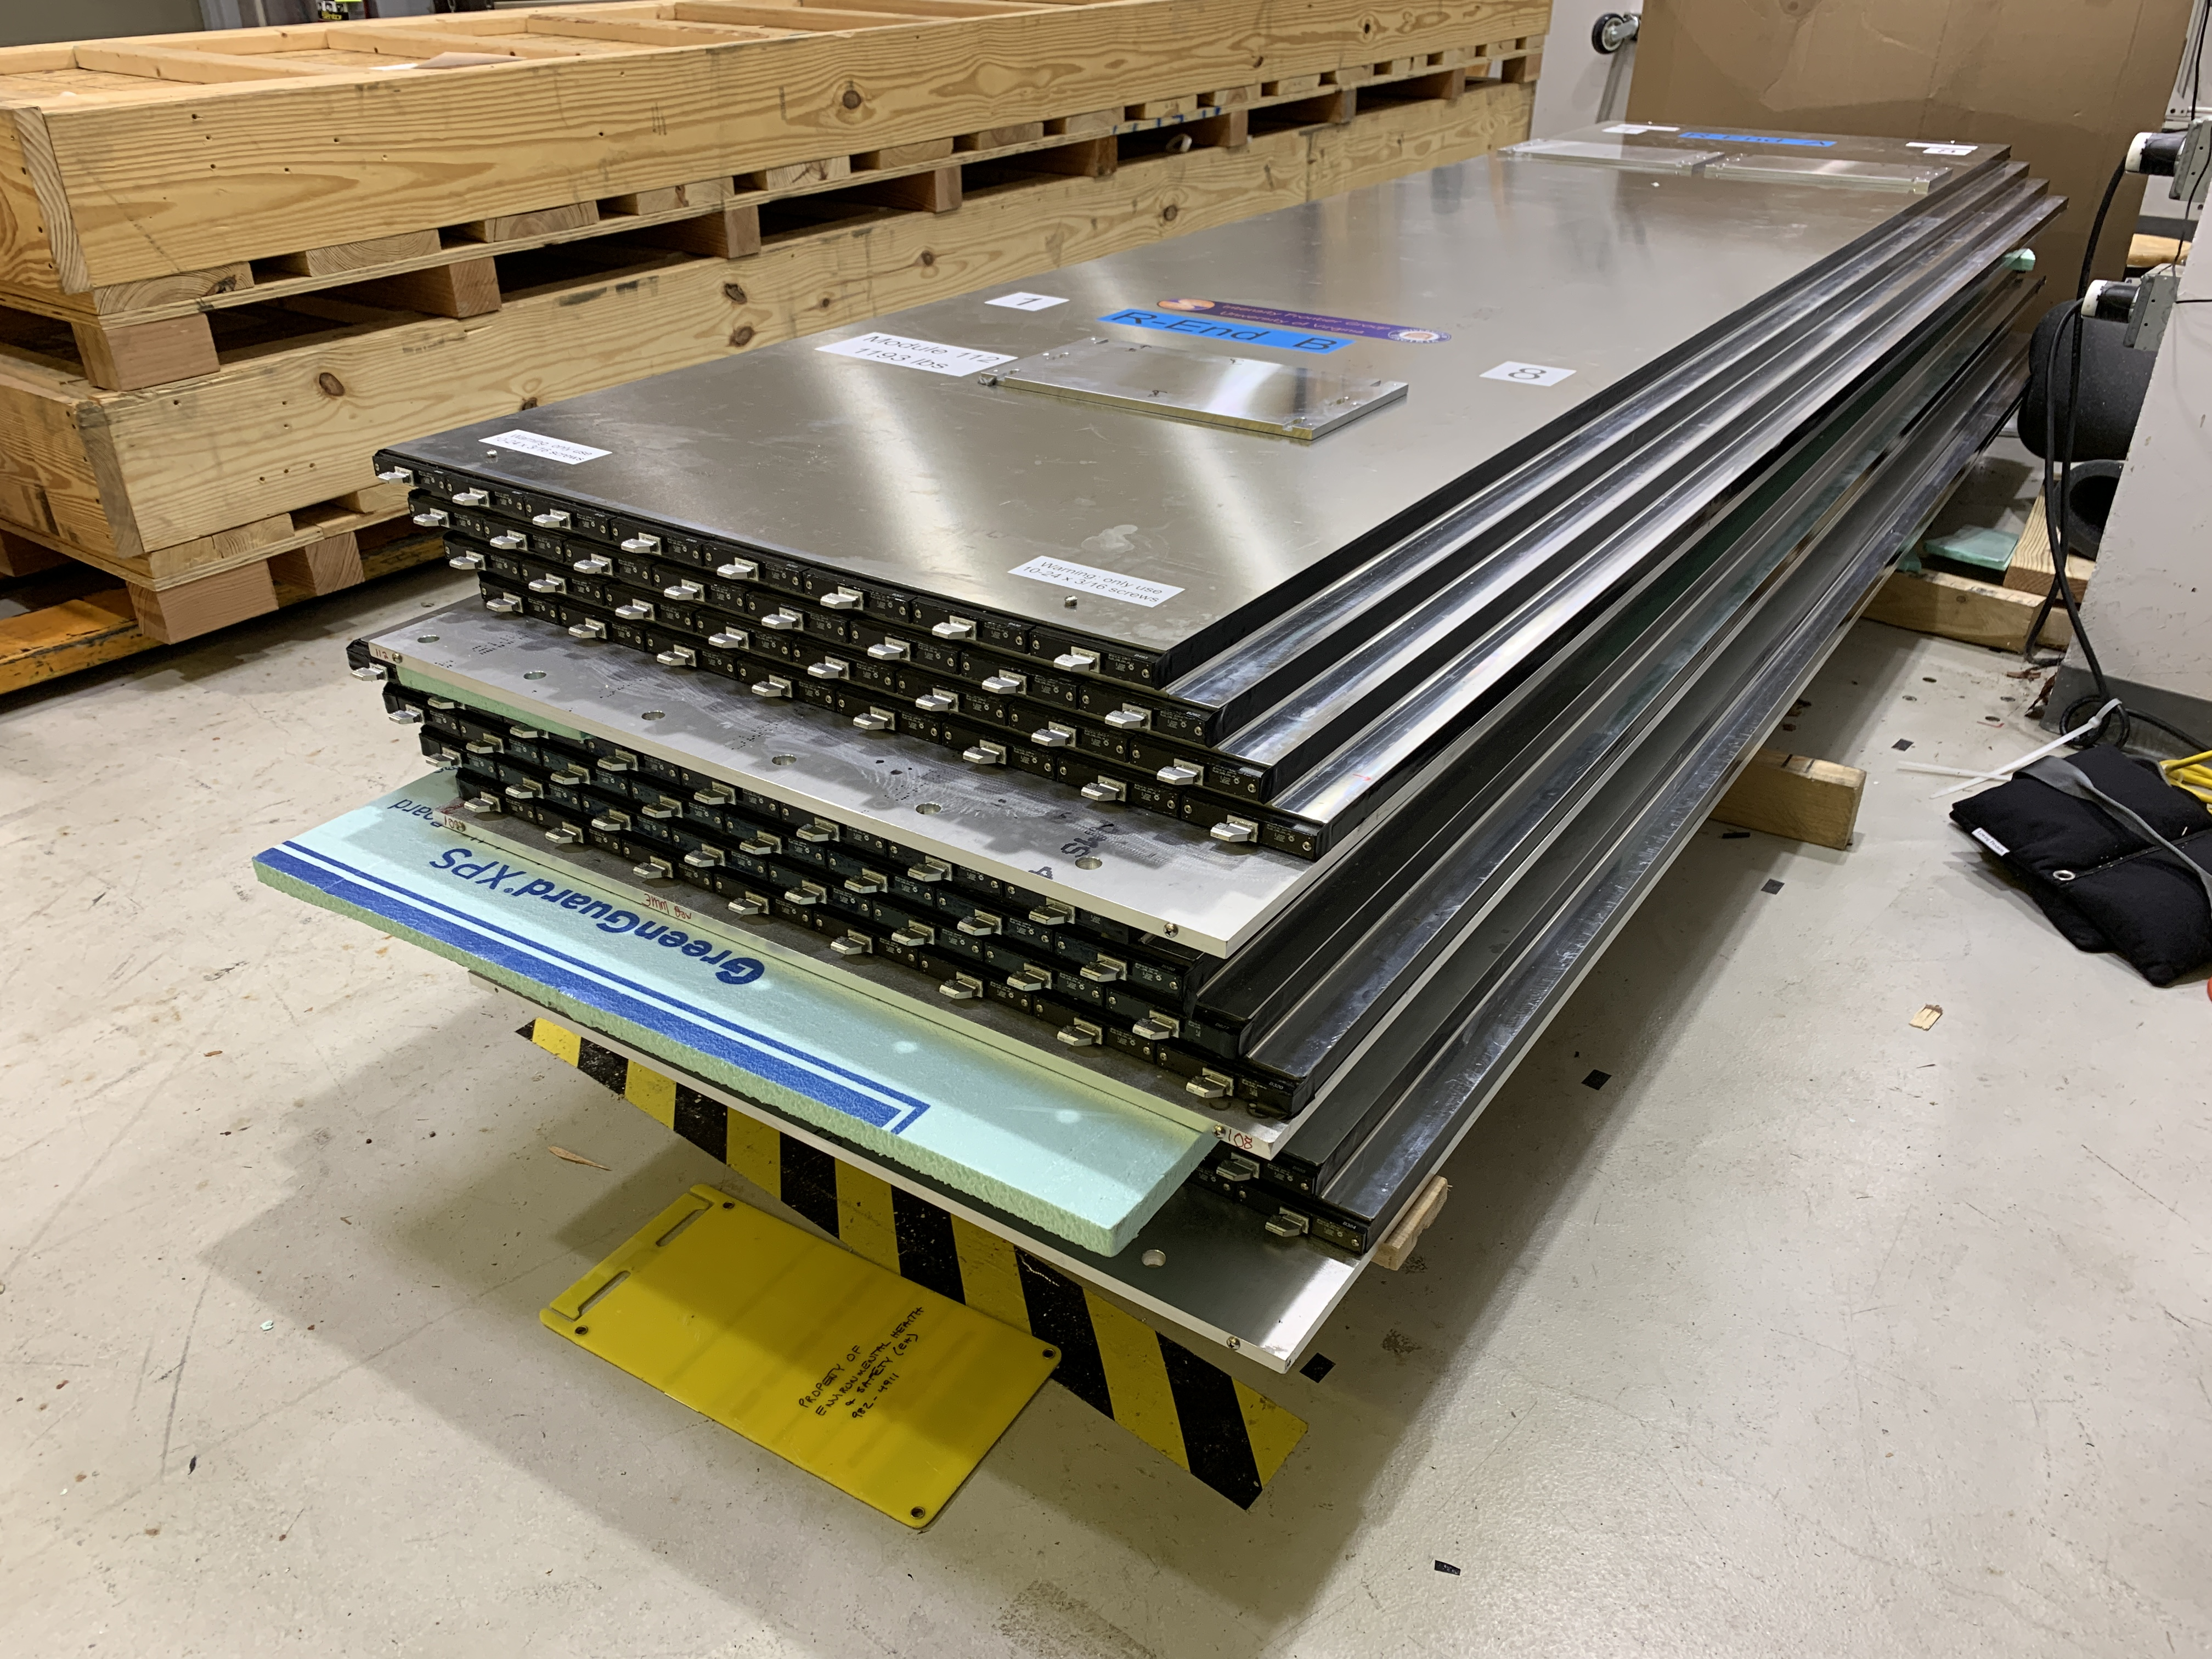
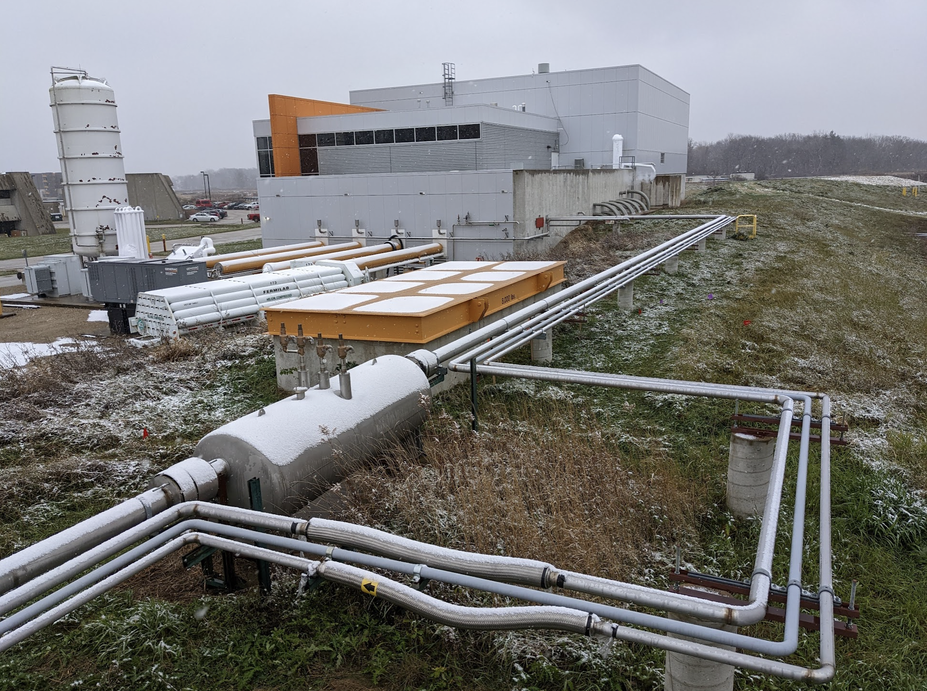
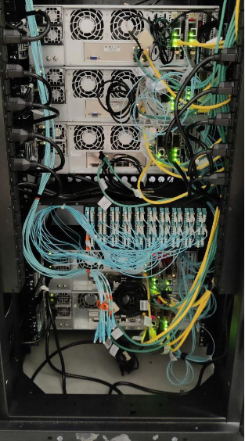
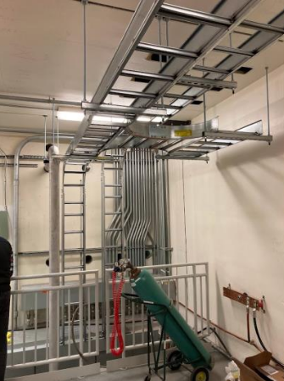
Status of Mu2e experiment
CSN1 meeting, 11 Sep 2023
Stefano Di Falco, INFN/Pisa

Slide 2
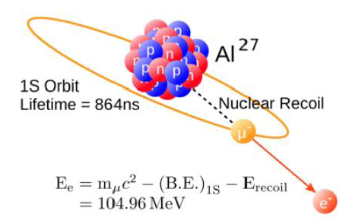
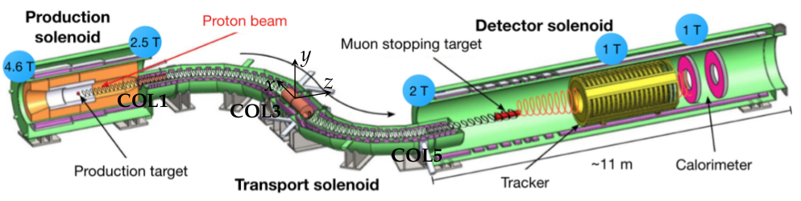
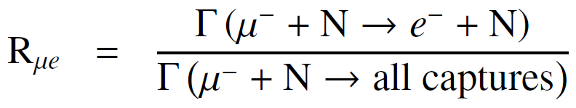
The Mu2e Experiment at Fermilab
Mu2e searches for Charged Lepton Flavor Violation (CLFV) via the coherent conversion:
m⁻ + Al → e⁻ + Al
Current 90% CL limit:
Rμe<7·10^{-13 SINDRUM II (2006)}
Bertl et al.
Eur.Phys.J.,C47,337
Mu2e goal: 5σ discovery or x10⁴ limit improvement
<numero>

Slide 3
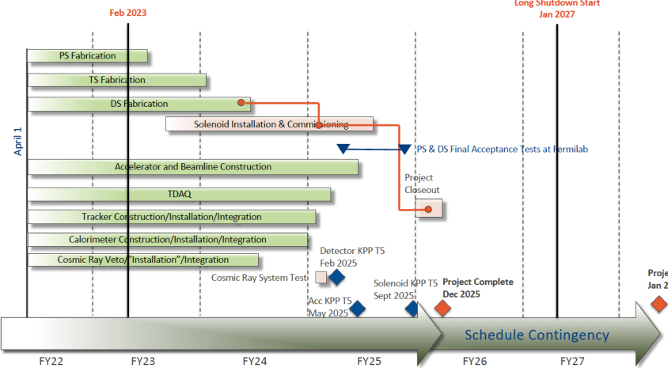
News from Mu2e
- Stefano Miscetti is the new Mu2e co-spoke person
- After 2022 rebaseline a new schedule has been released in Feb ‘23:
2024 will be devoted to detector installation in the Mu2e building!
<numero>

Slide 4
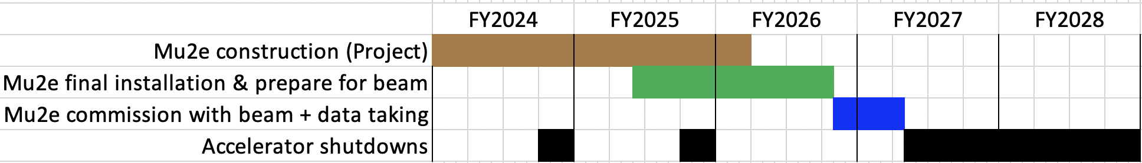
Mu2e Run Plan
Key:
Brown = Project
Green = Prepare for beam
Light blue = Commission with Beam
Dark blue = Physics Data Taking
Black = Summer shutdown
Detector KPP
Solenoid KPP
Project complete
Beam on target
Run 1
Long shutdown
Detailed field map complete
External shielding installed
CRV modules installed
Detector train inserted
Run 1 goal: get 3x10¹⁹ POT to improve by x10³ Sindrum II sensitivity*
Run 2 goal: get 3x10²⁰ POT to add an additional factor 10 on sensitivity
(longer run, higher average beam intensity, better shielding and CRV, ...)
* “Mu2e Run I Sensitivity Projections for the Neutrinoless mu- --> e- Conversion Search in Aluminum”,
Universe 9 (2023) 1, 54 (38 pages) http://arxiv.org/abs/2210.11380
<numero>

Slide 5
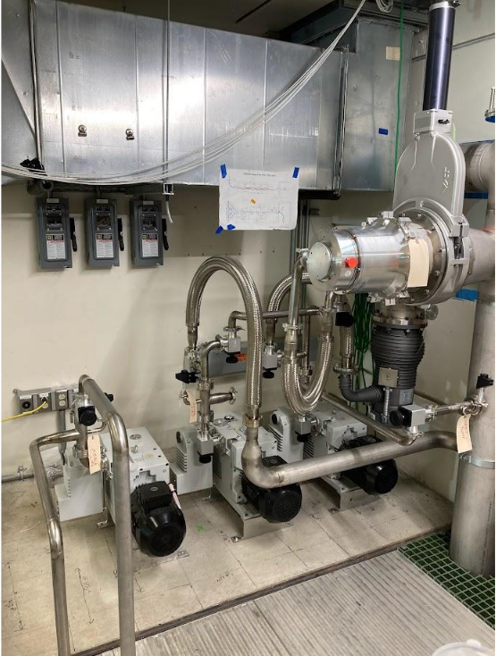
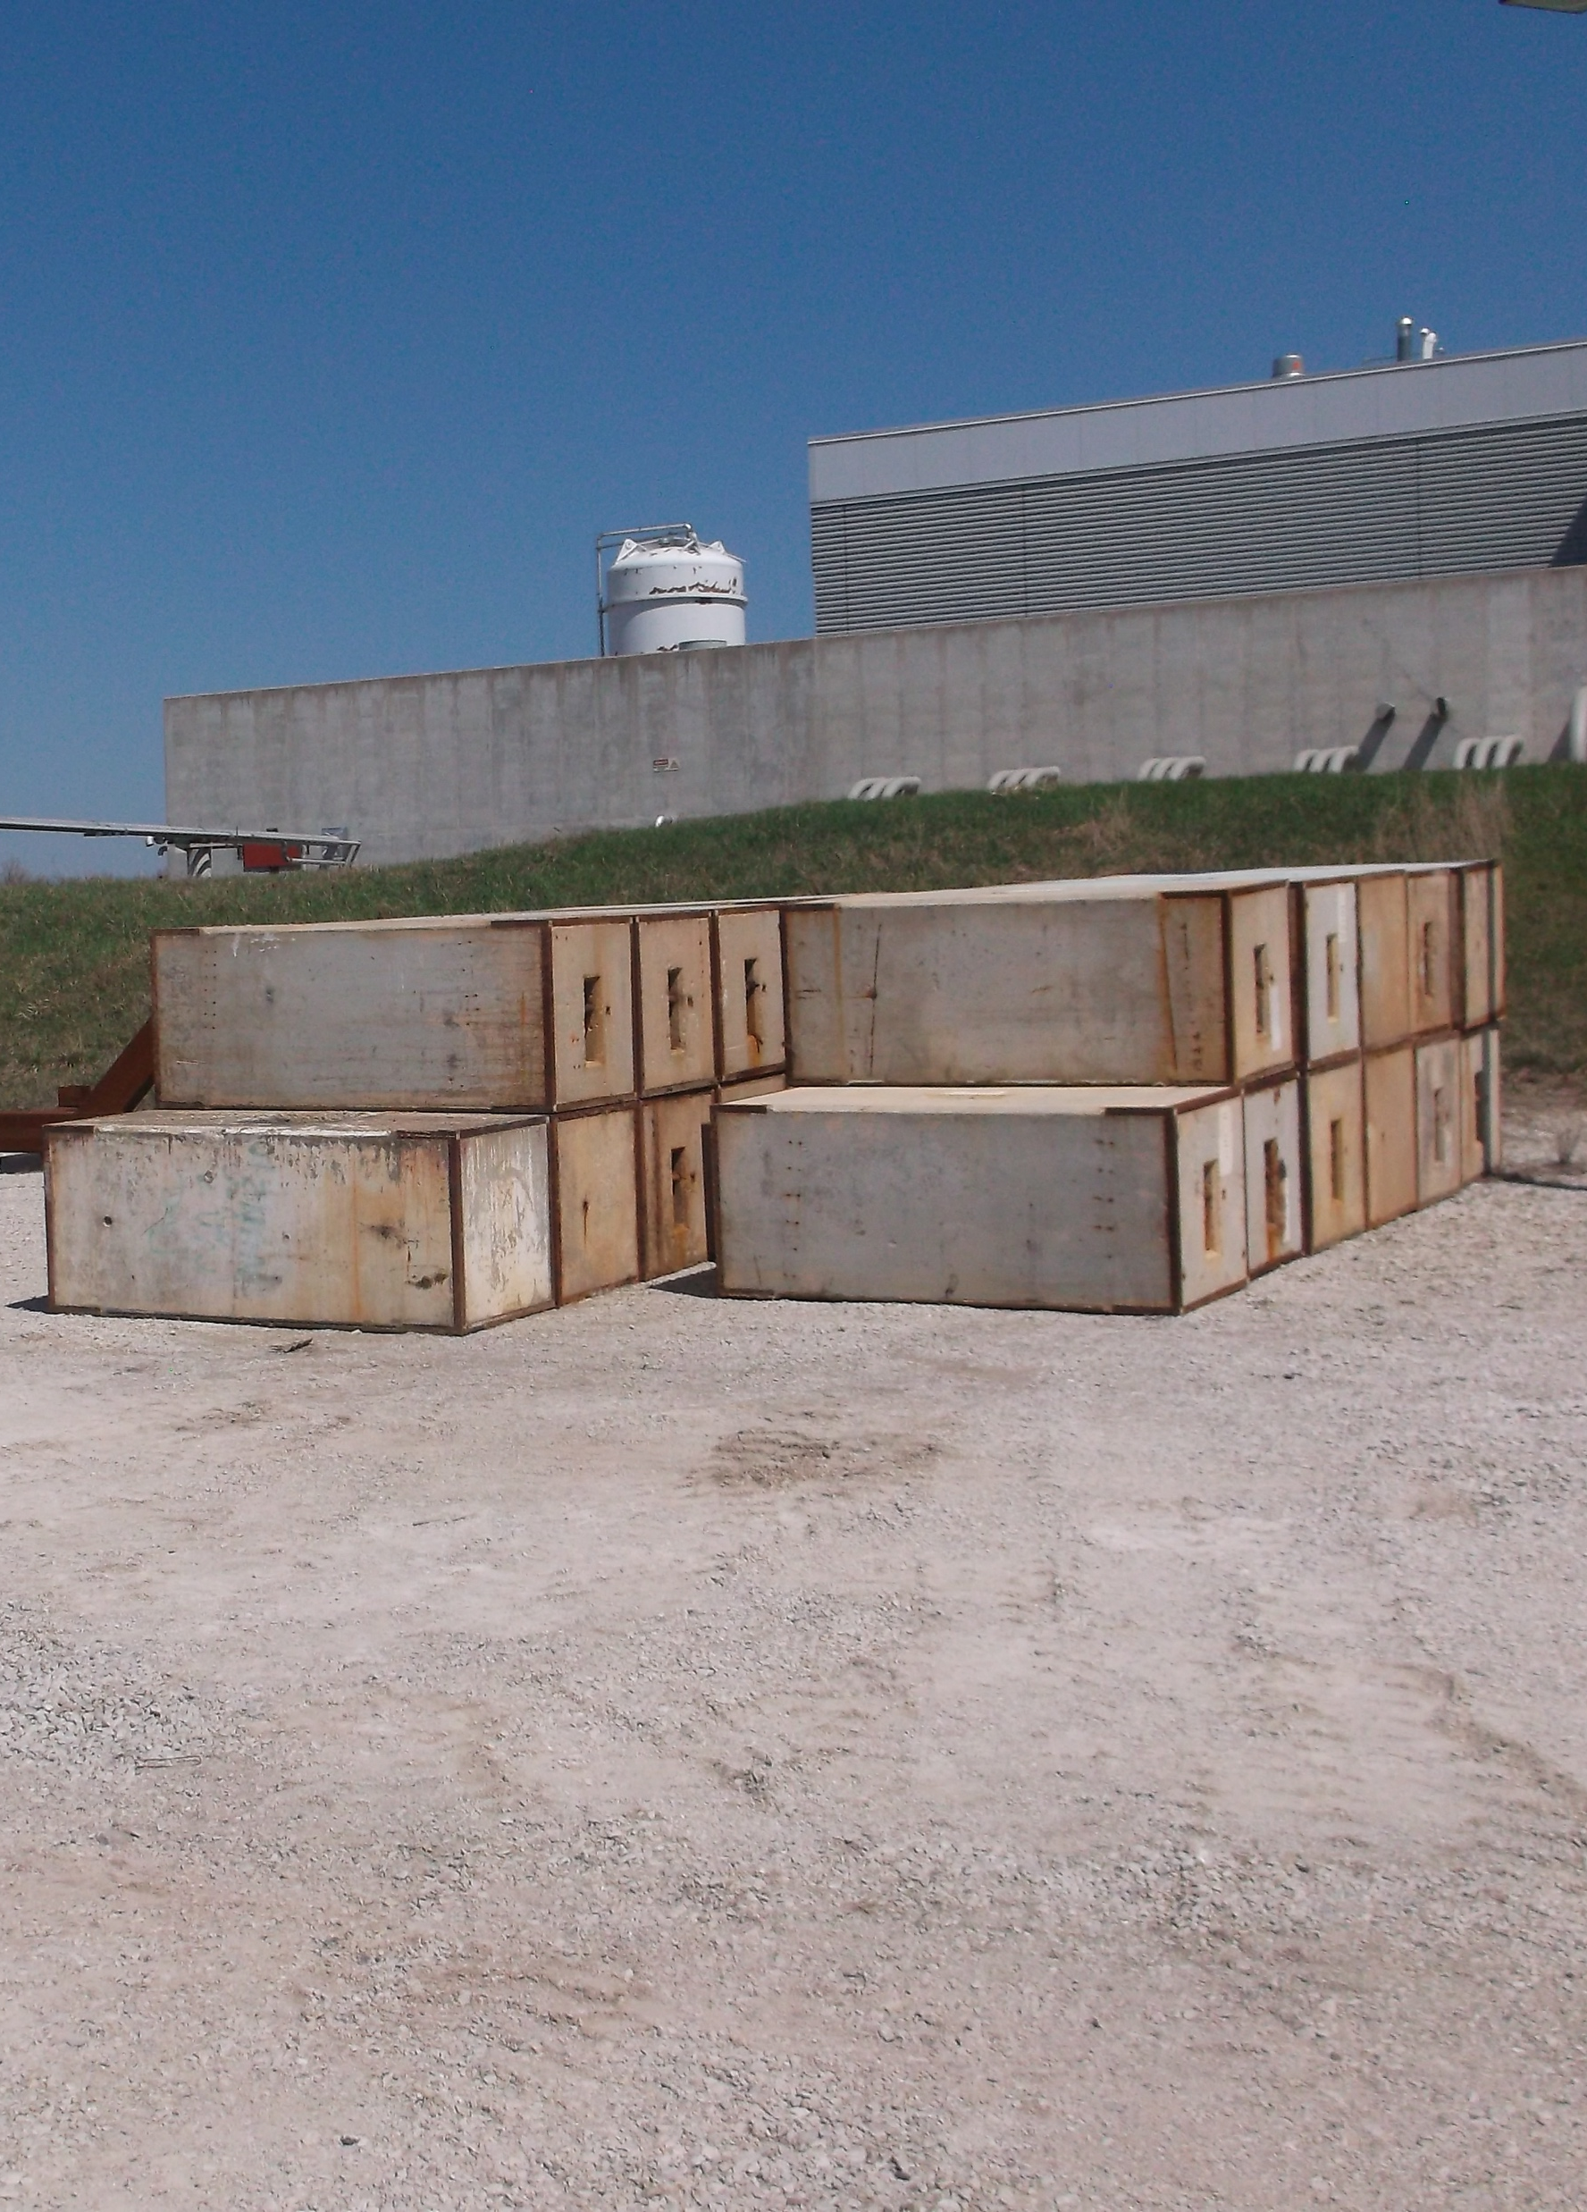
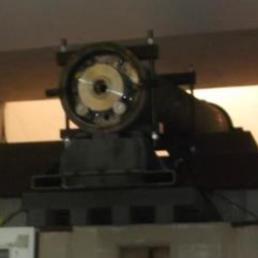
Some Pictures from Mu2e building
Cryogenic services*
Solenoids power supply
Rails and cable trails
Vacuum pumps
DAQ servers
Concrete blocks
Extinction monitor
* First Liquid He produced and stored in Mu2e building in Aug ‘23
<numero>

Slide 6
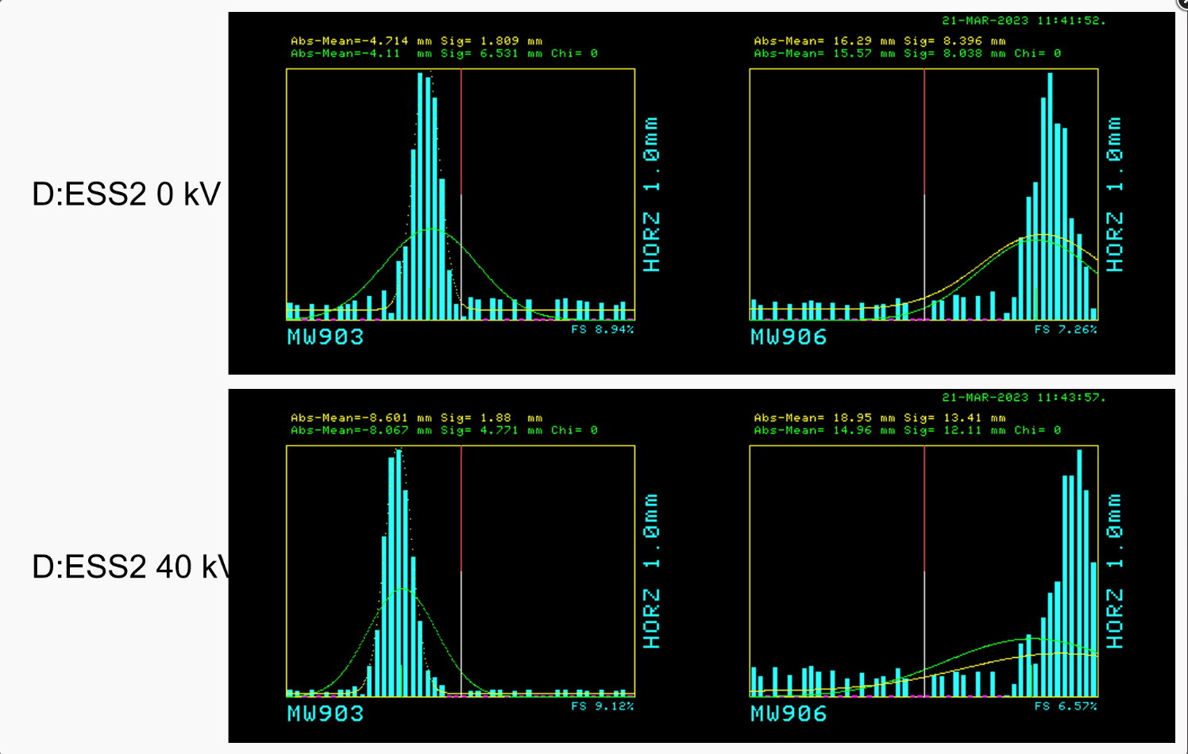
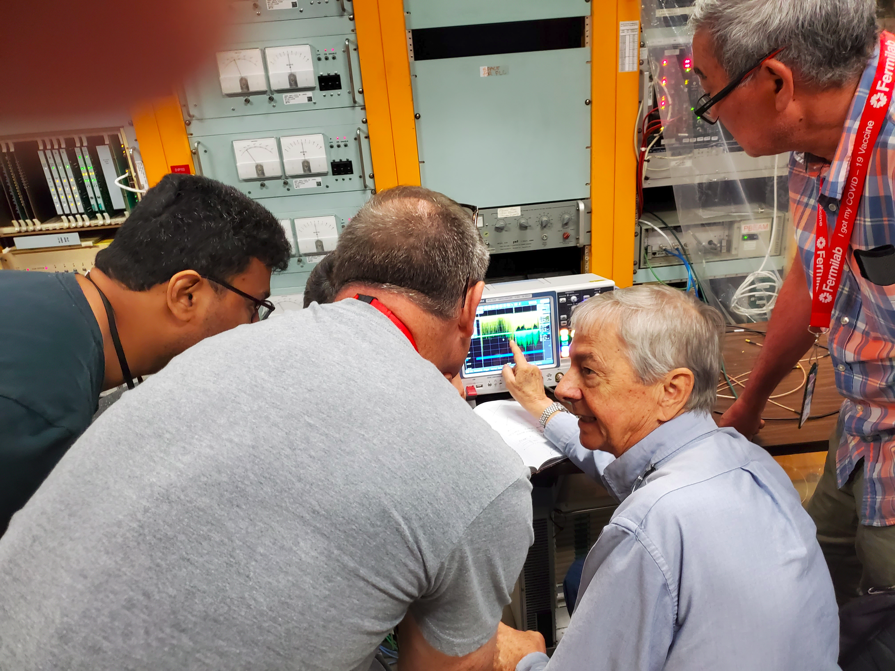
Accelerator
The first of the two Electro Static Septa (ESS)
has been installed in the last segment of the
beam line that will reach Mu2e
After a succesfull test of the AC dipole
needed to extract theproton bunches,
the first beam has been succesfully
directed to the Mu2e beam dump (July ‘23)
<numero>

Slide 7
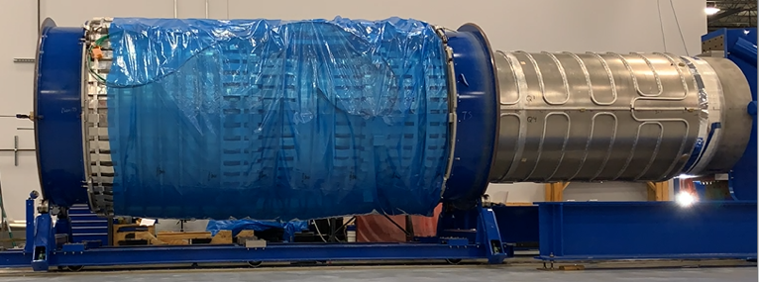
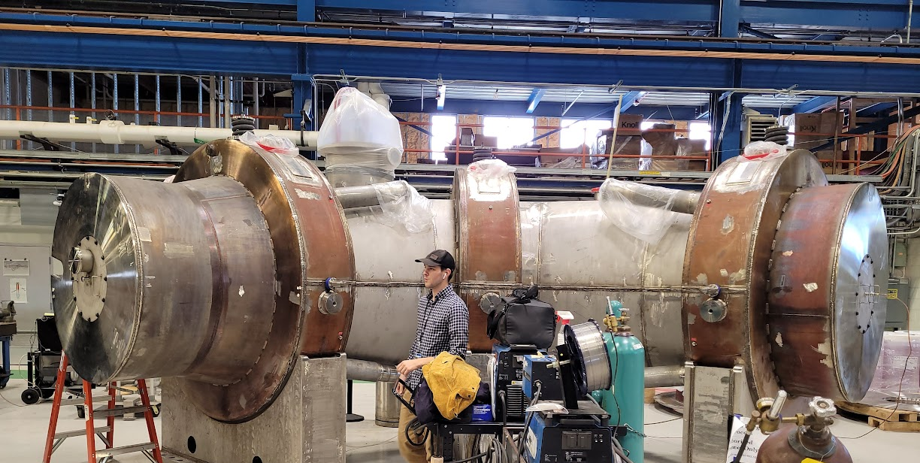
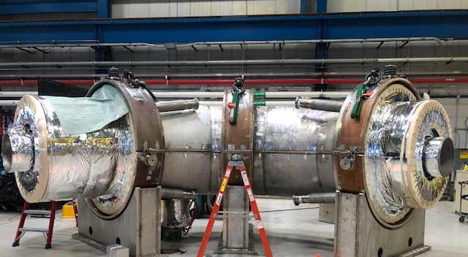
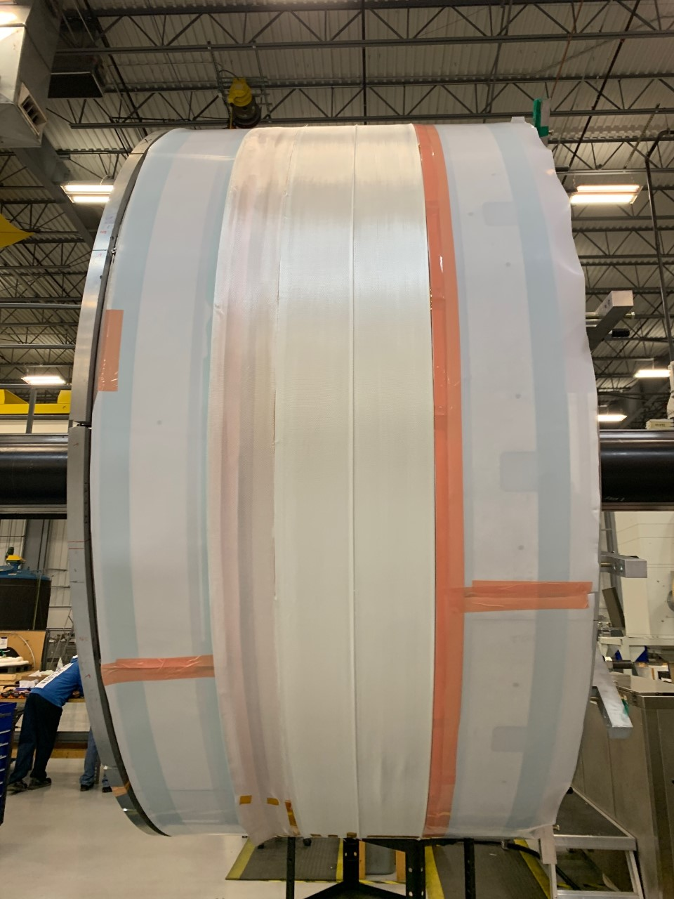
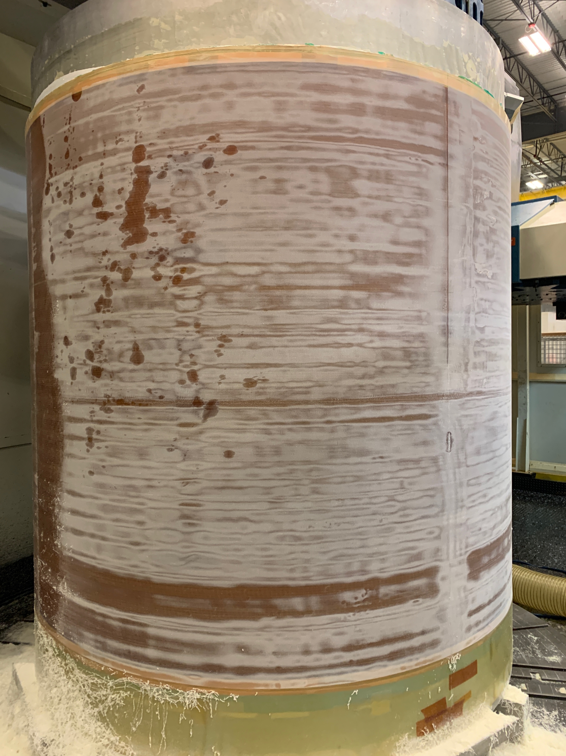
Solenoids
Production Solenoid:
3/3 coils completed
Cold mass assembled and integrated with the Inner thermal shielding
Rough B field map ok
TODO:Outer shield integration and sealing
Transport Solenoid (Nov ‘23):
Upper half completed, lower half almost
Ready. Installation end of 2023
Detector Solenoid (on critical path):
11/11 coils built
7/11 coils tested
TODO: - cold mass assembling
- preliminary field map
- final sealing
<numero>

Slide 8
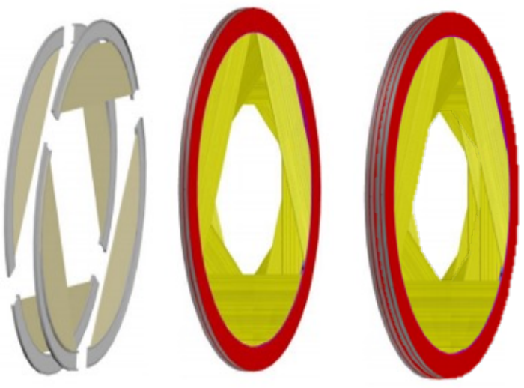
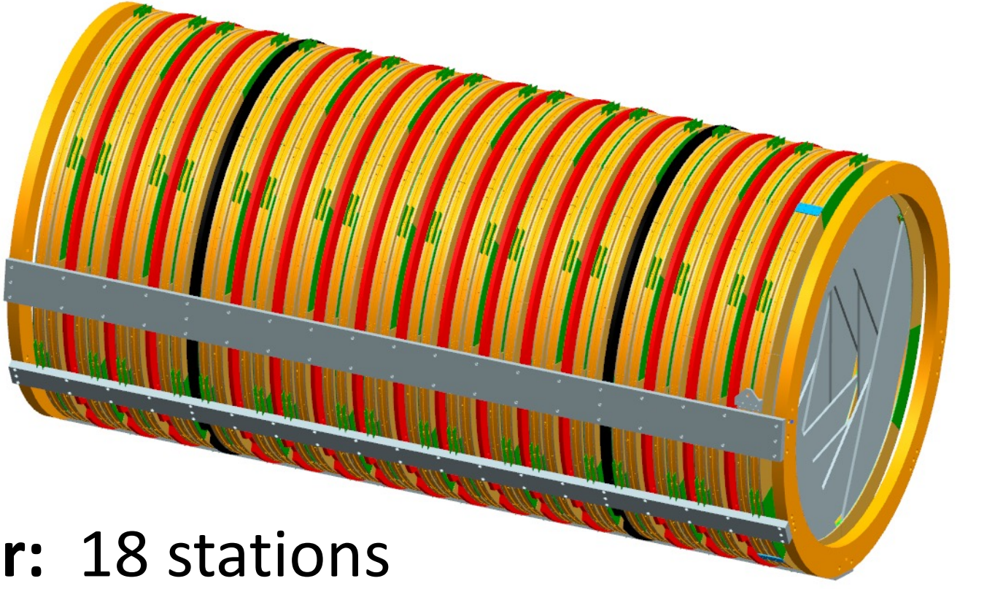
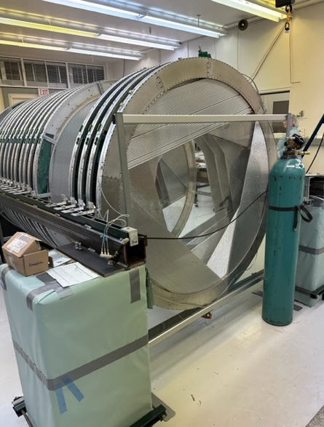
Tracker status
216 36 18
Panels Planes Stations
20000 straw tubes
216/216 panels completed
23/36 planes completed
Long term leakage test ongoing
TODO: - FEE test and assembling
- stations sealing
Expected completion: summer 2024
Installation in Mu2e experimental hall:
winter 2024
<numero>

Slide 9
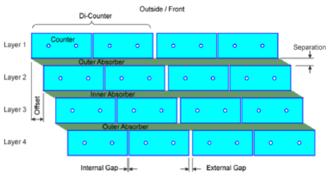
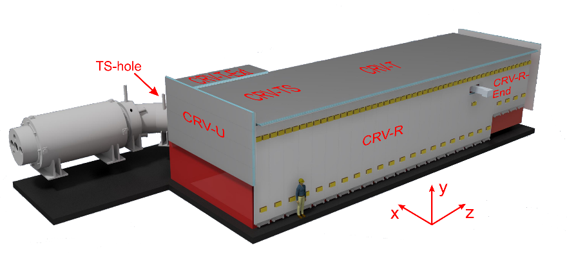
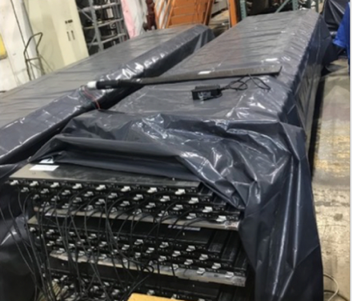
Cosmic Ray Veto Status
4 scintillator layers with WLS
Efficiency: 99.99%
Coverage: DS and Upper TS
83/83 modules ready
Cosmic ray stand to measure the aging rate
Small delays on electronics procurement (FPGA)
Installation in Mu2e building: 2025
(after concrete blocks placement)
<numero>

Slide 10
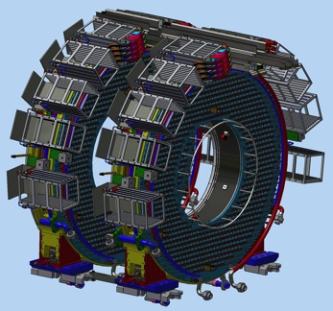
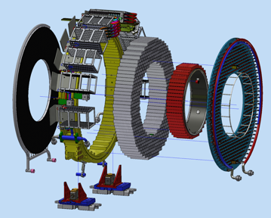
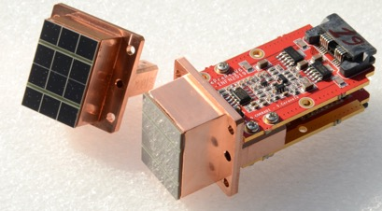
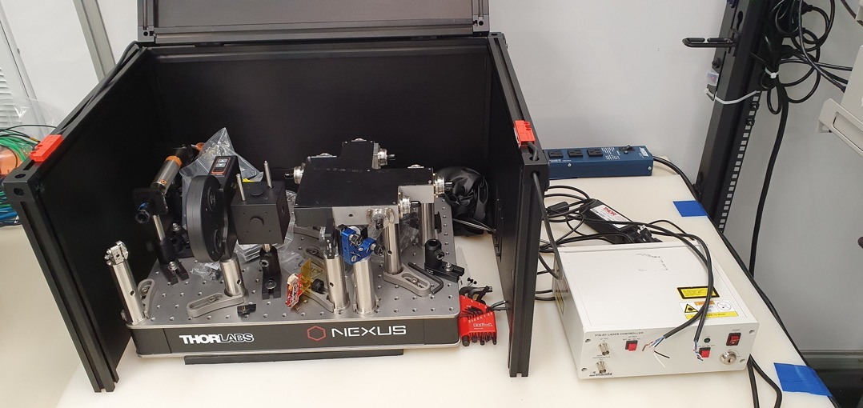
The Mu2e calorimeter
2 disks each consisting of
- 674 pure CsI crystals
- 1248 SiPMs+FEE boards
6 MeV
Calibration
source
External
ring
crystals
Inner
ring
Back plane
with SiPM housing
and cooling lines
LASER
Hole
for laser calibration
<numero>

Slide 11
Calorimeter Disk 1 status
‘Disk 1’ status:
- mechanical parts assembled
- Crystals and SiPMs+FEE readout
units installed
- digital electronic crates installed
- quick leak test of cooling system
performed
- all readout units tested with laser
pulses
TODO (disk 1):
- digital electronics installation
- TRAD monitors installation
- cabling
- DAQ test
- Long term cooling system test
- complete laser calibration system
(diffusive spheres and fibers)
<numero>

Slide 12
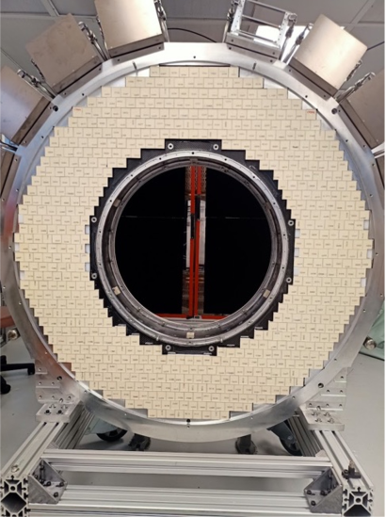
Calorimeter Disk 0 status
‘Disk 0’ status:
- mechanical parts assembled
- Crystals installed
- digital electronic crates installed
TODO (disk 0):
- install and test readout units
- install and test digital electronics
- install TRAD monitors
- cabling from FEE to crate
- DAQ test
- Long term cooling system test
- complete laser calibration system
(diffusive spheres and fibers)
Installation in Mu2e building (both disks):
Autumn 2024
<numero>

Slide 13
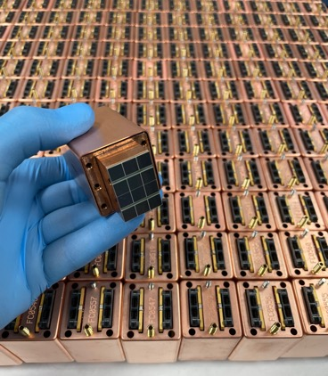
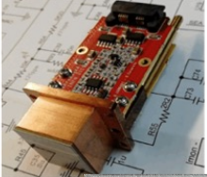
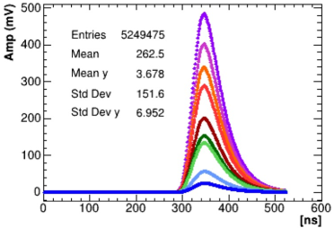
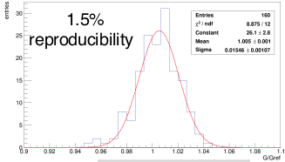
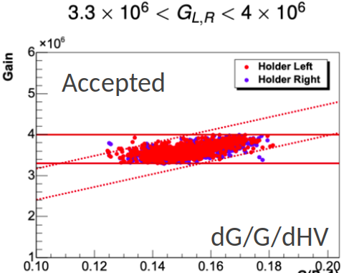
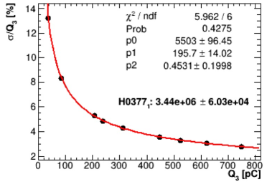
Status of production of basic components
1500 crystals produced and tested
(best 1348 selected)
4000 SiPMs produced and tested
3000 SiPM glued to 1500 SiPM holders
3300 FEE boards produced
400 FEE boards lost due to Russia-Ukraine conflict
ROU quality assurance
1188/1226 ROUs (2 SiPM+2FEE+Faraday cage) passed QA out of a total need of 1348
remaining 160 ROUs available by Sept 2023
<numero>

Slide 14
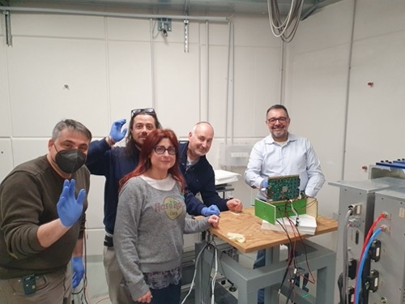
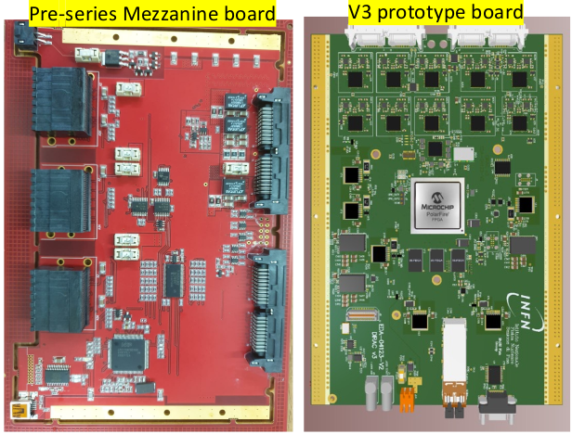
Status of digital electronic production
Last test at CNAO in April 2023 has finally qualified the Mezzanine Board (MB) and the Digitizer Board (DIRAC) against the expected levels of neutron radiation
The SEL protection circuit has also been validated
Components procurement will be completed by the end of 2023 (with some extracost)
All 160 MB and DIRAC will be available by Spring 2024
<numero>

Slide 15
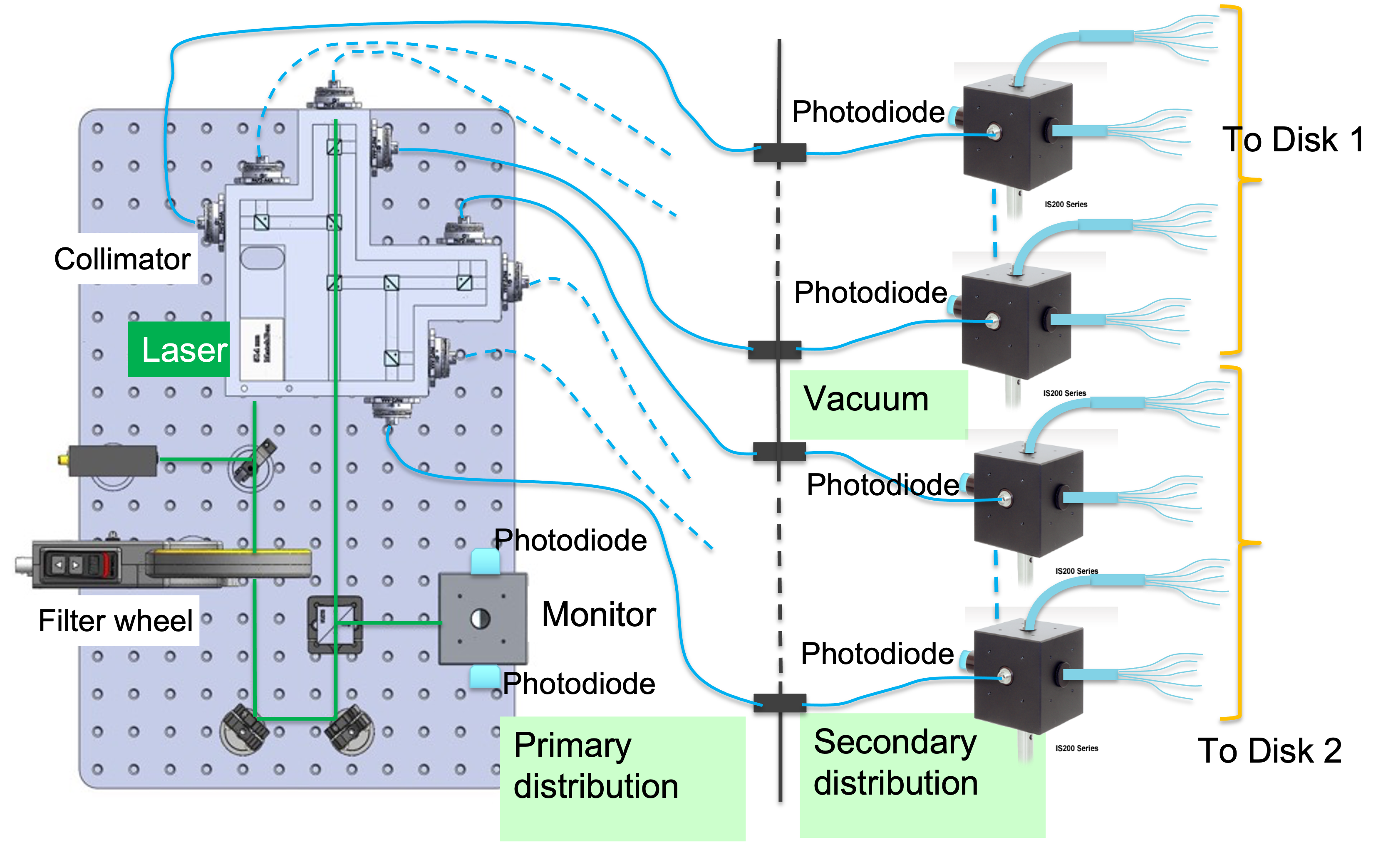
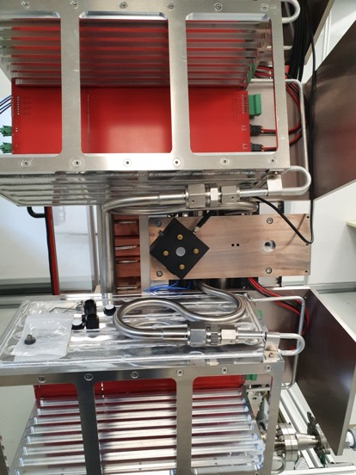
Laser System
A pulsed green laser will be sent to each crystal through a system of diffusive spheres and optical fibers. PIN diodes will check the system stability
Laser Head # 1 – under test for stability along time.
Interlock system based on two magnetic switches. Laser Key handling established
Nice results of light distribution losses down to integrating spheres and laser fiber needles in front of each crystal
80 % of fiber bundles delivered at SIDET
Mu2e Laser primary distribution optical system
placed inside a Thorlabs black Enclosure
<numero>
Mu2e Laser primary distribution optical system placed inside a Thorlabs black Enclosure.
→ Laser Head # 1 – from Standa Supplier. Under test for stability along time.
Interlock system based on two magnetic switches. Laser Key handling established
Nice results of light distribution losses down to integrating spheres and laser
fiber needles in front of each crystal
→ 80 % of fiber bundles delivered at SIDET

Slide 16
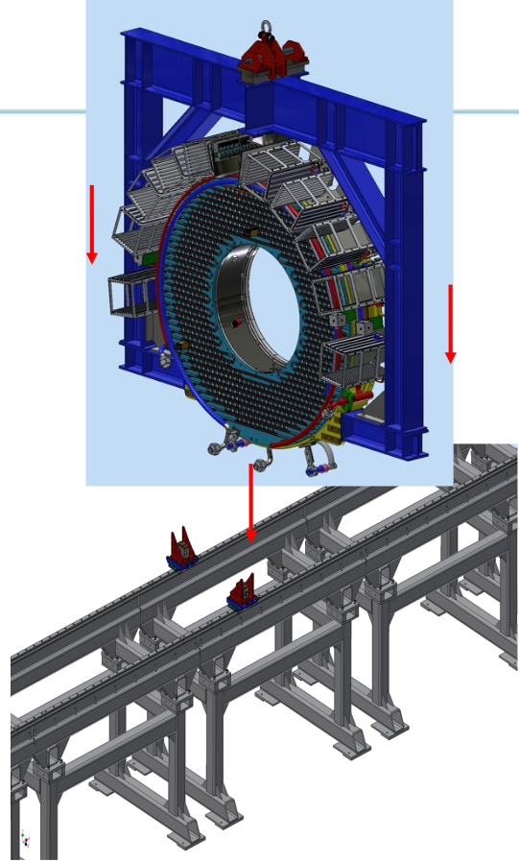
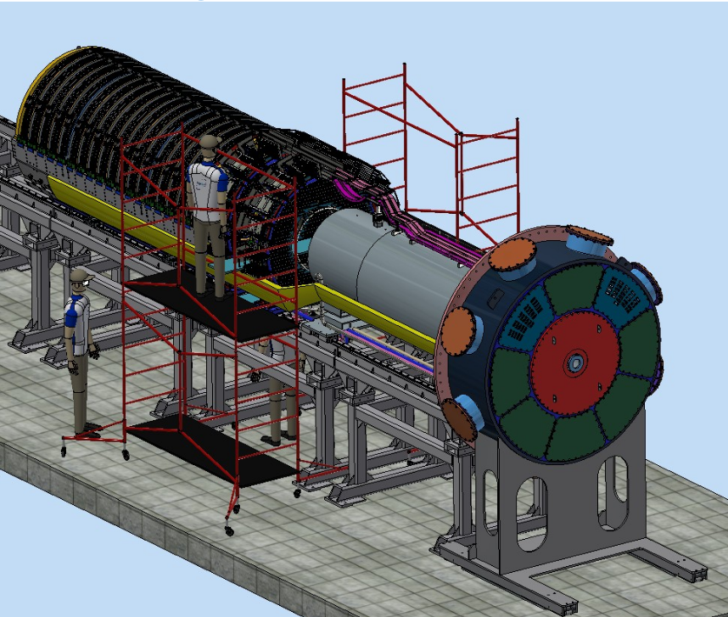
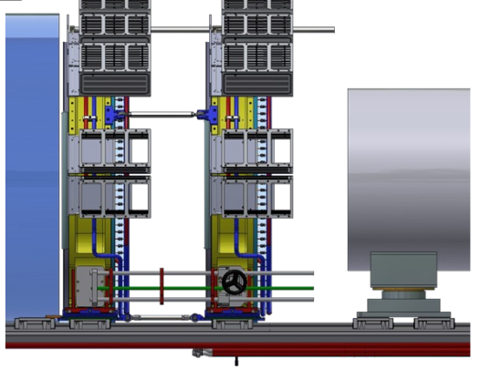
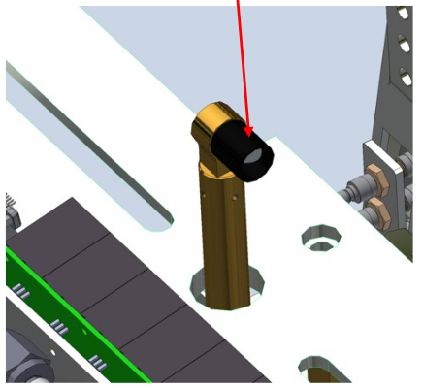
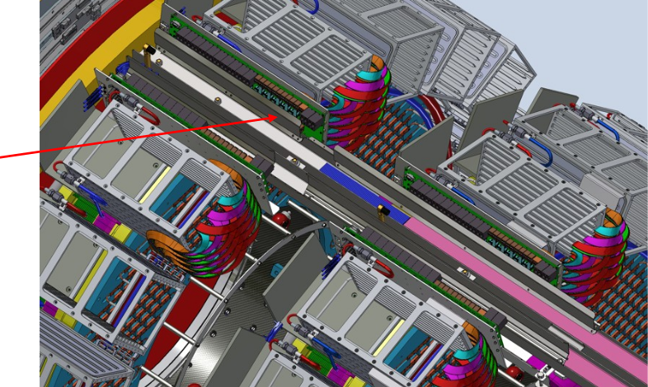
Moving the calorimeter to the Mu2e building
Additional tools are needed and still need to be constructed
<numero>

Slide 17
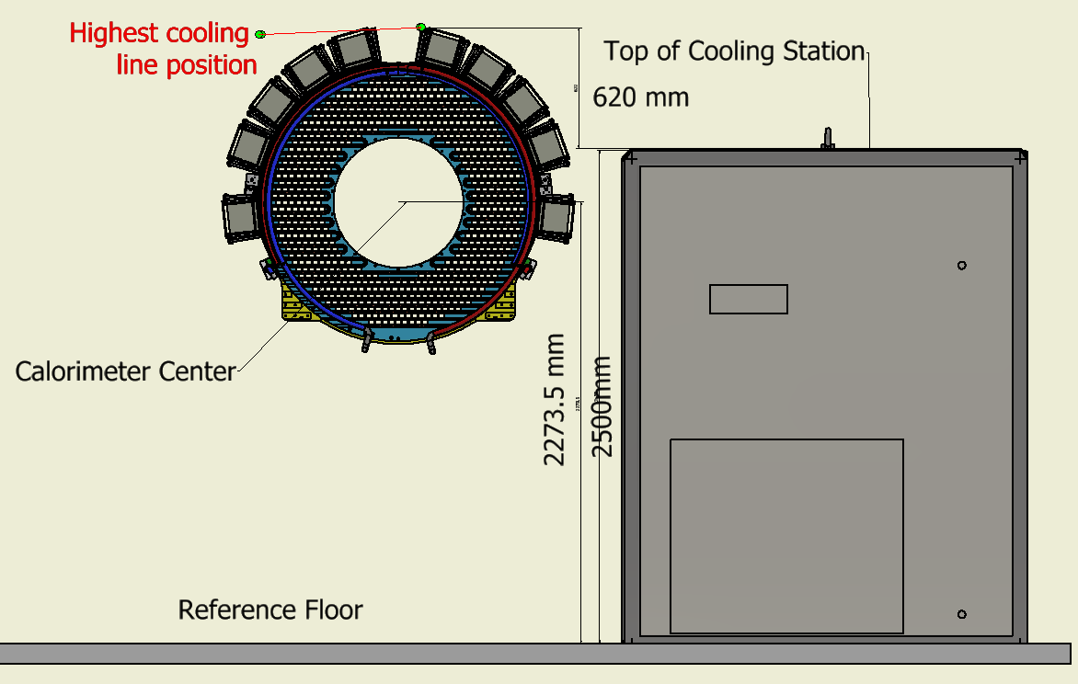
Calorimeter cooling station
A cooling station dedicated to the calorimeter will be located in the Mu2e building
A coolant liquid at -22º C will circulate in two indipendent cooling lines:
to keep SiPMs at -10º C
to keep all the electronic boards components below 50º C
The final design is completed
The last details of the tender are being discussed with Fermilab staff
The order is expected to be placed in 2024
Requirements:
<numero>

Slide 18




Vertical slice test with module 0 at LNF
Calorimeter module 0, equipped with 51 pure CsI
Crystals, 51 ROUs, cooling lines can be used to
perform a vertical slice test of the full readout chain
under vacuum
A preliminary test with a commercial digitizer and a
serial readout has been succesfully completed
A dedicated Cosmic Ray Tagger has been built to
allow a long term test with cosmic rays
Calorimeter module 0
The Cosmic Ray tagger:
2 layers each with 8 scintillator bars read by SiPMs
<numero>

Slide 19



Module-0 test beam
Calorimeter time and energy performances have been measured in 2017
with an electron beam at LNF BTF (doi:10.1016/j.nima.2018.09.043)
Since then Module-0 has been refurbished with production crystals and
SiPMs, and optical cross talk has been mitigated using some black Tedlar
between the crystals.
Module-0 will be used to measure the calorimeter performances in the final
configuration also including production digital electronics.
Available beams in 2024: BTF@LNF, MAMI@Mainz
<numero>

Slide 20
MoF status
The FY2024 will see the start of INFN contribution to the Mu2e
operation costs.
The contribution requested to INFN is ~220K/year for the first 3 years.
After the subtraction of the in-kind contribution of spares (SIPM, FEE,
MB, DIRAC, LV/HV, Laser Head) the amount is ~130K/year.
This can be given as in-kind contribution including also man power
(+50% of construction costs).
For 2024:
- Bent crystals 60 K + 30 K = 90 K
- Spill monitor 11 K + 5.5K = 16.5K (8 LYSO+PMT hodoscope)
- Vacuum flange 5 K + 2.5K = 7.5K (outgassing tests)
- Contingency* 16K
Total: 130K
* This should be added as an additional request for 2024 as SJ.
It includes: costs revision, quality controls, in-kind contribution evaluation.
<numero>

Slide 21



Bent crystals to reduce radiation levels
Beam extraction requires an
ElectroStatic Septum(ESS).
The beam impact on the inner electrode
produces a large amount of radiation.
The ‘shadow’ of a bent crystal can
reduce beam losses by a factor 3,
allowing for an higher beam intensity!
Ferrara group is ready to deliver it by Summer 2024.
A win-win in-kind contribution to Common Funds!
Bent crystal
<numero>

Slide 22



Bent crystals: change in sumitted requests
Since inventory item cannot be
easily considered as an in-kind
contribution, the requests for the
Etcher (20K) and the interferometric
Lens (8.5 K) will be replaced by a
contribution of 28.5 K for the use
and maintenace of the clean rooms.
This corresponds to what was
initially agreed as cost sharing
between INFN and UniFe.
The total request for the bent
crystals will still be 60K.
<numero>

Slide 23
The Mu2e upgrade proposal: Mu2e-2
The PIP-II upgrade of Fermilab accelerator will allow to have an higher intensity muon beam increasing by a factor 10 Mu2e statistical error.
A relatively cheap upgrade of Mu2e apparatus, saving the superconducting solenoids, have been included in the Snow Mass program in March 2022 (arxiv 2203:07569).
A dedicated workshop has been held in Caltech in March 2023
(https://indico.fnal.gov/event/57834)
The proposal has been submitted to the Fermilab Phisycs Advisory Committee in June 2023
The proposal discuss possible improvements of the accelerator, of the target and of the detectors (tracker, CRV e ECAL) to deal with the increased rate of particles and radiation levels.
Our Mu2e collaborators consider natural an involvement of INFN in this upgrade. Can certainly be a good occasion for INFN to keep an important collaboration with Fermilab at a reasonable cost.
<numero>

Slide 24






Mu2e-2 calorimeter: LYSO proposal
In Mu2e-2, we expect x10 increase in n-fluence up to 10¹³ n/cm²
SiPMs with pixel 10 or 15 μm can survive but they have a lower PDE
Hamatsu & FBK R&D
Short LYSO crystals (34x34x80 mm³)
can provide a rad hard solution at a reasonable cost (x2 BaF2)
Emission time: 40 ns
FEE would be connected to SiPMs via a coaxial cable to reduce radiation levels. A synergic R&D for muon collider (CRILIN and NEXT-100) is already ongoing
Proposed R&D for 2024:
- support design with simulation (required signal width vs pileup)
- test a 2x2 array of 6x6 mm² SiPM with 10 μm pixel
- build a PCB to read 16 3x3 mm² SiPMs
<numero>

Slide 25





Mu2e-2 calorimeter: BaF2 alternative proposal
BaF2 was the baseline also for Mu2e: it has a very fast component (0.6 ns) but an unacceptable dominating slow component (630 ns) that needs to be suppressed.
A long and expensive R&D to incorporate a filter in the sensor is going on (Caltech/JPL/FBK)
Radiation hardness is ok after an initial loss of ~40%
Alternative R&D proposal: dichroic filter+ photon trap
filter
reflector
A phototrap prototype with 5% PDE
Proposed R&D for 2024:
- procure and test different combinations of filters and WLS
- build a prototype to evaluate Light Collection and timing
- build a PCB to host SiPMs, shaper and amplifier
<numero>

Slide 26
European projects: summary of contributions
2022 | Returned to CSN1 (k€) | Before 1/9 | Before 1/9 |  |  | After 1/9
 |  | NEWS (from 2021) (k€) | NEWS (k€) | AMUSE (k€) | all (k€) | NEWS (k€) | AMUSE (k€) | INTENSE (k€) | all (k€)
LNF | 45,0 | 9,9 | 0 | 19,7 | 29,6 | 0 | 13,4 | 0 | 13,4
PI | 39,0 | 1,3 | 20,2 | 0 | 21,5 | 7,1 | 0 | 2,6 | 9,7
TOTAL | 84,0 | 11,2 | 20,2 | 19,7 | 51,1 | 7,1 | 13,4 | 2,6 | 23,1
2023 | Returned to CSN1 (k€) | After 1/9 |  | After 1/9
 |  | NEWS (k€) | AMUSE (k€) | INTENSE (k€) | PROBES (k€) | all (k€)
LNF | 47,5 | 0 | 31,7 | 0 | 0 | 31,7
PI | 24,5 | 17,1 | 0 | 8,6 | 2,2 | 27,9
TOTAL | 72,0 | 17,1 | 31,7 | 8,6 | 2,2 | 59,6
<numero>

Slide 27
Summary and conclusions
A lot of progresses in the construction of Mu2e at Fermilab
2024 will be a crucial year for the installation of Solenoids,
Tracker and Calorimeter in the Mu2e building
Detector key performance should be demonstrated by the end
of 2025. Still a lot of work and activity in situ is needed to
maximize the results of the Mu2e Run 1 that will start in 2026
Common funds should start in 2024
INFN contribution is visible and much appreciated by the
whole collaboration
<numero>

Slide 28
Important items for a succesfull activity at Fermilab
(also discussed with g-2 and DUNE)
Health insurance:
- Poste Vita requires to anticipate the expenses
- For the first 3 months Blue Cross only covers hospitalizations
- we are collecting experiences of people having troubles with this
Cost of life and travels to USA:
- daily salary is fixed by law, consider to ask for an adjustment
- flight costs increased by more than 50%, monthly reimbersument
should reflect this increase
Technician presence at Fermilab:
- consider the possibility of a laboratory allowance
(could be cumulated with ‘a piè di lista’ not with ‘a forfait’ refunding)
Researcher/technologist presence at Fermilab:
- similfellows/fellows to make long stays more attractive
- overhead and taxation to be discussed with Fermilab
- positive mood from INFN council
<numero>

Slide 29
BACKUP
<numero>

Slide 30





Solenoid installation : revised sequence?
PS delivery: October 2023 (Slight Slipping)
TSu delivery: October 2023 + TSd delivery: November 2023 (holding)
DS delivery: May 2024 (holding)
It is likely that TSu/TSd will be ready to install before PS
BASELINE – OPERATION STEPS
REVISED – OPERATION STEPS
→ Do not interrupt installation in Mu2e Hall when magnets are ready
→ Need to use a different (PS) hatch + external crane
PS hatch
We will have the first magnet in the Mu2 hall in 2023!
It probably will be the one with Italian coils !!!!!
<numero>

Slide 31





PS/DS fabrication steps
Make a bunch of coils
Assemble coils together into a “cold mass”
Insert shielded inner bore into cold mass
Insert cold mass/inner bore assembly into outer thermal shield and vacuum vessel
Close up vacuum vessel

Slide 32


Long term test of cooling system at SIDET (FNAL)
A first test of the cooling lines connected to the ECAL disks has been performed. The components used were too cheap to guarantee a stable performance over a long duration test.
The final coolant selected (ZULU) is slightly more aggressive from the chemical point of view. leggermente più aggressivo dal punto di vista chimico.
Higher quality pumps, sensors, valves, connectors, pipes ... are needed.
<numero>

Slide 33


Temperature and Radiation monitor (TRAD-v2)
We want to monitor the temperature and radiation in different places on each disk.
A first prototype has been built to validate the tecnology choice
A second prototype (TRAD-v2), including the SEL protection, will be done by the end of 2023.
Final production by Spring 2024.
<numero>

Slide 34

Next steps
2024: Test beam of module 0 fully equipped with the final electronics and DAQ
2024: Calorimeter disks installation in Mu2e building
2025: Commissioning with cosmic rays before the insertion
      in the DS
2026: First beam!
Subset of Cosmic Ray Veto modules
Detector Solenoid
Tracker
Calorimeter
<numero>

Slide 35

Mu2e expected backgrounds for Run 1
(assuming 6·10¹⁶ stopped muons,
mostly at half proton beam intensity*)
* More details in “Mu2e Run I Sensitivity Projections for the Neutrinoless mu- --> e- Conversion
Search in Aluminum”, submitted to MDPI Universe in October 2022 (38 pages)
http://arxiv.org/abs/2210.11380
<numero>

Slide 36

Electron momentum
The DIO spectrum falls as (Emax-E)⁵ close to the end point
Can be suppressed by the momentum window cut
<numero>

Slide 37

Electron time
Radiative Pion Captures (RPC) in the Al target producing photons converting in e⁺e pairs can be suppressed by a time window cut
Also delayed pions coming from antiproton annihilation can be suppressed
Time and momentum windows optimized to get the best discovery sensitivity
<numero>

Slide 38


Mu2e expected sensitivity for Run 1
Given the very low background level a 5σ discovery will require Mu2e to observe just 5 events of muon conversion
The Rμe corresponding to a 5σ discovery in Run 1 is:
Mu2e Run 1
5σ Discovery reach
If no events will be observed the 90% CL limit will be:
Mu2e Run 1
90% CL limit
that is more than x1000 better than current best limit!
<numero>

