Slide 1
Micromegas detectors at Saclay : Past, Present, and, Future experiments
16th Advanced detector PISA Meeting
Maxence Vandenbroucke for the Saclay MPGD lab
CEA Saclay
maxence,Vandenbroucke@cea.fr

Slide 2
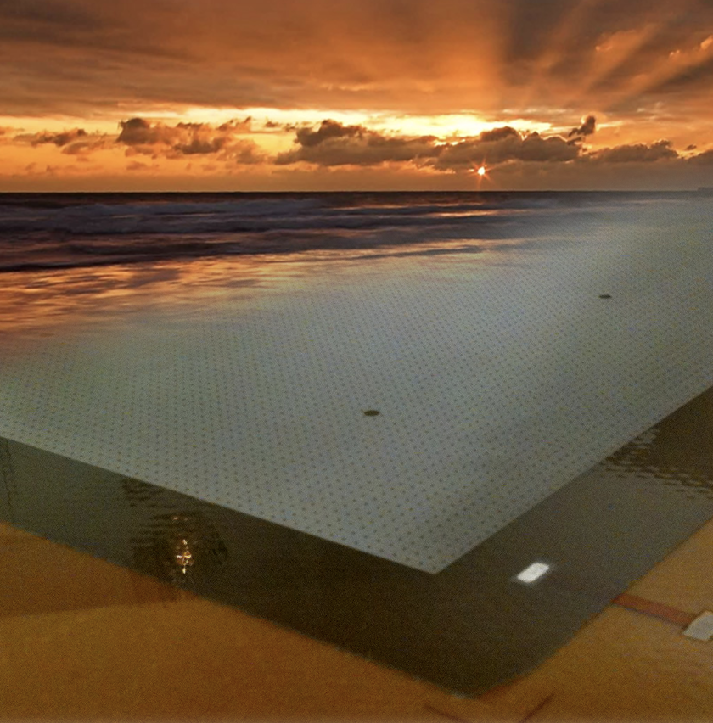
Micromegas

Slide 3
Micromegas Timeline at Saclay
COMPASS (2001)
Sparks reduction R&D (2010)
HDB
Future experiments

Slide 4
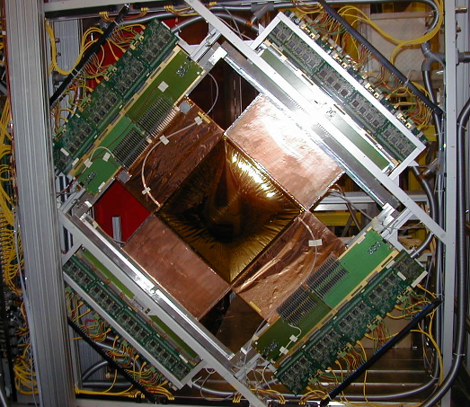
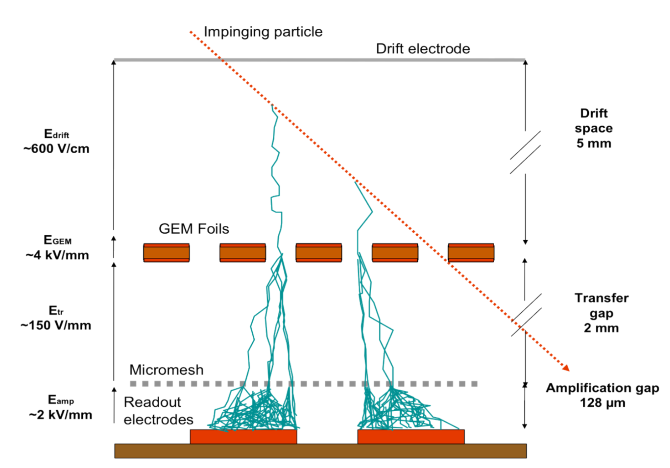
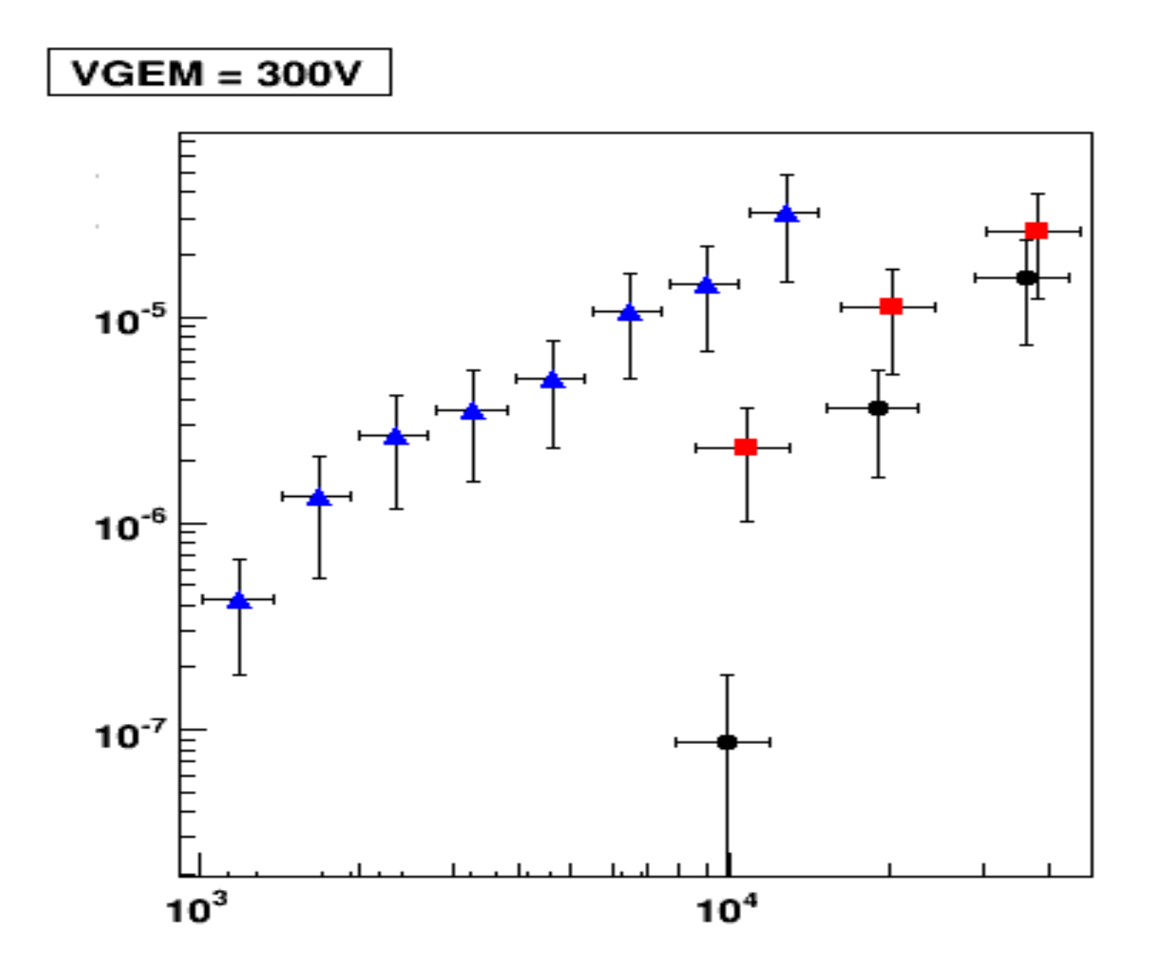
The Pixel Micromegas for COMPASS (2011)
What’s new ?
GEM preamplification
MM alone
GEM at 2mm
Spark probability VS Gain
Notes:
Sparks pb

Slide 5
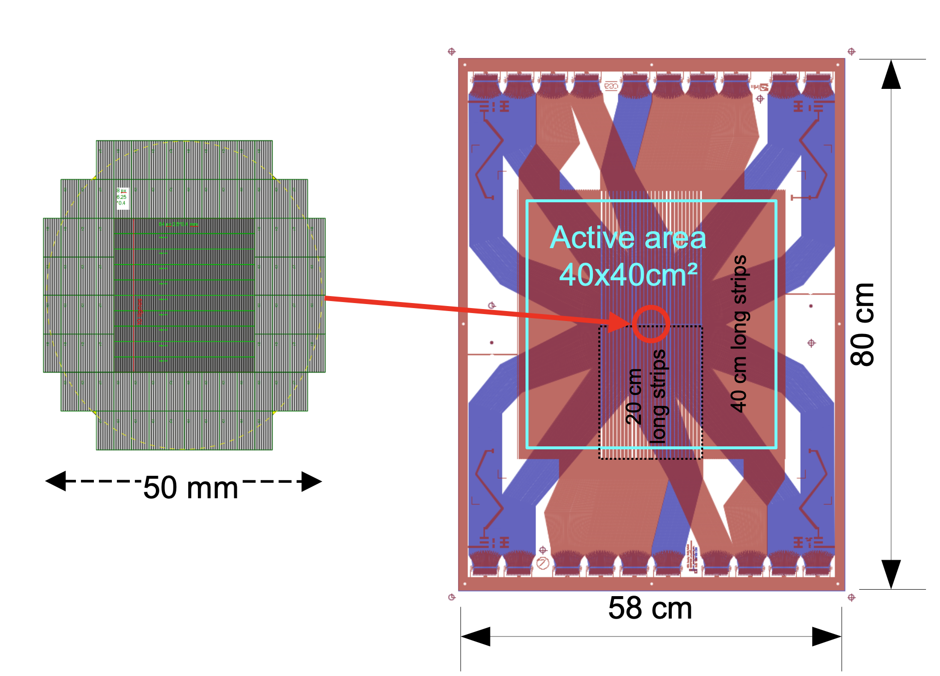
The Pixel Micromegas for COMPASS
What’s new ?
GEM preamplification for sparks
1280 Pixels in beam area for high rate (10 MHz/cm²)
Bulk Micromegas
Conditions
10⁷ Muon/s or 10⁸ hadrons/s beam
APV25 readout
Ne/C₂H₆/CF₄ (80/10/10)
The 40x40cm² COMPASS MM
Bulk MM
GEM
Integration
Test

Slide 6
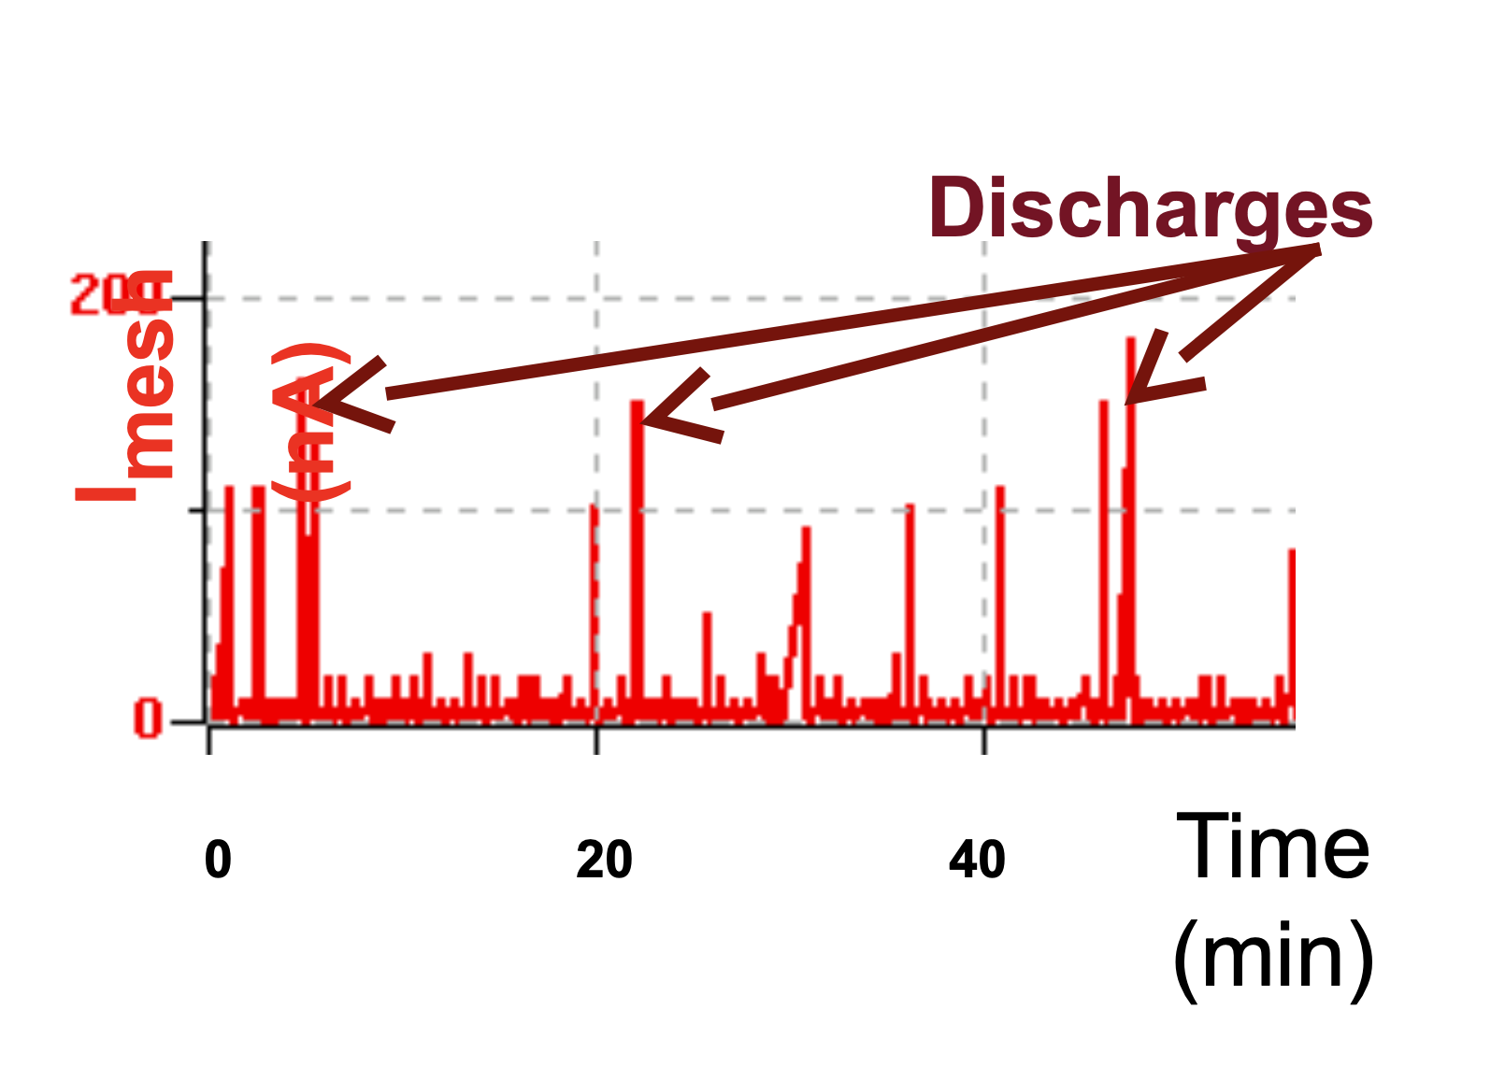
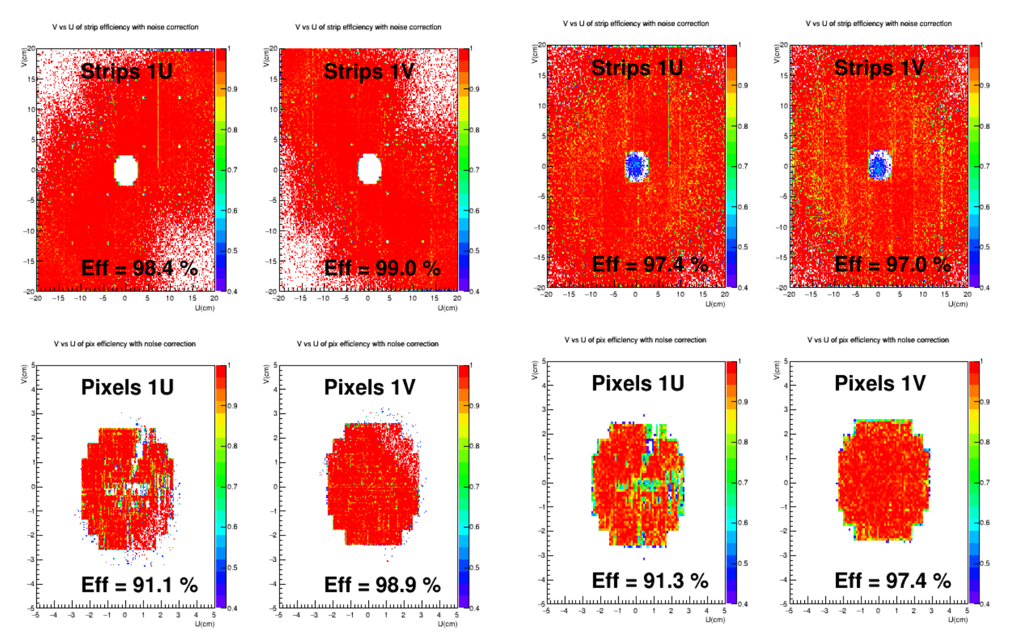
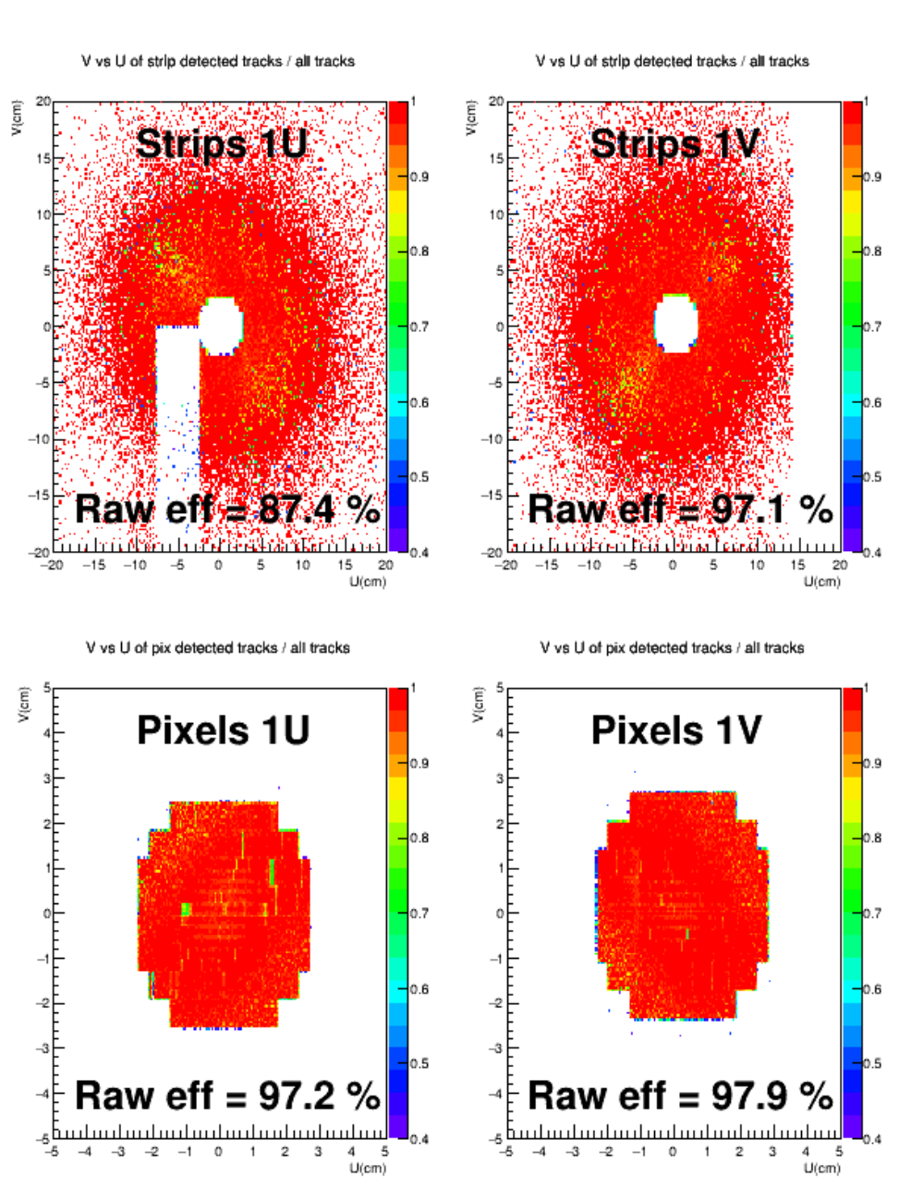
PMM – Results : Sparks and Efficiency
Sparks
Every 5-10 min in high rate hadrons
No consequence on efficiencies
No ageing
Muons (2015)
Hadrons (2015)
Muons (2022)
See : Aging effects in the COMPASS hybrid GEM-Micromegas pixelized
Detectors (JINST, 2023) D. Neyret et al.
(loss of area = APV card issue)
Notes:
Btw 11 years, efficiency increase, it gets better like wine

Slide 7
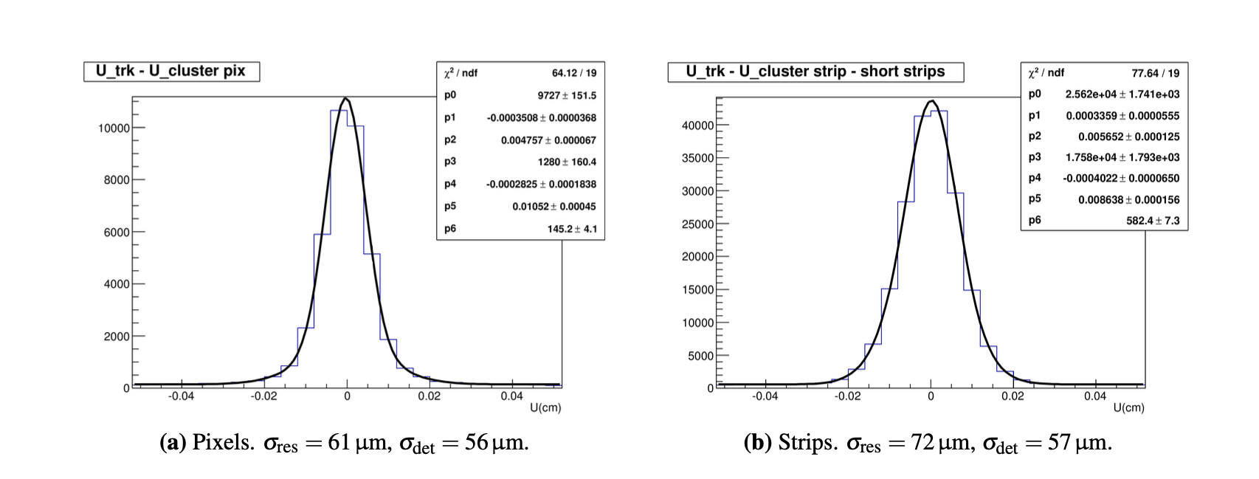
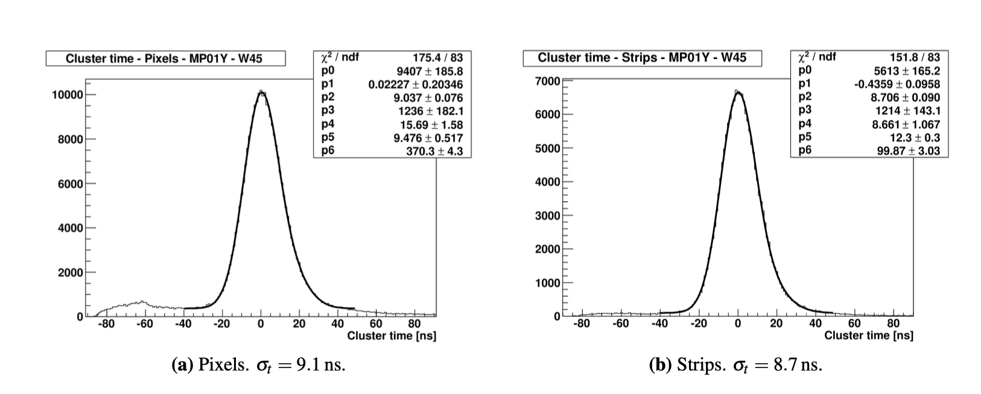
PMM – Results : Resolution
Resolution
Spatial : ~80um (down to 60um in the best conditions)
Time :
9ns muons (Ne/C2H6/CF4 80/10/10)
13ns hadrons (Ne/C2H6/CF4 85/10/5)
See: Performance of large pixelised Micromegas detectors in the COMPASS environment (JINST, 2013) F.Thibault et al.

Slide 8
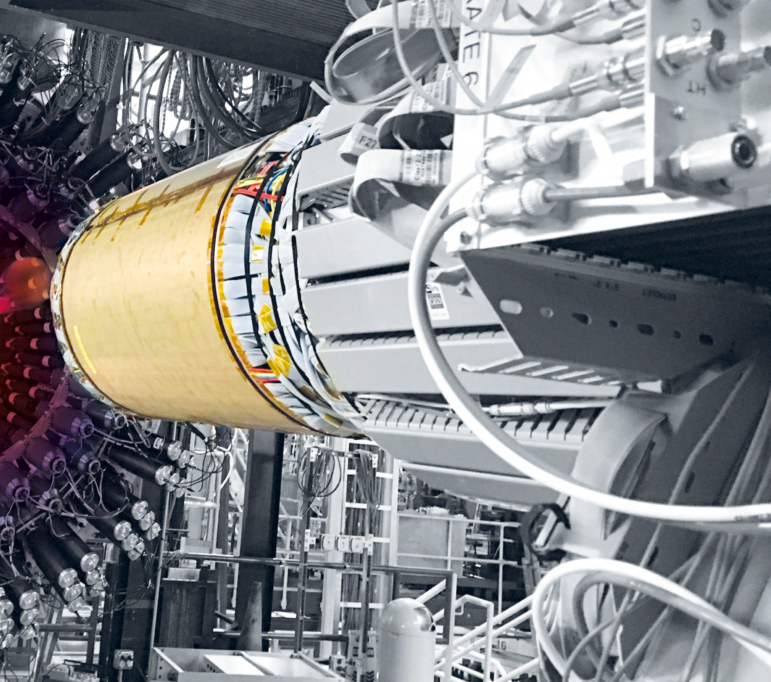
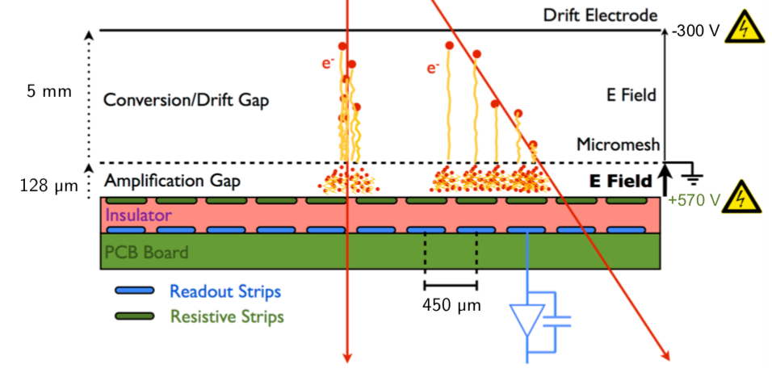
CLAS12 - 2017
What’s new ?
Cylindrical resistive Micromegas
DREAM electronics
-1000V
3mm
pillar

Slide 9
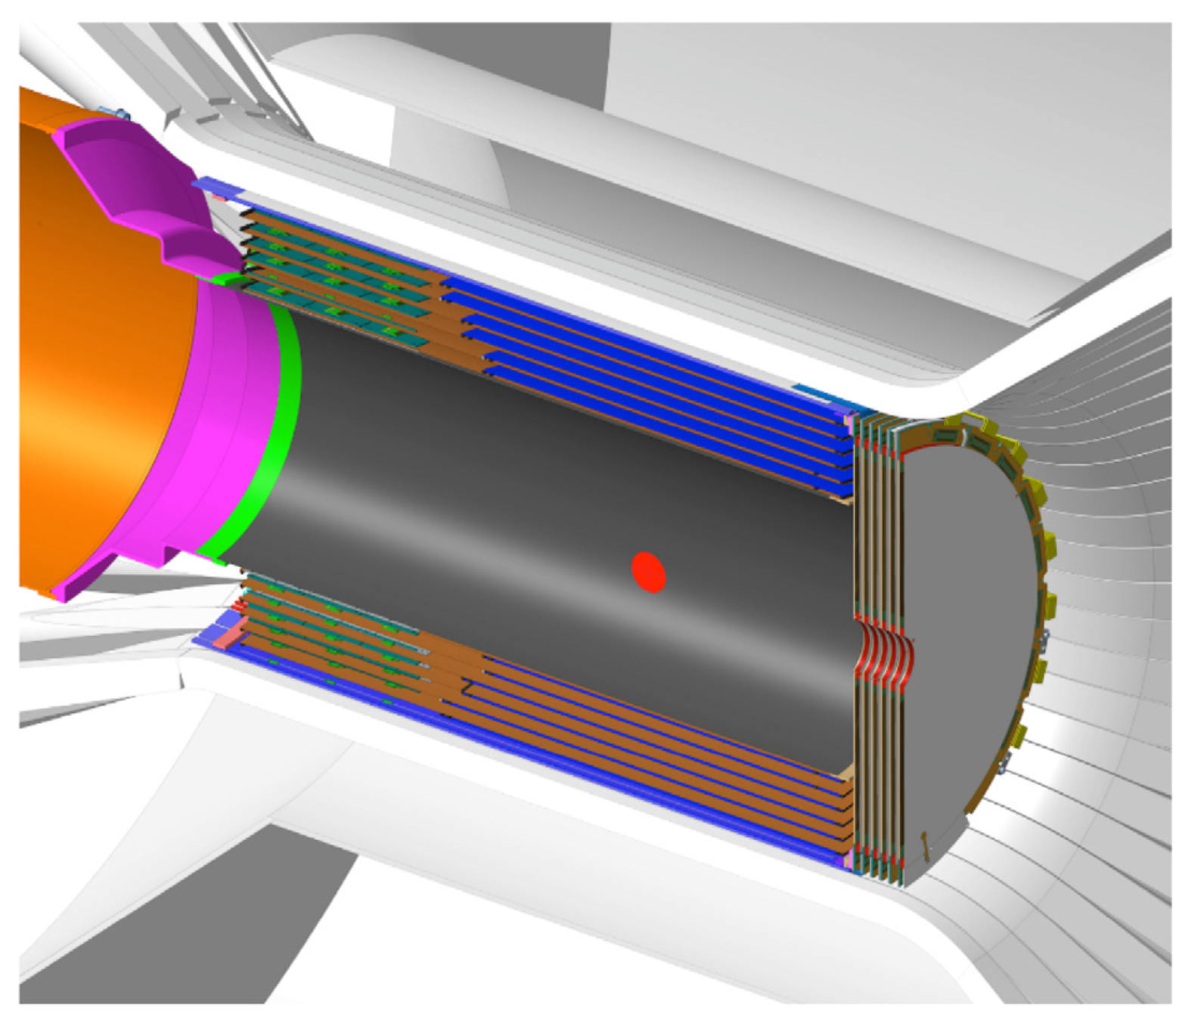
CLAS12 – Micromegas tracker
Cylindrical Micromegas
Strip resistive Micromegas
6 Layers with different radius (18 det.)
1D drift C or Z, 3mm drift
Very light : 0.5% of X0
Forward Disk Micromegas
20MHz integrate rate
2 independent resistive zone
1D strip design rotated at 60 deg
Conditions
5T Magnetic field, gas Ar/Iso (90/10)
11GeV e⁻ beam up to 10³⁵ cm⁻²s⁻¹
e⁻
target
Bulk
Resistive
Integration
Test
See: The CLAS12 Micromegas Vertex Tracker (NIMA, 2020) F.Bossu et al.

Slide 10
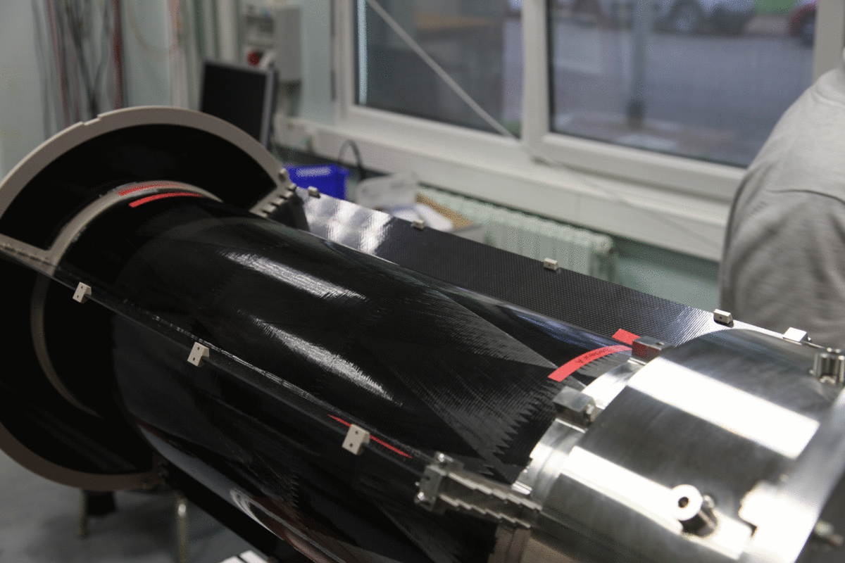
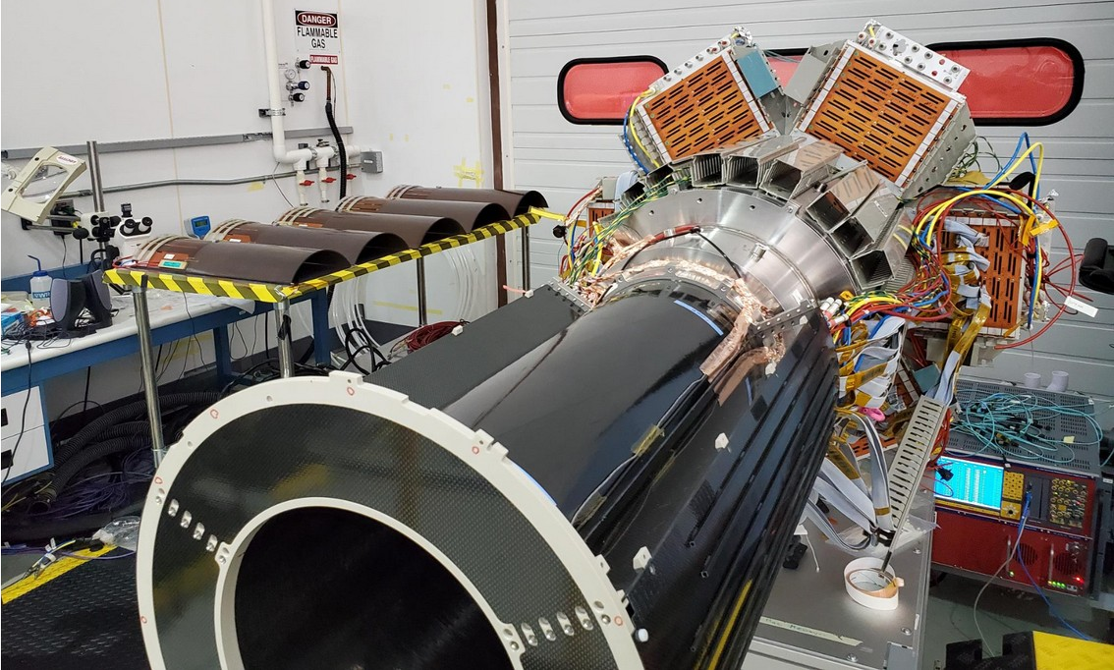
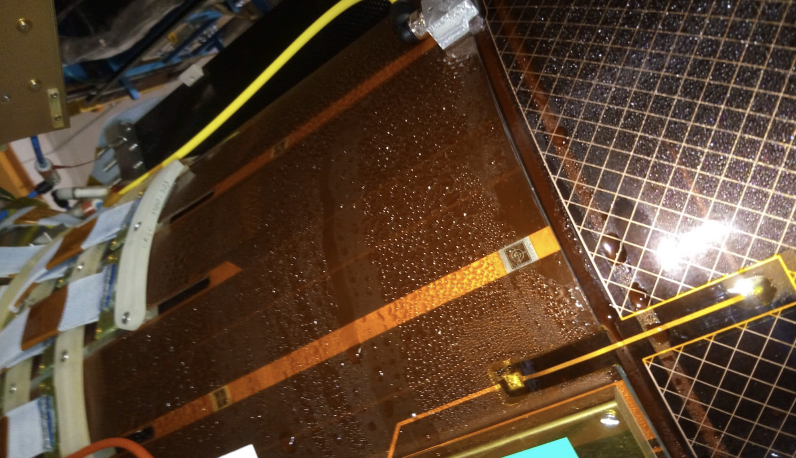
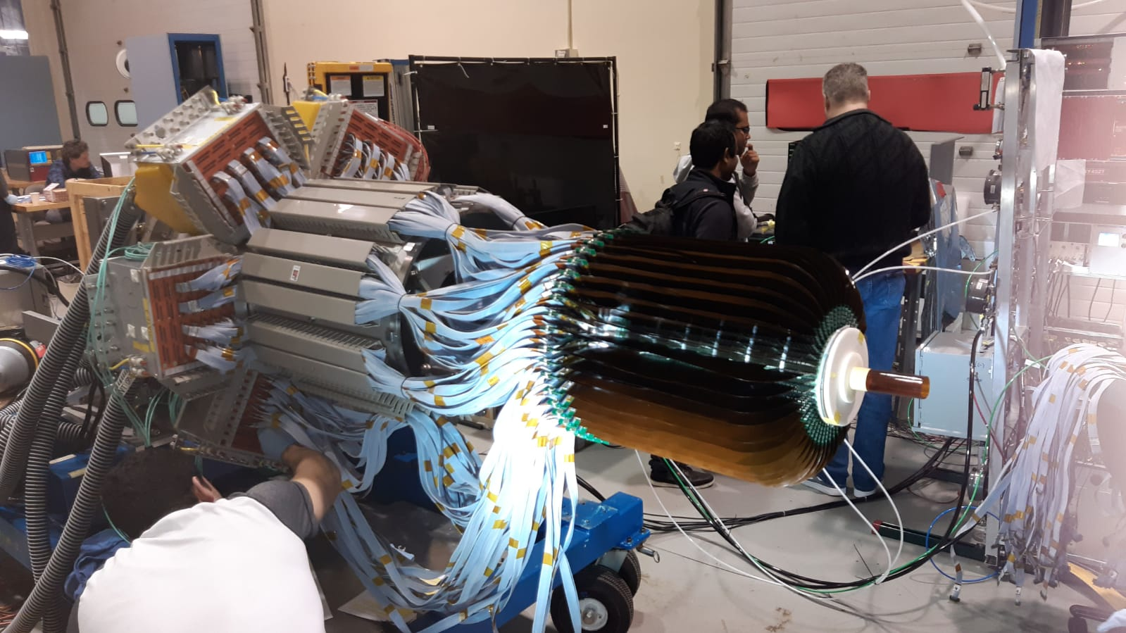
CLAS12 - Operations
6 Cylindrical layers
Maintenance by zoom since COVID
Operation issues
Multi purposes DREAM readout

Slide 11
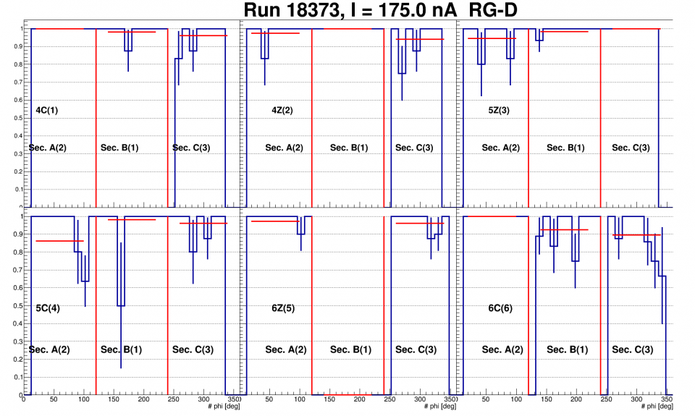
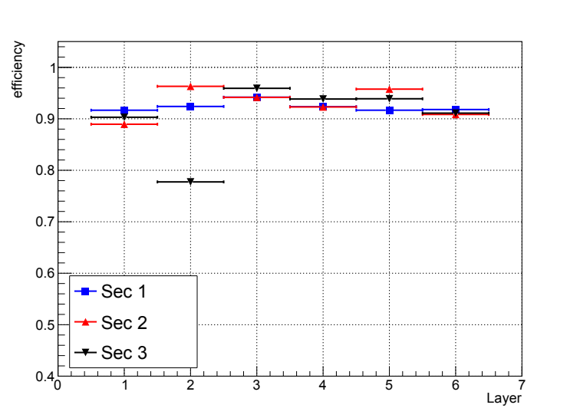
CLAS12 - Efficiencies
LH2 target, Efficiencies above 90%
Highest intensity e- beam on Cu/Sn target
2022 :
2019, LH2, 50nA
Efficiencies not 99% due to 3mm drift and 5T magnetic field
Efficiencies down to 80% due to wrong gas mixture and distribution, now swap with ALERT detector
Notes:
All layers works and we will see with fixed gas issues after ALERT

Slide 12
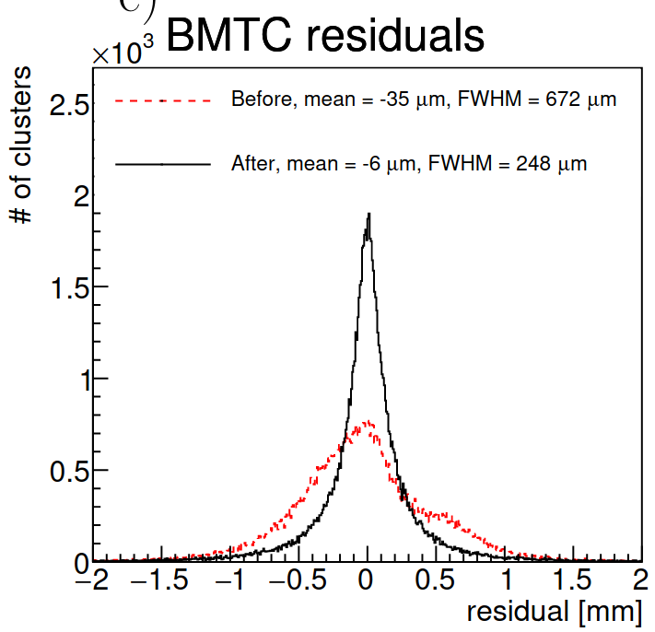
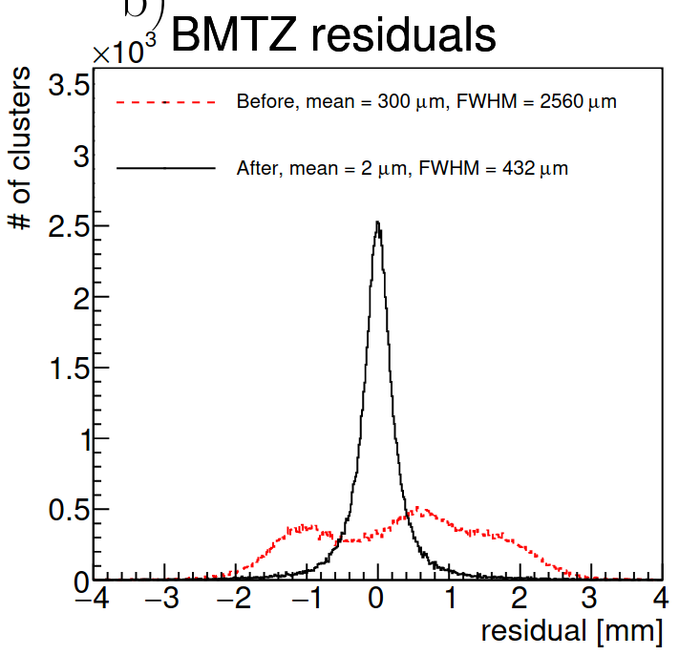
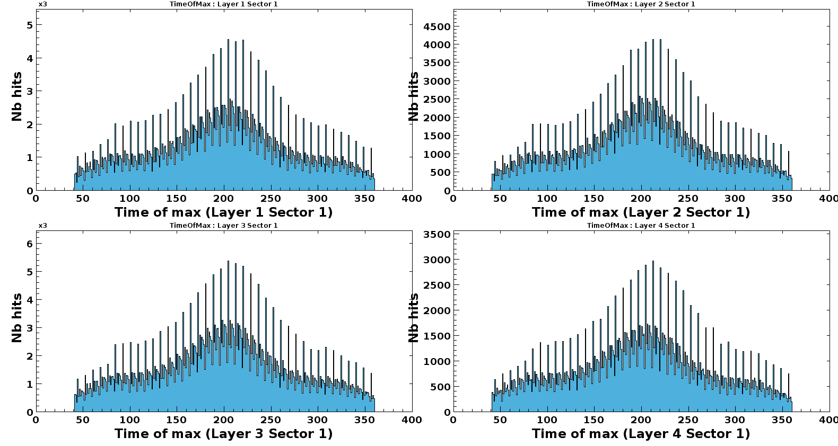
CLAS12 - Performances
Alignment data with cosmic
Average cluster size: ~4
Centroid residuals after alignment:
Z detectors: 432µm
C detectors: 258µm
With external tracker at Saclay ~200um
Time resolution of FMT : 15ns (LH2 target, 2018)
See: Alignment of the CLAS12 central hybrid tracker with a Kalman Filter (NIMA, 2022) M. Arratia et al.

Slide 13
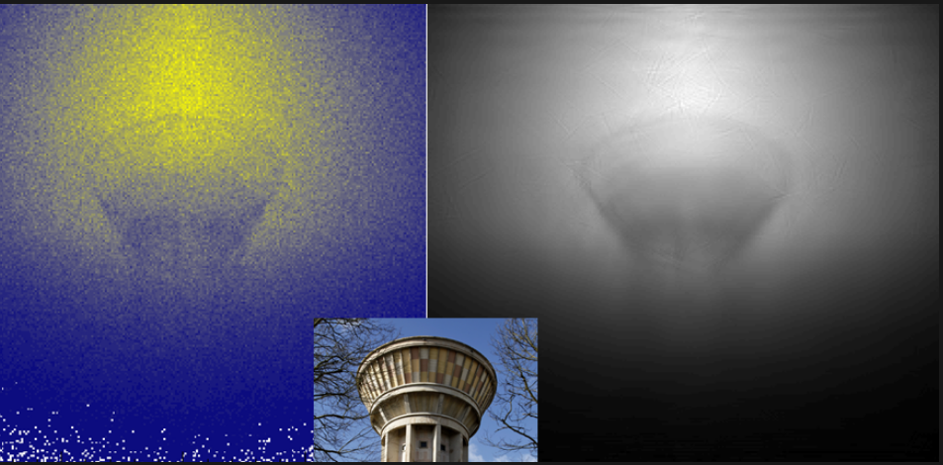
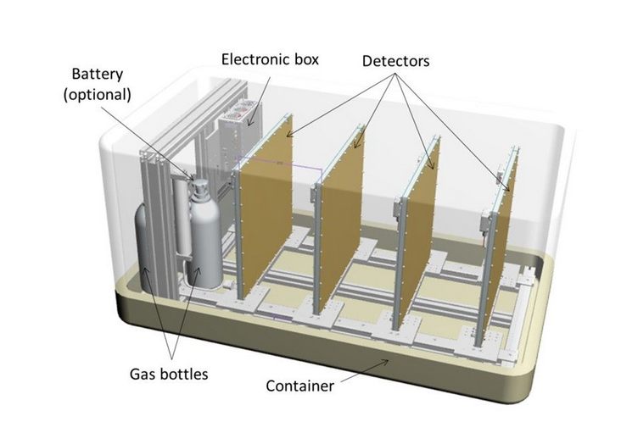
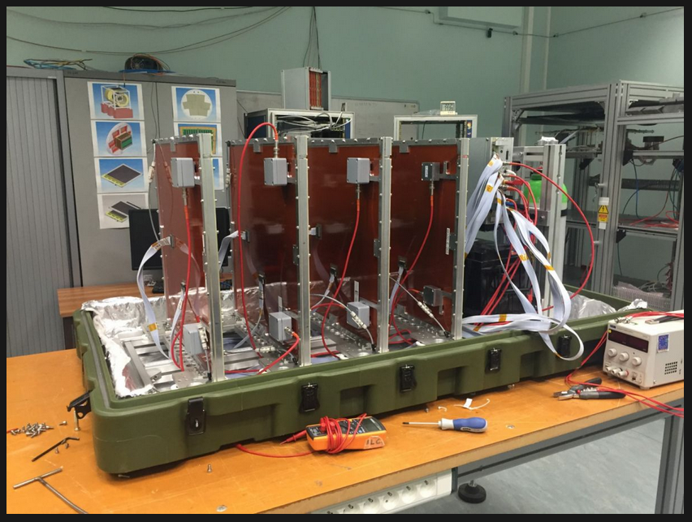
Muon Tomography – 2016
What’s new ?
Cheap 2D Resistive 50x50cm detectors
DREAM electronics
Bulk @ ELVIA
Resistive
Integration
Test @ Saclay
See Tuesday Talk : B. Lefevre, 2D and 3D analysis improvements with Machine Learning for Muography Applications

Slide 14
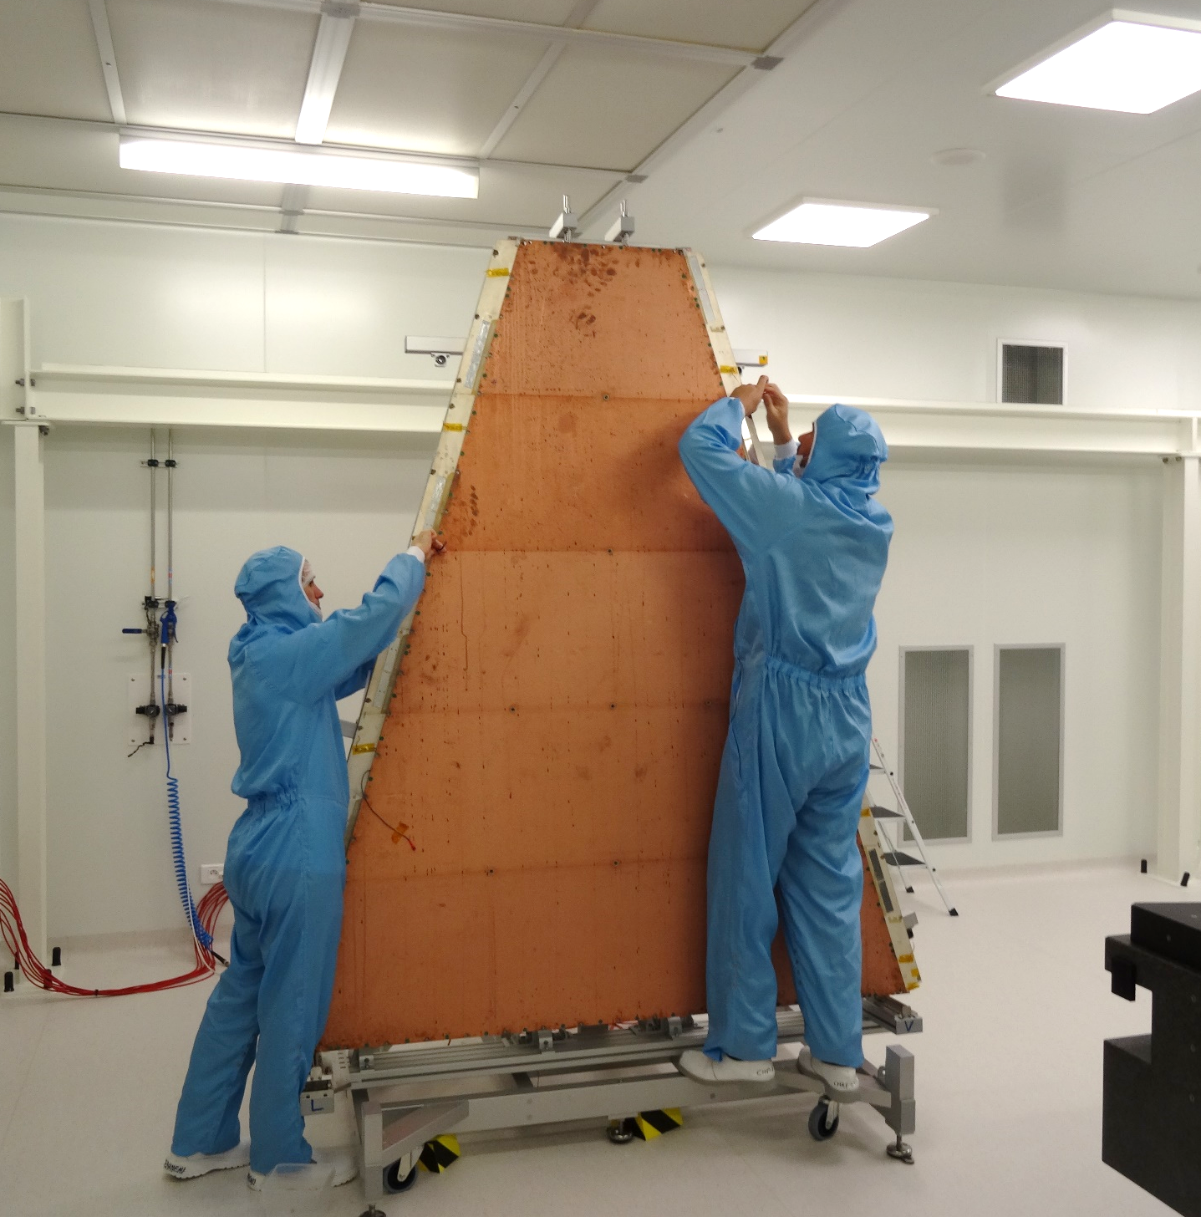
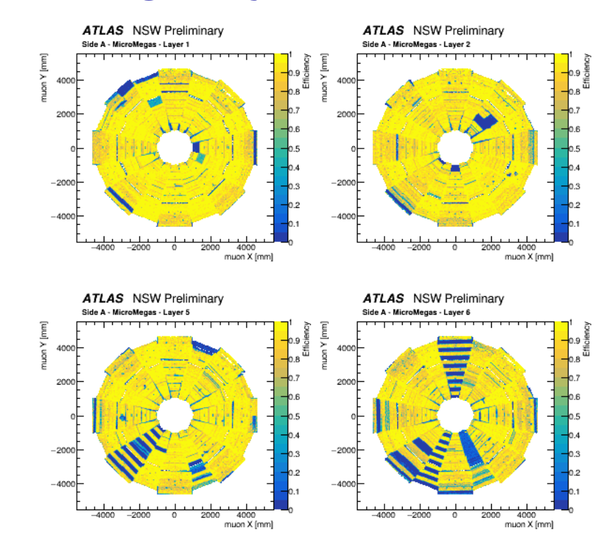
ATLAS NSW - 2021
What’s new ?
Large detectors
VMM electronics
Floating micromegas
See Friday Talk : S. Rosati, ATLAS New Small Wheel Performance Studies with 2023 (LHC Run3) data
See : The large inner Micromegas modules for the Atlas Muon Spectrometer upgrade: Construction, quality control and characterization, (NIMA, 2022) E. Ferrer et al.

Slide 15
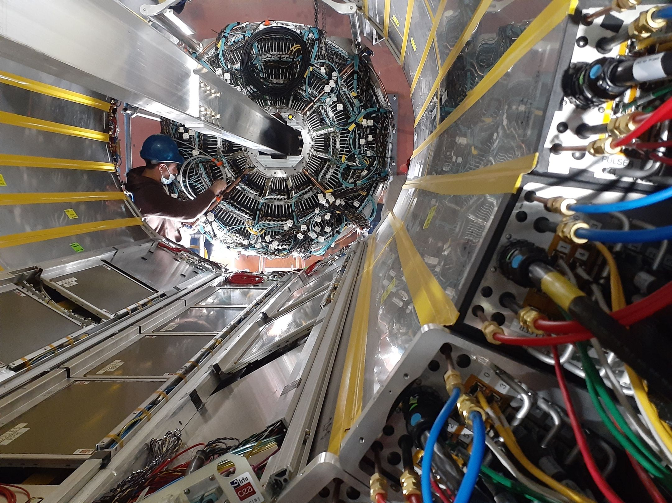
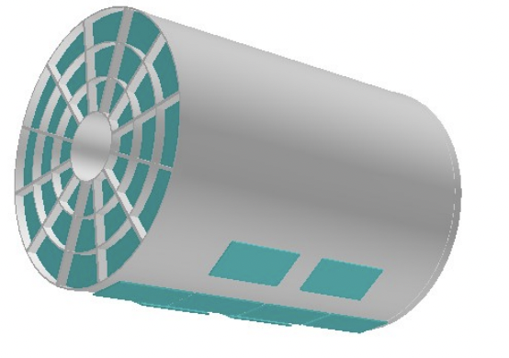
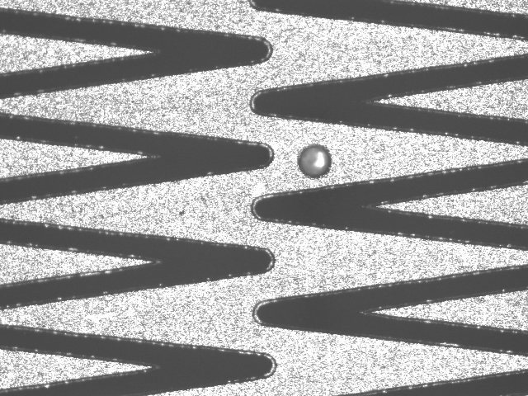
The TPC Outer Tracker for sPHENIX (2022)
What’s new ?
Fast design + production at Saclay (1y), 20 MM
Zigzags readout for 2mm
Resistive segmentation
SAMPA FEE from TPC
First design 09/2021
Installed 02/2023
🔎
Bulk MM
Resist
Integration
Test

Slide 16
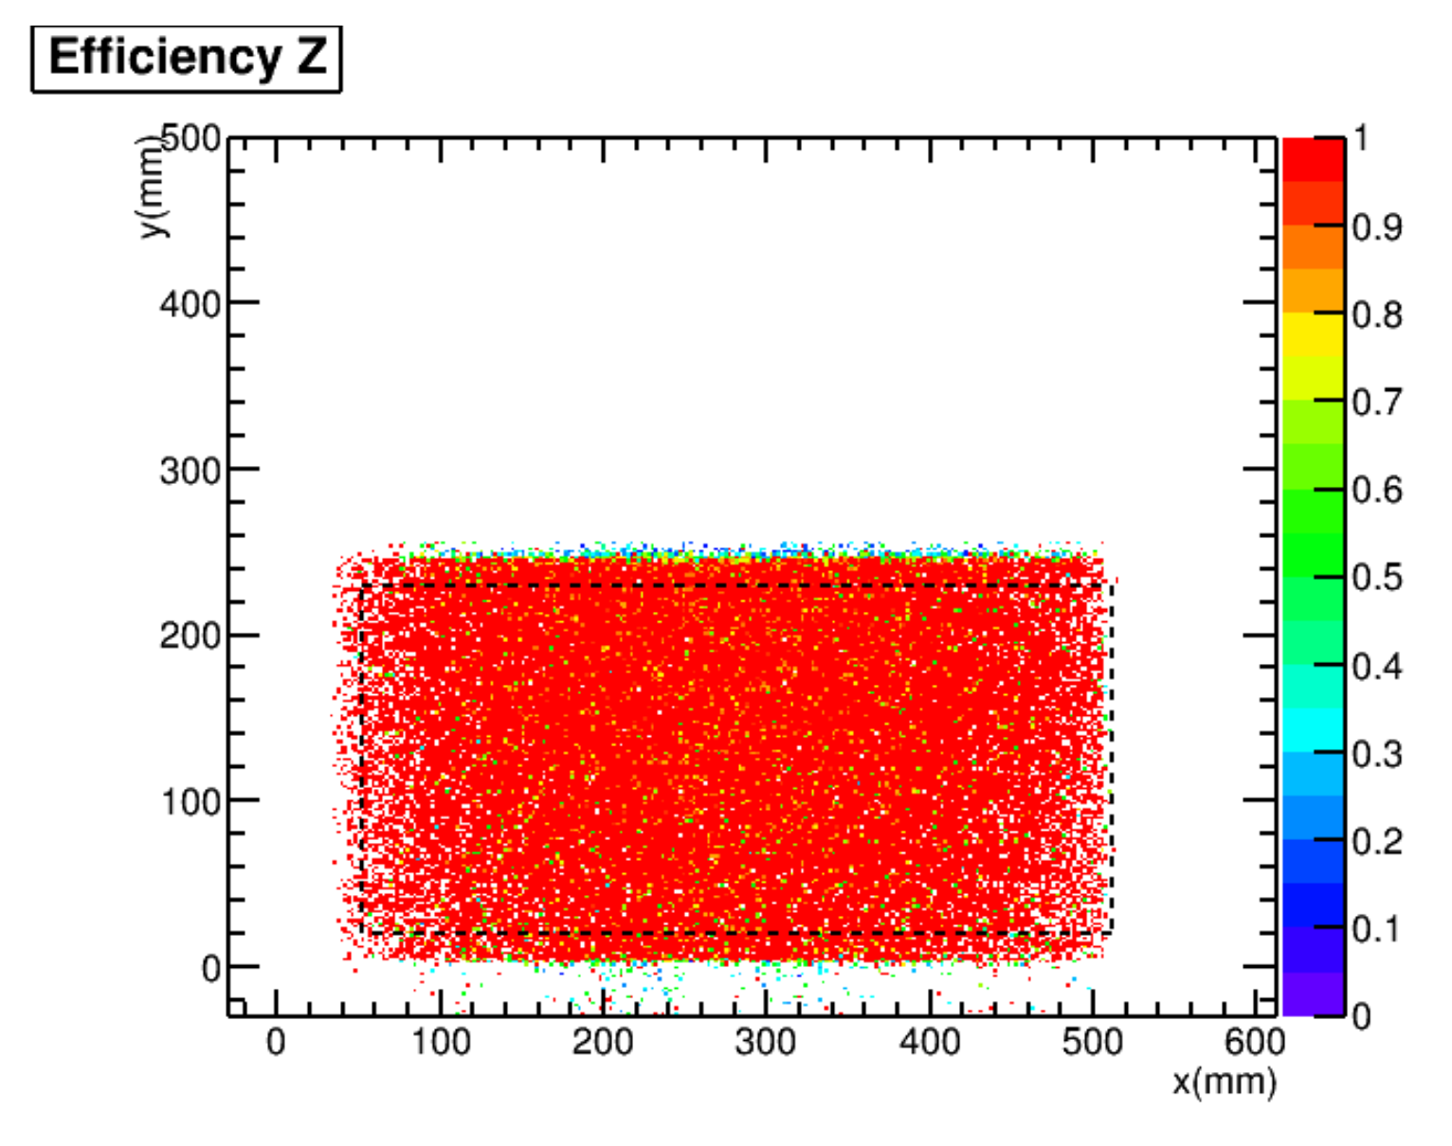
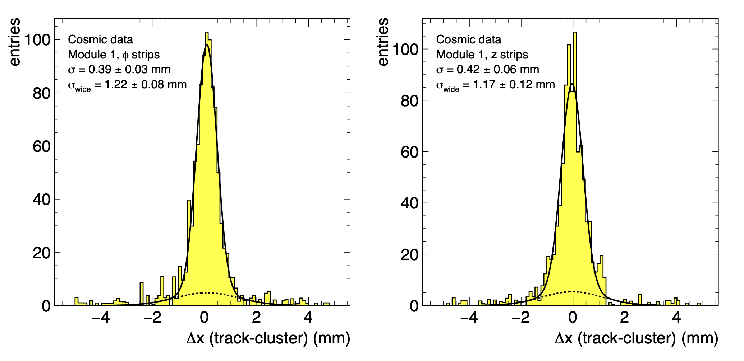
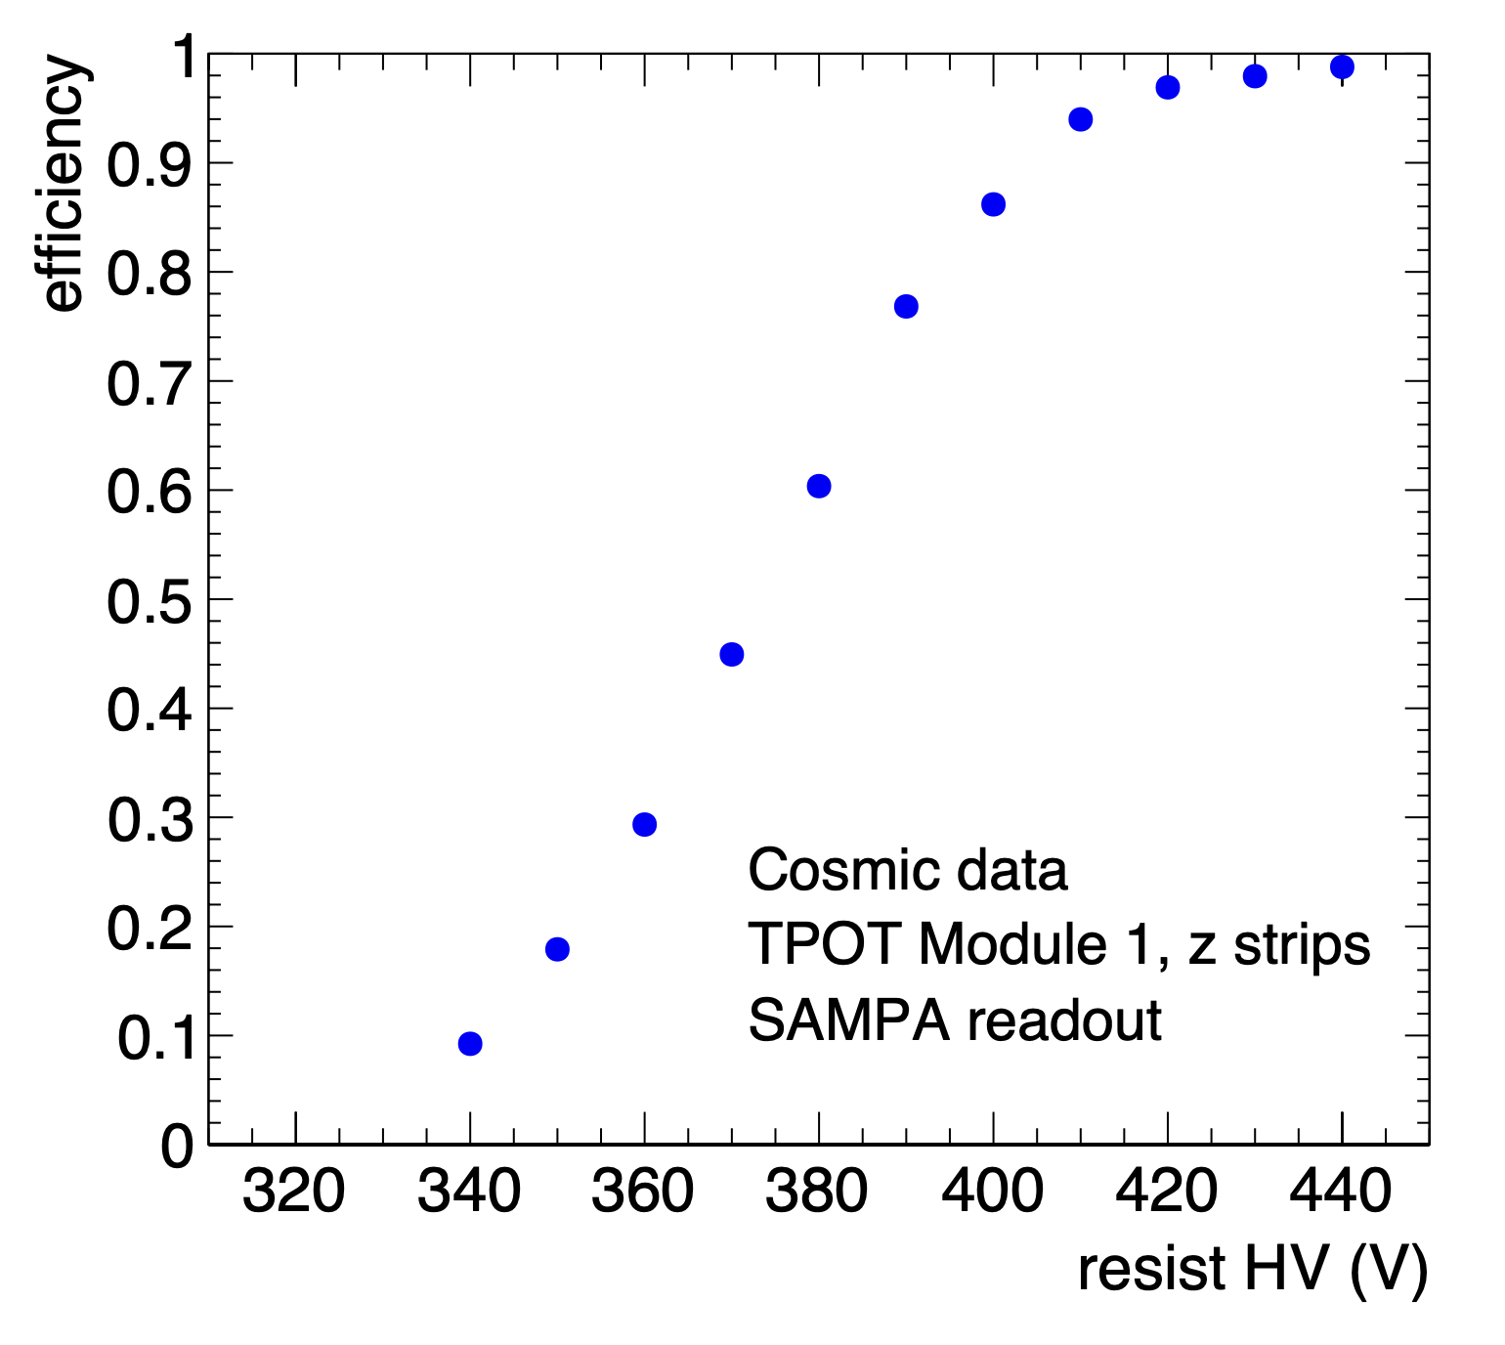
The TPC Outer Tracker for sPHENIX
Efficiency in cosmic rays ~99%
Resolution in cosmic rays
390um for 1mm strips (Phi)
420um for 2mm zigzag strips (Z)
See : The sPHENIX Micromegas Outer Tracker, (submitted to Elsevier, 2024) H. Pereira Da Costa et al.

Slide 17
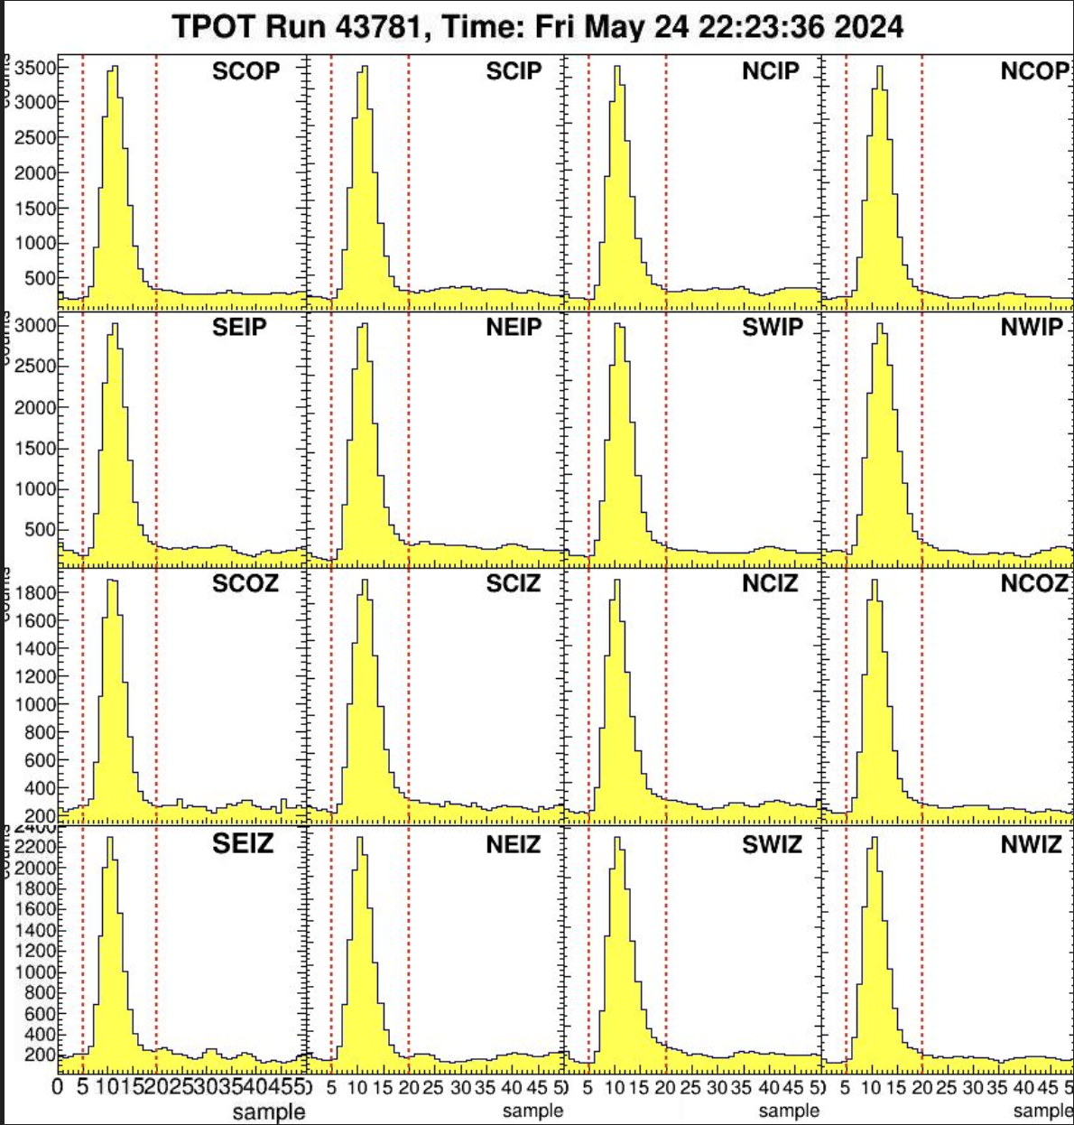
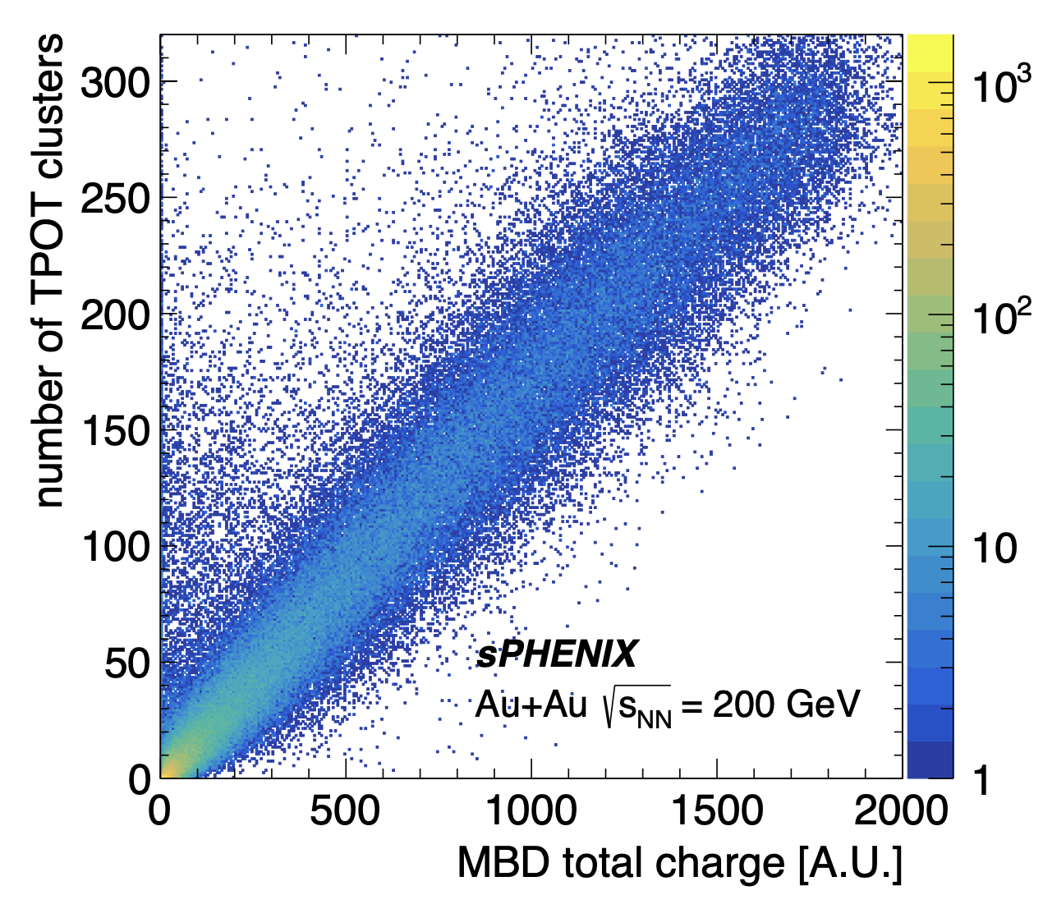
The TPC Outer Tracker for sPHENIX
Now in Au-Au collision
Correlation between MM and Minimum Bias Det.
Time Distribution of all MM in Au-Au
See : The sPHENIX Micromegas Outer Tracker, (submitted to Elsevier, 2024) H. Pereira Da Costa et al.

Slide 18
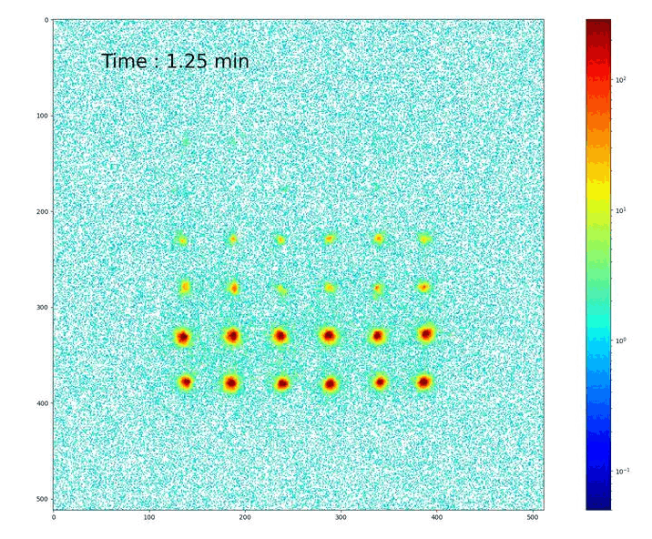
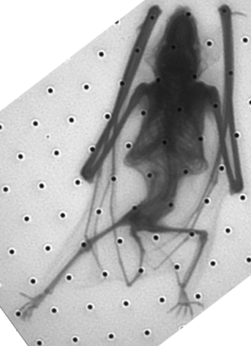
Other Micromegas « sparks »
From the HBD, coupling MM with photon convertor => Picosec (2015) (see A. Kallitsopoulou talk)
Glass Micromegas, X-Rays
Glass Micromegas, Neutrons
Glass Micromegas, Beta for medical imaging
Starting 2018
2024
2023
Bulk MM
From : Optical readout Micromegas for neutron and beta imaging Antoine Cools - 13/12/2023
Integration
Test

Slide 19
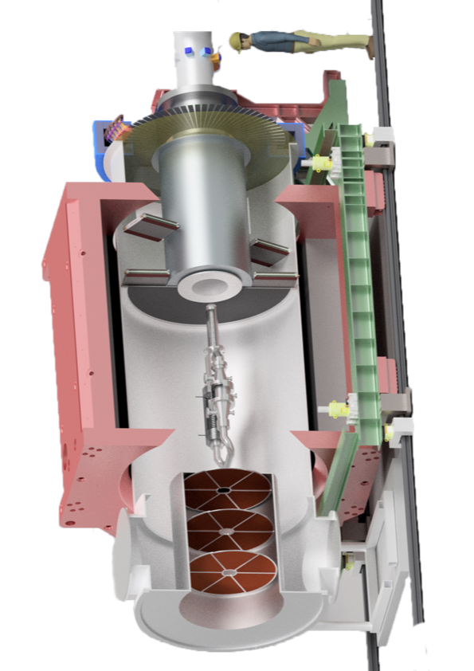
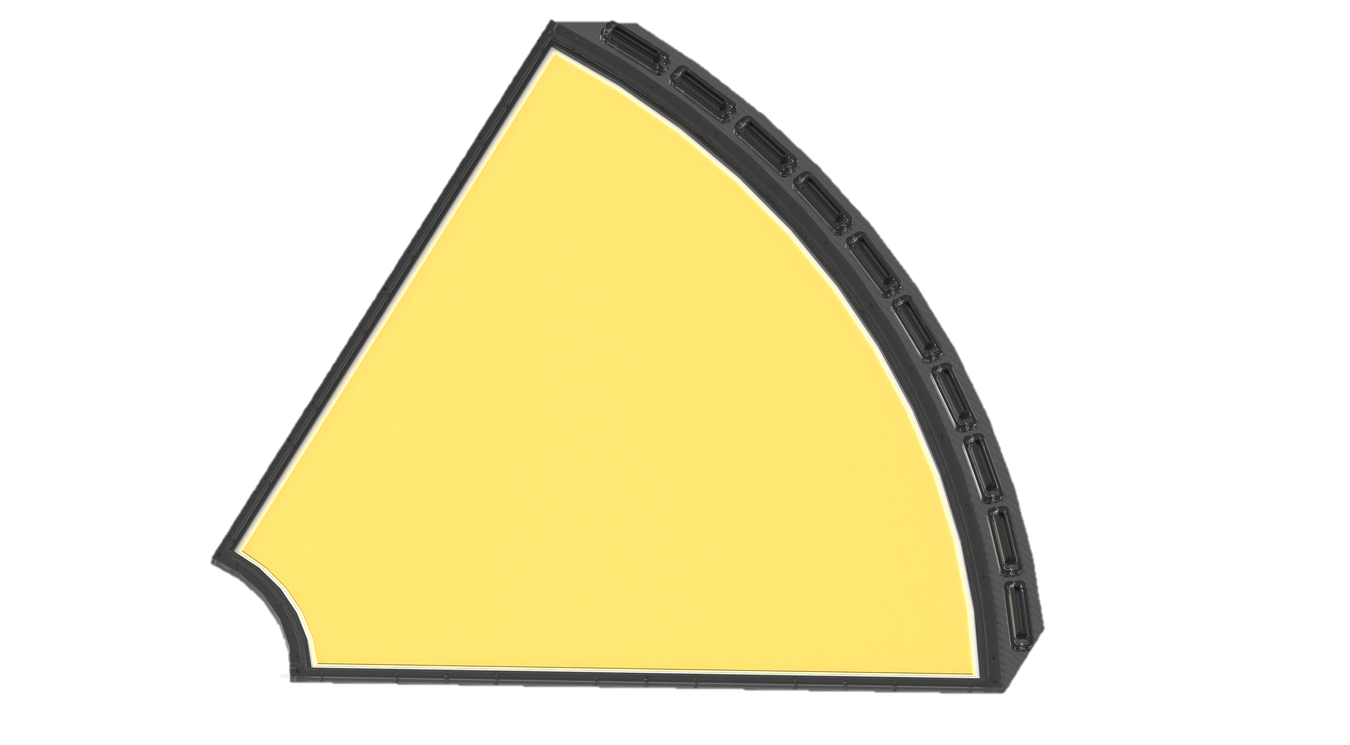
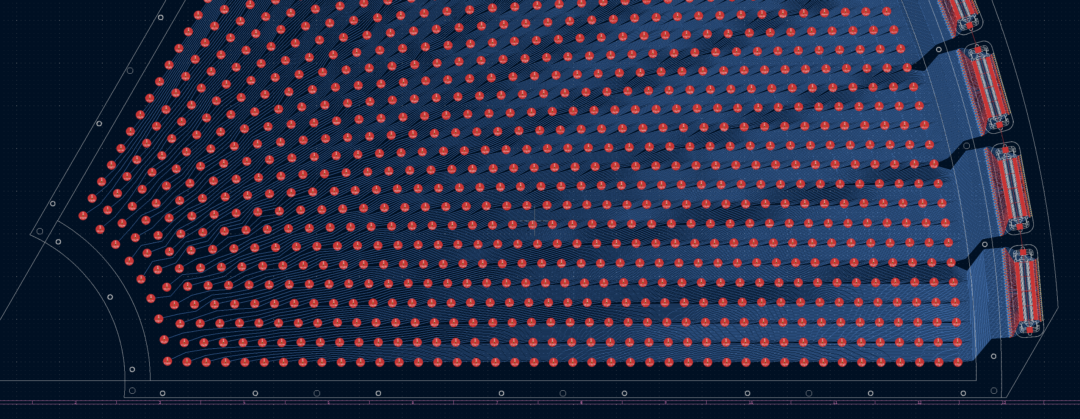
Future : P2 (2025-2026)
What’s new ?
Light metallic micromegas (aim at ~0.2% of an X0) “Sail tracker”
VMM SRS FEE + custom made backend + Online Trigger
1280x1cm² pads per 60º sector, 18 det. Total ~20k channels
Conditions :
E_{beam} = 155 MeV, I_{beam} = 150 mA
Backward scattered electron = Low energy (=xray)
100MHz signal integrated in backward (100GHz forward …)
<- 60cm ->
e-
Challenging PCB routing
Bulk MM
Integration
Test

Slide 20
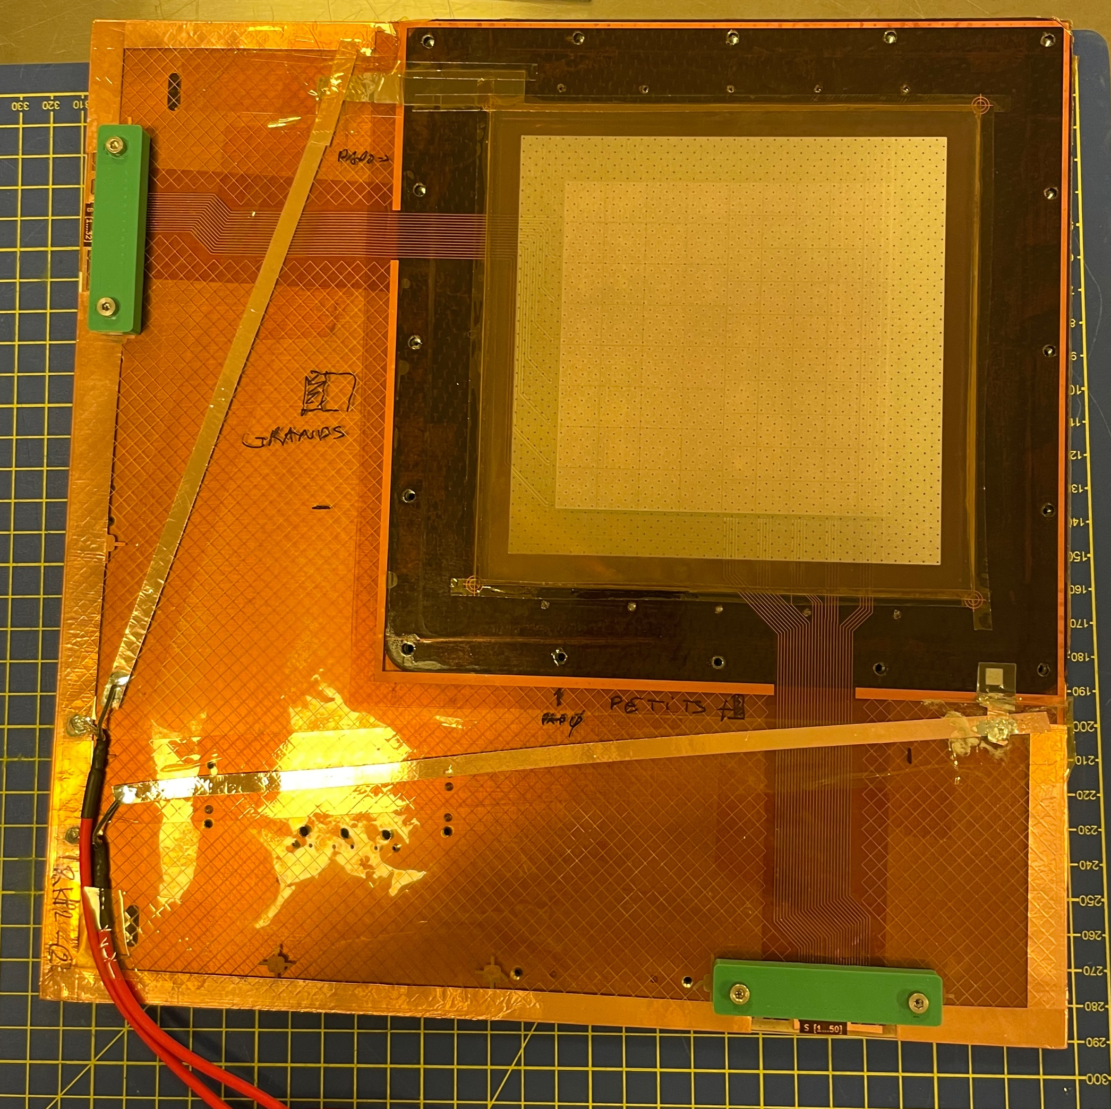
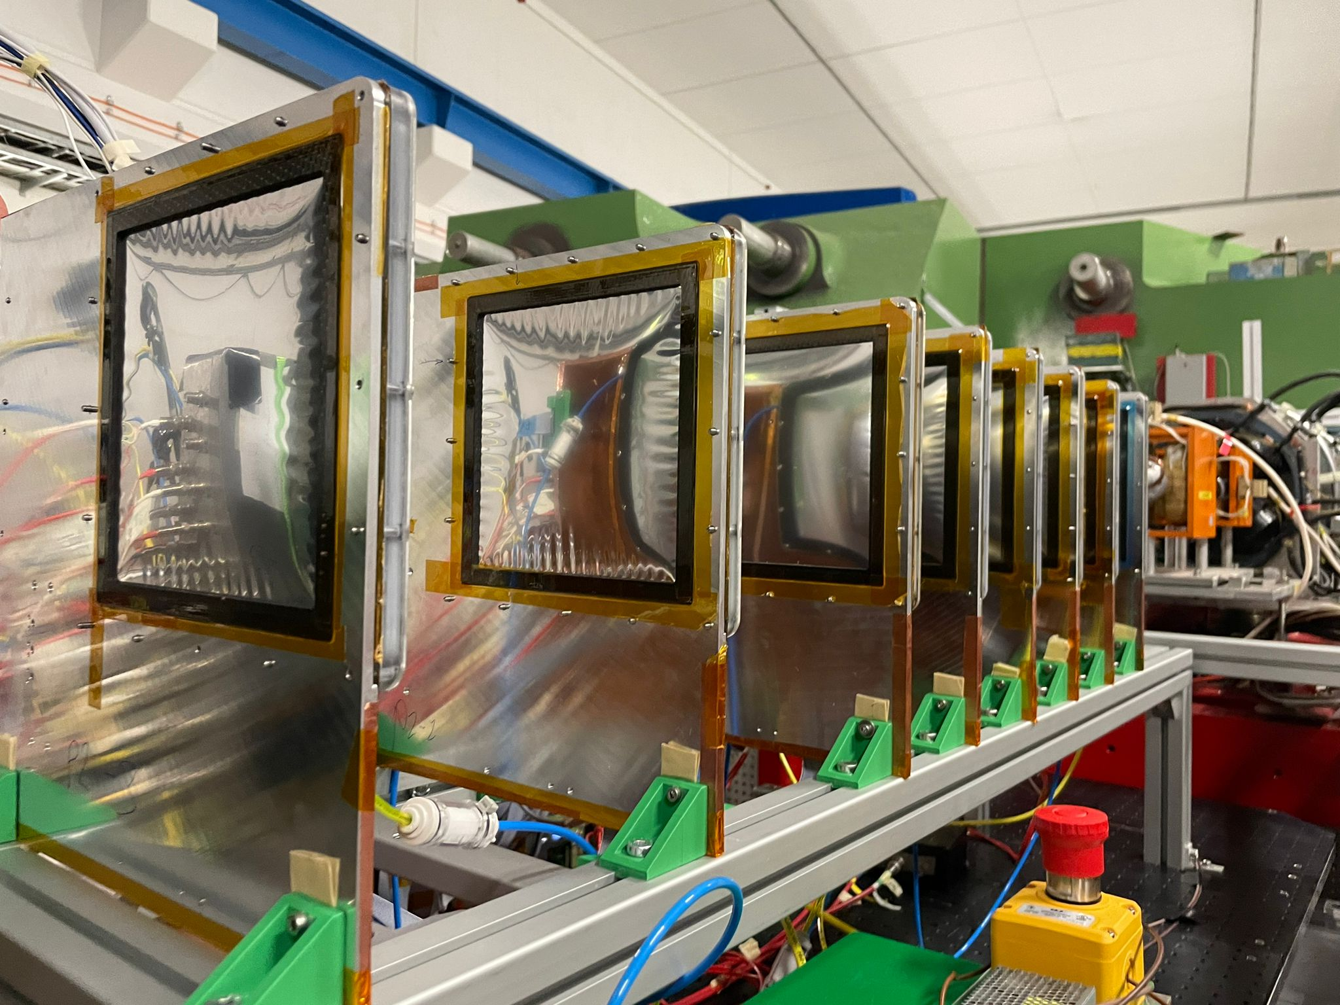
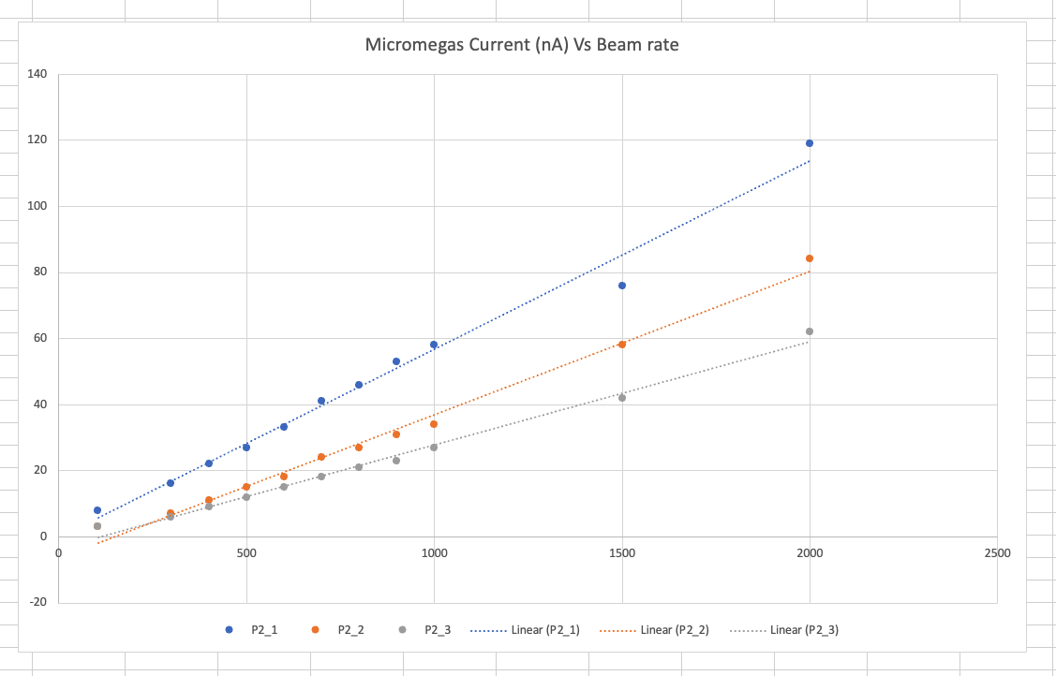
Future : P2 (2025-2026)
“RD4” 10x10cm2 prototypes
Sail trackers with carbon frame OK
Rate validated with 800MeV electrons at Mainz OK
~5 sparks during data taking (electrons below the hadronic threshold)
Remaining issues
Sail tracker difficult to bulk in full size
VMM hybrids are not well protected for sparks
3mm drift gap with mylar might be challenging
Mylar
Readout Kapton
Mesh
Drift
Mylar
Current Vs Rate

Slide 21
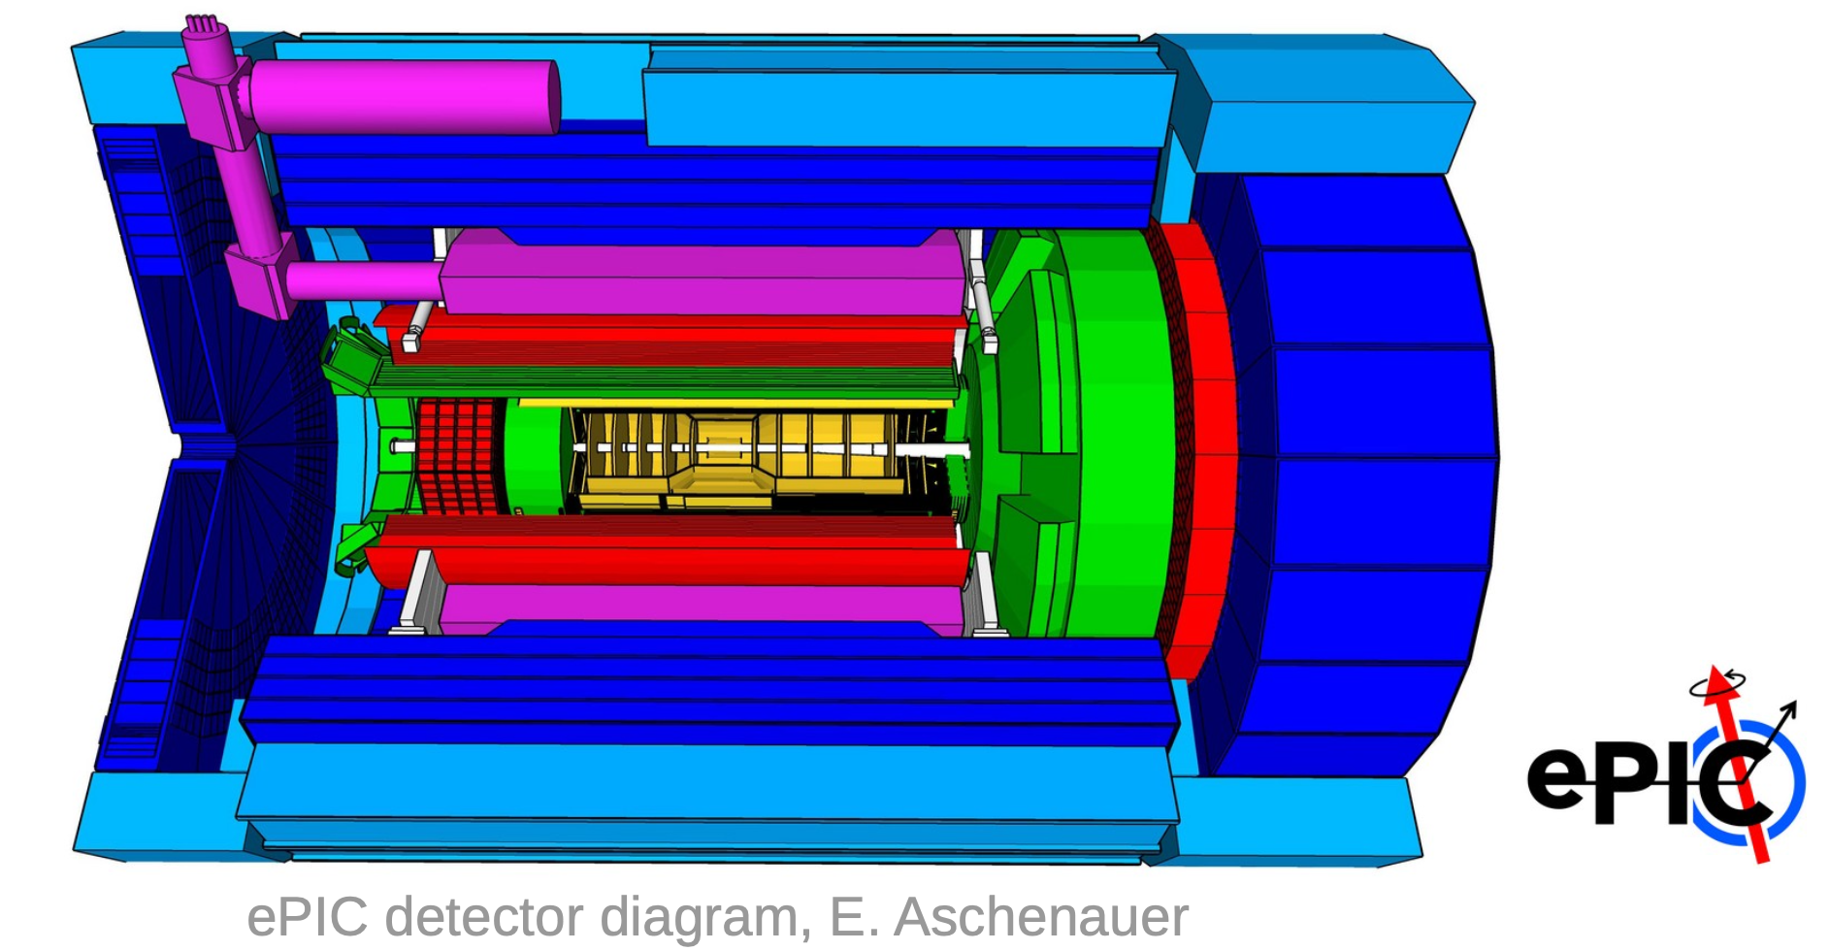
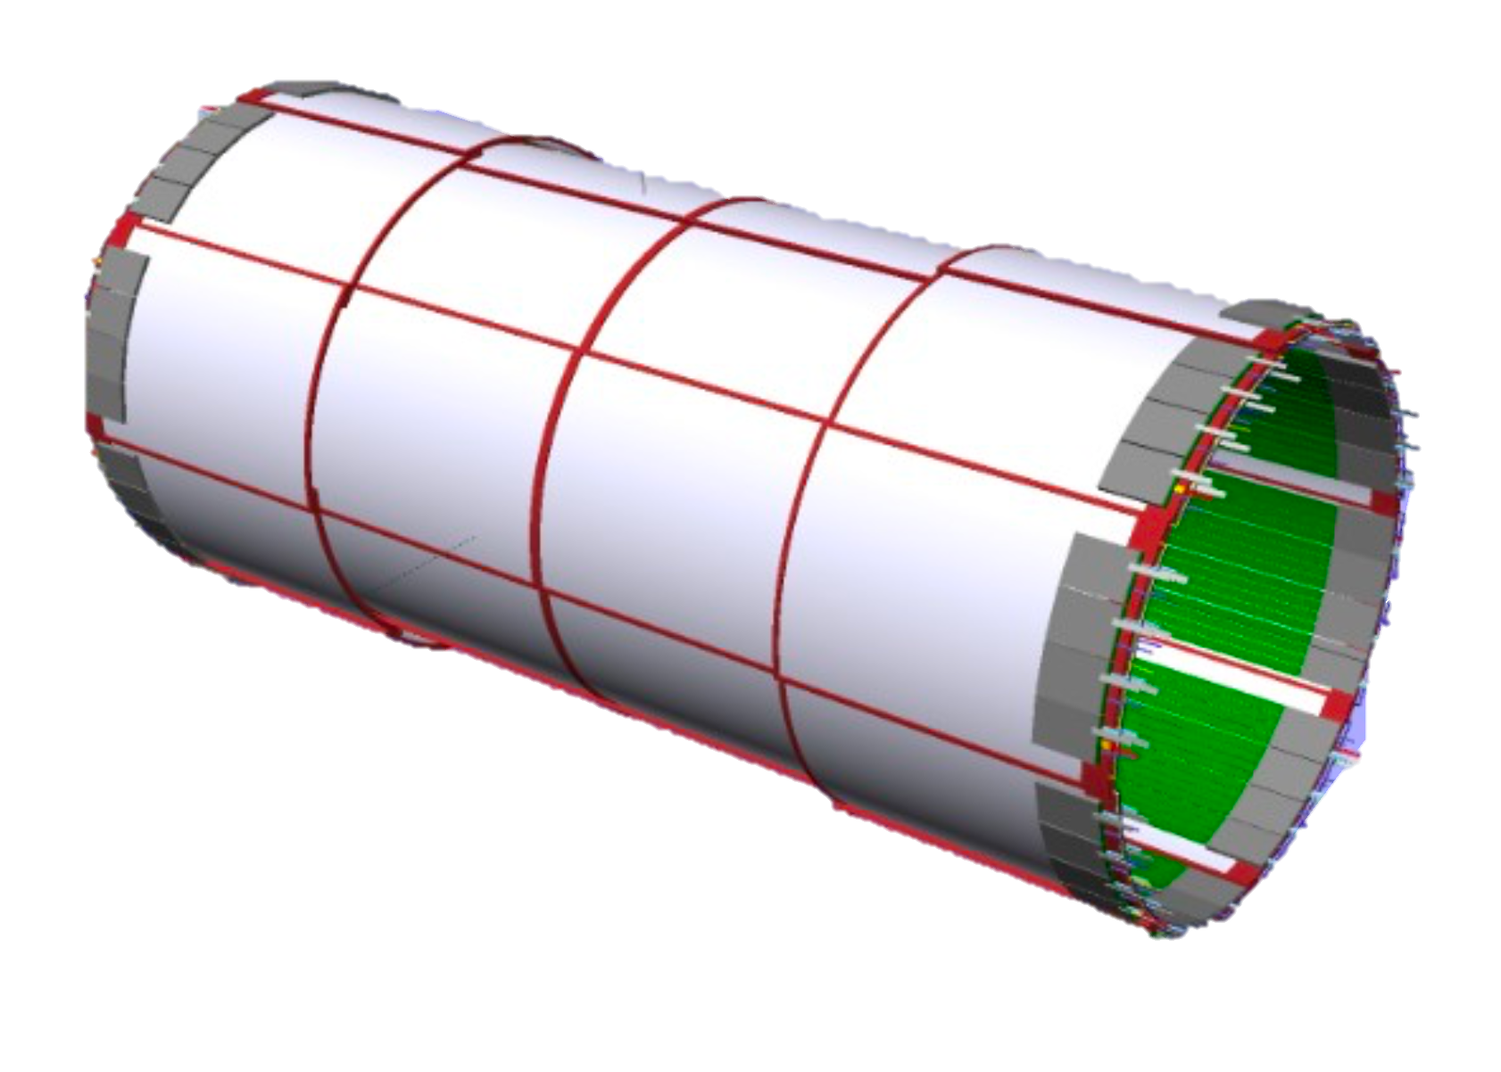
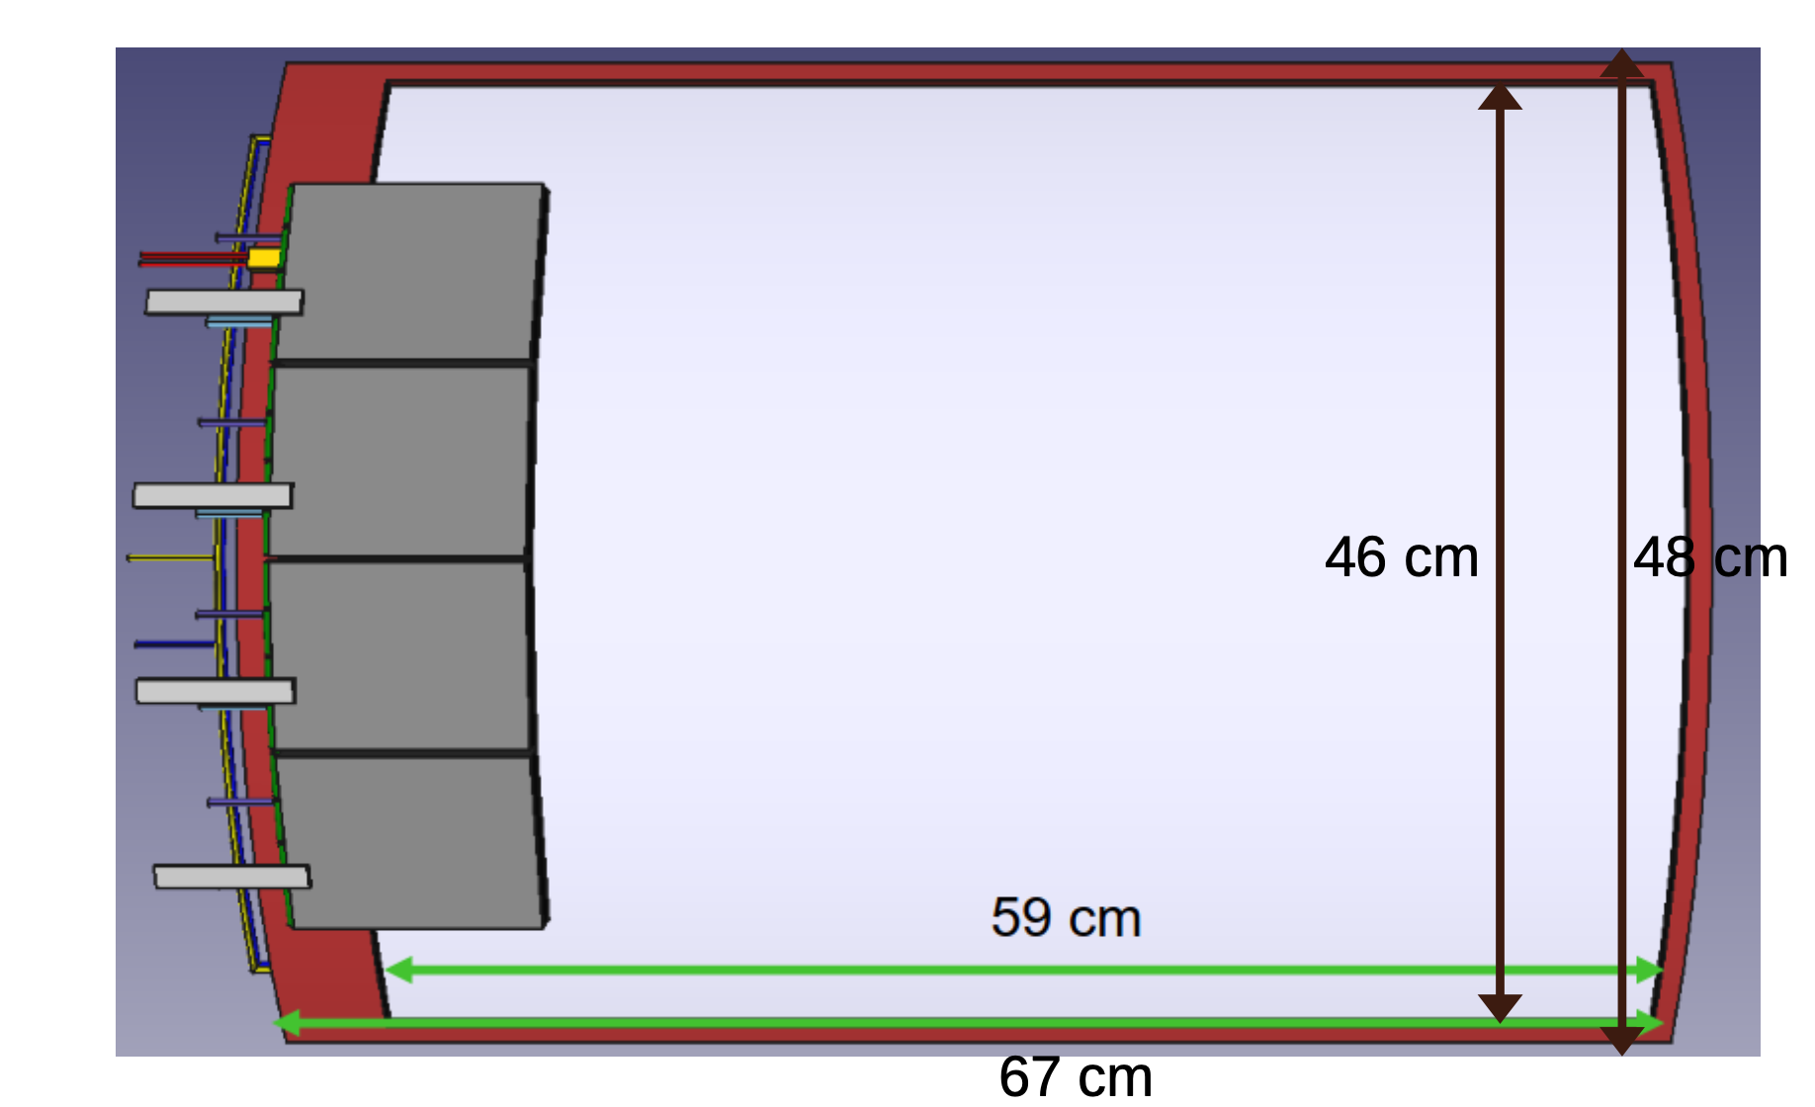
Future : EIC (2027-2029)
What’s new ?
Cylindrical resistive bulk MM
2D strip readout
SALSA chip
CyMBAL: Cylindrical Micromegas Barrel Inner Layer
Low material budget: 0.5% of an X0 in the active area
Spatial resolution of ~150μm
Timing resolution ~10ns
Compact design, inside a ~2T magnet
Single tile
Bulk MM
Resist
See poster : MPGD Trackers in the ePIC Detector at the EIC, Kondo Gnanvo
Integration
Test

Slide 22
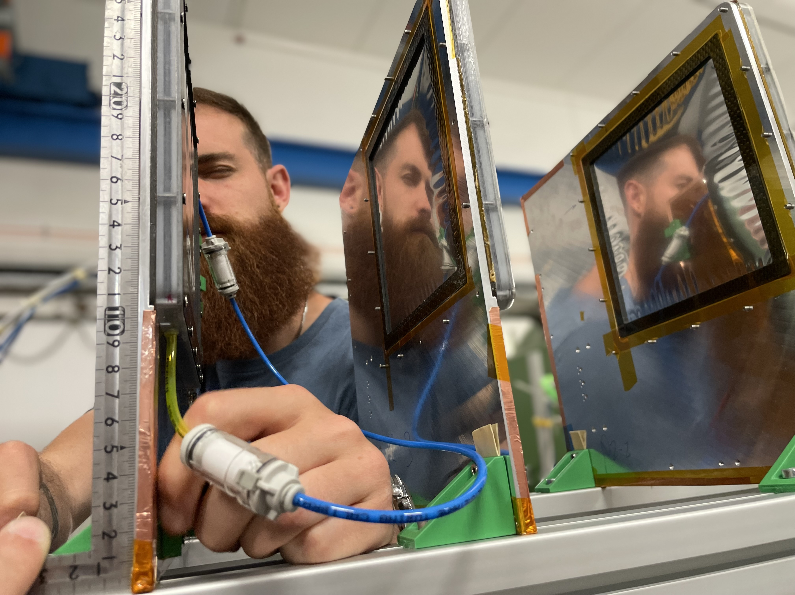
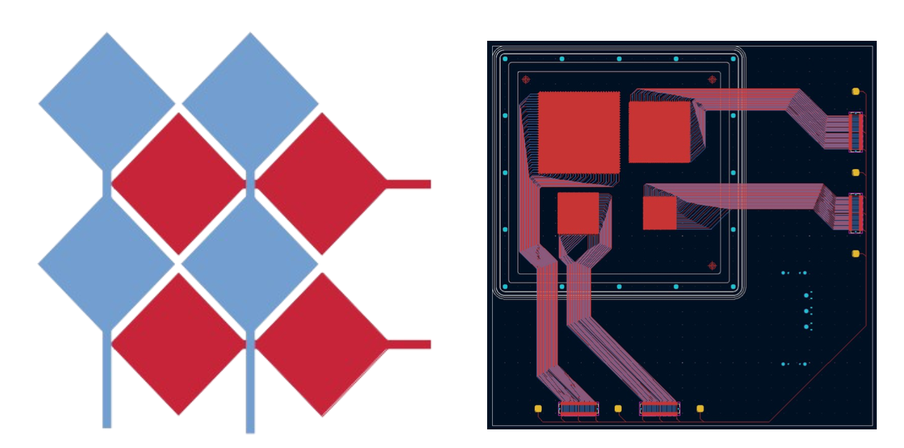
Future : EIC (2027-2029)
RD4 Test Beam at Mainz with 880MeV electrons
2xUrwell to study 2D readout
2D ”Diamonds” with resistive MM
2xResistive MM for 2D readout
Resistive grid patterns in production
Results non conclusive due to multiple scattering
Next test beam in September 2024 with fixed geometry to get best 2D readout design

Slide 23
SUMMARY AND OUTLOOK
All these projects made within large collaborations and thanks RD51 ! And welcome DRD1 !
GEM + MM for COMPASS
Cylindrical MM for CLAS12
Large MM for NSW
Robust MM for sPHENIX
And many more : T2K, forfire, ILC, ZZ R&D, ASACUSA, Gbar …
Next
Light sail trackers for P2 with fast VMM acquisition
Cylindrical and new ASIC for EIC

