Slide 1
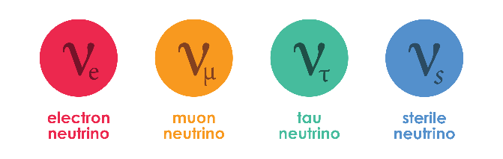

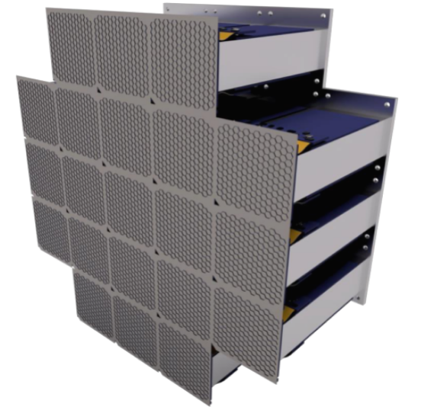
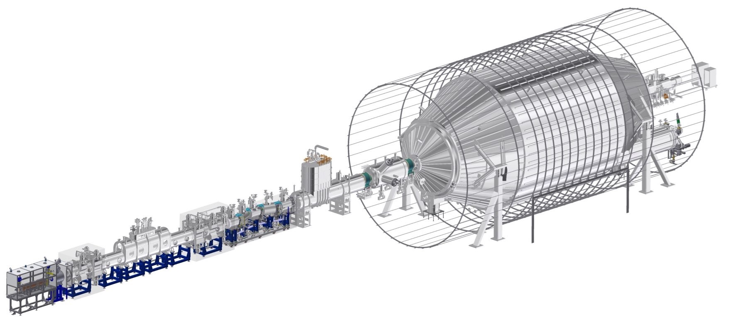


Sterile Neutrino Dark Matter Searches with the KATRIN Experiment
16th Pisa Meeting on Advanced Detectors
Frank Edzards
May 2024

Slide 2
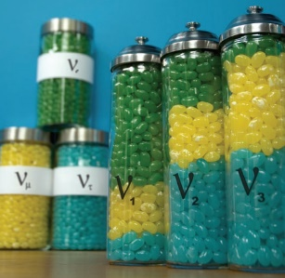
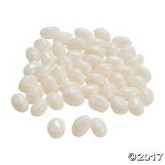

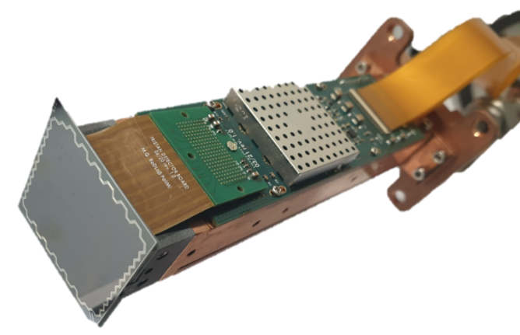
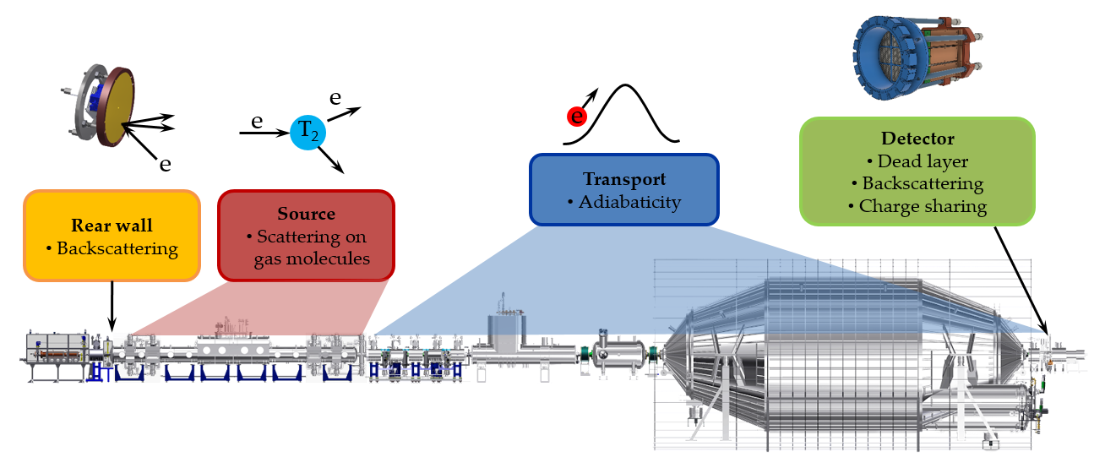
Agenda
Motivation
TRISTAN detector system
Conclusions

Slide 3
Agenda
Motivation
TRISTAN detector system
Conclusions

Slide 4

Active neutrinos

Slide 5
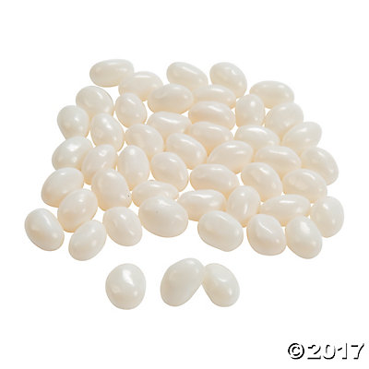

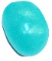



Sterile neutrinos
$$ν_{4}$$
$$ν_{R}$$
Mass eigenstate not purely sterile, can have any mass
Sterile neutrino: lepton that does not carry any charge

Slide 6

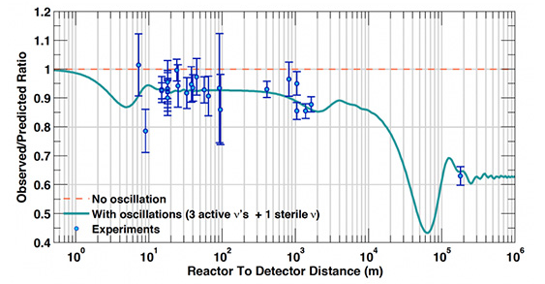
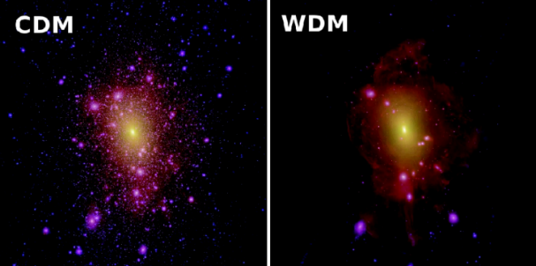

Sterile neutrinos
ϕ
$$ν_{4}$$
Heavy sterile neutrinos (> GeV)
Lightness of neutrinos
+ Matter/anti-matter asymmetry
Light sterile neutrinos (~1 eV)
Short-baseline neutrino oscillation anomalies
keV-scale sterile neutrinos (~1-50 keV)
Dark matter candidate
L
arXiv:1901.08330 (2019): C. Giunti and T. Lasserre
arXiv:1906.01739 (2019): S. Böser, C. Buck, C. Giunti, J. Lesgourgues, L. Ludhova, S. Mertens, A. Schukraft, M. Wurm
Prog. Part. Nucl. Phys. 104 (2019): A. Boyarsky, M. Drewes, T. Lasserre, S. Mertens, O. Ruchayskiy

Slide 7
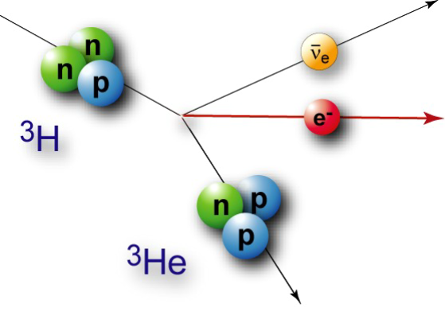
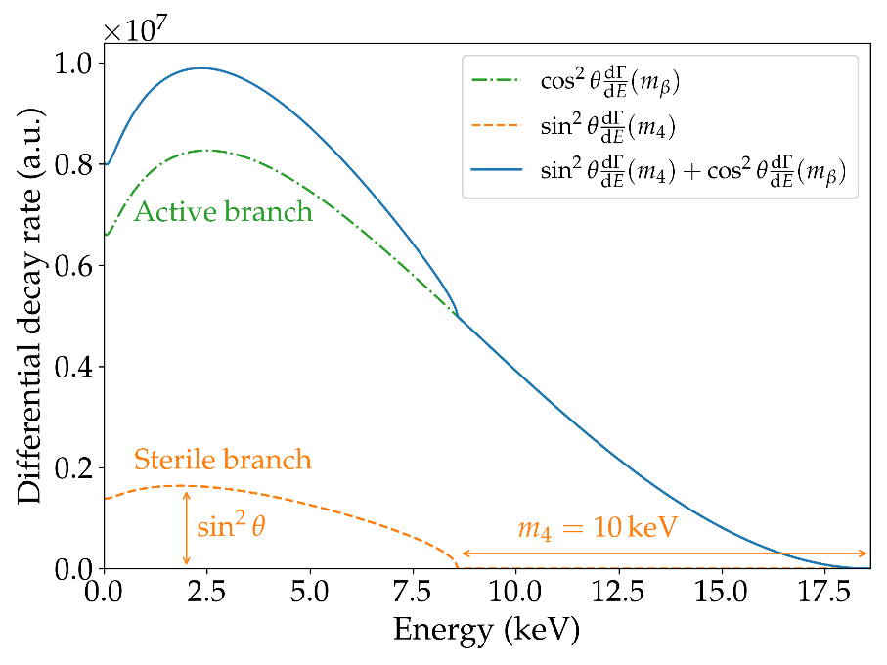

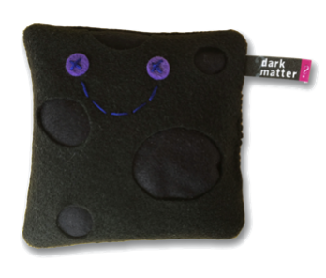



Sterile neutrinos in single β-decay
Signature: spectral distortion with kink-like feature
$$\frac{dΓ}{dE}= \cos^{2}{\text{θ}}\frac{dΓ}{dE}\left(m_{β}\right)+ sin²{\text{θ}}\frac{dΓ}{dE}\left(m_{4}\right)$$
+
$$m_{β}$$
$$m_{4}$$

Slide 8
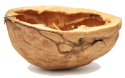
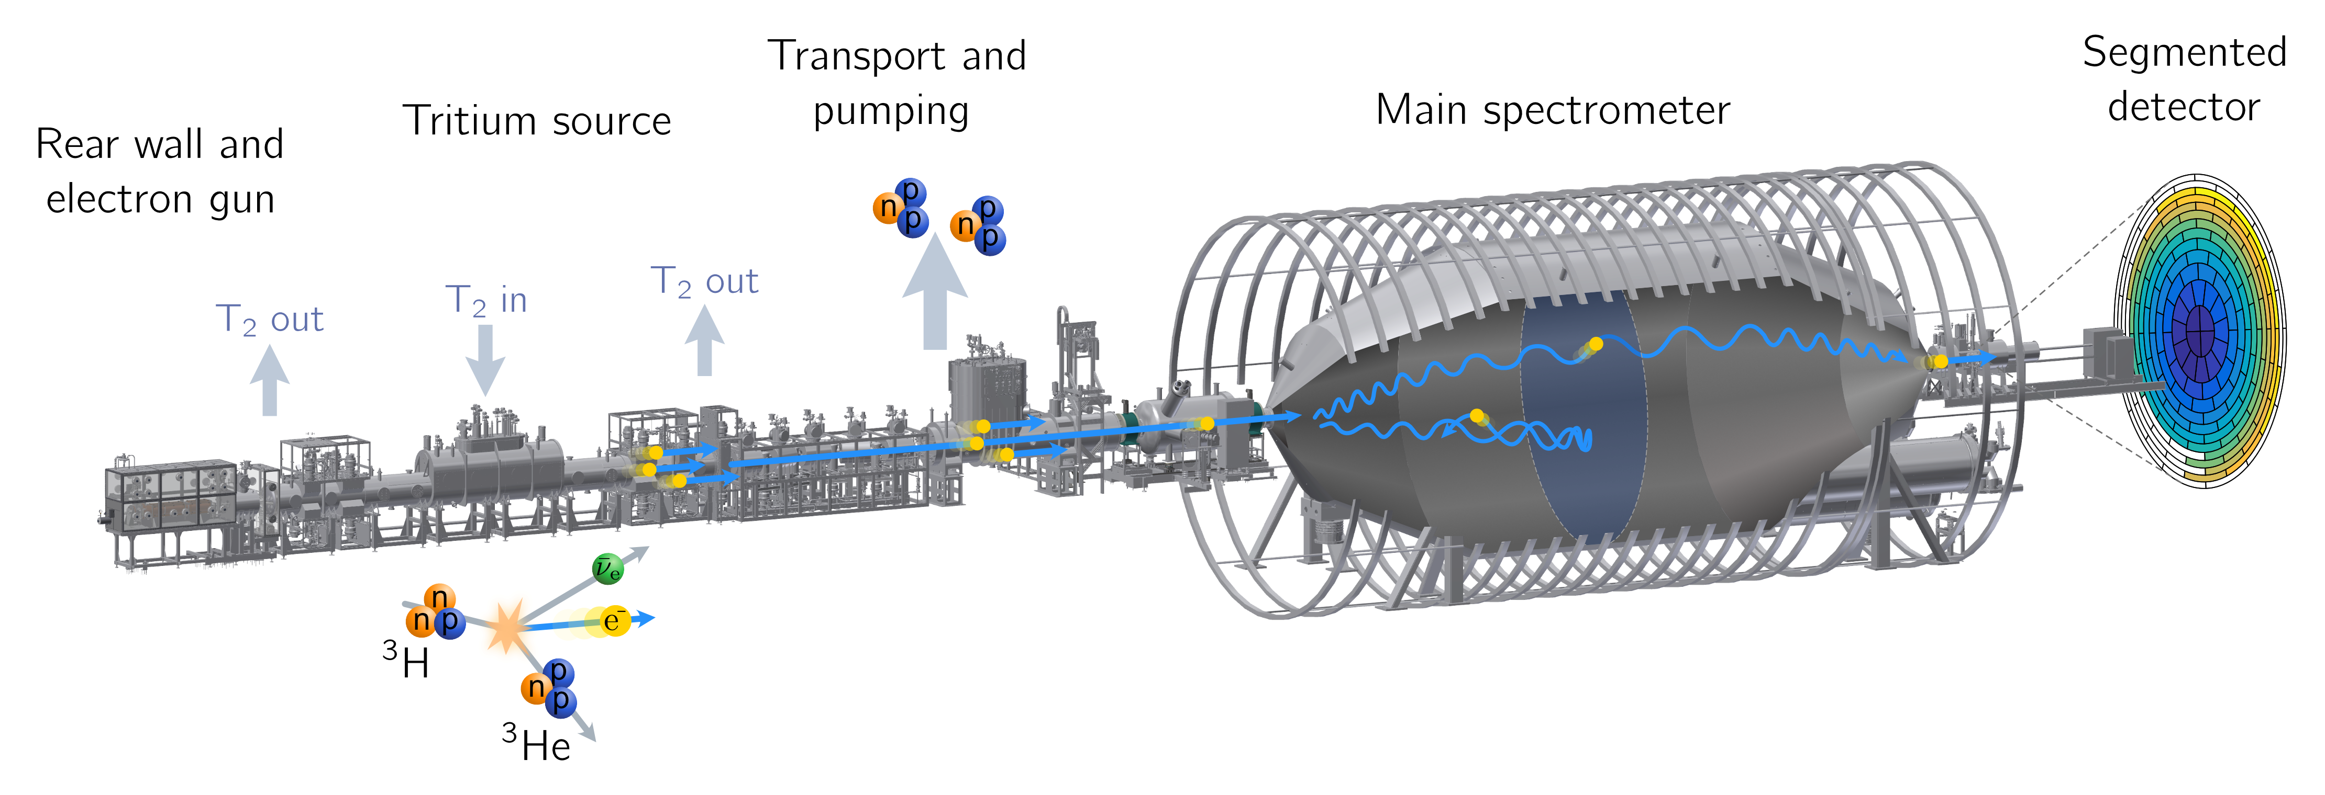
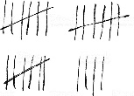
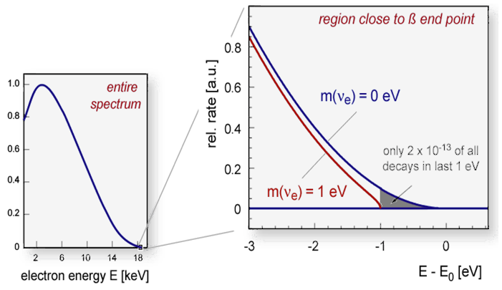
KATRIN - Working principle
Spectrometer
Electrostatic filter
MAC-E filter principle
Detector
Counts electrons
Rate vs HV
Tritium source
30 μg of gaseous T₂
10¹¹ T₂ decays/s
70 m long

Slide 9
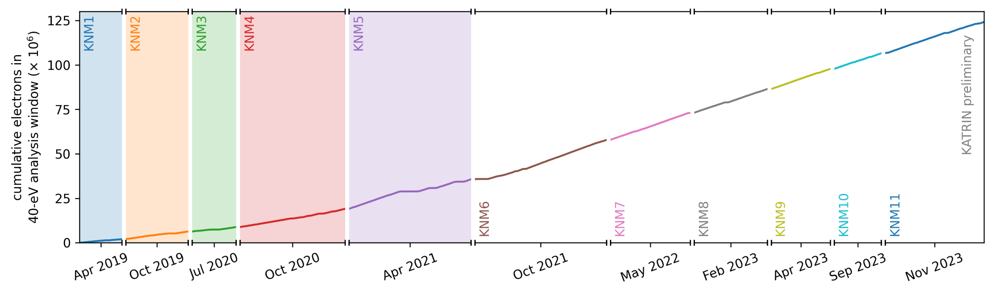
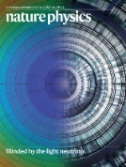
KATRIN - Data taking overview
1st m_{𝜈} campaign
m_{𝜈} < 1.1 eV
PRL 123, 221802 (2019)
Phys. Rev. D 104, 012005 (2021)
2nd m_{𝜈} campaign
m_{𝜈} < 0.8 eV
Nat. Phys. 18, 160–166 (2022)
1st to 5th m_{𝜈} campaign
Unblinded, will be released soon

Slide 10
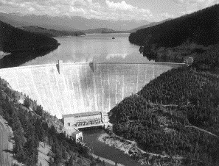
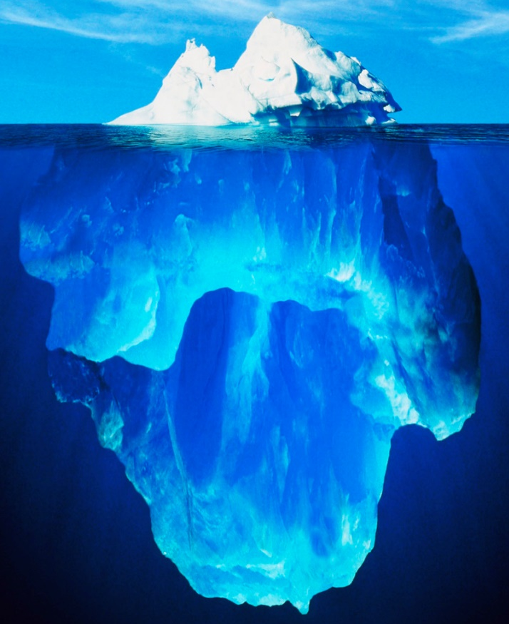

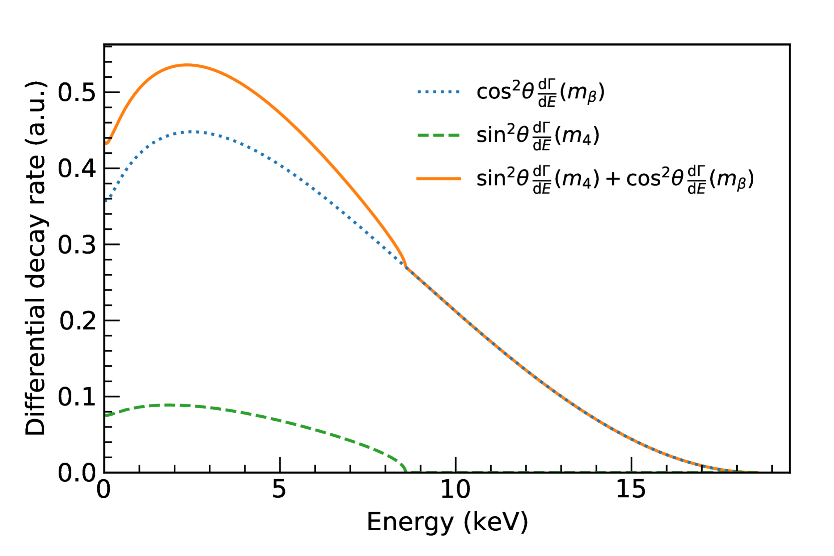
KATRIN - Challenge
10¹⁰ e/s
1 e/s
V_{ret} = -18 kV
Electron energy
Rate
Signature of
neutrino mass

Slide 11
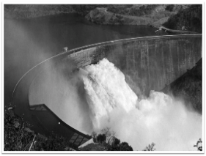

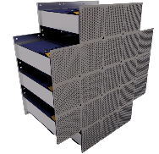
KATRIN - Challenge
10¹⁰ e/s
1 e/s
V_{ret} = -18 kV
V_{ret} = 0 kV
Detector:
- Integral
- differential
Signature of
sterile neutrino
Signature of
neutrino mass

Slide 12
Agenda
Motivation
TRISTAN detector system
Conclusions

Slide 13
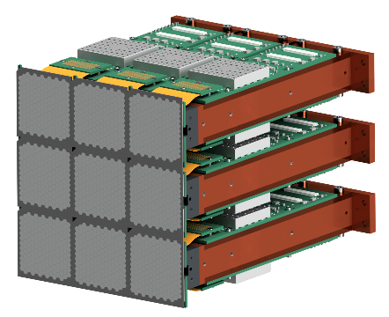
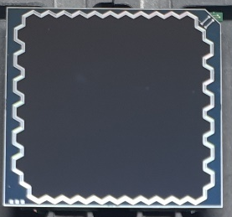
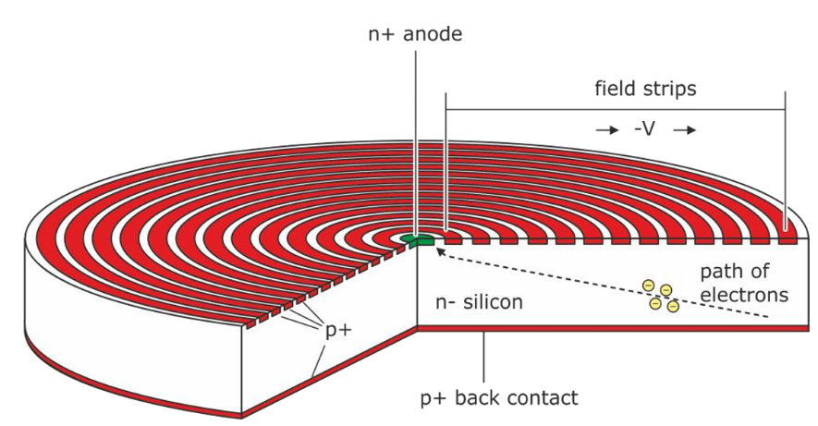


KATRIN - New detector (TRISTAN)
Silicon drift detector (SDD) technology
  Handling of high rates (100 kcps/pixel)
  Excellent energy resolution (300 eV at 20 keV)
Novelty: application to β-spectroscopy
4 cm
3 mm
4 cm
S. Mertens et al., J. Phys. G46 (2019)
S. Mertens et al., J. Phys. G48 (2020)
M. Gugiatti et al., NIM-A 979 (2020)
M. Biassoni et al., EPJ. Plus 136 (2021)
P. King et al., JINST 16 T07007 (2021)

Slide 14
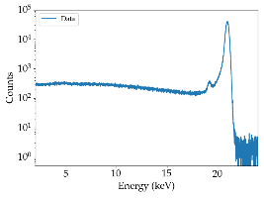
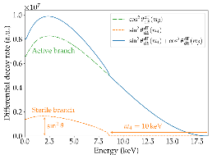
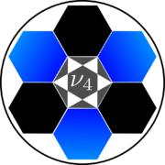
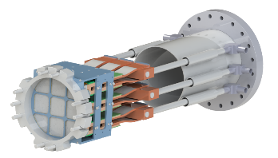
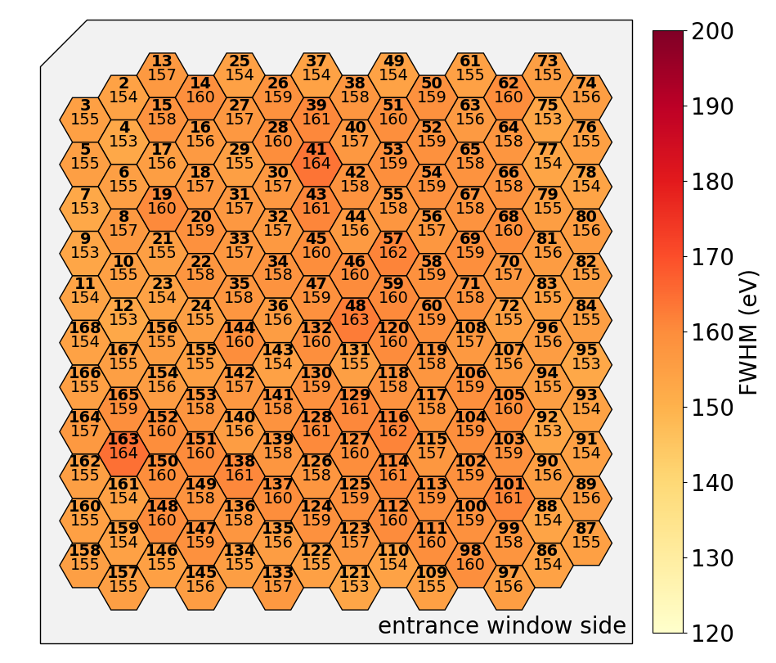
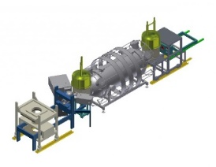
TRISTAN Detector
X-rays
Electrons
Sterile neutrino search
Detector module
Full system
Monitor spectrometer

Slide 15
TRISTAN Detector
X-rays
Electrons
Sterile neutrino search
Detector module
Full system
Monitor spectrometer

Slide 16
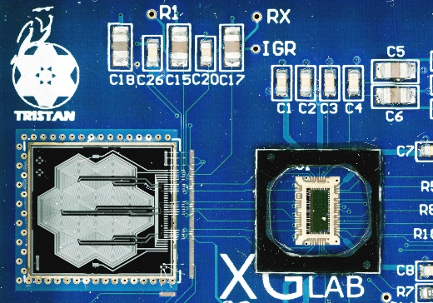
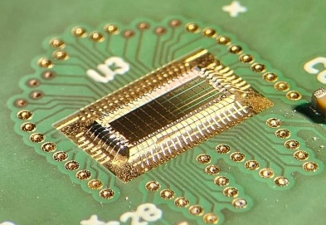
Performance with X-rays
Test of multiple prototype designs
Detector chip,
7 pixels, Ø 3 mm
ETTORE readout ASIC (12 channels)

Slide 17
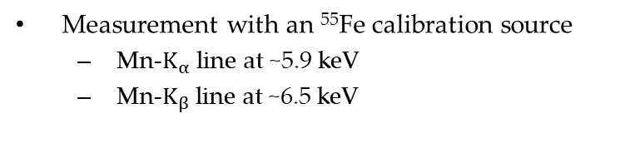
Performance with X-rays
Test of multiple prototype designs
Excellent performance demonstrated
  Energy resolution
Detector chip,
7 pixels, Ø 3 mm
140 eV FWHM at 6 keV (1 μs shaping)
⁵⁵Fe
ETTORE readout ASIC (12 channels)
Measurement with an ⁵⁵Fe calibration source
  Mn-$K_{α}$ line at ~5.9 keV
  Mn-$K_{β}$ line at ~6.5 keV
  S. Mertens et al., J. Phys. G46 (2019)

Slide 18
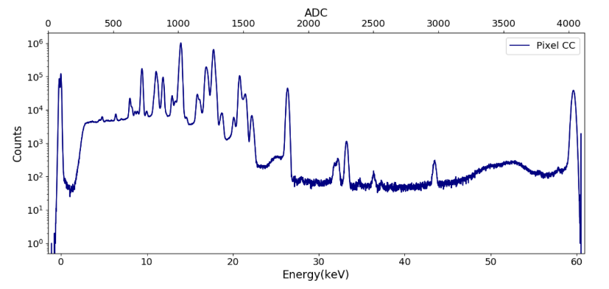
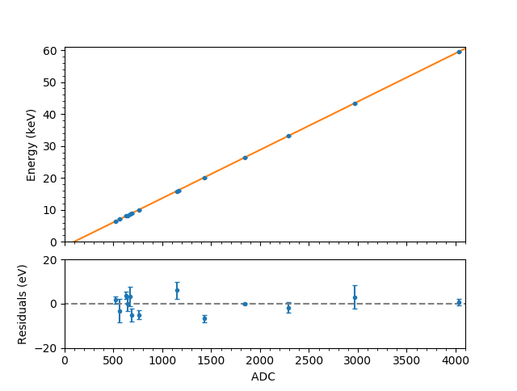
Performance with X-rays
Test of multiple prototype designs
Excellent performance demonstrated
  Energy resolution
  Linearity
²⁴¹Am
140 eV FWHM at 6 keV (1 μs shaping)
⁵⁵Fe
  S. Mertens et al., J. Phys. G46 (2019)
0.1% linearity (up to 60 keV)

Slide 19
TRISTAN Detector
X-rays
Electrons
Sterile neutrino search
Detector module
Full system
Monitor spectrometer

Slide 20
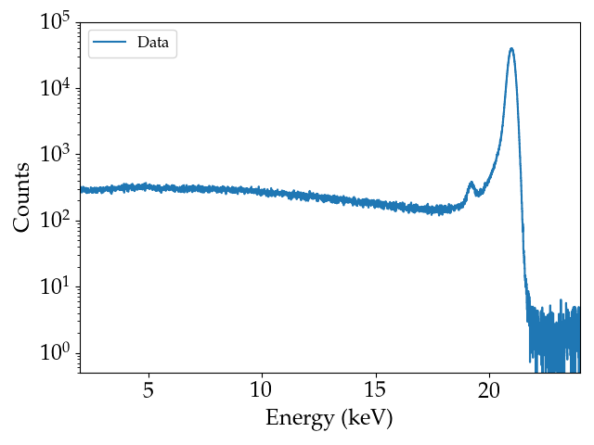
Detector response to electrons
Precise understanding and modeling of detector electron response required
Main peak
Electron microscope
Silicon escape peak
1. Dead layer
2. Charge sharing
3. Backscattering

Slide 21
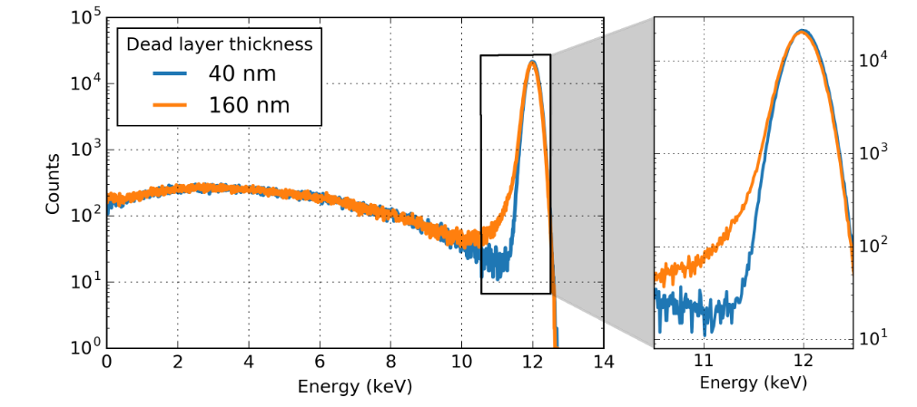
Detector response to electrons
1st effect: Dead layer
charge collection
e⁻
X-ray
Main peak
SiO₂ ~10 nm
Low-energy tail
Si 450 μm
sensitive volume
depth
Electron microscope
Silicon escape peak
Simulation
Measurement result: < 50 nm
S. Mertens et al., J. Phys. G48 (2020)

Slide 22
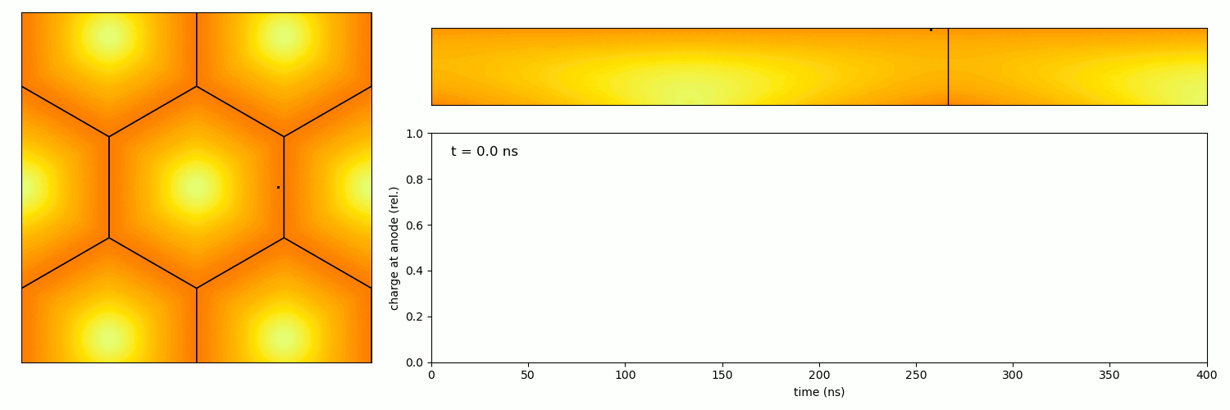
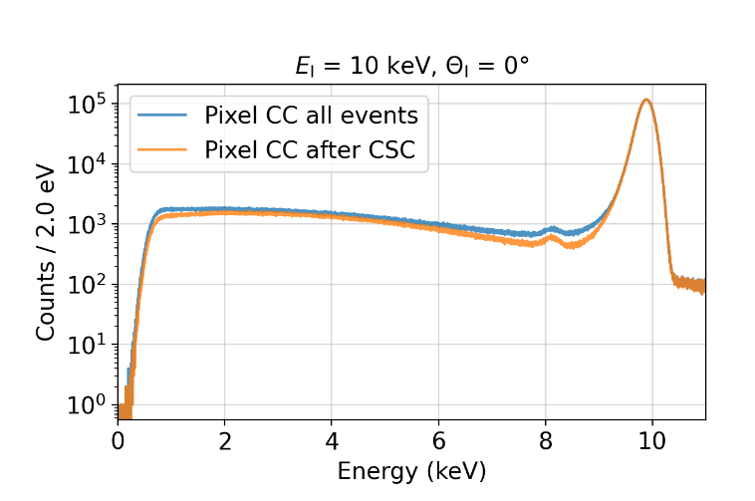
Detector response to electrons
2nd effect: Charge sharing of pixels
Main peak
Charge sharing plateau
Electron microscope
Silicon escape peak

Slide 23
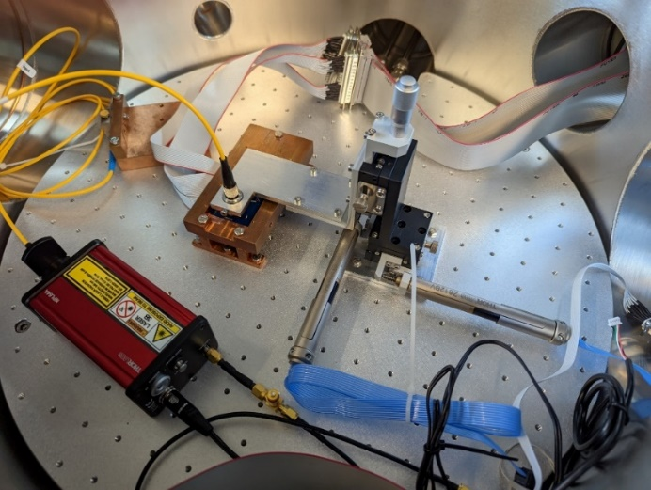
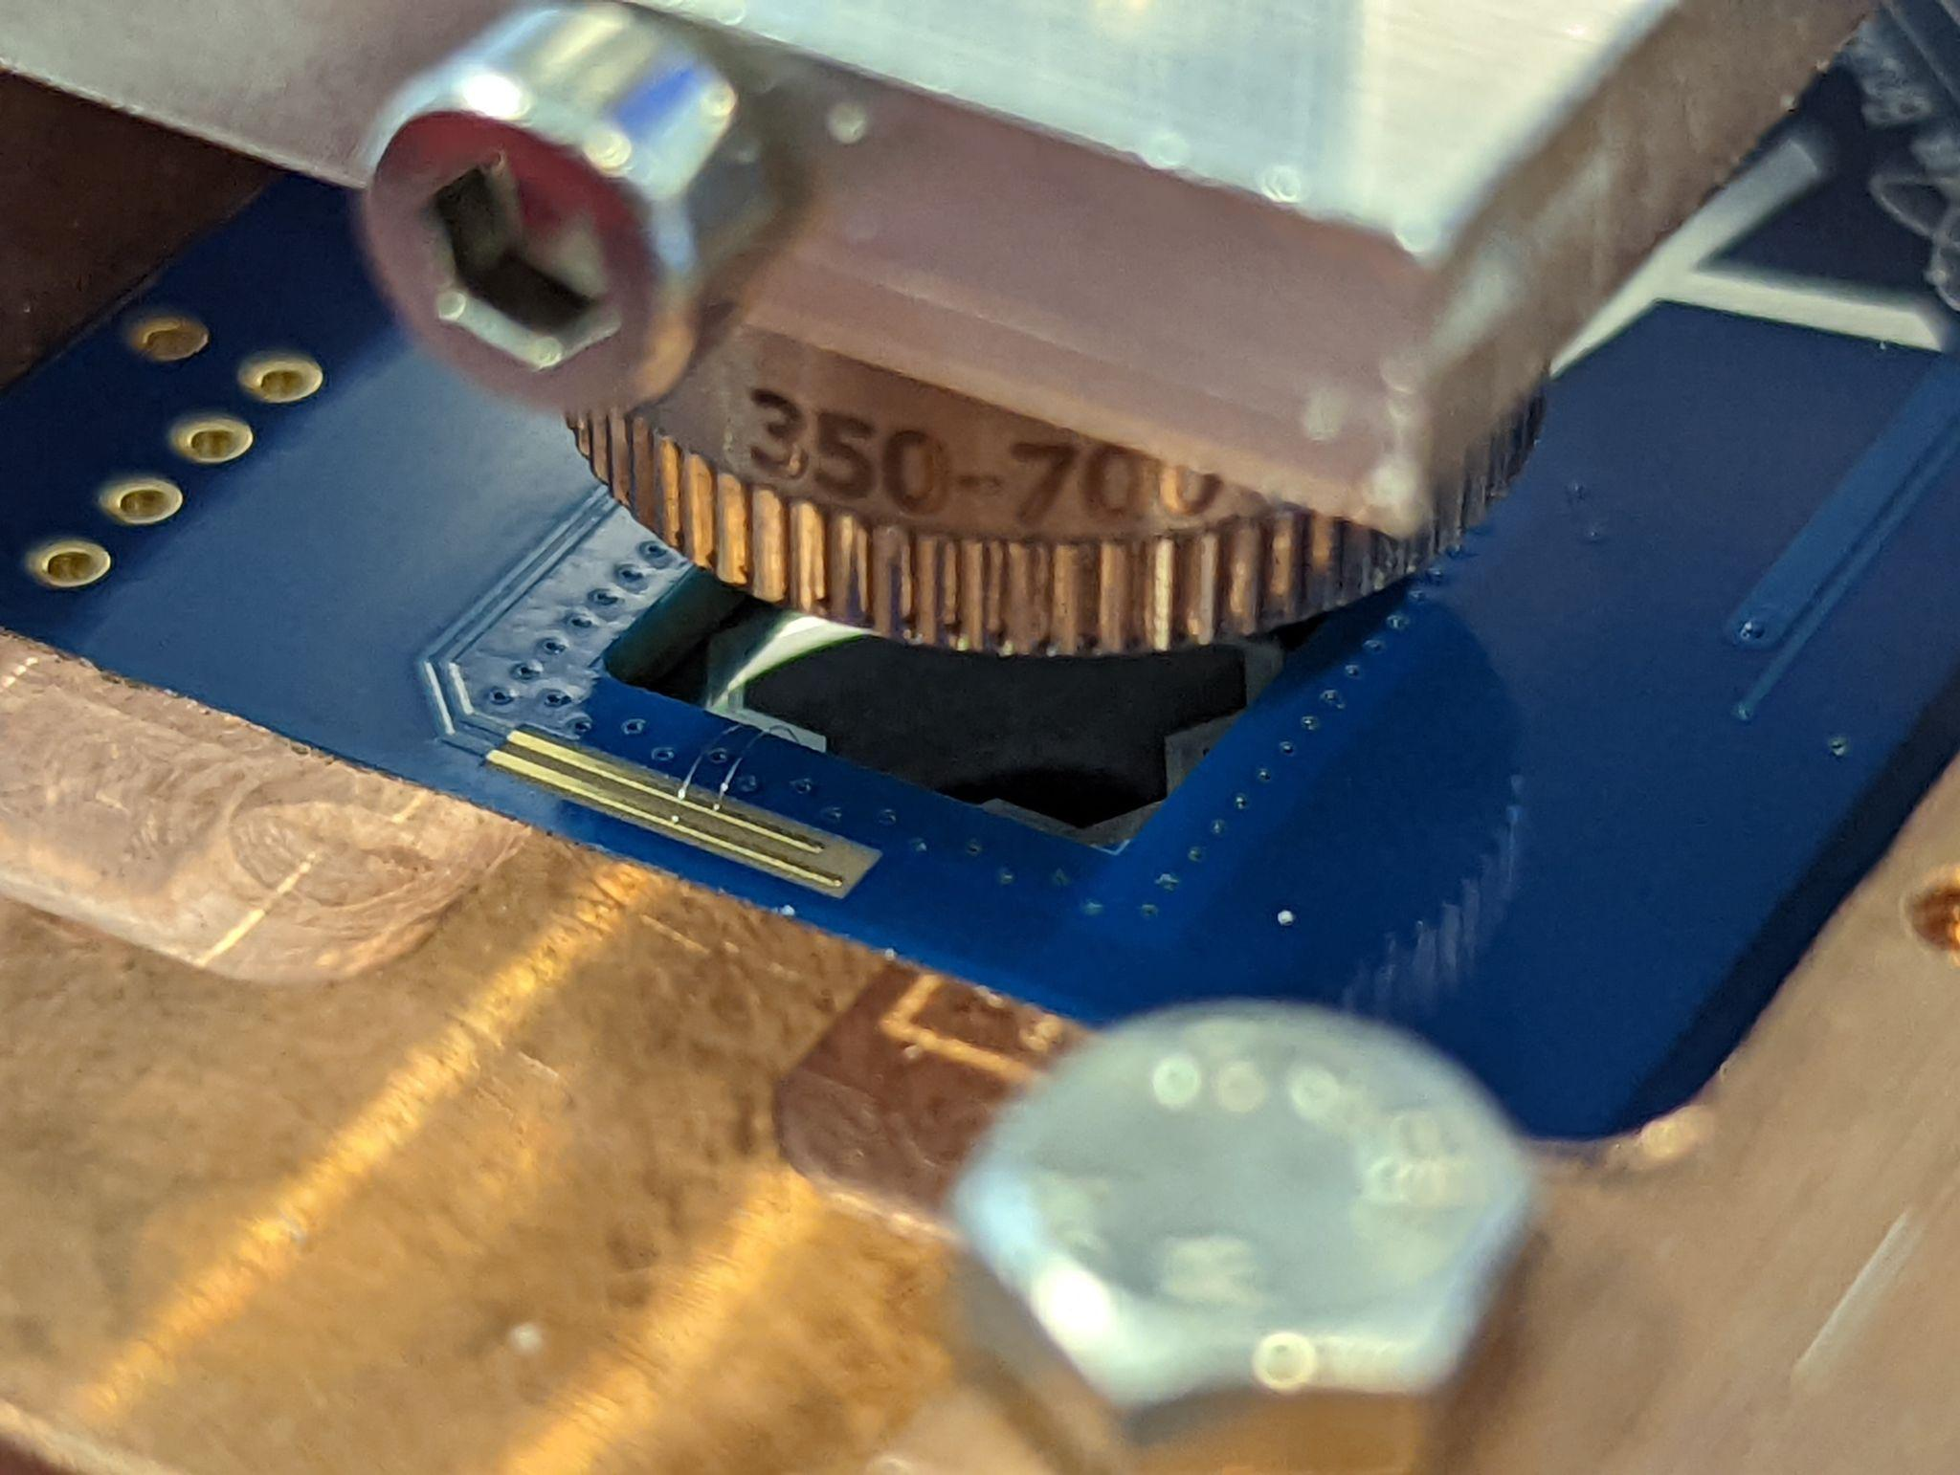
Charge sharing
Investigation of charge sharing with pulsed laser (640 nm, ⌀_{min}~7 μm)
Fiber optics
Collimator
xyz-stage
Collimating lens
Detector
Electron microscope
Laser
Entrance window of detector

Slide 24
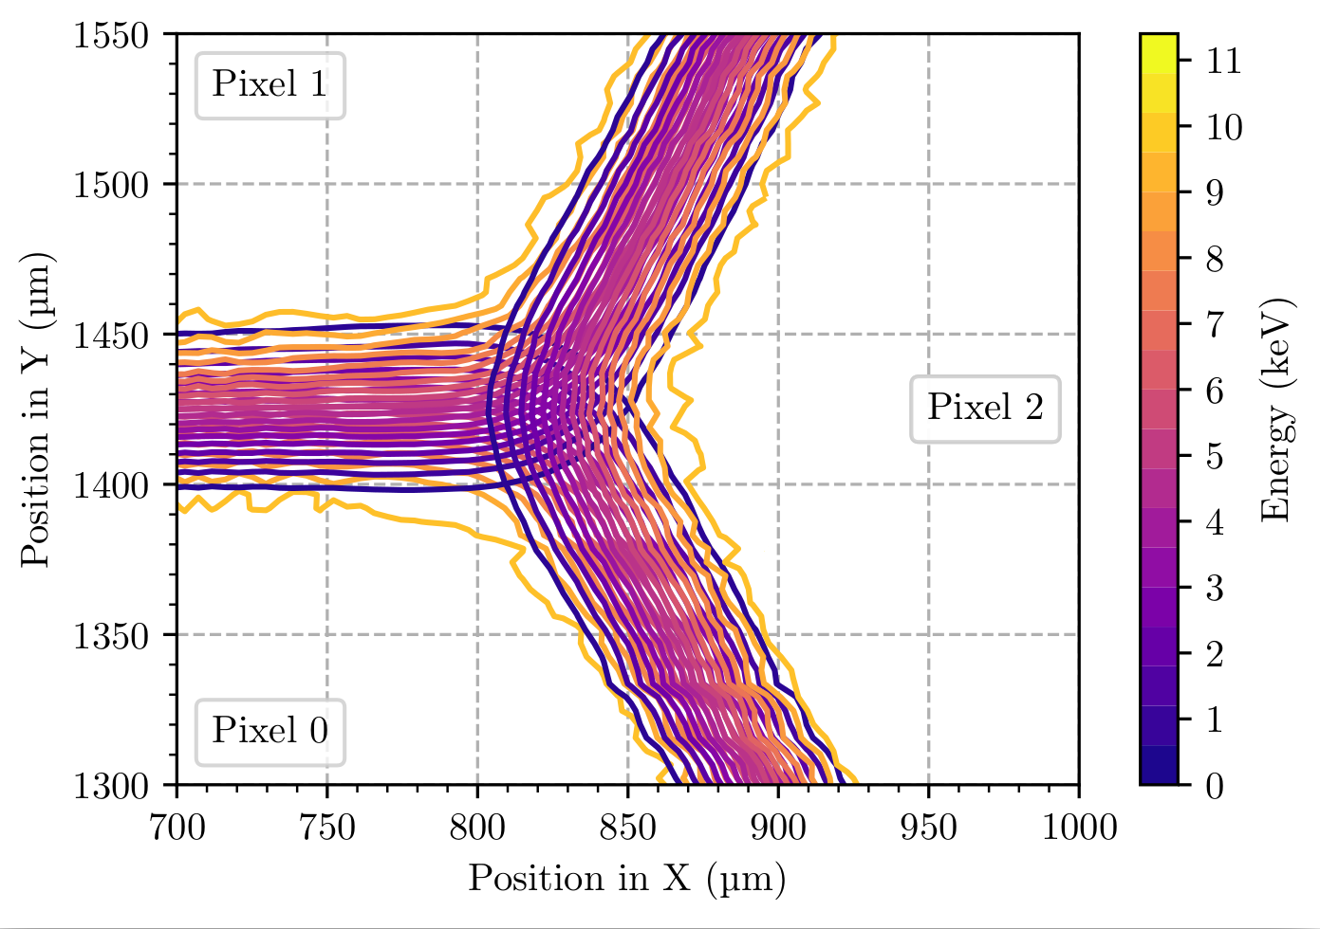

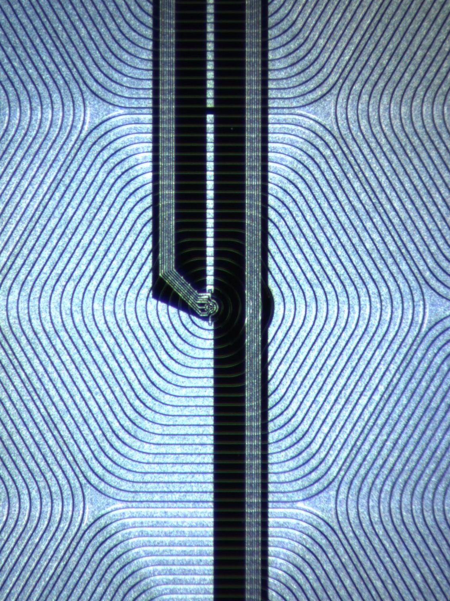
Charge sharing
Investigation of charge sharing with pulsed laser (640 nm, ⌀_{min}~7 μm)
Grid scan in triple point region
Electron microscope

Slide 25
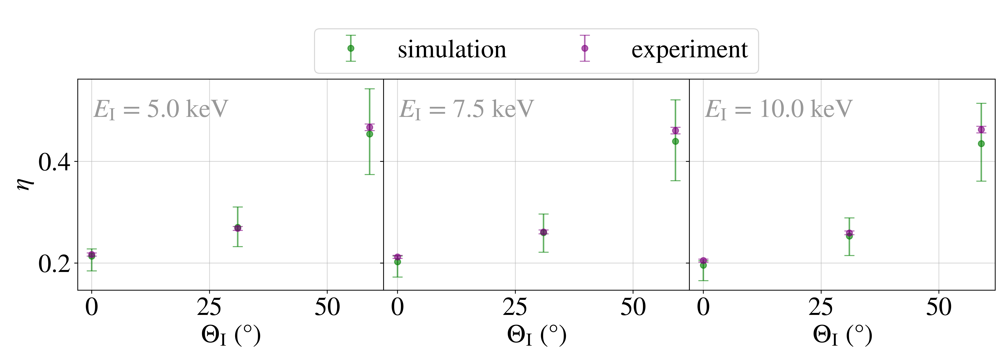
Detector response to electrons
e⁻
3rd effect: Backscattering
Main peak
Dead layer
Backscattering continuum
Sensitive volume
Electron microscope
Silicon escape peak

Slide 26
TRISTAN Detector
X-rays
Electrons
Sterile neutrino search
Detector module
Full system
Monitor spectrometer

Slide 27

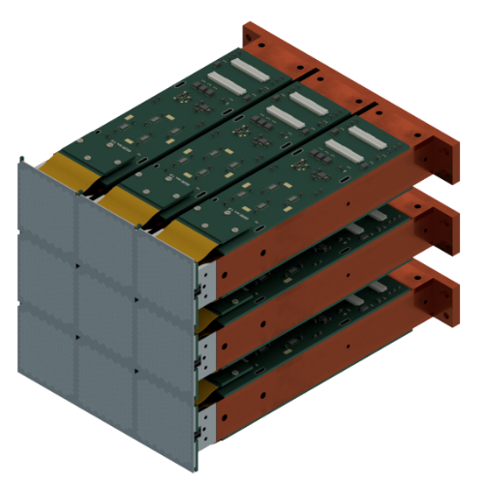
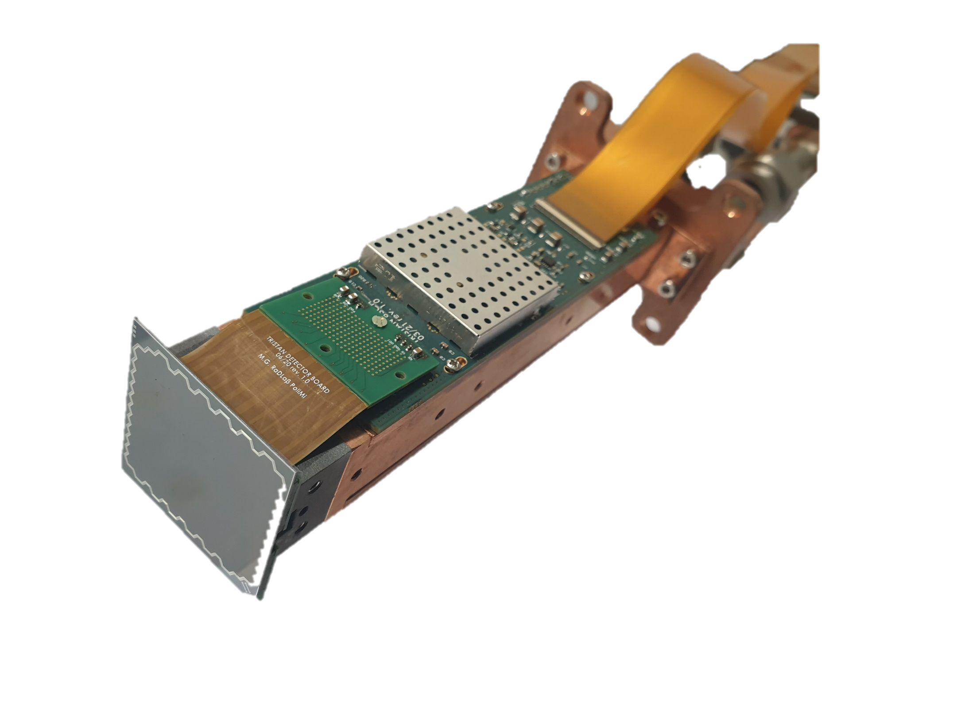
Detector module
Ettore ASICs
(below cap)
40 mm
38 mm
Copper cooling and holding structure
166 px SDD with integrated JFET
Rigid flex PCB (signal and power lines)
Silicon carbide (CeSiC)
cooling link

Slide 28

Detector Module
Largest SDD array operated ever!
All pixels working
Homogeneous performance
Average energy resolution at -35°C:
  ~160 eV FWHM at 5.9 keV

Slide 29
TRISTAN Detector
X-rays
Electrons
Sterile neutrino search
Detector module
Full system
Monitor spectrometer

Slide 30





Installation in KATRIN MoS
Test in quasi-realistic environment (B-field, vacuum, etc.) w/ X-rays and electrons
Excellent energy resolution: 147 eV FWHM at 6 keV
Stable long-term operation
^{83m}Kr

Slide 31
TRISTAN Detector
X-rays
Electrons
Sterile neutrino search
Detector module
Full system
Monitor spectrometer

Slide 32





Towards a detector tower
7 pixels
166 pixels
9 x 166 pixels
TRISTAN tower
(including vacuum shield and cooling structure)
Detector section
Installation in KATRIN beamline planned for 2026

Slide 33
Agenda
Motivation
TRISTAN detector system
Conclusions

Slide 34


Summary
TRISTAN will search for sterile neutrinos in the keV mass range with the KATRIN experiment
Excellent spectroscopic performance (electrons and photons) demonstrated in various test stands
Largest SDD array operated ever

Slide 35

Thanks for your attention!

Slide 38

Radiation damage test setup
tantalum hot cathode electron source
ceramic insulators
e-
electrically movable shutter
motorized stage with encoder
detector

Slide 39
Electron interactions in silicon
collision with electrons
elastic
ionization
threshold 1eV
collision with nucleus
elastic
primary knock on atom (PKA)
threshold 25eV
E_{kin}>255 keV necessary
with up to 50 keV electrons the only degradation of the detector can come from ionization
focus is not on bulk but on insulating 10 nm SiO2 layer

Slide 40
Detector cross section
mean deposit charge
insulator
SiO₂ ca. 10 nm
ionization can lead to trapped charges, etc...
Si 450 μm
doped area, conductive, dead layer
electrons
ionization cannot lead to any lasting change here, electrons and holes are movable
photons
depleted area, sensitive volume
z

Slide 41




Timeline
 | Jan | Feb | Mar | Apr | May | June | July | Aug | Sep | Oct | Nov | Dec
2024 | R&D, single-component manufacturing |  |  |  |  |  |  | Three modules in replica setup
2025 |  |  |  | Full TRISTAN tower in replica setup
2026 | Integration of TRISTAN tower in beamline & new RW material |  |  |  | Commissioning of TRISTAN tower |  |  | keV sterile neutrino search
2027 | Option A: Physics runs |  |  |  | keV sterile neutrino search
 | Option B: upgrade RW chamber

Slide 42



KATRIN - Latest results
First campaign
  Total statistics: 2 million events
  Best fit: $m_{ν}^{2}=\left({−1.0}_{−1.1}^{+0.9}\right)$ eV² (stat. dom.)
  Limit: $m_{ν}<1.1$ eV (90% CL)
Second campaign
  Total statistics: 4 million events
  Best fit: $m_{ν}^{2}=\left(0{.26}_{−0.34}^{+0.34}\right)$ eV² (stat. dom.)
  Limit: $m_{ν}<0.9$ eV (90% CL)
Combined result
  $m_{ν}<0.8$ eV (90% CL)

Slide 43


Charge sharing
Fit charge cloud distribution assuming a Gaussian charge cloud to determine the charge cloud size
Charge cloud width: 𝜎 ≲ 16 µm

Slide 44


Detector backscattering
Measurements with two TRISTAN SDDs in dedicated test setup
  At different electron energies
  At different incident angles
Custom e-gun
Steering coils
166 px SDD
7 px SDD

Slide 45


Detector backscattering
Good agreement between measurement and simulation
7 px SDD
166 px SDD

Slide 46
Detector backscattering
Backscattering
  increases with incident angle
  decreases with energy

Slide 47
Detector module
Copper cooling structure
200-pin
array connector
Wire bonds
Challenges:
High density: 400 wire bonds to detector chip
3D design to have readout electronics behind sensor
UHV vacuum and magnetic field compatibility
Cooling to -50°C
...
Flex cable
7x ETTORE ASIC
SDD chip, 38 x 40 mm
Cesic

Slide 48

Detector module

Slide 49



KATRIN - Sterile Neutrino Model
e
e
e
T₂
Detector
Dead layer
Backscattering
Charge sharing
e
Transport
Adiabaticity
Rear wall
Backscattering
Source
Scattering on gas molecules
Change rear wall material
Adjust gas density
Adjust magnetic field
New detector system

Slide 50



Rear wall
Backscattering of electrons at rear wall changes spectral shape → limits sensitivity considerably
Possible solutions:
  Change rear wall material, e.g. Au → Be
  Block electrons from rear wall with blocking potential, e.g. -20 kV potential
  Positive rear wall
e

Slide 51

Source section
Maximum allowed detector rate (100 kcps/px):
  defines column density for selected mass range
  defines retarding potential
Possible solution:
  Adjust column density to smaller value
Low retarding potential
High mass range
Shorter meas. time
Counts
High retarding potential
Low mass range
Longer meas. time
n
p
Electron energy

Slide 52

Transport section
Adiabatic transport needs to be assured
Non-adiabaticity:
  Chaotic transmission in spectrometer due to high E and B field gradients
  Energy-dependent transmission loss / gain
With existing coils / currents

Slide 53







Transport section
Adiabatic transport needs to be assured
Non-adiabaticity:
  Chaotic transmission in spectrometer due to high E and B field gradients
  Energy-dependent transmission loss / gain
Solution:
  Adjust B field settings (B_{max} on source side)
  No transmission loss for
  sufficiently large $ΔB$
  $$ΔB= B_{PS2}−B_{pinch}$$
$$B_{PS2}=4.55 T$$
$ΔB$>0
$ΔB$<0
$$B_{PS2}=4.05 T$$
$$B_{pinch}=4.2 T$$

Slide 54



Detector section
Replace current detector flange with novel flange holding TRISTAN detector
Upgrade sealings to UHV standard, add cooling option
Chamber for ~4000 connections
>> Maximize synergies with current setup

Slide 55

DAQ System
Custom-developed system
  Higher event rates
  More readout lines
  Operation in strong magnetic field, HV
  Trigger flexibilities, etc.
First successful tests

Slide 56
Spectrum Modeling
Systematics must be well understood
Complete model currently being developed

