Slide 1
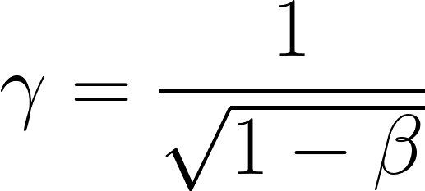
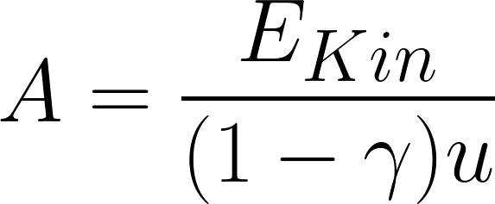

HIT MC Campaign: what have we done?
Goal: measure mass spectra with info from
TOF-Wall → β
Calorimeter → Kinetic Energy
u = 931.494 MeV/c2
How is it done?
Matching between Calo cluster and TW points → minimum distance matching
Cluster with center in the central crystal has been excluded → Beam particle cut
Starting from Tino’s Macro
Main Problems?
Only ‘’very good’’ TW point used
First time Padme Cluster algorithm is put to the test
A. Valetti
1
12/07/2023

Slide 2
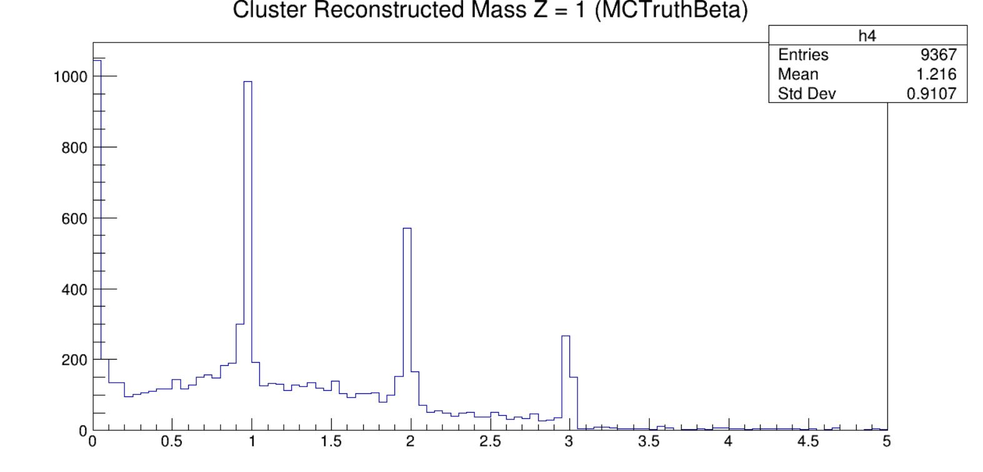
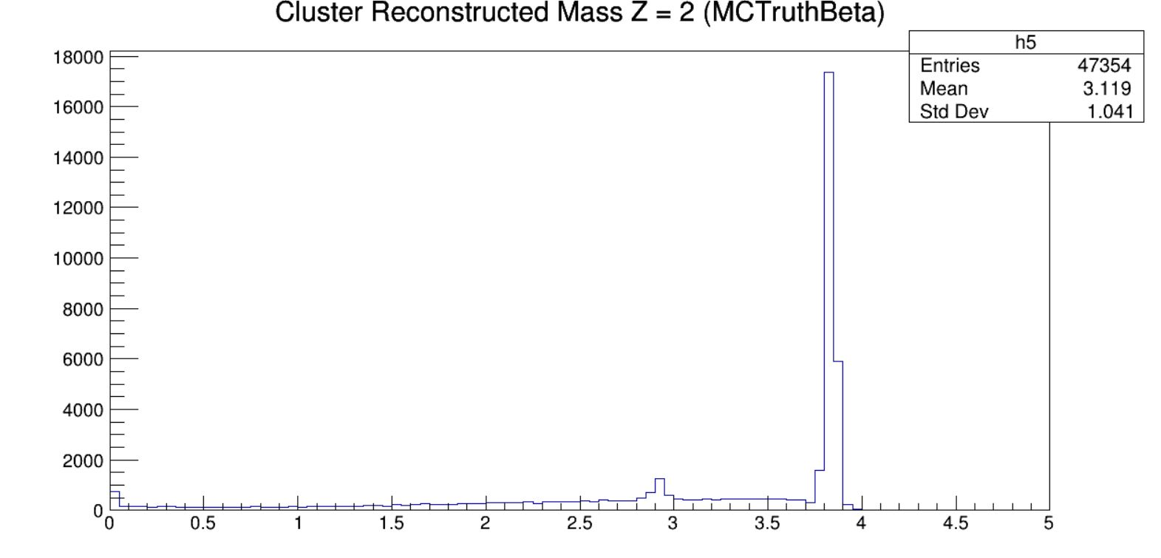
HIT MC Campaign: preliminary spectra
Too good to be true → MC truth β has been used
A. Valetti
2
12/07/2023

Slide 3
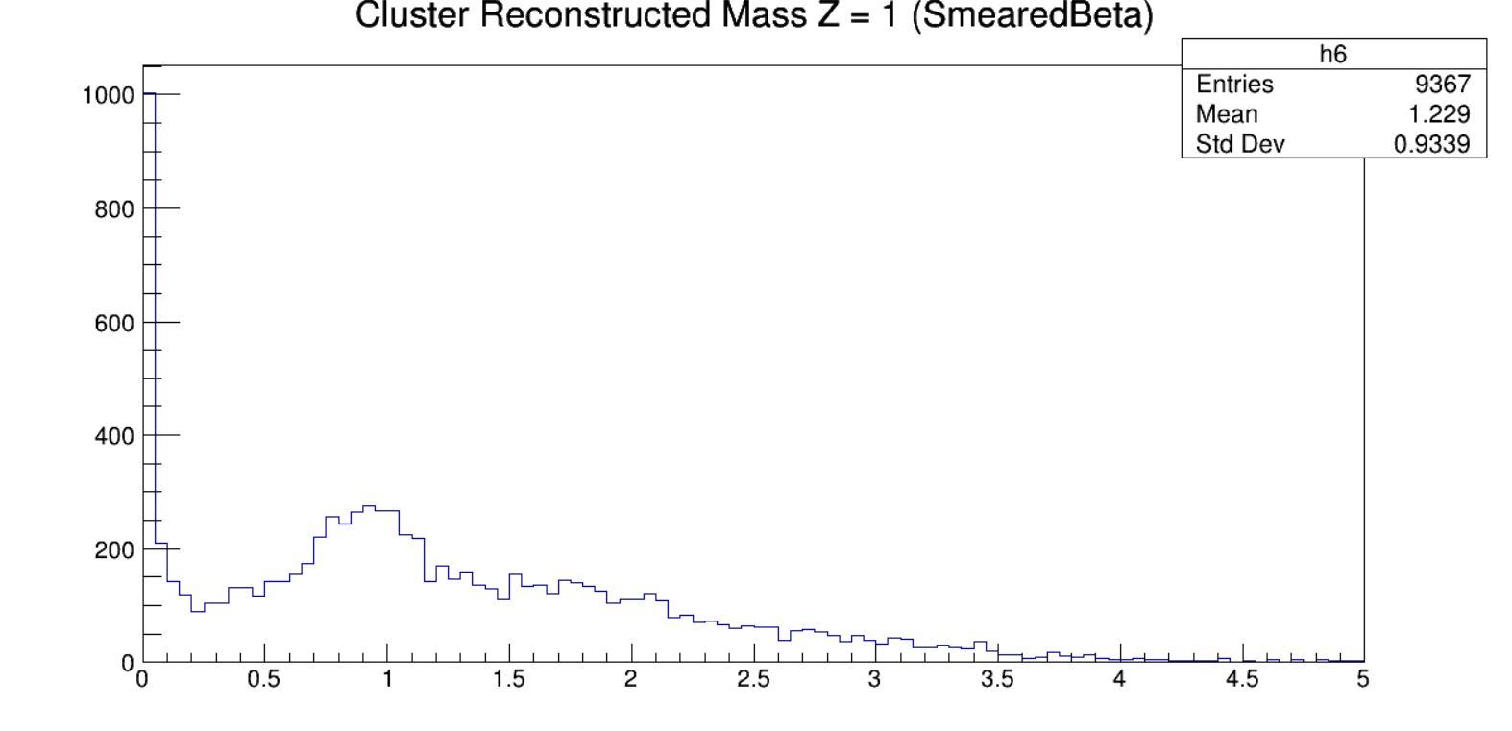
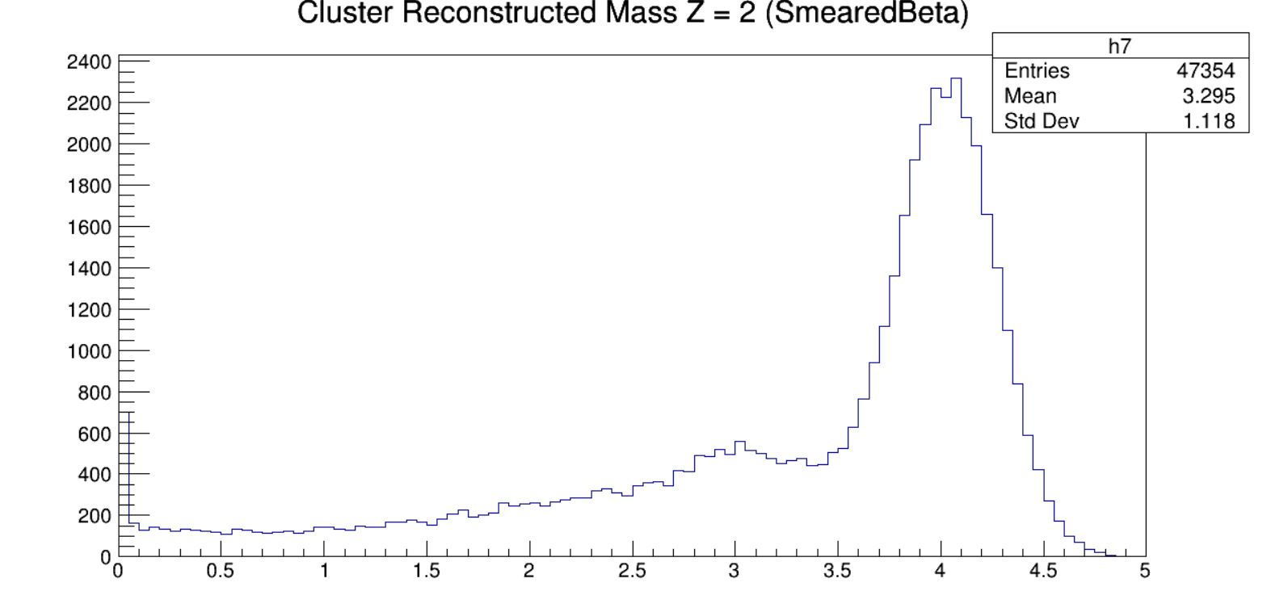
HIT MC Campaign: preliminary spectra
Less good so should be truer → Smeared β from SHOE has been used
A. Valetti
3
12/07/2023

