Slide 1
Technical Reporting workflow
10 July 2023
11 Sept 2023
22 Sept 2023
6 Oct 2023
13 Oct 2023
20 Oct 2023
26 Oct 2023
31 Oct 2023
Templates
Input from Benef & Partners
Task Activity Report
WP Activity Report
Project Office
Management team
StCom & GB approval
Final Submission
Project office send templates to WP and task leaders
Contact persons from each participant in a Task provide input to Task Leaders
Task Leaders assemble the Task Activity Report & submit it to the WP Coordinators
WP Coordinators assemble the WP Activity Report & submit it to the Project Office
Project Office edits the report and send it to the Management team for review
Management team send it to the StCom & GB
StCom & GB approve the document as final report
Project office submit the report to the EC
10 July 2023

Slide 2
Technical and TA report
Periodic reports = official reports to the EC
Must be sent to the EC at the end of each reporting period (+2 months for submission)
Template: https://ec.europa.eu/info/funding-tenders/opportunities/docs/2021-2027/common/temp-form/report/periodic-report_horizon-euratom_en.pdf
Content of Part A (tabs to be filled on the EC Portal)
Project summary
Researchers involved in the project
Critical implementation risks and mitigation actions
Results and Results ownership list
Publications
Datasets (if any)
Intellectual property rights (IPR) (if any)
Standards (if any)
Other results (if any)
Dissemination and communication activities
Impact (warning: much longer than for H2020 projects)
Research Infrastructure (see presentation focused on TA/VA activities reporting)
Content of Part B (Final document must be PDF)
1. Explanation of the work carried out and overview of the progress (during the period)
2. Follow-up of recommendations and comments from previous reviews (if applicable = not relevant for P1)
3. Exploitation primarily in non-associated third countries
(if applicable = most probably not relevant)
4. Open science
5. Deviations from Annex 1 and Annex 2
Length: ~ 4 pages/WP + pictures, tables, graphs
Periodicity: at M12 (end of P1: August 2023, submission deadline: October 2023),
M30 (end of P2: February 2025), M48 (end of P3: August 2026)
10 July 2023

Slide 3
Technical and TA/VA report
What to do
What Beneficiaries/Task Leaders should do:
Fill in the template EURO-LABS-P1 Technical Report-template-WPX.doc for your parts. You will find coloured instructions in the file.
Update the section Researchers involved in the project on the EC portal. They are the researchers working in the project, not the Users. PO can not fill this part on the portal for you, so each partner must do it from his own account (see slide 8.Researchers involved in the project)
Results are intended as discoveries and theories, products, services, methods etc. (not project results, as deliverables and milestones).
Publications: if you have any, fill in the table in the template and possibly upload the file in our EMDESK platform. Please, contact PO to update the EURO-LABS website also.
Access to research infrastructure: the information in the template are complementary to the excel files filled by Facility coordinators with Users’ information and Users’ projects. This part in the template should be filled by the Facility Coordinators, in cooperation with Beneficiaries/Task Leaders and partners’ Financial Officers to ensure consistency
What Facility Coordinators should do:
Fill in the template EURO-LABS-P1 Technical Report-template-WPX.doc for your parts. You will find coloured instructions in the file. FC should fill in the parts requiring information about Ris and TAs/VAs. You are invited also to contribute to several other sections of the template, if you have something to report. Fill the template in cooperation with Beneficiaries/Task Leaders and partners’ Financial Officers to ensure consistency.
TA: Upload the application excel files TA-application-data.xlsx on EMDESK platform. Please check the data and update information with the UA actually provided to users.
All detailed data of TA users will have to be entered manually on the EC portal. It is a long work that the PO will do for all partners. However, we ask you to make it as easy as possible by uploading data on time to the emdesk platform, checking users’ information and the consistency with the template.
Fill in the file EURO-LABS TA-VA-Report1.xlsx with providing information on Users’ projects, publications and VAs.
The signed application/confirmation form and users’ projects must be kept and shown in case of audits.
Periodicity: at M12 (end of P1: August 2023, submission deadline: October 2023),
M30 (end of P2: February 2025), M48 (end of P3: August 2026)
10 July 2023

Slide 4
Technical and TA/VA Report
Information is collected from Beneficiaries / WP Leaders (deadline 06.10.2023)
To be reviewed by Management Team (deadline 20.10.2023)
To be approved by Steering Committee (deadline 26.10.2023)
Information added to the EC Portal by the EURO-LABS Project Office (deadline 31.10.2023)
How to work on shared word documents?
Google docs
it works, but:
Google accounts needed
Data protection
INFN sharepoint
ok for data protection, but
INFN account needed
Other?
CERN?
How did you manage it in other big projects?

Slide 5
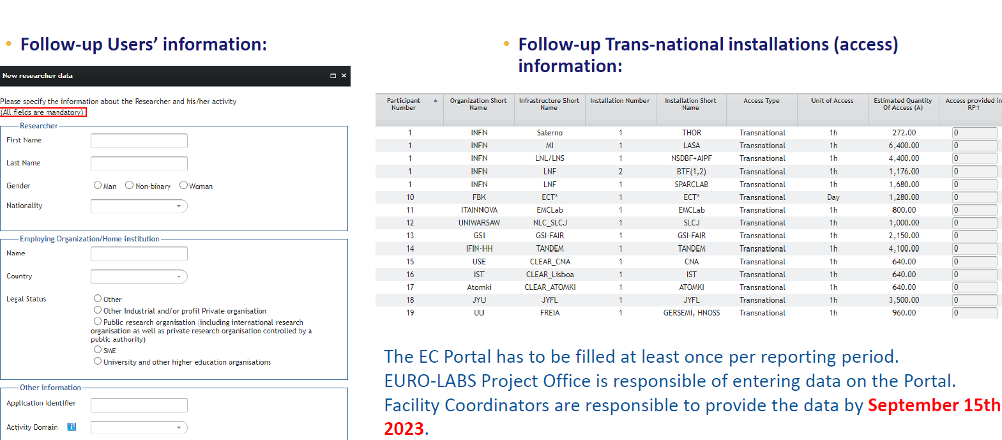
TA Report
TA :
users info to enter manually on the EC portal could be so many (more than 250 by now, just from CERN-PS SPS)
What about the TA Remote users (e.g. irradiations)? Do we have to include them in the portal?

Slide 6
Technical annual report
Slides and re-edited WP2 template : today SC09 meeting indico event https://agenda.infn.it/event/33382/
Everybody please send your final suggestions for improving the template before the meeting
so as to converge quickly.
We need to be finalize during the meeting.

