Slide 1


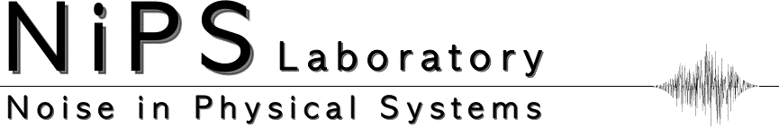
Type-III superconductivity
M. Cristina Diamantini
Superconductors with Topological Order, Eur.Phys.J. B53 (2006) 19, P. Sodano, C.A. Trugenberger, MCD
Higgsless superconductivity from topological defects in compact BF terms, Nucl. Phys.B 891 (2015) 401,
C.A. Trugenberger, MCD
arXiv:2205.07067 JHEP 10, 100 (2022); C.A.Trugenberger, V.M.Vinokur, MCD
arXiv:2303.14673 Adv. Sci. 2023, 2206523; C.A.Trugenberger, S.-Z.Chen, Y.-J.Lu, T.Liang ,V.M.Vinokur, MCD

Slide 2
Superconductivity (a field theorist’s perspective)
(3+1)
“A superconductor is simply a material in which electromagnetic gauge invariance
is spontaneously broken”
(S. Weinberg, The Quantum Theory of Fields, Vol. II)
screening of em field that become massive ⇒ Anderson–Higgs mechanism
Ginzburg-Landau (GL) phenomenogical model
Meissner effect
(3+1) Coulomb interaction subdominant

Slide 3

(2+1)
superconducting (SC) films with thickenss d comparable or smaller to the coherence length ξ
screening length (Pearl length) λ⊥ = λ²_{L} /d comparable to the characteristic sizes of the experimental systems e.g: TiN films λ⊥ ≈100 μm for d ≃ ξ ⇒ inside the sample the gauge is
not screened
harbour SIT
huge normal state dielectric constant ε ⇒ 2d logarithmic potential Coulomb interaction on scale
d < r < Λ_{c} ≃ εd ; for TiN films with d = 5 nm, Λ_{c} ≃ 200 μm
GL cannot describe global SC

Slide 4
what fails?
couple to electromagnetism, GL ⇾ non-relativistic scalar QED
IR divergent in 2D perturbative coupling scaling as ln(L/ξ) , L sample size (Jackiw, Templeton)
GL can only address local SC in the droplets of the typical size of order ξ
⇒ granularity exerimentally observed (Sacepe et al.)
global SC is realized by global phase coherence establishing over all
pre-existing condensate droplets
destruction is caused by a proliferation of Josephson vortices, not by
breaking of Cooper pairs ⇒ BKT (also quantum at T=0)
localized Cooper pairs survive above T_{c}
type-III
superconductor

Slide 5
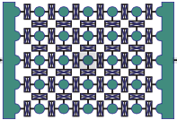
films:
Cooper pair tunnelling
droplet of local SC
phase of the local order parameter
coreless ballistic Josephson vortex
Josephson junction arrays:
the theory that decribes type III SC
describes also Jja

Slide 6
how can we establish global SC?
two ways in which gauge fields in (2+1) dimensions can get rid of their divergences:
generate a mass via magnetic monopole (instantons) ⟹ superinsulators
generate a topological Chern-Simons (CS) mass (BF) ⟹ SC
limited to 2d?
topological mass can be generetad in any dimensions
granularity not confined to thin films but also detected in bulk samples (Parra et al.); ground-state of the high-T_{c} cuprates
(Pelc et al.)
BKT⟹ VFT

Slide 7
T=0
S_{eff} (A_{μ} , Q_{μ}, M_{μ} )
phase structure: couple with e.m. field
S_{eff} (A_{μ} , Q_{μ}, M_{μν} )
Bose metal
bosonic topogical insulator
type-III superconductor
Higssless
g
type-I superconductors: H < H_{c} expel magnetic field, Meissner state , at the critical
field H = H_{c} superconductivity destroyed
type-II superconductors:
H < H_{c1} Meissner state
H_{c1} < H < H_{c2} magnetic field penetrates in form of Abrikosov
vortices having a normal core, H = H_{c2} vortex normal cores overlap ⟹ superconductivity
destroyed
type-III superconductors: proliferation of vortices
with no normal core also without magnetic field
superconductivity destroyed by proliferation of vortices, no Cooper pairs breaking

Slide 8
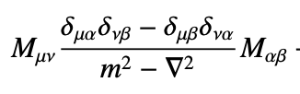
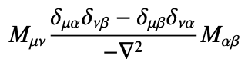
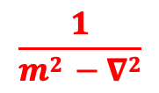
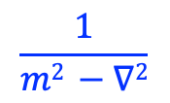

higgsless SC
(Sodano, Trugenberger, MCD 2006; Trugenberger, MCD 2017)
2d:
vortex interaction in S_{eff} (A_{μ} , Q_{μ}, M_{μ} ): statistical interaction causes screening of vortex vortex interaction
$$\frac{1}{m2 −∇2}$$
M_{μ}
M_{μ}
$$\frac{1}{m2 −∇2}$$
⟶
M_{μ}
M_{μ}
-M_{μ}
$$\frac{1}{∇2}$$
M_{μ}
screening suppressed
charge condensation
‘t Hooft loop for a vortex antivortex probe at distance R ⟹ V(R) ∝ ln R logarithmic confinement
3d:
vortex 1d object M_{μ} ⟶ M_{μν}
vortex interaction in
S_{eff} (A_{μ} , Q_{μ}, M_{μν} )
⟶
screening suppressed
charge condensation
‘t Hooft surface: self-energy of a circular vortex-loop of radius R ∝ R ln R ⟹ logarithmic confinement
(Sodano, Trugenberger, MCD 1996)
in 2d and 3d destruction of global superconductivity takes places by vortex liberation

Slide 9
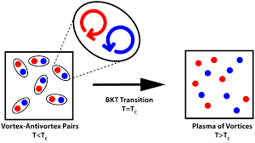


destruction of global SC:
2d BKT transition ⇒ BKT resistance scaling:
(picture from: Flamino and Giedt
PHYS. REV. D 101, 074503 (2020) )
3d vortices are 1d objects SC phase transition is thus caused by 1D strings becoming tensionless
scaling of resistence ⇒ VFT scaling (Gammaitoni, Trugenberger, Vinokour and MCD)

Slide 10
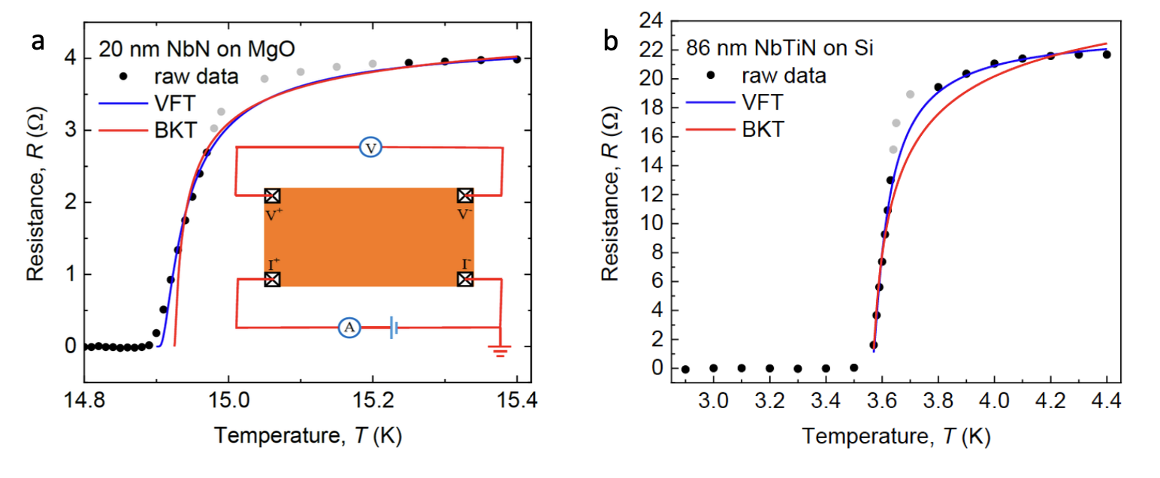

Slide 11
Thank you!!!!

