Slide 1
Discussion on ITS3 test beam analysis

Slide 2
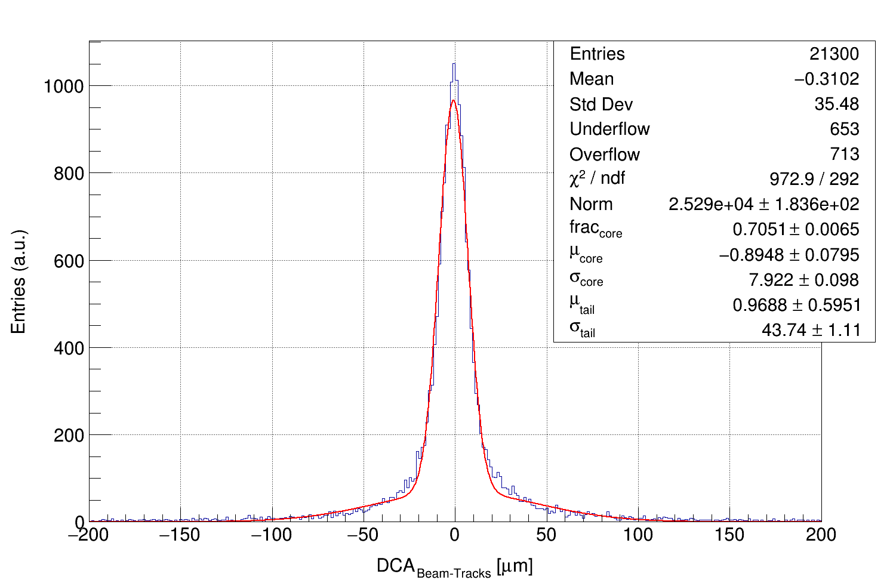
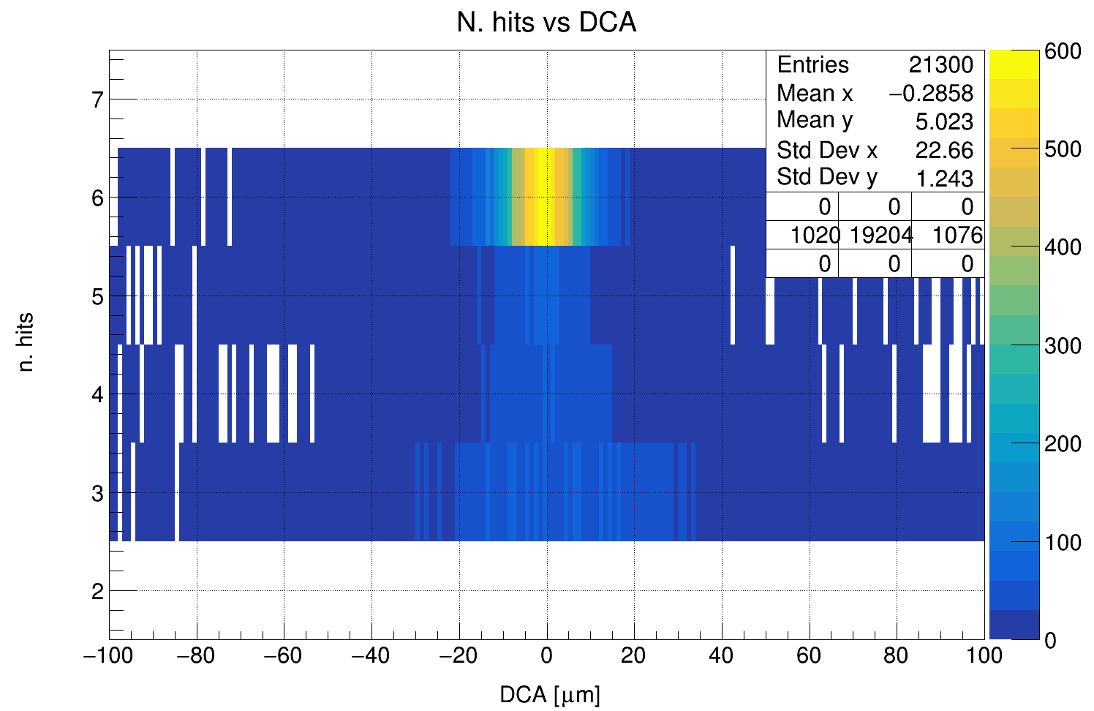
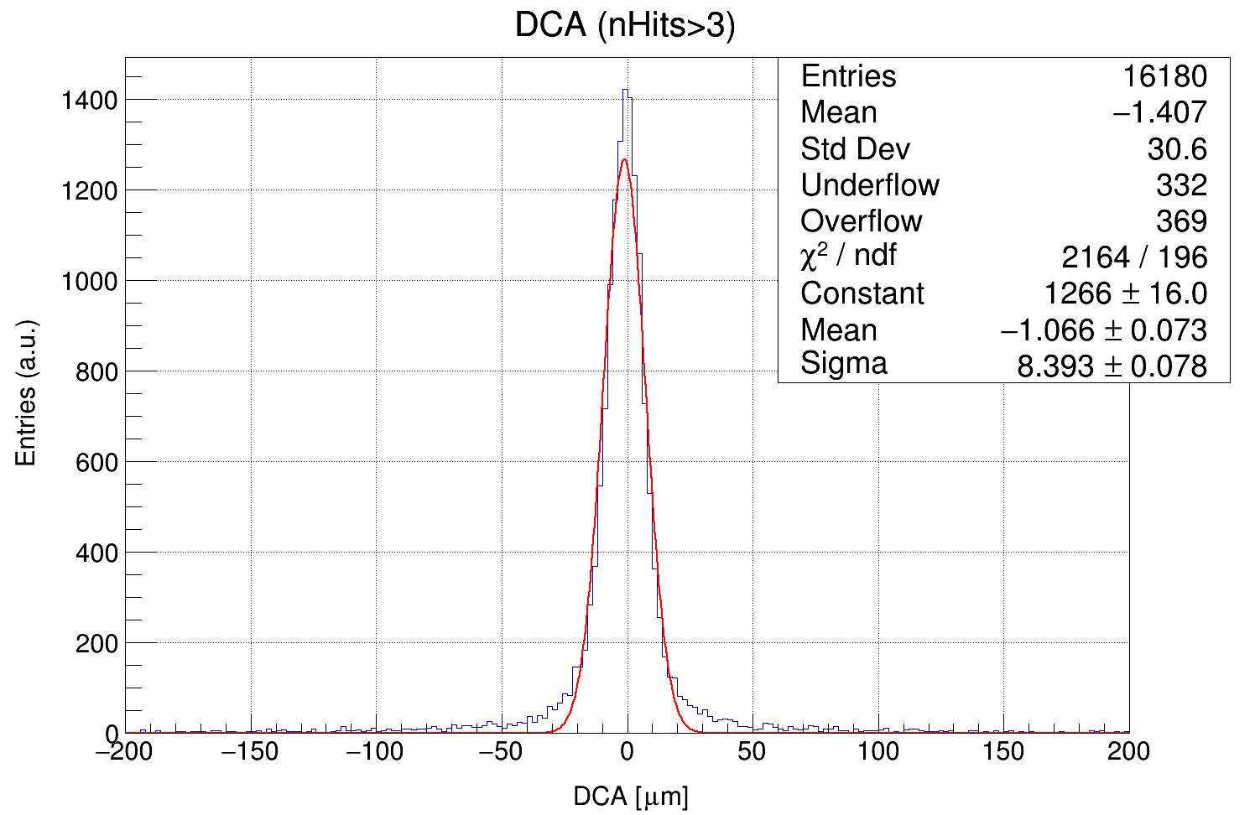
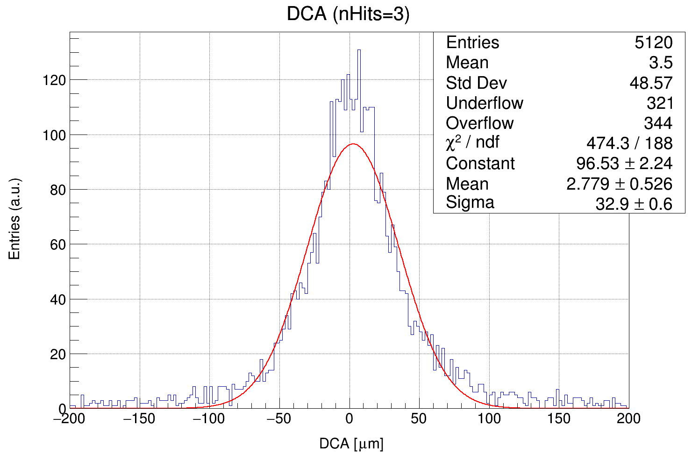
No quality cuts

Slide 3
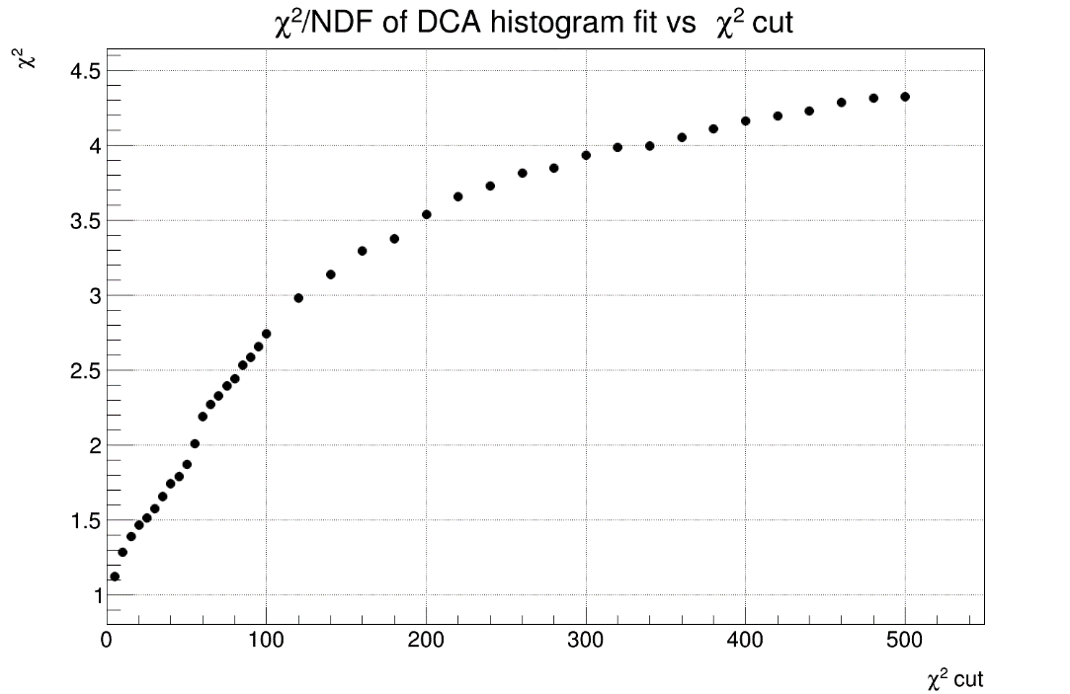
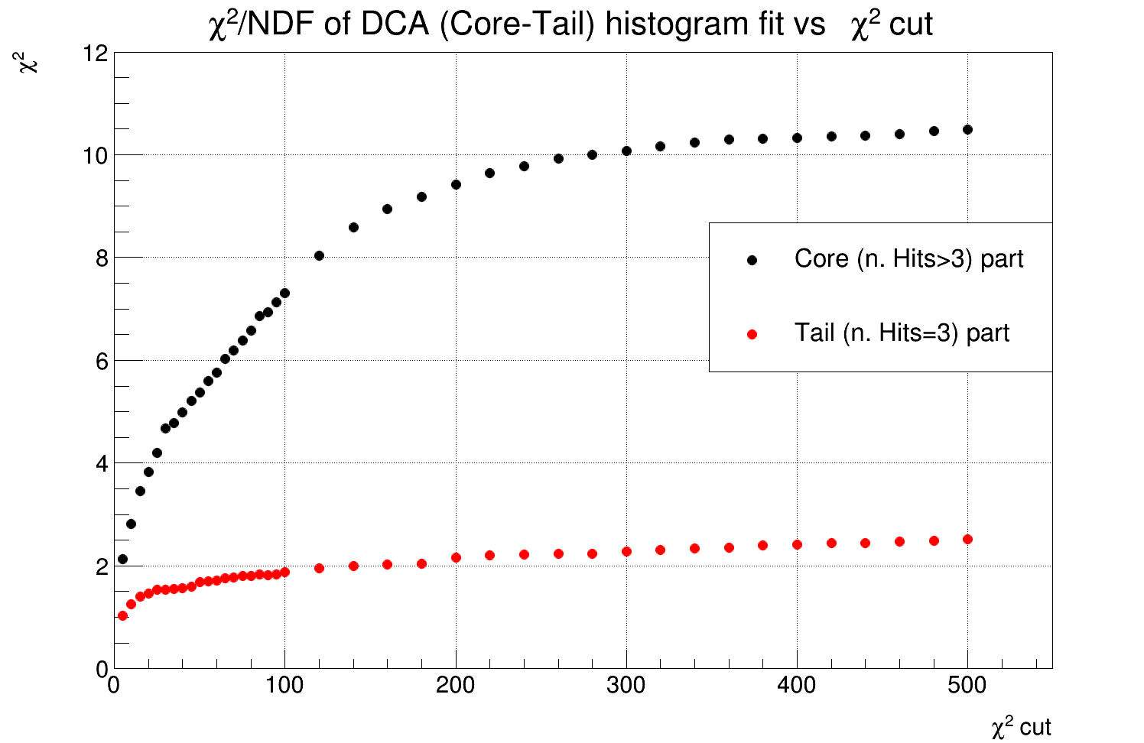
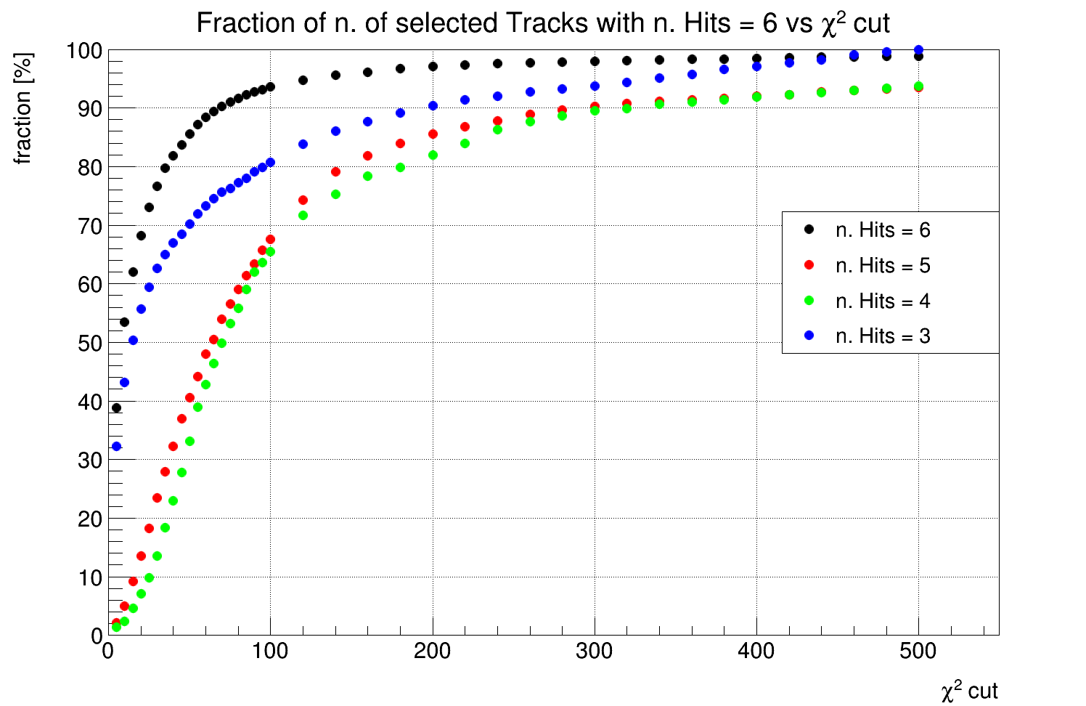
Effect of the Track selection based on the track χ²
DCA Histogram fit χ²
DCA Histogram fit χ²
Track χ² Cut | χ² all | χ² core | χ² tail | % 6 | % 5 | % 4 | % 3
No | 3.33 | 11.04 | 2.52 | 100 | 100 | 100 | 100
500 | 4.32 | 10.49 | 2.51 | 98.8 | 93.5 | 93.7 | 99.9
100 | 2.74 | 7.31 | 1.88 | 93.6 | 67.6 | 65.5 | 80.8
50 | 1.87 | 5.38 | 1.68 | 85.6 | 40.6 | 33.1 | 70.2
20 | 1.47 | 3.82 | 1.46 | 68.3 | 13.5 | 7.1 | 55.7
10 | 1.29 | 2.82 | 1.26 | 53.4 | 5 | 2.4 | 43.3
5 | 1.12 | 2.13 | 1.02 | 38.9 | 2.2 | 1.4 | 32.3
% of tracks that pass the χ² cut for tracks with different n. of Hits
Tracks with 4 and 5 hits are strongly cut

Slide 4
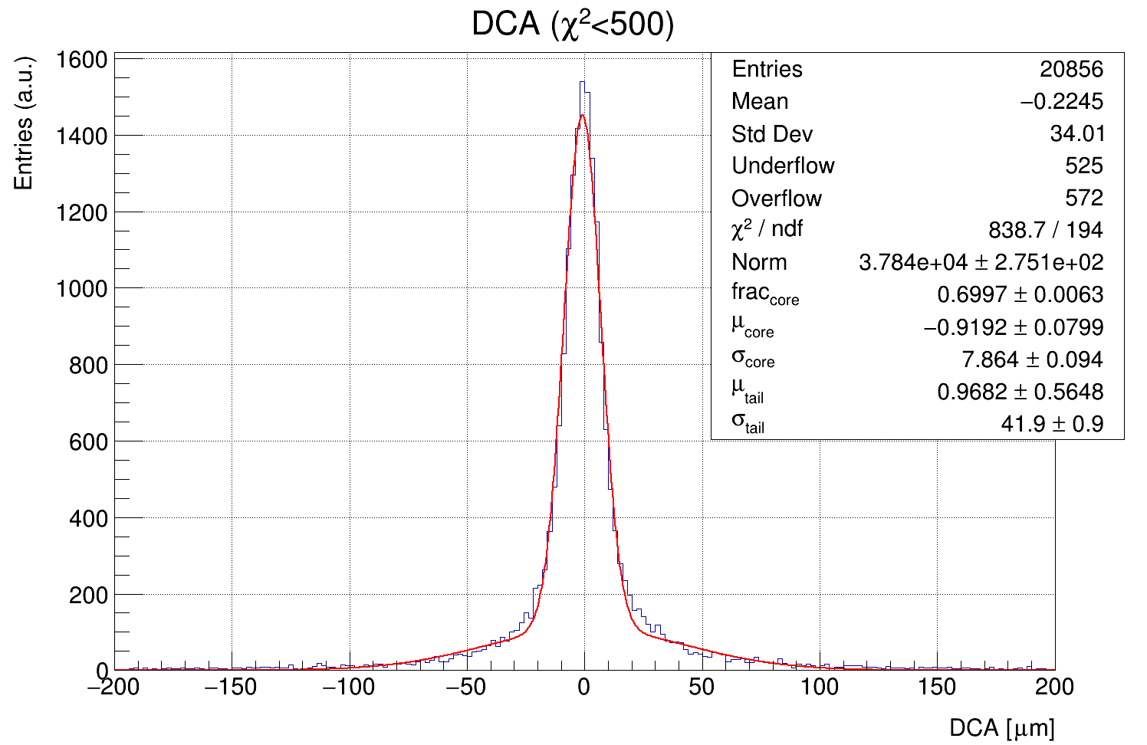
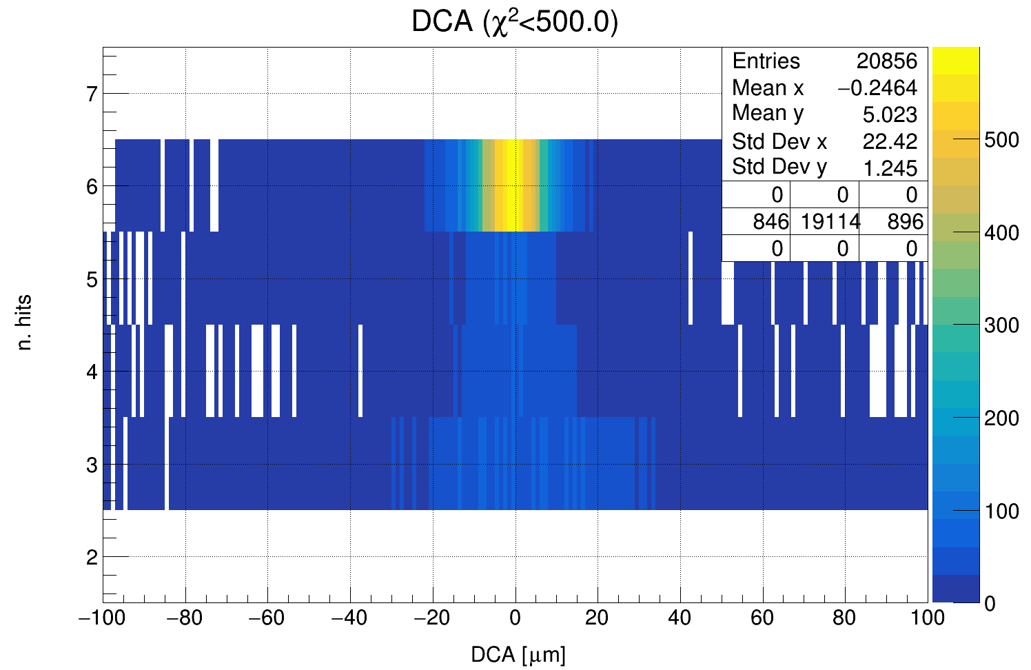
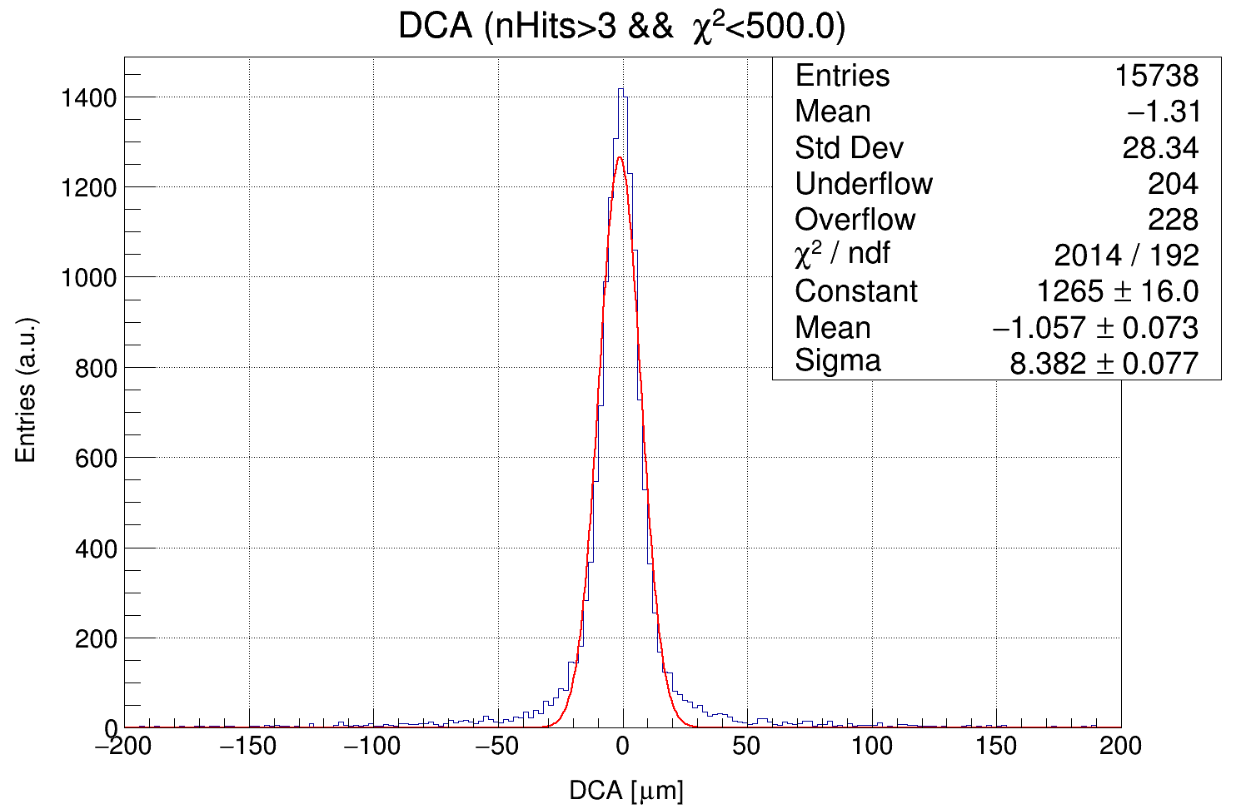
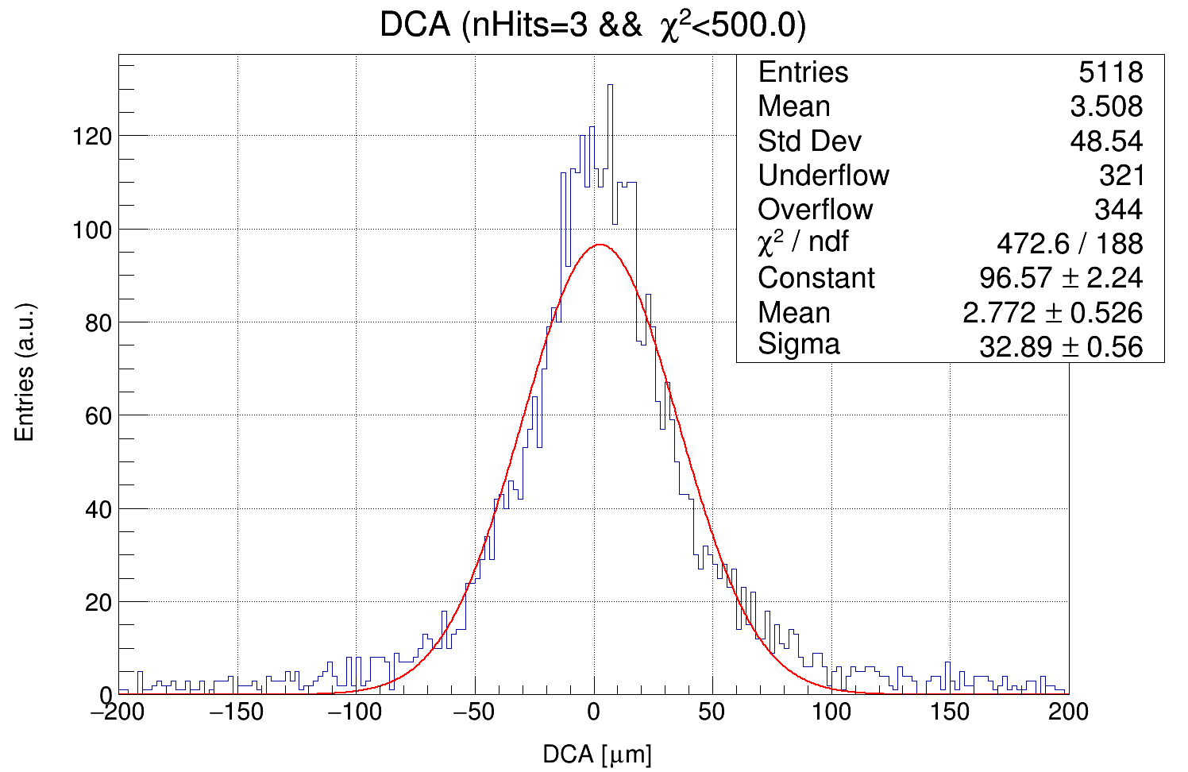
χ² < 500

Slide 5
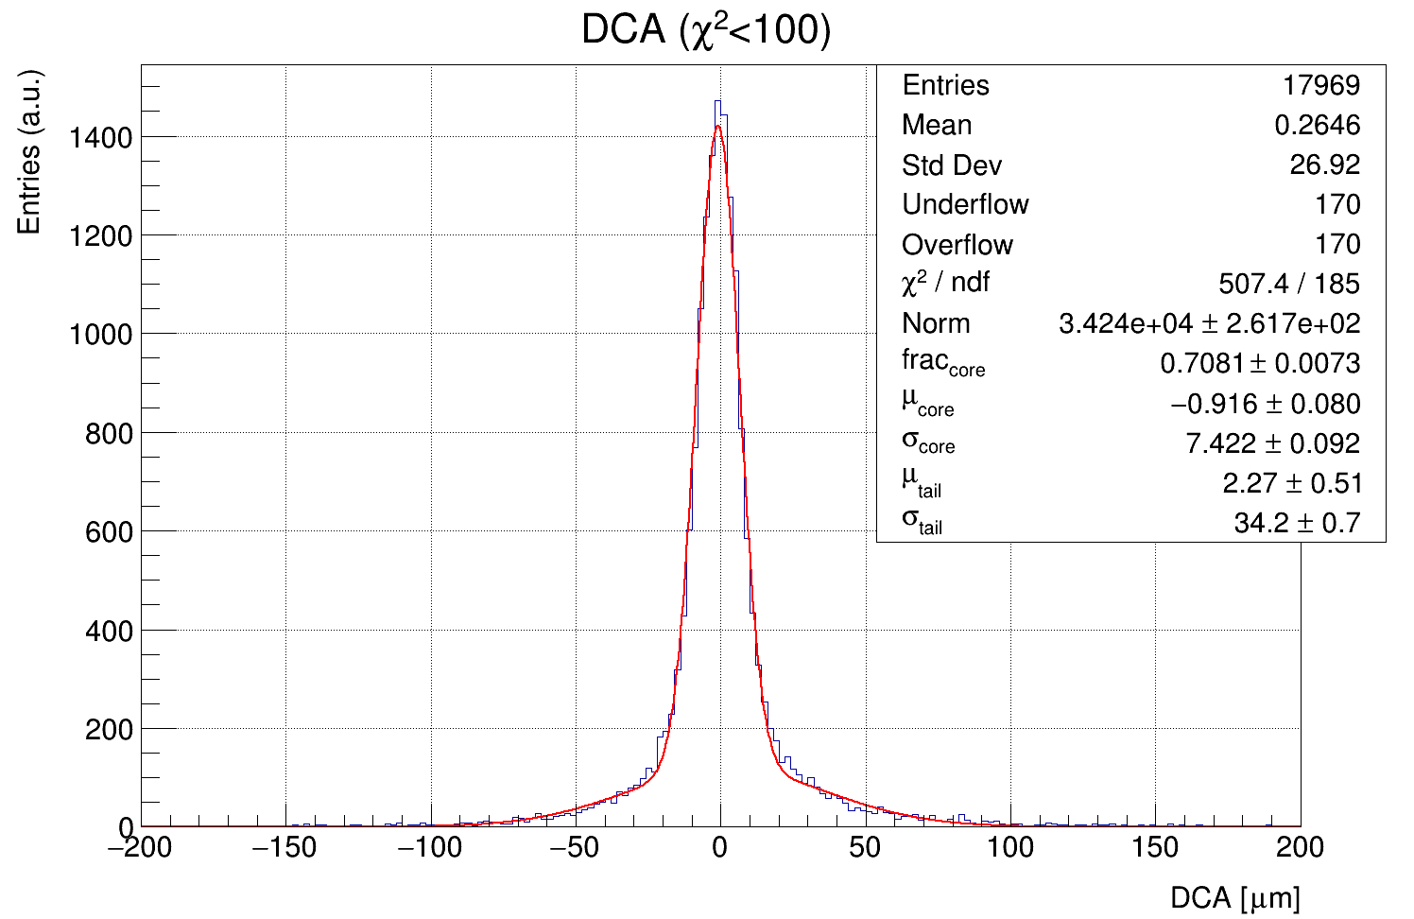
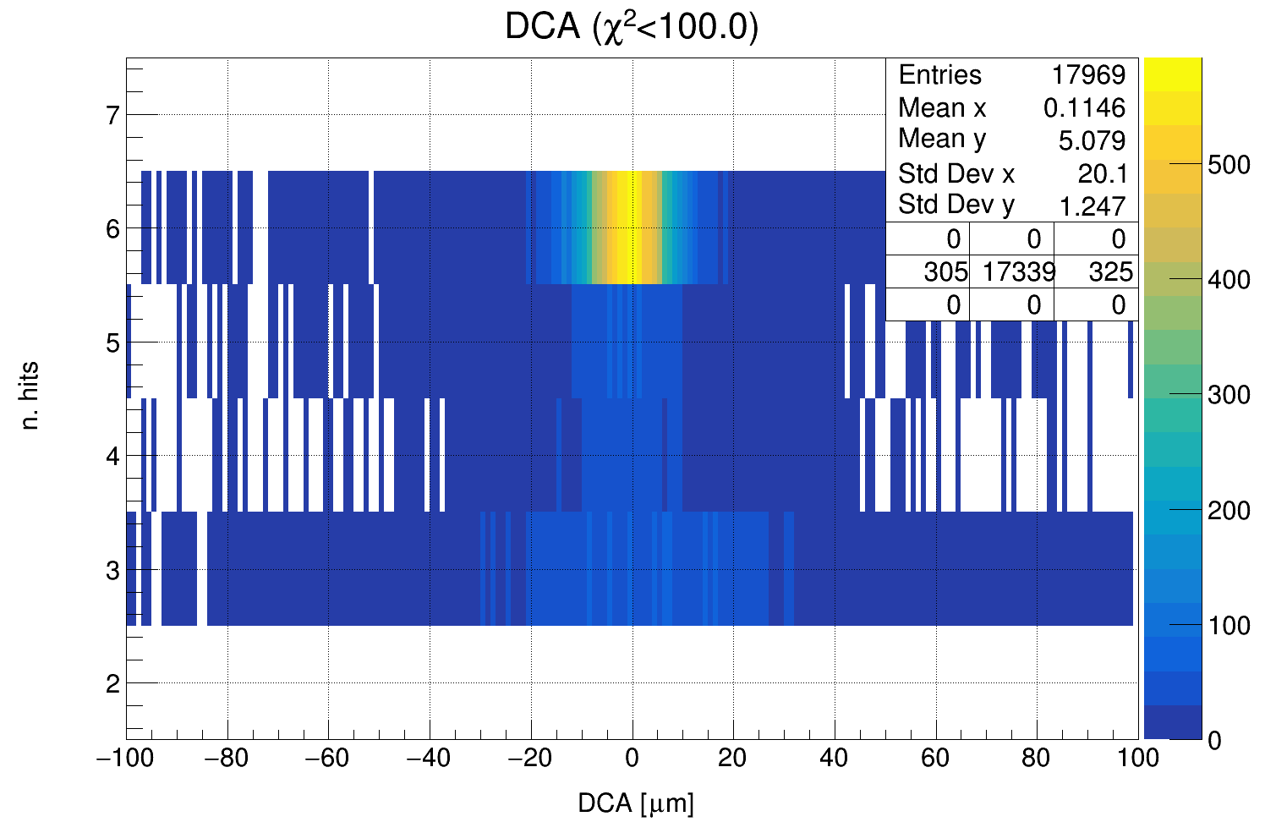
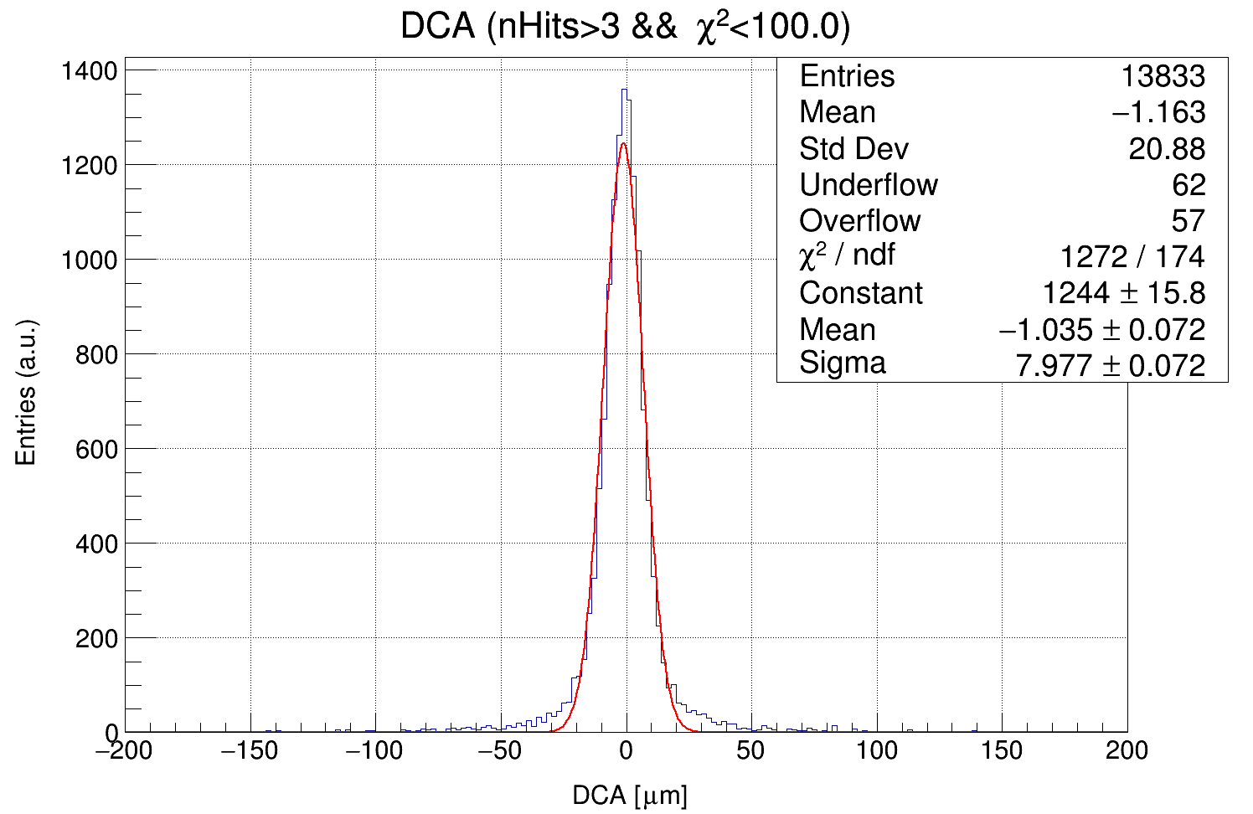
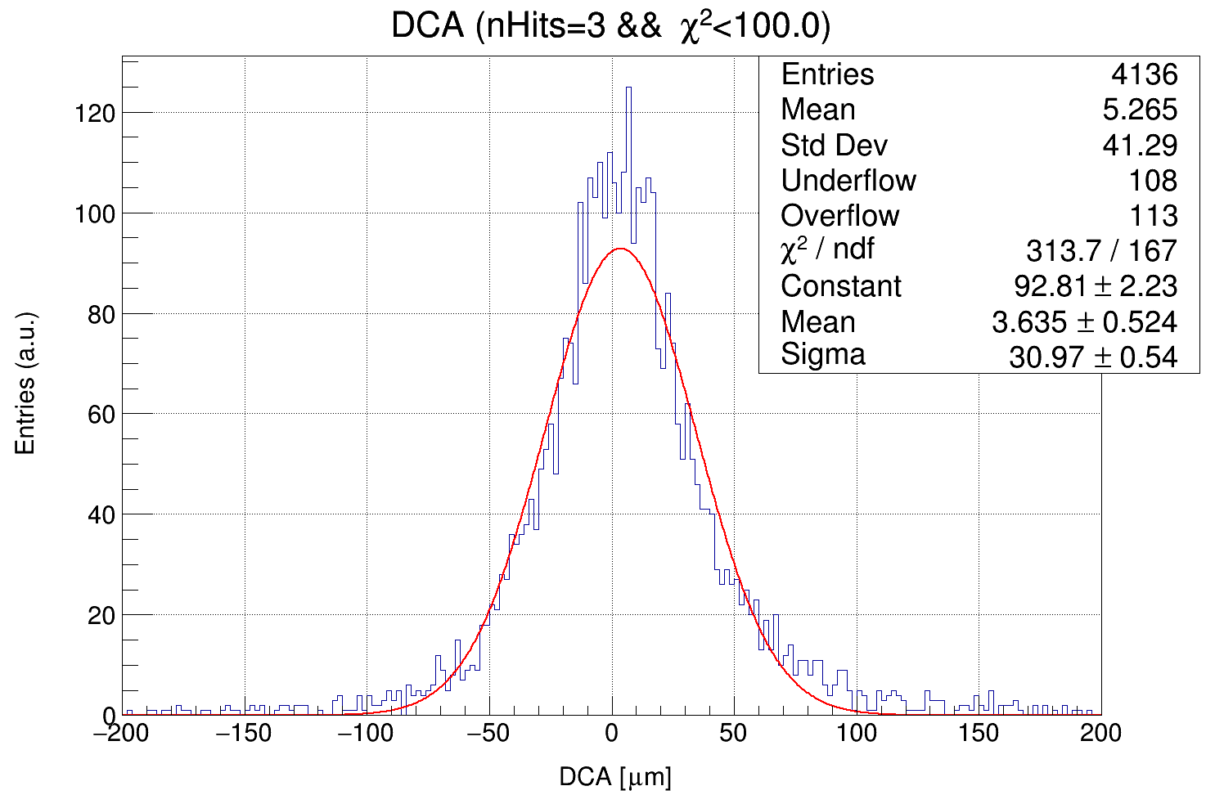
χ² < 100

Slide 6
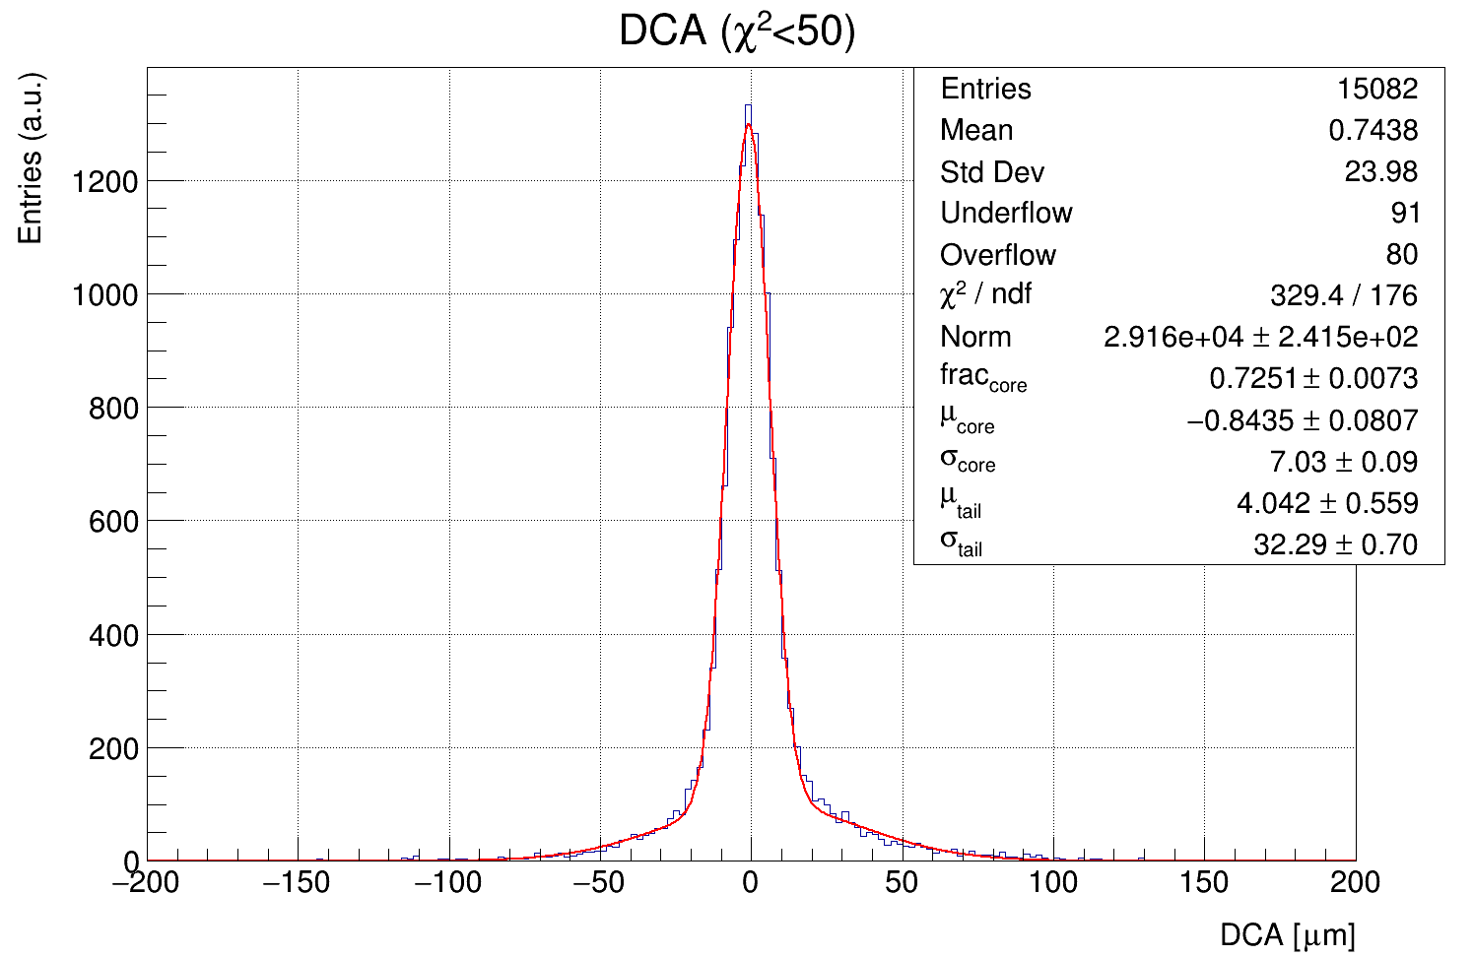
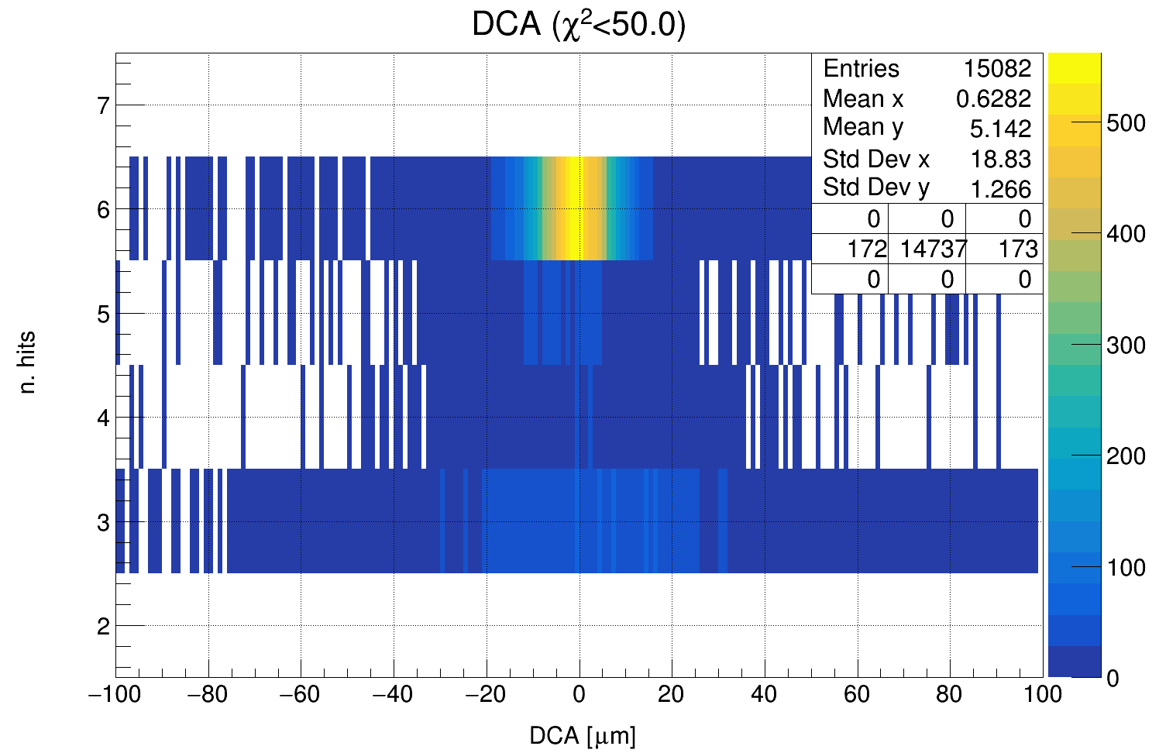
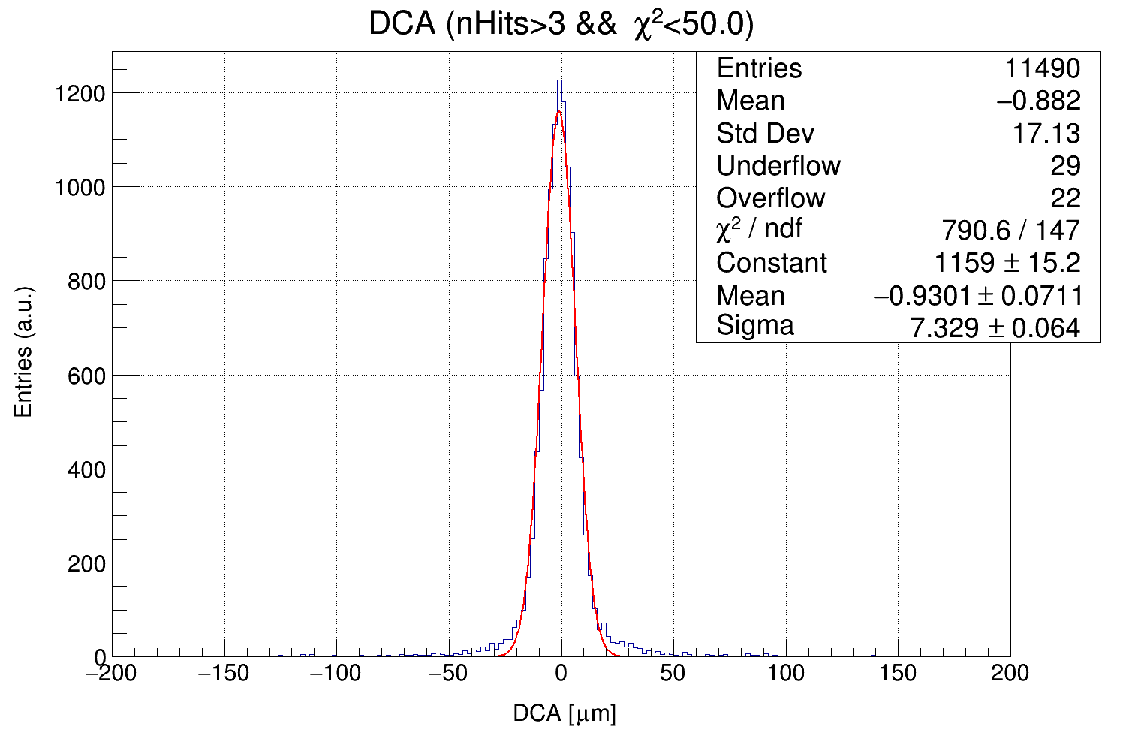
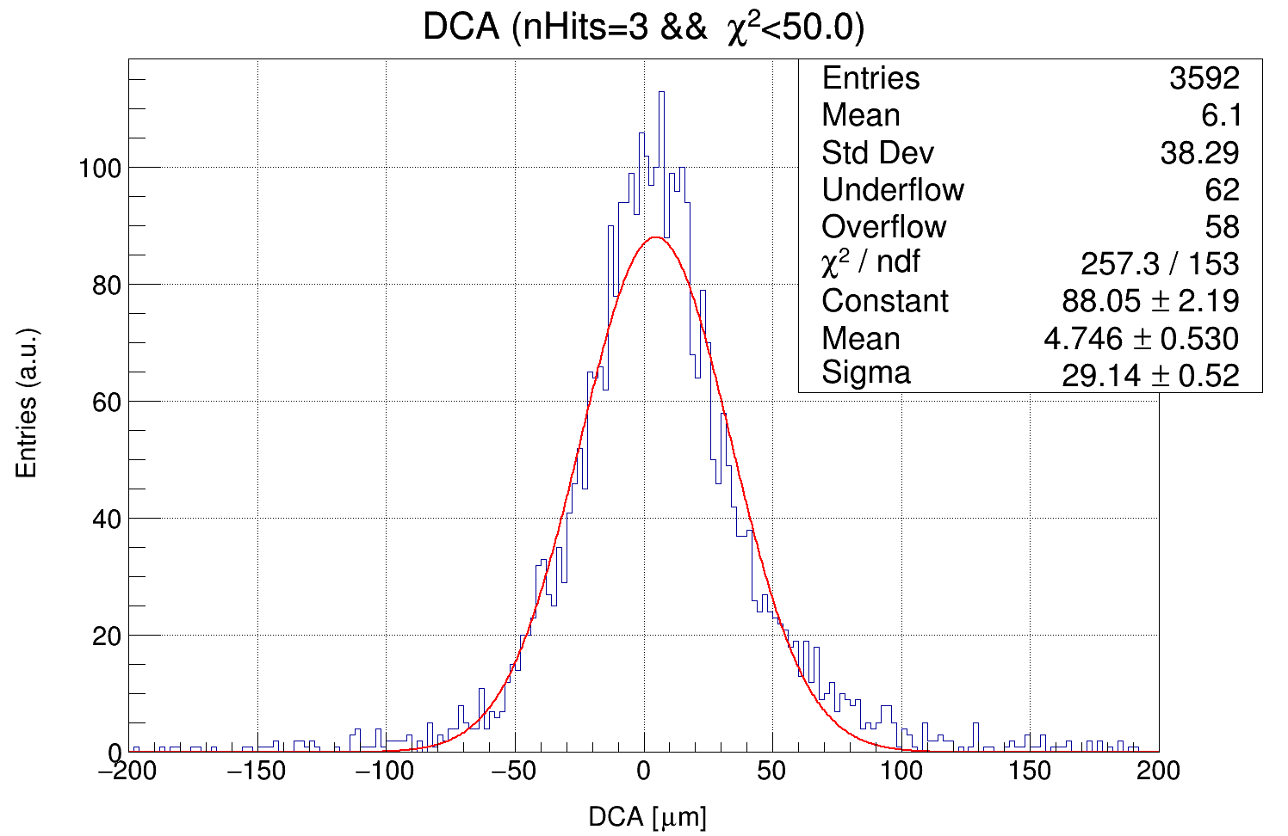
χ² < 50

Slide 7
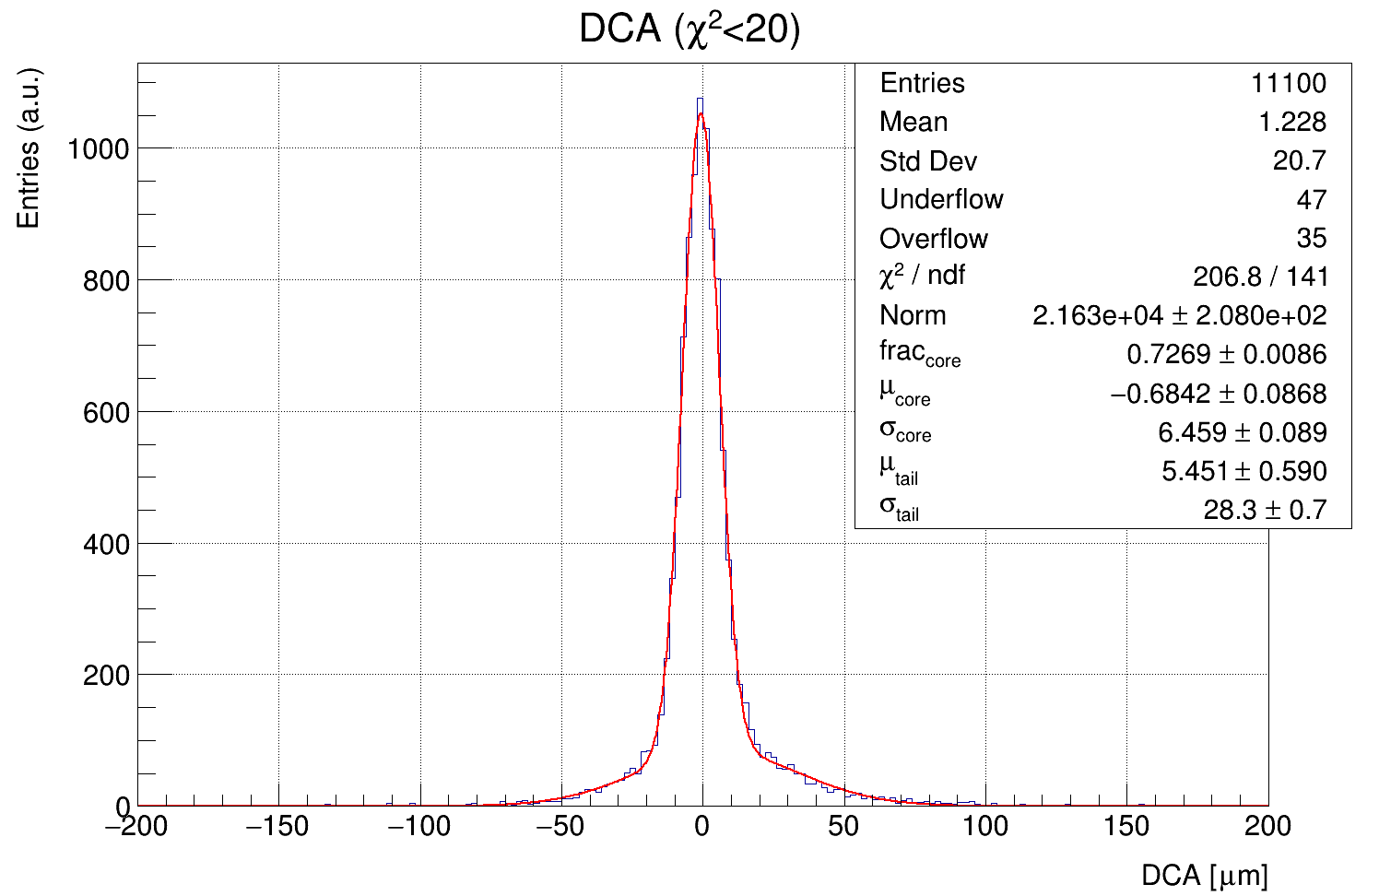
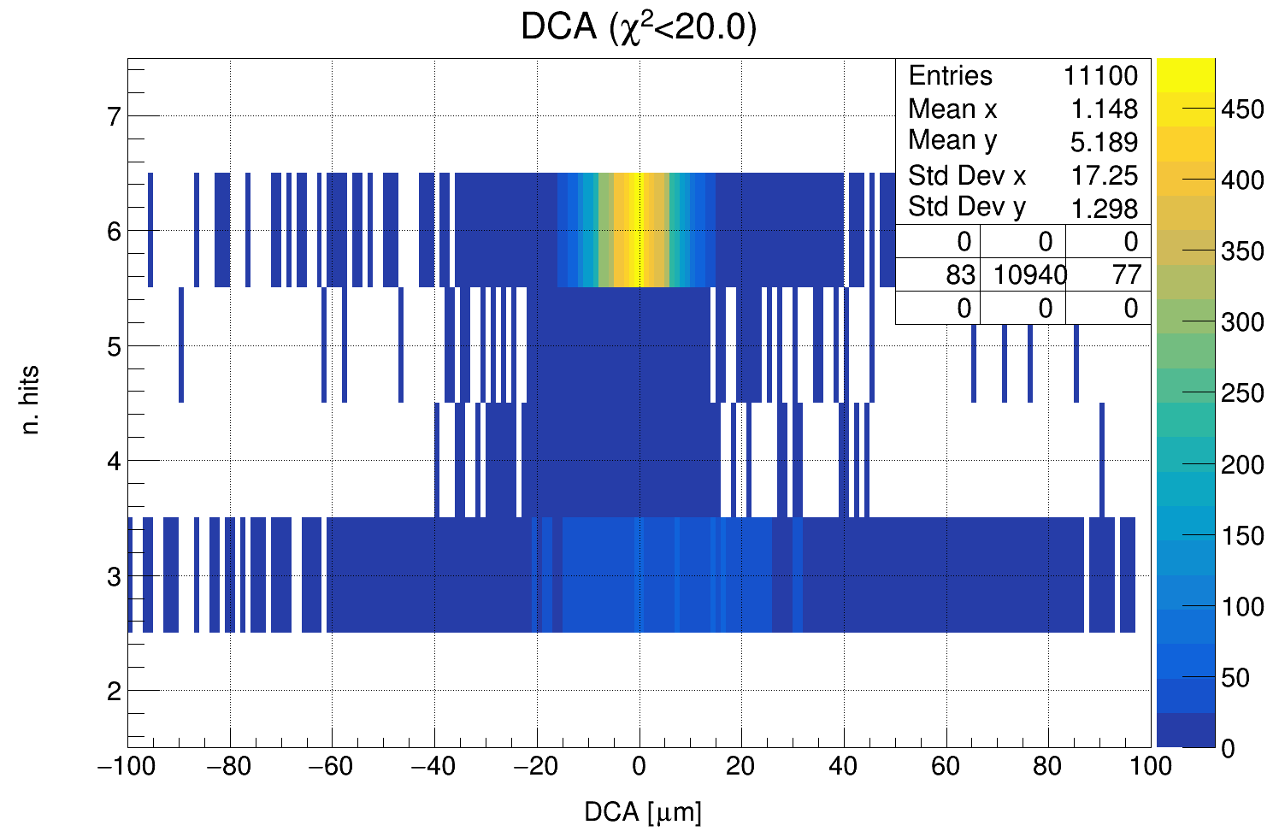
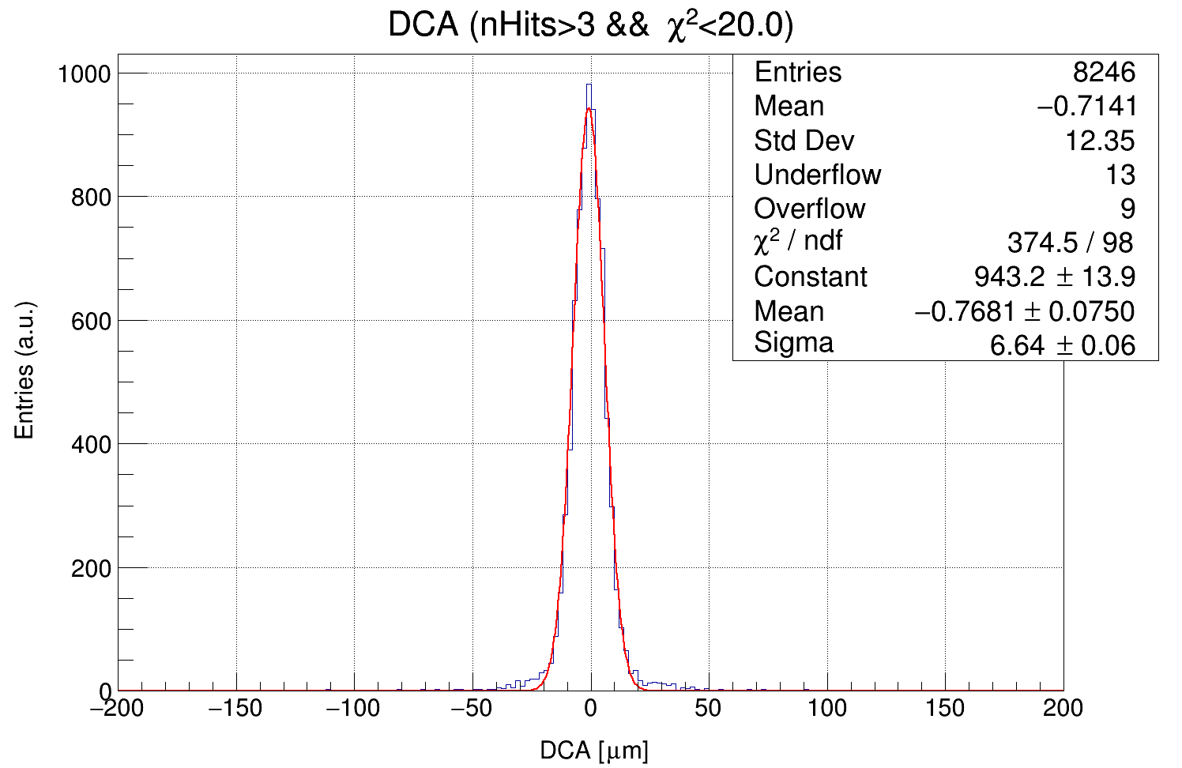
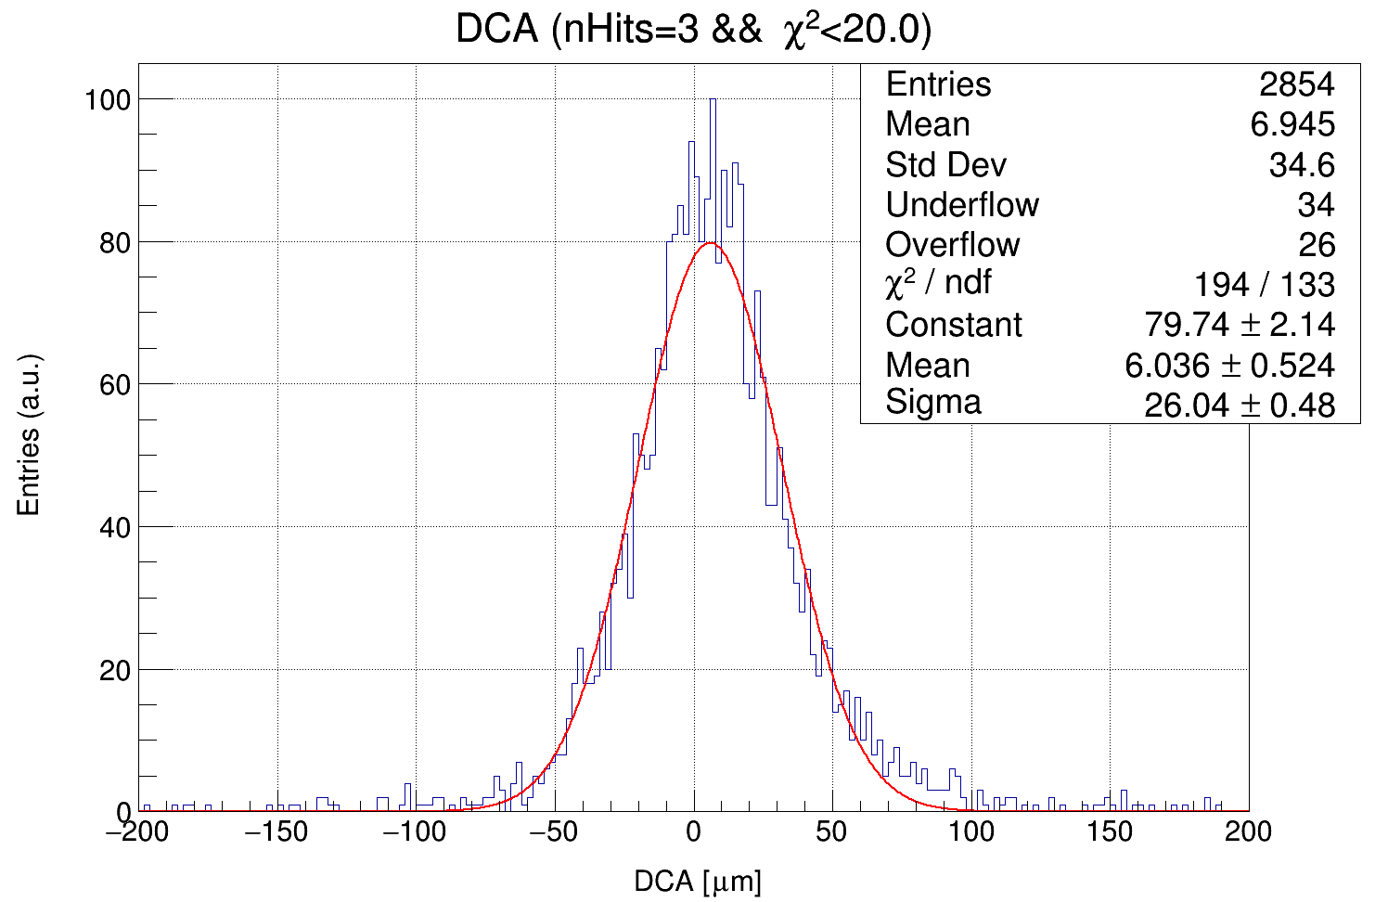
χ² < 20

Slide 8
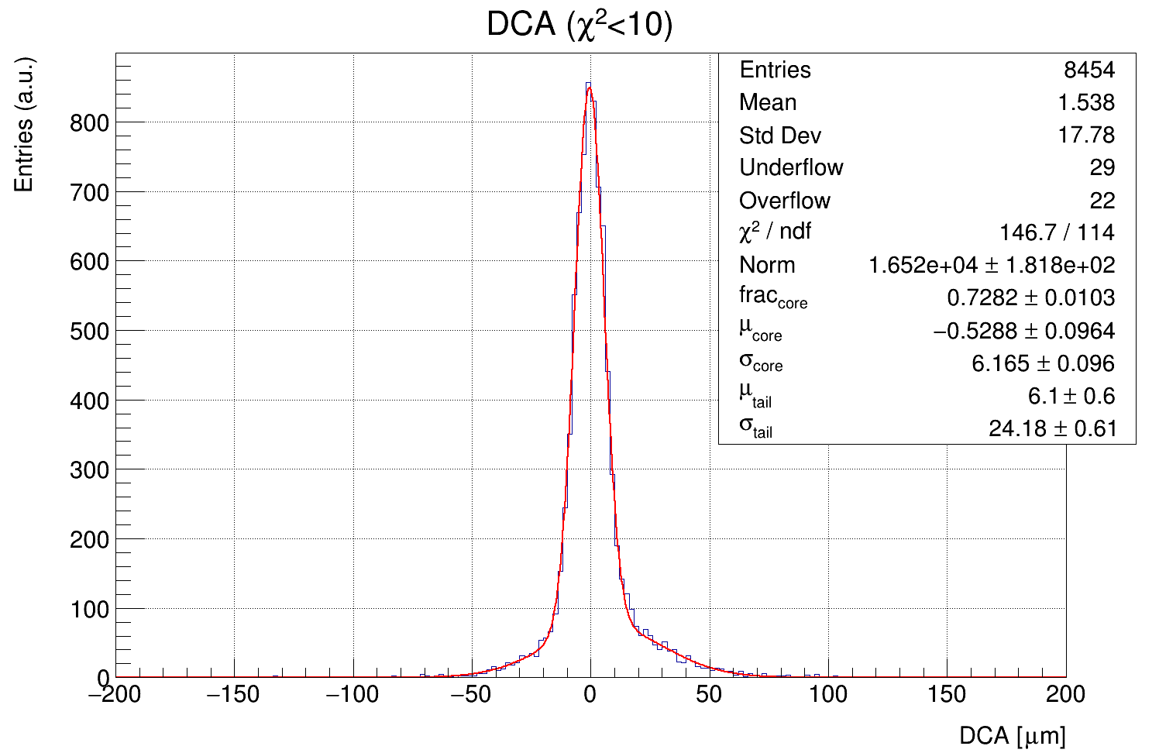
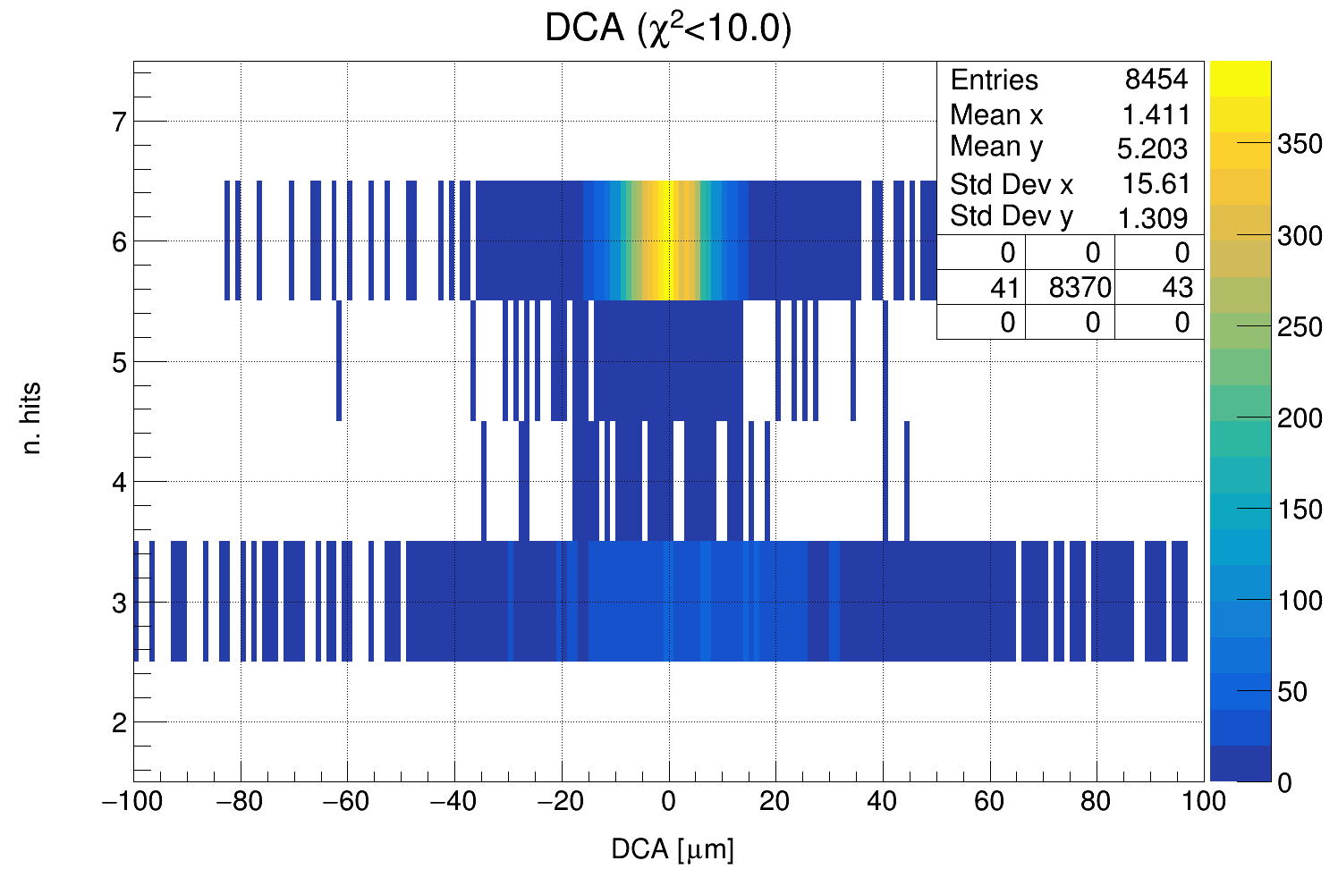
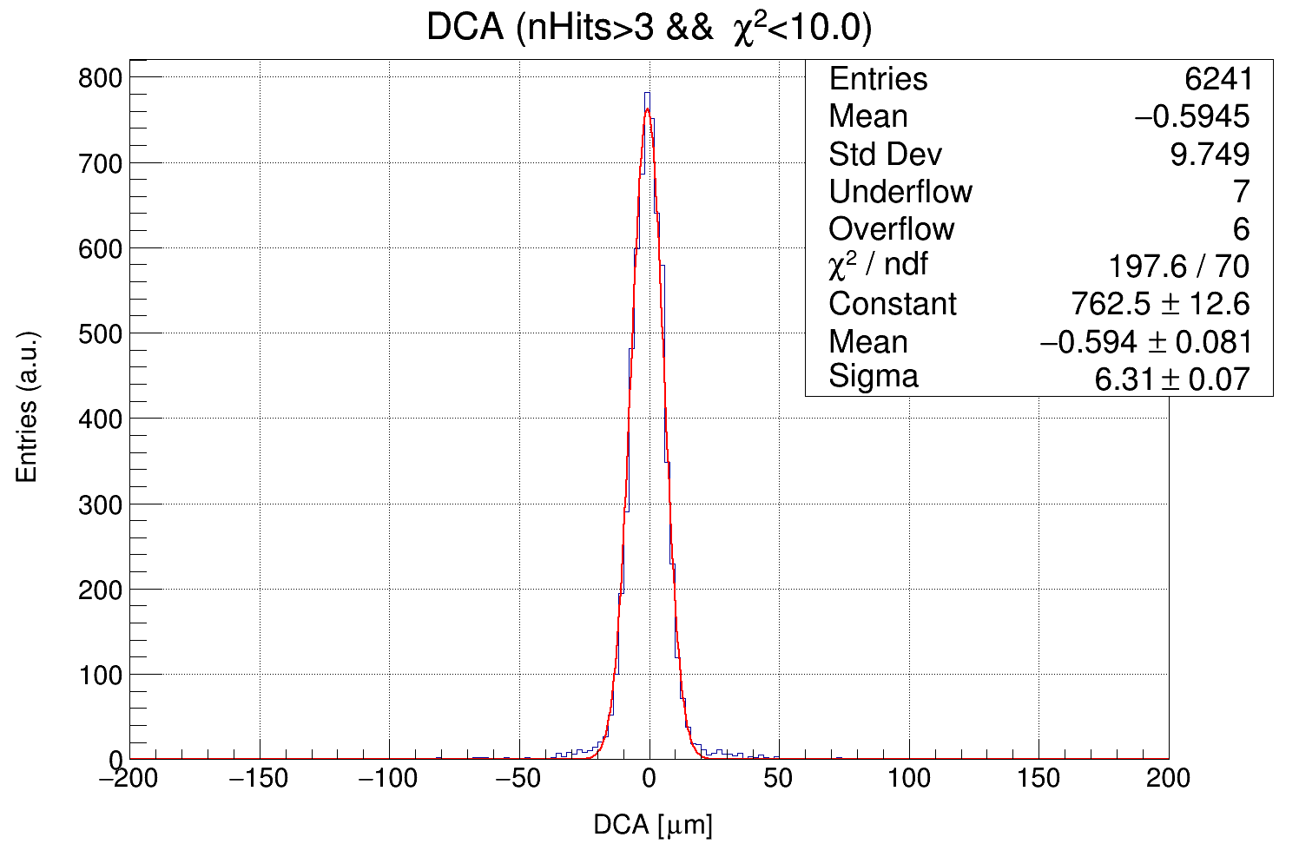
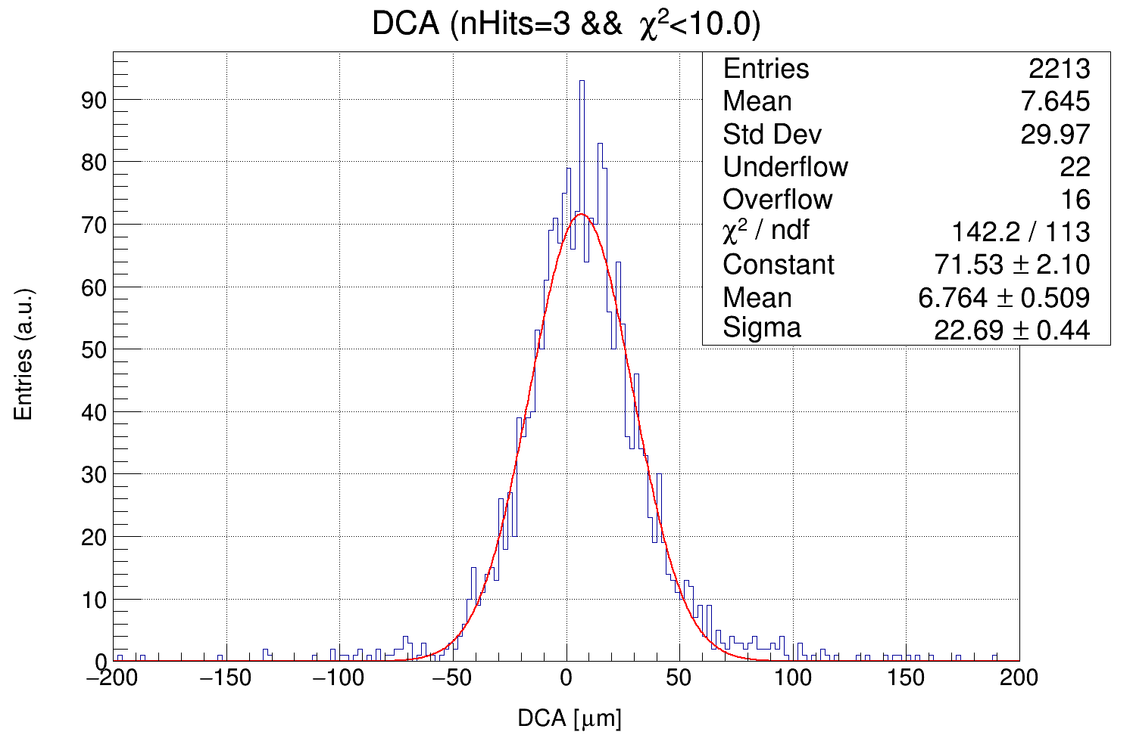
χ² < 10

Slide 9
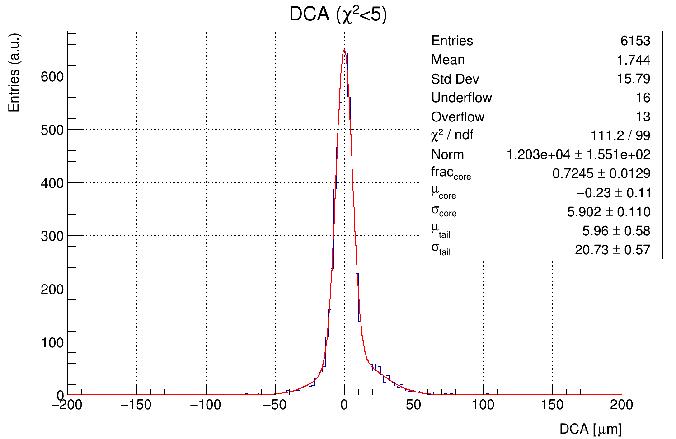
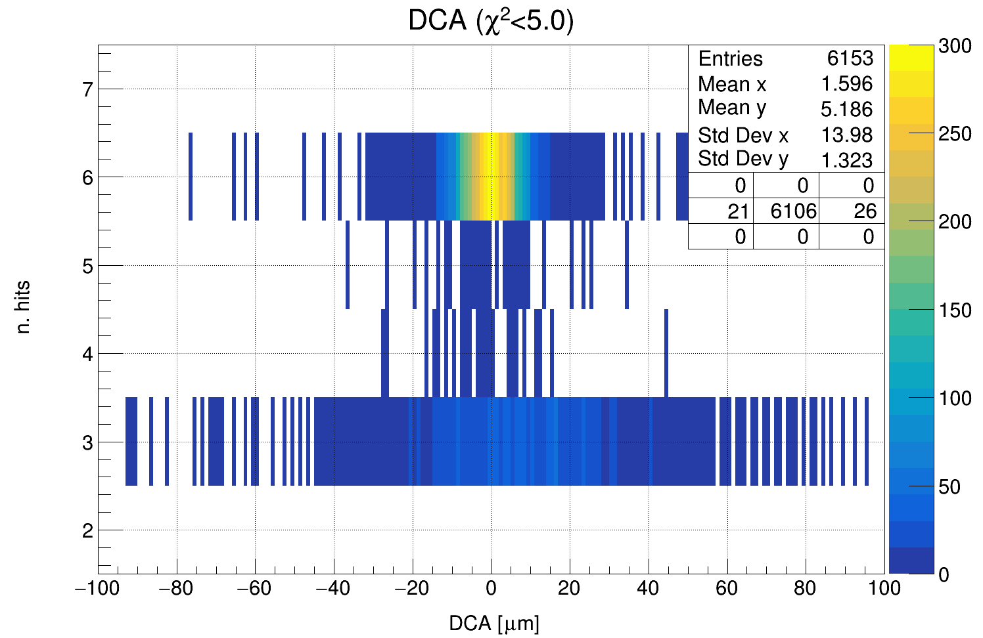
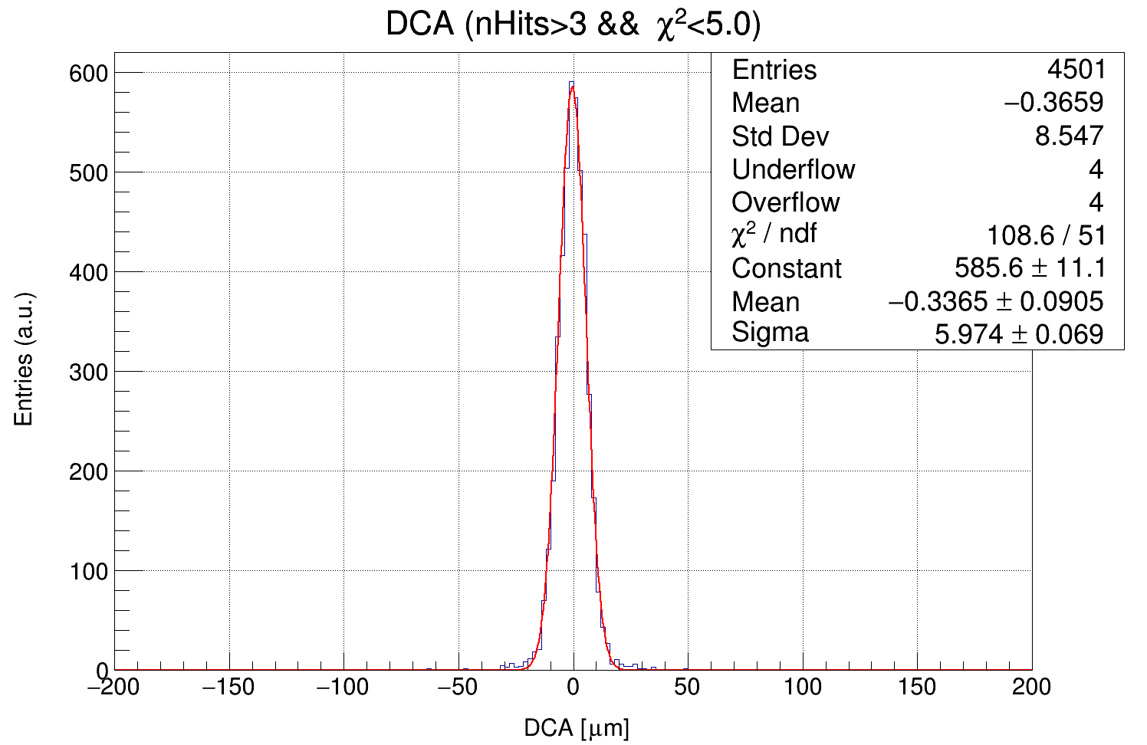
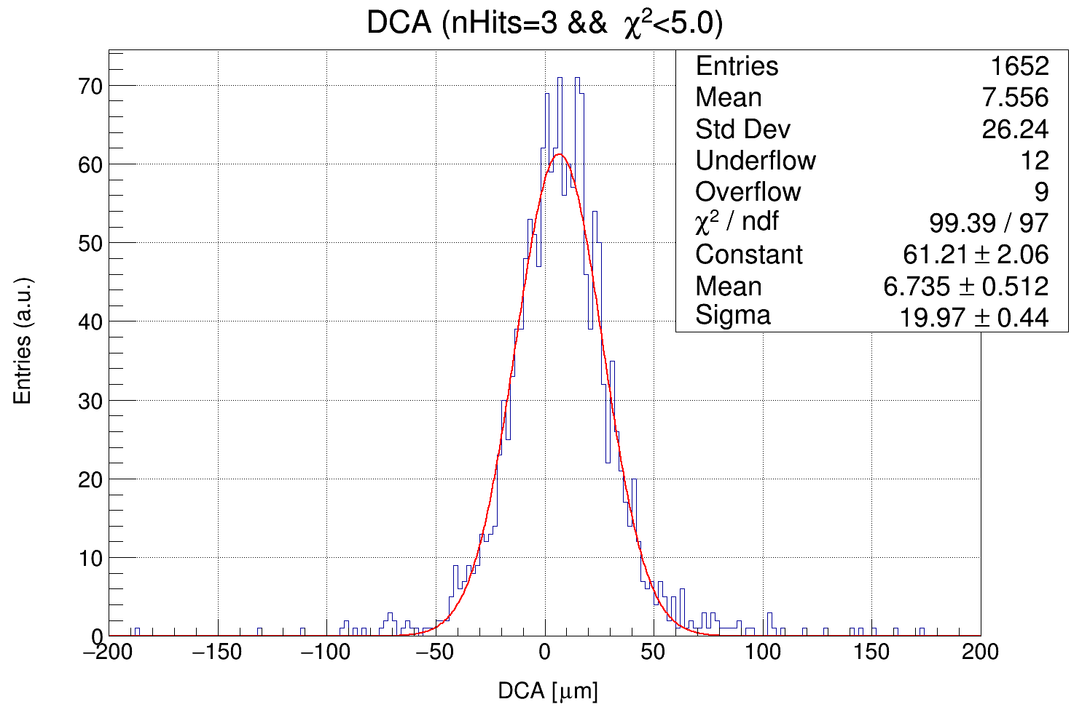
χ² < 5

Slide 10
Track Chi2 Cut | Entries | Eff. | Chi2 | % core | σ core [μm] | σ Tail [μm] | σ (n.H>3) [μm] | σ (n.H=3) [μm]
No | 21300 | 100 | 3.33 | 70.5 | 7.9 | 44 | 8.39 | 32.9
500 | 20856 | 97.9 | 4.32 | 70 | 7.86 | 41.9 | 8.38 | 32.9
100 | 17969 | 84.4 | 2.74 | 70.8 | 7.42 | 34.2 | 7.98 | 31
50 | 15082 | 70.8 | 1.87 | 72.5 | 7.03 | 32.3 | 7.33 | 29.1
20 | 11100 | 52.1 | 1.47 | 72.7 | 6.46 | 28.3 | 6.64 | 26
10 | 8454 | 39.7 | 1.29 | 72.8 | 6.2 | 24.2 | 6.31 | 22.7
5 | 6153 | 28.9 | 1.12 | 72.4 | 5.9 | 20.7 | 5.97 | 20

Slide 11
Beam – Track matching study

Slide 12
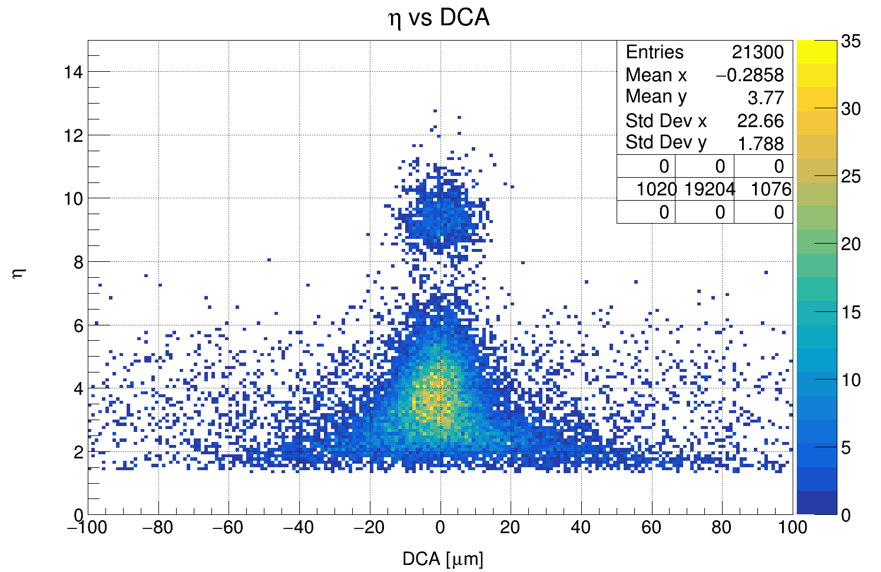
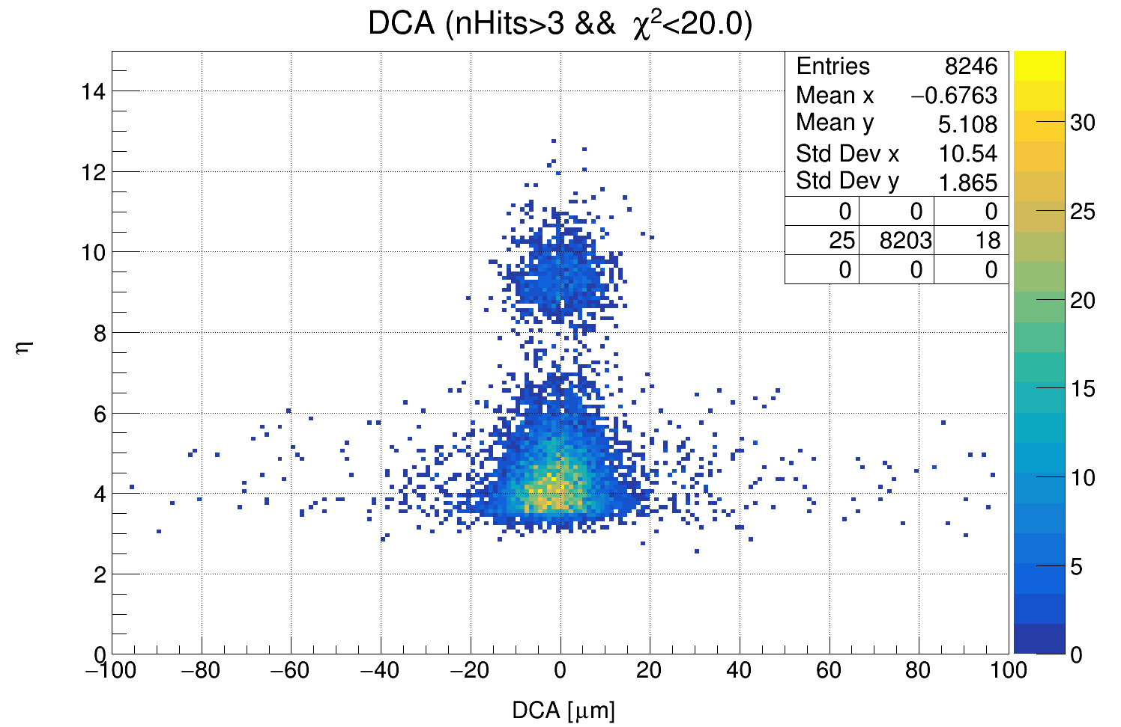
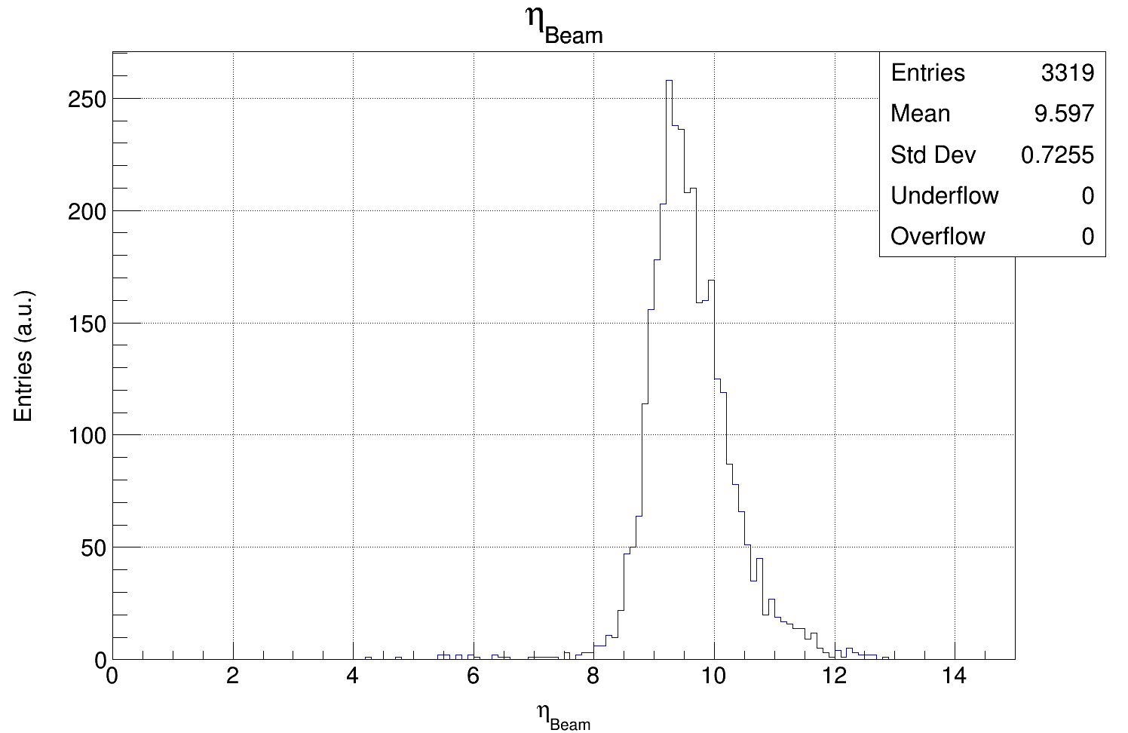
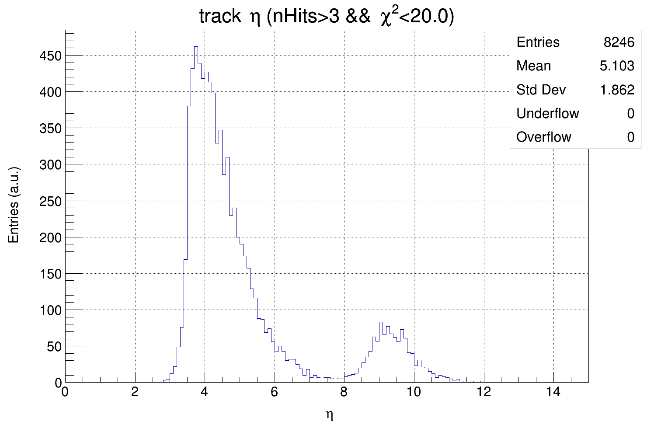

Slide 13
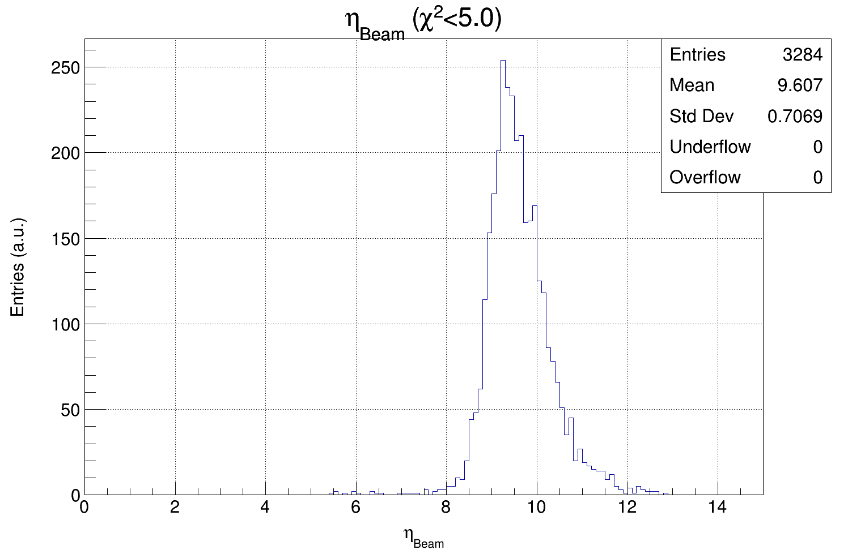
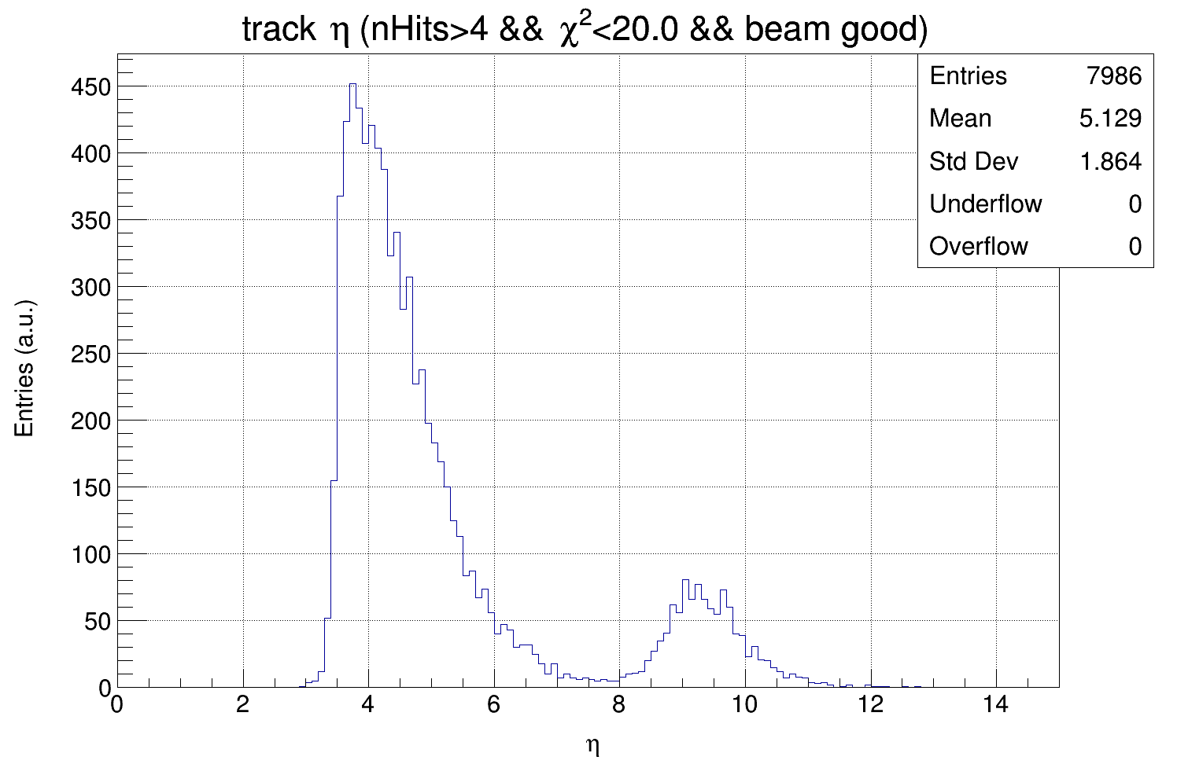
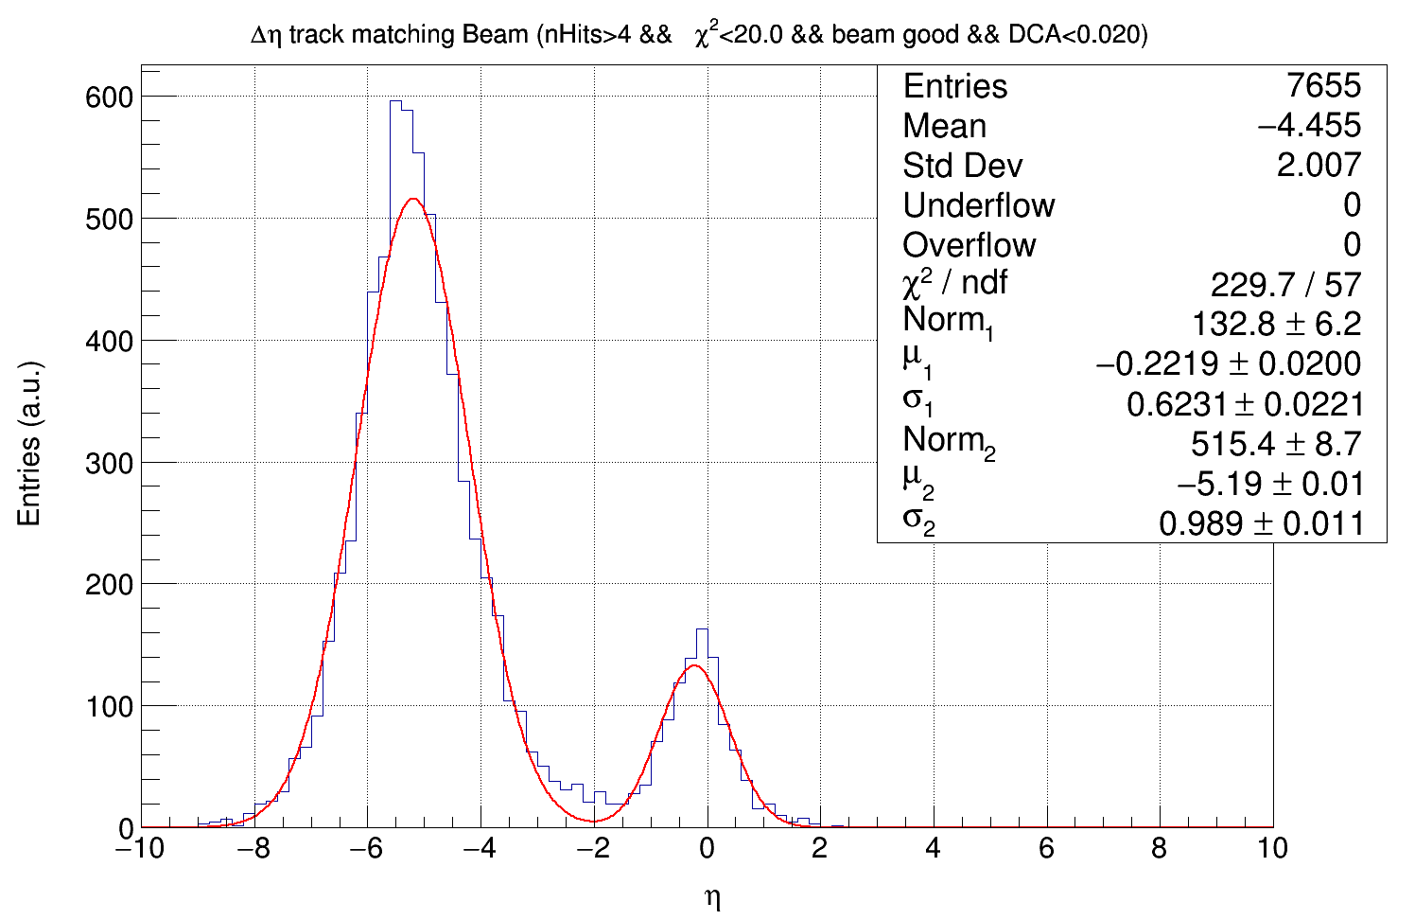
Additional selection criteria:
for beam («beam good»): beam χ² < 5
for tracks: n. Hits > 4
Beam-Track matching:
|Δdca|<20 μm and |Δη|<2

Slide 14
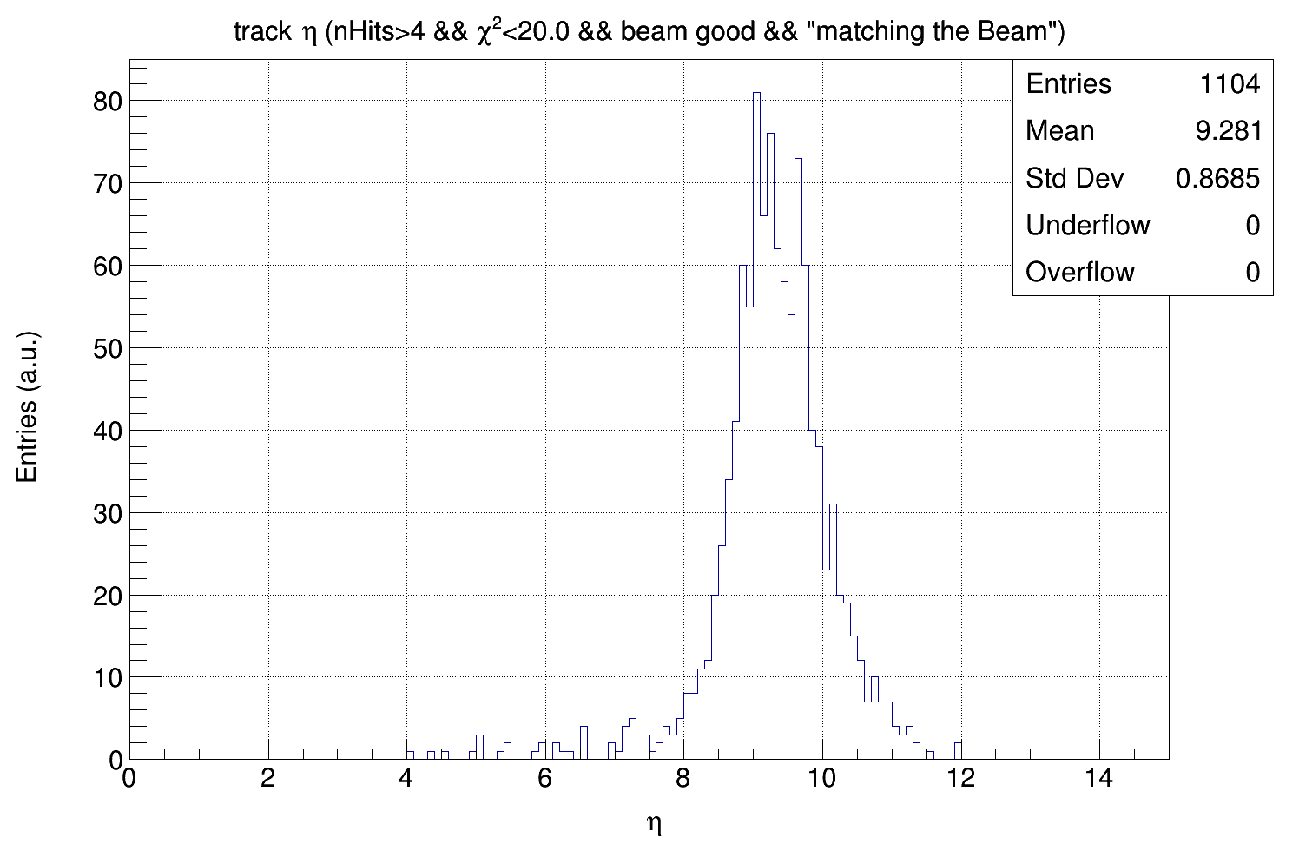
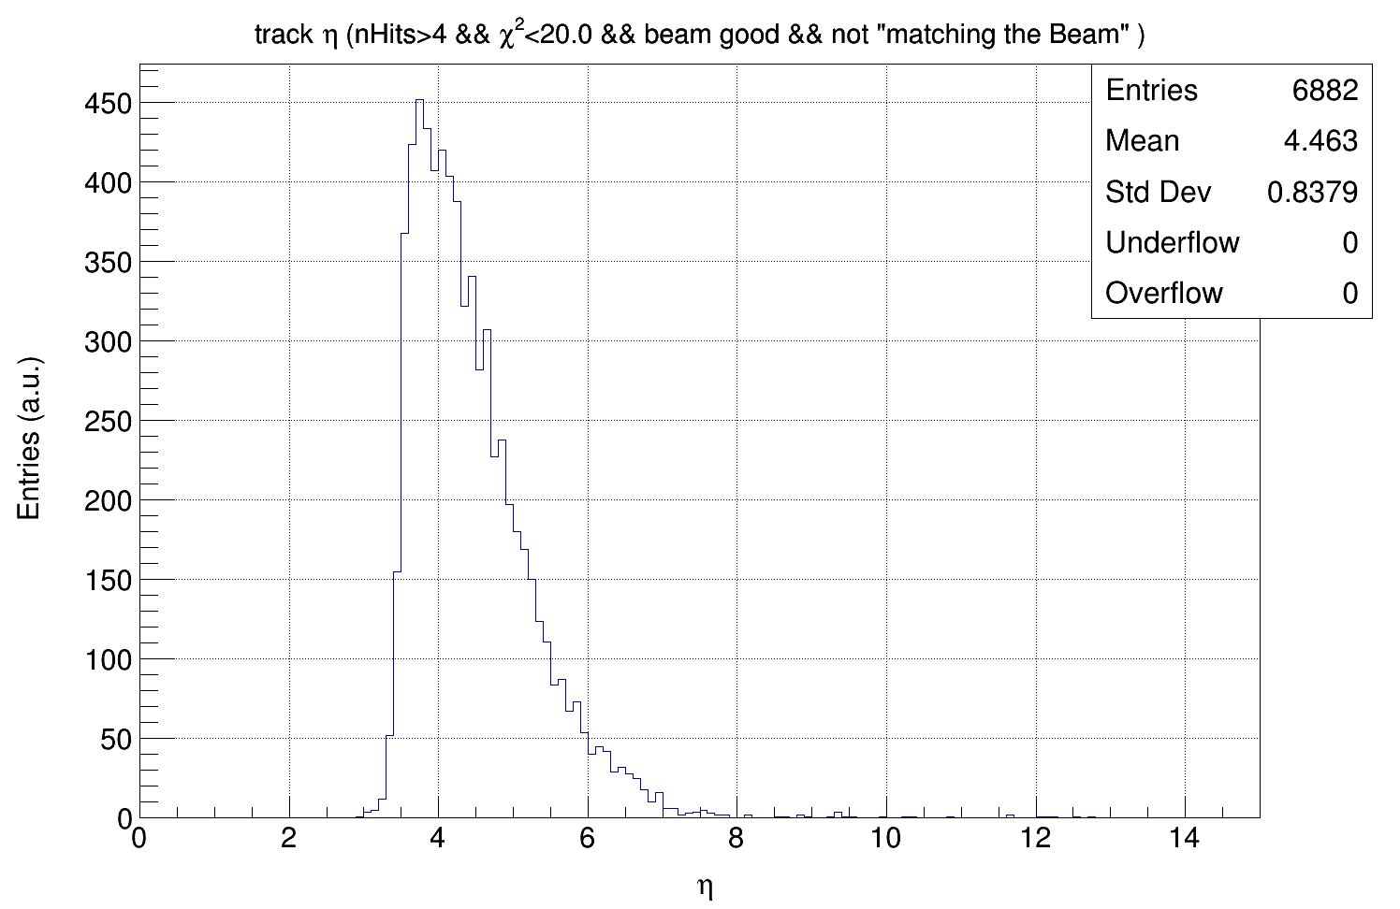
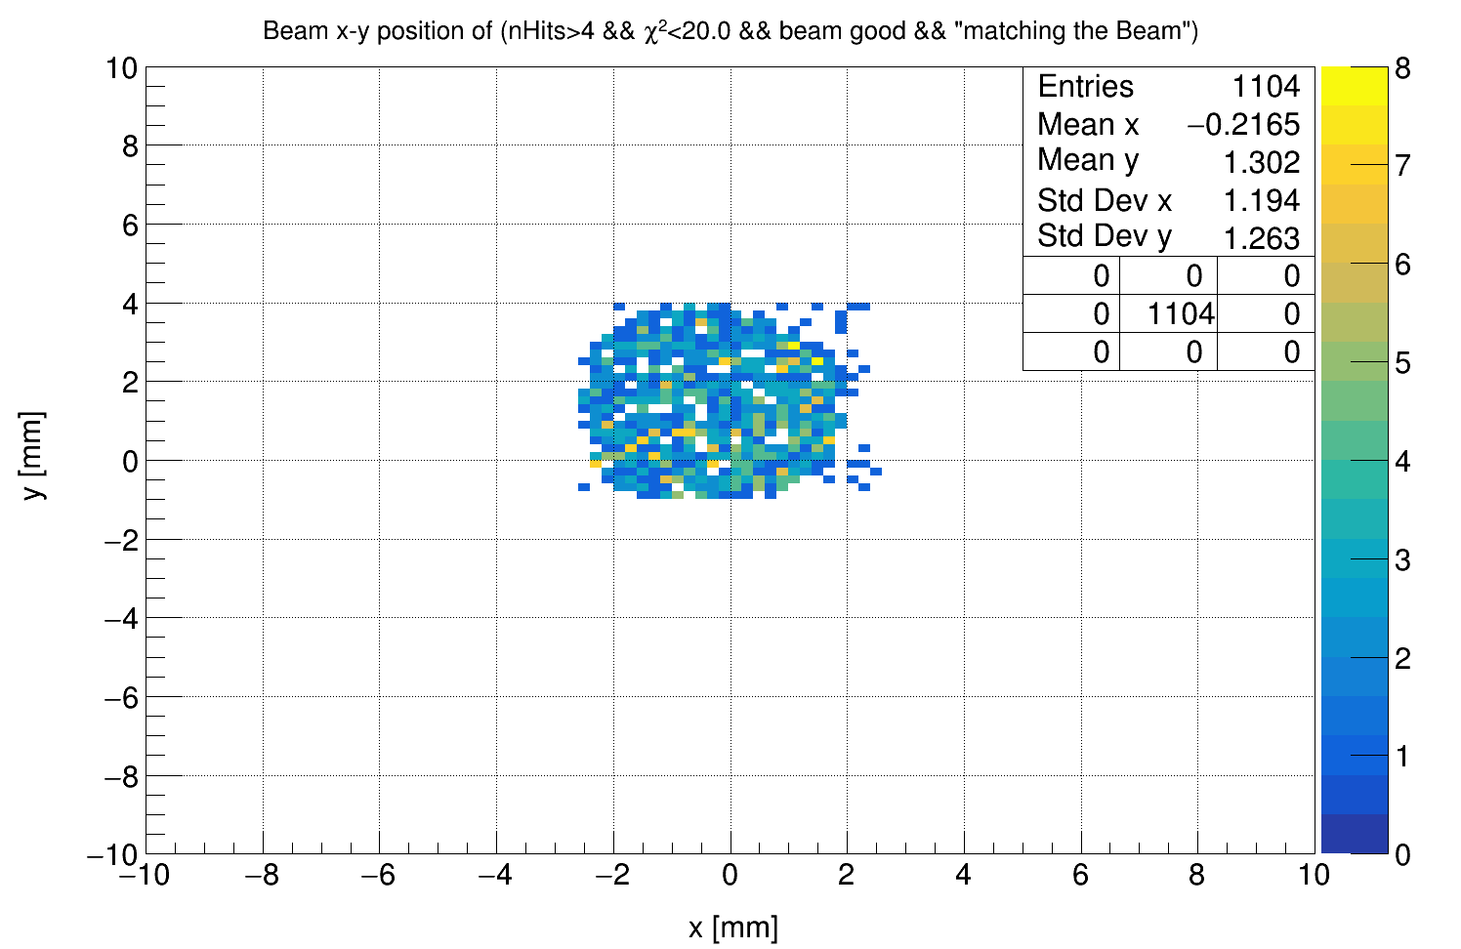

Slide 15
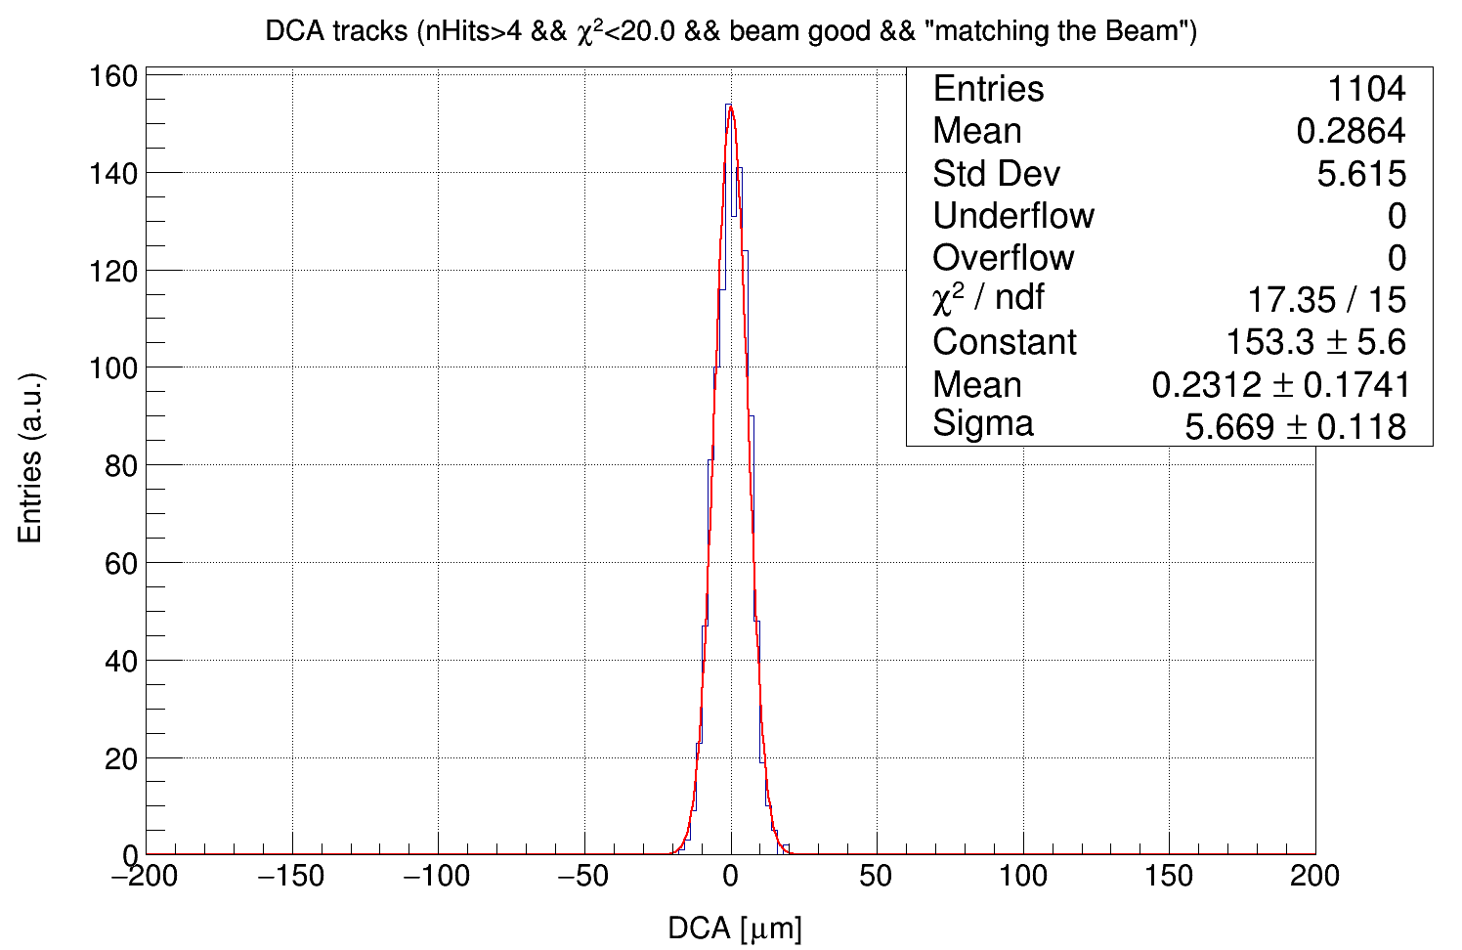
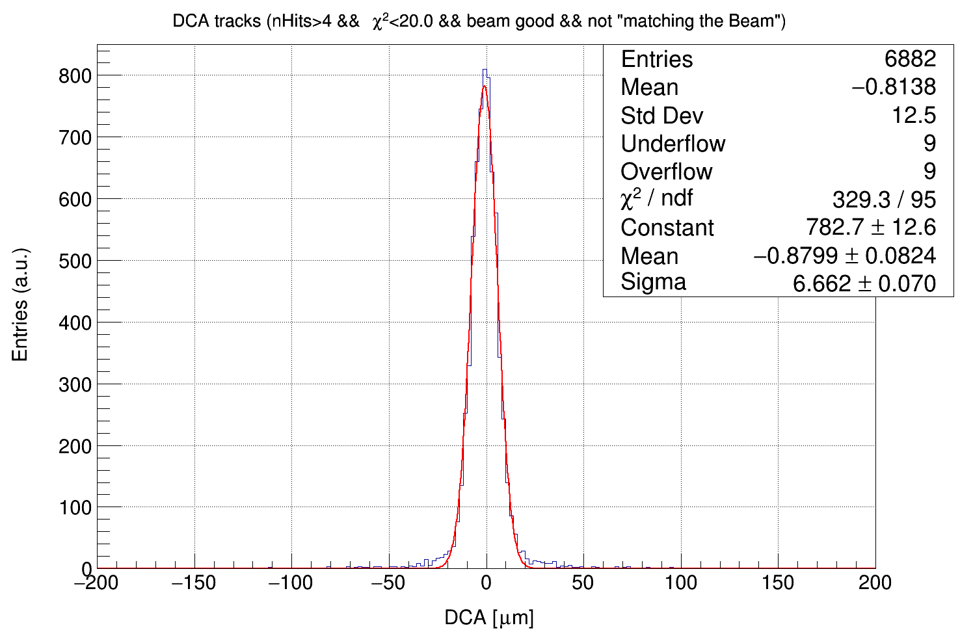
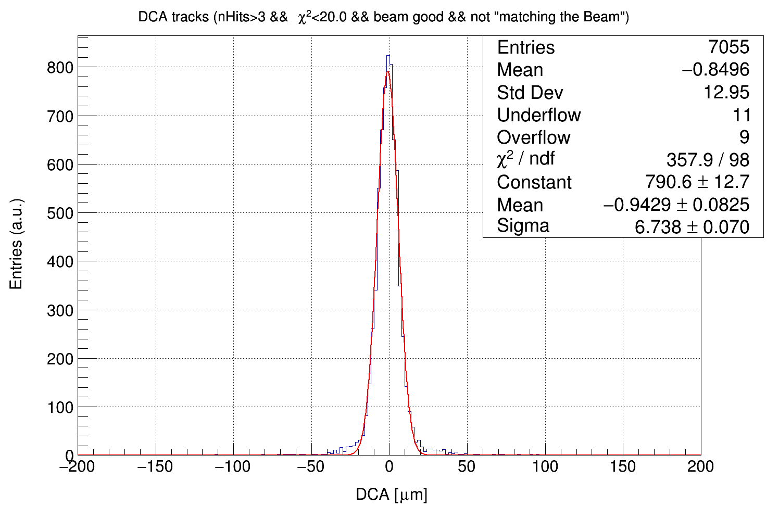

Slide 16
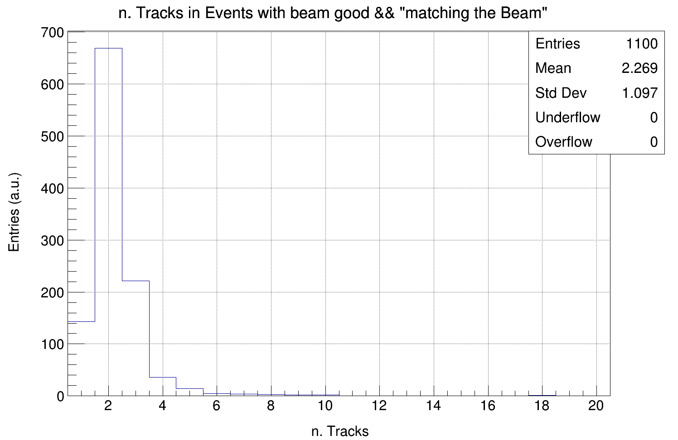
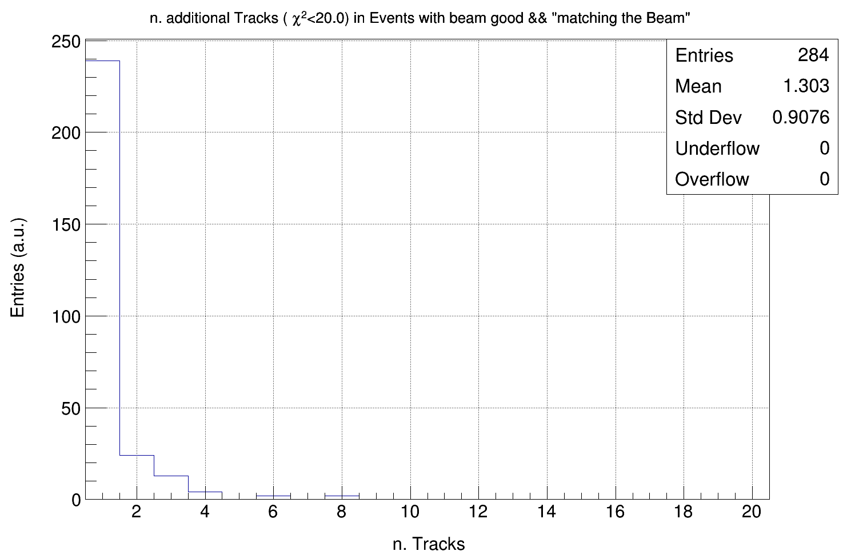
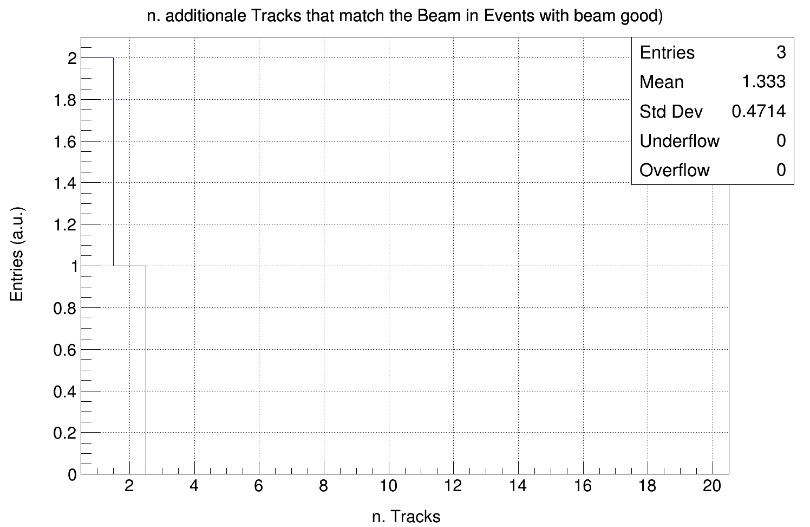
In about 33% of the good events the beam cross all the telescope.
In about 4.3% of the good events the beam cross all the telescope without interacting.

Slide 17
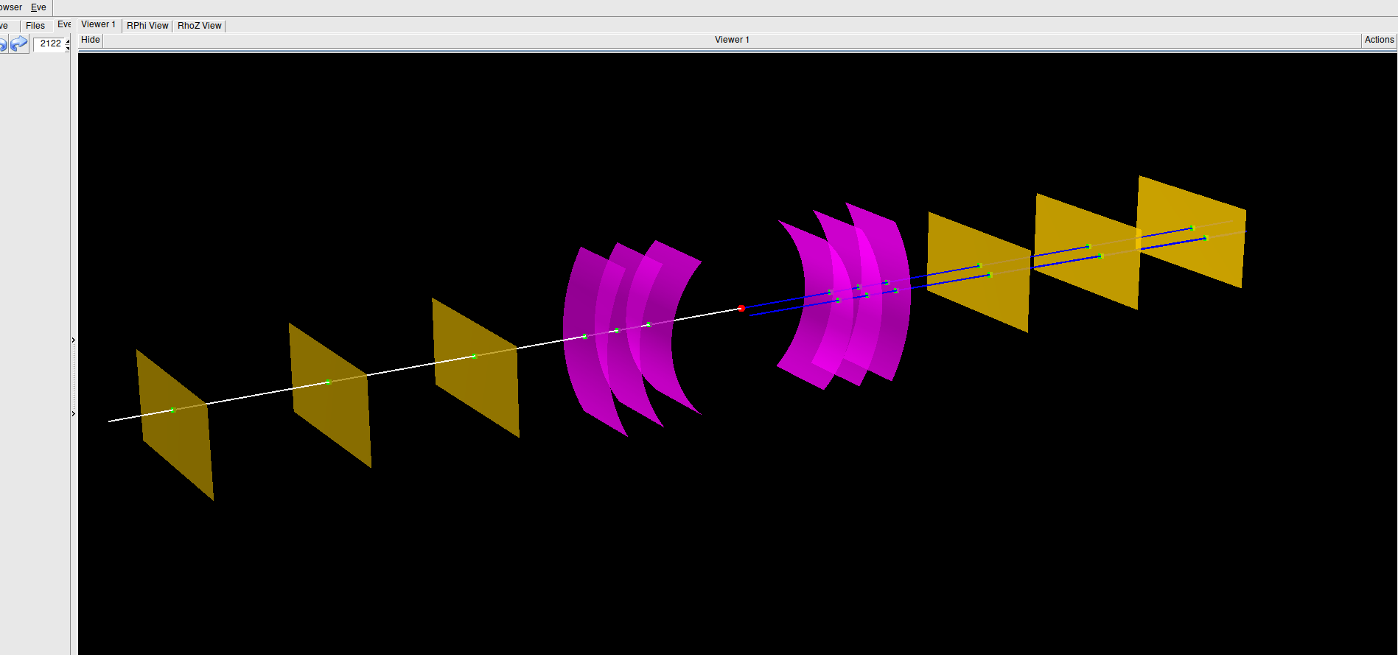
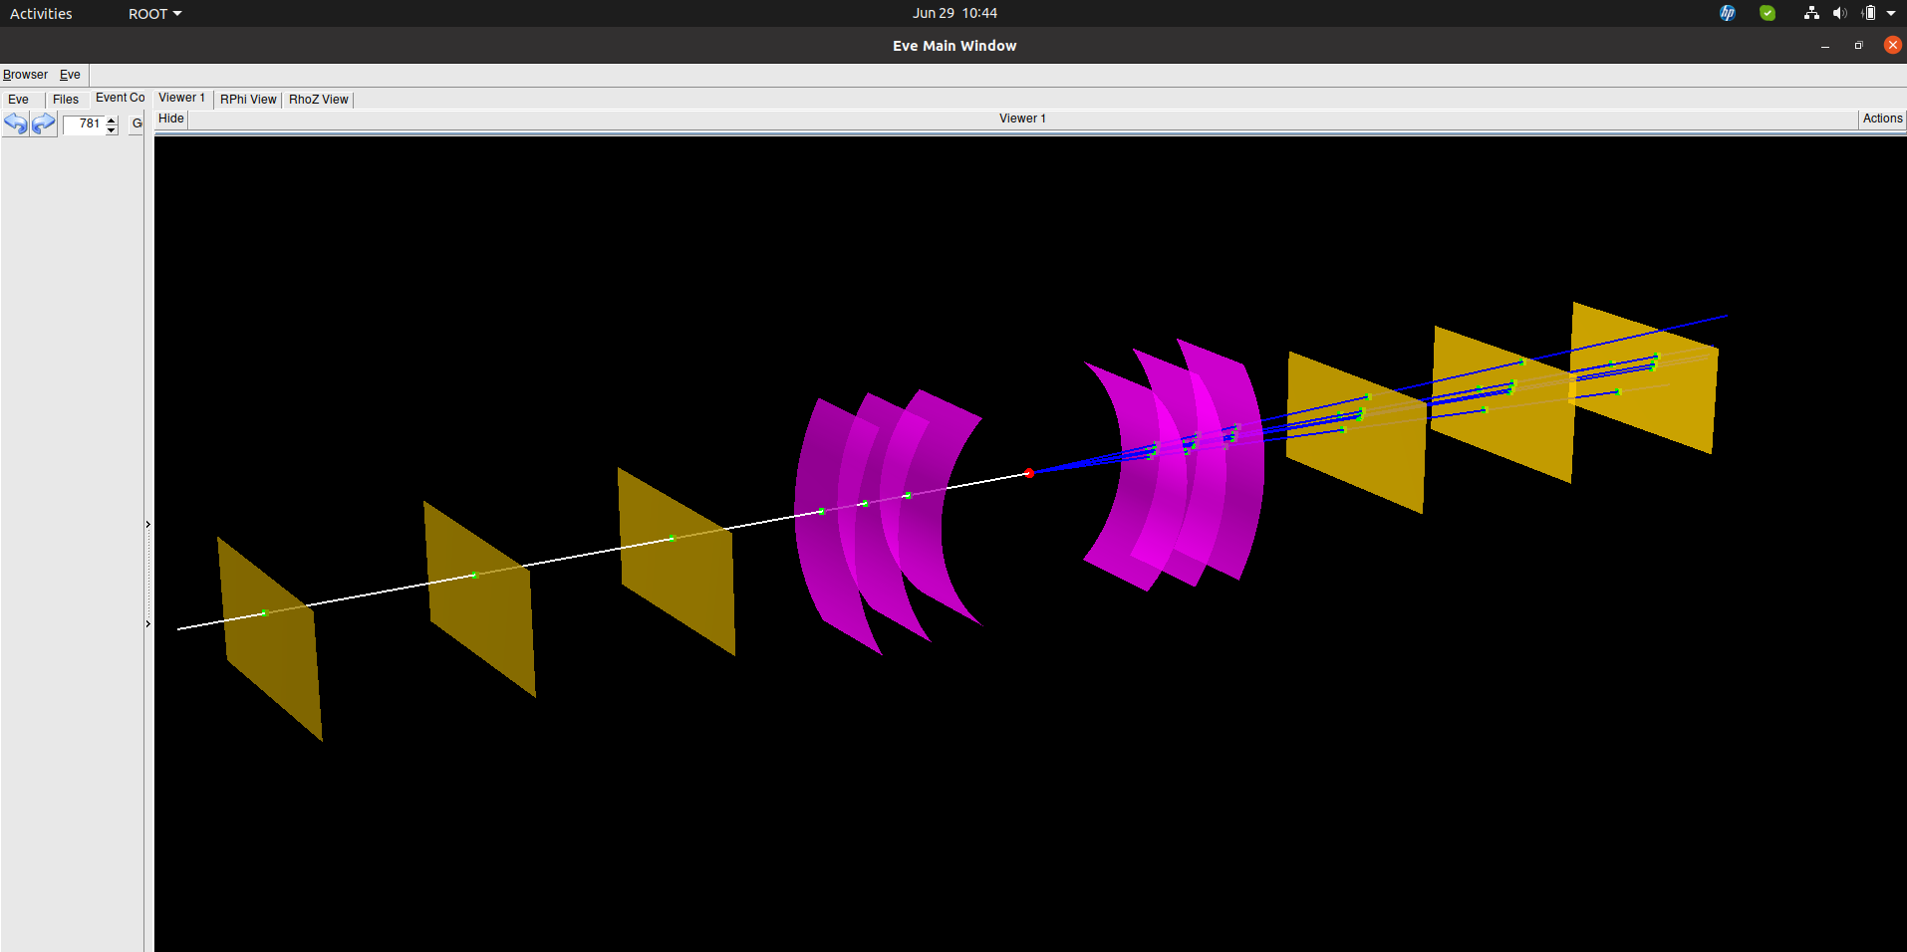

Slide 18
