Slide 1

CSN5 INFN-LNF
C. Vaccarezza Coordinatore LnF
CDL Preventivi july 6th 2023

Slide 2
Outline
CSN5 update
CSN5-LNF overview
New Experiment proposals and Calls
Ongoing experiment report

Slide 3
CSN5 update
14 July
NEW Data base preventivi 2023 open until July 14th Luglio 2023 (23:59)
17 July 2021
Data base assegnazioni (richieste aggiuntive, sblocchi sj) open until July 17th 2023
24–26 July
Next CSN5 meeting: July 24-25-26 2023 at LNF
Highligths: New selection rules for experiment proposals

Slide 4
CSN5 overview 2023
People= 95 (-45%) : Ric. 54 (-44%), Tec. 41( -46 %) FTE= 35.45 (-19 %)
DETECTORS 7
DARTWARS
INTERDISCIPLINARY 3
OLAGS DTZ *
ACCELERATORS 9
ARYA*
PEROV*
RESOLVE*
SINGULARITY*
SL_COMB2FEL*
TUAREG*
SAMADHA*
ENTER_BNCT*
IMPACT_CSN5*
MICRON
PBT
QUB_IT
URANIA_V*
LLMCP*
SAMARA DTZ
RESILIENCE
H2BTF
* CLOSING * EXT. REQUESTED

Slide 5
New proposals for 2024
New proposals con RN @ LNF
CROWN RN A. Marcelli
Extensions:
SAMADHA RL R. Bedogni
New proposal GRANT giovani:
FLYDOS RN A. Calamida
MICROSPEX RN D. Hampai
PEROV_XRAD RN M. Testa
SL_BETATEST RN E. Chiadroni
SPHINX. RN M. Iliescu
ELECSIR RN S. Bilanishvili

Slide 6
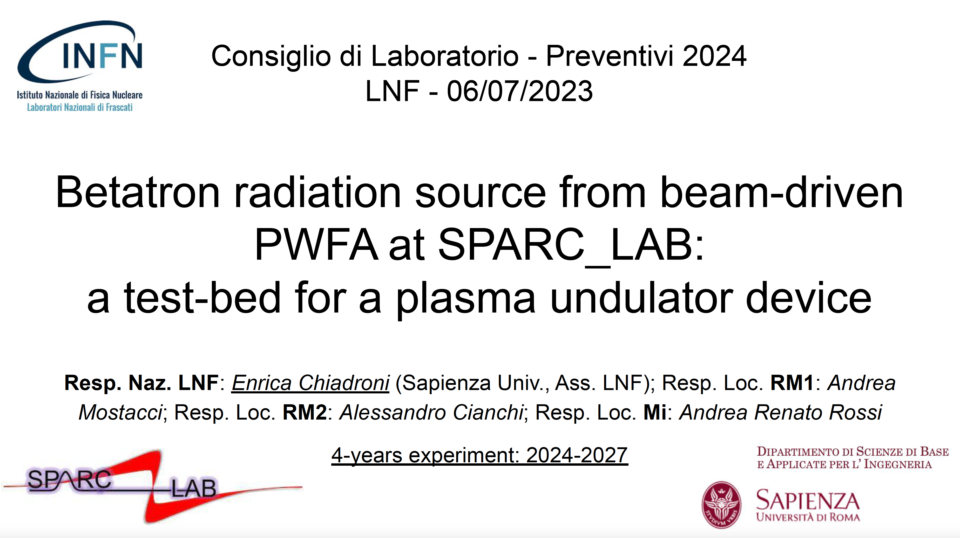

Slide 7
The proposal
This research activity focuses on the emission of betatron radiation from the beam-driven plasma wakefield acceleration at SPARC_LAB [1], as a test-bed for the study and development of a plasma-based undulator device, in the framework of the EuPRAXIA ESFRI facility [2] and EuPRAXIA@SPARC_LAB project [3].
Conventional undulators are still too cumbersome and expensive to meet the requirements of compactness and sustainability.
In this regard, a promising, very compact alternative is represented by the betatron motion of electrons in an ion-channel to emulate an undulator device.
The project aims at the study of the particle-driven PWFA betatron emission as a plasma-based alternative to the FEL, setting the ambitious goal of lasing in short distances paving the way to more compact light sources.
The primary objective is to advance the development of the ICL and establish its feasibility as a transformative technology.
While analytical and numerical investigations have provided an insight into the ICL, the lack of experimental studies poses a significant gap.
Our project aims at filling this gap through experiments at SPARC_LAB, where the proof-of-principle experiment, demonstrating the harmonic oscillation of electrons in a plasma undulator, will be performed.

Slide 8

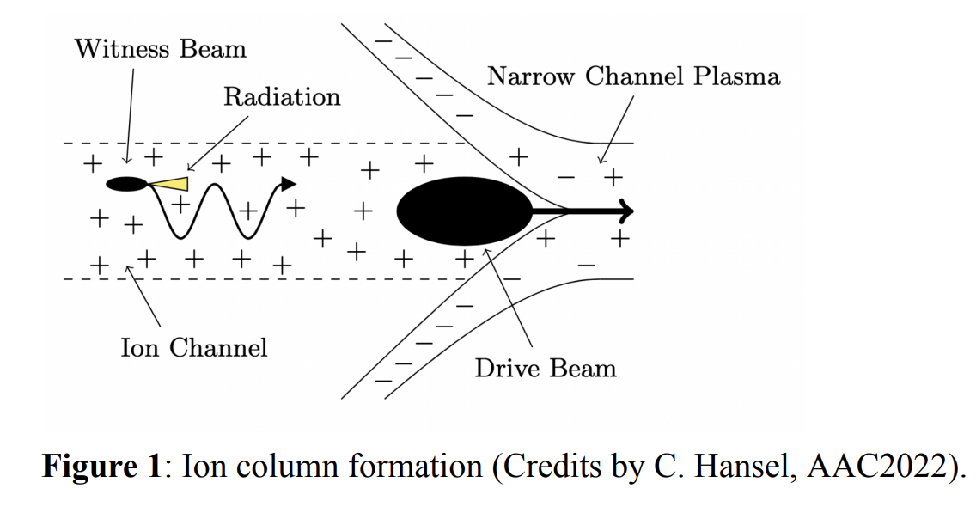
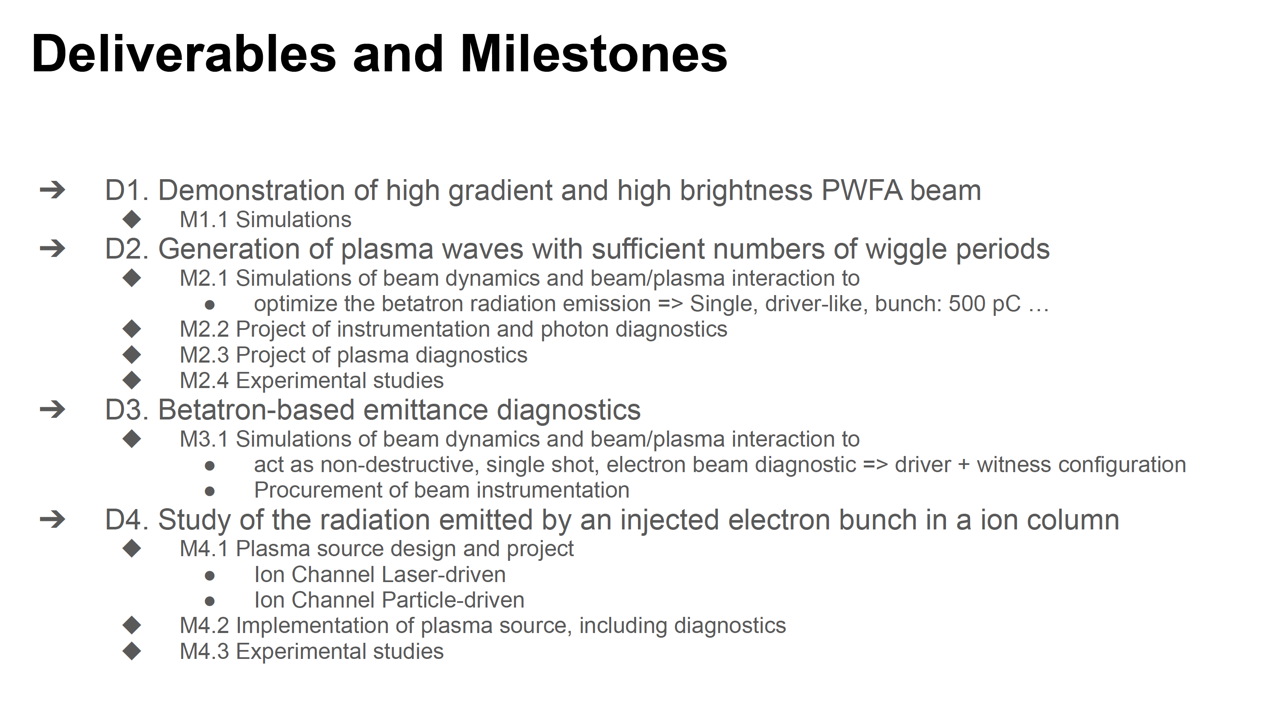
Tot DivAcc Ric. 1.0 – Tec. 1.0
Simulations will be set up to model the physical process and guide the design of the source and the experimental campaign:
● Design and realization of the ion column plasma source: simulations and experimental test to demonstrate the feasibility of a stable ion column able to emulate a compact undulator will be performed in the plasma lab;
● Wakefield studies: based on their potential applications in linearizing the beam's longitudinal phase space and modulating the current profile, numerical and simulation studies will be performed with the aim of designing a prototype;
● Betatron generation, optimization, characterization: based on beam-plasma interaction simulations, the SPARC_LAB working point will be set up to first generate betatron radiation for beam diagnostic purpose

Slide 9

2023 DivAcc ongoing experiments
h2btf, Micron, PBT

Slide 10
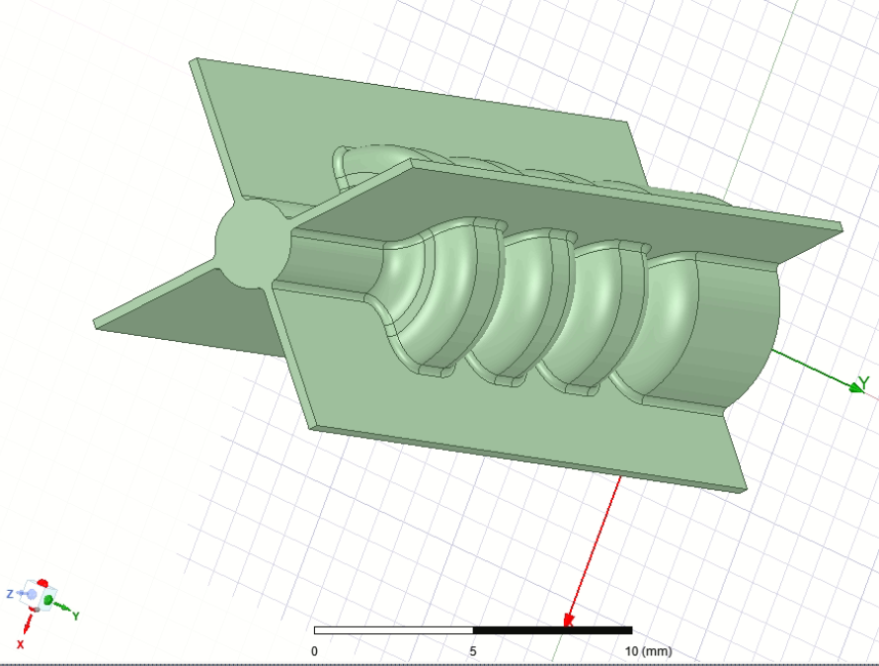
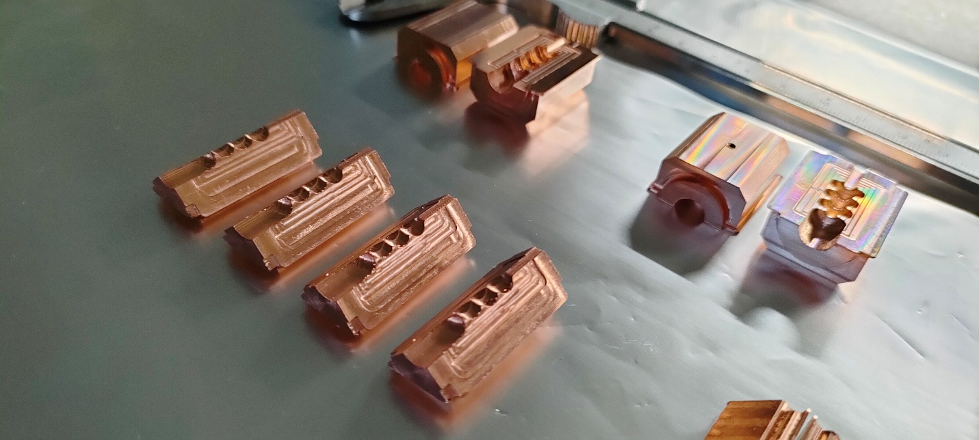
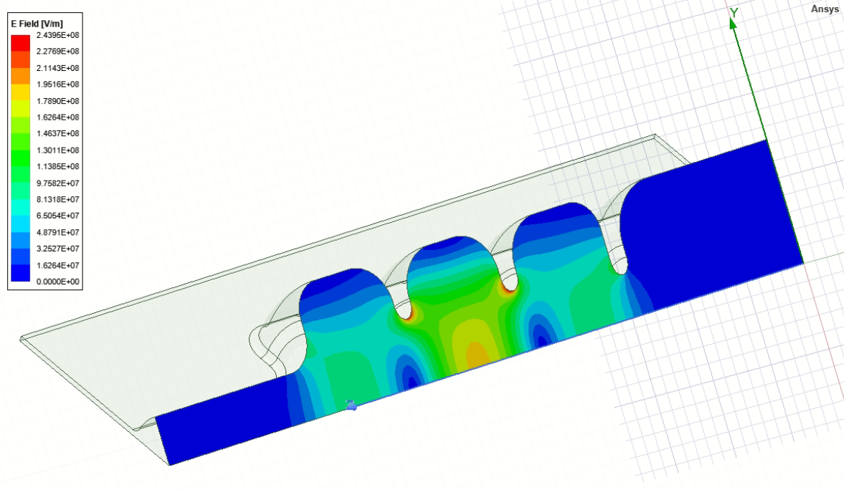
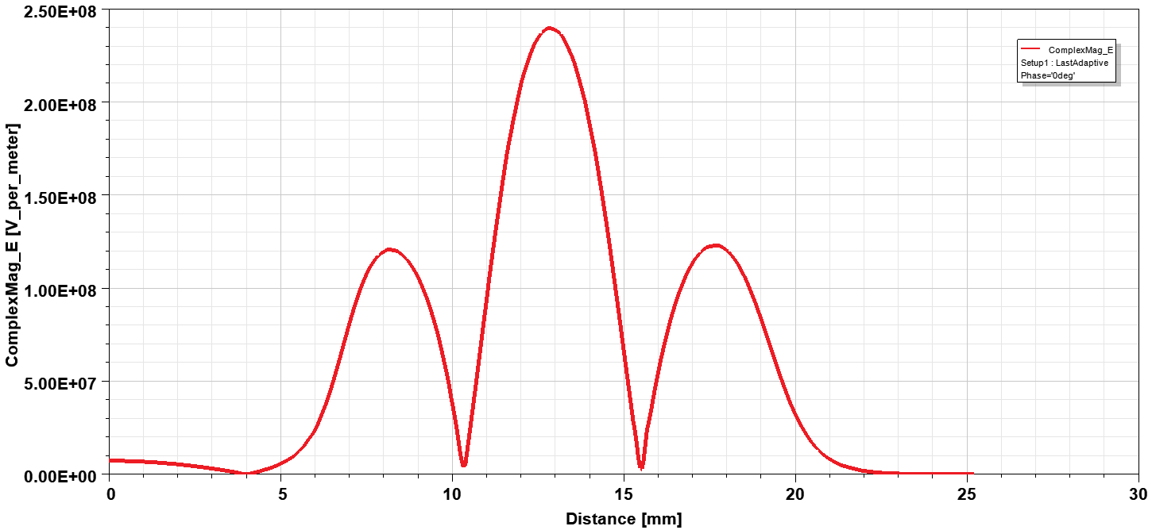
MICRON
Cavity Design, Prototyping and Fabrication – Multiple parts open structures
TIG welding on the outer slots → avoiding high temperature brazing and/or diffusion bonding processes (the typical assembly methods widely used to manufacture ultrahigh vacuum accelerating devices) which - occurring at about 800–1000 °C - significantly change the cavity mechanical properties.
Main RF Parameters
Parameter | Value
Resonant frequency, f [GHz] | 35.982
Quality factor Q | 6000
Shunt impedance [MΩ/m] | 160
Power loss [MW] | 0.75
a [mm] | 2
a/λ | 0.24
t [mm] | 0.635
Iris ellipticity | 1.38
Accelerating Gradient (MV/m) | 150 MV/m
Machined sectors for 2-halves and 4-quadrants Cavities
All cavity sectors were manufactured by using a CNC 5-axis milling machine.
Machining tool is crucial:
Tungsten-carbide tool → Tolerance = +- 10 µm; Roughness with Ra = 1.6 µm.
Diamond tool with spherical radius < 1 µm → Tolerance = +- 5 µm; Roughness with Ra < 80nm.
The electric field in the middle cell is two times higher in the middle cell in order to localize and analyze the RF breakdown events.

Slide 11
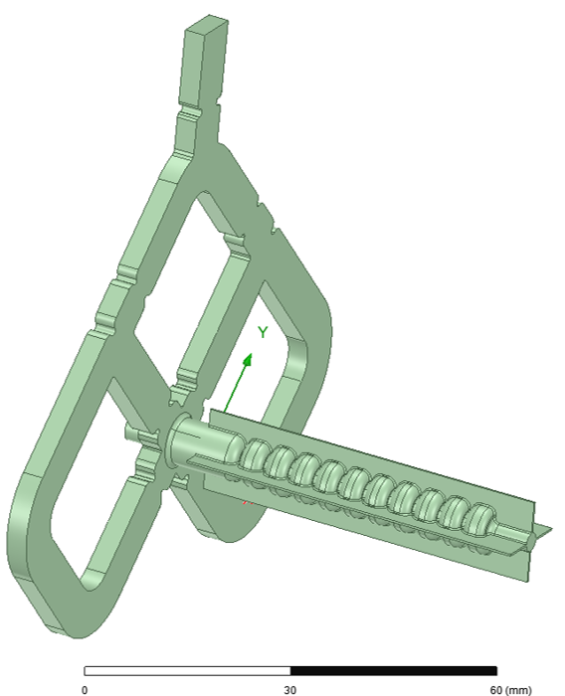
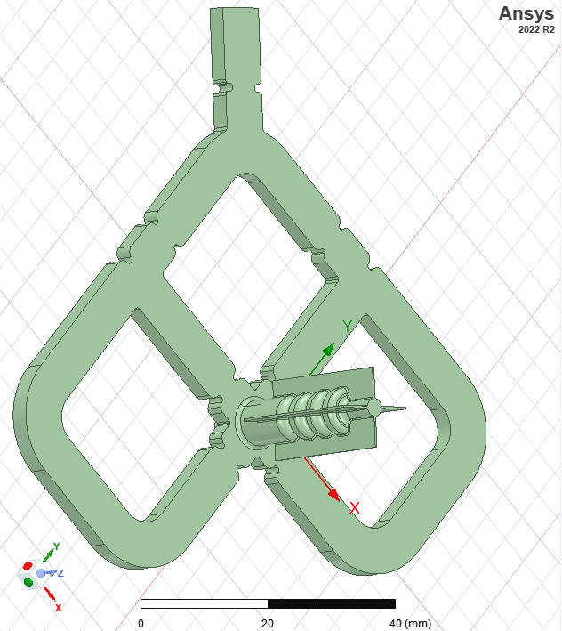
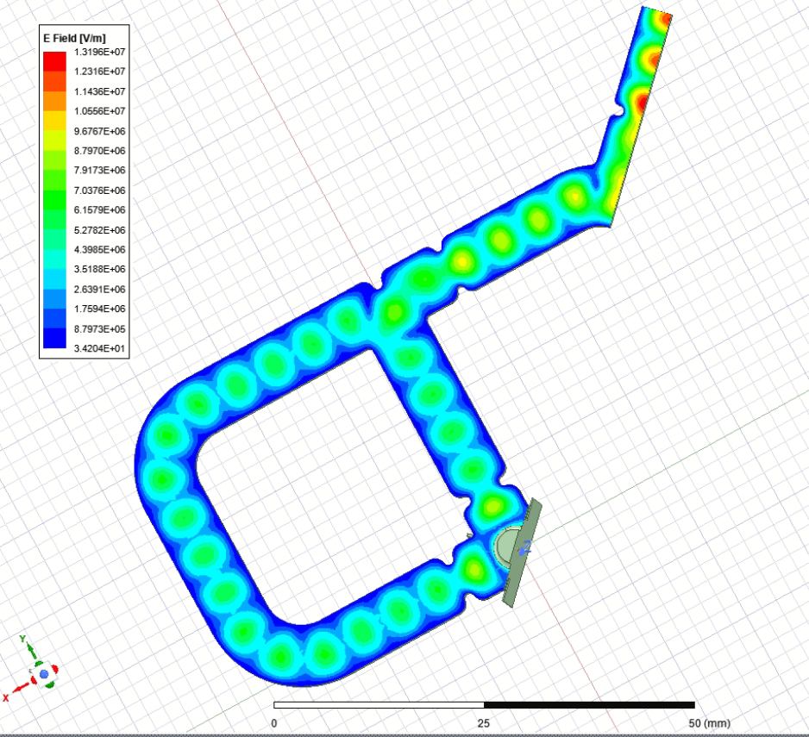
Four-port mode launcher for dipole and quadrupole component cancellation
Ka-Band RF Mode Launcher
Four-port mode launcher with 4-quadrants multicell-cavity
(engineering in-progress)
RF input power
Four-port mode launcher is matched with the resonant Ka-band structure made of four quadrants;
The launcher is optimized with a reflection coefficient at the RF input power port S11 < -40 dB;
Mechanical engineering and executive drawings (in-progress) for the Fabrication and Welding of the multi-cell cavity with mode launcher for low-power RF tests to be conducted during in 2024 @ RF-Lab LATINO, INFN-LNF.
Marco Bellaveglia 10%
Fabio Cardelli 10%
Luigi Faillace (RL) 30%
Alessandro Gallo 10%
Anna Giribono 10%
Claudio Marcelli 10%
Luca Piersanti 10%
Bruno Spataro 0%
Cristina Vaccarezza 15%
Tot: Ric. 0.10 - Tec. 0.95

Slide 12
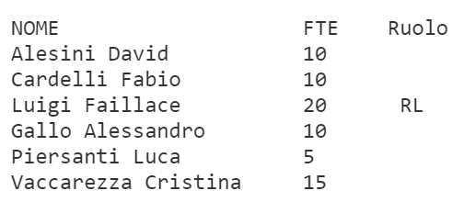
HB2TF (call)
The proposal is related to the development of a High Brightness Beams Test Facility (HB2TF) at the INFN-LASA laboratory. The Test Facility will allow to perform developments in the areas so far illustrated and to carry out experiments with the high current CW electron beam in frontier areas of accelerator physics. The Test Facility setup will comprise a high-performance laser driven DC Gun followed by a normal conducting RF buncher-acceleration section to provide 1 MeV 5 mA CW electron beam
The WP3 of HB2TF is devoted to the design, realization, installation of all the warm radio-frequency systems in the test facility. The core being the two normal-conducting RF, 650 MHz buncher cavities with all the ancillaries required to provide the design bunching and acceleration of the about 1 MeV, 5 mA, CW electron beam and namely: • 80 kW in total, 650 MHz RF power amplifier • Waveguides, circulator, RF load • RF field amplitude and phase control systems
Tot: Tec. 0.75

Slide 13
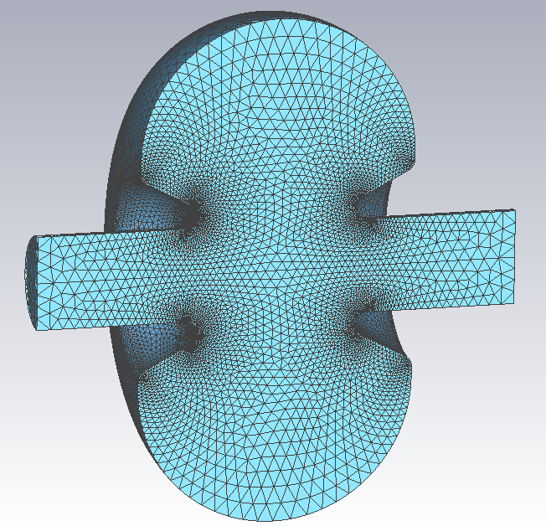
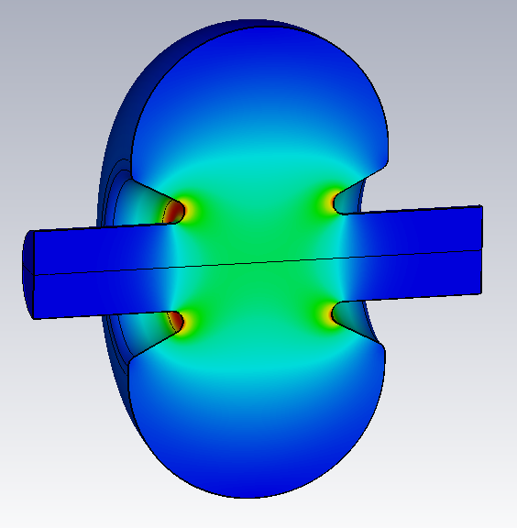
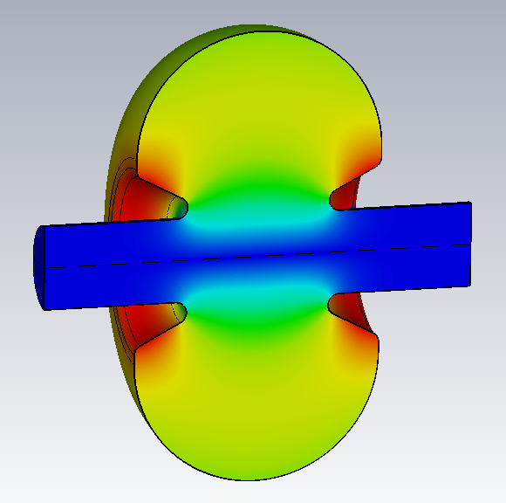
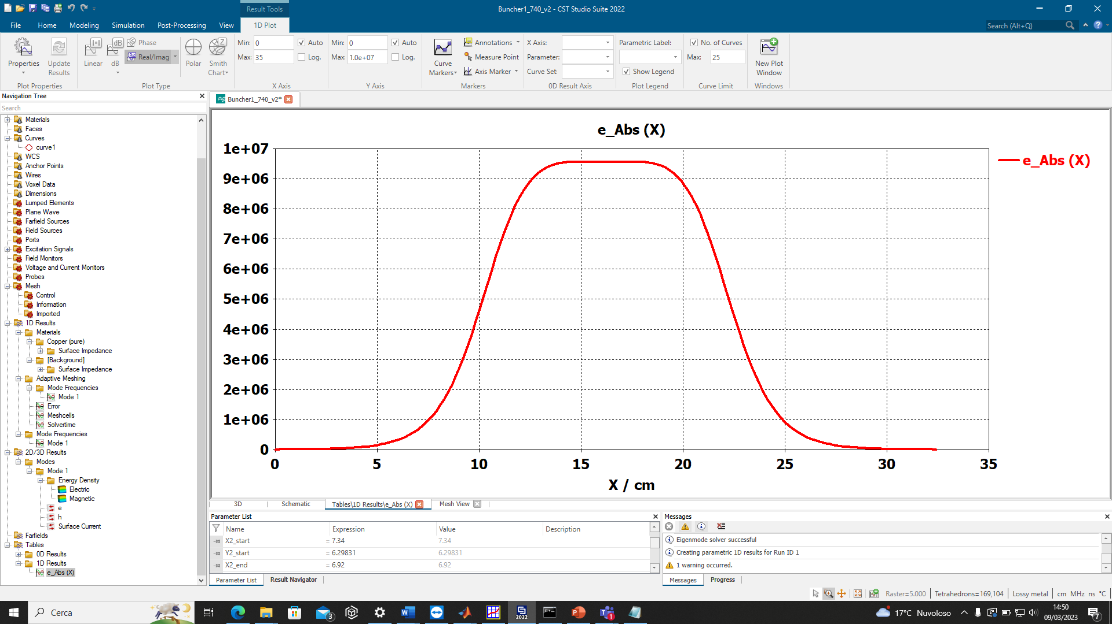
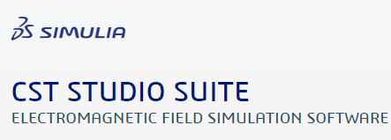
E-field
H-field
g
On-axis E-field (a.u.)
 | SF/Luigi | CST
Frequency | 650.372 MHz | 650.180 MHz
Quality Factor Q₀ | 31,710 | 31,699
Eff. Shunt impedance | 6.209 MOhm | 6.210 MOhm
On-axis E_{peak} | 2.7 MV/m | 2.7 MV/m
E_{peak} | 6.13 MV/m | 6.29 MV/m
H_{peak} | 4.66 kA/m | 4.66 kA/m
P_{RF} | 10.28 kW | 10.26 kW
g ≈ 17cm

Slide 14
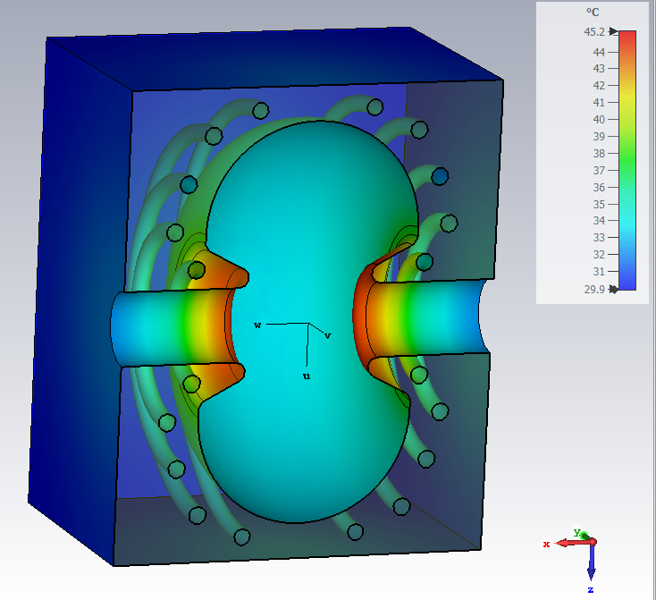
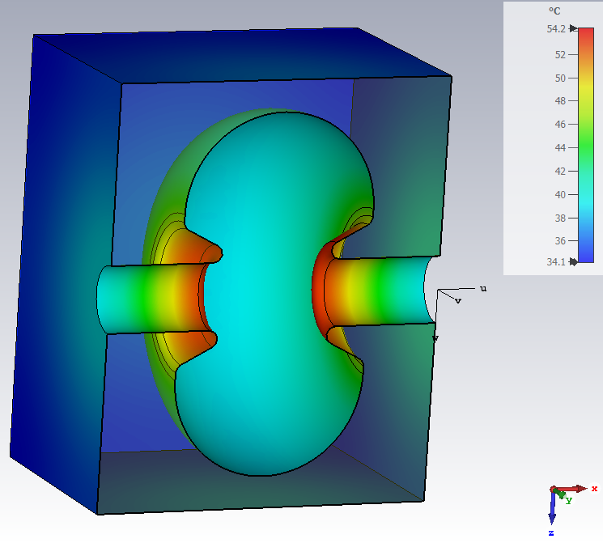
Buncher Machining Options and Preliminary Thermal Analysis
Cavity made of of bulk copper
Possible fabrication in two halves with lathe machine
Two parts are brazed
Cooling channels inserted on outer shell
RF power = 10.3 kW
No cooling, only Ambient
Channel radius = 7.5 mm
Water Temperature = 30 C
Water flux = 10 l/min

Slide 15
Plasma by TeraHertz (PbT)
Activity Report 2022
Plasma by Terahertz (PbT) project proposes an R&D activity through a collaboration of TERA- Lab at the Department of Physics, INFN Sezione Roma1, and SPARC_LAB LNF-INFN, for the development of an innovative diagnostic approach for the plasma density detection based on the exploitation of plasma optical criticality as measured by Terahertz radiation (1 THz corresponds to a wavelength of 300 μm and to an energy 4 meV).
This innovative technique will be used for measuring the properties of the plasma generated at SPARC_LAB and it is particular important in view of the EUPRAXIA facility that will be developed at LNF-INFN.
Time schedule
Pompili R. | Ric | 10%
Del Dotto A. | Ric | 10%
Costa G. | Tec | 30%
Biagioni A. | Tec | 40%
Anania MP | Ric | 10%
Tot Ric. 0.3 – Tec. 0.70
LNF
Roma1

Slide 16
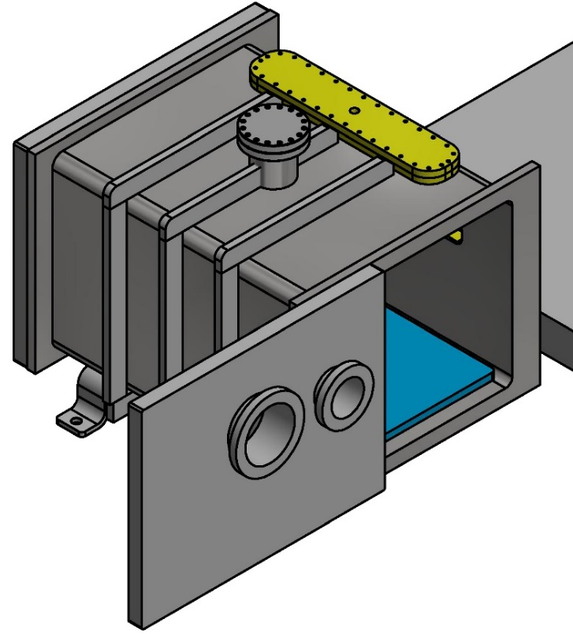

WP2 (LNF UNIT) – Design/building of a dedicated multidiagnostic chamber
Neutral gas injection
Flanges for two
Plasma sources
Optical table
Large Window
80 cm
50 cm
50 cm
THz detector It
Fiber coupled
THz emitter
Femtosecond laser
Windows
Sliding
door
THz detector Ir
THz emitter
HV source
The chamber design is ready, 10 weeks for producing it
Sliding doors
Two different settings for capillaries
5 windows for diagnostics (THz and conventional Stark broadening method)
Plasma formation by electrical discharges (Plasma source and HV electrical source are implemented and tested)
Pumping
System

Slide 17
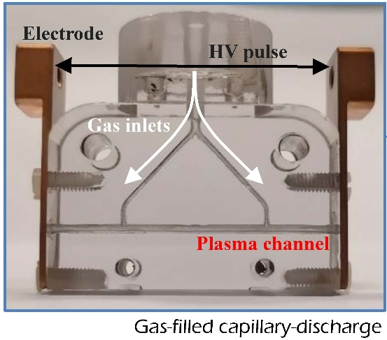
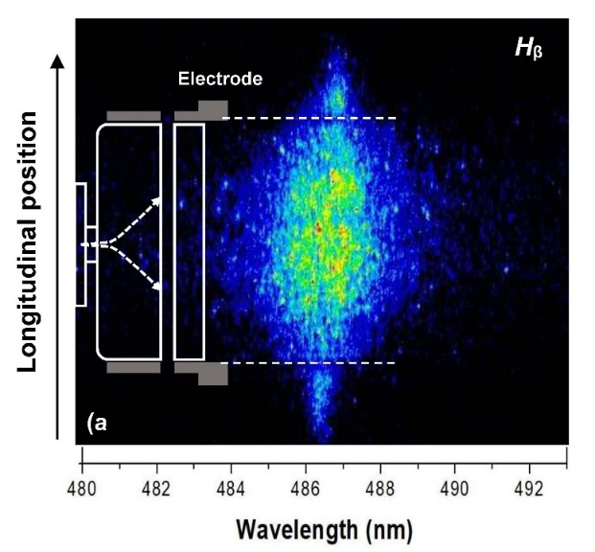

WP2 (LNF UNIT) – Design/building of a dedicated multidiagnostic chamber
The plasma sources used to implement a diagnostic system based on THz radiation are represented by gas-filled discharge capillaries, where the plasma will be formed by means of HV electrical discharge.
Plasma diagnostics. Hβ Balmer spectral line centered at 486.1 nm acquired by the ICCD camera (a) and corresponding plasma longitudinal profile (b) obtained by measuring the line width along the longitudinal coordinate.

Slide 18

THANKS FOR YOUR ATTENTION
z
z
z

