Slide 1
From CREMLINplus to EURIZON
Mikhail Zobov for WP4 Team
Riunione dei Resp. di Servizio e Progetto della DA
18 Giugno 2023

Slide 2
CREMLINplus at LNF (before 24 February 2022)
WP5 (LNF, Bari, Ferrara, Lecce)
Super Charm Tau Factory
Detector
DR
CREMLINplus
DA
Accelerator
USSR
WP4 (LNF)
1120 kEuro allocated for INFN, LNF – 400 kEuro

Slide 3
EURIZON
(Formally started on 4 April 2022, but the Grant Agreement Amendment was approved only on 28 March 2023)
WP4 - Synchrotrons: Collaboration with X-ray light sources in Europe (ESRF, DESY, Eurpean XFEL, INFN)
WP5 - Lepton Colliders: Joint technology development around future lepton colliders (CERN, JLU, CNRS, INFN)
1120 kEuro allocated for INFN, LNF – 400 kEuro

Slide 4
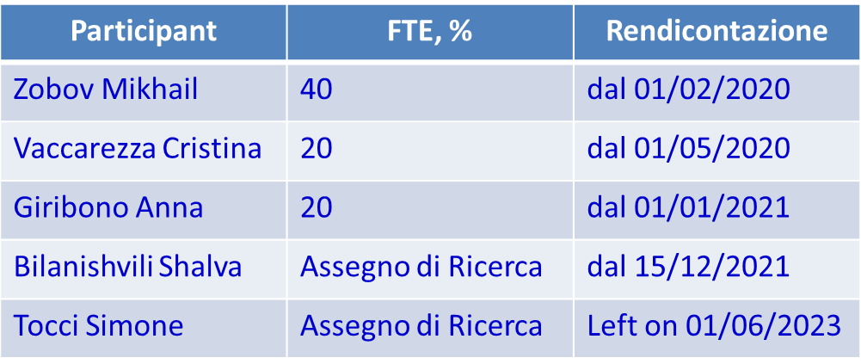
Task 4.3: Vacuum chamber impedances and beam instabilities
(DESY, INFN, Resp. Mikhail Zobov)
Task 4.4: Linac development
(DESY, EuFEL, INFN, Resp. Cristina Vaccarezza)
LNF Participants
With continuous help of David Alesini

Slide 5
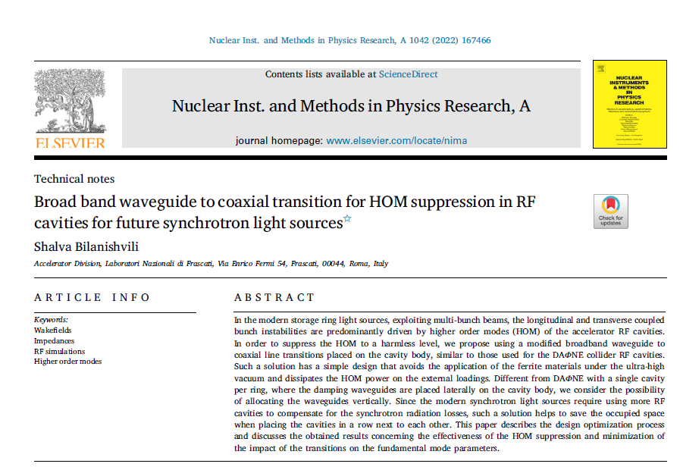
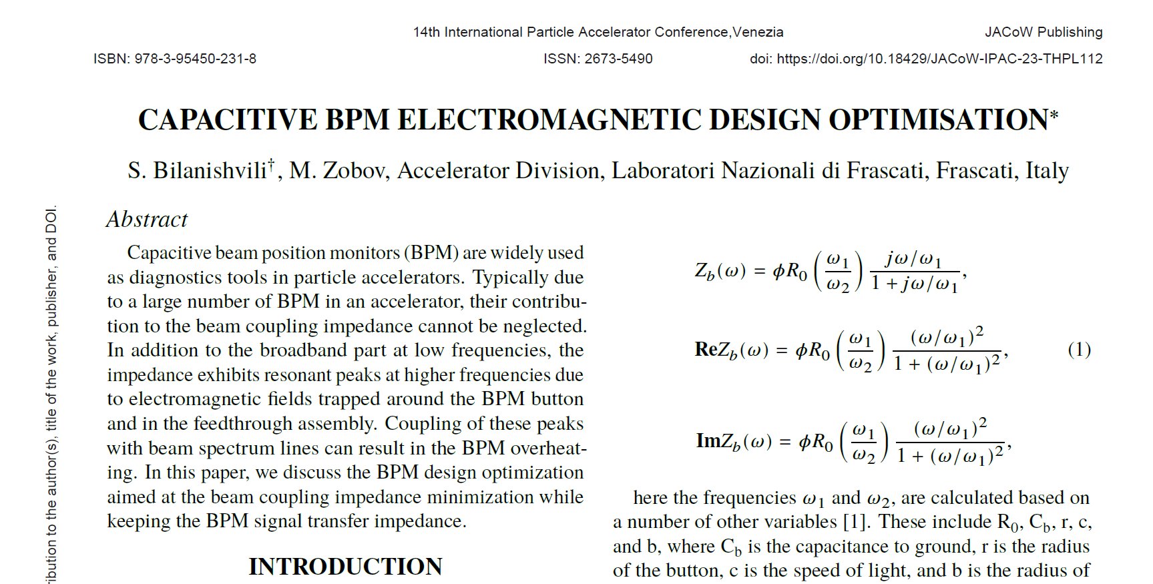
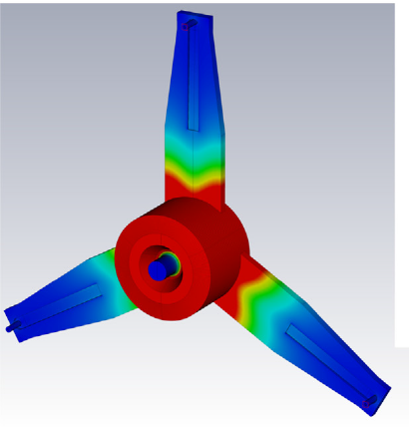
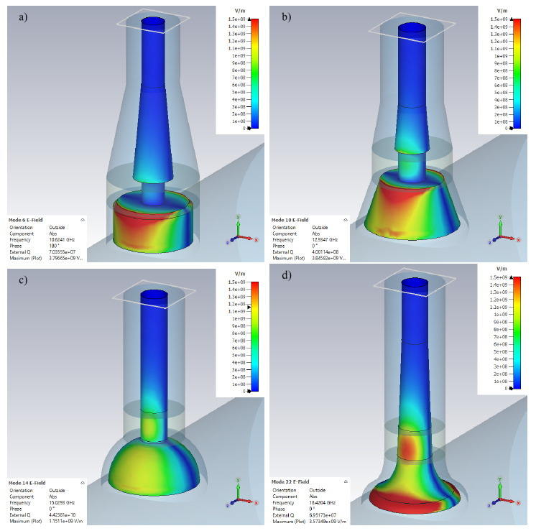
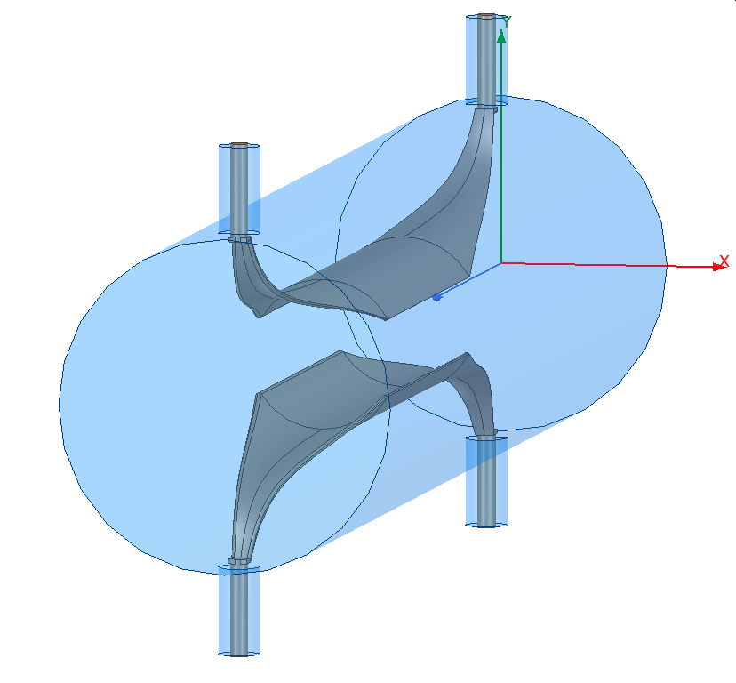
Some Results of Task 4.3
IPAC 2023 paper accepted in J. of Physics Conference Series
Devices with optimized beam coupling impedance

Slide 6
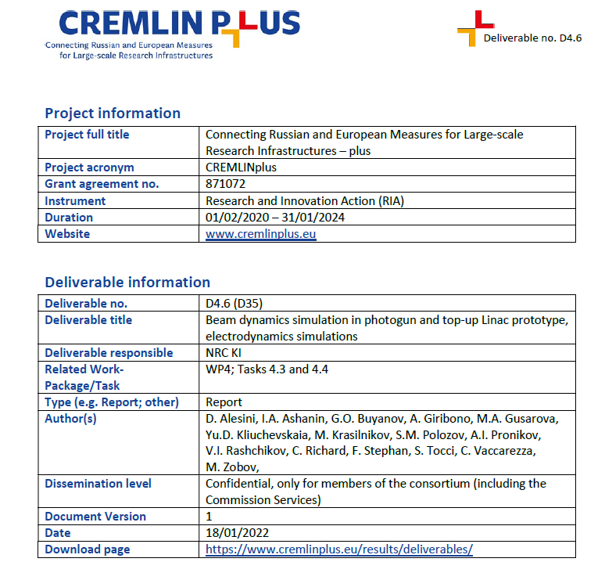
Task 4.4 Accepted Deliverables and Milestones
31 May 2023

Slide 7
Presently Considered Linac Layout
Presented by Cristina Vaccarezza at the EURIZON Annual Meeting 2023, 9-10 February 2023, Darmstadt, Germany

Slide 8
Deliverables to be prepared by the end of the Project
(1 February 2024)
D4.18 : Scientific report on collective effect studies and design solutions for low impedance vacuum chamber components in modern synchrotron light sources [M48, Task 4.3. INFN, DESY)]
D4.19 : Study report on a compact 6GeV high-brightness Linac (C-band) for top-up injection in storage rings and FEL applications [M46, Task 4.4. INFN, DESY, EuXFEL]
D4.20 : Report from the workshop at DESY [M48, Task 4.4,
EuXFEL, DESY, INFN ]

