Slide 1
STATUS OF THE LEGAL ISSUE AND NEW RESEARCH CONTRACT
The final agreement between EGS and IFIN to stop the legal dispute has been signed (June 2023) and submitted to the Court. The final decision is expected 8/8/23.
The agreement concludes the previous contract with the refunding of the penalties and stamp tax (∼10 MEuro).
We are now working on the new implementation contract that has to follow some general rules and is called “research contract”. Together with Florin Negoita we had the possibility to look at this typology of contract few weeks ago and there are several things to be well clarified to clearly understood what are the boundary conditions but, up to now, here few important points:
  The new research contract is only between Public Institutions
  In the contract we will insert few deliverables (4-5) that will be followed, after a report, to payment/reimbursement from IFIN to INFN (missions/equipment, etc...)
  Since the research contract is only between Public Institutions, we (INFN) will take care of the relationships with Amplitude and Scandinova for their services, costs and implementations
  It is a research contract w/o penalties, tribunals etc... but we have still to go into all the details...
  We think that a similar contract of this type, and related to the implementation of the laser transport line, should be also signed between IFIN and CNRS.
The project is oriented to implement a radioactive beam facility, instead of a Compton source with two phases. The first phase considers a lower performance demonstrator (single bunch instead of multi bunch, 10 Hz instead of 100 Hz,…) concluded by February 2026 with a proof of principle experiment;
The new machine will integrate all the component already delivered for phase I with some modifications (waveguide configuration, laser clean room, control system,… and will be installed in the original building but in a different position also for the technical rooms, ect.
The same experimental hall will host also another linac (VEGA machine).

Slide 2
SCHEMATIC LAYOUT AND BEAM PARAMETERS
K1
K2
K3
K4
The first phase considers a lower performance demonstrator (single bunch instead of multi bunch, 10 Hz instead of 100 Hz,…) to be provided by a common EGS-IFIN effort within the end of 2025 (1st experiment February 2026)
The phase I machine will integrate all the components already delivered for stage I with some modifications related to the waveguide configuration, laser clean room, control room, to adapt the machine to the new configuration.
50 MW, 10 Hz
S BAND
C BAND
S BAND STRUCTURES
C BAND STRUCTURE
GUN
Parameter | Phase 1
N Bunch/pulse | 1
Repetition frequency | 10 Hz
Charge per bunch | 100 pC
Average current | 1 nA
Max beam energy | 100 MeV
Total beam power | 0.1 W
Gun Gradient | 80-100 MV/m
S band accelerating gradient | 20 MV/m
C Band accelerating gradient | 25 MV/m
experiment
M1
M2
M3
M4
Laser transport line
M4A
laser
266 nm, 10 Hz, 100uJ

Slide 3
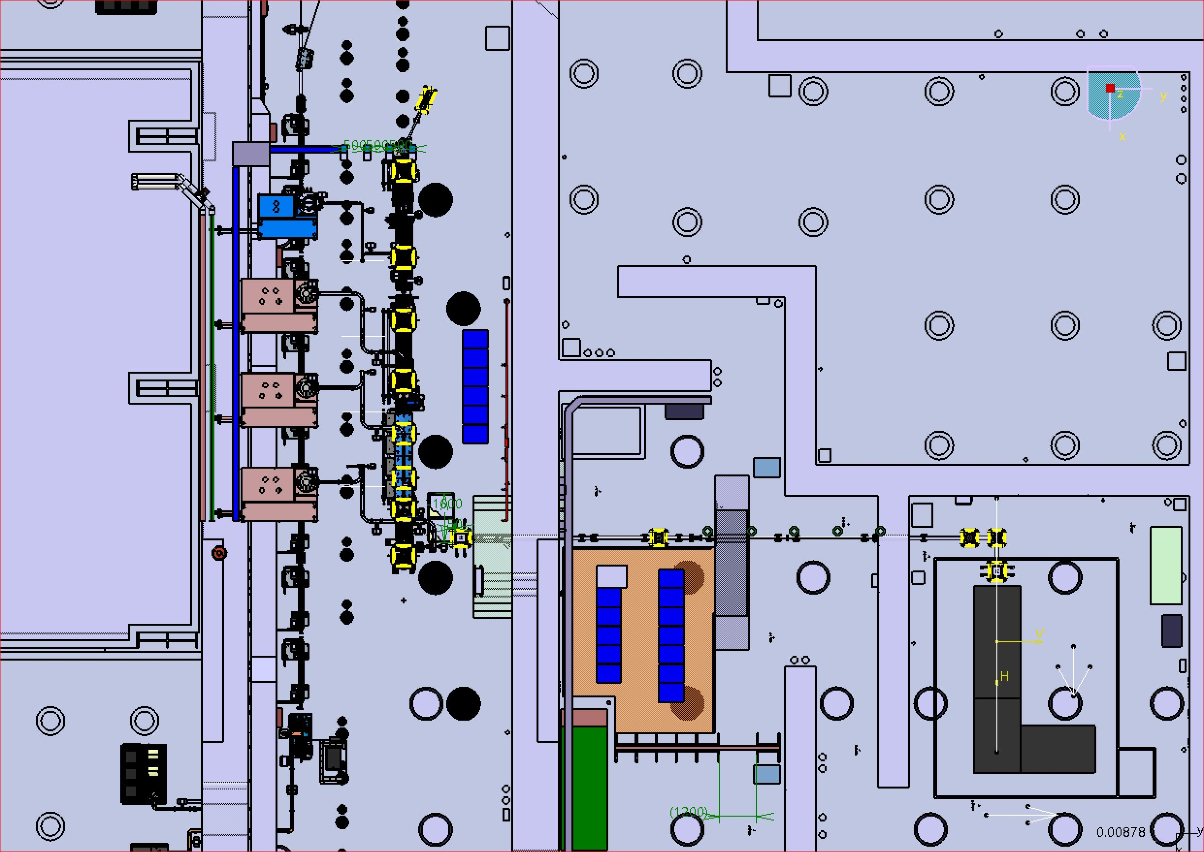
PLANT OF THE NEW FACILITY
The LINAC will be installed in AB1 in parallel with the VEGA linac
The Laser and laser clean room in the ANNEX
Control room on the ANNEX
Modulator and Klystron on the roof
Racks on the roof and ground floor
Cooling plant in the basement

Slide 4
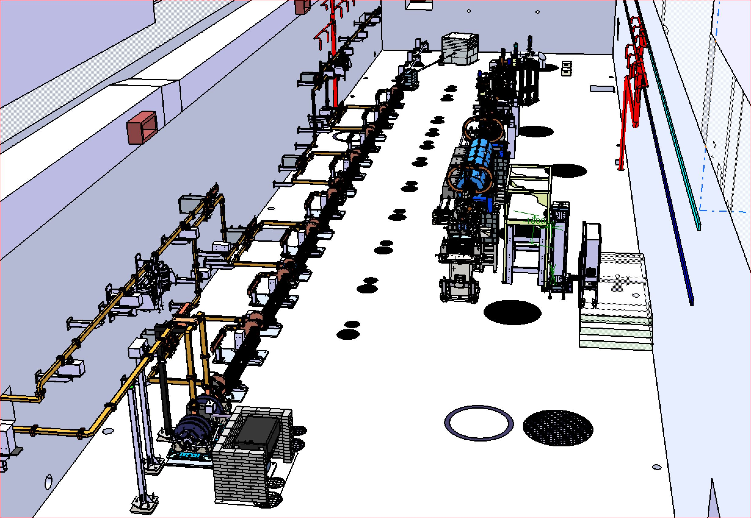
3D OF THE NEW FACILITY (1/2)
EGS LINAC
The 3D layout of the new machine is in a very good progress (95% defined)
VEGA LINAC

Slide 5
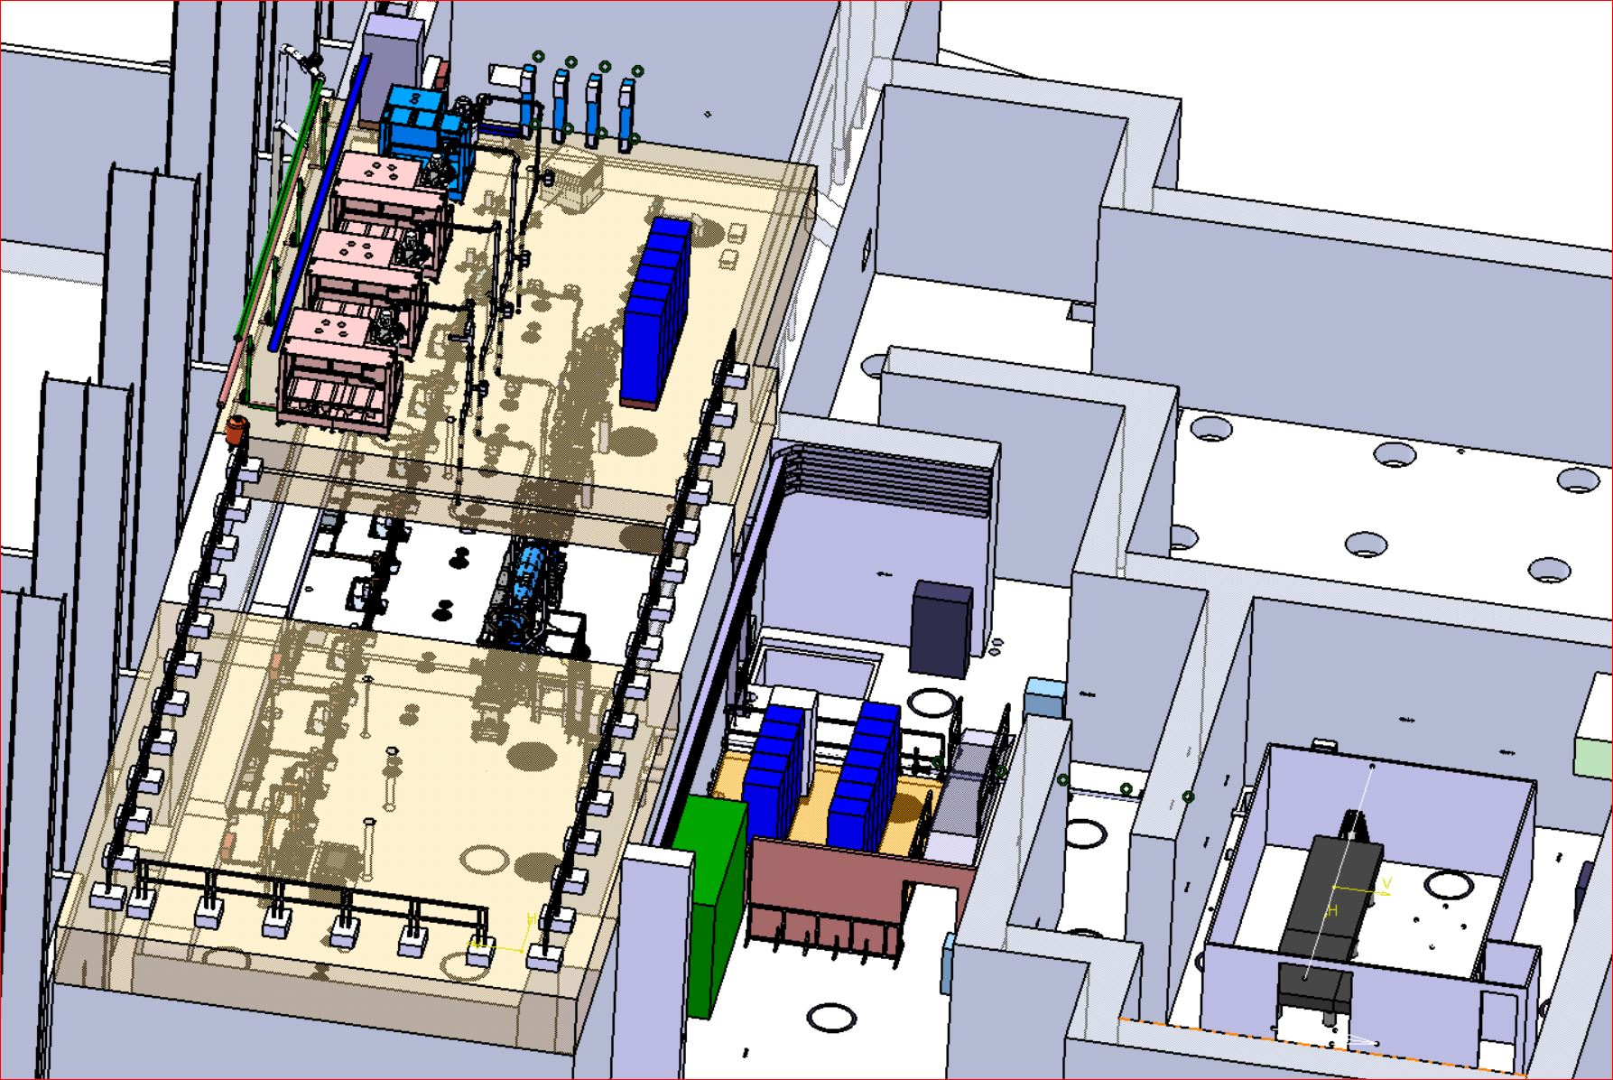
3D OF THE NEW FACILITY (2/2)
EGS LINAC
MODULATORS AND KLYSTRON
RACK ROOM (GROUND FLOOR)
LASER TRANSPORT
RACK ROOM (ROOF)
LASER
LASER CLEAN ROOM
VEGA LINAC

Slide 6
NEW IMPLEMENTATION ELI-NP: ORGANIZATION
PROJECT COORDINATION
D. Alesini
LASER
F.Falcoz (AMPLITUDE)
OPTICAL LINES F.Zomer, K. Dupraz
(CNRS)
RF SOURCES M.Lindholm
(SCANDINOVA)
RF DISTRIBUTION F.Cardelli
(LNF)
DIAGNOSTICS G. Franzini
(LNF)
CONTROLS & MPS
S.Pioli
(LNF)
VACUUM
A. Liedl
(LNF)
RF & SYNCRO L.Piersanti
(LNF)
LAYOUT & ALIGNMENT
E.Di Pasquale
(LNF)
MAGNETS & POWER SUPPLIES
A.Vannozzi
(LNF)
BEAM DYNAMICS L. Faillace
(LNF)
SAFETY
S. Vescovi
(LNF)
Activities under IFIN responsibility
ELECTRICAL PLANTS
G. Catuscelli, R.Ricci
(LNF)
COOLING AND VENTILATION
P. Tuscano, S. Cantarella, U Rotundo
(LNF)

Slide 7
IMPLEMENTATION PLAN: BUILDING WORKS

Slide 8
IMPLEMENTATION PLAN: SYSTEM MODIFICATIONS AND PURCHASING

Slide 9
IMPLEMENTATION PLAN: INTEGRATION ACTIVITIES LINAC
Contratto Polacchi/Eurosystem con nostra supervisione
Contratto Polacchi con nostra supervisione

Slide 10
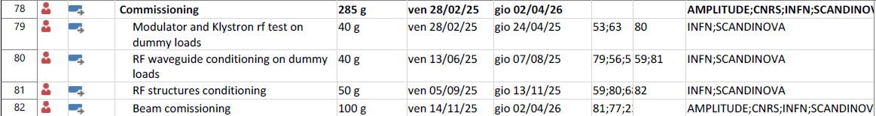
IMPLEMENTATION PLAN: COMMISSIONING

Slide 11
COSA ABBIAMO FATTO NEGLI ULTIMI MESI
Definizione piano di implementazione con tutti i partners (INFN, CNRS, SCANDINOVA, AMPLITUDE, IFIN): piano definito e condiviso
Definizione di tutto il layout (moduli, guide, etc…): layout concluso salvo piccolo correzioni
Test dei component a Magurele 20-24 Marzo e 27-29 Marzo:
    LRF&Synch, Vuoto, rete Allineamento (D. Alesini, A. Liedl, L. Piersanti, S. Tocci, E. Di Pasquale, R. Mascio)
    Modulatori e klystron (Scandinova)
    Linea trasporto laser (CNRS)
CONCLUSIONI: buono stato di tutti i component e sistemi, abbiamo n.1 klystron S band che ha problemi di vuoto
DA FARE:
    test alimentatori magneti, sto organizzando con A. Vannozzi la spedizione ai LNF di tutti gli alimentatori (23-26 Luglio) per effettuare test a LNF (da concludere a Settembre)
    test Sistema di controllo: S. Pioli (in accordo con IFIN) verificherà il costo di un upgrade delle macchine ormai obsolete
    test diagnostica: libera, Motion Box (da reperire), G. Franzini
Iterazione con IFIN per le specifiche degli impianti di potenza/elettrico (R. Ricci, G. Catuscelli) e a Fluido (P. Tuscano, S. Cantrarella): specifiche fornite e congelate
Lista di tutti i cavi fornita a IFIN (contributo di tutti i WPs): per poter consentire a IFIN di avviare procedure di gara
Tracciamento fori su soffitto e pavimento per consentire lavori di rifacimento substrato: E. Di Pasquale, M. Paris, F. Putino (8-10/7/23)
In progress: definizione del layout dettagliato di tutti i racks (S. Pioli), cablaggi CNRS, risoluzione questione Amplitude su fornitura cavità laser multi-pacchetto, layout periscopio laser ingresso gun, da affrontare in parallelo questione stoccaggio a STFC

