Slide 1
The Importance and Role of Serendipity
(in Instrumentation Innovation)
3rd EPS-TIG Hands-on Workshop, Montenegro, July 7, 2023
Markus.Nordberg@cern.ch

Slide 2
IdeaSquare
The Innovation Space at CERN
IdeaSquare is the innovation space at CERN, that uses collaborative methodologies, access to CERN expertise and cross-connectivity to ideate solutions for the future of humankind. A place where people have the licence to dream.

Slide 3

Why focus on Serendipity?
Serendipity is present in (fundamental) scientific research
Its power is recognized among scientists but seldom publicly acknowledged
It is fuzzy (and fun!)
It has value (for someone)
It can have unintended consequences (hopefully good)
It’s outcome is not (necessarily) pre-determined
As demonstrated by history of science and innovation, it can have major societal impact
Source: Soundcloud.com

Slide 4
So what is Serendipity?
Serendipity comes in many shapes and forms. Examples:
Finding something good without looking for it
Finding something good/useful while looking for something totally different
Ending up with something totally undesirable which by making it even worse turns into something useful
Accidentally stumling into something wonderful/useful
Accidentally/randomly stumbling into the solution (e.g. of a pre-defined problem)
Accidentally/randomly stumbling into the solution of a wrong problem
Unexpected, pleasant surprise (to a customer)
Typically, serendipity is a (fuzzy) process that results in new idea(s)
Source: Soundcloud.com

Slide 5

What does it take to come up with good ideas??
Right «state of mind»
«Right» question
«Right» place
«Right» time
«Right» people
«Right» luck
«Right» material

Slide 6
More definitions on Serendipity
Source: Wareham et al (2022)

Slide 7
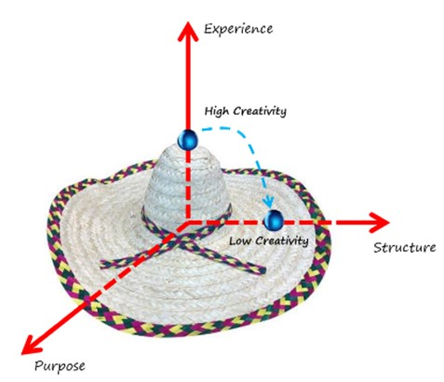
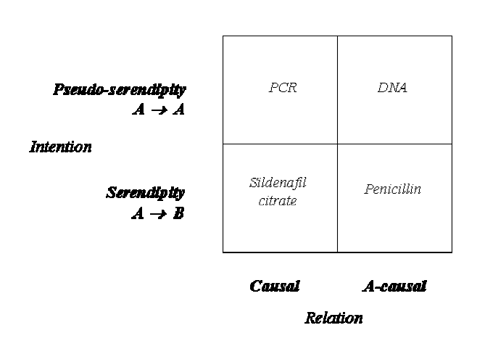
Systematizing Serendipity?
Source: de Rond (2014)
Source: CIJ (2023)

Slide 8
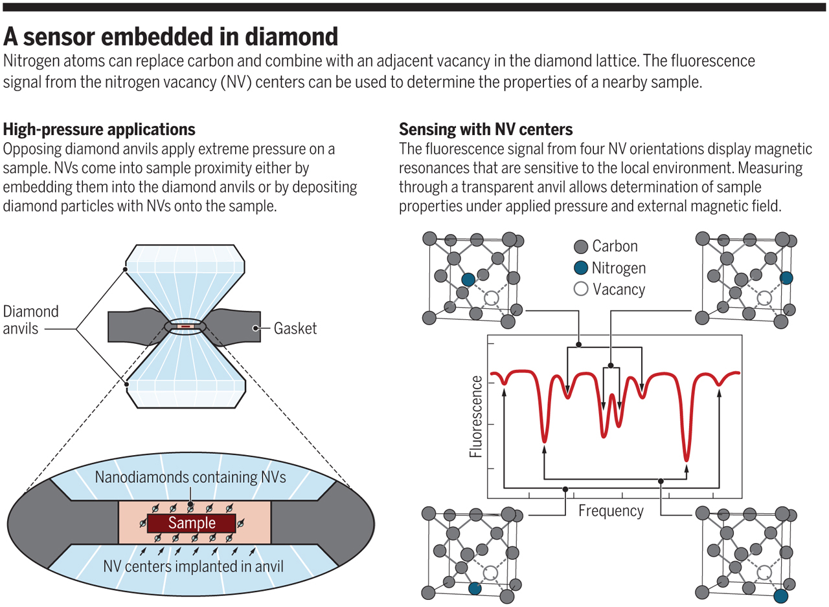
Example: How to Build (first time) a Quantum-effect magnetic sensor based on NV?
Necessary steps to plan ahead and then execute:
Why would I build a QE sensor based on NV- centers implanted in a diamond??
What do I expect to “see” (measure)? What not?
How does it work? (physical properties of NV- centers; optical pumping and read-out in the visible spectrum; quantum object behavior)
What does it do? What not (and why not)??
How to assemble the light source, Q-sensors, optical spectrometers, computer, software)?
How to test the set-up and the sensor (to be sure it works correctly)?
How to run the set-up?
What else could one do with this??
Figure: Science. See also e.g. here.

Slide 9

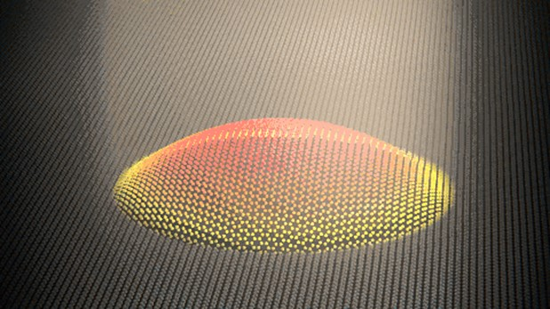

Example: How else could you use Graphene Optical Modulator (GMOD) Displays?
GMODs are developed in ATTRACT to create color displays with great contrast in bright environments, thus enabling ultra-high resolution while significantly reducing the average power consumption for e.g. portable devices
Graphene modulators are MOEMS, mechanical micro-membranes that physically move inside an optical cavity when applying a voltage difference between the graphene and the mirror-like layer at the bottom of the optical cavity
Opposite use: applying a pressure on the membrane (pixel) creates a voltage difference which can ne measured (sensed)
Thought: use this for artificial limbs with haptic (sensing) feedback?

Slide 10

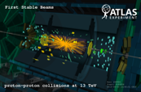


Detector R&D
Projects
Technology
MSc-Level Student Programs (e.g. CBI)
Initially undefined/open
Product
Process
Focus

Slide 11
