Slide 1
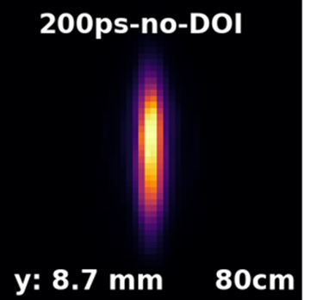
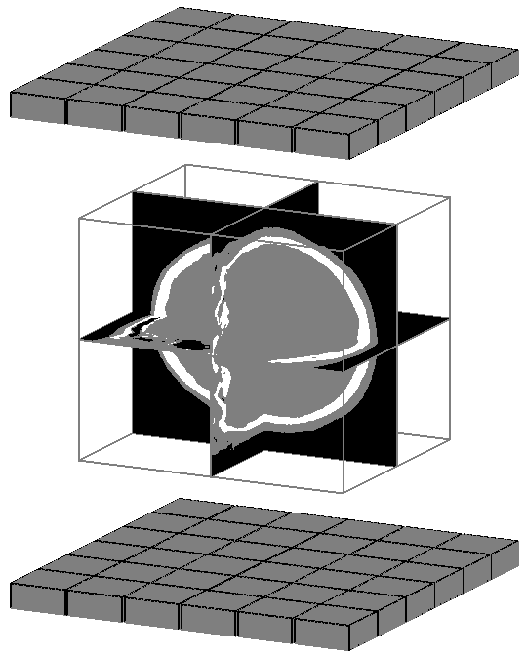
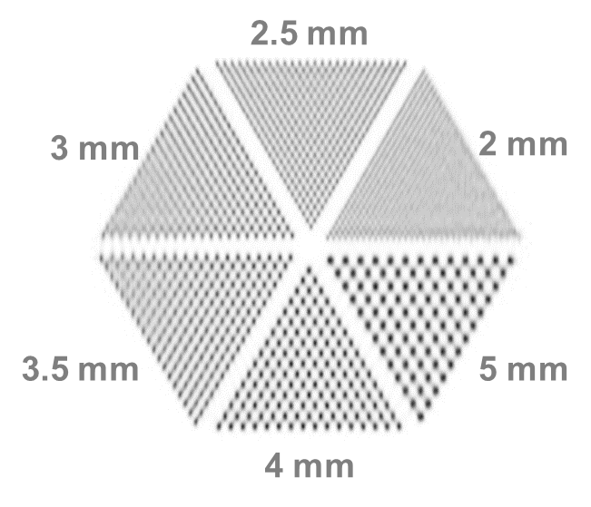
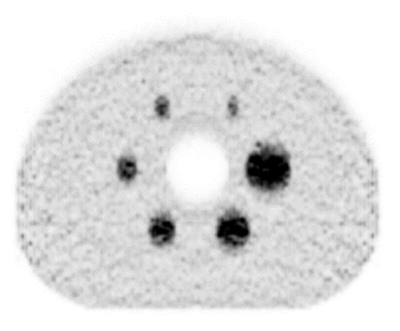
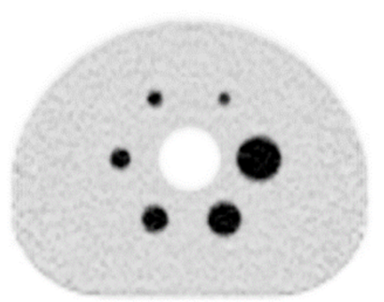
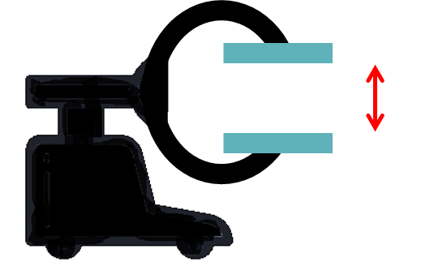
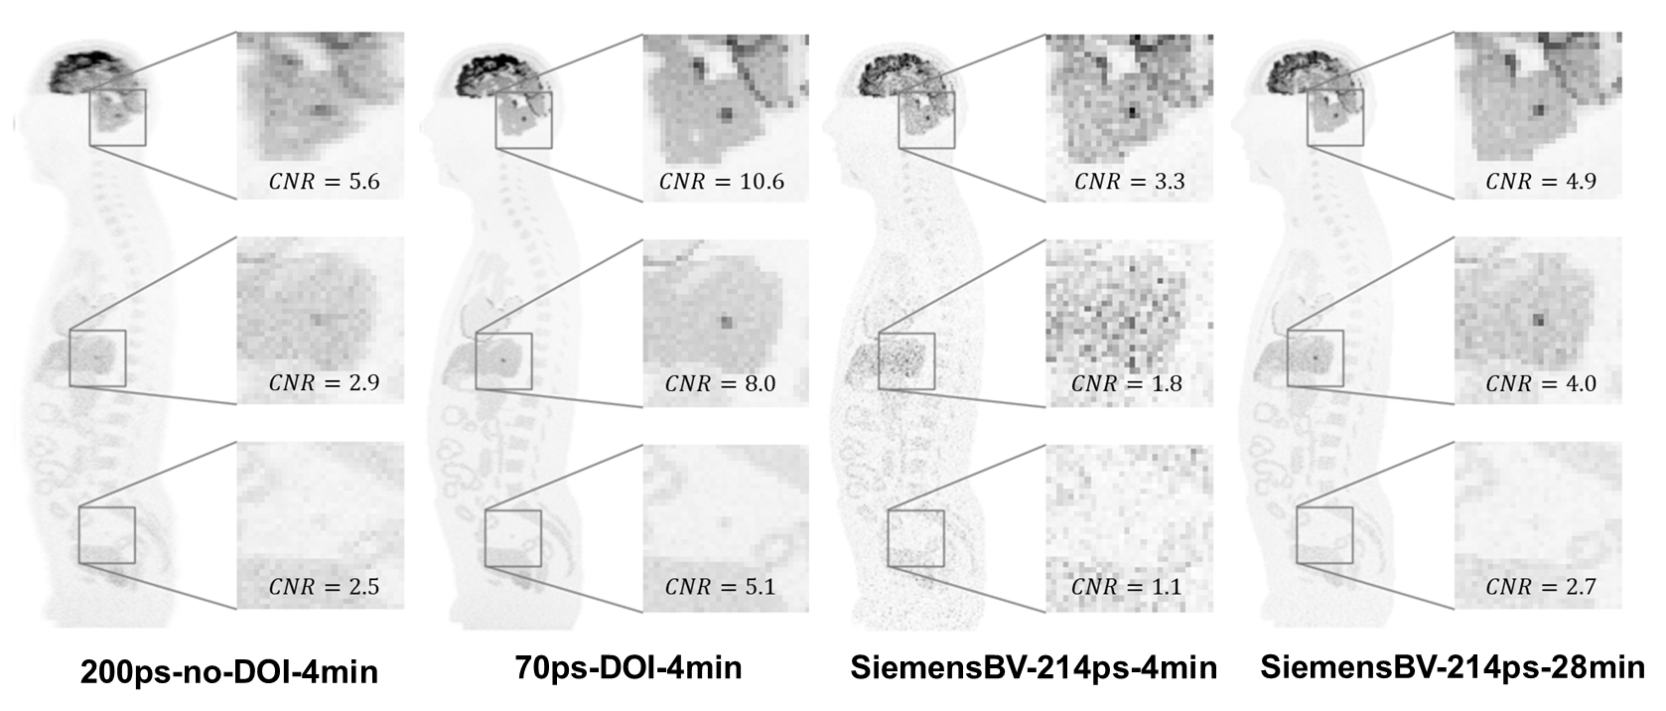
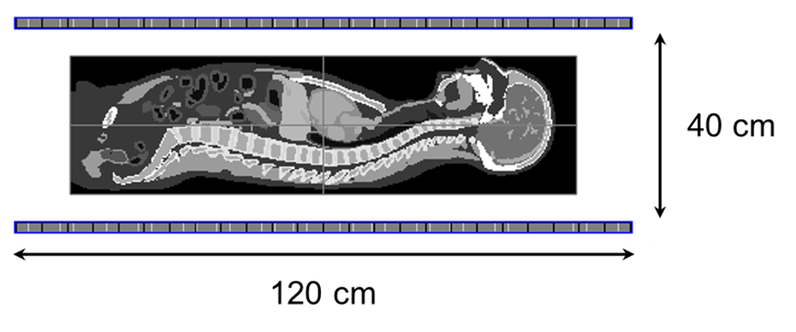
Novel detectors being developed
LSO crystals: 3 x 3 x 20 mm
Panel: 30 x 30 cm
40 cm
A relatively compact 2-panel PET system can achieve image quality comparable to clinical scanners while utilizing approximately four times less detector material.
Its mobility and flexibility enable novel applications, including bedside imaging and ICU diagnostics, as well as imaging in positions such as sitting or standing.
The modularity of panel detectors offers the potential to construct cost-effective, high-performance long axial field-of-view PET systems.

