Slide 1
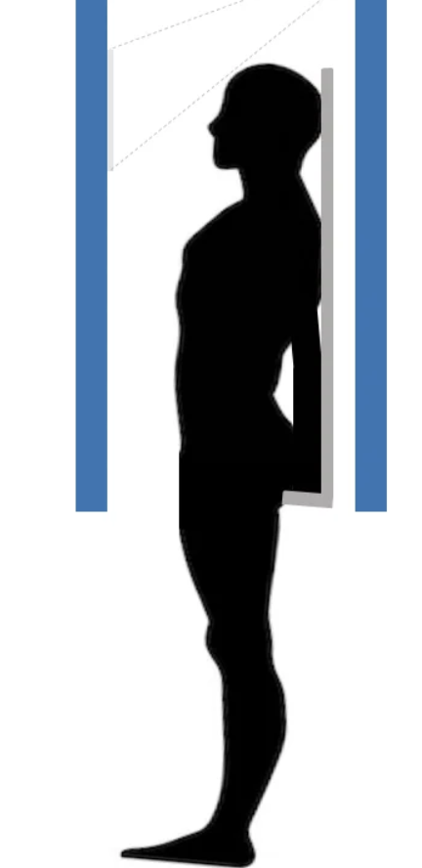
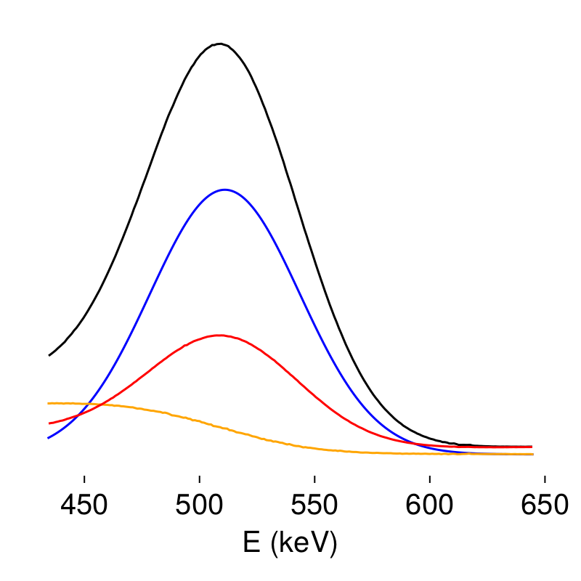
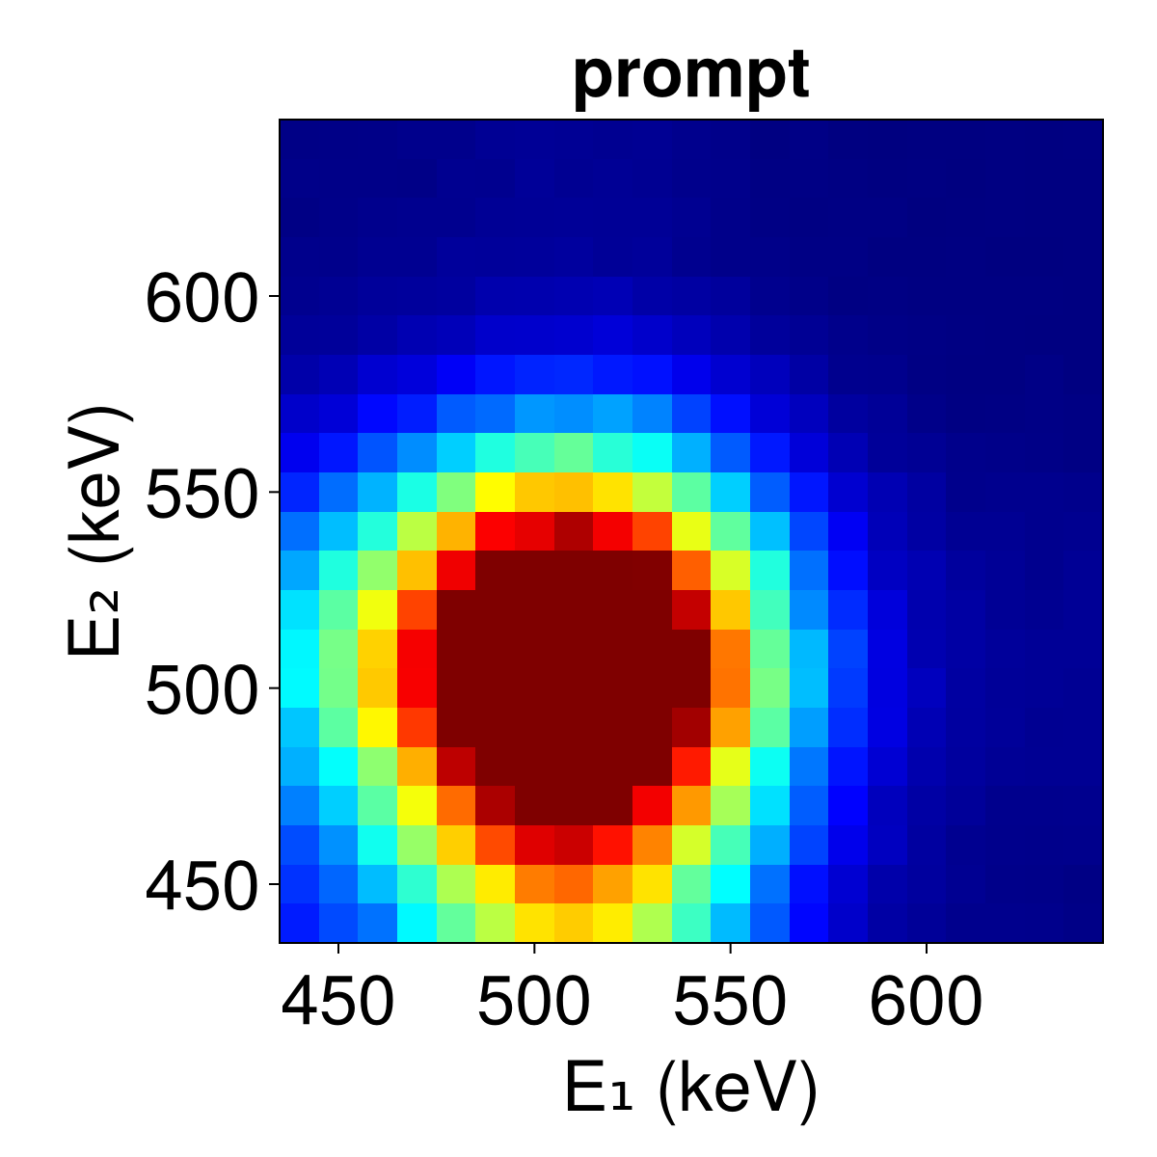
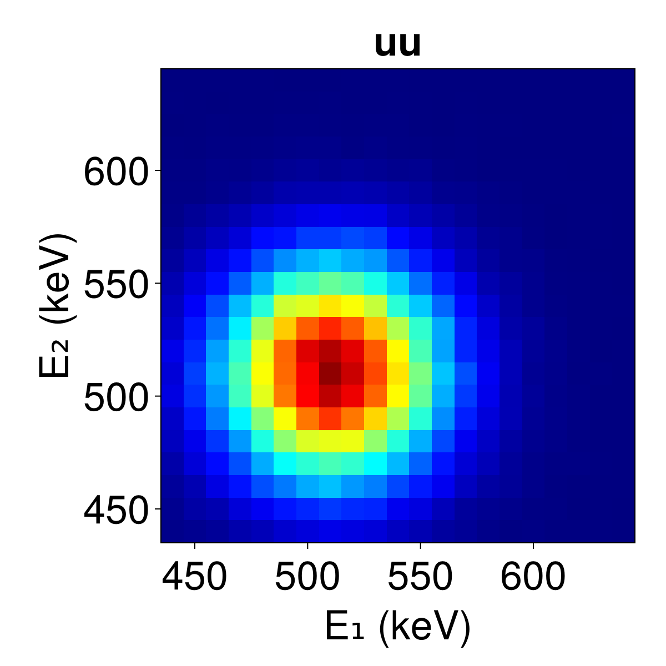
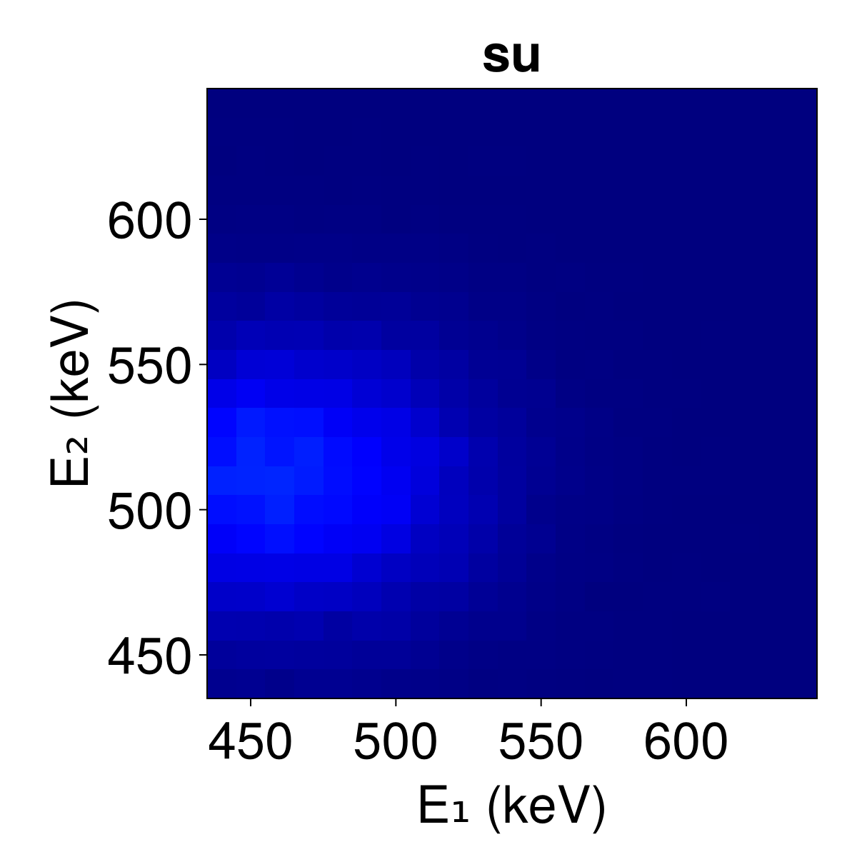
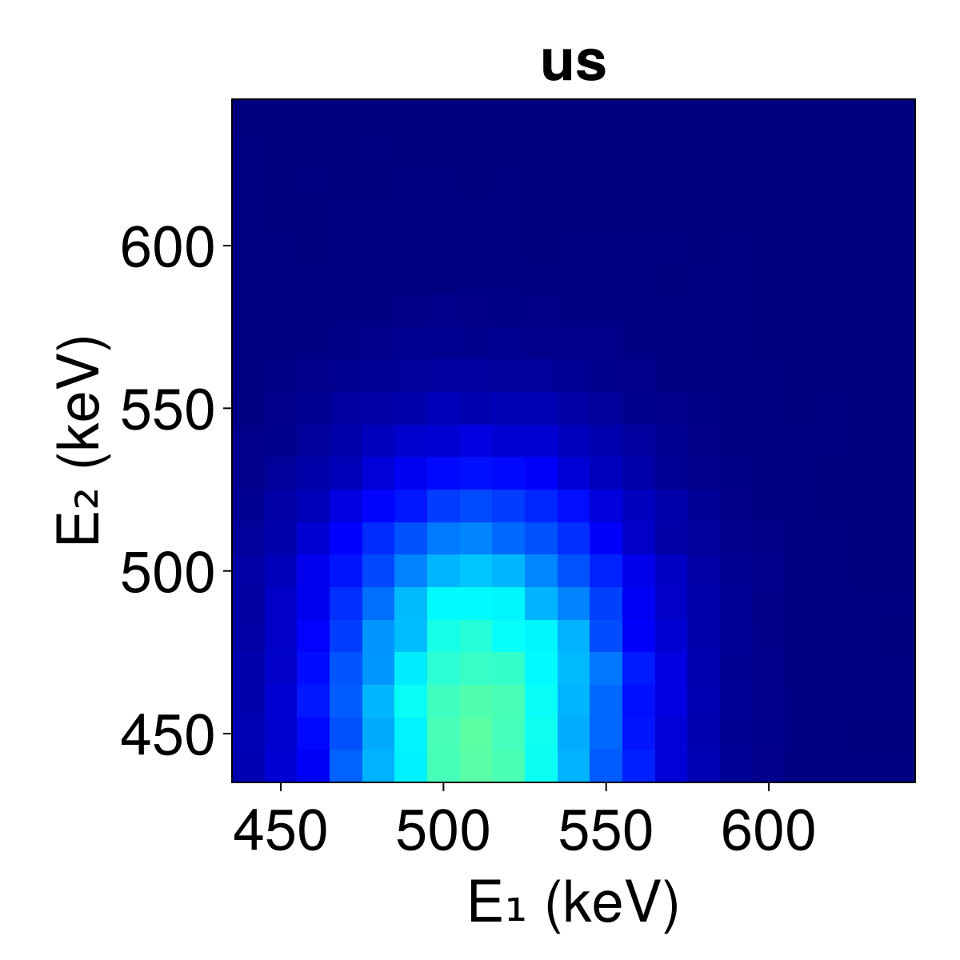
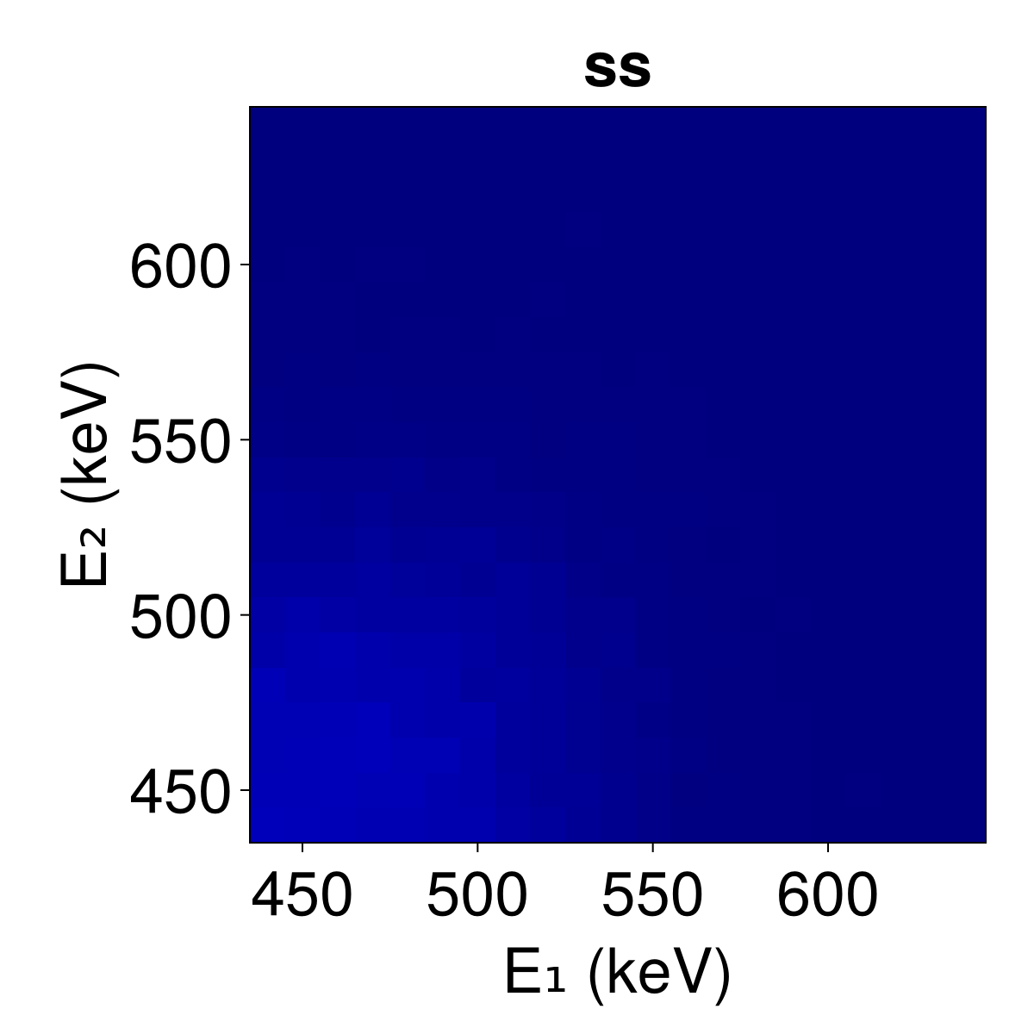
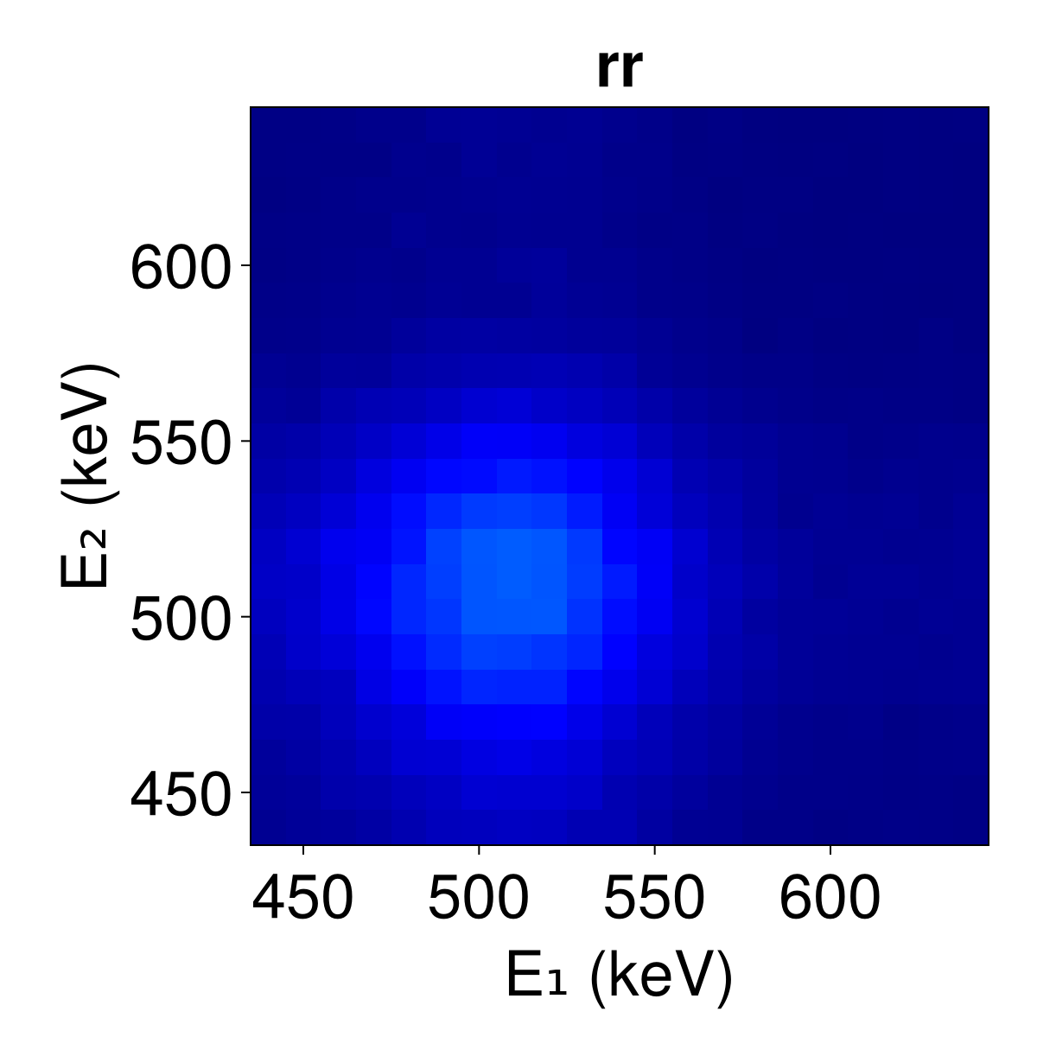
Energy-based scatter correction for the Walk-Through PET system
Jens Maebe and Stefaan Vandenberghe
Walk-Through PET
Flat panel geometry | Monolithic detectors | Standing patient design
→ Reduced costs | → High resolution | → Increased throughput
50 cm
74 cm
50 mm
50 mm
16 mm
106 cm
Energy-based scatter correction
Single energy histograms
Dual energy histograms
Unscattered
Scattered
Random
prompt = true + scatter + random

