Slide 1
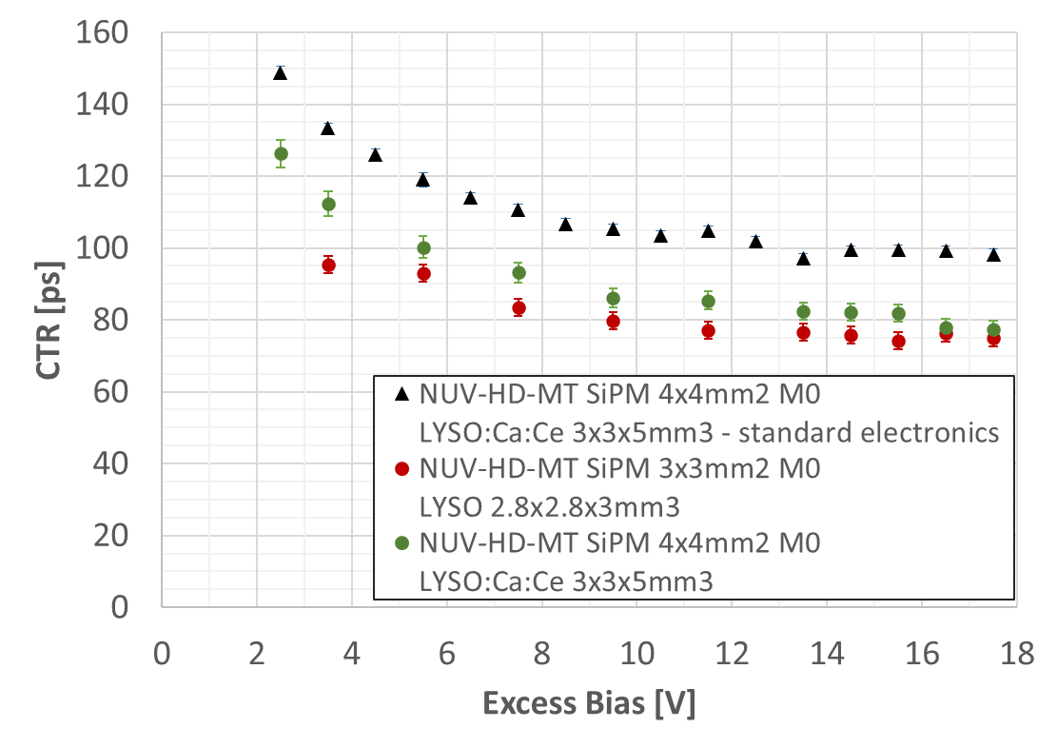
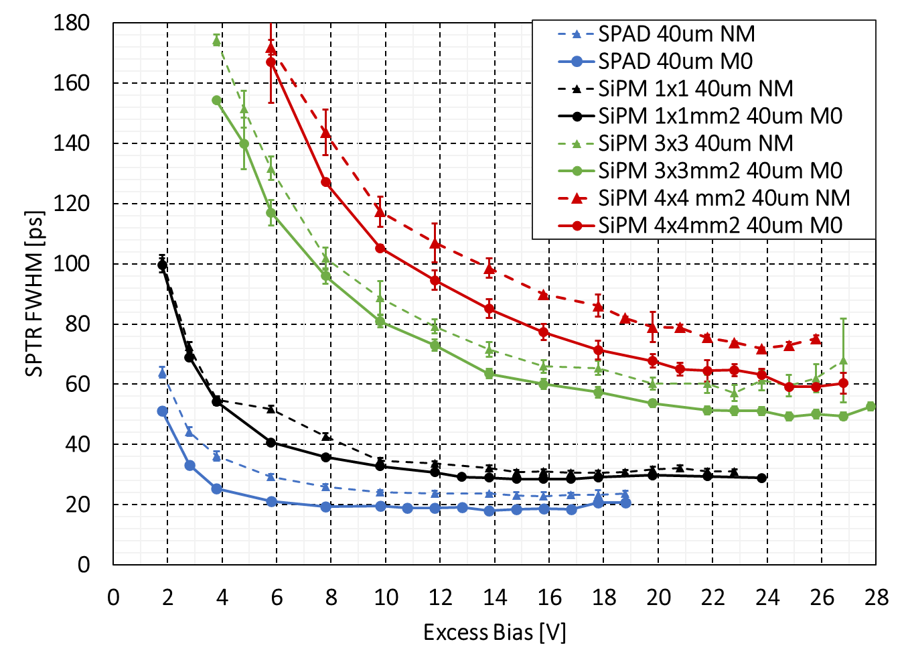
Timing performance of FBK SiPM NUV-HD-MT technology
Michele Penna (mpenna@fbk.eu – michele_penna@polito.it)
F. Acerbi, J.Dalmasson, A. Ficorella, S. Merzi, L. Monreal-Parellada, E. Moretti, G.Paternoster, M. Ruzzarin, O. A. M. Villarreal, N.Zorzi and A. Gola
Research context
The improvement of the timing performance is one of the main focus for several fields from big physics experiments to biomedical applications such as Time-of-Flight Positron Emission Tomography (ToF-PET). In this study we will present Single Photon Time Resolution (SPTR) and Coincidence Time Resolution (CTR) results of the recently introduced FBK NUV-HD Metal in Trench (MT) SiPM technology.
Material and methods
Thanks to the addition of the optically insulating material inside the trenches, FBK NUV-HD-MT devices show an extremely low CrossTalk (CT). Moreover, the Photon Detection Efficiency (PDE) reaches about 65% at 420𝑛𝑚. By using a femto-second laser with a wavelength of 390𝑛𝑚, we have measured the SPTR for SPADs with different microcell sizes and different versions with a metal mask outside the active area (capacitive coupling).
Moreover, a $1x1mm^{2}$ and a $3x3mm^{2}$SiPM with 40𝜇𝑚 cell size and M0 masking version have been tested. The CTR has been measured using a $4x4mm^{2}$SiPM to match the $3x3x5mm^{3}$LYSO:Ce:Ca crystal.
Results
By using a high frequency readout electronics, we achieved a CTR of about ≃80𝑝𝑠 FWHM and an outstanding SPTR of about ≃19𝑝𝑠 and ≃30𝑝𝑠 FWHM for the SPAD and $1x1mm^{2}$SiPM with 40𝜇𝑚 M0 masking respectively. This work opens the door to further investigations in order to study the role of the metal masking in the timing performance and to discuss about limitations and further improvements.

