Slide 1
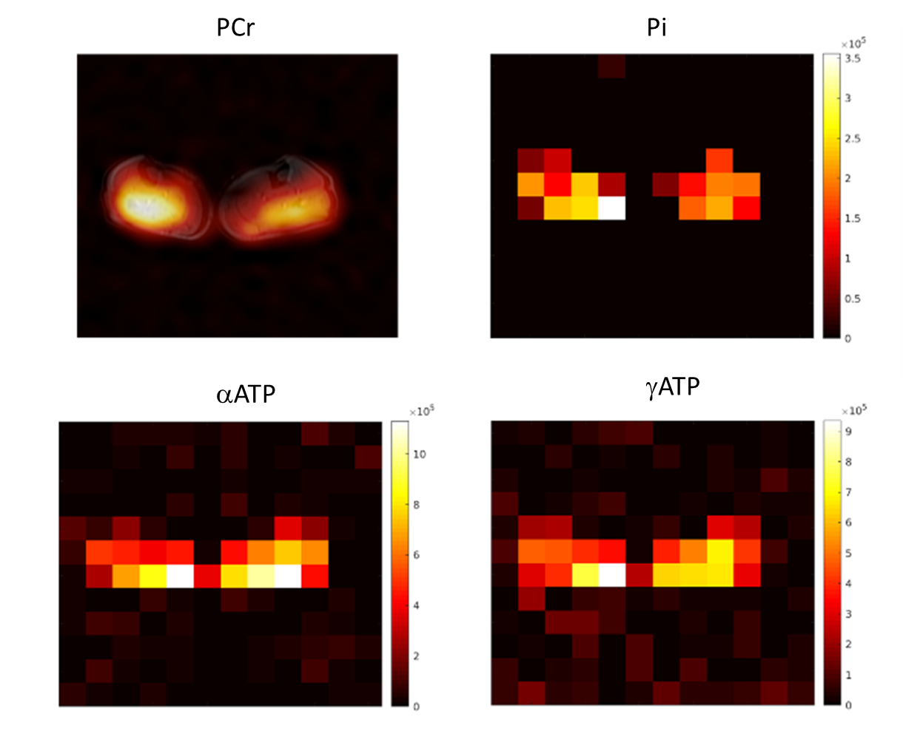
Estimating skeletal muscle metabolism from 31P MRSI at 7 Tesla using a dual-tuned volume coil: preliminary in-vivo results
P. Ambrosi^{1,2}, P. Cecchi^{2,3}, L. Biagi^{1,2}, G. Aringhieri⁴, B. Buchignani⁵, G. Astrea⁵, R. Battini^{5,6}, RF. Schulte⁷, M. Tosetti^{1,2}
¹Laboratory of Medical Physics and Magnetic Resonance, IRCCS Stella Maris, Pisa, Italy - ²Imago 7 Research Foundation, Pisa, Italy - ³Department of Translational Research and New Technologies in Medicine and Surgery, University of Pisa, Italy - ⁴Department of Clinical and Translational Research, University of Pisa, Italy - ⁵Department of Neuroscience, IRCCS Stella Maris Foundation, Pisa, Italy - ⁶Department of Clinical and Experimental Medicine, University of Pisa, Pisa, Italy - ⁷GE HealthCare, Munich, Germany
Phosphorus Magnetic Resonance Spectroscopy (31P MRS) is a non-invasive imaging technique that estimates concentrations of high-energy phosphates, offering insights into cell metabolism and neuromuscular disorders. Its clinical adoption is hindered by the need for specialized coils, but using a volume coil dual-tuned to 1H and 31P for 3D Magnetic Resonance Spectroscopy Imaging (3D-MRSI) can overcome this difficulty. Our approach allows for fast acquisition with improved spectral resolution at Ultra-High Field (7T). This approach can potentially enhance 31P metabolic imaging in clinical settings.
Pseudoimage of spectral peaks, i.e. the spatial distribution of Phosphocreatine (PCr), Inorganic Phosphate (Pi) and α,γ – Adenosine Triphosphate (α,γ – ATP) as estimated by LCModel. In the top left panel, the spatial distribution of PCr spectral peaks is superimposed over the corresponding anatomical image.
Results of a 31P 3D-MRSI acquisition at 7 Tesla in the human calf. The picture in the middle depicts an example of a transverse slice showing the presence of muscular tissue of the two legs (green circles). The red and blue boxes present the 31P spectra obtained in two representative voxels, each showing the correct detection of the most relevant metabolites: PCr, Pi, ATP
Acknowledgment
The project received funding in the framework of the HORIZON-EIC-2021-TRANSITIONOPEN-01-EIC Transition Open 2021 Grant agreement ID: 101058229:
“Non-ionizing Metabolic Imaging for predicting the effect of and guiding Therapeutic Interventions” (MITI project)

