Slide 1
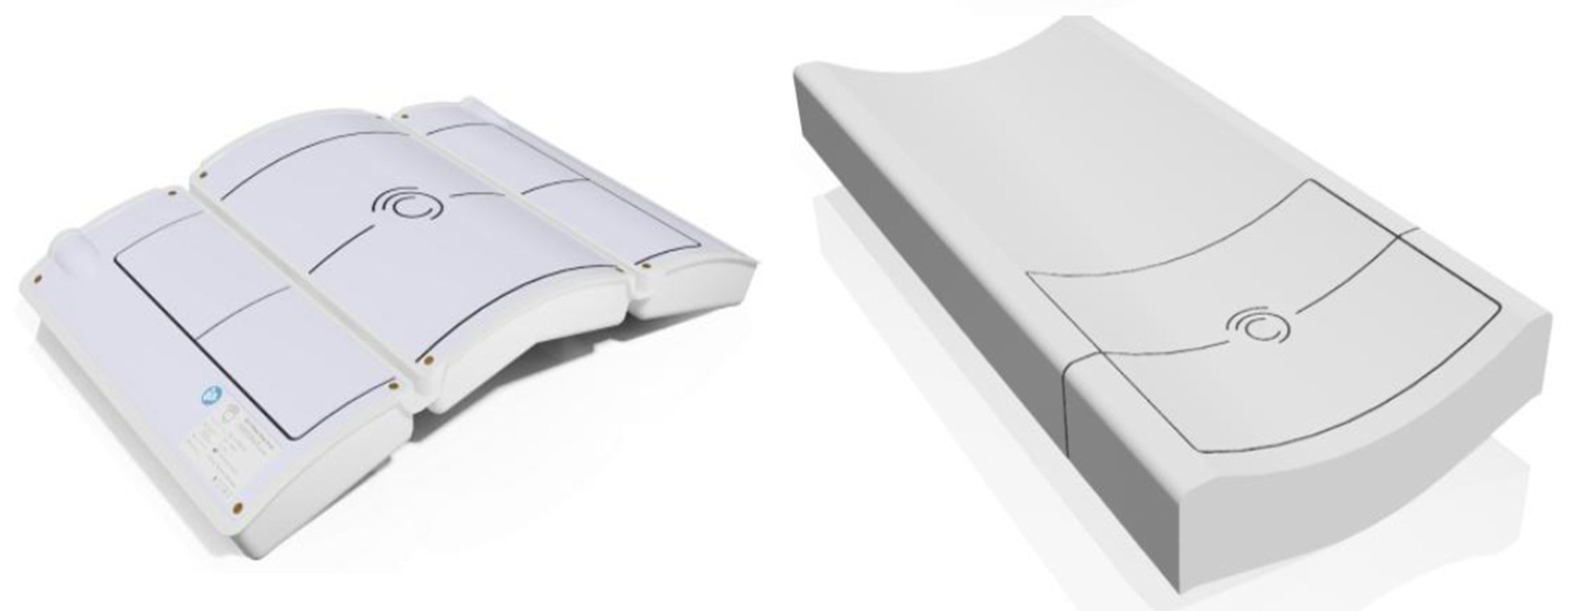
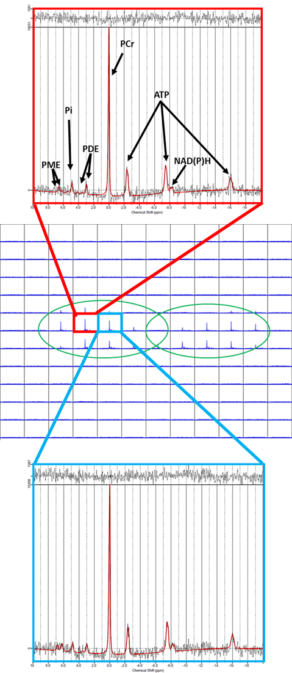
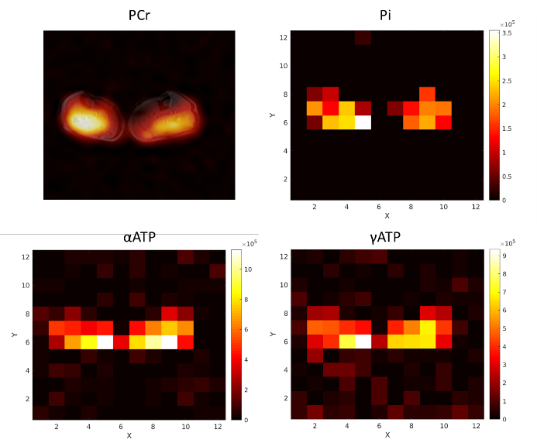
Estimating skeletal muscle metabolism from 31P MRSI at 7 Tesla using a dual-tuned volume coil: preliminary in-vivo results
Pierfrancesco Ambrosi^{1,2}, Paolo Cecchi^{2,3}, Laura Biagi^{1,2}, Giacomo Aringhieri⁴, Bianca Buchignani⁵, Guja Astrea⁵, Roberta Battini^{5,6}, Rolf F. Schulte⁷, Michela Tosetti^{1,2}
¹Laboratory of Medical Physics and Magnetic Resonance, IRCCS Stella Maris, Pisa, Italy - ²Imago 7 Research Foundation, Pisa, Italy - ³Department of Translational Research and New Technologies in Medicine and Surgery, University of Pisa, Italy - ⁴Department of Clinical and Translational Research, University of Pisa, Italy - ⁵Department of Neuroscience, IRCCS Stella Maris Foundation, Pisa, Italy - ⁶Department of Clinical and Experimental Medicine, University of Pisa, Pisa, Italy - ⁷GE HealthCare, Munich, Germany
Phosphorus Magnetic Resonance Spectroscopy (31P MRS) is a non-invasive imaging technique capable of estimating concentrations of critical high-energy phosphates involved in ATP metabolism and muscle force generation. It offers insights into cell metabolism, neuromuscular disorders, and treatment effectiveness. However, its clinical adoption has been hindered by the requirement for specialized 31P coils. Here, we introduce a non-ionizing, high-precision metabolic imaging approach using 3D Magnetic Resonance Spectroscopy Imaging (3D-MRSI) at Ultra-High Field (7T), focusing on calf muscle.
METHODS
3D-MRSI at Ultra-High Field (7T), focusing on calf muscle, was performed by using a custom-built volume coil, dual-tuned for both 1H and 31P, designed by Tesla Dynamic Coils (TDC). The coil features 8 transmit/receive antennas for 1H, and 32 for 31P (8 transmit/receive and 24 receive only coils).
The 31P dedicated acquisition sequence (FIDALL, GE Healthcare) provides calibration and the acquisition of the whole volume in less than 10 minutes (FOV = 40cm, voxel size = 3.5x3.5x3.5 cm3, Tacq = 6’26’’, TR/TE = 66/0.72 ms, FA = 6°, Nacq = 2048). The use of a short TE (0.72ms) suppresses signal from large membrane phospholipids, which would prevent the correct estimation of important metabolites concentrations.
Data were analysed with the LCModel software package, with a customized pipeline for the analysis of 31P MRS data.
RESULTS
FIGURE 1
Figure 1 shows the results of a 31P 3D-MRSI acquisition at 7 Tesla in the human calf. The picture in the middle depicts an example of a transverse slice showing the presence of muscular tissue of the two legs (green circles). The red and blue boxes present the 31P spectra obtained in two representative voxels, each showing the correct detection of the most relevant metabolites. the peaks of PCr (phosphocreatine), Pi (inorganic phosphate), ATP peaks (α-, β-, γ-Adenosine TriPhosphate) are correctly fitted by LCModel (CRLB < 15% with no zero-filling). Overall, 7.5% of voxels (129 on 1728, corresponding to a volume of 5530 cc) showed sufficient SNR to obtain reliable estimates of PCr, Pi and ATP (mean SNR = 15.4). Peaks from Phosphomonoesters (PME) and Phosphodiesters (PDE) are also visible, albeit not always with acceptable fit errors due to their intrinsically low concentration.
PCr
Pi
Figure 2 shows a pseudoimage of spectral peaks i.e. the spatial distribution of (in clockwise order) Phosphocreatine (PCr), Inorganic Phosphate (Pi) and α, γ – Adenosine Triphosphate (α, γ –ATP), as estimated by LCmodel. The top left panel shows the spatial distribution of raw PCr spectral peaks superimposed over the corresponding slice from the localizer image.
αATP
γATP
FIGURE 2
DISCUSSION
We employed a 31P 3D-MRSI acquisition to obtain a spatially encoded distribution of 31P spectra using a volume coil dual-tuned to 1H and 31P. Our preliminary results show that it is possible to detect most relevant metabolites for cellular metabolism of muscle tissue with acceptable scanning times for clinical use (Tacq < 7 minutes). Integration of a dual-tuned volume coil simplifies clinical use, since it allows a better interpretation of results correlating metabolic information with high-spatial resolution imaging by 1H, and an improvement in quantification of metabolites from 31P MRS by correcting for tissue content from 1H MRI. Future acquisitions will investigate the reliability of the results and the possibility of discriminating between health and disease.
Acknowledgment
The project received funding in the framework of the HORIZON-EIC-2021-TRANSITIONOPEN-01-EIC Transition Open 2021
Grant agreement ID: 101058229: “Non-ionizing Metabolic Imaging for predicting the effect of and guiding Therapeutic Interventions”
(MITI project)

