Slide 1
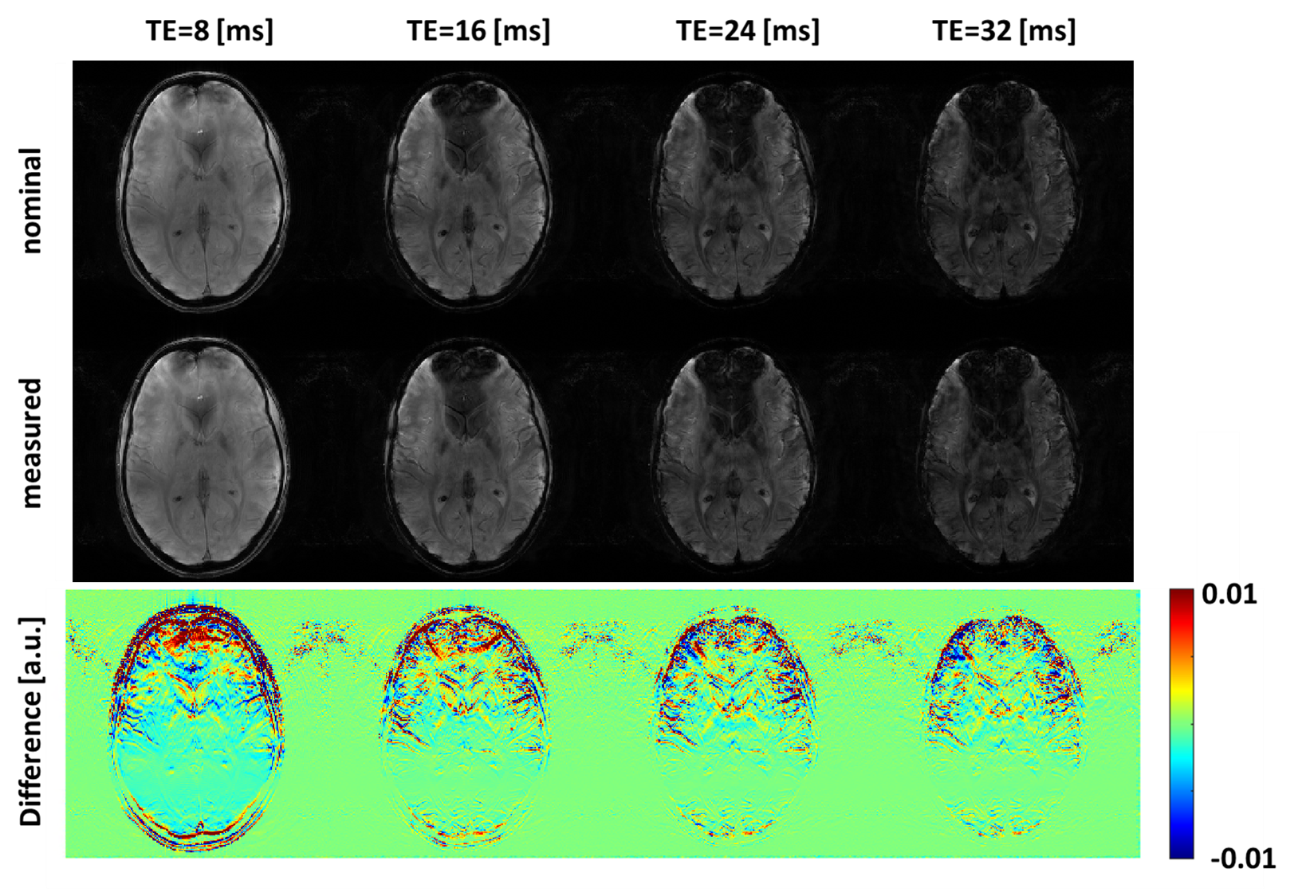
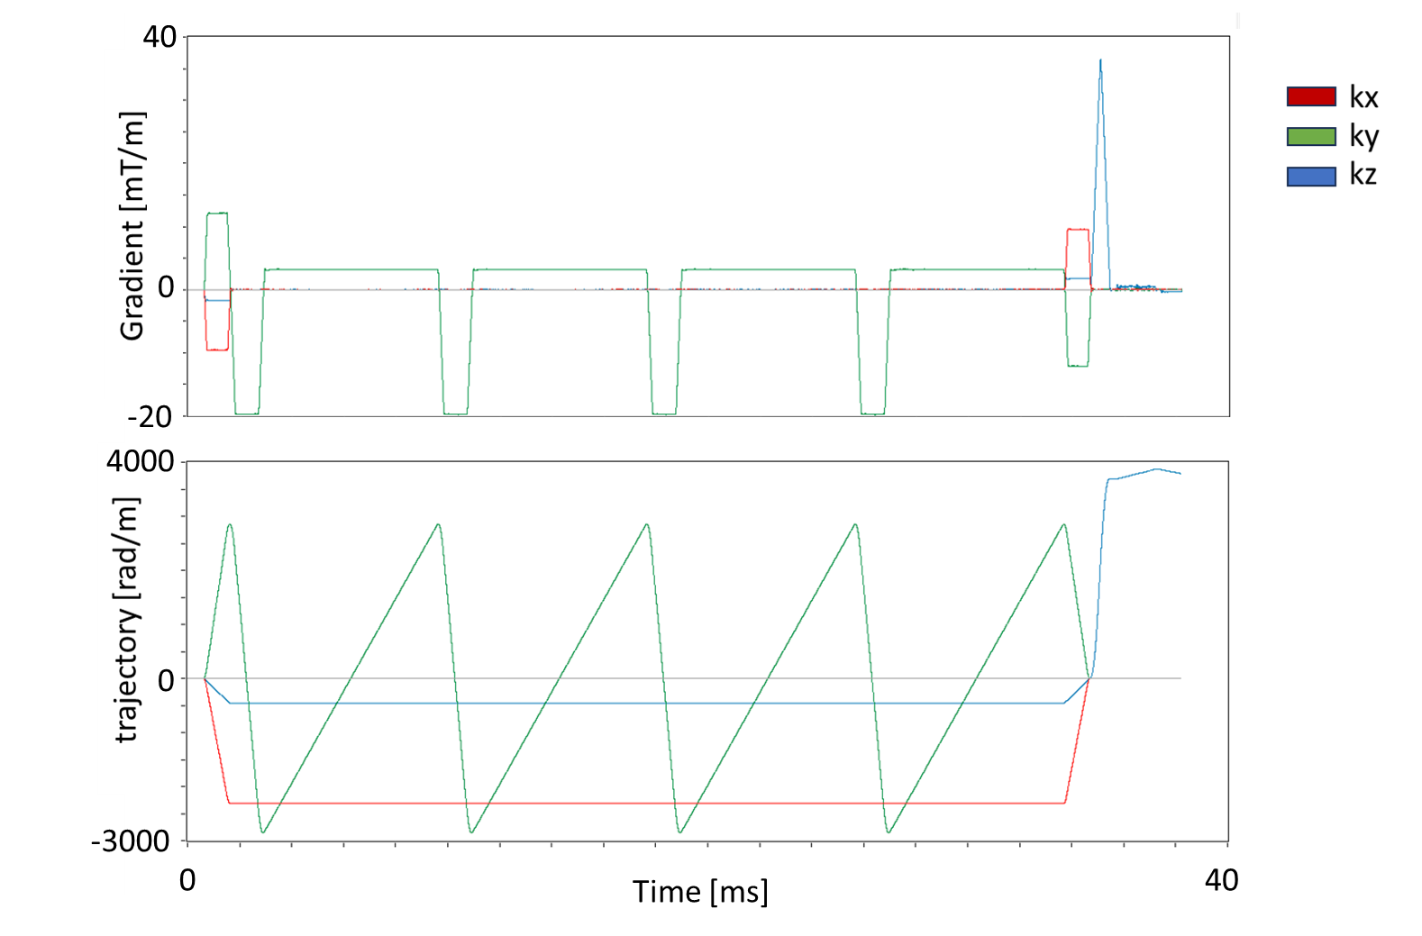
Actual trajectory measurement for multi-echo GRE at 7T using a field camera system
Matteo Cencini¹, Laura Biagi^{2,3}, Paolo Cecchi³, Marta Lancione², Michela Tosetti^{2,3}
¹INFN Sezione di Pisa, Pisa, Italy; ²IRCCS Stella Maris, Pisa, Italy; ³IMAGO7 Foundation, Pisa, Italy
Aim To improve qMRI image quality at UHF by measuring actual k-space sampling pattern
Impact of the correction on individual echo images. Reconstruction differences between nominal (first row) and measured trajectory (second row) increase near high field inhomogeneities, as in proximity of the fMRI visual stimulation device.
Measured gradient waveforms (top) and corresponding k-space sampling (bottom) used for T2* mapping.

