Slide 1
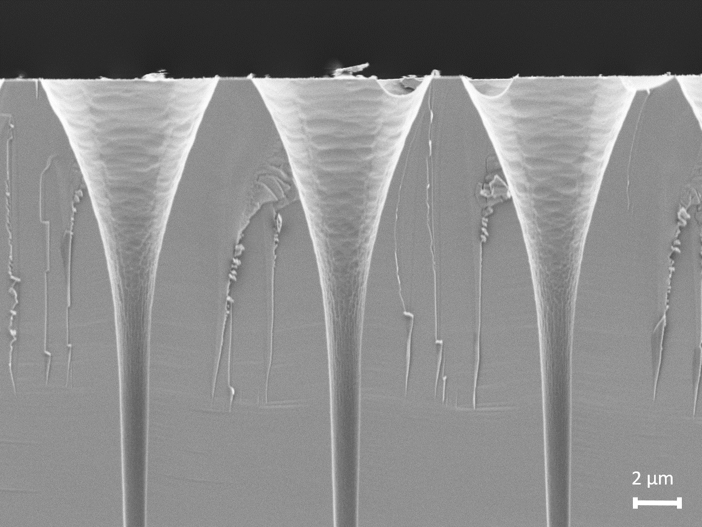
Amorphous Silicon Microchannel Plates: A new photon detector with 10 ps timing and 15 μm spatial resolution
Samira Frey, Georgios Konstantinou, Luca Antognini, Christophe Ballif and Nicolas Wyrsch

Slide 2
Contents
Micro-Channel Plates: A short functionality and structure introduction
Amorphous Silicon Micro-Channel Plates (AMCP)
Simulation and experiment
Design for spatial resolution
Functionality fit to new generation of scintillators

Slide 3
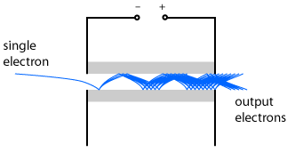
MCPs: A guide to functionality
Photocathode
Reverse Vbias
Ground
Photon
R. Paschotta, RP Photonics Encyclopedia
Broad application in low light environments (microscopy, LIDAR, night-vision)
Cost as the main barrier of entry for scintillator readout
Elba PSMR 2024

Slide 4
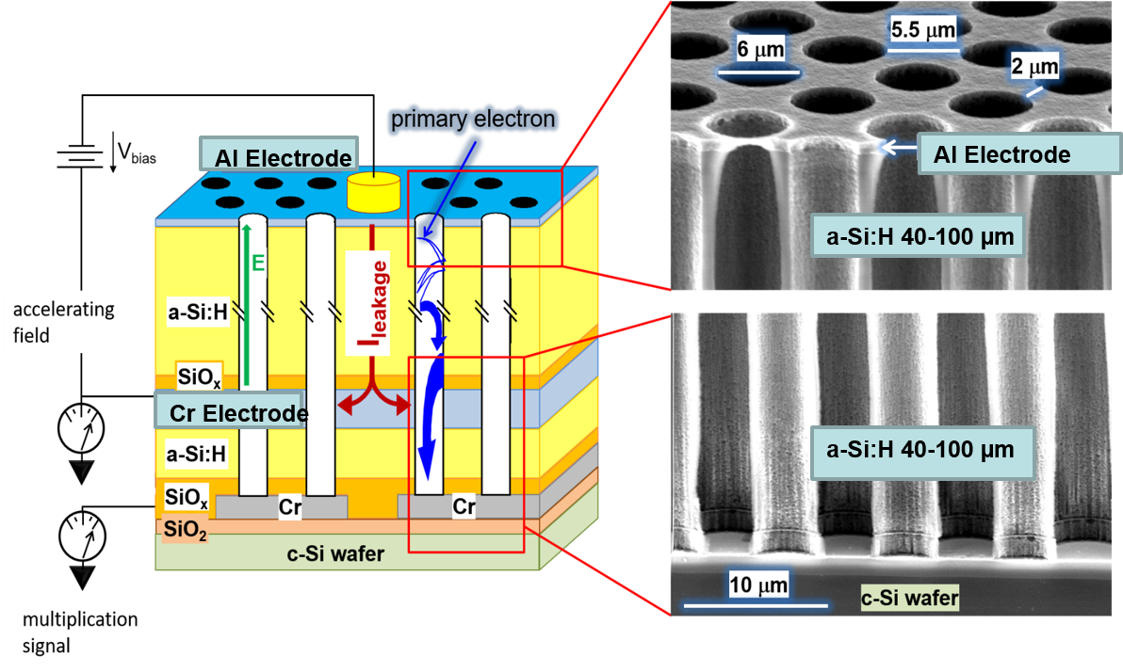
aSi-Based MCPs
Advantages of AMCP vs. conventional MCP:
Monolithic Integration
Flexibility in fabrication
a-Si:H tunable resistivity
Miniaturization
[1] A. Franco et al. Sci. Rep. 1 (2014).

Slide 5
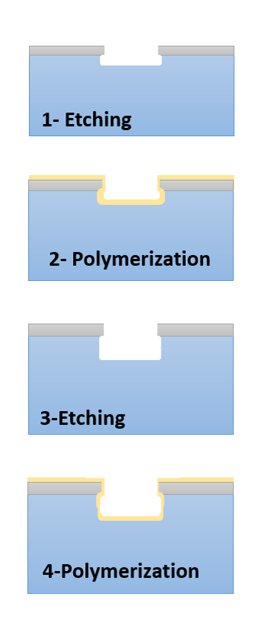
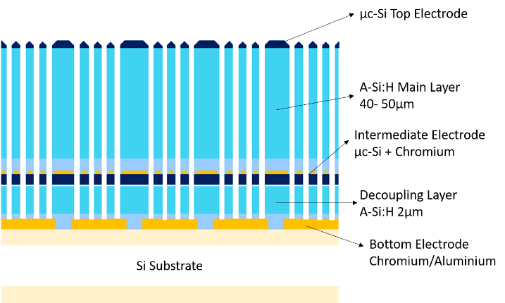
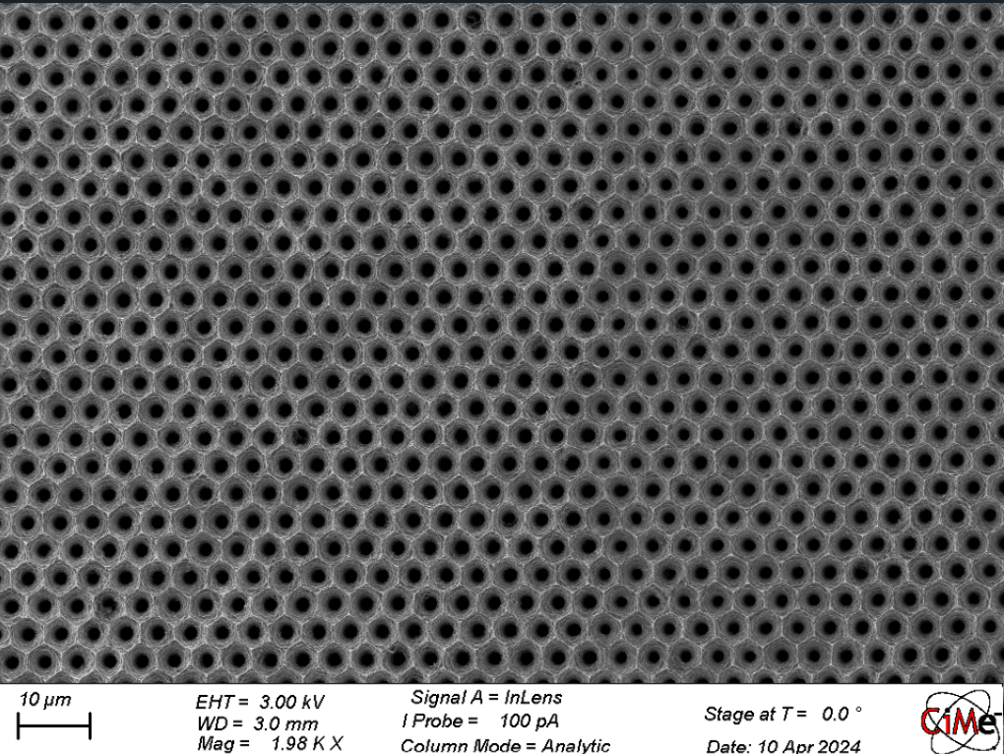
Fabrication process
Sulfur hexafluoride [SF₆]
Metal deposition (sputtering, evaporation)- Cr or Alu (or both)
Photolithography:
PR spin-coating, laser exposure, PR development, Chemical etching
Plasma enhanced chemical vapor deposition (PECVD):
Different recipies of H and SiH₄
Deep Reactive Ion Etching (DRIE): Bosch process
Si isotropic etching
Octafluorocyclobutane [C₄F₈]
Al Electrode
a-Si:H
Cr
a-Si:H
SiO₂
Cr
Cr
c-Si wafer

Slide 6
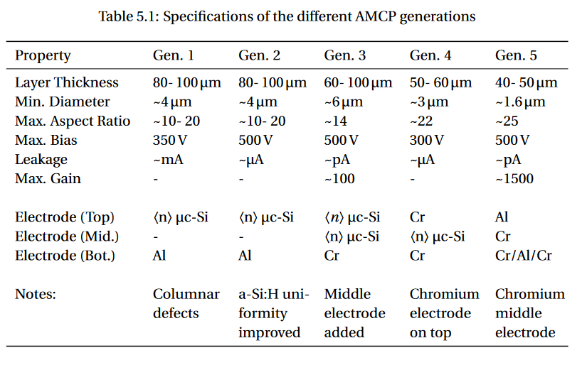
AMCPs: A history of development
Developed for Cherenkov TOF PET:
SNSF Synergia project
Funnels
2011
S. Frey PhD Thesis, 2023

Slide 7
Gain and efficiency Simulation
MgO sputtering
 | AMCP Straight Channel | AMCP Funnel Channel | AMCP Funnel Channel (+ MgO)
Gain (500 V) | 1515 | 1109 | 1712
Time Jitter [ps] | 6.1 | 6.3 | 5.5
Rise Time [ps] | 4.3$±$1.2 | 4.3$±$1.4 | 4.7$±$1.1
Det. Efficiency (Inside channel)* | 79.8% | 91.8% | 99%
MgO can compensate for loss in gain due to channel broadening
→Time Resolution not affected by funnel
*For an incoming particle with 200eV

Slide 8
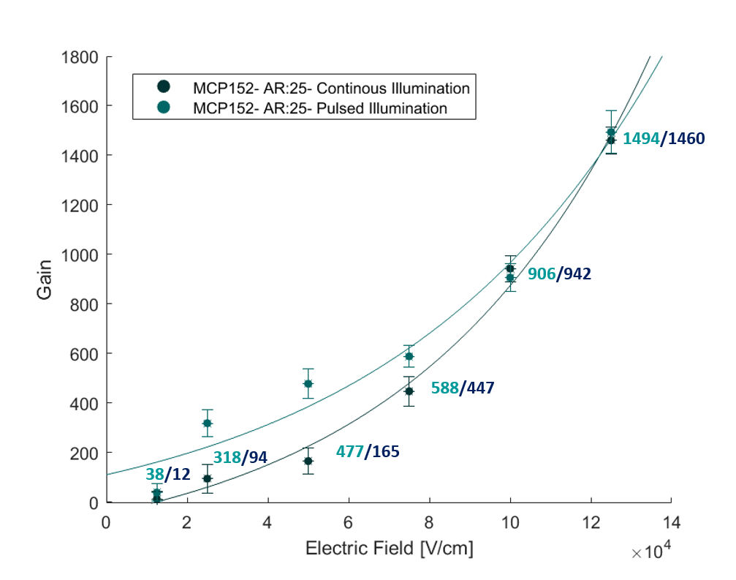
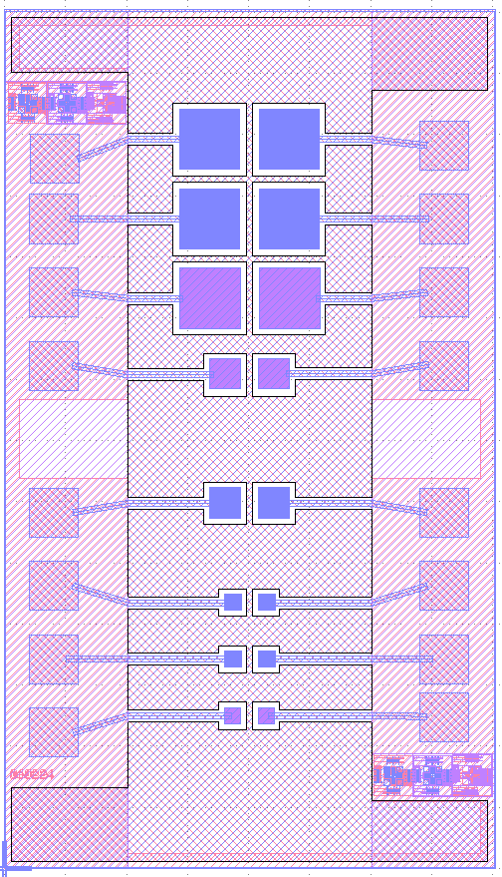
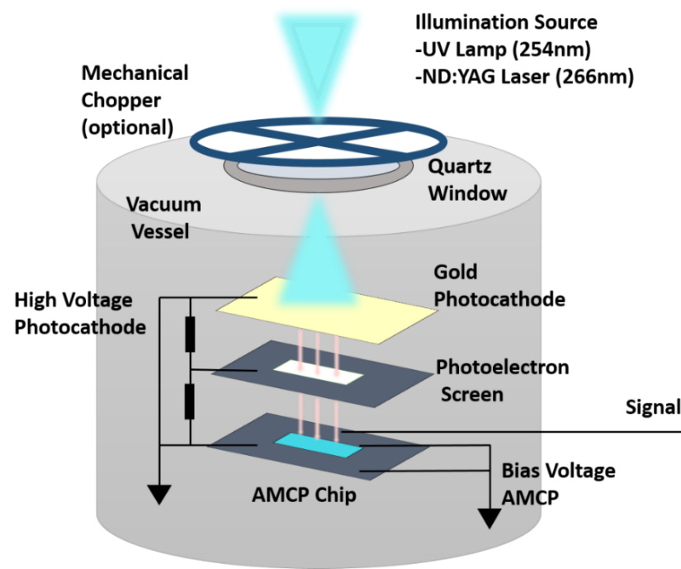
Characterization - Gain Measurements
Newest Generation of Devices : Aspect ratio 25 ➔ Gain 1500
Notes:
After the optimization we measured the gain of the new samples both under continuous and pulsed illumination. Few things I want to point out here. A gain of around 1500 could be measured which is quite an increase to the previous maximum of around 100 in the older generation. The increase in gain is due to the increase of aspect ratio and also because the structural defects in the amorphous silicon layer were reduced we were able to apply a high bias voltage of 500V on the 40um thick amorphous silicon layer. I again plotted the gain bias relationship in a log log plot.

Slide 9
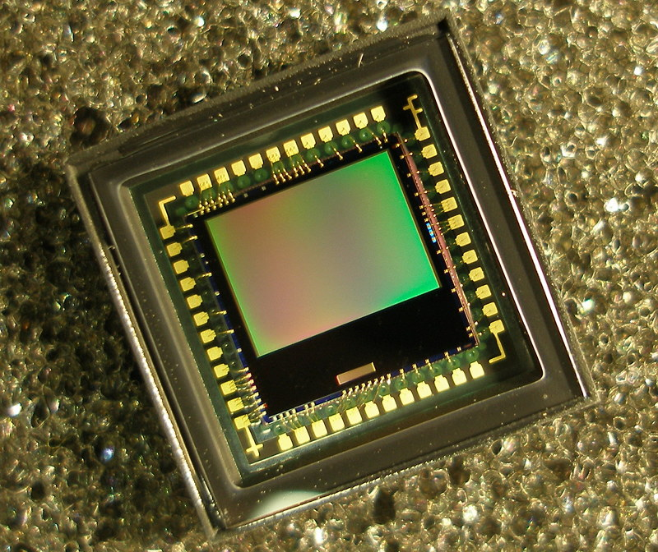
Integration on CMOS camera
To add high spatial resolution to this system, a matrix of read-out channels is necessary
Such approach is commonly followed on CMOS cameras
A CMOS tile with 4x4 um² active area and 15x15 um² pitch was chosen for prototyping
0.35 Mpix
Source: Wikipedia

Slide 10
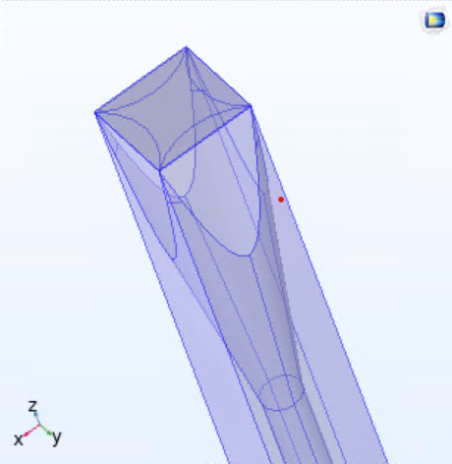
Design compromise of hexagonal and square grids
Hexagonal array is necessary to maintain geometrical coverage of the funnels (and improved packing fraction)
Design of the bottom electrode requires isolation between readout pixels to avoid cross-talk
It is important that the same number of microchannels are read-out by a single pixel

Slide 11
Design compromise of hexagonal and square grids

Slide 12
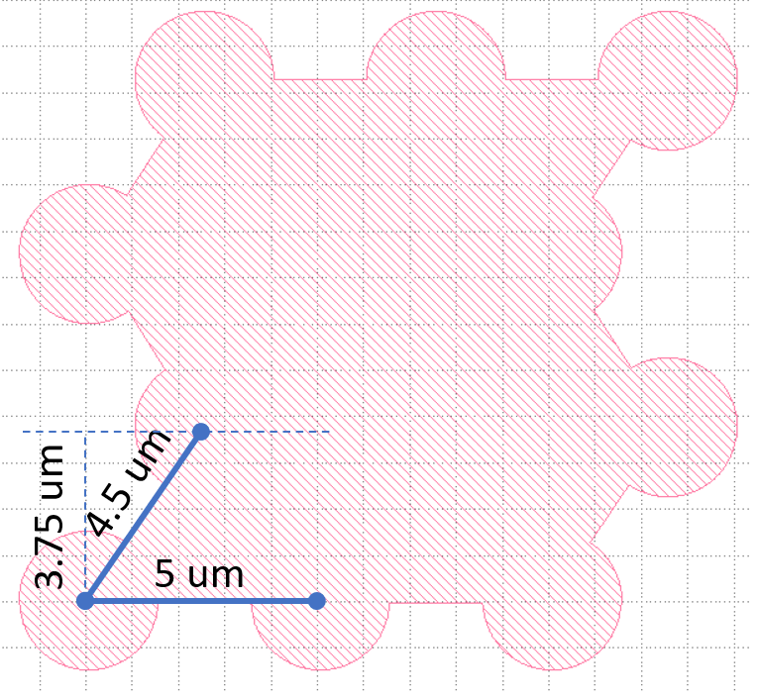
Design compromise of hexagonal and square grids
We slightly adapt the hexagonal grid to have the same pattern for each pixel
10% change is within specifications of design
The new pixel design interlocks with a critical distance of ~1.2 um and 15 um pitch

Slide 13
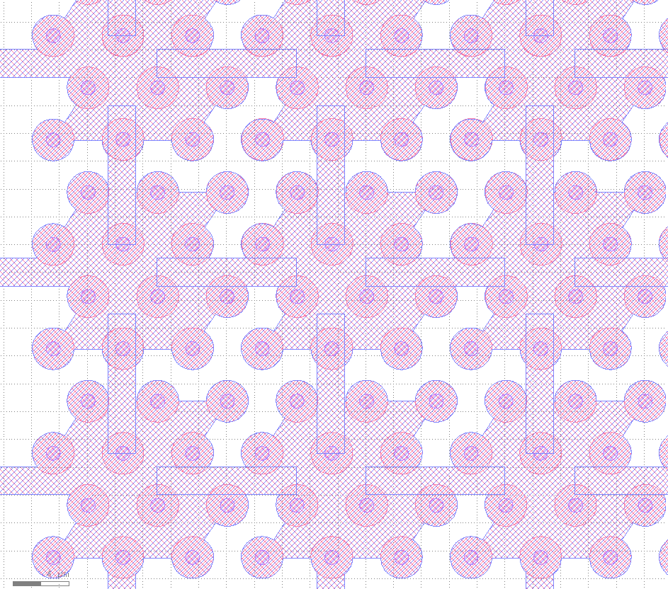
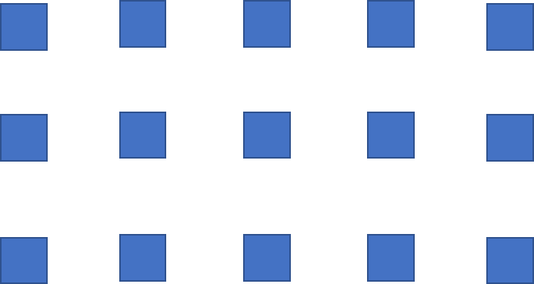
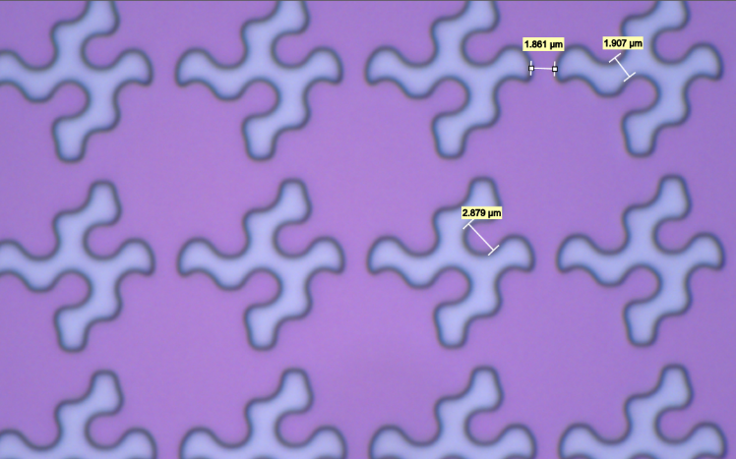
Design compromise of hexagonal and square grids
We slightly adapt the hexagonal grid to have the same pattern for each pixel
10% change is within specifications of design
The new pixel design interlocks with a critical distance of ~1.2 um and 15 um pitch

Slide 14
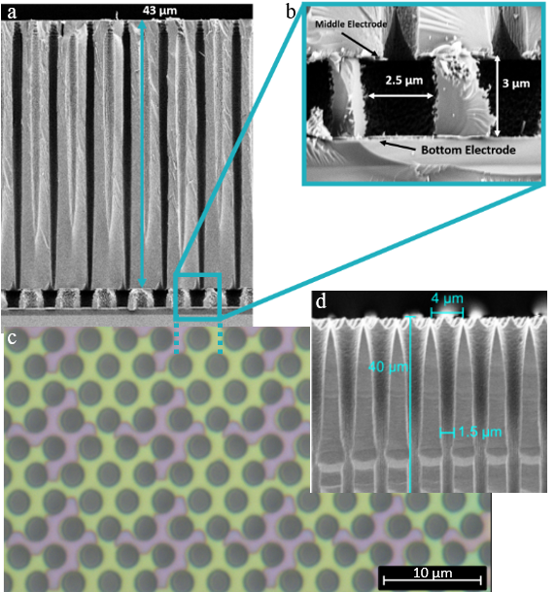
New design fabrication
Secondary changes to the fabrication process (design, bottom pad thickness and material (Cr/Al/Cr → Cr)
Criticality of alignment → more robust exposure laser process (no need for mask)
<300 nm misalignment, within specs

Slide 15
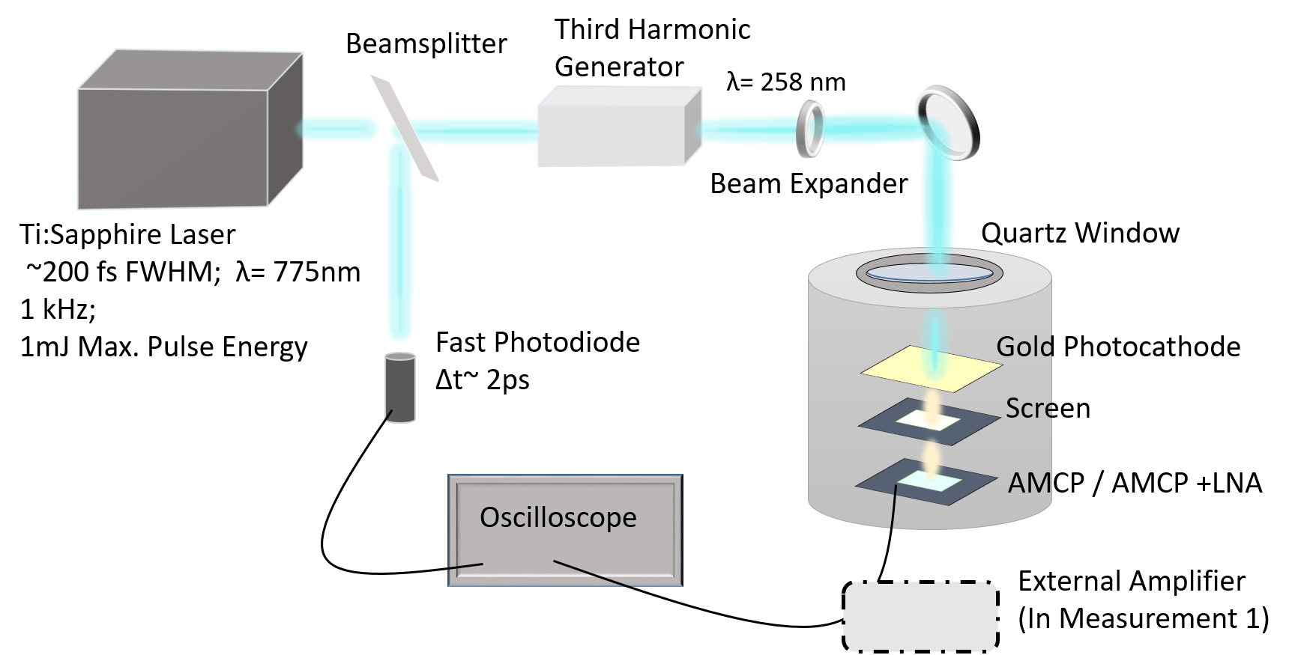
Timing characterization
Two different configurations - Chip + ext. amplifier / Chip LNA on board

Slide 16
Timing results: External Amplifier board
Low Flux / NO PC / Ext. Amplifier
12.6 ps
(FWHM)

Slide 17
Timing results: LNA on board
Low Flux / NO PC / Amplifier on the same board
6.1 ps
(FWHM)
(Note : Bias only up to 300V – Gain reduced)
Notes:
Which brings me to the final measurement- now this is the configuration where the AMCP and the amplifier were placed close to each other on the same board inside the vacuum chamber. Now there were a few problems with this AMCP chip- we could only bias up to 300V instead of the usual 500V which means the gain was significantly reduced. The reason for this was again due to electrical breakdowns that occured in this chips. But what we can see is even though the gain was low and the signal was amplitude was very low the time resolution was still good with 6.1picoseconds. So we can still increase the resolution a lot by having amcp and amplifier close or ideally in the future fully integrated.

Slide 18
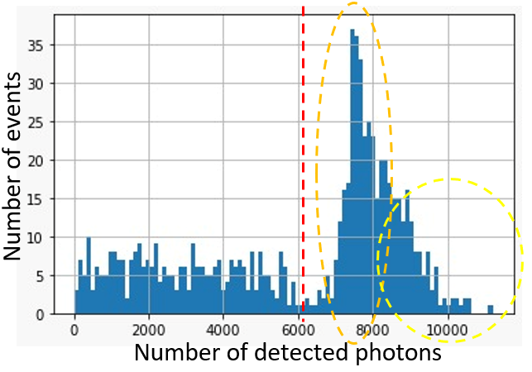
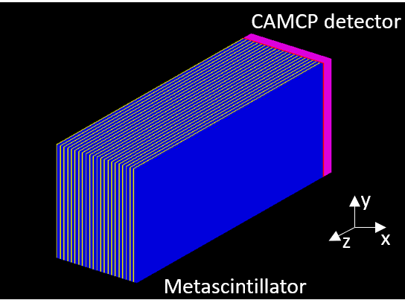
Simulation: Metascintillators on AMCPs
LYSO:Ce, (24x9.6x0.25 mm³)
PEA₂PbBr₄ perovskite (24x9.6x0.1 mm³)
Good energy resolution/ energy sharing resolution
Down to 1 mm Spatial Resolution
8 mm DOI
90 ps CTR
No need for 15 um² pixelation, 150 um² would render similar results → Digital SiPM people?

Slide 19
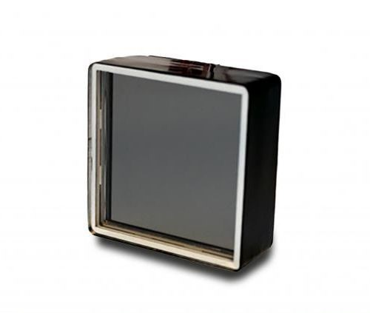
Next steps
Migrate the technology from the test design to the CMOS design
Confirm timing and spatial resolution characteristics through the dedicated low-noise CMOS readout
Experiment and integrate AMCP with a photocathode
standard solution: Photonis Planacon
Possible solutions: Bi-alkali sputtering, oxides, silicon
Navigate design specs for optimal PET application

Slide 20
Conclusions
MCPs have already proven their capabilities as TOFPET photon-detectors
AMCPs have the potential to improve the state of the art in MCP and photon detection timing
AMCPs on CMOS set the state of the art in spatial resolution
Fabrication is complex but versatile, allowing devices with variable and application specific specifications
Potential fit for scintillator read-out to be explored

Slide 21
Thank you for your attention

