Slide 1




ISOLPHARM project: Development of two preclinical imaging devices for ¹¹¹Ag β and γ radiation
PSMR2024, May 23th
Alberto Andrighetto - Istituto Nazionale di Fisica Nucleare
Laboratori di Legnaro

Slide 2
Talk Overview
1) Brief introduction on ISOLPHARM Project
2) Imaging results on PET and SPECT isotopes
3) R&D activities on tailored detectors for ¹¹¹Ag
4) Conclusions

Slide 3
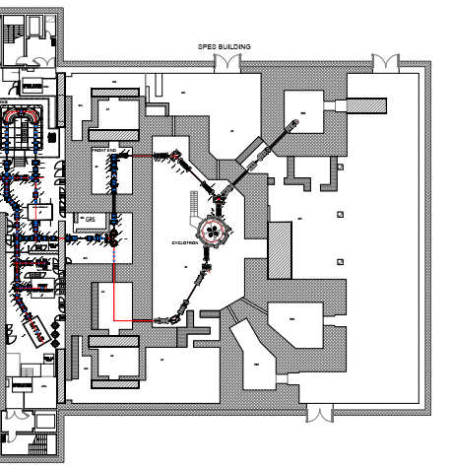


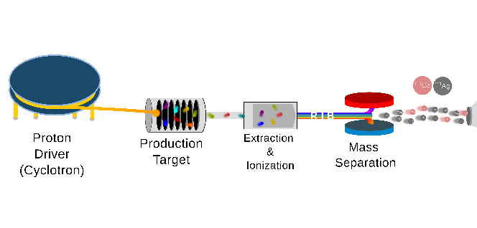
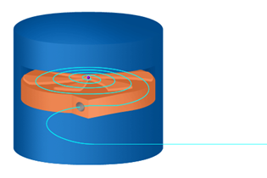
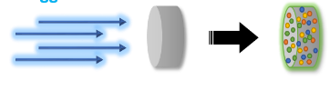
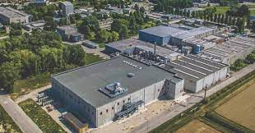
Medical radionuclides production @LNL
Tunable energy: 35 – 70 MeV; High output current: up to 500 µA in dual extraction mode
for Fundamental & Applied research
ISOL technique
Direct activation
technique
RIB
Neutron-rich radionuclides
E.g., UC_{x} target: ¹¹¹Ag, ¹³¹I, ⁹⁰Y, ⁸⁹Sr
MAINLY THERAPEUTIC
Proton-rich radionuclides
E.g.: ⁴⁷Sc, ^{99m}Tc, ⁵¹Mn/⁵²Mn
MAINLY DIAGNOSTIC

Slide 4
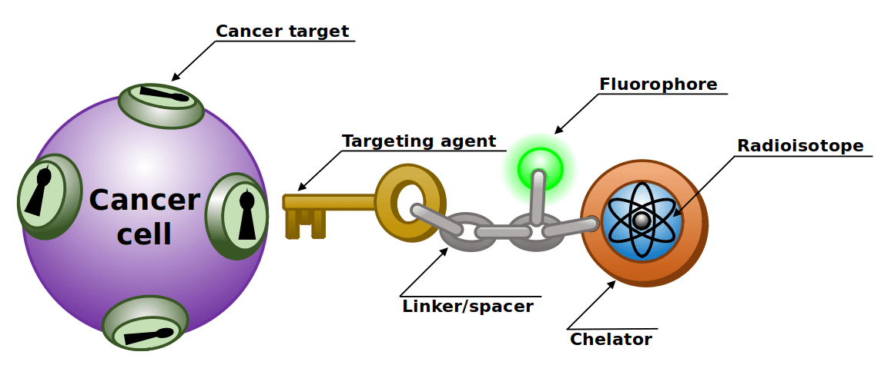
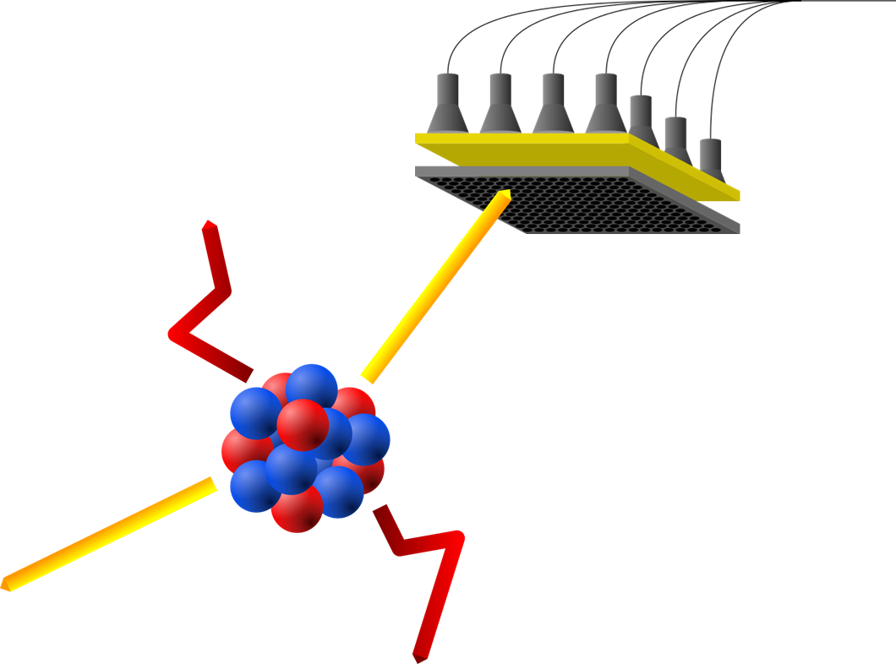

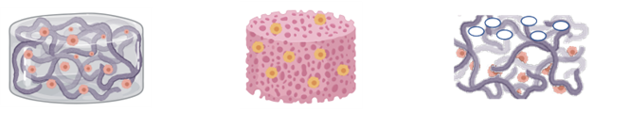
Radiopharmaceutical Frame (small molecules)
Detectors
Targeting Agent:
At present: PSMA-617
Before: CCK2R
Chelator: ¹¹¹Ag
Scaffold :
Best candidate
Linker: Bifunctional

Slide 5






The ISOLPHARM Project – 4 pillars
Also…Scientific and training hub
1. National Collaboration
Broad, focused on radio-
pharmaceutical development:
synthesis,characterization
and preclinical tests (vitro/vivo)
2. Innovative Method
Innovative production @SPES of several (medical)
Carrier Free + High Purity
radionuclides
(¹¹¹Ag,⁸⁹Sr,¹³⁶Cs..)
4. Activities, INFN Experiments
Financed by CSN5 (physics application): ISOLPHARM_Ag +
ISOLPHARM_EIRA + ADMIRAL
3. Facility at SPES
An irradiation station,
using the SPES
Low Energy Beams, is
planned in the SPES building
.

Slide 6








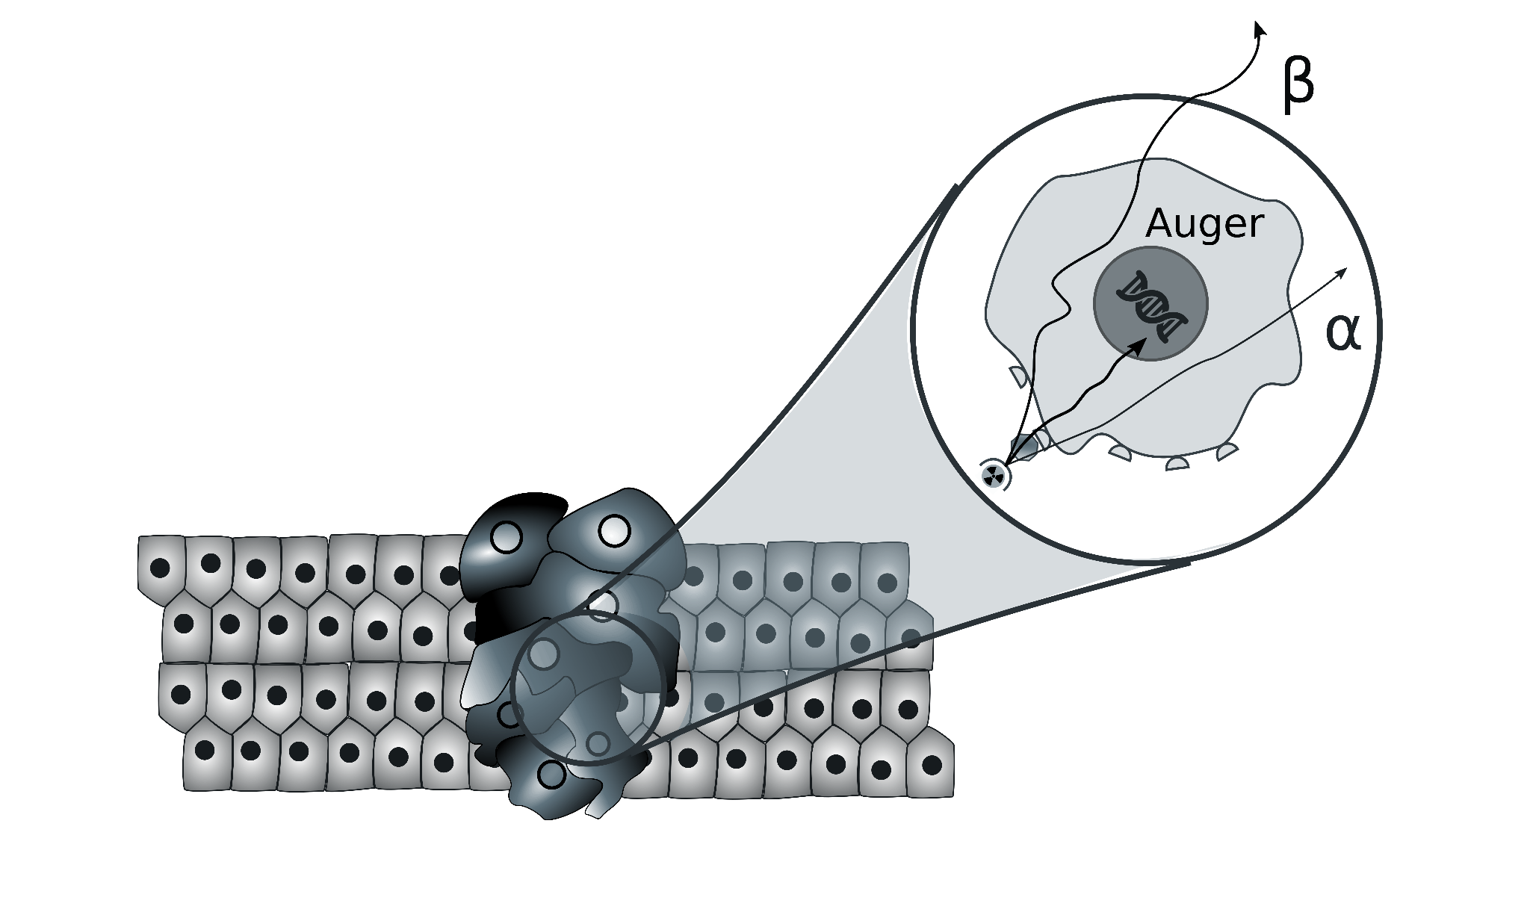

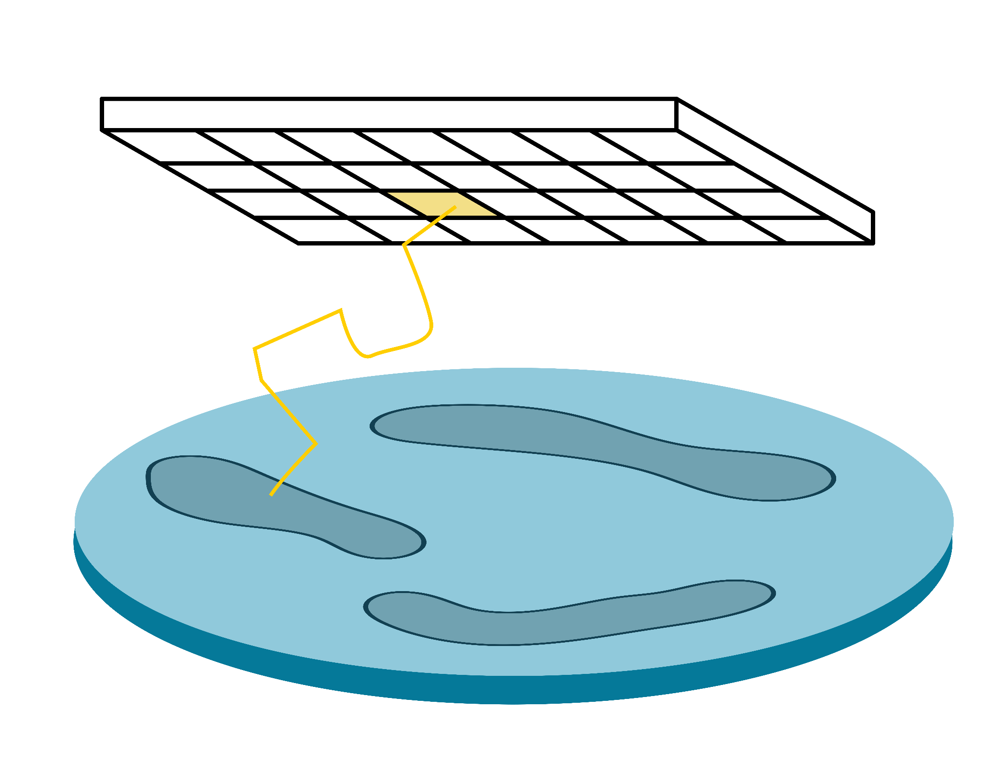
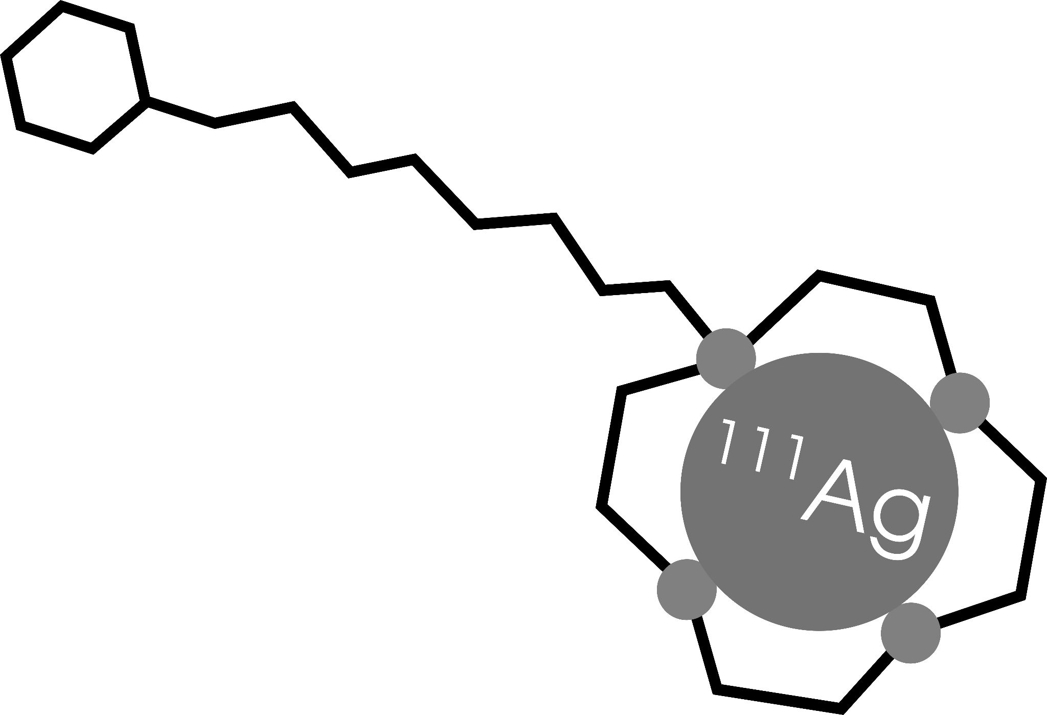
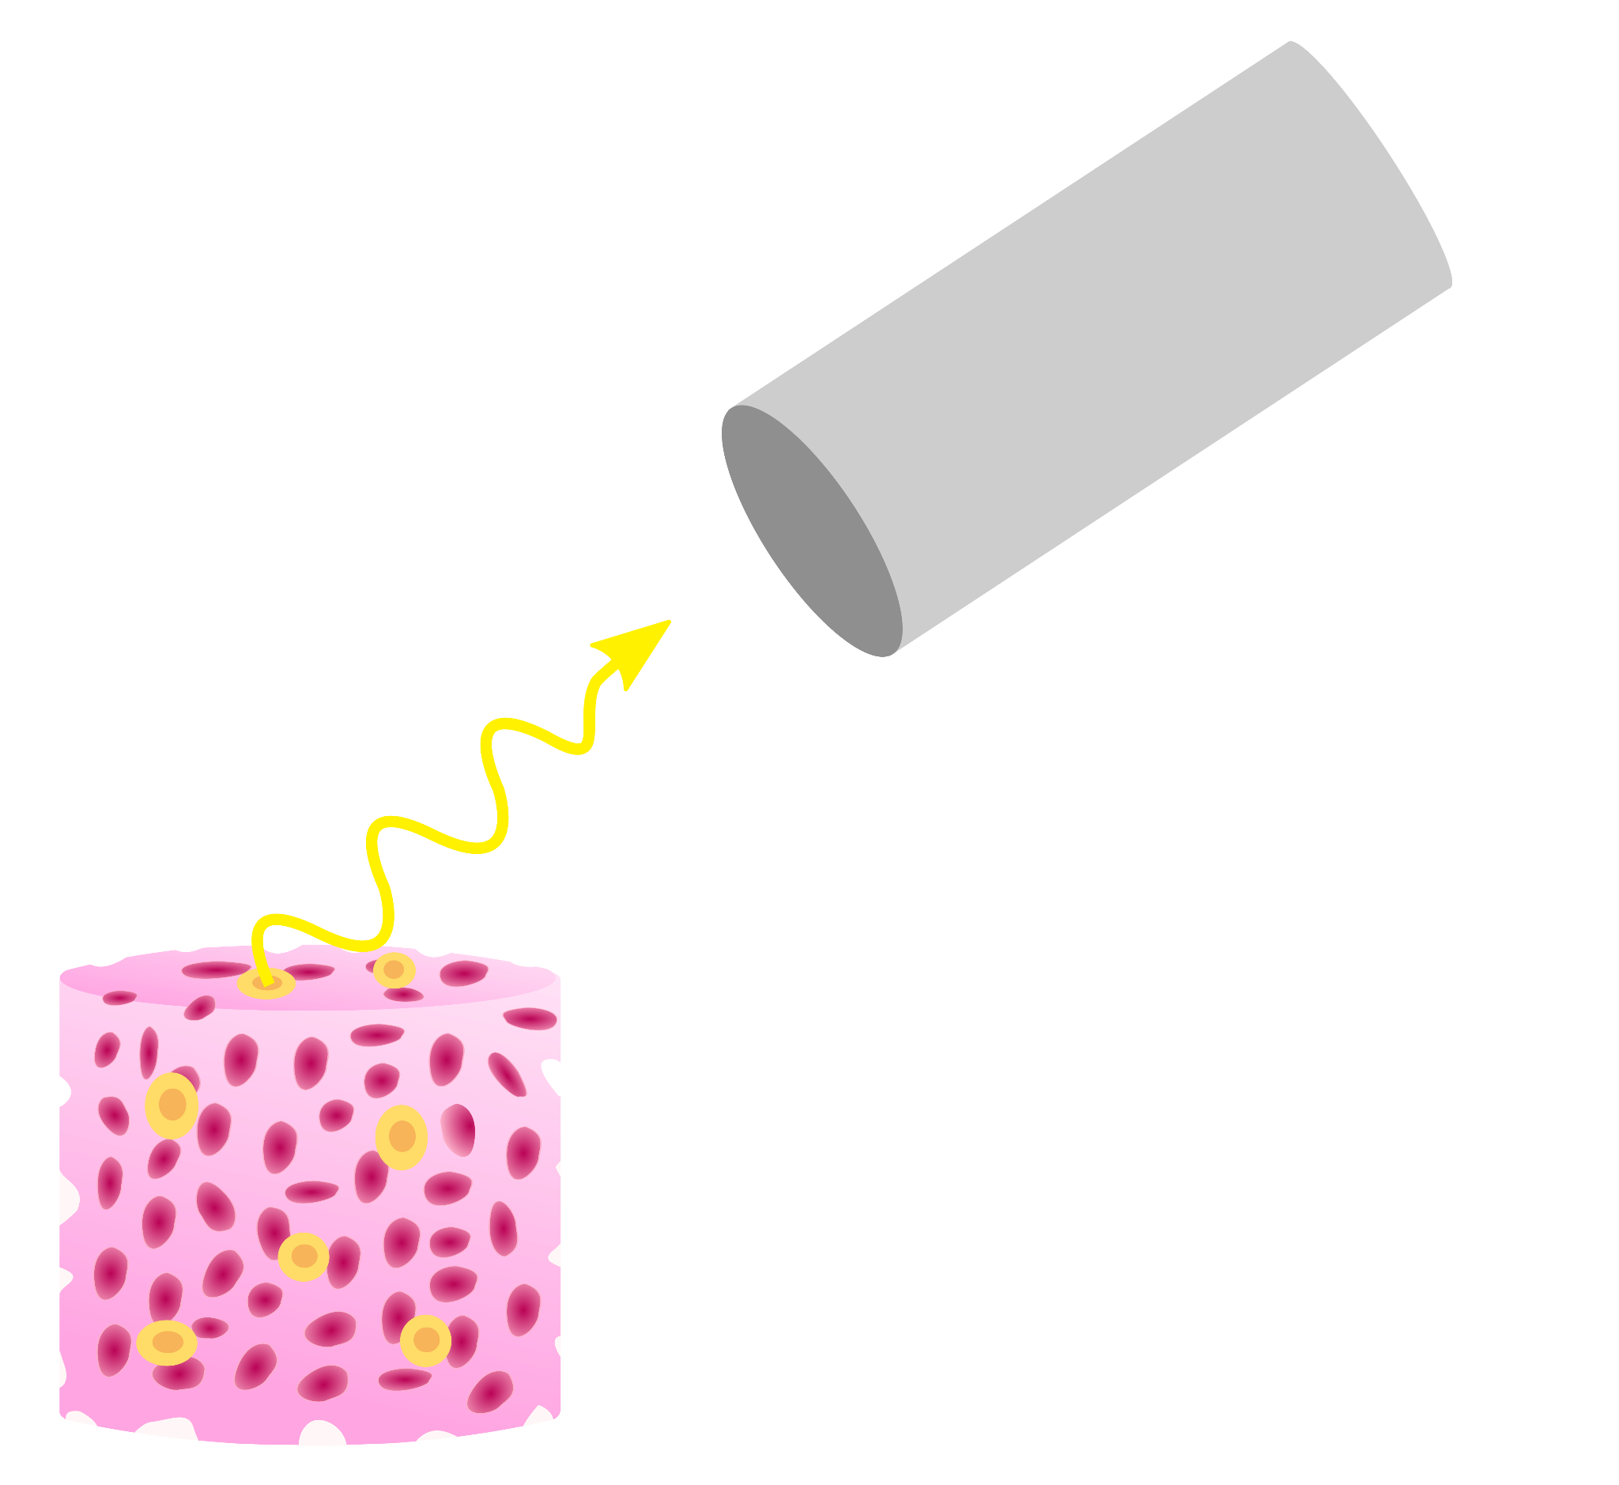















The ISOLPHARM collaboration
Development of a β-imaging
system based on solid-state detector
Radiopharmaceutical
production
Radiobiological characterization
Development of a γ-imaging scintigraphic system

Slide 7
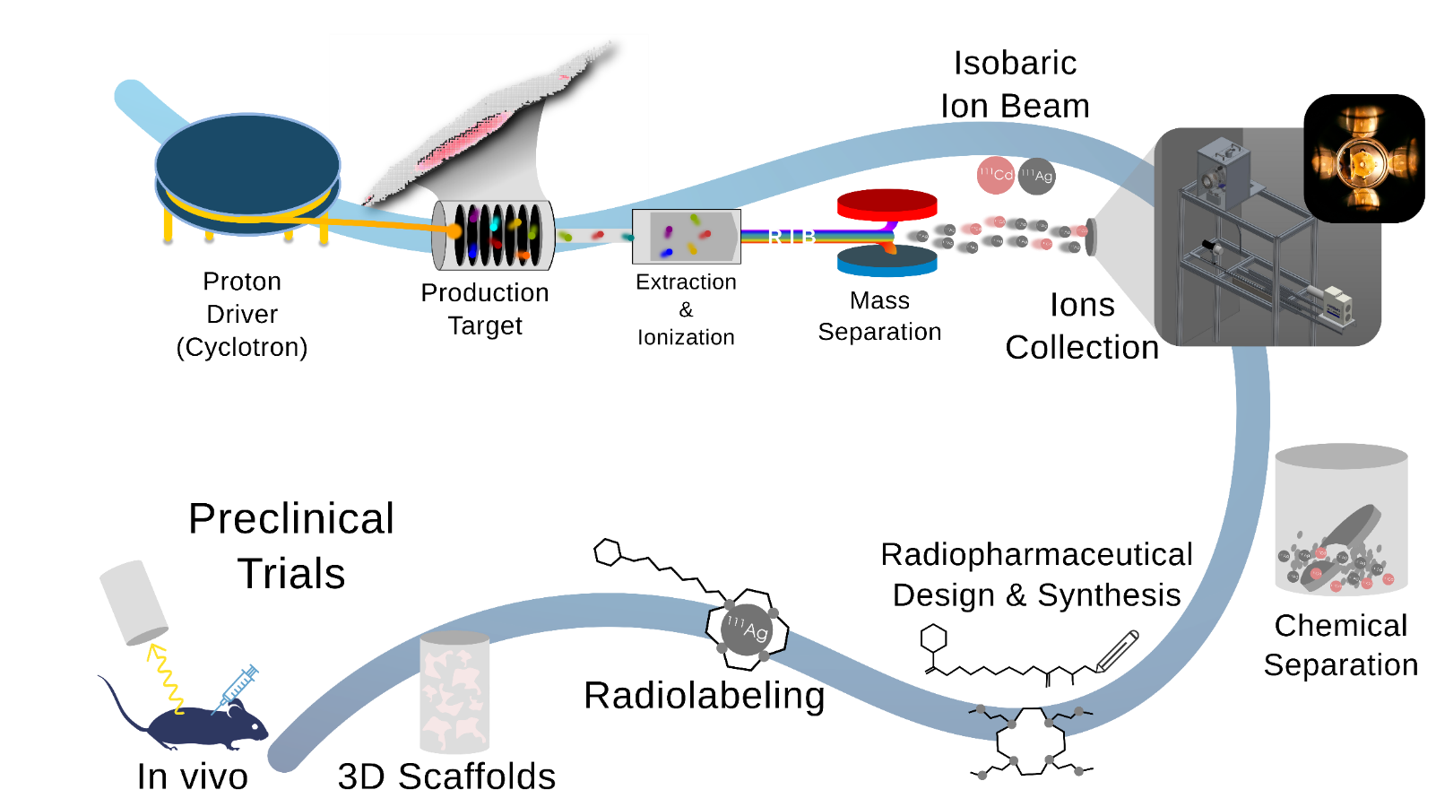

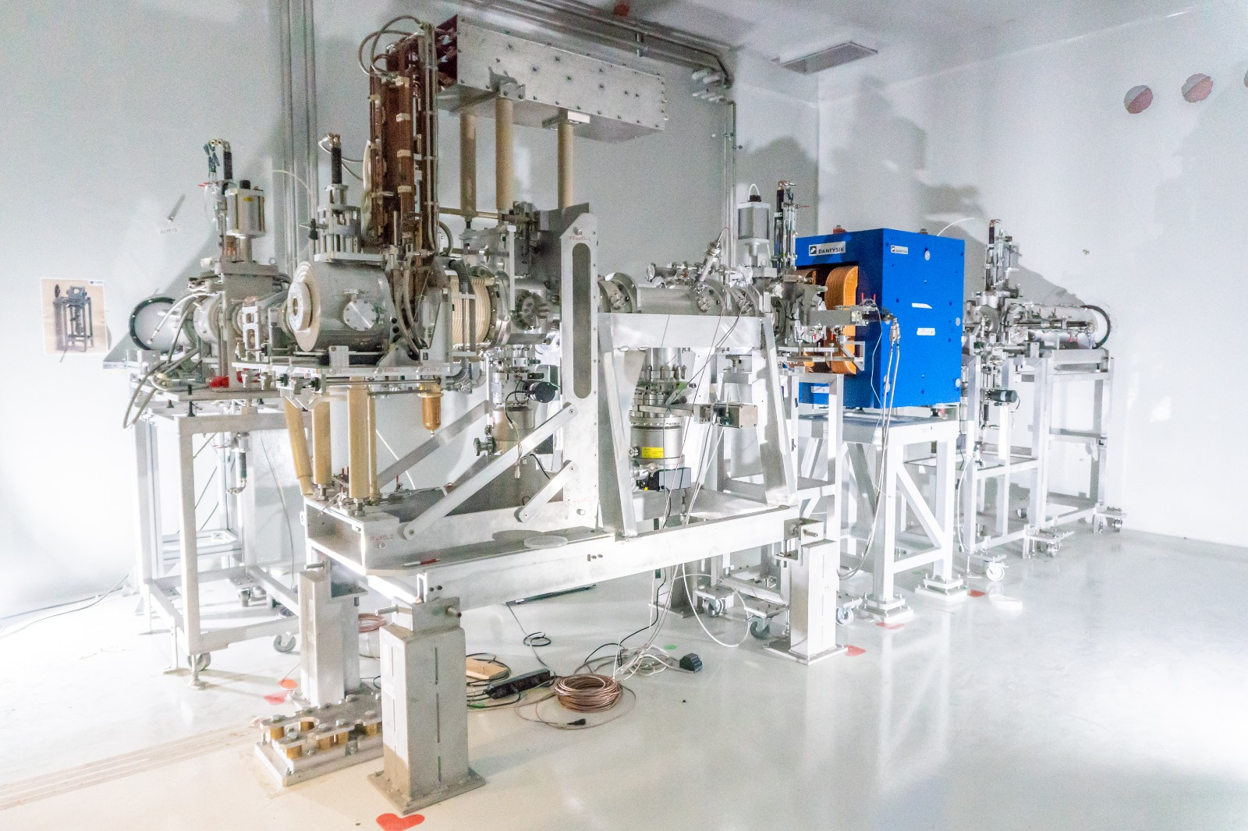
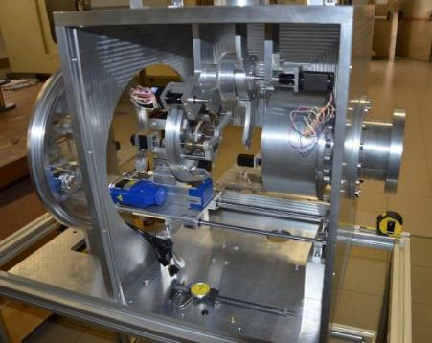
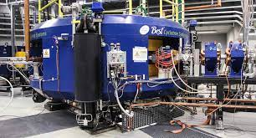
ISOLPHARM: Innovative Method
The ISOLPHARM method is able to produce and select a
SINGLE RADIO-ISOTOPE
+ high specific activity
+ radionuclidic purity

Slide 8
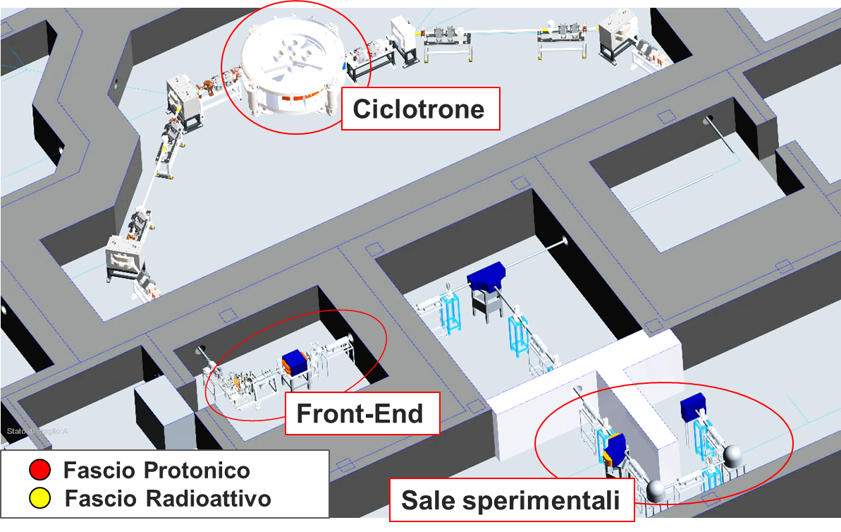
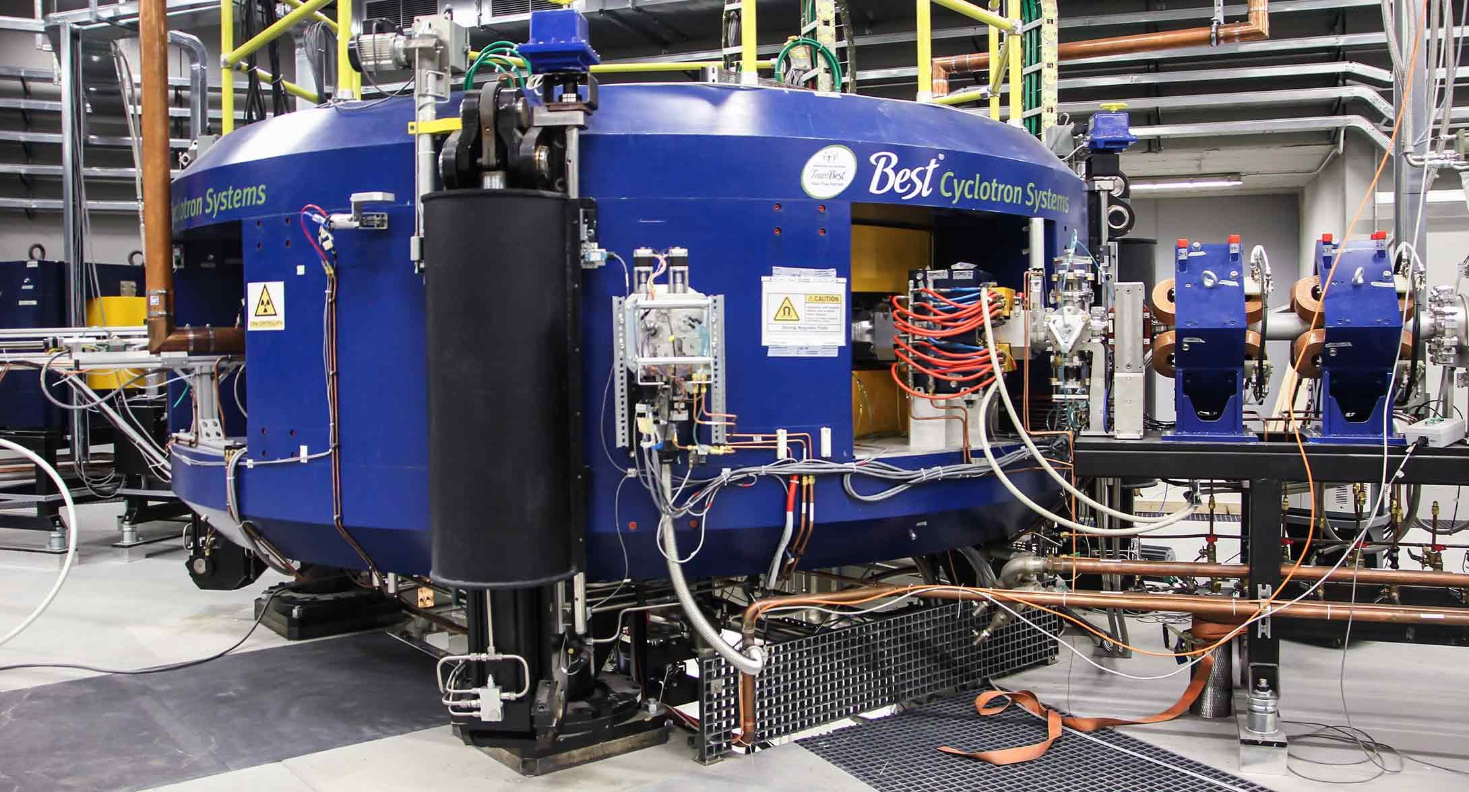
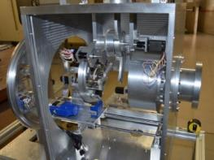
3. ISOLPHARM: the irradiation facilty at SPES
Starting Point: Some tens of mCi are sufficient to start a R&D on radiopharmaceuticals
Cyclotron
Front-End
Proton beam
Radioactive beam
IRIS Beam Collector
low costs, easy set-up

Slide 9
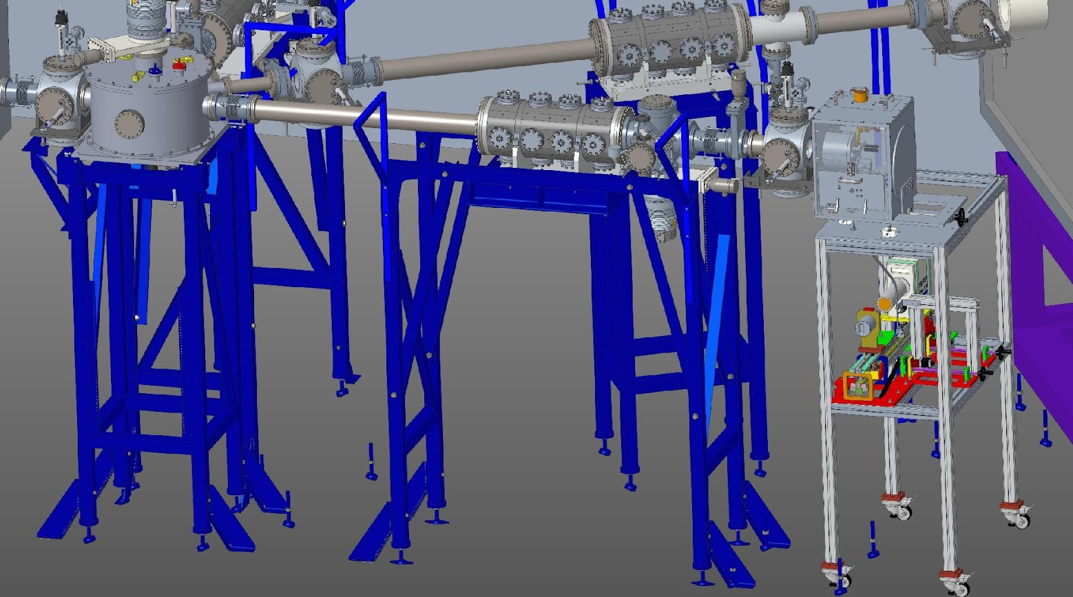
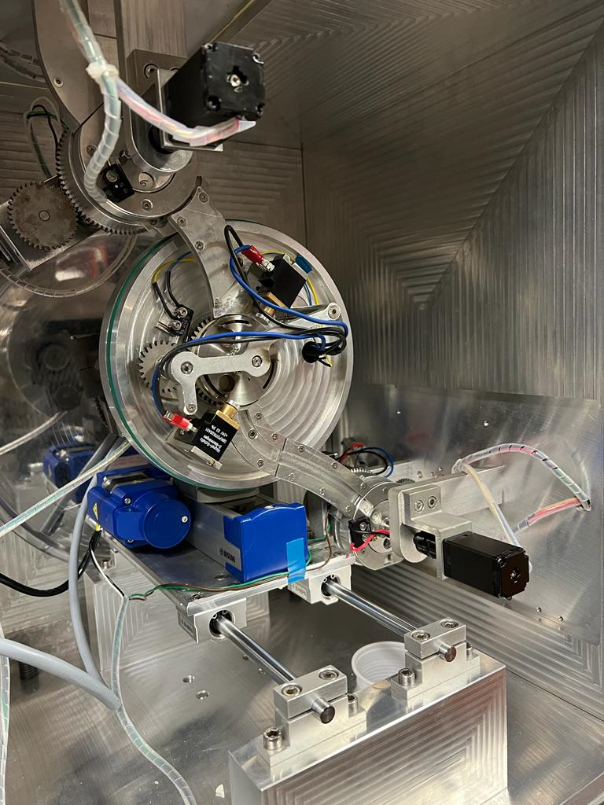
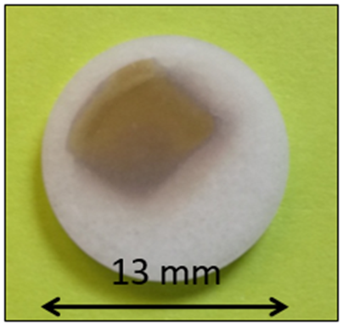
The ISOLPHARM Facility
IRIS: Detection and quality control station
Secondary Target with isotope deposited (¹⁰⁷Ag)

Slide 10


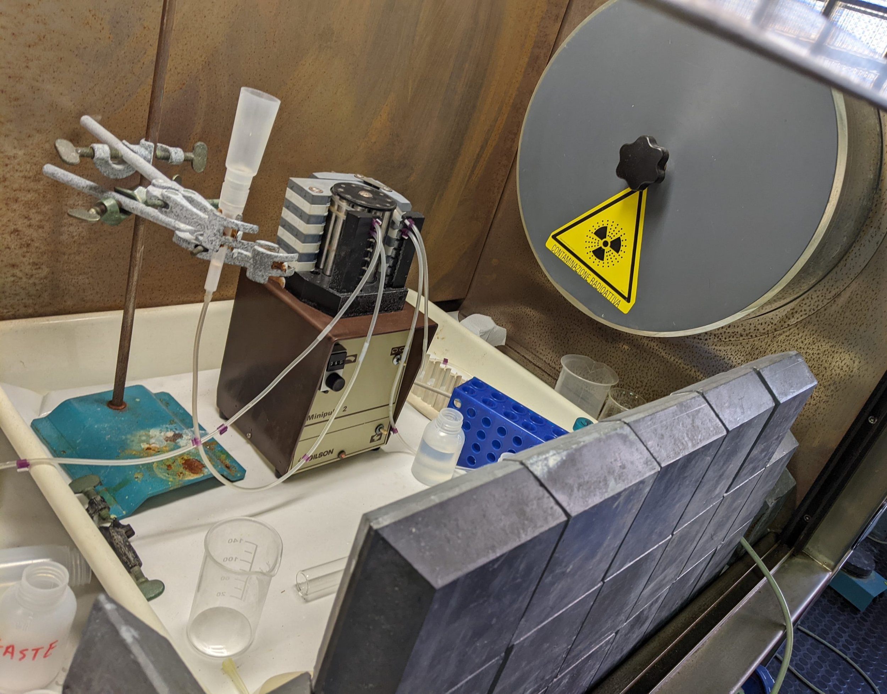


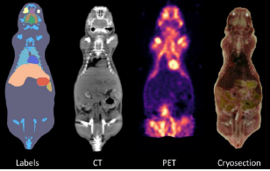


ISOLPHARM: 10 Years of activity
Interdisciplinary Study Group on production of medical radioisotopes at SPES
2014 - 2017
2018 - 2019
Simulations and feasibility evaluation
of Ag as radiopharmaceutical precursor
INFN experiments
2020 - 2022
First production of ¹¹¹Ag in reactor and beginning of in-vitro and in-vivo testing
2023 - 2025
Providing new tools for preclinical trials on 3D scaffolds
PRIN
Follows the technological aspect for the radionuclide production
2024 - 2025

Slide 11
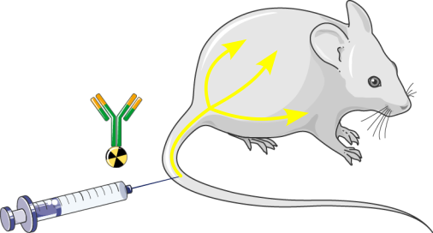
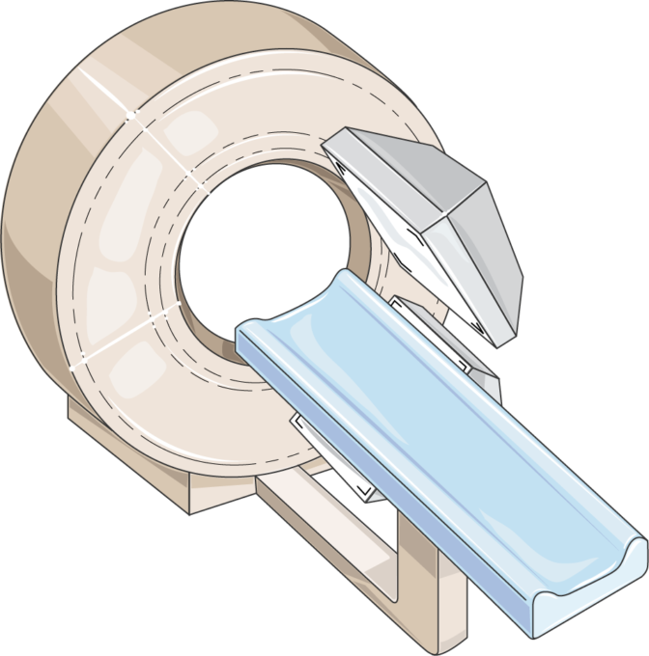
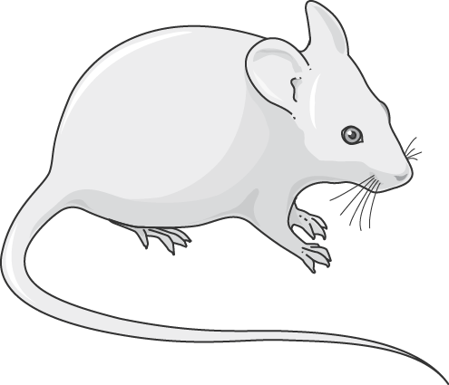

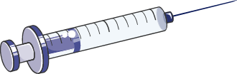
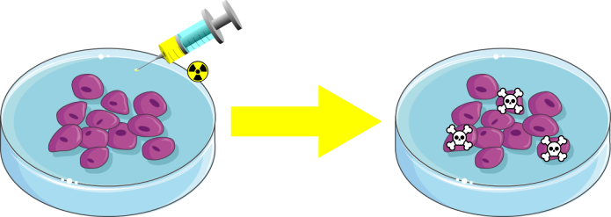
Why doing imaging within ISOLPHARM?
ISOLPHARM project performs imaging:
To track the radiopharmaceutical within a body for preclinical applications
To improve the existing imaging devices toward innovative radionuclides (tailored SPECT & γ camera )
To study the cellular uptake of radiopharmaceuticals

Slide 12

Imaging results using PET and SPECT
isotopes (quick review..)

Slide 13
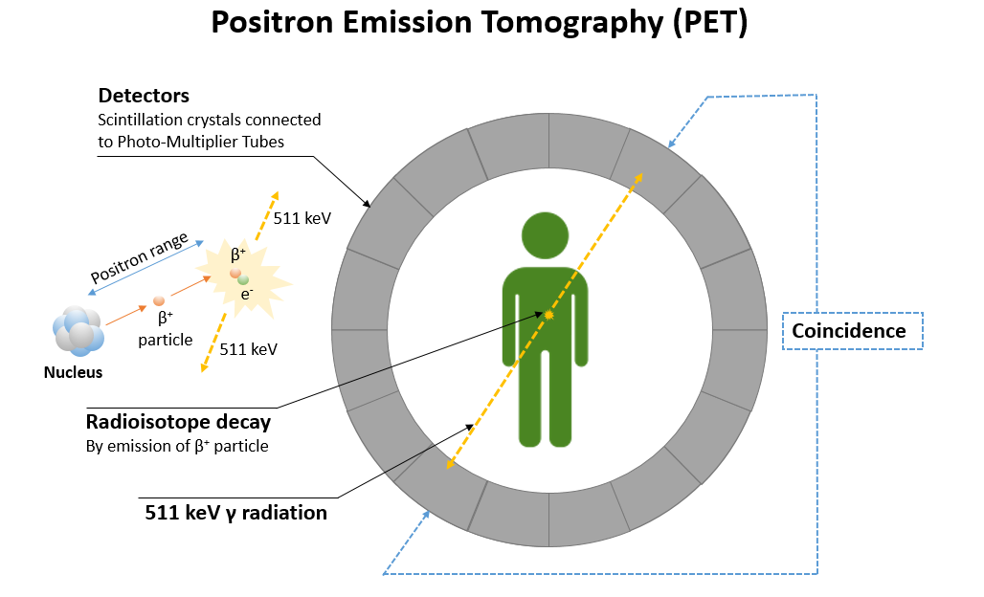
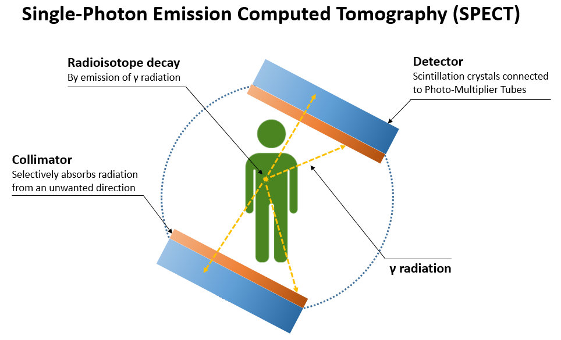
PET vs SPECT ISOLPHARM radioisotopes
⁶⁸Ga (half-life 67m) and
⁶⁴Cu (12h) emit:
positrons
  a pair of collinear 511 keV γ-rays
¹¹¹Ag (half-life 7.45d) emits:
γ-rays
  342 keV (7%)
  245 keV (1%)
¹¹¹In (2.8d) emits:
  245 keV (94%)
  171 keV (91%)
innovative isotope
M. Ballan, PhD thesis - Uni. Ferrara, 2019

Slide 14
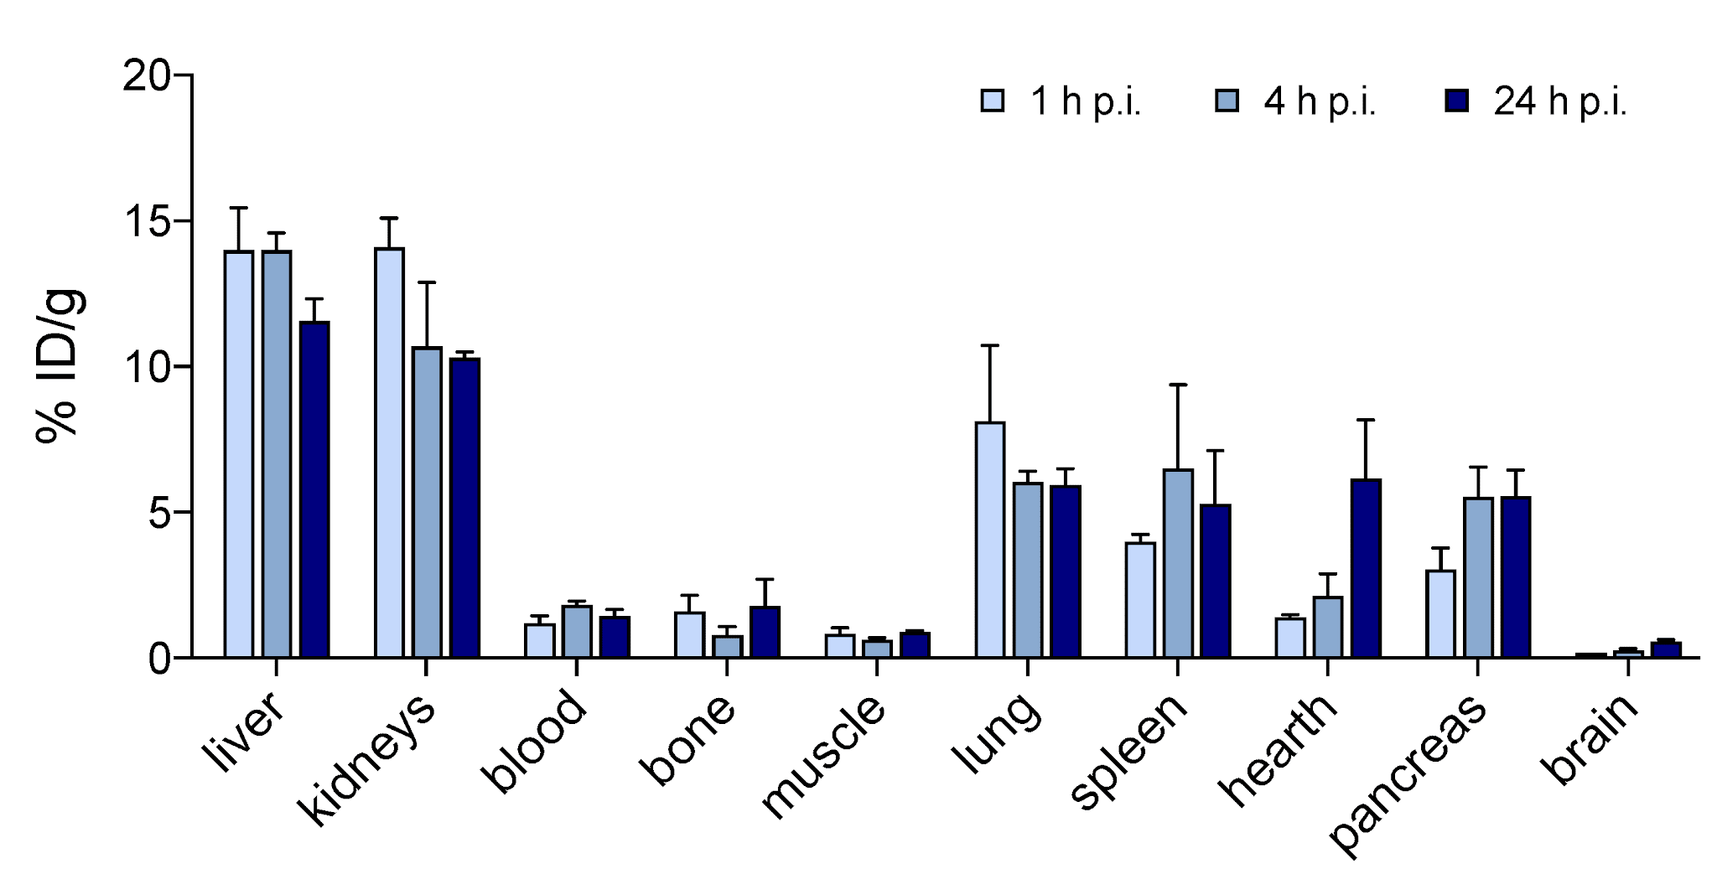
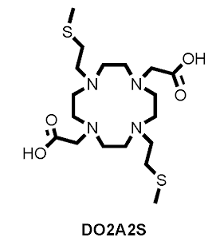
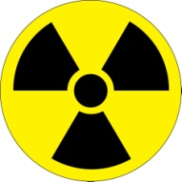
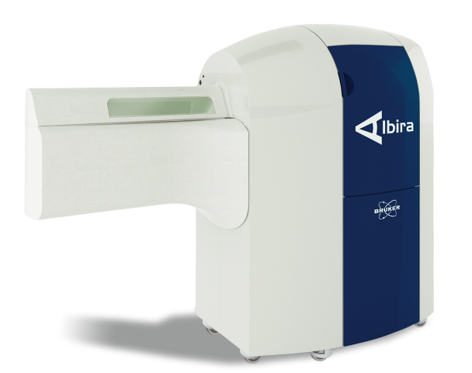
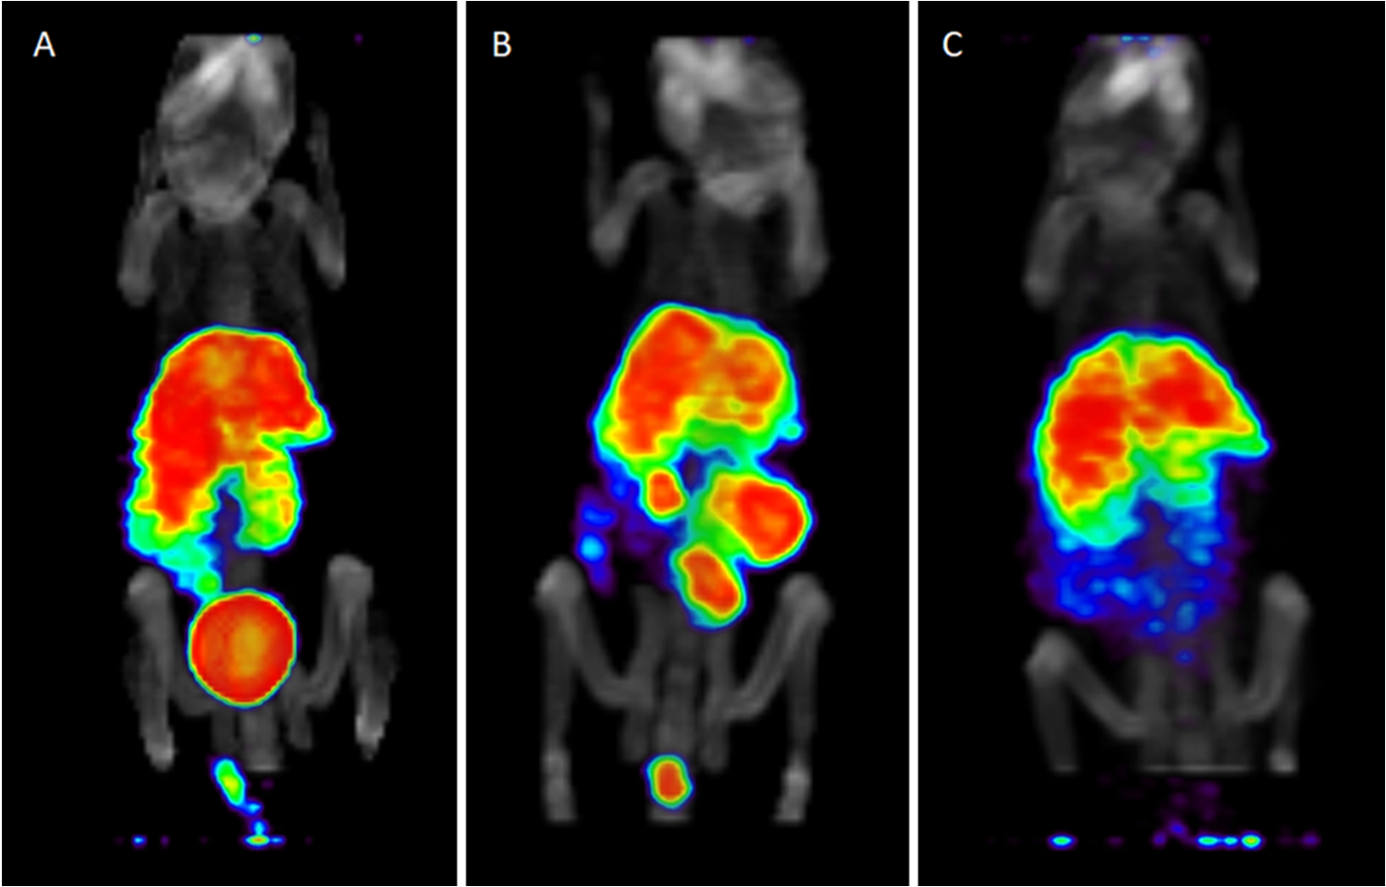
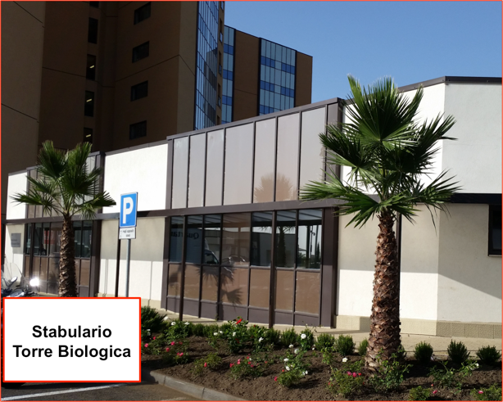

⁶⁴Cu – chelated (2021)
1
study of the in vivo stability of chelators
~ 10 MBq ⁶⁴Cu-DO2A2S injected in BALB/c nude mice
biodistribution obtained at 1, 4, 24 h post injection
PET/CT images
M. Tosato et al., Molecules, 27 (2022) 4158

Slide 15
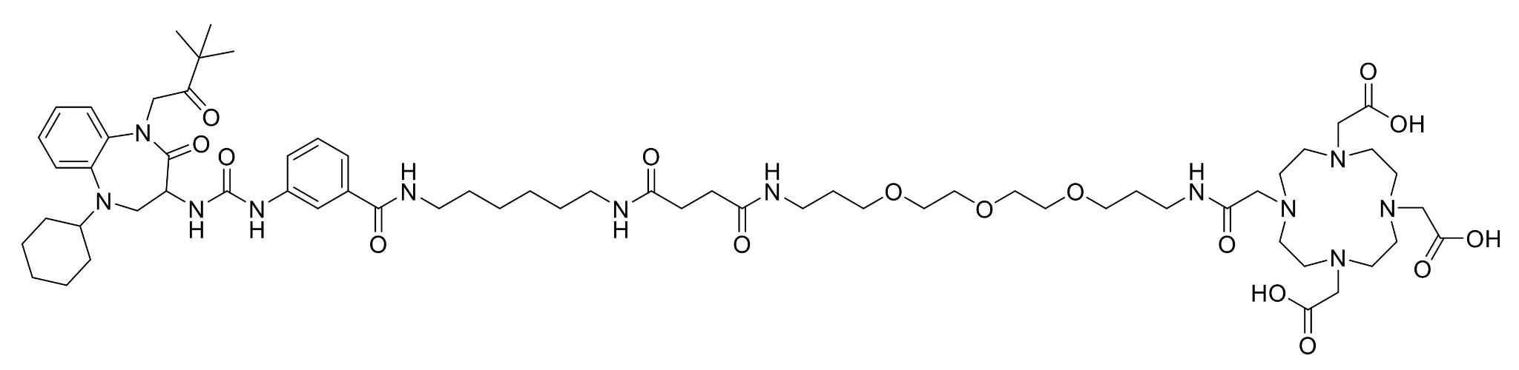
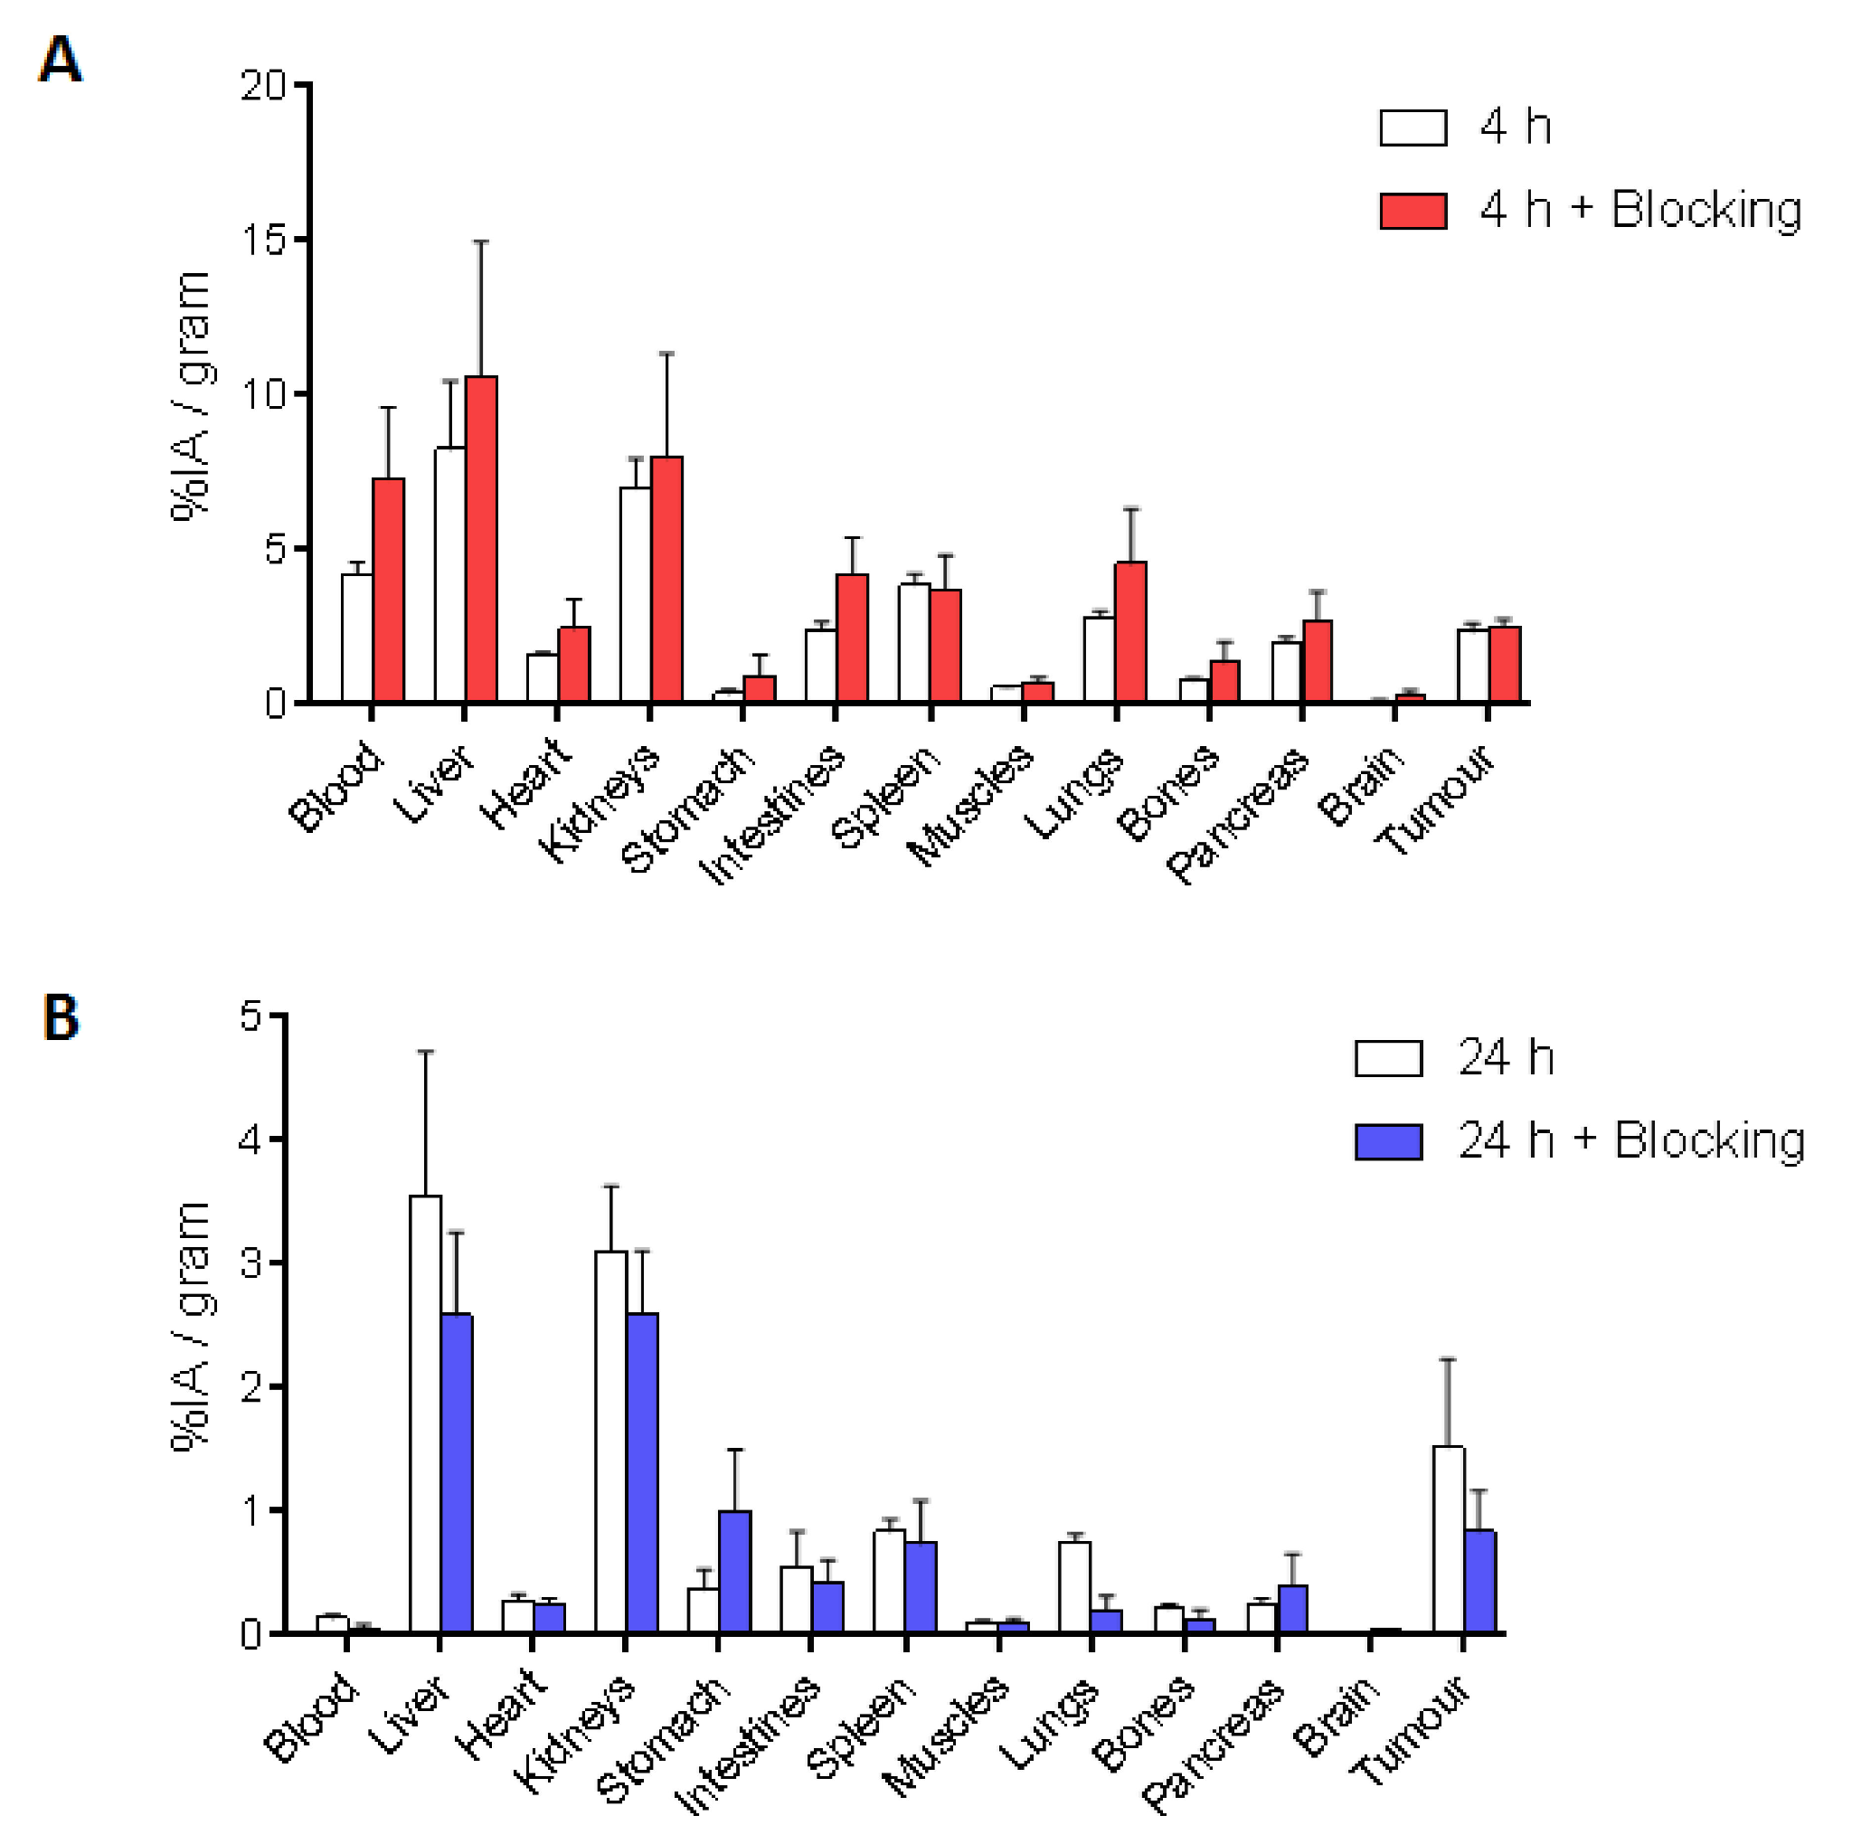

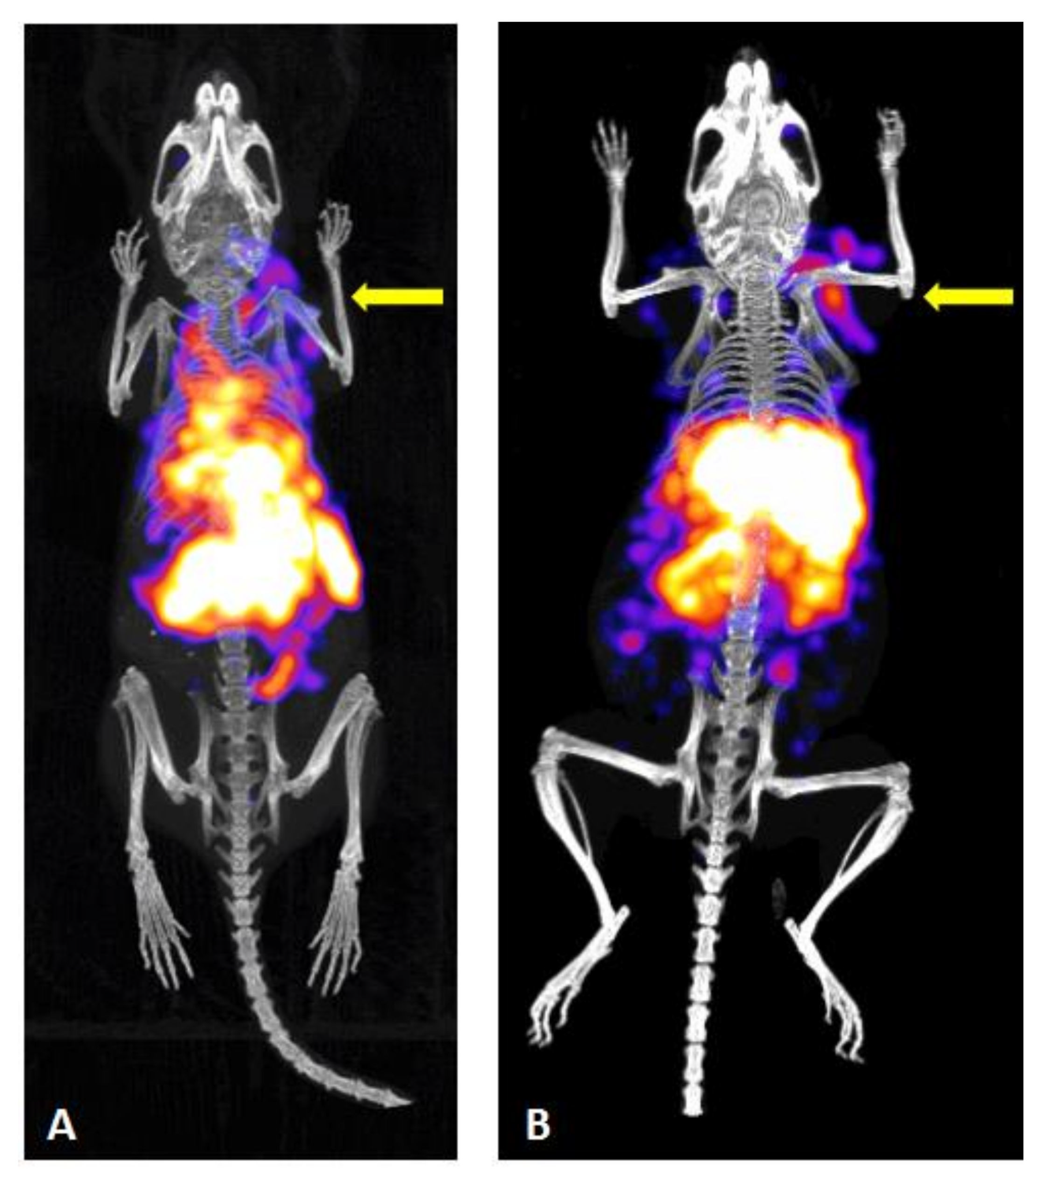
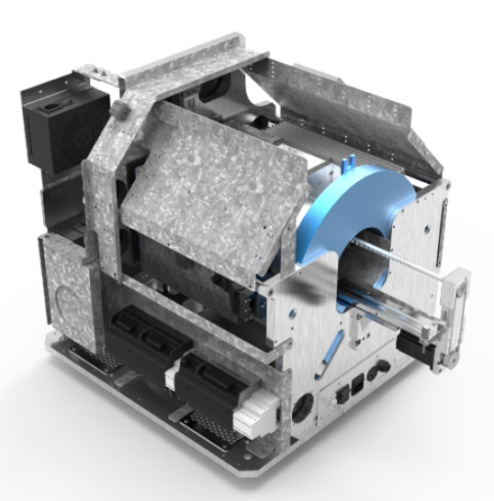
¹¹¹In – targeted (2021)
2
Z360
study of the in vivo stability of chelators (DOTA)
~ 7 MBq ¹¹¹In- DOTA- IP-001 + Z360 (ligand)
biodistribution obtained at 4, 24 h post injection
IP01= Isolpharm Linker
DOTA
SPECT/CT images at 4 (left), 24 (right) h p.i.
γ-CUBE mouse/rat SPECT
M. Verona et al., Molecules 26 (2021) 918

Slide 16
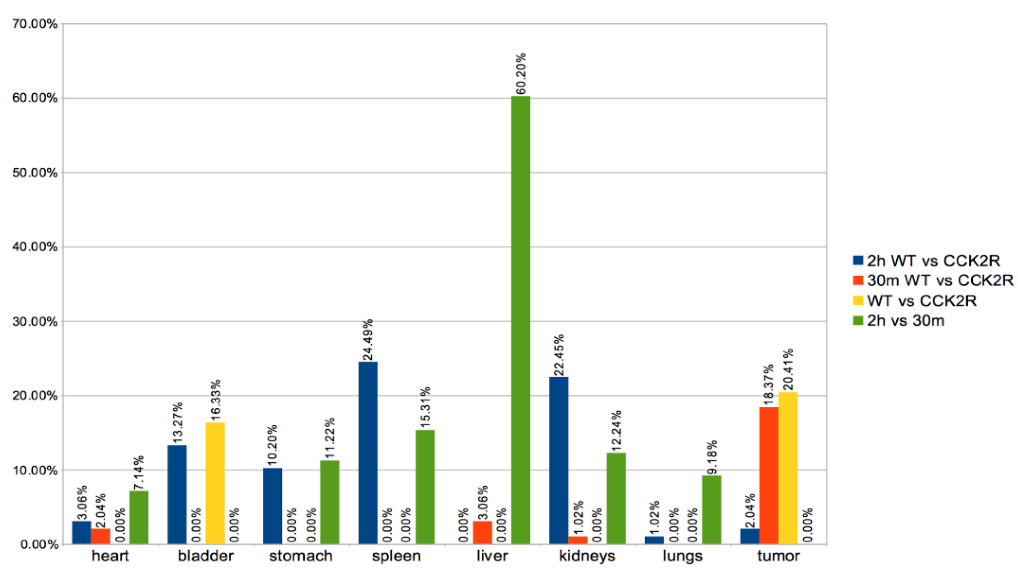
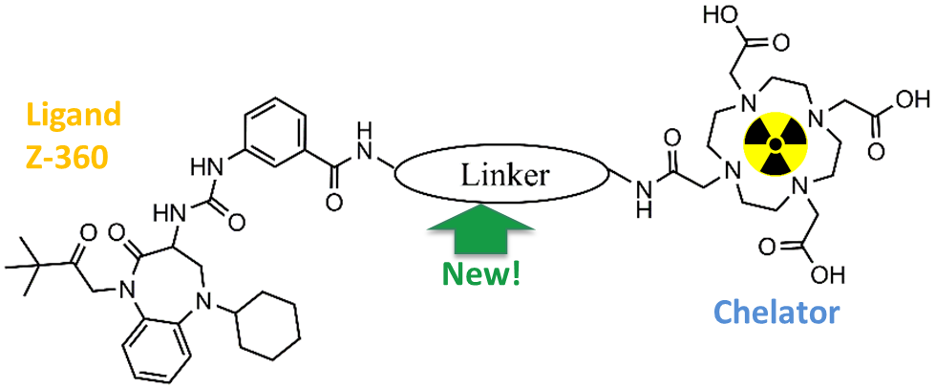
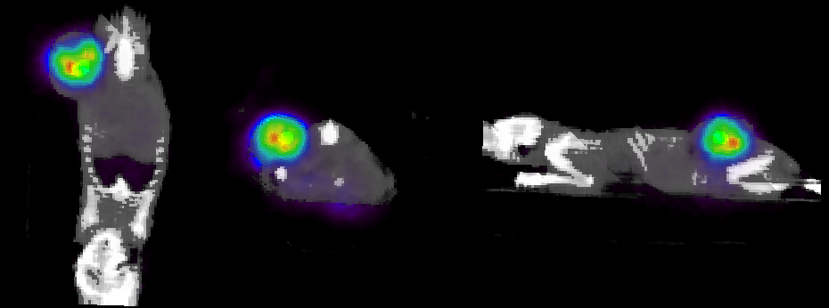
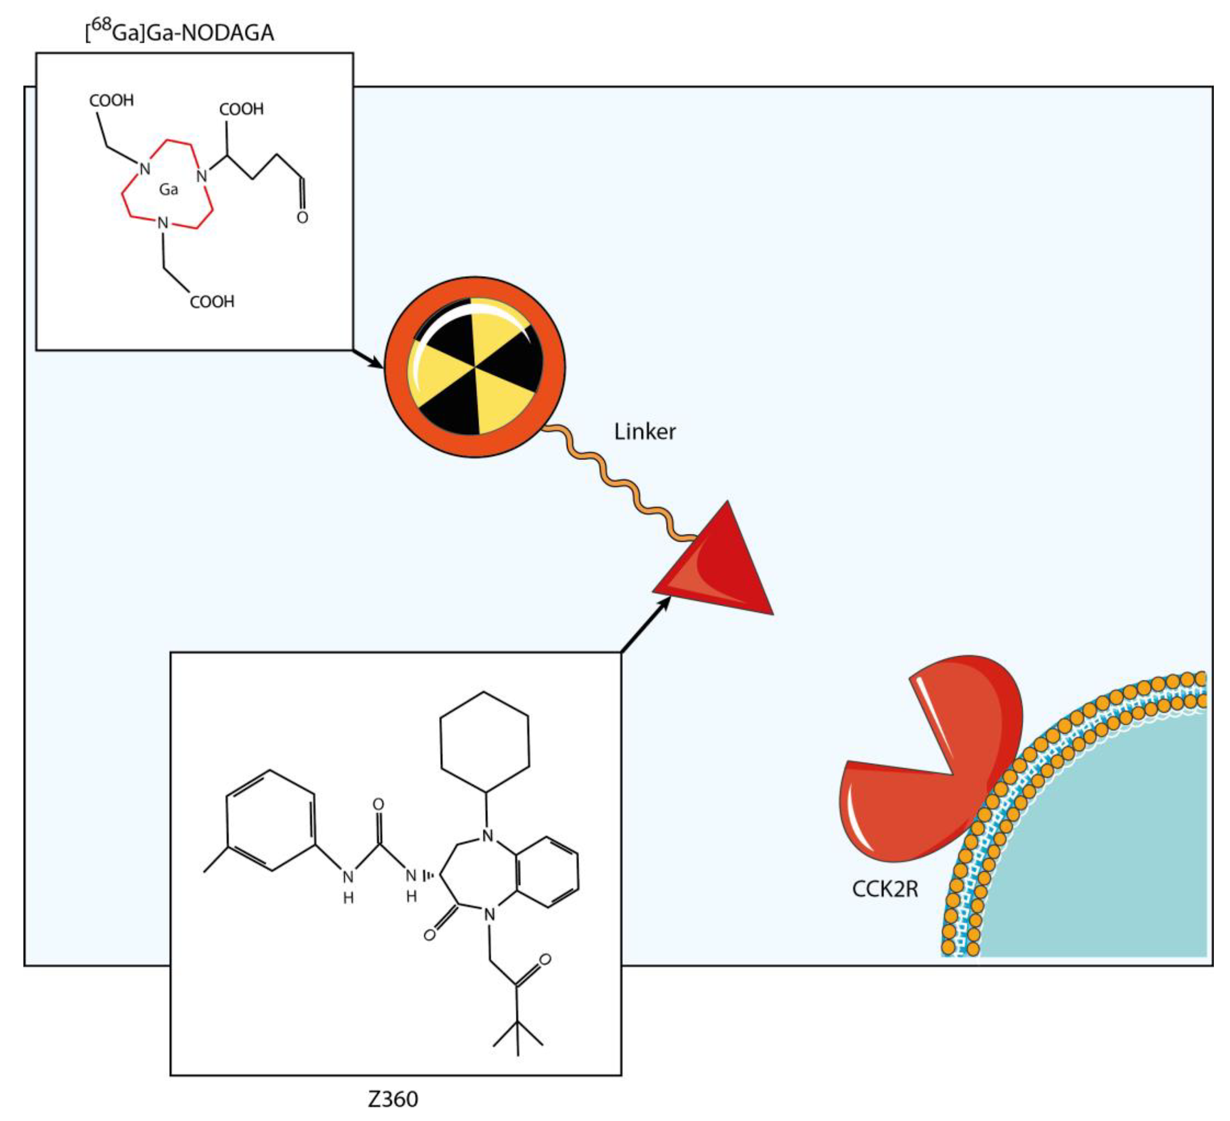
⁶⁸Ga – targeted (2022)
3
study of the biodistribution of targeting agent Z360 (CCK2R)
~ 6 MBq ⁶⁸Ga-NODAGA-IP01- Z360
biodistribution obtained for cells expressing the CCK2R
PET/CT images
A. M. Pavone et al., Life 14 (2024) 409

Slide 17
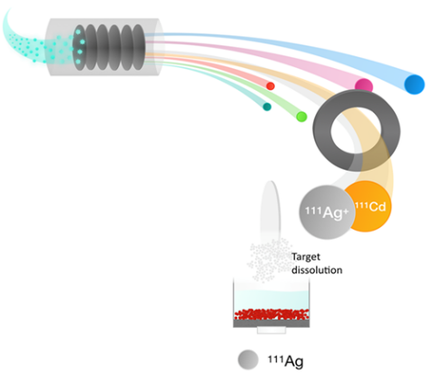
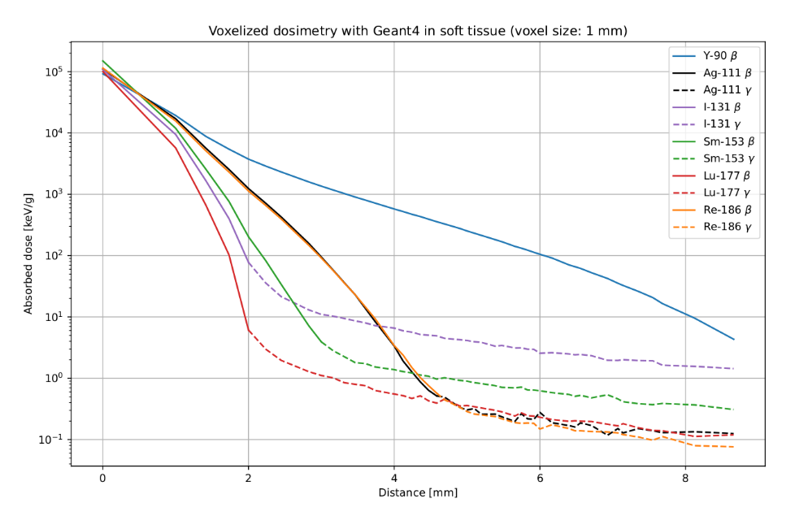

Radiopharmaceutical radiolabeled with ¹¹¹Ag
¹¹¹Ag properties
β⁻ emitter (average energy 360 keV)
Good half-life (7.45 days)
Average tissue penetration (1.8 mm)
Medium energy γ rays -> SPECT candidate
→ No radiopharmaceuticals radiolabeled with ¹¹¹Ag in the market.
→ ¹¹¹Ag can be produced @ SPES with high purity & with high production rate
→ No Isobaric 111 contamination in the secondary target (also with LASER off)!
→ ¹¹¹Ag exhibits possible ‘theranostic’ properties
similar to ¹⁷⁷Lu which was recently approved by FDA.
→ ¹¹¹Ag has dosimetric behavior equal to ¹⁸⁶Re, which was recently studied in Phase I / II trials
111 Isobaric chain | Half-Life T_{½} | Decay | Target Yield
Cadmium-111 | Stable |  | Low yield production
Silver-111 | 7.45 days | β─ | Good yield production
Palladium-111 | 23.4 min | β─ | Bad release, short T_{1/2}
Rhodium-111 | 11 sec. | β─ | No release, very short T_{1/2}

Slide 18

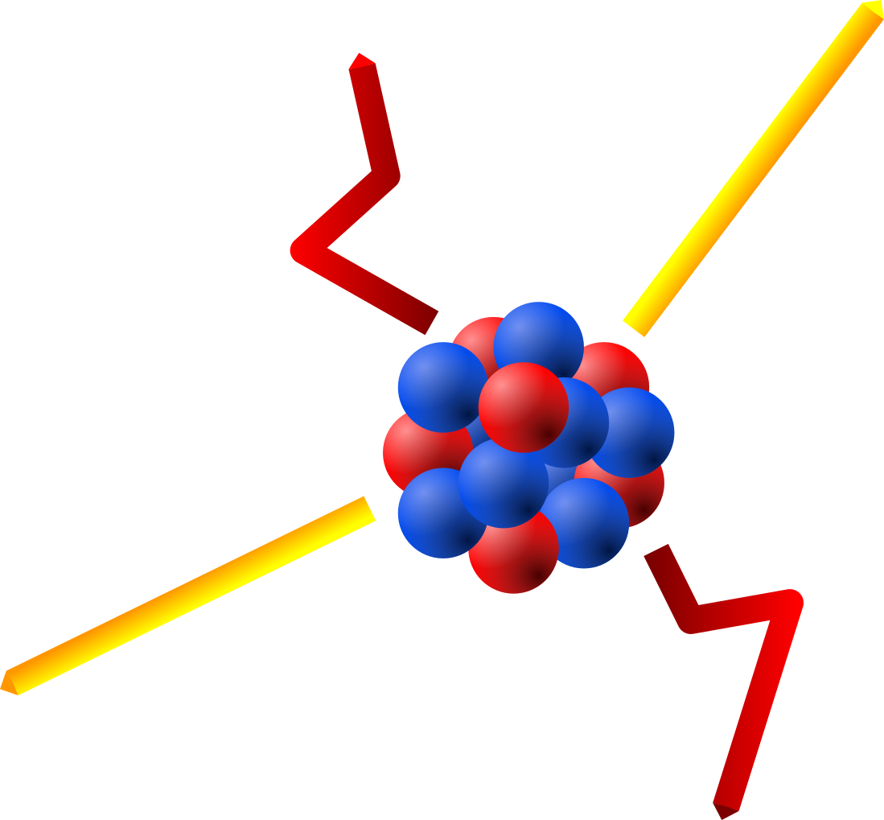
¹¹¹Ag versus ¹⁷⁷Lu
Is ¹¹¹Ag a possible alternative to ¹⁷⁷Lu?
 | ¹⁷⁷Lu |  | ¹¹¹Ag
half-life | 6.64 days |  | 7.45 days
β⁻ | 79 % intensity | 149 keV (average) | 92 % intensity | 360 keV (average)
γ | 10 % intensity | 208 keV (average) | 7 % intensity | 342 keV (average)
¹⁷⁷Lu
¹¹¹Ag

Slide 19
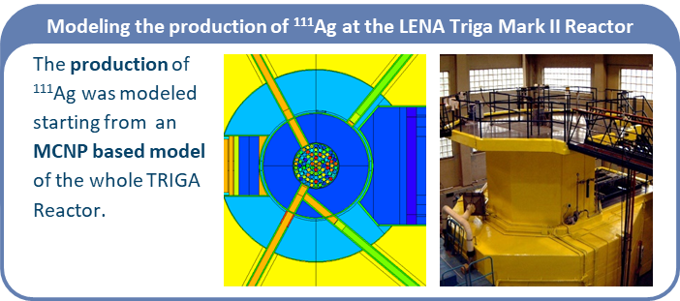
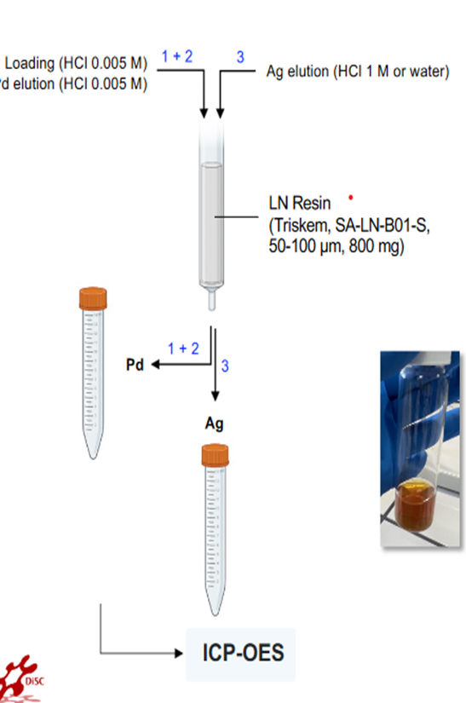

¹¹¹Ag production & separation

Slide 20




Test with ¹¹¹Ag in phantoms (2023)
4
Can Ag-111 be imaged?
Bruker In-Vivo Xtreme can perform pre-clinical imaging via ¹¹¹Ag radiopharmaceuticals:
  Used the Direct Radioisotopic Imaging (DRI)
  PMMA Phantoms filled with ¹¹¹Ag solution
Xtreme will be used to evaluate the targeting efficiency-> Only planar distribution
5 mm
2 mm
DRI
3 mm
Nicola Zancopè, M.Sc. thesis - Uni. Padova, 2022

Slide 21







Imaging with free ¹¹¹Ag (March 2024)
5
¹¹¹Ag
150 mg of ¹¹⁰Pd
irradiated in the LENA
central thimble
biodistribution
in vivo imaging
Obtained 88 MBq of ¹¹¹Ag
5 days after injection
21

Slide 22

R&D on tailored detectors for ¹¹¹Ag
¹¹¹Ag

Slide 23





ISOLPHARM gamma camera for γ-imaging
What we are doing
Design/perform a gamma camera tailored to ¹¹¹Ag
Aim: to localize radiopharmaceutical deposits within mice for pre-clinical experiment
3-1 - Detector Design & Electronics
Electronics:
CAEN FERS DT5202
Optical photon detectors (SiPM):
Hamamatsu S14161 8x8 ch 3x3 mm²
Tungsten Collimator:
2 mm holes, 1 mm septa, 30 mm length
Scintillating crystal:
(GAGG) 1x1x26 mm³ matrix

Slide 24




ISOLPHARM γ-imaging
GEANT4 Simulations: -> Detector performance
MOBY phantom used to generate activity distributions
  Injection of 3 MBq of ¹¹¹Ag in two spots of the liver
  5 min acquisition
Tumors are detectable according to the simulation
Two tumors 8 mm apart
First experiments (April 2024):
Tests are ongoing with sealed sources (¹³⁷Cs)
At the end of this year tests with ¹¹¹Ag phantoms are planned
24

Slide 25


ISOLPHARM Beta detector for β-imaging
What we are doing:
Design/perform a high-resolution and cost-effective beta imaging system
  to generate two-dimensional activity maps for in-vitro test
  Aim: to revealing the localization of radiopharmaceutical deposits within cell cultures (internalization)
Beta detector is based on ALPIDE chip. This is a monolithic active pixel sensor (MAPS) designed for the Inner Tracking System of the ALICE experiment at CERN.
The Silicon sensor is segmented into 1024 x 512 sensitive pixels of size 28 μm x 28 μm.

Slide 26




ISOLPHARM β-imaging
GEANT4 Simulations -> detector performance
Simulated images in a realistic 2D cell culture with ¹¹¹Ag:
• Radiopharmaceutical deposited in dispersed tumor cell clusters
• About 10^{^6} radiopharmaceutical molecules internalized per cell
• 15-minutes acquisition time
First experiments with ¹¹¹Ag (March 2024):
Dedicated firmware mounted on the detector
A collimated source of ¹¹¹Ag was imaged
3.5 MBq ¹¹¹Ag produced at LENA
26

Slide 27




¹¹¹Ag Imaging: preliminary results
3-1 - Detector Design & Electronics
β
γ
Scintillation
γ ray
optical photons
Source:
3 cylinders (5 mm diameter) of ¹¹¹Ag solution
Image after scintillation
Beta imaging:
0.2 mm resolution can be obtained → cell culture imaging
Gamma imaging:
~7 mm resolution can be obtained → in-vivo imaging

Slide 28
Conclusion

Slide 29















































ISOLPHARM is also a training hub:
good collaboration with Universities
4 PhD theses
4 Master theses in Industrial Engineering
13 Master and Bachelor theses in Physics
24 Master theses in Pharmacology
2 Master theses in Chemistry

Slide 30



The ISOLPHARM Team
Post-graduate and PhD students:
Alberto Arzenton, Daiyuan Chen, Jessica Delgado, Giorgio Grosso, Omorjit Singh Khwairakpam, Aurora Leso, Davide Serafini, Nicola Zancopè
Thank you for your kind attention!
Visit our webpage: https://isolpharm.pd.infn.it/web/

