Slide 1
On-Chip Analog Neural Network for In-Sensor Image Reconstruction Towards PET Scanners with Large Fields of View
Susanna Di Giacomo^{1,2}, M. Ronchi^{1,2}, M. Amadori ^{1,2}, M. Carminati^{1,2}, G. Borghi ^{1,2}, P. Carra^{3,4}, G. Sportelli^{3,4}, N. Belcari^{3,4}, C. Fiorini^{1,2}
¹Politecnico di Milano, Dipartimento di Elettronica, Informazione e Bioingegneria, Milano, Italy
²INFN Sezione di Milano, Milano, Italy
³Università di Pisa, Dipartimento di Fisica, Pisa, Italy
⁴INFN Sezione di Pisa, Pisa, Italy

Slide 2
Outline
Introduction
  Motivations
  Neural network offline Training and Performance
Analog Neural Network ASIC (ANNA)
  Concept
  Architecture and Working Principle
ASIC Experimental Characterization
  Measurement Setup
  Chip-based Model for Training
  Results
Conclusions and Future Work

Slide 3
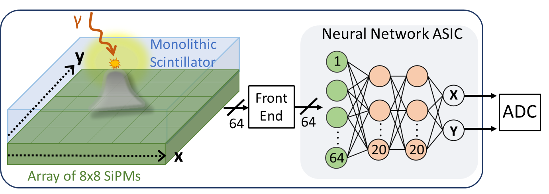
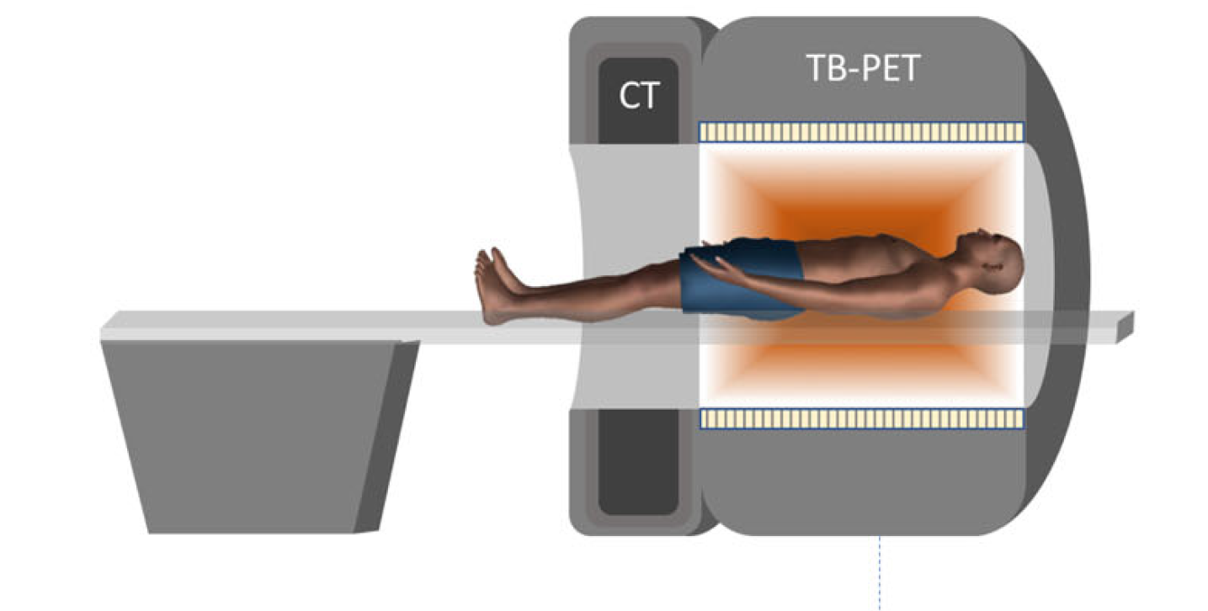

Motivations
Objective: Localization of the radiation event from detector signals for nuclear medical imaging (e.g. Anger Camera for PET/SPECT).
Detection Module
Motivations:
Analog operations directly on photodetectors analog signals.
No need for signal ADC and FPGA for embedded processing.
Reduction in number of interconnections and data to transmit.
Interaction coordinates directly at the ASIC output.
Fig. from: S. Vandenberghe, et al. "State of the art in total body PET." EJNMMI physics 7 (2020): 1-33.

Slide 4
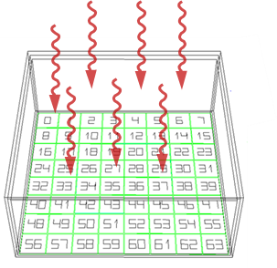
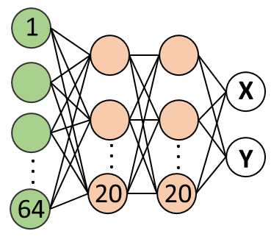
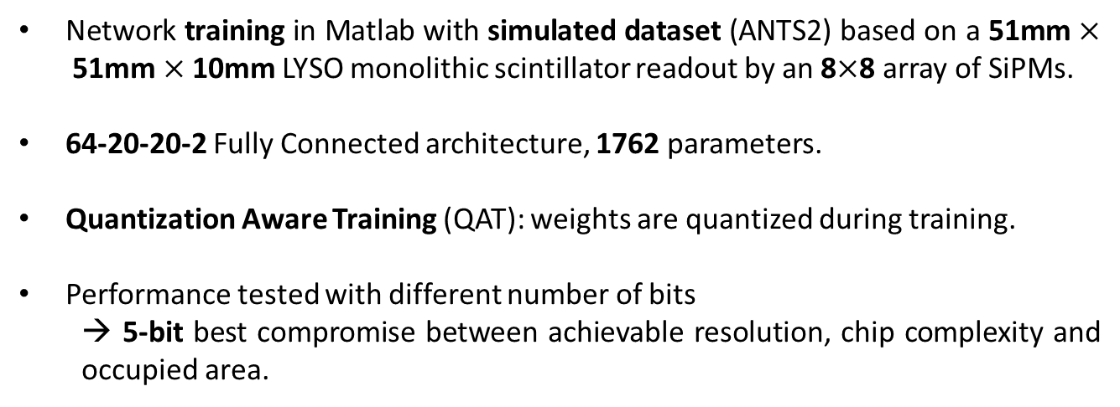
Network Performance with Simulated Data
Network training in Matlab with simulated dataset (ANTS2) based on a 51mm $×$51mm $×$10mm LYSO monolithic scintillator readout by an 8$×$8 array of SiPMs.
64-20-20-2 Fully Connected architecture, 1762 parameters.
Quantization Aware Training (QAT): weights are quantized during training.
Performance tested with different number of bits
  → 5-bit best compromise between achievable resolution, chip complexity and occupied area.
511 keV Gamma rays
LYSO
Scintillator
51x51x10 mm³
8x8 matrix
of 6.2x6.2 mm NUV-HD SiPM

Slide 5
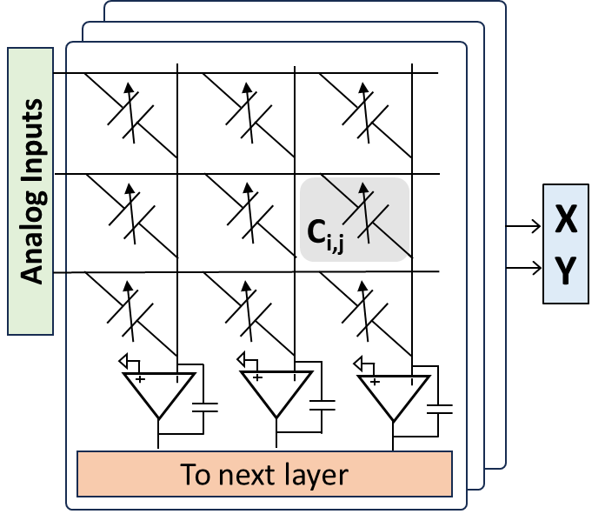
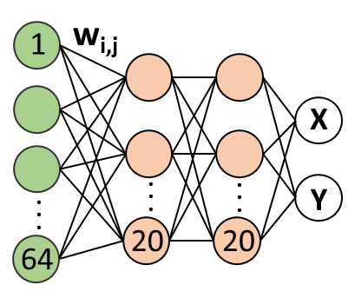
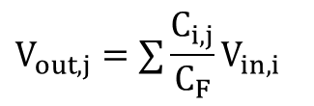
ASIC concept and architecture
Crossbar array of programmable switched capacitors.
S₅
S_{RST}
C_{F}
V_{in,i}
S₁
S₄
V_{out,j}
S₃
C_{i,j}
S₂
A
C
$$V_{out,j}=∑{\frac{C_{i,j}}{C_{F}}V}_{in,i}$$
2C
4C
8C
4-bit weight
1-bit sign
Integrator characteristic as Clipped ReLU

Slide 6
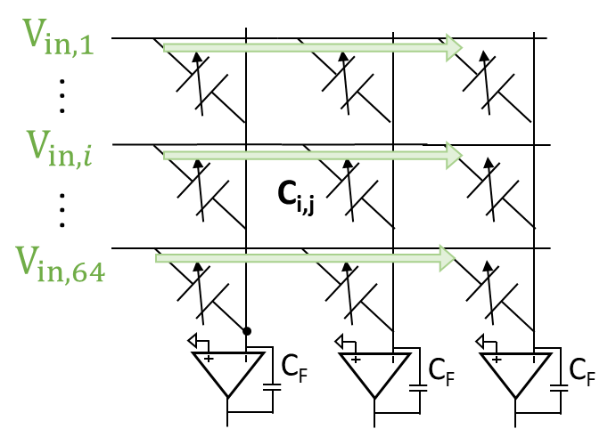
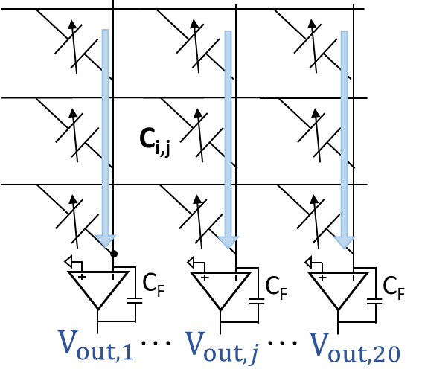
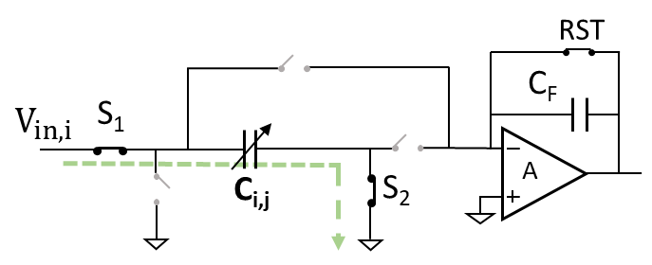
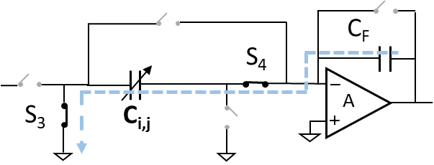
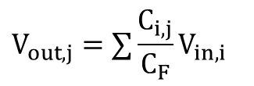
MAC Operation
1. Charging (multiplication)
2. Integration (accumulation + activation function)
weight
$$V_{out,j}=∑{\frac{C_{i,j}}{C_{F}}V}_{in,i}$$
Clipped ReLU

Slide 7
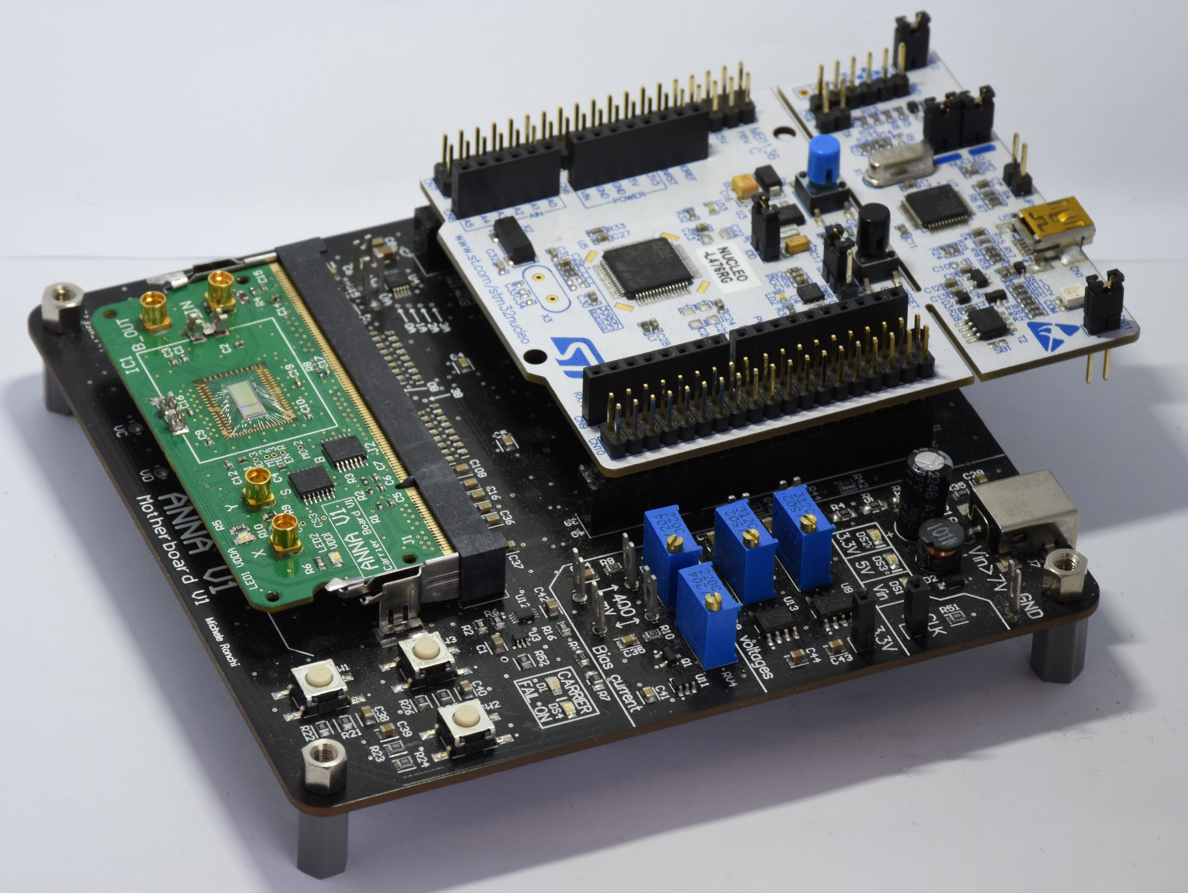

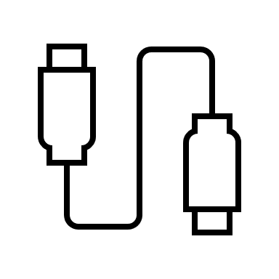
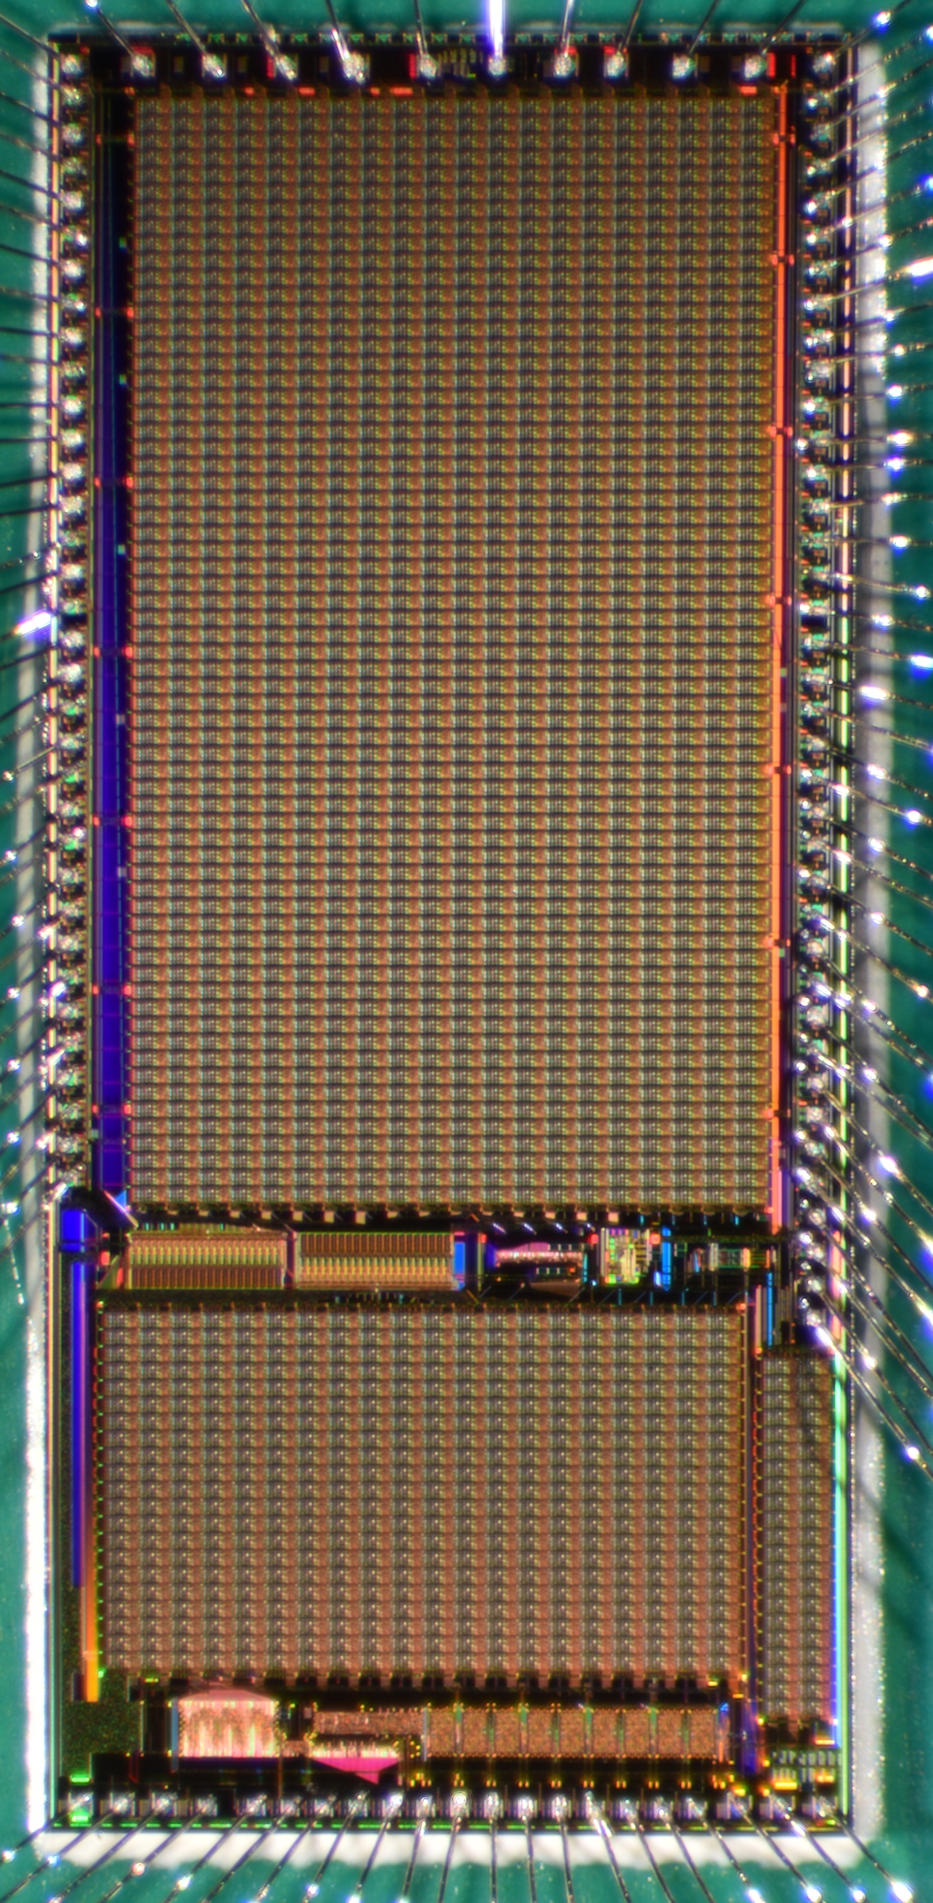
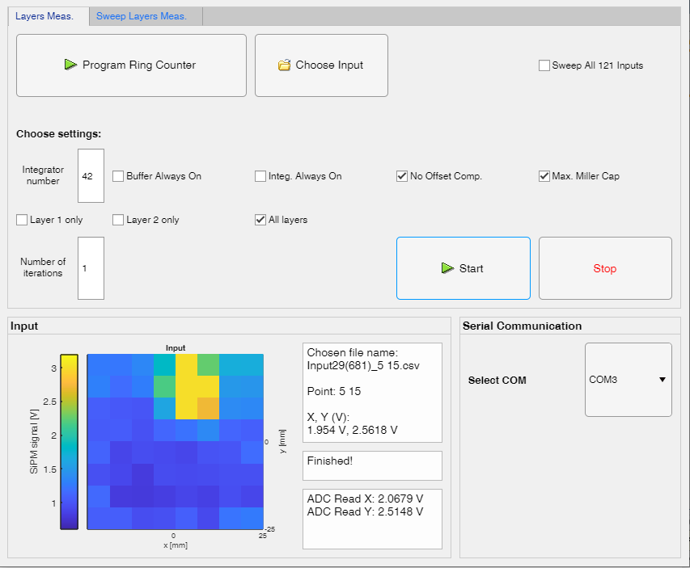
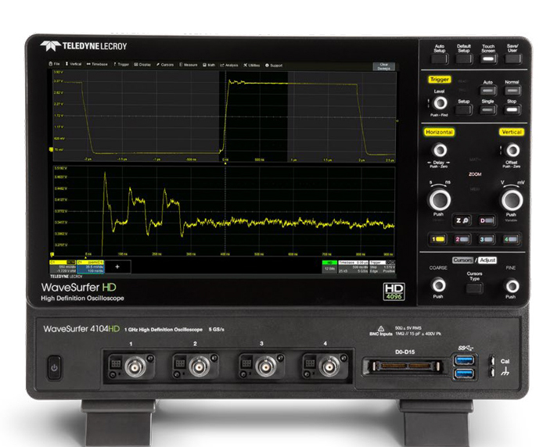
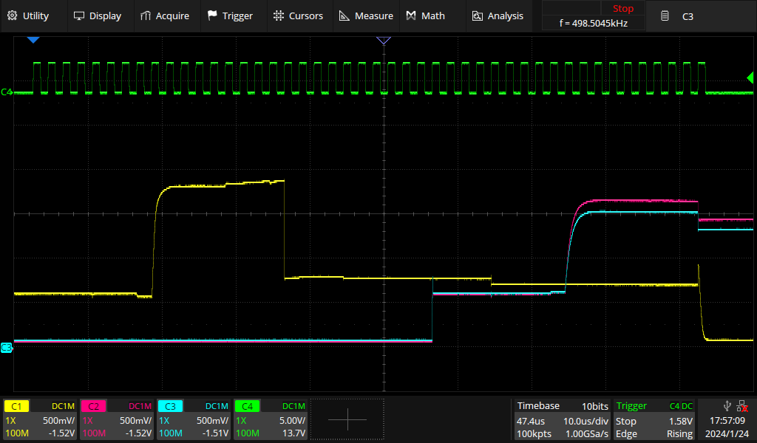
Setup for ASIC Characterization
CMOS 0.35 µm, 24 mm²
Microcontroller Board
Carrier Board
Layer 1
Inner nodes
Integrators
X
Mother Board
Graphic interface:
ASIC programming
Inputs delivery
Data acquisition
Layer 2
Y
3
Digital (SPI)

Slide 8
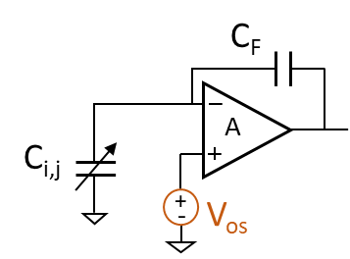
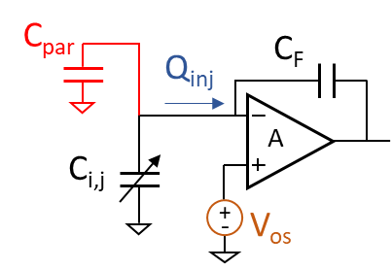


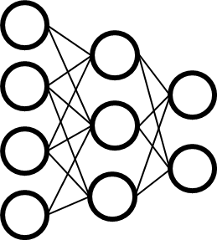
Chip-based Model for Training
Network Training (Matlab) → Accurate model of the electrical neuron including non-idealities.
Model V1
Integrators offset
Model V2
Integrators offset
Injected charges
Parasitic capacitances
Build analytical model of the electrical neuron;
Measure all integrator offsets;
Model fitting with experimental data (neuron outputs) to estimate values of non-idealities (parasitic capacitances and injected charges). This is done only for Model V2.
Measured neurons outputs with different input/weights combinations
Neuron Model fitting
Training with Neuron Model

Slide 9

Data Acquisition for Neuron Model Fitting
Analytical model of the electrical neuron
The model is based on experimental data measured from all 42 integrators (neurons).
We identified 6 free parameters (relative to parasitic capacitances and charges) to be fitted.
A dataset has been generated experimentally:
30 possible inputs
30 possible weight matrices
900 combinations x 42 integrators → 37,800 neuron outputs.
Mother Board
64 Analog Inputs
Carrier Board
I/O
µC
ANNA ASIC
The measure is repeated for each neuron of the NN, and for each input/weights combination.
Weights
Inputs/weights generation
Data acquisition
Model fitting
$j_{th}$ Neuron Output

Slide 10
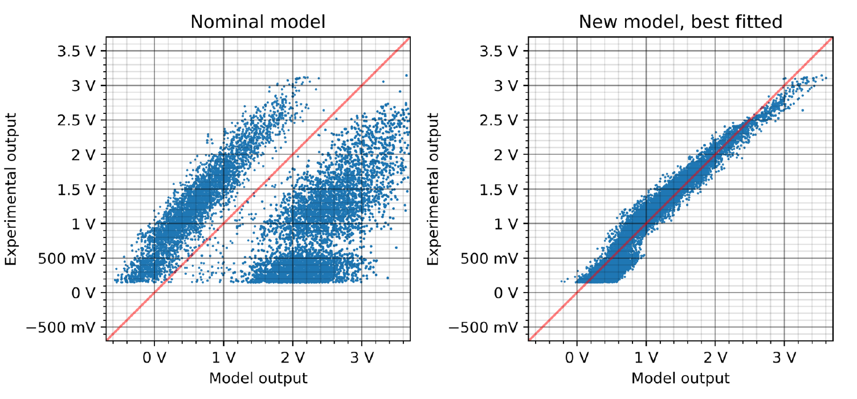
Neuron Model Performance
Model V1
Model V2
Model outputs are compared with experimental outputs, for the same input/weights combinations.
Model V1 is unable to replicate electrical neuron behaviour.
Model V2 with optimized parameters matches more closely the electrical neuron.

Slide 11
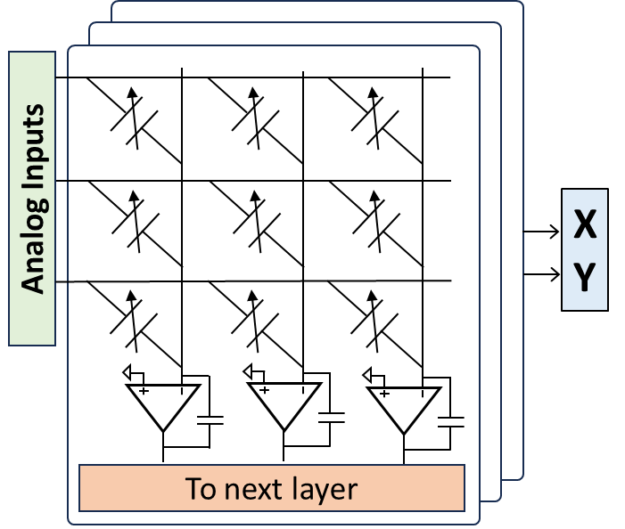
ASIC Performance Characterization
Training with the electrical model of the neuron.
Grid of 121 simulated points (ANTS2) is used to test ASIC performance.
8x8 SiPMs signal [V]
The two output voltages are the predicted X, Y.
The steady-state values are converted in mm values within the range ± 25 mm.
y [mm]
64
x [mm]

Slide 12
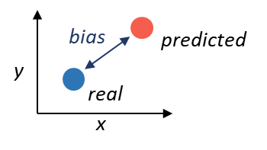
Accuracy Measurement
Neural Network | Bias [mm]*
Matlab 5-bit |  | 1.7
ASIC – Model V1 |  | 11.0
ASIC – Model V2 |  | 3.9
Test points
ASIC pred. – Model V1
ASIC pred. – Model V2
*
* Average bias among all 121 points in the grid.
Bias = displacement between position reconstructed by the network and the real event position.
It is fundamental, during training, to use a model that can accurately reproduce chip behaviour.
Figure: Example of a subset of grid points along diagonal reconstructed by the ASIC NN, comparing the two models used for training.
The average bias for these 9 points is 2.3 mm using Model V2.
Notes:
ERORRE SISTEMATICO DELLA RETE SUL CHIP SUI PUNTI

Slide 13
Precision Measurement
100 inferences of the same input.
Std. dev. of predictions (X ± σ_{x}, Y ± σ_{y}) to evaluate effect of noise on ASIC NN positioning precision.
2D FWHM = 0.166 mm
σ_{y} = 0.067 mm
σ_{x} = 0.074 mm
The predicted X, Y have standard deviation σ_{x} = 0.074 mm and σ_{y} = 0.067 mm.
The fluctuations produced by noise can be considered negligible if we target a resolution of ≈1.5 mm FWHM.

Slide 14
Optimization Study of NN Architecture
Objective: study of spatial and timing resolution of monolithic crystals (LYSO and LaBr3), optimizing neural network dimension compatible with ASIC implementation for a new chip version.
Geant4 simulation of LaBr3 and LYSO:
  50mm x 50mm x 12/16mm
  25mm x 25mm x 12/16mm
  6mm x 6mm and 3mm x 3mm Hamamatsu SiPM
Neural network training
  Min: 500 parameters, 2 layers
  Max: 5000 parameters, 6 layers
  100,000 events across 2-mm spaced points
LaBr3 results
LYSO results
Geometry | Neural Network | Res. (X,Y) [mm] | Res. Z [mm] | Res. T [ps]
50mm/16mm + 6mm SiPM | 2 layers 500 params | 1.91 | 3.50 | 580
50mm/16mm + 6mm SiPM | 4 layers 2000 params | 1.20 | 2.30 | 345
50mm/16mm + 6mm SiPM | 6 layers 5000 params | 0.75 | 1.84 | 287
25mm/12mm + 3mm SiPM | 6 layers 5000 params | 0.65 | 1.95 | 92
Geometry | Neural Network | Res. (X,Y) [mm] | Res. Z [mm] | Res. T [ps]
50mm/16mm + 6mm SiPM | 2 layers 500 params | 1.95 | 3.61 | 612
50mm/16mm + 6mm SiPM | 4 layers 2000 params | 1.25 | 2.39 | 383
50mm/16mm + 6mm SiPM | 6 layers 5000 params | 0.82 | 1.99 | 301
25mm/12mm + 3mm SiPM | 6 layers 5000 params | 0.77 | 2.11 | 122

Slide 15
Ongoing and Future Work
→ 4 layers/2000 parameters could be a good compromise for the next ASIC version.
Start the design of a new ASIC version in a more scaled technology (CMOS 110 nm):
  Revision of the crossbar structure and integrator.
  Avoid non-idealities found in the first version.
  More flexibility.
  Recurrent Neural Network (programmable number of inputs, outputs, layers).
  Improve speed, efficiency.
Figure of Merit | This Work @10 MHz
Technology | 350 nm
Area [mm²] | 24
I/O Latency [us] | 4.5
Energy per Inference [nJ] | 76
Energy Efficiency [GOP/J] | 46.8
Publication:
Di Giacomo, S., et al. ”Implementing an Integrated Neural Network for Real-Time Position Reconstruction in Emission Tomography With Monolithic Scintillators.” IEEE Trans. Rad. Pl. Med. Sci., vol. 8, no. 5, pp. 501-510, May 2024.

Slide 16
Thank you!
susanna.digiacomo@polimi.it

