Slide 1
Comparative Analysis of Novel Time-Walk and Kernel Correction Methods for Metascintillators
Riccardo Latella, Antonio J. Gonzalez, Member, IEEE, Paul Lecoq, Fellow, IEEE,
and Georgios Konstantinou, Member, IEEE
Riccardo Latella, PhD Student
Multiwave Metacrystal SA
Institute for Instrumentation in Molecular Imaging, i3M
Isola d’Elba, Italy, May 21st, 2024

Slide 2
Index
Results
LYSO:Ce,Ca bulkpixels
Discussion and Future Works
Introduction
ToF-PET & Time-Walk Correction
Metascintillators
Materials and Methods
Rise Time Methods
Setup Description
Linear and Differential TWC
Transformation (Galaxy) Plot
Full-Width Scale Factor
Balancing Functions
Hyperbolic TWC
BGO-EJ232 metapixels
Comparative Analysis
Key Findings

Slide 3
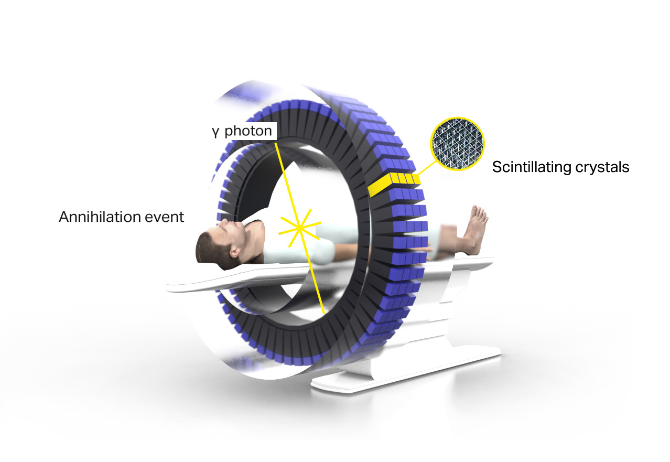
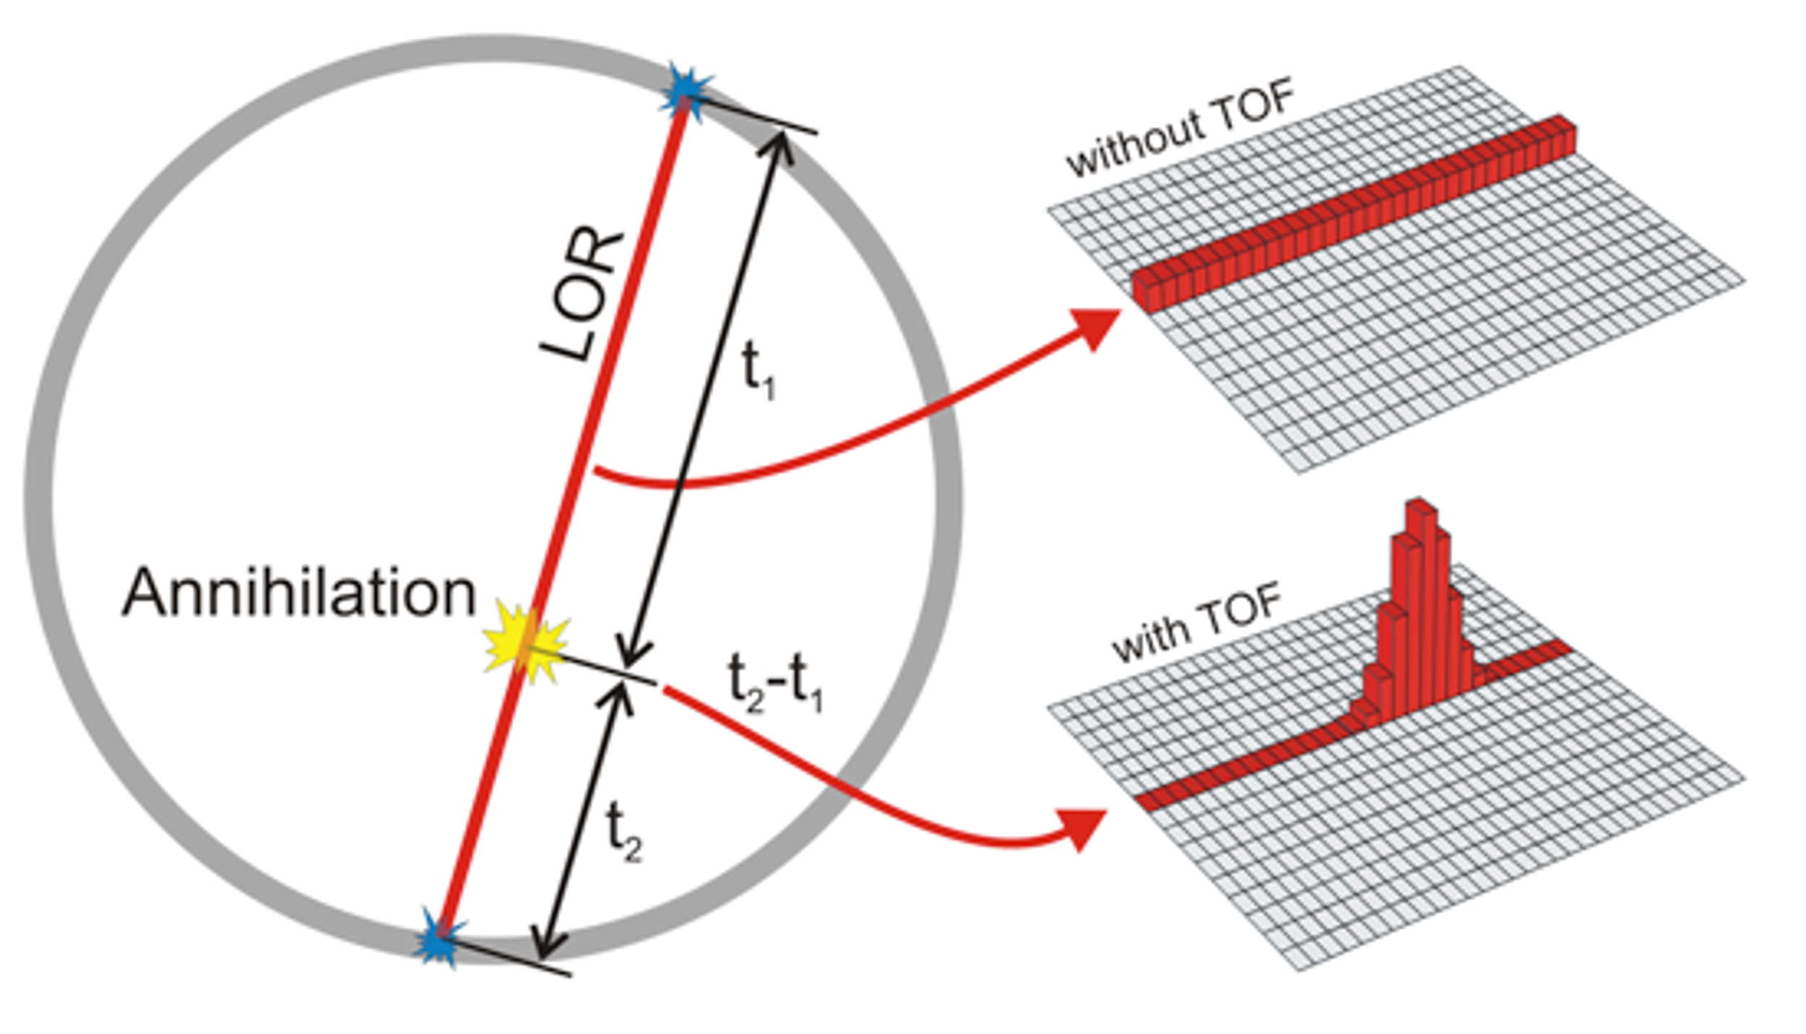
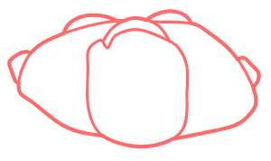
Index
Corrections:
Scatter Correction
Attenuation Correction
Random Coincidences Correction
Depth-of-Interaction (DOI)
Time-Walk Correction (TWC)
...
t1 - t2 < time_window
https://metacrystal.ch/
MRI
Positron Emission Tomography (PET)
Precise timing
Good energy resolution
High-quality imaging
Line Of Response (LOR) is not enough
Time-of-Flight information
https://the10ps-challenge.org/
TWC is a crucial aspect of Time-of-Flight (ToF) PET systems.
AIM: improve the Coincidence Time Resolution (CTR) using signal features/characteristics.

Slide 4
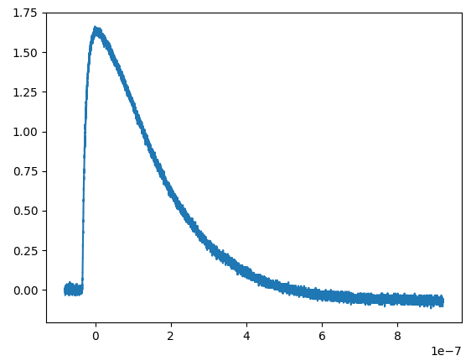
ToF-PET & Time-Walk Correction
Positron Emission Tomography (PET)
Precise timing
Good energy resolution
Line Of Response (LOR) is not enough
Time-of-Flight information
Slew Rate
https://metacrystal.ch/
The development of TWC methods:
mitigate time-walk effects
enhance the performance of PET imaging systems.
TWC approaches:
empirical data
complex models (e.g. deep learning)
Int. Charge
Amplitude
Rise Time
ToT
Focus on timing
Very effective for multiple-kernel scenarios like with BGO-Cherenkov
Possible use with Metascintillators.
N. Efthimiou et al.,
doi: 10.1109/TRPMS.2020.3048642
Signal information:
Energy (int-ch, amplitude, ToT)
Timing (rise-time, slew-rate)
N. Kratochwil et al.,
doi: 10.1088/1361-6560/ab87f9

Slide 5
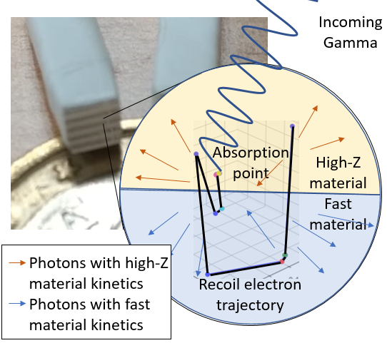
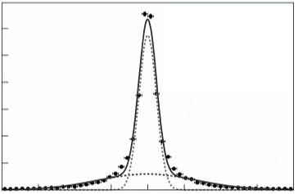
Metascintillators
Metascintillators:
Combine dense host material with a fast emitter
Heterostructure with complementary properties
Based on the shared events concept
Exploiting the recoil electron trajectory
Light guide
P. Lecoq et al.
doi: 10.1140/epjp/s13360-022-03159-8.
R. Latella et al., doi: 10.1109/TRPMS.2023.3310581
Pixel level
Different scintillation photons
-> Multikernel
G. Konstantinou et al.
doi: 10.1088/1361-6560/acac5f.
F. Pagano et al.,
doi: 10.1088/1361-6560/ac72ee

Slide 6
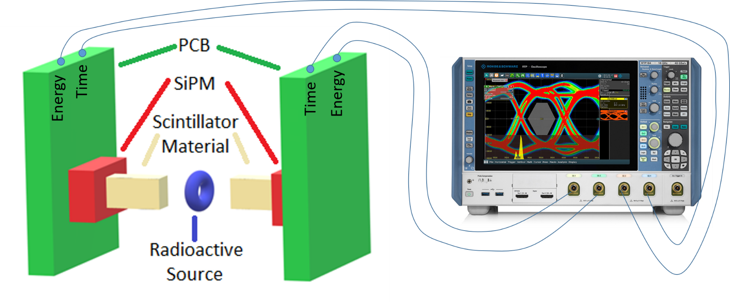
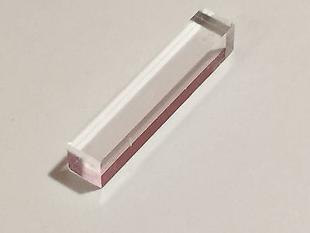
Setup Description
Coincidence Time Setup
- 8 GHz oscilloscope from R&S
- Double channel (Energy & Timing) Readout [1][2]
- 3×3 mm² NUV-HD-MT SiPMs from FBK [3]
- Optical grease
Scintillation materials
- 3×3×5 mm³ LYSO:Ce,Ca bulkpixel
- 3×3×15 mm³ BGO-EJ232 (200 μm – 100 μm) metapixel
All pixels are coated in ESR
[1] R. Latella et al., doi: 10.1109/nss/mic44845.2022.10399231
[2] R. Latella et al., doi: 10.1109/TRPMS.2024.3401391
[3] S. Merzi et al., doi: 10.1088/1748-0221/18/05/P05040

Slide 7
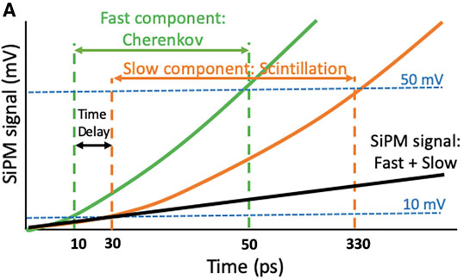
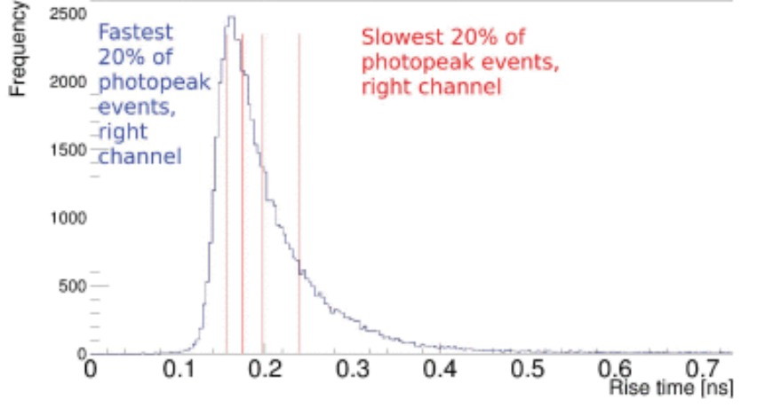
Rise Time Methods
Rise Time TWC Methods
Fitting Method
Classification Method
A. Gonzalez-Montoro et al., doi: 10.3389/fphy.2022.816384
N. Kratochwil et al., doi: 10.1109/TRPMS.2020.3030483
Divided each Rise time spectrum in 5 subcategories
From the classification method, we use only the 4% fastest events subset category over the total of 25, as a reference for the rest of the calculation
From the fit method, we use the formula

Slide 8
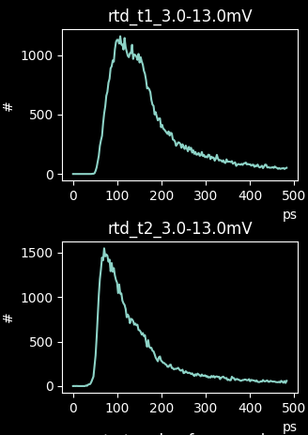
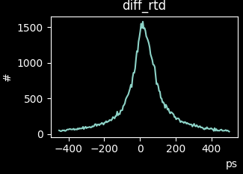
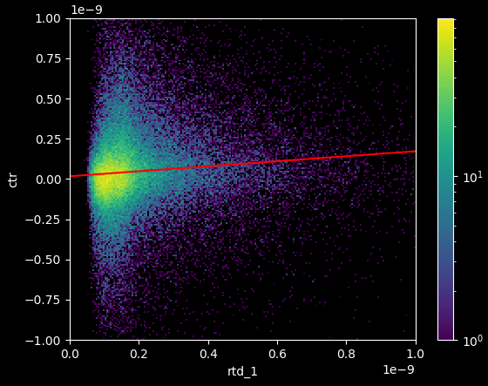
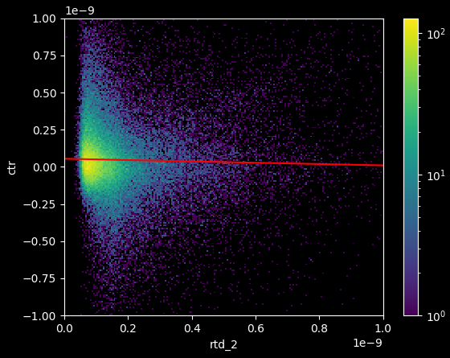
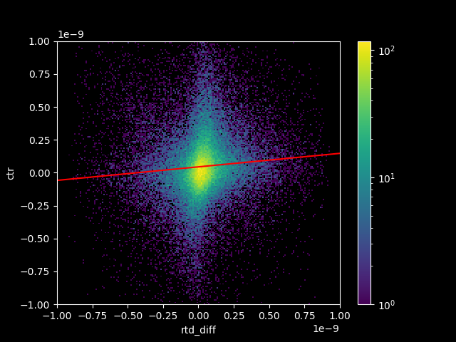
Linear and Differenctial TWC
Linear TWC
(L-TWC)
Differential TWC
(D-TWC)
Detector 1
-
RT distributions
DRT distribution
Detector 2
RT Rise Time
DRT Differential Rise Time
m₂
m
m₁
Coincidence time values
Rise time values
Coincidence time values
Differential rise time values

Slide 9
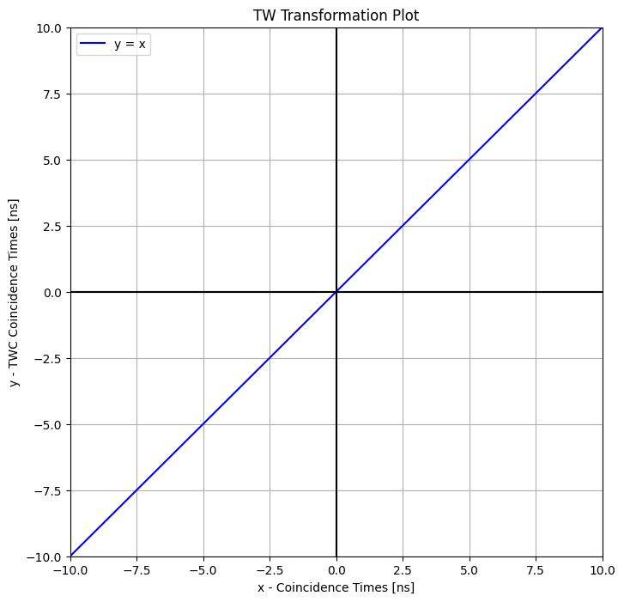
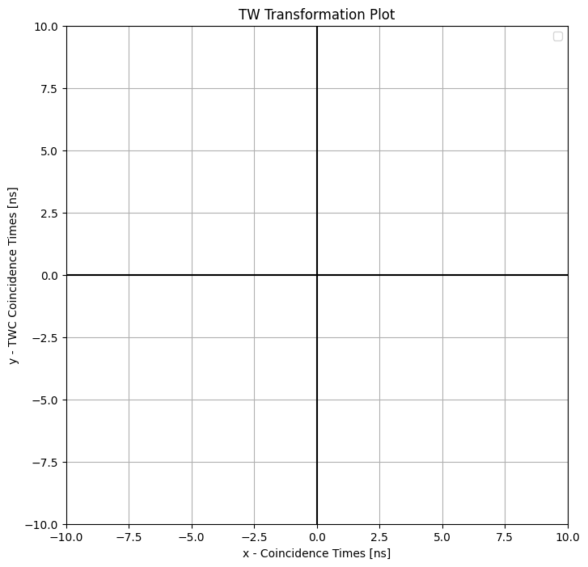
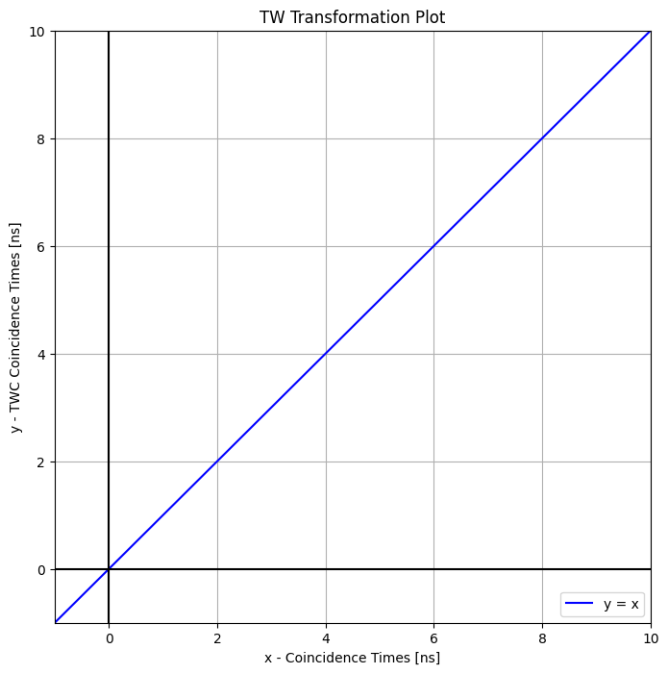
Transformation (Galaxy) Plot
TWC expectations:
Transformation (or Galaxy) Plot:
X as CT initial values
Y as TWC CT final values
Define the function
No TWC function: y = f(x) = x

Slide 10
Transformation (Galaxy) Plot
Which function to choose?
Let’s keep it simple:
$$y = f(x) = m ∗ x$$
Where 0 < m < 1
Problem: $μ_{CT}≠μ_{TWC}$
Solution: Coordinates shift
$$y→y_{mod}−μ_{TWC}$$
$$x→x_{mod}−μ_{CT}$$
Considering μ_{CT} = μ_{TWC}
$$y_{mod} = f_{mod}\left(x\right)= m ∗ x+μ_{CT}∗(m+1)$$
Assumption: μ_{CT} is known
The smaller m, the stronger the correction But how far can we exploit this method?

Slide 11
Full-Width Scale Factor
Full-Width Scale Factor (FWSF)
Full Width at Half of the Maximum (FWHM)
Full Width at a Tenth of the Maximum (FWTM)
Analytical Method
(fitted)
$$FWHM=2σ\sqrt{2ln⁡(2)}$$
$$FWTM=2σ\sqrt{2ln⁡(10)}$$
Combined Method:
$$FWSF=\frac{{FWTM}_{an}}{{FWHM}_{an}}×\frac{{FWHM}_{em}}{{FWTM}_{em}} =\frac{2σ\sqrt{2\ln{(10)}}}{2σ\sqrt{2\ln{(2)}}}×\frac{{FWHM}_{em}}{{FWTM}_{em}}$$
$$=\frac{\sqrt{\ln{(10)}}}{\sqrt{\ln{(2)}}}×\frac{{FWHM}_{em}}{{FWTM}_{em}}=\sqrt{\log_{2}{(10)}}×\frac{{FWHM}_{em}}{{FWTM}_{em}}$$
$$FWSF=\sqrt{\log_{2}{(10)}}×\frac{{FWHM}_{em}}{{FWTM}_{em}}$$
→ approaches 1 for Gaussian distributions
→ nears 0 for heavy-tailed distributions
Estimator of how far or closely the observed distribution resembles a Gaussian shape.
Empirical Method
(real)
100%
50%
10%
FWTM
0
Let’s combine them!

Slide 12
Linear FWSF TWC
Linear FWSF TWC:
$$y_{mod}=m∗x+μ_{CT}∗(m+1)$$
With:
$$m=FWSF$$
Simplifying:
$$y_{mod}=FWSF∗x+q$$
With:
$$q=μ_{CT}∗(FWSF+1)$$
y
We introduce two balancing functions dependent on the feature that will time-walk correct our data:
α(t) and β(t)
In this way, the overall twc function can be seen as:
$$y_{twc}=α\left(t\right)∗y+β\left(t\right)∗y_{mod}$$
y_{mod}
Not all events suffer from a time-walk effect!

Slide 13
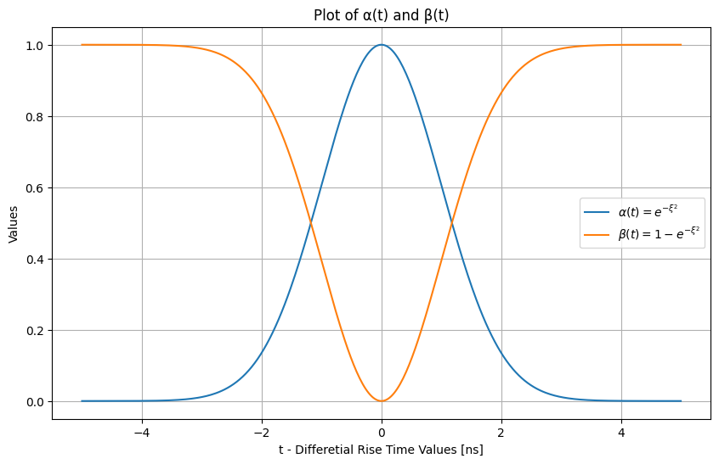
Balancing Functions
Balancing Functions:
$α\left(t\right)=e^{−ξ^{2}}$
$β\left(t\right)=1−e^{−ξ^{2}}$
DRT distribution
Gaussian Exponential Argument
$$ξ=\frac{t−μ_{t}}{\sqrt{2}σ_{t}}$$
-
DRT Differential Rise Time
Where:
t: DRT values.
μ_{t}: DRT distribution mean.
σ_{t}: DRT distribution standard deviation.

Slide 14
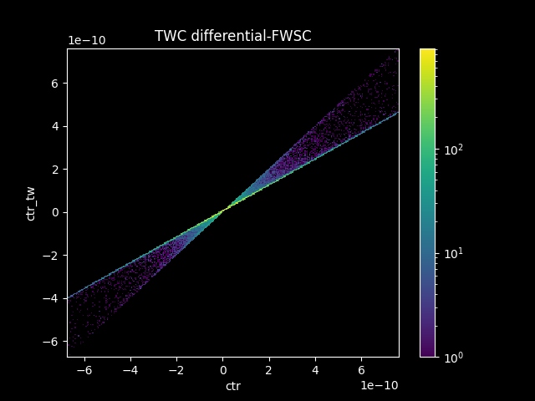
Linear FWSF TWC
$$1−e^{−({\frac{t−μ_{t}}{\sqrt{2}σ_{t}})}^{2}}$$
Where:
x: CT values.
μ_{CT}: CT distribution mean.
t: DRT values.
μ_{t}: DRT distribution mean.
σ_{t}: DRT distribution standard deviation.
Linear FWSF TWC behavior:
$$y_{twc}=α\left(t\right)∗y+β\left(t\right)∗y_{mod}$$
$$FWSF∗x+μ_{CT}∗(FWSF+1)$$
$$x$$
y
DRT Differential Rise Time
$$e^{−({\frac{t−μ_{t}}{\sqrt{2}σ_{t}})}^{2}}$$
y_{mod}
DRT distribution

Slide 15
From Linear To Hyperbolic
From Linear To Hyperbolic:
$$y_{twc}=α\left(t\right)∗y+β\left(t\right)∗y_{mod}$$
This method linearly compresses the overall distribution
We want to push the bad-tailed events closer to the center than the ones already in the center.
We need another function!

Slide 16
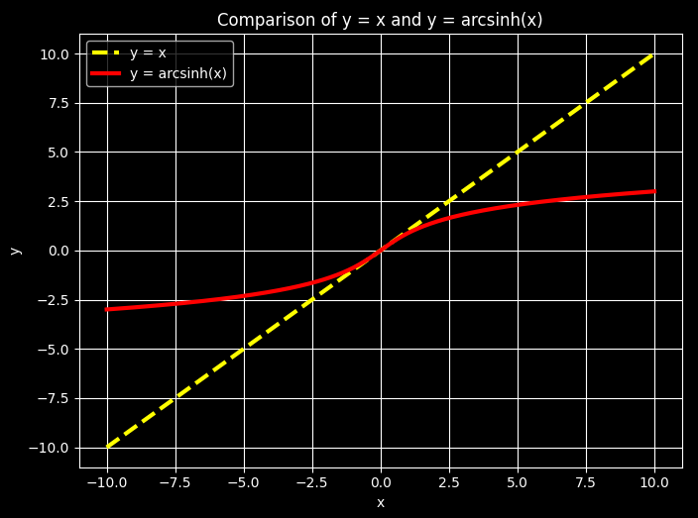
Hyperbolic TWC
Hyperbolic TWC:
$$y_{twc}=α\left(t\right)∗y+β\left(t\right)∗y_{mod}$$
Inverse Hyperbolic Sine:
$$y_{h}=\operatorname{arcsinh}\left(x\right)=\sinh^{−1}\left(x\right)=\ln{(x+\sqrt{1+x^{2}})}$$
Why?
Continuous function
Dominium and Codominium [-∞;+∞]
Inflection Point in [0;0]
FWSF
Coordinate shift and Adjustments
$$y_{modh}=μ_{CT}+\sqrt{2}σ_{CT} ∗arcsinh\left(\frac{x−μ_{CT}}{\sqrt{2}σ_{CT}}\right)$$

Slide 17
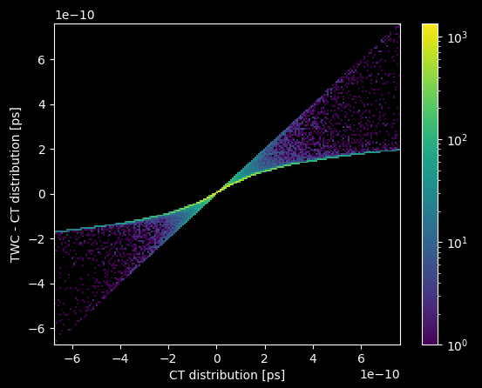
Hyperbolic TWC
$$1−e^{−({\frac{t−μ_{t}}{\sqrt{2}σ_{t}})}^{2}}$$
Hyperbolic FWSF TWC:
$$y_{twc}=α\left(t\right)∗y+β\left(t\right)∗y_{modh}$$
$$μ_{CT}+FWSF∗\sqrt{2}σ_{CT} ∗arcsinh\left(\frac{x−μ_{CT}}{\sqrt{2}σ_{CT}}\right)$$
$$x$$
$$e^{−({\frac{t−μ_{t}}{\sqrt{2}σ_{t}})}^{2}}$$
DRT distribution

Slide 18
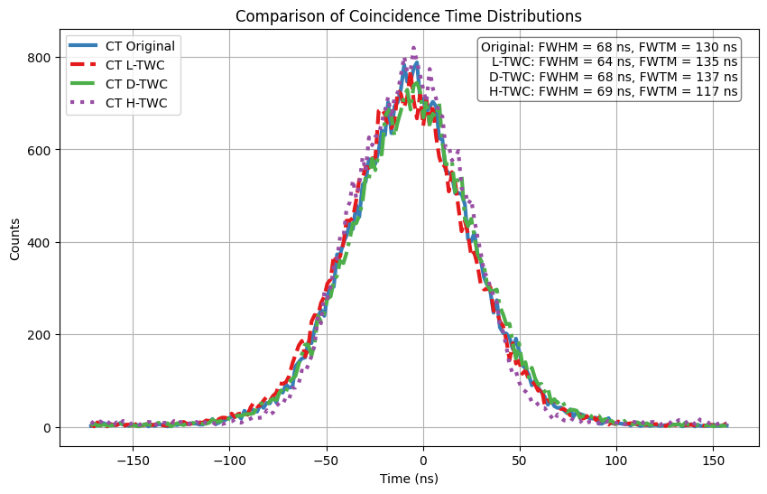
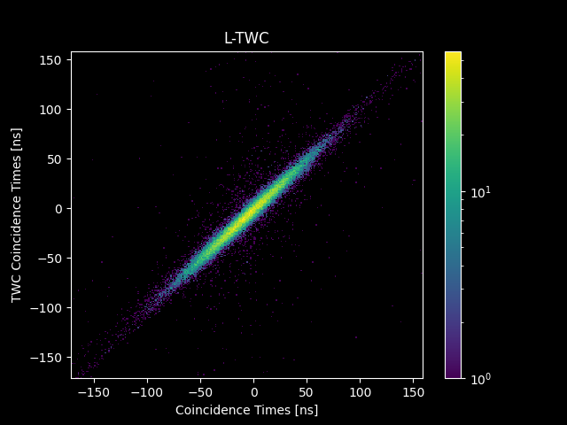
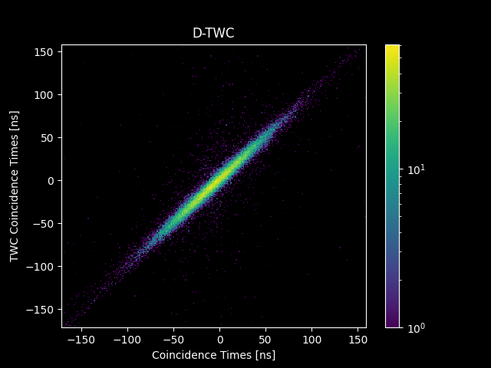
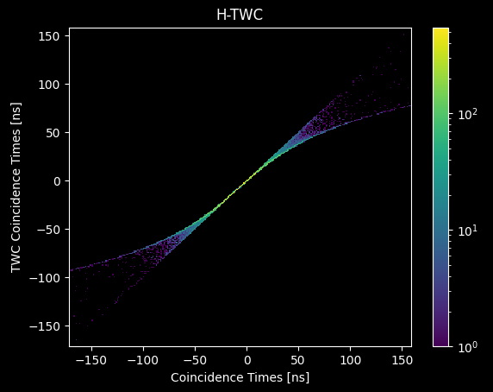
LYSO:Ce,Ca Results
Results: Reference Detectors
LYSO:Ce,Ca
Original L-TWC D-TWC H-TWC 4%-fastest
An.
FWHM 71 ps 74 ps 74 ps 72 ps 73 ps
An.
FWTM 130 ps 134 ps 134 ps 132 ps 133 ps
Em.
FWHM 68 ps 64 ps 68 ps 69 ps 76 ps
Em.
FWTM 130 ps 135 ps 137 ps 116 ps 168 ps
Distribution | R²
Original | 0,994
L-TWC | 0,995
D-TWC | 0,995
H-TWC | 0,994

Slide 19
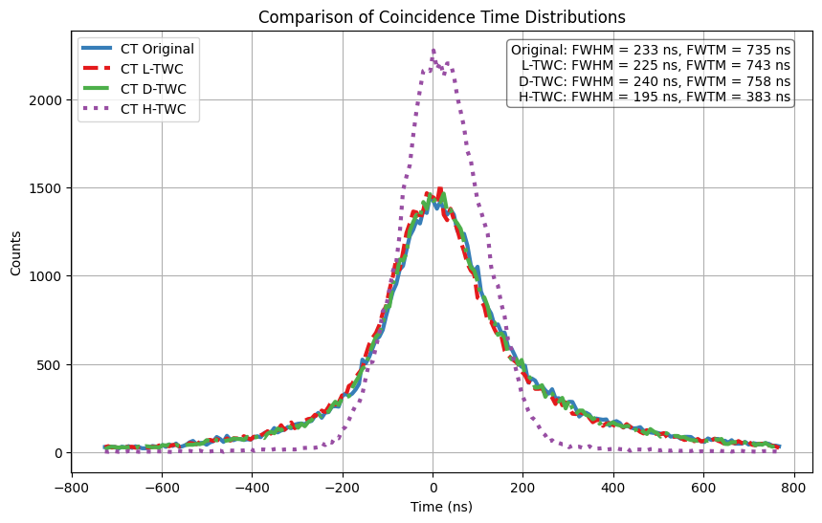
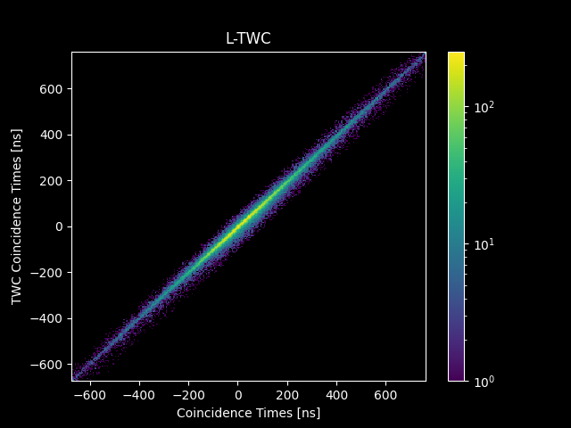
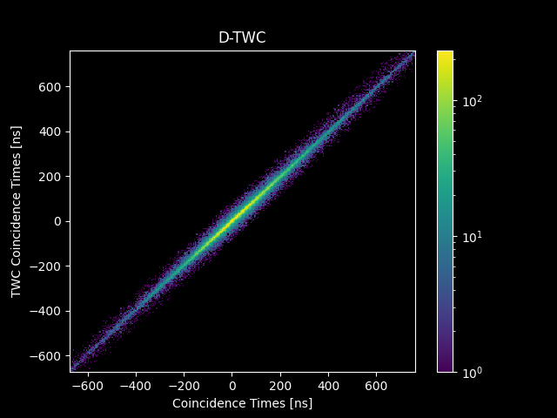
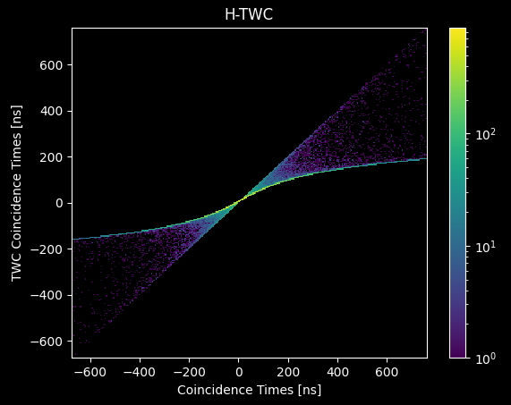
BGO-EJ232 Results
Results: Metapixel Detectors
BGO-EJ232
Original L-TWC D-TWC H-TWC 4%-fastest
An.
FWHM 278 ps 275 ps 277 ps 215 ps 202 ps
An.
FWTM - - - 393 ps 368 ps
Em.
FWHM 233 ps 225 ps 240 ps 195 ps 179 ps
Em.
FWTM 735 ps 743 ps 758 ps 383 ps 402 ps
Distribution | R²
Original | 0,948
L-TWC | 0,950
D-TWC | 0,950
H-TWC | 0,996

Slide 20
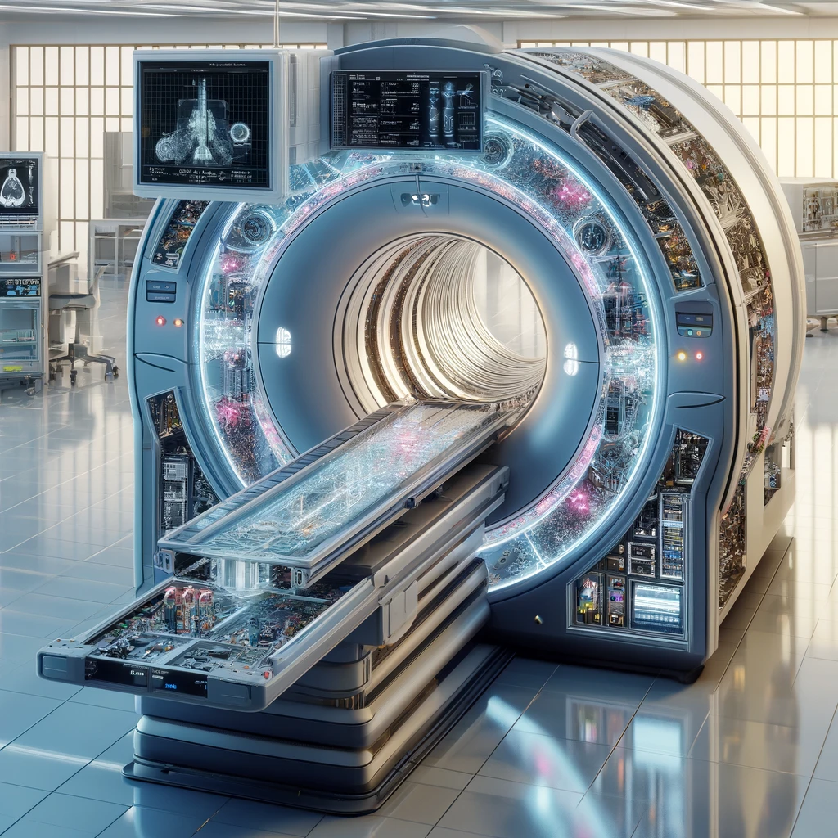
Discussion and Future Work
Comparative Analysis:
L-TWC and D-TWC yield similar results.
H-TWC performance:
enhancing CTR in single-LOR single-source ToF-PET systems.
aligning with physical constraints and avoiding data distortion.
Key Findings:
No significant improvements in LYSO:Ce,Ca scenarios.
H-TWC strongest improvement in BGO-EJ232 scenario:
Eliminates heavy-tailed distributions for a uniform Gaussian distribution.
Good CTR prediction: 215 ps (close to best 4%-fastest event selection result of 202 ps).
More than 20% CTR improvement (from 278 ps to 215 ps).
Future Work:
Extend TWC methods across multiple LOR and different radiation source configurations.
Verify universality and scalability of the method.
Integrate TWC strategies with emerging scintillator technologies and photodetector designs.

Slide 21
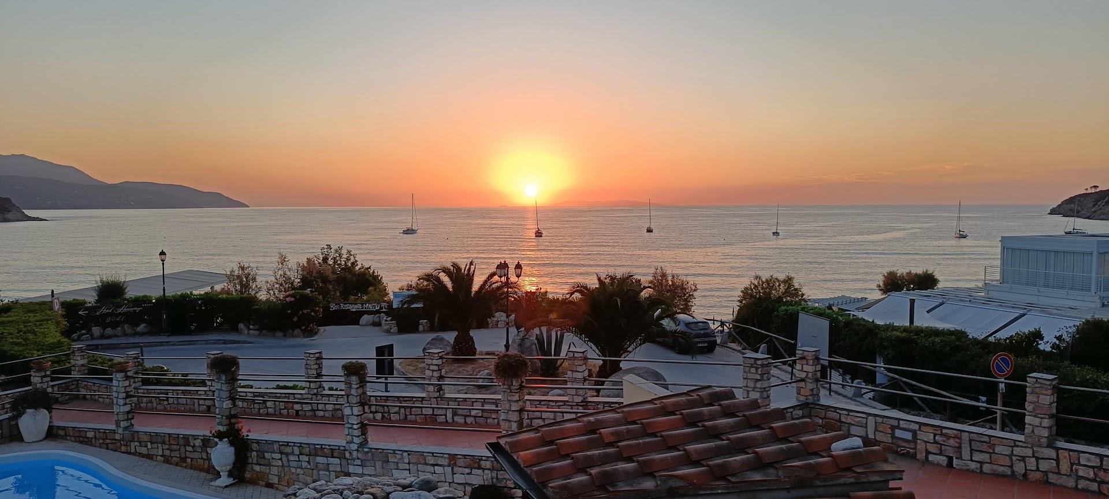
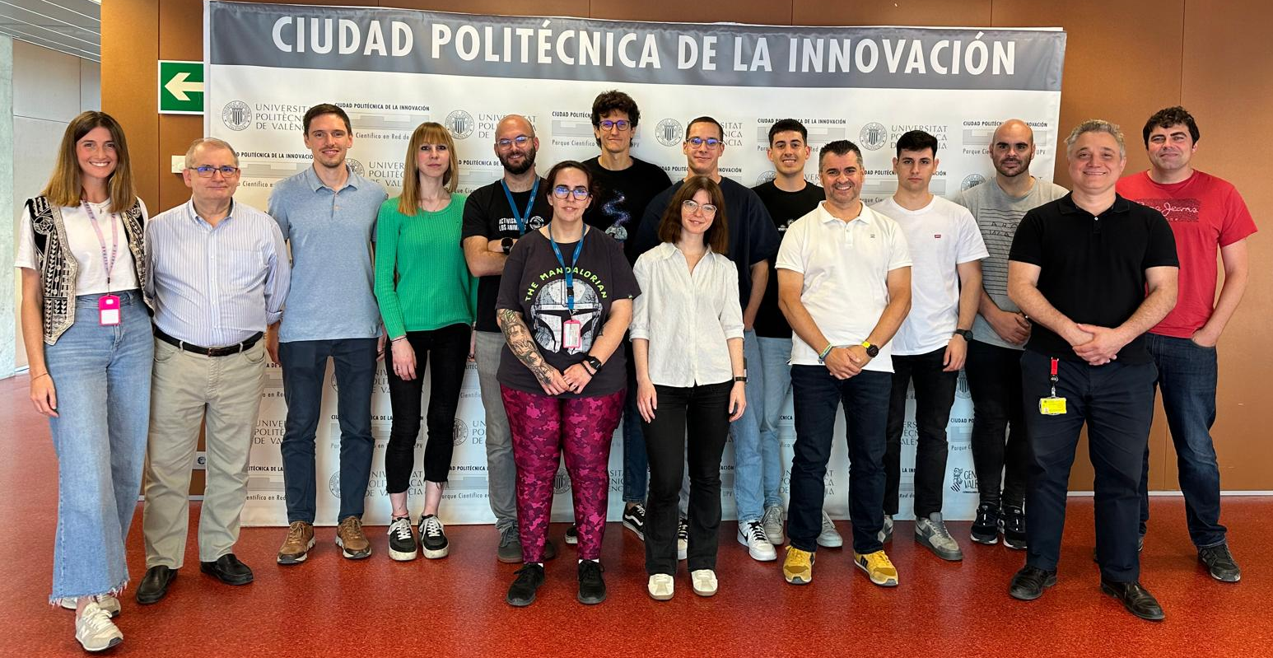
Thank you
Thank you for your attention!
Q&A

