Slide 1
High loading nanocomposites of cesium lead halide nanocrystals for fast timing
Jan Král^{1,2}, Vojtěch Zabloudil^{2,3}, Fiammetta Pagano⁴, Václav Čuba², Eva Mihóková^{1,2}, Kateřina Děcká^{1,2}, Etiennette Auffray³
¹ Institute of Physics of the Czech Academy of Sciences, Prague, Czech Republic
² Czech Technical University in Prague, Prague, Czech Republic
³European Organization for Nuclear Research (CERN), Meyrin, Switzerland
⁴ Instituto De Instrumentación Para Imagen Molecular, Valencia, Spain
Email: kralja13@fjfi.cvut.cz
10th Conference on PET, SPECT, and MR Multimodal Technologies, Total Body and Fast Timing in Medical Imaging, 21.5.2024

Slide 2
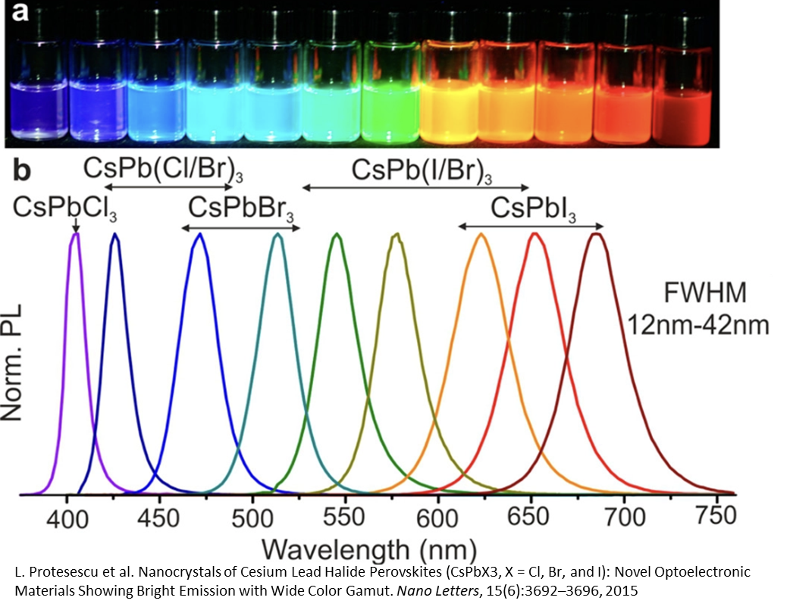
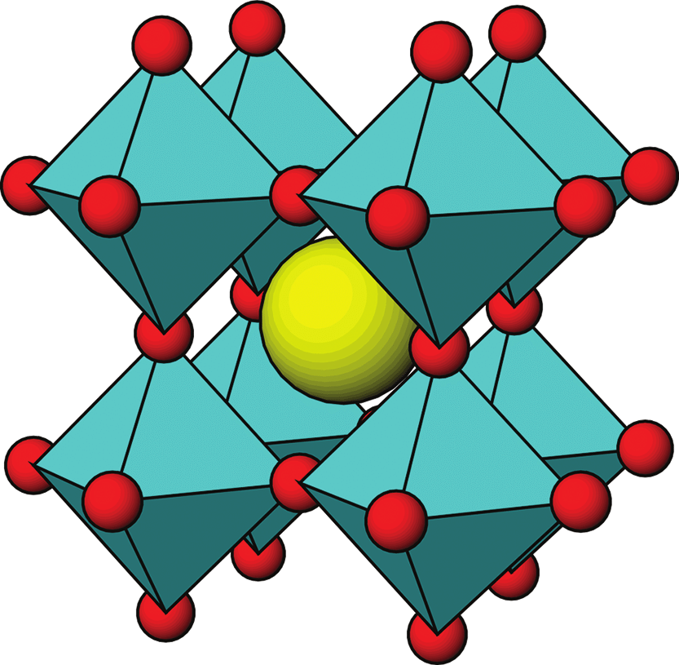
Cesium lead halide nanocrystals
ABX₃ (A=Cs⁺, MA⁺; B=Pb²⁺ ; X=Cl⁻, Br⁻, I⁻)
excitonic luminescence, weak quantum confinment
narrow tunable emission peak
Protesescu et al. Nano Lett. 2015, 15, 6, 3692–3696
1

Slide 3
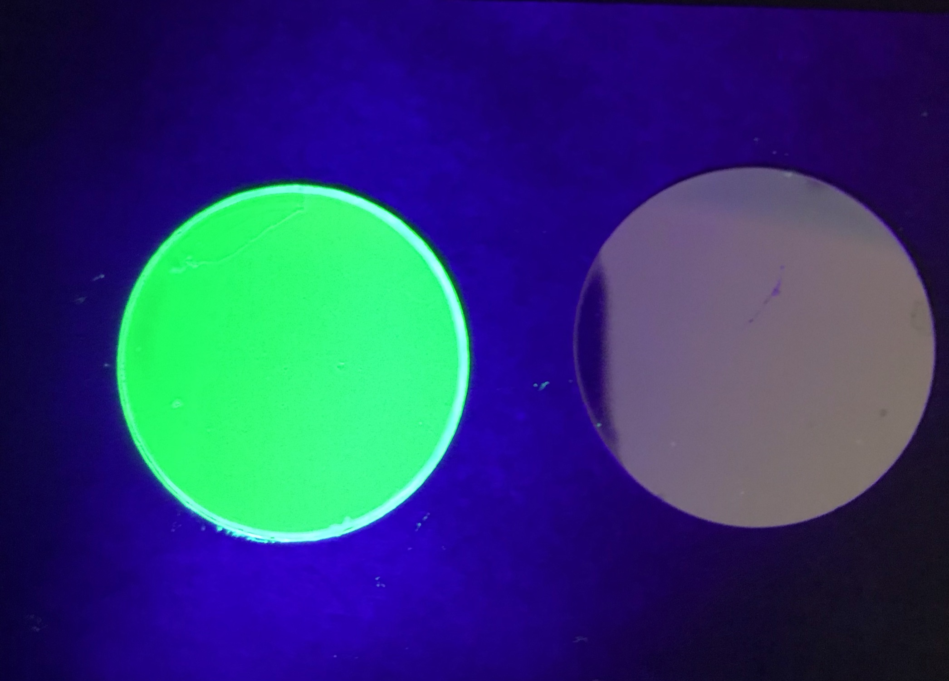
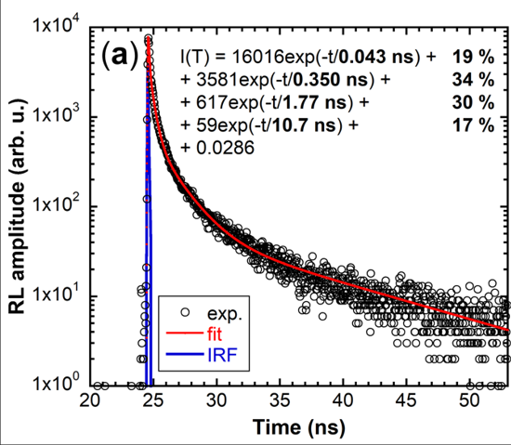
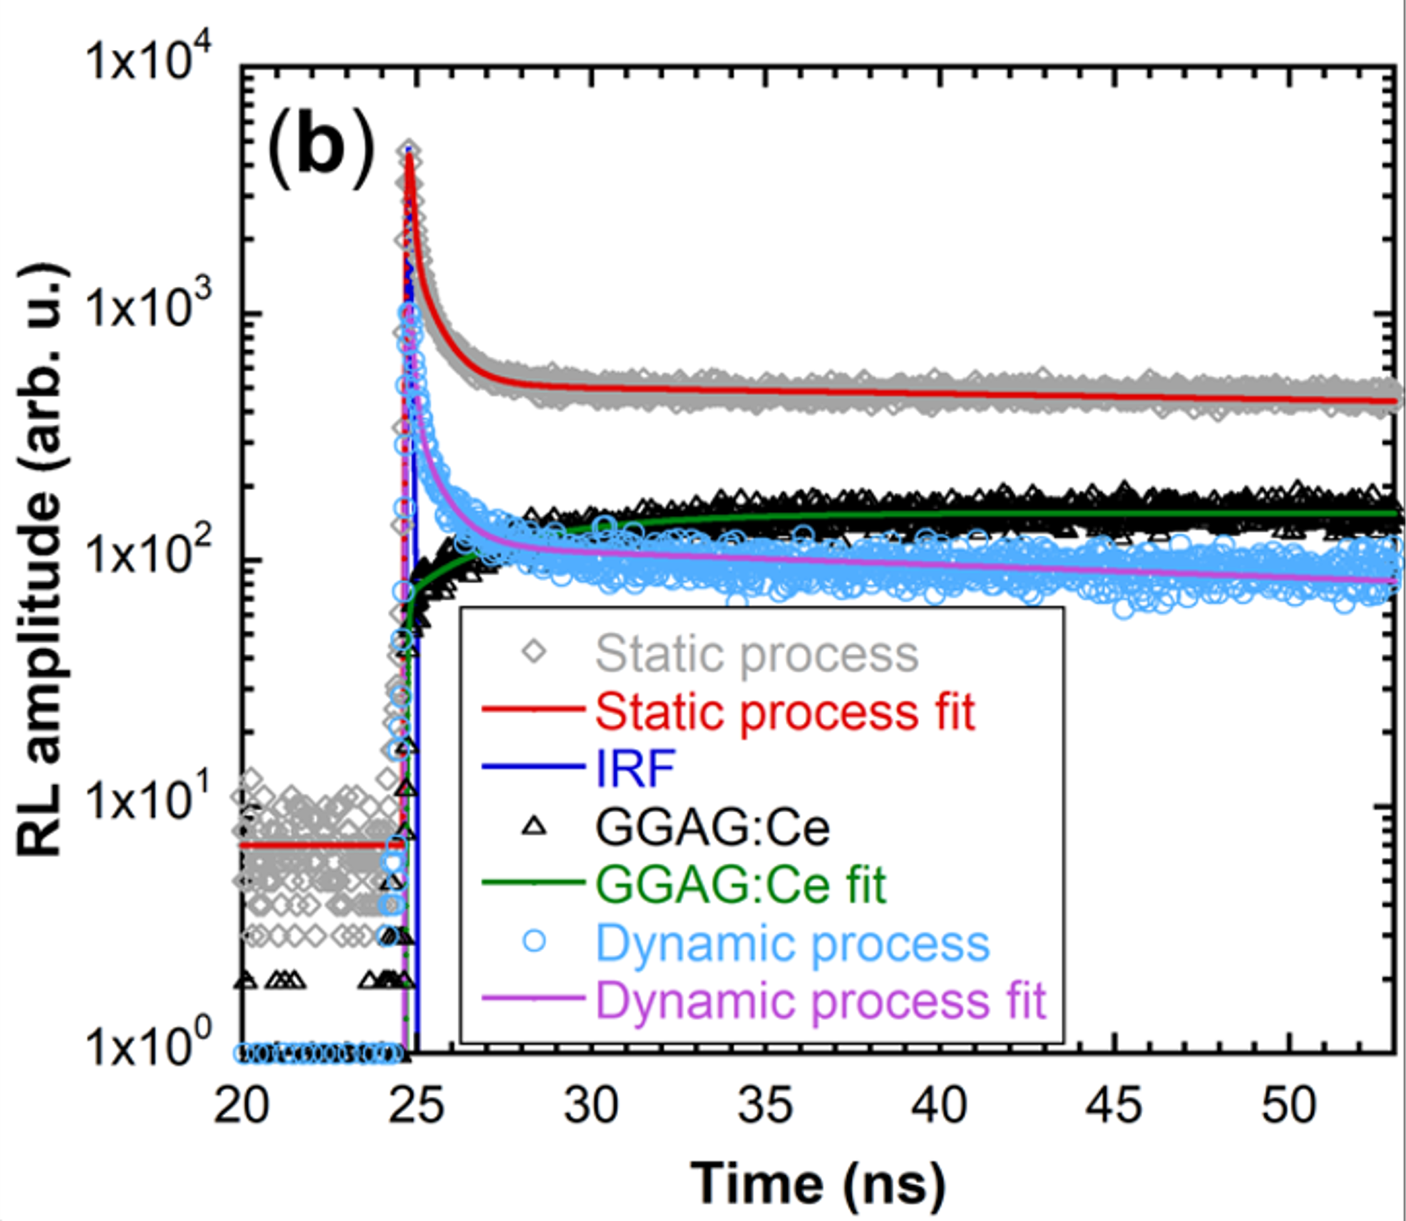
Fast timing potential
bi- and multiexcitonic decay comp. (A. Erroi et al., ACS Energy Lett. 2023)
Prompt photons to scintillation puls of composite scintillators
K. Děcká et al. Nanomaterials 2022, 12, 14.
2

Slide 4
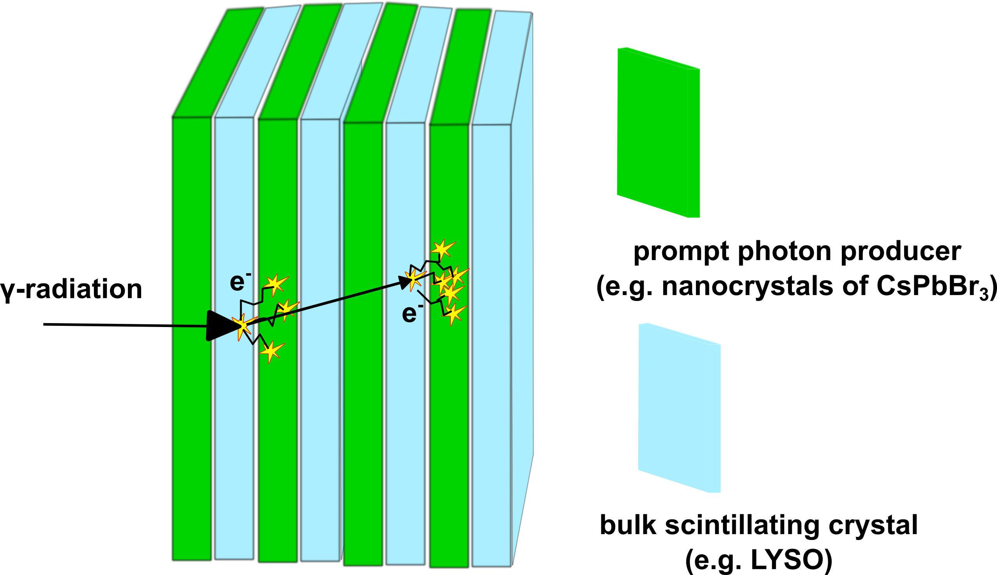
Radiation detection
coincidence time resolution
Fast timing capabilities
Cheap nanocomposite detectors
$$CTR∝\sqrt{\frac{τ_{r}∙τ_{d}}{n}}$$
$τ_{r}…$rise time
$τ_{d}…$ decay time
$n …$ photon density
TOF-PET – 10ps challange
TOF-CT
J Rossignol et al 2020 Phys. Med. Biol. 65 085013
Real-time single-proton counting
Mi, Z., Bian, H., Yang, C. et al. Nat. Mater. (2024).
HEP- nanocal
https://ep-news.web.cern.ch/content/birth-nanocalal. npj
F. Pagano et al. 2022 Phys. Med. Biol. 67 135010
R.M. Turtos et 2D Mater Appl 3, 37 (2019)
3

Slide 5
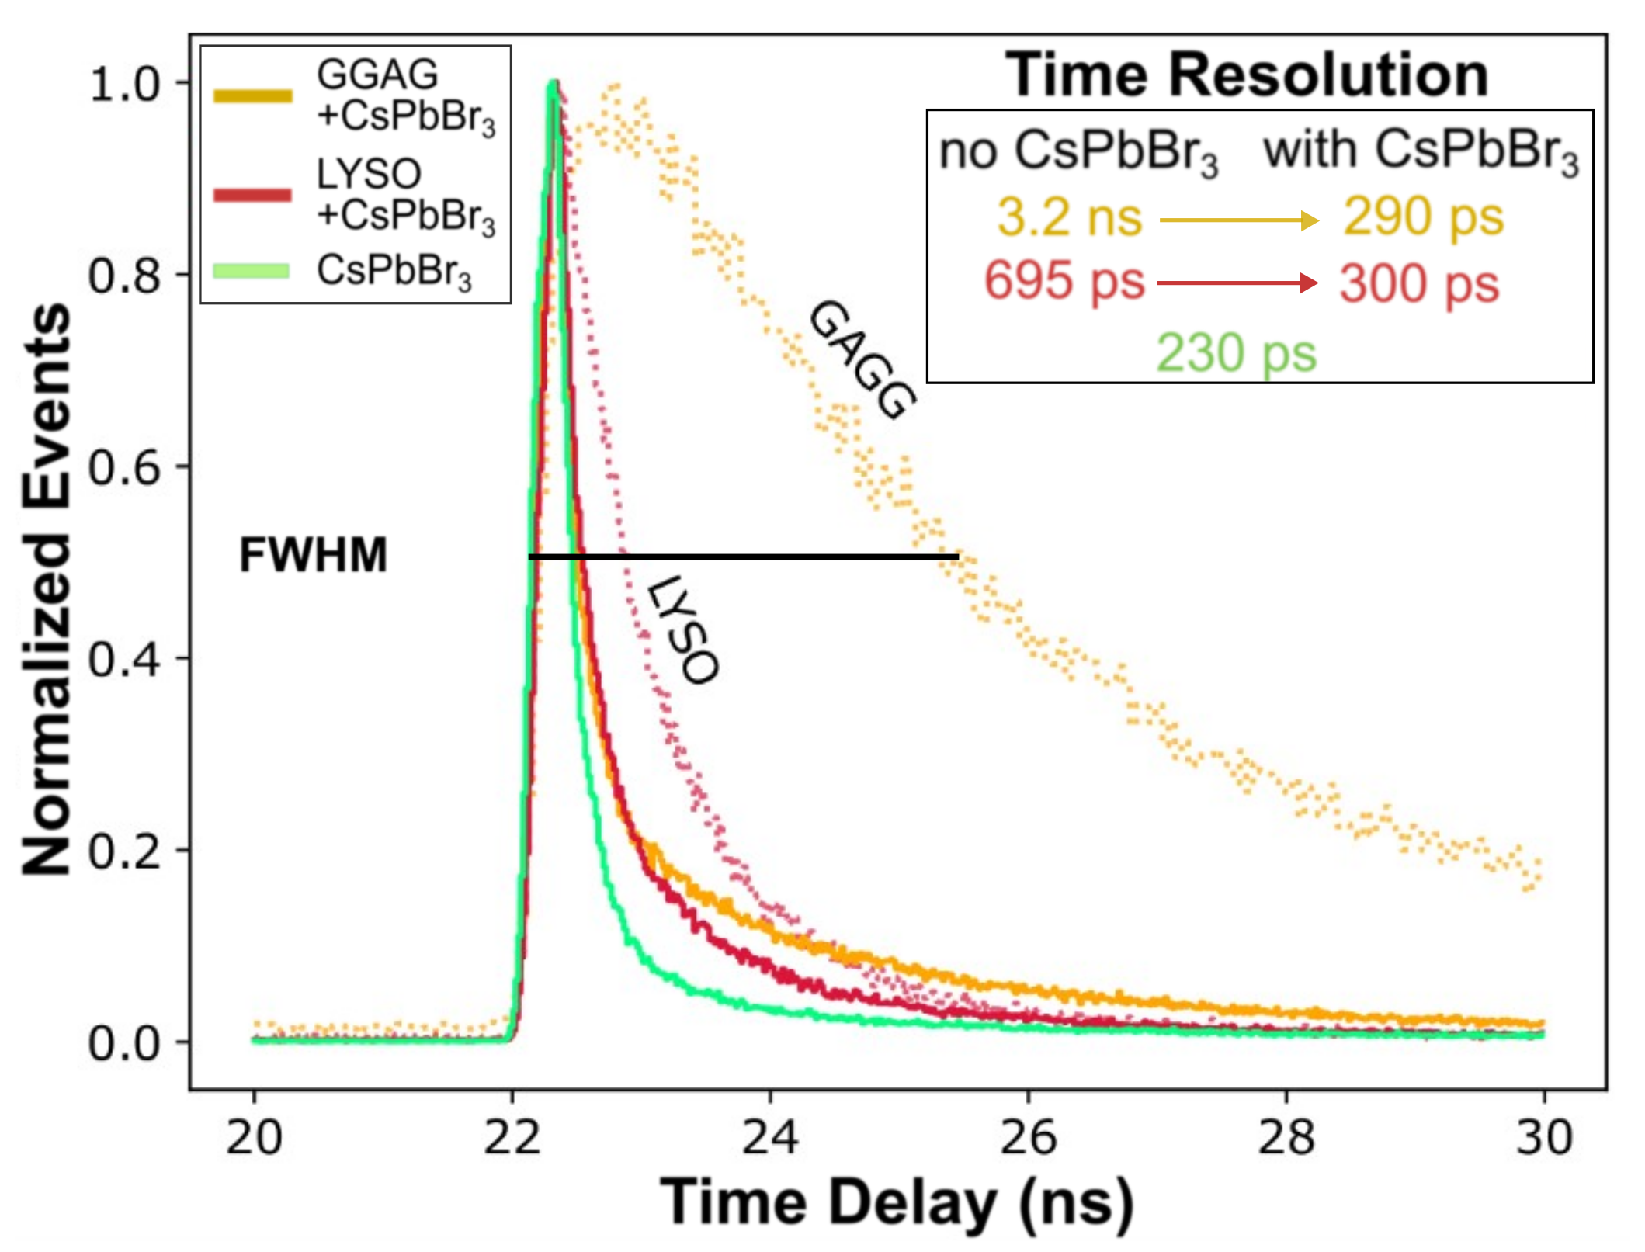
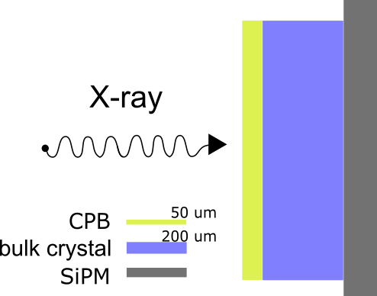
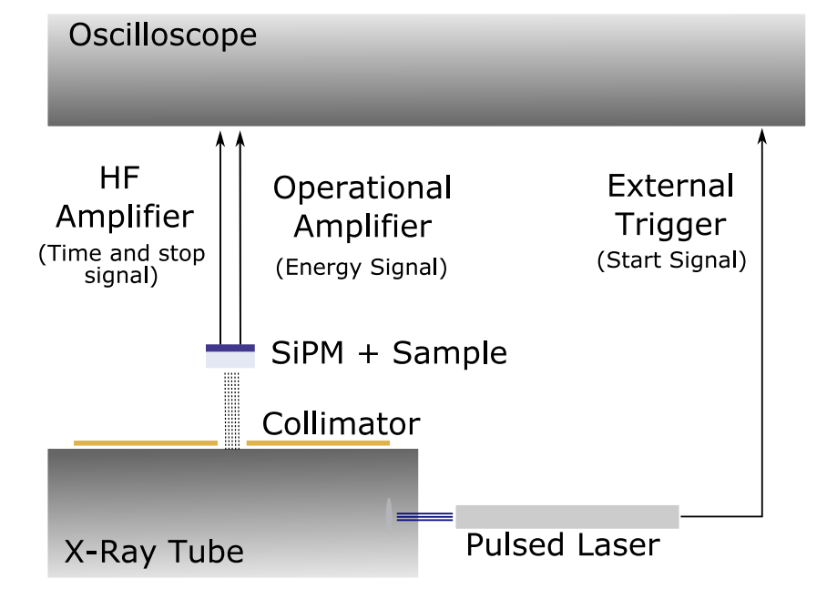
Timing performance under X-rays
F. Pagano et al. Adv. Mater. Interfaces 2023, 2300659.
DTR (detector time resolution) = FWHM of the time delay peak
significant improvements in timing performance under X-ray excitation
F. Pagano et al.(2022). In Frontiers in Physics (Vol. 10).
4
Notes:
Fig. in right—these are different results than those published in our Adv. Mater. Interf.? If not, add the reference

Slide 6
TOF – PET energy sharing
Shared events between NC layer and bulk scintillator under 511 keV excitation
Embedding nanocrystals in the matrix for chemical and mechanical protection to prepare nanocomposite material
F. Pagano et al. Adv. Mater. Interfaces 2023, 2300659.
5

Slide 7
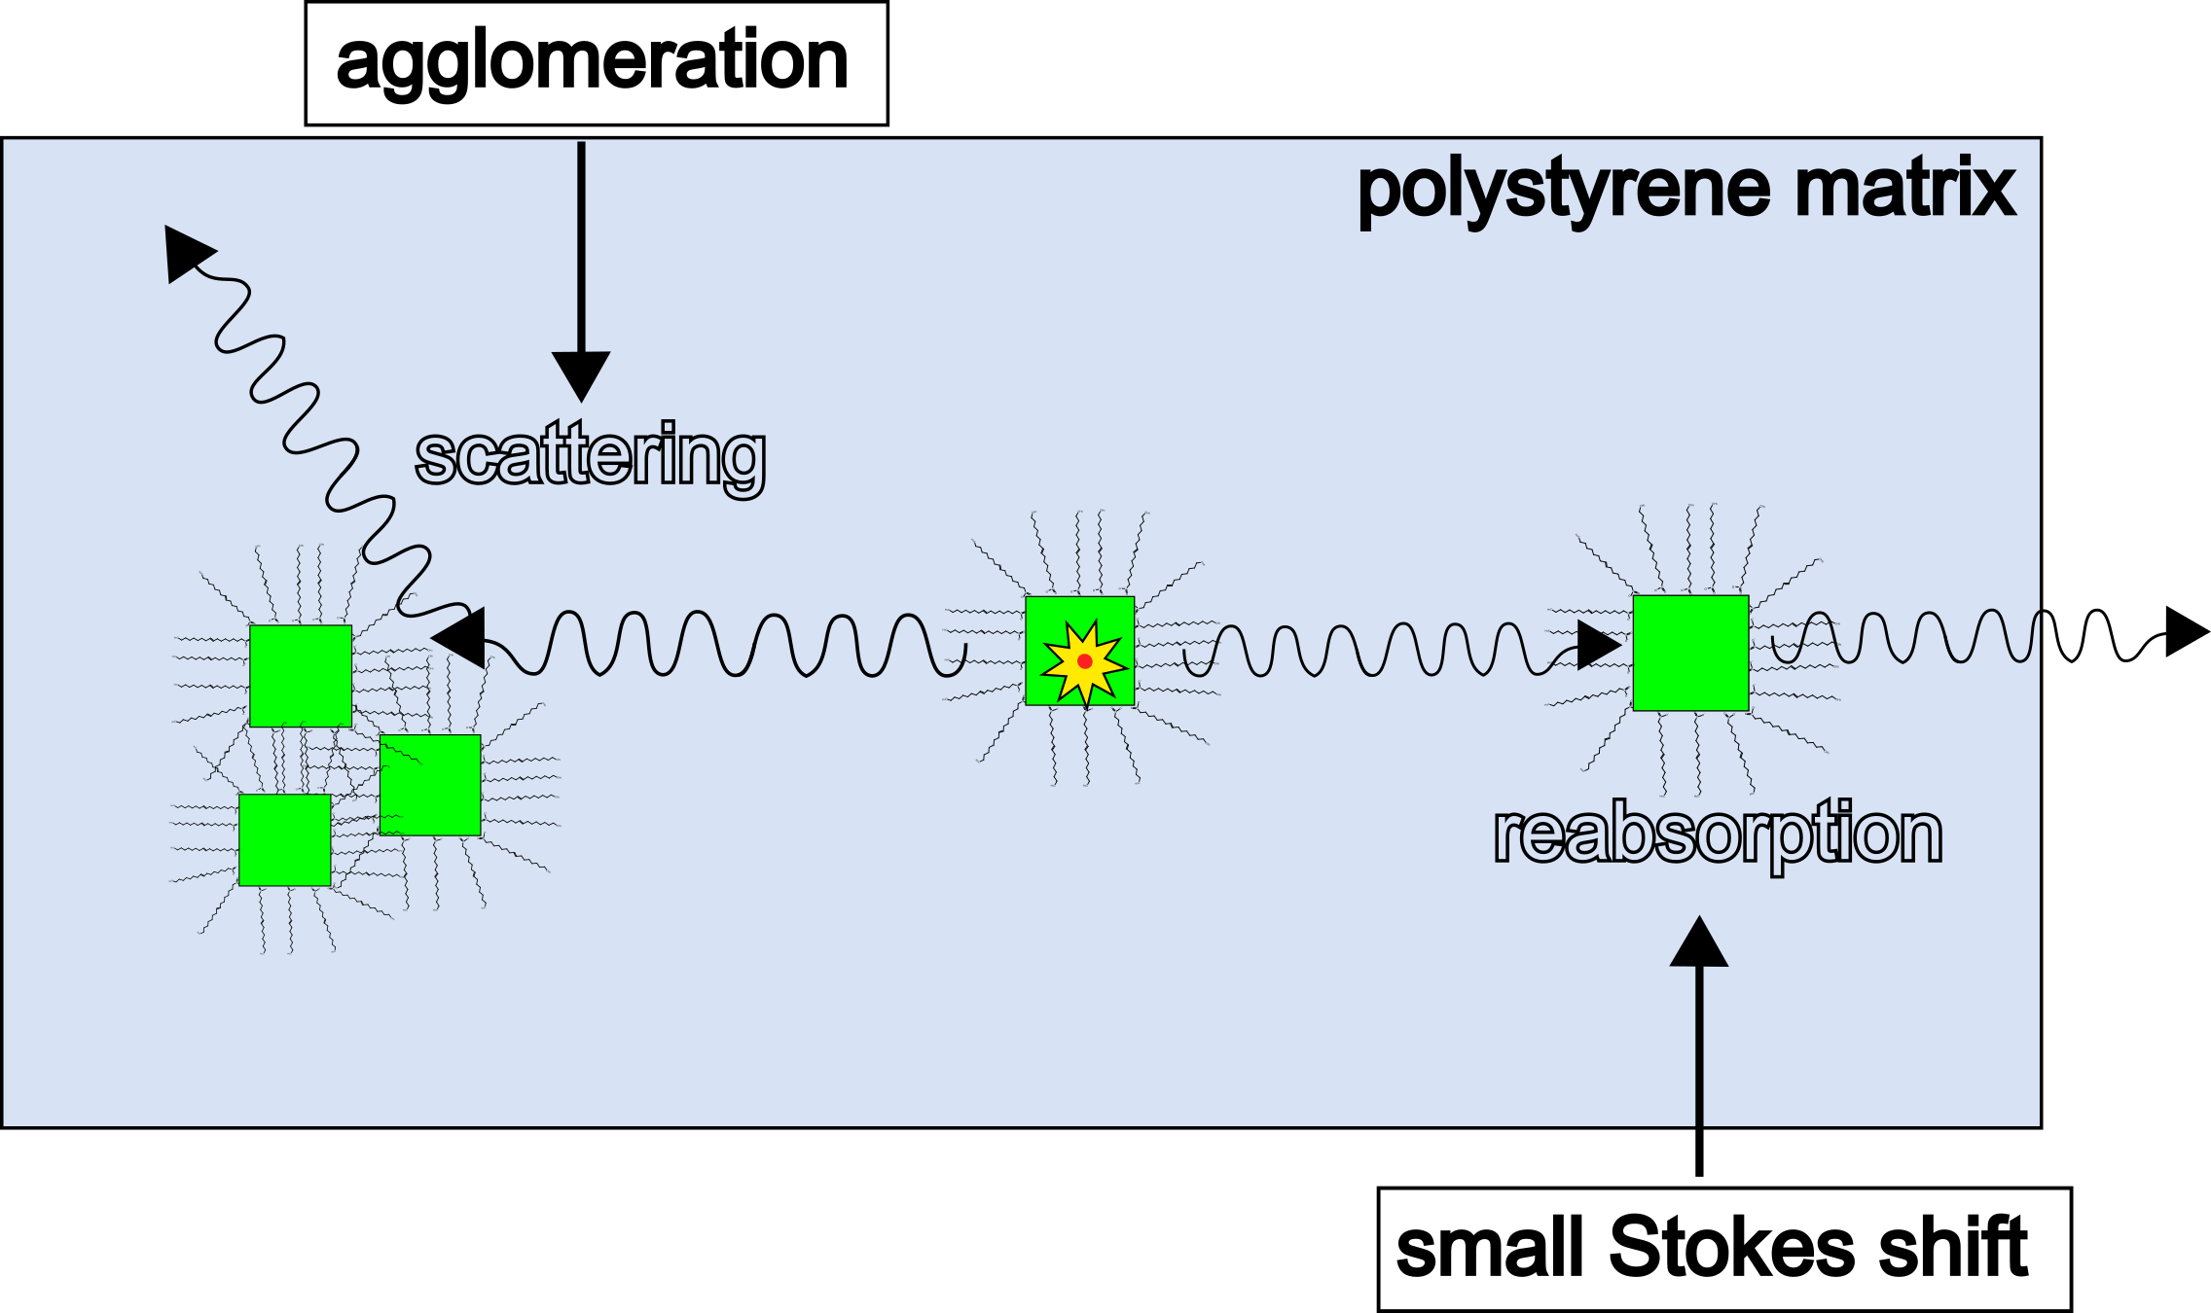
Embedding nanocrystals into a matrix
Needed: high loading (stopping power) and high transparency
Main goal: improving nanocrystal dispersion
6

Slide 8
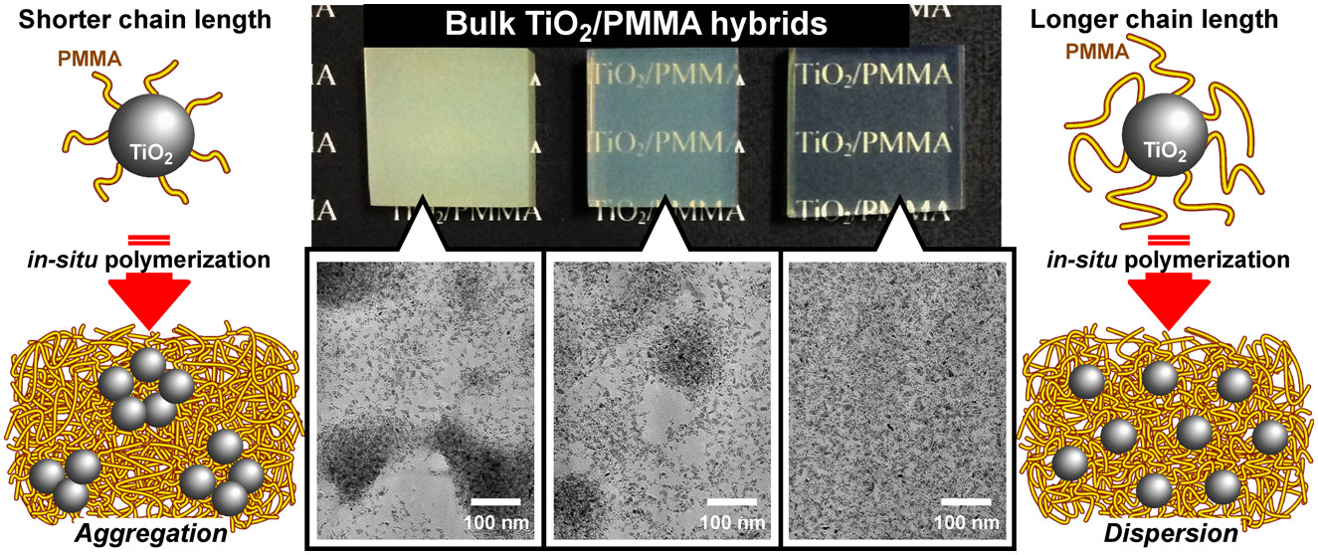
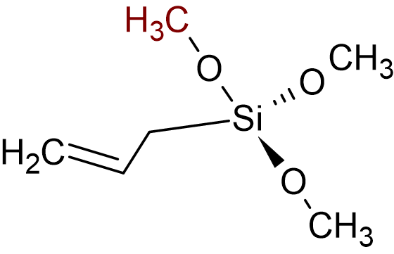
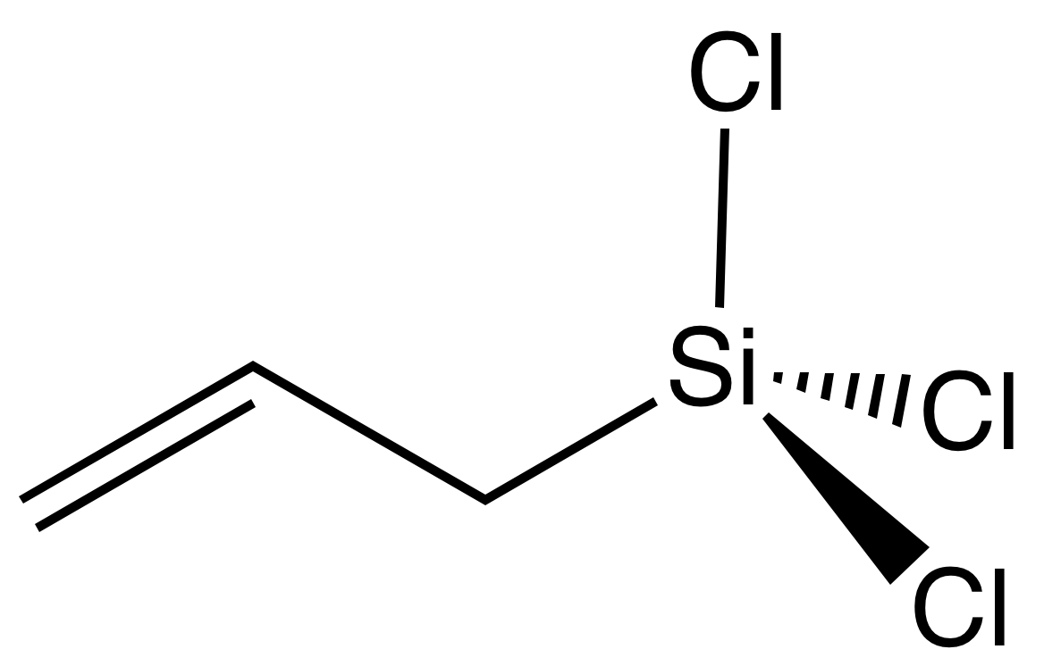
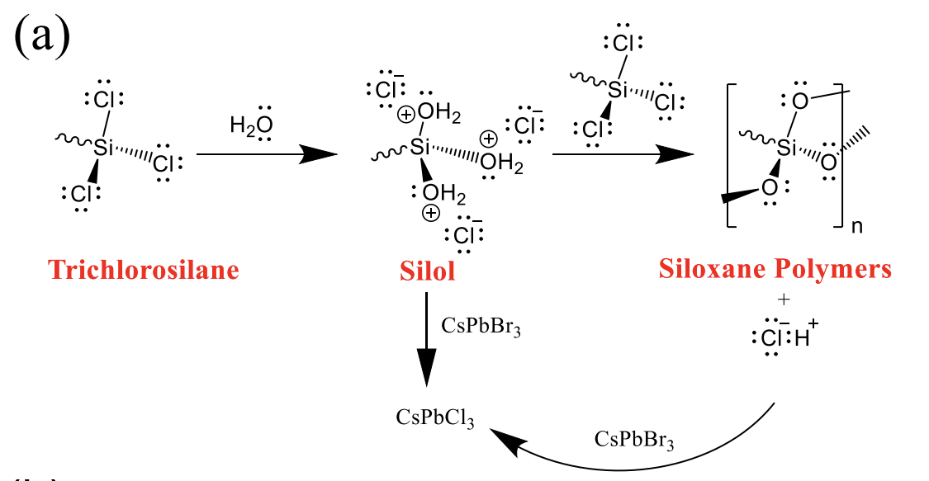
Introduction of copolymerizable functional groups
Allyltrimethoxysilane (ATMOS)
ACS Appl. Mater. Interfaces 2016, 8, 50, 34762-34769
Allyltrichlorosilane (ATS)
7

Slide 9
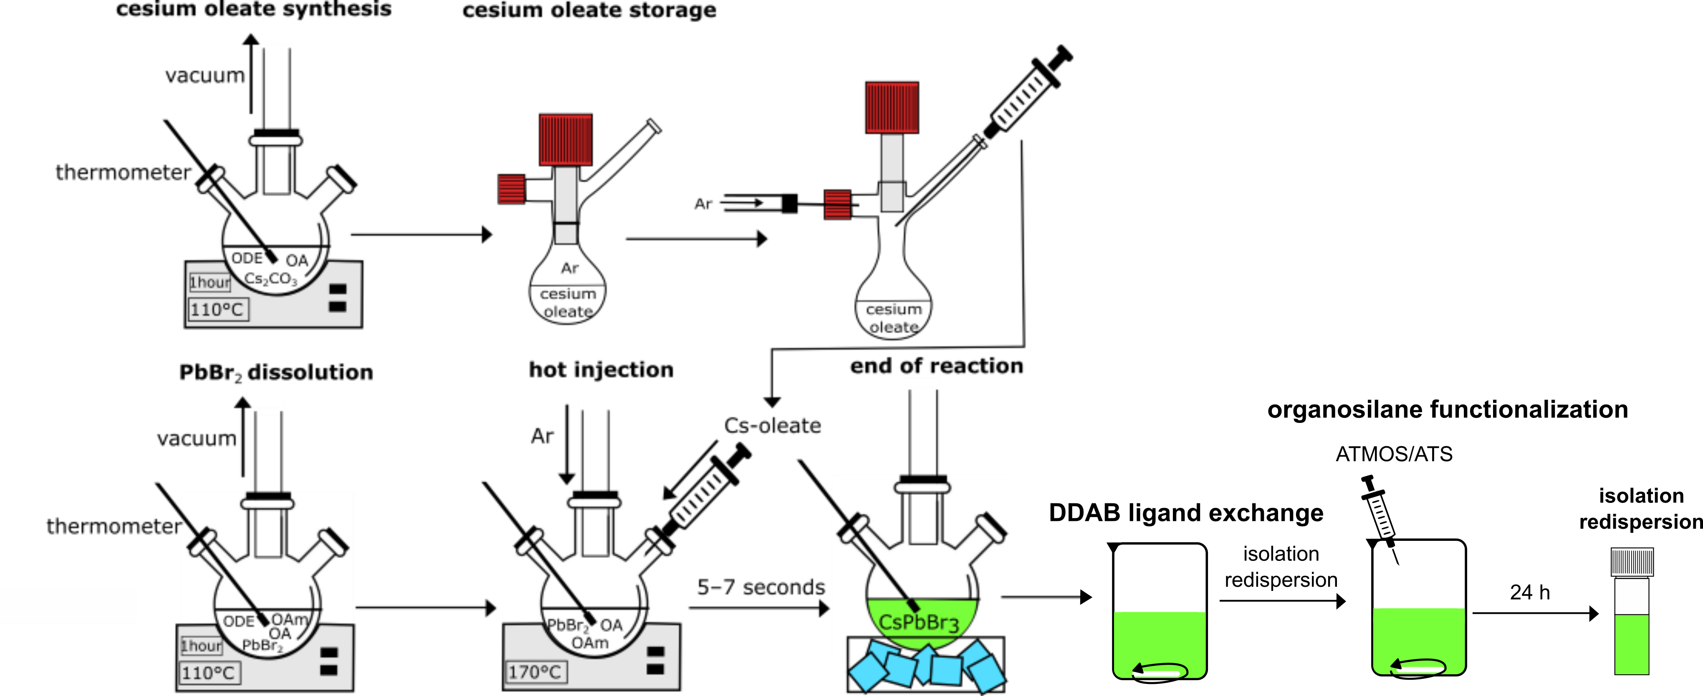
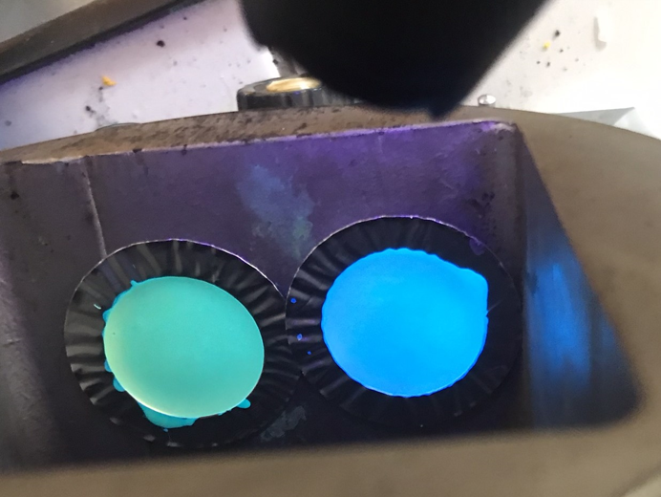
Nanocomposite preparation
Hot-injection synthesis and functionalization
styrene purification and prepolymerization
Sample preparation
+ thermal initiator
Polymerization at 80°C
8

Slide 10
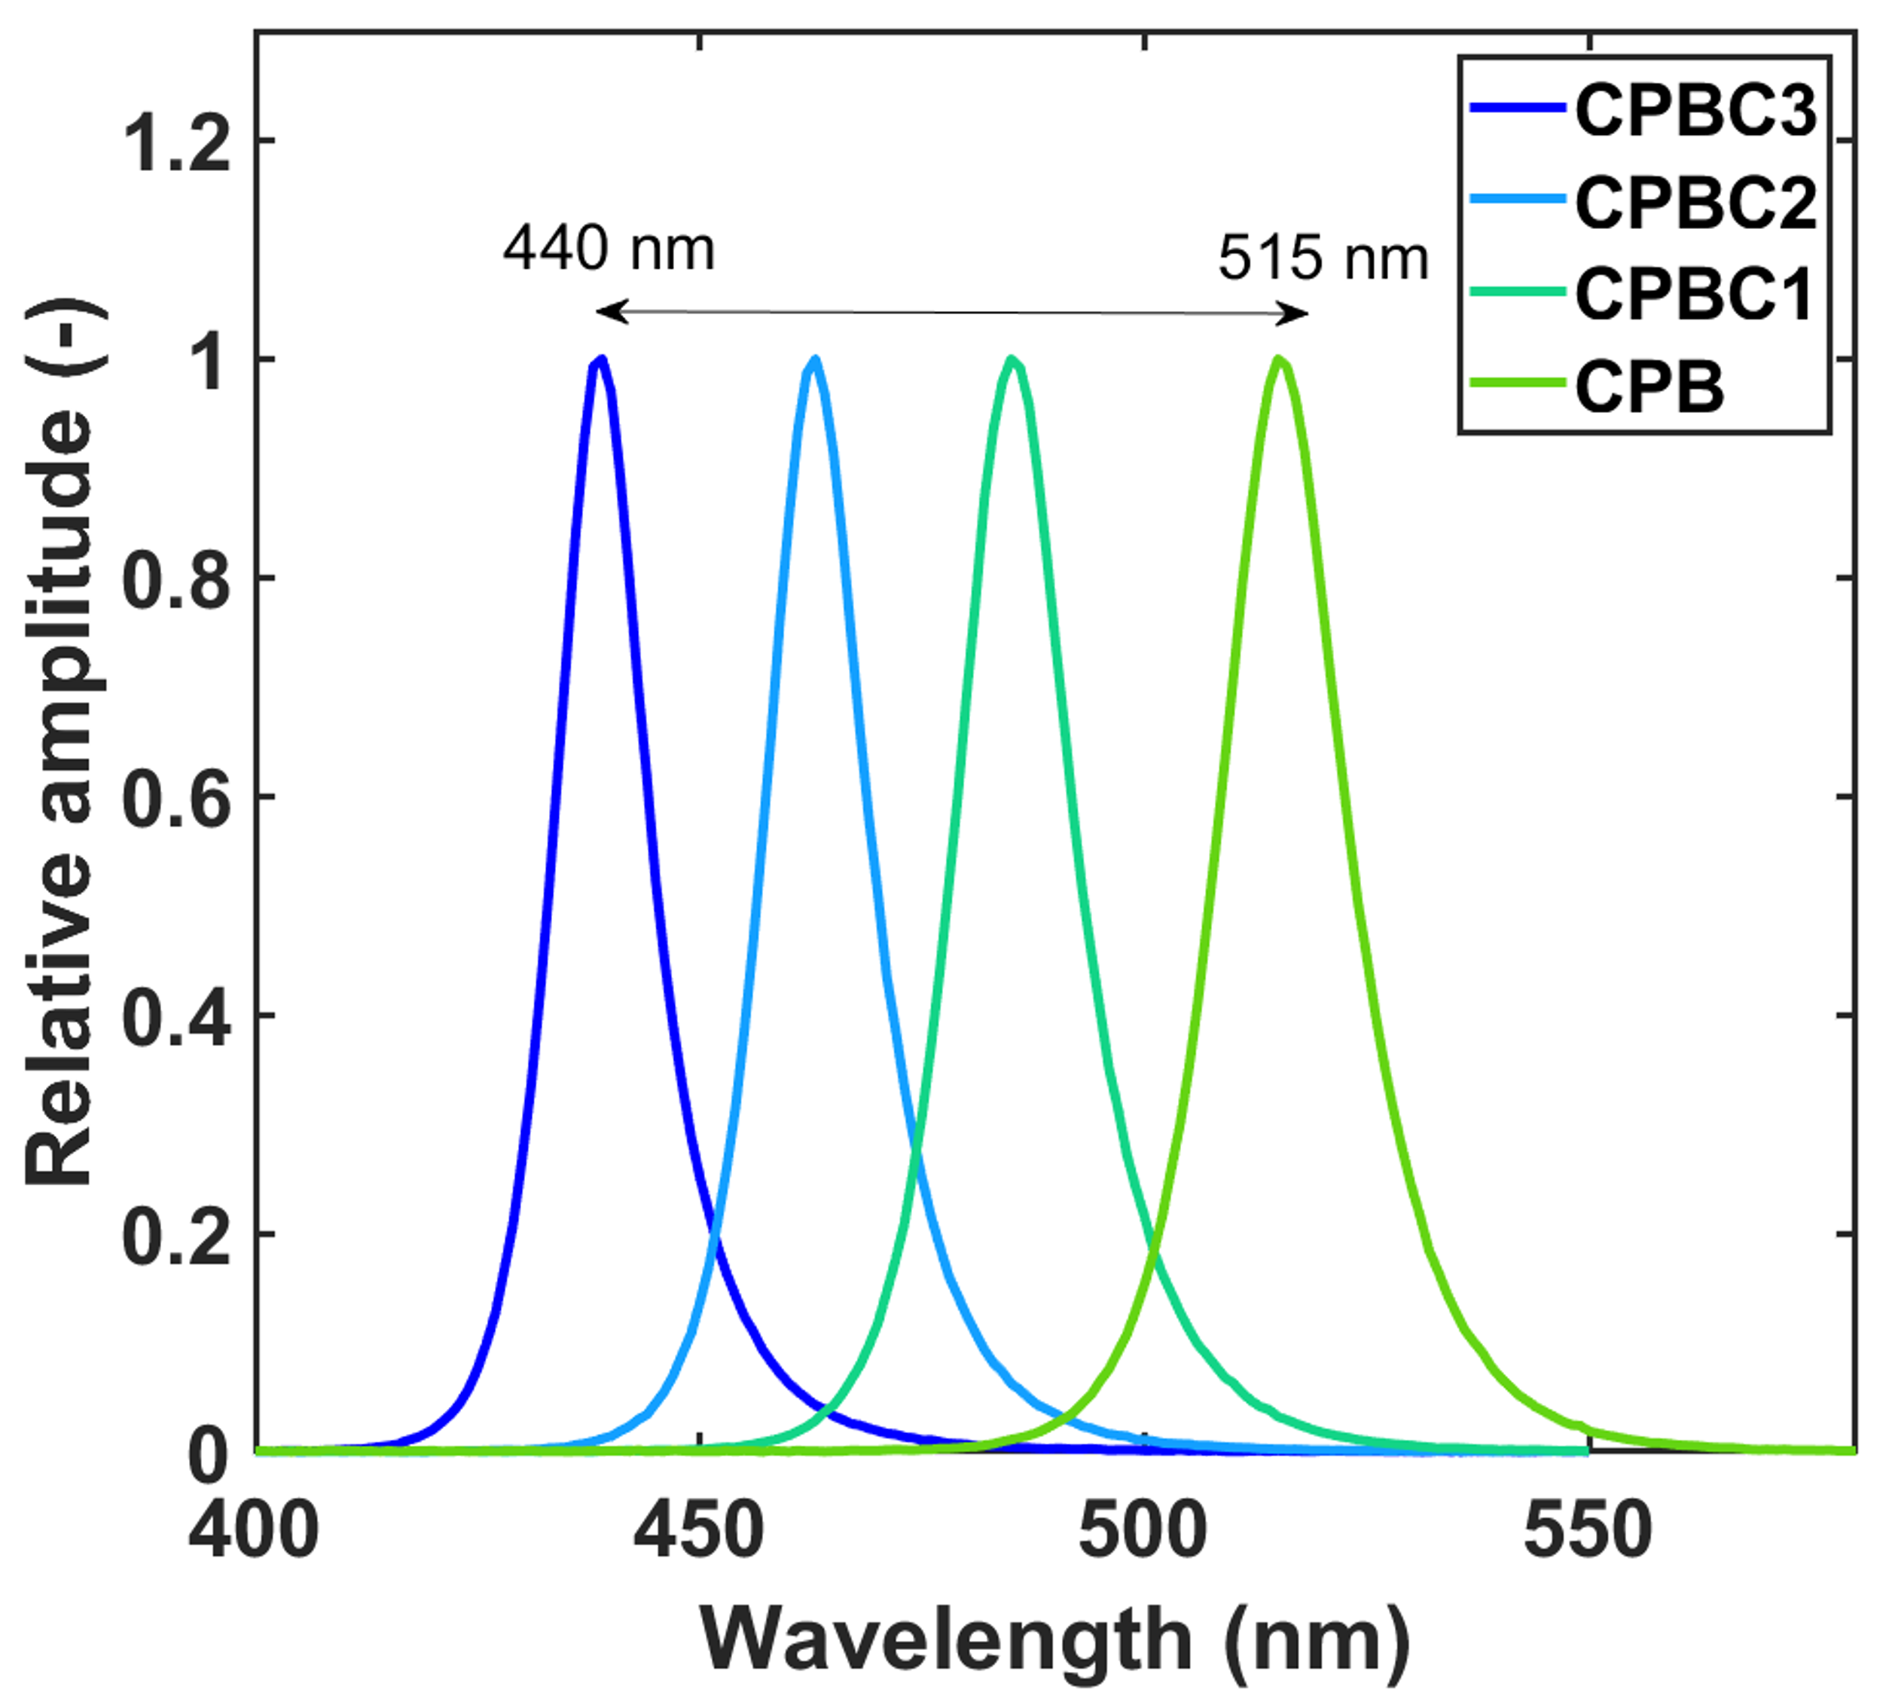
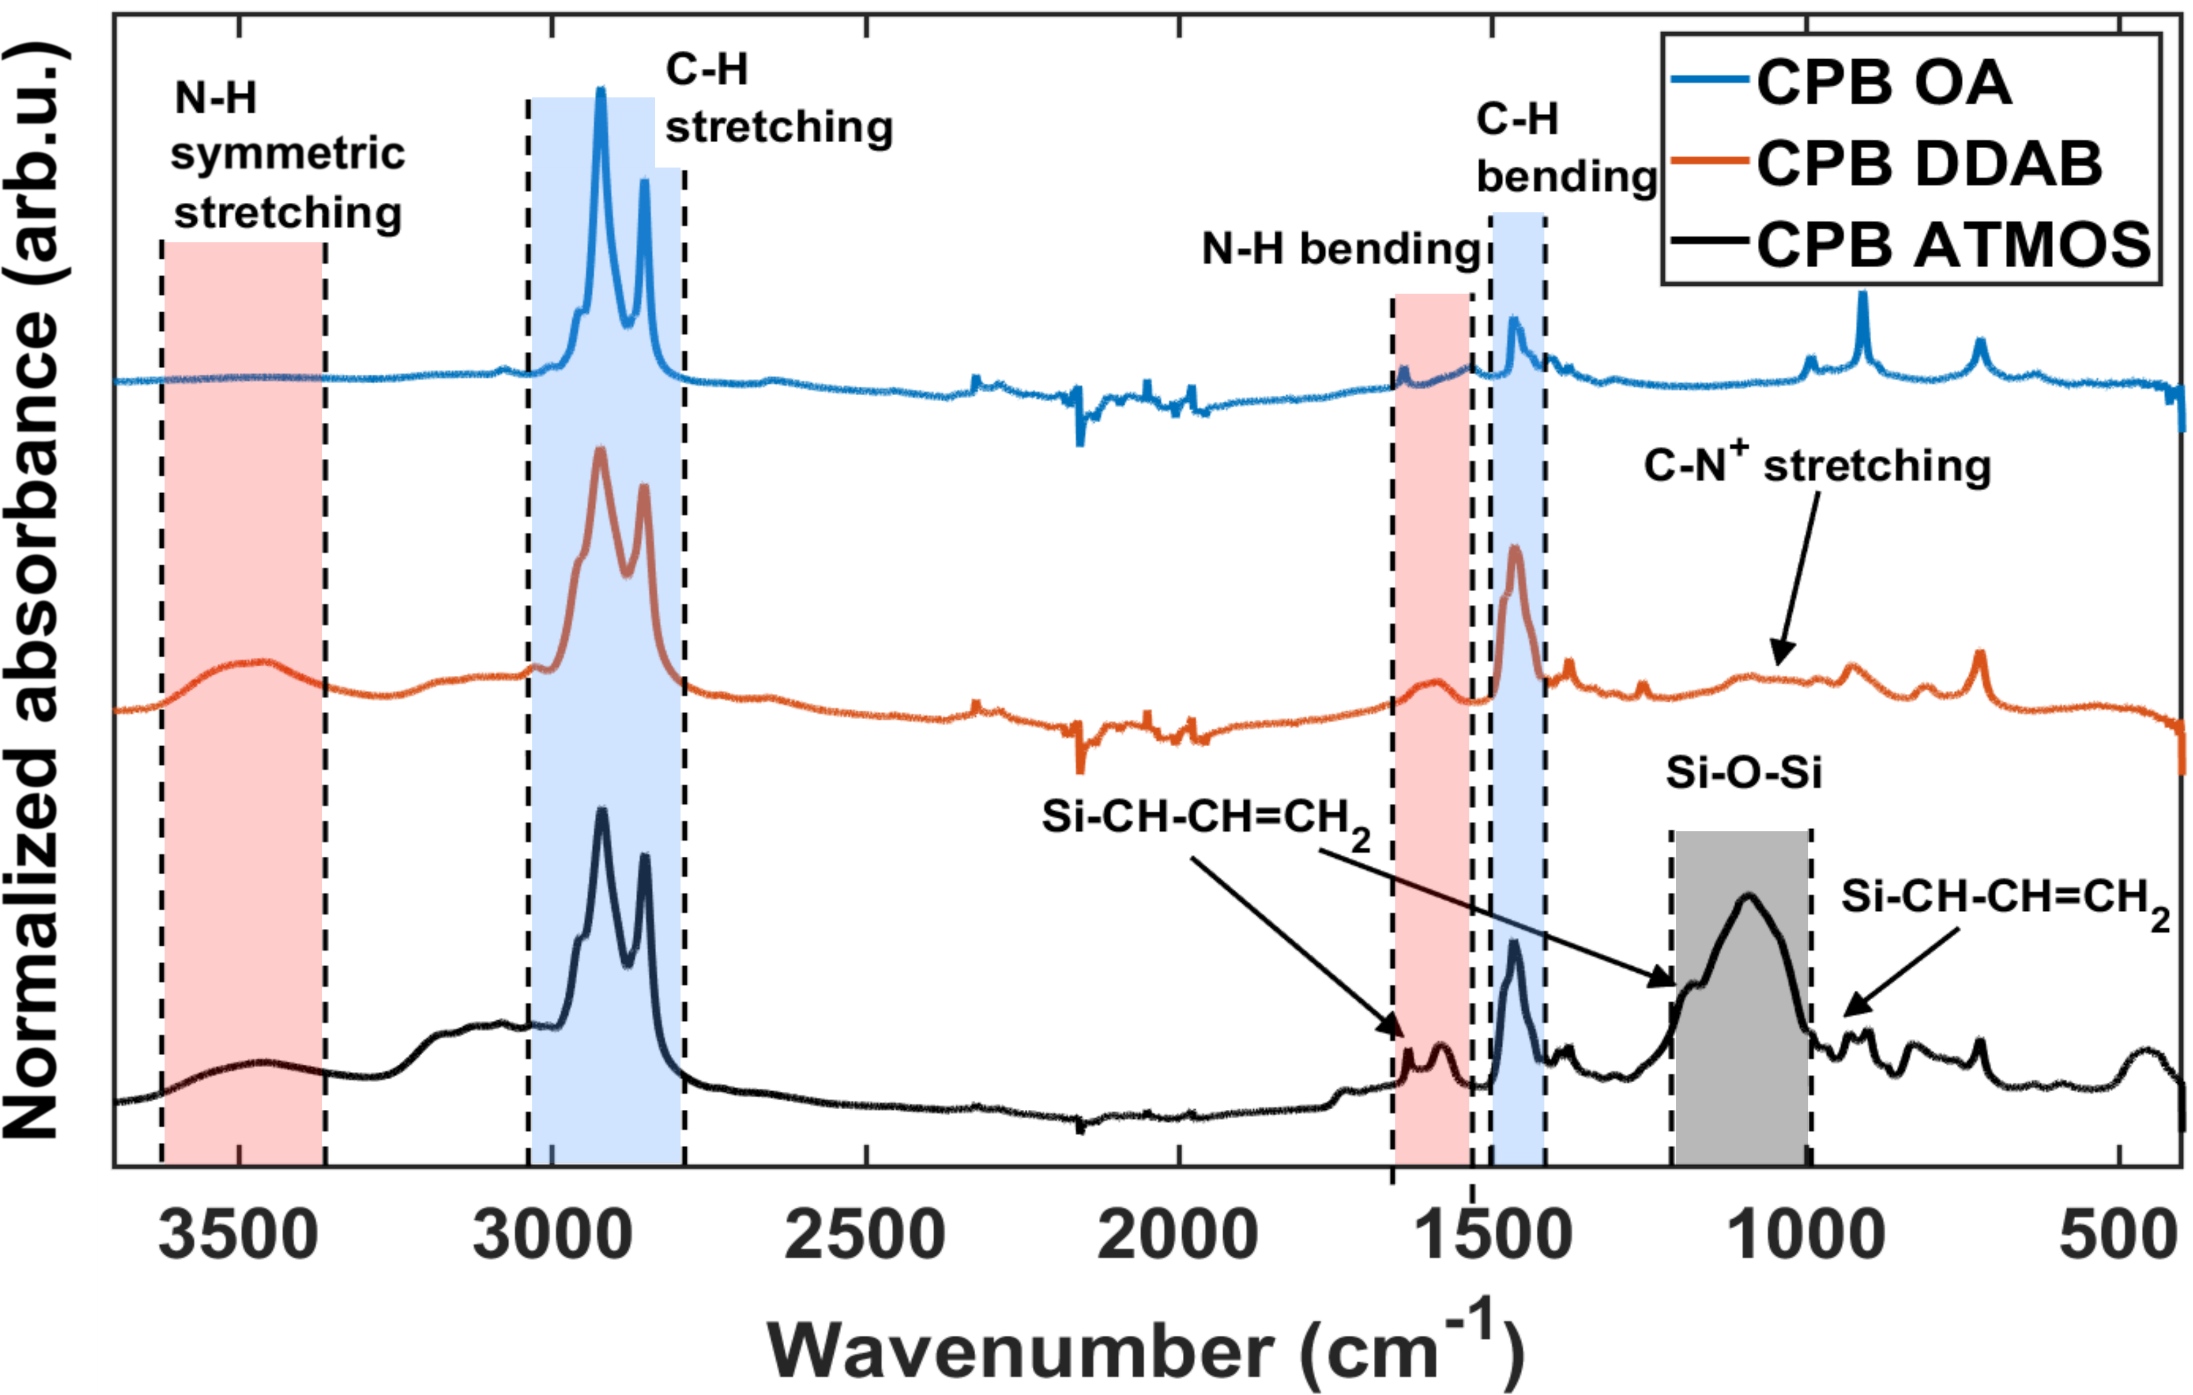
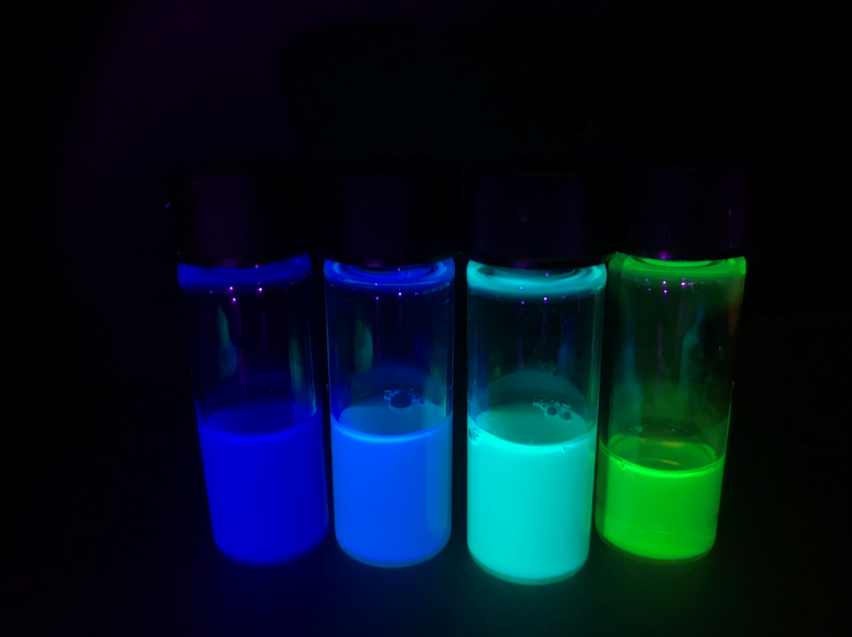
Nanocrystal characterization
CPB = CsPbBr₃
CPBC = CsPb(Br/Cl)₃
partial ligand exchange and introduction of allyl groups to the surface successful
tunable emission of the samples
9

Slide 11
Nanocomposite samples
Samples with 1 wt% loading
CPB@PS different ligands
Samples with high loading (>10 wt%)
CPB and CPBC samples with different loading and composition
10

Slide 12
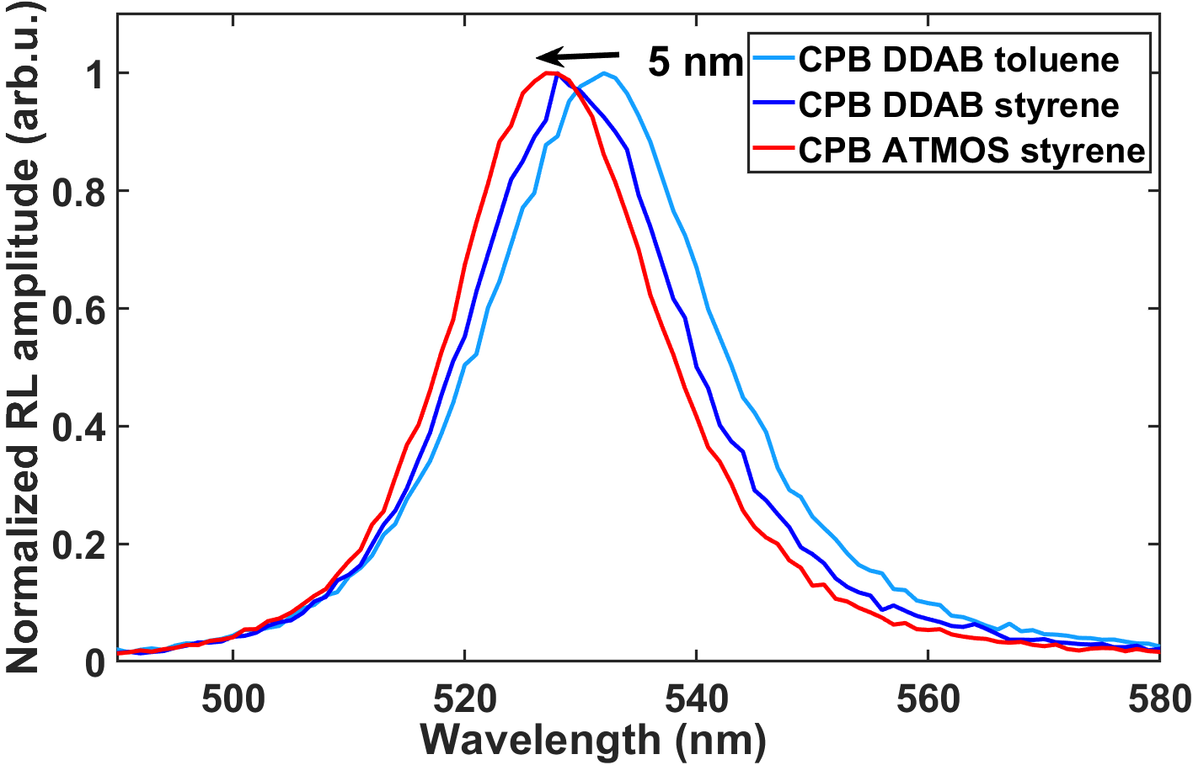
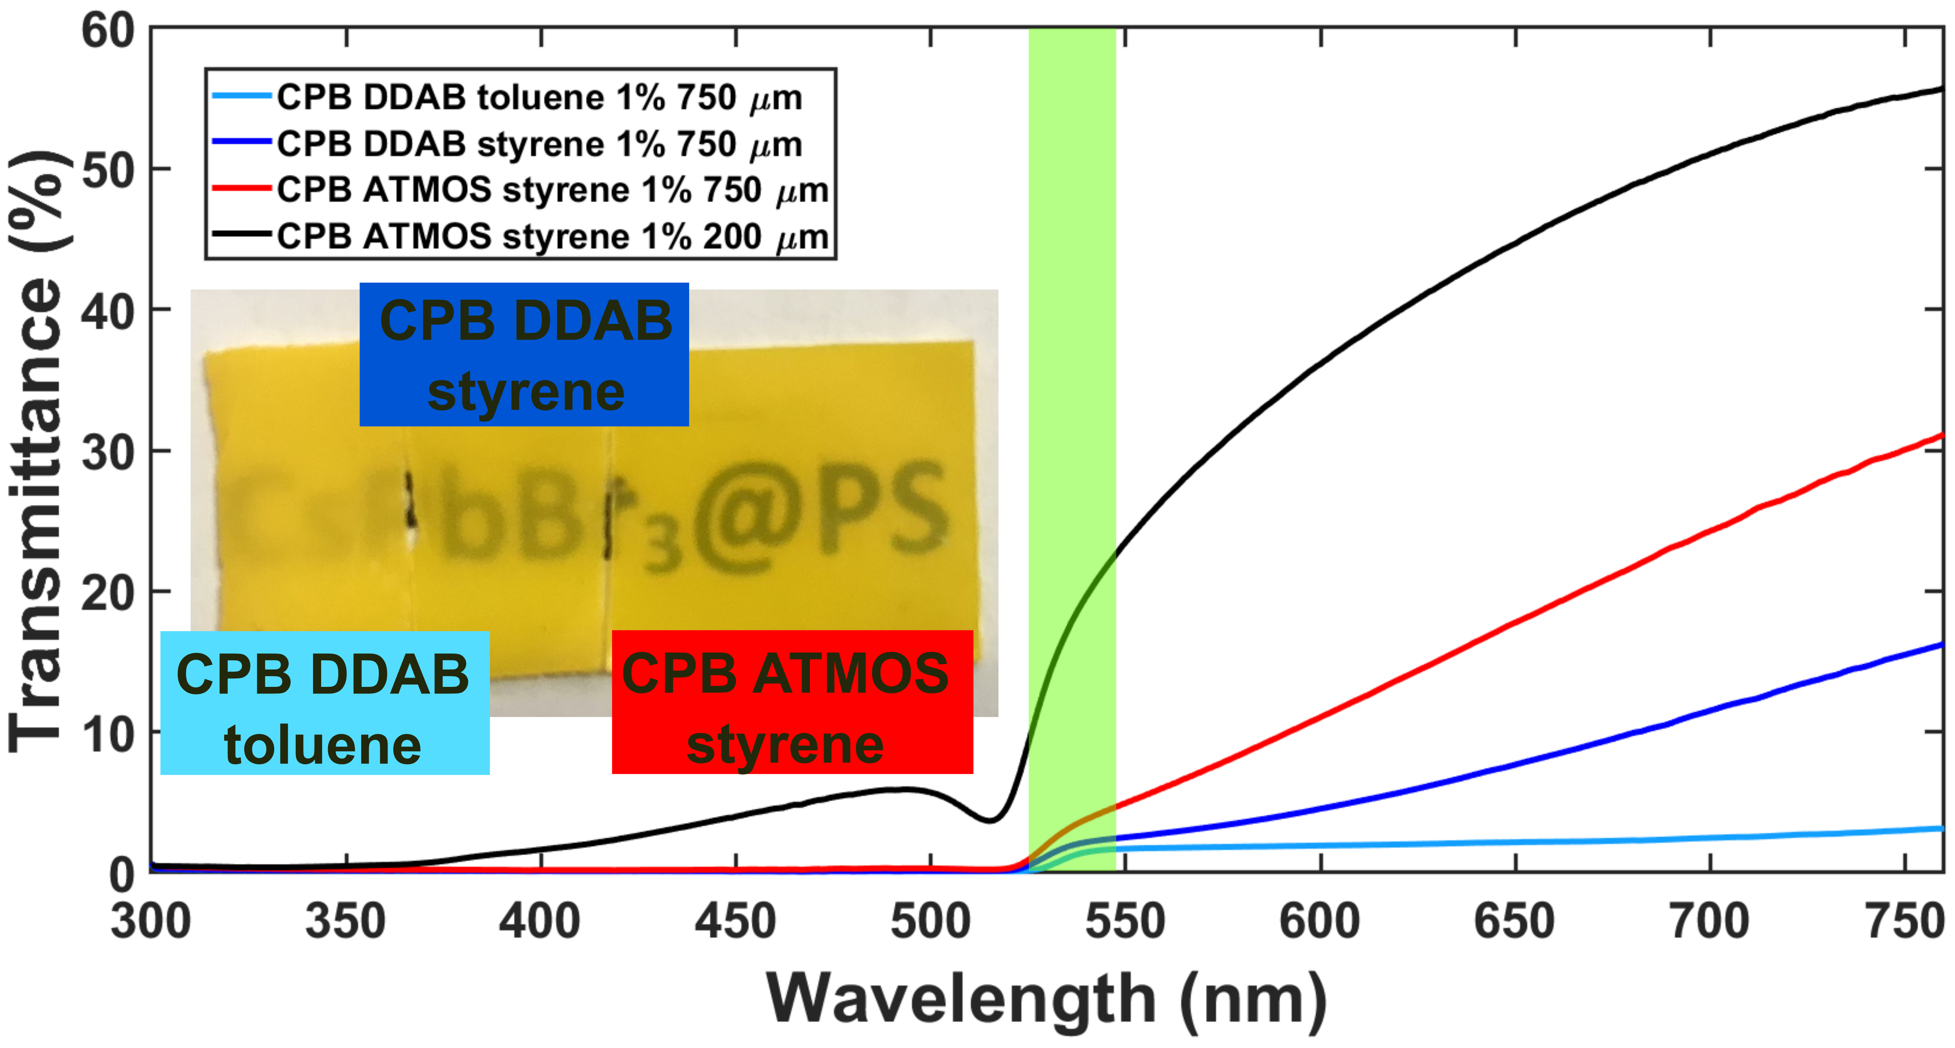
CPB@PS 1% - ligand comparison
improvement in transparency and blue-shift of emission when ATMOS ligand applied
11

Slide 13
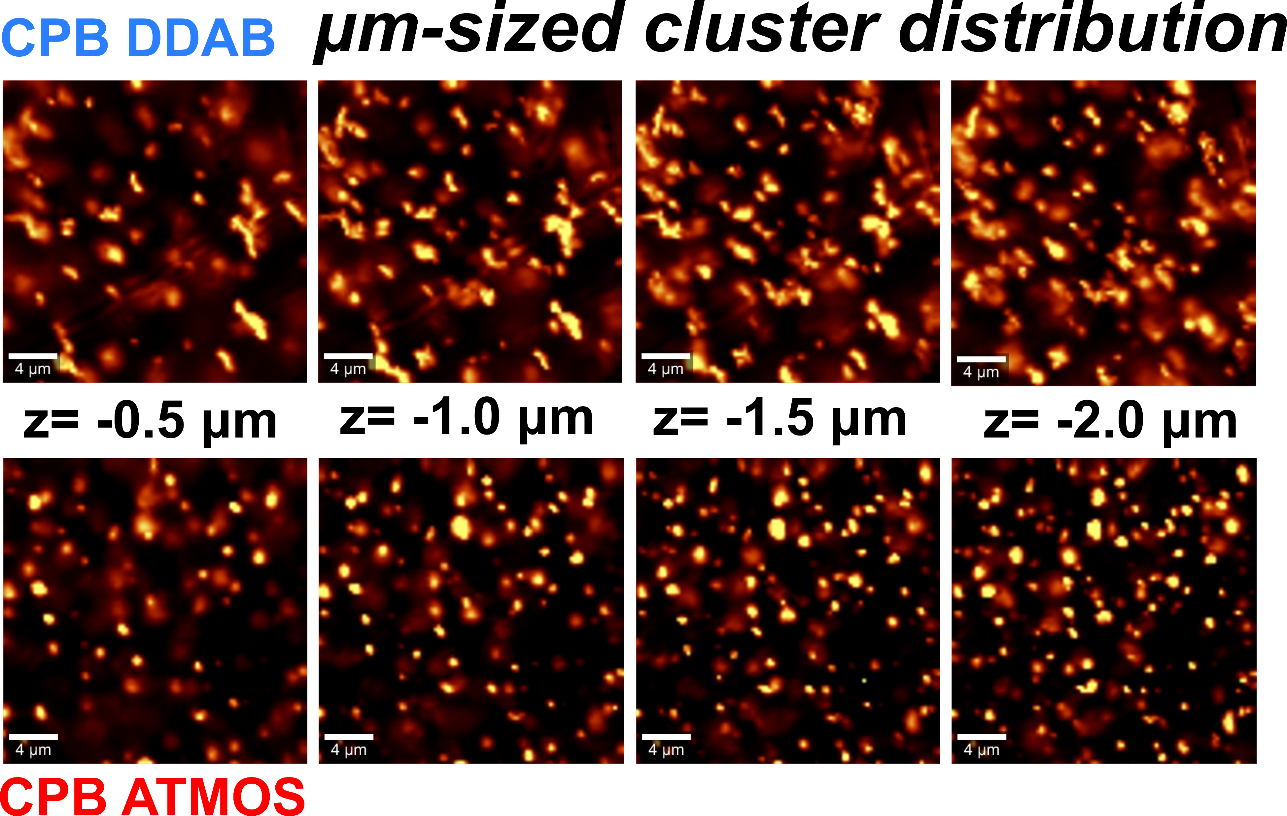
CPB@PS 1% confocal Raman microscopy
decreased agglomeration with ATMOS ligand
12

Slide 14
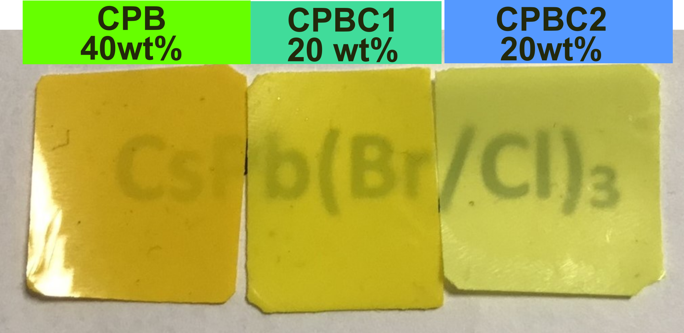
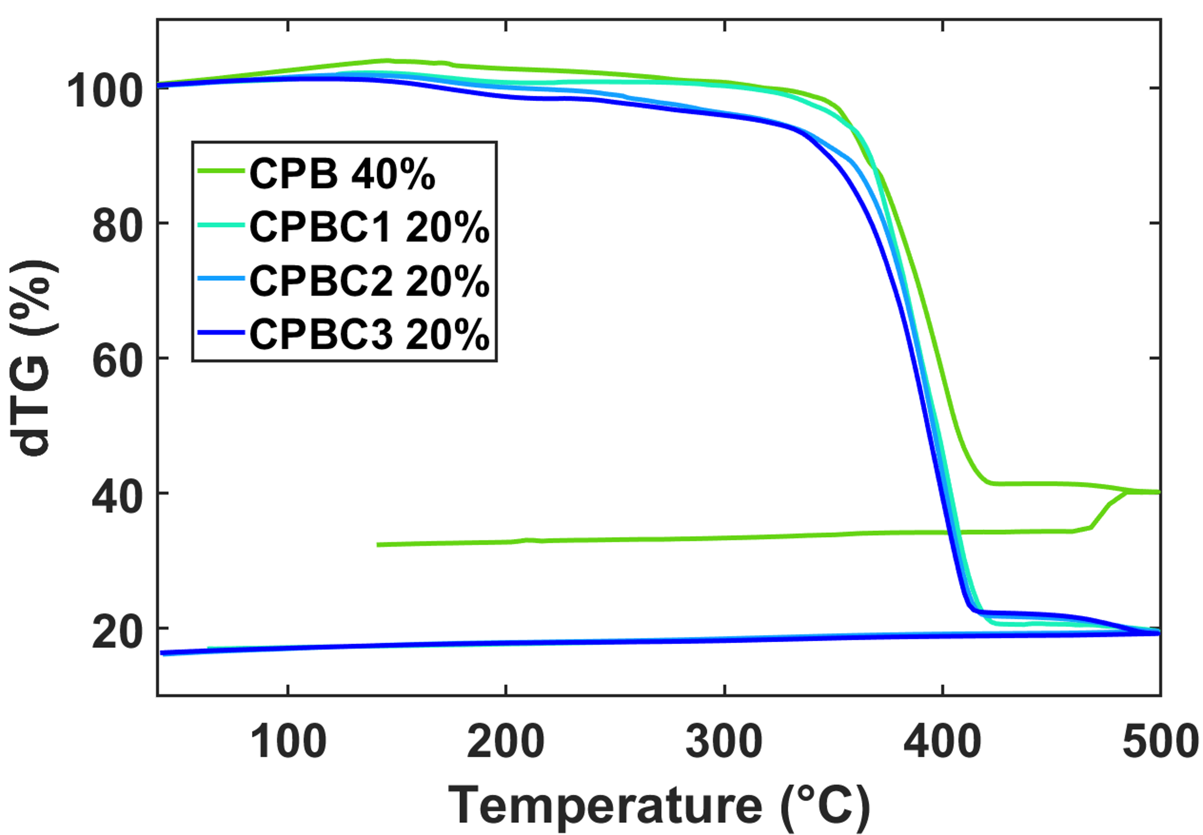
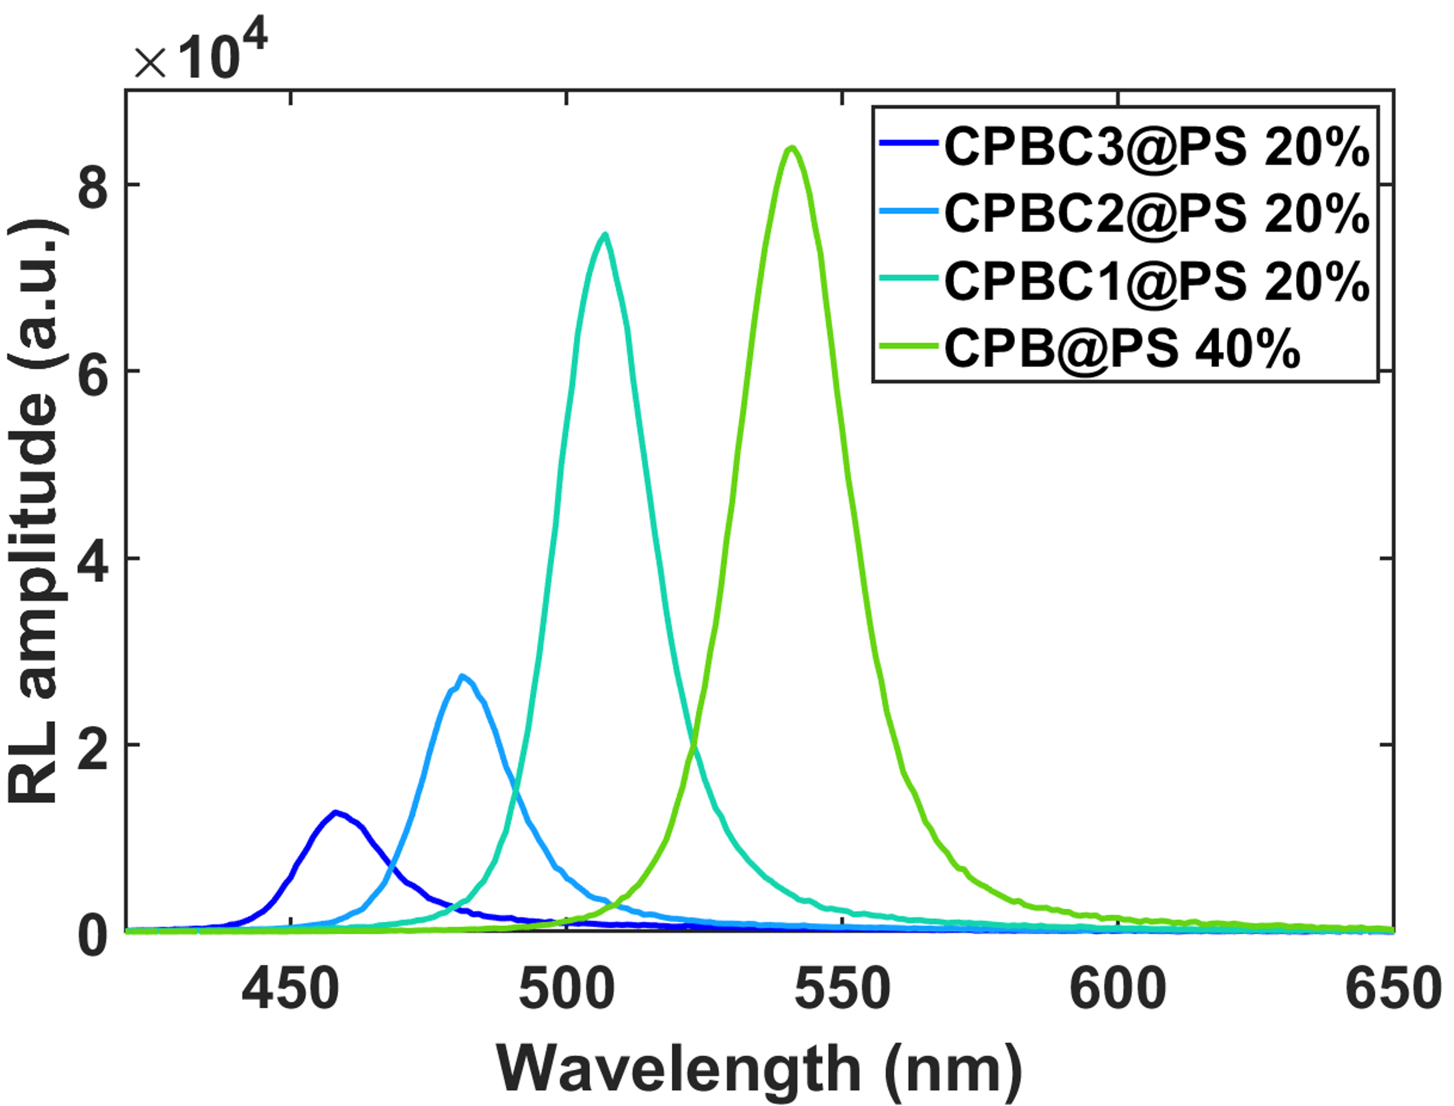
Nanocomposites with high loading
High loading up to 40 wt% with some transparency
thickness 200 µm
200 µm
14

Slide 15
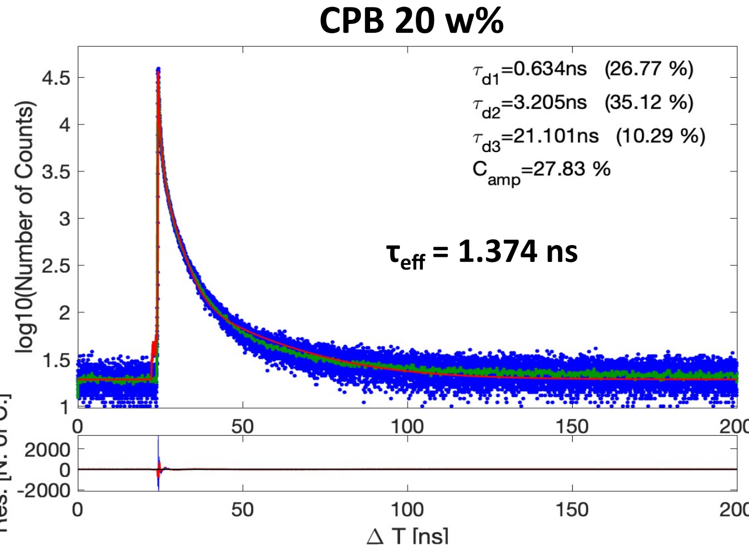
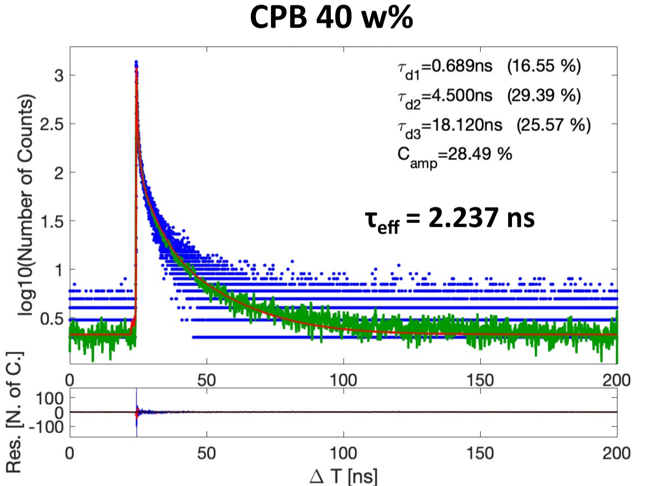
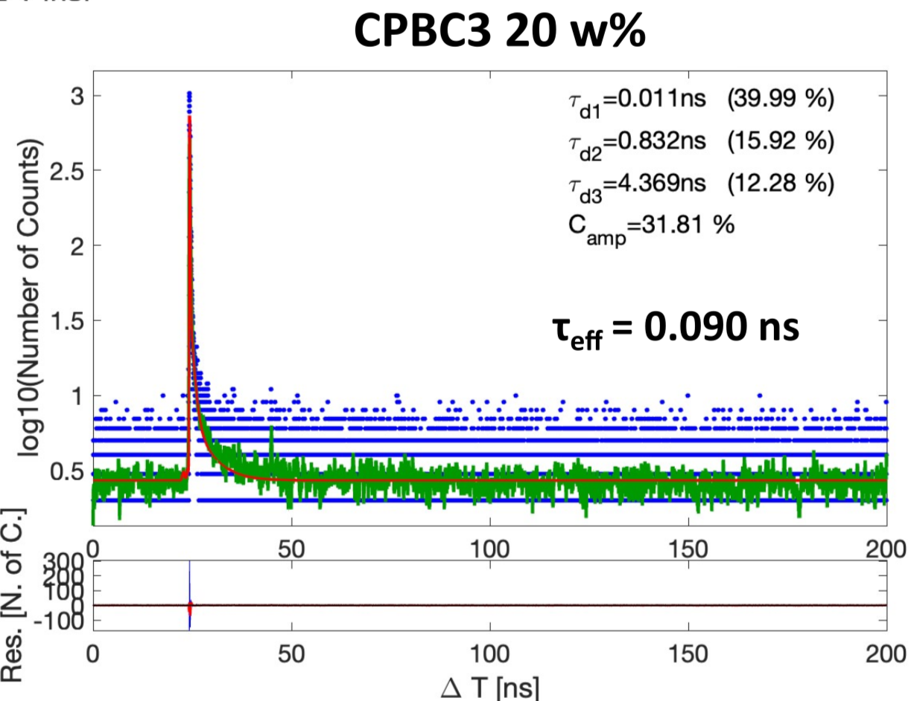
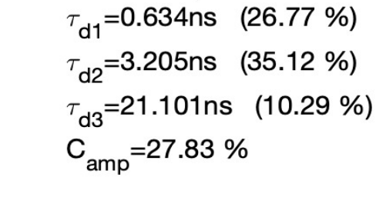
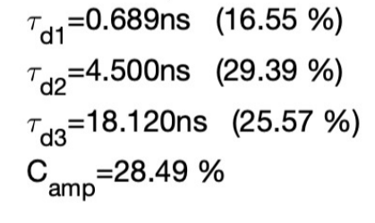
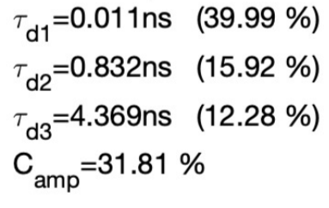
Decay under X-ray excitation
CPB decay kinetics mostly unaffected with increasing content up to 20 w%
Increased share in the slowest component for 40 w%
Significantly faster decay kinetics for increasing chloride content
15

Slide 16
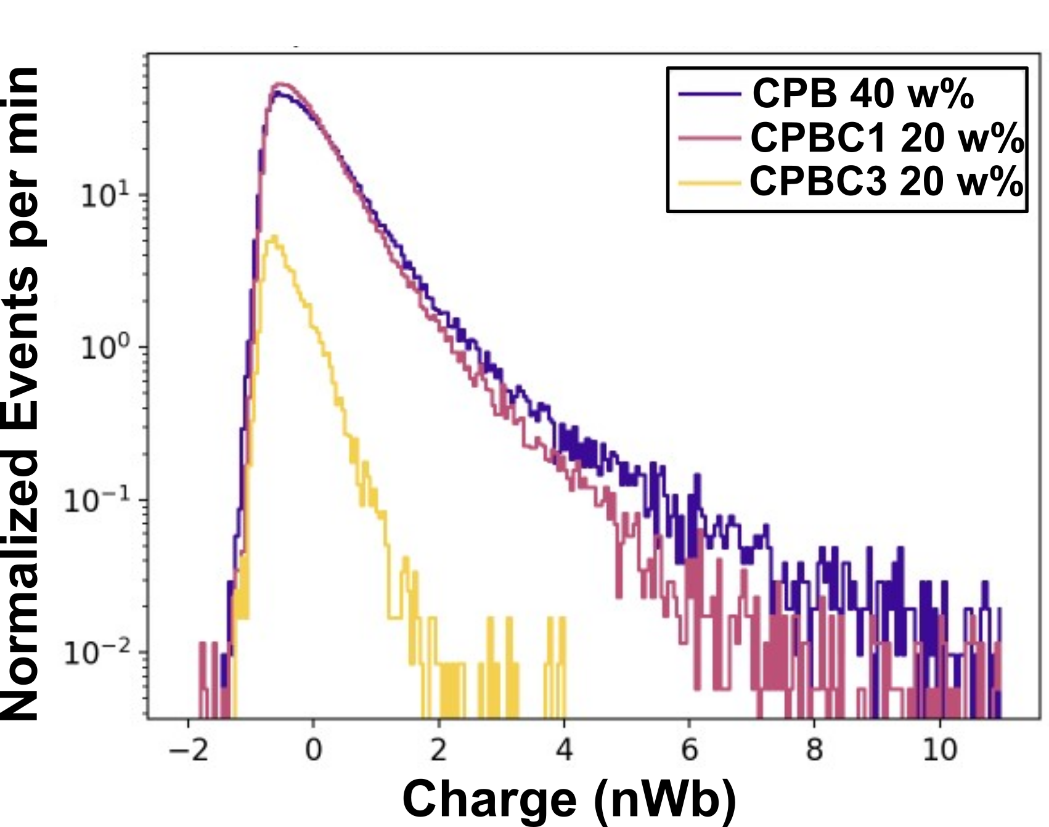
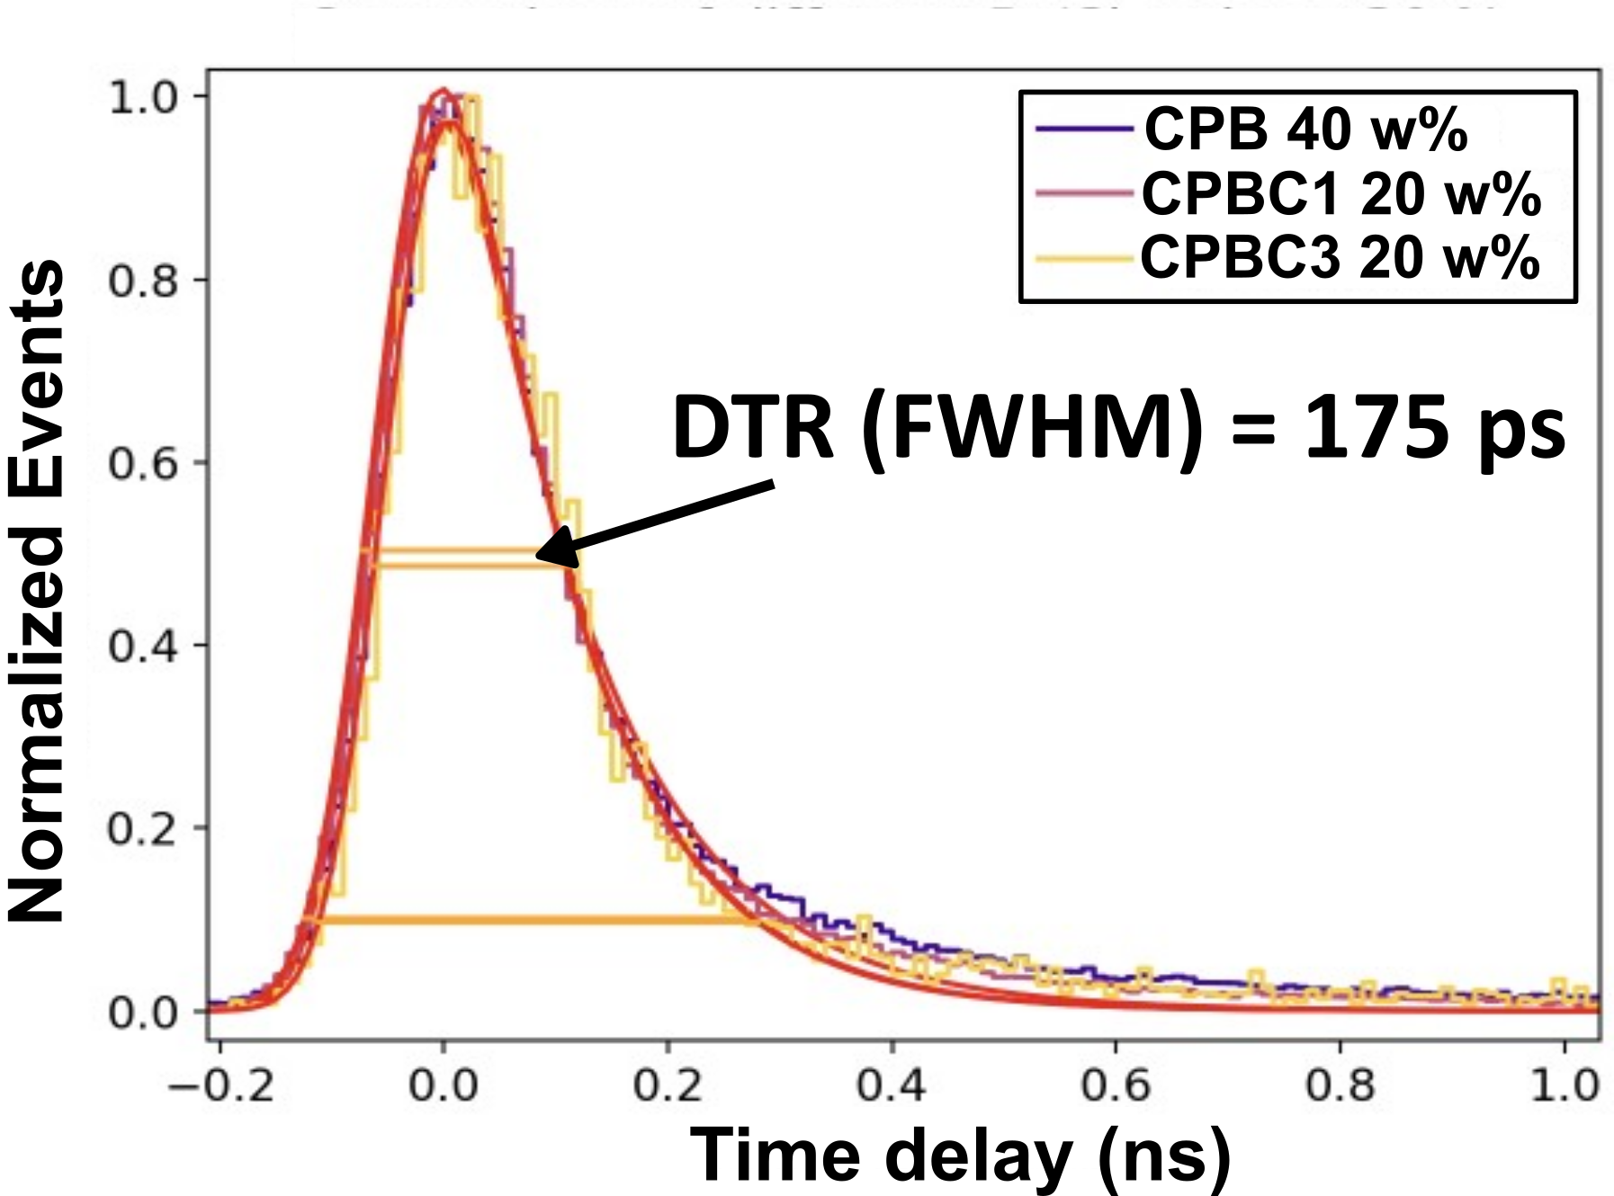
Time resolution under X-rays
significantly decreased light output with increased chloride content
comparable timing of CPB and CPBC nanocomposite under X-ray excitation
Significant improvement vs previously reported DTR for CPB nanocomposite ~ 300 ps K. Děcká et al., J. Mater. Chem. C 10, 12 836 (2022)
16

Slide 17
Conclusions
functionalization by allylsilanes was successful
introduction of allyl group improved transparency and dispersion of nanocrystals in the matrix
high loading up to 40 wt% was achieved
timing capabilities of CsPb(Br/Cl)₃ nanocrystals is comparable with CsPbBr₃ nanocrystals
improved timing for CPB nanocomposites under X-rays, significant increase in stopping power
Outlook
determination of nanocomposite light yield
utilization of high loading samples in heterostructures
preparation of high loading nanocomposites with newly modified NCs
17

Slide 18
Acknowledgements
This work was carried out in the frame of Crystal Clear Collaboration.
It was funded by OP JAC project financed by ESIF and the MEYS SENDISO (CZ.02.01.01/00/22_008/0004596), Czech Science Foundation (GA23-05615S), Grant Agency of the Czech Technical University in Prague (SGS23/189/OHK4/3T/14), and CERN Budget for Knowledge Transfer to Medical Applications
18

