Slide 1



Comparative Experimental and Simulation DOI
Analysis on Semi-Monolithic Metascintillators
Riccardo Latella, Lei Zhang, Antonio J. Gonzalez, Member, IEEE, Paul Lecoq, Fellow, IEEE,
Andrea Gonzalez-Montoro, Member, IEEE, Marta Freire, and Georgios Konstantinou, Member, IEEE
Riccardo Latella, PhD Student
Multiwave Metacrystal SA
Institute for Instrumentation in Molecular Imaging, i3M
Isola d’Elba, Italy, May 21st, 2024

Slide 2


Index
Results
Flood Map and Energy Spectrums
Discussion and Future Works
Introduction
PET, Corrections, and DOI
Metascintillators
Materials and Methods
SMMS Structure
Scintillators & Photodetectors
Setup Description
Collimation Points
Estimator and Interpolation
Centroid Comparison
Regression/Conversion Methods
DOI Average Results
Timing Simulation
Timing Setups
SMMS-slab
Final Remarks

Slide 3
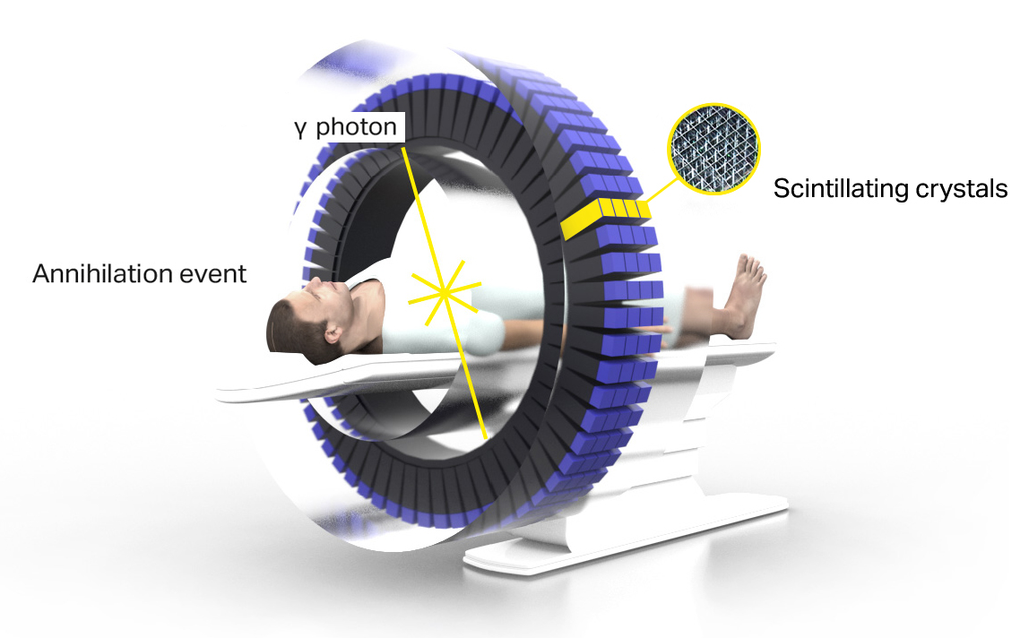
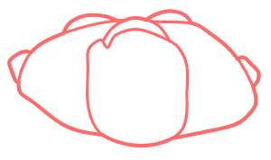
Introduction
Corrections:
Scatter Filtering
Attenuation Correction
Random Coincidences Filtering
Depth-of-Interaction (DOI)
...
DOI Correction
Occurs when:
Imaging a curved surface
The detector angle is not perpendicular to the surface being imaged.
Benefits:
Reduces parallax error.
Enhances image resolution
ToF improvement
CT or MRI
t1 - t2 < time_window
https://metacrystal.ch/
Positron Emission Tomography (PET)
Precise timing
Good energy resolution
High-quality imaging
The sole Line Of Response (LOR) is not enough to achieve significant improvements in terms of spatial resolution

Slide 4

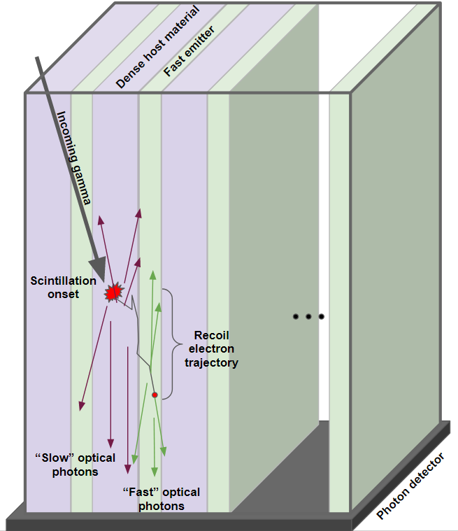
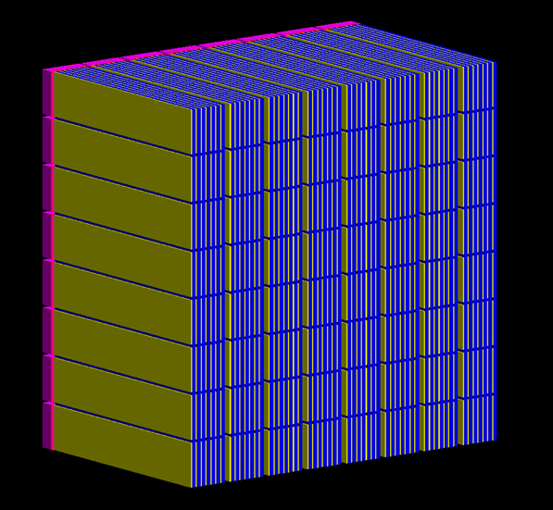
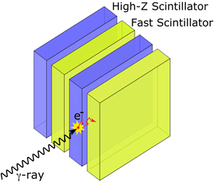
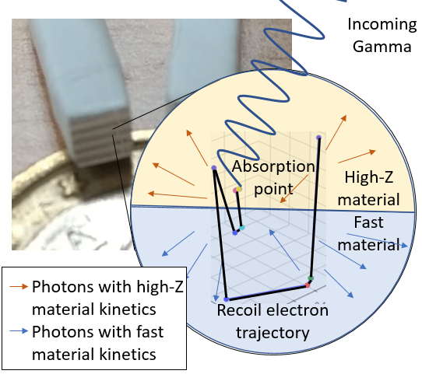
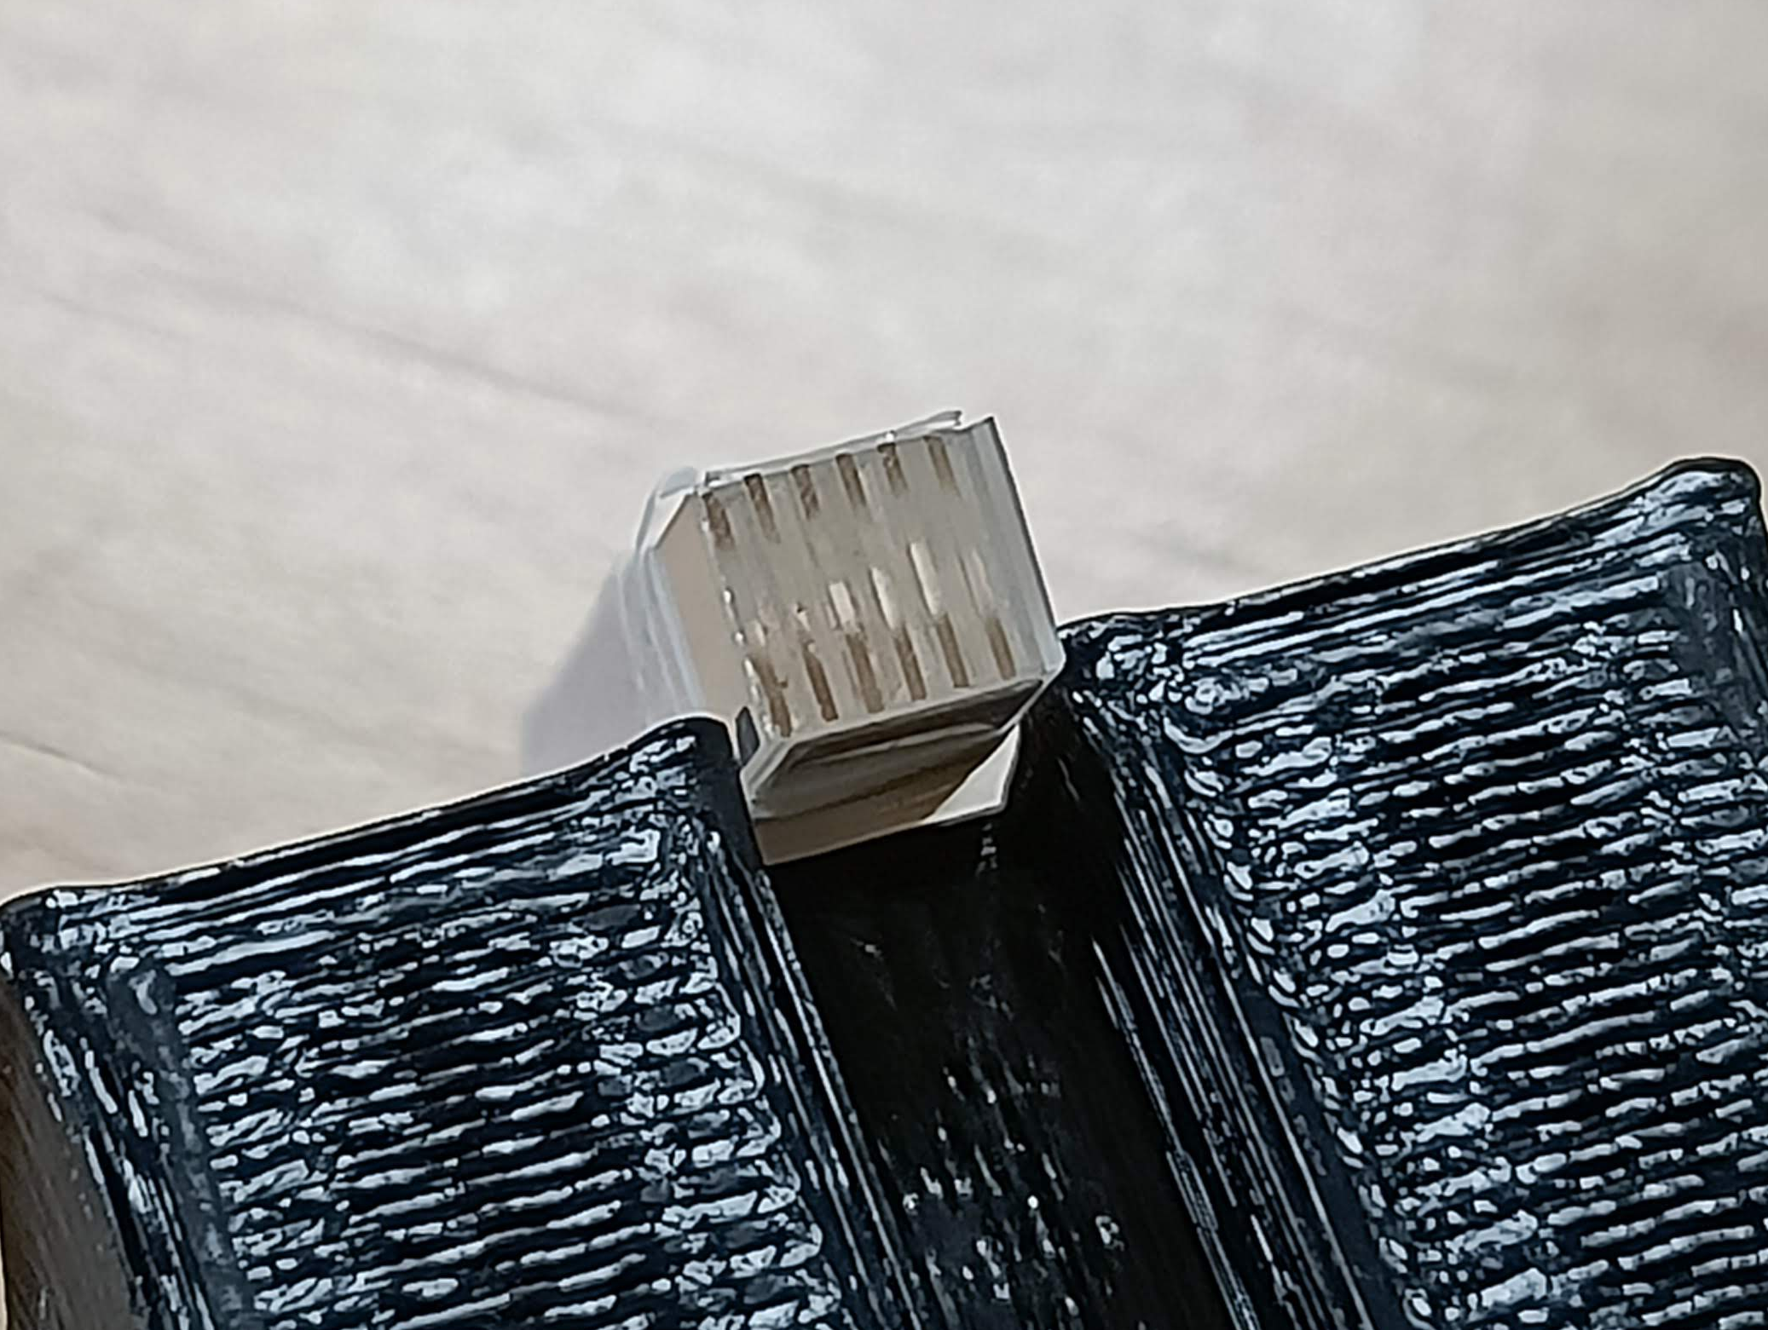
Metascintillators
Metascintillators:
Combine dense host material with a fast emitter
Heterostructure with complementary properties
Based on the shared events concept
Exploiting the recoil electron trajectory
Light guide
Semi-Monolithic MetaScintillators (SMMS)
P. Lecoq et al.
doi: 10.1140/epjp/s13360-022-03159-8
F. Pagano et al.,
doi: 10.1088/1361-6560/ac72ee
PATENT: González Martínez, A. J., Lecoq, P., Benlloch Baviera, J. M., Konstantinou, G., & Barrio Toala, J. (2023). Device for the detection of gamma rays based on segmented metascintillator block detectors.
G. Konstantinou et al.
doi: 10.1088/1361-6560/acac5f
R. Latella et al.,
doi: 10.1109/TRPMS.2023.3310581
G. Konstantinou et al.
doi: 10.1109/TRPMS.2024.3368802

Slide 5
SMMS Structure
Key components:
- LYSO:Ce plates
(25.4 × 24 × 0.3 mm³)
- EJ232 plates
(3 × 24 × 0.1 mm³)
SLAB
Each SLAB contains:
8 LYSO:Ce semi-monolithic plates
8 layers of Ej232
8 EJ232 pixellated plates for each layer
Total of 64 EJ232 pixelated plates.
ESR inter-slabs
Everything coated in ESR,
Except the extraction surface
x8

Slide 6
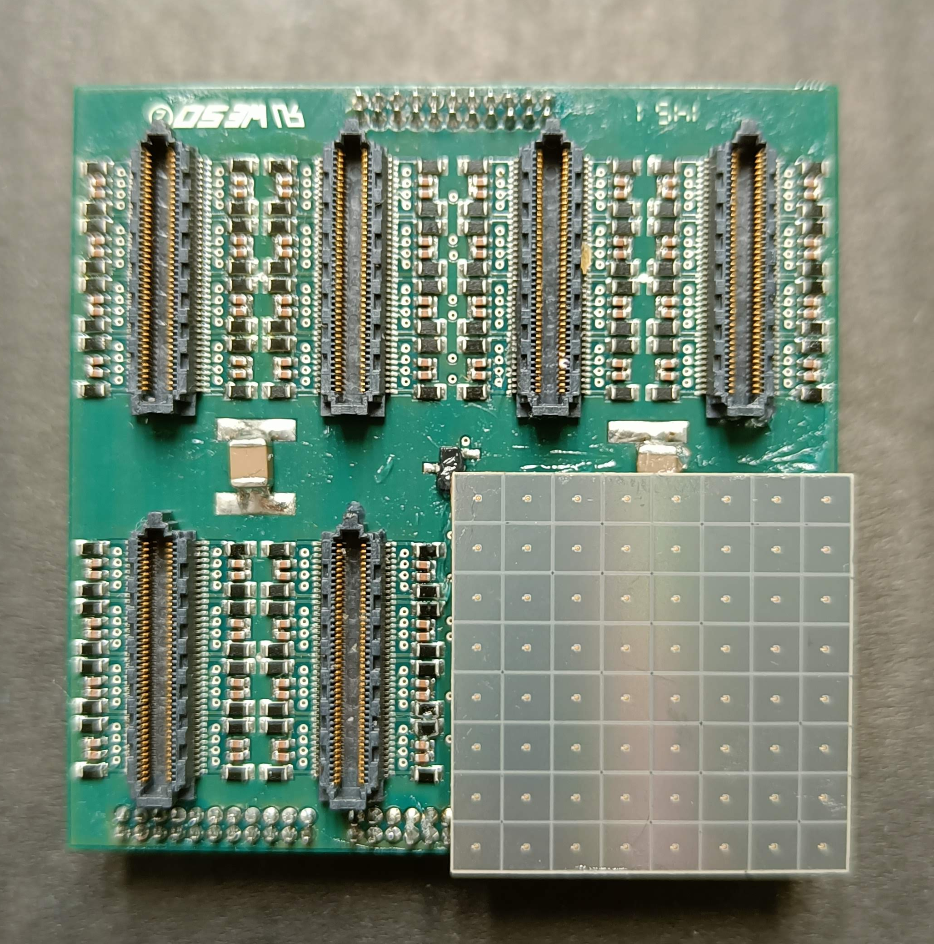
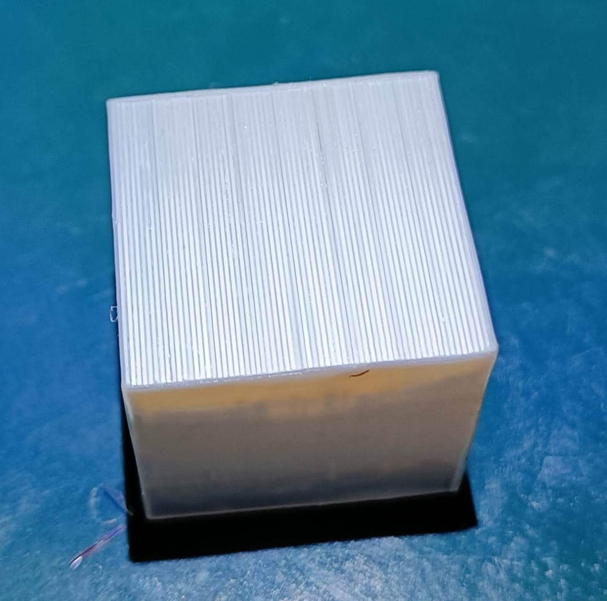
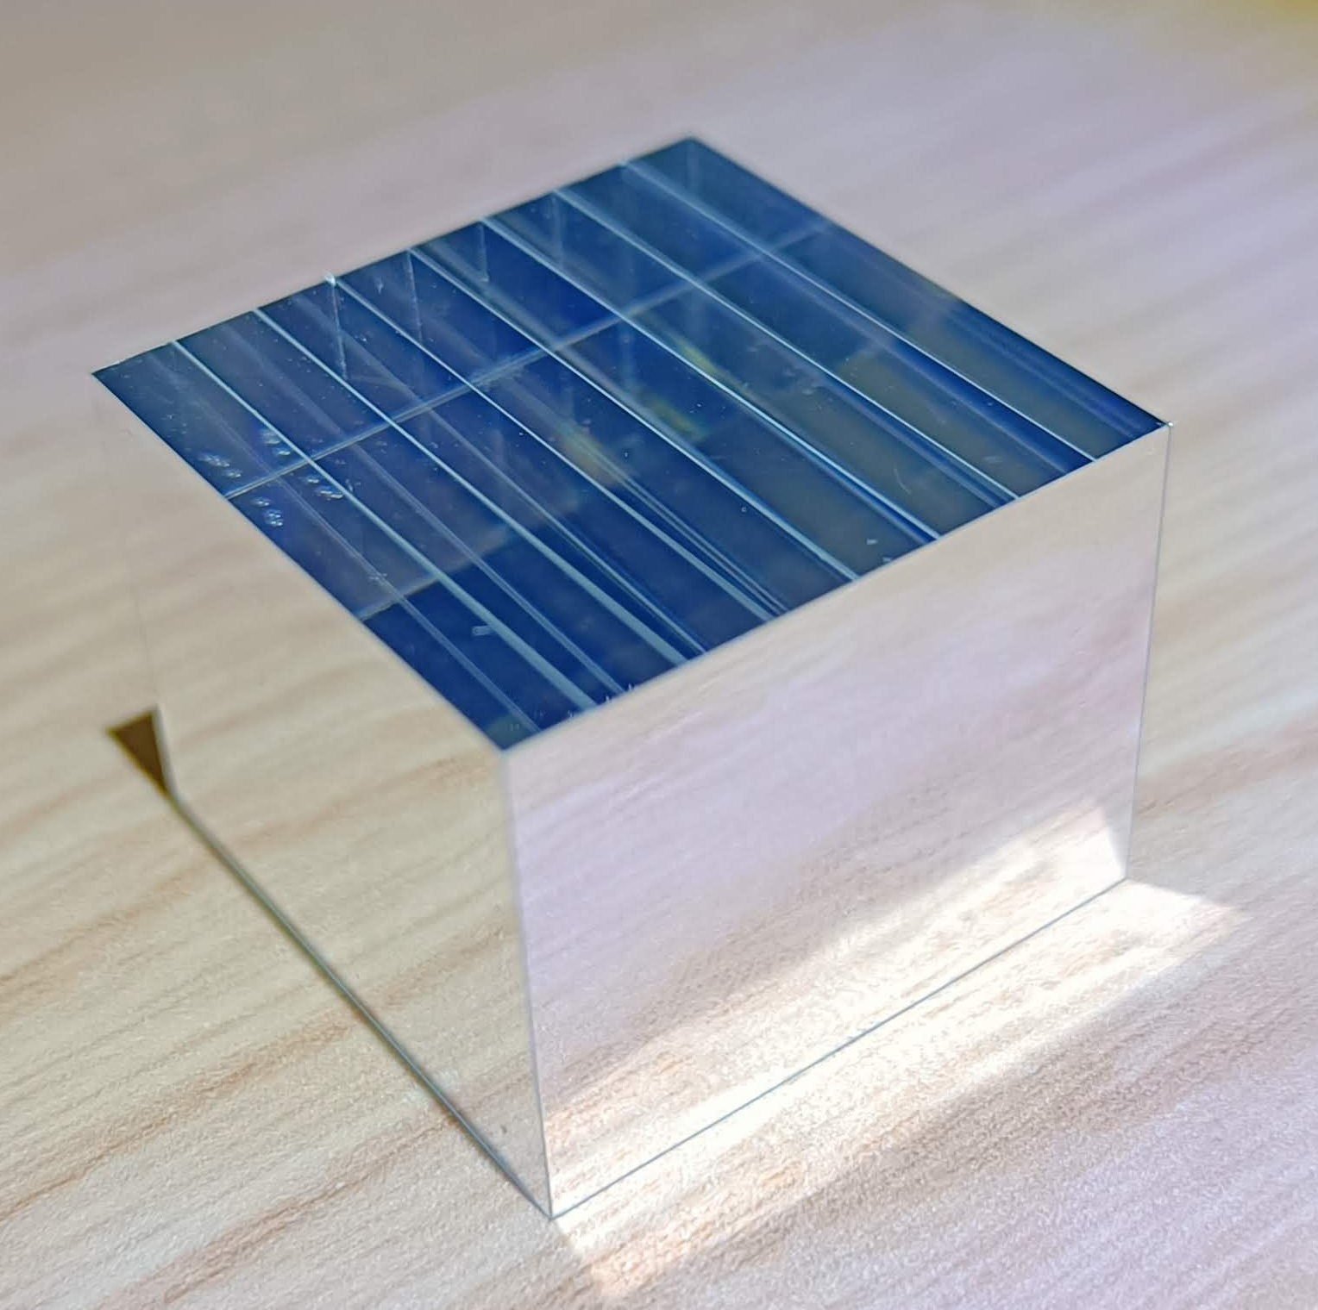
Scintillators & Photodetectors
Scintillators
Silicon Photomultipliers
Semi-Monolithic MetaScintillators (SMMS)
Standard
Semi-MONolithic
(SMON)
Hamamatsu SiPMs (HPK)
S14
M. Freire et al.,
doi: 10.1088/1361-6560/aca389
Dimensions:
25.4×25.4×24 mm³
100 μm Ej232 pixelated plates
300 μm LYSO:Ce semi-monolithic plates
25.4×25.4×20 mm³
8 bulk LYSO slabs
Custom made readout:
Rows and columns reduction circuit
(Patented)

Slide 7
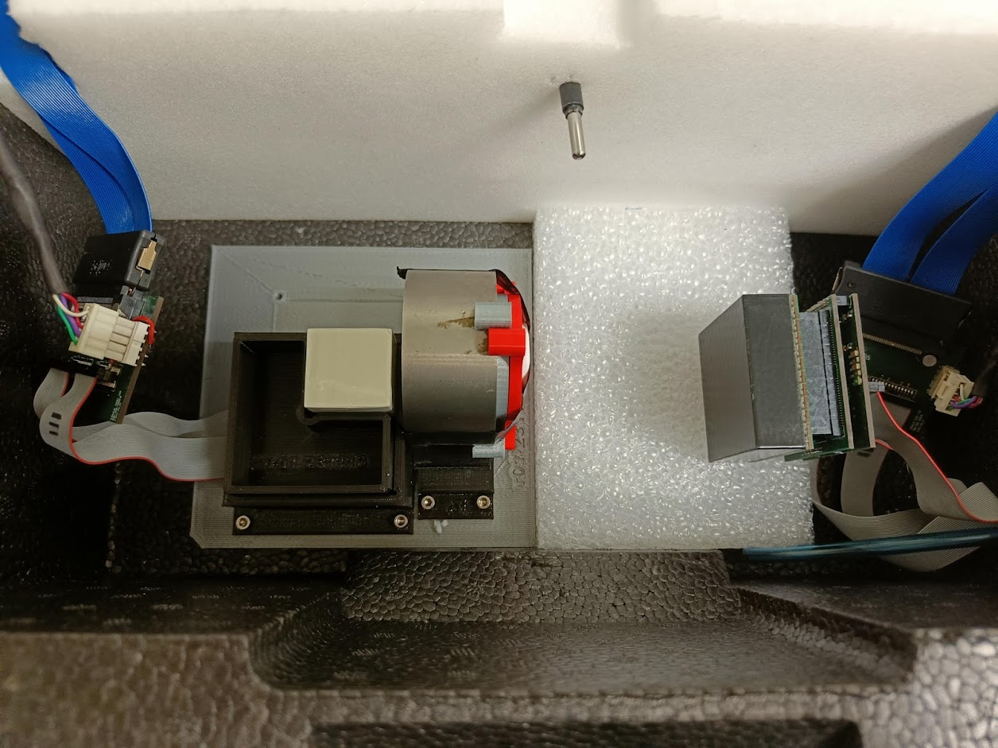
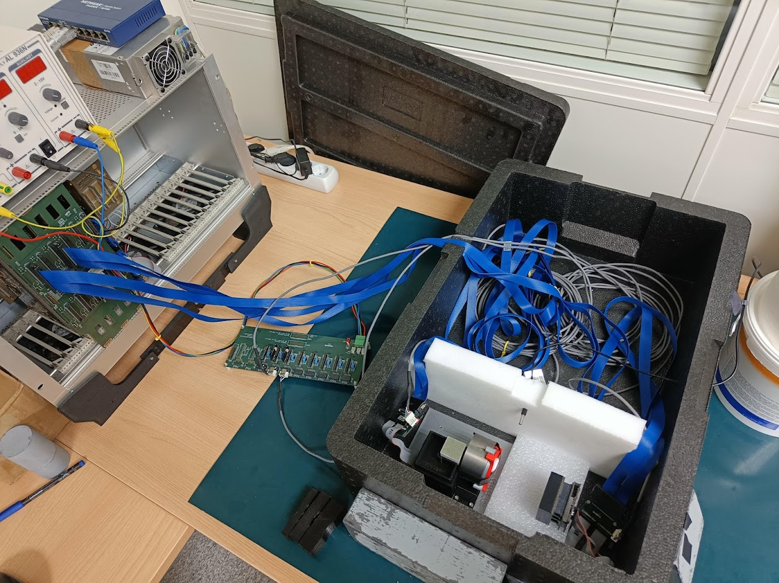
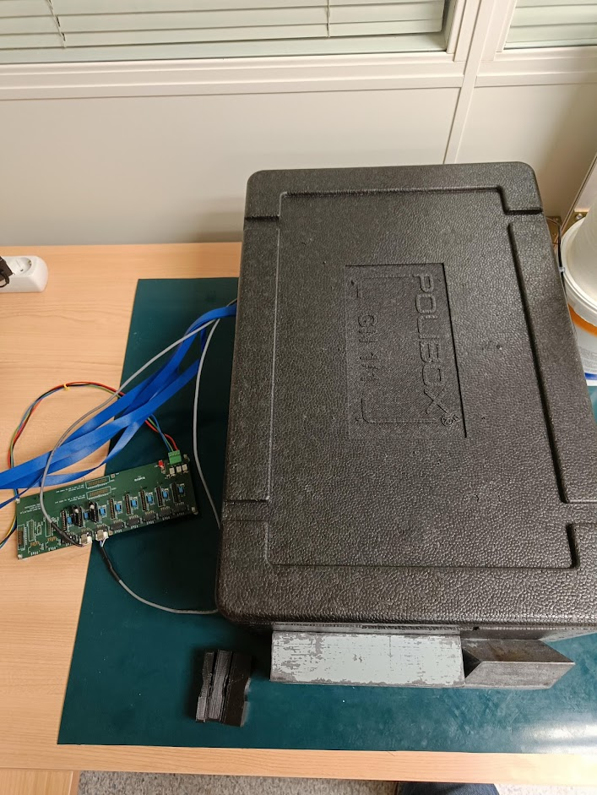
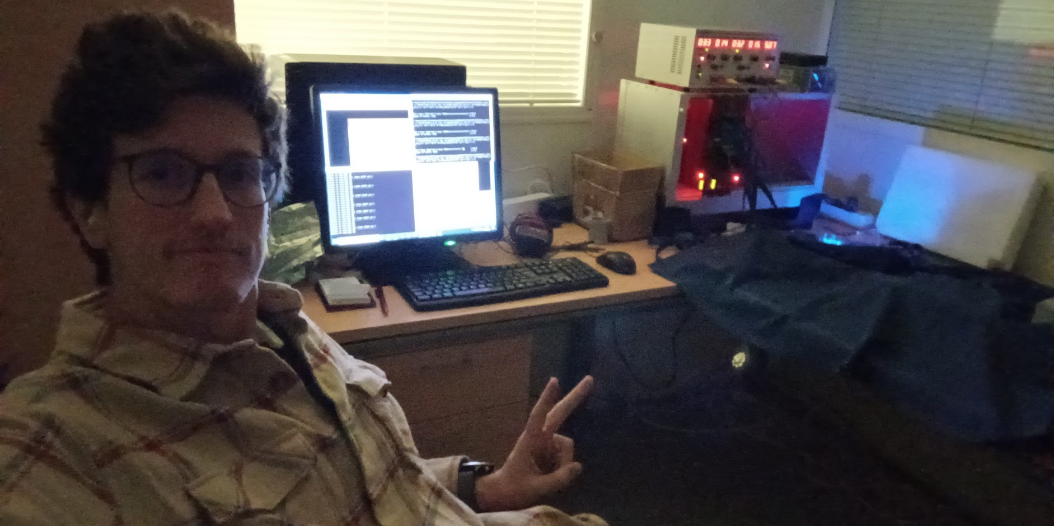
Setup Description
Setup Description:
Sodium-22 radioactive source
Tungsten collimator
Temperature sensor
Compressed air system
Two detectors in coincidence
Custom-made analog frontend (Oncovision partnership)
Testing Detector
Temperature Sensor
Reference Detector
Collimator
Radioactive Source
Compressed Air

Slide 8
Index
Custom-made analog frontend (Oncovision partnership)
12-bit 66-channel ADCs
Gbit connection
Integrated Charge
Trigger: 3-5-7ns coincidence time window

Slide 9
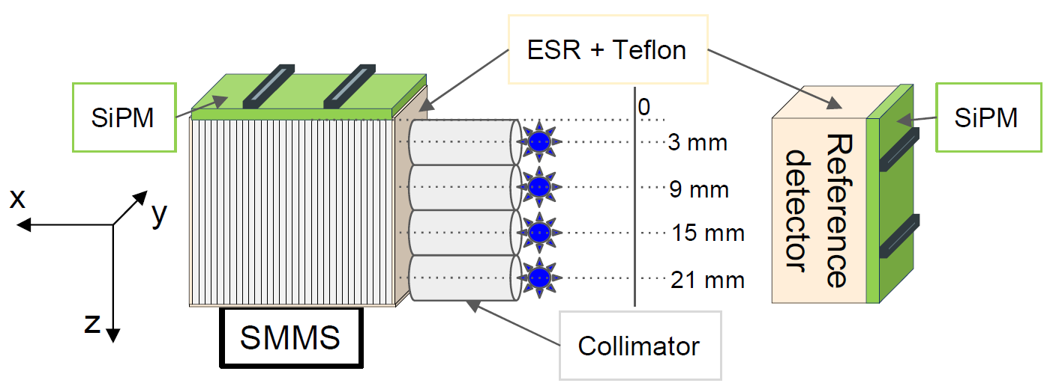
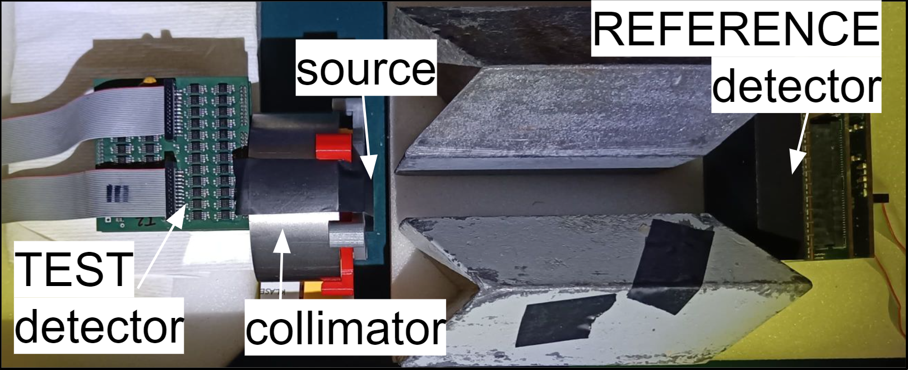
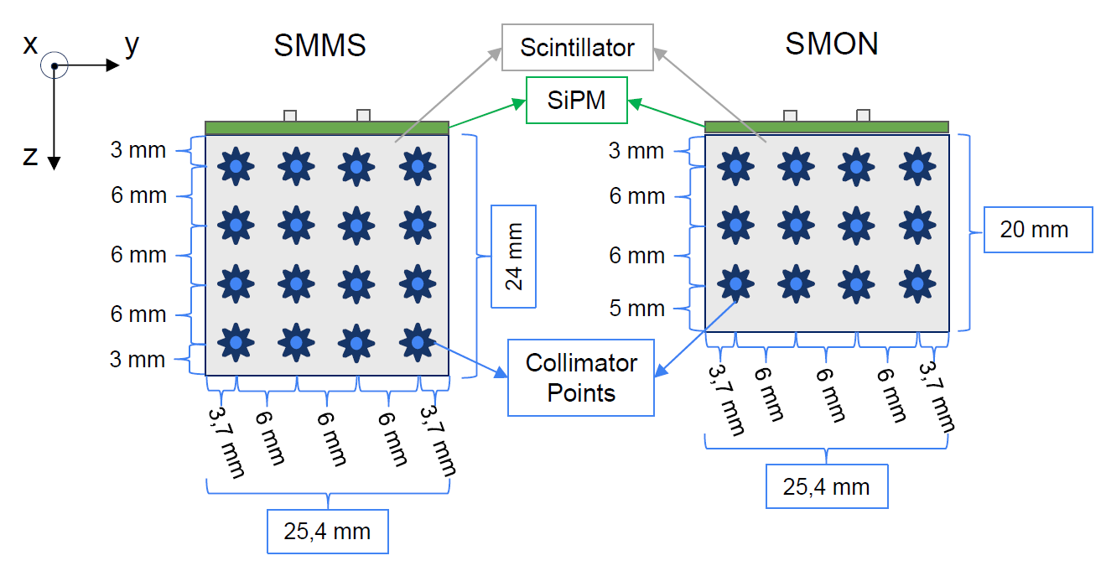
Collimation Points
Collimation:
Parallel incidence to the SiPMs
Perpendicularly to the monolithic side of the scintillator
Distance from the SiPMS
DOI1 = 3 mm
DOI2 = 9 mm
DOI3 = 15 mm
DOI4 = 21 mm
SMMS: 16 collimation points
SMON: 12 collimation points

Slide 10
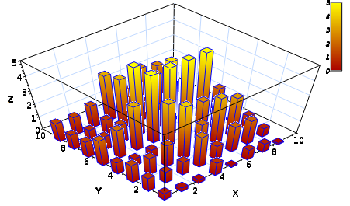
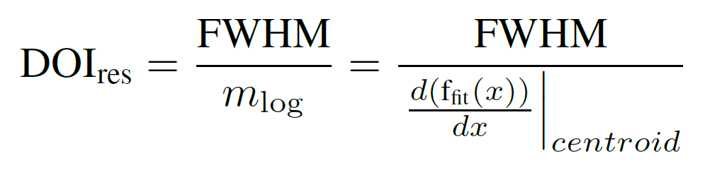

Estimator and Interpolation
DOI Estimator (E/I or N/I):
E (or N) is the total energy of all the SiPMs (summation of all rows or columns)
I is the energy of the row or column with the most energetic signal
Interpolation:
Using the centroid position of the DOI E/I Distribution:
Linear Interpolation
Exponential-Tangent Interponation
[a.u.]
[mm]
Convert
FWHM: Full-Width at Half Maximum
m_{log}: Fitting function slope or angular coefficient of specific points
R. Pani et al., doi: 10.1109/TNS.2016.2539287

Slide 11
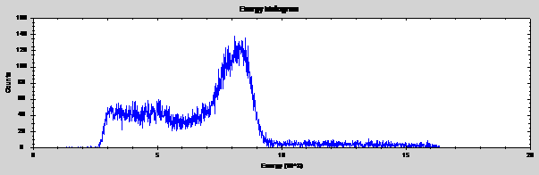
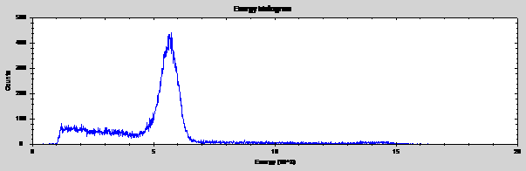
Flood Map and Energy Spectrums
SMMS
SMON
source
source
y
Raised To the Power (RTP)
y
R. Pani et al.,
doi: 10.1088/1748-0221/11/01/C01061
x
x

Slide 12
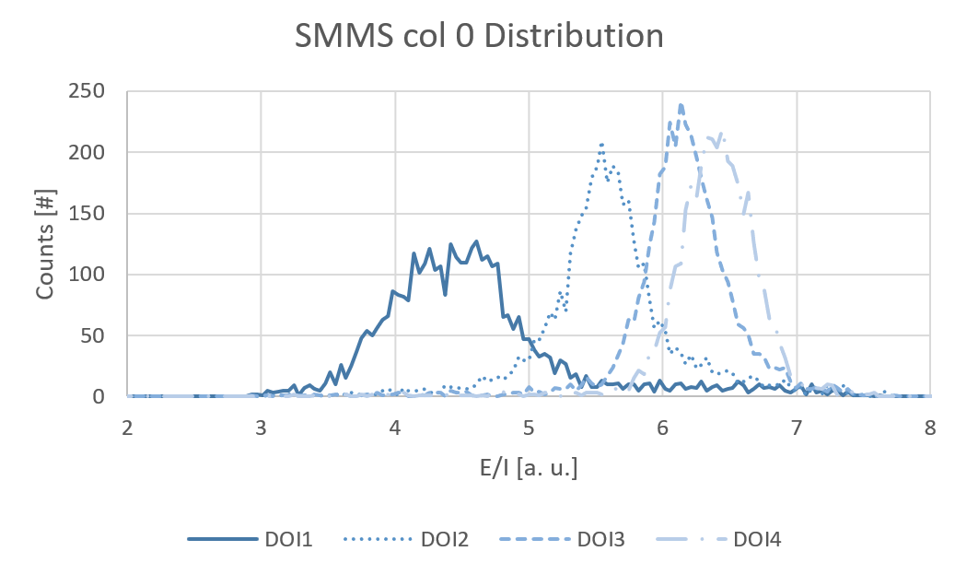
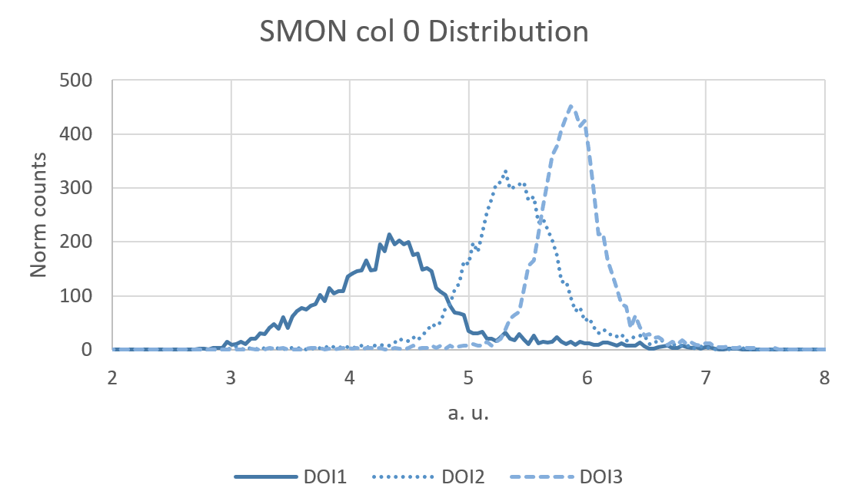
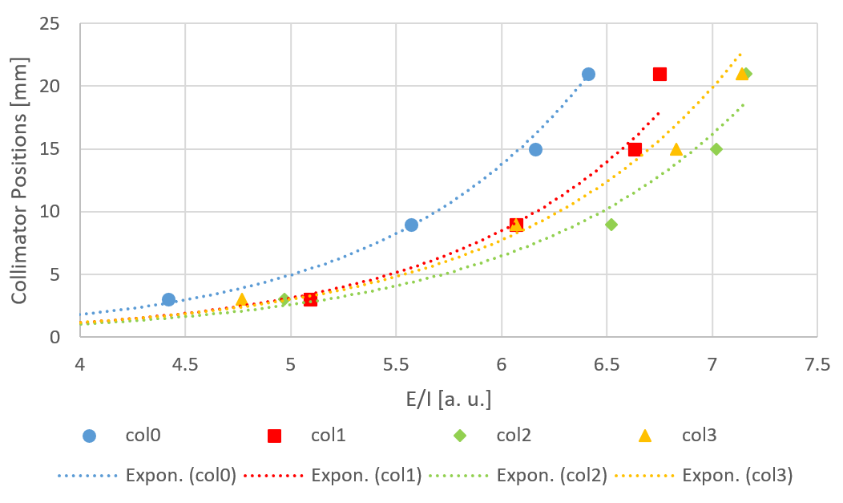
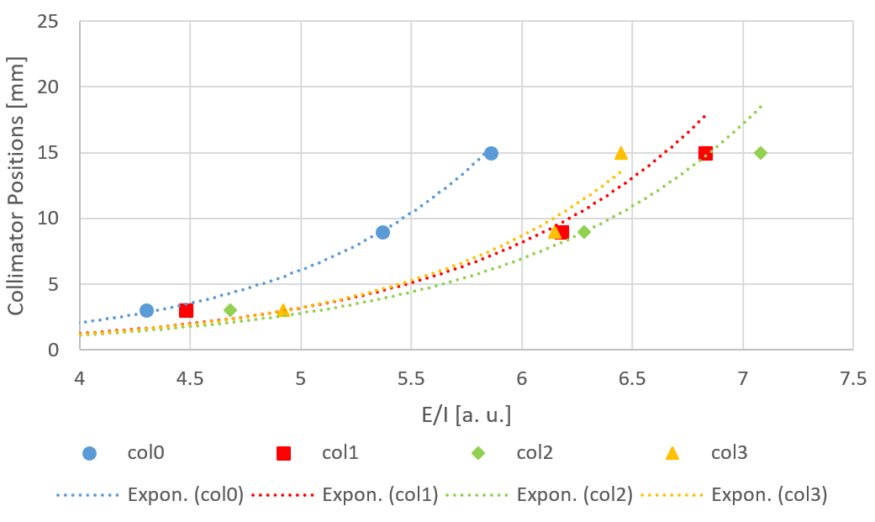
Centroid Comparison
col0
col1
col2
col3
SMMS
SMON
DOI4 = 21 mm
DOI3 = 15 mm
DOI2 = 9 mm
DOI1 = 3 mm
Distance from the SiPMS
0
SiPM

Slide 13
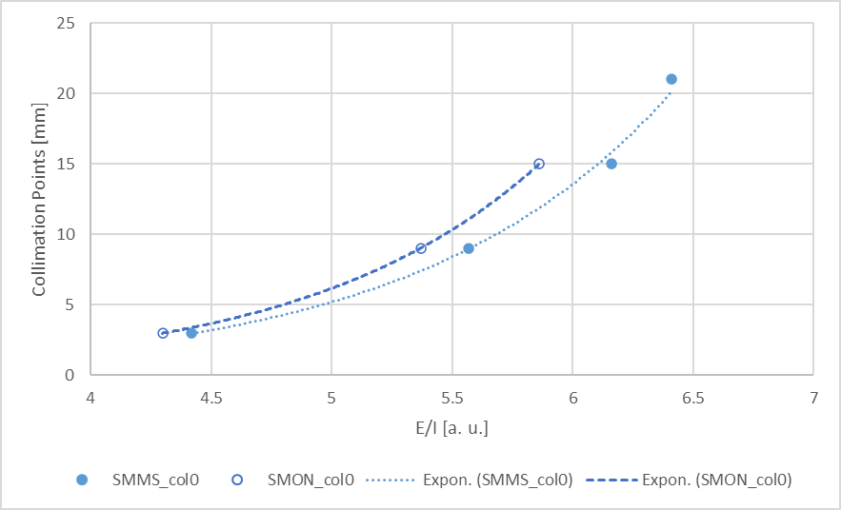
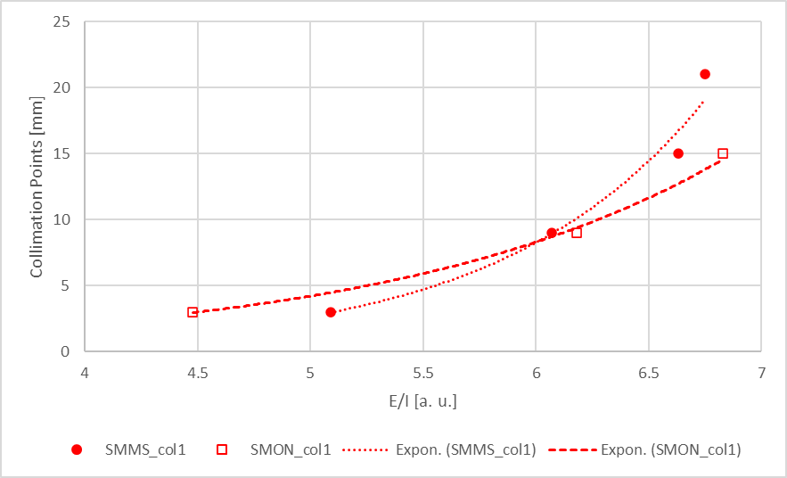
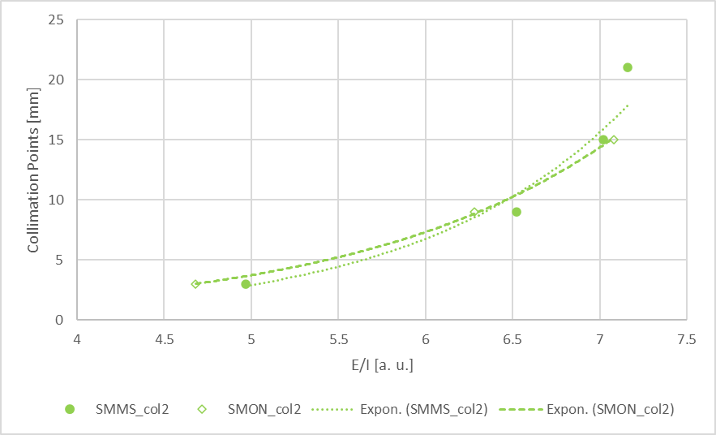
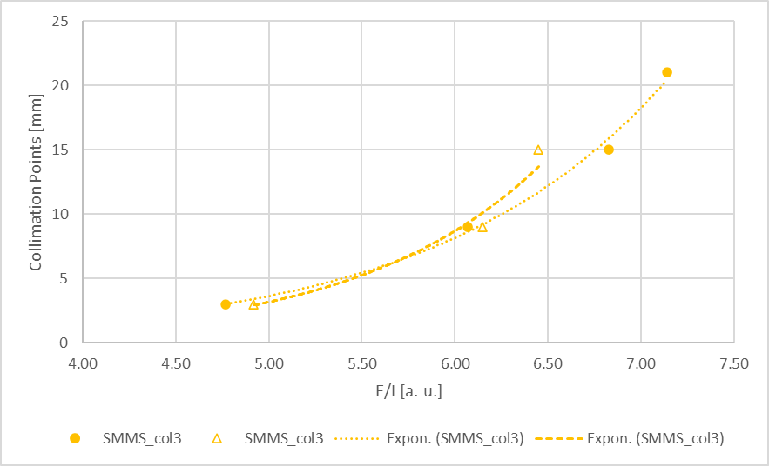
Centroid Comparison
Column 0
Column 1
col0
col1
col2
col3
DOI4 = 21 mm
DOI3 = 15 mm
DOI2 = 9 mm
DOI1 = 3 mm
Distance from the SiPMS
Column 2
Column 3
0
SiPM

Slide 14
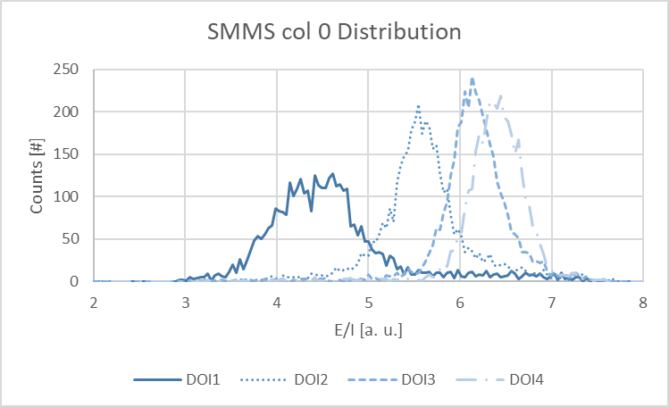
Regression/Conversion Methods
DOI4 = 21 mm
DOI3 = 15 mm
DOI2 = 9 mm
DOI1 = 3 mm
Distance from the SiPMS
Exponential
Linear
0
SiPM
Both report Gaussian-like distributions without major distortions

Slide 15
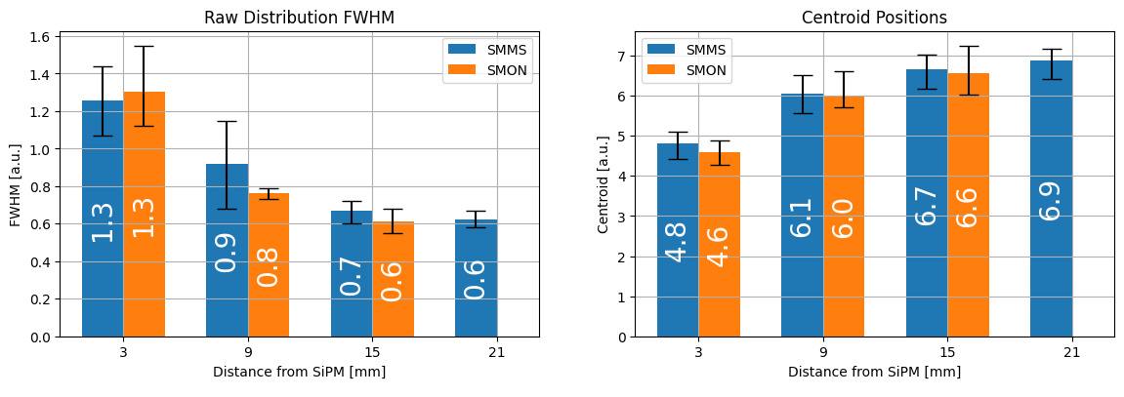
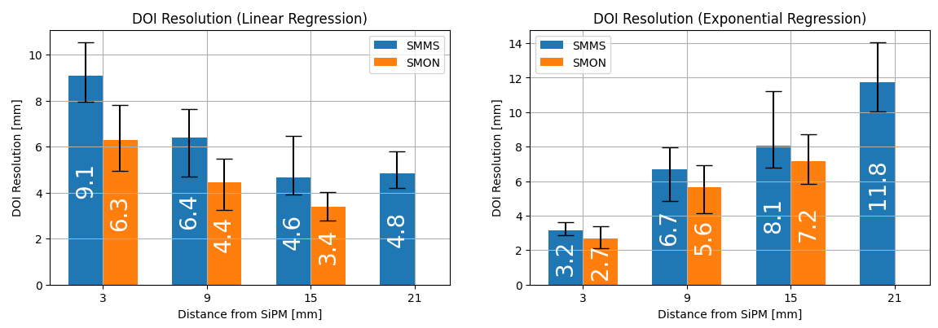
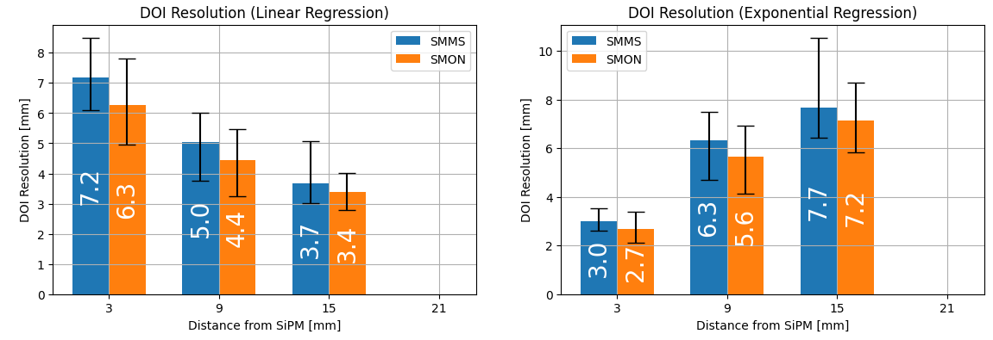
DOI Average Results
SMON SMMS
(4 DOI)
Linear 4.7 mm 6.2 mm
Expo 5.2 mm 7.4 mm
(3 DOI)
Linear ‘’ 5.3 mm
Expo ‘’ 5.7 mm
GOAL:
- Achieve similar results in terms of DOI
- Not to achieve the best DOI
SMMS: 4 DOI Layers
SMON: 3 DOI Layers

Slide 16
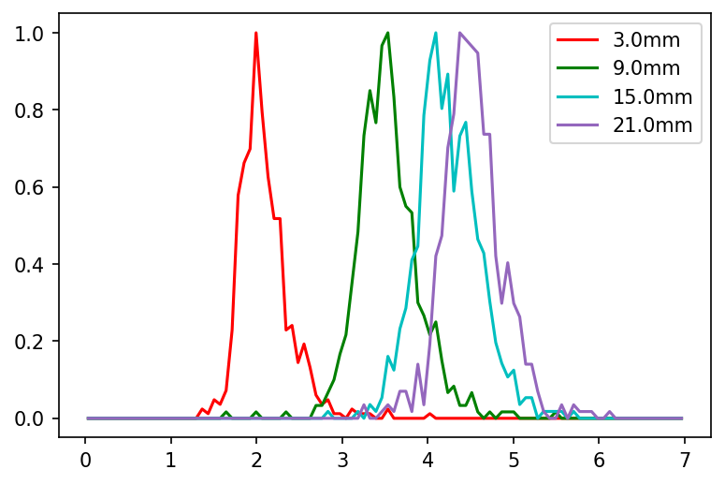
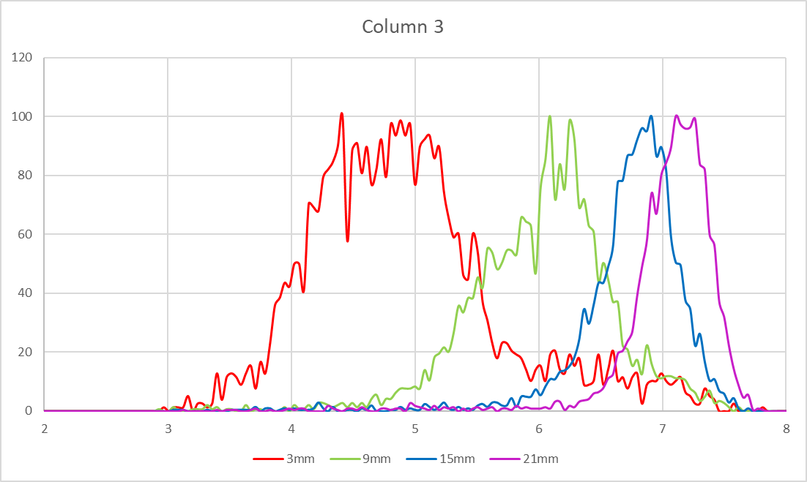
Timing Simulation
Simulation
Experimental
Simulation & Experimental Data
SMMS simulation results match experimental data regarding the logarithmic behavior of centroid positions.
Timing Improvements:
Correction based on 8 DOI categories.
After DOI time-walk correction, CTR improvement from 136 ps to 98 ps
A potential 28% improvement in timing.

Slide 17
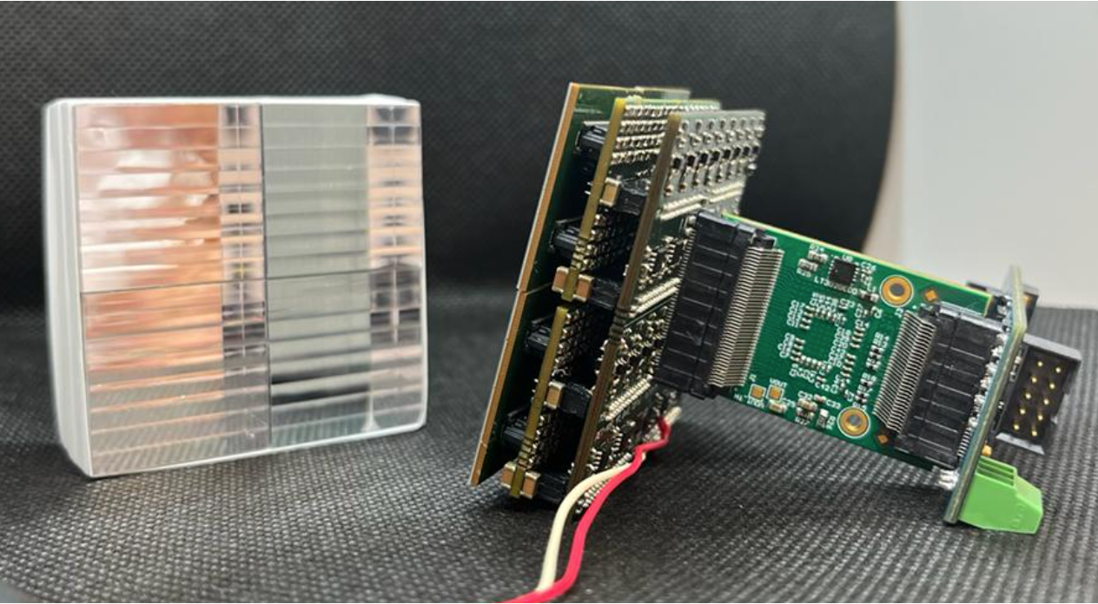
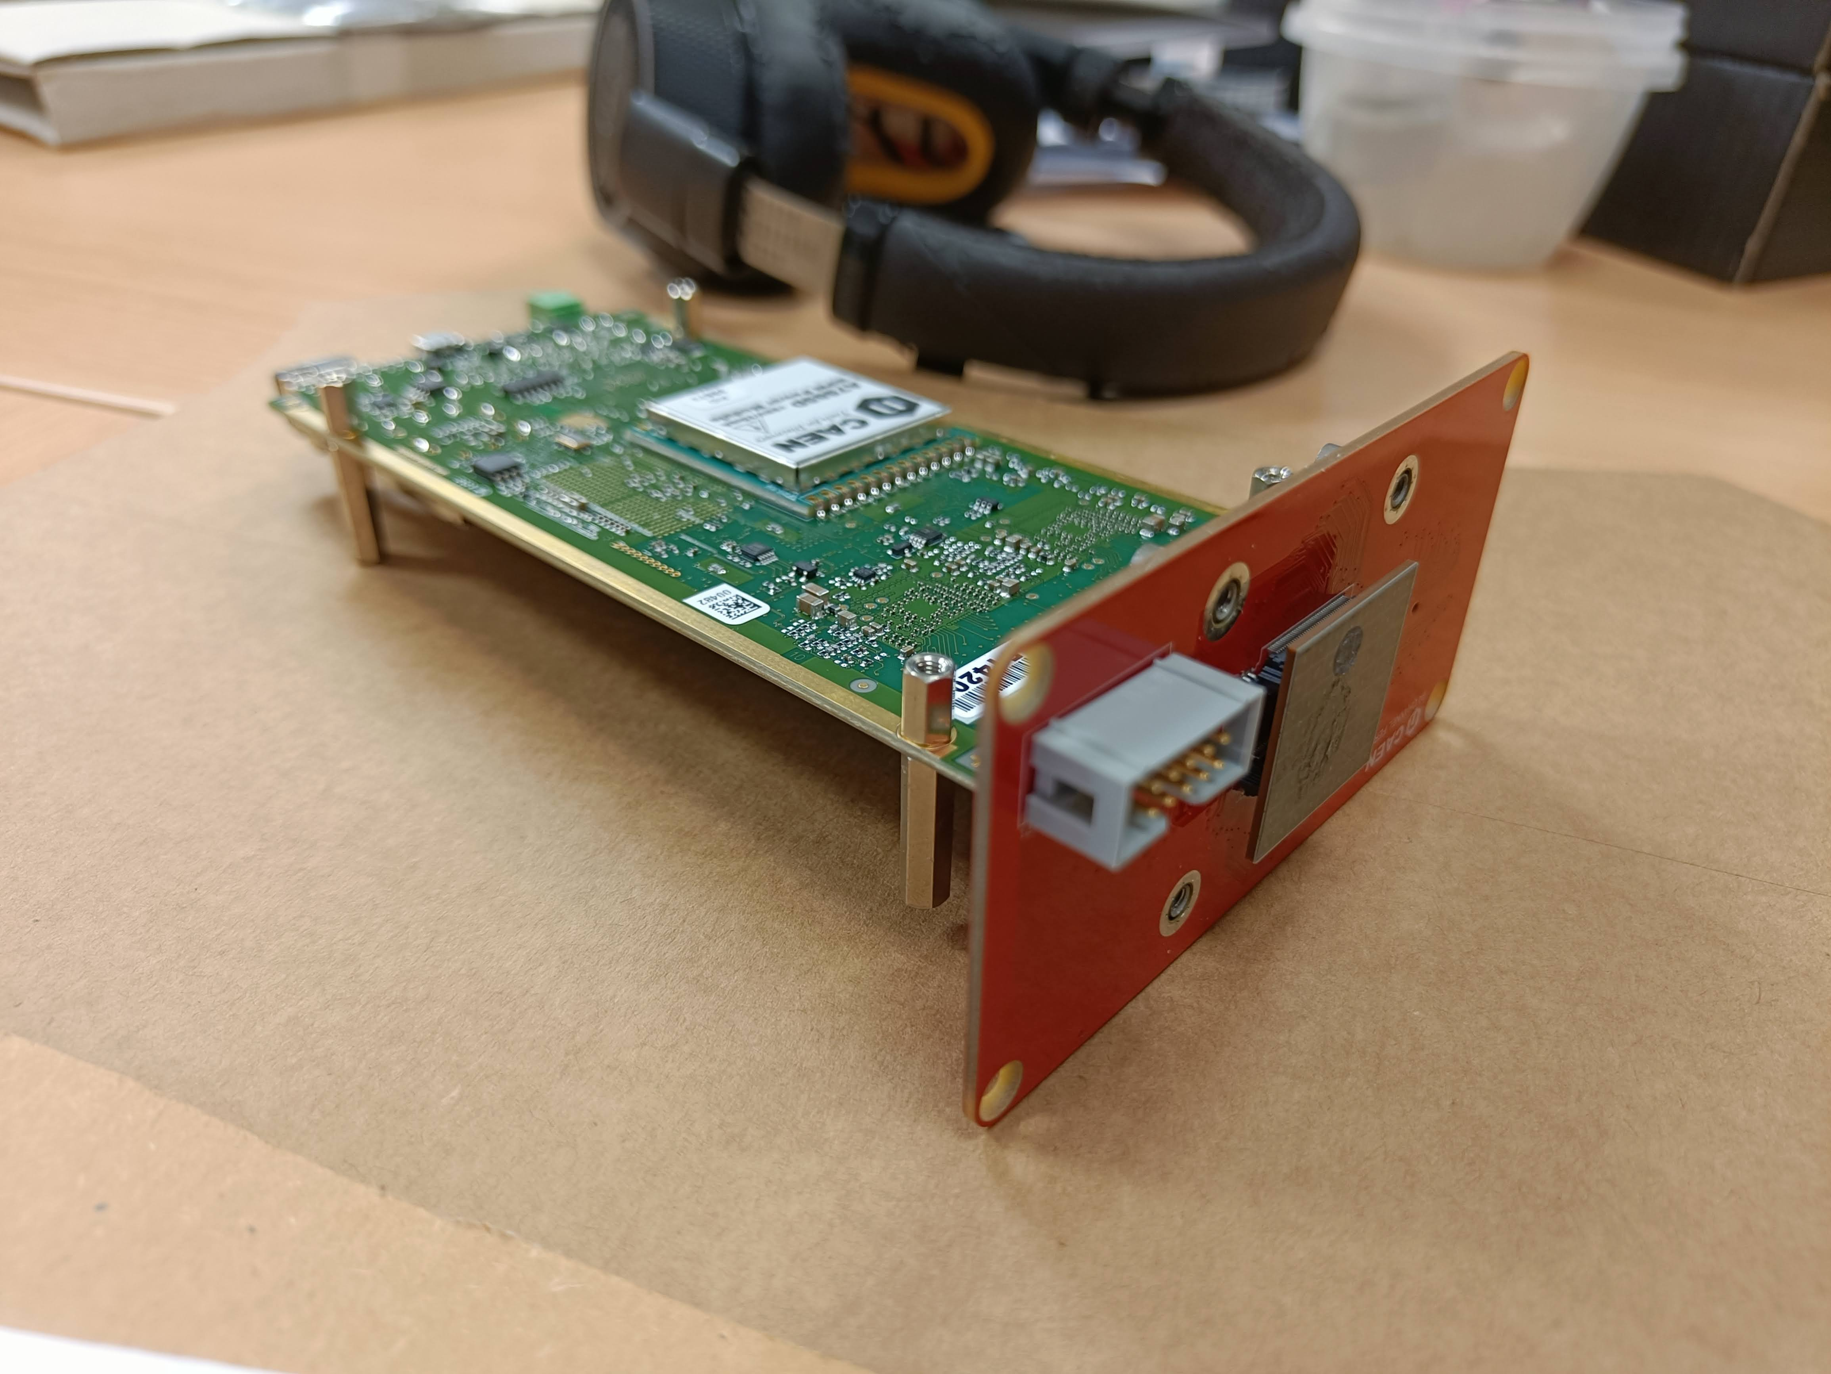
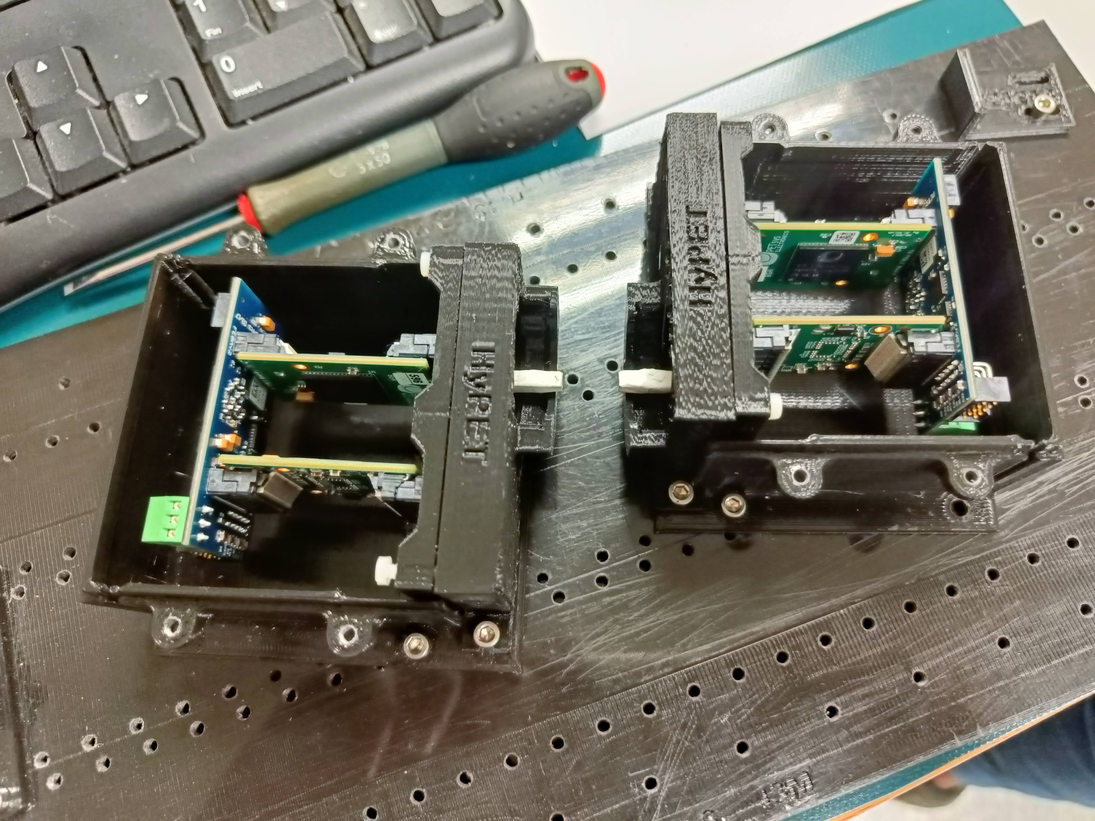
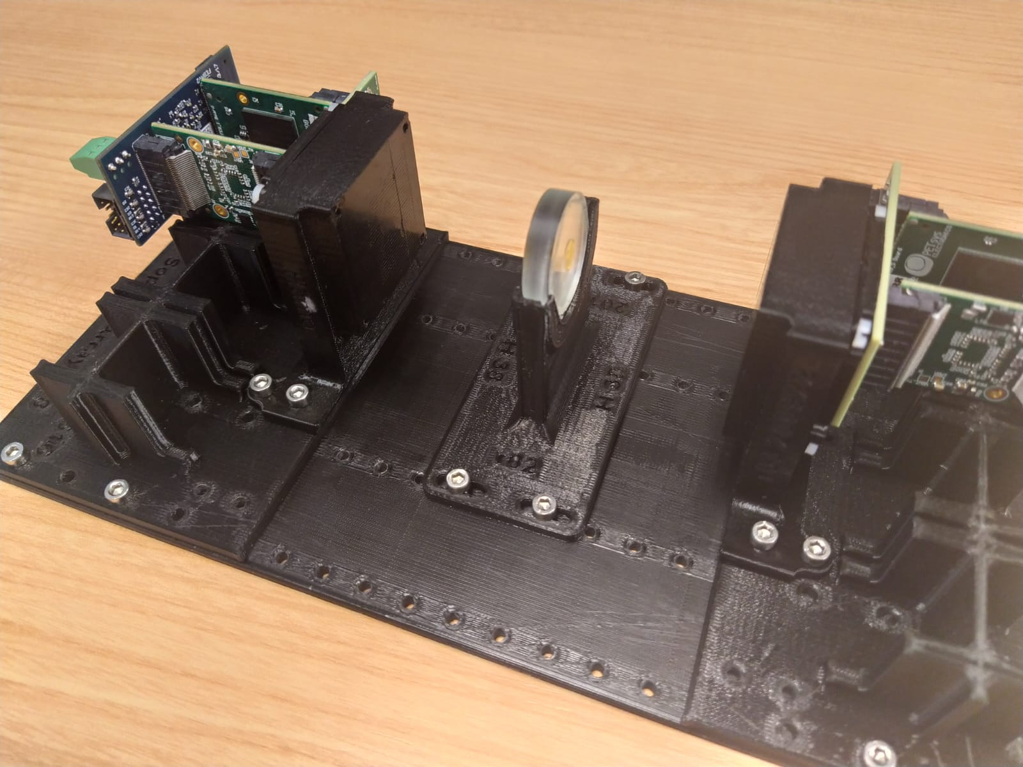
Timing Setups
CAEN A5202+A5251
(Citiroc-based readout)
PETsys TOF-PET2

Slide 18
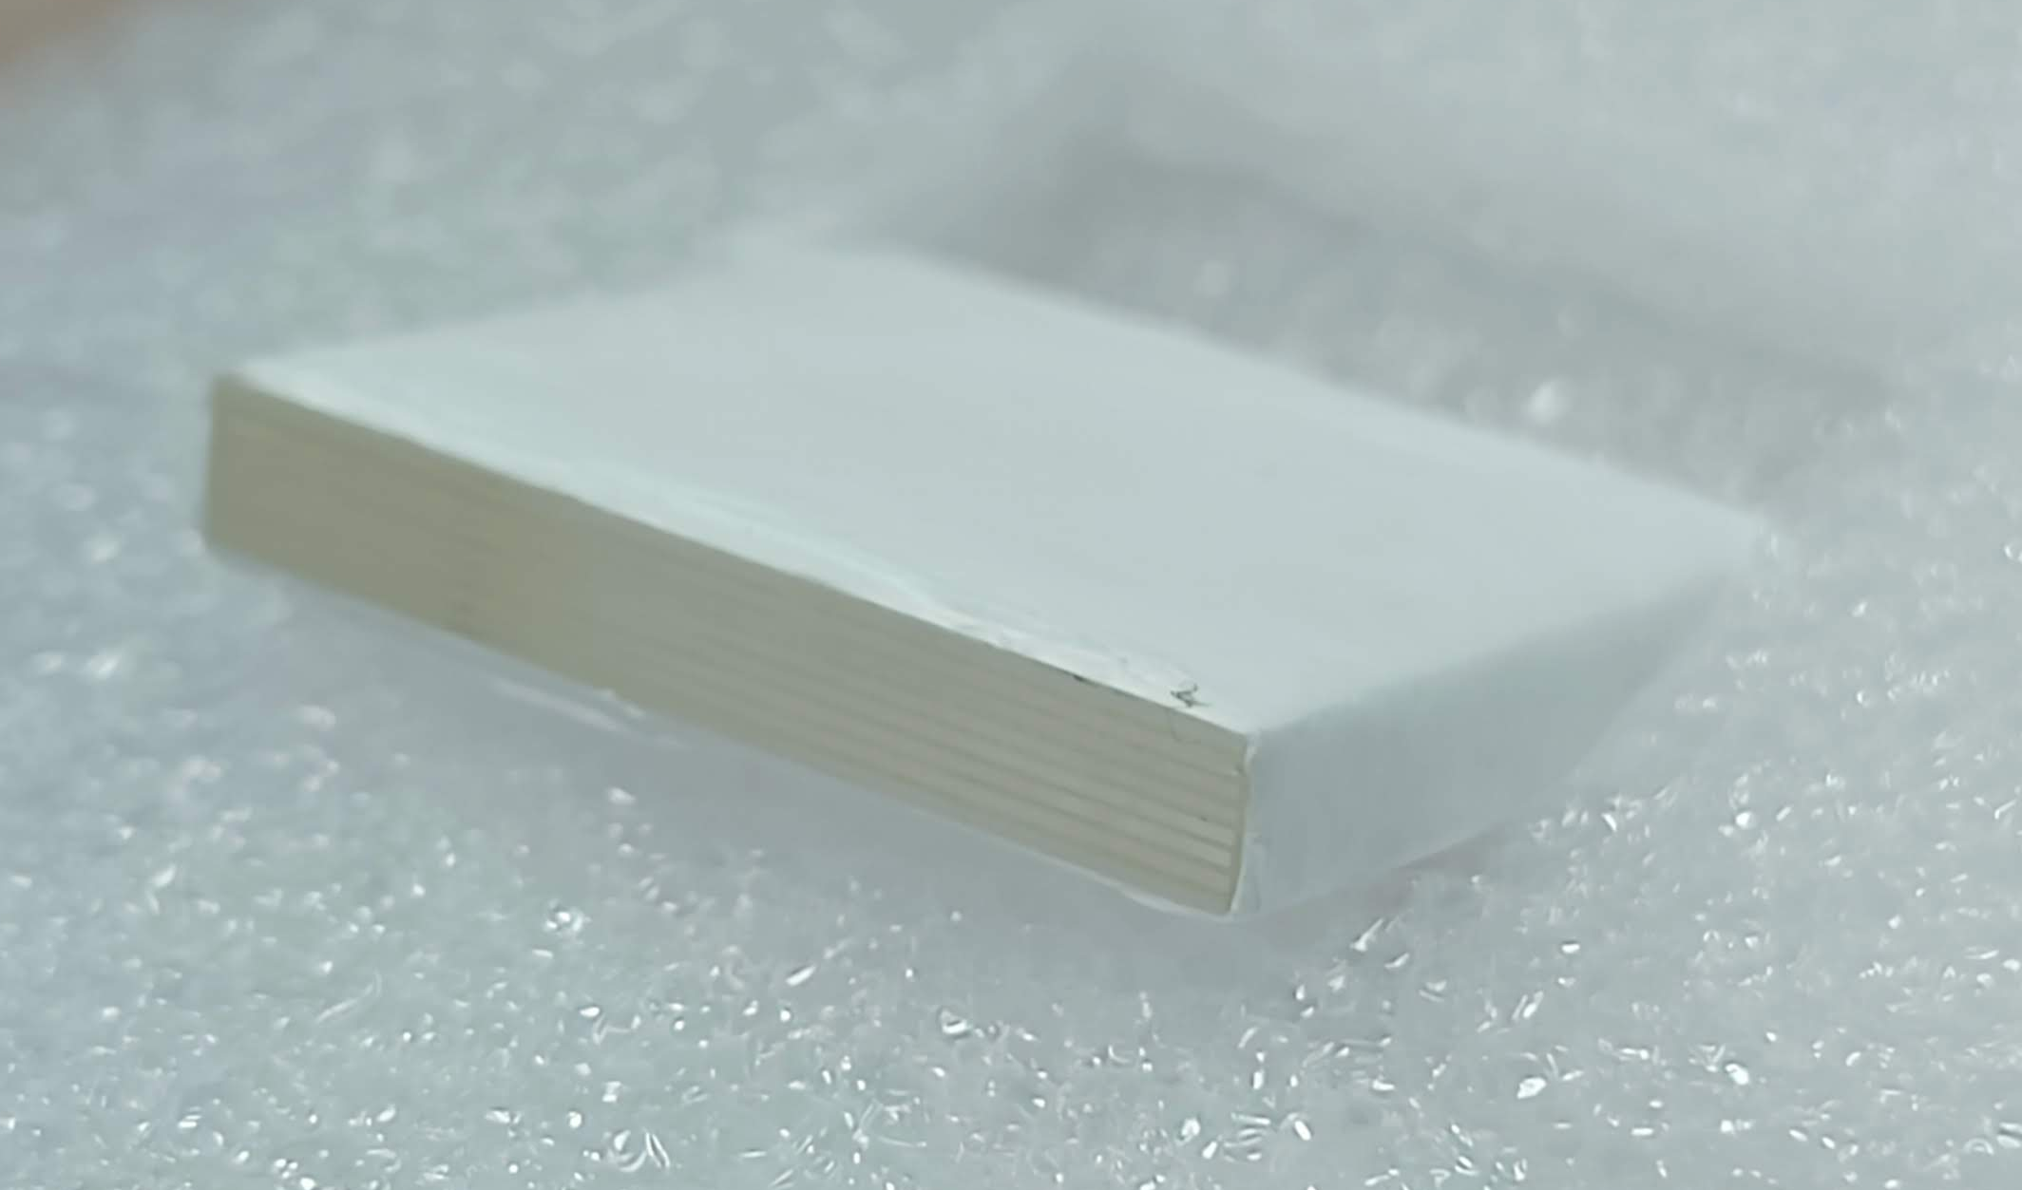
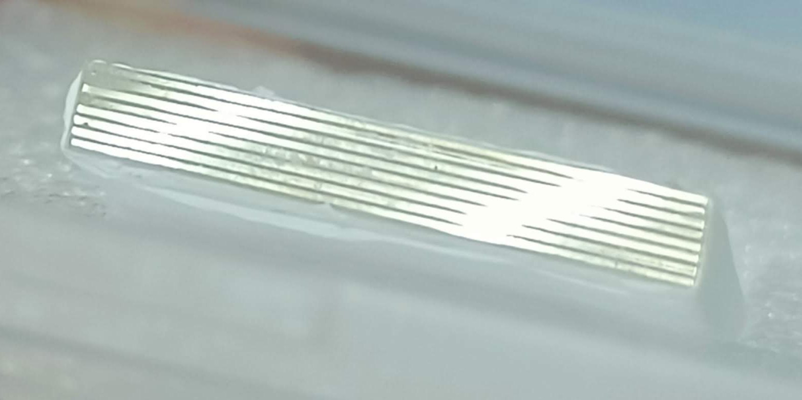
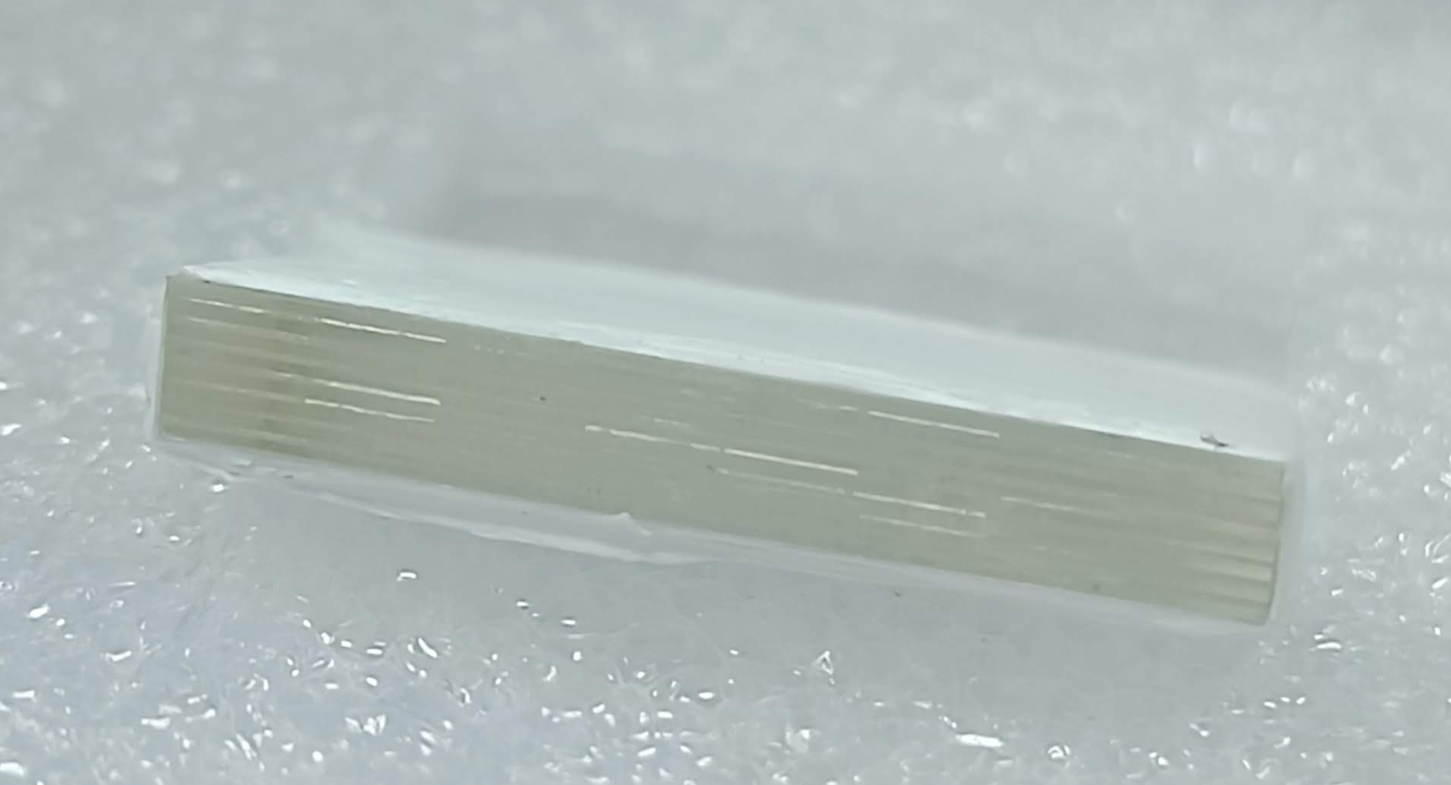
SMMS-slab
Key components:
- BGO plates
- EJ232 plates
Each SLAB contains:
8 BGO semi-monolithic plates
7 layers of Ej232
8 EJ232 pixellated plates for each layer
Total of 56 EJ232 pixelated plates.

Slide 19
Discussion and Future Work
Key Findings:
Comparable performance of SMMS and SMON in DOI capabilities,
despite the 20% discrepancy in scintillation block height.
SMMS structure does NOT compromise the semi-monolithic DOI performances.
Exponential regression DOI resolution: 5.7 mm for SMMS vs. 5.2 mm for SMON.
Simulation Insights:
Simulation aligns with experimental data, following the same logarithmic behavior of centroid positions.
Main discrepancy noted in FWHM trends: experimental data decreases, simulation increases with distance from SiPM.
Timing improvements: potential 28% enhancement in coincidence time resolution after DOI time-walk correction.
Future Directions:
Continued validation of SMMS architecture for PET applications.
Explore SMMS timing capabilities using PETsys or Weeroc ASICs

Slide 20
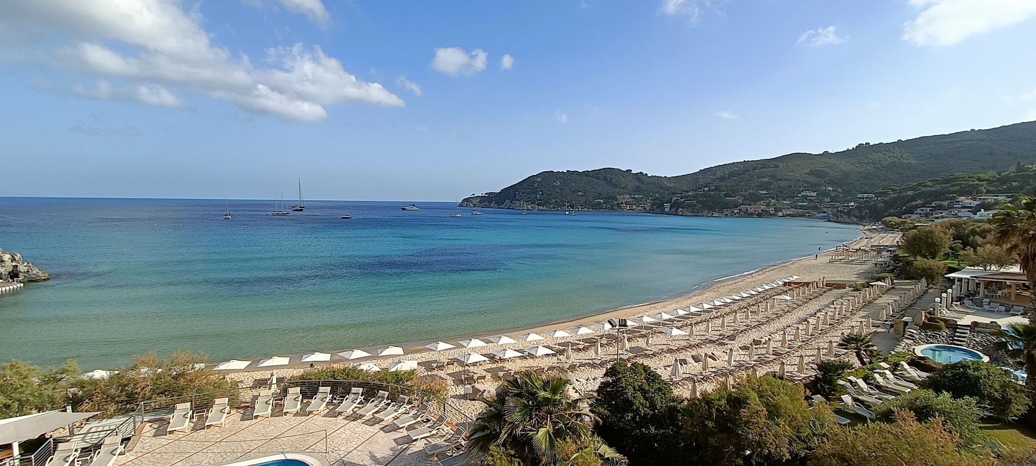
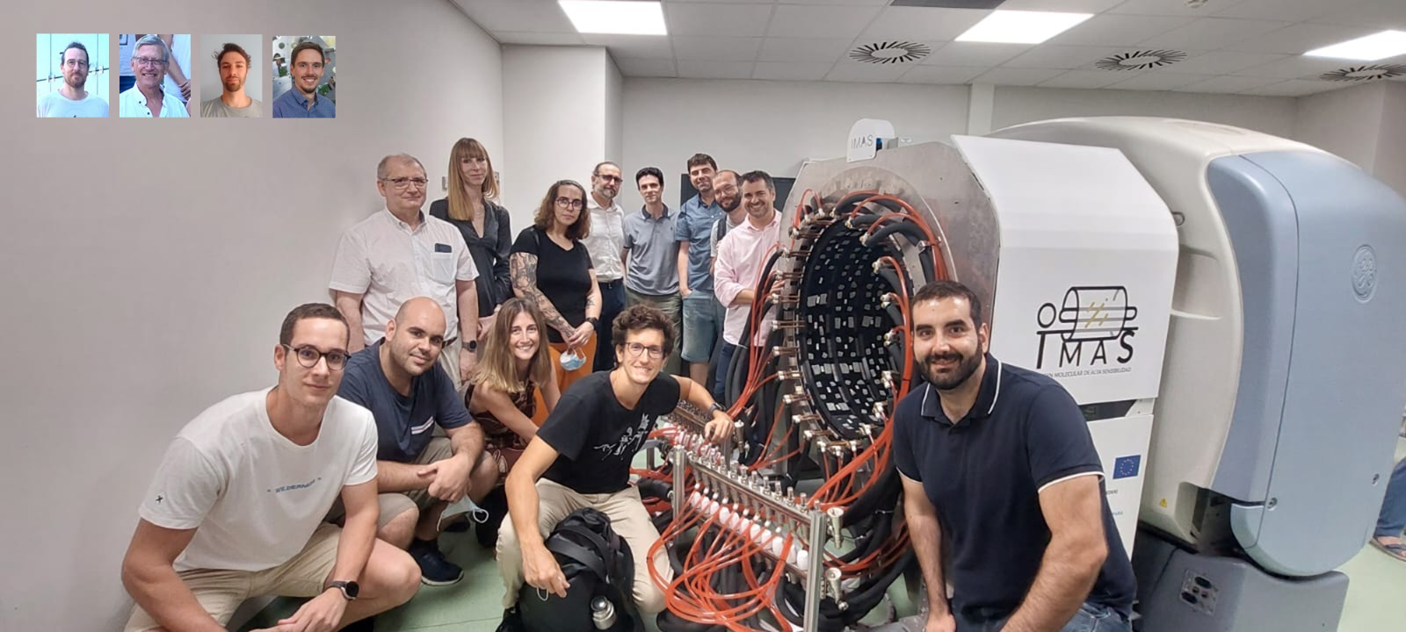
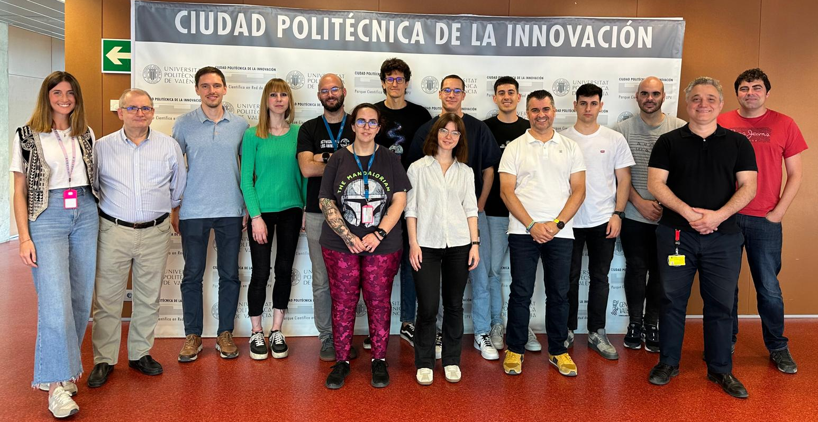
Thank you
Thank you for your attention!
Q&A

