Slide 1
Deep learning image denoising for a cost-effective walk-through pet design with sparse detector coverage
Maya Abi Akl, Florence Muller, Jens Maebe, Meysam Dadgar,
Othmane Bouhali & Stefaan Vandenberghe
MEDISIP, Department of Electronics and Information Systems, Ghent University, Belgium
Maya.AbiAkl@ugent.be

Slide 2
Walk-Through PET concept Walk-Through PET system design deep learning model for image denoising Results conclusion and future work

Slide 3
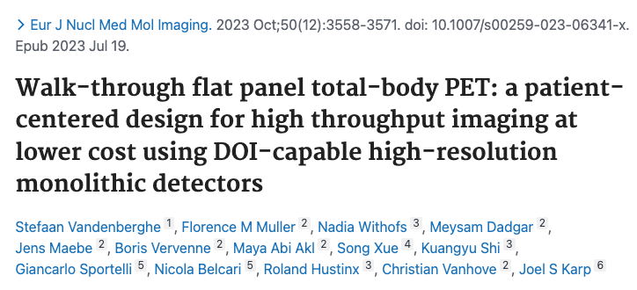
WT-PET concept: Vertical flat panels of monolithic detectors
50 cm
High throughput (no bed – 30s scan)
106 cm
Smaller footprint
(2 x 1.5 x 2.3 m³)
82 cm
Lower cost (1.9x less detector surface) 3-4 MEuro
106 cm
Superior spatial resolution + DOI (monolithic detectors)
71 cm
Long axial FOV
Short/lower-dose scans

Slide 4
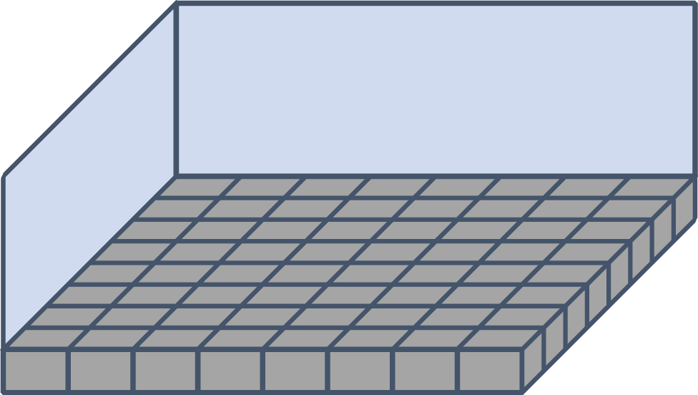
WT-PET: flat panels of monolithic detectors
12
LYSO 50 x 50 x 16 mm³
20
1.14 mm FWHM spatial resolution + 6 virtual DOI layers (experimental results) [1]

Slide 5
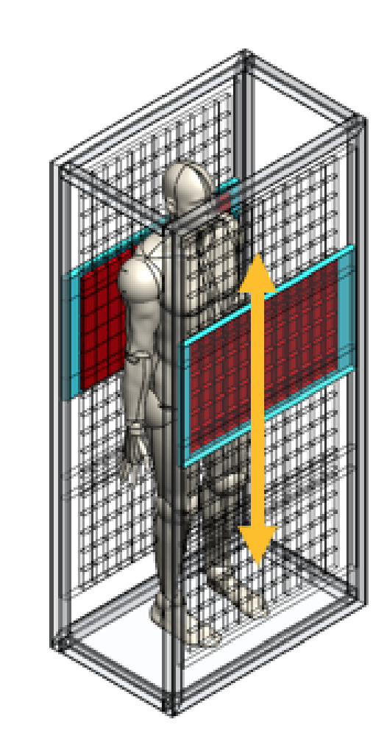
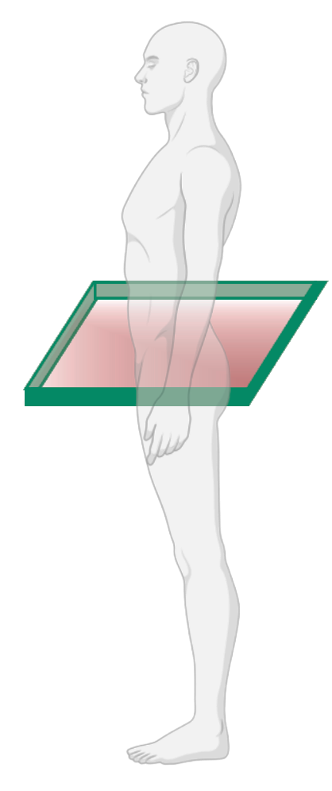
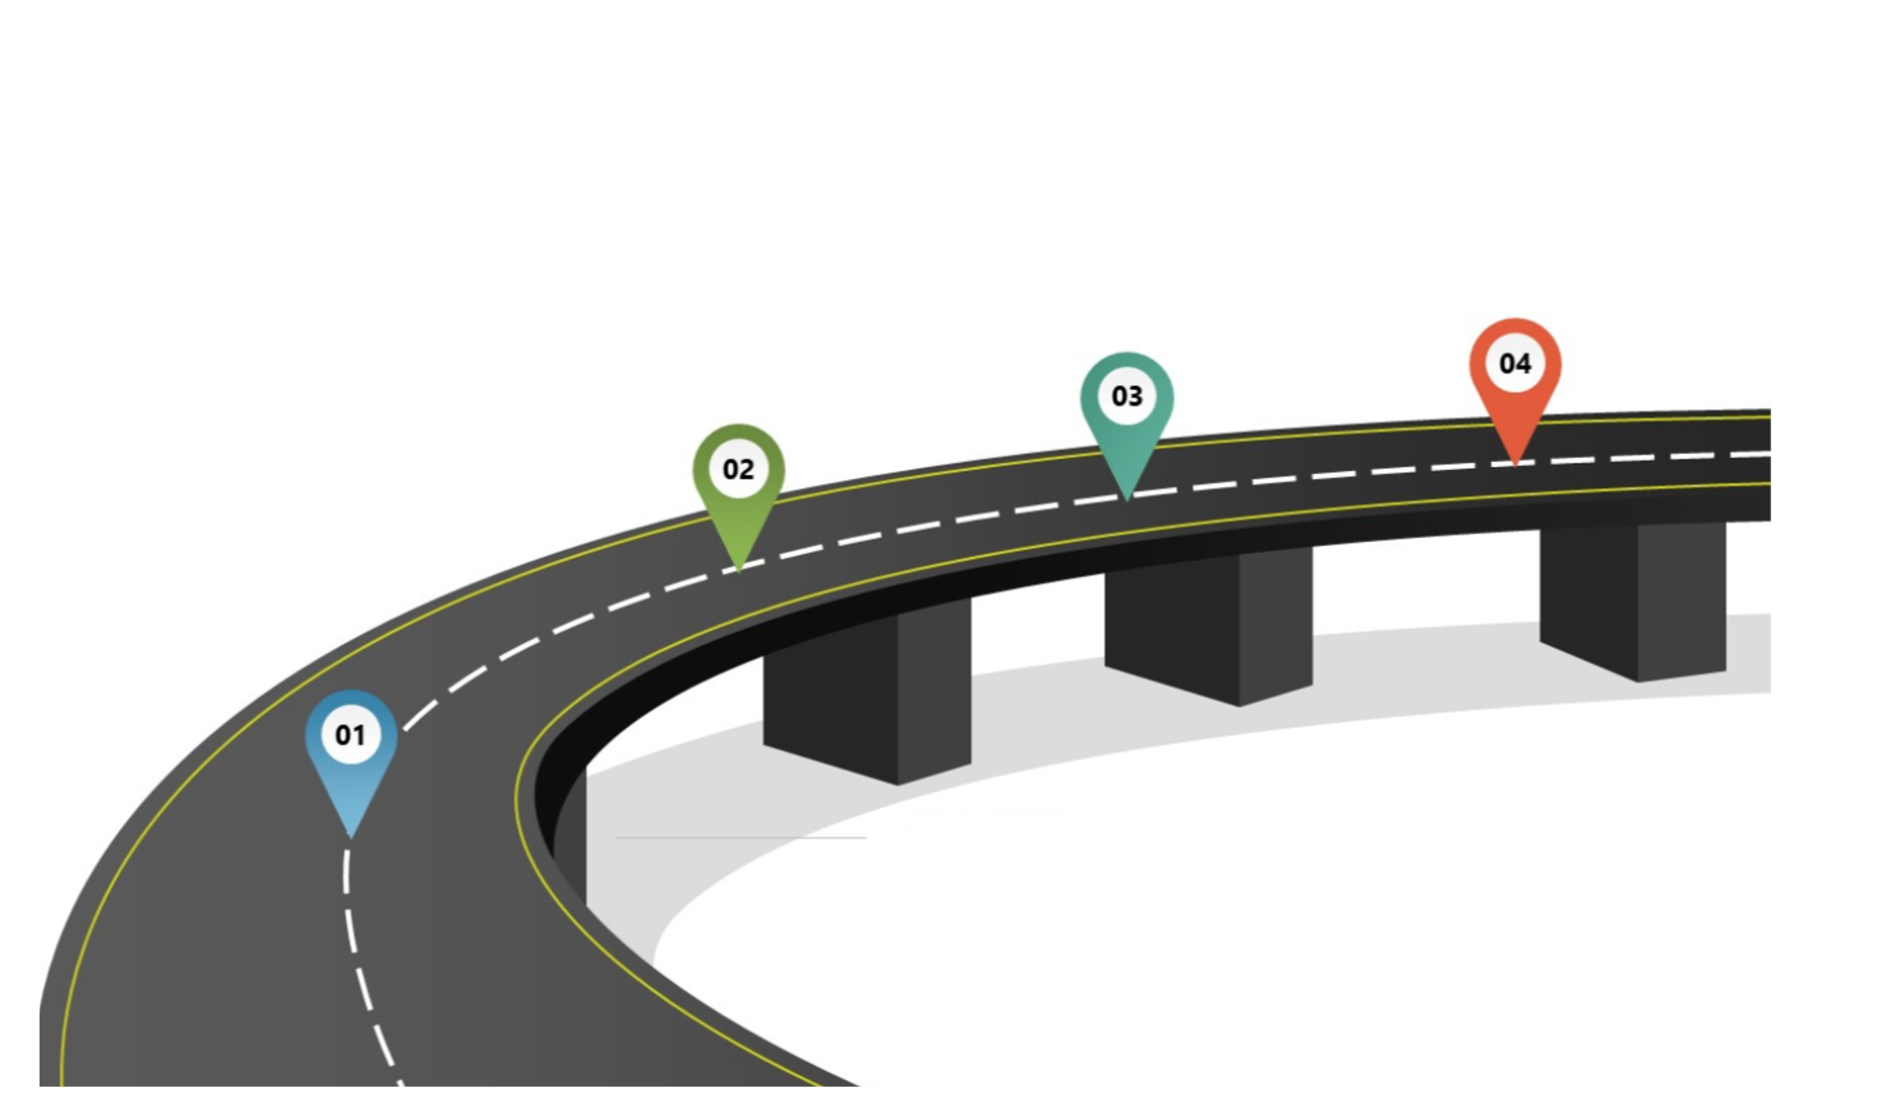
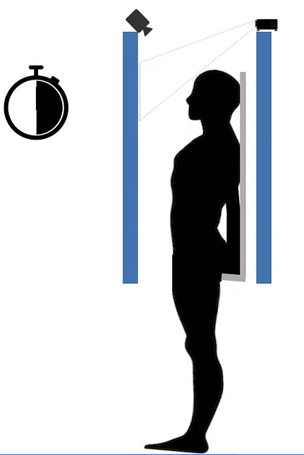
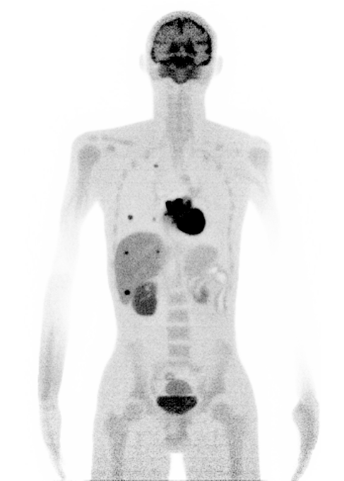
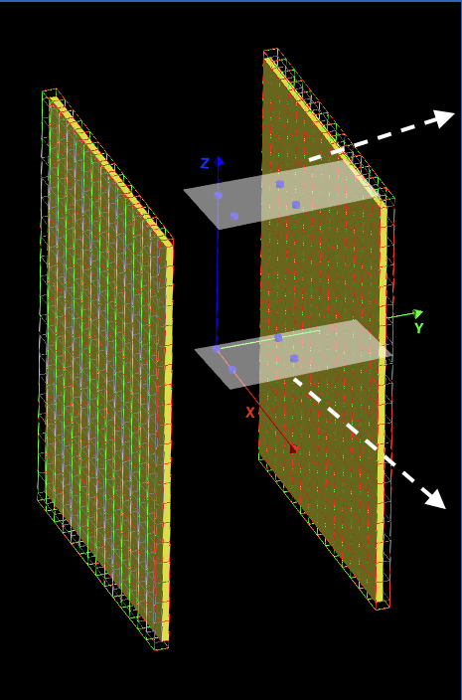
Project timeline 2022-2025
First prototype
Q1-Q2 2025
Detector & CT design
Q1-Q4 2024
Simulations & Recon & Motion
Q1-Q4 2023
Concept &
Early tests
Q3-Q4 2022

Slide 6
Walk-Through PET concept Walk-Through PET system design deep learning model for image denoising Results conclusion and future work

Slide 7
System design: full and reduced sparse
Full Design
LYSO 50 x 50 x 16 mm³
Sparse design
106 cm
57.5 cm
25 mm gap (1/2 detector)
20 rows 8 rows
71 cm

Slide 8
Sparse design motion to cover the afov
Stationary panels
Panels upward motion
Notes:
AFOV motion: 1.62 cm/s
Gap motion: 0.125 cm/s (translating ½ detector module)

Slide 9
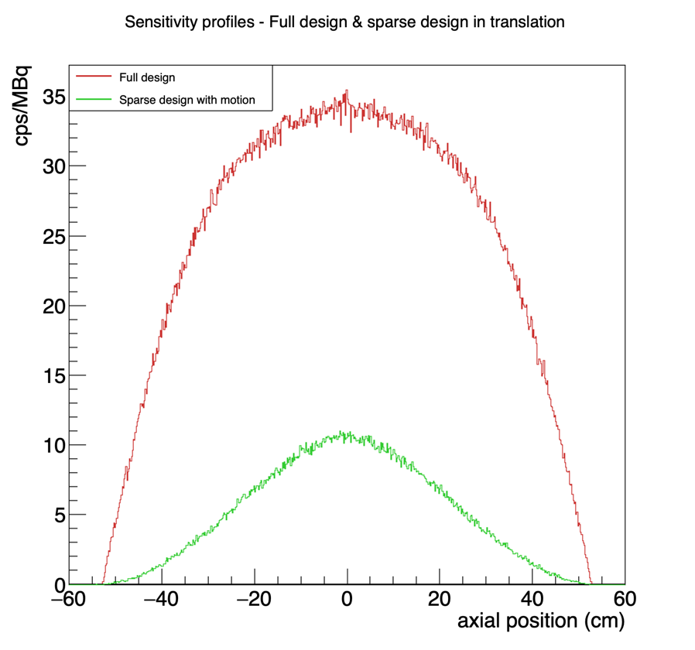
Sensitivity comparison
4.8x lower sensitivity
Full design
Sparse design with motion
110 cm line source inside a cylindrical water phantom of radius 10 cm

Slide 10
Walk-Through PET concept Walk-Through PET system design deep learning model for image denoising Results conclusion and future work

Slide 11
Why deep learning denoising?
Reduced AFOV
Sparse detector coverage
Panel motion
Lower count statistics & more noise in the reconstructed images!
AIM: Images from the sparse design of similar quality as the full design

Slide 12
Convolutional Neural Network: 4-layer 2D U-Net
3
64
64
Residual connection: Add
128
64
64
1
1
1
⨁
Variable matrix size:
2D Image Slice
Skip connection: Copy and Concatenate
128
128
256
128
Conv (3x3), ReLu
MaxPool2d (2)
ConvTrans2d (2), Pad
Conv (1x1)
ReLU
256
256
512
256
512
# trainable parameters: 12,260,353

Slide 13
Training of the network
Model | Low Dose Challenge data (Quadra)
Train/Val/Test | 30/3/3
Target image | Full count: 6 & 10 min acquisitions
Input image | Count reduction factors: 2, 4, 10, 20

Slide 14
Walk-Through PET concept Walk-Through PET system design deep learning model for image denoising Results conclusion and future work

Slide 15
Low bmi patient
1/20
1/10
1/4
1/2
Input image
Full
SUV
DL denoised image

Slide 16
High bmi patient
1/20
1/10
1/4
1/2
Input image
Full
SUV
DL denoised image

Slide 17
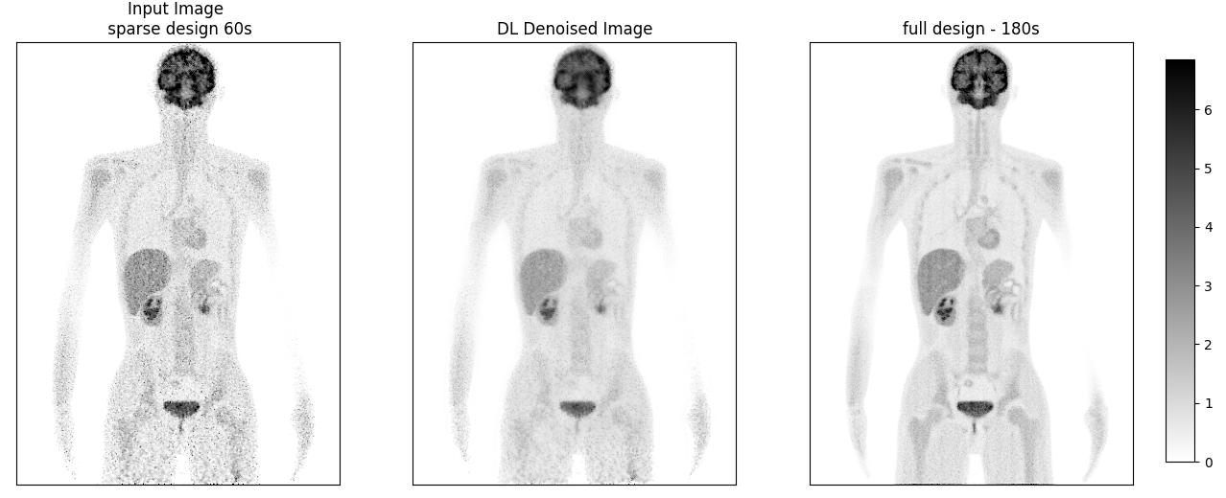
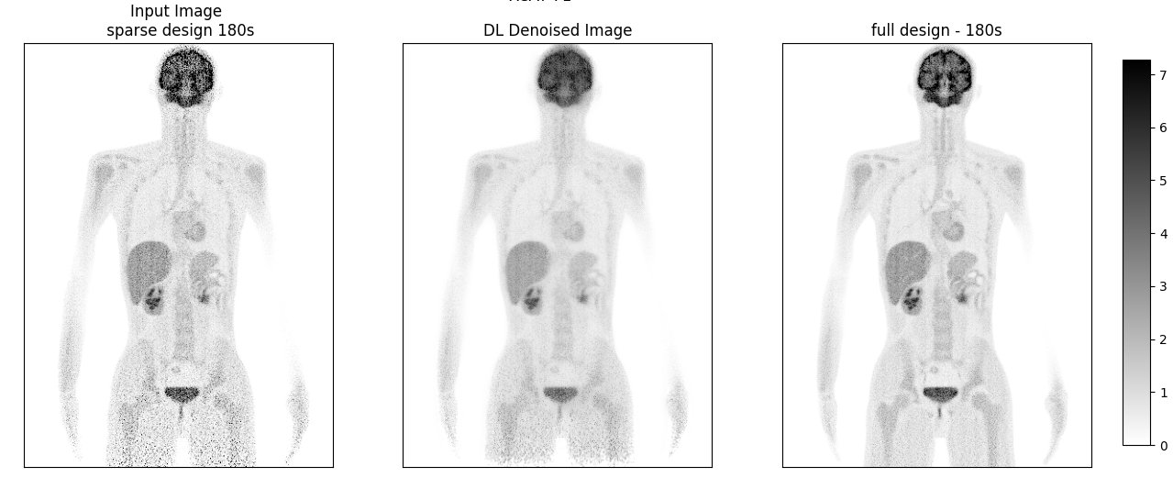
Test XCAT – low bmi
Reconstructed using LM MLEM
TOF resolution 300 ps (LYSO)
kBq/mL
To meet design scan requirement
60s simulation/reconstruction sparse design
To match lowest count level in the Quadra training data
180s simulation/reconstruction sparse design

Slide 18
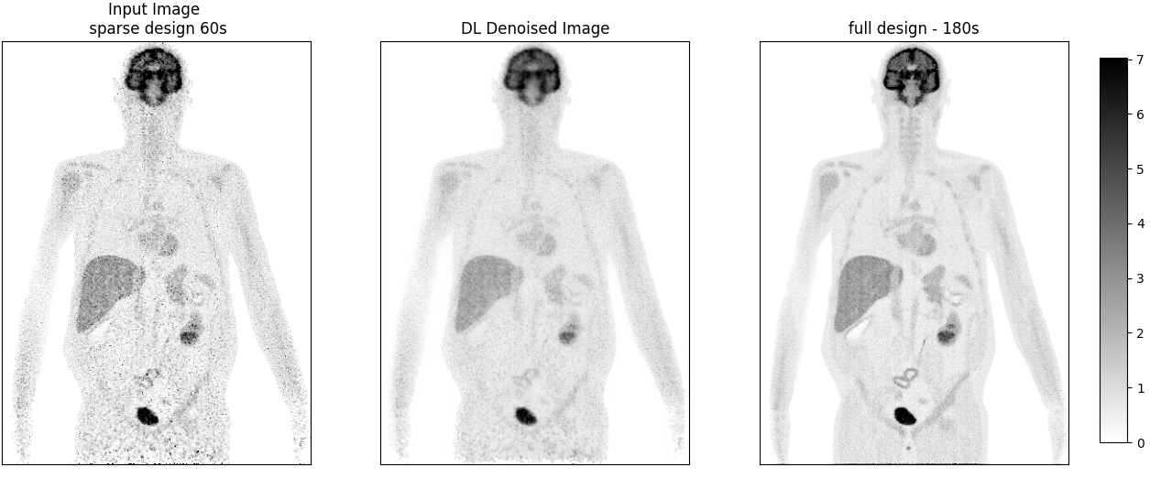
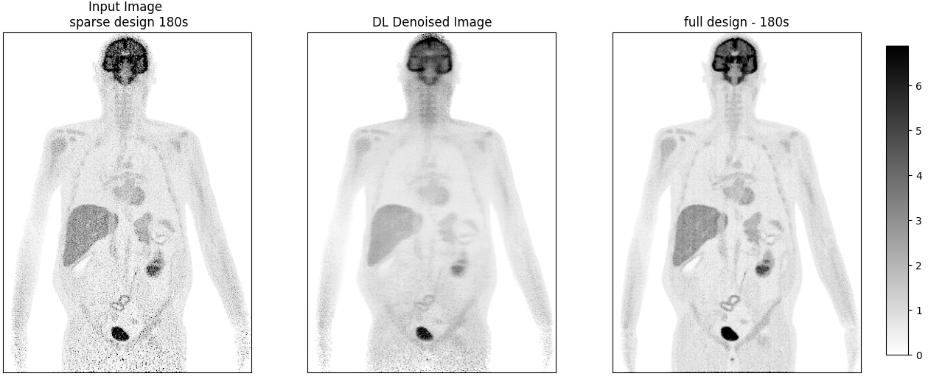
Test XCAT – high bmi
kBq/mL
60s simulation/reconstruction sparse design
180s simulation/reconstruction sparse design

Slide 19
Walk-Through PET concept Walk-Through PET system design deep learning model for image denoising Results conclusion and future work

Slide 20
Conclusion
The first images obtained with the sparse WT-PET design show good image quality. Further improvement is possible by optimizing the motion of the panels.
The DL network performs well!
Main issues of the current denoising model(s):
The non-uniform counts statistics in the Walk-Through-PET XCAT images
The count level of the test XCAT data is lower than the lowest count level used for training
The distribution of the XCAT data is different than the distribution of the Quadra data

Slide 21
Model: Trained on WT-PET XCAT data
Sparse design
DL denoised
Full design
kBq/mL
20 s simulation
40 s simulation

Slide 22
future work
Train the DL model on realistic data but simulated with the WT-PET sparse/full designs
Optimize the motion of the panels for the sparse WT-PET design to get more statistics and reduce the noise in the brain and leg areas
Evaluate the effect of DL denoising on the spatial resolution of the denoised images
Reminder
AIM: Use deep learning to achieve images of similar quality to the full WT-PET design with data acquired by the sparse design!

Slide 23
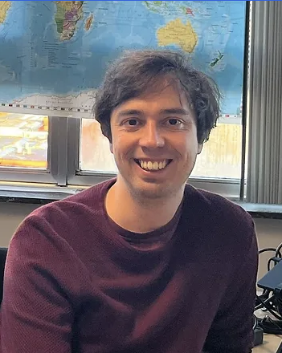
Look out for more presentations!
Investigating the Influence of TOF and DOI on Spatial Resolution in Flat-Panel and Cylindrical Total-Body PET
Different Deep Learning Training Strategies for Attenuation and Scatter Correction in PET
Motion analysis of Subjects standing in walk-through total body PET using infrared based localization
Energy based scatter correction for the Walk-Through PET system
Performance characteristics of multi-mouse imaging on monolithic large flat panel PET

Slide 24
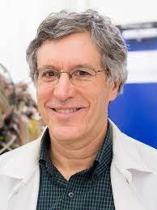
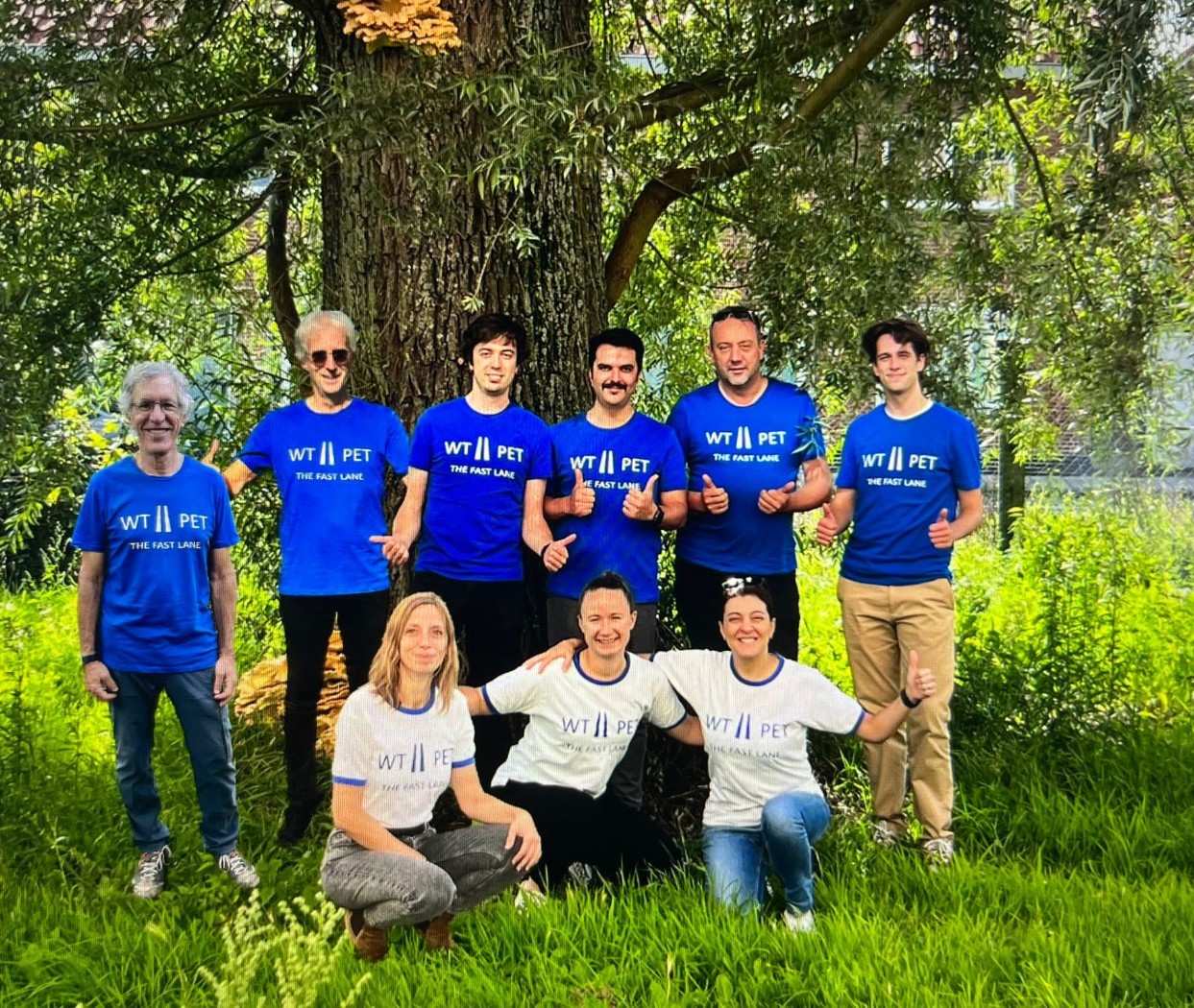
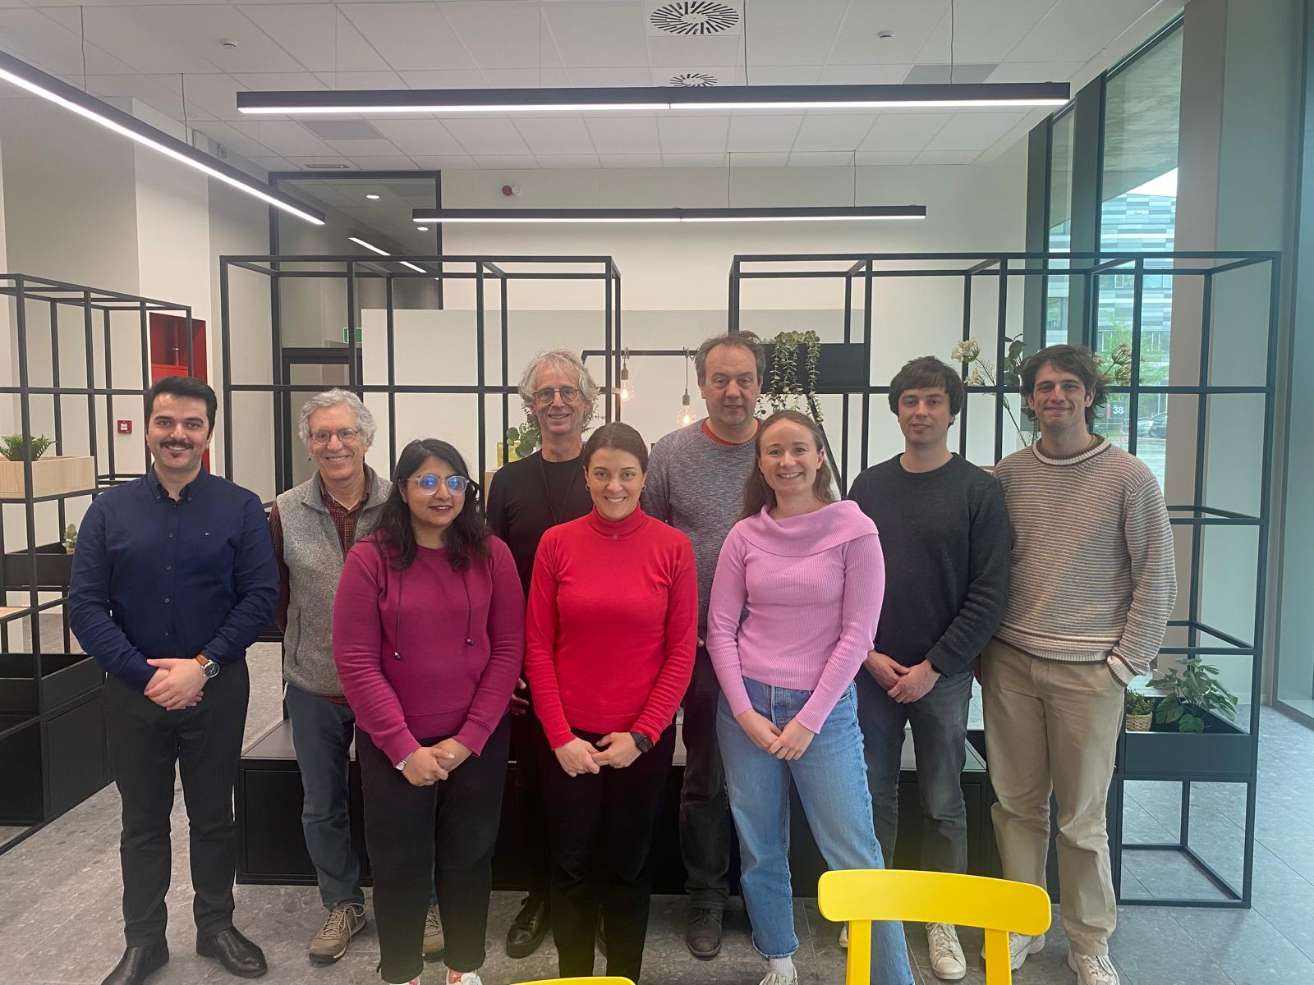
Thank you! THE Walk-through PET team
WT-PET.org

Slide 25
Back-up slides

Slide 26
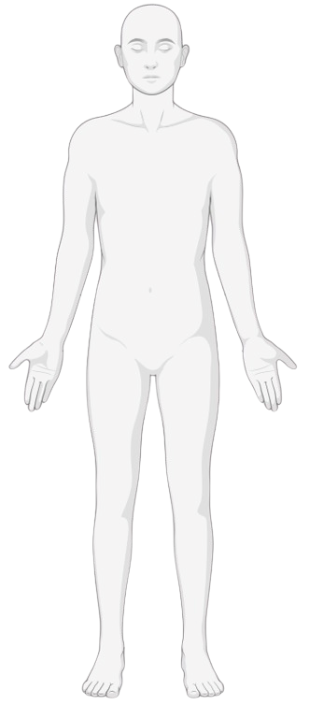
CT component design
WT-PET
rectangular CT
.
photon-counting
line detectors
.
.
.
.
.
.
.
.
.
.
.
.
.
.
.
.
.
.
.
.
.
.
.
.
.
.
.
.
.
.
.
.
.
.
.
.
.
.
.
.
2 CNT source arrays
CT-meeting – August 2024
Bamberg, Germany

Slide 27
Training details
Loss function: Mean Absolute Error
Optimiser: Adam
Learning rate: 1e-4
2D slices along three views

Slide 28
Training of the network on xcat data
Model | XCAT simulated with the WT-PET design
Train/Val/Test | 9/2/2 BMI: 18 – 38
Target image | Full design (40s simulation)
Input image | Sparse design (20s simulation)

