Slide 1
EIC_NET
aggiornamento progetto ePIC@EIC
attività a Bari
percentuali e richieste 2024
Domenico Elia
per Consiglio di Sezione Bari 6.7.2023

Slide 2
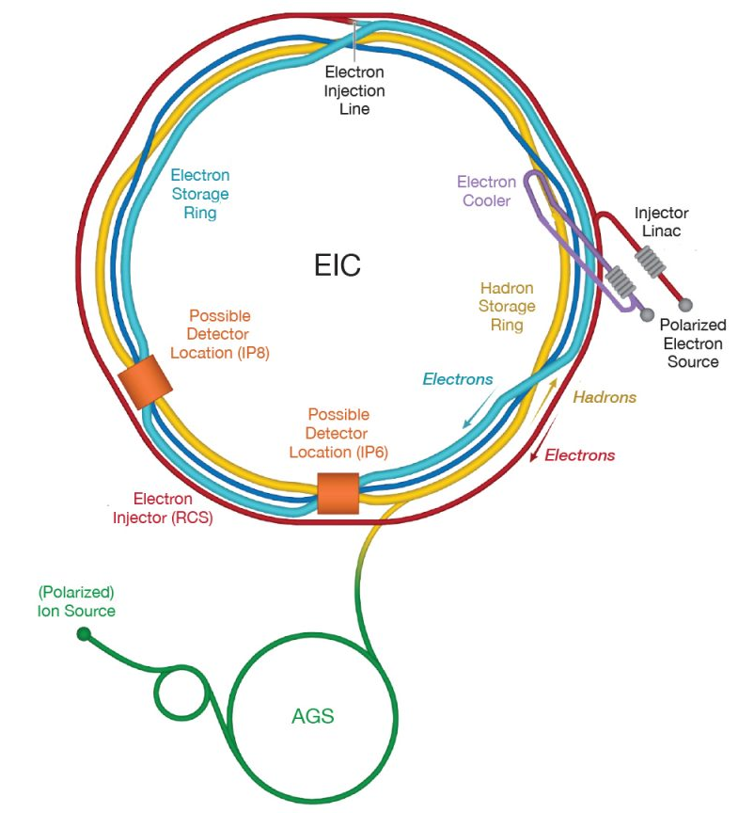
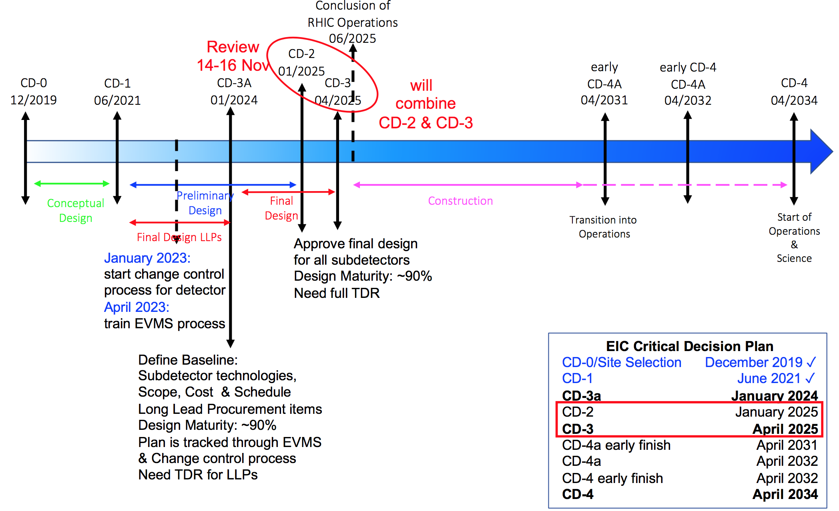
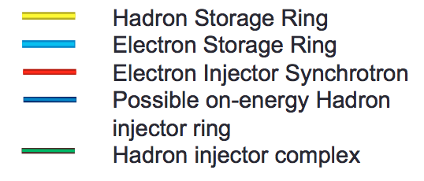
Aggiornamento progetto ePIC
From RICH to EIC @ BNL in 2030’s:
IP8
IP6

Slide 3
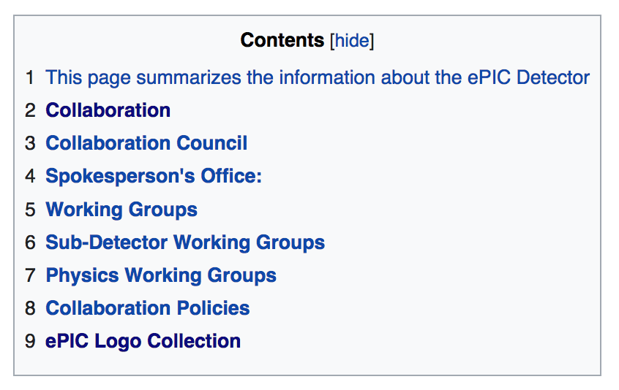
Aggiornamento progetto ePIC
Selected logo
ePIC Collaboration @ EIC:
born with in person meeting 9-11/1/2023 @JLab
https://indico.bnl.gov/event/17621/
Approved Charter:
https://wiki.bnl.gov/EPIC/images/6/6c/EPIC_Charter-v1.0.pdf
ePIC wiki pages:
https://wiki.bnl.gov/EPIC/

Slide 4
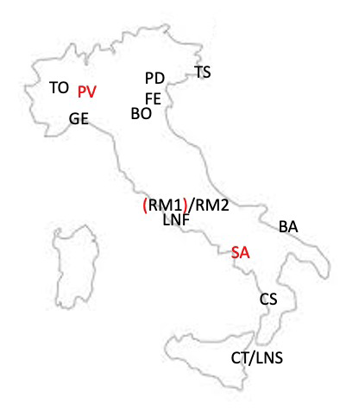
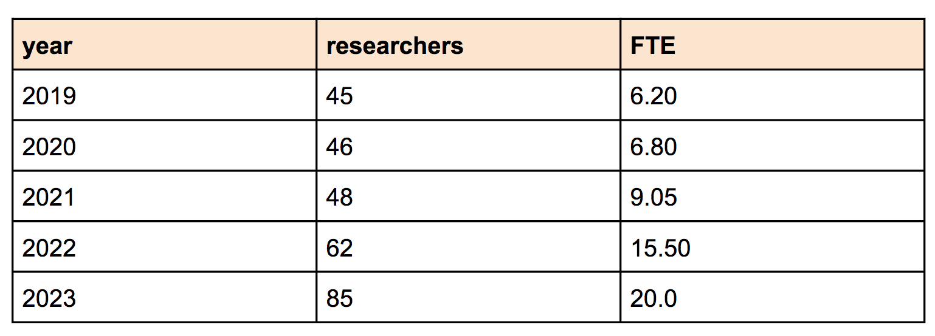
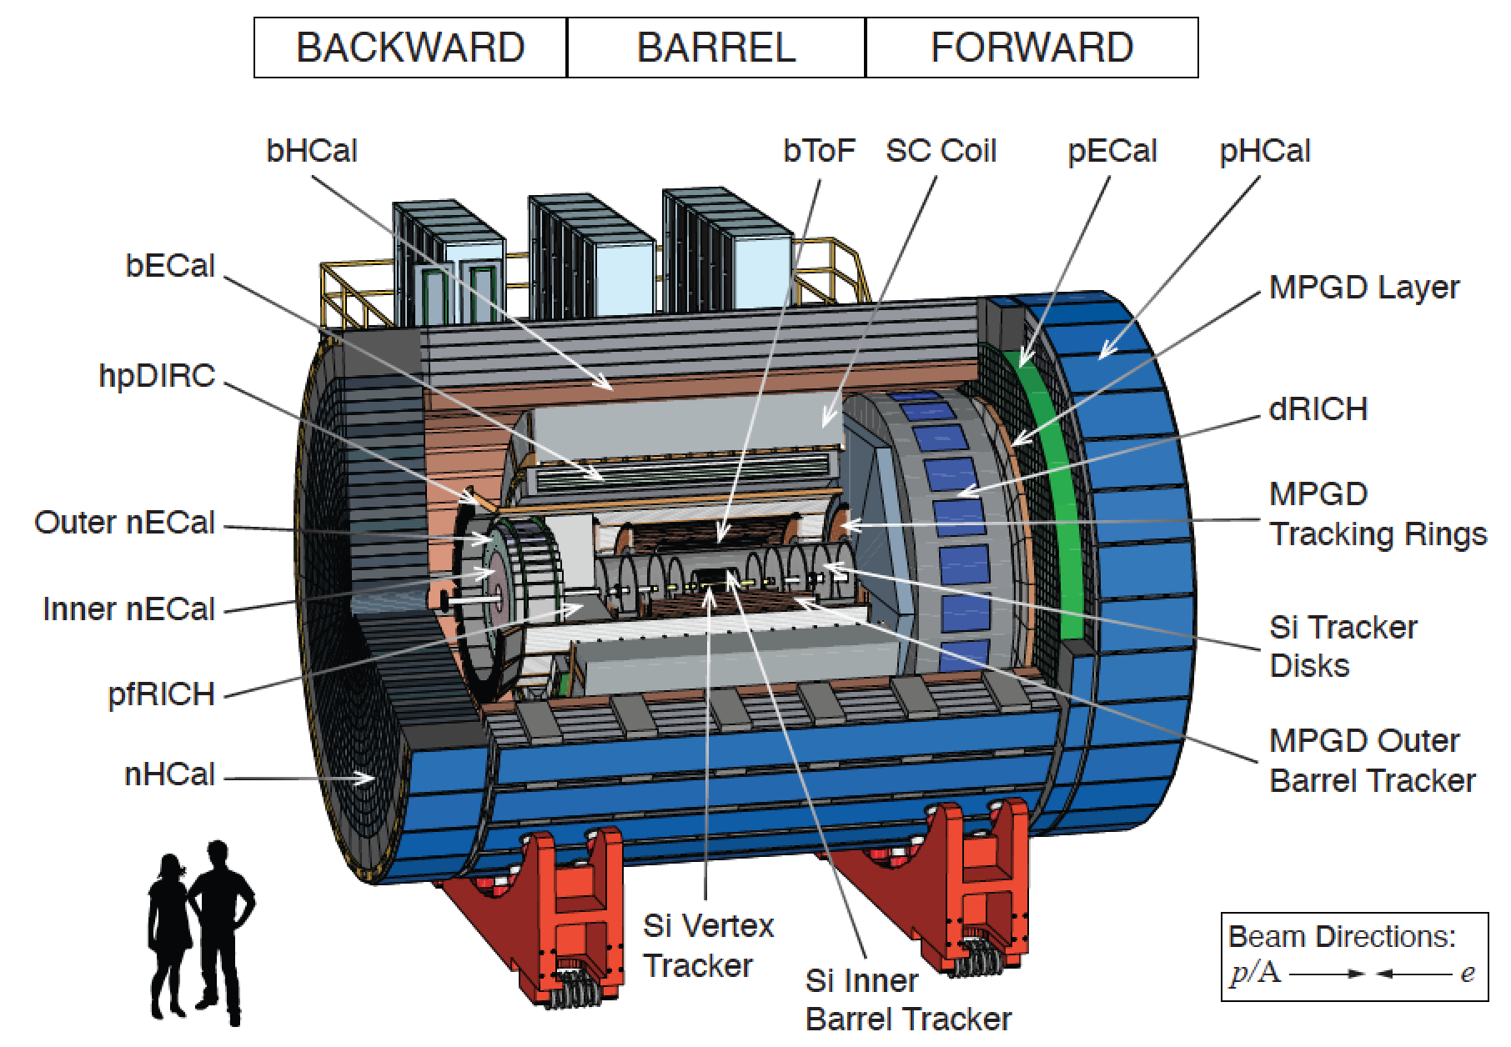
Contributo INFN EIC_NET
INFN involvement in EIC:
started in the very early phases (< 2019)
various roles in the EIC User Group
Steering Committee (vice-chair and members)
Institutional Board (vice-chair)
Conference Committee
Yellor Report initiative 2020
Detector and Simulation conveners
Tracking and PID conveners, Physics conveners
Detector Proposal (ATHENA) 2021-22
proto-collaboration spokesperson
Tracking and PID conveners, Physics conveners
ePIC Collaboration since 2022-2023
leading the Collaboration formation process
contributing to Tracking/PID/Simulation/ Physics WGs
deputy SP in ePIC (+ incoming roles in ePIC DSCs)
Main detector interest/contributions:
Silicon Vertex tracker (MAPS in 65 nm technology)
Forward PID (dual RICH)
computing/simulation and streaming readout

Slide 5
Attività a Bari per EIC_NET
Main contributions from Bari group:
innermost layers of the ePIC SVT (sinergies with ALICE ITS3)
aerogel and SiPM studies for the ePIC dRICH (sinergies with ALICE 3)

Slide 6
Percentuali e richieste 2024
 | FTE 2023 | FTE 2024 | Sinergie | FTE + sinergie 2024
Altamura A. R. |  | 30 |  | 30
Cicala G. | 30
Colella D. | 20 | 30 |  | 30
Di Bari D. |  | 20 |  | 20
Di Ruzza B. |  | 10 |  | 10
Elia D. | 25 | 25 |  | 25
Kumar S. | 30 | 30 |  | 30
Ligonzo T. | 30
Mastroserio A. | 20 | 20 |  | 20
Nappi E. | 20 | 20 | 10 (AIDAINNOVA) | 30
Nicassio N. |  | 20 |  | 20
Pastore C. | 5 | 5 |  | 5
Perrino R. | 20 | 20 |  | 20
Volpe G. | 20 | 20 | 10 (AIDAINNOVA) | 30
Terrevoli C. |  | 10 |  | 10
 | 2.2 (2.4 con sinergie) | 2.6 | 0.2 | 2.8

Slide 7
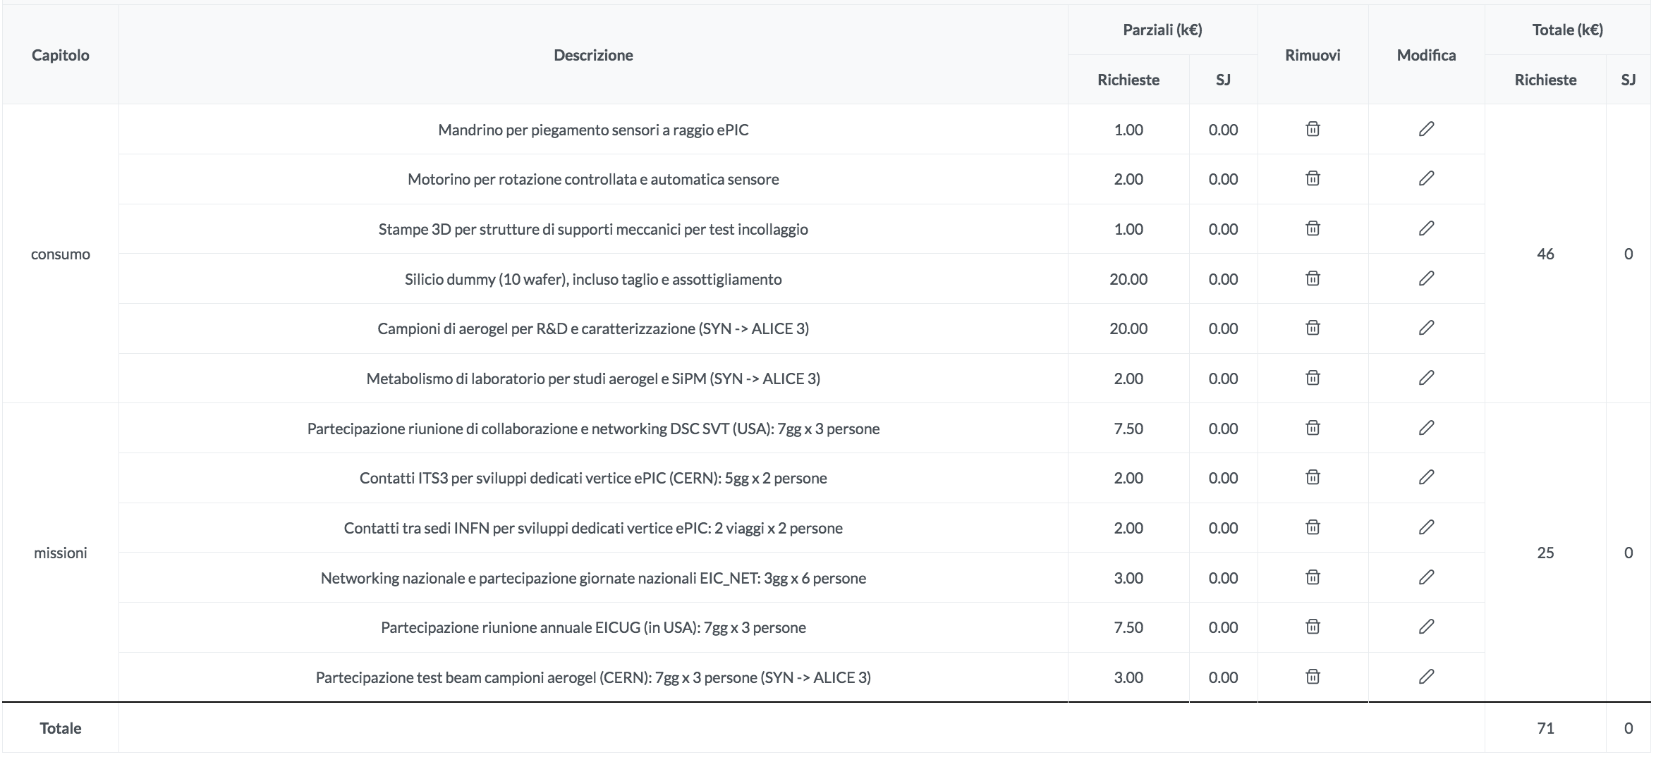
Percentuali e richieste 2024
Consumo
R&D aerogel
e SiPM per PID:
sinergia con ALICE 3
Missioni
R&D silici per tracker: sinergia con ALICE ITS3 → richieste SERV. SEZ. su ALICE

