Slide 1
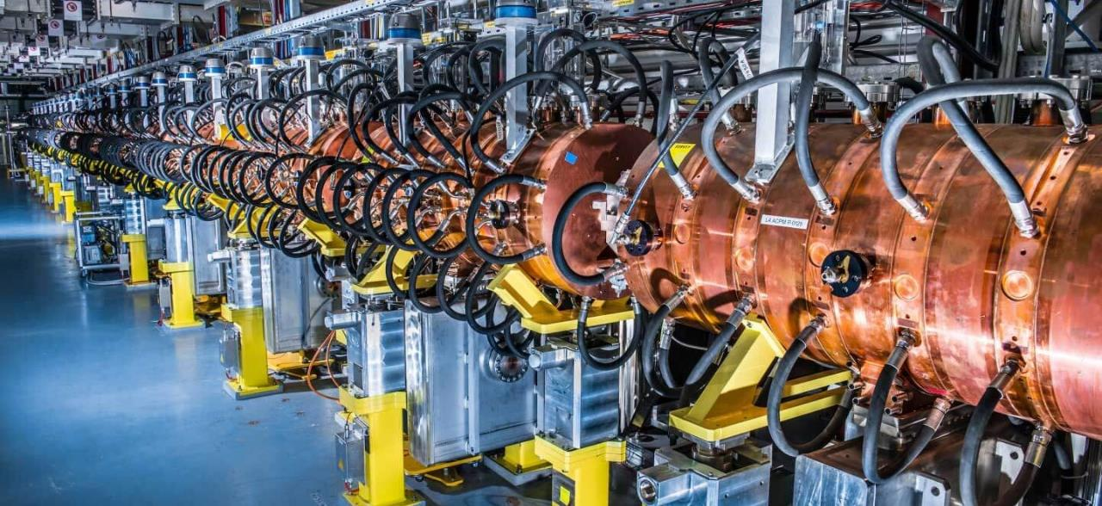
Accelerators for Society – lecture 2
Maurizio Vretenar CERN Scuola F. Bonaudi, Cogne, 30.6.2023

Slide 2

Medical applications of accelerators

Slide 3
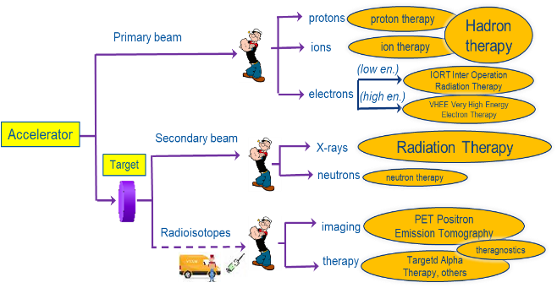
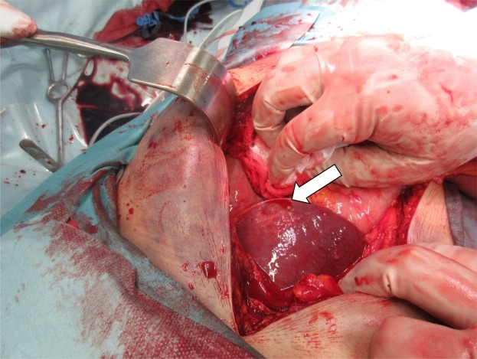

Particle accelerators: a formidable tool for medicine
Accelerators are the way to realise the old dream of a bloodless surgery and imaging: penetrate into the human body to treat diseases and to observe internal organs without using surgical tools.
Operating facilities
> 150
12
>300
0
≈ 14’000
7
≈ 1’500
0
Cancer treatment
Imaging
New cancer treatments
≈ 16’000 particle accelerators operating for medicine worldwide, in cancer therapy and imaging
M. Vretenar | NIMMS

Slide 4

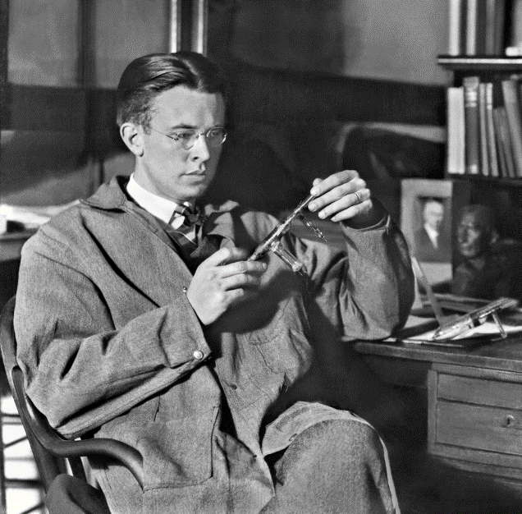
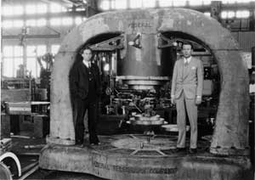
Medicine at the first accelerators
The idea of using accelerators for treating diseases is almost as old as accelerators
After the cyclotron invention in 1936, the new Berkeley 37-inch cyclotron was producing isotopes for physics, biology and medicine – in parallel to the time devoted to discoveries in nuclear physics.
In 1938 starts direct irradiation of patients with neutrons from the new 60-inch cyclotron.
In 1946, Robert Wilson proposed to use protons to treat cancer, profiting of the Bragg peak to deliver a precise dose to the tumour.
First treatment of pituitary tumours took place at Berkeley in 1956.
First hospital-based proton treatment centre at Loma Linda (US) in 1990.

Slide 5
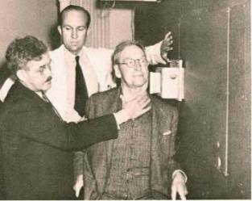
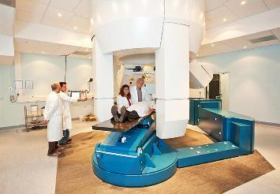
Modern accelerators for cancer treatment and isotope production
There are today about 16’000 accelerators in hospitals or working for hospitals, complex devices that have specific requirements, somehow different from a scientific accelerator:
The beam must be perfectly known, stable and reliable.
The accelerator (as the radiopharmaceutical unit in case of production of isotopes) have to follow strict Quality Assurance procedures.
Example: factor 4 in the complexity and cost of the control system for a medical accelerator as compared to a scientific one.
The role of the medical physicist is essential in planning the treatment and in guaranteeing the delivered dose.
From the early tests at Lawrence’s cyclotron to a modern treatment room at CNAO

Slide 6
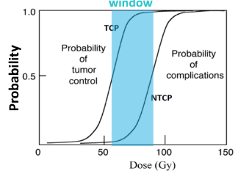
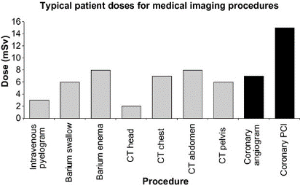
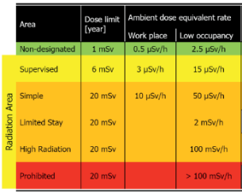
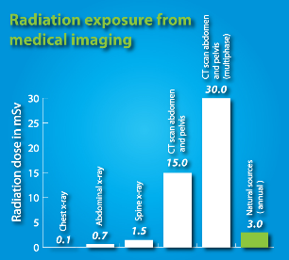
Medical exposure – a critical issue
TCP=Tumor control probability
NTCO=normal tissue complication probability
Radiation management and control is a key issue in nuclear medicine.
- important doses are delivered to patients (comparison risk-benefit)
- the dose to medical personnel is subject to strict legal limits.
CERN limits
Up to 2000 mSv highly targeted dose in conventional radiotherapy !
Source: S. Liauw et al., Translational Medicine, 5, 173

Slide 7
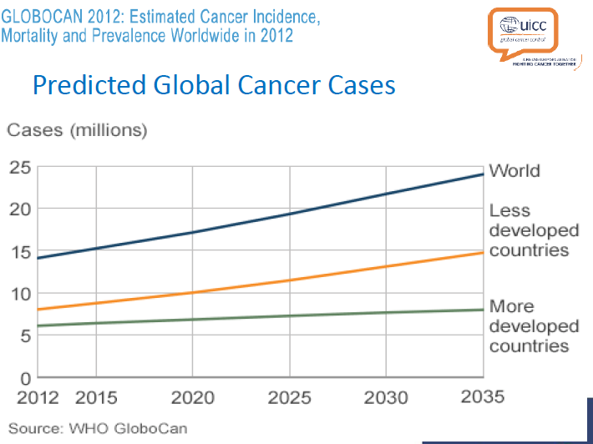
Impact of cancer on world population
Cancer is the second leading cause of death globally, and was responsible for 8.8 million deaths in 2015. Globally, nearly 1 in 6 deaths is due to cancer (WHO).
Increase of cancer cases due to:
Increasing age of population
Aggressive environmental and living conditions in developing countries.
Nowadays, the standard protocol for treatment of most cancers is based on:
Surgery
Radiotherapy (accelerator-based)
Chemiotherapy
(Immunotherapy)
(courtesy M. Dosanih)

Slide 8
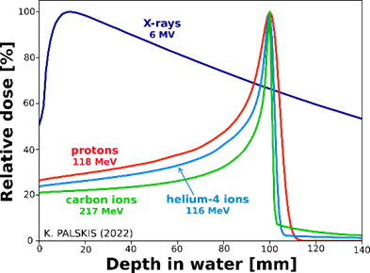
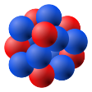
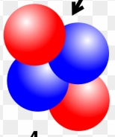
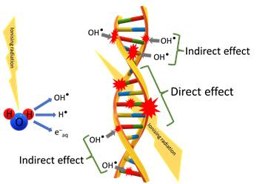
Treating cancer with particles (photons and ions)
m₀= 1.67 × 10⁻²⁷ kilograms
Photon (X-ray)
no mass
Proton
mass: 1 m₀
Helium ion
mass: 4 m₀
Carbon ion
mass: 12 m₀
Linear Energy Transfer low high
Effect on DNA¹ indirect (via ROS) direct (SSB and DSB)
Conformality low high high + fragm.
Required Energy² low medium high
Size of accelerator small medium large
Number of op. units ~15,000 108 0 14
¹ ROS = Reactive Oxygen Species, SSB = Single Strand Breaking, DSB = Double Strand Breaking
² Energy required for full body penetration (30-35 cm)

Slide 9
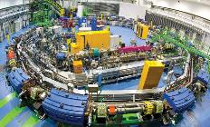
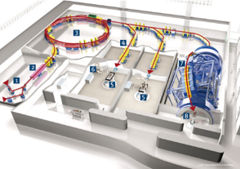
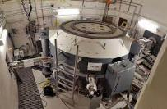
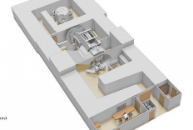
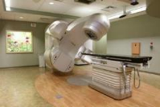

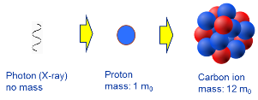
Comparing accelerator designs
Ions deliver more energy to the tissues but need more energy to enter the body → factor 2.8 in accelerator diameter going from protons to carbon
courtesy IBA
Synchrotron, carbon ions
~5,000 m²
>200 M€
Cyclotron, protons
~500 m²
~few 10 M€
Commercially available Specially designed and built
Linac, X-rays
~50 m²
~few M€
Space for translational R&D
Range: max. 300 mm (Bragg Peak)
Protons: 220 MeV (max. Bρ = 2.4 Tm )
Helium: 220 MeV/u (max. Bρ = 4.5 Tm )
Carbon: 400 MeV/u (max. Bρ = 6.3 Tm)

Slide 10



1. Radiation therapy
protons
proton therapy
Hadron therapy
Primary beam
ions
ion therapy
(low en.)
IORT Inter Operation Radiation Therapy
electrons
(high en.)
VHHE Very High Energy Electron Therapy
Accelerator
Secondary beam
Radiation Therapy
X-rays
Target
neutrons
neutron therapy
imaging
PET Positron Emission Tomography
Radioisotopes
therapy
theragnostics
Targetd Alpha Therapy, others

Slide 11
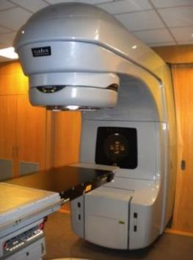
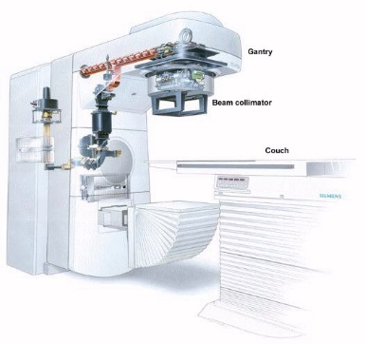

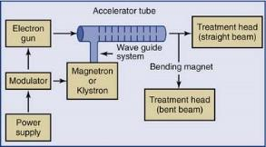
The most successful accelerator
Electron Linac (linear accelerator) for radiotherapy (X-ray treatment of cancer)
5 – 25 MeV e-beam
Tungsten target
14,000 in operation worldwide!

Slide 12
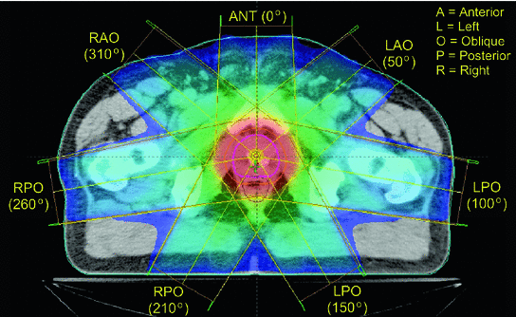
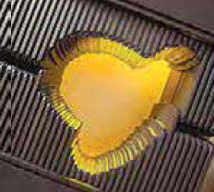
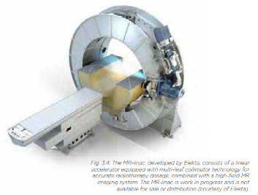
Modern radiotherapy
X-rays are used to treat cancer since last century. The introduction of the electron linac has made a huge development possible, and new developments are now further extending the reach of this treatment.
Accurate delivery of X-rays to tumours
To spare surrounding tissues and organs, computer-controlled treatment methods enable precise volumes of radiation dose to be delivered. The radiation is delivered from several directions and transversally defined by multi-leaf collimators (MLCs).
Combined imaging and therapy
Modern imaging techniques (CT computed tomography, MRI magnetic resonance imaging, PET positron emission tomography) allow an excellent 3D (and 4D, including time) modelling of the region to be treated.
The next challenge is to combine imaging and treatment in the same device.

Slide 13
2 – Hadron therapy (protons and ions)
Note:
Therapy with electrons will be left for the last lecture by W. Wünsch
protons
proton therapy
Hadron therapy
Primary beam
ions
ion therapy
(low en.)
IORT Inter Operation Radiation Therapy
electrons
(high en.)
VHHE Very High Energy Electron Therapy
Accelerator
Secondary beam
Radiation Therapy
X-rays
Target
neutrons
neutron therapy
imaging
PET Positron Emission Tomography
Radioisotopes
therapy
theragnostics
Targetd Alpha Therapy, others

Slide 14
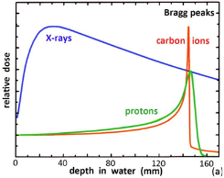
Treating cancer with particle beams
Cancer today: ~ 65% of cancers are curable; ~ 35% of cancer treatments fail, 2/3 because of metastasis, 1/3 in the primary site.
Priority of cancer research is treating the >10% “not curable” cancers, usually large, deep seated, radioresistant.
Techniques: Advanced Radiation Therapy (e.g. IMRT), or Hadron Therapy (protons or ions).
Challenge: Deposit enough dose on the cancer, sparing the surrounding tissues (secondary cancers, quality of life).
Hadron Therapy or Particle Therapy allows concentrating the radiation dose on the tumour, thanks to the «Bragg peak».
Required energy to penetrate the full body (about 33 cm): 230 MeV protons, 430 MeV/u carbon ions.
Required beam current: generally small, 10 nA for a typical dose of 1 Gy to 1 liter in 1 minute.
Bethe-Bloch equation of ionization energy loss by charged particles (~1/β²)

Slide 15
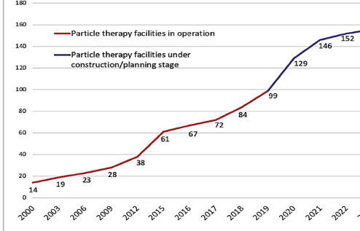

The rise of proton and ion therapy
Hadrons = protons and heavier atomic nuclei (ions)
Proposed 1946, first experimental treatment Berkeley 1954.
First hospital-based proton treatment facility in 1993 (Loma Linda, US).
First treatment facility with carbon ions in 1994 (HIMAC, Japan).
Treatment in Europe at physics facilities from end of ‘90s.
First dedicated European facility for proton-carbon ions in 2009 (HIT).
From 2006, commercial proton therapy accelerators (mostly cyclotrons) come to market.
In 2022, 6 competing vendors for protons, 1 for carbon ions. A total of 152 centres worldwide.
A success story, but … many ongoing discussions on effectiveness, costs and benefits.
ptcog.com
The Heidelberg Ion Therapy (HIT) facility (protons and carbon ions)

Slide 16
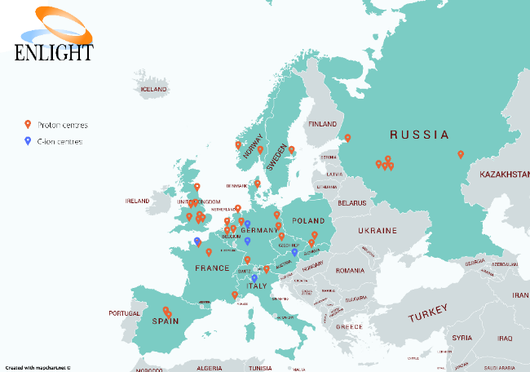
Particle therapy in Europe
Only 2 regions in Europe without particle therapy facilities:
South East Europe
Baltics
Particle therapy centres in Europe. Courtesy of ENLIGHT, 2020

Slide 17
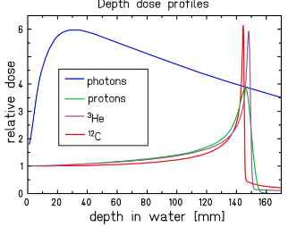
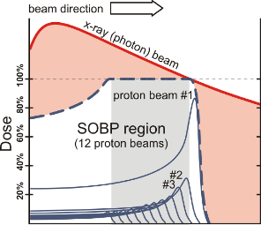
The Bragg peak is not all…
The Bragg peak is very simple physics concept: distribution of energy deposition inside the tissue, leading to atomic ionisations (LET = Linear Energy Transfer, energy loss per unit mass)
Biology is more complex than physics:
Radiobiological effect RBE has a complex dependence on LET and particle type: need of experimental work, complex models and sophisticated treatment plans.
Practical dose delivery reduces effectiveness:
Longitudinal scan of tumour leads to higher dose in the penetration zone (Spread Out Bragg Peak, SOBP),
The precise dose distribution requires comparable accuracy in imaging of tumours and in compensation of organ motion.
Levin et al., Br J Cancer (2005) 93:849–54

Slide 18
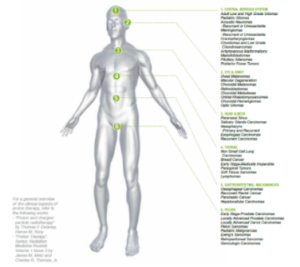
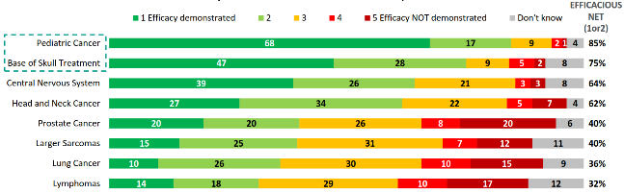
Particle therapy: an ongoing debate
Reduced toxicity to organs adjacent to the tumour is the main advantage of particle beams. Using particles reduces the risk of secondary cancers and other diseases after treatment, and in general improves quality of life after treatment. Particle treatment is particularly indicated for paediatric tumours and tumours close to vital organs.
There is still much space for further improving particle therapy (organs in motion, dose optimisation, type of particle,…) and research is essential: pre-clinical research, optimisation of treatment modalities, long-term clinical trials, etc.
The goal of particle therapy is improving health more than just treating cancer!
Source: IBA, state of proton therapy market entering 2017
Image: IBA proton therapy fact-sheet,

Slide 19
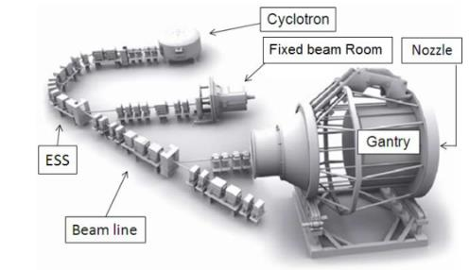
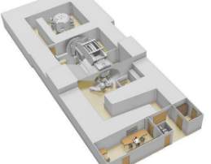
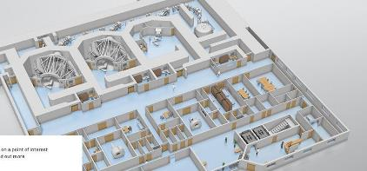
Proton therapy accelerators: cyclotrons
At present, the cyclotron is the one of the best accelerators to provide proton therapy reliably and at low cost (4 vendors on the market).
Critical issues with cyclotrons:
Energy modulation (required to adjust the depth and scan the tumour) is obtained with degraders (sliding plates) that are slow and remain activated.
Beam loss indices activation requiring large shielding
ProteusOne and ProteusPlus turn-key proton therapy solutions from IBA (Belgium)

Slide 20
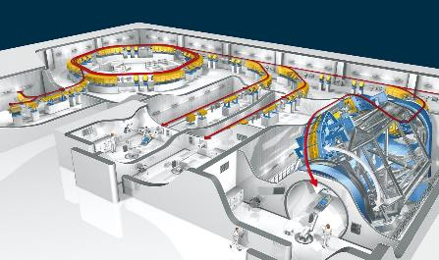
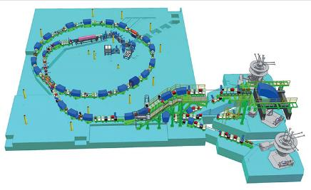
Synchrotrons for proton and ion therapy
The Loma Linda Medical Centre in US (only protons) and the ion therapy centres in Japan have paved the way for the use of synchrotrons for combined proton and ion (carbon) therapy).
2 pioneering initiatives in Europe (ion therapy at GSI and the Proton-Ion Medical Machine Study PIMMS at CERN) have established the basis for the construction of 4 proton-ion therapy centres: Heidelberg and Marburg Ion Therapy (HIT and MIT) based on the GSI design, Centro Nazionale di Terapia Oncologica (CNAO) and Med-AUSTRON based on the PIMMS design.
HIT Heidelberg
CNAO

Slide 21
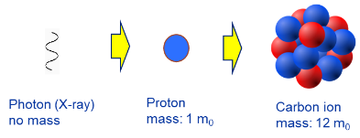
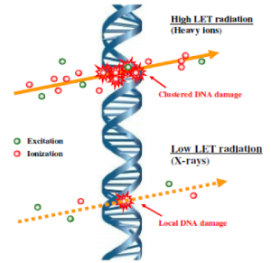
Ion therapy: from photons to protons to ions
High LET radiation (ions) generates denser ionisations inducing clustered DNA lesions difficult for the cell to repair.
→ RBE(carbon)=2.0-2.4
Advantages of heavier ions (compared to protons or X-rays)
Higher LET and RBE generate non-reparable double-strand DNA breakings that are effective on hypoxic radioresistant tumours.
Energy deposition is more precise, with lower straggling and scattering
Emerging opportunities from combination with immunotherapy to treat diffused cancers and metastasis.
Helm A, Ebner DK, Tinganelli W, Simoniello P, Bisio A, Marchesano V, et al. Combining heavy-ion therapy with immunotherapy: an update on recent developments. Int J Part Ther. (2018) 5:84–93.
Durante M, Formenti S. Harnessing radiation to improve immunotherapy: better with particles? Br J Radiol. (2019) 192:20190224.
Only carbon ions licensed for treatment, after the pioneering developments at HIMAC (Japan) from the 90’s
First patient treatments with carbon ions only in 1994: ion therapy is still in an early stage of its development !

Slide 22
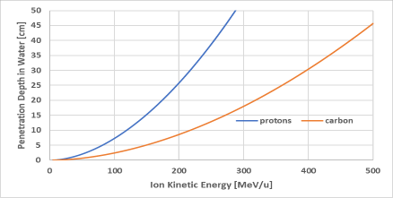
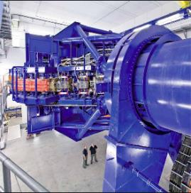
Ion therapy: accelerator challenges
Particle accelerators for heavy ions are large and complex:
1. The high energy deposition means that to reach deep seated tumours ions must be accelerated to higher energies than protons: ion energy loss goes as (charge of the incident particle)^2. → around 440 MeV/u for carbon, compared to 240 MeV for protons.
Magnetic rigidity Bρ for carbon ions at full energy is 2.76 times higher than protons.
→ For cyclotrons and synchrotrons, accelerator diameter scales with rigidity
2. The required energies fall into a transition range between accelerator technologies: cyclotrons and linacs are better at low energies, synchrotrons at high energies. In the intermediate region, there is not an ideal accelerator configuration → need to compare options, characterised by complexity, cost, and R&D requirements.
For a given magnet field, in an ion synchrotron or cyclotron accelerator and gantry are almost 3 times larger than for protons.
The HIT gantry has a mass of 600 tons for a dipole bending radius of 3.65 m.

Slide 23
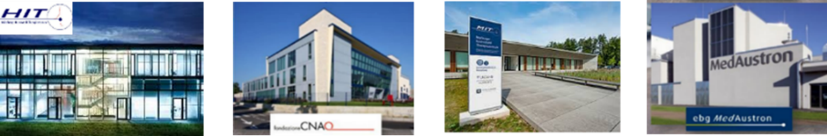
New technologies for ion therapy accelerators
Ions deliver more energy to the tissues but need more energy to enter the body → the required diameter of the accelerator increases with energy, accelerator dimensions increase by a factor 2.8 going from protons to carbon
The main limitation to the diffusion of ion therapy is the cost and size of the accelerator
Only 4 ion therapy facilities operating in Europe (+ 6 in Japan, 3 in China, 1 planned in US)
CNAO and MedAustron based on a design started at CERN in 1996. 1st patient at CNAO in 2011.
HIT and MIT based on a design started at GSI (Germany) in 1998 . 1st patient at HIT in 2009.

Slide 24


A strategy for CERN: the Next Ion Medical Machine Study
Proton therapy is now commercial, and CERN, as an international organisation, cannot interfere with a mature commercial market.
Therapy with heavier ions is still in an early phase despite its advantages. Its diffusion is limited mainly by:
  Size and cost of the accelerator;
  Lack of experimental data.
New demands from the medical community and new opportunities from recent research can be integrated in a newly designed ion therapy facility.
Approval in 2019 of the Next Ion Medical Machine Study (NIMMS) in the frame of the CERN Knowledge Transfer for Medical Applications.
In line with CERN mission, the goal of NIMMS is to build on CERN expertise to develop a portfolio of technologies that can be used in a next generation facility, more than developing a single design (NIMMS as a «toolbox»).

Slide 25
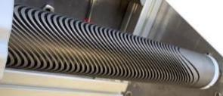
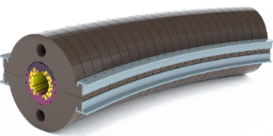
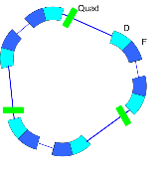
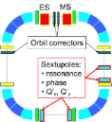
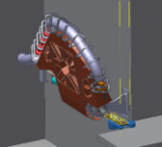


Four avenues to future ion therapy: the NIMMS Work Packages
Curved superconducting magnets
for synchrotrons and gantries
Superconductivity to reach higher magnetic field and small dimensions
IFAST EU project
Small synchrotrons
for particle therapy
Reduced dimensions with improved performance (injection, extraction)
HITRIplus EU project
Superconducting gantries
Precise beam delivery on multiple angles
High-frequency ion linacs
EU supporting initiatives
Compact bent layout

Slide 26






Superconducting magnets for synchrotrons and gantries
The main avenue to reducing the dimensions of a magnetic system is superconductivity.
But medical accelerator magnets have specific challenges: ramped field, curved shape, integrated focusing
4 projects launched for the construction of 5 demonstrator magnets (short length, pre-prototypes) supported by 3 collaborations:
Cos-theta (2 demonstrators, thermal and curved) for gantry
4 T, 0.4 T/s, 80 mm ø, r=1.65 m (430 MeV/u)
collaboration INFN-CERN-CNAO-MedAustron
CERN (courtesy M. Karppinen)
2. Canted Cosine Theta (CCT) curved demonstrator
4 T, 0.4 T/s, 80 mm ø, r=1.65 m (430 MeV/u), 30⁰
EU Project HITRIplus (2021-25)
3. Combined-functions CCT straight demonstrator
4 T + 5 T/m quadrupole, 80 mm ø, L=0.73 m
4. Combined-functions HTS CCT straight demonstrator
4 T @ 10 K, ReBCO tapes, 80 mm ø, L=1 m
EU Project I.FAST (2021-25)
INFN (courtesy E. De Matteis
HTS=High Temperature Superconductor
Timeline: mid-2025 for experimental results!

Slide 27







The compact superconducting synchrotron
Considerable gain in dimensions thanks to superconductivity
Lattice with 60⁰ magnets
Additional features
High intensity (2 x 10¹⁰ C ions per pulse
Slow and FLASH extraction
Multiple ion operation
6.5 m
Alternative synchrotron layouts
Compact faciliy with 2 rooms
Goal: a compact single-room C-ion therapy facility in about 1,000 m²
E. Benedetto et al., Comparison of accelerator designs for an ion therapy and research facility, CERN-ACC-NOTE-2020-0068, http://cds.cern.ch/record/2748083?ln=en

Slide 28



The carbon linac
A. Lombardi (CERN)
High repetition frequency (360 Hz) with pulse-to-pulse energy modulation allow fast and accurate dose delivery to the tumour
Parameter | Value
Frequency | 750 MHz/3 GHz
Species | ¹²C⁶⁺
Final energy | 100-430 MeV/u
Repetition rate | 200 (400) Hz
Pulse length | 5 μs
Acceleration of fully stripped Carbon with 750MHz/3GHz structures
Innovative «folded» version to save space
Particle tracking completed
Prototype EBIS source under commissioning
RFQ designed, agreement with CIEMAT for construction in Spain
Test stand being prepared at CERN for test of the injector using a He-source provided by a donor, in collaboration with Sarajevo Univ. and ITRE (Slovenia)

Slide 29




Gantries: superconducting ion gantry, gatoroid
Development of a rotating SC gantry for Carbon ions:
CERN-INFN-CNAO-MedAustron: magnets, dose delivery, range verification, scanning system.
HITRIplus EU project (CNAO, RTU, SEEIIST, CERN: optics and mechanics design.
Courtesy L. Piacentini (CERN, RTU), E. Felcini, M. Pullia (CNAO)
4 magnets 45⁰, 360⁰ rotation
Development of a toroidal gantry (Gatoroid) at CERN.
Explored proton and carbon versions, now concentrates on a non-superconducting version for electrons, to be tested with low-energy protons.
VHEE version of the Gatoroid gantry, based on normal conducting magnets.
Inherent FLASH capability with multidirectional treatment.
Being designed at CERN.
(image courtesy T. Lehtinen, L. Bottura)

Slide 30


Outside NIMMS: FLASH with high energy electrons
Treating tumours delivering radiation in short pulses at ultra-high dose rates appears to reduce toxicity to healthy tissue while maintaining tumour control.
Dose delivered in fractions of a second instead of several minutes.
First observed in the 70’s, rediscovered in 2014 (Favaudon and Vozenin), 1st treatments 2014-18, 1st clinical trial in 2020.
Balloon debate at FLASH conference 2022:
Photon, electrons or protons, what has the best long-term potential for FLASH for clinical application?
1st vote: 37% protons, 33% electrons, 30% photons.
2nd vote: 53% electrons, 47% protons.
New interest in cancer treatment with very high energy electrons (VHEE) !
Dose distribution for high-energy electron beam
Three collaborations are starting construction of the first accelerator for treating deep seated tumours with 100 MeV FLASH electron beams, using technology from particle physics:
CERN-CHUV-THERYQ, 12 GHz
Curie Institute-THALES, 6 GHz
Rome University-INFN-(?), 6 GHz
+ experimentation for proton FLASH
Courtesy W. Wuensch, CERN
Courtesy W. Wuensch, CERN

Slide 31


New “disruptive” directions: the ITRF design
LhARA (Laser-hybrid Accelerator for Radiobiological Applications) collaboration coordinated by Imperial College:
Innovative laser ion source (100 TW laser at 10 Hz, production of 15 MeV protons)
Two Gabor lenses for beam capture
Fixed Field Accelerator technology.
Ion Therapy Research Facility proposal
Innovative and challenging accelerator
No patient treatment, only research programme (no need to licence for medical use, no constraints and risks with patients).
Image courtesy K. Long, H. Owen, STFC)
Innovative, with strong potential, requires robust R&D effort to demonstrate new laser-driven source
2-year funding from UKRI to deliver a Conceptual Design Report.
Collaboration agreement with CERN/NIMMS for exchange of ideas and technologies.

Slide 32

New proposed facilities
The construction site of Saint-Denis, "Les Grandes Chroniques de France”, XIV c., Wikimedia commons

Slide 33



The SEEIIST initiative
SEEIIST (South East Europe International Institute for Sustainable Technologies): a new international partnership aiming at the construction of a new Research Infrastructure for cancer research and therapy in South East Europe (11 member countries).
SEEIIST is supported by the European Commission, to develop the facility design in collaboration with CERN and other partners.
Goals are to develop a new advanced design and to build international cooperation and scientific capacity in a region that will join EU but is less develop and divided, in the line of “science for peace”.
All ions up to carbon and oxygen
Conventional synchrotron, PIMMS design
3 treatment rooms (H, V, SC gantry)
Large experimental room.
Estimated cost (2021): 240 M€

Slide 34


The SEEIIST ion therapy and research facility
Intensive design work in 2019/20 in collaboration between CERN and SEEIIST, with the contribution of TERA and other NIMMS partners, and of the European ion therapy centres
A. Innovative SEEIIST features:
Optimised for 50% research and 50% patient treatment (~400 patients/year);
Providing 20 times higher beam intensity for carbon ions than present facilities;
Equipped with flexible extraction for operation in FLASH mode;
Equipped with dual mode linear injector capable of producing radioisotopes for cancer imaging and therapy.
C. Conservative SEEIIST feature:
  The synchrotron adopts the well-established PIMMS design (known and available components, flexible layout for research);
D. Specific SEEIIST features:
Environmental strategy: minimise energy consumption, strategy for energy generation;
Conceived as a multiple-hub facility, to federate partners in different countries.
B. Advanced SEEIIST features (common to other advanced facilities):
Operation with multiple ions: protons, Helium, Carbon, Oxygen, Argon;
Multiple energy extraction (multiple flat-tops) for faster treatment;
Equipped with a compact superconducting gantry of novel design.

Slide 35


Helium beams for cancer treatment
Helium ions: treatment started at Berkeley in the 70’s then stopped.
Recent years have seen a surge of interest for He in the European ion centres, first patient treated in September 2021 at HIT Heidelberg.
An accelerator designed for helium treatment can easily produce protons for standard treatment, and be used for research with helium and heavier ions.
Advantages:
reduced lateral scattering w.r.t. protons, better conformality.
lower fragmentations than carbon, lower dose after tumour.
lower neutron dose than protons or carbon, less risks in paediatric patients,
could treat some radioresistant tumours at lower cost than carbon.
might be better suited for FLASH than other ions.
Spread-out Bragg peak for proton, helium, carbon compared to X-rays
(K. Kirkby et al., Heavy Charged Particle Beam Therapy and related new radiotherapy technologies, https://doi.org/10.1259/bjr.20200247)

Slide 36


Main features of a helium therapy facility
An advanced accelerator capable of cancer treatment with modern techniques in parallel with a robust experimental programme (in-vitro and in-vivo).
Main synchrotron parameters:
maximum magnetic rigidity 4.5 T/m (220 MeV/u for 4He, penetration 30 cm in water).
4 x 10¹⁰ ions extracted, to irradiate a 1 litre tumour with 2 Gy.
Synchrotron because of size, flexibility, cost, available expertise at CERN and elsewhere:
Designed for helium ions, can accelerate protons at treatment energy;
Can use protons at higher energy for full body on-line radiography;
Can accelerate other ions (e.g. carbon) for biophysics experiments.
Can be equipped with modern FLASH extraction and can produce mini-beams.
The linac injector can be used in parallel for production of radioisotopes (e.g. 211At) using helium ions or protons.
Based on CERN experience in small synchrotrons (LEAR, LEIR, ELENA)
Preliminary circumference 33 m
The recently (2011-17) built ELENA antiproton decelerator synchrotron at CERN, 30 m circumference, 6 magnets

Slide 37




Helium facility layout
Two beamlines for treatment, one for research.
Rotating superconducting gantry.
Injector with parallel radioisotope production
Surface ~2,000 m2
NIMMS Collaboration, IPAC23 Conference
10 m
Image credit: A. Kolehmainen, CERN
NIMMS goal: from the present CDR to a complete Technical Design Report (TDR) in June 2025, to be used by anyone willing to build the facility.
FLASH extraction being studied: high-voltage RF KO for 100 ms pulses, RF phase displacement ramp for ms pulses.

Slide 38

The proposed helium facility for the Baltic States
Multiple use, patient treatment, research, isotopes.
Modular design, options can be added/removed (radioisotopes, gantry, treatment rooms, experimental rooms).
Flexible operation with protons and/or helium. Operation (and medical certification) can be adapted to future medical requirements.
Upgradable to future needs (ions, intensities, etc.).

Slide 39
3 – electrons and neutrons
protons
proton therapy
Hadron therapy
Primary beam
ions
ion therapy
(low en.)
IORT Inter Operation Radiation Therapy
electrons
(high en.)
VHEE Very High Energy Electron Therapy
Accelerator
Secondary beam
Radiation Therapy
X-rays
Target
neutrons
neutron therapy
imaging
PET Positron Emission Tomography
Radioisotopes
therapy
theragnostics
Targetd Alpha Therapy, others

Slide 40



Electrons: IORT and VHEE
Inter Operational Radiation Therapy (IORT) – (5-20 MeV):
Technique derived from radiation therapy, where a compact electron linac is not used to produce X-rays, but to send the electrons directly on the tissues.
It delivers a concentrated dose of radiation therapy to a tumour bed during surgery. This technology may help kill microscopic diseases, reduce radiation treatment times, preserve more healthy tissue.
Very High Energy Electrons (50-250 MeV) for radiotherapy:
Proposed as a lower-cost alternative to hadron therapy, treat deep seated tumours with high-energy electron beams. High dose deposition, less sensitive to errors, good sparing of healthy tissues.
Made possible by recent advances in high-gradient NC linac technology (CLIC, etc.).

Slide 41


Neutrons: Boron Neutron Capture Therapy (BNCT)
Boron Neutron Capture Therapy
The (normal) stable version of boron, boron-10, captures slow neutrons to give boron-11. This then decays into lithium-7 and alpha particles, which kill any surrounding malignant tissue.
A boron-containing drug designed to localise in cancerous cells is injected into the patient, and a beam of low-energy neutrons shaped to optimise capture by the injected boron is directed at the cancerous sites.
Two-stage creation of the delivered dose, particularly effective with some difficult-to-treat cancers such as brain tumours or malignant melanoma.
Neutron production requires intense proton beams (e.g. 3 MeV, >1 mA CW) with problems of heat load, activation, target (usually solid lithium).
A BNCT centre is in operation in Tokyo, a first commercial unit installed at Helsinki, more BNCT stations are in construction worldwide.

Slide 42

4- Radioisotopes – imaging and therapy
protons
proton therapy
Hadron therapy
Primary beam
ions
ion therapy
PET and SPECT scanning
A radioisotope (radiotracer) produced by an accelerator (usually cyclotron) is attached to a chemical compound (glucose).
The compound is injected to the patient and accumulates in tissues with high metabolic activity, (usually tumours).
The radioisotope decays emitting particles detected by a scanner.
PET (Positron Emission Tomography) is using Fluorine-18 (1h50’ half-life) attached to Fludeoxyglucose (FDG)
(low en.)
IORT Inter Operation Radiation Therapy
electrons
(high en.)
VHHE Very High Energy Electron Therapy
Accelerator
Secondary beam
Radiation Therapy
X-rays
Target
neutrons
neutron therapy
imaging
PET Positron Emission Tomography
Radioisotopes
theragnostics
therapy
theragnostics
Targetd Alpha Therapy, others
Targetd Alpha Therapy, others

Slide 43



Radioisotope-based tomographies
A radioisotope (radiotracer) is produced by an accelerator (usually a cyclotron) and attached to a normal chemical compound, usually a glucose, in a radiopharmaceutical unit.
The compound is injected to the patient and accumulates in tissues with high metabolic activity, as tumours – and metastasis.
When the radioisotope decays, the emitted particles are detected by a scanner allowing a precise mapping of the emitting areas.
In SPECT (single photon emission computed tomography) is used Technetium-99 (6 hours half-life) that emits a photon. 99-Te is generated in the hospital by Molybdenum-99 (66 hours half-life) produced at a nuclear plant.
In the much more precise PET (Positron Emission Tomography) is used Fluorine-18 (1h50’ half-life) attached to Fludeoxyglucose (FDG) molecules, which emits positrons that annihilates with electrons producing 2 gamma rays in opposite directions.
(source: Huntsman Cancer Institute)
90% of PET scans are in clinical oncology

Slide 44


The isotope production and distribution scheme
Isotopes and radiochemical drugs are produced in large centres equipped with a commercial cyclotron.
After production, the drugs are shipped by road or air to the hospital (FDG half-life 1h50’).
This scheme works well in Europe and US (good transport networks, shows limits in Asia and rest of world).
(courtesy Robert Hamm)
Sales in 2015 - US$165M (~ 60 units sold per year).
Top 5 manufacturers sell more than 50 units per year.
PET sales dominate market (> 95% of all PET procedures use FDG.
Sales flat (saturated?) in North America and Europe due to FDG distribution model.
Sales increasing in Asia and rest of the world.

Slide 45



Linear accelerator for radioisotope production
Coupling particle therapy with nuclear medicine
The linear injector of a helium therapy synchrotron can be used to produce radioisotopes for imaging and therapy, in parallel to operation for therapy.
Linear accelerators are more efficient and less demanding than conventional cyclotrons for operation with helium ions.
Radioisotope | Usage
Scandium-43, 44 | Diagnostic – PET
Cobalt-57 | Diagnostic – SPECT
Copper-64 | Theranostic (β⁻)
Copper-67 | Theranostic (β⁻)
Indium-111 | Diagnostic – SPECT
Tin-117m | Theranostic (β⁻)
Samarium-153 | Theranostic (β⁻)
Rhenium-186 | Theranostic (β⁻)
Astatine-211 | Therapeutic (α)
synchrotron
radioisotope production target
Courtesy K. Palskis, RTU/CERN
Example: Targeted Alpha Therapy with Astatine 211
Alpha particles = Helium ions (2 protons, 2 neutrons) are the most dangerous radiation, short range and high toxicity!
The linear injector produces alpha-emitting therapeutic isotopes like 211At that are attached to antibodies and injected to the patient. The targeting vector accumulates the isotopes in the cancerous tissues where they selectively deliver their dose.
Advanced experimentation, promising for solid or diffused cancers (leukaemia).
Image credit: Caterina F Ramogida, CERN Courier

Slide 46

Theragnostics
Theragnostics = integration of diagnostics and therapeutics. Disease identification, targeting, treatment and monitoring opens a new chapter in precision medicine.
In Molecular Nuclear Medicine, theragnostics consists in using targeting molecules labeled either with diagnostic radionuclides (e.g., positron or gamma emitters), or with therapeutic radionuclides (e.g., beta emitters) for diagnosis and therapy of a particular disease. Molecular imaging and diagnosis can be followed by personalised treatment utilizing the same targeting molecules. Example: gallium 68 (Ga-68) labeled tracers for diagnosis, followed by therapy using lutetium Lu-177 to radiolabel the same targeting molecule for personalized radionuclide therapy.
A recent success story:
Lutathera developed by AAA (company with old relations to CERN, based in St. Genis, near CERN).
AAA acquired by Novartis in 2018 for 3.9 billion $

Slide 47

Some conclusions: looking into the future
Proton Therapy, carbon therapy, helium therapy, VHEE, FLASH, BNCT, radioisotopes, theragnostics, targeted alpha therapy, superconductivity, linacs, lasers… What is going to be the future landscape of our tools to fight cancer ?
A few key concepts:
Medicine is one of the main technology drivers of XXIst century. The development of sophisticated medical tools is generating a fantastic progress in all technologies, and this trend is going to continue (think of the progress over the last 50 years!).
Research in accelerators has the potential to provide new breakthroughs in cancer therapy based on new techniques that are complementary, with different cost and range of applications. They are going to provide oncologists with an arsenal of instruments to fight different types of cancer.
The trend is towards compact systems, controlled by artificial intelligence algorithms, that can act at the atomic and molecular level. Therapy and diagnostics are going to be more and more integrated, in the device or via “theragnostic” approaches.
Particle accelerators will be crucial actors in this technological evolution – what is advanced medicine and technology today will be standard clinical practice tomorrow!

Slide 48

End of Lecture 2
Elwood Smith

