Slide 1
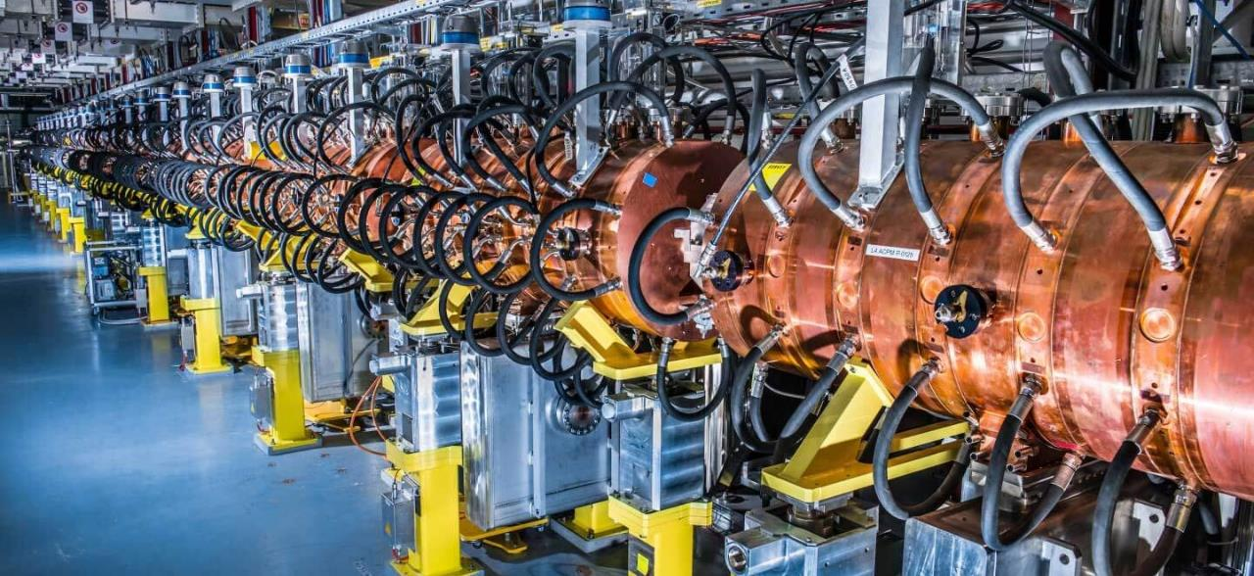
Accelerators for Society – lecture 1
Maurizio Vretenar CERN Scuola F. Bonaudi, Cogne, 30.6.2023

Slide 2
Outline
LECTURE 1:
General concepts
Accelerators for industry and environment
Accelerator for material analysis and security
Accelerators for energy
LECTURE 2:
Accelerators for medicine
Disclaimer: will not cover photon sources (synchrotron lights and FELs) and neutron sources.

Slide 3

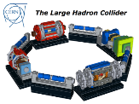
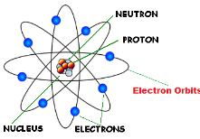
Particle Accelerators can concentrate energy
A particle accelerator is an instrument capable of concentrating large amounts of energy at subatomic scale, to be used for applications in science, medicine, and industry
Particle accelerators are our door to access the subatomic dimension… to study and exploit the atom and its components
When we extract particles from an atom and we accelerate them, we concentrate enormous amounts of energy in tiny volumes
proton

Slide 4
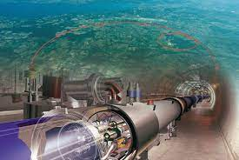



How large is the energy of a particle beam?
Comparing the energy of a proton out of the CERN Large Hadron Collider, the largest particle accelerator ever built.
The energy is small, but the energy density is enormous!
 | LHC Proton | LHC Bunch | Yoghurt | TGV train
Energy | 1.1 10⁻⁶ J | 1.3 10⁵ J | 5 10⁵ J | 1.4 10⁹ J
Energy density | 5.3 10³⁸ J/m³ | 5 10¹¹ J/m³ | 3.3 10⁹ J/m³ | 6 10¹¹ J/m³
Type of energy | Kinetic Subatomic scale | Kinetic Subatomic scale | Chemical Macroscopic | Kinetic Macroscopic
Accelerator energies in eV (energy acquired by an electron in a potential of 1V)
1 eV = 1.6 x 10⁻¹⁹ Joules
1 Joule is really tiny:
=1 W*s, cost ≈ 10⁻⁷ €
LHC bunch: 7 TeV, 1.15 10¹¹ protons, at interaction point (30 cm, 16x16 μm²)
Yoghurt: 150 g, 120 calories
TGV train: 400 tons, 200 m, 300 km/h

Slide 5
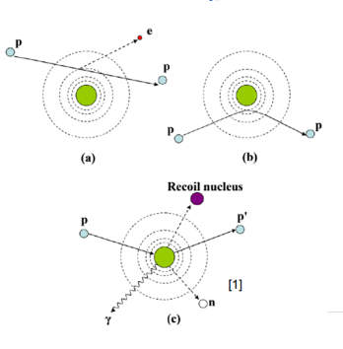
Where does the energy go?
The accelerated particle can:
kick an electron out of the atom (ionization) or to a higher orbital (excitation) – in the latter case, the electron can come back generating an X-ray (photon).
be deflected by the nucleus and give energy to the atom - increase of temperature, breaking of molecular bonds.
be absorbed by the nucleus bringing it to an excited state that can generate radiation or secondary particles.
Scattering of an accelerated beam of particles
The 3 effects of a particle beam
 | Charge | Mass
Electrons | -1 e | 1 m_{e}
Protons | +1 e | 1 m_{p}
Ions | +1 / +82 e | 1 – 238 m_{p}
Unit charge 1 e = 1.6 × 10⁻¹⁹ Coulombs
Electron mass 1 m_{e} = 9.1 × 10⁻³¹ kg = 511 keV/c²
Proton mass 1 m_{p} = 1.67 × 10⁻²⁷ kg = 938 MeV/c²

Slide 6

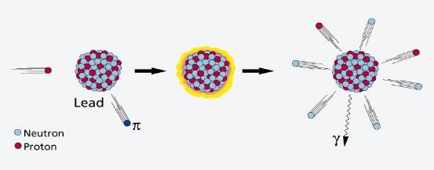
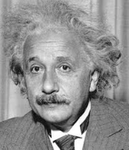
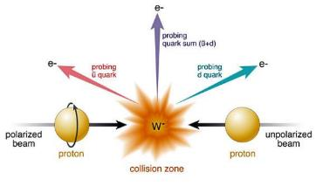
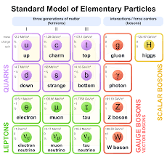
1: Accelerators can modify the nuclei and create new particles
If the energy is sufficiently high, the particles in the beam transfer energy to the nucleus and its components (and are then scattered, reflected or absorbed).
The dream of the ancient alchemists coming true!
NUCLEAR PHYSICS
Particles in the beam can break and modify the nucleus (and then generate new elements and transform the matter!)
PARTICLE PHYSICS
In the collisions can be generated new particles.
E = m c²

Slide 7
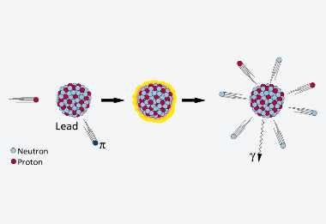
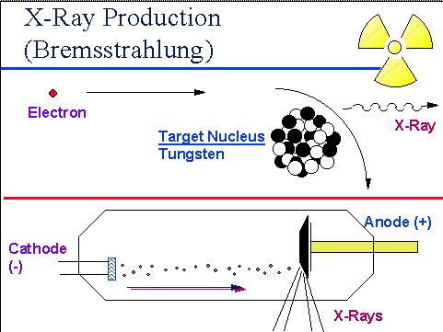
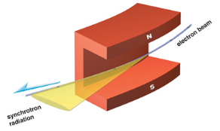
2. Accelerators can produce intense secondary beams
Accelerated electrons produce X-ray beams by interaction with a metal target (bremsstrahlung) or by synchrotron radiation in accelerator magnets)
Accelerated protons produce neutron beams by spallation reactions in a heavy metal target
Image courtesy of PSI
X-rays generated by accelerators are commonly used in medicine
Both X-rays and neutrons generated from accelerators are used for advanced imaging in many fields: life sciences, condensed matter, energy, material science, cultural heritage, life sciences, pharmaceuticals,…
Additional applications are appearing for other types of secondary beams.

Slide 8
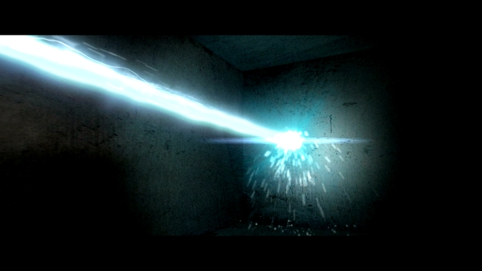
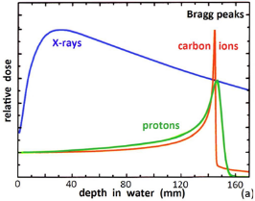
3. Accelerators can precisely deliver energy
A «beam» of accelerated particles is like a small “knife” penetrating into the matter
Thanks to the «Bragg peak» a particle beam can deliver energy to a precisely defined area.
Particles can penetrate in depth
(different from lasers!).
Because of these properties, particle beams are widely used in medicine and industry.

Slide 9
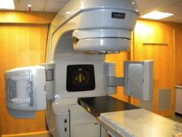
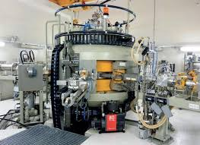
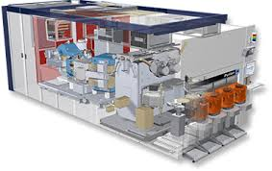
Accelerators for Society
More than 35’000 particle accelerators are in operation world-wide.
Only ~1% are used for fundamental research.
Medicine is the largest application with more than 1/3 of all accelerators.
Research |  | 6%
 | Particle Physics | 0,5%
 | Nuclear Physics, solid state, materials | 0,2 - 0,9%
 | Biology | 5%
Medical Applications |  | 35%
 | Diagnostics/treatment with X-ray or electrons | 33%
 | Radio-isotope production | 2%
 | Proton or ion treatment | 0,1%
Industrial Applications |  | <60%
 | Ion implantation (semiconductors) | 34%
 | Cutting and welding with electron beams | 16%
 | Polymerization | 7%
 | Neutron testing | 3.5%
 | Non destructive testing | 2,3%
Radiotherapy electron linac
Proton cyclotron for radioisotope production
9
Commercial system for ion implantation

Slide 10
The application map – protons and ions
protons
heavier ions
material studies
Every application requires a well defined range of energies and beam currents → a different type of accelerator and a different operational environment
10
waste burning, energy production
Current (mA)
beam power
5
ion beam analysis
ion implantation
cancer therapy
neutron sources
cancer therapy
radioisotope production
100
200
300
500-1000
electrostatic
Energy (MeV)
cyclotron
RF linac
synchrotron

Slide 11
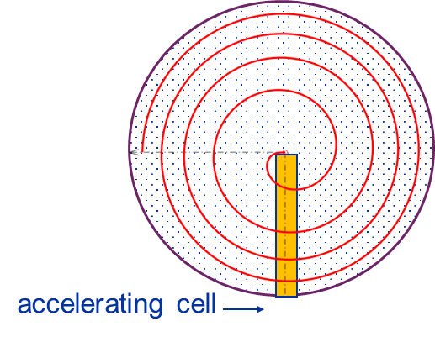
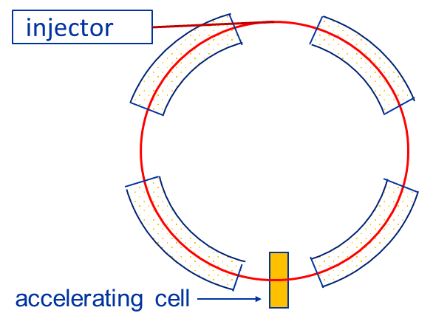
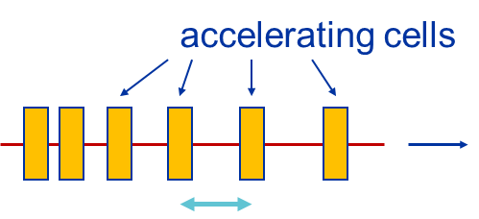
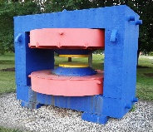
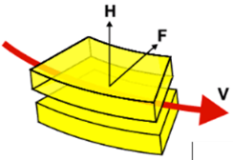
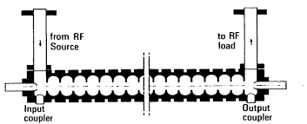
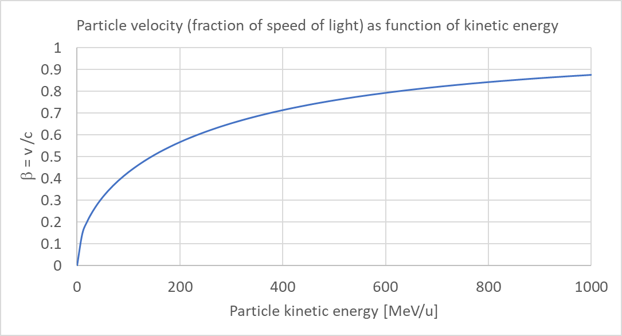
Ion accelerators: linac, cyclotron, or synchrotron?
Linac
many cells, low efficiency, any beta, no magnet
Cyclotron
one cell, high efficiency, low beta, large magnet
Synchrotron
one cell, high efficiency, high beta, small magnets
A particle accelerator is made of a sequence of accelerating cells, adapted to a particle velocity (beta=v/c)
To increase efficiency (accelerate many times through the same accelerating cell) magnets can be added to keep particles on a circular trajectory.
Bρ [Tm] = 3.33 p [GeV/c]
For a standard magnetic field (1-2 T), the accelerator diameter (2ρ) increases with the energy.
?
synchrotrons
cyclotrons
“ideal” energy range for different accelerator types
linacs
Linac, cyclotron: low β
Synchrotron: high β

Slide 12
The application map - electrons
material processing
Current (mA)
direct electron beam application
150
polymerisation
conversion to X-rays application
100
beam power
50
flue gas
detection
sterilisation
photon sources
water treat.
cancer therapy
5
10
15
20
Energy (MeV)
electrostatic
Rhodotron
RF linac

Slide 13
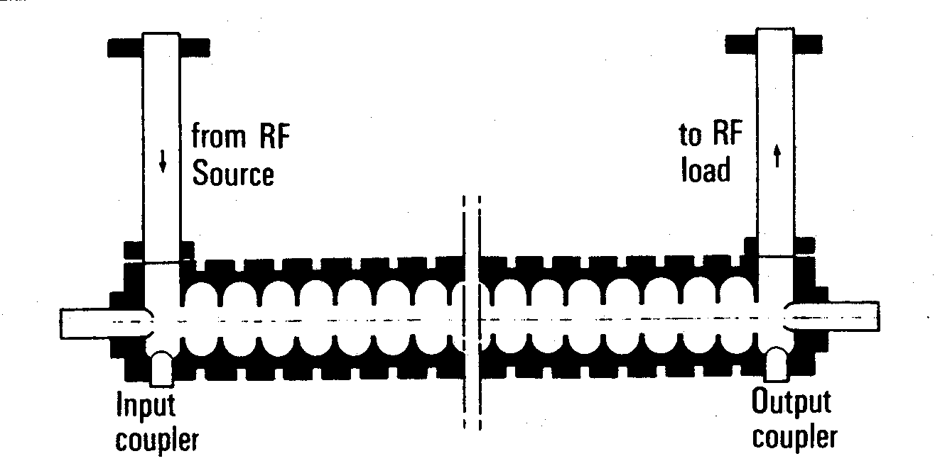
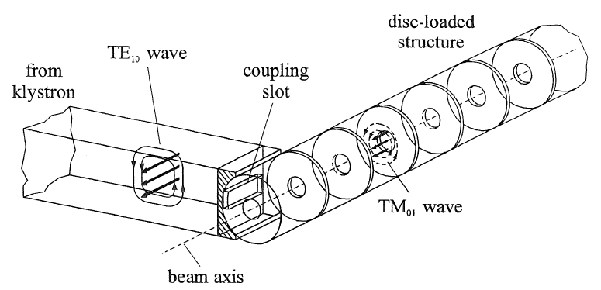
Electron accelerators: linacs
At the low energies of interest for applications, only linear accelerators are used for electrons.
In an electron linac velocity is ~ constant.
the linac structure is made of a sequence of identical cells. The cells are grouped in cavities operating in travelling wave mode.
Pictures from K. Wille, The Physics of Particle Accelerators

Slide 14
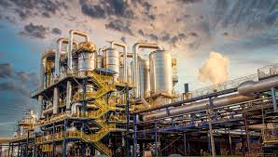
Accelerators for industry

Slide 15
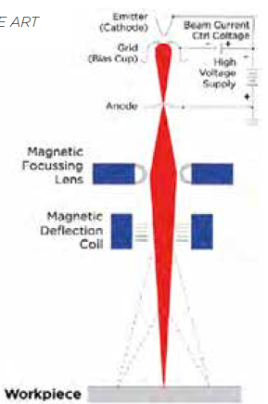
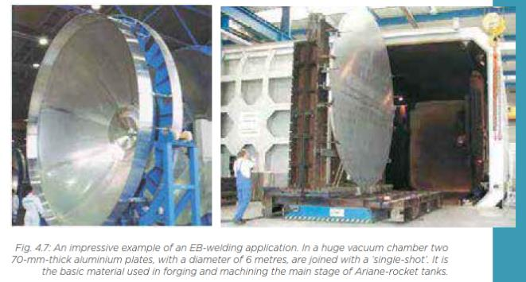
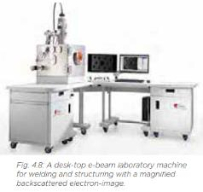
Very low energy electrons
 | Energy | Applications
Very low energy electrons | <350 keV | detection, welding, 3D-sintering, sterilisation, seed and grain treatment
Low-energy electrons | <10 MeV | polymer modification, sterilisation, treatment of flue-gas, wastewater, sewage
Non-thermal: breaking molecular bonds, chemical modifications of organic materials, creation of radicals.
Thermal: melting, evaporation, welding, joining, drilling, hardening, sintering,…

Slide 16
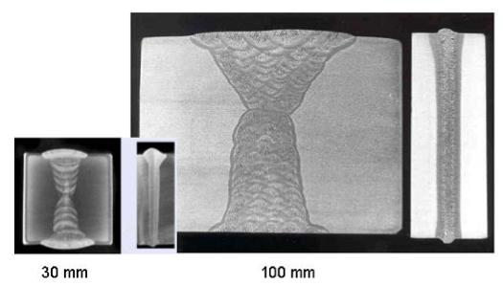
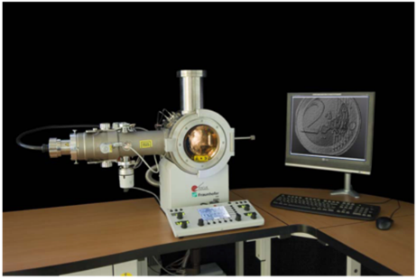
Electron beam welding
Cross-sections - Comparison of extensive TIG-welding with a lot of weld seams with the single-weld seam of EB-welding at the same material thickness

Slide 17
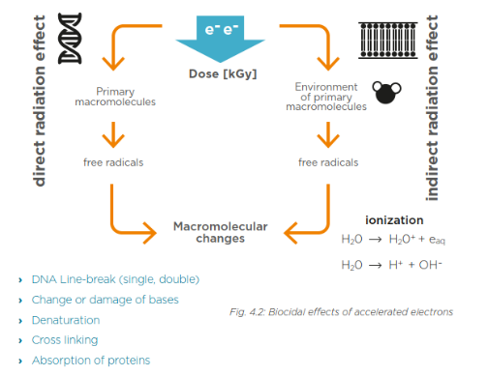
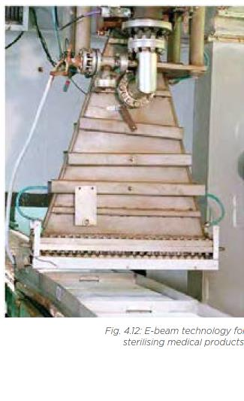
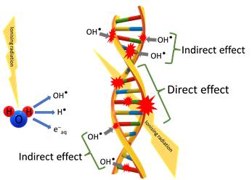
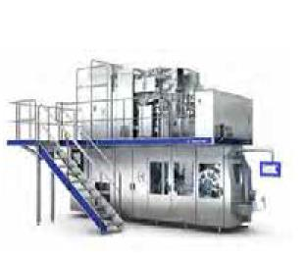
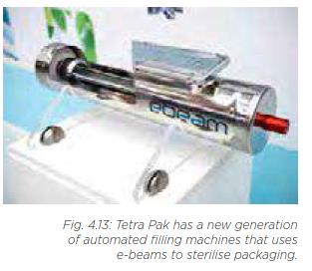
Sterilisation
Sterilisation processes caused by the breaking of molecular bonds associated with the water and DNA in microbial cells.
Medical products (implants and instruments), food, and pharmaceutical packaging can be sterilised.
Energy between 1 and 10 MeV, all surfaces must be accessible (small penetration depth).
The world market-leader in the aseptic carton packaging of liquid foods has installed e-beam sterilisation machines in the majority of its production facilities.

Slide 18
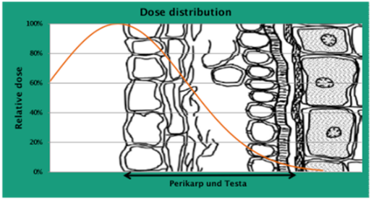
Food sterilisation and radiophobia
Seed and crop treatment – 20 to 30% of food harvested is lost to rotting and insect infestation
Crop seeds must be free from pathogens (fungi, bacteria and viruses) that can endanger health and food security. Standard treatment: chemical seed dressing that can result in the contamination of soil and ground water with waste products, drifting of dressing agents across ﬁelds, killing of probiotic microorganisms.
Alternative: physical disinfection of seed using the biocidal effect of accelerated electrons. By precisely adjusting the energy of the e-beam, contamination on the seed surface can be treated without damaging the DNA of the seed grain.
Advantages:
no change in taste, texture of colour;
no toxic residue;
less energy consumption than e.g. steaming;
E-beam treatment diffusion is limited by low social acceptance of any association between “radiation” and “food”, which results (in Europe) in stringent regulatory constraints.
Crop treatment companies never use the word “radiation”…

Slide 19
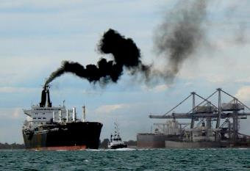
Environmental applications of accelerators - 1
Low-energy electrons can break molecular bonds and be used for:
Flue gas treatment (cleaning of SOx from smokes of fossil fuel power plants)
Wastewater and sewage treatment
Treatment of marine diesel exhaust gases (removal of SOx and NOx).
Maritime transport is the largest contributor to air pollution: a cruise ship emits as much sulphur oxides as 1 million cars!
Ships burn Heavy Fuel Oil, cheap but rich in Sulphur. Diesels (high efficiency) emit Nitrogen oxides and particulate matter.
New legislation is going to drastically limit SOx and NOx emissions from shipping, with priority to critical coastal areas.
So far, technical solutions exist to reduce SOx or NOx, but there is no economically viable solution for both.
150 kV electron accelerator to break the high order molecules that are then cleaned by a water jet (scrubber)
To air
Hybrid Exhaust Gas Cleaning Retrofit Technology for International Shipping (HERTIS)
A project based on a patent from INCT Warsaw promoted by a collaboration of research institutions (including CERN), accelerator industry, shipyards, maritime companies, maritime associations (Germany, UK, Switzerland, Poland, Latvia, Italy).
From engine

Slide 20
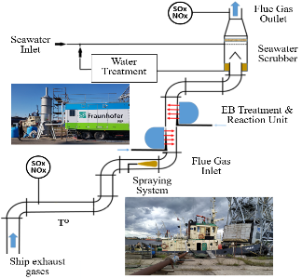

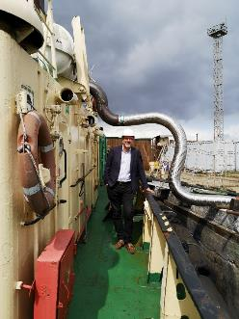
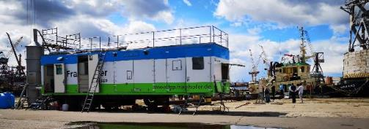
Test of HERTIS at Riga Shipyard, July 2019
Mobile electron accelerator system from FAP Dresden commonly used to treat crops connected to the exhaust funnel of the Orkāns, an old Soviet-built tugboat. The fumes then passed through a small water scrubber before being released in the air.
The tests confirmed the laboratory measurements and the overall effectiveness of the system.
Measured NOx removal rate 45% at full engine power with the available scrubber and accelerator. Estimated removal with optimised scrubber and homogeneous e-beam 98%.
SOx removal only measured in laboratory (no Sulphur allowed in port) with similar removal rates.

Slide 21


At the border between high- and low-tech…

Slide 22
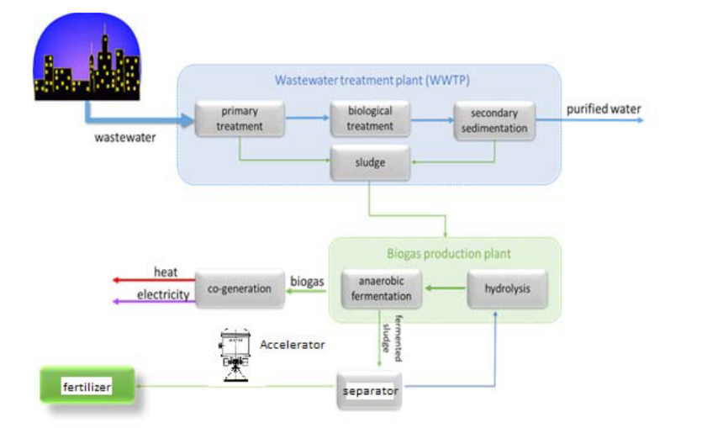
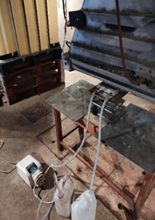
Environmental applications of accelerators - 2
Design of an advanced electron accelerator plant for biohazards treatment
Sludge produced in municipal sewage treatment plants is highly contaminated with parasite eggs.
An expensive hygienization process is needed before agricultural utilization, with the consequence that in most cases the sludge is dumped.
Treatment with an electron accelerators provides a simple and inexpensive way to sanitize sludge and directly convert it into fertiliser, using the energy produced onsite.

Slide 23
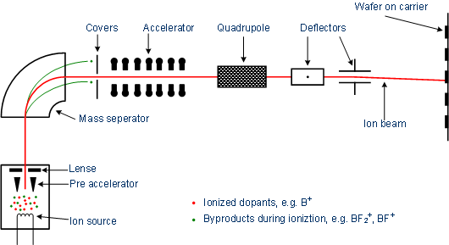
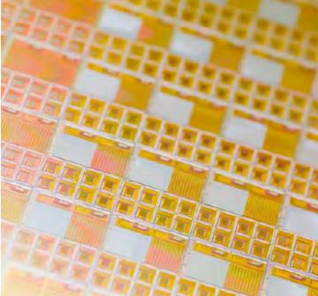
Ion implantation
The semiconductor industry requires
ion implantation to introduce atoms into semiconducting materials to alter
their electronic properties (doping).
Huge industry and one of the most important uses of particle accelerators.
Developing into research for quantum computing (single ions with nanometre-scale spatial accuracy) and novel opto-electronic devices (nano-precipitates in silicon-dioxide layers for light-emitting devices).
23
23
Commercial system for ion implantation

Slide 24
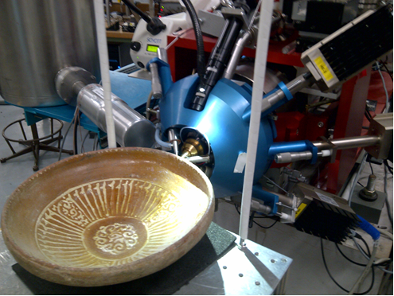
Surface analysis applications

Slide 25
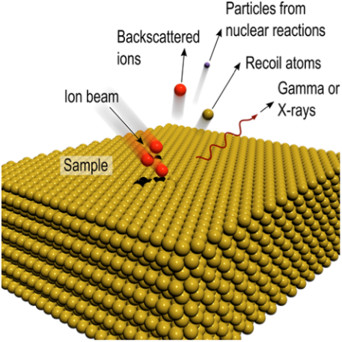
Ion Beam Analysis
Analytical techniques that exploits the interactions of MeV protons or heavier ions with matter in order to determine the elemental composition and structure of the surface regions of solids (to depths of about 100 μm), from measured quantities such as the characteristic spectra of the resulting X-rays, gamma-rays or charged particles emitted.
Elastic or Rutherford backscattering (EBS or RBS), with a particle detector at a backscattering angle;
Particle-induced X-ray emission (PIXE), with an X-ray detector;
Particle-induced gamma-ray emission (PIGE), with a gamma detector;
Elastic recoil detection analysis (ERDA) with a particle detector at a forward recoil/scattering angle.

Slide 26
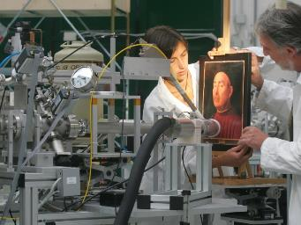
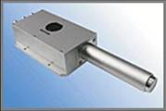




Accelerators for art
PIXE, Proton Induced X-ray Emission
A beam of particles (protons) from an accelerator is sent on a sample (e.g. a painting)
The atoms are excited and emit different types of radiation (X-rays, gammas, etc.)
Different atomic elements emit X-rays at different energies – Spectral analysis from one or more detectors allows determination of the chemical composition (e.g. of the pigments).
Radiation detection and spectral analysis
Emission of radiation of characteristic energies (X-rays, γ, particles…)
Ritratto Trivulzio by Antonello da Messina, 1476 – analysis at INFN-LABEC (Florence)
particle beam
particle accelerator
Portable PIXE system based on an RFQ linac built by CERN and LABEC
2 m

Slide 27



The MACHINA project
MACHINA (Movable Accelerator for Cultural Heritage In situ Analysis) project of CERN and INFN.
Construction of a transportable RFQ (PIXE-RFQ) optimized for the analysis of material with a 2 MeV proton beam.
Will be installed in the Opificio delle Pietre Dure in Florence (Italian central institution for artwork analysis)

Slide 28










Towards the miniature accelerator?
Important trend towards miniaturization of accelerators, for use in medicine and industry
Here are presented only three examples of recent developments at CERN:
The mini-RFQ
X-band structures
Compact accelerators for ion therapy
750 MHz
92 mm diameter
2.5 MeV/m
12 GHz
100 MeV/m
Superconducting C-ion synchrotron
Bmax 3.5 T
27m circumference
Proton therapy injector (in operation)
Artwork PIXE analysis (in construction, transportable)
Isotope production (design)
Neutron radiography (conceptual stage)
Developed for CLIC, in operation at CLIC test stand
- Compact XFEL (CompactLight Design Study)
- VHEE and FLASH therapy linac (design)
- SmartLight (table top inverse Compton scattering light source, design)
Folded C-ion linac,
Tot. length 53 m
Tot. RF power 260 MW

Slide 29

Accelerators for energy

Slide 30


Accelerators addressing the issues of nuclear power
Main public concerns with nuclear power:
Risk of critical accidents
Long-term waste disposal
Risk of nuclear proliferation
The accelerator answer:
Accelerator-driven sub-critical operation
Waste treatment (transmutation) with accelerators
Thorium-based reactors
Transmutation of Minor Actinides (heavier radioactive isotopes of neptunium, americium and curium) requires a fast-neutron system, possibly not reactor-based.

Slide 31

Accelerator Driven Systems
A linac coupled to a spallation source provides the missing neutrons to maintain the reaction in a subcritical reactor.
Could be used for energy production allowing alternative fuel cycles (thorium) and with no safety concerns (subcritical).
Pros | Cons
Safety: subcritical reaction, allows for immediate switch-off | High reliability (→cost) required for the accelerator, to protect structures from thermal shocks
Possibility to operate below criticality opens the way to new reactor concepts | Reduction in net plant power efficiency due to power consumption of accelerator
Simple reactor control by modulating accelerator current | Increased complexity (and cost)

Slide 32


The MYRRHA project
SCK-CEN project at Mol, Belgium
Multi-purpose hYbrid Research Reactor for High-tech Applications)
Development, construction & commissioning of a new large fast neutron research
❶ ADS demonstrator
❷ Fast neutron irradiation facility
❸ Pilot plant for LFR technology
subcritical reactor core,
spallation target
particle accelerator
Advantage: large quantities (<40% of core) of MAs loaded for transmutation.
A small number of dedicated ADS transmutation systems in Europe can burn the waste from a large number of fast reactors for electricity generation.

Slide 33

Roadmap of ADS project in China
2014.06, 2.1 MeV/10 mA/CW
Goal in 2015.06, 5 MeV
Injector II, 162.5 MHz
Goal in 2015.12, 10 MeV
Goal in 2016.09, 25 MeV
Injector I, 325 MHz
Stage 1: Research facility (CIADS)
(250 MeV, 10 mA, 10 MWt)
Y2017-2022, 2.25 B CNY
“Strategic Technology Pilot Project”
of the Chinese Academy of Sciences
Key technology R&D
Y2011-2017, 1.78 B CNY
Stage 2: Demo facility (CDADS)
(1.2~1.5GeV, 10~25 mA, 100 MWt)
Y2030

Slide 34

Neutron sources for material testing
3 fields of application:
Compact neutron radiography → cargo screening, concrete analysis
Advanced organic material analysis (spallation sources)
Test of nuclear materials (e.g. for fusion)
RIKEN (Japan):
Concept of a a truck-mounted device sending neutrons from a source (accelerator + target) aboard the truck to the detector attached to the arm.
The system can non-invasively inspect the structural soundness of bridges by detecting steel fractures and their water content (rust). Neutrons have much better penetration than X-rays that are blocked by the steel structure inside the concrete.

Slide 35



Neutron sources for security and inspection
Neutron radiography: detecting the neutrons transmitted through an object;
Neutron-induced gamma spectroscopy: gamma-rays produced by neutron interactions with the cargo are detected.
Application to nuclear detection, e.g. of highly shielded nuclear materials. Neutron sources stimulate detectable fission in nuclear material.
Accelerators: acceleration of protons or deuterium to targets made of deuterium or tritium.
Pictures courtesy of Starfire Industries, USA

Slide 36

Accelerators for fusion material testing: IFMIF
Test under strong neutron fluxes of materials to be used in ITER

Slide 37


IFMIF - DONES
In construction near Granada (Spain), will reach a beam power of 5 MW (125 mA, 40 MeV, D+)

Slide 38

Beam power
Figure of merit for accelerators at the intensity frontier is beam power P=W×I×duty cycle
Production rate (cross-section) for most of the particles in high-intensity applications is independent on the energy (above a certain threshold) but proportional to beam power.
The new generation of accelerators under project or construction aims at moving the power from the 100 kW’s range to the MW’s range.
A MW-class machine presents a large number of challenges and requires the development of specific technologies.
Jie Wei, IPAC 2014

Slide 39

Some resources for further reading
Many of the pictures and some text of this lecture have been taken from the
2017 EuCARD2 Report on Accelerator Applications in Europe (112 pages):
http://apae.ific.uv.es/apae/wp-content/uploads/2015/04/EuCARD_Applications-of-Accelerators-2017.pdf
Other useful resources are:
The TIARA site on accelerators for society:
http://www.accelerators-for-society.org/
The US action on Accelerators for America’s future: http://www.acceleratorsamerica.org/report/index.html

Slide 40

End of Lecture 1
Elwood Smith

