Slide 1


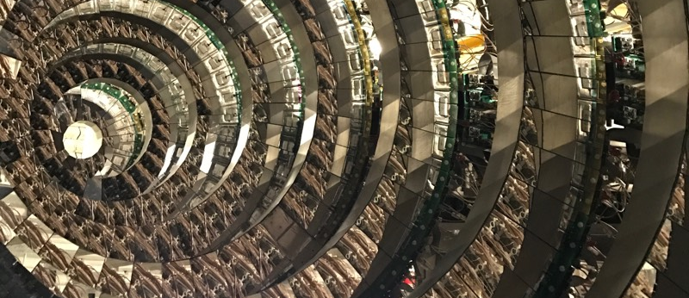
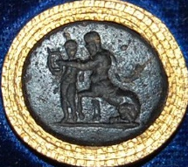
CHIRONE…
2021-2023 & 2024-2025…
…as seen from MILANO
Chiara Guazzoni
Milano, 5 Luglio 2023 – Consiglio di Sezione, INFN Sezione di Milano

Slide 2
Outline
CHIRONE, who’s who?
The Collaboration: participating Sections and People @ INFN-MI
The CHIRONE main apparata:
  (CHIMERA and) FARCOS
  Novel detection system for in-flight tagging and tracking for exotic beams
  NARCOS Charged particle/neutron detection system
Main activities and results 2022 - 2023
Activities foreseen for 2024 – 2025

Slide 3
CHIRONE, who’s who?
CHIRONE (Chieron), Χείρων, held to be the superlative centaur amongst his brethren since he was called the "wisest and justest of all the centaurs“
CHIRONE was sired by the Titan Cronus when he had taken the form of a horse and impregnated the nymph Philyra
Apollo took him under his wing and taught him the art of music, lyre, archery, medicine and prophecy. Artemis trained him in archery and hunting. Chiron with his uniquely peaceful character, kindness and intelligence was a highly revered teacher and tutor
Gem of black glass paste engraved with the centaur Cheiron teaching Achilles to play the lyre.
Brithish Museum, 1923,0401.772
I-III century
https://www.britishmuseum.org/collection/object/G_1923-0401-772
CHI → CHImera
R → R3B
O → hOdoscopes
N → Neutrons
E → Experiment

Slide 4
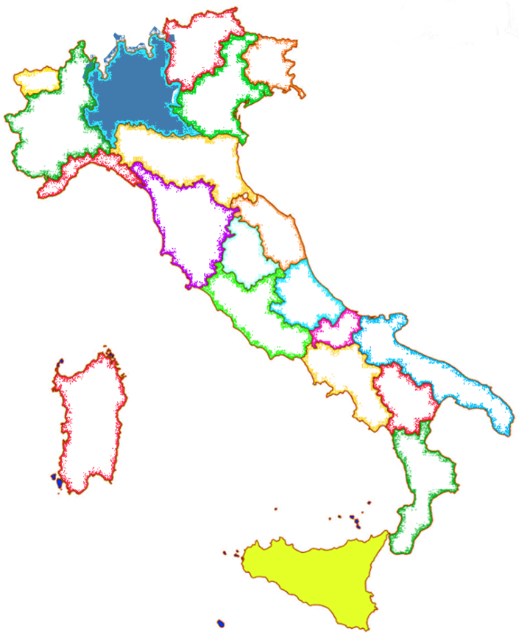
CHIRONE (2021-2023+2024/25)
Resp. Nazionali: Sara Pirrone (INFN-CT) & Paolo Russotto (INFN-LNS)
Sezione di Milano (RL: C.Guazzoni)
Anagrafica Milano 2024
C. Guazzoni 0.8 FTE (0.2 Gr. V ASTAROTH)
A. Castoldi 0.8 FTE (0.2 Gr. V ASTAROTH)
+ PhD student in corso di associazione 0.5 FTE
Richieste Servizi Milano 2024
      = Servizio Elettronica:
      2 mesi/uomo (nella persona di Ciro Boiano, per conoscenza setup)
      = Uso CleanRoom e Bonding Machine ???
      = Servizio Officina Meccanica:
      1 mese/uomo
      - supporti bonding rivelatore
      piccole lavorazioni flange
      stampa particolari 3D
      consulenza struttura meccanica sistema di tagging
Anagrafica Nazionale
2024 - 17.8 FTE
22 persone ( 19 Ric. + 3 Tecno)
2023 - 16.1 FTE
20 persone ( 18 Ric. + 2 Tecnο)
Sezione di Catania (RL: G. Politi)
LNS (RL: E.V.Pagano)
Richiesta Prolungamento 2024 - 2025
- Restrizioni COVID 19 (2020 - 2021- PARTE 2022)
- Chiusura attività sperimentali @LNS (da giugno 2020) per upgrade Ciclotrone HI e FRAISE
- Restrizioni assegnazione @GSI (2023-2024-2025) er upgrade FAIR
Assegnazione PRIN - ANCHISE (da giugno 2022 a 2025)
Partecipazione PNRR – SAMOTRACE @CT (da ottobre 2022 a 2025)

Slide 5
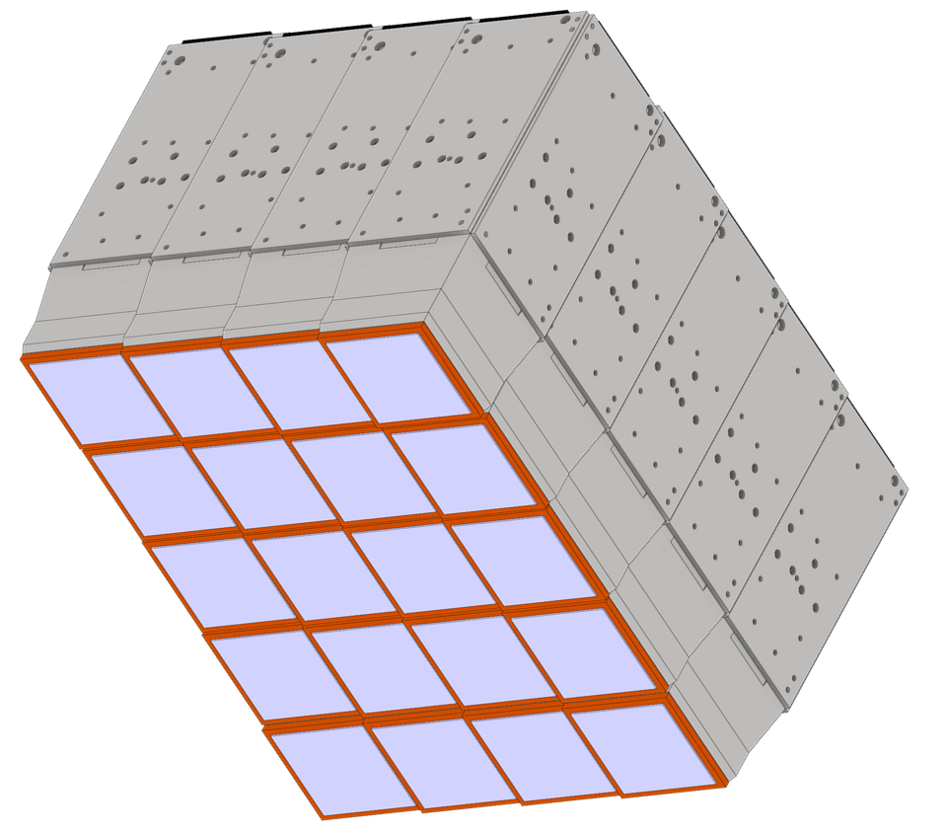
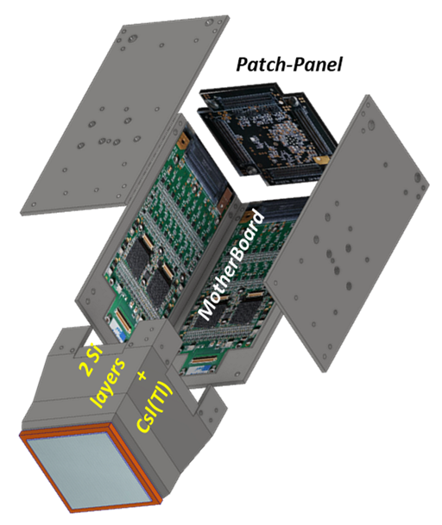
The CHIRONE main apparata… (existing…)
CHIMERA - Charge Heavy Ion Mass and Energy Resolving Array
FARCOS - Femtoscope Array for COrrelations and Spectroscopy
20 clusters

Slide 6
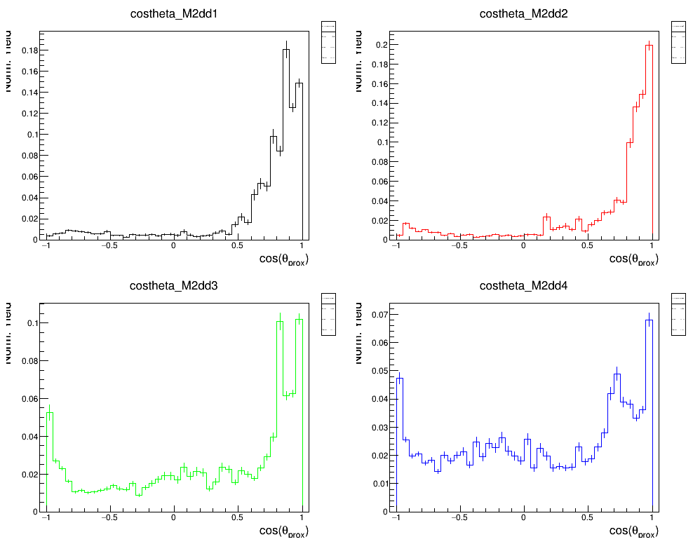
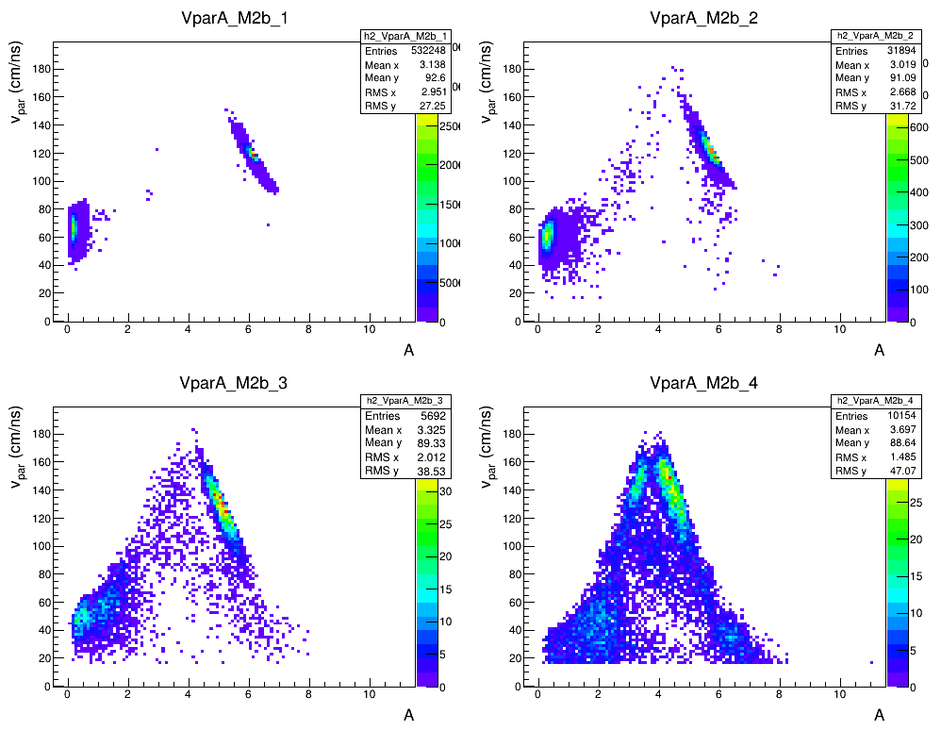
Esperimento CHIFAR
CHIMERA DATA
✅ Analysis of fusion-fission events in central collisions
✅ Selection of PLF splitting events
✅ Extraction dynamical component for various splitting mass asymmetries and energy dissipation
✅ Simulations by using HIPSE event generator filtered with a software replica of the detector
Estensione a bassa energia degli studi sulla competizione delle componenti dinamica e statistica e sull’influenza dell’isospin nel break-up del proiettile.
¹²⁴Sn+⁶⁴Ni
¹¹²Sn+⁵⁸Ni
¹²⁴Xe+⁶⁴Zn
at 20 AMeV
¹²⁴Sn+⁶⁴Ni
4.6<A^{H}/A^{L}<10
2.6<A^{H}/A^{L}<4.6
TKE>2200 MeV
1900<TKE<2200 MeV
1.6<A^{H}/A^{L}<2.6
1.0<A^{H}/A^{L}<1.6
1675<TKE<1900 MeV
TKE<1675 MeV &&
θ_{cm} ¹>25°
Dyn %
¹²⁴Sn+⁶⁴Zn
0.76±(<0.01)
0.70±(<0.01)
0.38±0.01
0.13±0.01
0.73±(<0.01)
0.66±(<0.01)
0.37±0.01
0.10±0.01
Extension of the analysis to ¹¹²Sn and ¹²⁴ Xe beams in progress

Slide 7
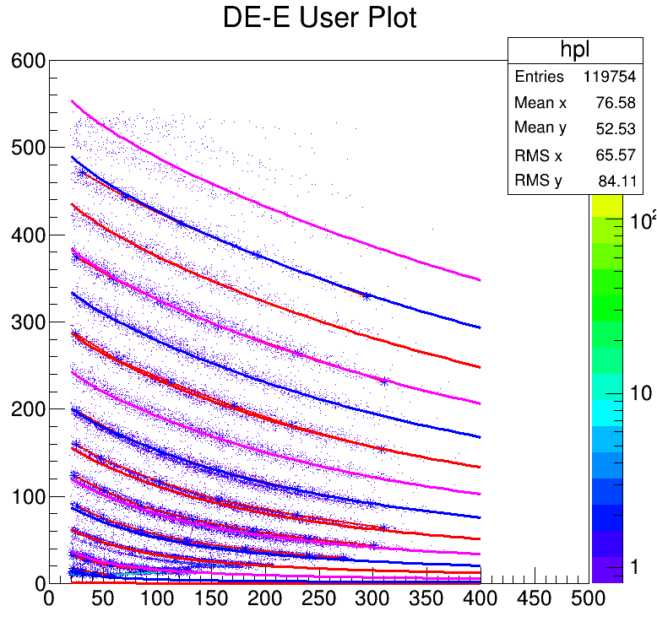
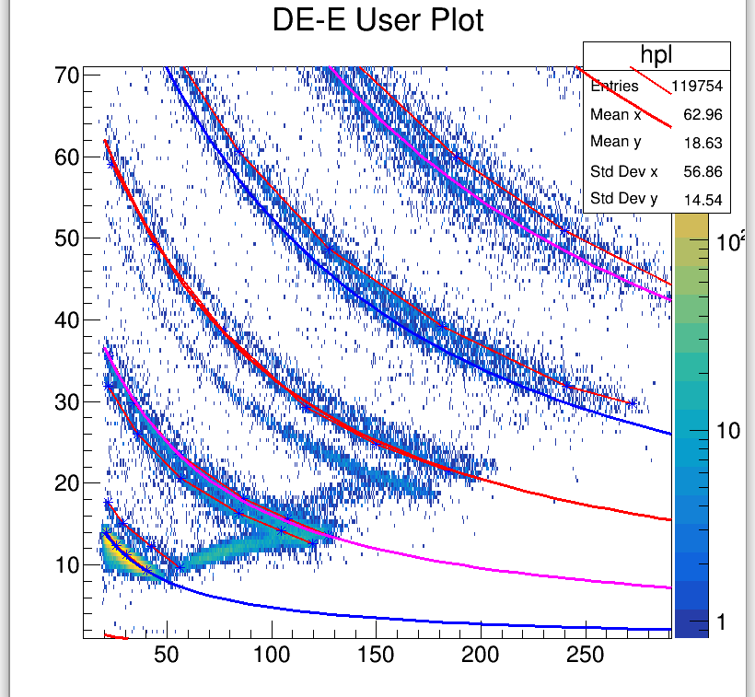
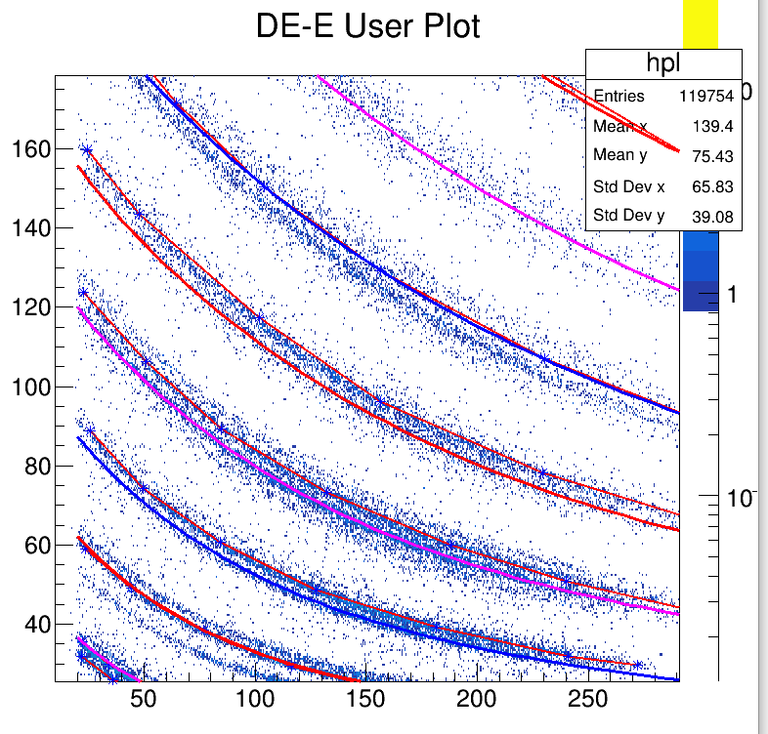
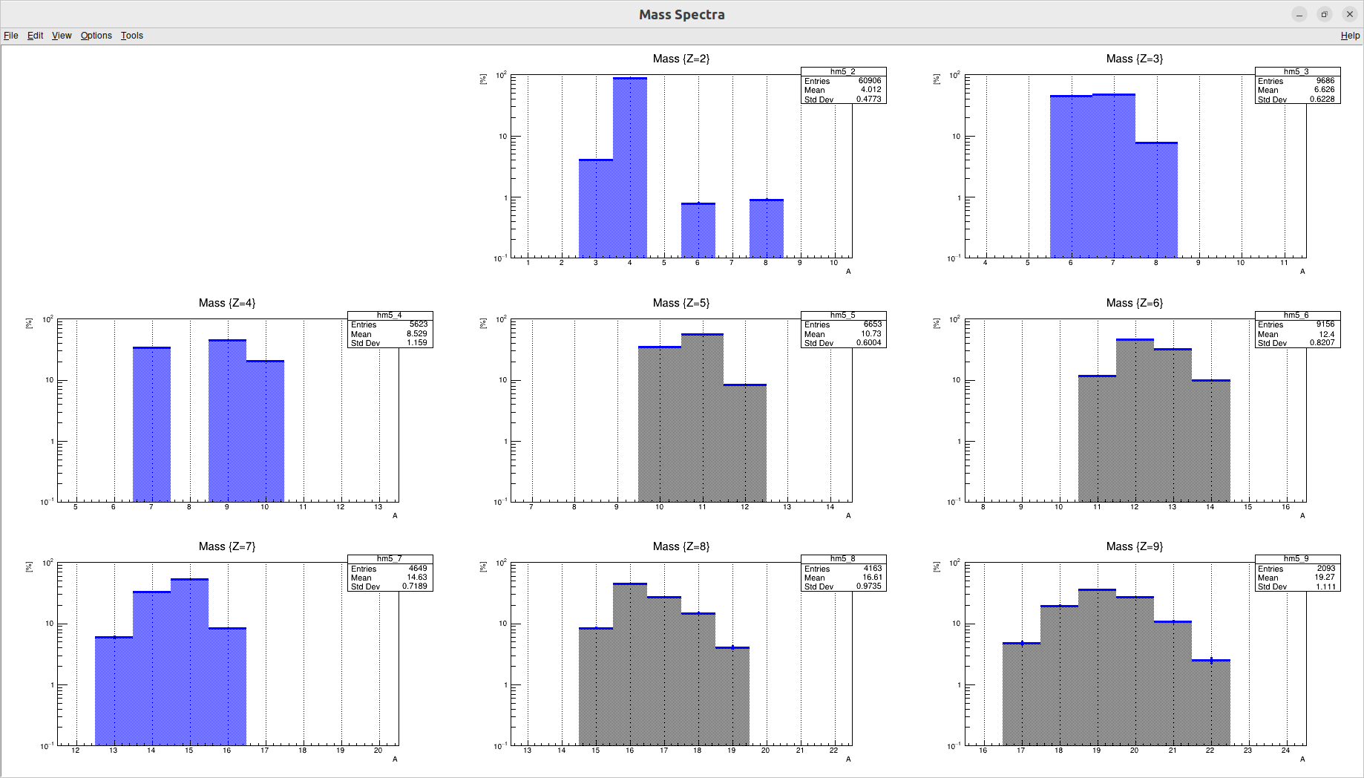
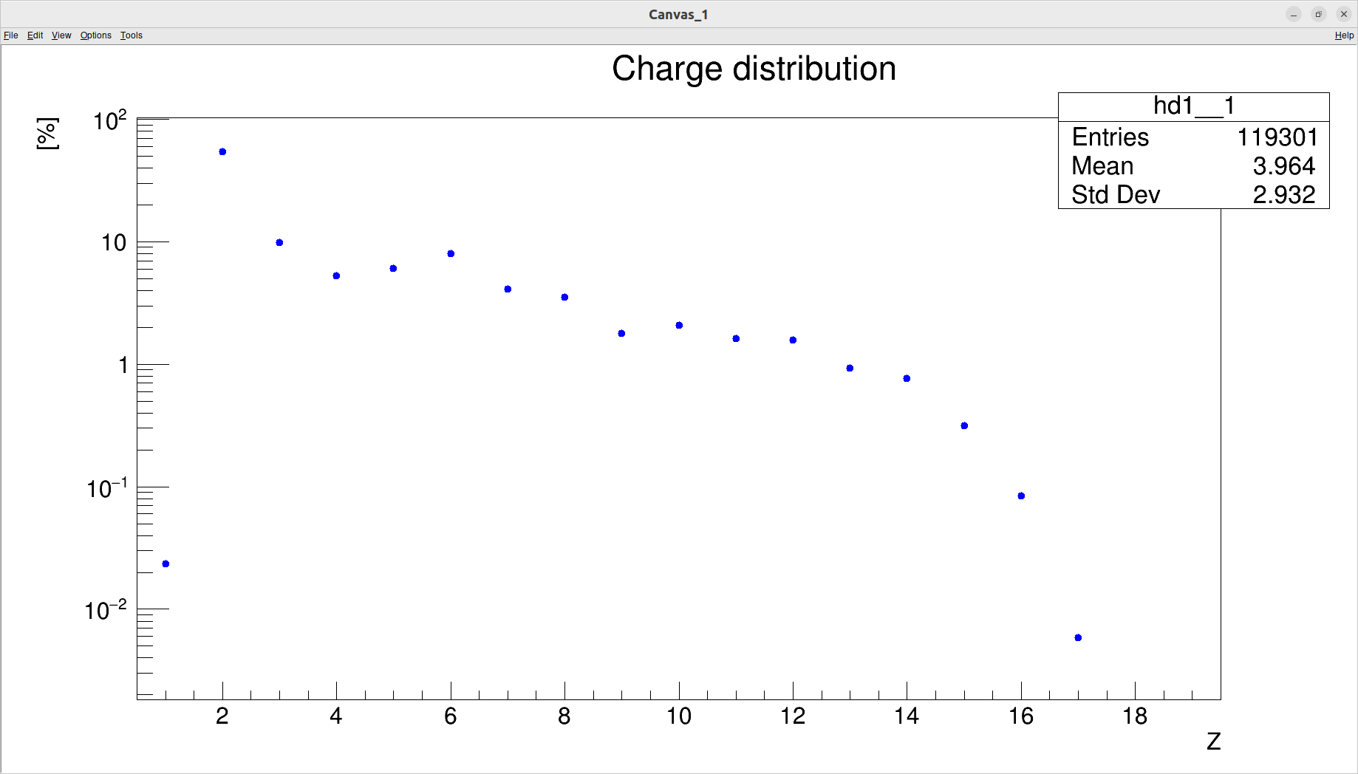
Esperimento CHIFAR - FARCOS Data (NEW)
Estensione a bassa energia degli studi sulla competizione delle componenti dinamica e statistica e sull’influenza dell’isospin nel break-up del proiettile.
¹²⁴Sn+⁶⁴Ni
¹¹²Sn+⁵⁸Ni
¹²⁴Xe+⁶⁴Zn
at 20 AMeV
Z=4
Z=6
Mass spectra: isotopic identification

Slide 8
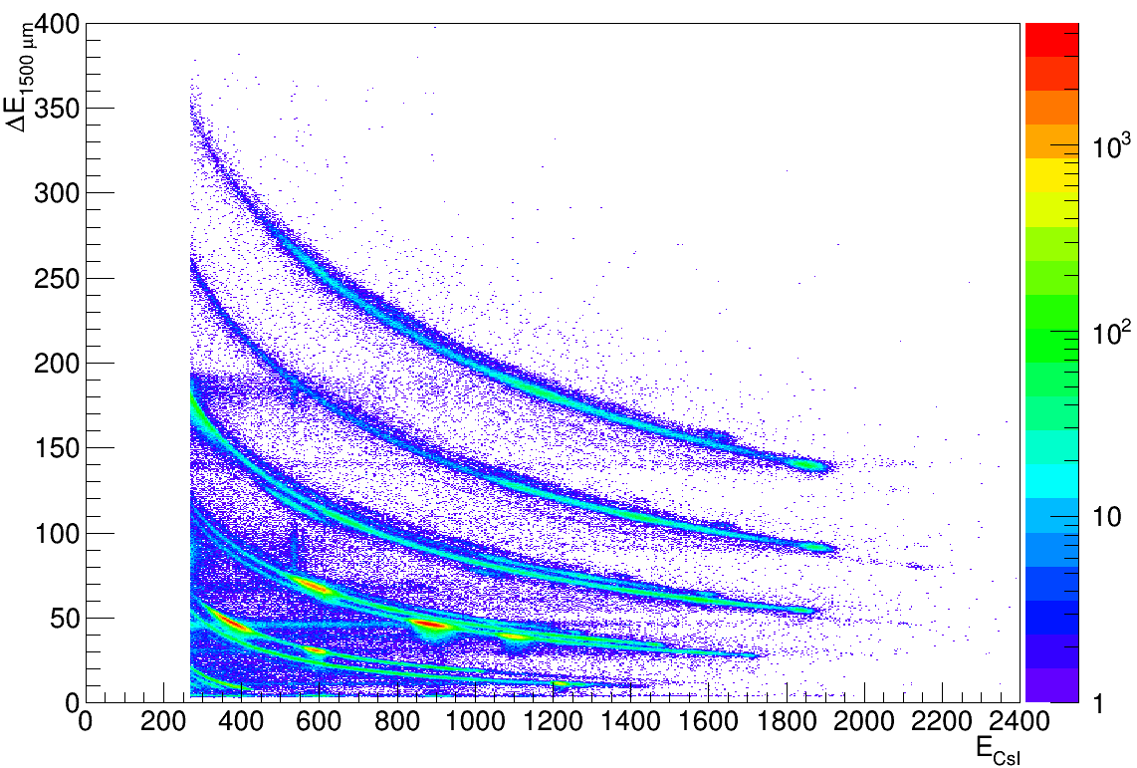
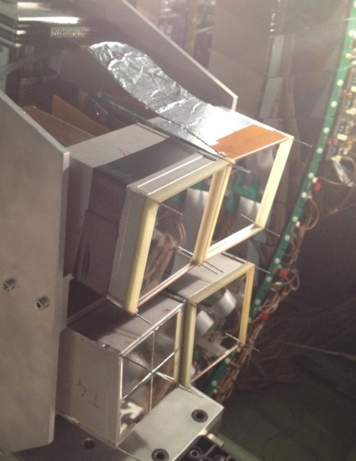
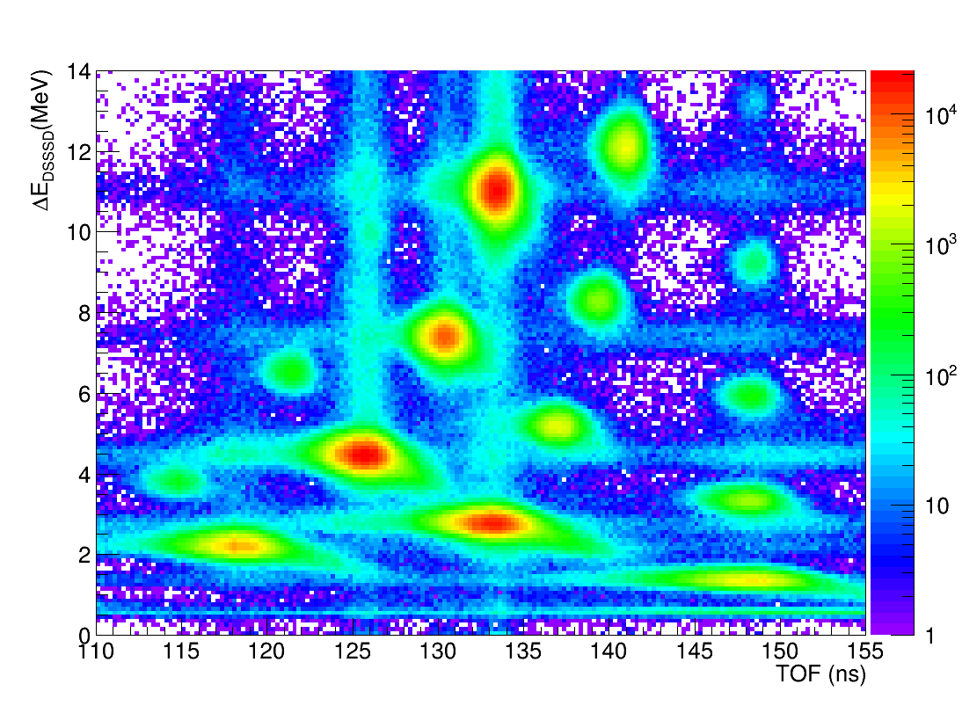
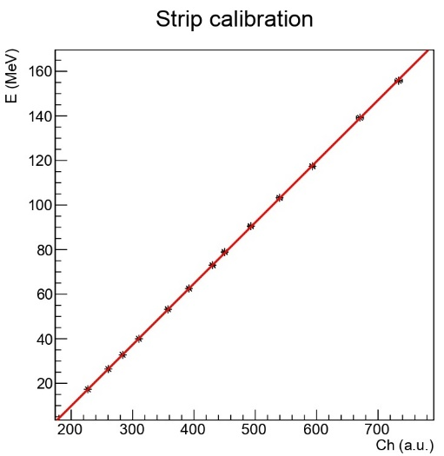
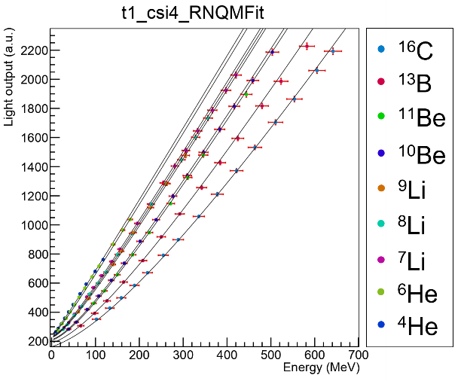
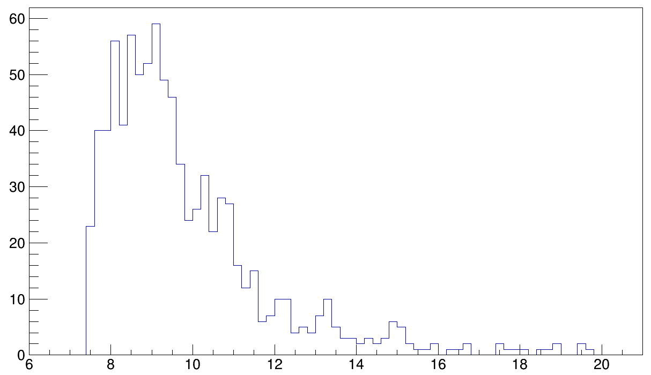
Esperimento CLIR
Studio di stati di clustering in nuclei leggeri (¹⁰Be – ¹⁶C)
In-Flight ¹⁸O + ⁹Be (1500 μm) 55 MeV/A - Cocktail beam (FRIBs@LNS) on (CH₂)n
4 FARCOS telescopes + CHIMERA
FARCOS: calibrations through energy loss simulations of the three stages
Tagging calibration by simulations with LISE++
¹⁶C
¹⁷C
¹⁴B
¹⁵B
¹²B
¹³B
¹¹Be
¹²Be
⁹Be
¹⁰Be
⁸Li
⁹Li
⁷Li
⁶He
¹⁰Be relative energy spectrum obtained for the ⁴He+⁶He break-up channel. Location of known peaks is shown, while possible evidence of the 13.5 MeV (6+) state is shown.
10.6 MeV
Preliminary – PHD thesis Risitano
Counts per 200 keV
11.8 MeV
13.5? MeV
14.8? MeV
Calibration of the front and back strips of the 1500 μm stage;
Calibration of the CsI(Tl) stages through RNQM model (Parlog M., et al., NIM A 482 (2002) 693);

Slide 9
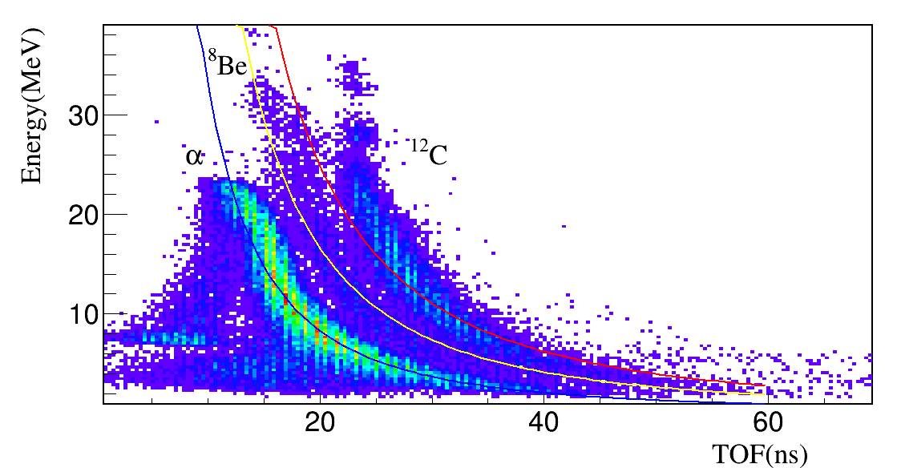
Analisi dei metodi di rivelazione del ⁸Be con CHIMERA e FARCOS
2. Si è poi evidenziato come CHIMERA permetta di misurare il ⁸Be con la rivelazione delle 2 alfa in pile up nello stesso rivelatore evidenziando questi eventi nelle matrici TOF
Pulse shape silicio (mai osservata prima)…..
…..Ma anche pulse shape CsI(Tl) e ovviamente ΔE-E in silicio
1. Si è confrontato la risoluzione del picco del ⁸Be_{gs} misurato a vari angoli con CHIMERA e FARCOS con cui otteniamo σ = 7 keV
G.Cardella, B.Gnoffo, …, C. Guazzoni, et al Eur. Phys. J. Plus (2023) 138:89

Slide 10
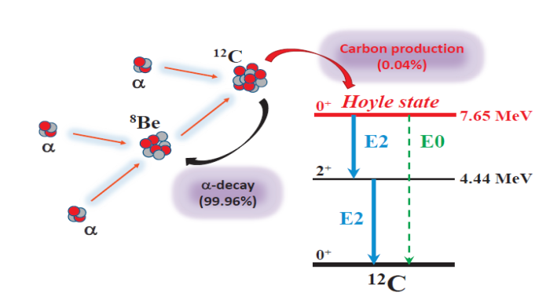
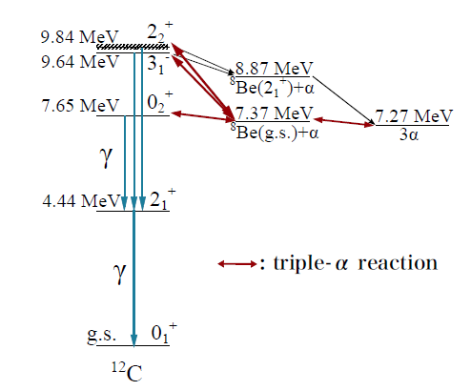
Esperimento Hoyle-γ
Misura del branching ratio dello stato di Hoyle del ¹²C e studio del livello 9.64 MeV
A.Raduta et al., PLB 705, 65 (2011)
G. Cardella et al., Nucl. Instr. and Meth. A 799, 64 (2015)
LNS – CHIMERA & FARCOS
Luglio 2019

Slide 11
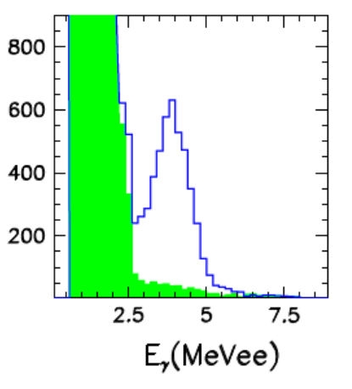
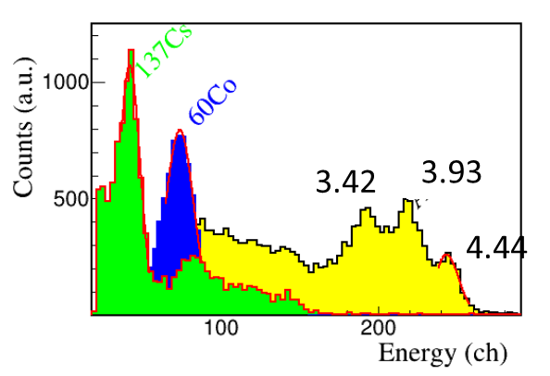
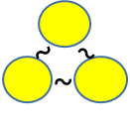
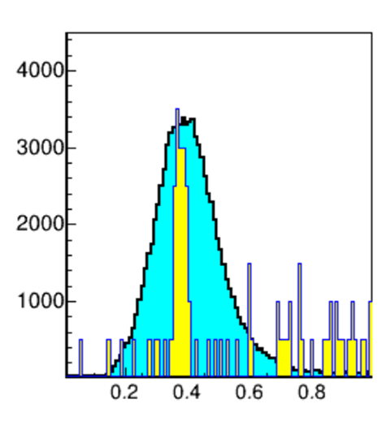
Highlight 2023 CHIRONE - study of γ-decay of excited ¹²C states
The γ-decay of ¹²C levels above the particle emission threshold have a crucial role in the production of ¹²C in astrophysical environments, and the Hoyle state is fundamental for the synthesis of ¹²C. Despite of the numerous studies in this field, there is still a lot to understand.
The CHIRONE collaboration performed 4 fold coincidence measurements with the results of enhancement both the 9.64 MeV level and the Hoyle state γ-decay yields. This last result can be explained by the excitation of an Efimov state
We will use α beam at energy of 40 MeV on ¹²C
(Tandem @LNS) measuring both particles and γ rays with FARCOS telescopes
New more precise measurements needed to confirm effects on ¹²C creation in the universe
CHIMERA
We take advantage by the improved γ-resolution with FARCOS (respect to CHIMERA) from 1 MeV to 150 KeV
FARCOS
Cardella G. et al., PRC 104, 064315 (2021)
EFIMOV
Each couple of α has a CM energy like a ⁸Be - Energy of the level results 180 keV - 200 keV smaller than the Hoyle state
With FARCOS, we will get a relevant improvement in measuring CM energy for 3-α coincidences (yellow 27 KeV) than with CHIMERA (cyan 200 keV)
G. Cardella, A. et al., Nuclear Physics A 1020 (2022) 122395
E_{CM}

Slide 12
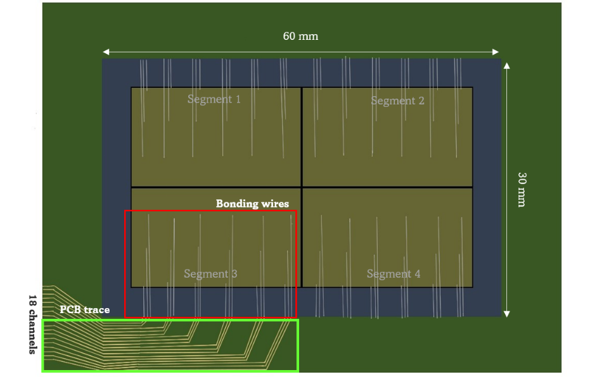
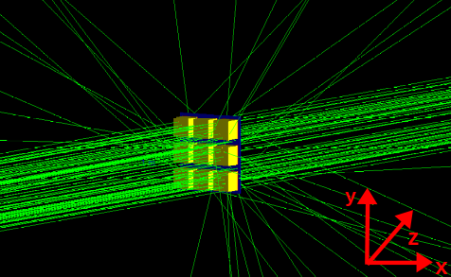
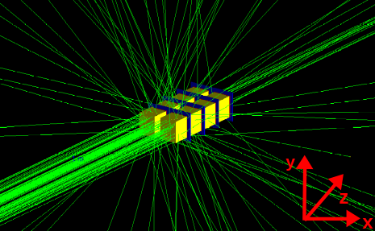
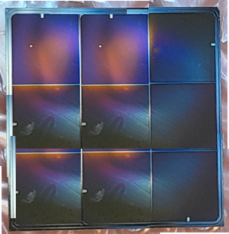
The CHIRONE main apparata… (new developments)
NArCoS (Neutron Array for Correlation Studies)
New CHIMERA RIBs tagging system
PRIN ANCHISE-2020 (period 3 years starting June 2022 cod. 2020H8YFRE)
Collaboration: INFN-Unict-UniMe-PoliMI.
Coordinator and spokes: A.Pagano (INFN) – G.Politi (Unict) - M.Trimarchi (UniME) - A.Castoldi (PoliMI).
3x3 Matrix
2 Clusters

Slide 13
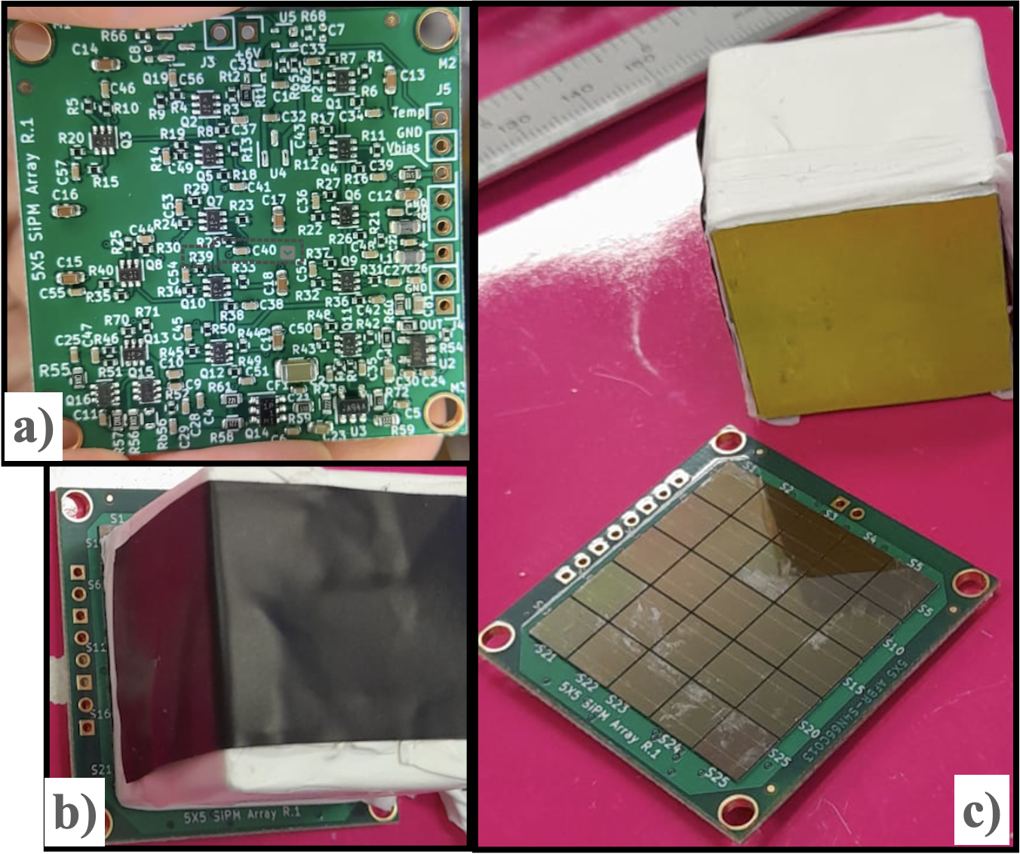
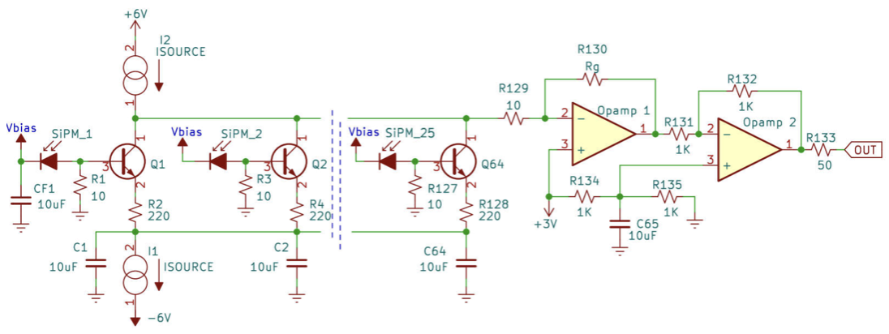
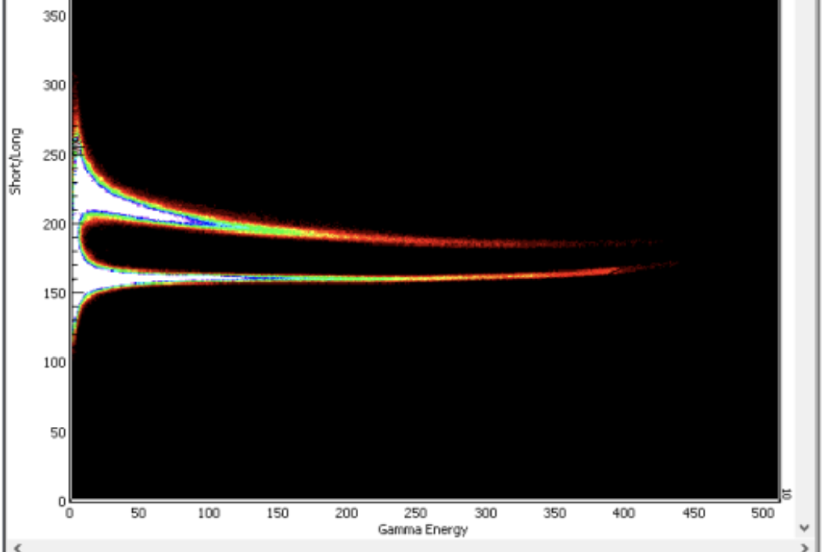
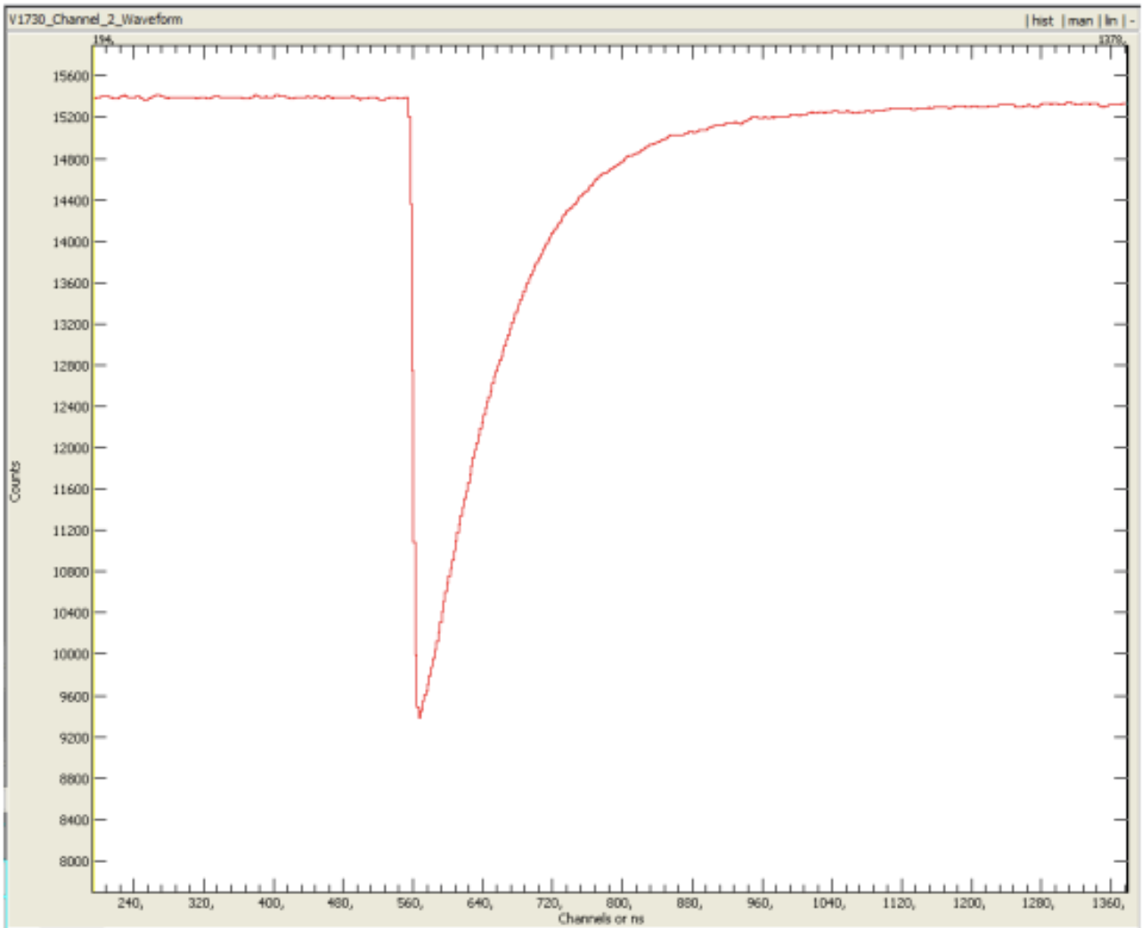
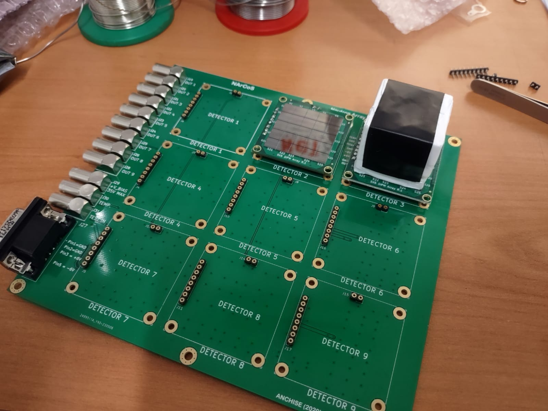
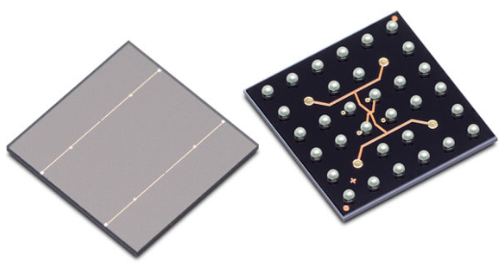
NArCoS (Neutron Array for Correlation Studies)
Prototypal readout electronic in preparation of the CROSSTEST exp at LNL (end of 2023)
(C. Boiano)
EJ276G
AmBe source: PSD test
Fast respons < 4 ns
400 ns
Each elementary cell of EJ276G (3x3x3 cm³) is equipped with a matrix of 25 SiPM (6x6 mm²) of 30 𝜇m of thickness (≈ 40k microcells). The SiPM matrix is coupled with the plastic having their PAC and bias/temperature compensation circuit
500 MHz sampling

Slide 14
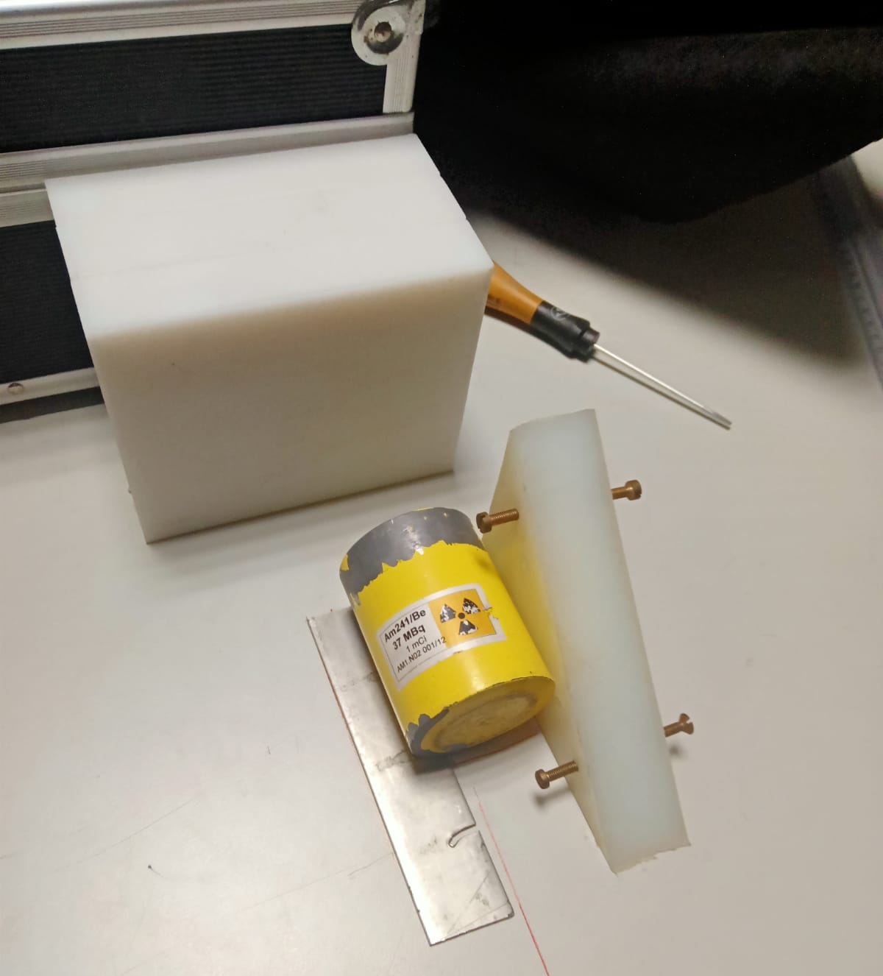
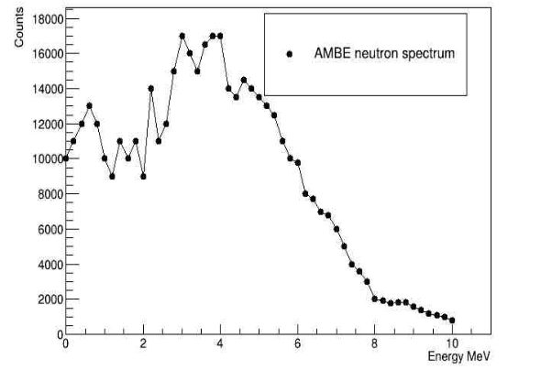
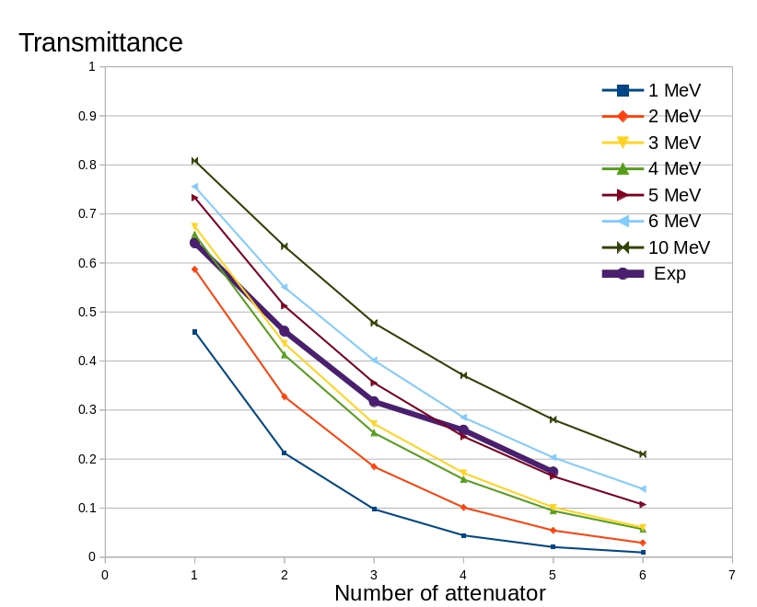
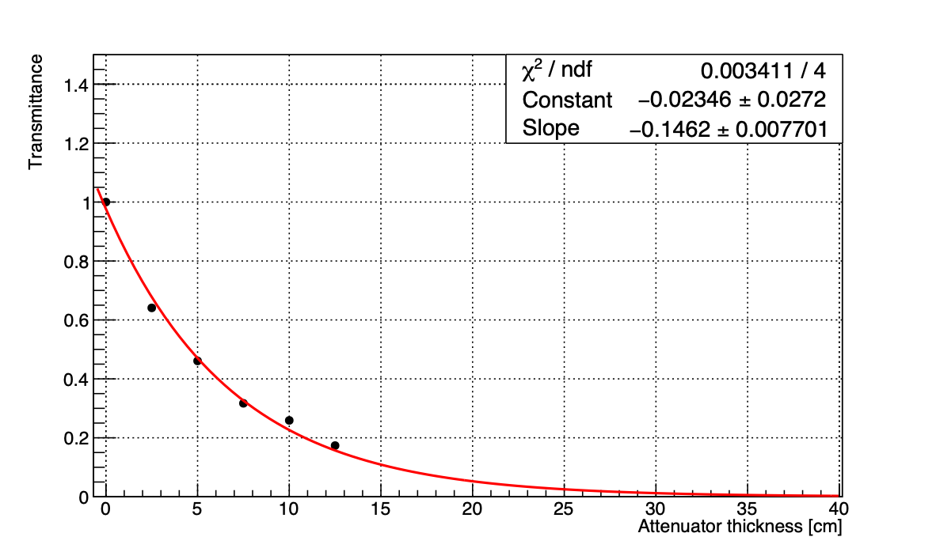
NArCoS (Neutron Array for Correlation Studies)
Attenuation shield tests in preparation of the CROSSTEST exp at LNL (end of 2023)
Material: Polyethylene
Neutron source: AmBe
Attenuator Thickness: 2.5 cm
Attenuator of 30 cm ≈ 1%
≈1%

Slide 15

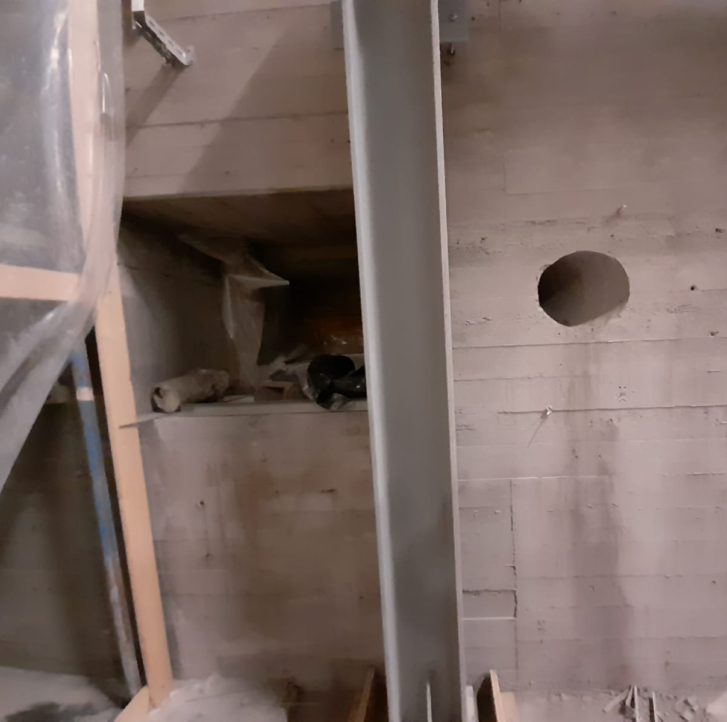
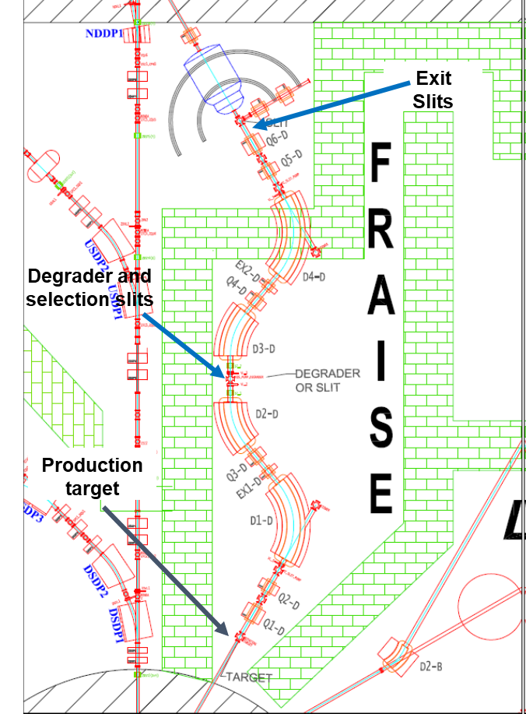
FraIsE @ LNS
The FraISe fragment separator, presently being built at INFN-LNS, will produce particle rate ranging from 10² pps (very exotic isotopes, extremely far from stability valley) up to 10⁷ pps (exotic isotopes near to stability valley).
beam exit
Some examples (E/A≈40 MeV)
FraIsE
Improvement in intensity opens the way to more precise studies on nuclei close to stability and allows to extend investigations to nuclei far from stability
Nuclide of interest | Intensity* (kHz)
¹⁴Be | 1.4
¹⁶C | 6800
¹⁷F | 99700
²⁰O | 190
courtesy of G. Cardella, P. Russotto, N. Martorana
* in the cocktail beam
Several beam diagnostic/tagging devices provide beam info:
within the fragment separator in two points (degrarder & exit slits):
  need of a point-to-point measurement of cocktail intensity, relative composition, energy distribution, 2D profile, angular distribution during optimization;
  monitoring of beam properties, start time for event-by-event ToF/energy mesurement during data taking;
in the final set-up point (measurement chamber):
  need of event-by-event tagging of cocktail beam and trajectory measurements
15

Slide 16
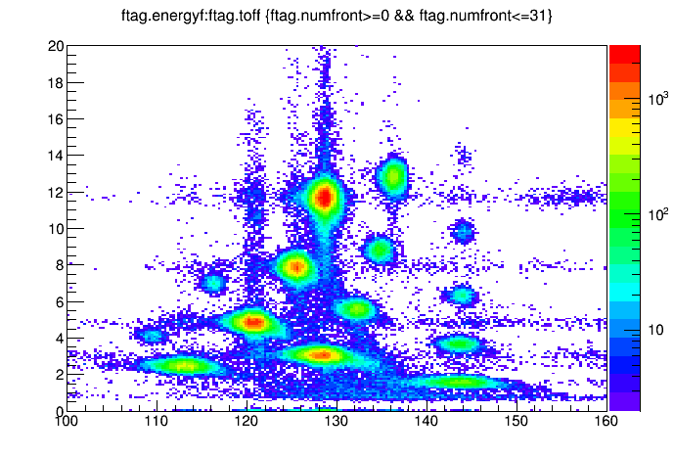
State of the art tagging systems
FRIBS@LNS
Diagnostics:
  plastic scintilators: check yield at rate< 10⁵ pps
  RF-DSSSD: check yield, composition (ΔE-ToF), 2D profile
At final user point of CHIMERA line:
  event-by-event tagging of cocktail beam, ΔE-ToF with a MCP-DSSSD system
LISE@GANIL
Diagnostics:
  CATS: multi-wire proportional detector for ToF and trajectory measurements
  MCP for ToF and X-Y position measurements
  Si at low beam intensity to check composition (ΔE-ToF)
Limited below 10⁶ pps and significant damages at high rates.
¹⁸O(55 AMeV) + ⁹Be(1500 um)
Bρ=2.78Tm
MCP: up to 10⁵ pps
Δt ≈ 200-300 ps
DSSSD: max rate 200 kHz, performance worsening ≈1 week with medium mass beam at 30 kHz;
overall Δt <≈1 ns
I. Lombardo et al., NIMB 215, 2011
ΔE (MeV)
¹⁸C
Super-FRS@GSI
Diagnostics:
  Combination of GEM-TPC, Diamond detector, Scintillator detector
Other fast and rad-hard sensors are welcome
¹⁶C
¹⁵B
¹²Be
⁹Li
⁸Li
⁶He
ToF (ns)
courtesy of G. Cardella & P. Russotto

Slide 17
The tagging system: specs and design
network of rad-hard sensors, equipped with optimized fast frontend electronics, DAQ with Data Real-Time Management capabilities and a dedicated software layer implementing AI and ML techniques
The system needs to be compact, removable and easily interchangeable.
The system must sustain a beam intensity up to 10⁷ pps for several experiments a year,
Housed in a DN160 spherical cross, the full detection system is based on a matrix of 100 mm thick 4H-SiC detectors with 30 mm x 60 mm active area segmented in small detection units (25mm²), large enough to cover the entire beam size with a maximum dead area of 15%.
RIB composition determined by joint measurement of energy loss DE and time of flight (ToF).
Required energy resolution below 100 - 200 keV, required time resolution below 100 ps rms.

Slide 18

SPOKE 5 (INFN), WP4: Micro detectors for particle therapy, dosimetry e micro-dosimetry
TASK: Design study of a Silicon Carbide (SiC) particle detector for dose measurements in radiation dosimetry and real-time beam monitoring
Stato
scelta configurazione finale rivelatori (slice da 15x15 mm² con 9 pixel da 5x5 mm²)
In consegna substrati per la crescita epitassiale dei rivelatori – ordine in preparazione per la realizzazione dei rivelatori - Prevista consegna primi prototipi Luglio 2024
In corso
test con rivelatori simili realizzati in precedenti batch
Scopo
ottimizzare produzione di un fascio test di ¹¹C per eseguire in contemporanea adroterapia e PET – attivo da 1 ottobre 2022 - finanziamento INFN WP 700k€ - finanziamento tematica beam monitor circa 250 k€ (costi produzione SiC tagging)

Slide 19
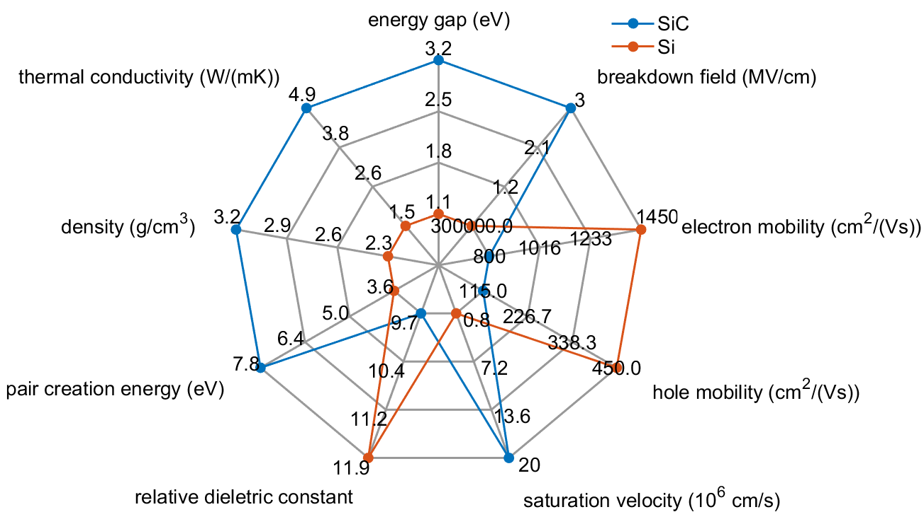
SiC vs. Silicon

Slide 20
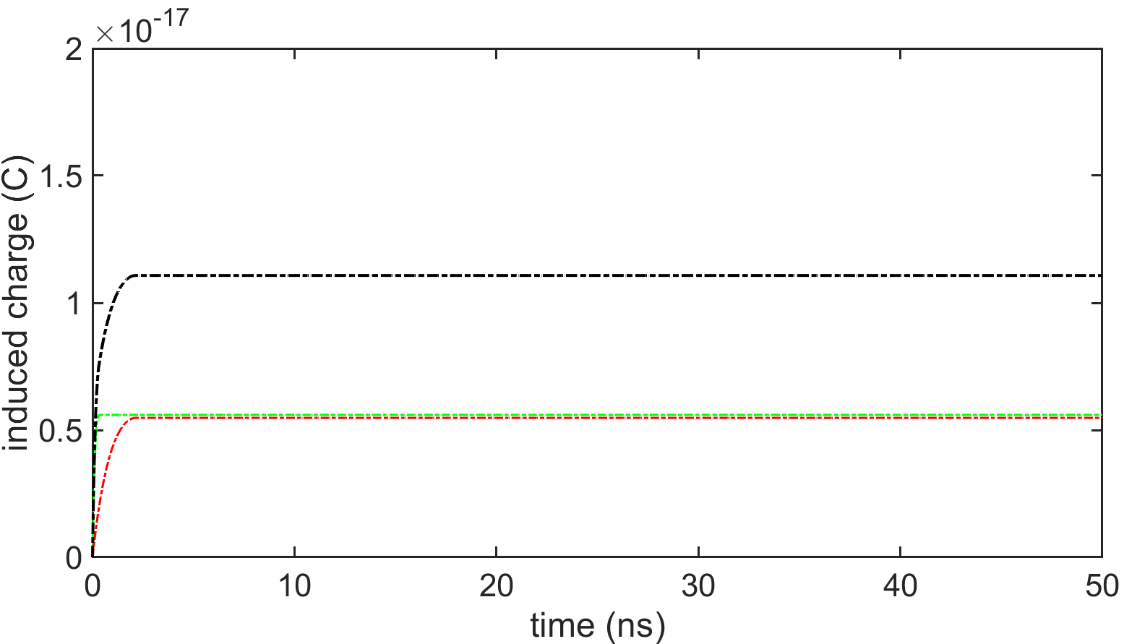
Simulation of induced signals in SiC & Si
¹¹Be ion at 47 AMeV – as produced in the FraISe facility in the case of a primary beam of ¹³C at 55 AMeV – passing through a 100 μm thick detector in transmission mode
induced current in SiC
energy loss
induced charge in SiC/Si
deposited charge

Slide 21
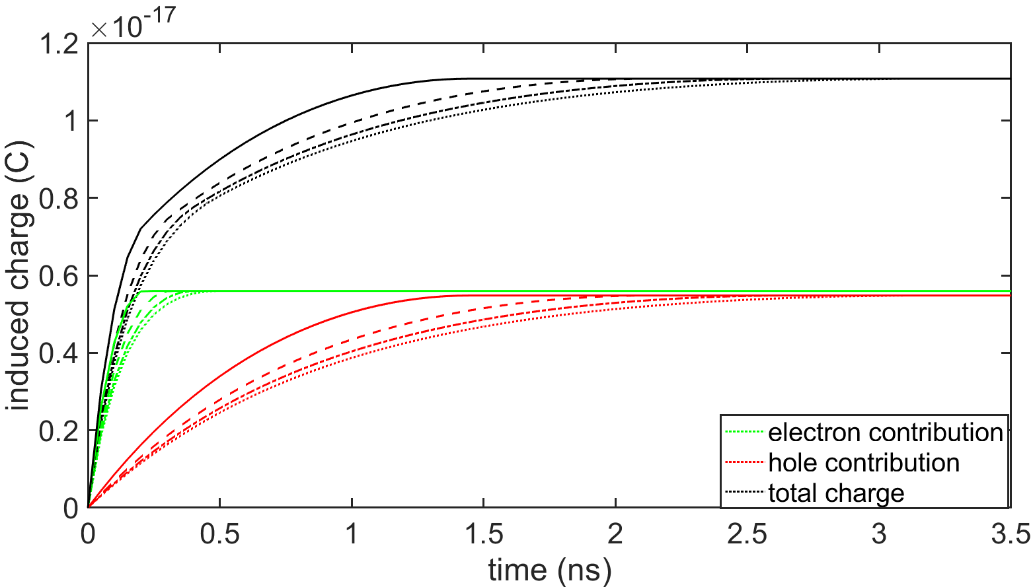
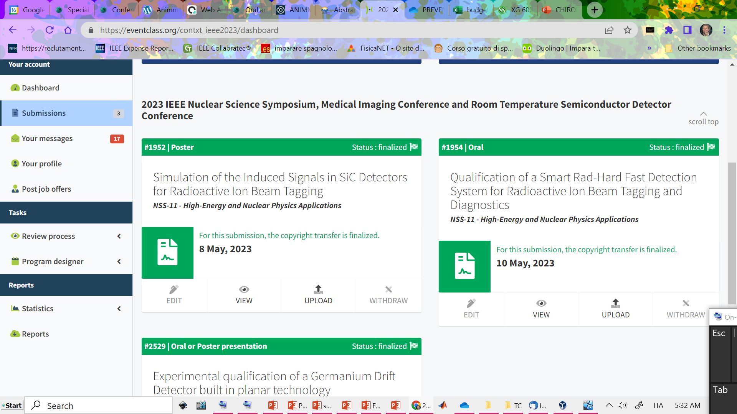
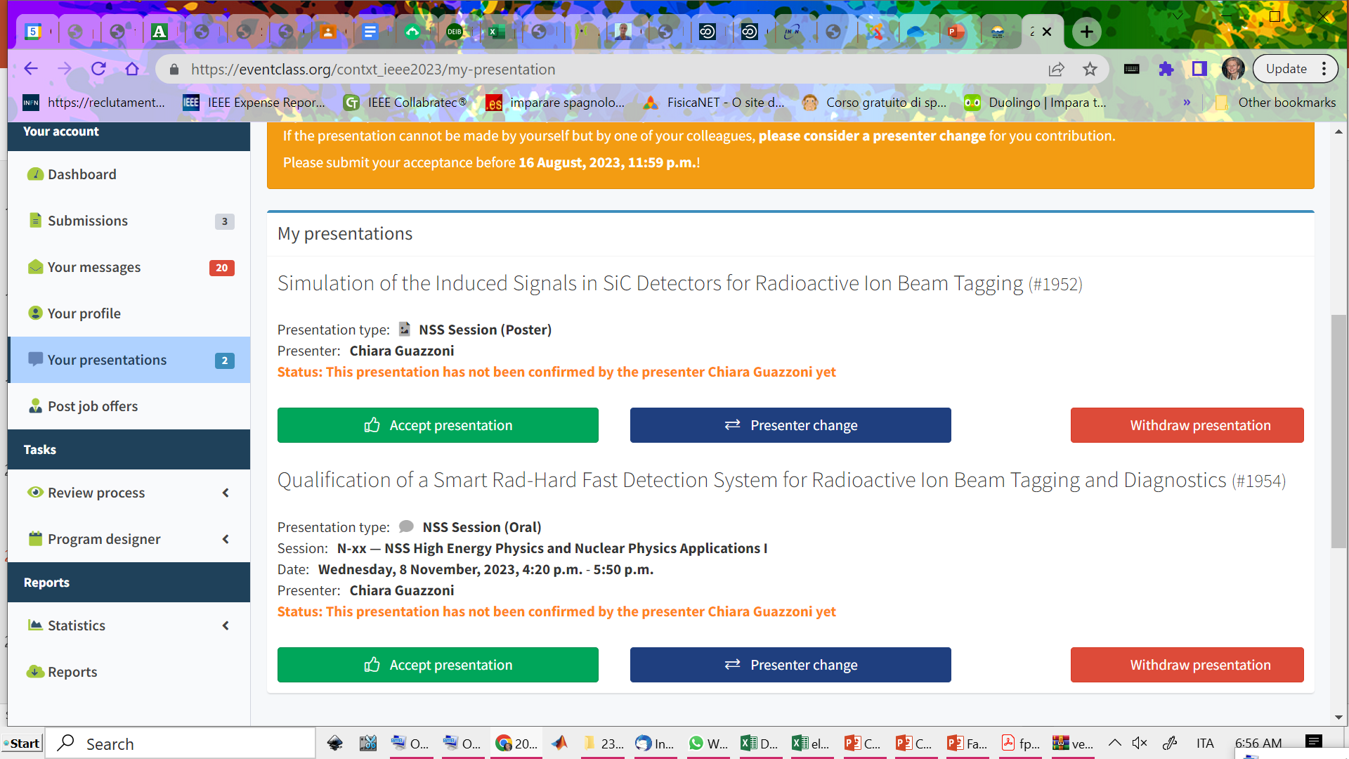

Simulation of induced signals in SiC & Si
impact of overbias on induced charge
¹¹Be ion at 47 AMeV – as produced in the FraISe facility in the case of a primary beam of ¹³C at 55 AMeV – passing through a 100 μm thick detector in transmission mode
5%, 10%, 20%, 50% overbias
energy loss
deposited charge

Slide 22
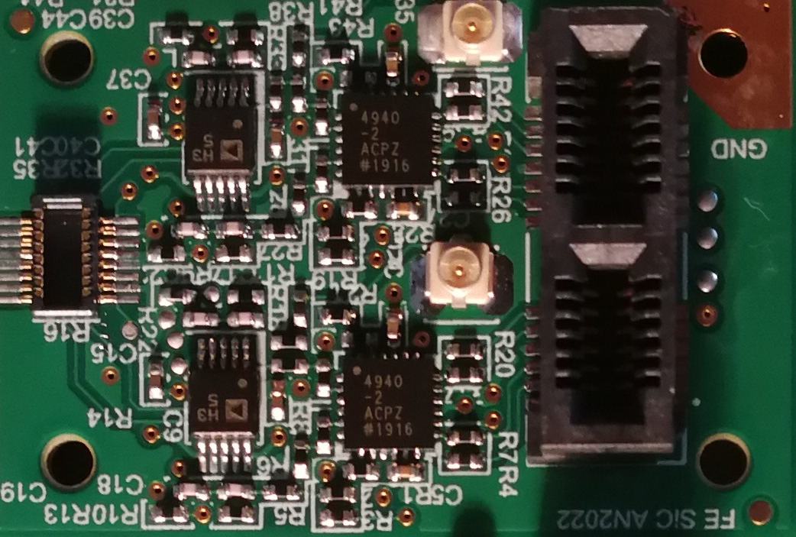
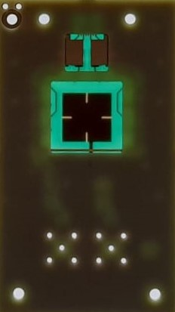
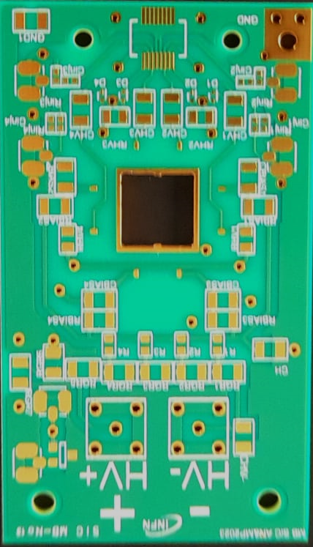



Prototype Detection System Components
100 μm thick SiC detectors
4-channels preamplifier/shaper board with differential output drivers
1cm² detector carrier with custom stackup or full transmission mode
25 mm² single unit
25 mm² unit segmented in 4 subunits
1 cm² single unit & 1 cm² segmented in 4 subunits
5 mm
25 mm
5 mm
35 mm
10 mm
HSEC8-113-01-S-DV-A-K
differential output line driver
0.50mm Pitch SlimStack Plug
preamplifier/shaper
U.FL-R-SMT-1(10)
Pico-Clasp PCB Header (bot)
10 mm

Slide 23



SiC detector 100 μm thick, 25 mm²: device qualification
Experimental apparatus for CV measurements, based on the Agilent E4980A, custom modified for high voltage operation

Slide 24




Frontend electronics: Functional qualification
Output waveforms
Integral Non Linearity
“rise” time
for every input signal amplitude: INL computed as maximum deviation from linear LSQ fit up to considered amplitude
INL < 0.2% up to 50 MeV input dynamics
measured rise time includes 3.8ns input signal risetime (Agilent 33250A Function / Arbitrary Waveform Generator)

Slide 25

Impact of reverse bias voltage on the output response
100 μm thick SiC detectors
At very low reverse bias (<100V), detector capacitance is too high for a stable response
Increasing reverse bias, output slope increases (beneficial for time resolution).
No degradation of the output response up to tested overbias (250 V).

Slide 26

Preliminary system performance - in air
mixed nuclei α source
100 μm thick SiC detector – 25 mm²

Slide 27




Coupling with custom ASIC for spectroscopy - preliminary
in vacuum
68M
100 μm thick SiC detector – 25 mm²
Custom CMOS preamplifier with a target dynamic range of 100 MeV (Si equivalent), over an output voltage range of 1.1 V.
Telescopic cascode topology with external feedback network. Trade-off between the requirement of a low equivalent input series noise and low-power constraint (10 mW/channel).
AMS CMOS C35B4C3 technology

Slide 28
Financial requests

Slide 29
CHIRONE Richieste Finanziarie Preliminari per 2024 @MI
MISSIONI: 7.2 k€ + 2.0 k€ SJ
  Spostamenti Responsabile Locale e riunioni di collaborazione 0.5 k€
  Partecipazione preparativi per esperimento GSI SJ 2.0k€
  Spostamento @INFN-CT per iniziative specifiche (SiC) (x 2 viaggi, x2 pp) 3.0 k€
  Spostamento @LNS per iniziative specifiche (SiC) (x 1 viaggi, x2 pp) 2.0 k€
  Spostamento @Labec per qualificazione rivelatori SiC con protoni (x 1 viaggio, x2 pp) 1.7k€
CONSUMO: 4.0 k€
  mat. specifico da laboratorio: filo bonding, colle, alcool isopropilico, thermal pads 1.0 k€
  cavi schermati linee differenziali per setup di test in aria e in vuoto 1.0 k€
  cavi distribuzione power per setup di test in aria e in vuoto 1.0 k€
  materiale consumo per montaggi e test 0.5 k€
  materiale stampante 3D 0.5 k€
COSTRUZIONE APPARATI: 29.7 k€
  run produzione ASIC elettronica frontend FARCOS 11.2 k€
  PCB custom for SiC MB + mounting & PCB final frontend SiC + mounting 3.0 k€ + 4.5 k€
  componenti attivi e passivi 8.0 k€
  meccanica SiC 3.0 k€
INVENTARIO: 7.2 k€
  AMETEK HV power supply XG 600-1.4MEBR 3.6 k€
  5 slots NIM crate 3.6 k€
TRASPORTO: 1 k€​
  Trasporti elettronica, flange/cavi da/per CT e LNS 1.0 k€ ​
Miss.@MI | Cons.@MI | Tras.@MI | App. @MI | Inv. @MI
7.2 + 2.0SJ | 4 | 1 | 29.7 | 7.2

