Slide 1
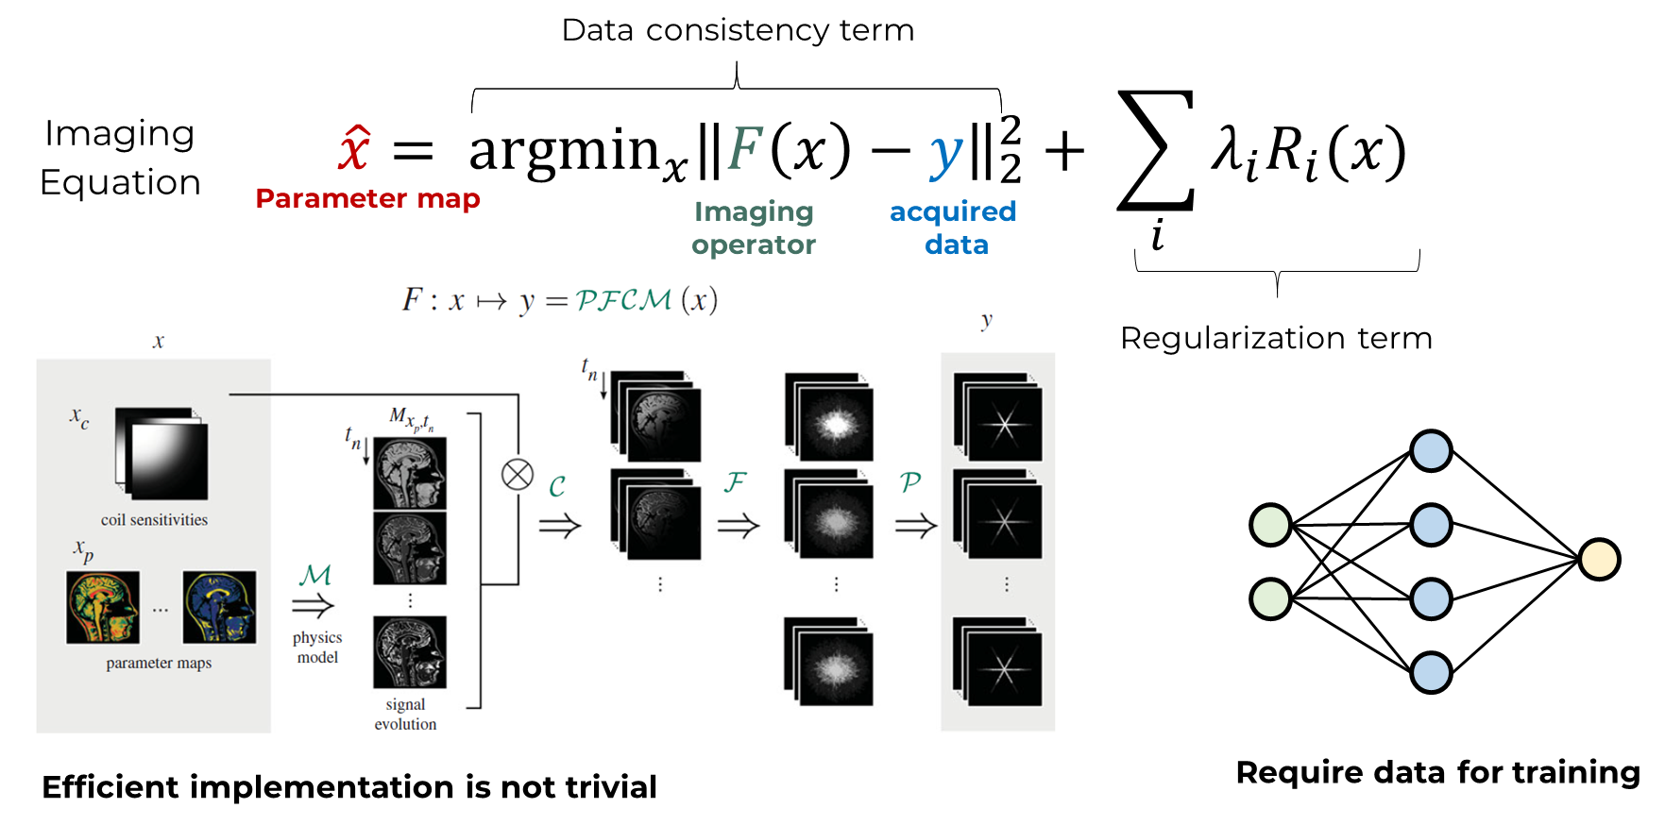
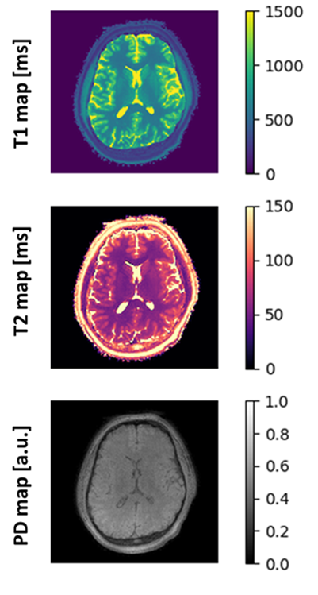
PREDATOR project [INFN-CSN5 2023-2024]
Quantitative Magnetic Resonance Imaging (qMRI) represents a powerful tool for the diagnosis and longitudinal evaluation of pathologies and the comparisons of exams from different clinical centers. Conventional qMRI has a clinically unfeasible acquisition time - acceleration is possible, but efficient reconstruction becomes challenging.
AIM
To develop computationally-efficient reconstruction algorithms for real-time reconstruction of accelerated qMRI acquisitions and provide free, reusable and easy-to-use tools to the MR community.
Project design
People:
Matteo Cencini (Principal Investigator; INFN Pisa)
Alessandra Retico (INFN Pisa)
Marta Lancione (FSM)
Michela Tosetti (FSM)
Laura Biagi (FSM)
Mauro Costagli (FSM)
Luca Peretti (FSM)
Development of an open-source framework for development of advanced qMRI reconstruction
Application to real-world MR acquisition (retrospectively and prospectively)
Implement on-line reconstruction on MR scanner and measure scalability

Slide 2
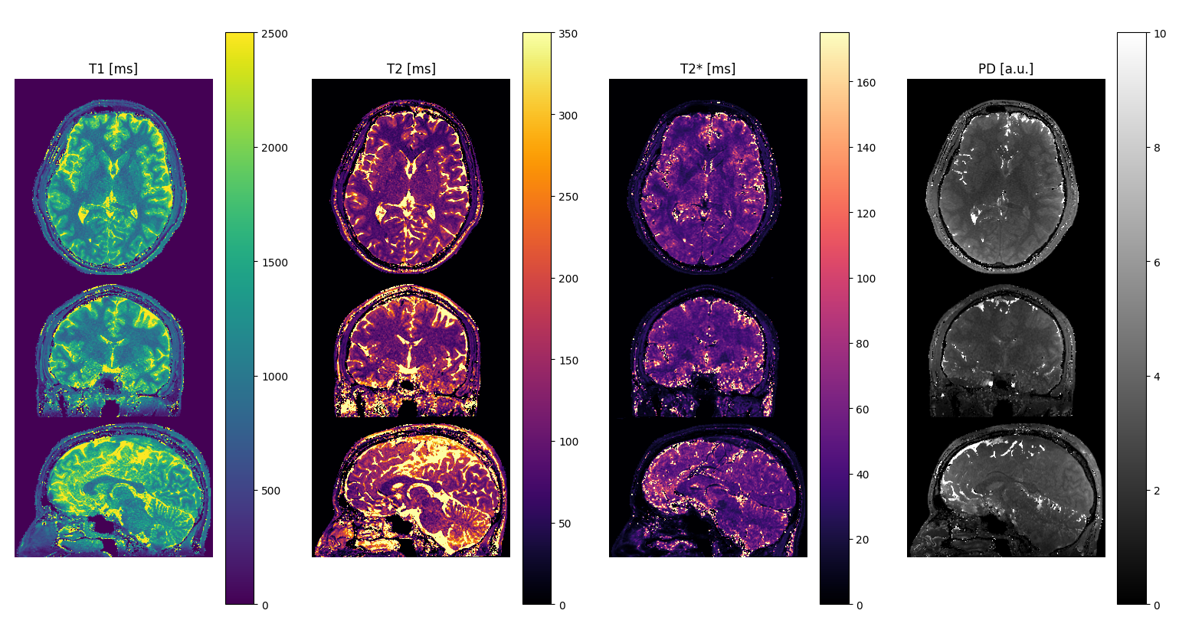
PREDATOR project: current state
M1. Development of qMRI reconstruction framework (31 Dec 2023).
Detailed description:
Read / Write functions with executable examples on vendor-independent data format (MRD).
MR encoding operators (FFT, NUFFT, Coil Combination) with executable examples on numerical data.
Conventional regularizers (L1-Wavelet, Total Variation, Local Low Rank) with executable examples on publicly available datasets (ISMRM Reproducibility Challenge).
MR simulator for gradient and spin echo sequences applied to parameter mapping with executable example on multi-echo gradient echo T2* mapping.
M2. Creation of training qMRI database of healthy volunteers (31 Dec 2023).
Detailed description:
Generation of sub-millimetric T1, T2, T2*/susceptibility maps of at least 10 subjects.
TODO: improve post-processing

Slide 3
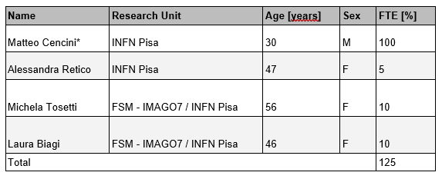
PREDATOR project: FTE and requests
FTE
Budget
Tot: 17 k€
Tot: 125%

