Slide 1
INFN-Milano beam dynamics activities in the frame of FCC study
A. Bacci, F. Broggi, Illya Drebot, M. Rossetti Conti

Slide 2

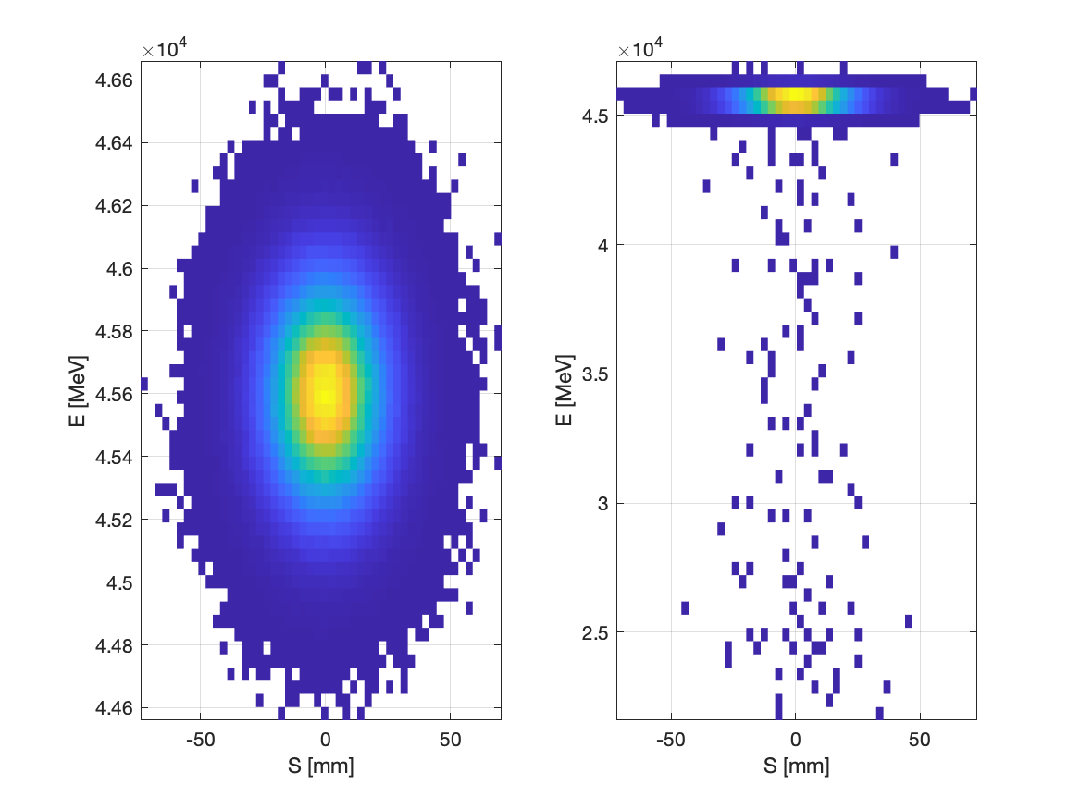
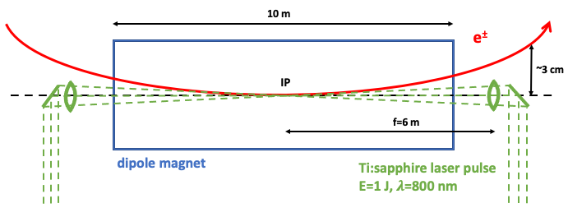
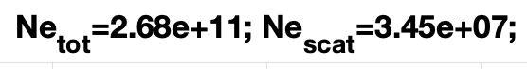
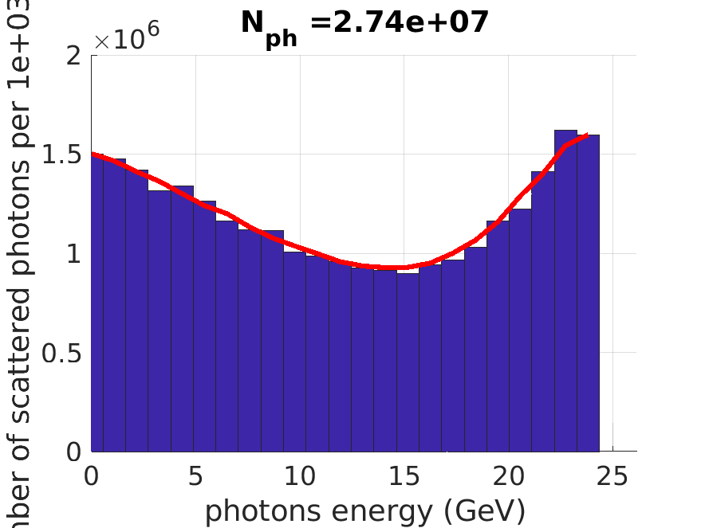
Diagnostics and bunch intensity control via Compton scattering
I. Drebot, S. Cialdi², INFN-Milano, [20133] Milano ²also at Universitá degli Studi, [20133], Milano, Italy
A. Abramov, M. Hofer, F. Zimmermann, CERN, [1211] Geneva, Switzerland
In the future circular electron-positron collider “FCC-ee”, the intensity of colliding bunches must be tightly controlled, with a maximum charge imbalance between collision partner bunches of less than 3–5%. Laser Compton back scattering could be used to adjust and fine-tune the bunch intensity.
Before collision
After collision
Sketch of the Compton collision inside a single 10 m long dipole.
To-Do: Find better position for Compton IP and optimise focusing parameters to increase efficiency of collision
Next step start simulation with polarisation for beam diagnostic

Slide 3

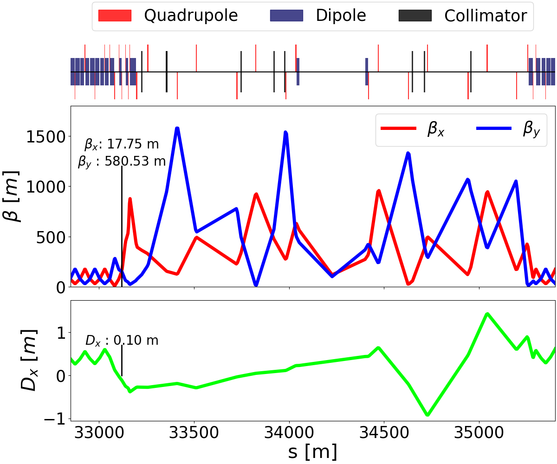
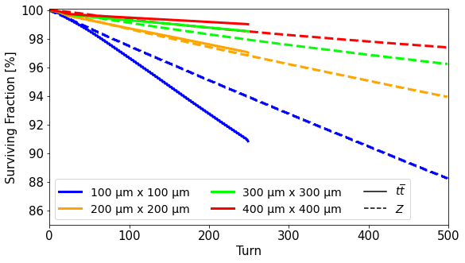
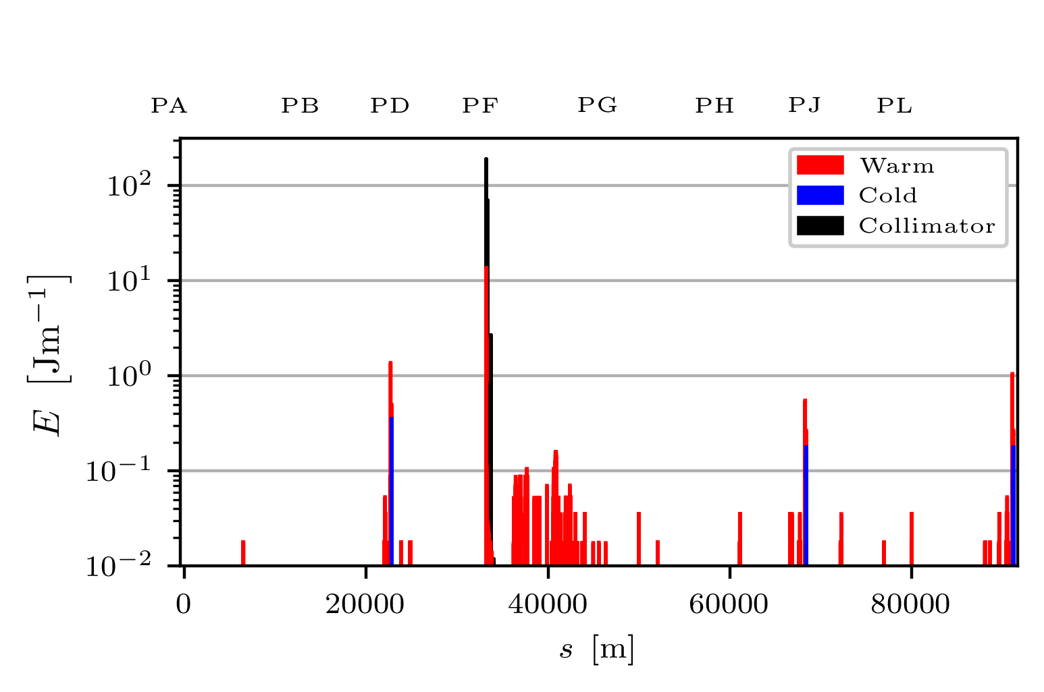
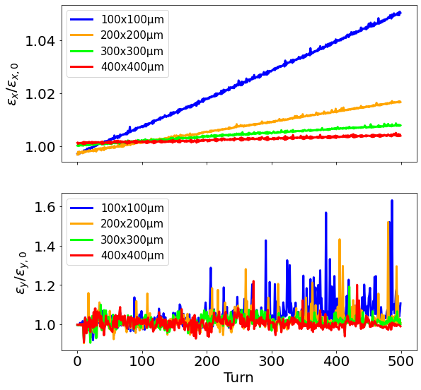
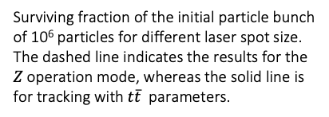
Defined optimal place for IP
Improved tracking code to simulate CBS during injection in the FCC ring
Result was presented at
IPAC23
List ToDo:
Improve IP inside bending magnet
Find optimum between reducing bunch charge to exclude flip-flop instability and emittance growing
Study possibility to optimise energy distribution e⁻ e⁺ using dispersion inside bending magnet
Study possibility to reduce beam halo using Donuts-shaped laser beam
Study polarization of scattered photons for diagnostic
Find application and users for 25 and 150 GeV photon beam 🖖
Layout of the collimation section under study for the FCC-ee at the Z operation mode. The location of the laser interaction is indicated by black bars, together with the optics functions.
Surviving fraction of the initial particle bunch of 10⁶ particles for different laser spot size. The dashed line indicates the results for the 𝑍 operation mode, whereas the solid line is for tracking with 𝑡$\overline{t}$ parameters.
https://www.ipac23.org/
preproc/pdf/MOPA074.pdf
Single-bunch loss map after 500 turns with laser interaction for the Z operation mode and a laser spot size of 100 μm. Aperture losses in normal conducting magnets are shown in red, and losses on superconducting magnets are shown in blue.
Emittance evolution of the particle bunch for different laser spot size and for the Z operation mode.

Slide 4
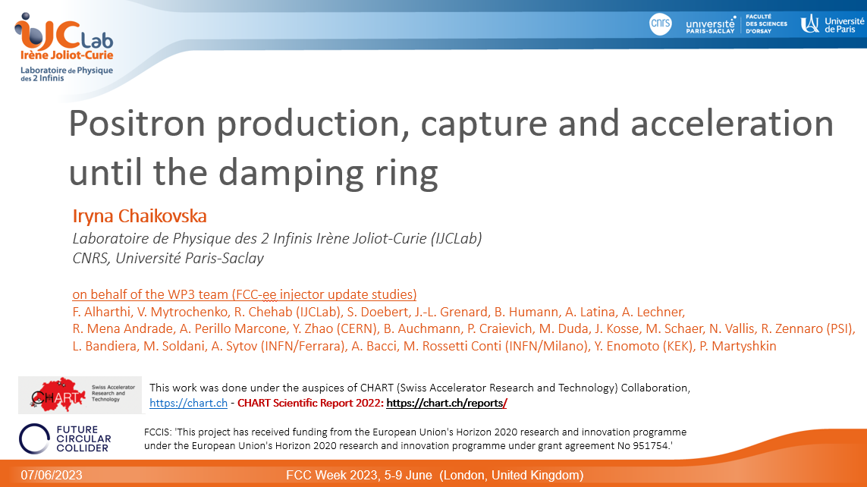
FCC Week 2023 – London
Iryna Iryna Chaikovska courtesy

Slide 5
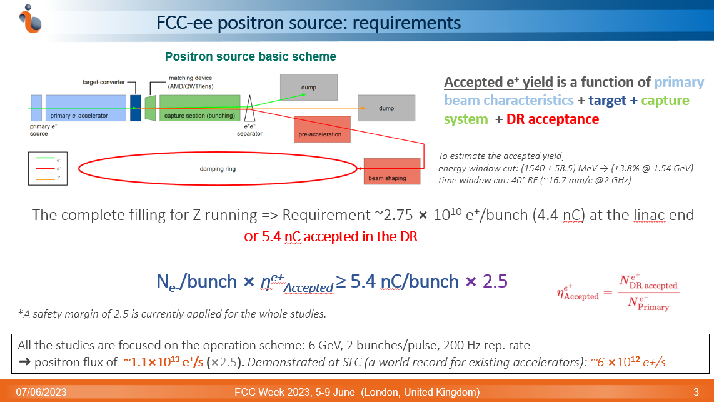
FCC Week 2023 – London
Iryna Iryna Chaikovska courtesy

Slide 6
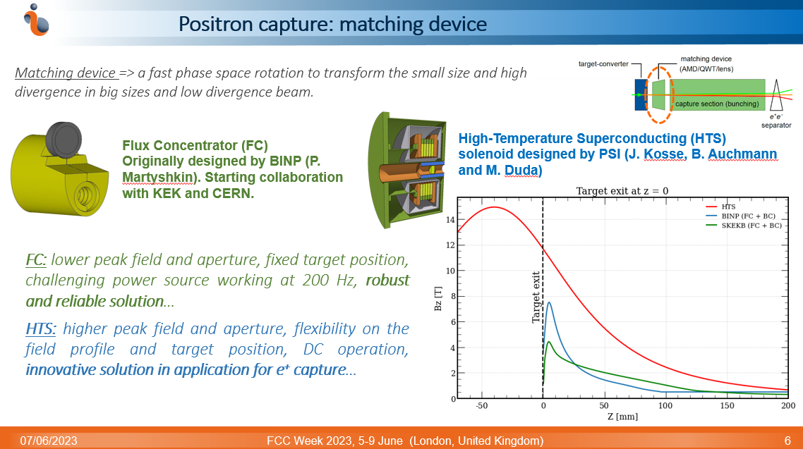
FCC Week 2023 – London
Iryna Iryna Chaikovska courtesy

Slide 7
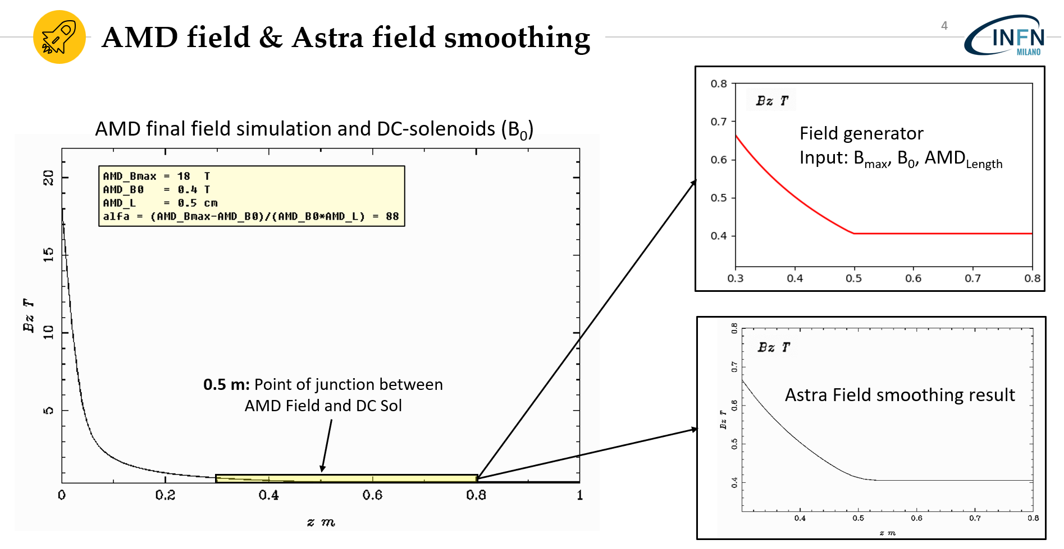
FCC-ee Pre-Injector: CHART Collaboration Meeting, 21 April 2023, LNF, Italy
Marcello Rossetti Conti Talk

Slide 8
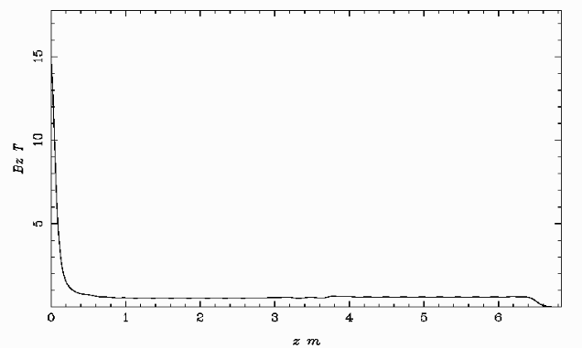
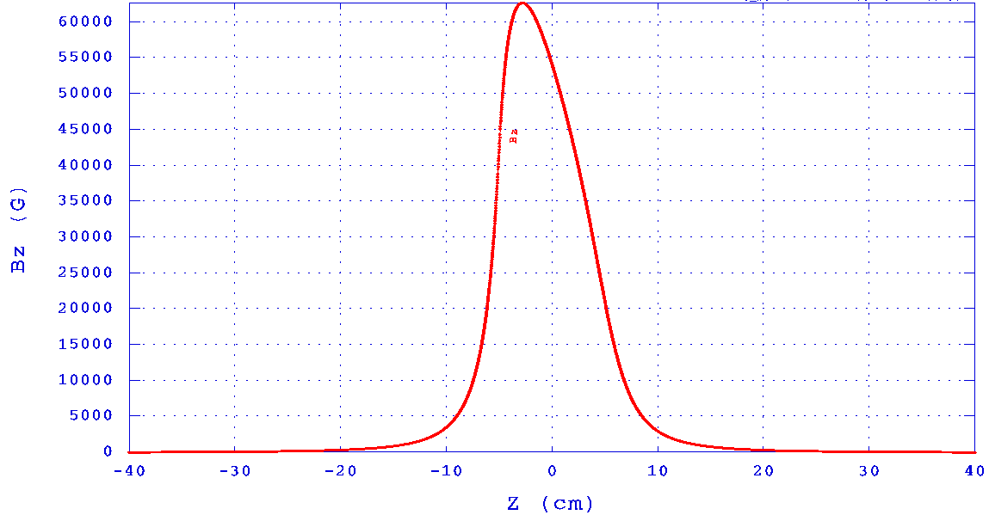
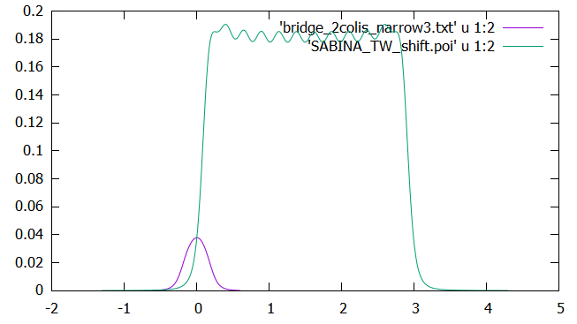
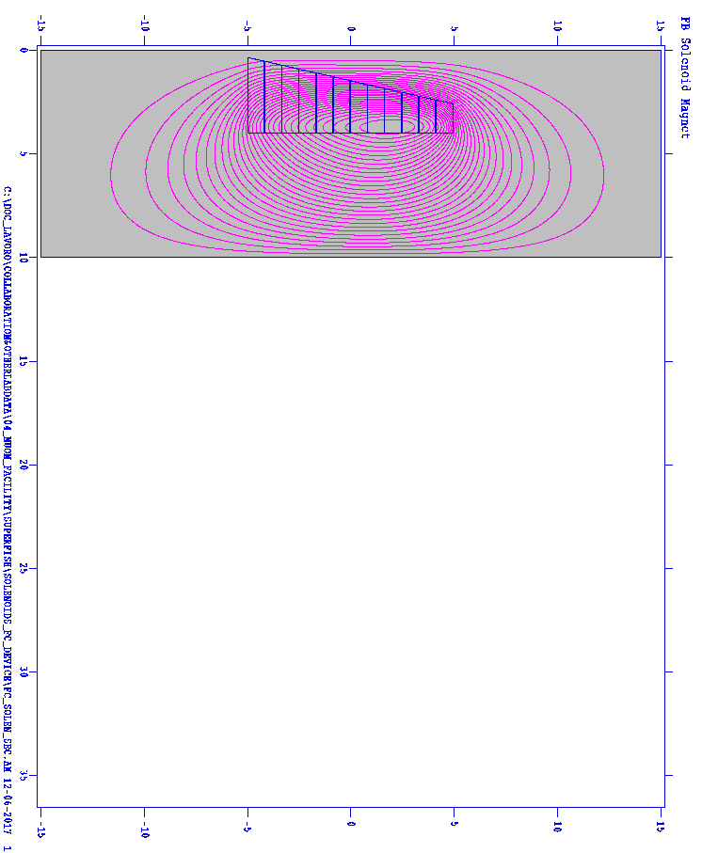
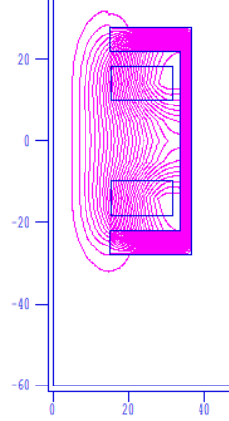
All beam dynamic optics regenerated by us to maximize optimization knobs
Bridge
Solenoids
Acc. cavities solenoids
Flux concentrator
Bz [T]
Z [m]

Slide 9
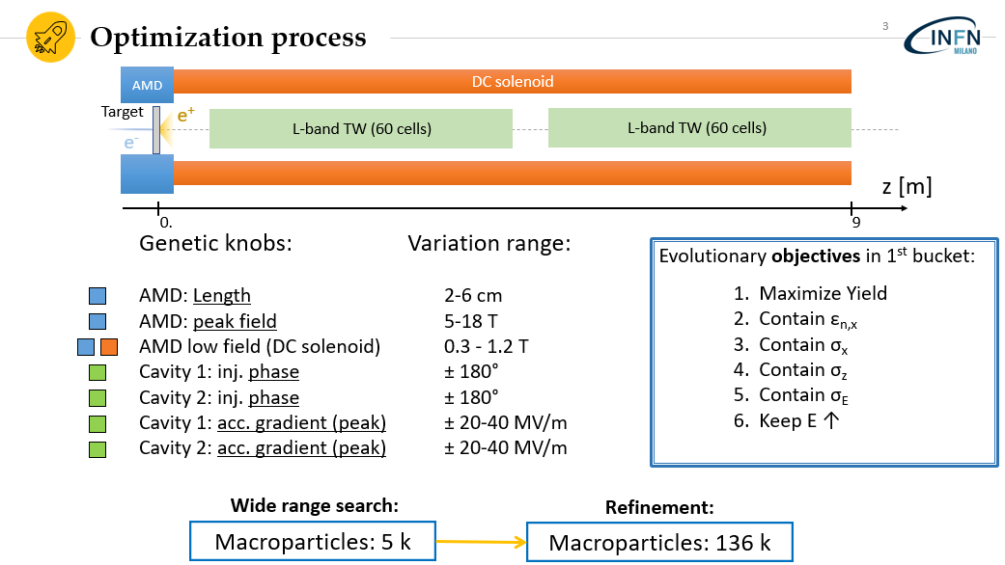
FCC-ee Pre-Injector: CHART Collaboration Meeting, 21 April 2023, LNF, Italy
Marcello Rossetti Conti Talk

Slide 10




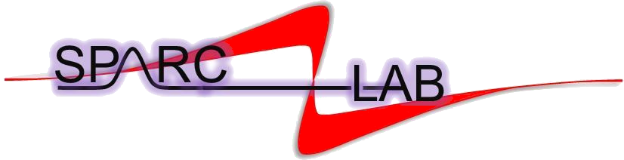
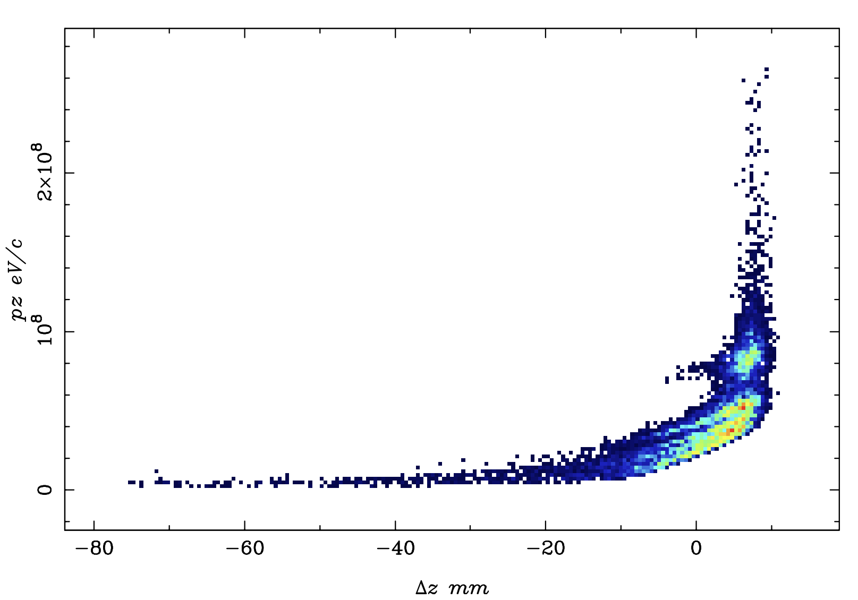
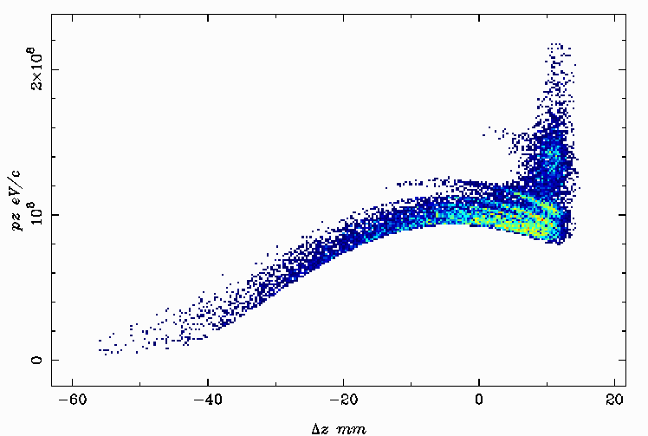
Genetic Interface for OpTimizing Tracking with Optics
One of first AI codes for beam line design & optimization born @ INFN-Milano.
Solves complex multi-objective problems (space-charge BD) & statistical analysis (BD jitters studies).
Successfully used in important projects, as:
Publication on major journals:
PRAB 22 (2019) - NIM A 909 (2019) - JAP 133 (2013)
New study Submitted @ PRAB in January (2023)
Disponibilità di GIOTTO + la nostra compentenza nella fisica dei fasci.
@ FCC-ee: first application in e⁺ capture line
presented by M. Rossetti Conti in Lyon FCC-workshop 21-nov-22
Starting Point
GIOTTO Optimized Point
40.7% of extracted e⁺ in 1st RF bucket
E = 45 MeV (64% ΔE/E)
59.4% of extracted e⁺ in 1st RF bucket
E = 100 MeV (24% ΔE/E)

Slide 11
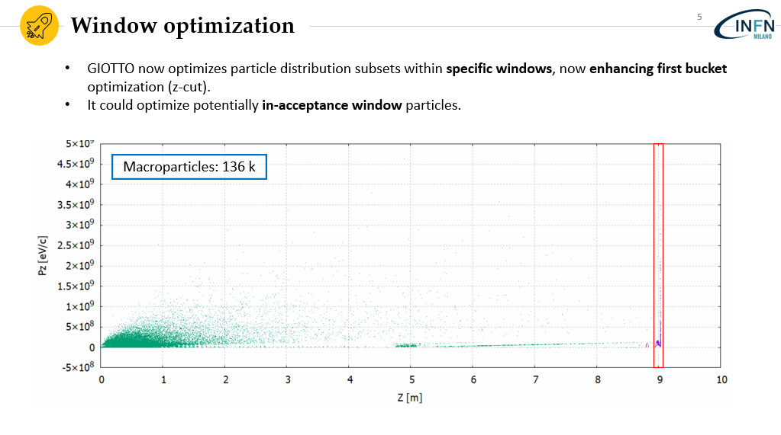
Capability to optimize into a rf bucket
Few weeks ago update

Slide 12
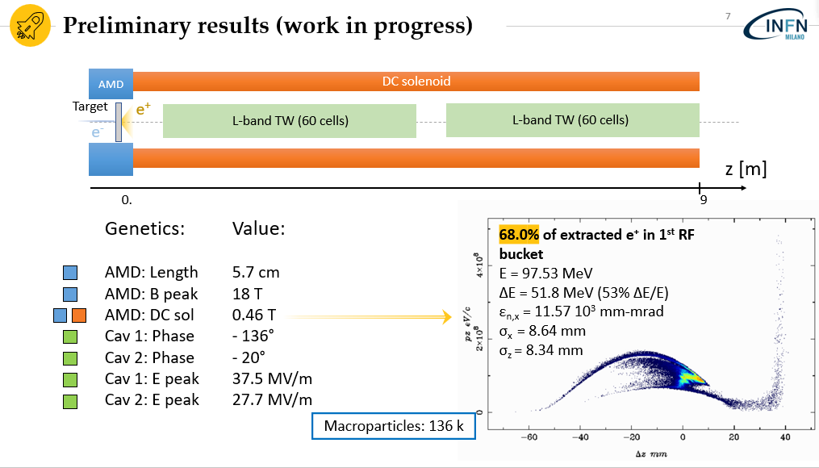
59.4%

Slide 13
Contribute recap beam dynamics Milano group
Lione:
Marcello Rossetti Conti talk
Illya Drebot talk
Orsay: Iryna talk
Frascati: Marcello Rossetti Conti talk
IPAC 2023:
2 Posters & proceedings
London:
Iryna Chaikovska talk

Slide 14
1 missione Illya Orsay ~800 € altri fondi + 1 Marcello su Milano 1000 €
Io escluso per infortunino
1 missione Illya IPAC ~2000 € Pisa
1 missione Marcello IPAC ~2000 € altri fondi
1missione 2 persone Frascati ~500 € Milano
Milano (Romualdo): 1.5k€
Pisa:2.5k€
Altri fondi:2.8k€
A disposizione circa 20k€ di workstation
Totale Missioni 2023: 6.8k€ (nessuno è andato alla FCC week)
Richieste solo missioni 2024: 7 k€ (deve si possono allocare?)
Non sempre straight forward l’utilizzo dei fondi missione
FTE Marcello (5 -> 15), Illya (5 -> 15), Alberto (5 -> 15), Francesco (10)

