Slide 1
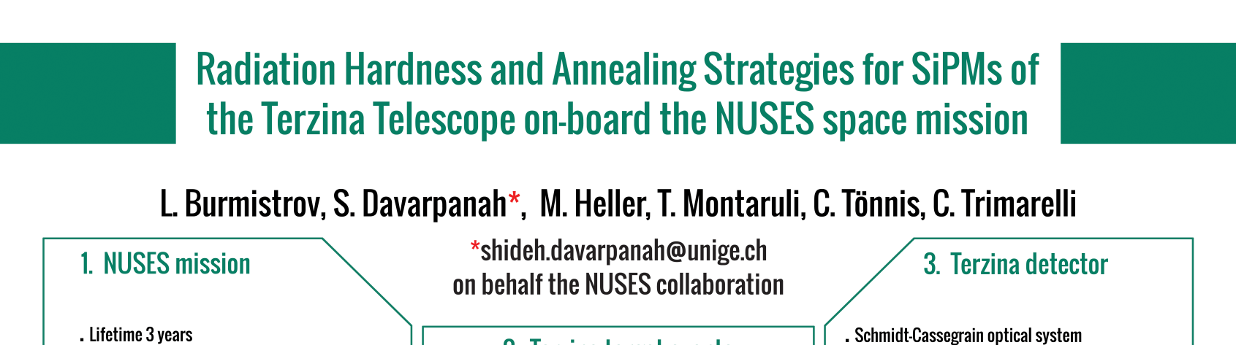
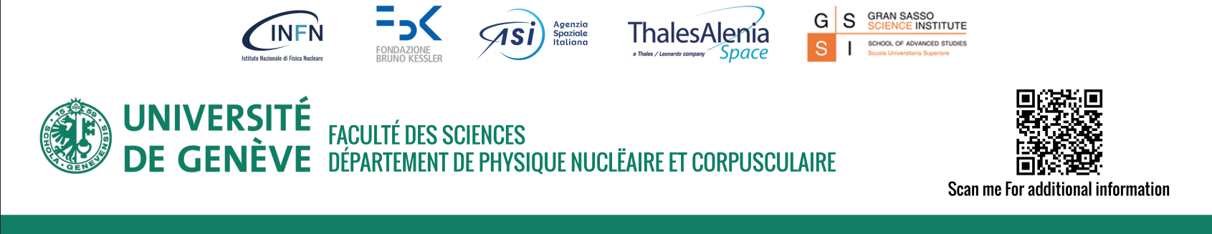

Slide 2
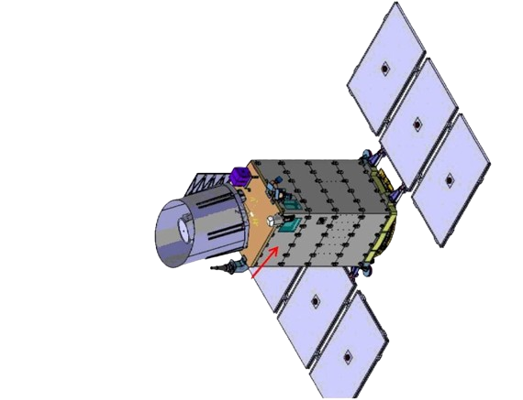

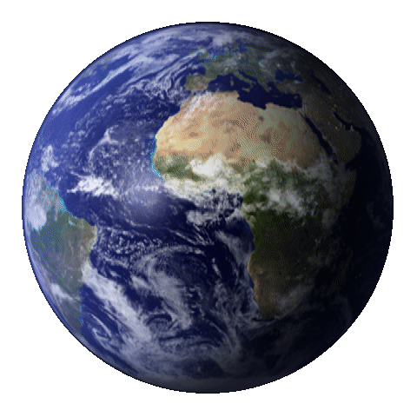
THE NUSES SPACE MISSION
E
NeUtrino and Seismic Electromagnetic Signals
N
U
S
S
SCIENCE SCOPE
3 years mission
mid-2026
ZIRÈ
Low Earth orbit 535km
Sun-sunchronous
Technology pathfinder for New processing, Low power,
High speed electronics of novel silicon photosensors and radiation hardness
TERZINA
First observation of Cherenkov light emitted by atmospheric showers from space!
to limb
TERZINA
(not in scale)
1
S Davarpanah

Slide 3

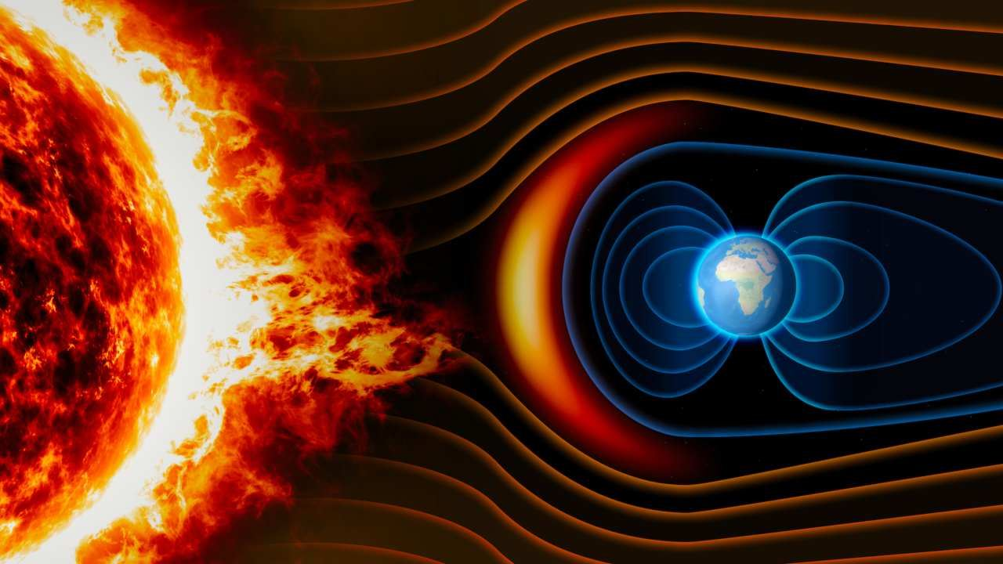
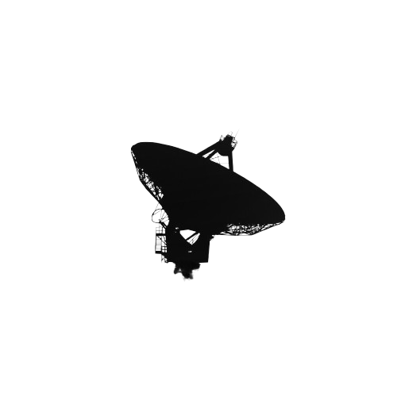
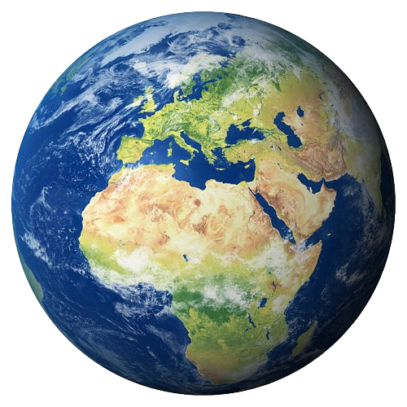
Radiation Background at the NUSES Orbit
No atmospheric shield
e
Background radiation
p
Energy loss
Absorption
Multiple Scattering
Radiation damage
Sensor noise
Image quality
Energy threshold
trapped electrons, trapped protons, solar protons
Flux from SPENVIS
2
S. Davarpanah

Slide 4
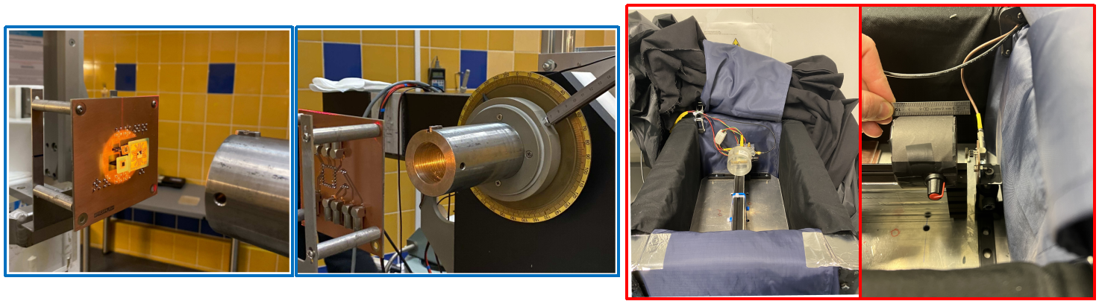
Measurements and results
FBK NUV-HD_MT ( 3x3 mm², 30um cell size )
Realistic simulation with Geant4 gives us Non-ionizing dose
IV measurement during irradiation:
Proton irradiation: 50MeV proton beam
Electron irradiation: β-source strontium-90, up to 2.2MeV
SiPM response to the irradiation
+
non-ionizing dose
+
SiPM specification
Annealing
Dark Count Rate
by placing the devices in a climatic chamber
@ fixed temperature for a set period of time
at T > 50°C, annealing cycle ~ 84 hours
recovery up to 40%
3
S. Davarpanah

Slide 5
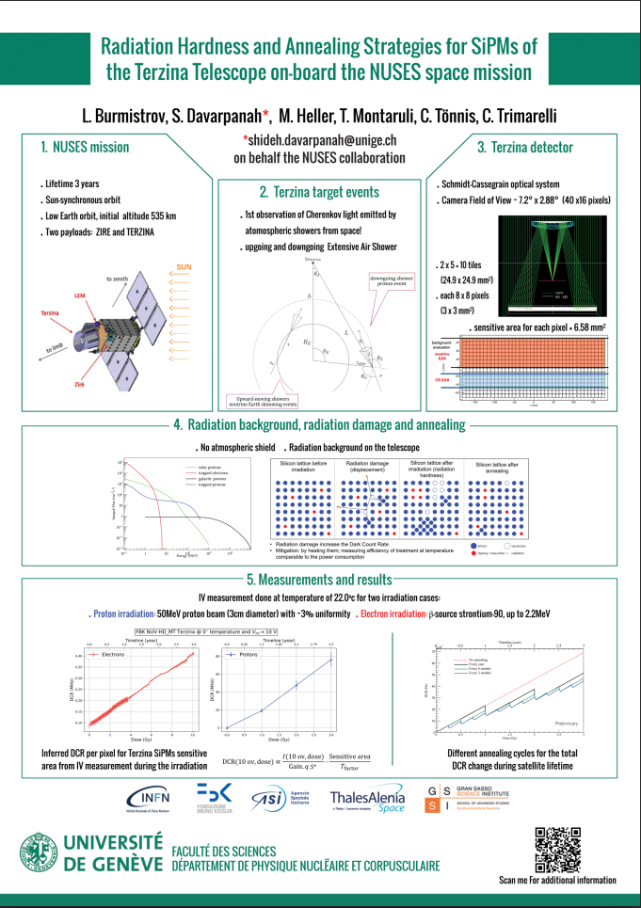
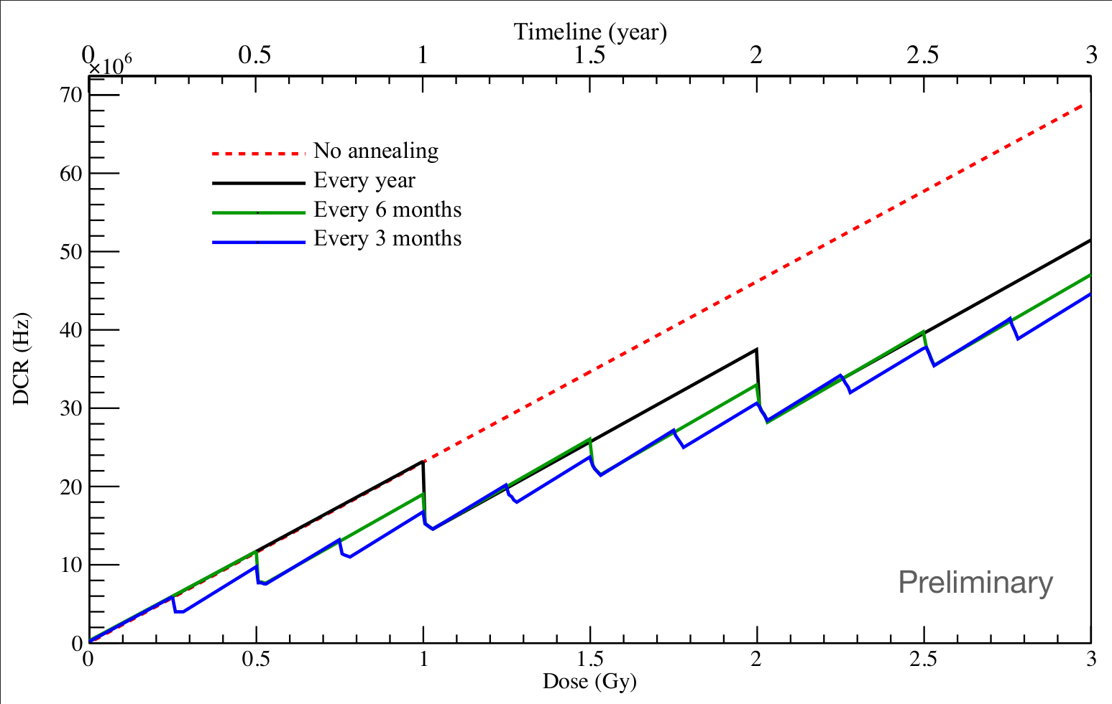
Thank you for your attention!
S. Davarpanah

