Slide 1
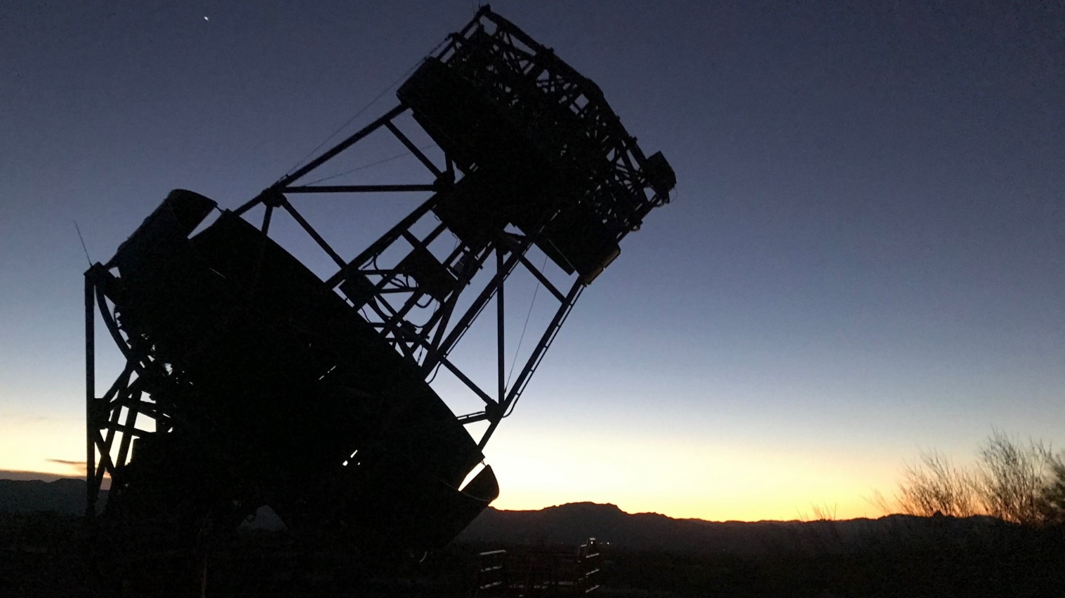




Status of the prototype
Schwarzschild-Couder Telescope
Francesco Giordano
for the CTA SCT Project
13th CRIS-MAC 2024 June 17, 2024

Slide 2
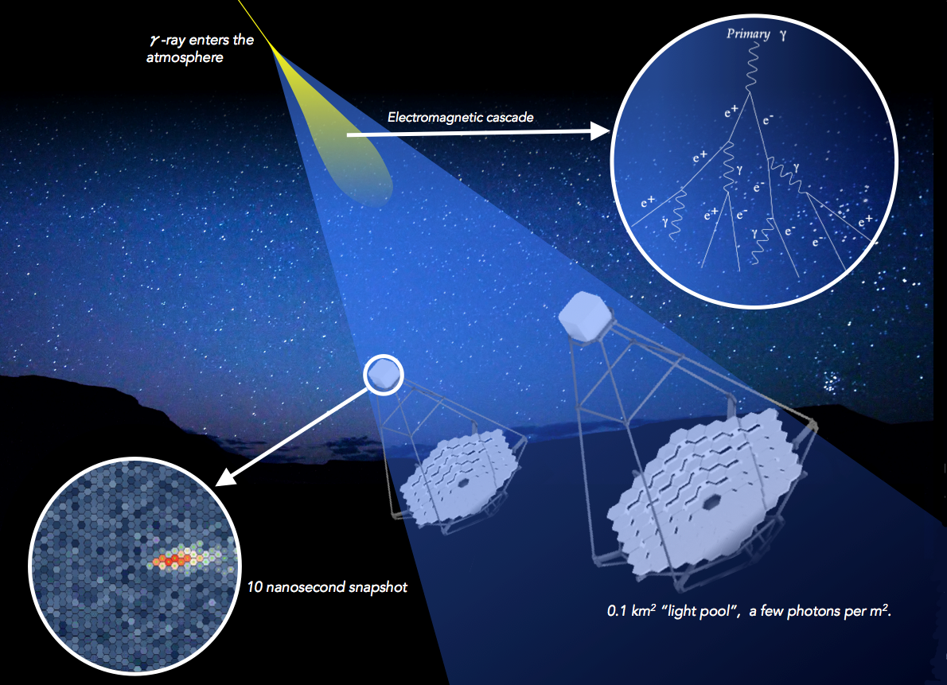
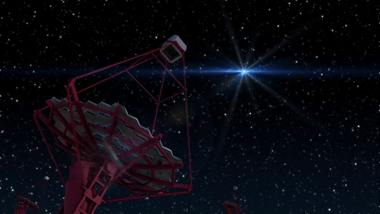
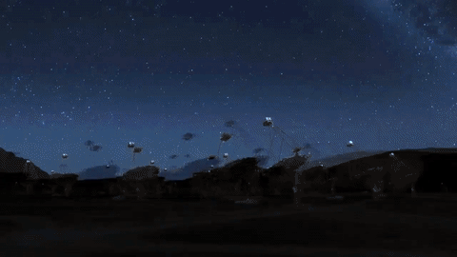
v
Imaging
Air Cherenkov
Telescopes
https://www.ctao.org

Slide 3
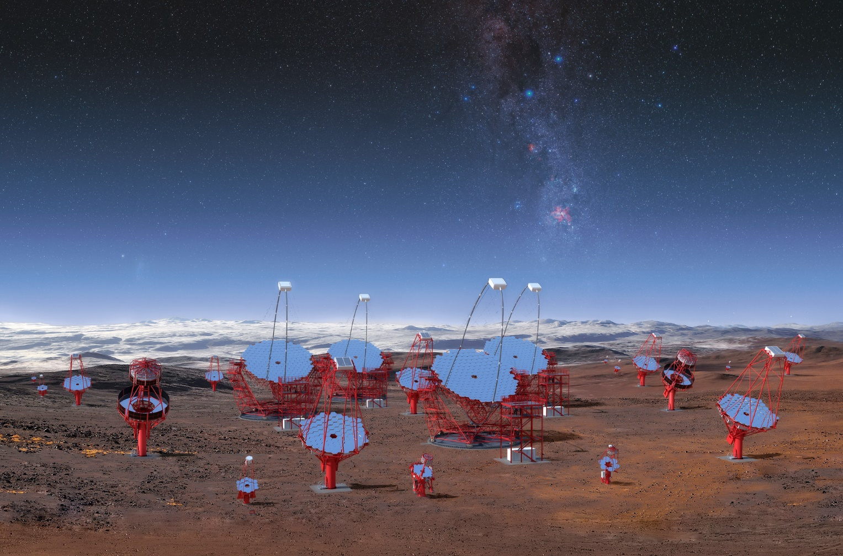
The Cherenkov Telescope Array Observatory
Next generation ground-based observatory for gamma-ray astronomy at very-high energies
It will employ several tens of telescopes located in two sites, one for each hemisphere, allowing for full-sky coverage
- Large Size Telescopes (LSTs), from ~20 GeV to ~1 TeV
- Medium Size Telescopes (MSTs), from ~100 GeV to ~10 TeV
- Small Size Telescopes (SSTs), from ~few TeV to ~100 TeV

Slide 4
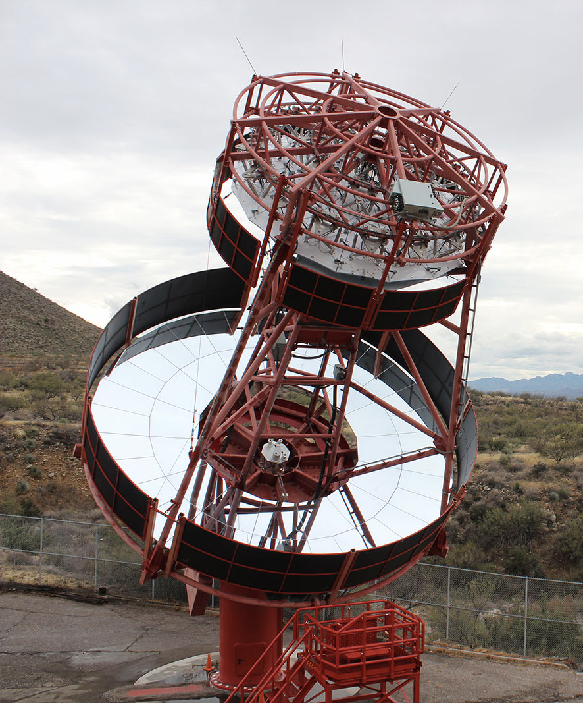
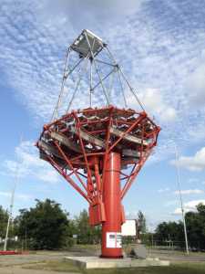
The Cherenkov Telescope Array Observatory
Schwarzschild-Couder
Schwarzschild-Couder Telescope (SCT)
A medium-sized double mirror telescope
Aim: increase sensitivity and performance of the CTAO Southern Array
SCT
(MST)
Davies-Cotton

Slide 5
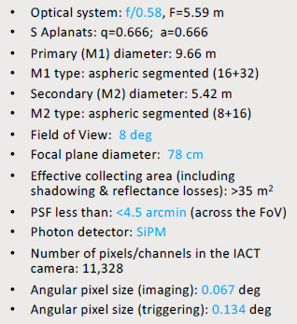
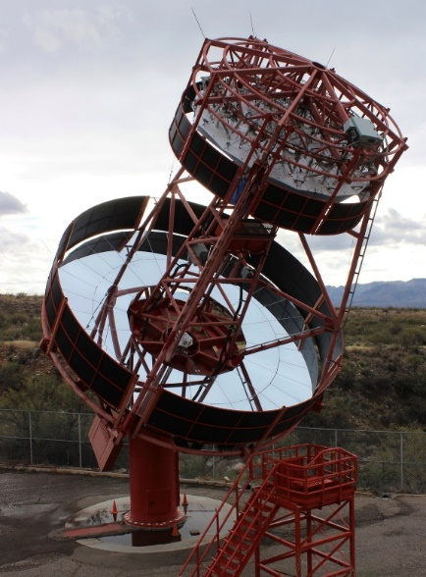
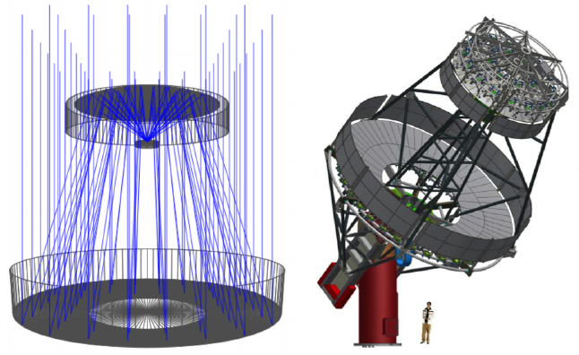
The Schwarzschild-Couder Telescope for CTAO
Candidate for a Medium Sized Telescope for CTA
  With an advanced telescope optical system
Aplanatic dual mirror optical system
  Correction of spherical and comatic aberrations
  Increased FoV
  Demagnification of shower images to be compatible with a compact high-resolution SiPM camera
  Main challenges: Mechanical stability and mirror alignment
First Prototype (pSCT) inaugurated in January 2019 at the Fred Lawrence Whipple Observatory, Arizona
Notes:
Joint effort of US and Italian institutes,
MRI Consortium: Development Of A WideField-of-View Camera For The Schwarzschild-Couder Gamma Ray Telescope

Slide 6






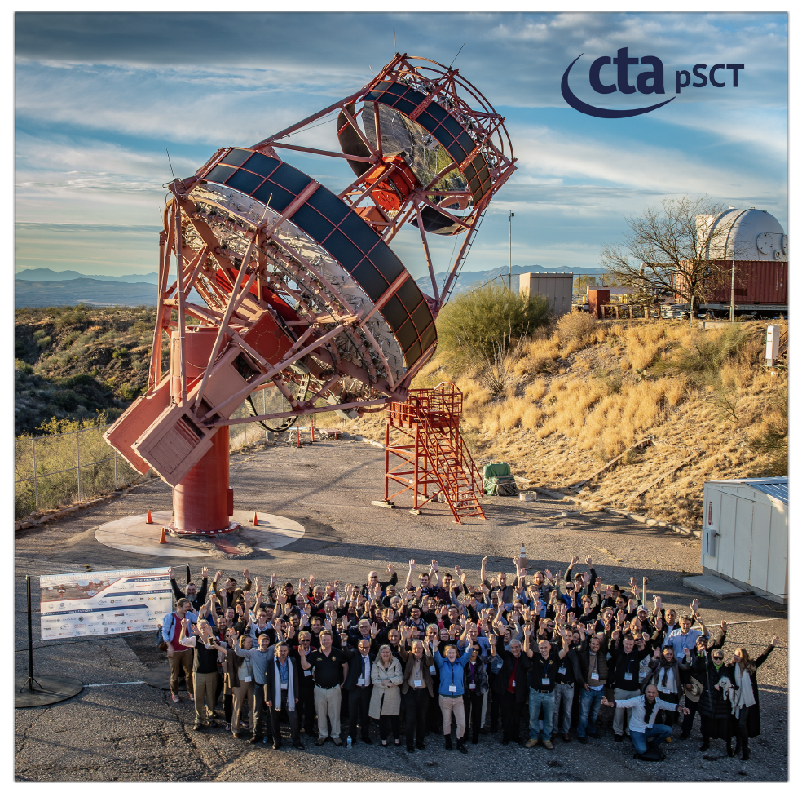
The CTA SCT project
~30 participating Institutions
Milestones:
1st construction: 06-23-2015
Inauguration: 01-17-2019
1st light: 01-23-2019
December 2019: optical alignment achieving preconstruction estimated PSF
January 2020: detection of the Crab Nebula
https://doi.org/10.1016/j.astropartphys.2021.102562
Endorsement by the CTA Consortium for supporting
the development and construction of SCTs to add to
the array and complement single-mirror MSTs
Next steps:
Ongoing (NSF/INFN funded MRI):
population of the focal plane to
~11k channels with upgraded
SiPMs and electronics

Slide 7
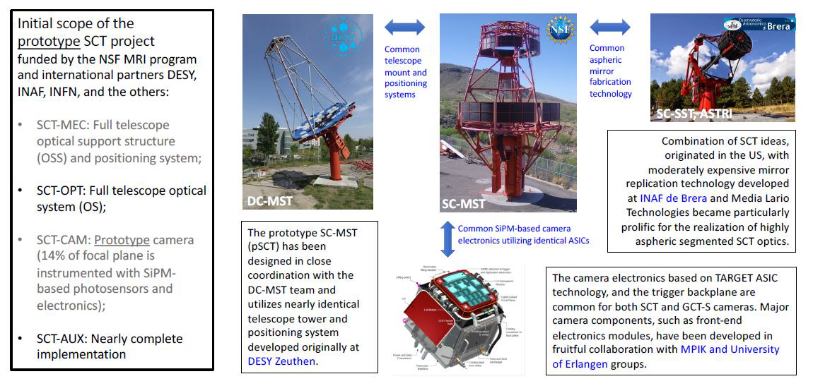
Project scope & common CTAO technologies
Slide by V.V.Vassiliev – SPIE 2022

Slide 8
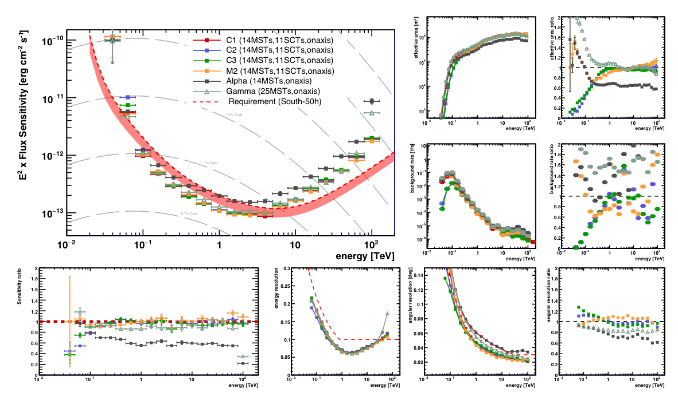
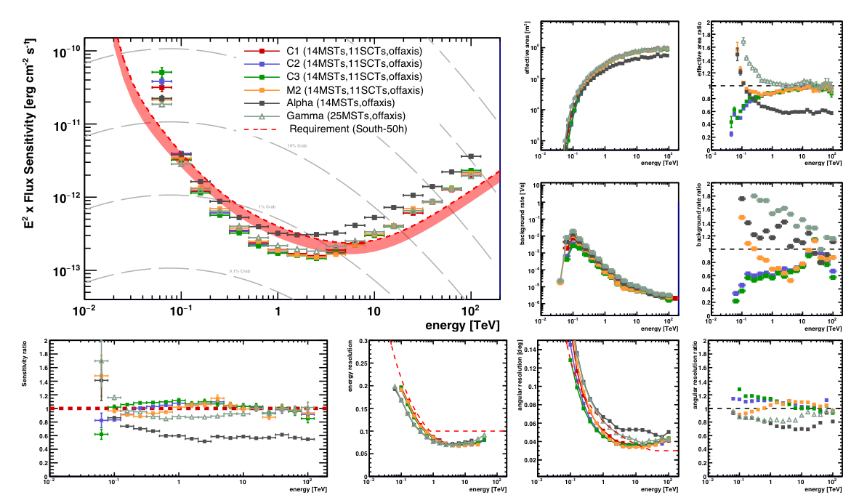
SCT in CTAO-S
Performance studies for dedicated science cases:
Transients and gamma-ray bursts
D. Cerasole et al., PoS(ICRC2023)726,
Galactic extended sources
R. Y. Shang et al., PoS(ICRC2023)587
Goal: enhance the performance of CTAO
Complete the medium-sized telescope array at CTAO-S with additional 11 SCTs
Simulation studies of performance w/ and w/o SCTs
On axis
Off axis

Slide 9
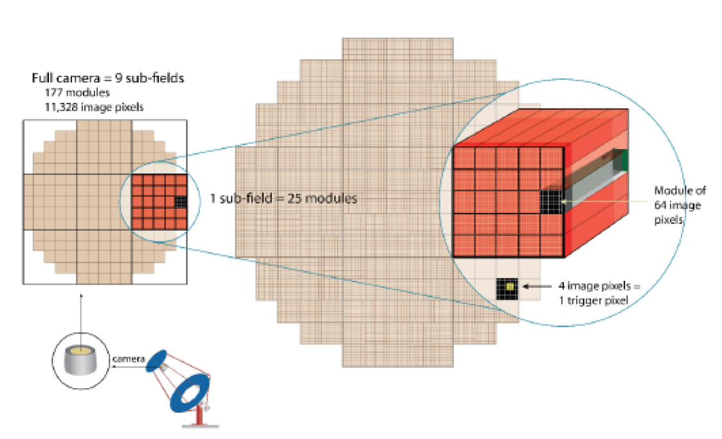
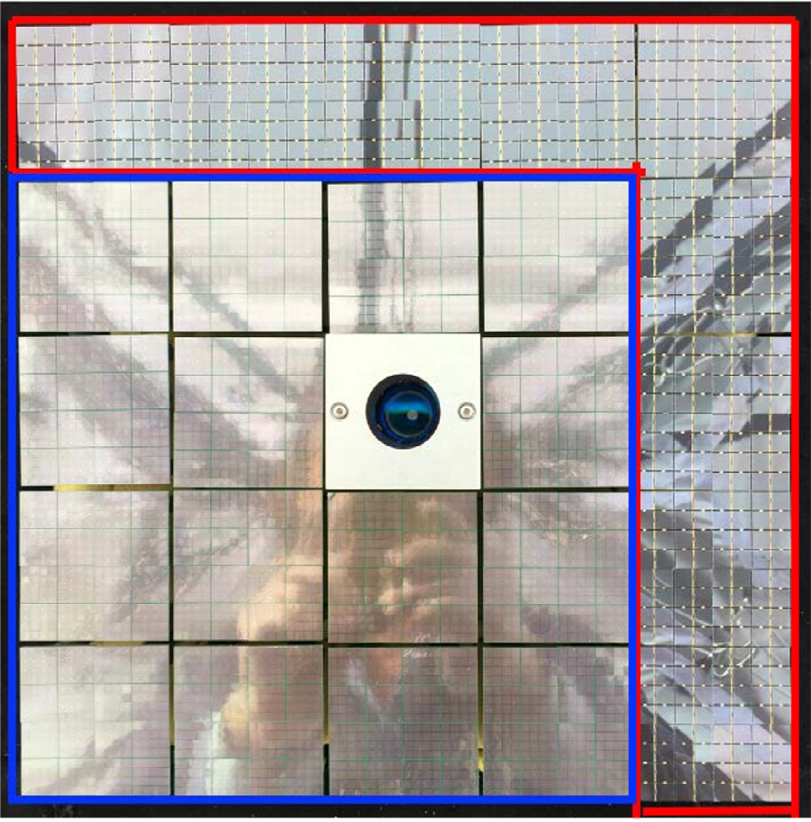
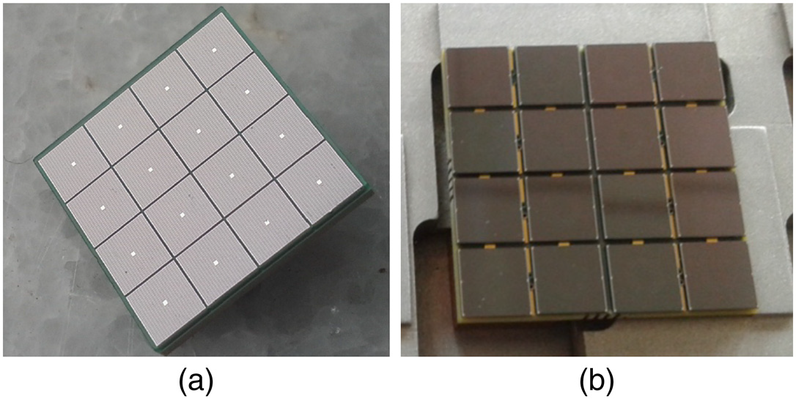
The pSCT camera
SiPM pixels providing much higher resolution air shower image
  Better angular resolution
  Better background rejection
Modular design:
  9 backplanes, 177 modules, 11’328 pixels
  Each module contains focal-plane module (FPM) + Frontend electronics (FEE)
  FPMs form a curved focal plane facing secondary mirror
Pre-upgrade configuration:
  25 modules, 1536 pixels, 2.68° FoV
  Hamamatsu (S12642-0404PA-50(X), USA,
  16 modules, 3x3 mm2 ) +
  FBK (NUV-HD3, Italy, 9 modules, 6x6 mm2) Silicon Photomultipliers (SiPMs)
FBK
HAM
Hamamatsu MPPC FBK HD3

Slide 10
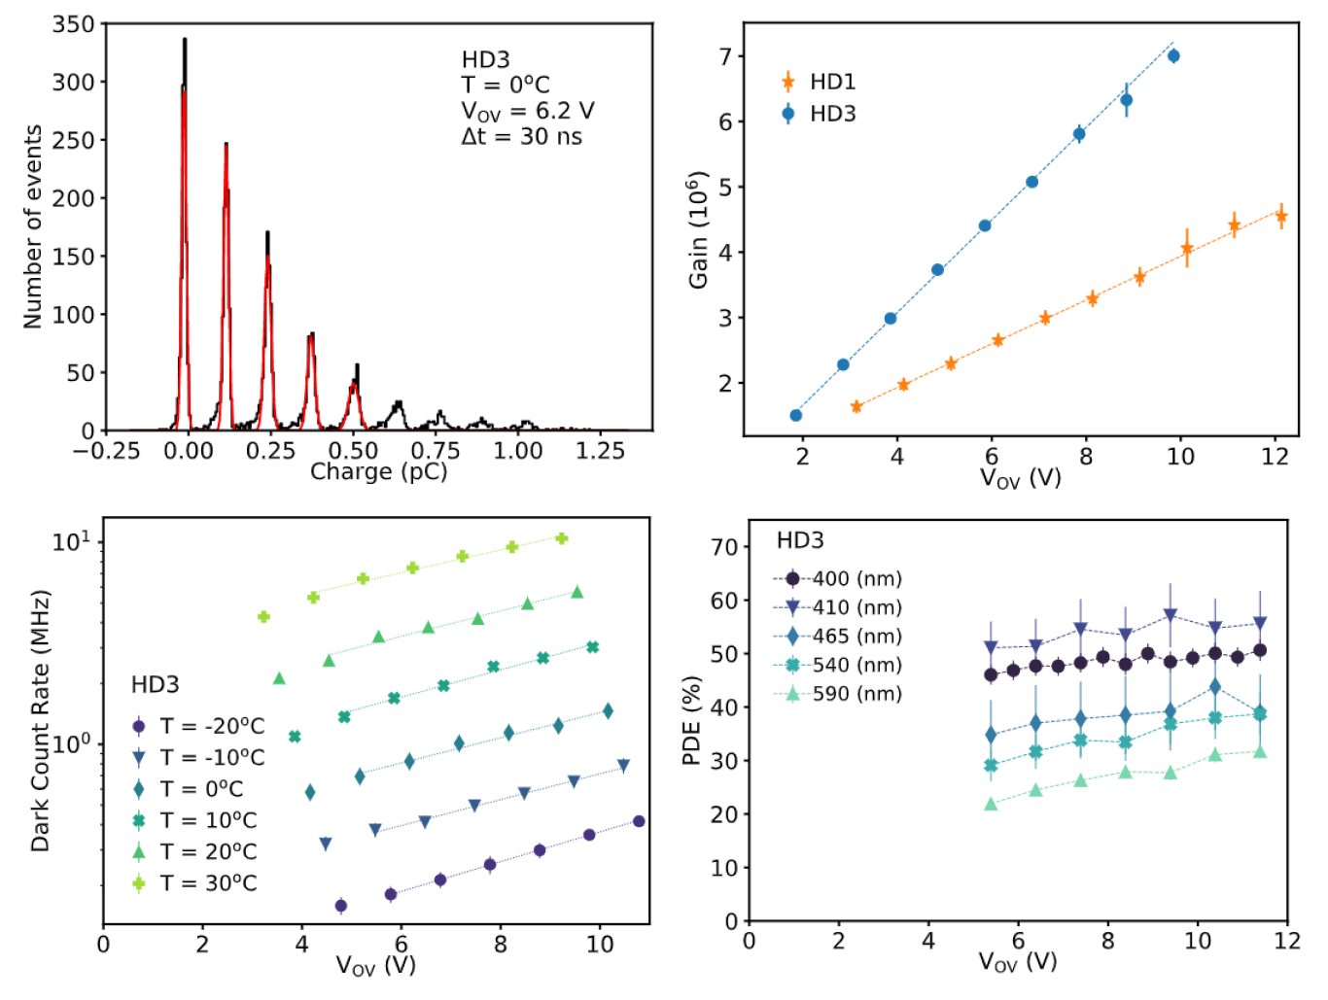
FBK NUV-HD SiPM
INFN involved in the development and testing of SiPMs suitable for Cherenkov light detection in the Near Ultraviolet (NUV SiPMs)
  NUV High-density (HD) SiPMs produced by Fondazione Bruno Kessler (FBK, Trento, Italy)
Main features:
  Wide dynamic range
  High Fill Factor (FF)
  Increased PDE at NUV wavelengths
  Low correlated noise
  40 x 40 μm² cell
  6 x 6 mm² area
G. Ambrosi et al. 2023, NIMA 1049(2023)168023

Slide 11
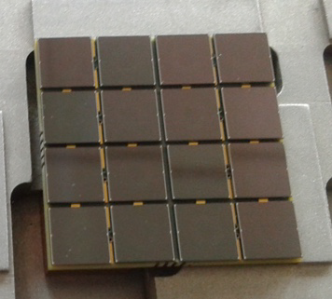
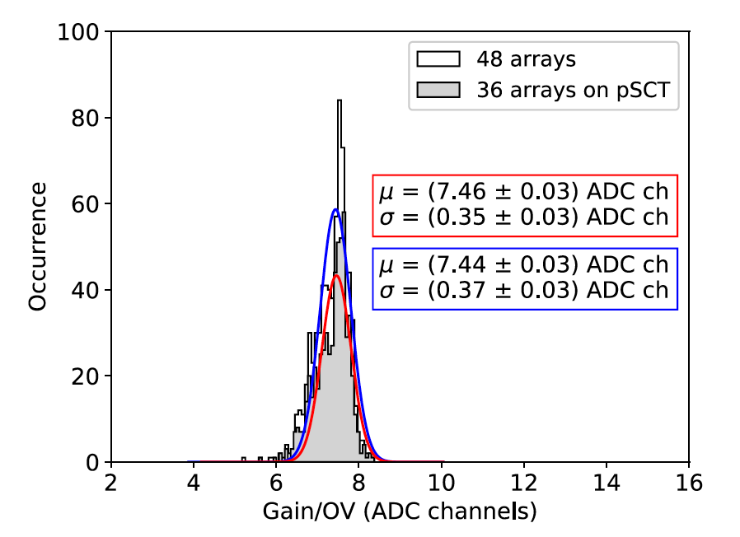
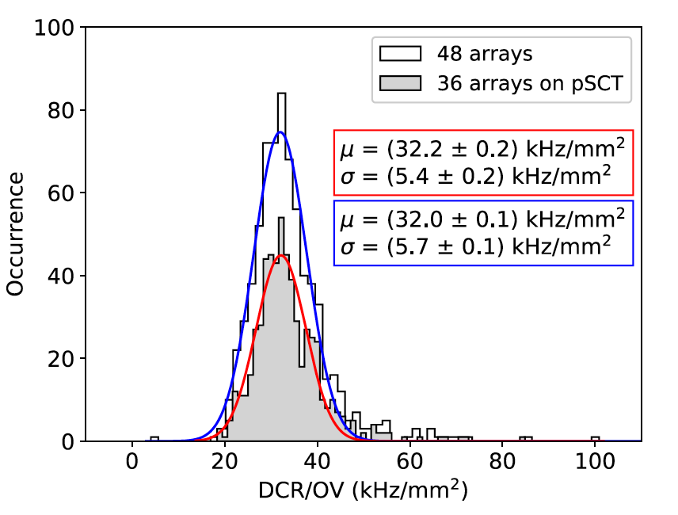
FBK NUV-HD SiPM
4x4 SiPM matrices assembled and tested
36 FBK NUV HD3 optical units assembled, tested and characterized at INFN laboratories in Italy
Study of performance and homogeneity in terms of breakdown voltage, gain, signal to noise ratio (SNR), and dark count rate (DCR)
G. Ambrosi et al. 2023, NIMA 1049(2023)168023

Slide 12
Frontend electronics
Front-End Electronics (FEE) functionalities:
  Amplification and digitization of SiPM signals
  Waveform data sampling and transfer to storage
  Low-level trigger generation
  Control of SiPM bias voltage
  Temperature monitoring and stabilization of FPM
Electronics distributed over 2 circuit boards,
primary and auxiliary
Based on TARGET7 chips
  7th generation TeV Array Readout with GSa/s sampling and Event Trigger
  Samples and digitizes 16 input channels
    Analogue ring buffer of 16k capacitors
    Storage of analogue waveforms @1GSa/s
  Trigger generation based on the sum of four
  adiacent pixels
Adams+2022
https://doi.org/10.1117/1.JATIS.8.1.014007

Slide 13
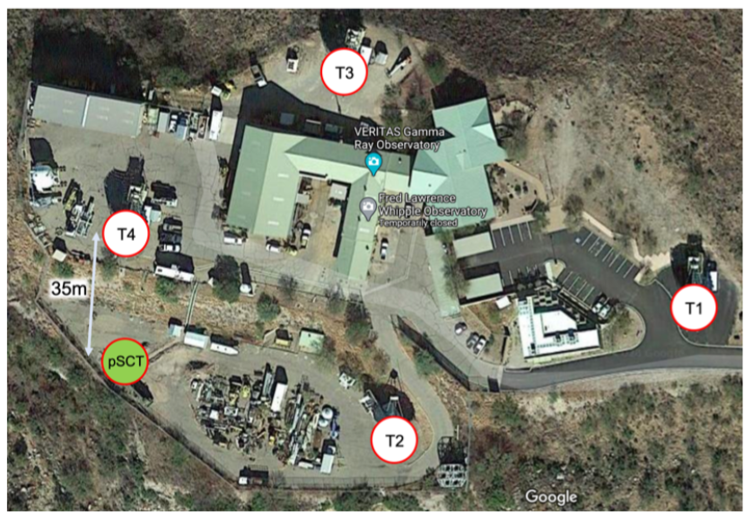
Crab detection with pSCT
First pSCT observation campaign conducted in January and February 2020
Total exposure (without correction for acquisition deadtime):
21.6 hours OFF, 17.6 hours ON
No full MC simulations → simultaneous VERITAS observations used to identify gamma-rays in shower events (2.2 hours)
Coincident events detected through time tagging
Adams+2021
https://doi.org/10.1016/j.astropartphys.2021.102562

Slide 14
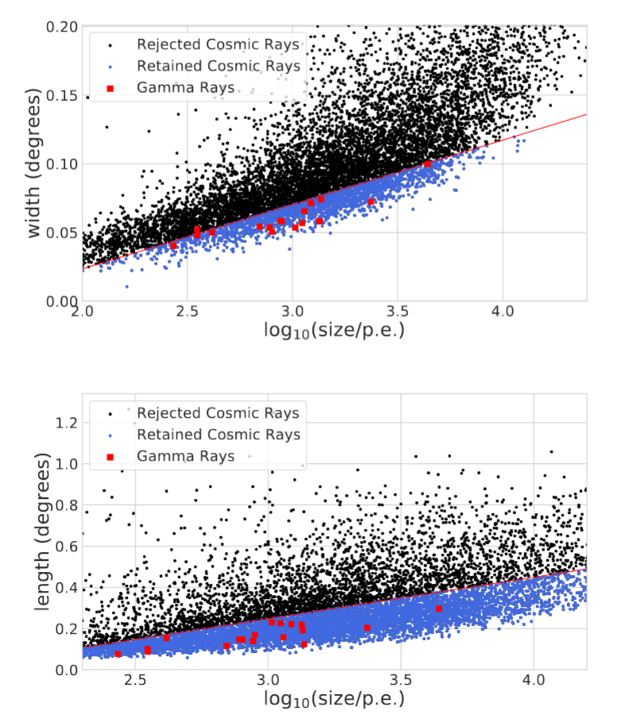
Crab detection with pSCT
Gamma-rays identified by Veritas used to define cuts on the pSCT sample
Detection of gamma-ray signal from the Crab Nebula with a statistical significance of 8.6 σ
Adams+2021
https://doi.org/10.1016/j.astropartphys.2021.102562

Slide 15
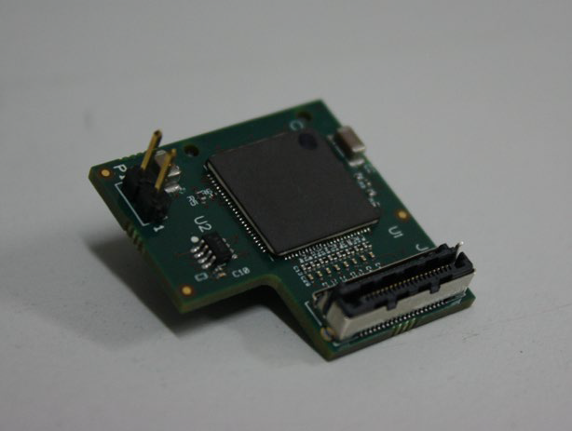
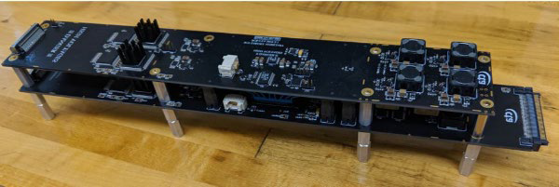
Camera upgrade
Populate all 9 camera sectors: 177 modules, 11328 pixels
SiPMs produced by FBK with high PDE and low optical CT
New electronics to reduce noise:
  SMART ASIC: Integrated preamplifier attached to SiPM boards
  CTC ASIC: 16-channel 1GSa/s digitizer
    Analog buffer with 16k cells per channel → 16 us storage depth
  CT5TEA ASIC: 16-channel trigger ASIC
    Channels are summed in groups of 4 to obtain 4 trigger pixels per ASIC
    Adjustable threshold for each group
New backend electronics and mechanics
Improvement in single photon resolution, lower minimum threshold and lower noise
Reduction of noise both on digitized signals and in the trigger circuit
SMART ASIC
CTC+CT5TEA FEE module

Slide 16
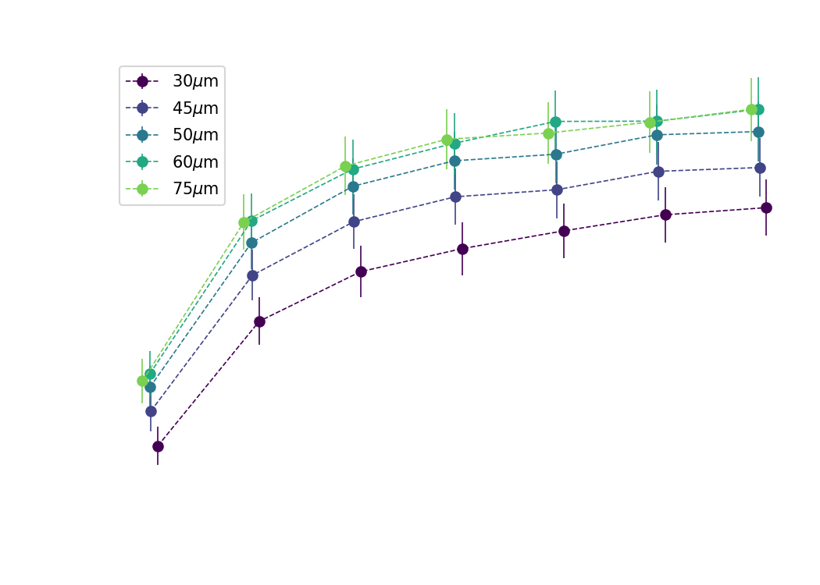
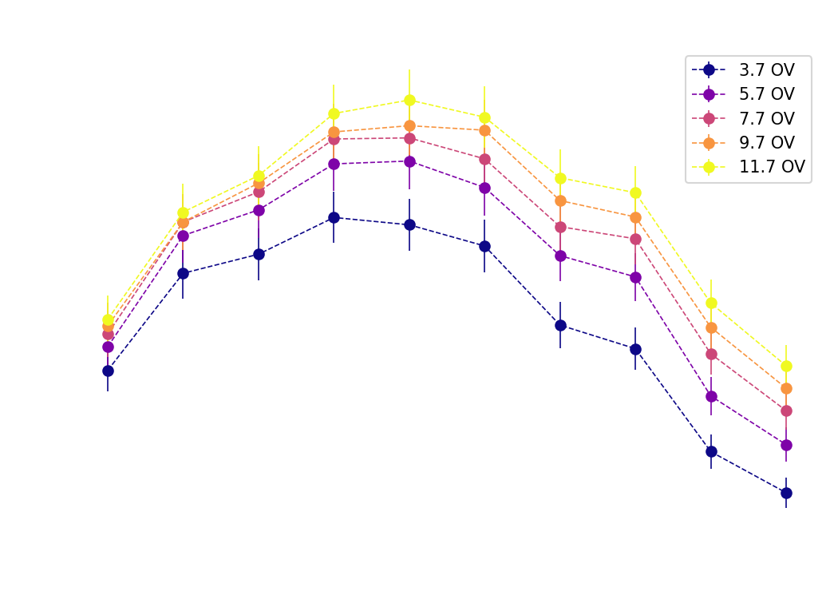


SiPM NUV-HD MT
P. Loizzo, Master’s thesis
SiPM technology developed by FBK
Reduced Cross Talk probability (<5%)
Maximum Photon Detection Efficiency (PDE) for wavelengths ranging between 420 nm to 450 nm
NUV-HD MT technology is well suited for Cherenkov light detection
Maximum PDE >60%
Close to 50% at 400 nm
$$λ=420 nm$$
PRELIMINARY
PRELIMINARY
Notes:
Ratio between detected/incident photons

Slide 17
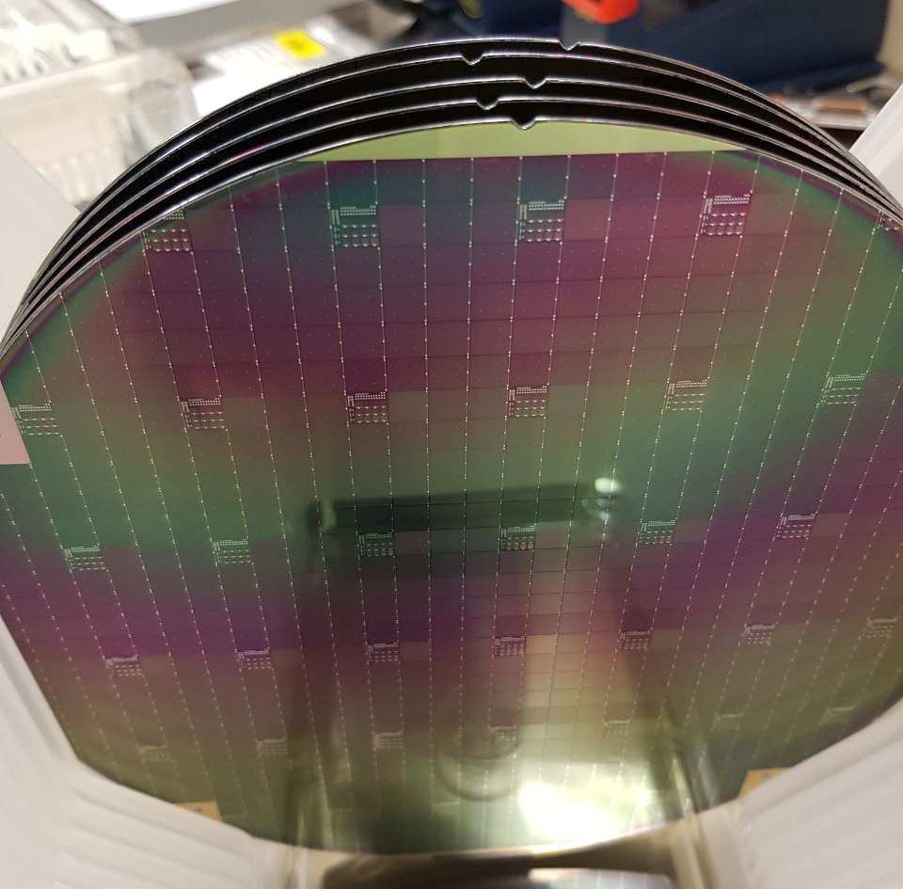
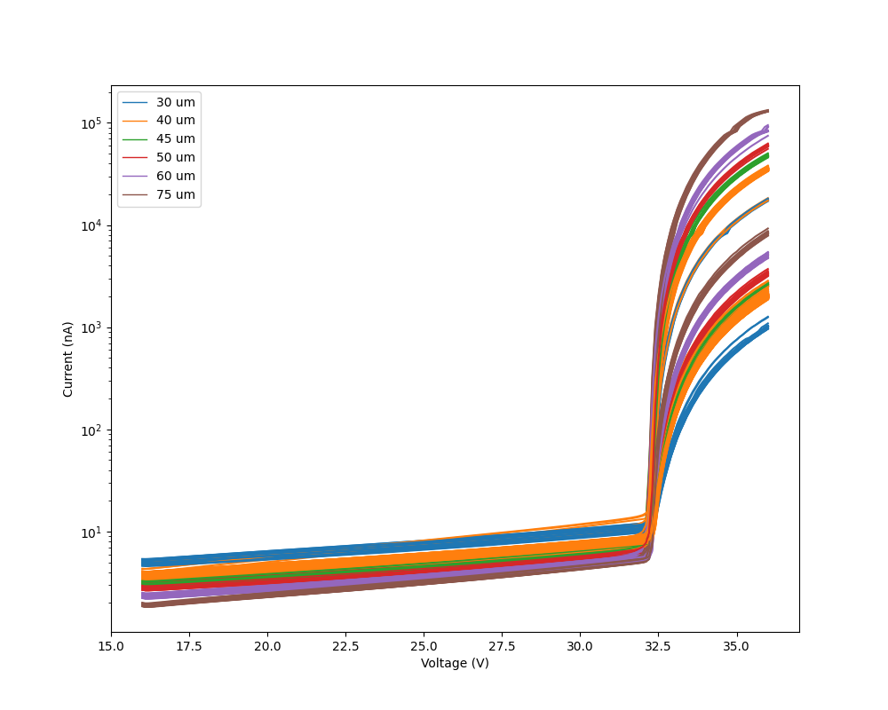
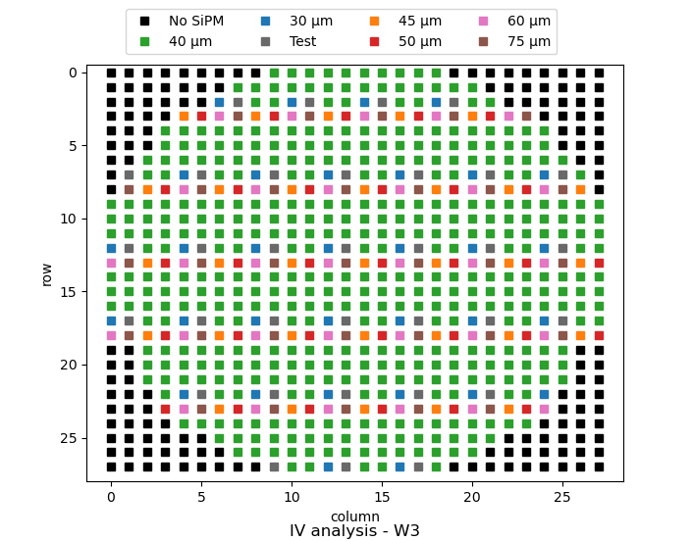
SiPM mass production
48 wafers of SiPMs produced in Lfoundry for a total amount
of about 20k SiPMs
Quality check with IV measurements on wafer performed
Assembly on SiPM matrices for pSCT telescope ongoing
Notes:
Two batches of 24 wafers each were produced by FBK. Each wafer contains approximately 600 SiPM, of which 447 are 40um, giving a total of 21k SiPM of 40 micrometres. Initially, current measurements were carried out with a 200mV step, but to shorten the measurement time, the step was increased first to 250 and finally to 300mV.

Slide 18
SMART: a SiPM Multichannel Asic for high-Resolution Cherenkov Telescopes
Pre-amplifier designed for photon counting
16-channel trans-impedance amplifier
20-bit global adjustment: gain (8 bits), bandwidth (6 bits), Pole-Zero (6 bits)
8-bit DAC for SiPM bias fine tuning
(1 DAC per channel)
Slow monitoring of SiPM current
(10-bit ADC)
1 MHz LVDS SPI interface
SPI
&
Digital control
Digital
Control Unit
10 bit
ADC
Analog
MUX
In_Ch0
Analog Channel 0
Out_Ch0
In_Ch1
Analog Channel 1
Out_Ch1
In_Ch15
Analog Channel 15
Out_Ch15
Global Bias
Designed by F. Licciulli & G. De Robertis at the Electronics CAD INFN Bari
Contact: francesco.licciulli@ba.infn.it

Slide 19
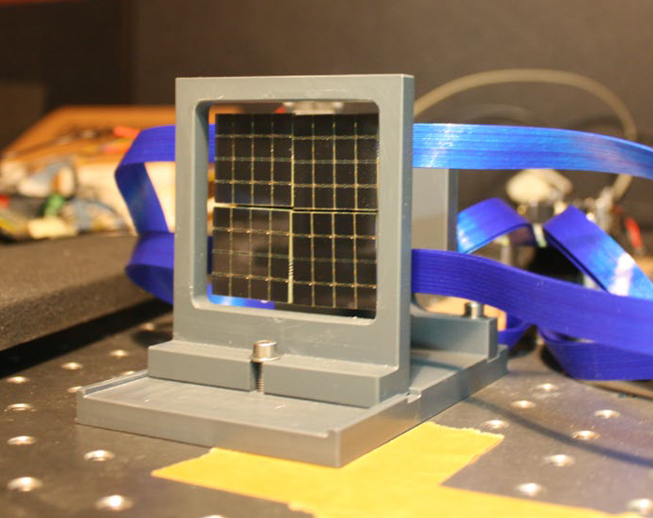
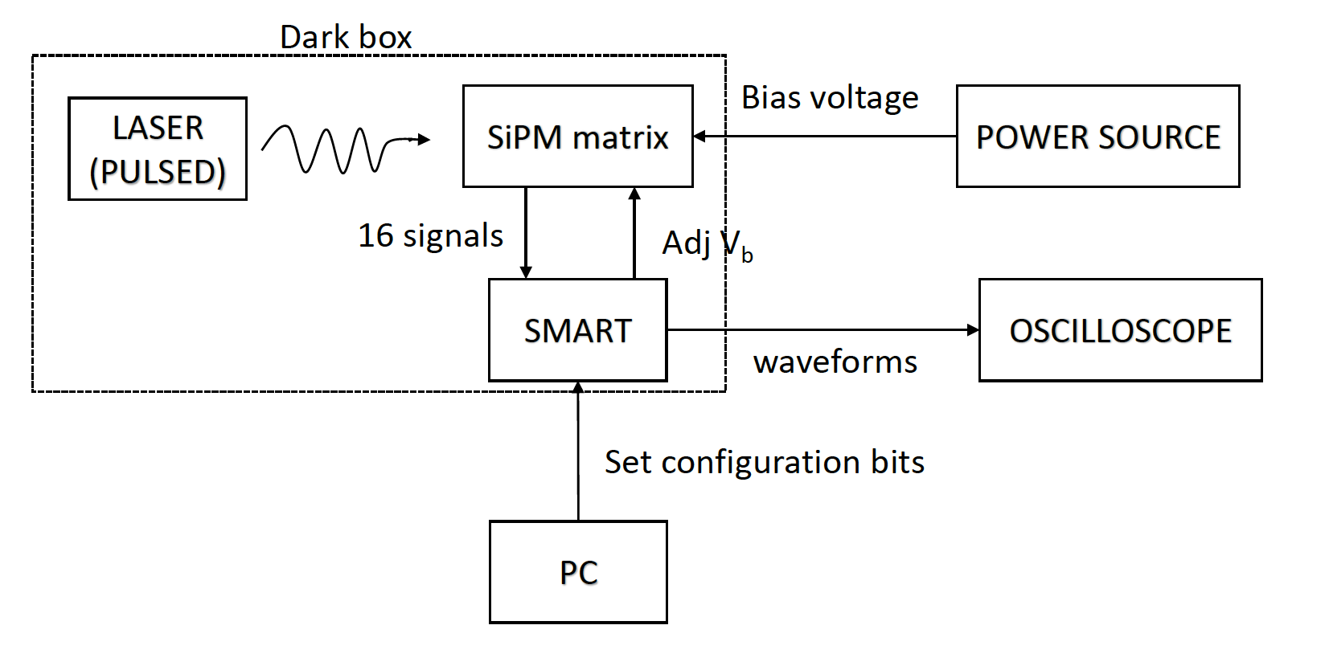
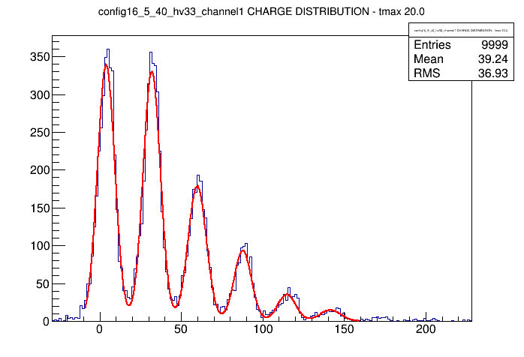
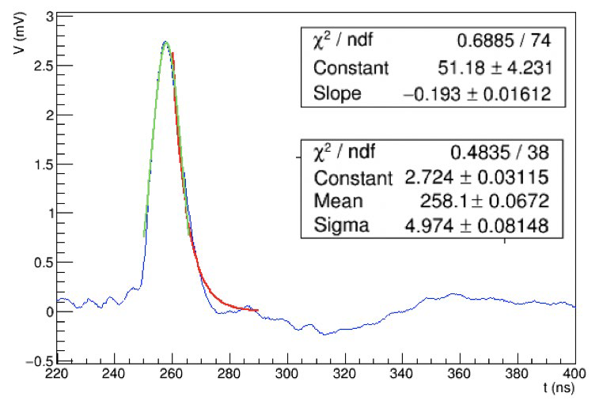
SMART laboratory tests
Gain, signal-to-noise ratio and pulse width as a function of configuration bits
  R : gain resistance
  C : filtering capacitance
  PZ: pole zero cancellation
External PZ fixed with discrete components
to match SiPM recovery time
Output dynamic range:
  900 mV without external PZ
  600 mV with external PZ
About 750 ASICs produced and
tested
Gain= (2.41±0.01) mV/pe
SNR_amplitude= 4.93±0.08
SNR_charge= 5.19±0.08
FWHM= (11.69±0.19) ns
tau = (5.81±0.43) ns

Slide 20
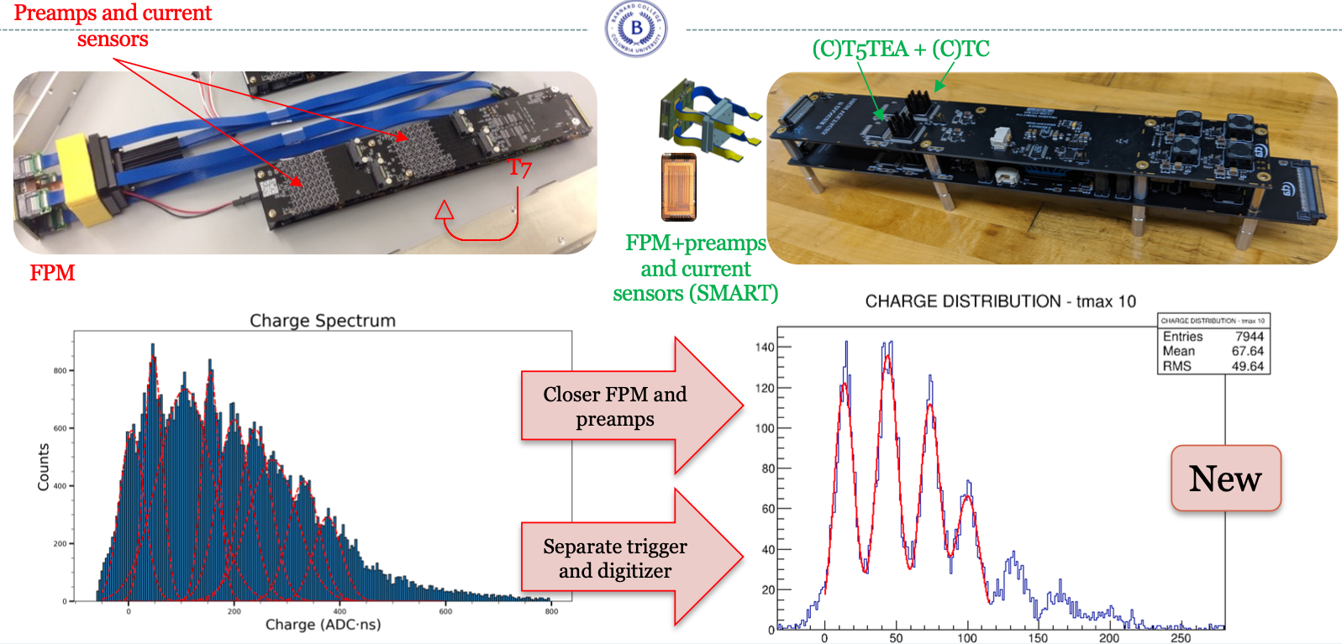
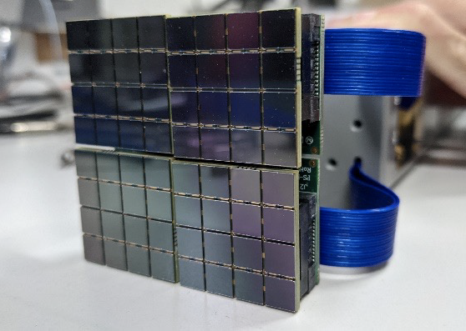
Upgraded electronics performance

Slide 21
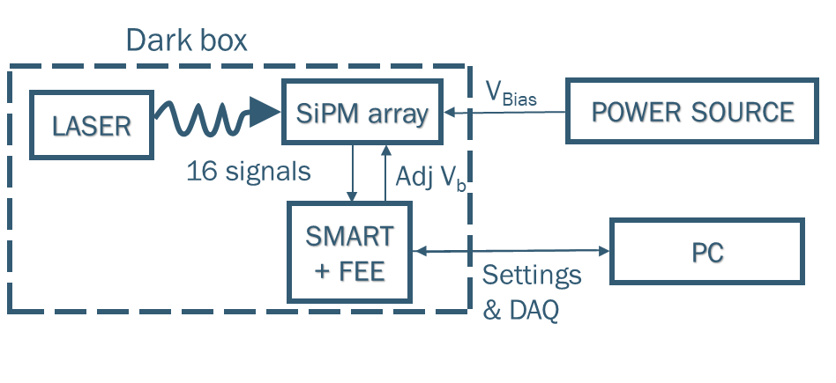

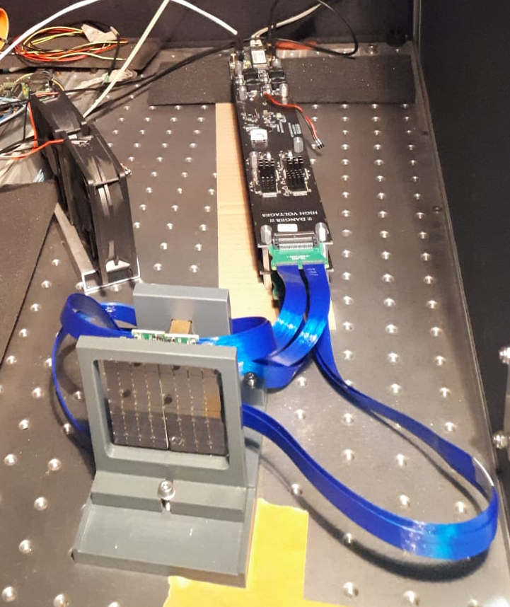
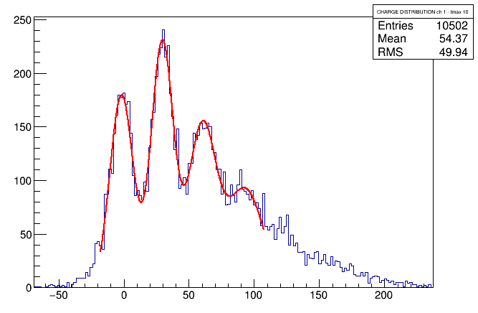
Upgraded electronics performance
Laser pulses to illuminate a full 64-channel module
Laser far away from SiPM arrays,
diffusing lens placed in between
to achieve uniform illumination
Readout consisting of + SMART + TC module
Single p.e. resolution achieved
10 ns integration time

Slide 22
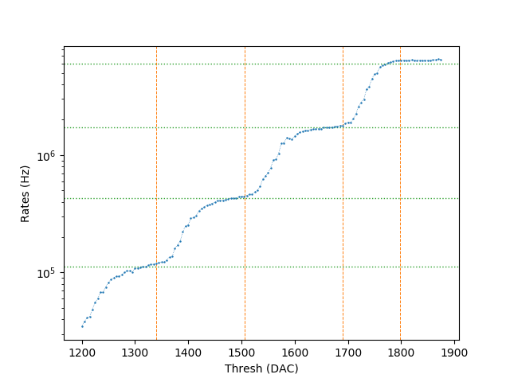
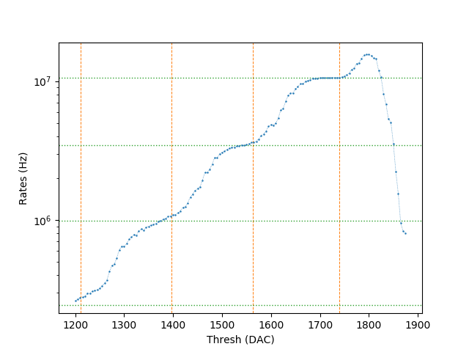
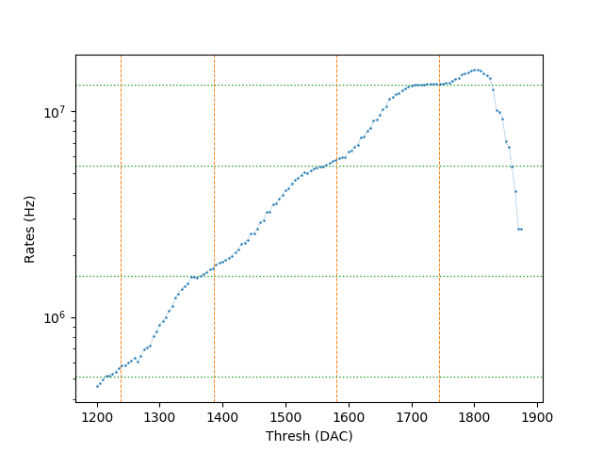
Upgraded electronics performance
Trigger on SiPM dark noise on groups of 4 pixels
Rate scan in threshold value trigger on one group
  Possibility to disable individual channels through SMART
Single p.e. plateaux in the rates visible
1 pixel on, 3 off
2 pixels on, 2 off
3 pixels on, 1 off

Slide 23

Summary
The Schwarzschild-Couder Telescope is one of the proposed designs
for the Medium-Sized Telescopes for CTAO
  Improved angular resolution and sensitivity with respect to single-mirror telescope
First prototype installed at the FLWO in Arizona and inaugurated in Jan 2019
  Optics aligned reaching pre-construction estimated PSF – Dec 2019
  Crab detection – May 2020
Camera upgrade ongoing
→ install new camera on pSCT in 2024-2025
Stay tuned!
Acknowledgements:
https://www.cta-observatory.org/consortium_acknowledgments/

Slide 24
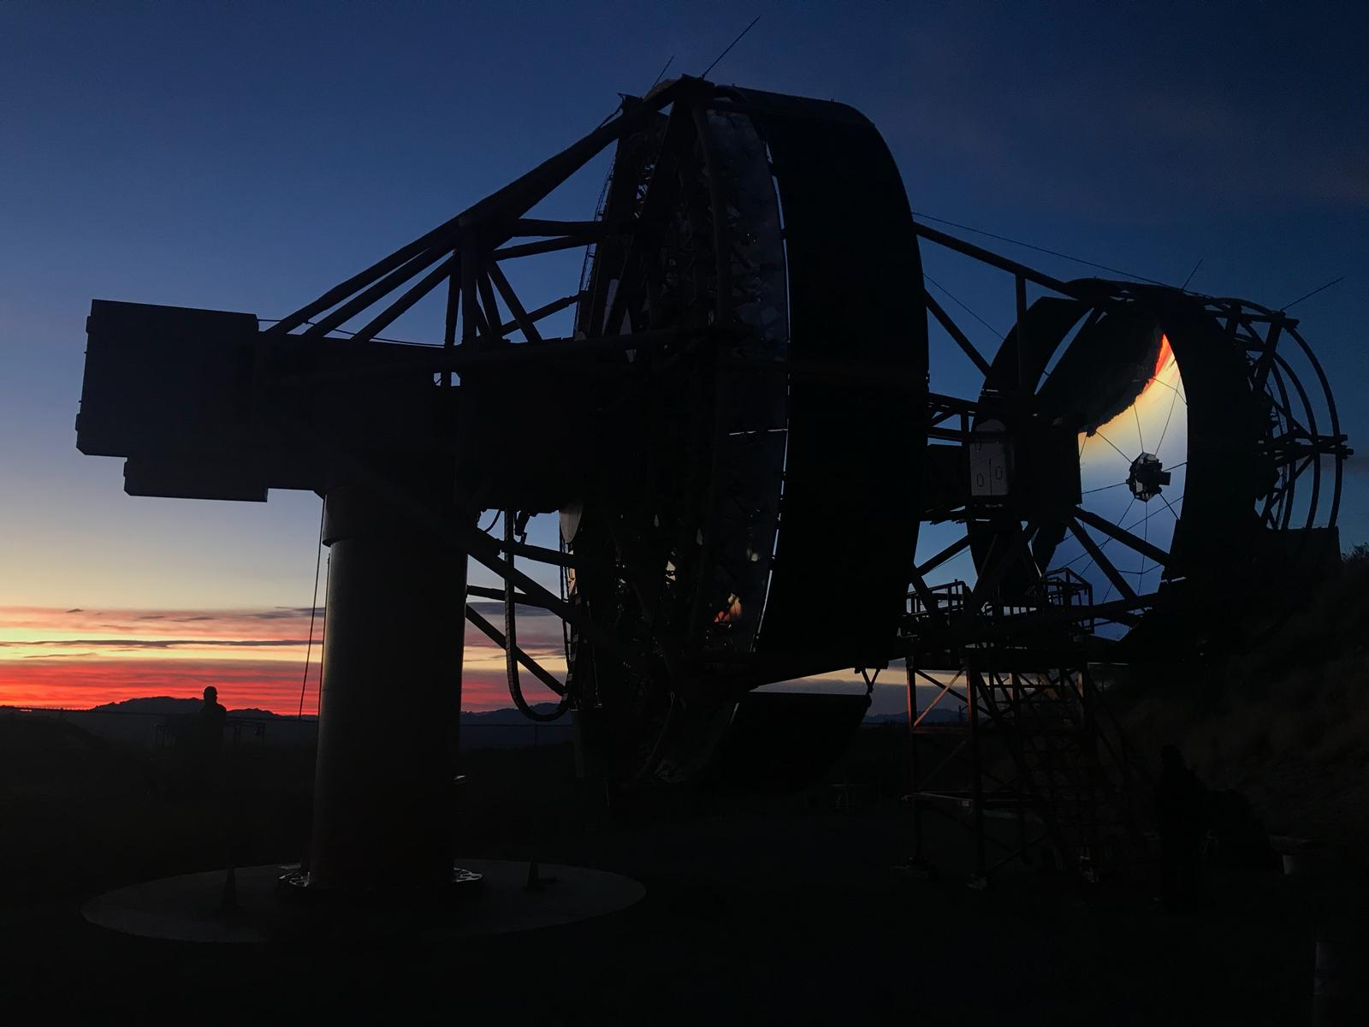
Thanks!

