Slide 1
Technology and benchmark evolution last update 30-june-2023
Andrea Chierici

Slide 2
General aspects and common technologies

Slide 3
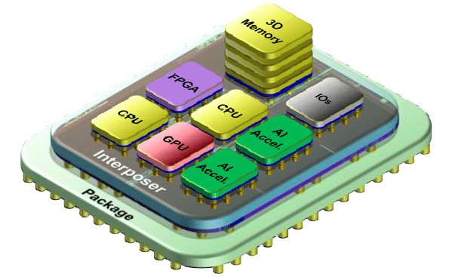

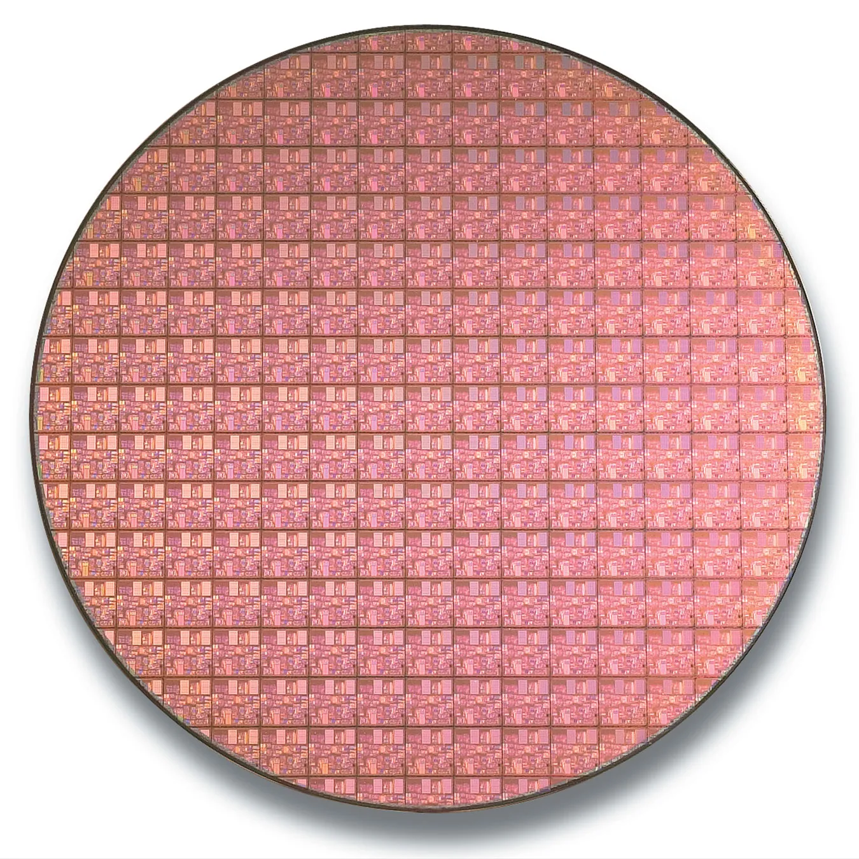
Introducing the “chiplet” (a.k.a. tile)
Chiplets are small, modular chips that can be combined to form a complete system-on-chip (SoC).
  designed to be used in a chiplet-based architecture, in which multiple chiplets are connected to create a single, complex integrated circuit.
  offer several benefits over traditional monolithic SoCs, including improved performance, reduced power consumption, and increased design flexibility.
Universal Chiplet Interconnect Express (UCIe)
  Promoters include Intel, AMD, ARM, e Samsung
  Trying to define standards to allow integration of chiplets from different manufacturers within the same chip.
A modern CPU like AMD EPYC gen3, is composed of separated modules containing core, memory controller, PCIe bus.
  All built with different fabrication technology

Slide 4
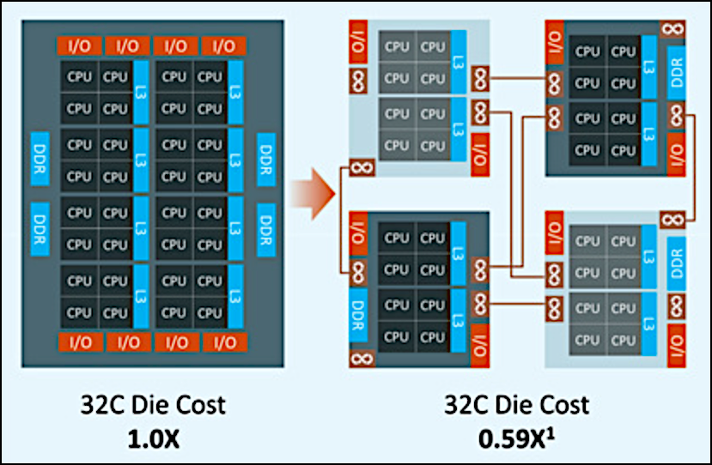
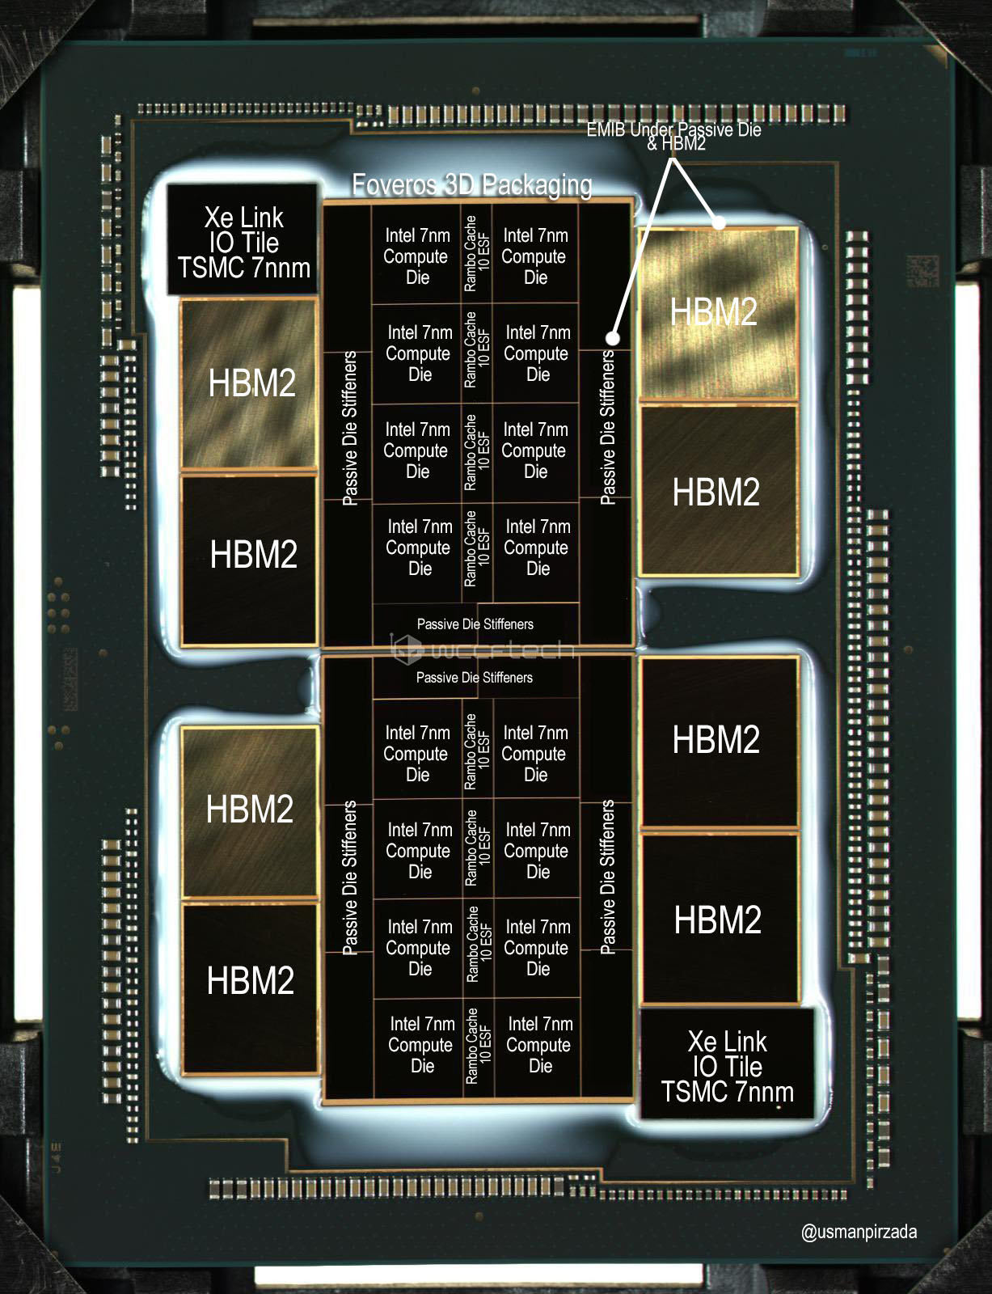
Chiplet: example (1)

Slide 5
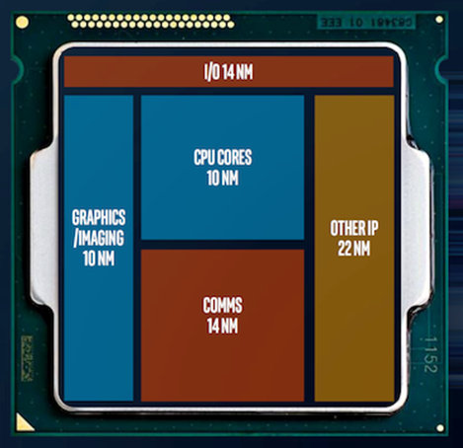
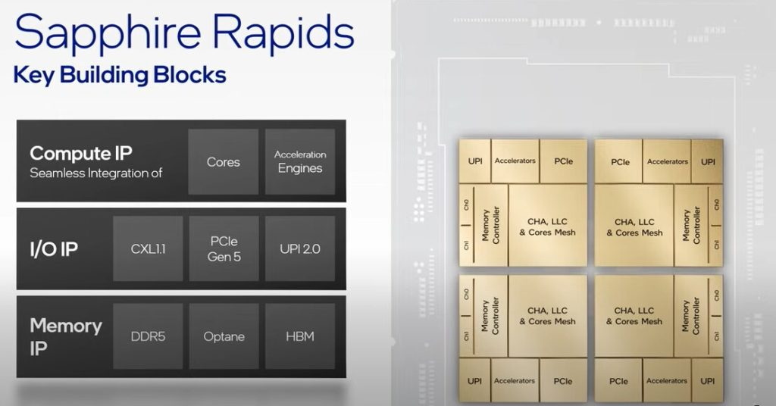
Chiplet: example (2)

Slide 6
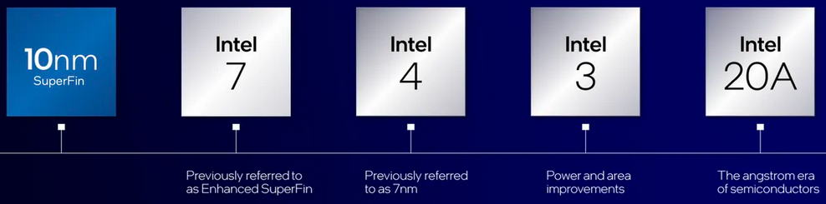
Fabrication technology
In a CPU, nm is used to measure the size of the transistors that make up a processor.
In technological terms, a processor's nm is also referred to as a process node or technology process, or just node.
  It is the manufacturing process and design of a CPU made through lithography.
Lower nm is better for your machine due to the following reasons
  More power efficient
  Less cooling required
  Transistors are faster
  Transistor density is higher
14nm, 10nm, 7nm… today the terms are used primarily as marketing terms to refer to new or improved generation of chips

Slide 7


Major foundries are in Asia
Top 5 semiconductor companies
  TSMC 55% Taiwan, Samsung 13% Korea,
  Globalfoundries 7% USA, UMC 6% Taiwan, SMIC 5% China
On 8 February 2022, the European Commission proposed the Chips Act, a comprehensive set of measures to confront semiconductor shortages and strengthen Europe’s technological leadership
  And yet ASML, the largest supplier for the semiconductor industry and the sole supplier in the world of extreme ultraviolet lithography, is Dutch.
Notes:
Tutto, in realtà, è nato da una dichiarazione di un membro del Congresso, Seth Moulton, secondo il quale gli Stati Uniti dovrebbero avvertire la Cina di essere pronti a far "esplodere" TSMC se attaccasse Taiwan.

Slide 8
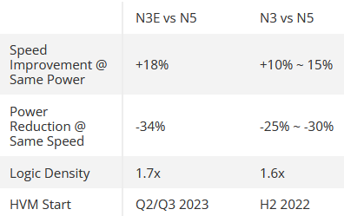
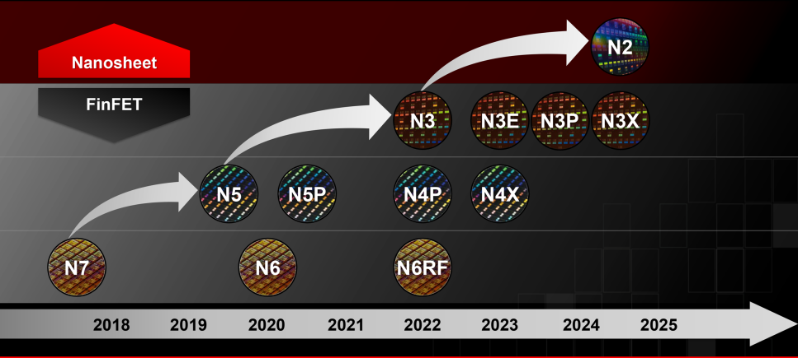
TSMC Roadmap
Specifically targeted for HPC
+15% vs N5 performance

Slide 9


Slide 10
CPU roadmap

Slide 11
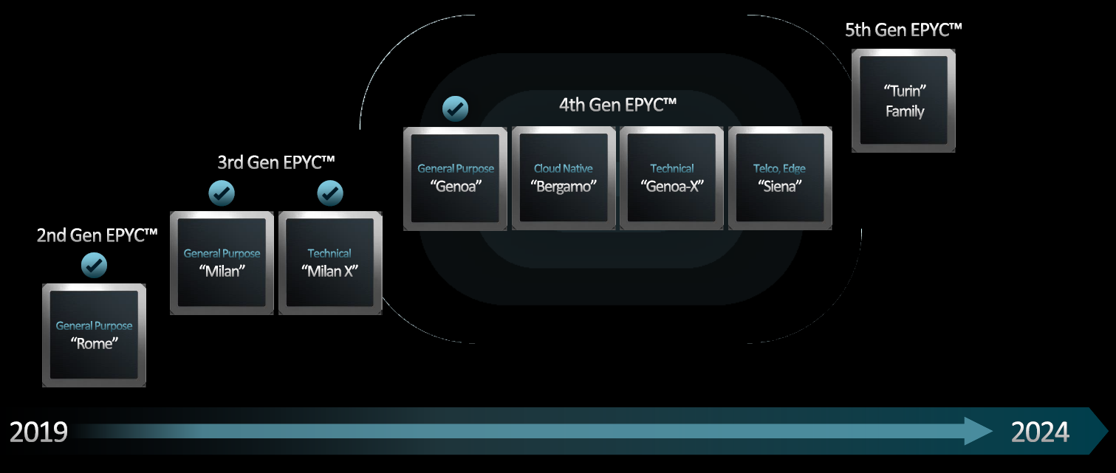
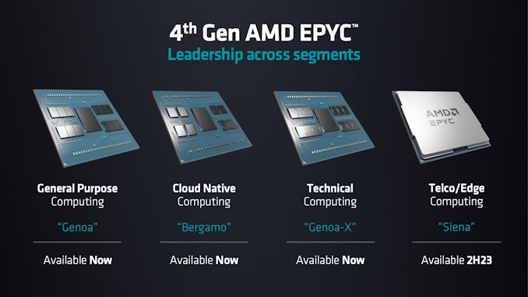
EPYC family
Sticking to “regular” cadence and “flawless” execution
Carved the datacenter up into four segments:
  General purpose - socket level performance
  Technical – core level performance
  Cloud-native – maximum core and
  thread density
  Telco/Edge – lower-cost platform
Just announced

Slide 12
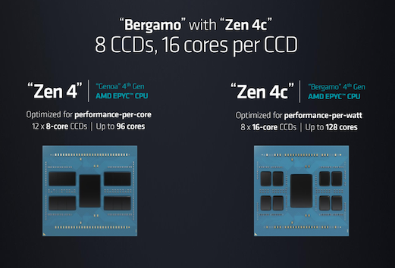
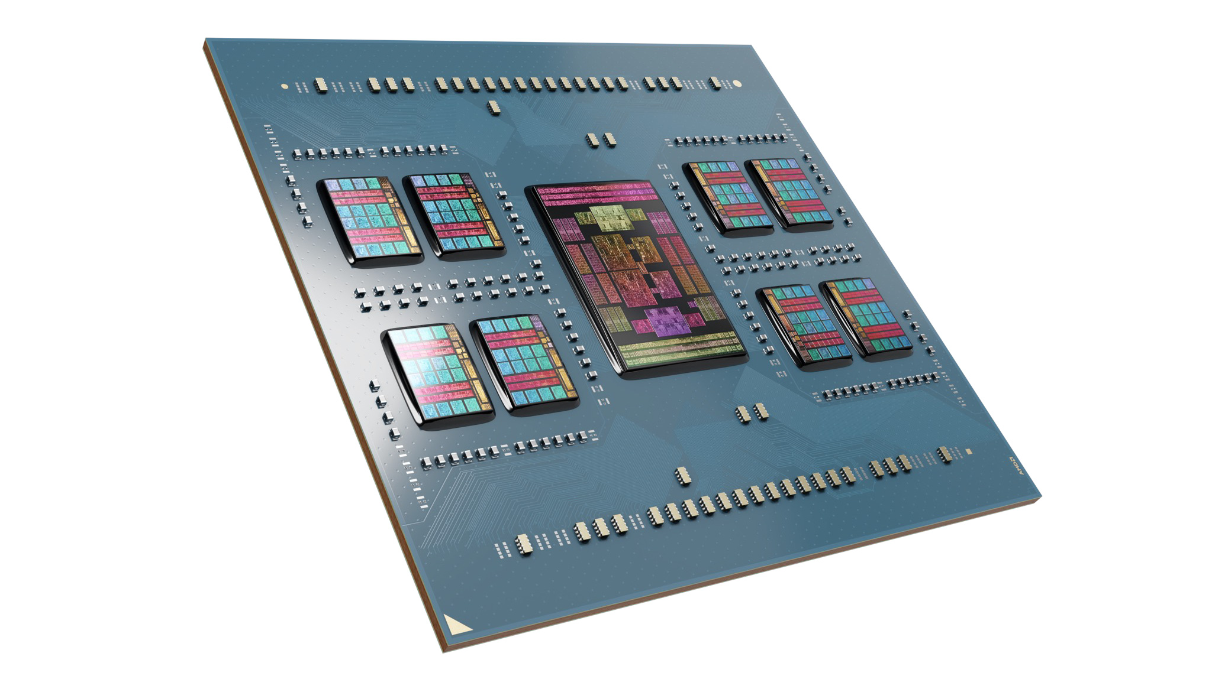
Introducing EPYC 97x4 «Bergamo»
CPU | Core/ Thread |  | Base Freq | 1T Freq | L3 Cache | PCIe | Memory | TDP (W) | Price (1KU)
9754 | 128 | 256 | 2250 | 3100 | 256MB | 128 x 5.0 | 12 x DDR5-4800 | 360 | $11,900
9754S | 128 | 128 | 2250 | 3100 | 256MB | 128 x 5.0 | 12 x DDR5-4800 | 360 | $10,200
9734 | 112 | 224 | 2200 | 3000 | 256MB | 128 x 5.0 | 12 x DDR5-4800 | 320 | $9,600
Taken several steps to boost CPU core density.
  Redesigning the architectural layout to favor density over clock
  speeds – high clock speed circuits are a trade-off with density,
  and vice versa
  cutting down the amount of cache per CPU core.
  More CPU cores within an individual Core Complex Die (CCD);
  whereas Zen 4 is 8 cores per CCD, Zen 4c goes to 16 cores per CCD.
Compete with Arm-based rivals with Ampere, Amazon, and others using Arm
architecture cores to fit 128 (or more) cores into a single chip

Slide 13
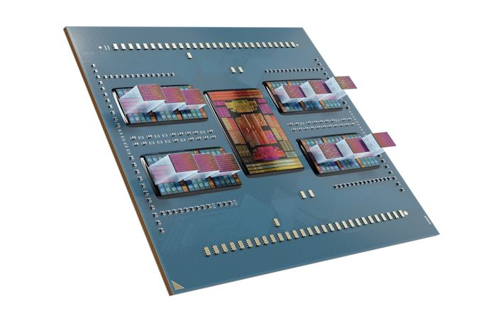
Introducing EPYC «Genoa-X»
CPU | Core/ Thread |  | Base Freq | 1T Freq | L3 Cache | PCIe | Memory | TDP (W) | Price (1KU)
9684X | 96 | 192 | 2550 | 3700 | 1152MB | 128 x 5.0 | 12 x DDR5-4800 | 400 | $14,756
9384X | 32 | 64 | 3100 | 3900 | 768MB | 128 x 5.0 | 12 x DDR5-4800 | 320 | $5,529
9184X | 16 | 32 | 3550 | 4200 | 768MB | 128 x 5.0 | 12 x DDR5-4800 | 320 | $4,928
large cache capacity “Genoa-X” EPYC processors
  V-cache equipped EPYC server CPU, augmenting the L3 cache capacity of AMD’s core complex dies by stacking a 64MB L3 V-cache die on top of each CCD.
  A fully-equipped Genoa-X CPU can offer up to 1152MB of total L3 cache.
Niche market segment of workloads that benefit specifically from the additional cache
  workload needs to be cache capacity limited – that is to say, it needs to significantly benefit from having more data available on-chip via the larger L3 cache.
  fluid dynamics, databases, and electronic design automation

Slide 14
5th gen EPYC (Turin)
Based on Zen 5 architecture, 4nm
Expected end 2024
4nm node
Four variants: plain, with 3D V-Cache, Zen 5c, AI
  Plain should have 128 cores, up to 500W TDP
  3D V-Cache is a packaging technology that stacks additional layers of cache on top of a CPU
  Zen 5c is the version with high core count, up to 192 (rumored 3nm)
  AI version should include a Zen 5c plus an AI chiplet
1 socket could be enough in many situations
  Cheaper platform
  Still high core count

Slide 15
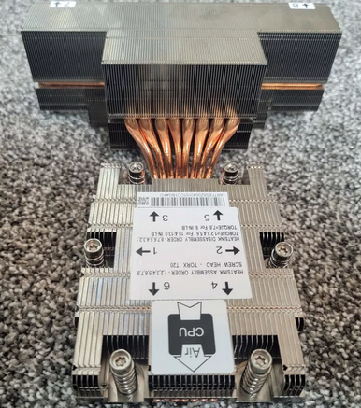
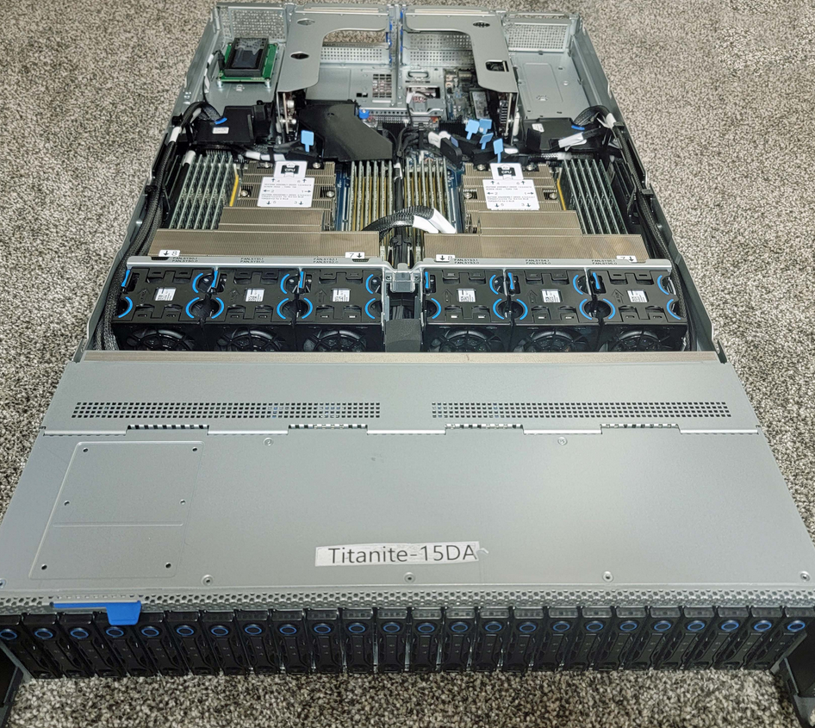


Cooling
128 cores Turin has a default TDP of 500W
  In 2P configuration 1KW only for CPUs! 2U servers!

Slide 16
GPU roadmap

Slide 17

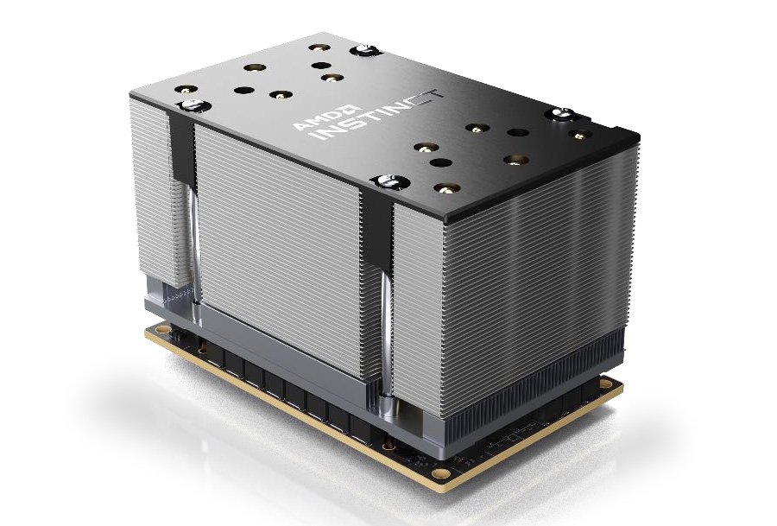

AMD GPUs in Data Center
GPU architecture for Data Center is called CDNA - RDNA is for
Current “Instinct” MI200 family is based on CDNA 2
Thanks to IF links, can achieve coherent memory space between CPU and GPU (advantages for the right workloads)
For the MI250x the form factor is the OCP Accelerator Module (OAM)
  Can reach 700W for a single card
  Can potentially offer interoperability
  with other OAM hardware
Frontier supercomputer is based on it
  #1 top 500

Slide 18
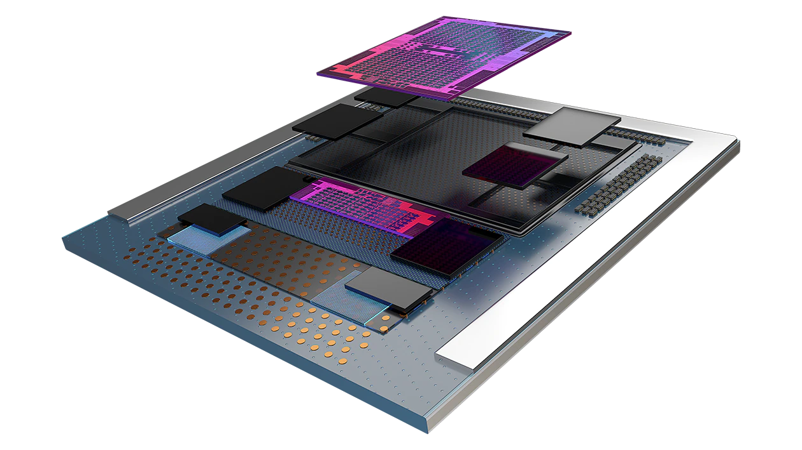
Next gen: MI300 Data Processing Unit
Combining AMD CPU and GPU technologies
  multiple chiplets built on 5nm process
  3D die stacking over a base die
  paired with on-package HBM memory to maximize bandwidth
Specs
  146B transistors
  24 Zen4 CPU cores
  CDNA 3 CU
  128GB HBM3 memory

Slide 19

Next gen: MI300 XPUs
MI300A, combining AMD CPU and GPU technologies
  multiple chiplets built on 5nm process (3 CPU + 6 GPU chiplets)
  3D die stacking over a base die
  paired with on-package HBM memory to maximize bandwidth
  No competitors this year
MI300X pure high-perf GPU with 192GB HBM3 memory
  replaced MI300A's trio of CPU chiplets with just two CDNA 3 GPU chiplets
    12 chiplet design overall - 8 GPU
    chiplets and 4 IO memory chiplets

Slide 20
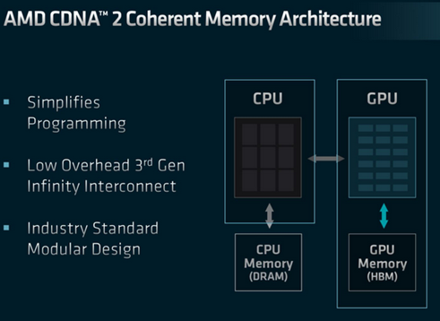
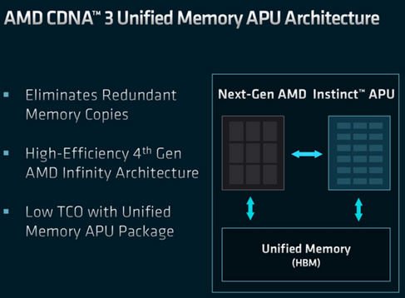
MI300A: Unified memory
Unified memory PROS
  Performance increased by eliminating redundant memory copies
  CPU no longer needs to copy data over to the dedicated memory pool
  No additional memory (DRAM) is required
  No static memory allocation between CPU and RAM
Unified memory CONS
  Memory on chip can’t be increased

Slide 21
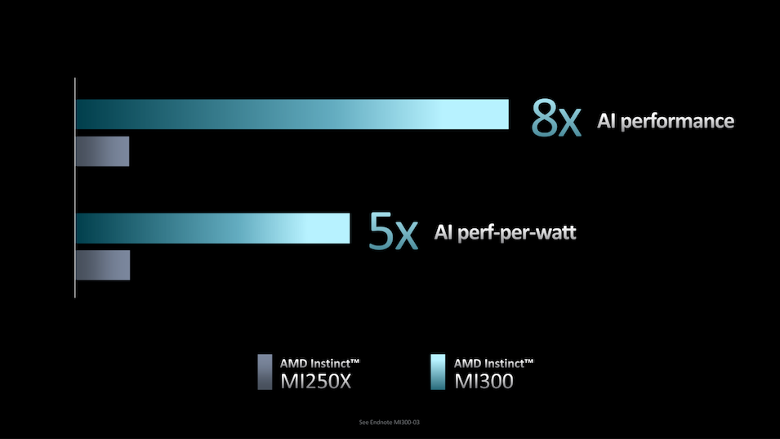

MI300A: Figures and results
According to AMD
  >5x improvement in AI performance-per-watt
  versus the MI250X (Frontier GPU)
  overall >8x improvement in AI training performance
  simplify HPC programming at a socket level by giving both processor types direct access to the same memory pool
    not just a unified virtual memory space with copies to hide the physical differences
    A truly shared and physically unified memory space

Slide 22
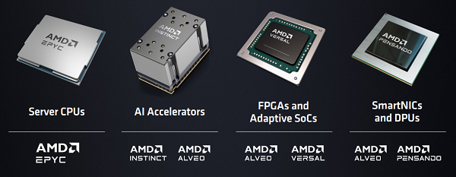
Product portfolio

Slide 23


Slide 24
CPU roadmap

Slide 25
Xeon Roadmap - details
Xeon Scalable Generations
Date | Generation | Codename | Abbr. | Max Cores | Node | Socket
Q3 2017 | 1st | Skylake | SKL | 28 | 14nm | LGA 3647
Q2 2019 | 2nd | Cascade Lake | CXL | 28 | 14nm | LGA 3647
Q2 2020 | 3rd | Cooper Lake | CPL | 28 | 14nm | LGA 4189
Q2 2021 |  | Ice Lake | ICL | 40 | 10nm | LGA 4189
Q1 2023 | 4th | Sapphire Rapids | SPR | 60 P | Intel 7 | LGA 4677
Q4 2023 | 5th | Emerald Rapids | EMR | >60 P | Intel 7 | LGA 4677
H1'2024 | 6th? | Sierra Forest | SRF | 144 E | Intel 3 | ?
2024 |  | Granite Rapids | GNR | ? P | Intel 3
2025 | 7th? | Clearwater Forest | CWF | ? E | Intel 18A | ?
? |  | Next-Gen P | ? | ? P | ?

Slide 26
Sapphire rapids
4th Generation Xeon Scalable chip come with XCC, MCC, and HBM Variants
  XCC ties together four compute tiles into one logical CPU. Each tile has up to 15 active cores that allow Intel to build up to 60 core CPUs
  HBM is a variant of XCC rebranded as Xeon Max
    Each of the four tiles gets its own 16GB HBM2e memory stack for 64GB of high-speed HBM2e memory on the CPU package
  MCC is almost like an update to the previous generations of Xeons as a monolithic die
    Half to a quarter of the onboard acceleration capability
    TDP range is 125W to 350W with up to 32 active cores

Slide 27
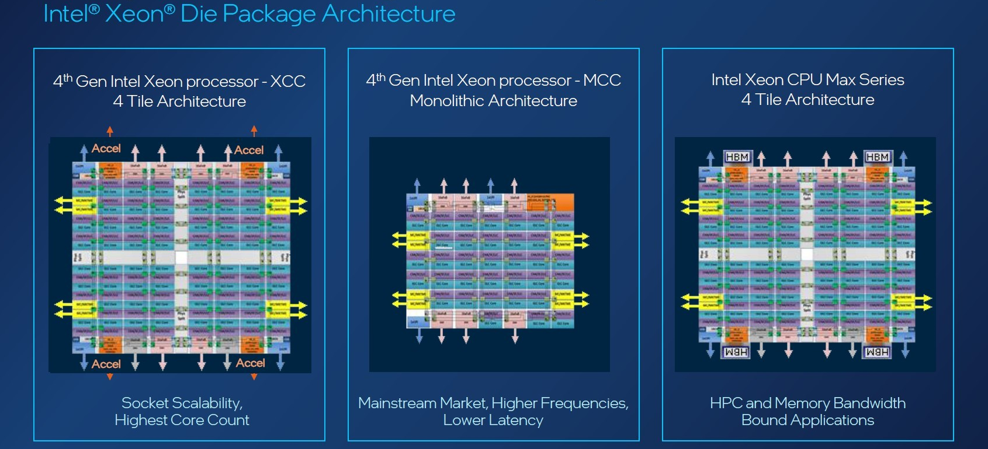
Sapphire rapids die architecture

Slide 28
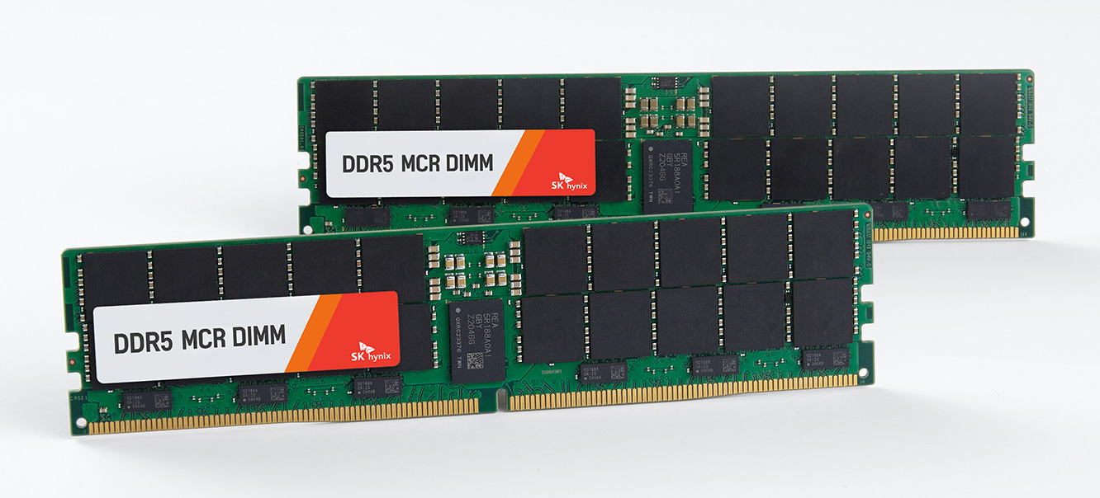
Granite Rapids
Granite Rapids is a tile-based architecture, with separate compute and I/O tiles – an evolution from Sapphire Rapids
Tiles are being built on the Intel 3 process
Will also come with a notable new memory feature: MCR DIMM support.
  Multiplexer Combined Ranks (MCR) DIMMs
  essentially gang up two sets/ranks of memory chips
  in order to double the effective bandwidth to
  and from the DIMM
  Aiming to get data rates equivalent to
  DDR5-8800 (or higher) speeds
  Preliminary tests show 1.5TB/s on a dual
  socket system, 12 channels

Slide 29
Introducing E-cores and P-cores
x86 CPUs used core layouts comprised of cores that are, for the most part, identical to one another.
  Each core has the same processing capacity and clock speed
British semiconductor developer Arm decided to switch things up with what's known as a big.LITTLE architecture.
  ARM architectures effectively have two sets of cores doing different tasks.
    The bigger, performance-focused cores handle the heavier tasks
    the smaller, efficiency-oriented cores take up background tasks while consuming way less energy.
Intel first introduced this approach in Alder Lake chips (for clients) two sets of CPU cores: E-cores and P-cores.

Slide 30
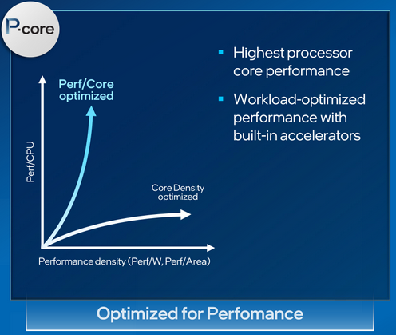
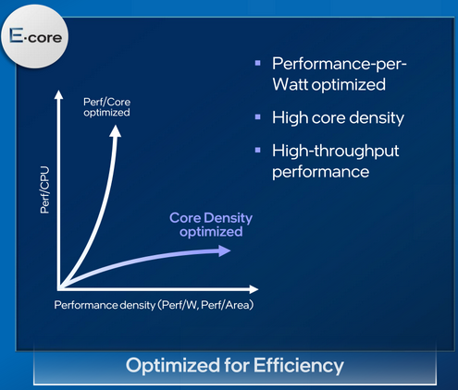
Sierra Forest (H1-2024)
First E-core Xeon
Using only optimized “efficiency cores”
Up to 144 processor cores
Built for cloud-optimized workloads
Sharing the same platform as Granite rapids
  Also, same I/O tiles
P-core and E-core Xeons are remaining distinct product lines.

Slide 31
GPU roadmap

Slide 32


A bit of a bombshell
Intel cancelled multiple server GPU products that were planned
  No more HPC-class Rialto Bridge GPU this year
Falcon shores delayed until 2025
Previous roadmap was too tight
  Two-year product release cadence for server GPUs.
Announce given at 5pm on a Friday, just when stock exchange was closing…

Slide 33
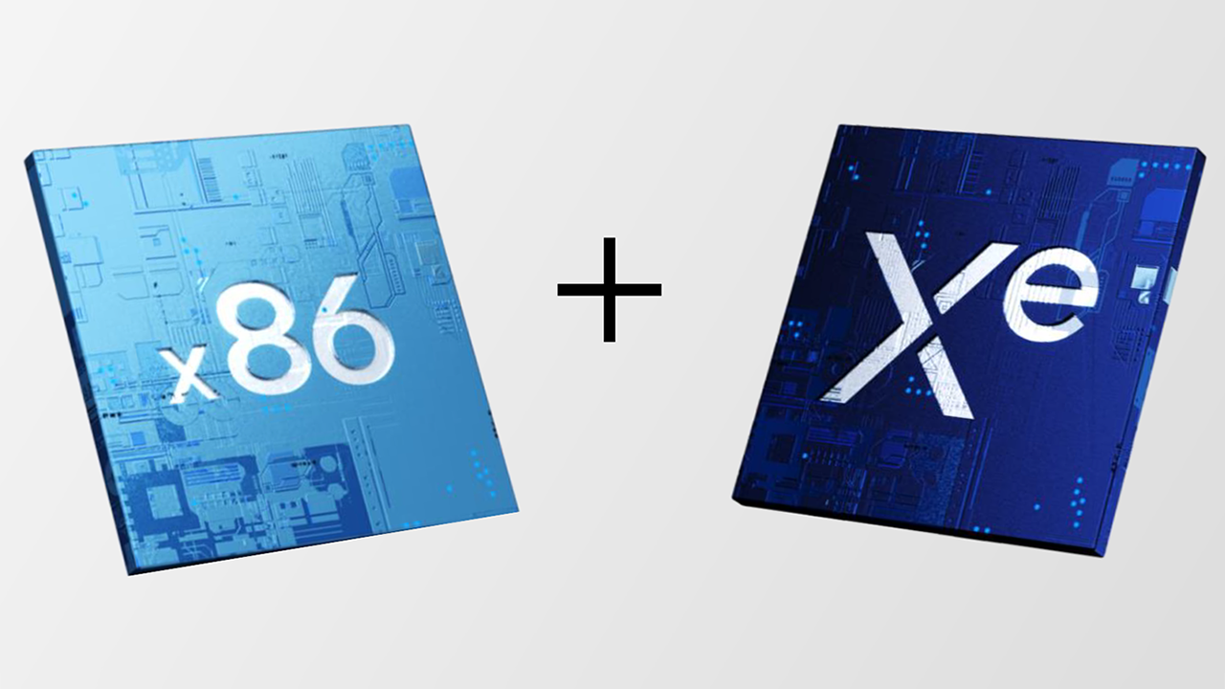

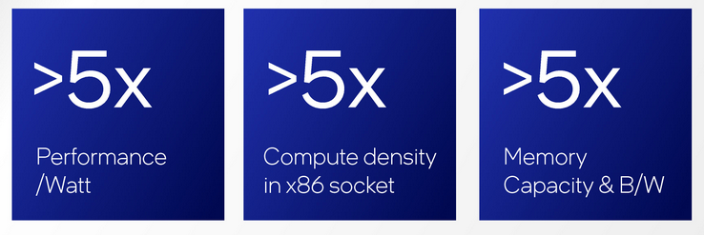
Falcon Shores
XPU concept
  The “X” in “XPU” stands for any compute architecture that
  best fits the need of your application.
  X can be CPU, GPU, FPGA
oneAPI software stack is designed to abstract away many of the hardware differences to allow easier multi-architecture development.
Targeting the market for HPC users with absolutely massive datasets
  the kind that can’t easily fit into the relatively limited memory capacity of a discrete GPU
offering multiple SKUs with different numbers of cores
    likely enabled by varying the number of x86 and Xe titles
Refactored

Slide 34

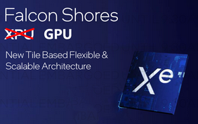
From a XPU in 2024 to a GPU in 2025
This is the future of Falcon Shores
A bit of a problem here for intel:
  Ponte Vecchio is already an old design today
  The delay to 2025 for the new product is a concern
    No real competition from intel in GPU market in the near future
  Intel will not be able to compete with AMD MI300A and Nvidia Grace Hopper up until 2026

Slide 35
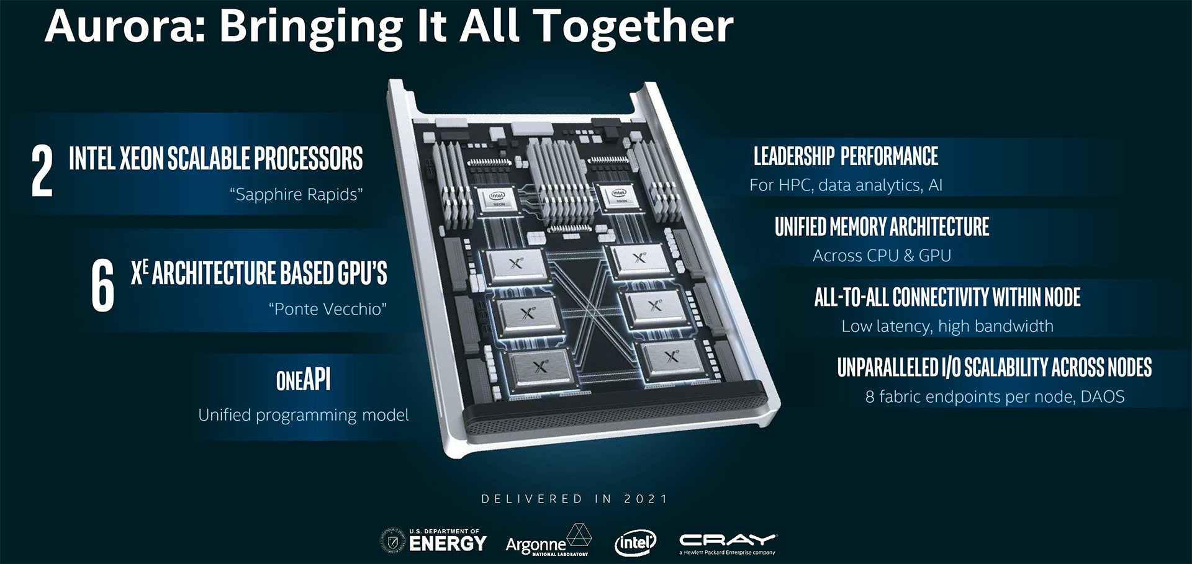
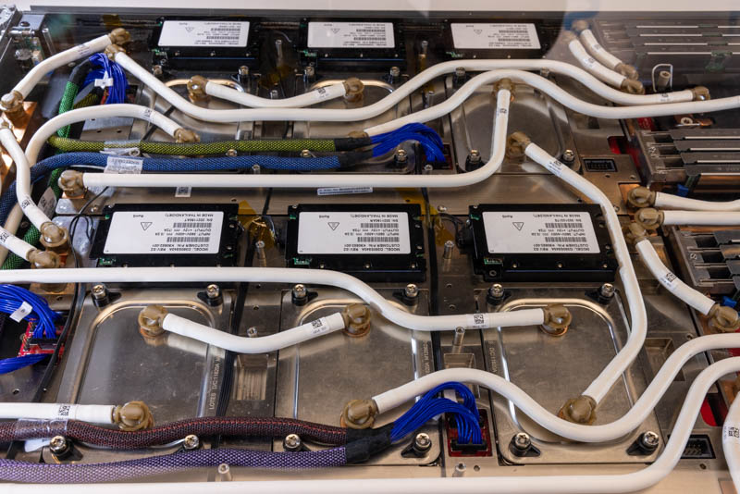
Aurora supercomputer
Installed 10.624 blades HPE CRAY
166 racks housing 66 blades each
  21.248 Xeon Max 'Sapphire Rapids' CPUs with on-package HBM2E memory
  63.744 GPU Max 'Ponte Vecchio’
Performance: over 2 FP64 ExaFLOPS

Slide 36


Slide 37
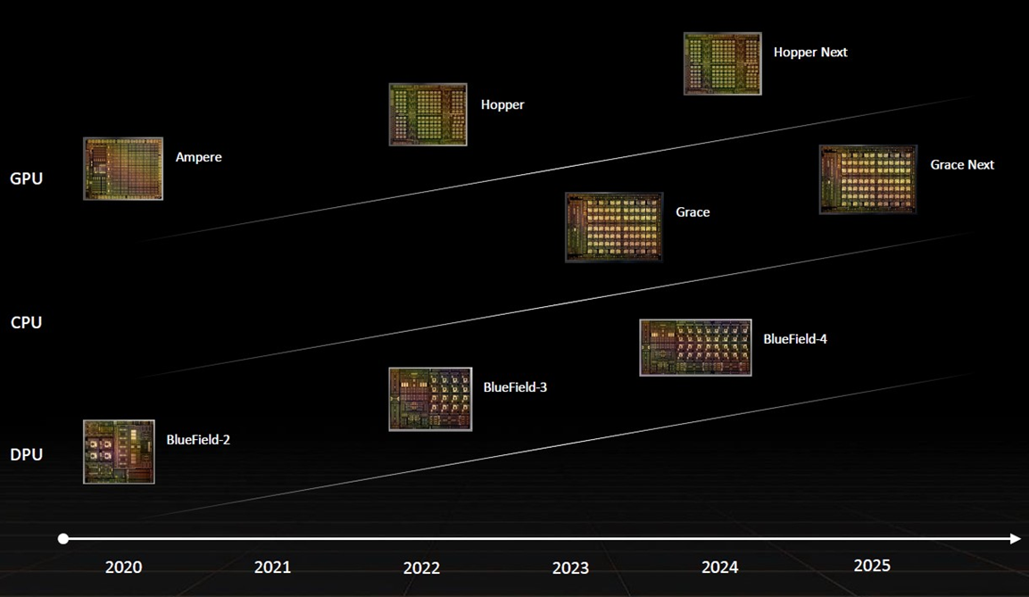
Data Center roadmap
Notes:
NVIDIA BlueField® data processing units (DPUs) ignite unprecedented innovation for modern data centers and supercomputing clusters. By offloading, accelerating, and isolating a broad range of advanced networking, storage, and security services, BlueField DPUs provide a secure and accelerated infrastructure for any workload, in any environment, from cloud to data center to edge.

Slide 38
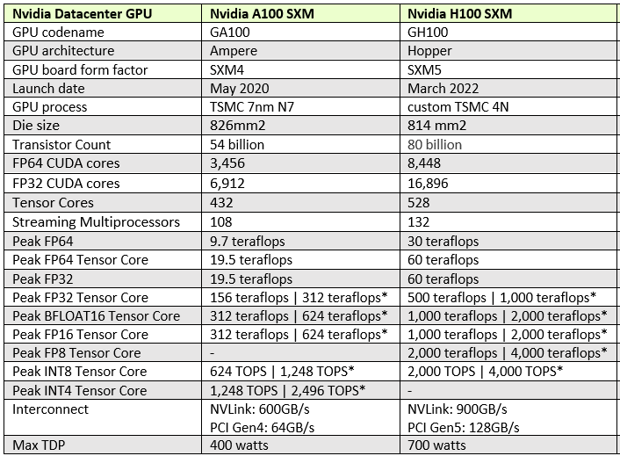
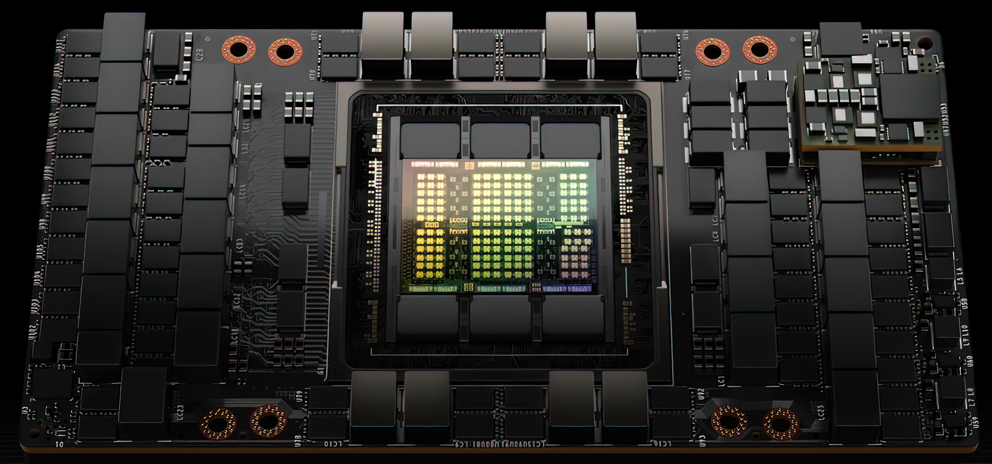
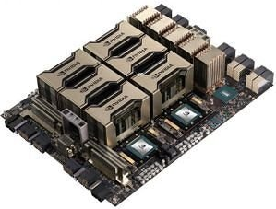
NVIDIA H100

Slide 39
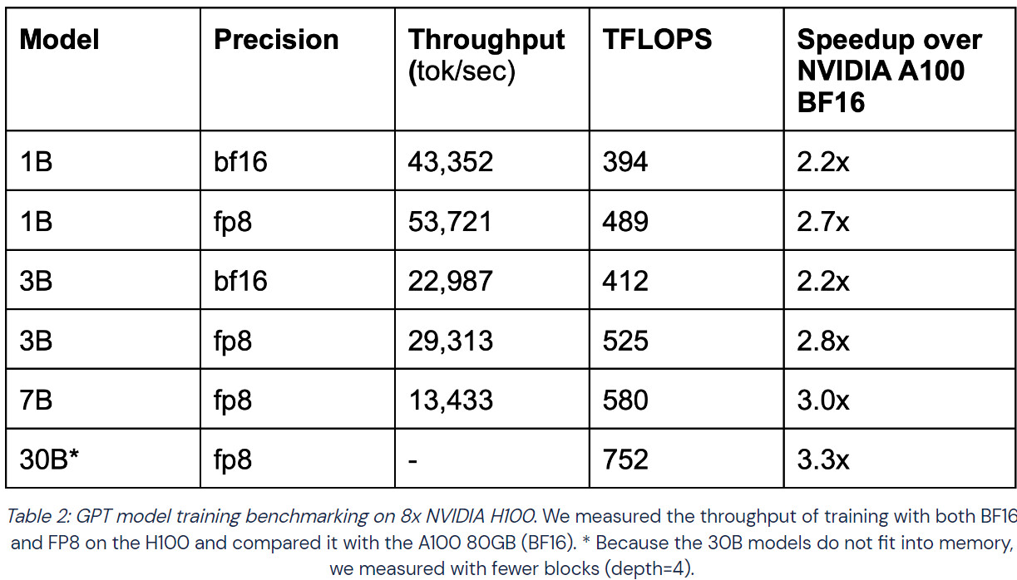
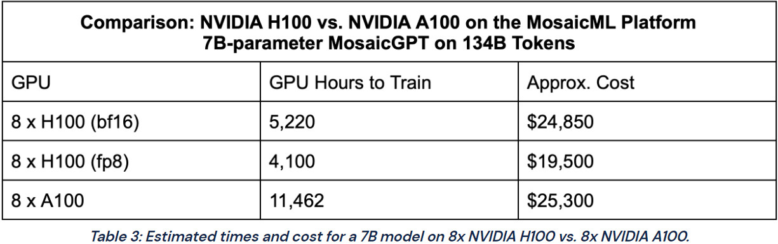
NVIDIA H100 Compared to A100 for training
NVIDIA H100 GPU achieved 2.2x to 3.3x speedup.
Cost of running these GPUs in the cloud:
  H100 SXM GPUs at $4.76/hr/GPU, A100 80 GB SXM at $2.21/hr/GPU
  While the H100 is 2.2x more expensive, the performance makes it up, resulting in less time to train a model and a lower price for the training process.
    This makes H100 more attractive for researchers and companies wanting to train Large Language Models (LLMs) and makes choosing the newer GPU more viable, despite the increased cost.

Slide 40
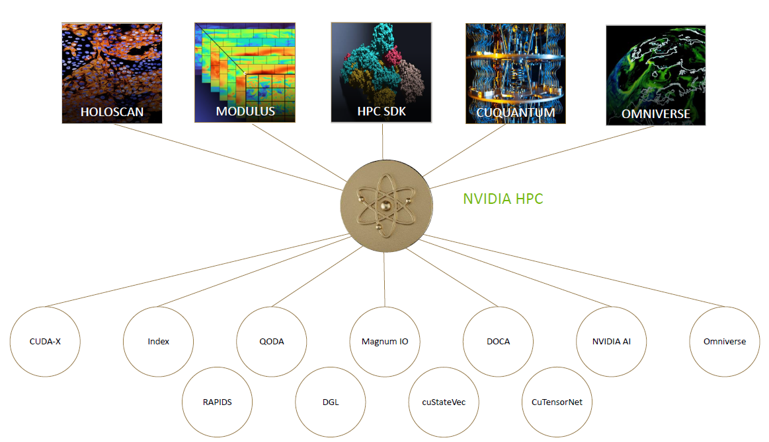
Nvidia HPC Platform

Slide 41
Grace CPU specs
CPU for AI and HPC infrastructure
144 Neoverse V2 ARM Cores
  2 CPUs, 72 core each
LPDDR5x with ECC 1TB/s bandwidth
500W total power consumption, including memory

Slide 42
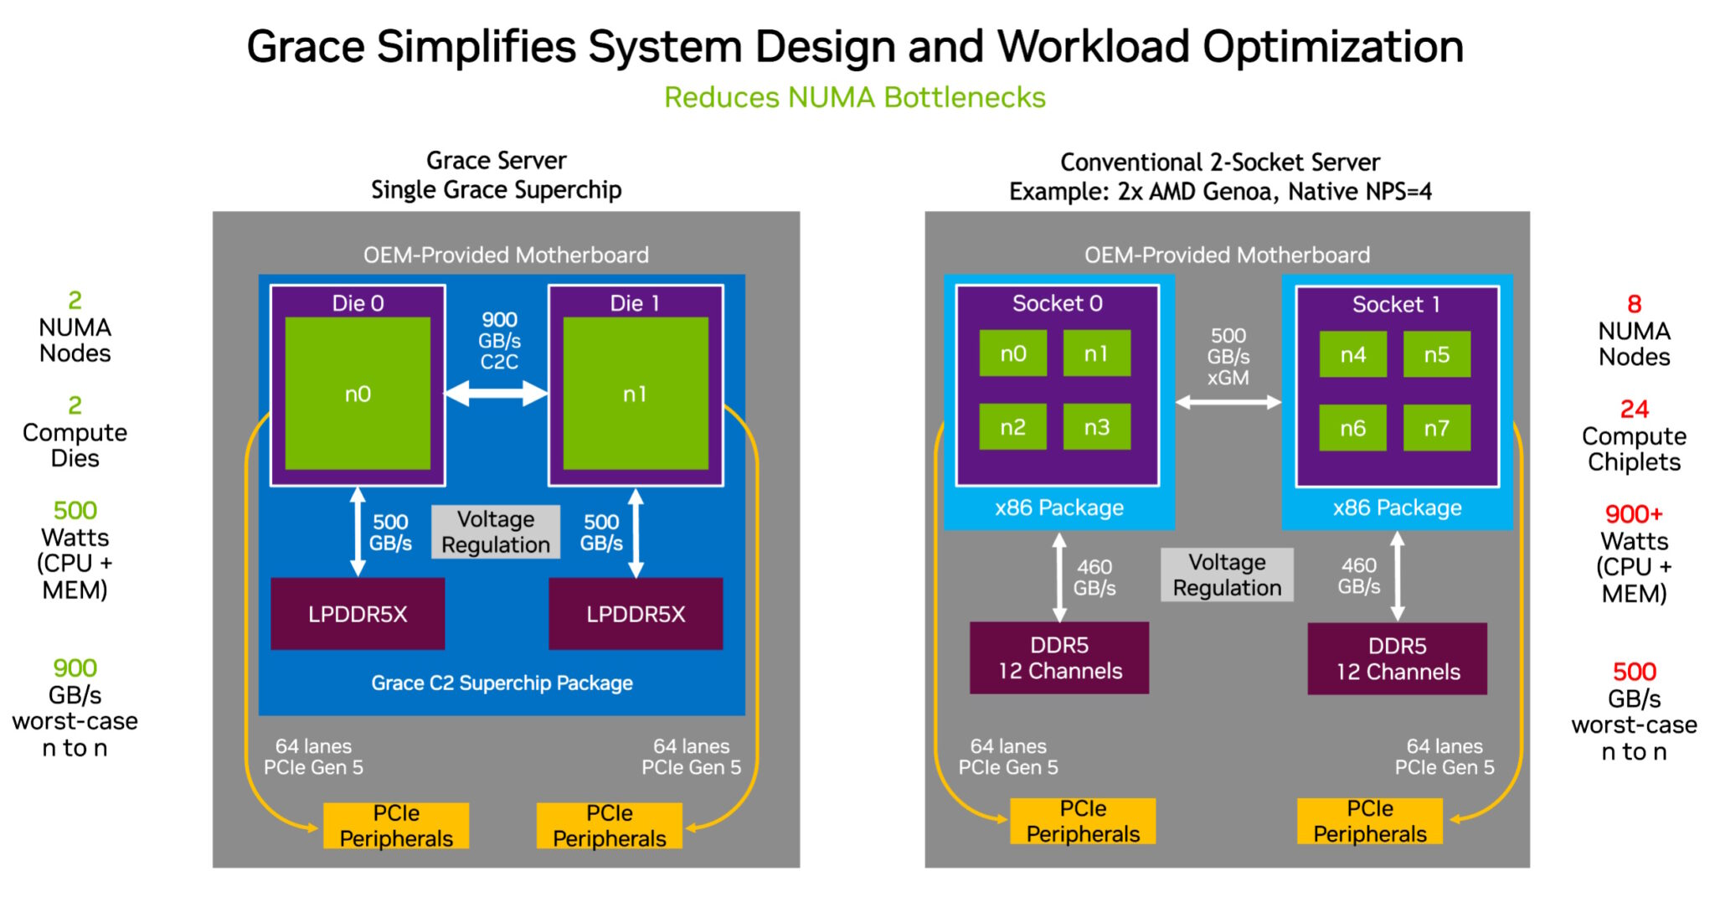
Architecture

Slide 43
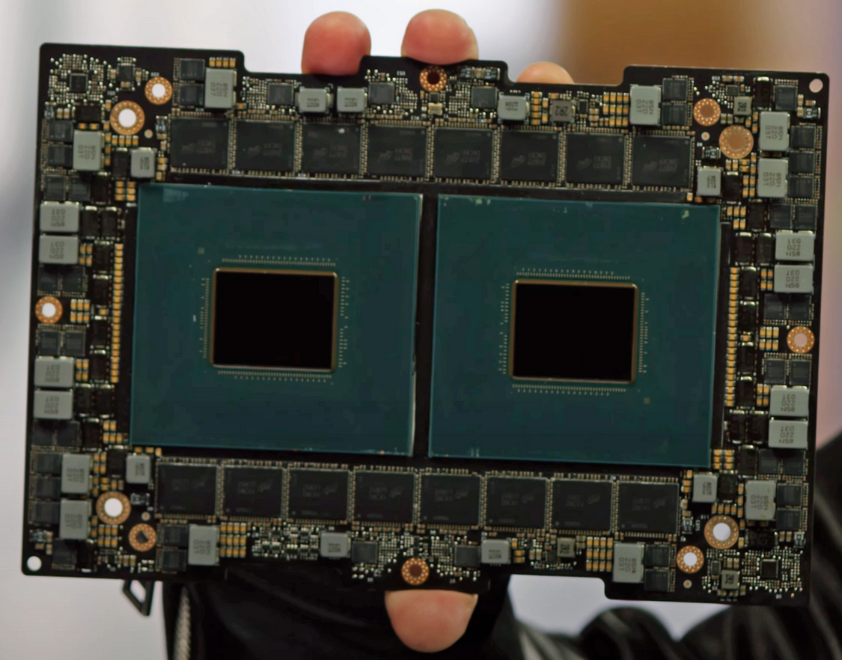
Some figures
NVIDIA declares Grace 1.2 times faster than an “average x86 next-gen CPU”
Requires just 60% of the power
  Can fit into passively-cooled modules
1.7 times more servers in limited
power DC
Not targeted to general purpose server market
  Optimized for AI and cloud

Slide 44
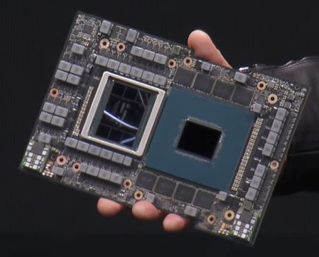
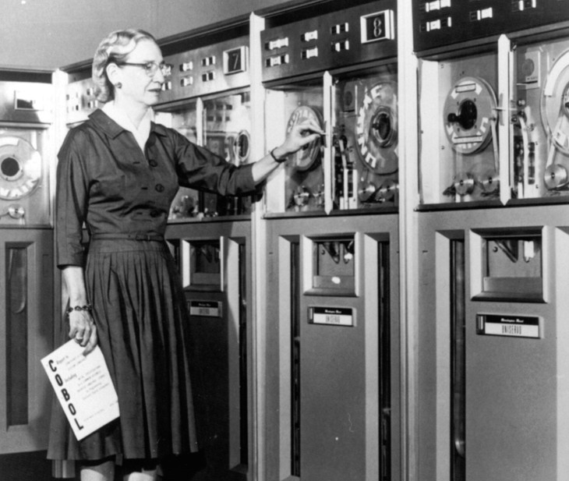
Grace Hopper
Grace CPU plus Hopper GPU
600GB mem available to GPU
LPDDR5x and HBM3
15x higher system memory bandwidth to GPU
  Via NVLink-c2c
Available end of
2023

Slide 45
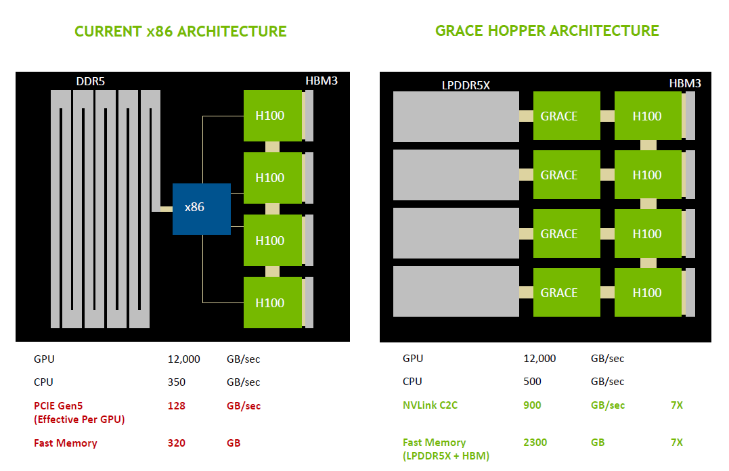
Architecture
NVIDIA declares this approach to allow CPU and GPU to share information held in memory at unrivalled speed

Slide 46
Conclusions
AMD seems to be the leader in CPU performance
Intel is catching-up trying to differentiate the product portfolio
Nvidia with Grace Hopper is trying to introduce ARM architectures inside the HPC world
Superchips (CPU+GPU products) seem to attract the biggest efforts by chip makers
  combining the best of CPUs with the best of GPUs for workloads that are not purely bound by either
  Intel is effectively ceding this market to AMD (and to a lesser extent, NVIDIA) for at least a few more years

Slide 47
CPU benchmarking in WLCG

Slide 48
About HEP-SCORE
The HEPscore application orchestrates the execution of user-configurable benchmark suites based on individual benchmark containers.
It runs the specified benchmark containers in sequence, collects their results, and computes a final overall score.
HEPscore is specifically designed for use with containers from the HEP Workloads project.

Slide 49
Latest updates
Workload for ARM processor and refresh to latest releases
  Multi-architecture (“ma”)
  Many of them are multi-threaded (“mt”)
  All LHC workload are now for Run3
Ongoing effort to develop a benchmark for GPUs
  Prototype workloads are under study (summer student will work on it but no time estimate)
Ongoing studies on power consumption and fast benchmark

Slide 50
Transition Plan
Sites are expected to run HEPscore23 on new hardware
  Existing hardware doesn’t need to be benchmarked with the new benchmark
HEPscore23 will be normalized to HS06 on the refence machine
  To simplify the transition and the calculation of pledges and accounting statistics
  At some point HEPscore will become the default WLCG benchmark

Slide 51
Useful links
Gitlab repository for HEPSCORE
HEP workloads gitlab repository
Transition plan during Lancaster WLCG workshop
Kibana Dashboard with collected results

