Slide 1
\
Flavor oscillation and torsion in Quantum Field Theory
Raoul Serao
Dipartimento di Fisica «E. Caianiello»
E Istituto Nazionale di Fisica Nucleare
rserao@unisa.it
Notes:
Good afternoon to all,
My name is Raoul Serao and I am a Ph.d student at university of Salerno.
In this talk i will discuss the flavor oscillation and torsion in quantum field theory.

Slide 2
Overview
Introduction and motivations
Neutrino mixing in Quantum Field Theory
Torsion
Neutrino mixing in Quantum Field Theory with torsion
Conclusion
Notes:
The layout of this lecture is the following: i will give you an introduction and motivations of thsi type of research; moreover i will introduce the torsion; after that I discuss the neutrino mixing in QM and QFT and finally i will treat the case of QFT with a torsion background.

Slide 3
Introduction and motivations
Neutrinos play a prominent role in cosmology and astrophysics
Leptogenesis
Stellar evolution
Possible contributions to dark matter/ dark energy*
Some of the most interesting question in modern physics are related to neutrino
Why neutrino has mass?
Why does flavour oscillations exist?
Necessity to go beyond the standard model.
Standard model is composed by three types of fields: spinors, vectors and scalars; general relativity yelds one more field: metric.
If there exists a more fondamental theory, it yields to some low energy manifestation by means of some additional characteristics of the space-time; one of the candidates for this role is the space-time torsion.
*A. Capolupo, G. Lambiase, A. Quaranta, S. M. Giampaolo, Phys. Lett. B 804, 135407 (2020);
A. Capolupo, S. Carloni, A. Quaranta Phys Rev D 105, 105013 (2022);
A. Capolupo.; S. M. Giampaolo, G. Lambiase, A. Quaranta Eur Phys. J vol 80 pag 423-1-423-5 (2020);
A. Capolupo, A. Quaranta, Phys. Lett B vol 839 pag 1-15 (2023)

Slide 4
Spacetime torsion
In general relativity the requirements of metricity of the covariant derivative and symmetry uniquely determine the connection Coefficients in terms of the metric
A more general theory, the so called Einstein-Cartan (or Riemann-Cartan geometry), is obtained if the assumption of symmetry is relaxed, keeping only metricity. The connection coefficients acquire an antysimmetric part
The torsion can be rewritten as:
The scalar curvature reads

Slide 5
where R is the general relativistic Ricci scalar given in terms of the metric. Notice that the covariant derivatives here are the usual ones involving only the Christoffel symbols. The vacuum action for Einstein-Cartan is given by the natural generalization of the Einstein-Hilbert action
The torsion-related terms form a total derivative, not contributing to the field equations. As a consequence the vacuum theory is equivalent to general relativity. The situation changes in presence of matter, where a coupling of the form
angular momentum. In the following we will be interested in Dirac spinors minimally coupled to torsion. The spin covariant derivatives, in presence of torsion, get modified as follow
The spinor action is simply

Slide 6
Particle mixing in quantum mechanics*
For two flavor state we have
The Hamiltonian is diagonal in the mass states, then the time evolution is given by
The Flavor oscillation formula are
With $Δ ω=ω_{1}−ω_{2}$.
*S. M. Bilenky and B. Pontecorvo, Phys. Rep. 41 (1978) 225 M. C. Gonzalez-Garcia M. Maltoni, Phys. Rep. 460 (1–3): 1–129 (2008). C. Giunti and C.W. Kim, Fundamentals of Neutrino Physics and Astrophysics, Oxford University Press (2007)

Slide 7
Particle mixing in quantum field theory*
The mixing relations for the fermion field are
Where $ν_{i} (i=1,2)$ are free field operators with definite mass:
with
The mixing relations can be written as:
Where the generator is given by:
*M.Blasone and G.Vitiello, Annals Phys. 244: 283-311, (1995) M. Blasone, A. Capolupo, and G. Vitiello, Phys. Rev. D 66, 025033 (2002 K. Fujii, C. Habe, and T. Yabuki, Phys. Rev. D 59, 113003 (1999); 64, 013011 (2001) K. C. Hannabuss and D. C. Latimer, J. Phys. A 33, 1369 (2000); 36, L69 (2003); C. R. Ji and Y. Mishchenko, Phys. Rev. D 65, 096015 (2002); Ann. Phys. (Amsterdam) 315, 488 (2005)

Slide 8
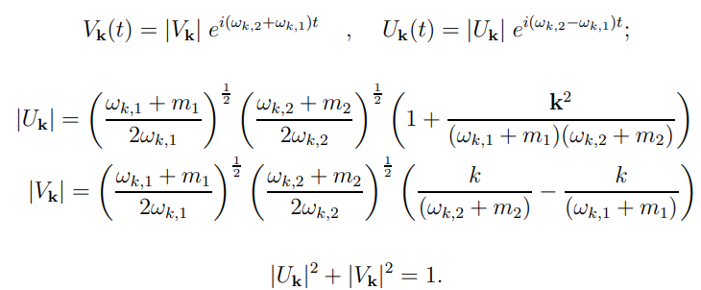
$G_{θ}(t)$ is a unitary operator: $G_{θ}^{−1}\left(t\right)=G_{−θ}\left(t\right)=G_{θ}^{+}\left(t\right)$ preserving the canonical anticommutation relations
$G_{θ}^{−1}(t)$ maps $ℋ_{1,2}$ to $ℋ_{e,μ}$ $G_{θ}^{−1}\left(t\right): ℋ_{1,2}→ℋ_{e,μ}$
The structure of the annihilation operator for ${|0\left(t\right)>}_{e,μ}$ is:
Where

Slide 9
The vacuum ${|0\left(t\right)>}_{e,μ}$ is not invariant under the action of the generator $G_{θ}(t)$, at finite volume:
Mass and flavor representation are unitary inequivalent in the infinite volume limit
The existence of the two inequivalent vacua is also the origin of the non-zero vacuum energy which could contribute to the dark sector of the Universe
Condensate structure of $|0>_{e,μ}$
Note that this considerations can be generalized in case of three neutrinos oscillations; but this generalization will be done only when torsion is considered.
Given the U(1) symmetry, the oscillation formulae* are given by
Note that the generalization to curved space time has be done. **
*M.Blasone, P.Henning and G.Vitiello, Phys. Lett. B (1999). M.Blasone, A.Capolupo, O.Romei and G.Vitiello, Phys. Rev. D (2001); M.Blasone, A.Capolupo and G.Vitiello, Phys. Rev. D (2002) A.Capolupo, C.R.Ji, Y.Mischenko and G.Vitiello, Phys. Lett.B (2004)
**A. Capolupo, A. Quaranta, Phys. Lett. B, 840, 137889 (2023) A. Capolupo, A. Quaranta, R. Serao, Symmetry, 15, 807 (2023). A. Capolupo, A. Quaranta, and P. A. Setaro, Phys. Rev. D, 106, 043013 (2022). A. Capolupo, S. Carloni, A. Quaranta, Phys. Rev. D, 105, 105013 (2022). A. Capolupo, G. Lambiase, A. Quaranta, Phys. Rev. D, 101, 095022 (2020)

Slide 10
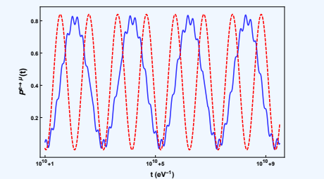
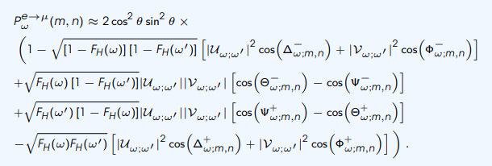
Mixing in curved spacetime
Schwarzschild metric
FLRW metric with exponential expansion

Slide 11
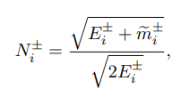
Particle mixing in quantum field theory with torsion
The free field operator is given by
Which satisfy the Dirac equation with torsion
The solutions* for free particle(antiparticle) with aligned spin $u_{\vec{k},i}^{↑}$($v_{k,i}^{↑}$) or opposite $u_{\vec{k},i}^{↓}$ ($v_{k,i}^{↓}$) to torsion are given by
with
*F. Cabral, F. Lobo and D. Rubiera-Garcia,”Imprints from a Riemann-Cartan space-time on the energy levels of Dirac spinors”,Class. Quantum Grav. 38, 195008 (2021).

Slide 12
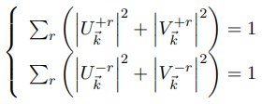
The mixing relations are:
Or equivalently
Where the generator is given by:
And all the consideration of previous case are still valid.
The flavor annihilation operator are
The Bogoliubov coefficients satisfy
Which in the torsionless case read as:

Slide 13
Given the U(1) symmetry, the oscillation formulae are*
Generalization of the QFT oscillation formulae
Oscillation formulae are spin-dependent
*A. Capolupo, A. Quaranta, R. Serao «Quantum Field Theory of neutrino mixing in spacetimes with torsion” (2023) IN PREPARATION

Slide 14
Figure: on the left: Plot of oscillation formulae for spin up and spin down in fuction of time. On the right: a comparison between oscillation formulae for spin up, spin down and Pontecorvo one.
For low value of torsion, there are some «secondary fluctuations»
For high value of the torsion, these «secondary fluctuation» are deleted
Note that for high value of the torsion ${\tilde{m}}_{i}^{±}$ are related only at the torsion; this makes $E^{+}$ and $E^{−}$ equal.
Notes:
In the QM mixing case, the spin does not affect the amplitudes but affects only the oscillation frequency.

Slide 15
Three-flavor fermion mixing and torsion*
The free field operators are given by:
Which satisfy:
with
By means of Pontercorvo-Maki-Nakagawa-Sakata mixing matrix, the flavor fields are given by:
Or equivalently
Where $G_{θ}\left(t\right)=G_{23}\left(t\right)G_{13}\left(t\right)G_{12}\left(t\right)$ and
*A. Capolupo, A. Quaranta, R. Serao «Quantum Field Theory of neutrino mixing in spacetimes with torsion” (2023) IN PREPARATION

Slide 16
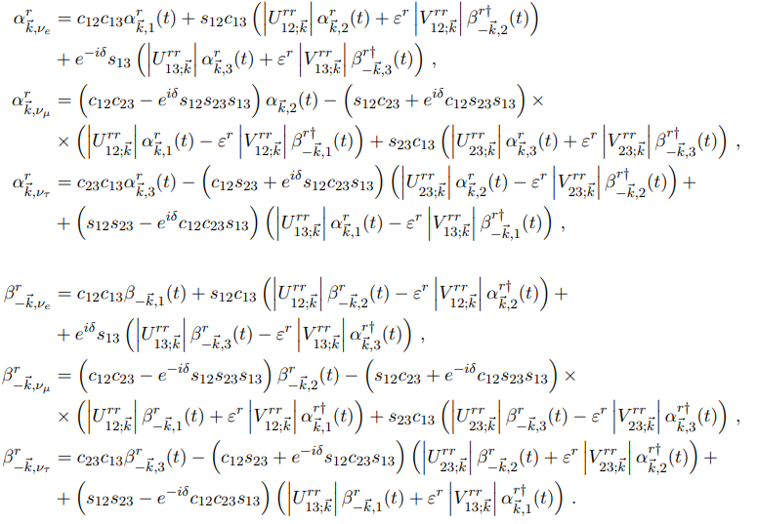
\
The flavor annihilators are then define as:
with
Note that if $r≠s$ the Bogoljubov coefficients $U_{ij;\vec{k}}^{rs}$ $V_{ij;\vec{k}}^{rs}$ are 0.

Slide 17
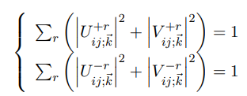
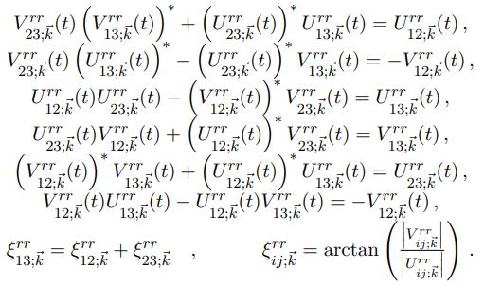
The bogoljubov coefficients are:
The Bogoljubov coefficients respect the following identities:
The time dependences are given by

Slide 18
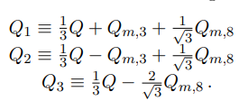
The lagrangian for three Dirac fields with different masses
where
It Is not invariant under SU(3) global transformation
The variation is
$$λ_{}$$
Led us to introduce the Noether charges
And a linear combination of these
And in a similar way the flavor charge

Slide 19
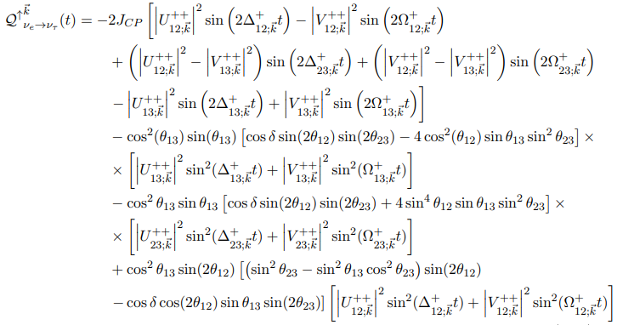
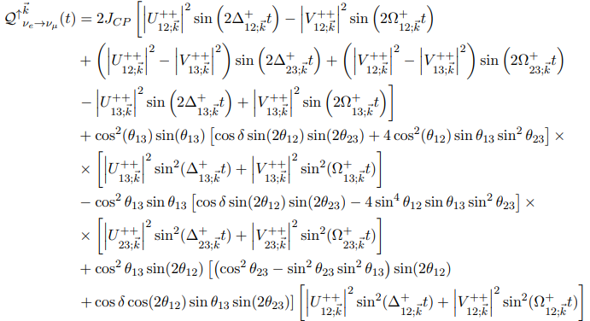
Three-flavor neutrino oscillation formulae
The oscillation formulas are given by*:
where
Is related to CP violation
*A. Capolupo, A. Quaranta, R. Serao «Quantum Field Theory of neutrino mixing in spacetimes with torsion” (2023) Work in progress
Notes:
COEFFCIENTE DI JASLOG

Slide 20
Figure: on the left: Plot of QFT oscillation formula: $Q_{e→e}^{↑\vec{k}}$ in function of time. On the Right a comparison between $Q_{e→e}^{↑\vec{k}}$ and $Q_{e→e}^{↓\vec{k}}$

Slide 21
Figure: on the left: Plot of QFT oscillation formula: $Q_{e→μ}^{↑\vec{k}}$ in function of time. On the Right a comparison between $Q_{e→μ}^{↑\vec{k}}$ and $Q_{e→μ}^{↓\vec{k}}$

Slide 22
Figure: on the left: Plot of QFT oscillation formula: $Q_{e→τ}^{↑\vec{k}}$ in function of time. On the Right a comparison between $Q_{e→τ}^{↑\vec{k}}$ and $Q_{e→τ}^{↓\vec{k}}$

Slide 23
Cp violation
In QFT, for a given spin:
We have
Explicitly we obtain

Slide 24
Figure: on the left the trend of the CP asymmetry for spin up. On the right a comparison of CP asymmetry between spin up and spin down

Slide 25
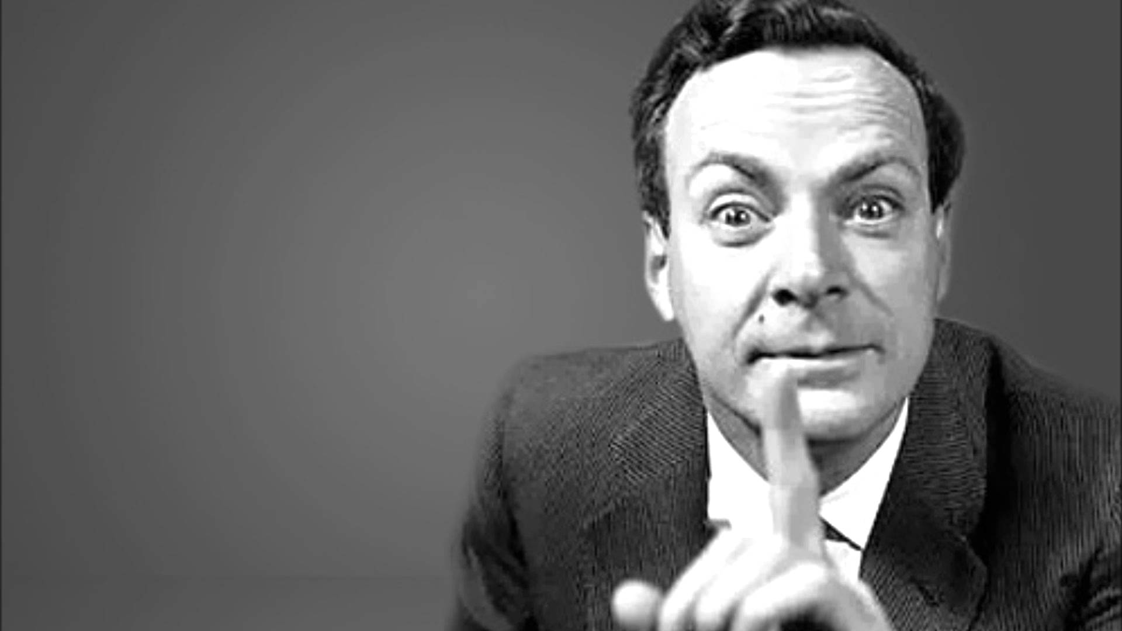
Thank you for your attention
Questions?
‘’I would rather have questions that can't be answered than answers that can't be questioned’’
-Richard P. Feynman

Slide 26
Mixing in curved spacetime
Schwarzschild metric
FLRW metric with exponential expansion

