Slide 1
Torino – 9 giugno 2023
Discussione su R&D rivelatori @ Torino
stato DRD @ CERN
Aggiornamento generale
Preparazione programmi di ciascun DRD
R&D di interesse INFN ➔ Quadro complessivo: DRD et al.: call, PRIN…
Prossimi passi e tempistica
RICHIESTO CONTRIBUTO DA:
presidenti CSN1, CSN2, CSN3, CSN5
coordinatori – direttori …..

Slide 2

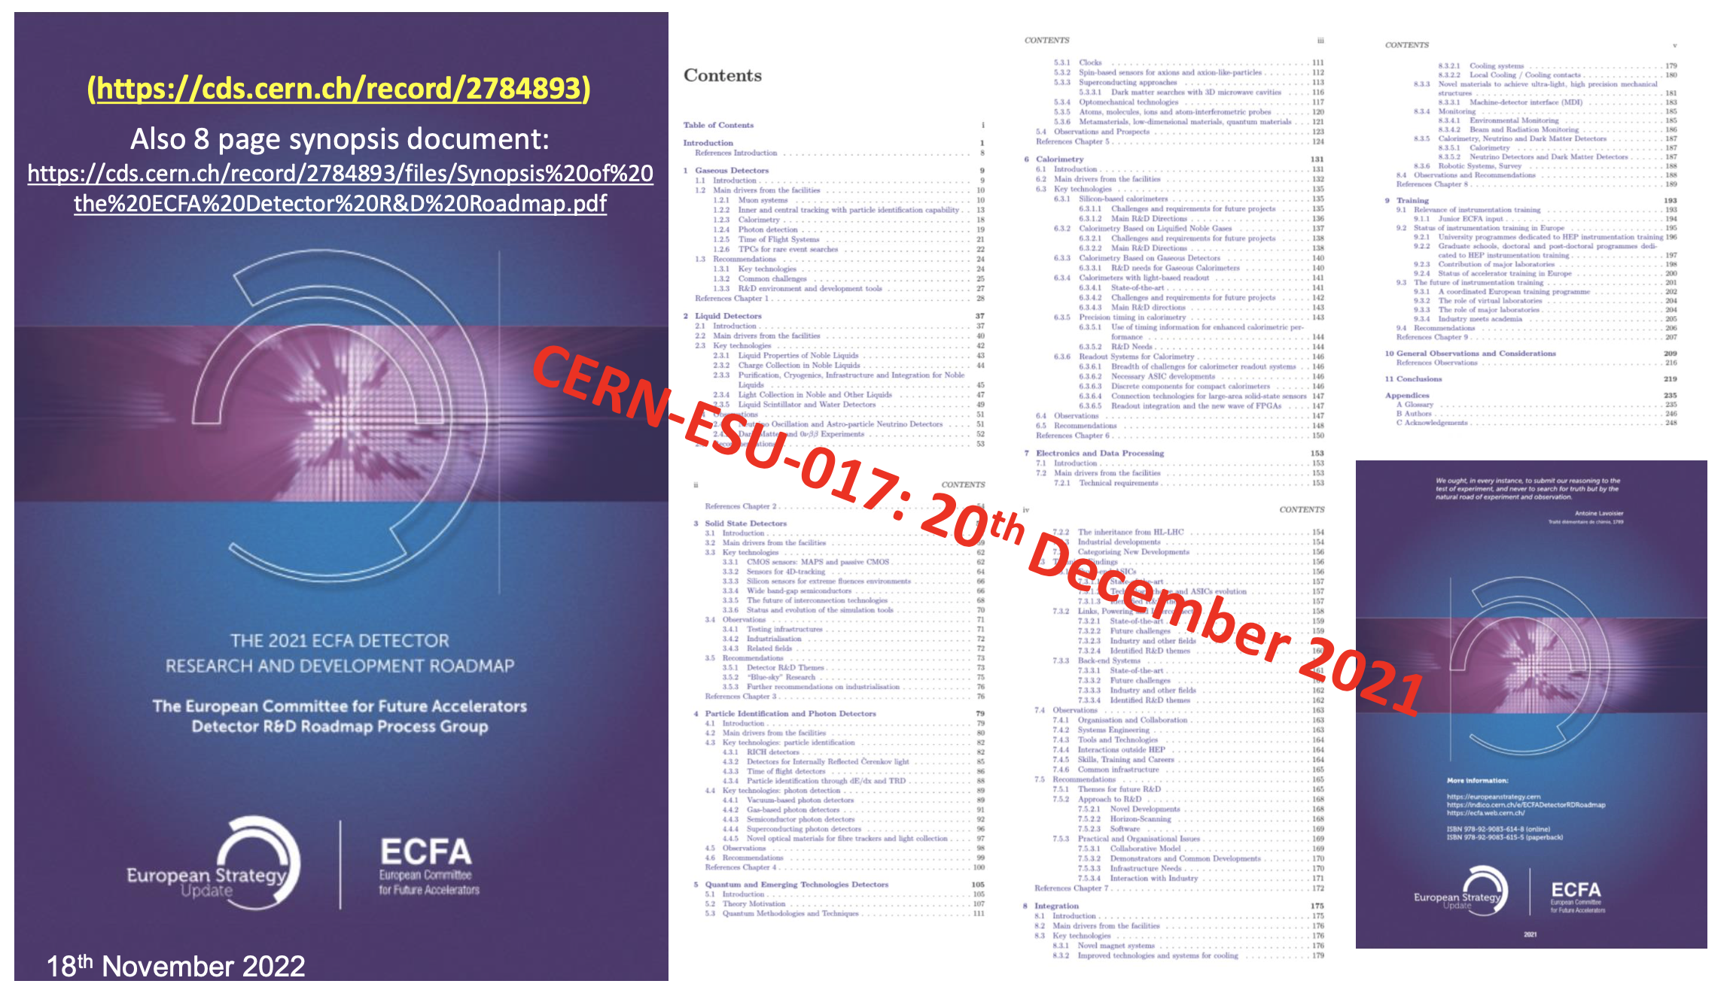
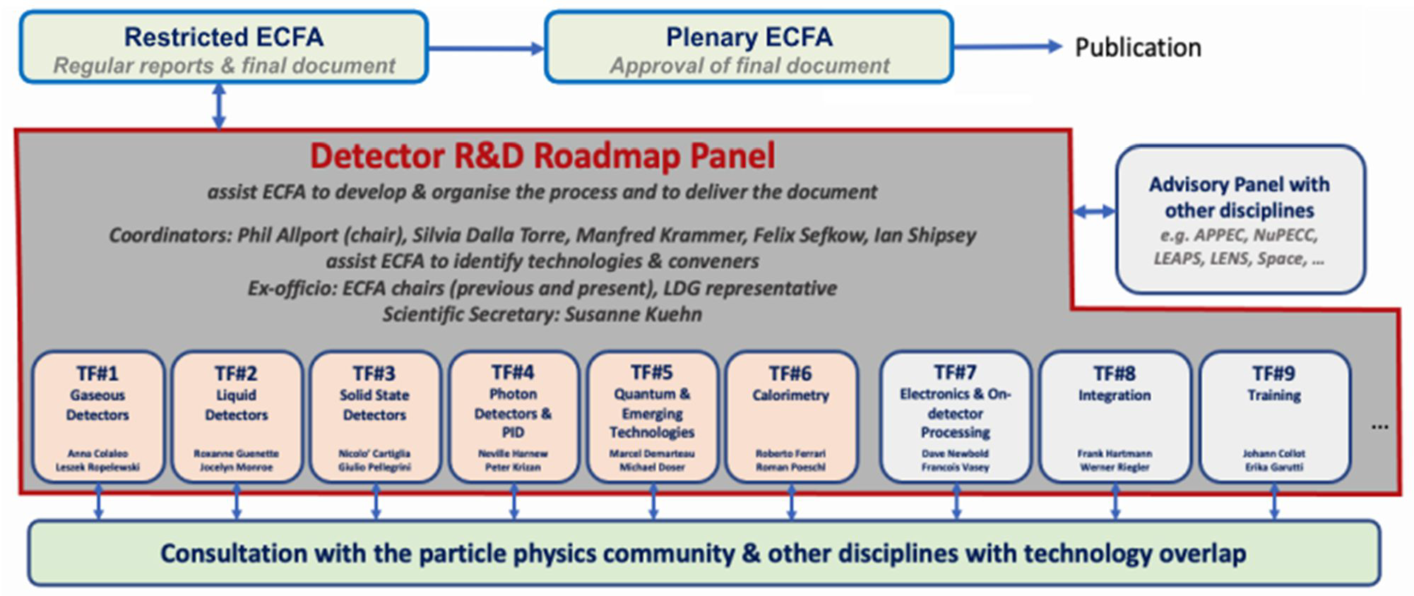


Detector Research and Development – DRD
international collaborations anchored at CERN: implementation
ECFA Detector R&D Roadmap
DRD1 – Gaseous Detectors <<== RD51
DRD2 – Liquid Detectors
DRD3 – Solid State Detectors <<== RD50-42
DRD4 – Photon Detectors and PID
DRD5 – Quantum and Emerging Technologies
DRD6 – Calorimetry
DRD7 – Electronics and On-detector Processing
<<== RD53
(DRD8 – Integration) ➔ Starting
(DRD9 – Training) ➔ included in others / Starting

Slide 3
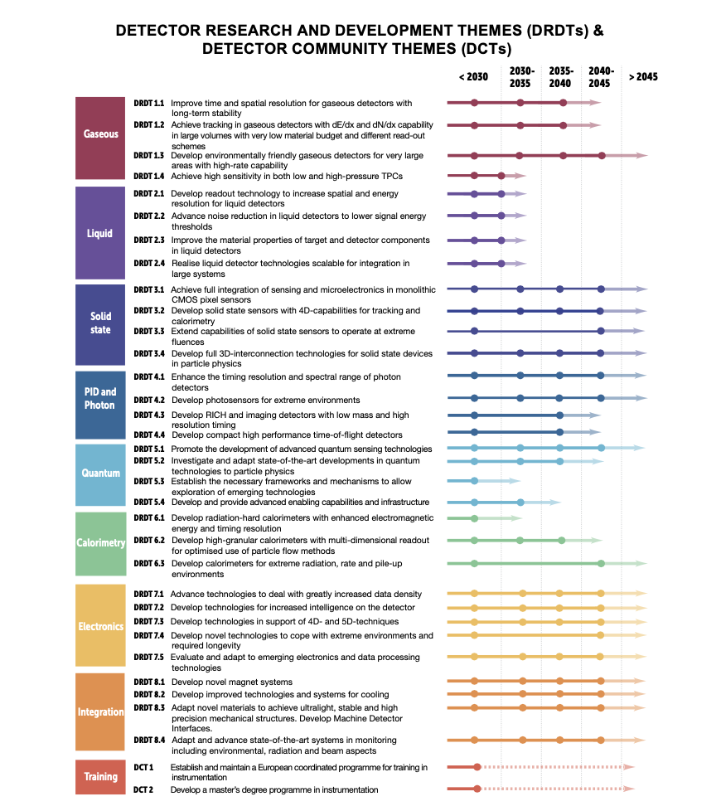
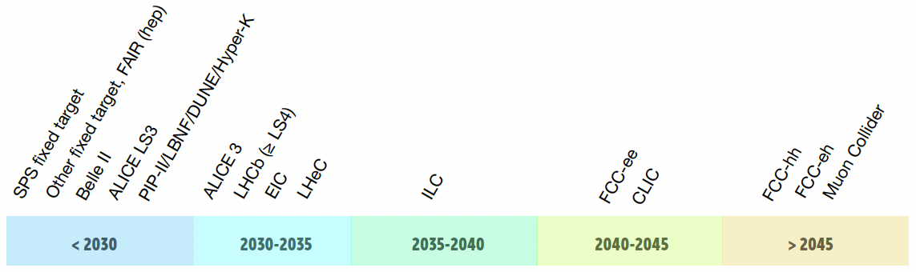
ECFA Detector R&D Roadmap dec 2021
Goal della Roadmap – DRDT
Accelerator R&D Roadmap dec 2021

Slide 4
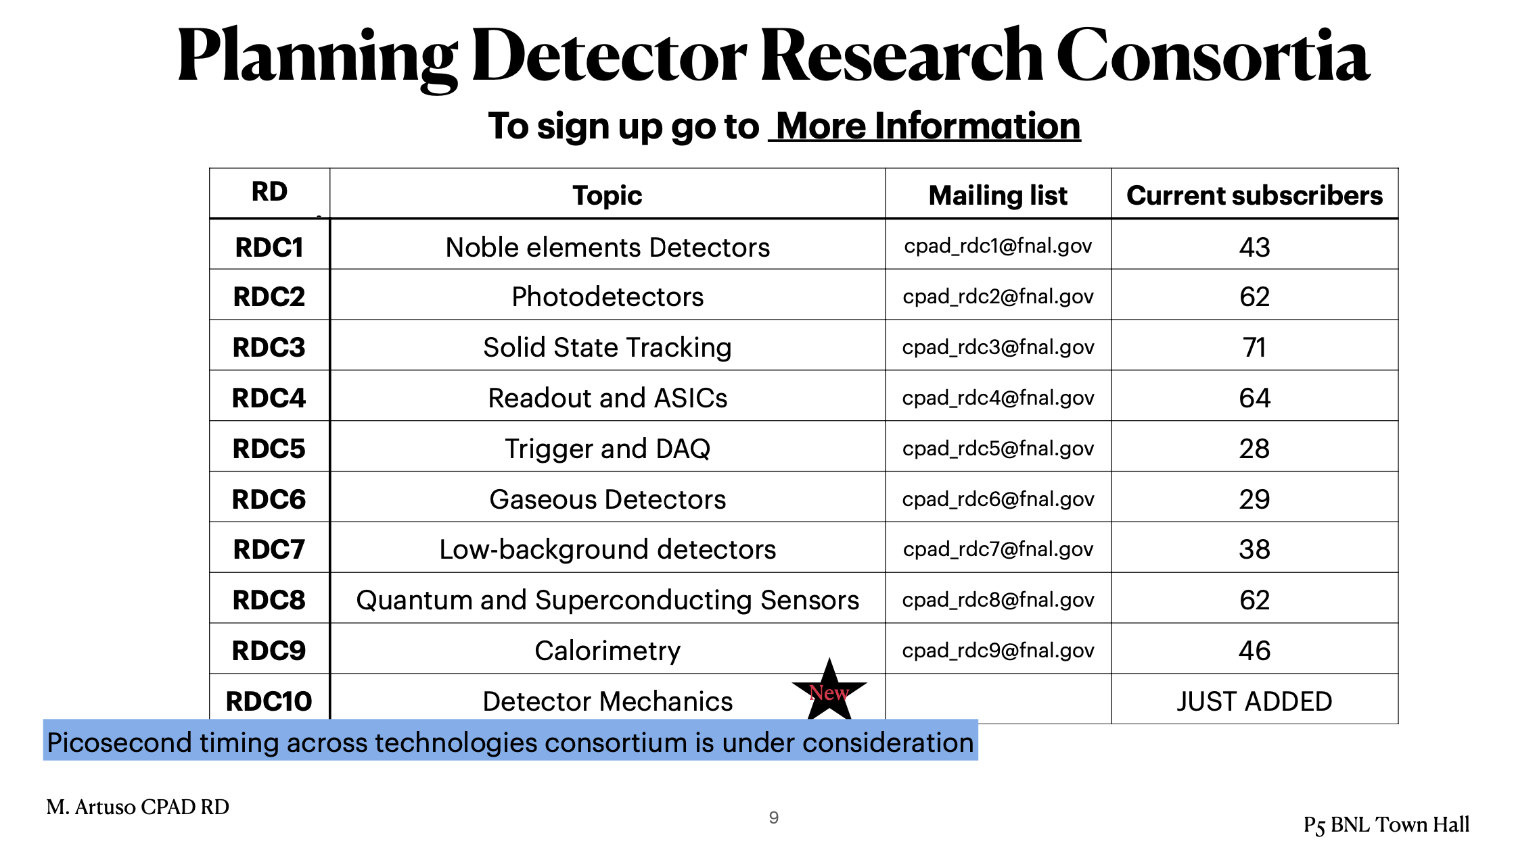
U.S. Detector R&D – CPAD
Coordinating Panel for Advanced Detectors
Marina Artuso Syracuse University
@ P5 Town Hall Meeting BNL April 12, 2023
Develop and maintain the critical and diverse technical workforce
Double the US Detector R&D budget over the next five years, and modify existing funding models to enable R&D consortia along critical key technologies for the planned long-term science projects, sustaining the support for such collaborations for the needed duration and scale.

Slide 5
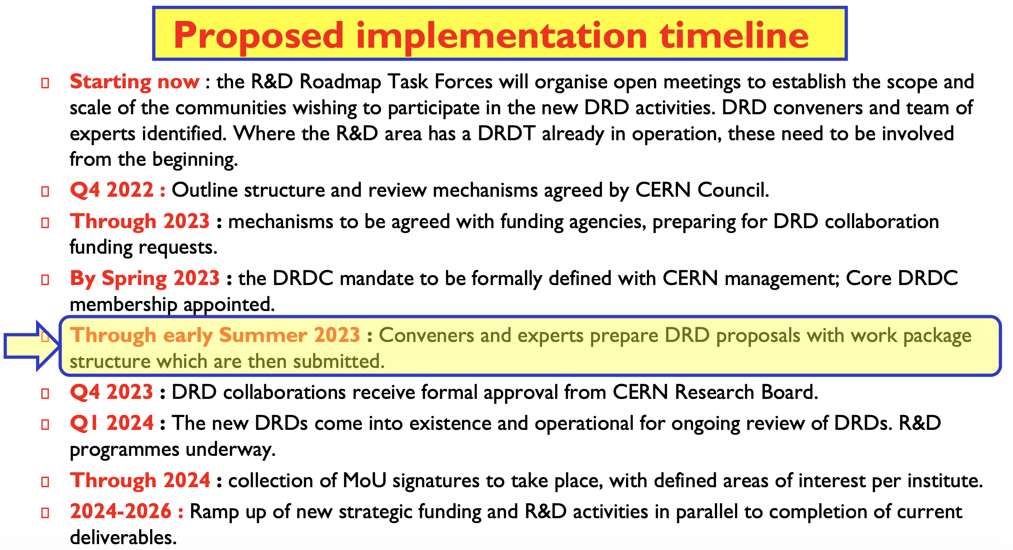
31.07.2023
Official deadline for proposal submission
Document approved by the SPC and CERN Council in September 2022

Slide 6
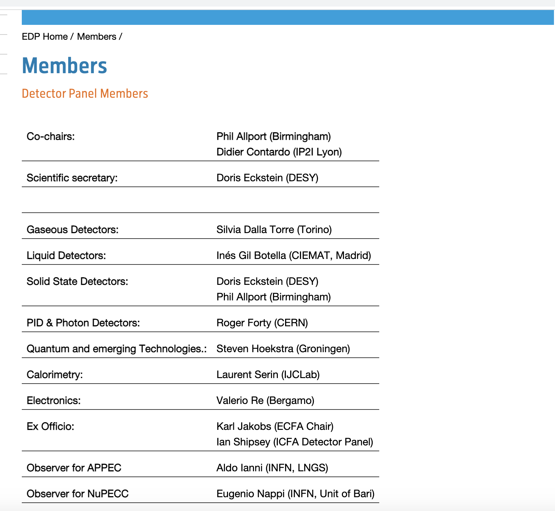
ECFA Detector Panel Members

Slide 7
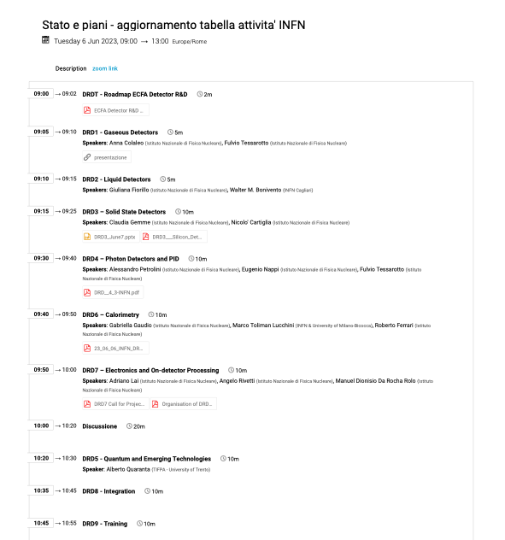
Riunioni INFN – ultima 6 giugno
https://agenda.infn.it/event/36436/

Slide 8
DRD1 – Gaseous Detectors Community meeting March 1-2-3
https://indico.cern.ch/event/1245751/
Conveners: Anna Colaleo (University and INFN Bari) , Leszek Ropelewski (CERN)
Experts: Klaus Dehmelt (SUNY), Barbara Liberti (INFN - Tor Vergata), Maxim Titov (CEA Paris-Saclay), Joao Veloso (University of Aveiro)
Link to the coordination team : Silvia Dalla Torre (INFN Trieste)
great contributions to MPGDs development in RD51
Technologies
Applications (tracking, triggering, drift chambers, TPC, calorimeters….)
Gas and material studies
Detector physics, simulations, and software tools
Electronics for gaseous detectors
Detector production
Common test facilities
Revised preliminary draft proposal document
DRD1 community meeting
@ CERN June 22-23
https://indico.cern.ch/event/1273991

Slide 9
DRD proposal preparation – example DRD1
INFN: LNS, LNF, BA, FE, LE, NA, PD, PV, RM1, RM2, RM3, TS
DRDT 1.1 - Improve time and spatial resolution for gaseous detectors with long-term stability.
DRDT 1.2 - Achieve tracking in gaseous detectors with dE/dx and dN/dx capability in large volumes
with very low material budget and different read- out schemes.
DRDT 1.3 - Develop environmentally friendly gaseous detectors for very large areas with high-rate capability.
DRDT 1.4 - Achieve high sensitivity in both low and high-pressure TPCs.
New structures operational and
new R&D programmes underway
from beginning 2024
Through 2024,
collection of MoU signatures
with defined contribution areas per institute
Ramp up of new strategic funding
and R&D activities 2024-2026
• WG1 Technological Aspects and Developments
of New Detector Structures, Common Characterization and Physics Issues
• WG2 Applications
• WG3 Gas and Materials
• WG4 Modelling and Simulation
• WG5 Electronics for gaseous detectors
• WG6 Production and Technology Transfer
• WG7 Collaboration Laboratories and Facilities
• WG8 Knowledge Transfer, Training, Career

Slide 10
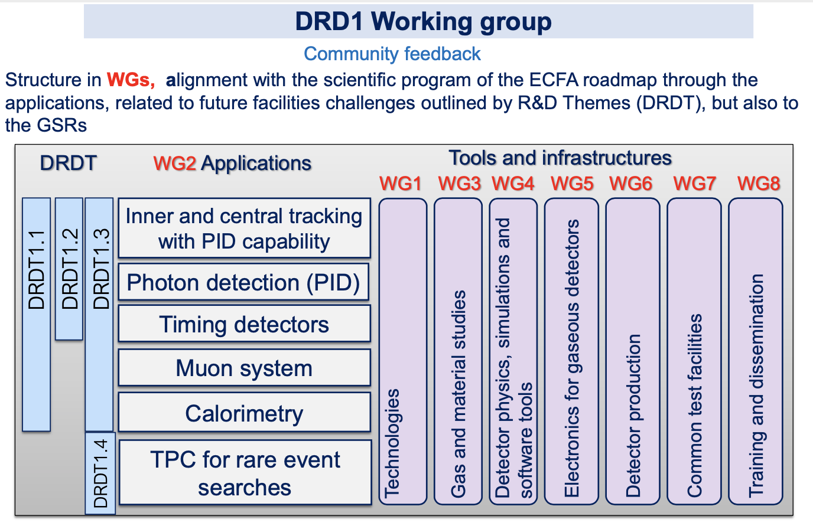

Slide 11
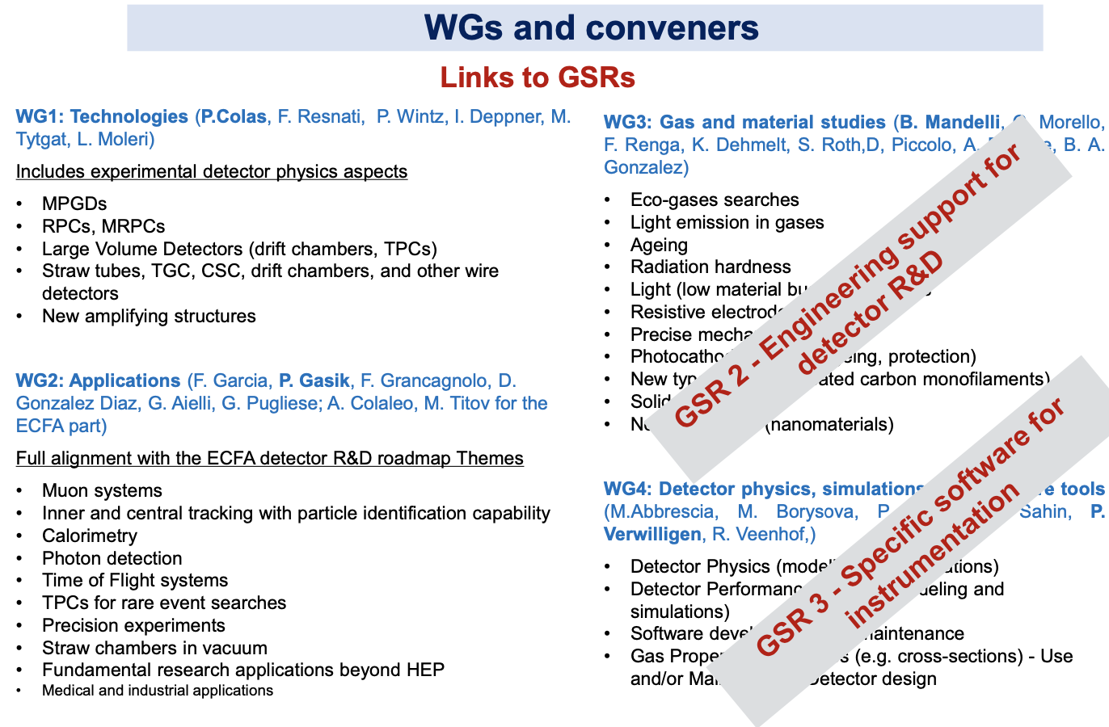
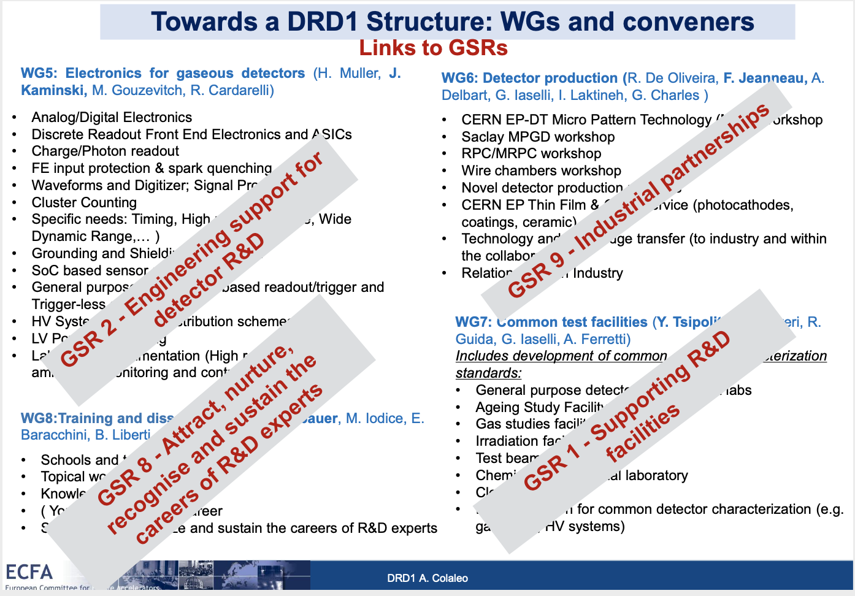

Slide 12
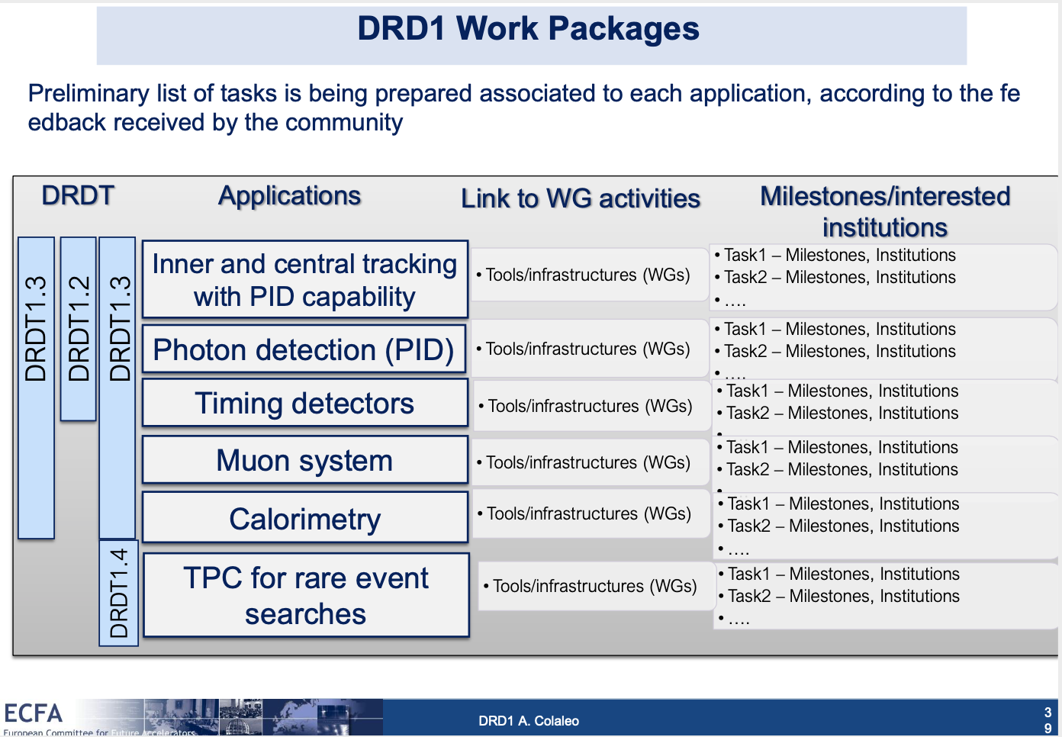
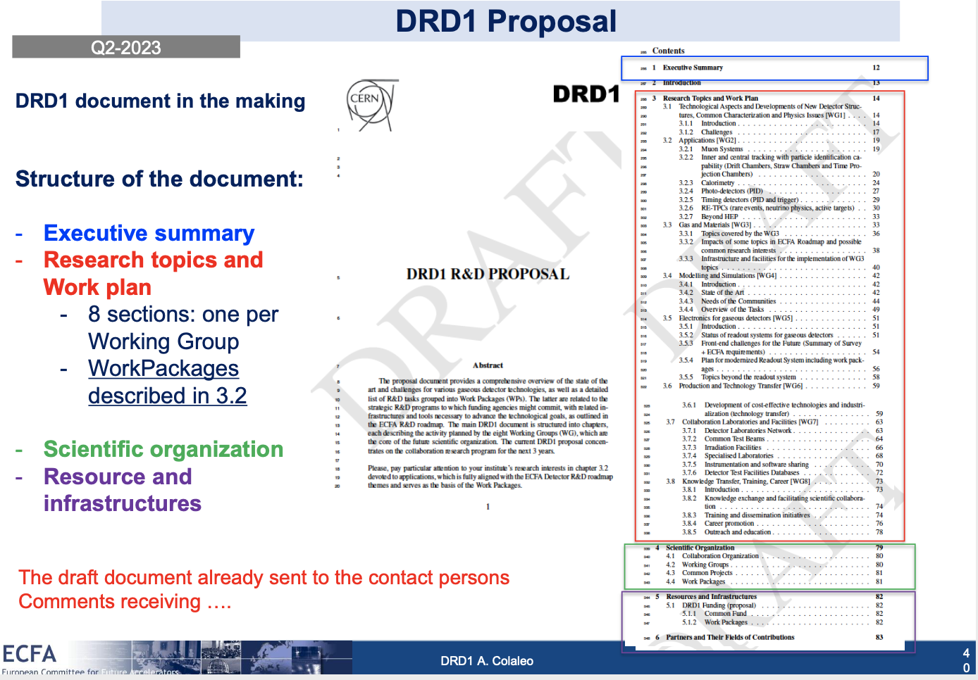

Slide 13
DRD2 – Liquid Detectors Community meeting April 20
https://indico.cern.ch/event/1214404/
Conveners: Ian Shipsey (Oxford, UK), Jocelyn Rebecca Monroe (Royal Holloway, UK), Roxanne Guenette (Harvard, U.S.)
Contact: Giuliana Fiorillo (INFN Napoli), Walter Bonivento (INFN Cagliari)
Charged readout
Light readout (Improved sensors for liquid scintillators and water-based detectors….)
Target properties (Purification….)
Scaling-up Challenges (radiopurity and background mitigation…..)
Draft proposal document in preparation

Slide 14
DRD3 – Solid State Detectors Community meeting March 22-23
https://indico.cern.ch/event/1214410/
Conveners: Eva Vilella Figueras, Gianluigi Casse, Giulio Pellegrini, Gregor Kramberger, Ioana Pintilie, Ivan Vila Alvarez, Michael Moll,
Nicolo Cartiglia (INFN Torino)
Monolithic CMOS Sensors
Eva Vilella Figueras, Didier Contardo
Solid state sensors for tracking and calorimetry. Community structure, interests, and blue sky R&D
Nicolo’ Cartiglia (INFN-Torino), Claudia Gemme (INFN-Genova), Anna Macchiolo
Sensors requirements for the next generation of trackers (~<2035)
Radiation Damage and Extreme Fluences
Michael Moll, Sally Seidel, Marko Mikuz, Ioana Pintilie
Simulations
Gregor Kramberger, Marco Bomben, Simon Spannagel, Arianna Morozzi (INFN-Perugia)
New characterization techniques and facilities of common interest
Ivan Vila Alvarez, Marcos Fernandez Garcia, Dominik Dannheim, Milko Jaksic
Non-silicon semiconductor and other material studies, introduction
Giulio Pellegrini, Thomas Bergauer, Xin Shi, Alexander Oh
Interconnect and device fabrication technologies
Giovanni Calderini, Dominik Dannheim, Fabian Huegging

Slide 15
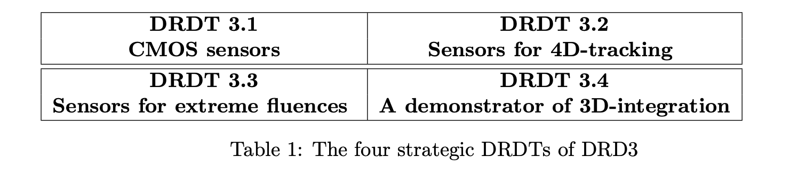
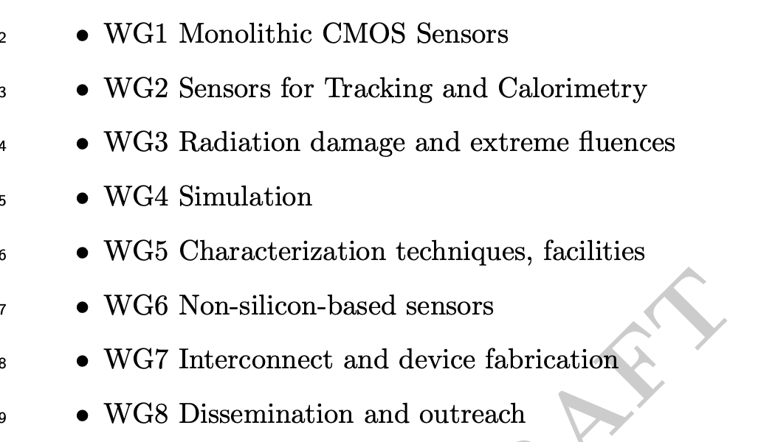
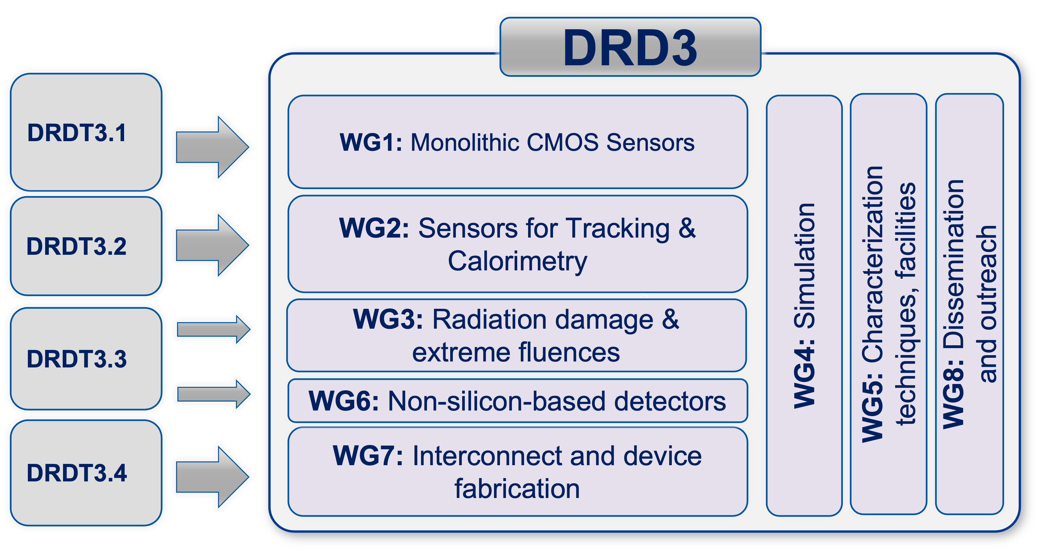
DRD3 update: DRDT and WG
Two building blocks: DRDTs and WGs
From roadmap
Social networks

Slide 16
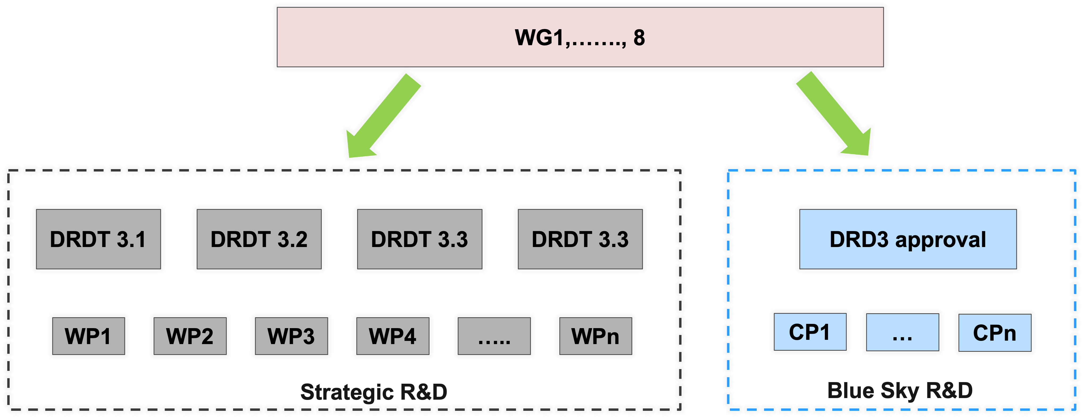
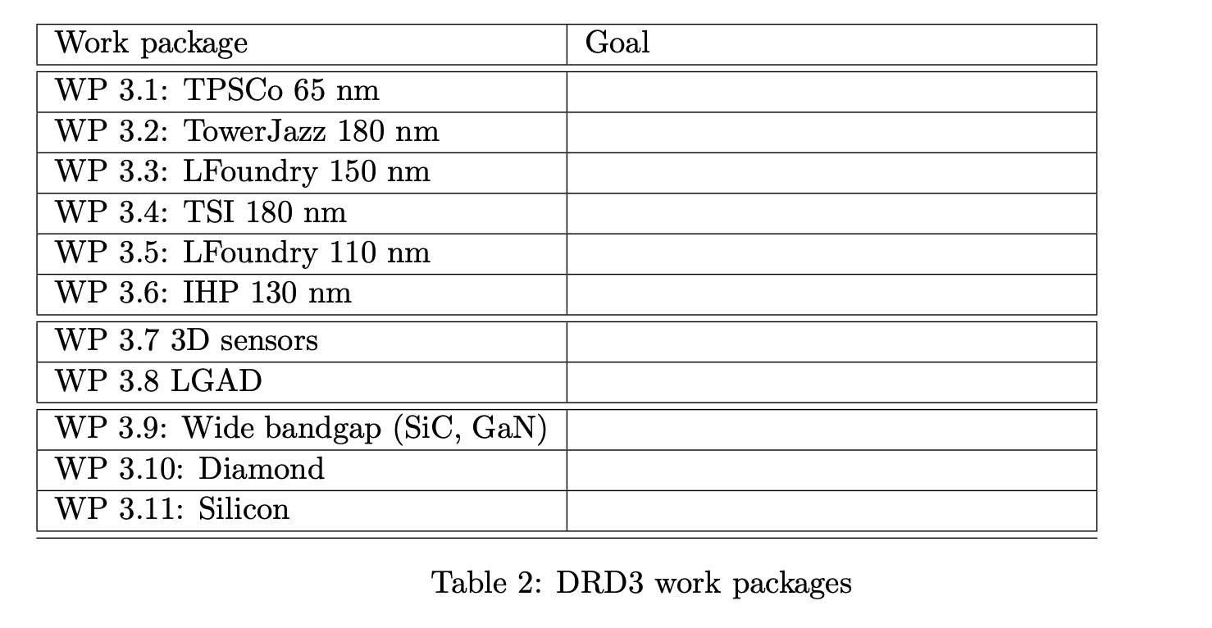
Implementation of the DRD3 mandate
Strategic R&D via Work Package, identified by technology
Blue sky R&D via common project, approved by the DRD3
Projects to be defined by the community
Shortly, a new questionnaire to the community.
This questionnaire will ask to indicate to which Milestones each group is interested and with what resources.

Slide 17
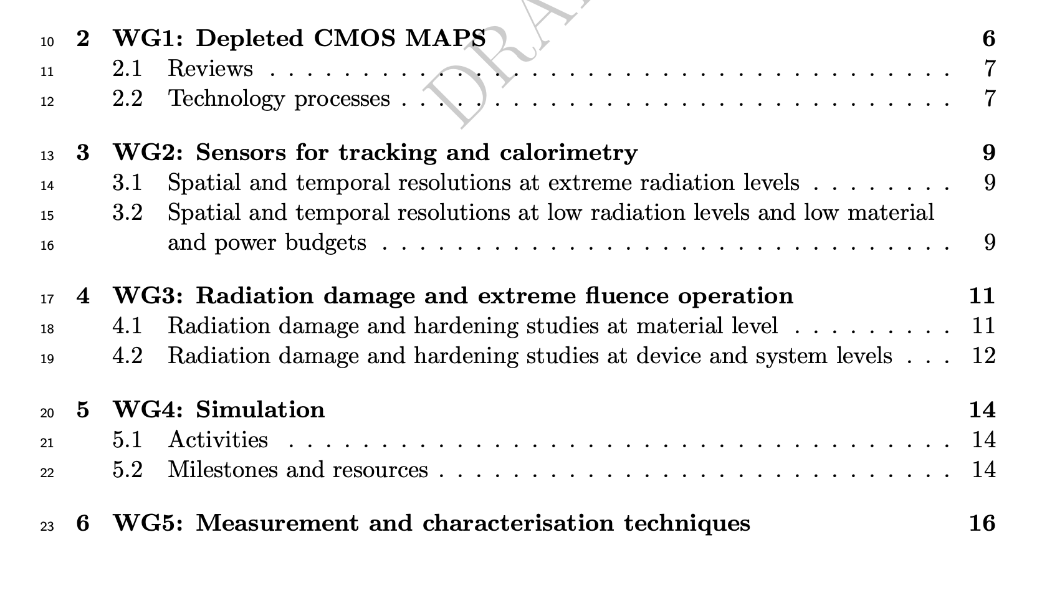
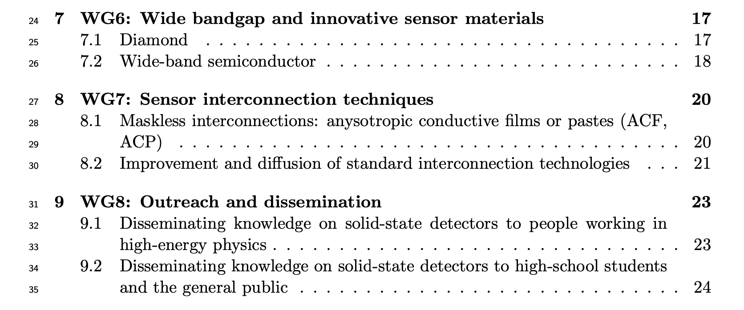
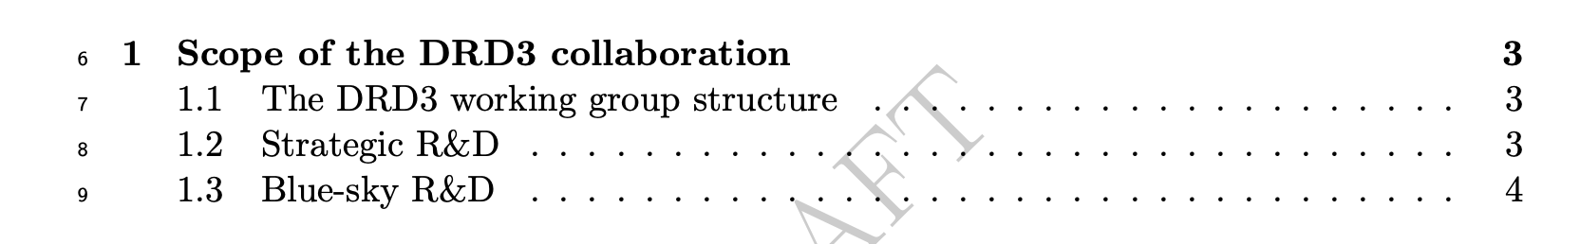
WG description

Slide 18
DRD4 – Photon Detectors and PID Community meeting May 16-17
https://indico.cern.ch/event/1214407/
Conveners: Christian Joram (CERN), Peter Krizan (Ljubljana)
Contact: Eugenio Nappi (BA), Fulvio Tessarotto (TS), Alessandro Petrolini (GE), Massimiliano Fiorini (FE)
DRDT 4.x
DRD4 - Particle Identification and Photon Detectors
4.1 - Enhance the timing resolution and spectral range of photon detectors
4.2 - Develop photosensors for extreme environments
4.3 - Develop RICH and imaging detectors with low mass and high timing resolution
4.4 - Develop compact high performance time-of-flight detectors
Late start: TF4 community meeting 16-17 May 2023.
Checkpoint at open meeting on June 15.
Try to have a draft by end of June...
Interaction/feedback/iterations with groups started/starting.

Slide 19
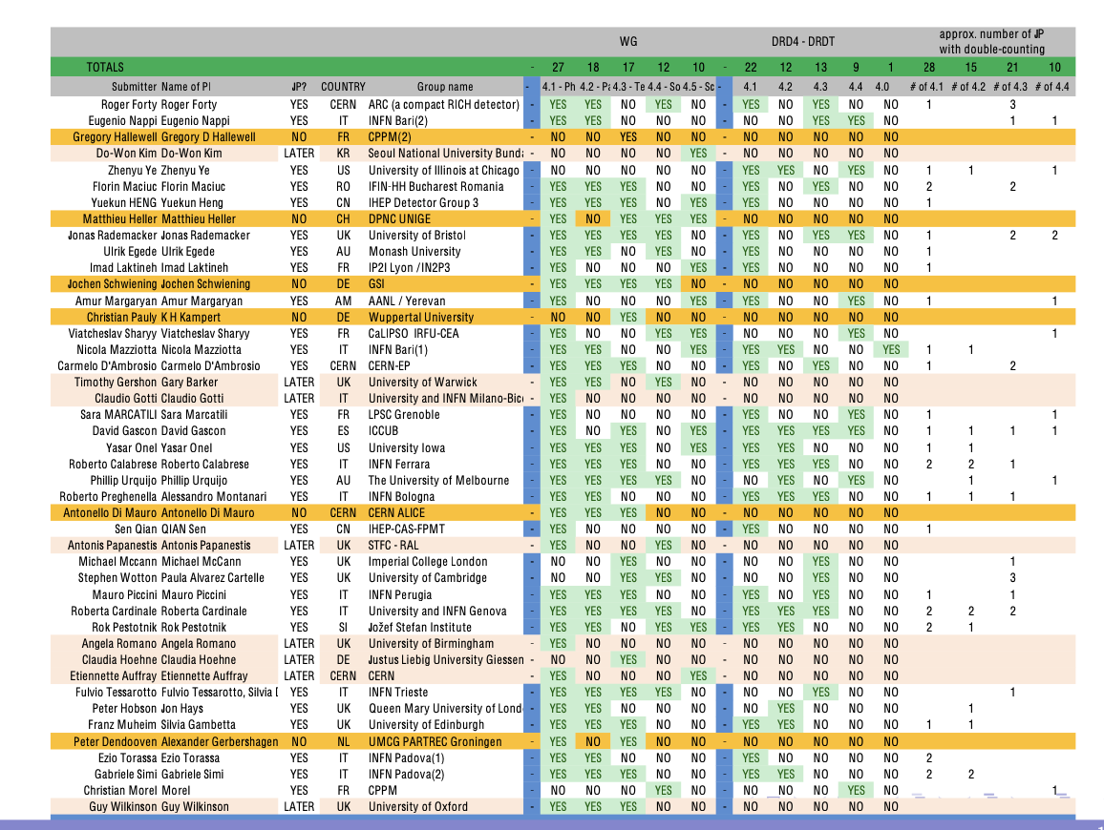

Slide 20
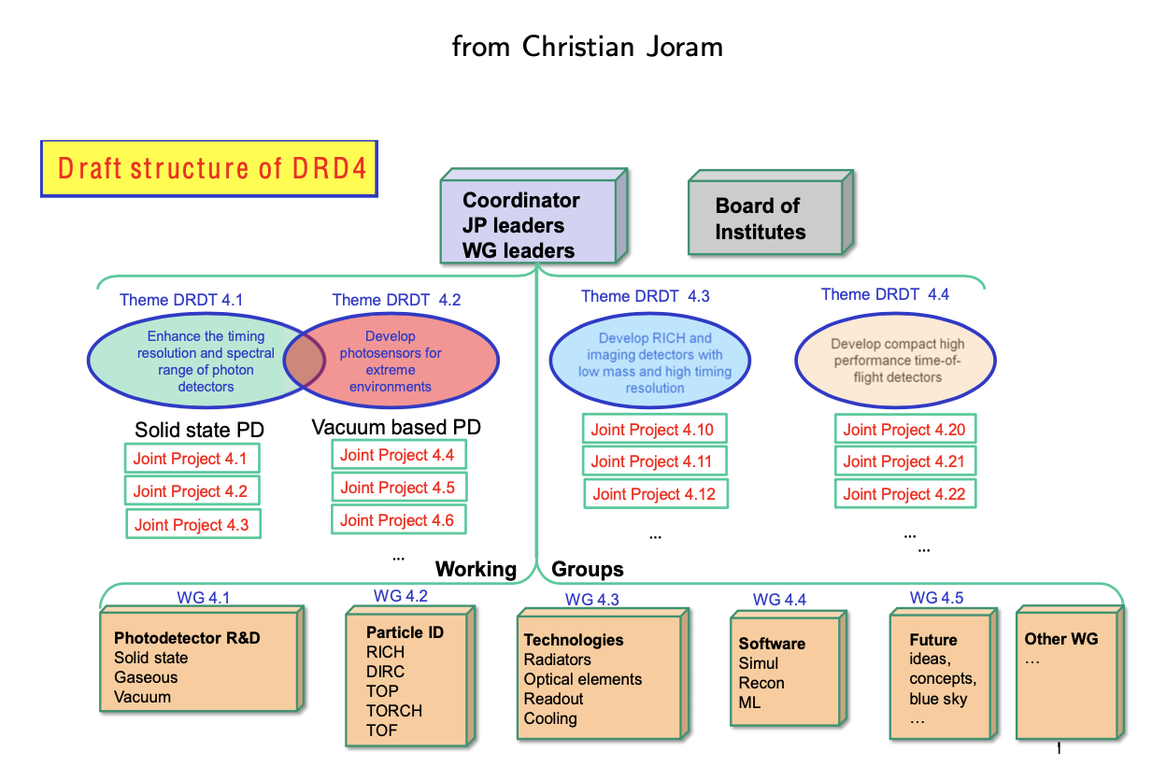

Slide 21
DRD6 – Calorimetry Community meeting January 12 April 20 https://indico.cern.ch/event/12126 https://indico.cern.ch/event/1246381/
Conveners: Roberto Ferrari (INFN Pavia), Roman Pöschl (CNRS/IN2P3/IJCLab)
Experts: Martin Aleksa (CERN), Etiennette Auffray-Hillemanns (CERN), Dave Barney (CERN), Gabriella Gaudio (INFN Pavia),
Frank Simon (KIT/MPP), Tommaso Tabarelli de Fatis (INFN Milano Bicocca),
Link to the coordination team: Felix Sefkow (DESY)
PROPOSAL TEAM
Track 1: Sandwich calorimeters with fully embedded Electronics – Main and forward calorimeters
Track conveners: Adrian Irles (IFIC), Frank Simon (KIT), Jim Brau (University of Oregon), Wataru Ootani (University of Tokyo)
Track 2: Liquified Noble Gas Calorimeters
Track Conveners: Martin Aleksa (CERN), Nicolas Morange (IJCLab), Marc-André Pleier (BNL)
Track 3: Optical calorimeters: Scintillating based sampling and homogenous calorimeters
Track Conveners: Etiennette Auffray (CERN), Gabriella Gaudio (INFN Pavia), Marco Lucchini (INFN Milano-Bicocca), Philipp Roloff (CERN),
Sarah Eno (University of Maryland), Hwidong Yoo (Yonsei University)

Slide 22
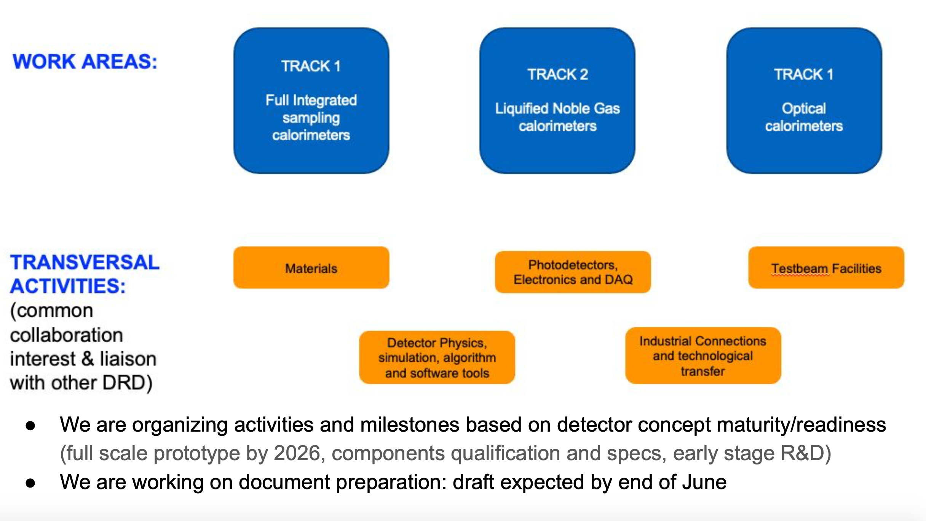

Slide 23
DRD7 – Electronics and On-detector Processing Community meeting March 14-15
https://indico.cern.ch/event/1214423/
Conveners:Dave Newbold, Francois Vasey
Data Density
Track conveners: Christophe Flouzat, Jeffrey Prinzie, Szymon Kulis
Intelligence on detector
Track conveners: Davide Ceresa, Francesco Crescioli, Frederic Magniette
4D techniques
Track conveners: Adriano Lai (INFN Cagliari), Marek Idzik, Patrick Robbe, Sophie Baron
Extreme environments and longevity
Track conveners: Giulio Borghello, Manuel Dionisio Da Rocha Rolo (INFN Torino), Oscar Francisco
Emerging technologies
Track conveners: Conor Fitzpatrick, Jan Troska, Michele Caselle, Niko Neufeld
Monolithic sensor ASICs
Track conveners: Iain Sedgwick, Marlon B. Barbero, Walter Snoeys
Technologies and tools
Track conveners: Kostas Kloukinas, Mark Willoughby, Xavi Llopart Cudie
Survey entro 30 giugno!!!

Slide 24
DRD7 – call for projects
Dear Colleagues
You receive this message because you registered to the ECFA DRD7 interest group.
In view of drafting its Letter of Intent, DRD7 is now calling for projects in electronics, following the priorities established in the ECFA Detector R&D roadmap document.
Interested scientists, groups or collaborations are invited to express their interest by contacting the relevant DRD7 WG conveners with their project intentions.
Conveners will collect the community feedback and aggregate it into a portfolio of projects in each WG.
These preliminary project intentions will form the basis of the Letter of Intent, due to be submitted in July 2023.
The two attached documents give all necessary information on the call for projects itself, and on the DRD7 future organization.
Please express your interest before 30 June 2023.
Francois Vasey, on behalf of the steering and technical committees.

Slide 25
R&D di interesse INFN
DRD
DRD1 | WP | task | WG | DRDT | Delivery date | TOTAL |  | INFN |  | INFN Groups | Comments
 |  |  |  |  |  | Cost | FTE | Cost | FTE
DRD3 | Milestone | Deliverable | WG | DRDT | Delivery date | TOTAL |  | INFN |  | INFN Groups | Comments
 |  |  |  |  |  | Cost | FTE | Cost | FTE
Prossimi passi e tempistica
31.07.2023 Official deadline for proposal submission
6 giugno Riunione INFN ==> TABELLA DRAFT ATTIVITA DRD INFN – FTE – RISORSE RICHIESTE
15 giugno Verifica stato tutti proposals ==> TABELLA DRAFT ATTIVITA

Slide 26
ECFA-LDG WG for Detector R&D Infrastructures
Preparation of Questionnaire to assess Needs of DRDs for Infrastructure
Ingrid-Maria Gregor (DESY & Bonn Univ.) – Marko Mikuz (Jozef Stefan Institute (SI)) – Nadia Pastrone (INFN Torino)
Test beam Facilities
Irradiation facilities
Test set-up for characterisation and test-bench measurements
Engineering support for detector R&D
Specific software for instrumentation
Task to create a matrix to connect the requests from the DRD collaborations with the resources of the (national) labs and the institute facilities
Matrix to be filled during summer to be ready for presentation at EPS meeting

Slide 27

DRD5 – Quantum and Emerging Technologies Community meeting April 3-6
https://indico.cern.ch/event/1229782/
Conveners: Marcel Demarteau, Michael Doser
Contact: Caterina Braggio (INFN Padova), Alberto Quaranta (INFN TIFPA)
atomic clocks/networks
superconducting and spin-based sensors
kinetic detectors
atoms, ions, molecules and atom interferometry
optomechanical sensors
metamaterials, 0-,1-,2-dimensional materials
https://agenda.infn.it/event/36188/
NEW COMMUNITY
identify a limited number
of key detector R&D projects
to form the backbone of a Letter of Intent to the DRDC
➔ larger workshop in Autumn

Slide 28
DRD8 – Integration
Conveners: Frank Hartmann, Werner Riegler
Contact:
Lightweight Mechanics
Local Cooling
Cooling Systems
Magnet Systems
Machine Detector Interface
Environmental Monitoring
Radiation and Beam Monitoring
Integration of Liquid Calorimetry, Imaging Calorimatry
Integration of Neutrino Detectors
Integration of Dark Matter Detectors
Robotics
DRD9 – Training
Conveners: Erika Garutti, Johann Collot
Contact:
Nessuna novità su avanzamenti – da investigare

Slide 29
Attività/DRD @ Torino

Slide 30
extras
Per ricevere aggiornamenti sulle varie tematiche registratevi alle mailing list
https://lists.infn.it/sympa/info/infn_drd1_gas
R&D Gas detectors
https://lists.infn.it/sympa/info/infn_drd2_liquidi
R&D Liquid detectors
https://lists.infn.it/sympa/info/infn_drd3_solidstate
R&D Solid State detectors
https://lists.infn.it/sympa/info/infn_drd4_photonpid
R&D photon detectors - PID
https://lists.infn.it/sympa/info/infn_drd5_quantum
R&D Quantum and emerging technologies
https://lists.infn.it/sympa/info/infn_drd6_calorimetry
R&D Calorimetry
https://lists.infn.it/sympa/info/infn_drd7_elettronica
R&D Electronics
https://lists.infn.it/sympa/info/infn_drd8_integration
R&D detectors integration

Slide 31
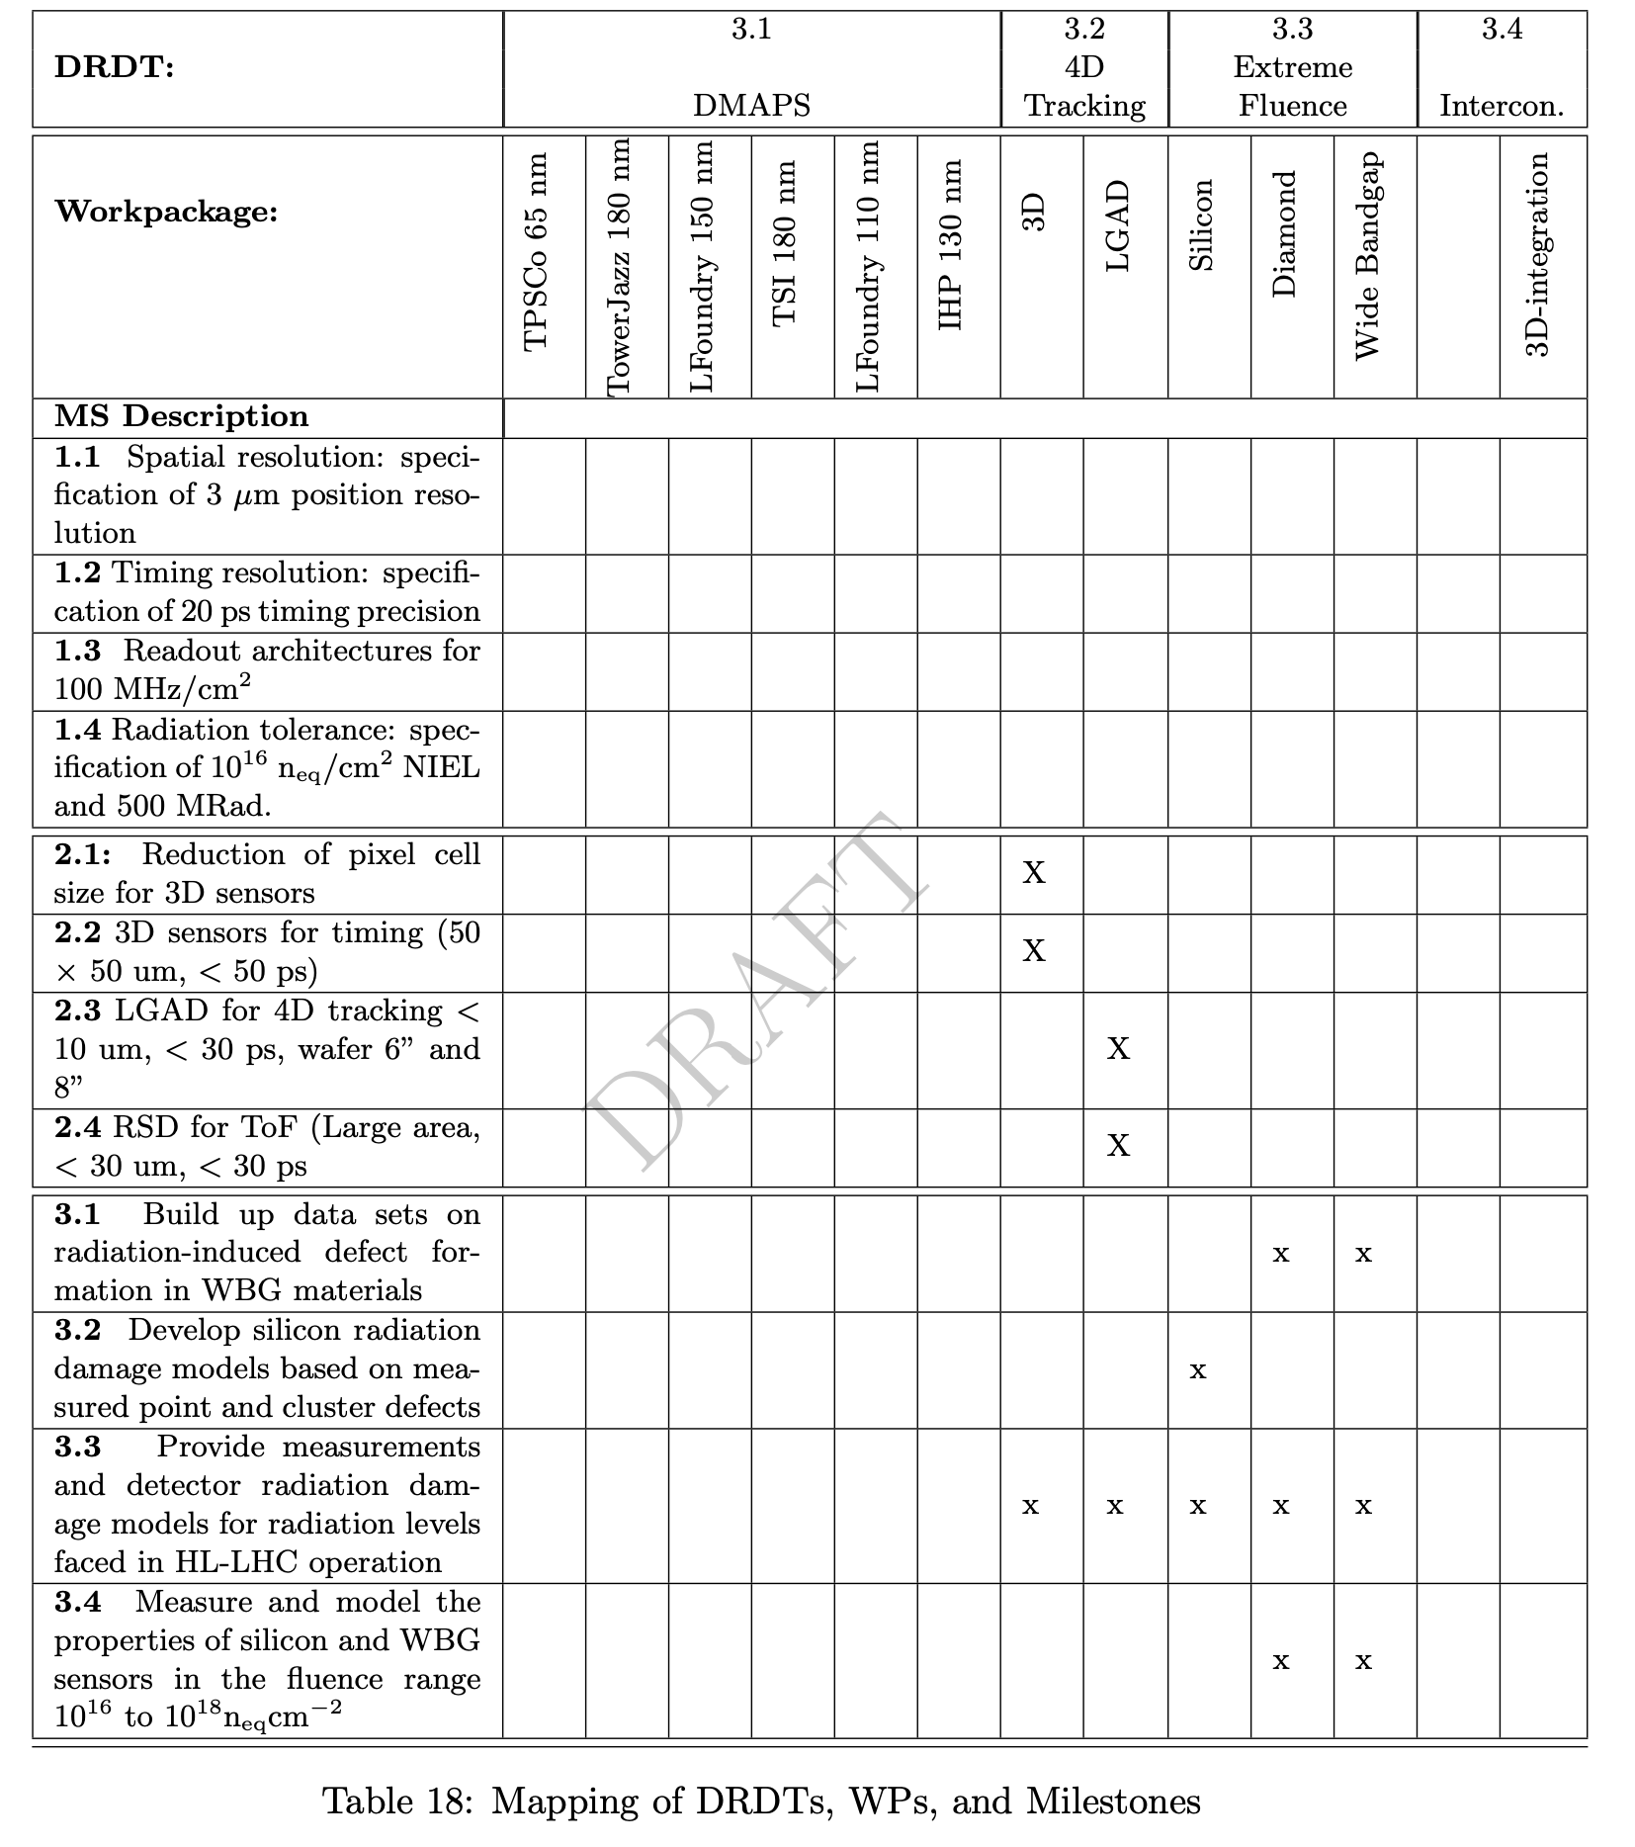
Relationship between WG and WP
WGs define the milestones geared to meet the WP (strategic) and CP (blue sky) goals

Slide 32
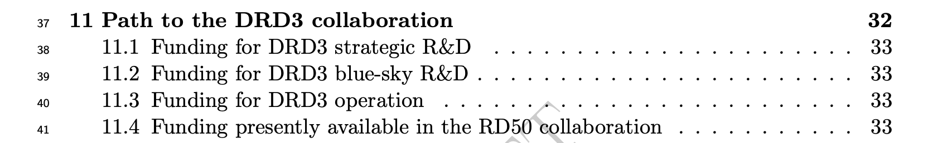
Forming the collaboration

Slide 33
DRD3 interplay with DRDn, Industry
The most considerable interplay is with DRD7 (electronics), on the field of DMAPS
Presently, there is no DRD3 group that has expressed interest in silicon for calorimetry. We still need to develop this field
Industry: the present plan is to collaborate with industry in the same way we did in RD50

