Slide 1
DAQ system with TERA-08 chip
Roberto Catalano¹, Pablo Cirrone¹, Giacomo Cuttone¹, Giada Petringa¹
¹Istituto Nazionale di Fisica Nucleare – Laboratori Nazionali del Sud
Roberto Catalano, PhD INFN-LNS, Catania (Italy) - roberto.catalano@lns.infn.it

Slide 2
Haspide Project at INFN-LNS
Main goal
Realize an electronic chain based on the TERA-08 chip able to work in two different configu-rations: continuous and pulsed proton beams.
TERA-08 chip was realized by INFN-TO and available on the market through DE.TEC.TOR. s.r.l. company
It was designed for continuous beams
LNS-INFN group modified it for pulsed beams (laser-driven applications)
Acquisition by means of a PXIe FPGA 782x board
1-year post-doc position (Bando INFN N. 24956/2022)
(hardware assembling, software developing, electronic read-out characterization, ex-
perimental runs with pulsed beams)
Roberto Catalano, PhD INFN-LNS, Catania (Italy) - roberto.catalano@lns.infn.it

Slide 3
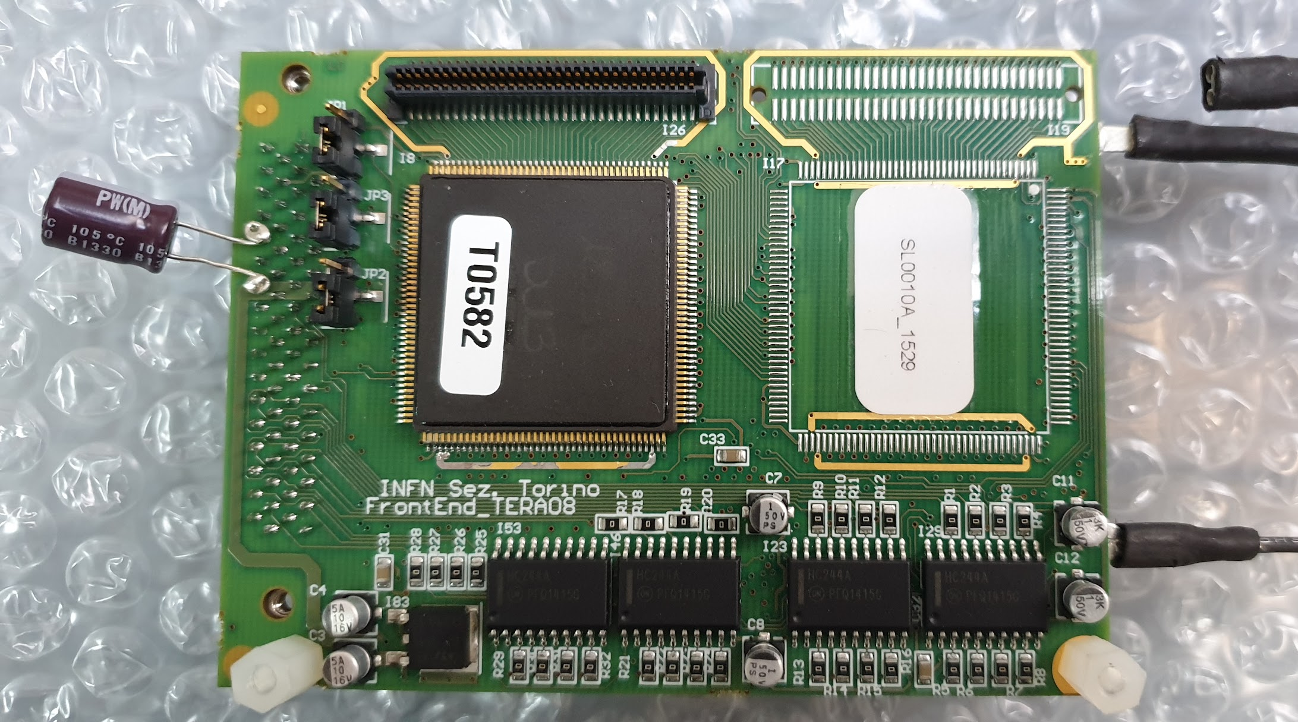
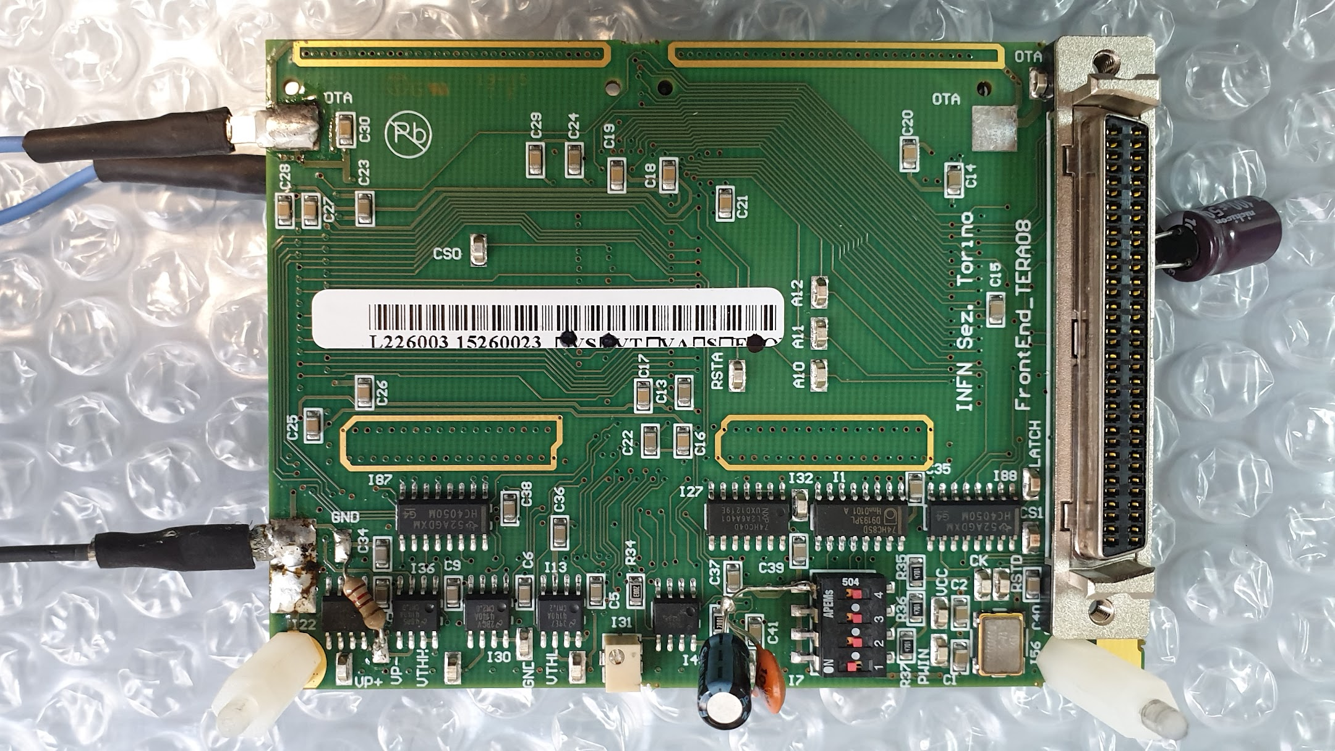
Features of TERA-08 chip
The TERA08 chip is based on 64-channel ASIC integrated circuit (4.5 × 4.5 mm²), designed in the CMOS AMS 0.35 μm technology which hosts in every channel a current-to-frequency conver-ter followed by a 32-bit synchronous up/down digital counter.
TERA-08 front
1. Bipolar input .
2. 32-bit digital output .
3. Charge quantum set qₒ= 25 fC - 1.155 pC .
4. Maximum conversion frequency νmax = 20 MHz .
5. Maximum input current Imax = qₒ × νmax = ± 22 μA .
7. Linearity range < 1,5% from 500 pA to 3 μA .
TERA-08 back
Roberto Catalano, PhD INFN-LNS, Catania (Italy) - roberto.catalano@lns.infn.it

Slide 4
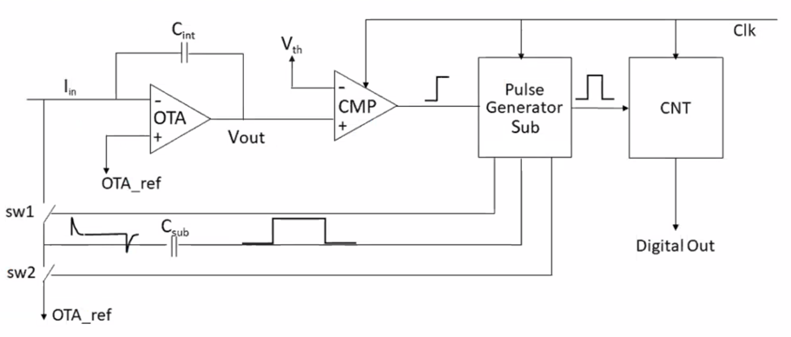
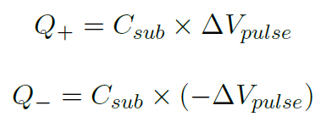
Chip architecture
Recycling integration principle
The OTA amplifies the potential difference according to G:
V_{out} = G (V_{in} – V_{OTA_ref})
V_{out} is compared to different fi-xed thresholds by two CMPs
When V_{out} crosses the threshold, the related CMP sets a level at the input of the PG
The C_{sub} output responses are two opposite current signals δ+ (po-sitive) or δ- (negative) with the associated quantum charge:
Roberto Catalano, PhD INFN-LNS, Catania (Italy) - roberto.catalano@lns.infn.it

Slide 5
Chip architecture
Acting on the timing of the com-mands on sw1 and sw2, Q+ and Q- can be addressed either to the OTA input or to the OTA referen-ce voltage, thus adding or sub-tracting a fixed charge amount at each pulse generated by PG
- Q_{tot}
Q⁺
If, after the recycling, V_{out} re-mains below/above the threshold, PG will continue to issue pulses until the voltage returns above/ below the threshold
All operations are synchronized to an external master clock implemented in the block PG. The maximum conversion frequency of 20 MHz corresponds to one fifth of the clock frequency which is 100 MHz.
Q⁻
Roberto Catalano, PhD INFN-LNS, Catania (Italy) - roberto.catalano@lns.infn.it

Slide 6
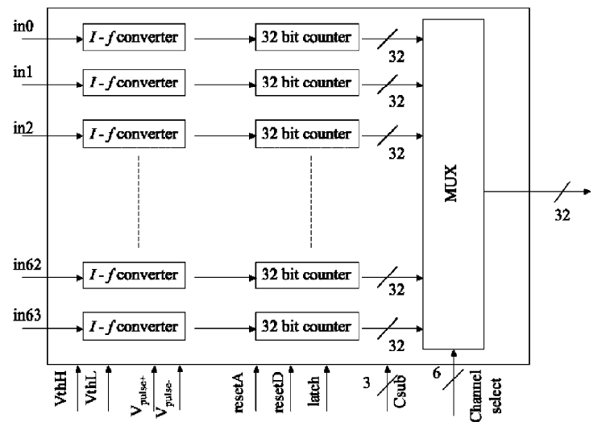
Chip architecture: data storing and read-out
The counter is constructed of latches connected in cascade, used as data storage elements
each counter is copied to a 32-bit register
this operation is done in parallel for all 64 channels
Each channel can be acquired by selecting it via a MUX that transfers the data to the out-put
Data acquisition does not stop the counter ac-tivity: it means no dead-time related to read-out operation
Roberto Catalano, PhD INFN-LNS, Catania (Italy) - roberto.catalano@lns.infn.it

Slide 7
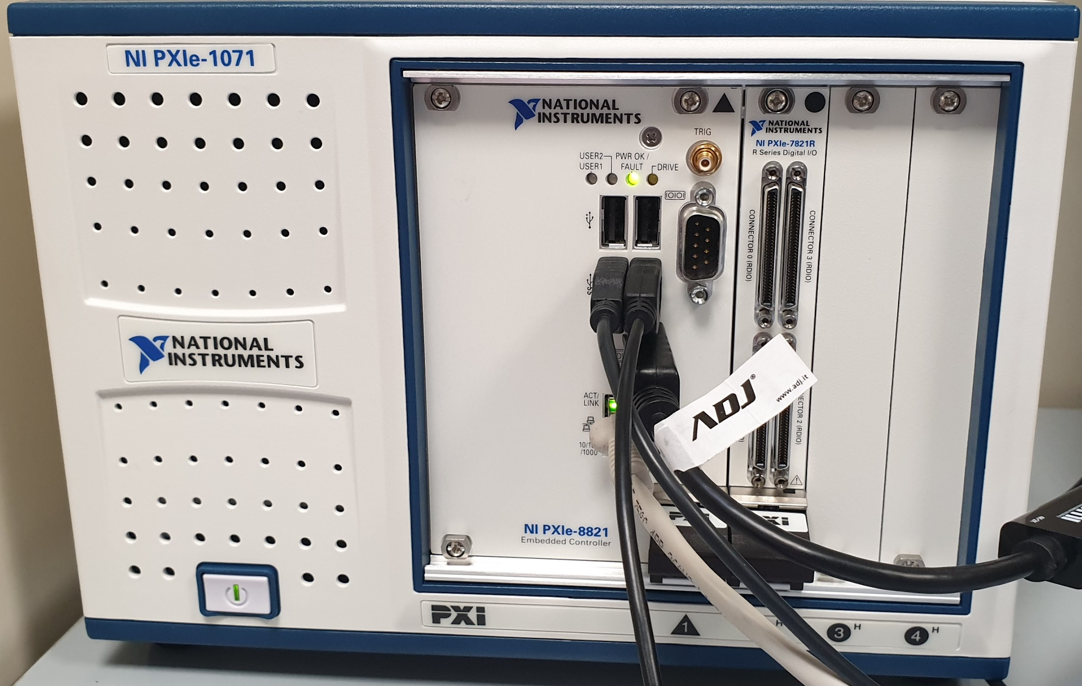
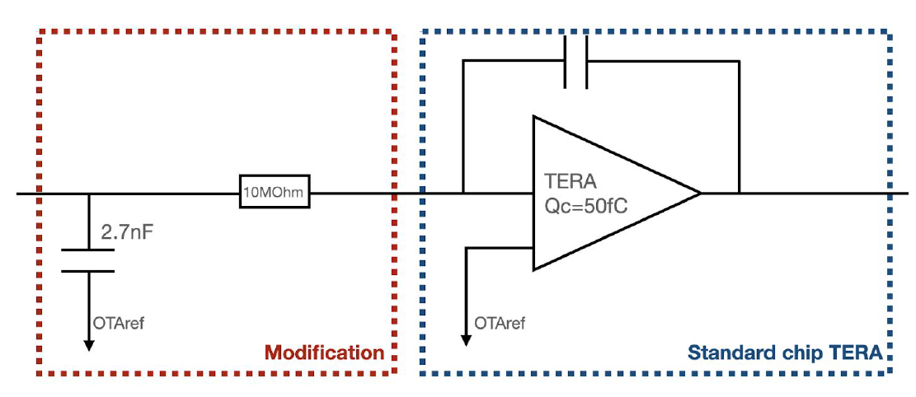
Electronic chain for pulsed beams
NI PXIe-1071 chassis
NI PXIe-7821R → Digital I/O
Thanks to: Antonino Amato (INFN-LNS)
The Digital I/O module include a FPGA (Kintex-7 160T type, National Instruments)
We will use LabView to configure the FPGA and thus set the characteristics of the acquisition system (as the externally settable parameters of TERA08). In addition, LabView enables on-line data processing, resulting in a significant spare of time.
Roberto Catalano, PhD INFN-LNS, Catania (Italy) - roberto.catalano@lns.infn.it

Slide 8
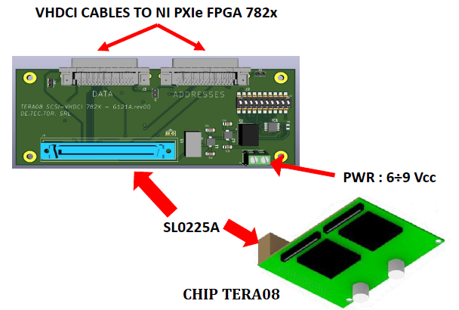
Electronic chain for pulsed beams
SETUP CONFIGURATION FOR ACQUISITION
WITH NI PXI CRATE AND PXIe FPGA 782x BOARD
NI PXIe-1071 chassis
NI PXIe-7821R → Digital I/O
The Digital I/O module include a FPGA (Kintex-7 160T type, National Instruments)
We will use an electronic board to connect the chassis input/output modules to the TERA08. The board was specifically designed by DE.TEC.TOR. s.r.l. to allow the connection between the two devices, which have different binning characteristics.
Roberto Catalano, PhD INFN-LNS, Catania (Italy) - roberto.catalano@lns.infn.it

Slide 9
Haspide Project at INFN-LNS: next steps
Hardware assembling - april 2023
Realization and optimization of the software control system – june 2023
Read-out characterization (background current, linearity of current-to-frequency con-version, charge conversion efficiency, gain uniformity, channel cross-talking) – july 2023
Detector tests and characterization with pulsed proton beams accelerated by laser-matter interaction at ELI-Beamlines (Prague, Czech Republic) – from august 2023
THANK YOU FOR YOUR ATTENTION
Roberto Catalano, PhD INFN-LNS, Catania (Italy) - roberto.catalano@lns.infn.it

