Slide 1
WP4 summary
Gianpiero Mangano and Francesco Villante
Nat-net meeting L’Aquila 18 july 2023

Slide 2
Plan of the session
Summary of the WP4 activity (Gianpiero Mangano & Francesco Villante)
Highlight talk: Impact of trans-Planckian quantum noise on the Primordial Gravitational wave and scalar spectrum (Mattia Cielo)
Higlight talk: Primordial Blach Holes (PBH) in cosmology (Roberta Calabrese)

Slide 3
WP4 issues
THE STANDARD COSMOLOGICAL MODEL AND BEYOND:
Cosmological perturbations
Neutrino cosmology and dark radiation (N_{eff})
Big bang Nucleosynthesis
Dark matter
Archimedes project
Pre-big bang cosmology
Axion cosmology

Slide 4


papers in the WP4 (2021 – today)
22 papers in peer review journals (PRD, JHEP, JCAP, …)
14 published
2 submitted
5 no acknowledgments to NAT-NET
1 experimental paper of the PTOLEMY Collaboration

Slide 5
BIG BANG NUCLEOSYNTHESIS
A follow up of the Nature paper on LUNA results
on d(p,gamma)³He
Primordial Deuterium after LUNA, concordances and error budget
O. Pisanti, G. Mangano, G. Miele and P. Mazzella,
JCAP 04 (2021) 020

Slide 6
BIG bang nucleosynthesis

Slide 7
Violation of Equivalence principle
IceCube constraints on violation of equivalence principle
D.F.G. Fiorillo, G. Mangano, S. Morisi and O. Pisanti
JCAP 04 (2021) 079
See also: Sensitivity of Km3Net to Violation of Equivalence Principle M. Chianese et al Symmetry 13( 2021) 8, 1353

Slide 8
Primordial perturbation and Bunch Davis vacuum. BH (real and virtual) as a source
Impact of trans-Planckian quantum noise on the Primordial Gravitationa Wave spectrum
M. Cielo, G. Mangano and O. Pisanti
2211.04316, in print in Phys. Rev. D (2023)

Slide 9
The «ultimate» calculation of N_{eff}
Neff in the Standard Model at NLO is 3.043
M. Cielo, M. Escudero, G. Mangano and O. Pisanti
2306.05460, submitted to Phys. Rev. Lett.

Slide 10
Ptolemy, neutrino mass and NCB
Heisenberg’s uncertainty principle in the PTOLEMY project: a theory update
Apponi et al Phys. Rev. D 106 (2022) 5, 053002

Slide 11
AI for dark matter
Limits of DM distribution in galaxies:

Slide 12
PBH’s in cosmology I
“Towards baryogenesis via absorption from primordial black holes”.
A. Ambrosone, R. Calabrese, Damiano F.G. Fiorillo, G. Miele, S. Morisi.
Arxiv: 2106.11980 [hep-ph]. Phys.Rev.D 105 (2022) 4, 0450015)
“Limits on light primordial black holes from high-scale Leptogenesis”.
R. Calabrese, M. Chianese, J.Gunn, G. Miele, S.Morisi, N. Saviano.
Arxiv: 2305.13369 [hep-ph]. Phys.Rev.D 107 (2023) 12, 123537

Slide 13
PBH’s in cosmology II

Slide 14
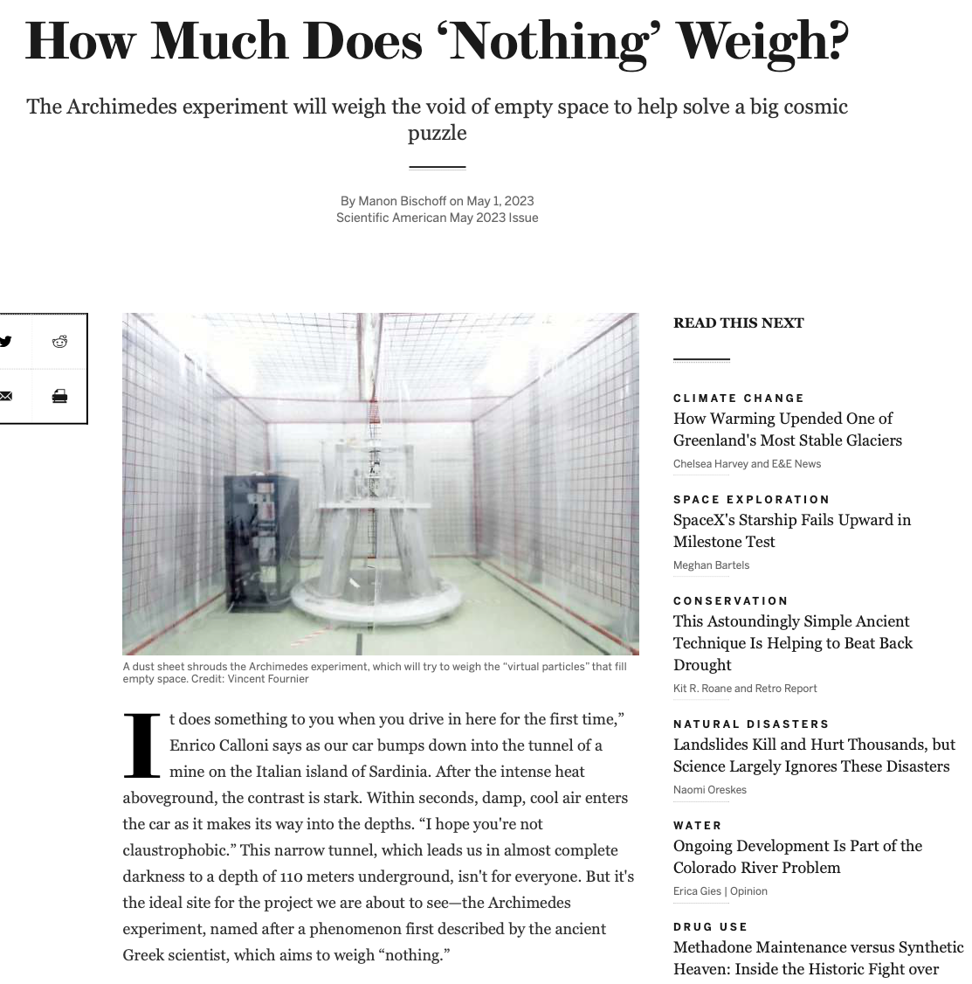
Archimedes
1) Quantum zero point electromagnetic energy difference between the
superconducting and the normal phase in a high-Tc superconducting metal bulk sample
Annalisa Allocca, et al.
Phys. Rev. B 106, 134502 – Published 3 October 2022
2) Casimir energy for N superconducting cavities: a model for the YBCO
(GdBCO) sample to be used in the Archimedes experiment
Annalisa Allocca, et al.
The European Physical Journal Plus volume 137, Article number: 826 (2022)
3) Picoradiant tiltmeter and direct ground tilt measurements at the Sos
Enattos site Annalisa Allocca, et al.
The European Physical Journal Plus volume 136, Article number: 1069 (2021)

Slide 15
Per francesco
Lascio a te la cura dei seguenti papers
- M. Gasperini,
From pre- to post-big bang: an (almost) self-dual cosmological history,
in ``The future of mathematical cosmology''',
ed. by S. Cotsakis and A. Yefremov,
published in Phil.Trans. Roy. Soc. A 380, 2230 (2022).
https://doi.org/10.1098/rsta.2021.0179
[arXiv:2106.12865 [hep-th]]
- M. Gasperini,
Gravity at finite temperature, equivalence principle, and local Lorentz
invariance,
in ``Breakdown of the Einstein's Equivalence Principle'',
ed. by A. G. Lebed (World Scientific, 2023), Cap. 3, p. 77.
ISBN: 978-981-125-358-4
https://doi.org/10.1142/9789811253591_fmatter
[arXiv:2101.00458 [gr-qc]]
- M. Gasperini and G. Veneziano,
"Non-singular pre-big bang scenarios from all-order $\alpha'$ corrections",
arXiv:2305.00222 [hep-th]

Slide 16
Unfinished fabric of the three neutrino paradigm
F. Capozzi et al, Phys. Rev. D 104 (2021) 8,083031
Precession shift in curvature base extended theories of gravity and quintessence fields A. Capolupo, G. Lambiase and A. Tedesco Eur. Phys. J C82 (2022) 4, 286
Axion-like particles from primordial black holes shining through the Universe, F. Schiavone, D. Montanino, A. Mirizzi and F. Capozzi JCAP 08(2021) 063
Massive sterile neutrinos in the early universe: from thermal decoupling to cosmological constraints, L. Mastrototaro, P.D. Serpico, A. Mirizzi and N. Saviano, Phys. Rev. D 104 (2021 1 016026
Thermal axions with multi-eV masses are possible in low reheating scenarios
P. Carenza, M. Lattanzi, A. Mirizzi and F. Forastieri JCAP 07 (2021) 031

