Slide 1
Calculation of g01 coupling costant trought HFSS simulation
Emanuele Palumbo
Felix Henrich

Slide 2
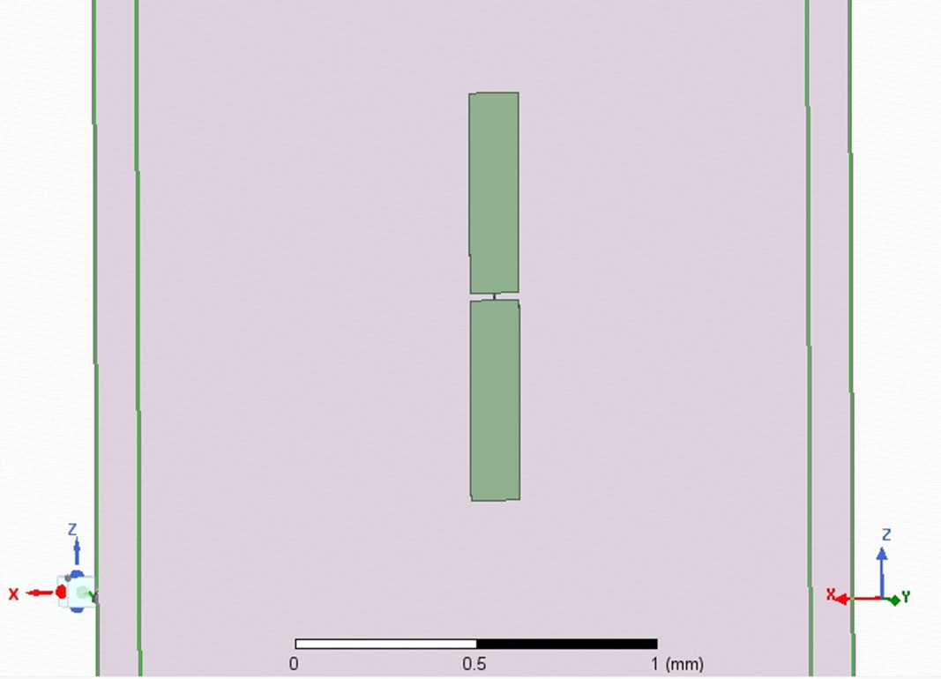
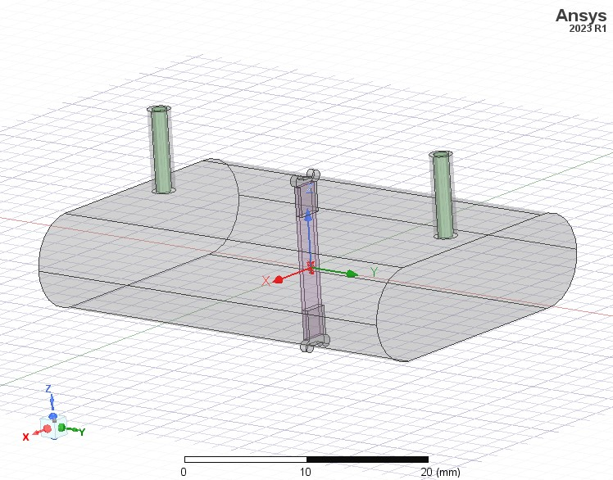



HFSS design
144 $μ\text{m}$
d2 = 566 $μ\text{m}$
2 $∙$d1 = 20 $μ\text{m}$

Slide 3
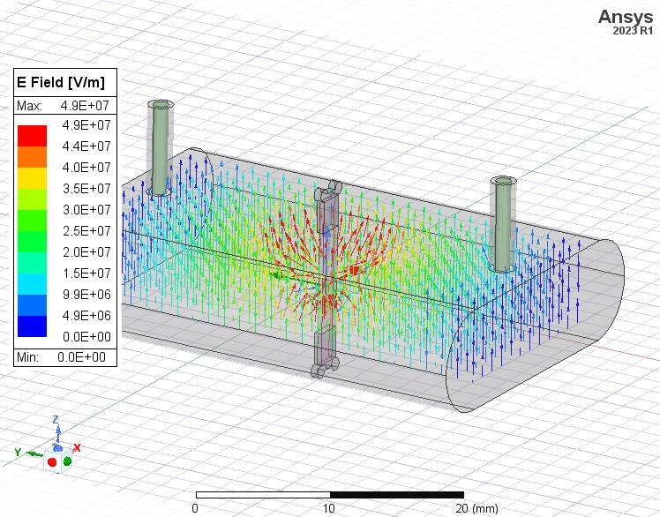
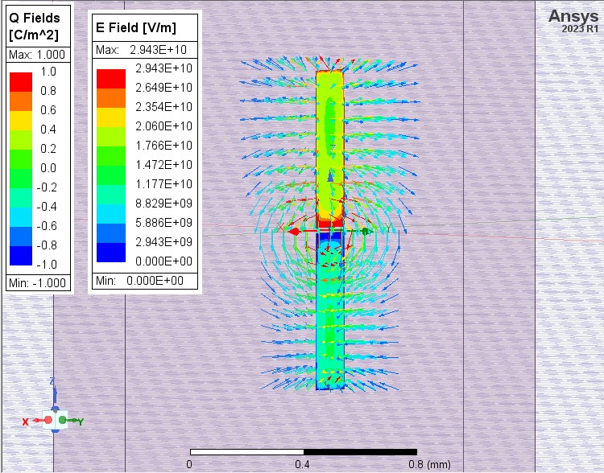
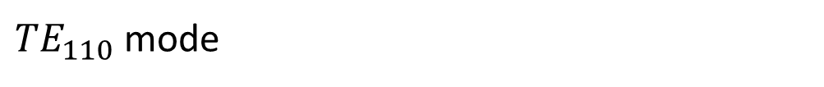
HFSS electric field simulation
${TE}_{110}$ mode

Slide 4
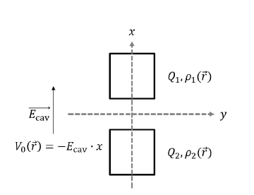




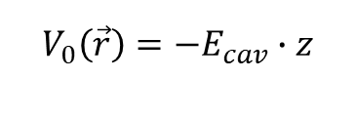


Interaction hamiltonian
$$V_{0}\left(\vec{r}\right)=−E_{cav}∙z$$
$${Q= Q}_{1}=−Q_{2}$$
z
- x
$$V_{0}\left(\vec{r}\right)=−E_{cav}∙z$$
$$H_{int, JC}=ℏ g_{01}(a^{+}σ^{−}+aσ^{+})$$
(Reference: Stefanie Miller, A tunable 20 GHz transmon qubit in a 3D cavity)

Slide 5



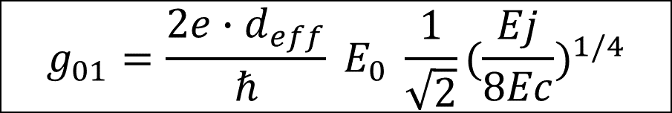
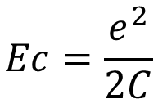

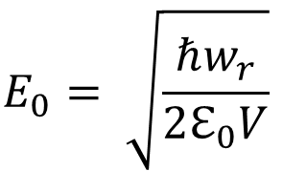
Coupling constant g01
From HFSS simulation
$$ℏ w_{q}= \sqrt{8 Ec Ej}−Ec$$
$$g_{01}=\frac{2e∙d_{eff}}{ℏ} E_{0} \frac{1}{\sqrt{2}}({\frac{Ej}{8Ec})}^{1/4}$$
$$Ec=\frac{e^{2}}{2C}$$
$$E_{0}= \sqrt{\frac{ℏw_{r}}{2ℇ_{0}V}}$$
$$≈ \frac{1}{4} Vcavity$$
For ${TE}_{110}$ mode

Slide 6
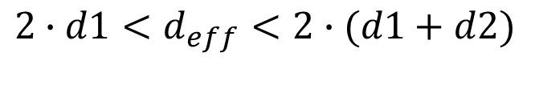

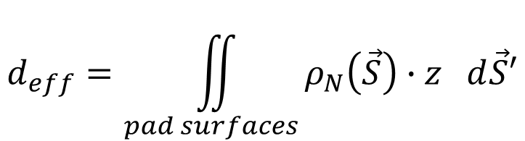
Effective distance
144 $μ\text{m}$
$$d_{eff}=\iint_{pad surfaces}{ρ_{N}\left(\vec{S}\right)∙z d\vec{S}′}$$
d2 = 566 $μ\text{m}$
$$ρ_{N}(\vec{S})=\frac{ρ_{1}(\vec{S})}{|Q|}+\frac{ρ_{2}(\vec{S})}{|Q|}$$
2 $∙$d1 = 20 $μ\text{m}$
$$2∙d1<d_{eff}<2∙(d1+d2)$$

Slide 7
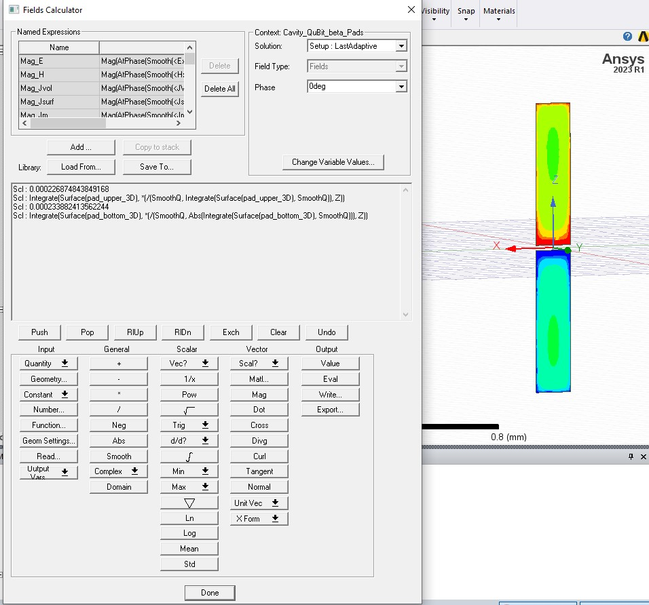
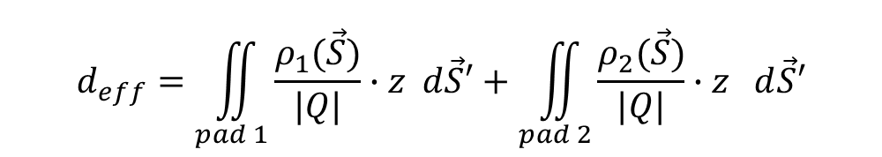
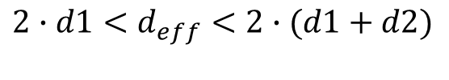
Calculation with the HFSS calculator
$$d_{eff}=\iint_{pad 1}{\frac{ρ_{1}(\vec{S})}{|Q|}∙z d\vec{S}′}+\iint_{pad 2}{\frac{ρ_{2}(\vec{S})}{|Q|}∙z d\vec{S}′}$$
$$d_{eff}=440 μm$$
$$2∙d1<d_{eff}<2∙(d1+d2)$$

Slide 8
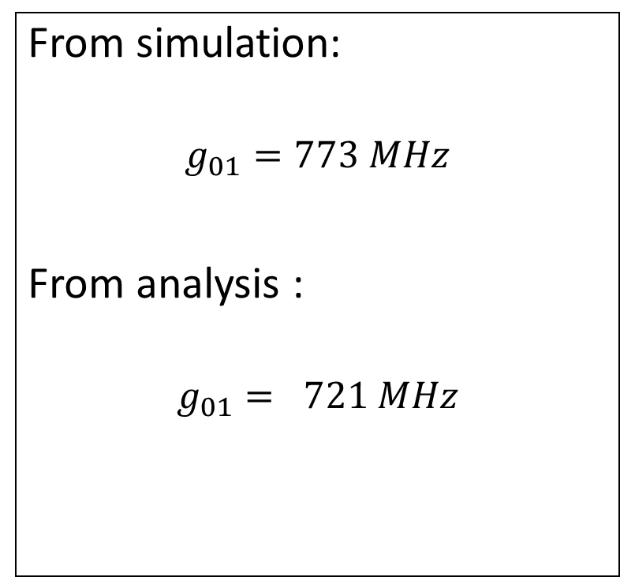
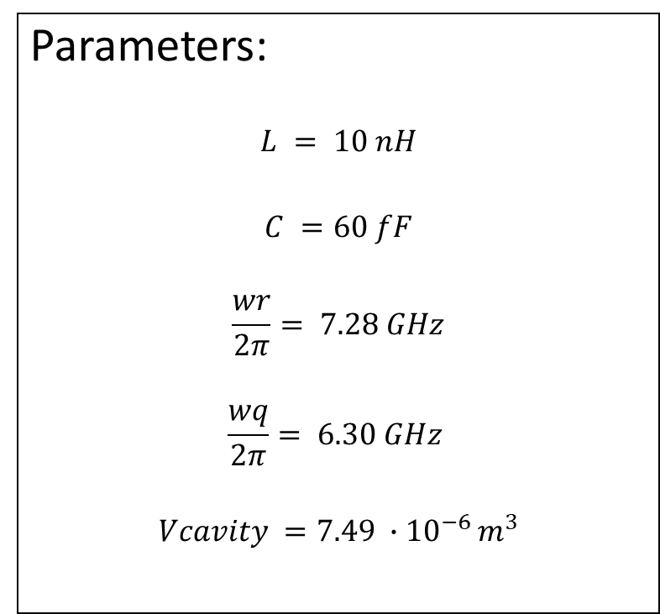
Results
Parameters:
$$L = 10 nH$$
$$C =60 fF$$
$$\frac{wr}{2π}= 7.28 GHz$$
$$\frac{wq}{2π}= 6.30 GHz$$
$$Vcavity =7.49 ∙{10}^{−6 }m^{3}$$
From simulation:
$$g_{01}=773 MHz$$
From analysis :
$$g_{01}= 721 MHz$$

Slide 9
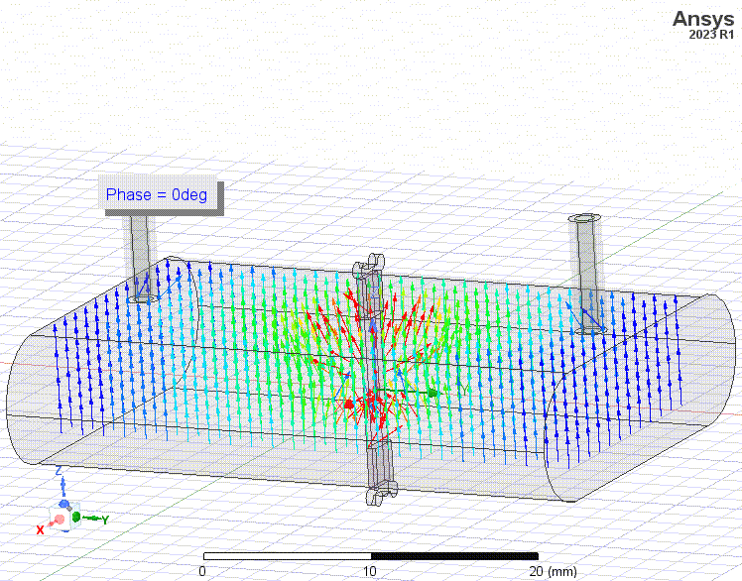

Slide 10
