Slide 1
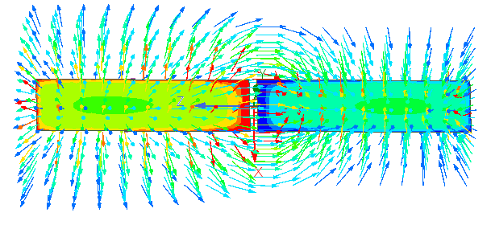
Ansys Hfss - Recipe
For the calculation of the effective distance d_{eff} of a dipole antenna

Slide 2
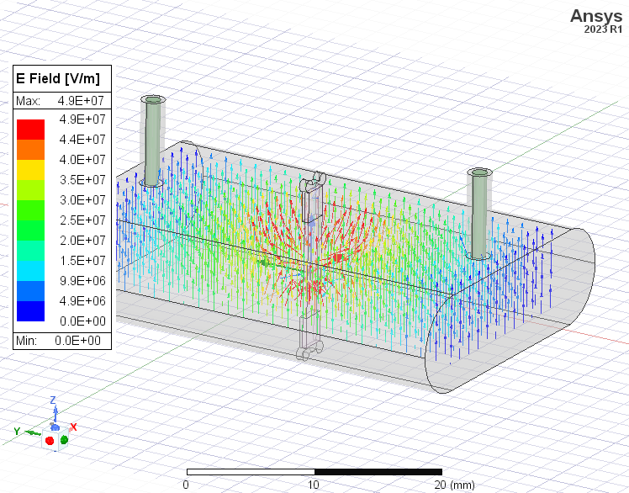
Setup:
RF cavity dimensions: 26x36x8 mm (vacuum)
Silicon substrate (silicon)
QuBit
  2x 3D Superconducting pads
  0.15mm x 100nm x 0.556mm (perfect conductor)
    (2D Pads with boundary condition: Perfect E
    work the same)
  JJ in between (vacuum)
    Modeld with Lumped RLC boundary condition
    L = 10 nH (also added C = 0.8 fF, only minor difference)
Settings:
Solution Type: Eigenmode
Field Source: Mode 1 TE₁₀₁

Slide 3
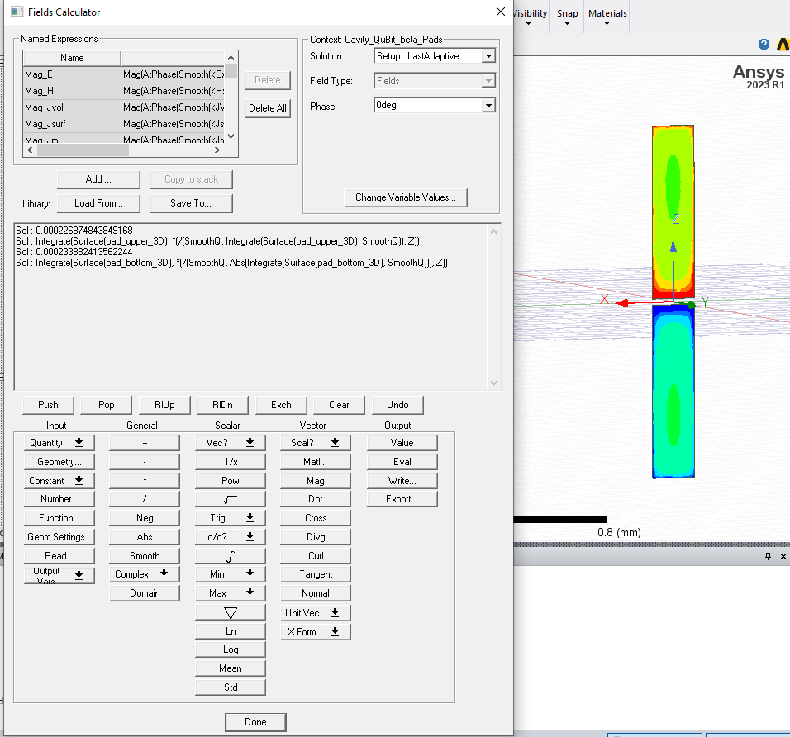
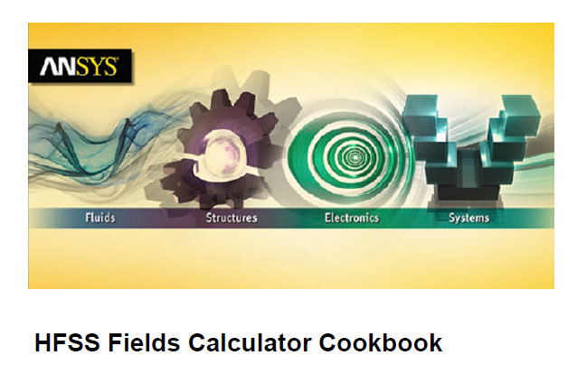

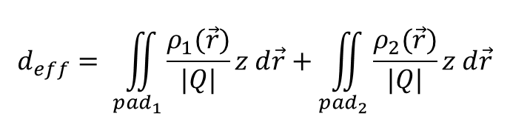
Fields Calculator
Effective distance:
Surface charge densities SmoothQ at phase $=$0
z
$$d_{eff}= \iint_{{pad}_{1}}{\frac{ρ_{1}(\vec{r})}{|Q|}z d\vec{r}}+\iint_{pad_{2}}{\frac{ρ_{2}(\vec{r})}{|Q|}z d\vec{r}}$$
Introduction with examples how to use the Fields Calculator
Charge on each pad Q=Q₁=-Q₂

Slide 4
Recipe to calculate d_{eff} with the Fields Calculator
Calculator Operation | Resulting Stack Display
Namend Expressions>SmoothQ(Copy to Stack) | Scl : SmoothQ
Namend Expressions>SmoothQ(Copy to Stack) | Scl : SmoothQ Scl : SmoothQ
Geometry…>Surface>pad_bottom | SclSrf : SurfaceValue(Surface(pad_bottom_3D), SmoothQ) Scl : SmoothQ
∫ | Scl : Integrate(Surface(pad_bottom_3D), SmoothQ) Scl: SmoothQ
Abs | Scl : Abs(Integrate(Surface(pad_bottom_3D), SmoothQ)) Scl: SmoothQ
/ | Scl : /(SmoothQ, Abs(Integrate(Surface(pad_bottom_3D), SmoothQ)))
Function…(>Scalar)>Z | Scl : Z Scl : /(SmoothQ, Abs(Integrate(Surface(pad_bottom_3D), SmoothQ)))
* | Scl : *(/(SmoothQ, Abs(Integrate(Surface(pad_bottom_3D), SmoothQ))), Z)
Geometry…>Surface>pad_bottom | Srf : Surface(pad_bottom_3D) Scl : *(/(SmoothQ, Abs(Integrate(Surface(pad_bottom_3D), SmoothQ))), Z)
∫ | Scl : Integrate(Surface(pad_bottom_3D), *(/(SmoothQ, Abs(Integrate (Surface(pad_bottom_3D), SmoothQ))), Z))
Eval | Scl : (value for deff in m)
*
* Z is the position in the Global CS! So the junction has to sit at (X,Y,0)

