Slide 1


Giuseppe Ronco
PhD Seminars
14/05/2023

Slide 2

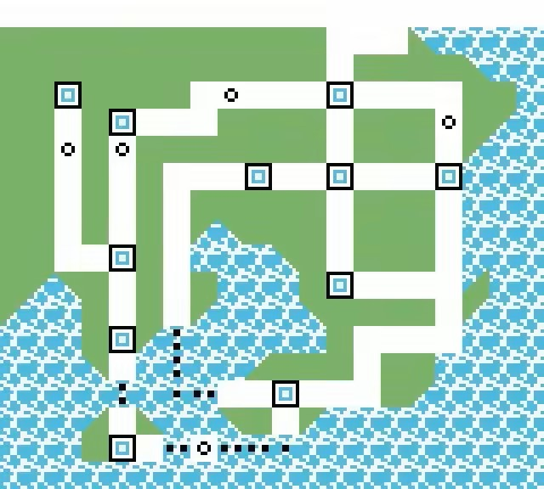
TABLE OF CONTENTS
The quantum revolution
Single-photons
2D Single-photons sources
Stretching 2D materials

Slide 3
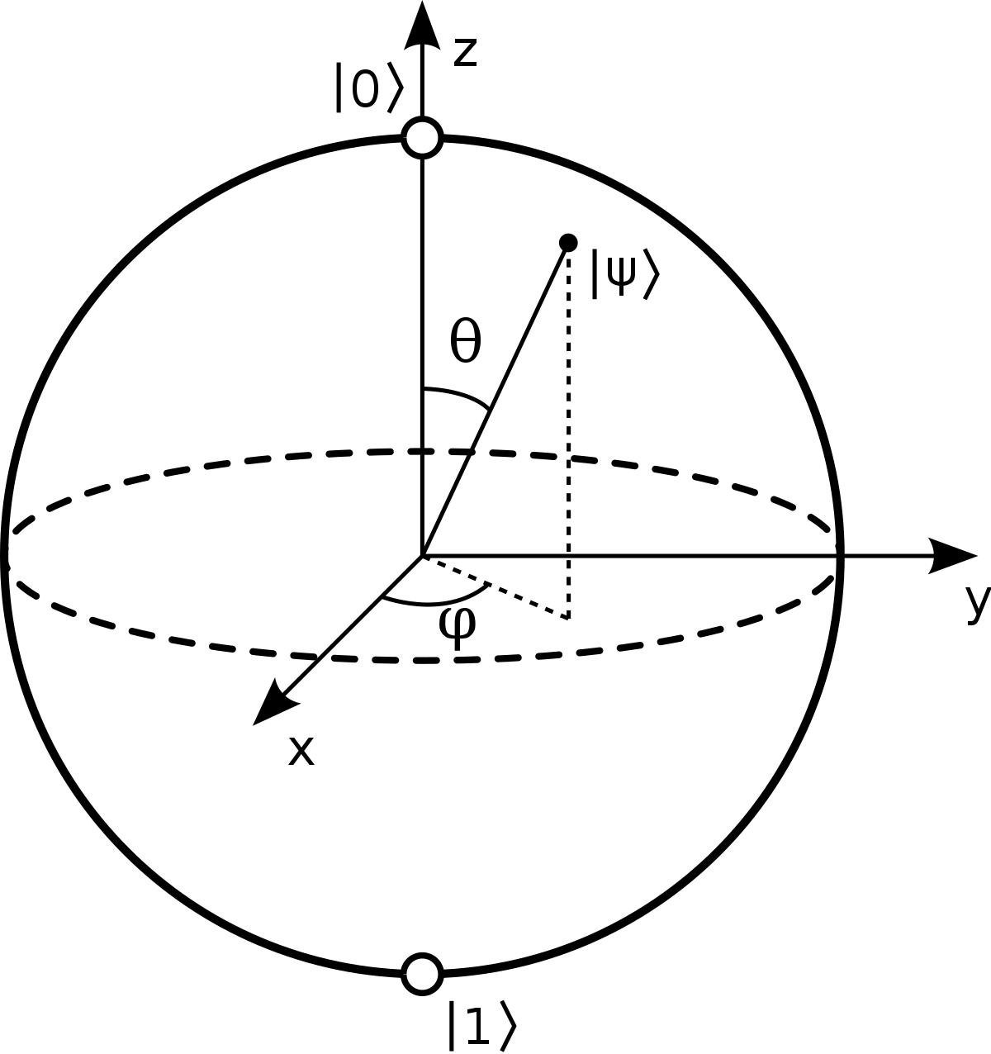


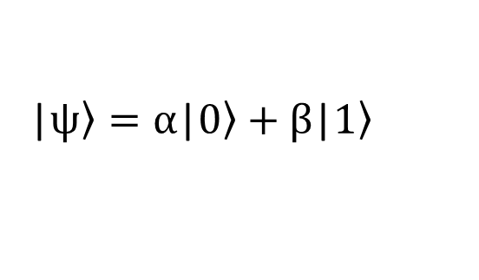
The Qubits
Quantum information encoded in qubits
Classical information encoded in bit
Superposition of quantum states
Both 0 and 1
They can be 0 or 1
0
1
|$\left.ψ\right\rangle =α$|$\left.0\right\rangle +β\text{|}\left.1\right\rangle$
1

Slide 4
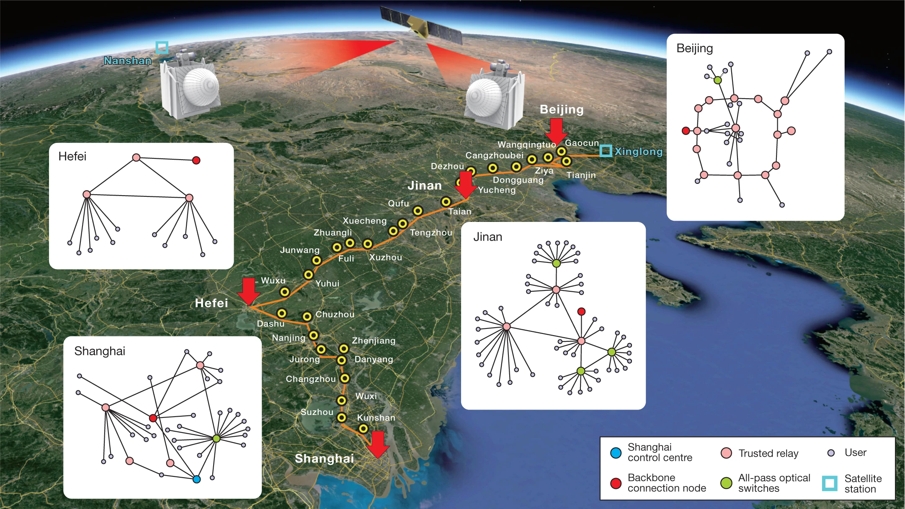
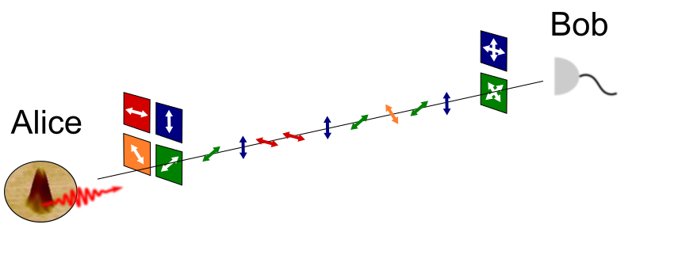



The quantum revolution
1984
1997
2019
2021
20??
Proposal for Quantum key distribution protocol
Shor algorithm
Quantum supremacy
QKD over 4600 km
Quantum Network
BB84
2

Slide 5
WHICH QUBIT DO WE CHOOSE?
SINGLE PHOTONS

Slide 6
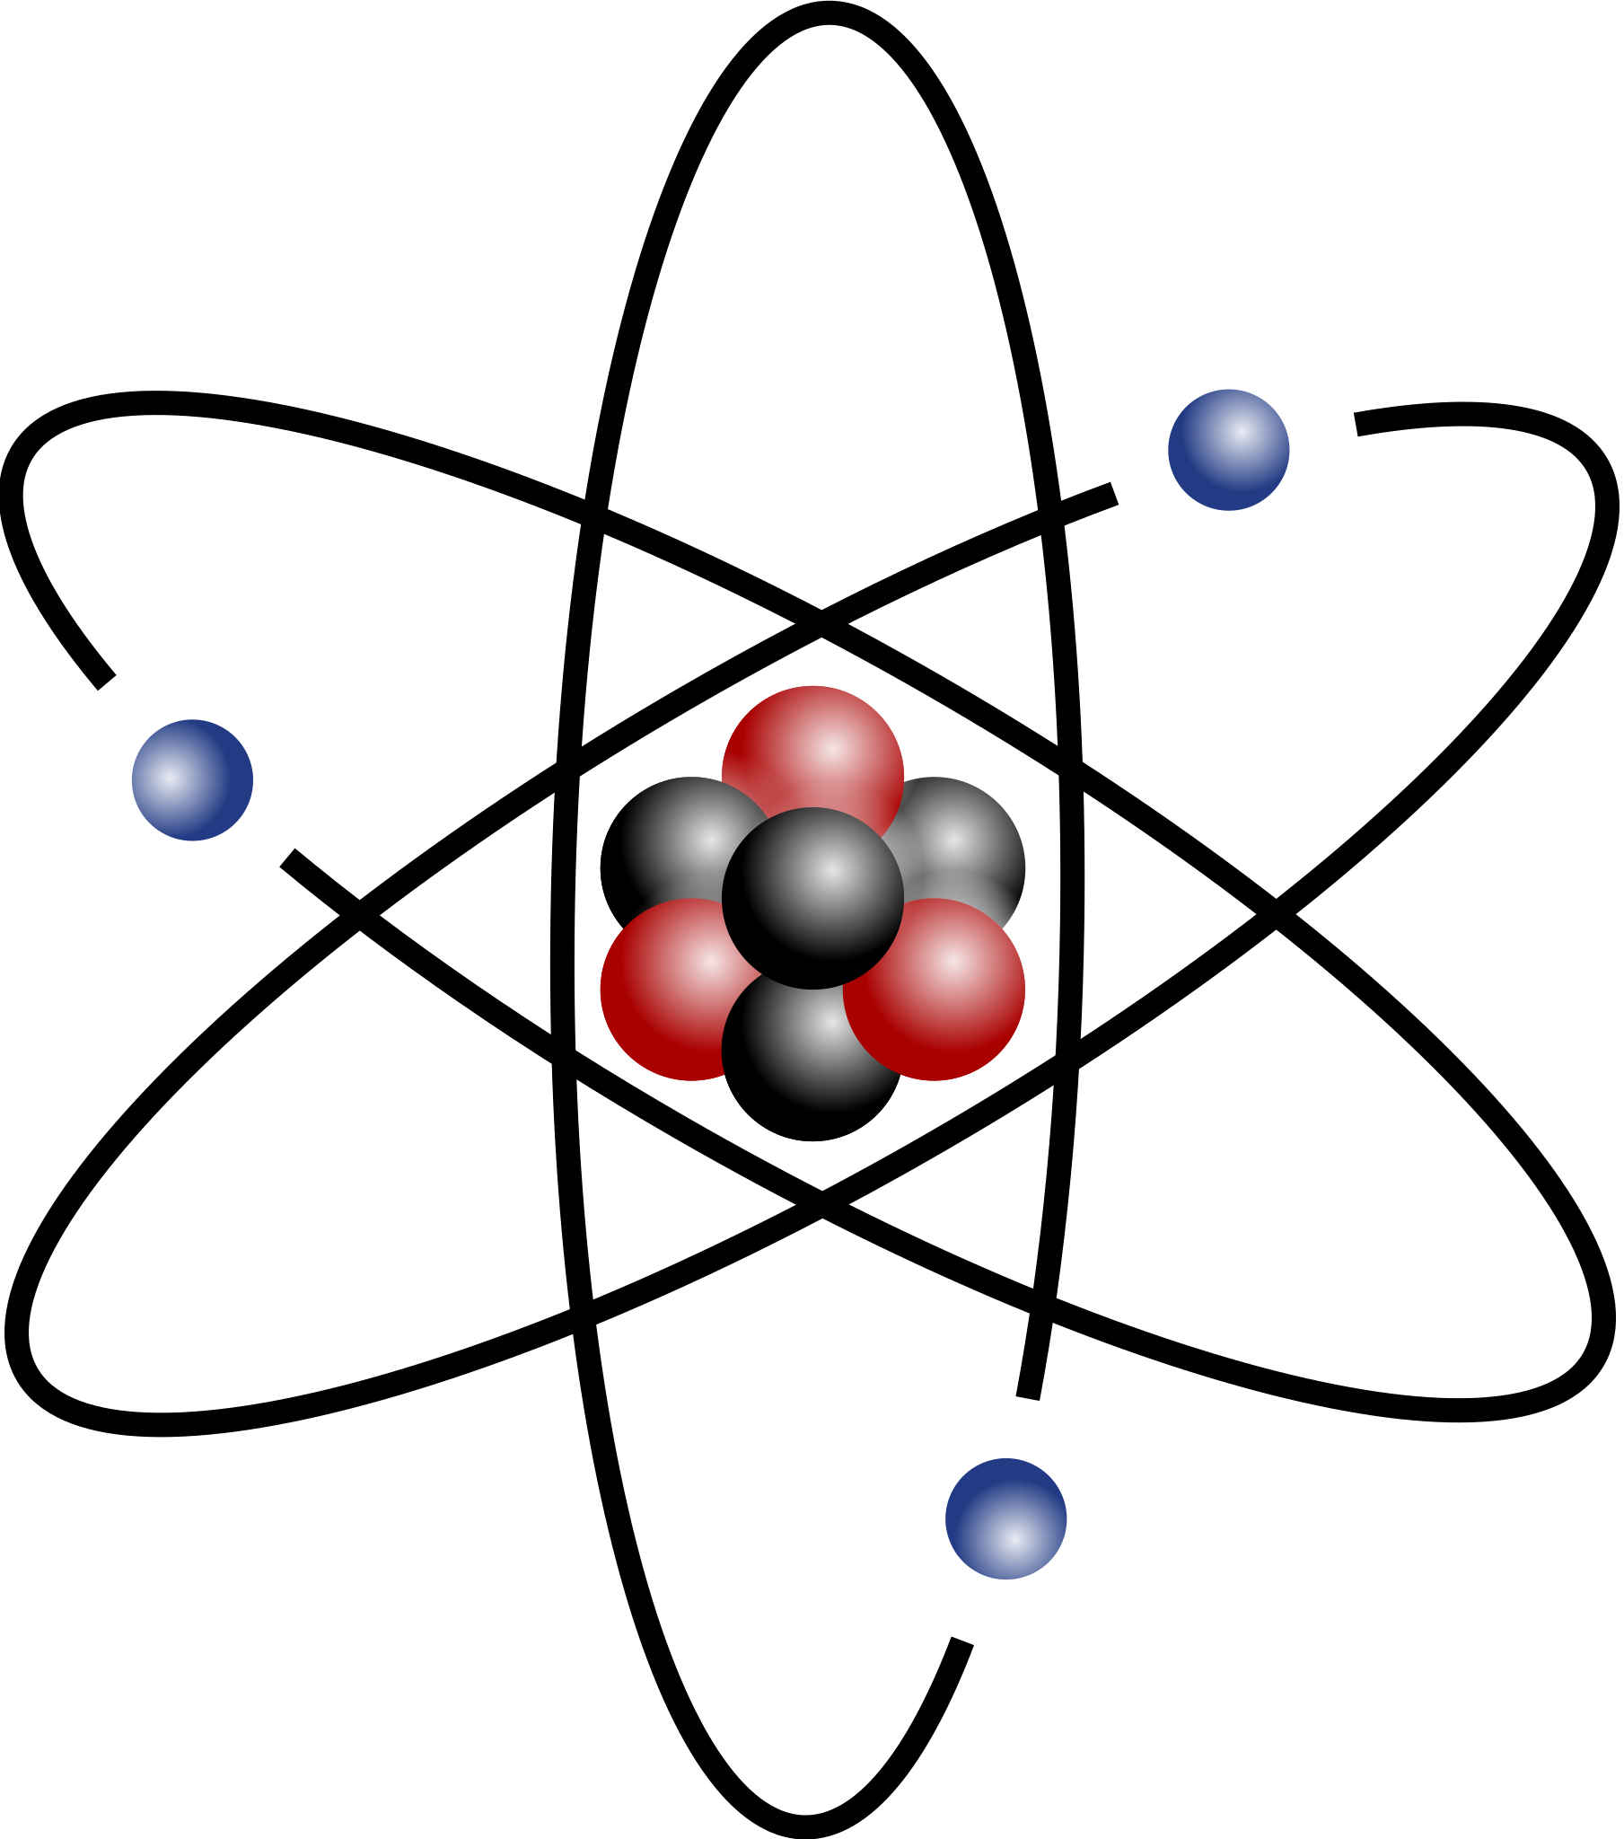

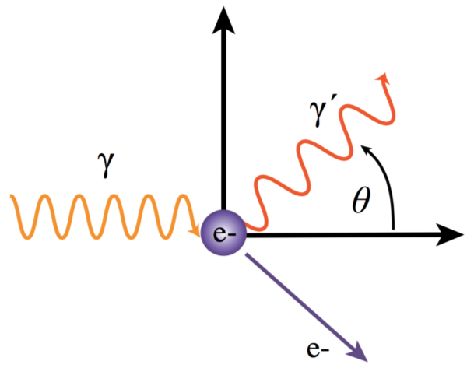
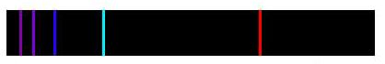

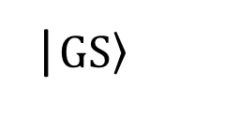
Single-photons
Quantum source
|$\left.ES\right\rangle$
Atomic-like two level system
Single photon
Monochromatic emission
|$\left.GS\right\rangle$
The spectrum looks like…
3

Slide 7
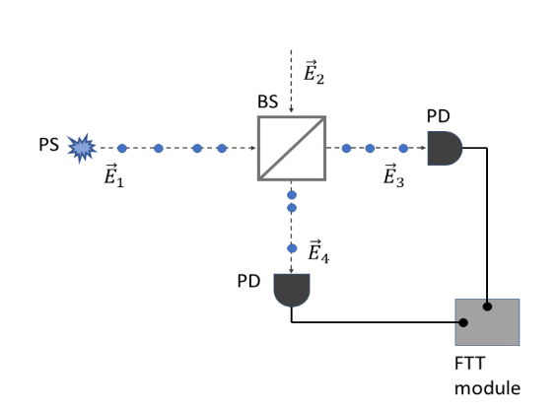
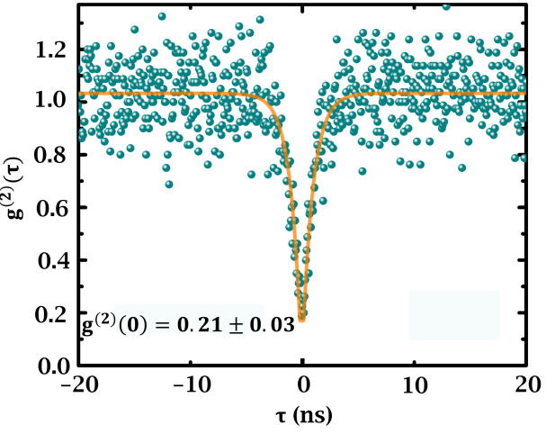

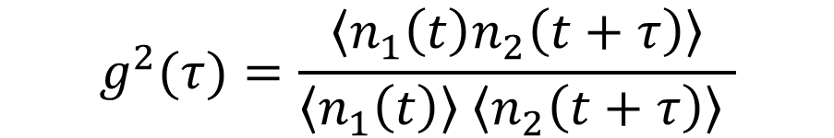

Measuring single-photons
Second order auto-correlation
$$g^{2}(τ)=\frac{\left\langle n_{1}\left(t\right)n_{2}\left(t+τ\right)\right\rangle }{\left\langle n_{1}\left(t\right)\right\rangle \left\langle n_{2}\left(t+τ\right)\right\rangle }$$
Hanbury-Brown-Twiss
$$n_{1}\left(t\right)$$
$$n_{2}\left(t\right)$$
4

Slide 8
WHERE ARE SINGLE-PHOTONS FROM?

Slide 9
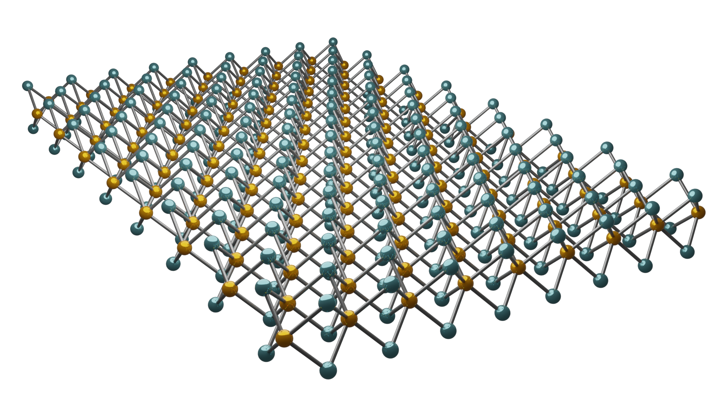
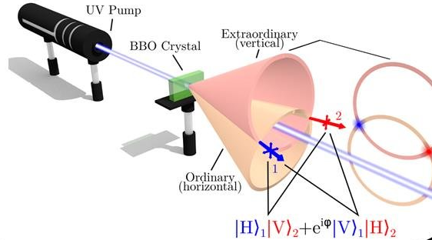
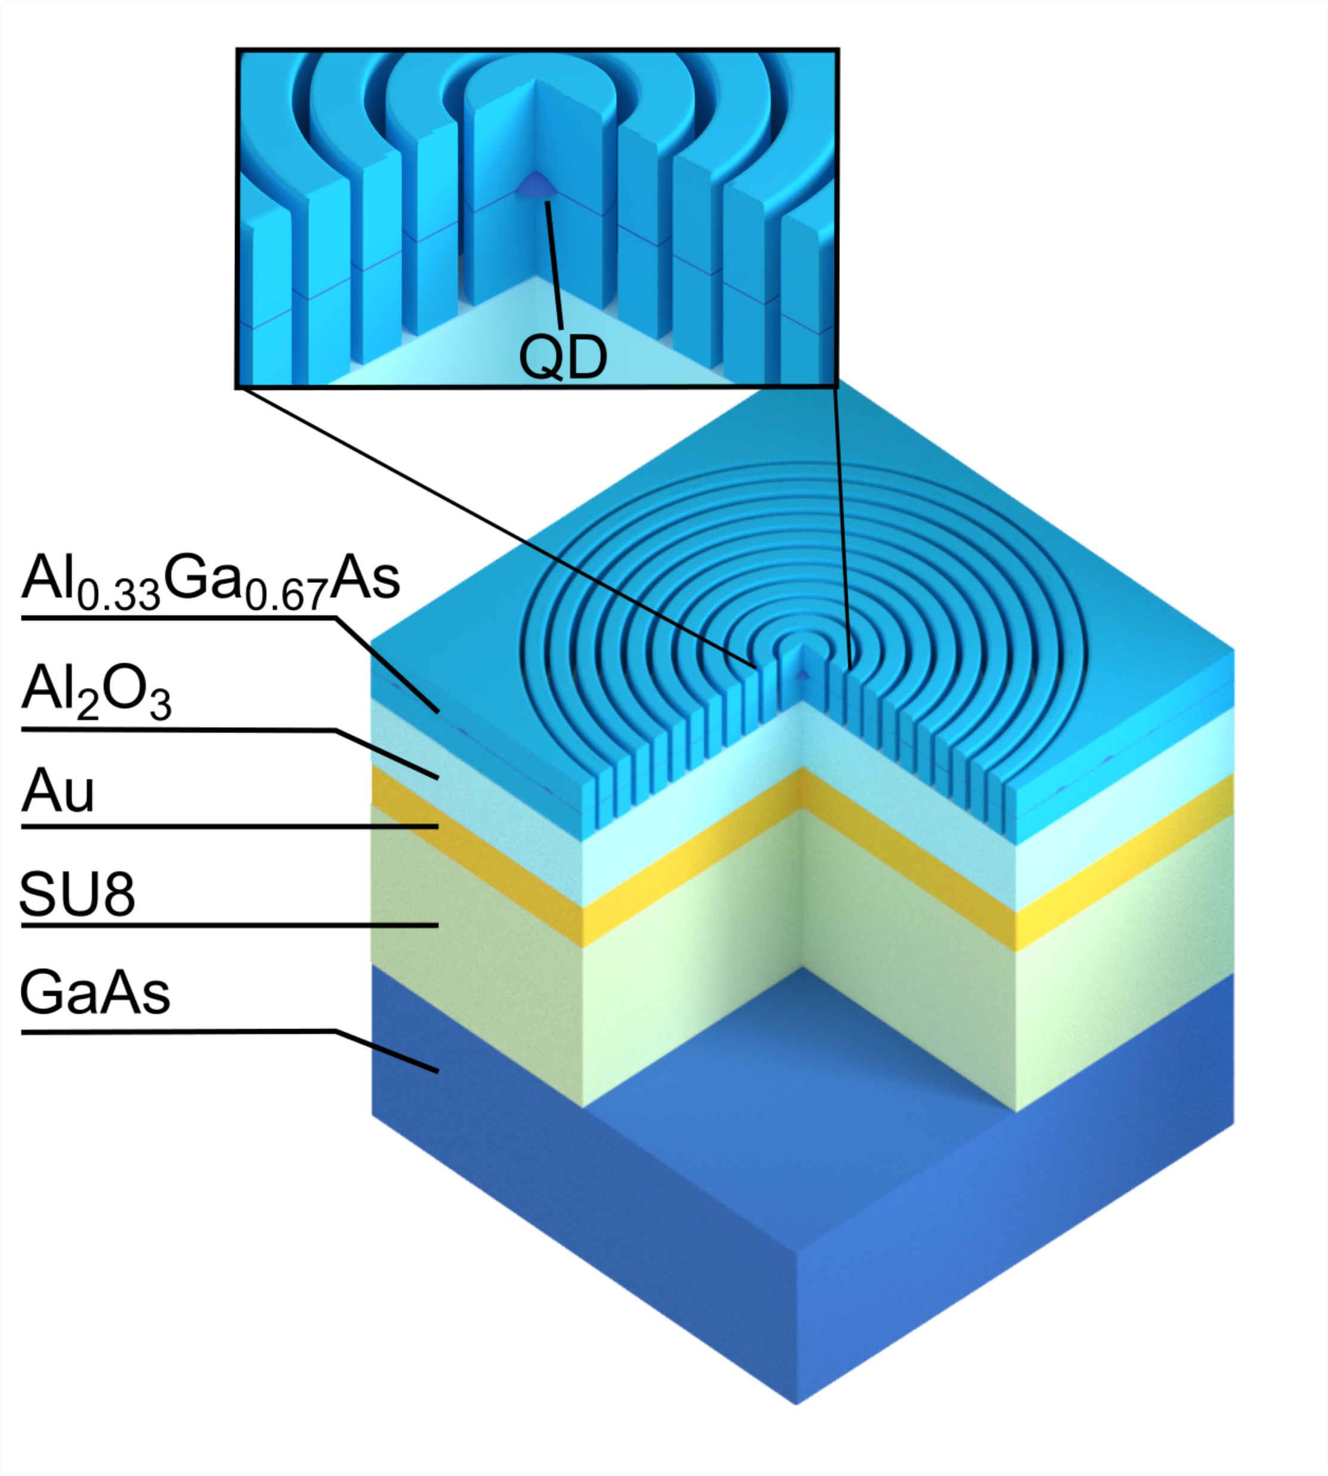
Single-photons sources
SPDCs
Non-linear crystals
Second-order process
Low single-photon purity
Quantum dots
2D Materials
Semiconductor nanostructures
Single layer materials
Quantum confinement
High confinement
Low brightness
Largely deformable
5

Slide 10

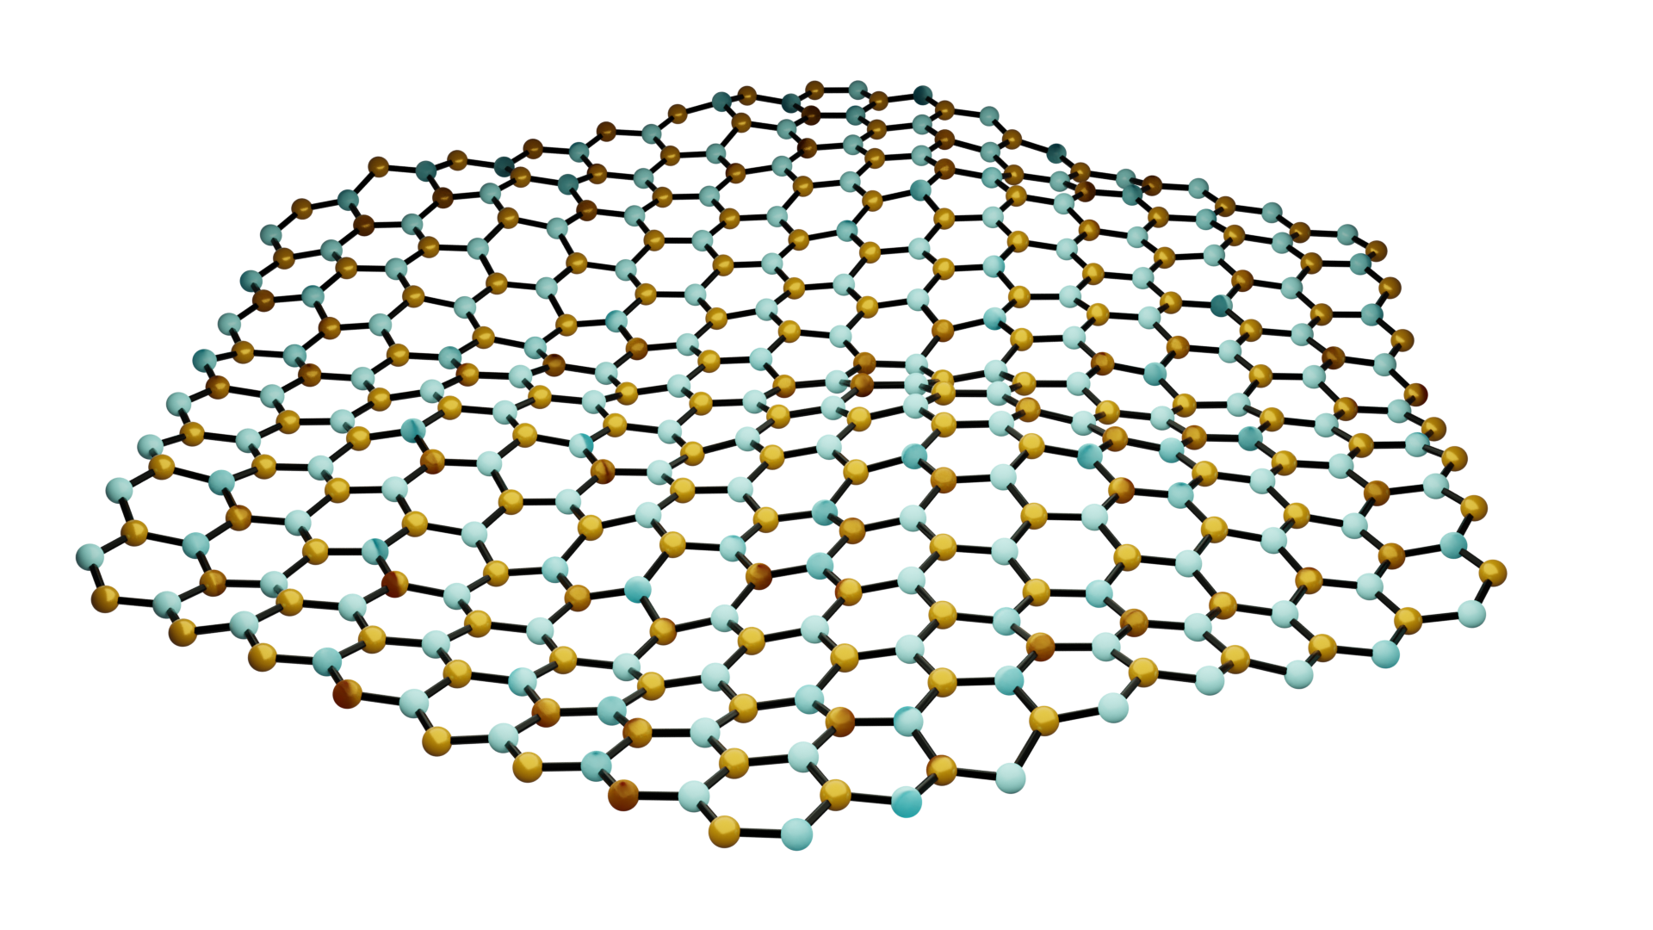
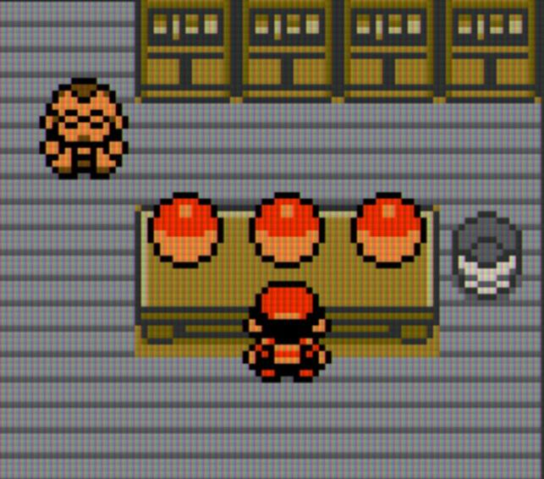
2D single-photons sources
CRYSTAL INFO
MOIRE’ HETEROSTRUCTURES
001
CRYSTAL INFO
CRYSTAL INFO
MoSe2/WSe2
MONOLAYER hBN
002
Semiconductor
MONOLAYER WSe2
003
hBN
Bilayer
Insulator
2019
WSe2
Confinement
Semiconductor
Single-layer
Single-layer
2017
Two layers of TMDs stacked with a small angle
Potential that confines carriers
2015
Color centers
Strain + defects
Hexagonal Boron-nitride
Vacancies of defects provide single-photon
One layer of Transition-Metal Dichalcogenide
Defects and strain provide single-photon
6

Slide 11
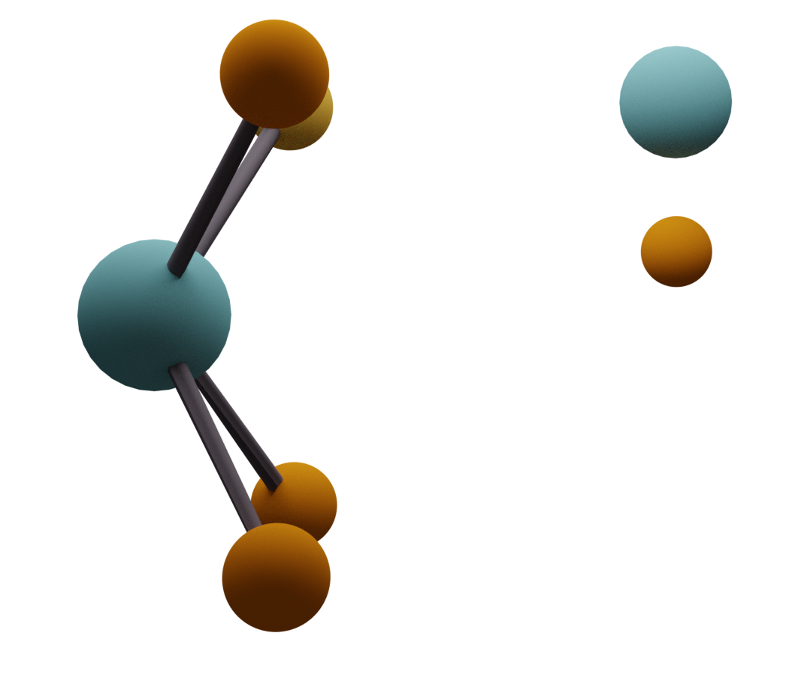
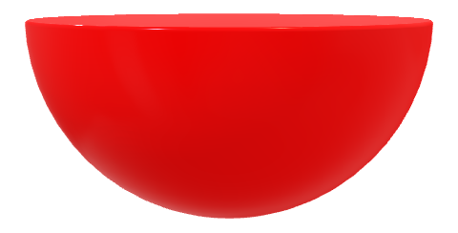


M
2D single-photons sources
X
TRANSITION METAL DICHALCOGENIDES
Compounds with a transition metal and due chalcogens
M =Transition Metal
X = Chalcogen
Semiconductor
One layer of atoms
PHOTOLUMINESCENCE SPECTROSCOPY
Excitation
Laser excite the crystal’s electrons
ħω
The crystal emits light
7

Slide 12



2D single-photons sources
Stretching the crystal changes its bands
Pulls the electron on the atomic-like level
Energy levels are “bands”
Chemichal defects provide atomic-like energy levels
Single-photon
E
E
E
Strain
e-
e-
e-
h+
h+
h+
k
k
k
8

Slide 13
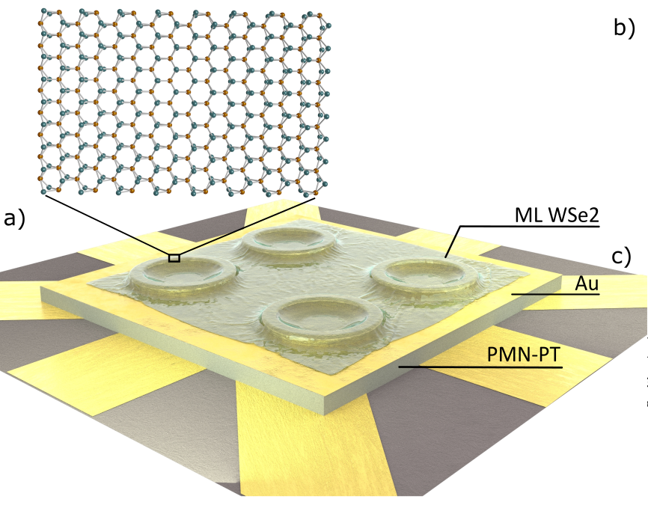
Stretching 2Ds for single photon
Nanopillars
ML-WSe2
How do we stretch them?
PMN-PT
Piezoelectric (PMN-PT) device
Gold
Nanopillars arrays
Gold Contacts
WSe2 flake on top
Apply voltage to the piezoelectric
9

Slide 14
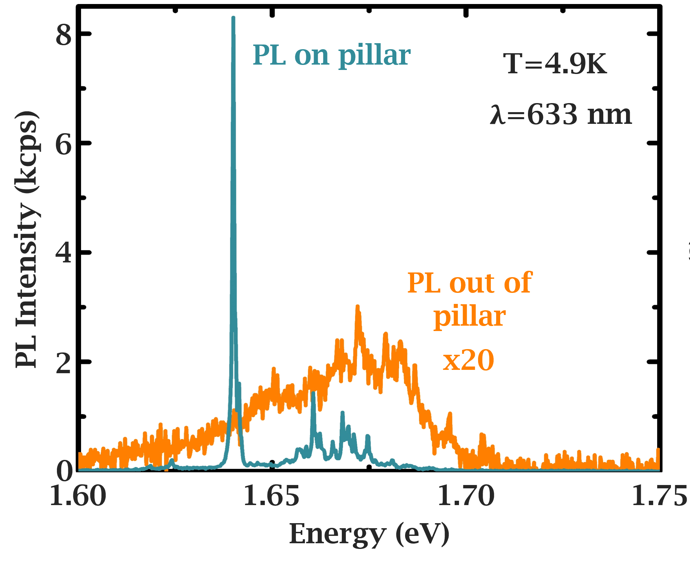
Stretching 2Ds for single photon
Single-photon
Do pillars enable single-photon emission?
Nanopillars stretch the monolayer
Collecting light from the monolayer WSe2
Are there signatures of single-photon emission?
YES
10

Slide 15

Outlooks
Quantum information potentialities
Single photons for quantum technologies
Monolayers Transition-Metal Dichalcogenides
Stretrching 2D materials for quantum light

