Slide 1
DarkSide 20k – Financial Board Meeting May 31, 2023
Gemma Testera

Slide 2
Agenda
Updates about approval of pending grants, new funds since Jan. 2023
PMMA and Gd-PMMA acrylic procurement
Status update on possible extra costs, uncovered, funds at risk (e.g. PON), implication on budget
of the procedure for the TPC assembly inside the cryostat
Status of the procurement plan for major items: (GdPMMA, PMMA), cryostat, cryogenics, slow control, other tenders
Strategy for VAT
Recommendation tracker
Common fund
Agreement about sharing of costs for items with multiple responsibilities: Detector Safety System
Money spent vs baseline: example of EVM light from NSF funds

Slide 3
Updates about pending grants

Slide 4
Acrylic 1) Pure Acrylic for anode & cathode
Material only, no machining
1 cathode, 1 anode + 1 spare
Order to RPT in progress
205387 USD from NSF Midscale , Williams College: order to be signed today!
Machining
CFI Alberta
PRR just completed: https://edms.cern.ch/document/2900178/1

Slide 5
Acrylic 2) Gd-PMMA
R&D and pre-production : from Yi e-mails : 10-20 kg Gd₂O₃ from Shin-Etsu ≈10 k$ + VAT (485 $ /kg + VAT for small orders)
pre-production? 27 kEuro from IHEP ( from our costbook)
additional R&D finalization costs?
Full production: polymerization
quote from DonChamp of Aug 2022 (see next slide) for polimerization (we need an updated one)
Barrel, no spares (4 sheets, 17 cm thick, 8m X 3.2 m ) : 840 k USD + 30 k USD shipping + VAT
email update from Yi on Feb . 2023 ≈ 780 k USD + ≈40 k USD shipping + VAT
Additional communication about possible cost increase.....
Bricks for top&bottom optical planes?
Full production: Gd oxide and final Gd compound
≈100 k USD (550 kg Gd₂O₃ from Shin-Etsu, 180 USD /kg extrapolated from large amount orders of nanoparticles)
≈300 k USD production of Gd(MAA)₃
Full production: precise machining
Not included
Cost to be defined
Note: rec. 63 in the recommendation tracker
As soon as formal quotations will be available (March 2023?),
please send us a one-page update on the Gd-PMMA costs and proposed funds sharing between institutions

Slide 6
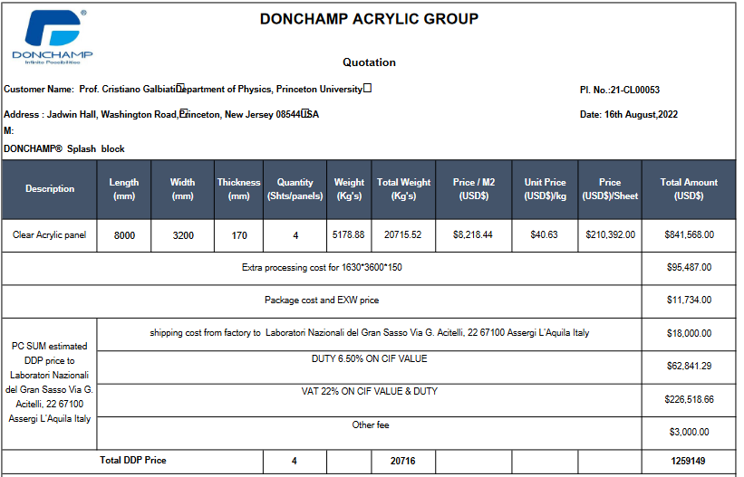
Acrylic 2) Gd-PMMA
????

Slide 7
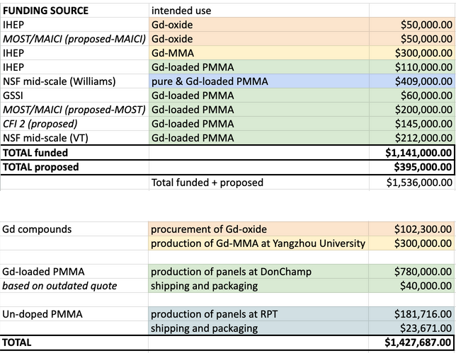
Table from Graham G.
No spares, no VAT,
no machining
Schedule for MOST/MAECI response
not known
Gd2O3 is the first component needed
Not easy to exchange scope of these funds
Backup in case of not approval?
Saved from other items

Slide 8
Updates about pending grants
1)
2)
3) NSF Base grant?

Slide 9
Unfunded items (Gd-PMMA excluded)
From the costbook, excluding:
GdPMMA (already discussed)
Cost classified as Operations etc..
Urania

Slide 10
Extracosts, cost impact of new technical choices , critical funds (PON) part 1)
Plastic shell around the Stainless Steel vessel:
Design to be done & costs to be quantified
Funding source unassigned
Not listed in the costobook
TPC installation within the cryostat and not in CR2:
no big modification of CR2 needed (cost was under-estimated in the cost book!)
no Rn abatement in NOA with DarkSide funds (saving 850 k from INFN CIPE)
Clean room on top of the cryostat
design to be finalized
it was assigned to CFI (to be rediscussed ?)
Tools for assembly of the TPC in the cryostat
design and cost estimation to be finalised

Slide 11
Critical funds - PON
AAr cryogenics (PON funds)
Tender in progress (CERN) (to be close 2 June, 2023): more details before the Forti meeting
extracost expected
Baseline is 1372 k Euro
Cryogenics support structure and ladder (PON funds, LNGS order)
Order preparation in progress: from LNGS
Work in progress about the approval of the engeneering design
WinCC licenses, slow control and detector safety system (PON funds, LNGS order)
list of items to be finalised soon (see Camillo)
support for CERN expert form VT : we need internal approval of this strategy
Several additional orders to be placed by LNGS with PON funds
When the AAr tender is closed we will make a full summary of the true cost of PON items
Deadline: good news
extended to Dec 2023 (it was initially granted only to Oct. 2023)

Slide 12
Status of the procurement plan for major items
Item | Status
Cryostat | In construction
AAr Cryogenics | Tender will close on June 2th
Ladders+ Cryogenic support structure | Engeneering project to be approved
Cryogenics Slow Control & Safety system | List of parts under revision, order in preparation
PMMA for anode/cathode | Order signed
GdPMMA | Under discussion
Printed circuit boards | Tender in progress, samples of 2 vendors under test
Electronics componenents | 80% delivered
Cables | PRR under preparation
Digitizers | Approved (?)
Power supplies | Decision to be finalised
UAr cryogenics parts
Stainless Steel vessel

Slide 13
Item | Status
Optical plane mechanics
Large evaporator chamber
.......
Rn abatement in NOA | removed from DS funds
CR2 modifications | Simplified thanks for the installation inside the cryostat
Clean Room on top of the cryostat

Slide 14
Strategy for VAT
Cryostat and cryogenics: documentation done
VAT not paid, all material in customs warehouse in Hall C
saved 22% of 6.5 M€ (almost)
Under discussion with Central Administration INFN: deposito IVA for material of Italian and EU origin
LNGS lab may work as deposito IVA too
interesting for Stainless Steel vessel and other major items
GdPMMA and PMMA: Italian VAT will be saved thanks to the direct expedition underground, assembly in the cryostat
without work in CR2
USA to Canada, China to Canada VATs: I do not know
Most of the detector components will be VAT free is they will be directly delivered in Hall C

Slide 15
Recommendation tracker
item 95 Develop the budget for commissioning, operations and decommissioning of the experiment.
My proposal is to delay this answer, we are not ready and we should not invent numbers.
item 96 "Assess Urania and Aria cost shortfalls and find ways to cover them"

Slide 16
Common funds
INFN CSN2 approved the Common funds may exist during the construction phase (new)
Rules based on the FTE to get the funds
We need to approve a sharing rule (IB duty): can we do during next IB?
INFN needs this rule approved by July 1, 2023

Slide 17
Common funds: rules to be discussed/modified/approved
Define each year the items belonging to common fund (Collaboration and RRB).
To match the INFN deadline for funding requests we need:
To approve the list of items within June 1 of the current year (example within June 2023)
Expenses refer to the following calendar year (example year 2024)
This year we are not ready... we need to compromise
Proposal for a sharing rule (to think about it and approve/modify at the next IB)
Freeze the author list on June 1 of the current year
Count the number of authors of Collaboration papers and define N_{CF} by
excluding the technician (they are not default authors according to our rules)
Excluding or not the authors in the grace period ?
Build a weight for each Institution considering that
Each author has a weight equal to 1 (we do not consider FTE)
Authors with double affiliation: weight 0.5 for each Institute (?)
Weight of the Institute: sum over the authors weight
Fraction of the Common fund to be paid by each Institution = (Weight of the Institute) / N_{CF}

