Slide 1
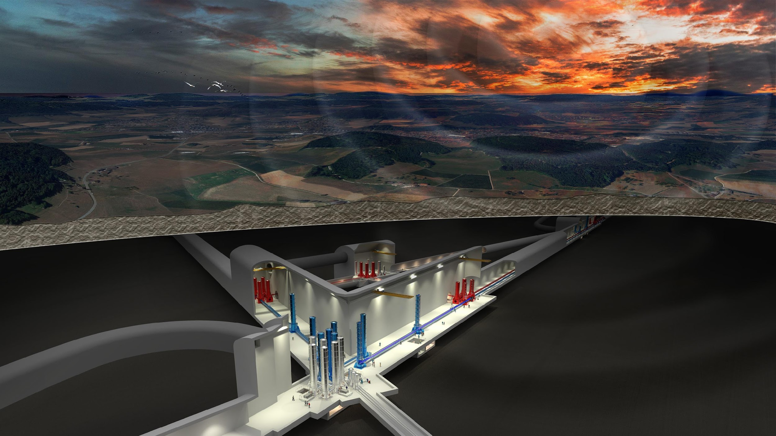
INFN-IFAE Meeting Round-table

Slide 2
Electronics
radio comms to reduce cables in the vacuum chambers
Optics
New projects

Slide 3
ETIC
network of facilities

Slide 4
VACUUM
Facilities around Europe: Karlsruhe, Nikhef, …
ETIC (CALATIA)
new method to measure hydrocarbon partial pressure
study of hydrocarbon contamination on surface in UHV systems (procedures and cryostat)

Slide 5
CRYOGENICS
cryogenic shields
mechanical engineers (already involved in the ET Pathfinder project)
Wireless DC tilt control of marionette

Slide 6
SUSPENSIONS
electronics ?
optical sensors
cable reduction
low noise device for controlling suspensions

Slide 7
Wave front sensing and control
Simulation
Thermal compensation for HF
radiative cooling

Slide 8
ANM
models and simulations
computing effort to support NN simulations
lidar test for atmospheric NN cancellation
FEA/FEM simulation
Comp. resources
manpower
custom DAQ systems
Electronics
NN
MN
EnvSensorNoise

Slide 9
Core Optics and Coatings
Many coating facilities for small prototype samples
Possibility to qualify prototype samples for baffles

Slide 10
Quantum Noise Reduction
QNR optical simulations
electronics development
integrated optics

Slide 11
Scattered Light Mitigation
Experimental facility to measure scattering properties
Dust qualification

Slide 12
Computing
Low-latency analysis and alert infrastructures
HPC access and interfaces
ML applications in low-latency
Support for the next Mock Data Challenge

Slide 13
Agenda: R&D activities and facilities
ET R&D Activities @ Italy
3G Vacuum Systems and Cryogenics
Cryogenic payload
Suspensions and Seismic Isolation Systems
Active Noise Mitigation
Core Optics and Coatings
Wave front sensing and control
Quantum Enhancements
Stray light mitigation
Computing

Slide 14
Agenda: R&D activities and facilities
ET Infrastructure Consortium (ETIC)
upgrade of existing facilities
setup of new R&D facilities
Ready by the end of 2025 (PNRR timeline)

