Slide 1
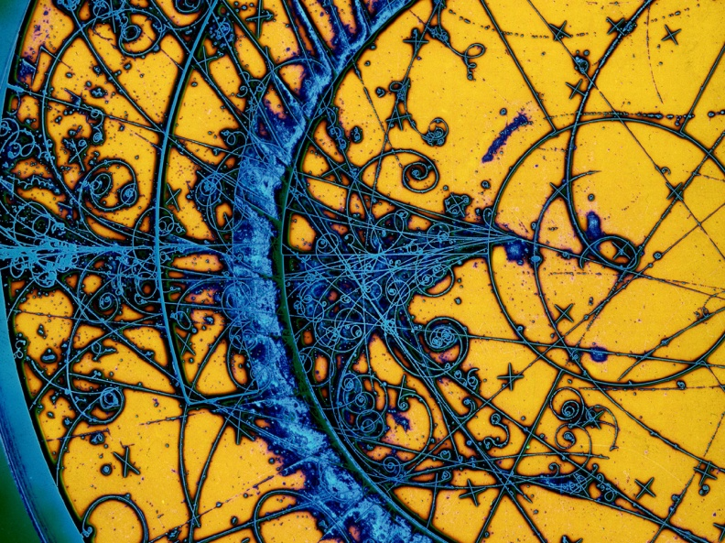
Commemorazione Professor Vaccaro
Last works (experimental and analytical researches)
29/05/2023
Istituto Nazionale di Fisica Nucleare
The Italian National Institute for Nuclear Physics
Carlo Zannini & Andrea Passarelli

Slide 2
Overview
Analytical impedance models
  Asymmetric round chamber
  Impedance of a step transition
Stretched wire method
Mode Matching and bench measurements techniques

Slide 3
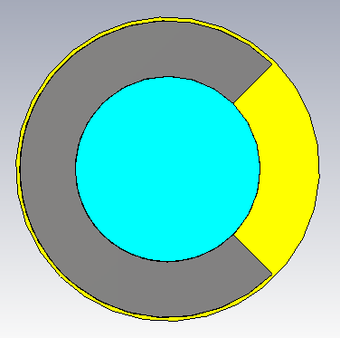
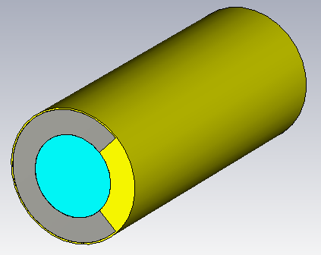
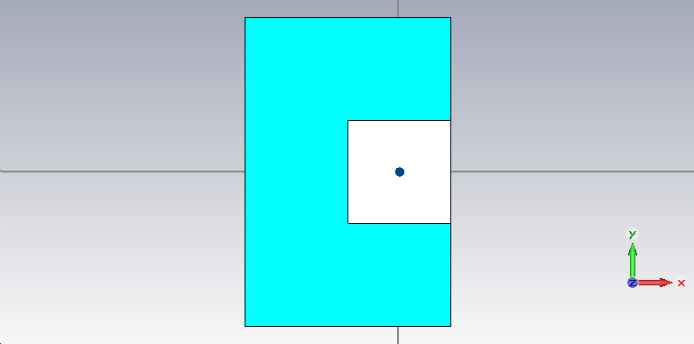
Asymmetric round chamber
y
Vacuum
d
Simplified model for a C-shaped ferrite loaded magnet
b
Ferrite
x
PEC

Slide 4
C-Magnet: Comparing theoretical model and 3-D simulations
The theoretical predictions and simulations show a very good agreement

Slide 5
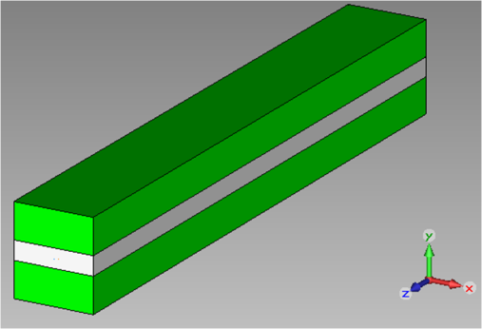
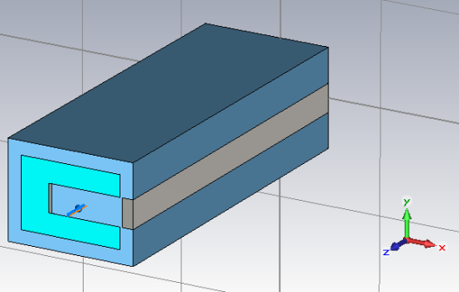
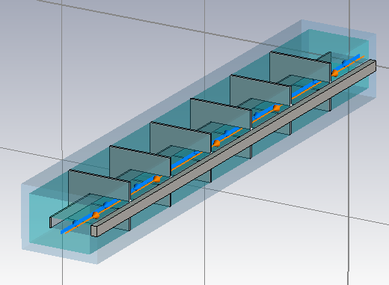
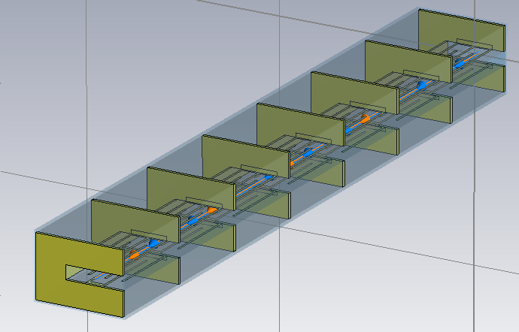
CERN-SPS ferrite loaded kickers
SPS kicker magnet
Tsutsui model
C-magnet model
Realistic models: longitudinal cell segmentation and serigraphy

Slide 6
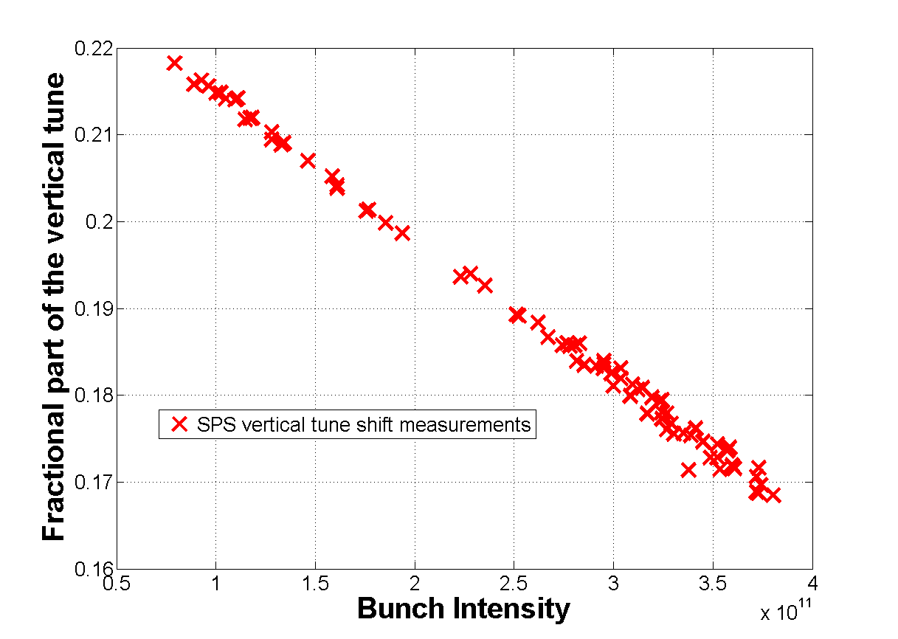
C-Magnet: comparing theoretical model and 3-D simulations
20 %
40 %
60 %
80 %
100 %

Slide 7
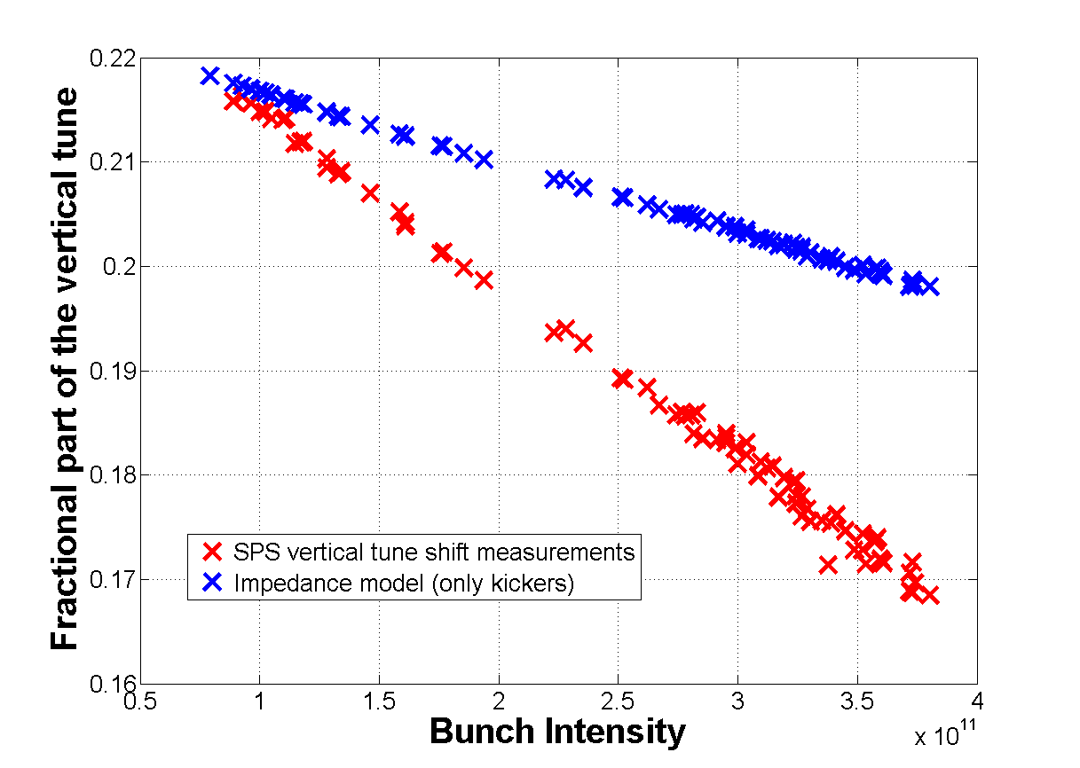
C-Magnet: comparing theoretical model and 3-D simulations
20 %
40 %
60 %
80 %
100 %
Better understanding and accurate evaluation of kicker impedance
Prediction of beam instabilities, induced heating of the kickers and countermeasures

Slide 8
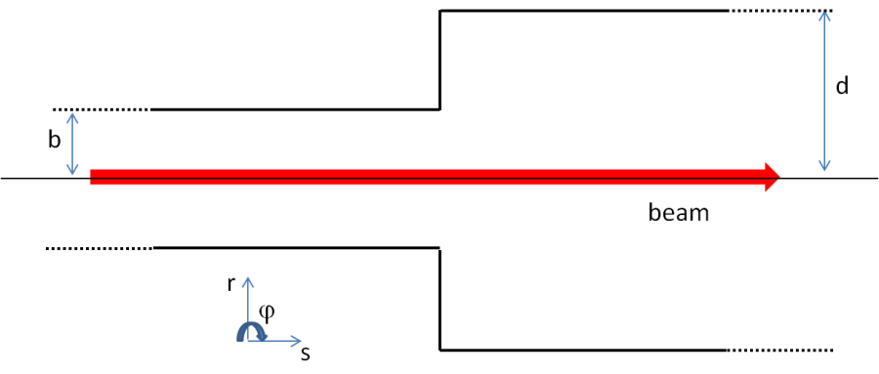
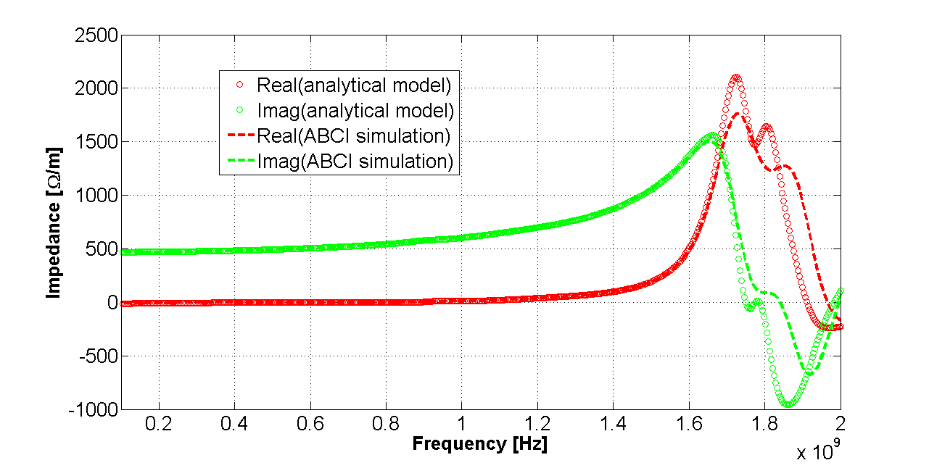
Broadband impedance of a step transition
Based on the results of 3D EM simulations, the broadband impedance contribution due to an abrupt transition is independent of the relativistic beta. Therefore, based on the aperture model, the generalized broadband impedance of the PSB transitions has been calculated as:
C. Zannini, Electromagnetic simulations of CERN accelerator components and experimental applications. PhD thesis, Lausanne, EPFL, 2013. CERN-THESIS-2013-076.

Slide 9
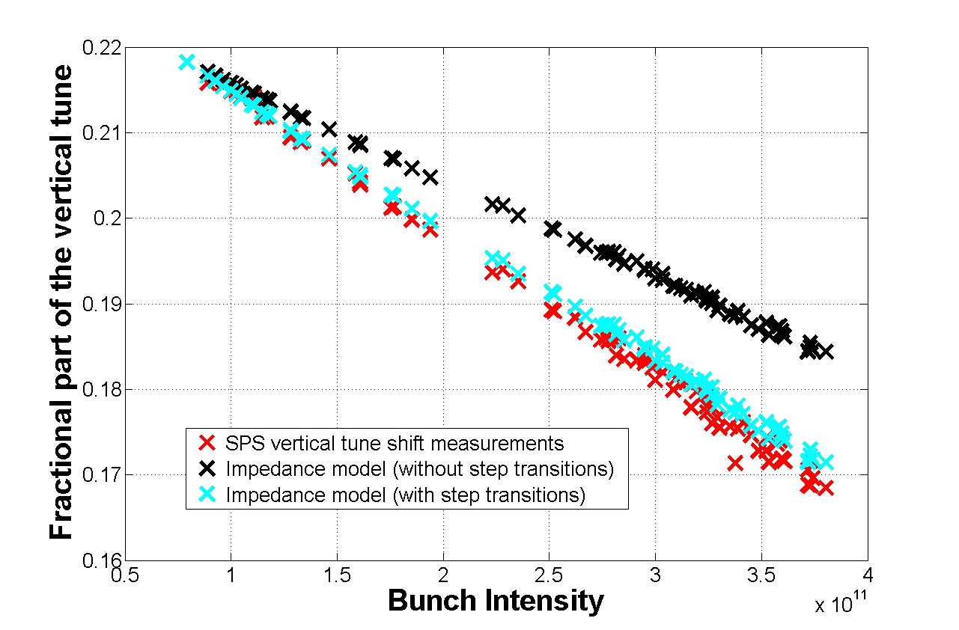
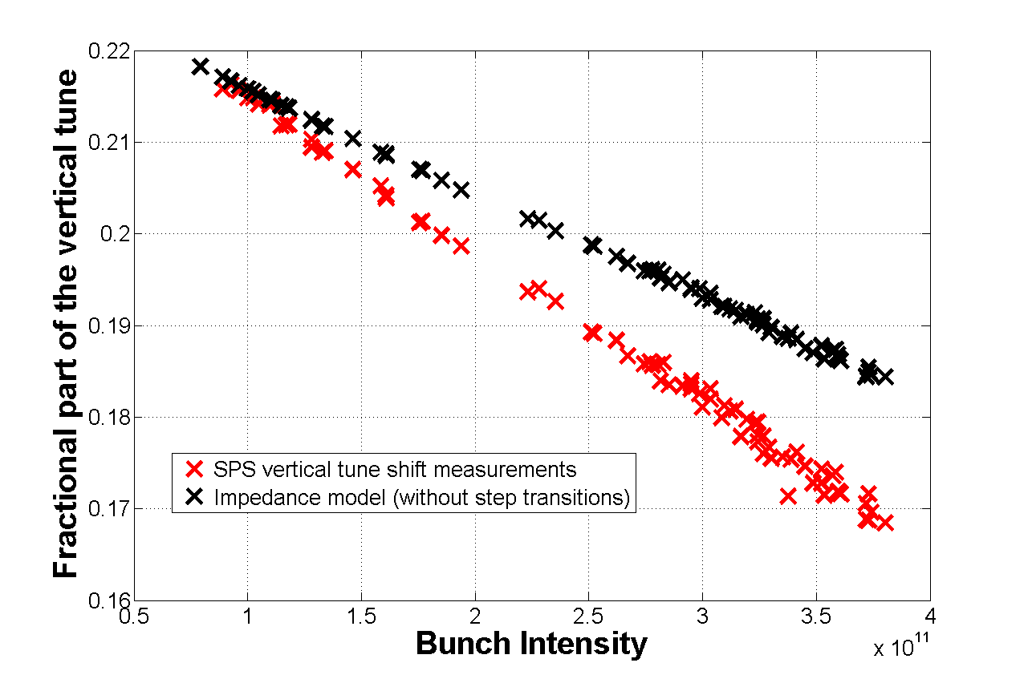
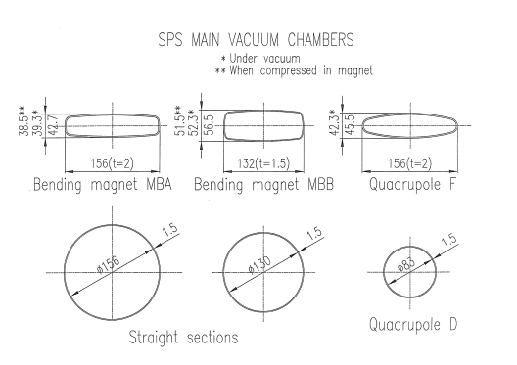
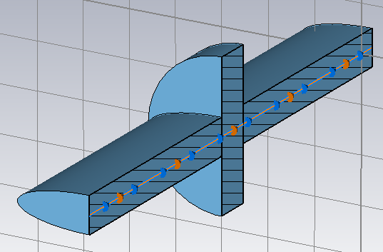
Broadband impedance of a step transition
Beam pipe
Coherent tune shift
20 %
40 %
60 %
80 %
100 %
Step transitions
The impedance of step transitions explains the long-standing missing impedance contribution of the SPS impedance model

Slide 10
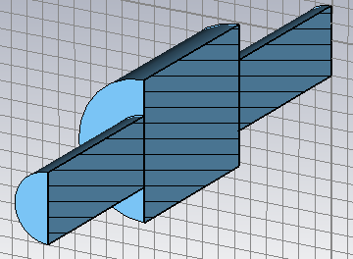
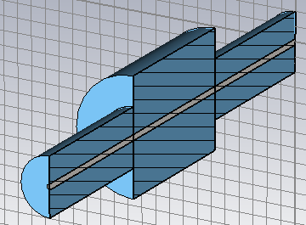
Bench measurements of the beam coupling impedance: the wire method
The measured quantity is the transmission S₂₁
TEM Propagation losses
M.R. Masullo, V.G. Vaccaro, M. Paniello. The stretched wire method : a comparative analysis performed by means of the mode matching technique, LINAC10
Measured Losses = True Losses + Propagation losses
For resonant structures:

Slide 11
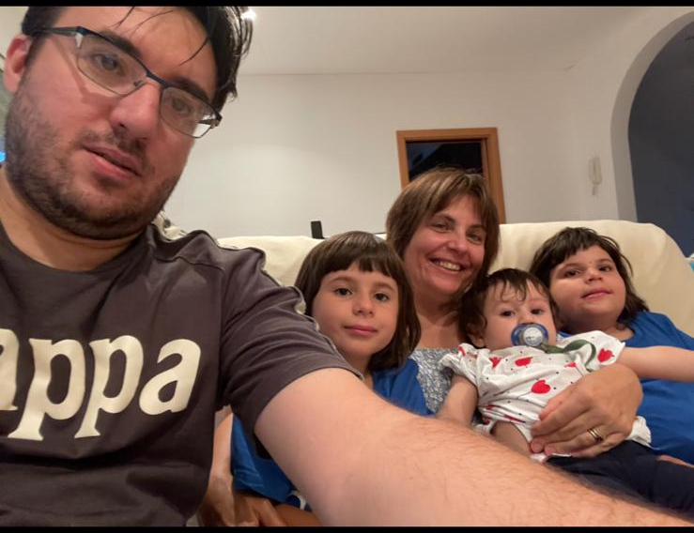
Non ho mai avuto il piacere di essere vostra studente però da voi ho imparato davvero molto. La vostra cultura andava ben al di là della fisica e le discussioni con voi erano un costante insegnamento.

Slide 12
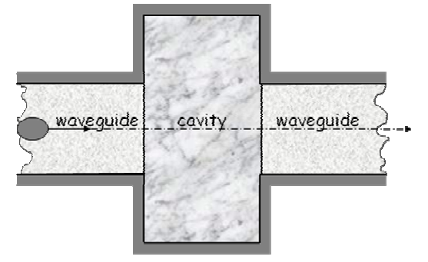
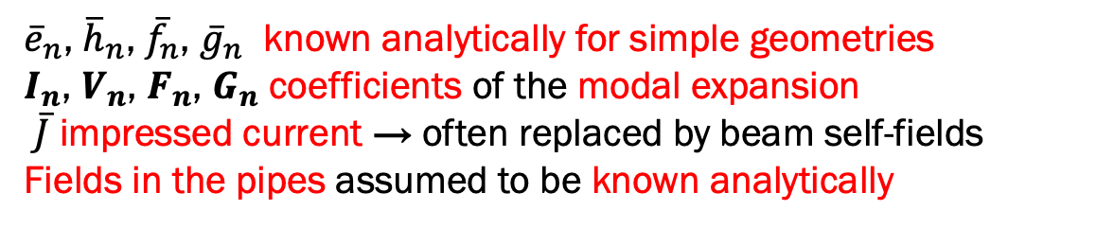
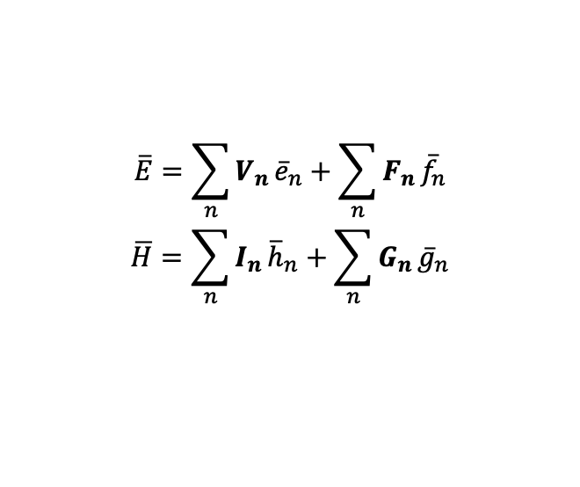


Mode Matching Technique
Cavity connected by two beam pipes
The electromagnetic fields in the volume can be expanded in a sum of solenoidal and irrotational modes
$$\overline{E}=\sum_{n}{V_{n}}{\overline{e}}_{n}+\sum_{n}{F_{n}}{\overline{f}}_{n}$$
$$\overline{H}=\sum_{n}{I_{n}}{\overline{h}}_{n}+\sum_{n}{G_{n}}{\overline{g}}_{n}$$
$$S_{1}$$
$$S_{2}$$
${\overline{e}}_{n}$, ${\overline{h}}_{n}$, ${\overline{f}}_{n}$, ${\overline{g}}_{n}$ known analytically for simple geometries
$I_{n}$, $V_{n}$, $F_{n}$, $G_{n}$ coefficients of the modal expansion
$\overline{J}$ impressed current → often replaced by beam self-fields
Fields in the pipes assumed to be known analytically
Magnetic field matching between the closed volume and the access pipes
Electric field matching between the closed volume and the access pipes
2 equations
1 equation
The source (beam) field is the known term
The system is solvable with a unique non-zero solution

Slide 13
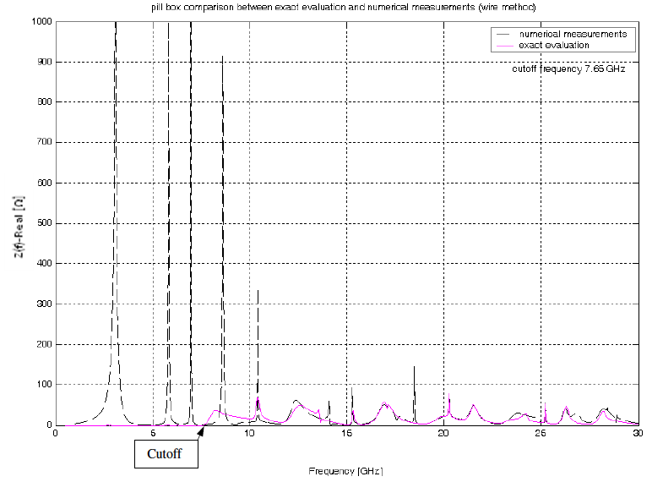
Mode Matching Technique
Study the loss-less and with-losses (perturbative analysis) pillbox cavity with mode matching technique.
Limitations of the stretched wire method
Wrong results below cut-off frequency
The wire introduces a TEM wave (zero cut-off frequency).
All resonant frequencies depleted because of power drained in the pipes by the TEM mode.
Above frequency 30% larger than the cut-off, wire method gives fairly good results.
M.Panniello, “A numerical-analytical method for particle accelerators”, PhD thesis, University of Naples “Federico II”, 2009

Slide 14
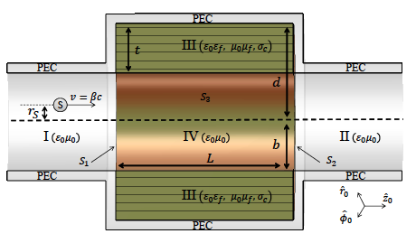
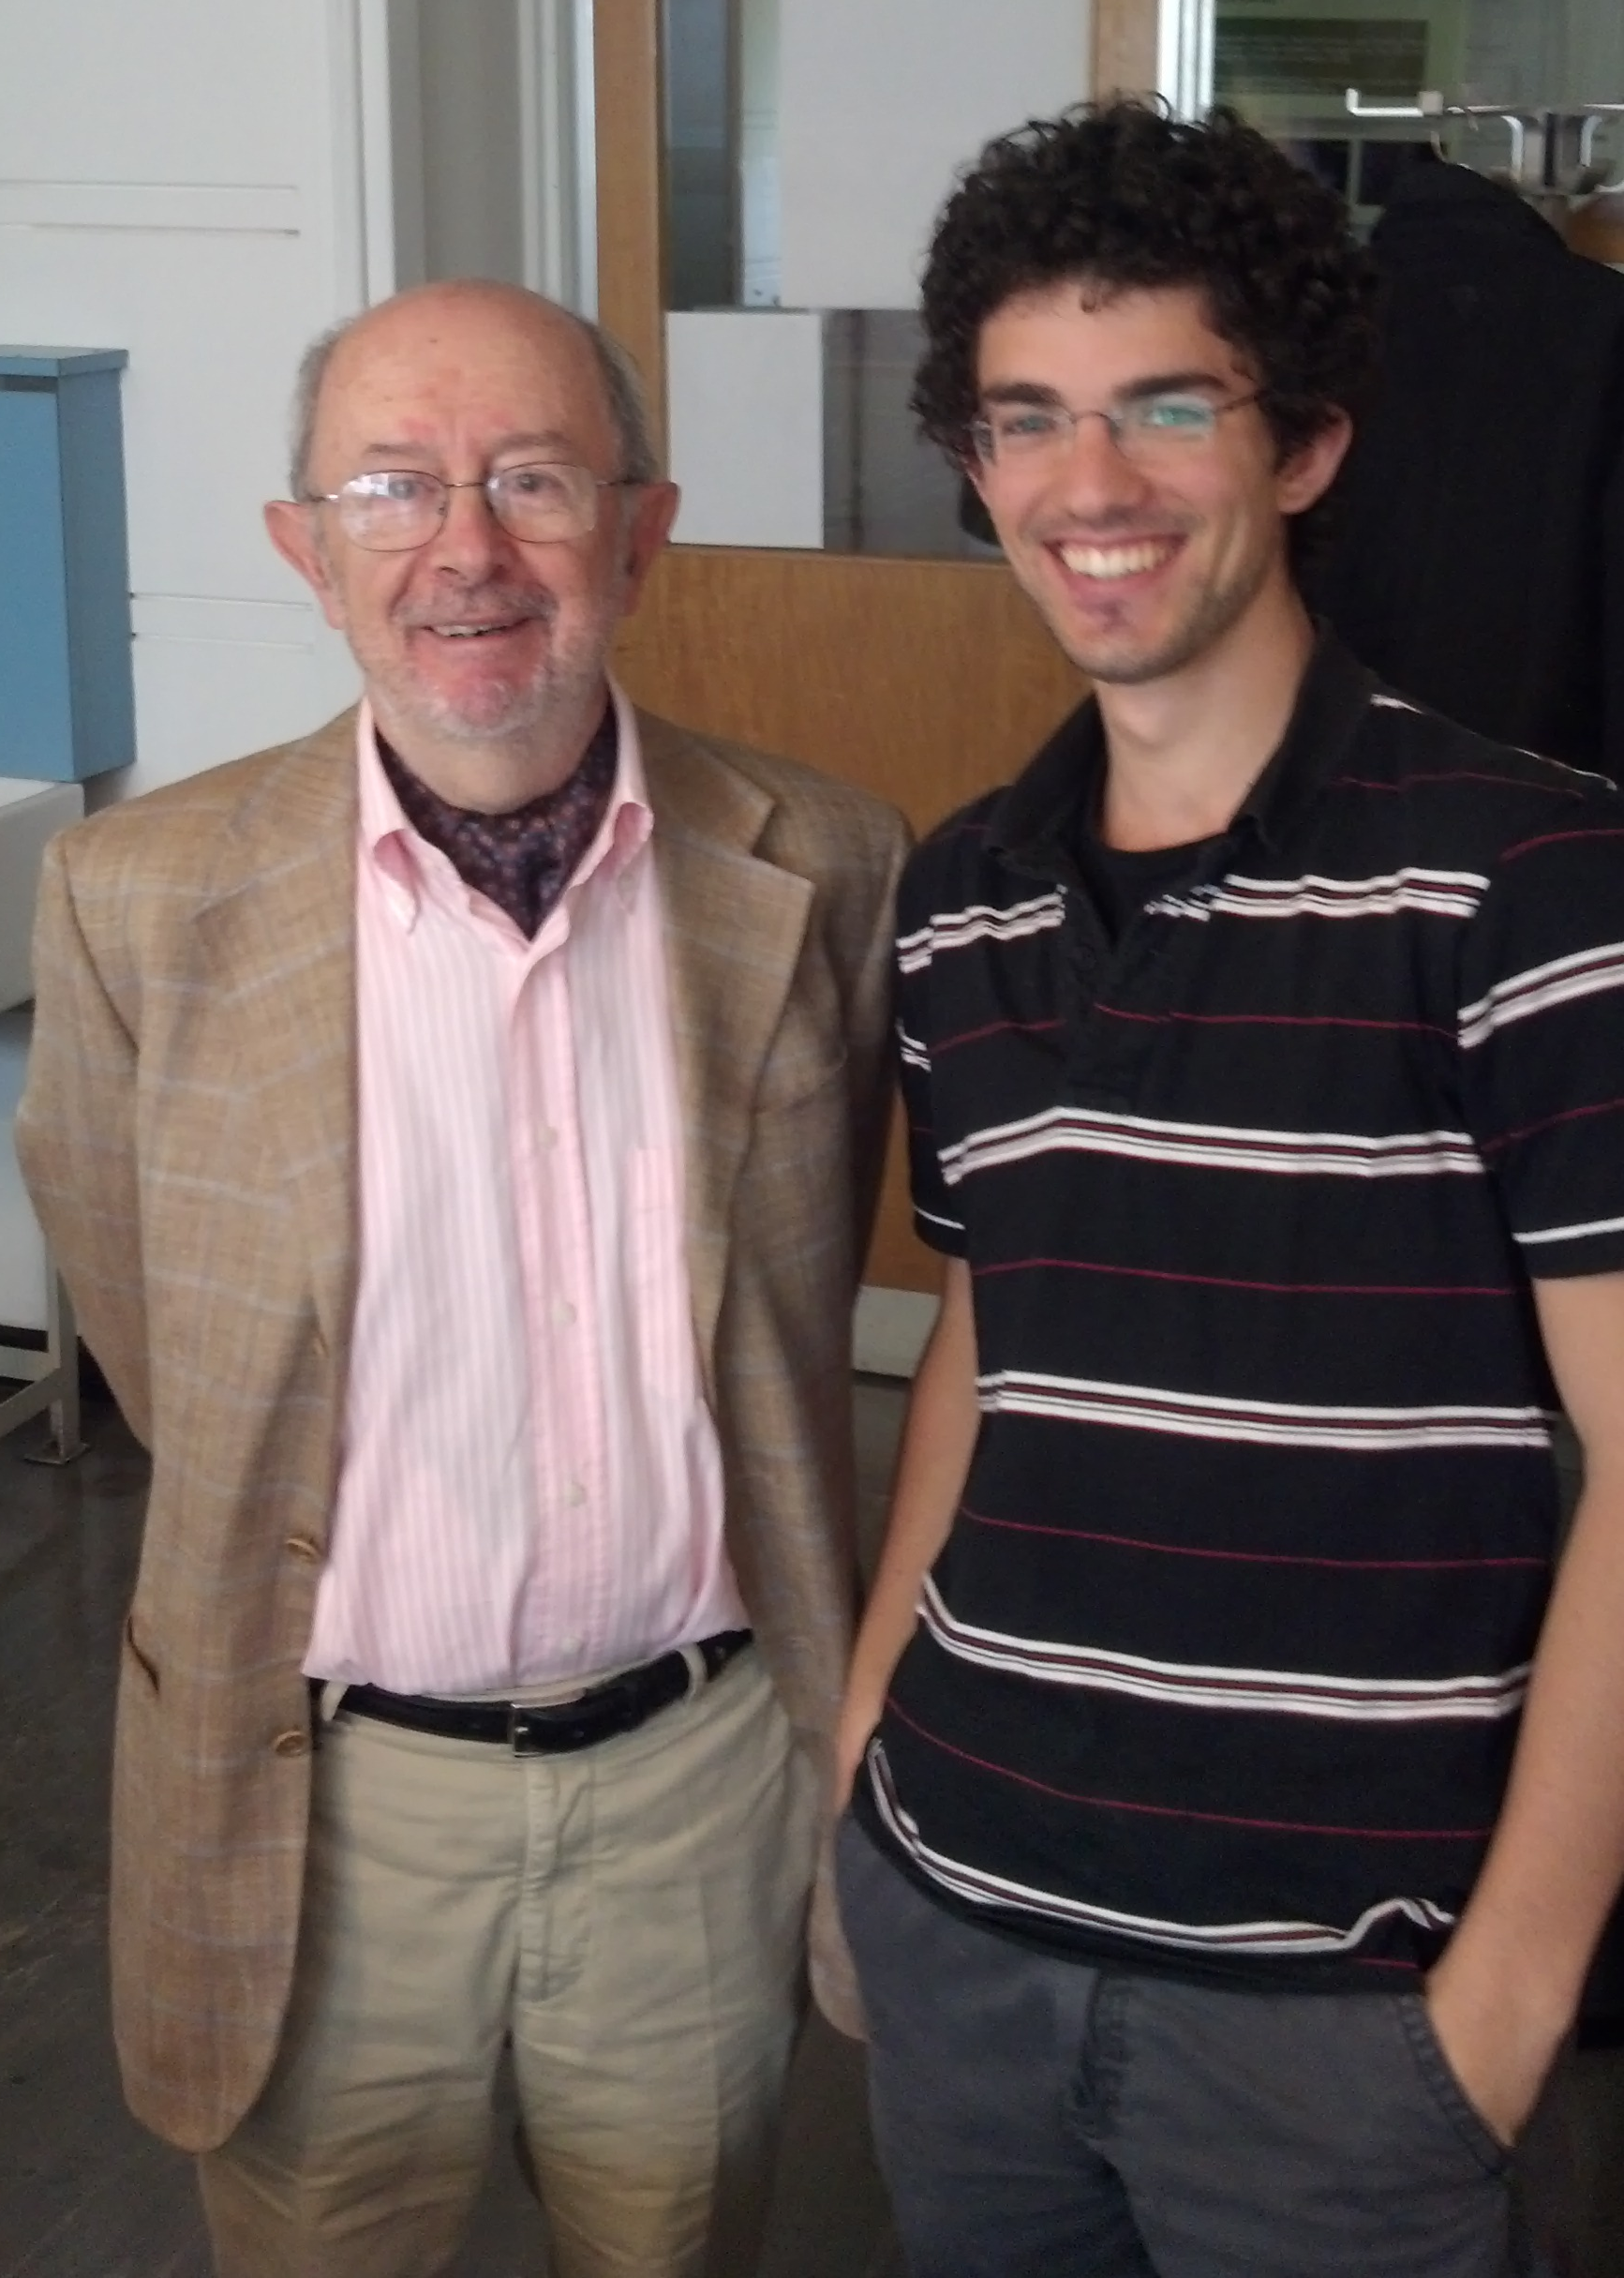





Mode Matching Technique
Lossy-insert loaded pillbox
Electric and magnetic field matching also between the cavity and the toroidal slab of lossy dielectric
The model allows to study:
resistive wall
collimators
loaded cavities
small discontinuities, etc...
Fully dispersive magnetic/electric materials!
$$S_{3}$$
N.Biancacci, “Improved techniques of impedance calculation and localization in particle accelerators”, PhD thesis, University of Rome “La Sapienza”, 2014.
N. Biancacci et al. Phys. Rev. ST Accel. Beams 17, 021001 – Published 12 February 2014
N. Biancacci et al. Phys. Rev. Accel. Beams 26, 042001 – Published 13 April 2023
On going
Hybrid mode matching to study complex structures
CST Eigenmode simulations for resonant modes
Analytical fields in canonical beam pipes
Matching integrals performed numerically at the interfaces
$$V$$
$$\overline{J}$$
$$I$$
$$II$$

Slide 15
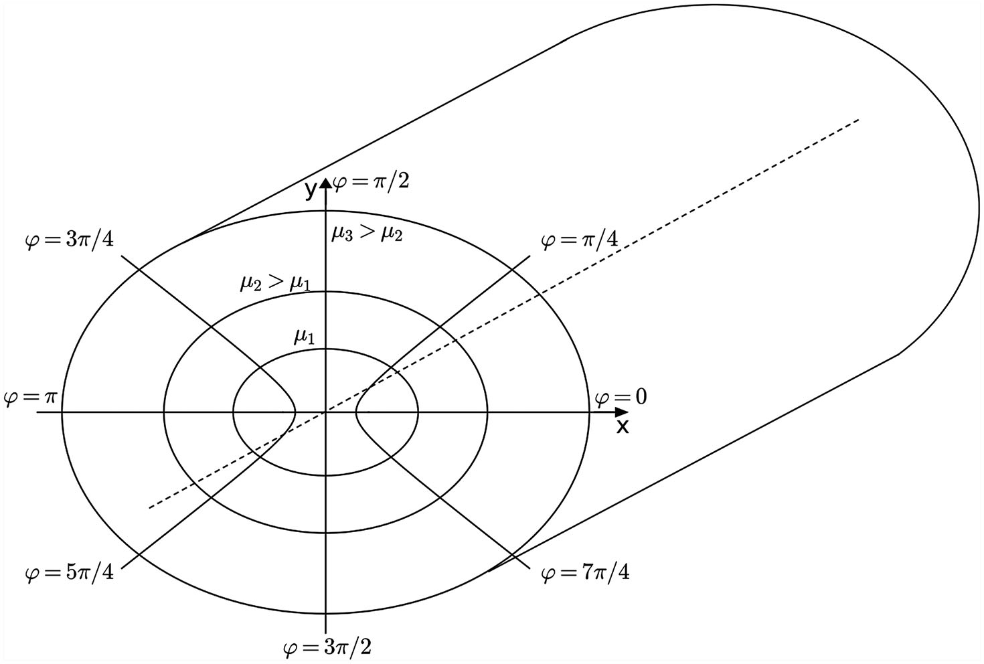
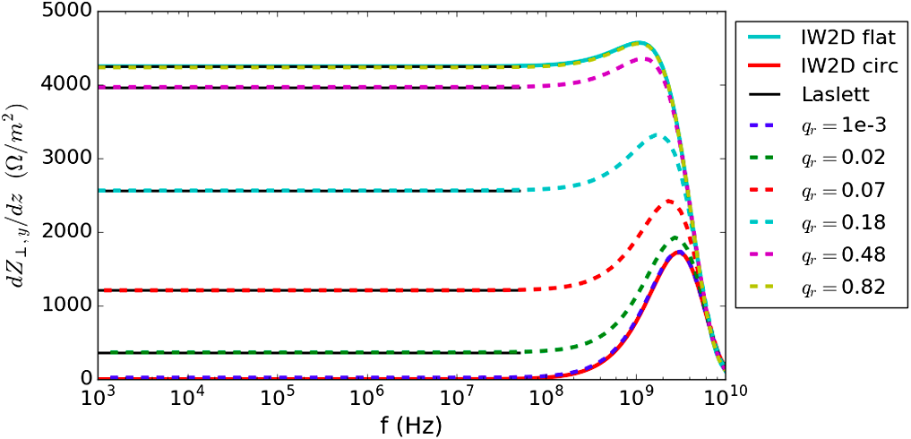
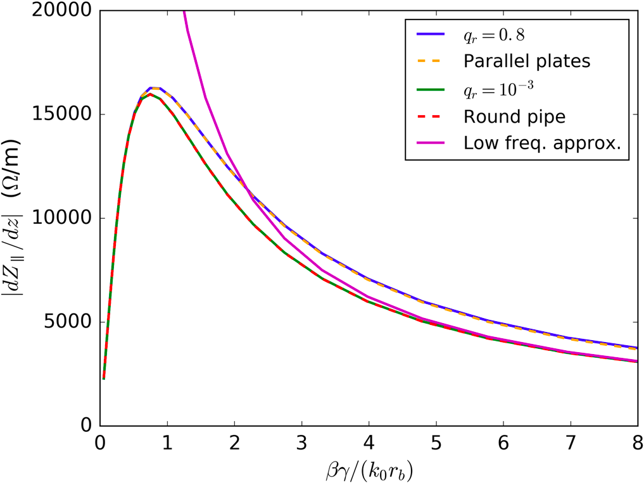
Elliptical vacuum chambers
Transverse indirect space charge per unit of length
for different q_{r}=(a−b)/(a+b)
q_{r} = 1e-3 → circular pipe
q_{r} > 0.8 flat beam pipe
Space charge impedance of circular pipe (q_{r} = 10⁻³) and parallel plates (q_{r} = 0.8)
The space charge impedance changes with energy (and with β)
Impedance study
Space charge
Resistive wall
The future
The elliptical step
M. Migliorati et al. Phys. Rev. Accel. Beams 22, 121001 – Published 12 December 2019
M. Migliorati et al. Phys. Rev. Accel. Beams 21, 124201 – Published 20 December 2018
S. Persichelli et al. Phys. Rev. Accel. Beams 20, 101004 – Published 23 October 2017

Slide 16
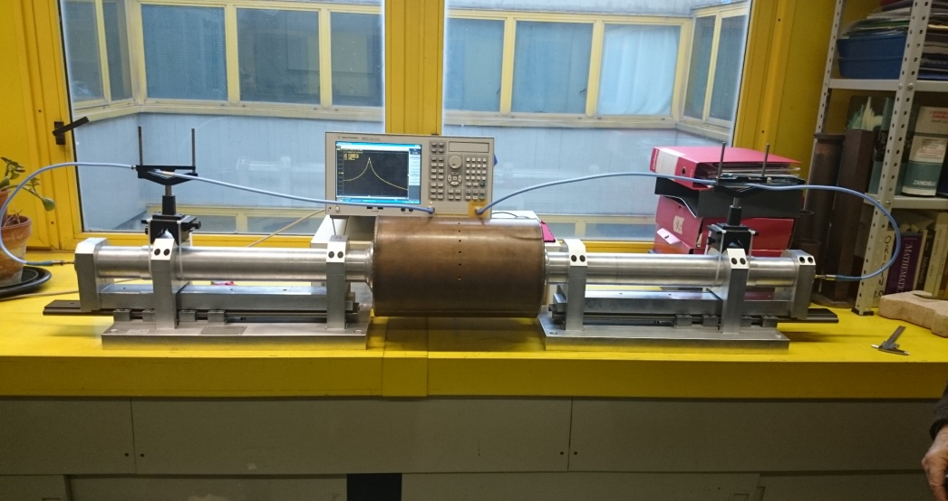
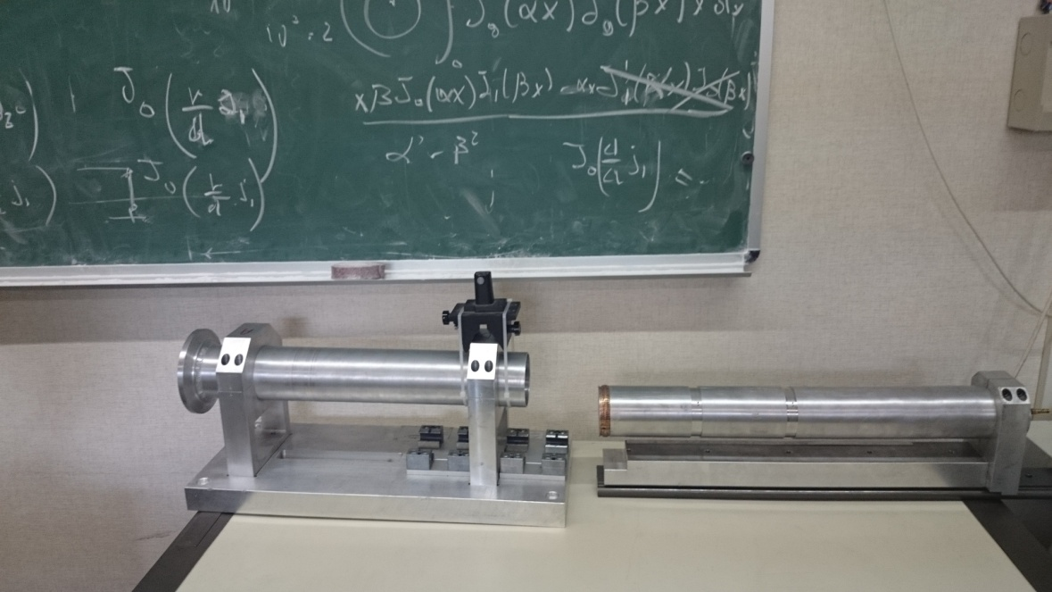
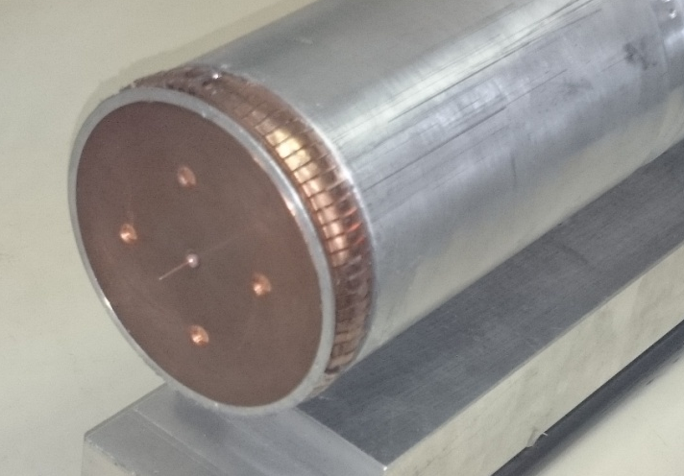
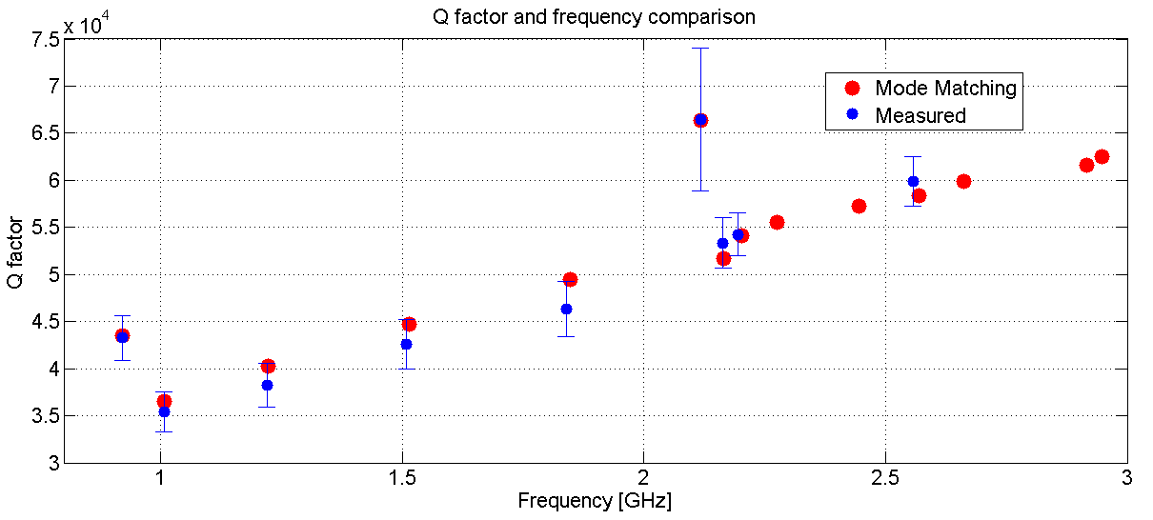
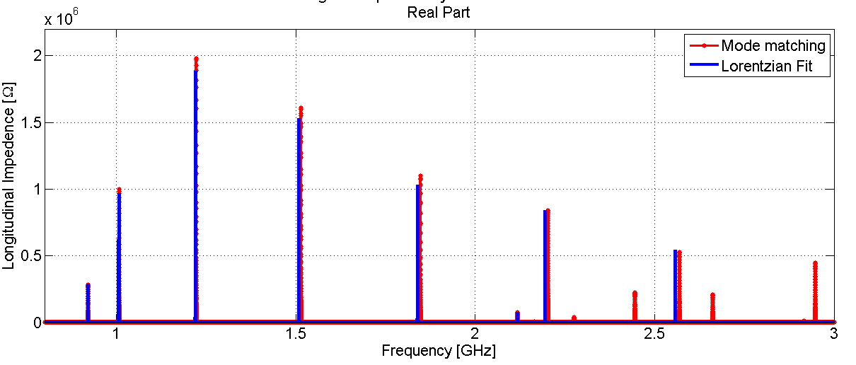
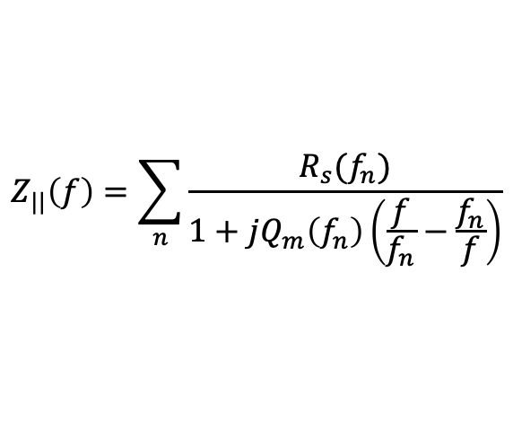
Telescopic measurements on canonical structures
Hybrid method to compute the impedance
Accurate Q factor evaluation by varying antenna-cavity entrance distance
$$Z_{||}\left(f\right)=\sum_{n}{\frac{R_{s}(f_{n})}{1+jQ_{m}\left(f_{n}\right)\left(\frac{f}{f_{n}}−\frac{f_{n}}{f}\right)}}$$
A. Passarelli, “Beam equipment electromagnetic interaction in accelerators: simulation and experimental benchmarking”, Master thesis, University of Naples “Federico II”, 2014
S. Gallo, “Caratterizzazione dell'interazione elettromagnetica di uno "scraper" con il fascio di particelle in un acceleratore” , Master thesis, University of Naples “Federico II”, 2014
To study the first propagating TM mode of the DUT (instead of the TEM mode in the case of the Wire Method) to directly compute the impedance of a beam chamber.
On
going
Validated with simulations → Future measurements

Slide 17
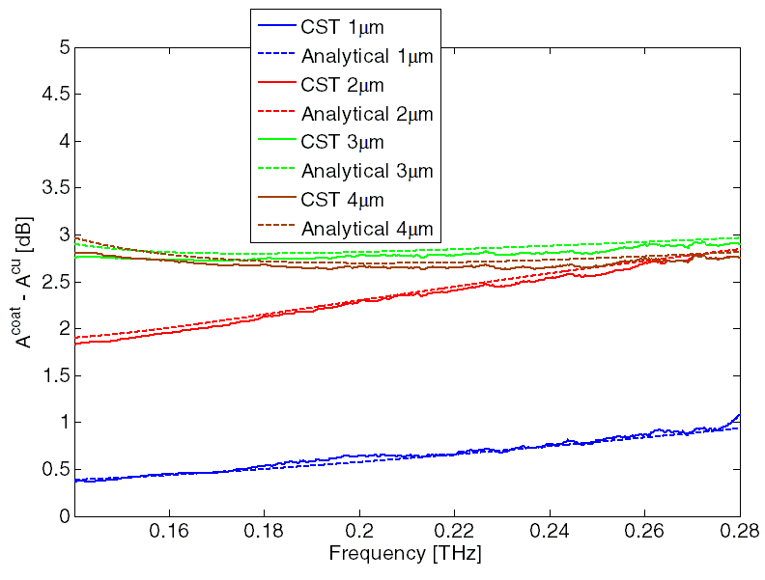
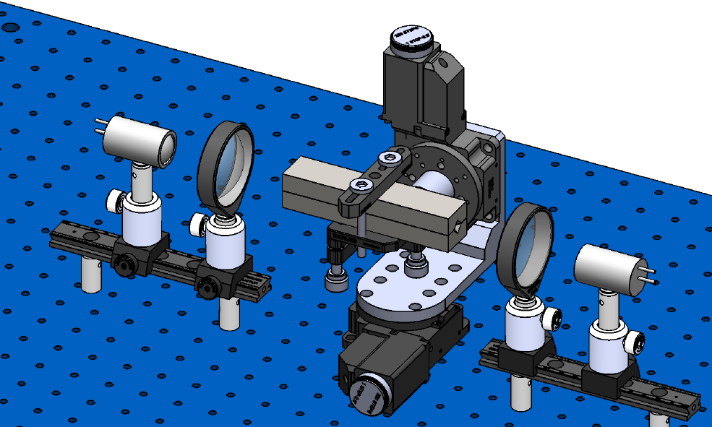
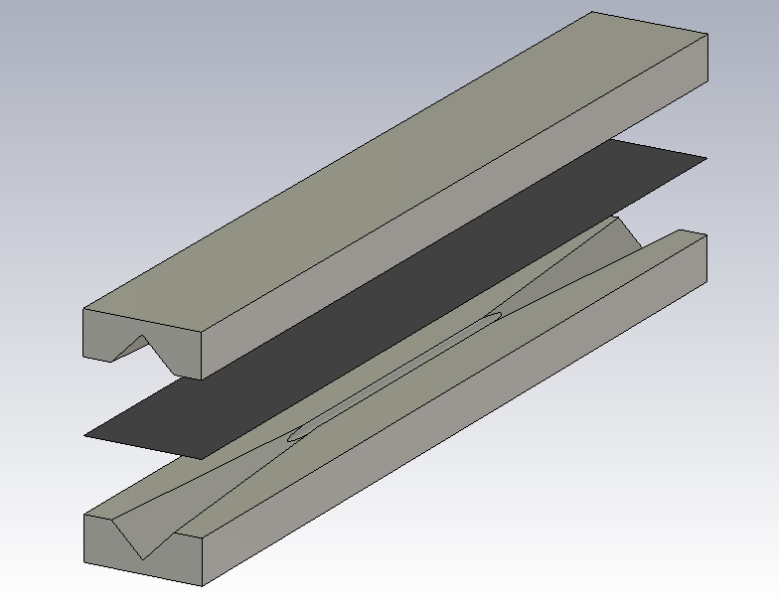
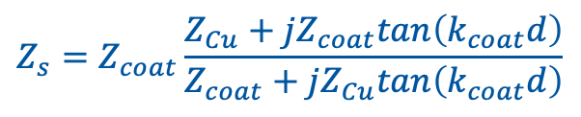
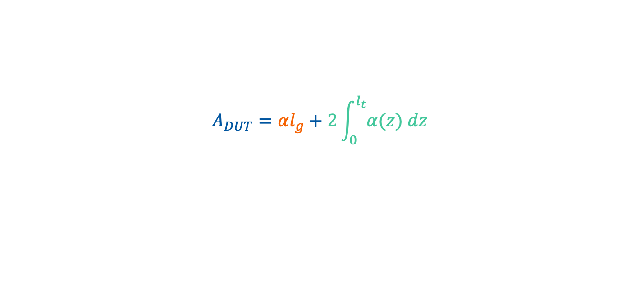
Electromagnetic characterization of coatings in sub-THz
Signal attenuation in DUT with coating
Reliable analytical tool
EM characterization
In-house retrieval method
Waveguide of length l_{g} (TE_{1,1}) + pyramidal transitions of length l_{t} (TE_{1,0}&TE_{0,1})
$$A_{DUT}=αl_{g}+2\int_{0}^{l_{t}}{α(z) dz}$$
$$Z_{s}=Z_{coat}\frac{Z_{Cu}+jZ_{coat}tan\left(k_{coat}d\right)}{Z_{coat}+jZ_{Cu}tan\left(k_{coat}d\right)}$$

Slide 18
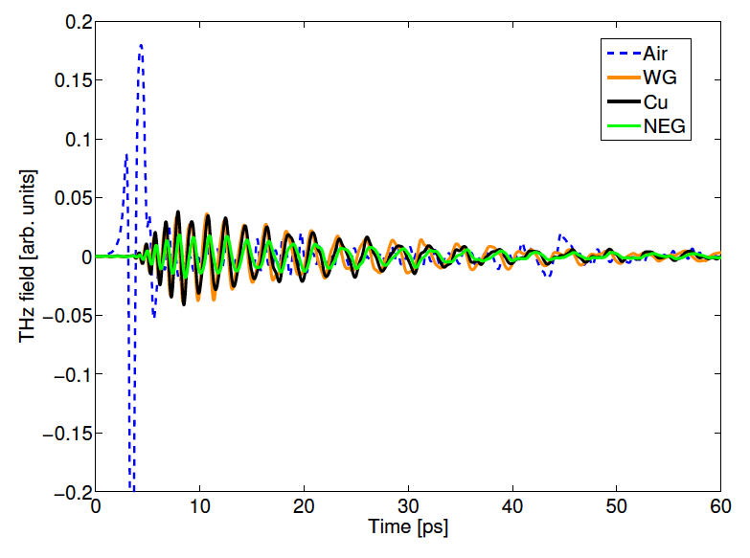
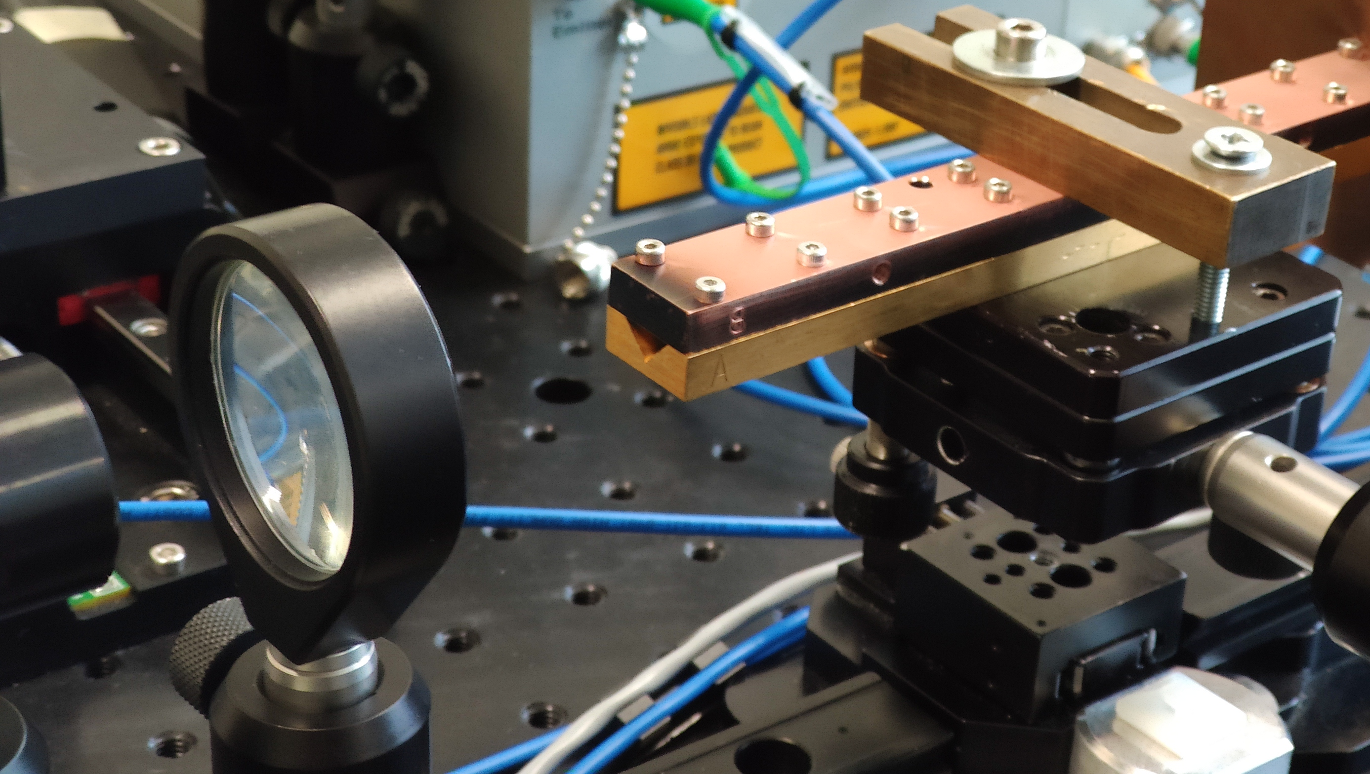
Electromagnetic characterization of coatings in sub-THz
TD measure
A. Passarelli, PhD Thesis 2019
A. Passarelli, et al. Phys. Rev. Accel. Beams, vol. 21, issue 10, Oct. 2018
A. Passarelli, et al. Condens. Matter 2020, 5(1), 9
FT
The next future
Two samples with 3 μm of Amorphous carbon on copper bulk
Electromagnetic characterisation of three different NEG coatings:
CERN Standard coating
Porous, coated at high Pressure
Densified film using HiPIMS coating

Slide 19


