Slide 1
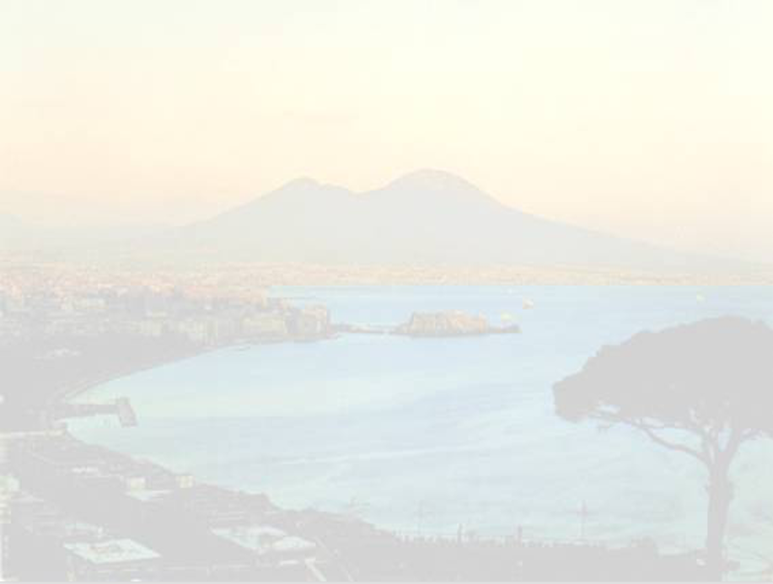
Vittorio, le impedenze e … il nostro ricordo

Slide 2
My life with Vittorio (Roberto)
Vittorio has always been a reference in my life. He showed me how beautiful it is to live with passion.
During the studies, he was my teacher for the subject “Propagazione delle onde elettromagnetiche”. I learnt the true meaning of “ritardo accademico”, but also he broke the distance between students and teacher, becoming one of us and making us love the subject.
During my master thesis, he taught me to be (scientifically) honest, and also never to be the judge of my own work: peers should always judge you
During the beginning of my professional life, he guided me and helped me to get into the world of particle accelerators. I owe to him both my experience at LAL and at CERN.
He leaves me with a baggage full of good memories and values.

Slide 3
Preamble (Giovanni)
Vittorio and Giovanni (Miano) introduced me to accelerator physics back in 1995
Vittorio was co-supervisor of my masters’ degree thesis and head of the committee which examined my PhD thesis in 1999. We kept in close contact throughout my subsequent years at CERN, GSI, ALBA and then back to CERN – he always actively supported my job applications and moves without hesitation
He was knowledgeable, wise, jovial, forward-thinking, with a wide culture spanning from physical to human sciences and an open mind – plus a complex personality sometimes difficult to decode ☺
Vittorio’s contributions remain key in the field of beam physics, having introduced during his pioneering studies the fundamental concepts of beam coupling impedance and stability diagrams.

Slide 4
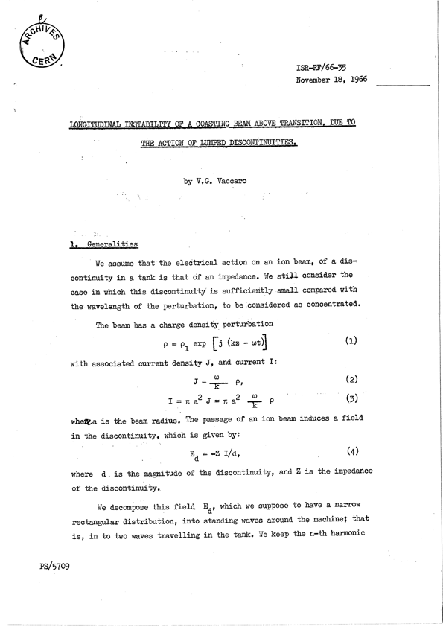
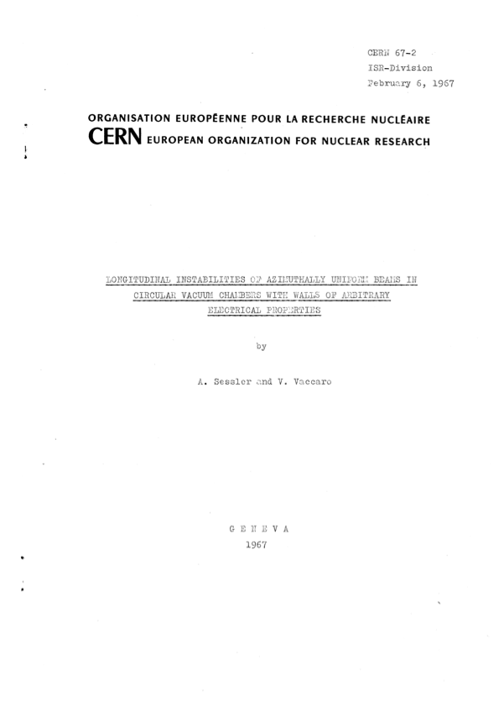
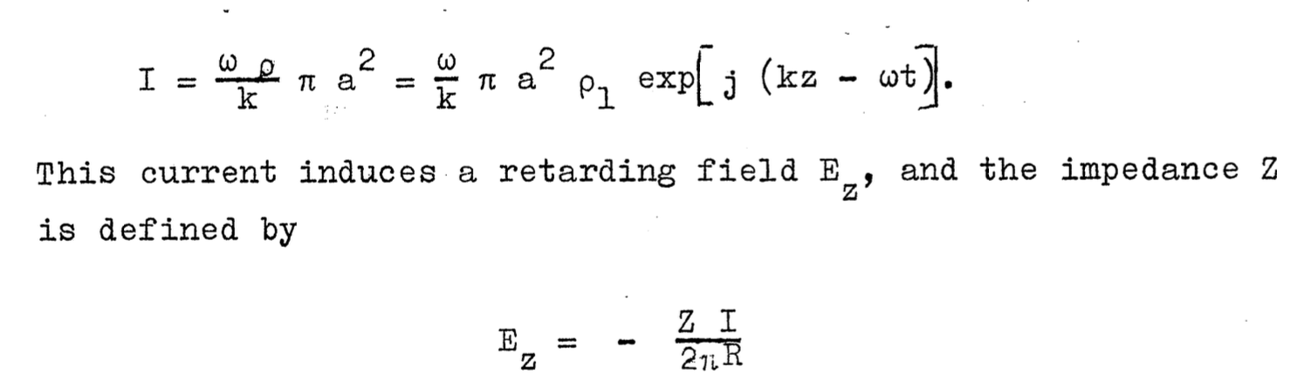
V. G. Vaccaro
A pioneer on beam coupling impedance …
The concept of beam coupling impedance
applied to accelerators dates back to
1966-67, when it was introduced to express
the self-induced EM fields
  First from a lumped discontinuity (e.g., an RF
  cavity)
  Later on generalized to a distributed source
  around the machine (e.g., the resistive vacuum
  chamber)
A shift of viewpoint? Not “impedance” to
current for an applied voltage, but impedance
associated to a source current … however
leading to power loss …

Slide 5
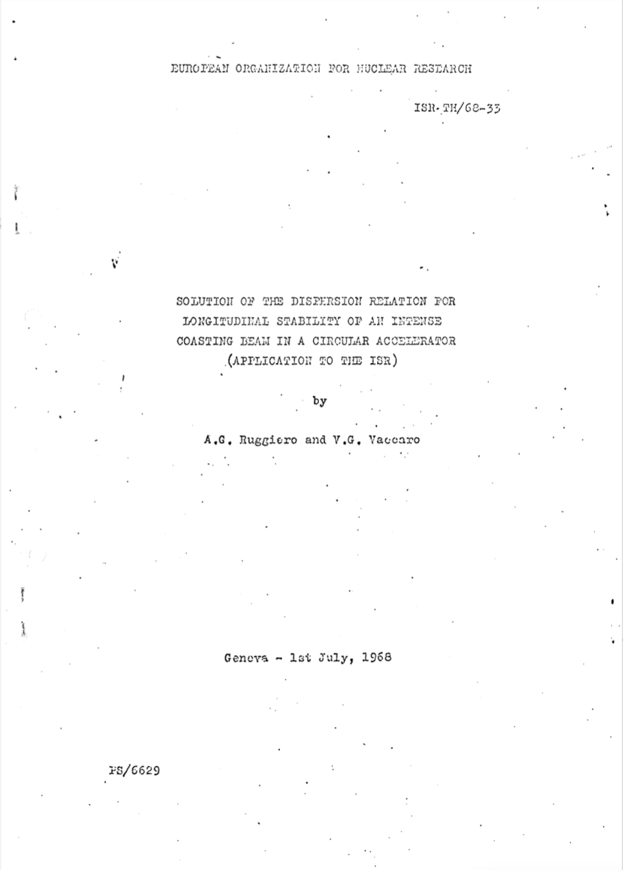
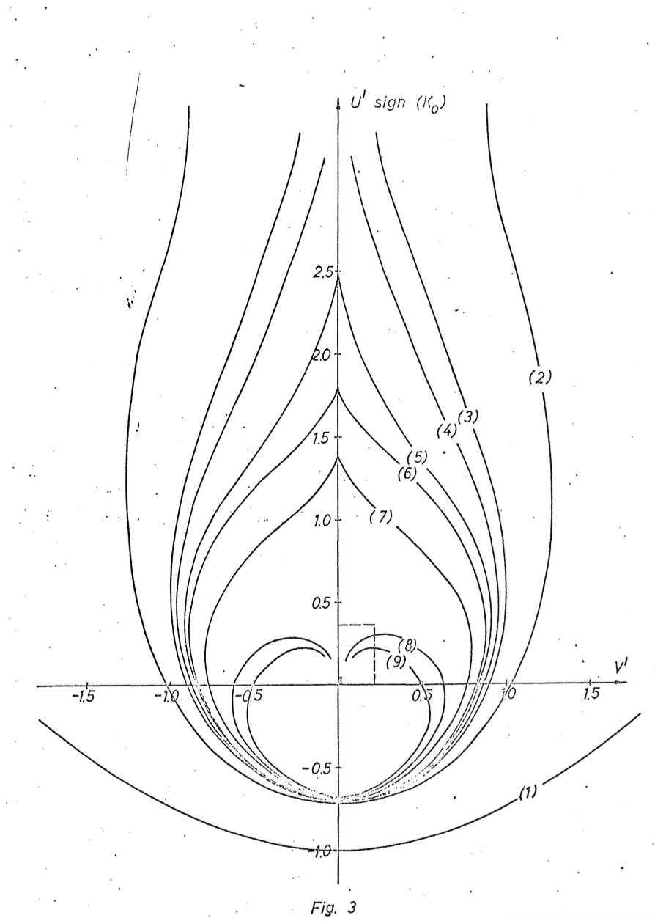
V. G. Vaccaro
… and on stability diagrams
The concept of impedance was then
instrumental to define the stability
diagrams and stability region approach
  First introduced for a coasting beam in the
  longitudinal plane
  Applied to ISR
In spite of the limited calculation tools
of the time, stability regions were derived
for a wide range of momentum spread
distributions

Slide 6
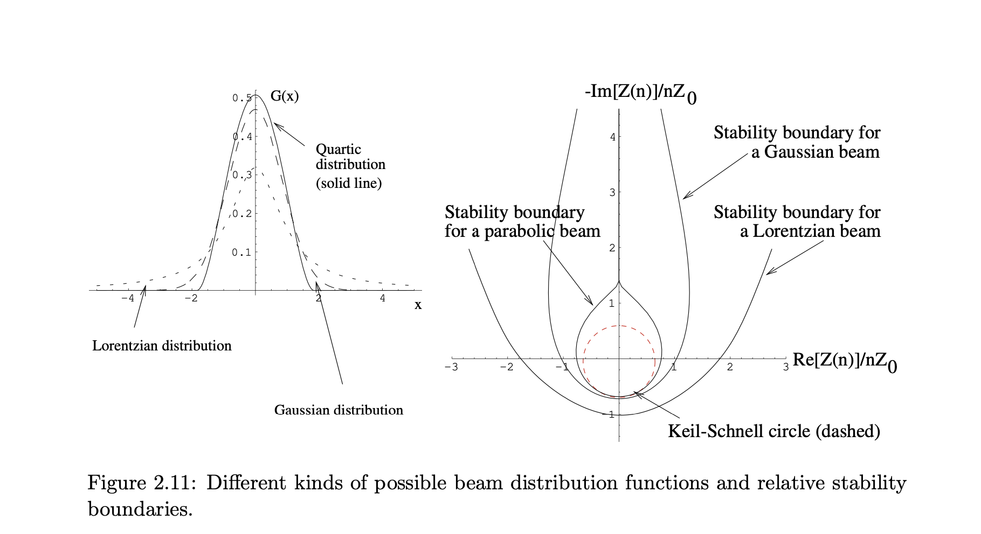
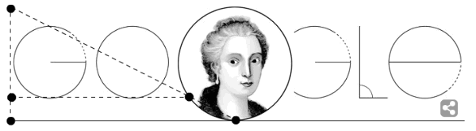
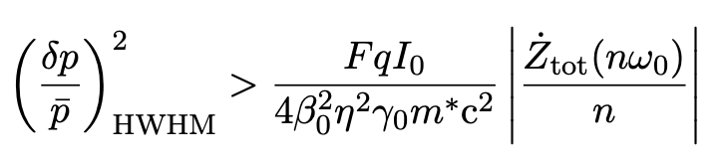
V. G. Vaccaro
… and on stability diagrams
30 years later, I re-did his calculations in my PhD thesis …
The witch of Agnesi!
Keil-Schnell became more known in beam physics than Ruggiero-Vaccaro….

Slide 7
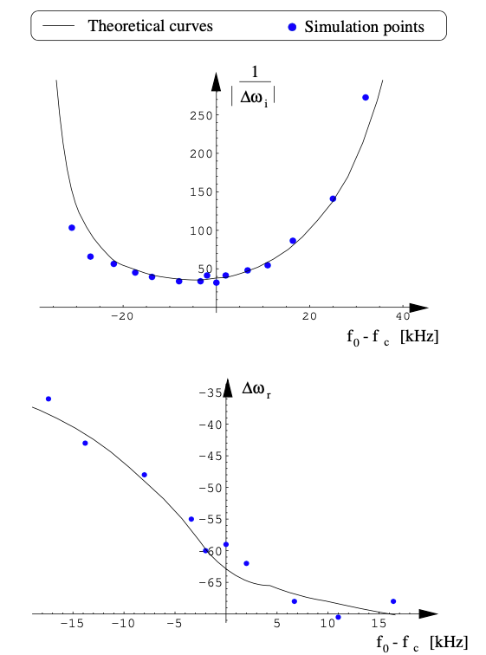
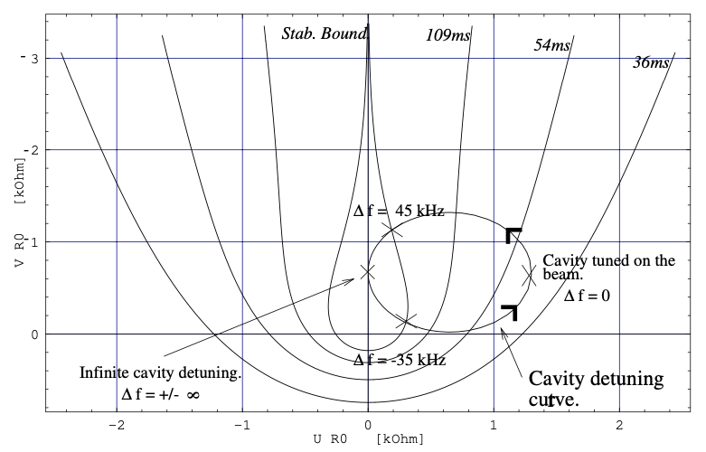
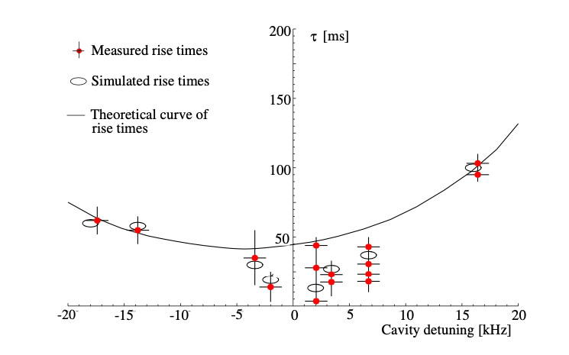
V. G. Vaccaro
The 40 years after CERN
1999 PhD thesis: Giovanni Miano and I showed the first complete benchmark of Vittorio’s stability diagram theory against macro-particle simulations and measurements at the ESR (GSI-Darmstadt)

Slide 8
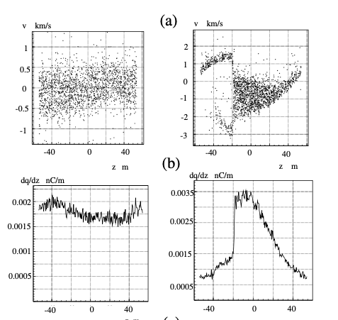
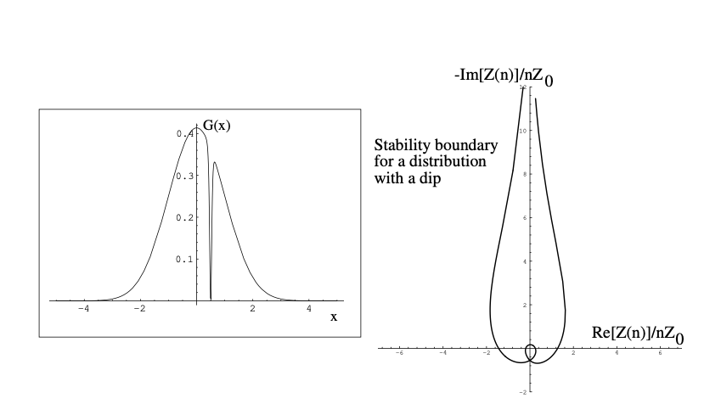
V. G. Vaccaro
The 40 years after CERN
1999 PhD thesis: Giovanni Miano and I showed the first complete benchmark of Vittorio’s stability diagram theory against macro-particle simulations and measurements at the ESR (GSI-Darmstadt)
  Moved beyond linear theory to study saturation
  with a kinetic model
  Studied stability with laser cooling – so many
  discussions with Vittorio on the effect of holes
  in the momentum spread distribution …

Slide 9
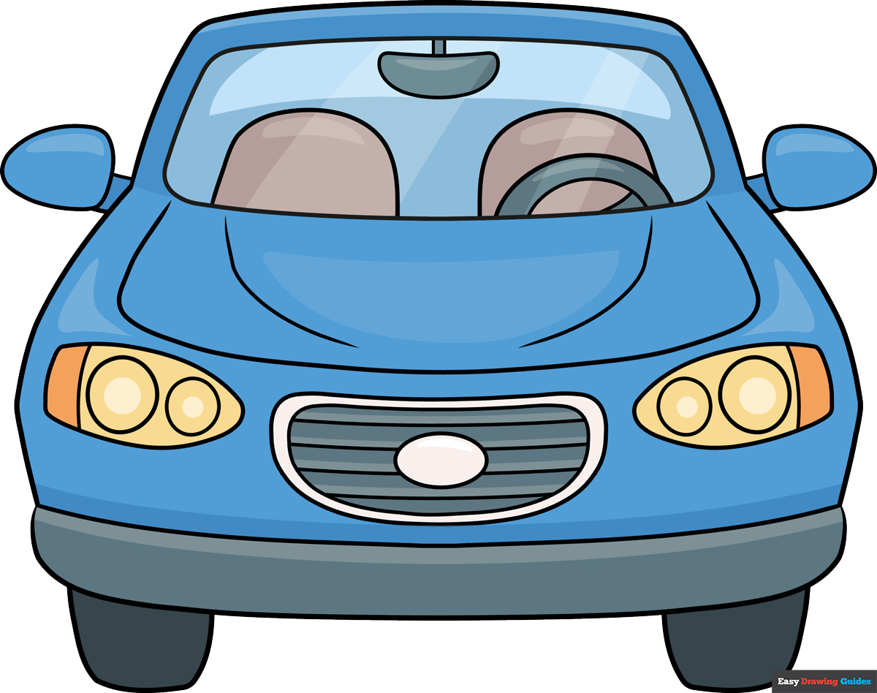
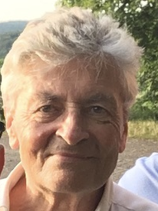
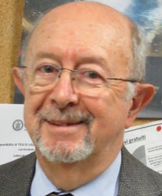
V. G. Vaccaro
The 40 years after CERN
1999 PhD thesis: Giovanni Miano and I showed the first complete benchmark of Vittorio’s stability diagram theory against macro-particle simulations and measurements at the ESR (GSI-Darmstadt)
  Moved beyond linear theory to study saturation
  with a kinetic model
  Studied stability with laser cooling – so many
  discussions with Vittorio on the effect of holes
  in the momentum spread distribution …
Vittorio and Ingo on a tour through the Naples’
rush hour traffic ☺ ☺

Slide 10
V. G. Vaccaro
From 2008 onwards
Vittorio decided to make a clear comeback to beam coupling impedances after 2008
  First sent Carlo to CERN as a Technical Student, ensuring me he was the right person to take over the hard challenge of bridging EM simulations to beam dynamics ☺
  Thanks to Elias and Gianluigi, after 2010 joined CERN as Scientific Associate multiple times, raising awareness on some important topics, e.g., a critical eye on the stretched wire measurement technique
According to a well accepted theory, by means of the measured scattering parameters in setup with stretched wire one may get the Coupling Impedance
However, its results are only partially reliable at least in some range of frequencies. This is due to the presence of the wire which perturbs the measurement making uncertain some results. The presence of the wire, indeed, shifts the cutoff frequency to zero by introducing a TEM mode.
This implies that all the resonances which should in reality fall in the cutoff region will be depressed

Slide 11
V. G. Vaccaro
From 2008 onwards
Vittorio decided to make a clear comeback to beam coupling impedances after 2008
  First sent Carlo to CERN as a Technical Student, ensuring me he was the right person to take over the hard challenge of bridging EM simulations to beam dynamics ☺
  Thanks to Elias and Gianluigi, after 2010 joined CERN as Scientific Associate multiple times, raising awareness on some important topics, e.g., a critical eye on the stretched wire measurement technique
  With the enthusiasm of the student, began working on a range of semi-analytical impedance calculations and involved a large number of young scientists, e.g., impedance of a C-shaped magnet (kicker), impedance of step transitions, resistive wall of elliptical beam chambers, Mixed Mode Matching (MMM) techniques for impedance of inserts (cavity, iris, finite length collimator, etc.) – also picked up some cutting edge subjects like development of alternative bench measurement techniques (e-gun, antenna) and material properties and contributed to Massive Open Online Course (MOOC) on electromagnetism with Elias!
  My impression: Wanted to catch up on some ‘lost time’ but also finally enjoy the recognition of his achievements that wasn’t probably appropriately given decades earlier …

Slide 12
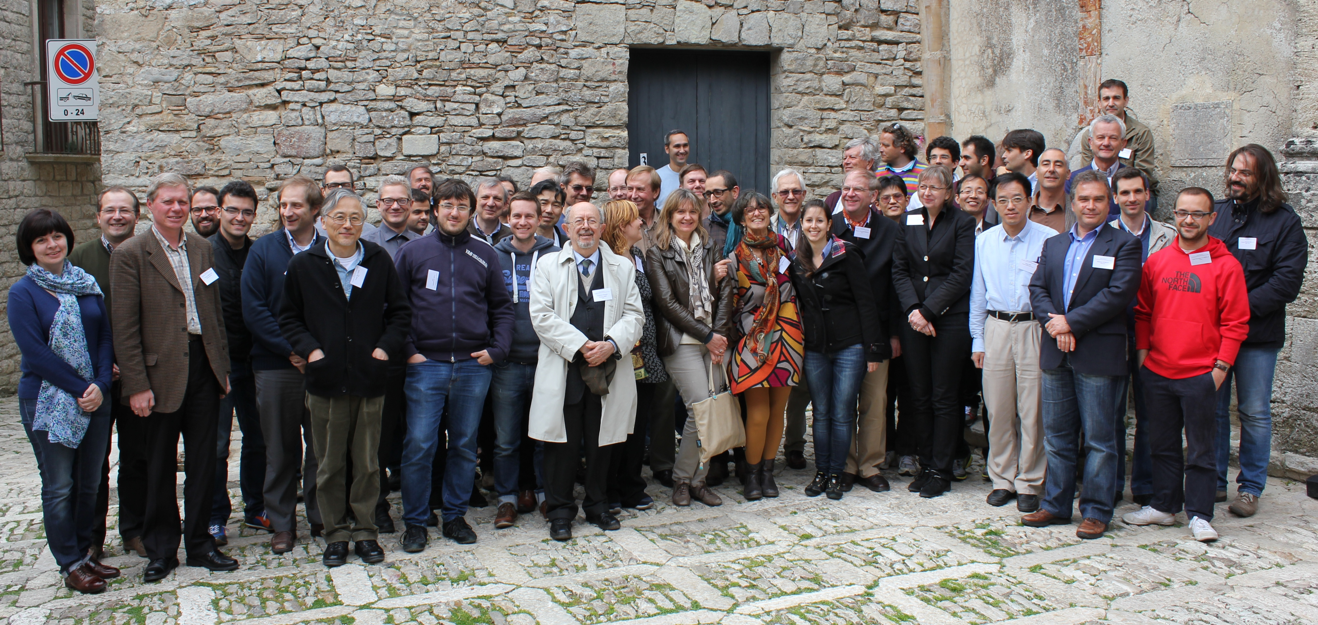
V. G. Vaccaro
From 2008 onwards
ERICE 2014
First Impedance Workshop co-chaired with Elias and iaia

Slide 13
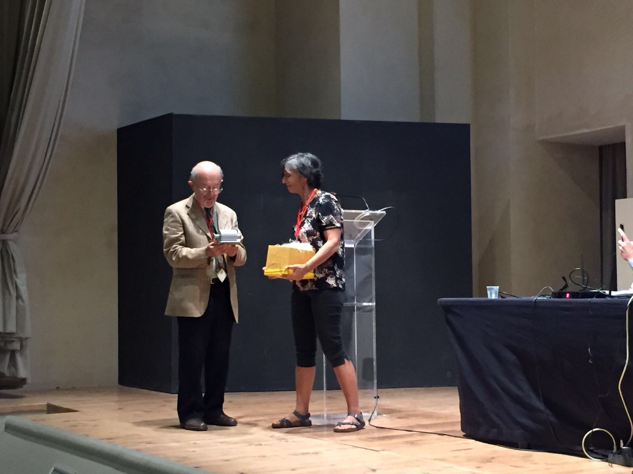
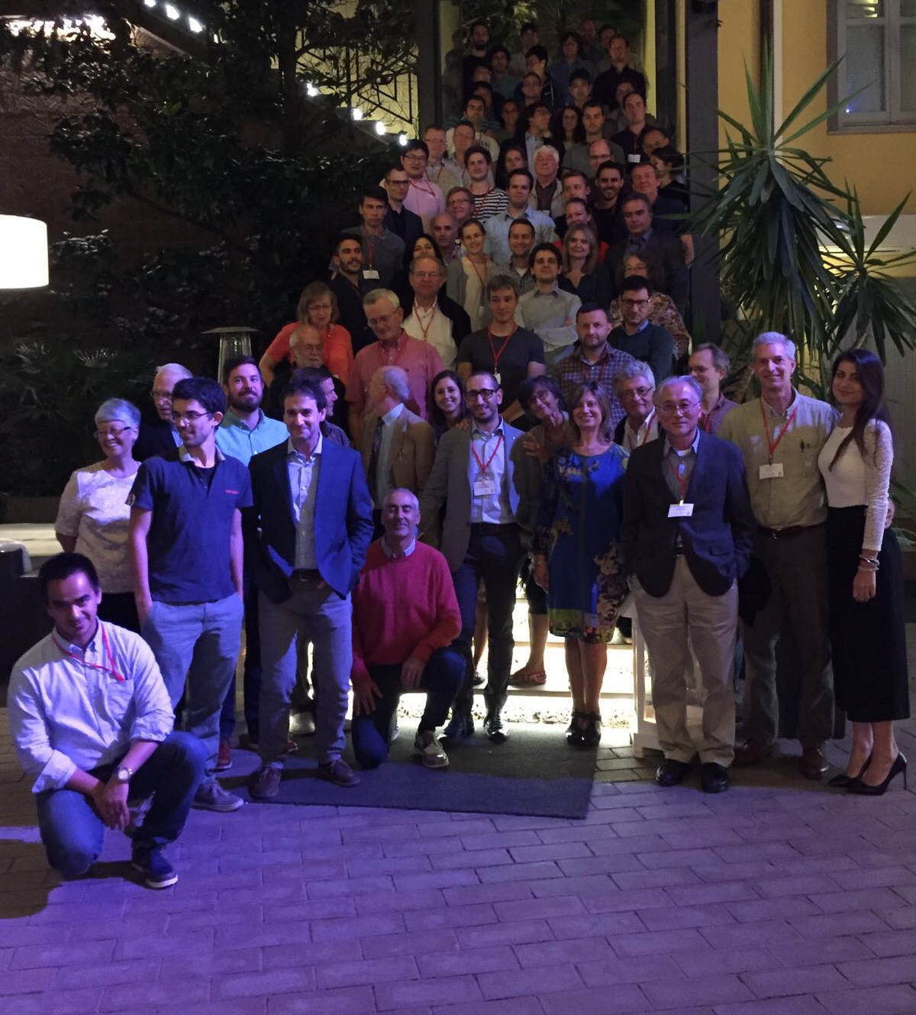
V. G. Vaccaro
From 2008 onwards
ERICE 2014
First Impedance Workshop co-chaired with Elias and iaia
BENEVENTO 2017: Workshop on Impedances and Beam Instabilities
We gave Vittorio a honorary plaque to congratulate him on the first 50 years of beam-coupling impedances !!

Slide 14
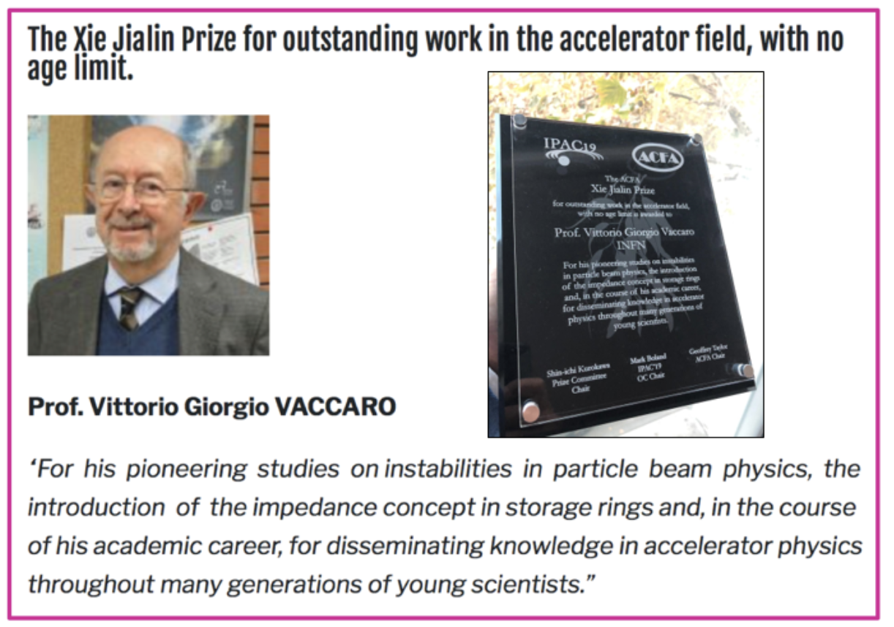
V. G. Vaccaro
From 2008 onwards
ERICE 2014
First Impedance Workshop co-chaired with Elias and iaia
MELBOURNE 2019: Received an award at
IPAC – Elias represented him as he couldn’t finally
travel to Australia …
BENEVENTO 2017: Workshop on Impedances and Beam Instabilities
We gave Vittorio a honorary plaque to congratulate him on the first 50 years of beam-coupling impedances !!

Slide 15
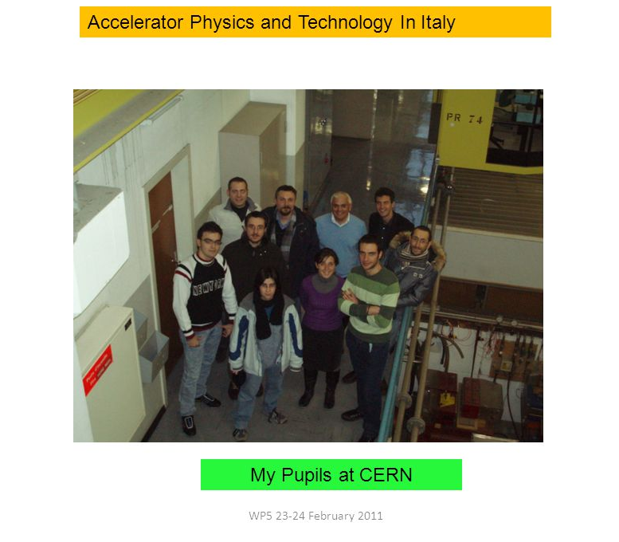
V. G. Vaccaro
From 2008 onwards
Always proud of the young scientists that he trained and unleashed ☺
Roberto
Giovanni

Slide 16
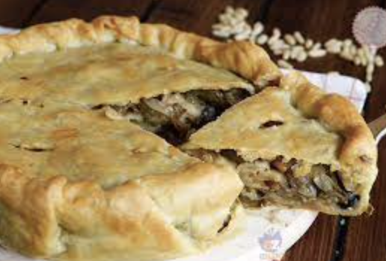
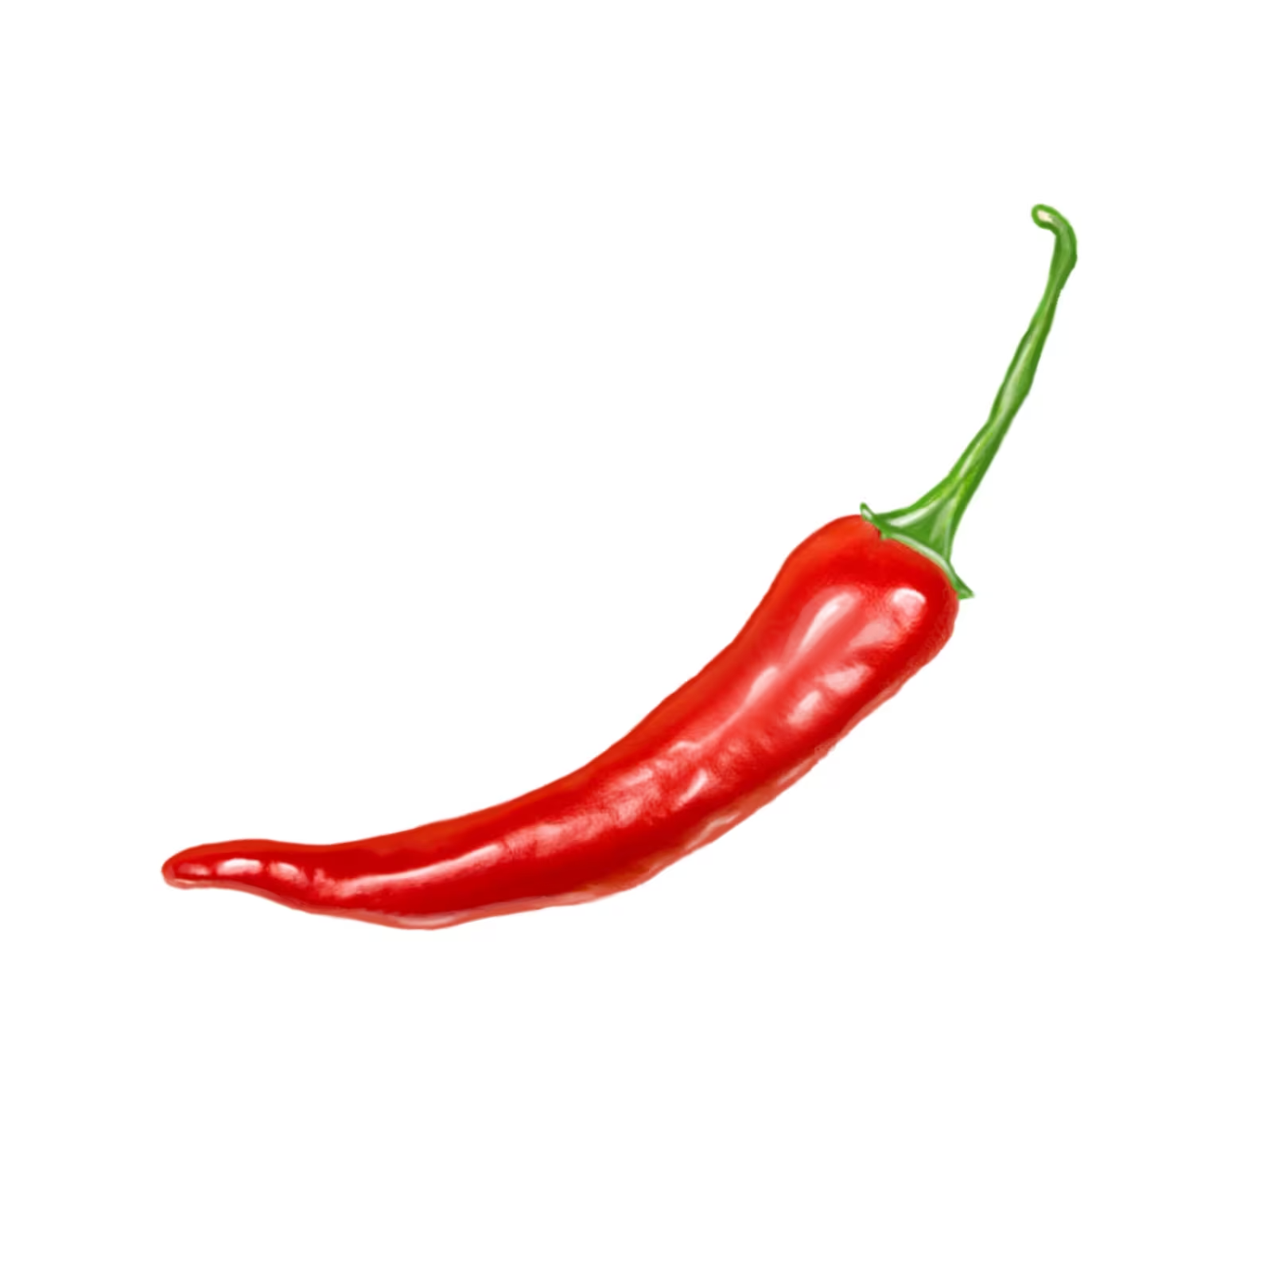
V. G. Vaccaro
From 2008 onwards
Indeed, Vittorio leaves a long-standing legacy in the realm of accelerator physics not only for his outstanding contributions but also through his ‘posterity’!
Other miscellaneous things I have learnt from him over the years ☺
  How to make a stuffed pizza with scarola
  The different mechanisms that cause pepper and chili pepper to give a burning feeling when you eat them (pepper stimulates the ‘hot’ receptors by irritation, chili pepper numbs the ‘cold’ receptors!!)
  The origin of my family name ‘Rumolo’ has nothing to do with Romolo, the founder of Rome!!!

Slide 17
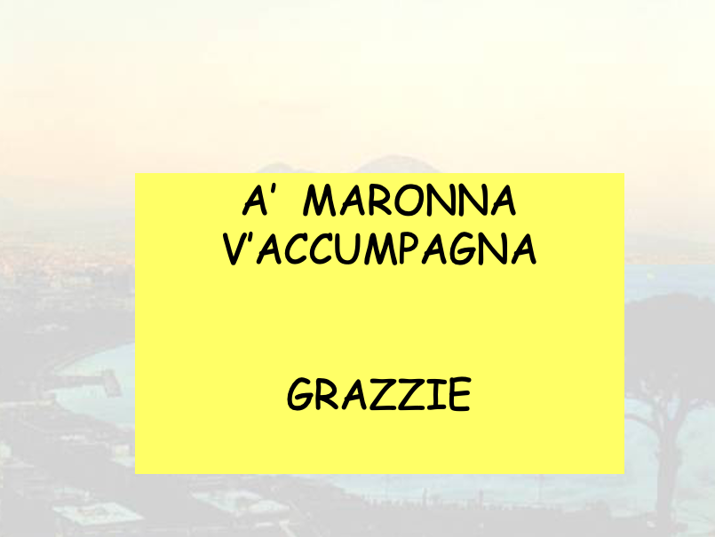
V. G. Vaccaro
From 2008 onwards
Indeed, Vittorio leaves a long-standing legacy in the realm of accelerator physics not only for his outstanding contributions but also through his ‘posterity’!
Other miscellaneous things I have learnt from him over the years ☺
  How to make a stuffed pizza with scarola
  The different mechanisms that cause pepper and chili pepper to give a burning feeling when you eat them (pepper stimulates the ‘hot’ receptors by irritation, chili pepper numbs the ‘cold’ receptors!!)
  The origin of my family name ‘Rumolo’ has nothing to do with Romolo, the founder of Rome!!!
We will all miss him a lot, but now we should celebrate his long and productive life of scientific achievements, enthusiasm, anecdotes, 360º views, good spirits
Thanks to you for everything Vittorio!

