Slide 1
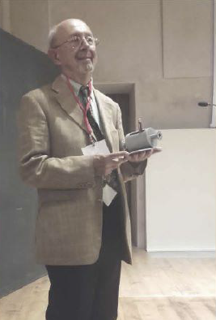
GIORNATA IN RICORDO DI VITTORIO VACCARO
THE EARLY YEARS AT CERN
Luigi Palumbo
Università di Roma La Sapienza
Napoli, 29 maggio, 2023

Slide 2
NAPLES SCHOOL of ELECTROMAGNETISM
Vittorio Vaccaro graduated in Electronic Engineering in 1965, at the age of 24, at the University of Naples, under the supervision of Giorgio Franceschetti.
Giorgio Franceschetti graduated in Electrical Engineering at the University of Naples in 1959, at the age of 24, full Professor at the age of 30.
Franceschetti collaborated with Gaetano Latmiral who, in 1955 was appointed to the chair of "Theory and Technique of Electromagnetic Waves” at the Istituto Universitario Navale of Naples.

Slide 3
G. LATMIRAL: NAPLES SCHOOL of ELECTROMAGNETISM
Gaetano Latmiral was born in Rome on April 23, 1909, and graduated in Mechanical Industrial Engineering, specializing in Electrical Engineering and Radiotechnology from the Polytechnic University of Milan
During World War II, he served in the 1st Mountain Artillery Regiment of the Italian Army, contributing, among other things, to the development of the first Italian radar.
Together with Tiberio, Barzilai, Gerosa, established the “new” electromagnetism school at the Engineering schools in Italy.

Slide 4
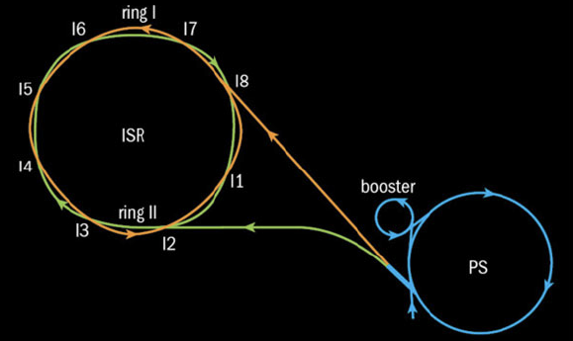
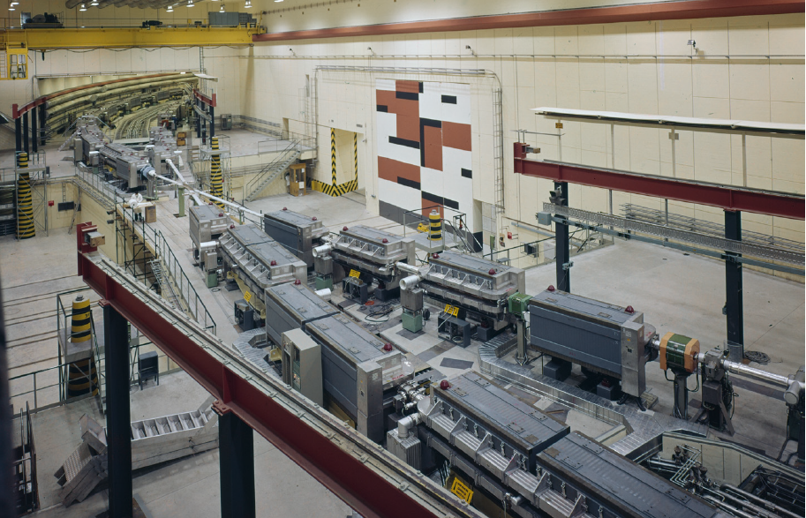
VITTORIO VACCARO, EARLY YEARS AT CERN
In 1966 Vittorio began his career as an electronic engineer at CERN in the RF group.
It was the year when the construction of the Intersecting Storage Ring (ISR), the world's first hadron collider started.
The machine consisted of two intersecting rings. It became operational in 1971.
To achieve a high luminosity it was necessary to store a high current of protons with unknown stability limits of accumulated current
E 26.5 GeV
I 10 A
L 1 km

Slide 5
with his words:
… When I was hired by CERN on June 1966, I joined the RF group of the Intersecting Storage Rings (ISR). ISR was under construction and was destined to be the world’s first hadron collider.
At that time at CERN there was a big concern about the stability of the beams because of a large number of various kinds of lumped equipment (pick-ups, cavities, clearing electrodes ..), which could be “seen” by the beam.
Unfortunately, the stability criteria did not apply to the situation of ISR.
I was committed to work on this problem

Slide 6
lumped device
vacuum chamber
c
proton coasting beam
lumped device
vacuum chamber
c
perturbation
Perturbation in the beam density generates electromagnetic fields
Electromagnetic fields act back on the beam, and the amplitude of the perturbation can growth

Slide 7
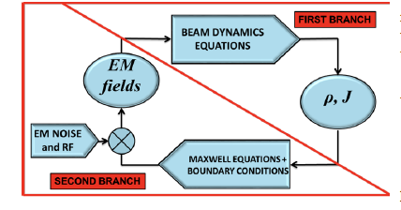
with his words:
… The phenomenon of beam instabilities can be understood by resorting to a pictorial representation. This follows the explanation that I gave to myself when I first tackled the beam instability problem.
Like many modulational instabilities, this one is triggered by the electric field noise.
The field noise acting on the charged particles introduces a small modulation on the beam current density.
At the same time, the interaction of the perturbed current with the surroundings produces an additional electric field. This process is continuous ….
FEEDBACK SYSTEM !! Can be stable or unstable ….

Slide 8
As in any scientific work, Vittorio started from the state of the art,
and faced the problem with few main ingredients
1) Beam dynamics equations
2) Vlasov and Laudau’s theory for plasma physics
(Relativistic particles)
(Dispertion relation)
3) Theory of electromagnetism, Maxwell’s equations
(Coupling Impedance Concept)
4) Mindset and electronic engineering education
(feedback model)

Slide 9
Vittorio introduced the concept of Coupling Impedance.
The average voltage per turn seen by a charge, due to the fields generated by the perturbed current in the beam I_{i} is proportional to the coupling impedance of the machine Z||.
$$\left\langle \left.L_{0} E_{||}\right\rangle \right.=−Z_{||}I_{i}$$
Then, inserted the voltage into the Vlasov dispertion relation
and solved with Landau approach (Landau Damping)

Slide 10
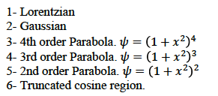
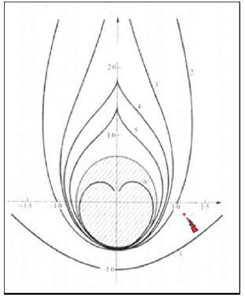
UNIVERSAL STABILITY DIAGRAMS
Beam with energy spread: Parabolic distribution

Slide 11
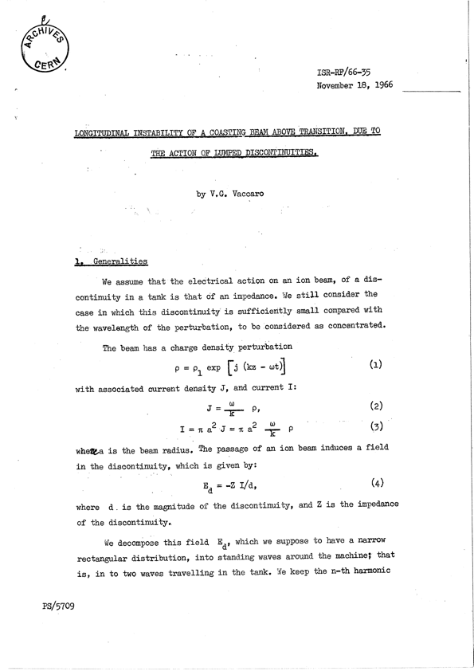
This fundamental paper was issued in closed distribution
restricted to ISR scientific staff only …
The small circle became a famous
stability criterion used worldwide …
Unfortunately not with his name…
with his words:

Slide 12
In November 1966, wrote the internal report "Longitudinal instability of a coasting beam above transition, due to the action of lumped discontinuities."
In February 1967, together with Andrew Sessler, he presented a more general treatment in the CERN Yellow Report titled "Longitudinal instabilities of azimuthally uniform beams in circular vacuum chambers of arbitrary electrical properties."
In 1969, together with Kurt Hubner and Alessandro Ruggiero, he extended the research to transverse instabilities in the article “Stability of the coherent transverse motion of a coasting beam for realistic distribution functions and any given coupling with its environment.”
In 1969, with Alessandro Ruggiero and Paolo Strolin, he published “Instabilities of an intense coasting beam in the presence of conducting plates, a theoretical Investigation,"
in 1970, he published "Dispersion relation and stability of coasting particle beams" with Kurt Hubner.

Slide 13
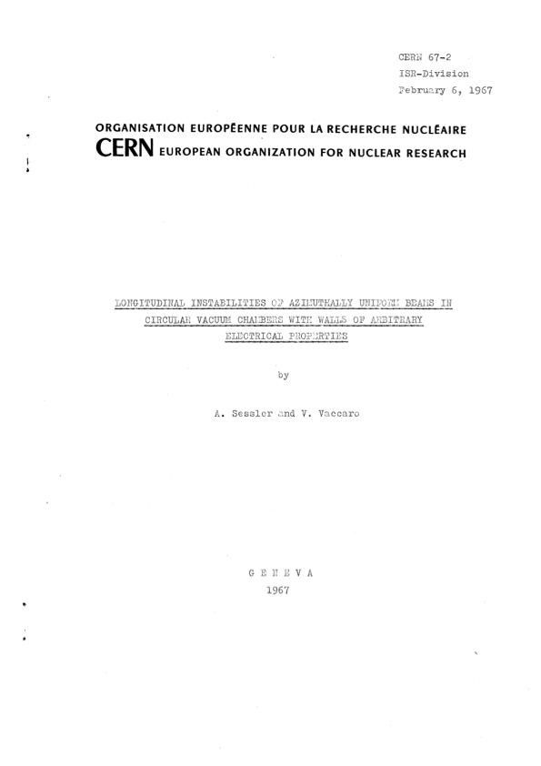
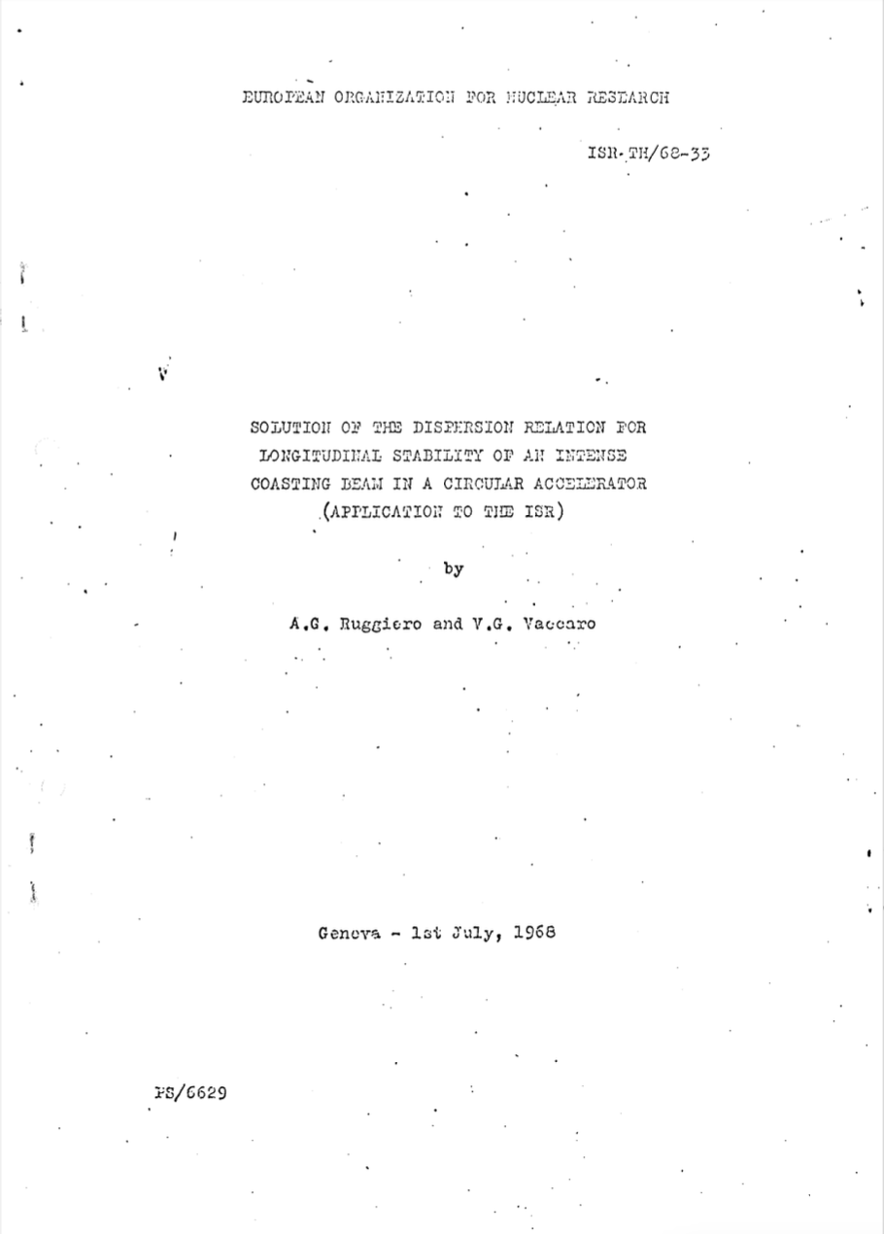

Slide 14
In a few years, with these works, Vittorio Vaccaro laid the foundations of a solid theory for the study of instabilities in an accelerator ring.
He showed how the universal stability curves can be obtained from the dispersion relation and that the instability thresholds depend on the machine coupling impedance.
Regarding these studies, Simon Van de Meer, Nobel Prize winner with Carlo Rubbia, stated: “The stream of this research, born at CERN and still lasting, gave and gives results that have been of great importance for the ISR project and for particle accelerator in general ”.
Indeed, these works were the beginning of many studies, which have taken place in the last fifty years; impedance and wake fields continue to be an important field of activity in theory, simulations, laboratory, and particle beam measurements.
Building a reliable impedance model for a machine is today the first step necessary to evaluate the performance limits of circular accelerators used as colliders or as sources of synchrotron radiation, as well as for linear accelerators.

Slide 15
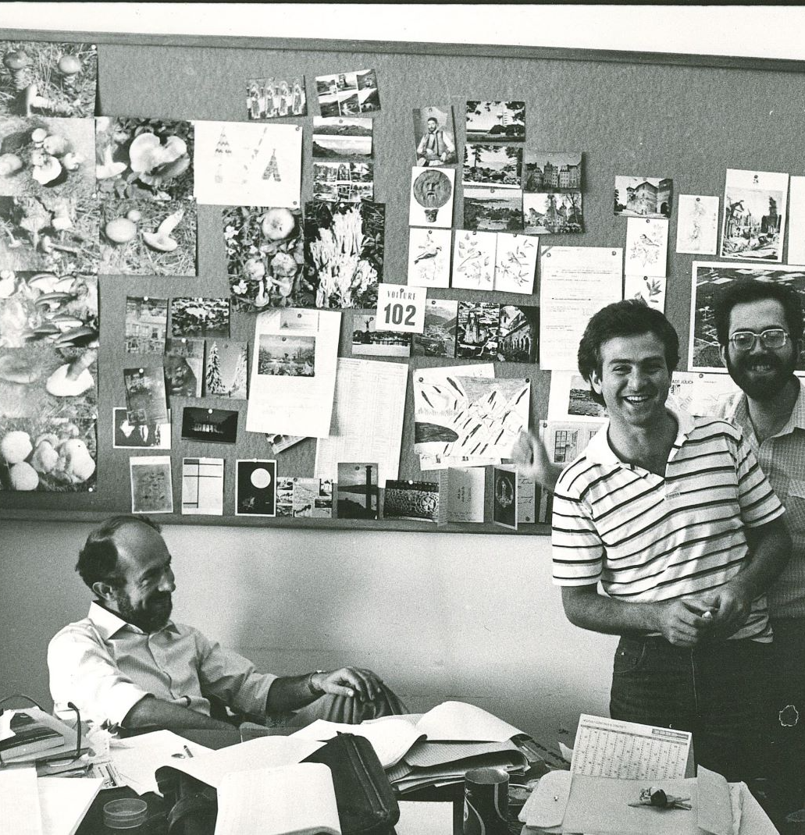
Vittorio was a free spirit, open to all new things and at the same time a profound connoisseur of history and traditions. He felt European, Italian, but above all Neapolitan. He loved his city, the Neapolitan culture, the profound humanity of the people, the richness of his language.
In each of his travels, in each personal contact, Vittorio brought a little of the Neapolitan culture, of which he was proud.
His motto was: The starry sky above me and the moral law within me
THANK YOU VITTORIO !!!
Courtesy of Luciana Vaccaro

