Slide 1
Neutron sources from the CN accelerator
Luca Bellan – INFN LNL

Slide 2
Outlines
CN accelerator
Neutron lines
  High dose bunker
  BELINA line
    TOF with Li target
  MUNES line
    PNRR: ANTHEM

Slide 3
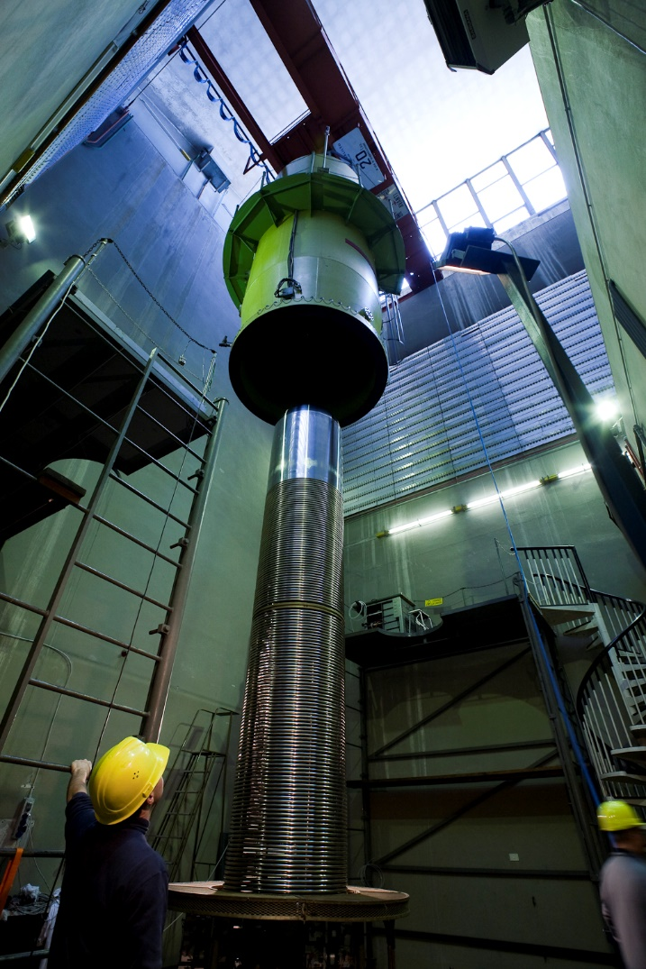
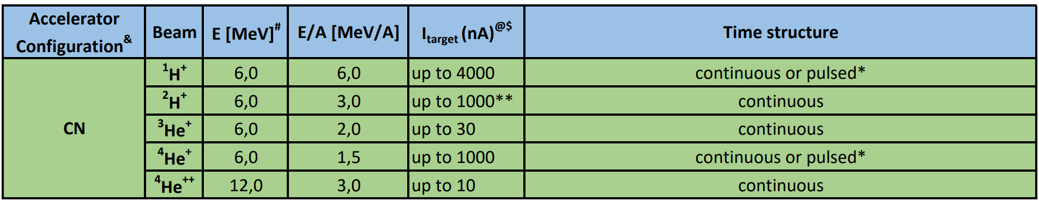
CN neutron experiments
Van der Graaf accelerator type. Light ions up to 5.5 MV terminal voltage.
Used for applied physics and nuclear physics experiment
Neutron irradiation experiments.
Variable frequency pulsing system is available
For questions about beams, mail to PACbeams@lnl.infn.it

Slide 4
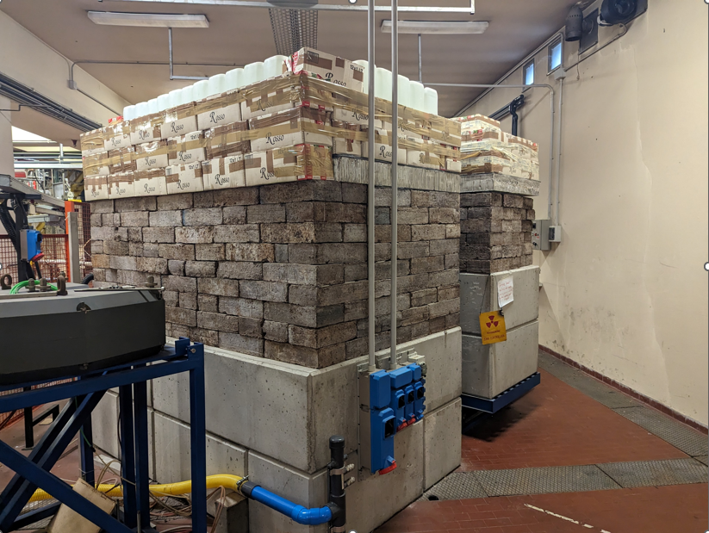
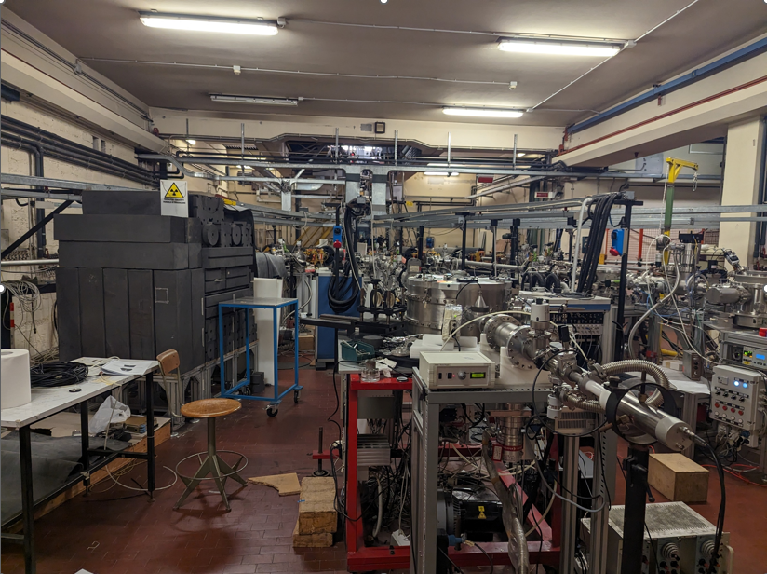
CN neutron lines
Several possible beam combination for neutron production:
D⁺, H⁺ with 2.0 to 5.5 MV onto different targets
15 deg line: MUNES line,
equipped with heavy-water graphite moderator -> thermal neutron source
Interaction point placed closer to the focusing quadrupoles for smaller beam spot
High dose bunker:
Heavy shielding for “high” current and longer neutron experiments
0 deg line: BELINA line
equipped for pulsed beam operation (variable Rep rate)
exchangeable targets/moderators

Slide 5
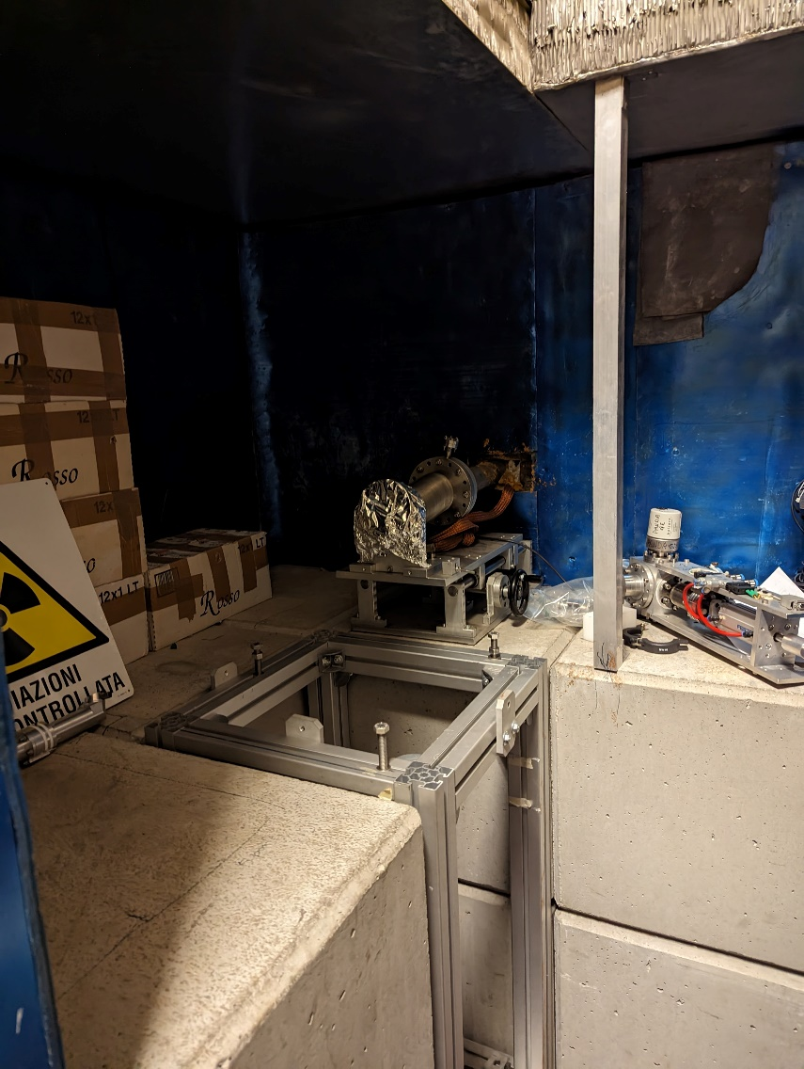
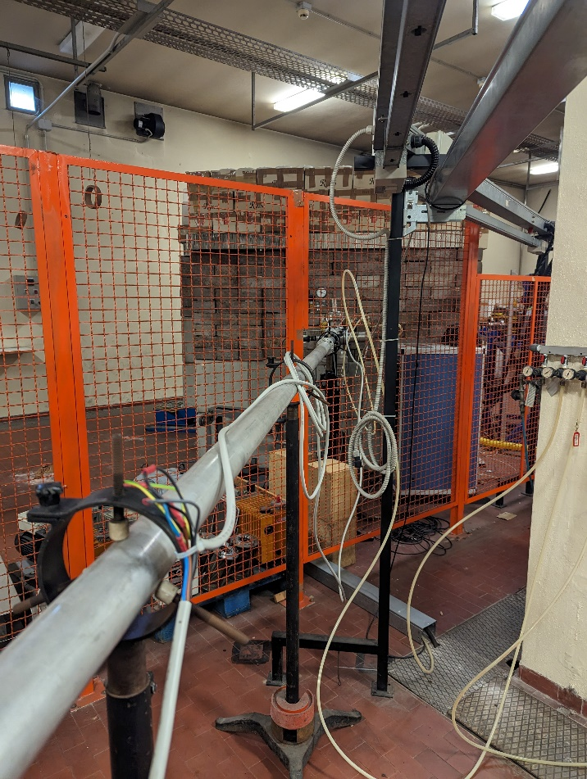
High dose bunker
Some misalignment problems of the line solved
Mainly used when long period of neutron production is required
Not so often used
90 cm
1 m
1 m

Slide 6
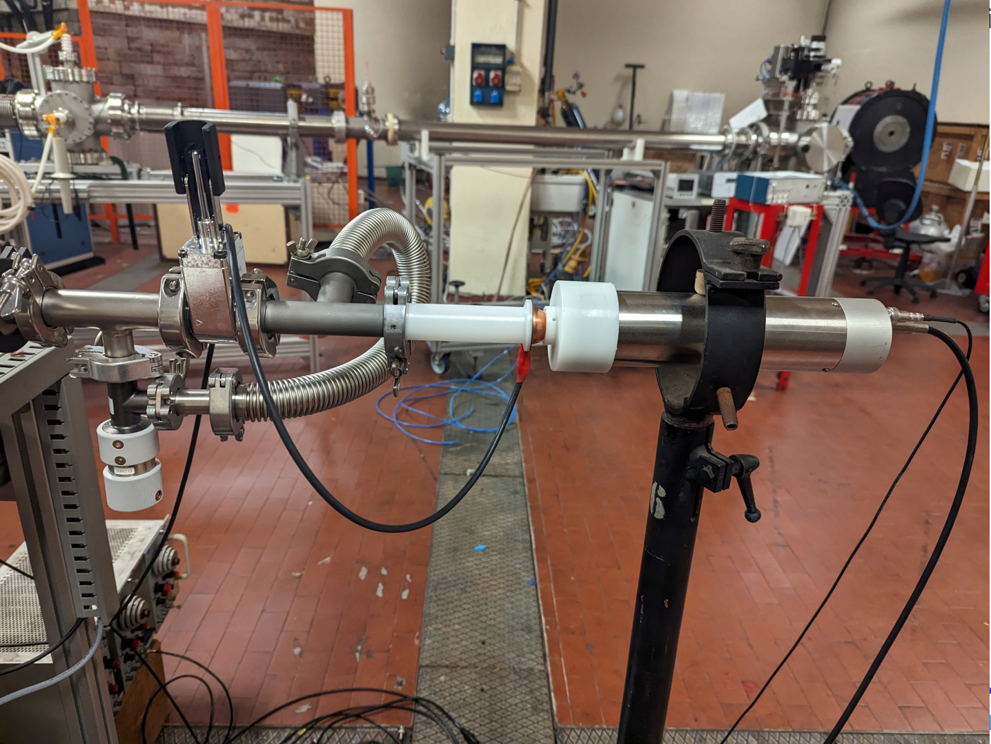
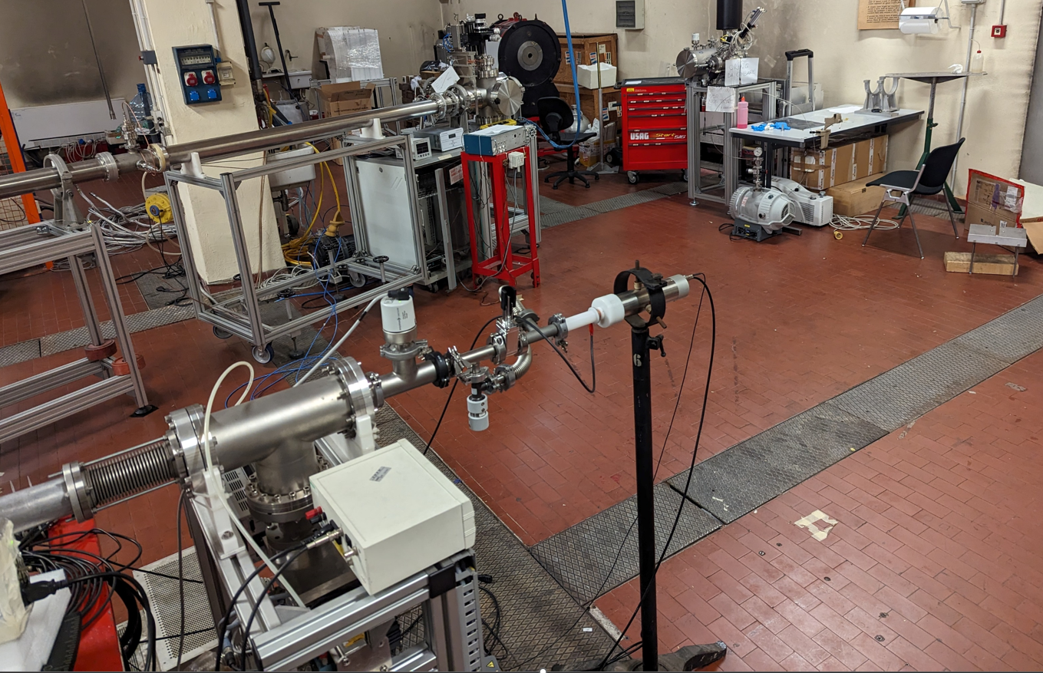
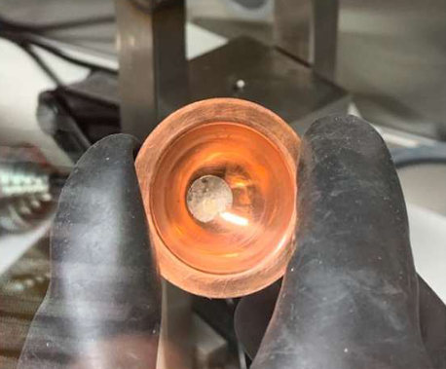
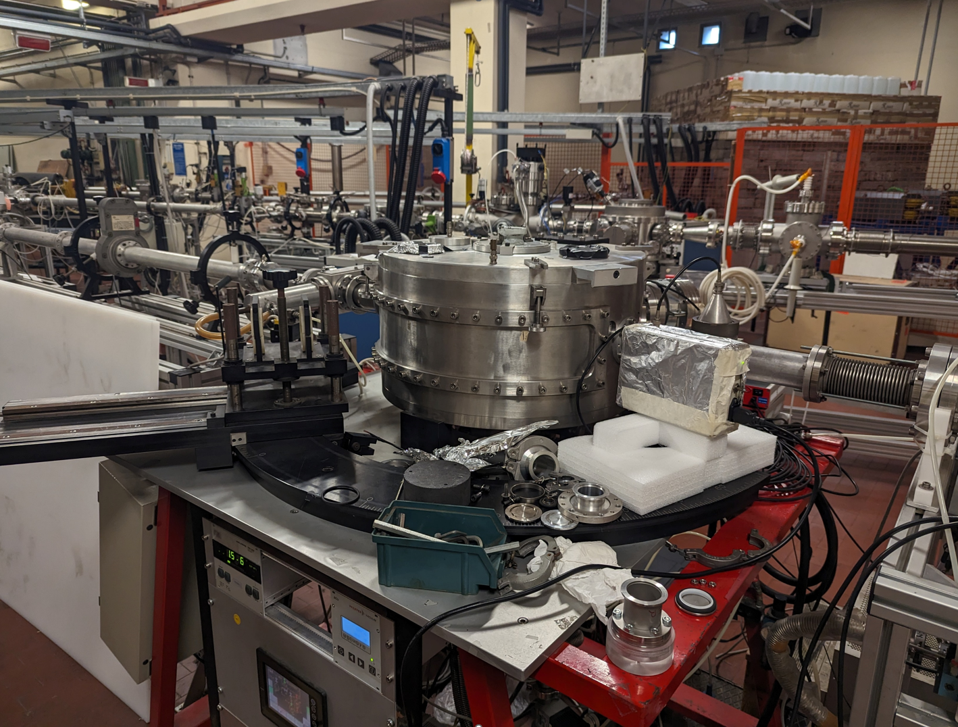
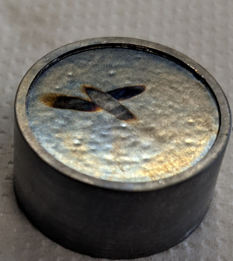
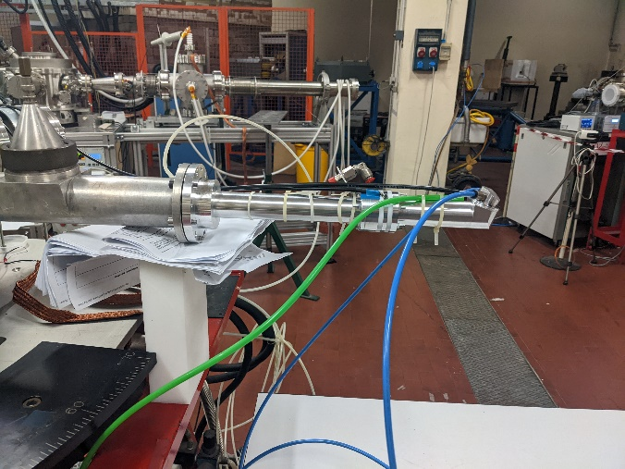
0 line: BELINA
0 Line: can be equipped with different targets and moderators:
  Li metal target, it is possible to reach (3.5 MeV protons, 9 μA) 2 × 10⁵ n cm⁻² s⁻¹ ( @ 20 cm), QMN spectra.
    Thick Li target up to hundreds microns thickness
  Be, we can reach a neutron flux (5 MeV protons, 5 μA) of 3.6×10⁶ n cm⁻² s⁻¹ ( @ 20 cm), peaked at 1.2 MeV, with maximum 3.2 MeV, broad spectrum energy (without moderator). Courtesy of Felix Pino
  Pulse system Rep rate from 3 MHz down to few Hertz (in step of 330 ns) and pulse width of 2 ns FWHM allows TOF experiments in a wide energy range
Low mass Metal-Li target (Cu backing 300 um)
> 1 m
Courtesy of P. Mastinu and E. Gonzalez
Air cooled Li target
Courtesy of P. Mastinu and E. Gonzalez
Be
55 cm
60 - 240 um
Target handler designed by accelerator division and built in collaboration with LNL workshop and technical division (M. Miglioranza)
Water-air cooled composite Be target

Slide 7
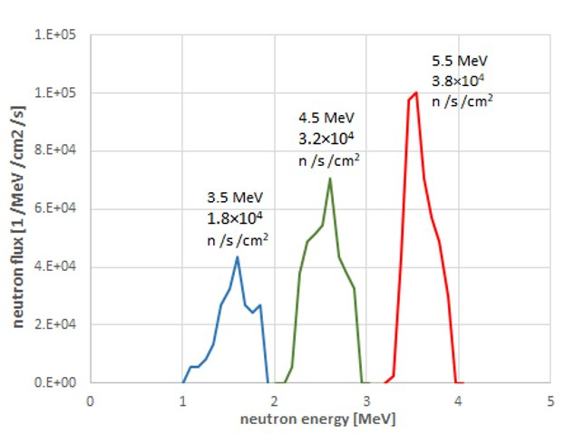
Litium target neutron spectra (coasting beam)
The 0° beam line of the old 5.5 MV CN can deliver protons on a thin (20-50 µm) lithium target to produce QMN neutron beams.
Courtesy of P. Mastinu and E. Gonzalez
3 uA protons
Semi-spherical metal lithium target
With the present radioprotection limits of the CN, the maximum current is 9 μA. At a proton energy of 5 MeV and at a distance of 20 cm, the simulated peak neutron energy is 3.5 MeV and integral flux under the peak is ∼2 × 10⁵ n cm⁻² s⁻¹ using 20 um thickness target.

Slide 8
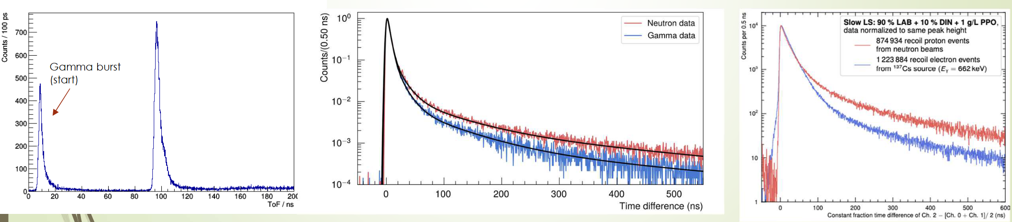
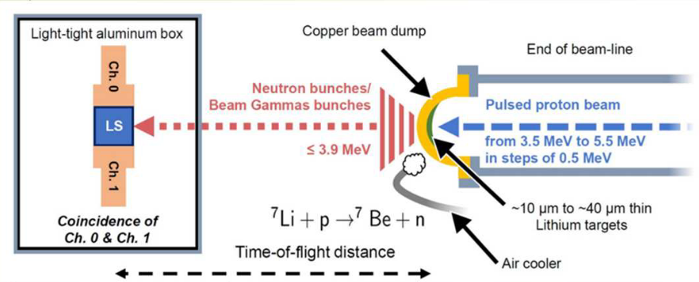
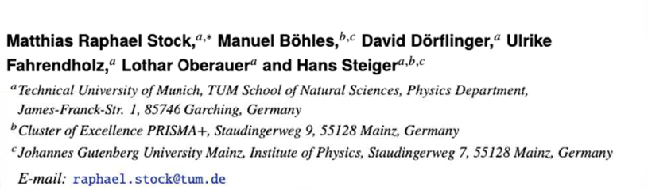
Neutrino detector characterization (courtesy of Hans Steiger)
The pulsing system in the BELINA 0 deg line allows TOF experiments, extremely important for the neutron spectra analysis over a wide range of neutron energies.
ToF Spectrum
PSD in JUNO
PSD in Slow Organic LS
Proton beam between 3.5 up to 5.5 MeV onto BELINA Litium target
Pulsed proton beam with pulse length of order of ns, (600 kHz beam pulse frequency).

Slide 9
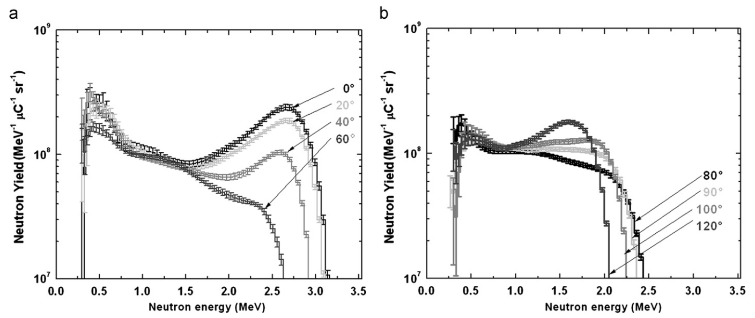
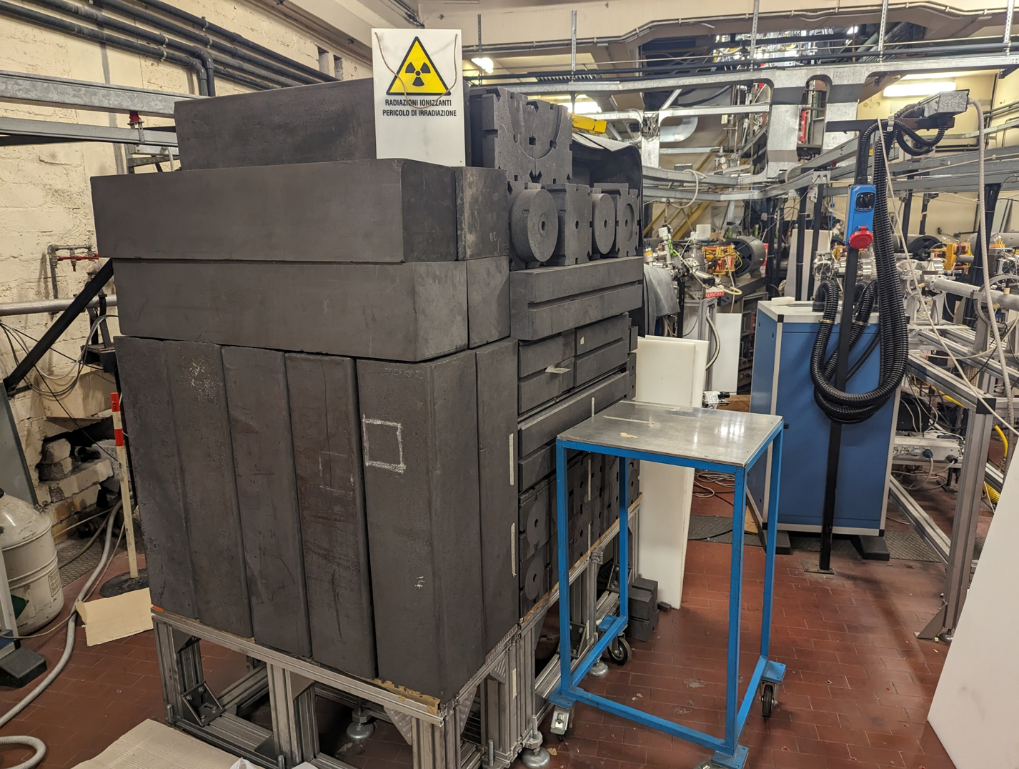
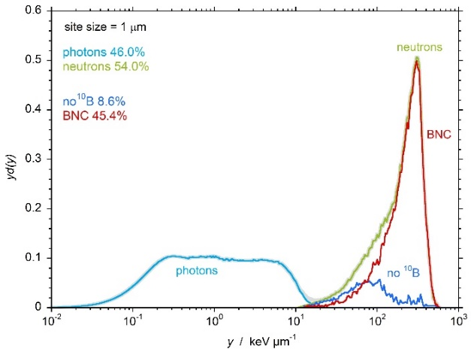
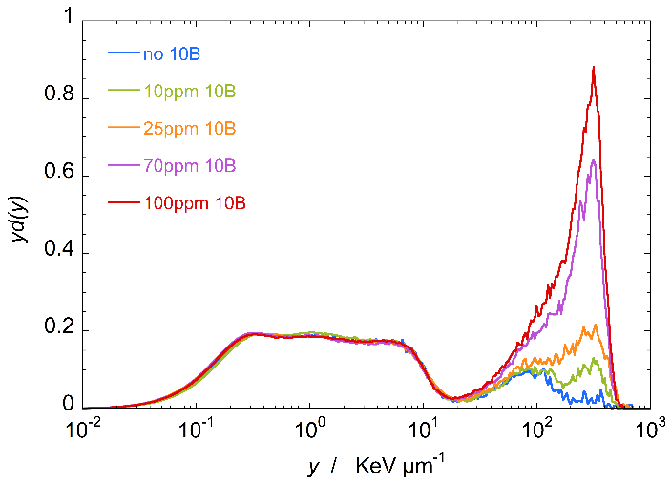
15 Line: MUNES Line
MUNES line: equipped with a graphite and heavy water thermal neutron moderator that generates a neutron flux of 4.5×10⁵ n s⁻¹cm⁻², 96% thermal fraction [0] (3 uA, 5 MeV) and gammas.
  Used for testing the robustness of composite Be targets with respect to irradiation driven phenomena, such as blistering.
  1.9 kW/cm² power density reachable (collimator beam spot diameter of 1 mm).
Be without moderator
[1]
Bi window
1.4 m
1 m
[2]
Design and built by J. Esposito, E. Fagotti and P. Colautti
[0] Ceballos et al., 2011.” Towards the final BSA modeling for the accelerator-driven BNCT facility at INFN LNL.” Appl. Radiat. Isot. 69, 1660.
From thermal BSA
[1] Agosteo et al, 2011, “Characterization of the energy distribution of neutrons generated by 5 MeV protons on a thick beryllium target at different emission angles.”, Appl. Radiat. Isot. 69, 1664
[2] Selva et al, 2022, “Microdosimetry of an accelerator based thermal neutron field for Boron Neutron Capture Therapy” Appl. Radiat. Isot. 182, 110144

Slide 10

PNRR: ANTHEM - (courtesy of A. Pisent)
Construction of a BNCT facility at Caserata, which will increase of 4 order of magnitude neutron flux w.r. CN neutron source, with an epithermal spectra via the usage of a high intensity linear accelerator.
  Usage of a well establish accelerator design for high intensity proton beam.
  Usage of TRASCO high intensity proton RFQ and TRIPS high intensity ion source
  Development of high power (150 kW) Be target (1000 h lifetime expected), high intensity MEBT proton lines
Φ=10¹⁴ n/s (at neutron converter)
CN
Prototype Be neutron converter
5 MeV 3 uA
Prototype BSA thermal/epithermal
Low current lines
15 W
Final Be neutron converter
IS
5 MeV 30 mA
Epithermal BSA
RFQ
High current lines
150 kW

Slide 11
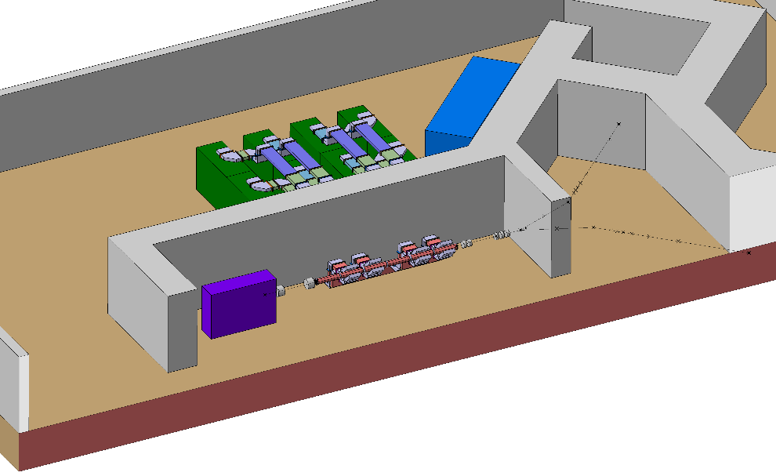
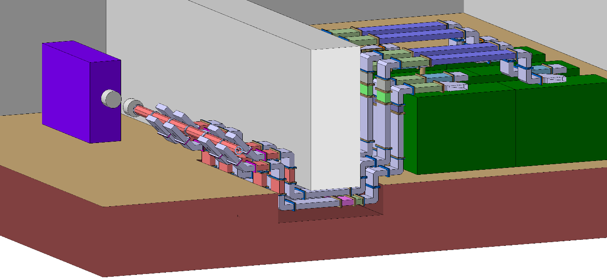
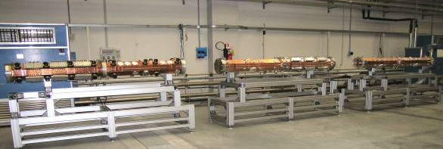
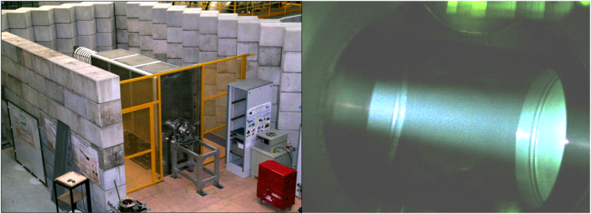
PNRR: ANTHEM
High intensity ion source
High intensity RFQ

Slide 12
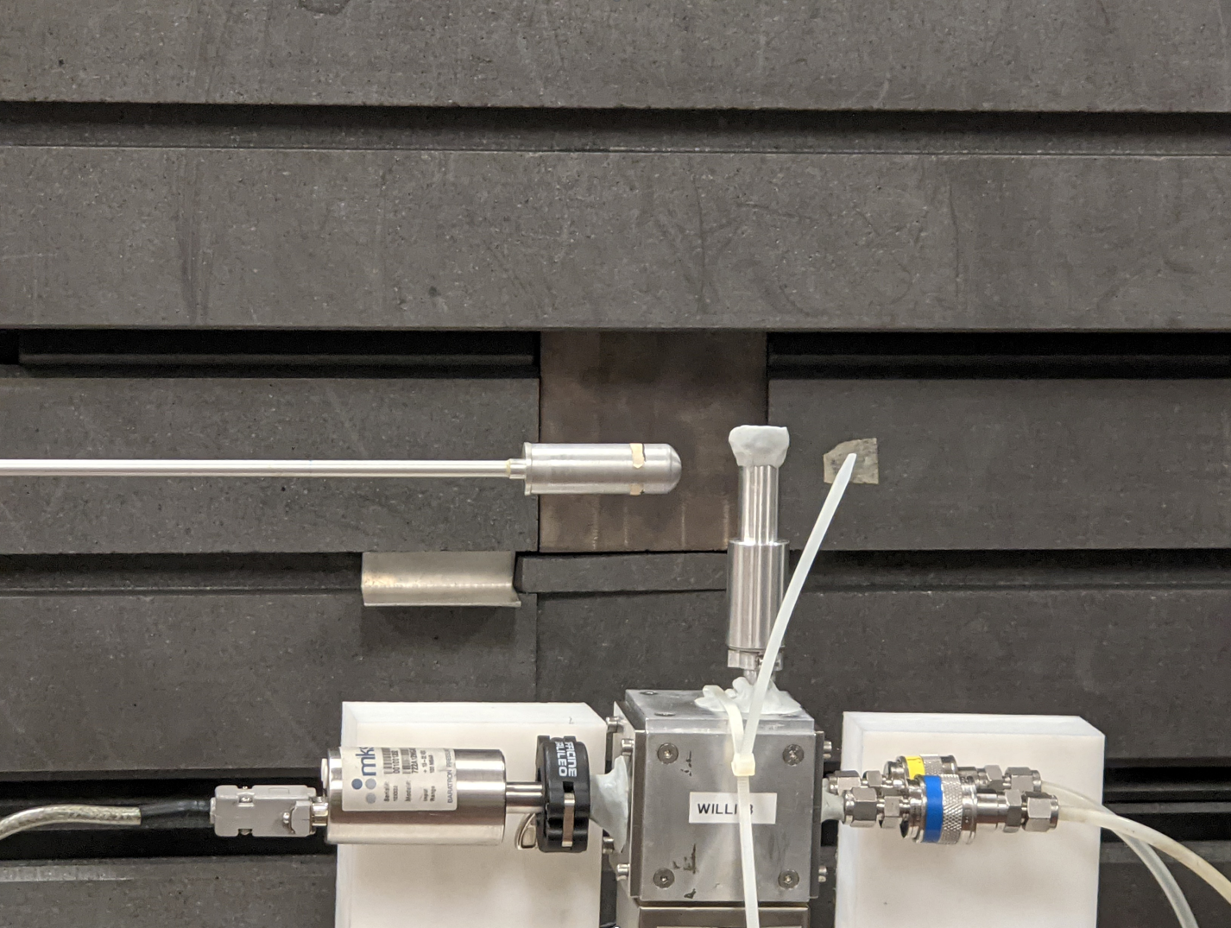
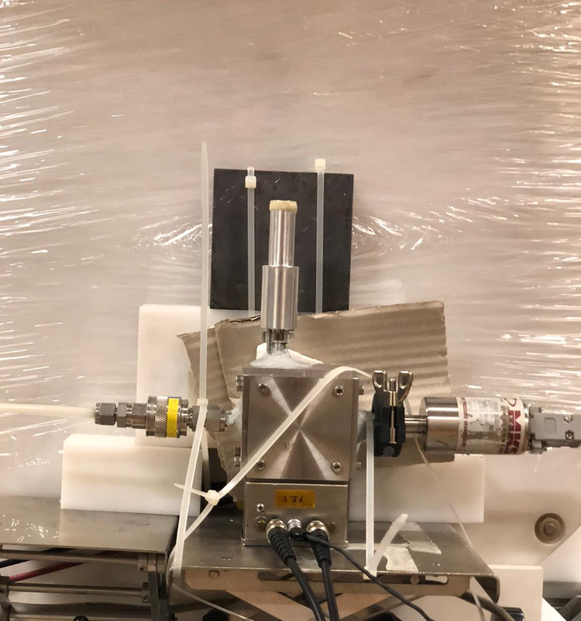
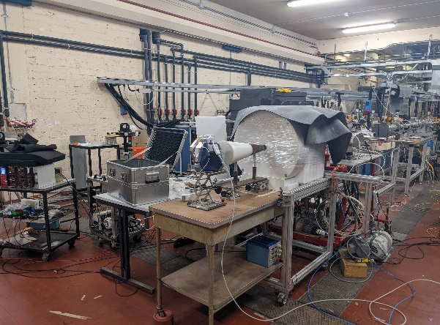
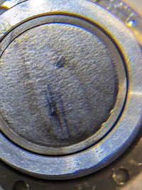
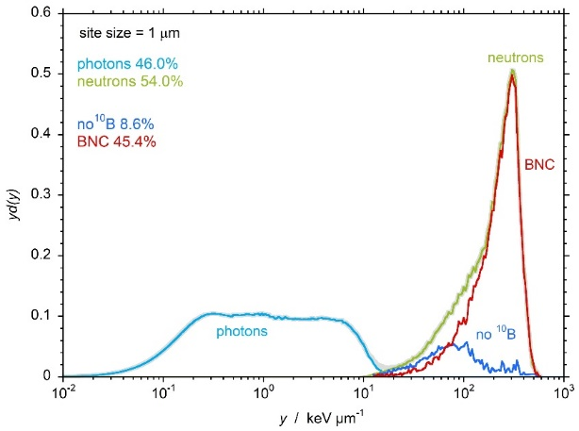
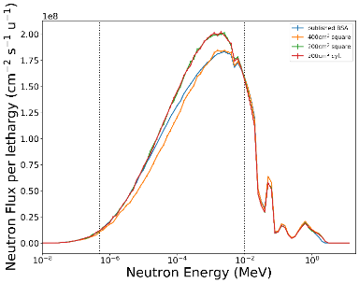
PNRR: ANTHEM
Activities at CN accelerator are (BELINA and MUNES line) essential in order to study the final design of the neutron converter + BSA.
INFN-PAVIA epithermal BSA prototype
Courtesy of Gabriele Sciacca
Courtesy of Anna Selva
Courtesy of Ian Postuma
High power target.
Microdosimetry dose
BSA design

Slide 13
Acknowledgment
Thank you for your attention
Pierfrancesco Mastinu, Elisabeth Gonzalez, Jeff Wyss, Hand Steiger, Anna Selva, Andrea Pisent, Enrico Fagotti, Felix Pino, Valeria Conte, Luca Maran

