Slide 1
DETECTOR DEVELOPMENTS AND N3G
2023 LNL User Community Meeting – CN/AN Session
C. Carraro* ¹, S. Bertoldo ^{1,2,3,4}, W. Raniero¹, G. Maggioni^{1,2}, S. Carturan^{1,2}, F. Sgarbossa^{1,2} , D. De Salvador^{1,2}, D.R. Napoli¹, E. Napolitani^{1,2}.
* email: chiara.carraro@lnl.infn.it
INFN-Laboratori Nazionali di Legnaro, Legnaro, Italy
University of Padova, Padova, Italy
CSIC-Istituto de Fisica Corpuscolar, Valencia, Spain
Universitat de Valencia, Valencia, Spain
Legnaro, 16- 17 Nov 2023
Notes:
Good morning, I’m Chiara Carraro I will talk about detectors developments and the n3g project.

Slide 2
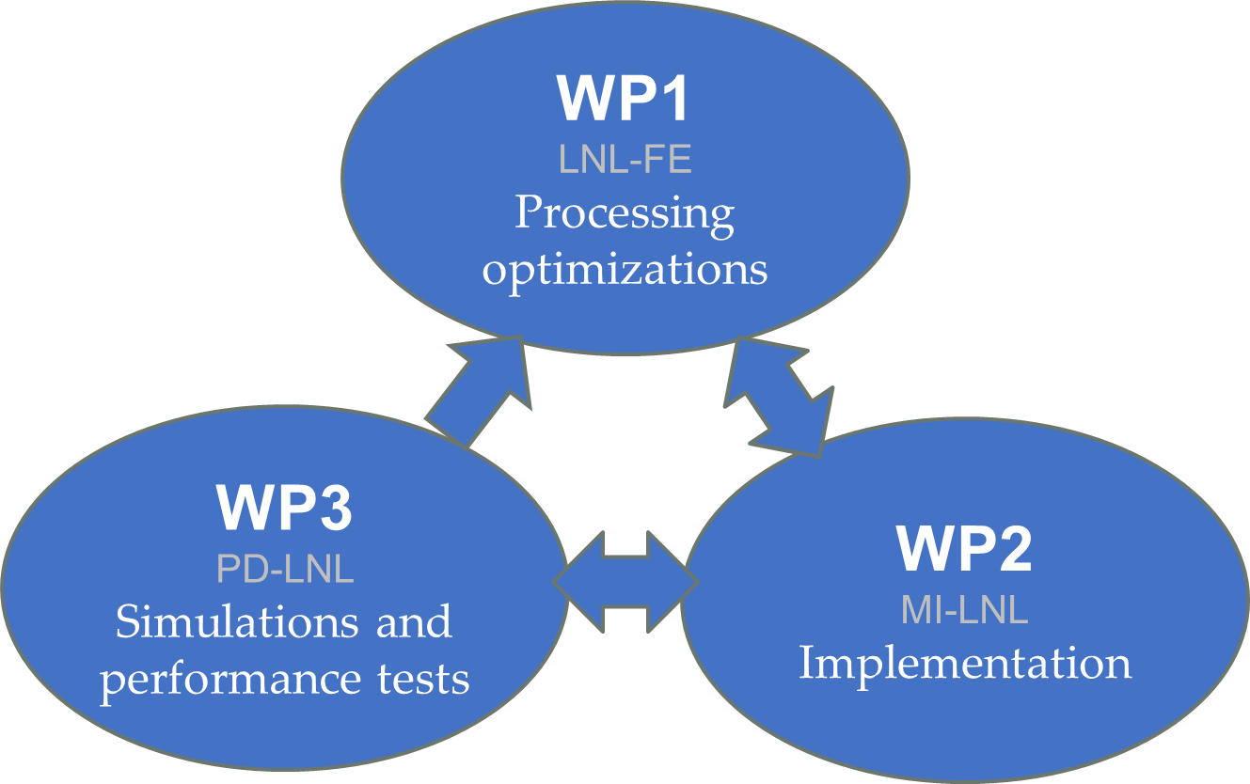
The project
N3G: Next Generation Gamma Germanium Detectors
Proof of concept of segmented HPGe coaxial detectors with thin and stable PLM diffused contacts
Legnaro, 16- 17 Nov 2023
Notes:
N3g stands for ….
The aim of the project is to produce prototypes of segmented high purity germanium gamma ray detectors with thin and stable contacts fabricated with the plm technology

Slide 3
Introduction
p⁺(B) [V+]
n-HPGe
Boron junctions are thin, thermally stable and easily segmentable on n-HPGe.
Lithium junctions are thick and thermally unstable.
n⁺(???) [GND]
n⁺(Li) [GND]
E
Thin and thermally stable n-type dopants (Pulsed Laser Melting).
e
h
p-HPGe with thin n+ junction collecting electrons.
Expansion of these techniques to p+ dopants.
Passivation
Legnaro, 16- 17 Nov 2023
Notes:
Germanium detectors are P-I-N diodes with a very large intrinsic region: common devices are hyperpure n-type cilyndrical ingots with less than ten to the tenth atoms of impurity par cube centimeter.
The external p junction is Boron implanted and inner contact is located in a coaxial hole and it consists of a thick Lithium doping.
Once the device is reversely polarized, the depletion field increases until all the volume depletes: when a photon is then absorbed, holes are collected on the Boron and electrons on Lithium.
Thick lithium junctions are a big dead region and they are thermally unstable. On the other hand Boron junctions are thin and stable, but they suffer from charge loss due to hole traps in the bulk.
So we studied the application of the Pulsed Laser Melting Technique to develop thin and stable n+ junctions giving access to detectors with different geometries or polarity. We are also extending the same application to p- dopants.

Slide 4
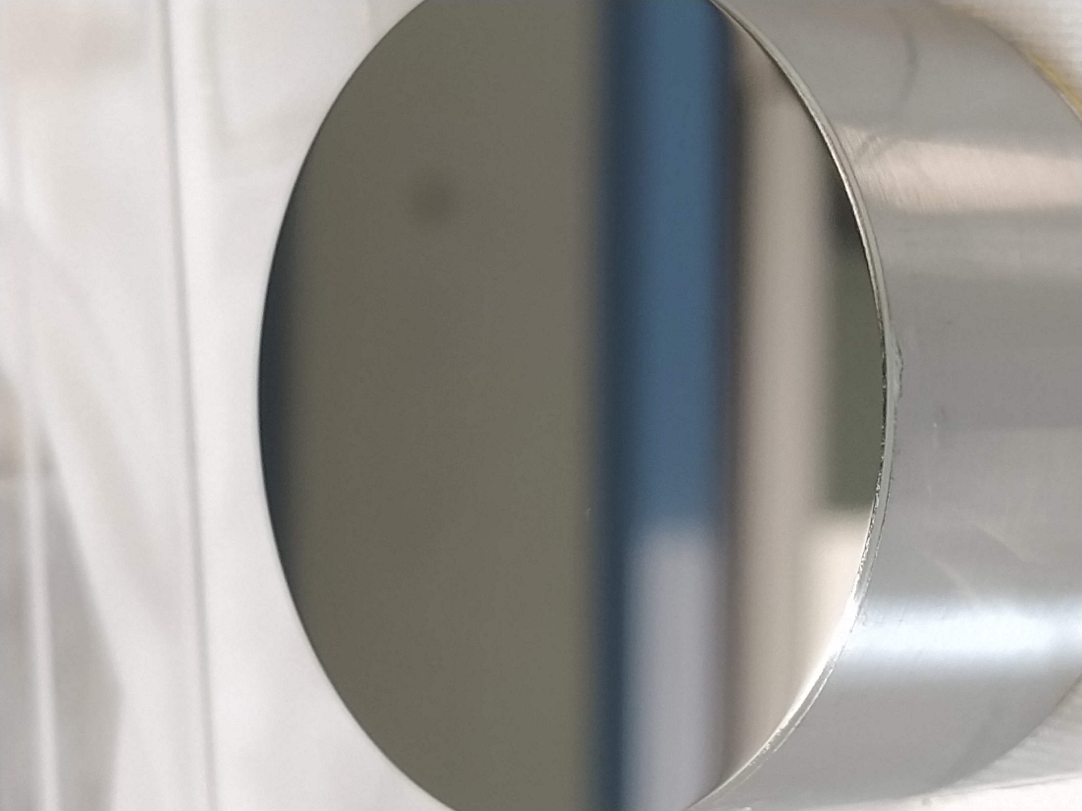
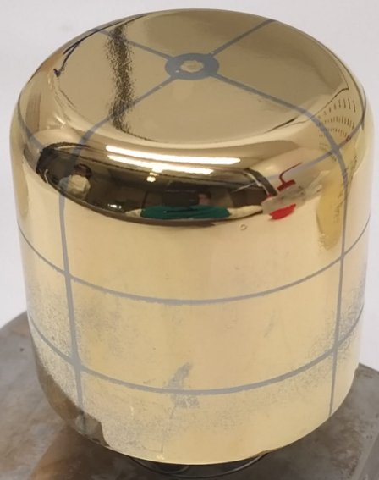
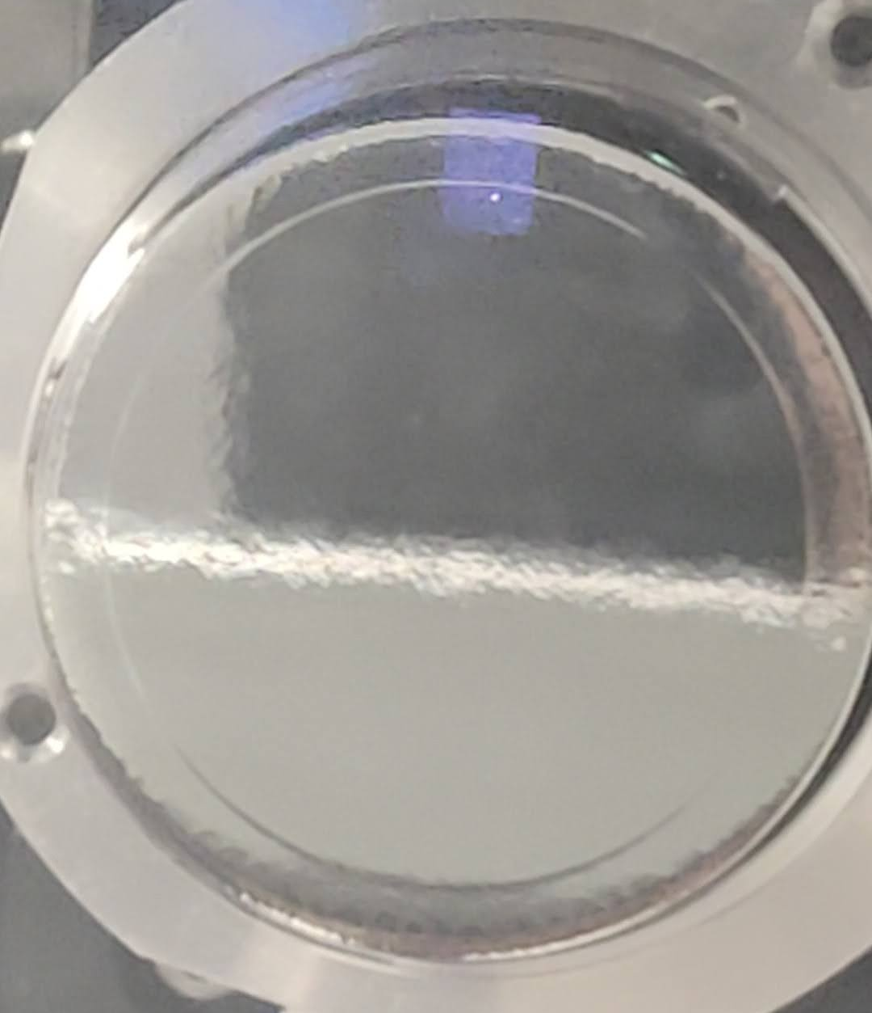
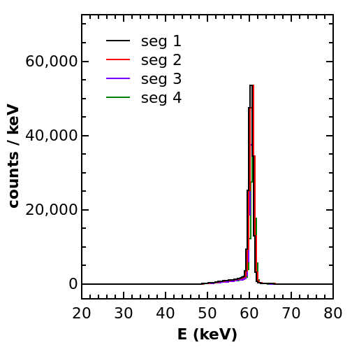
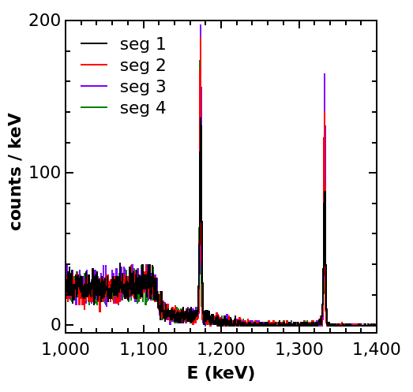
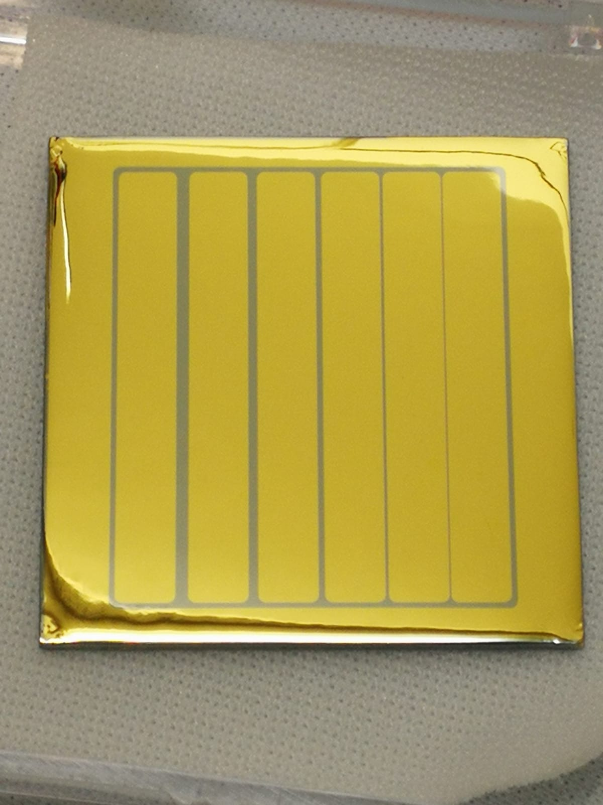
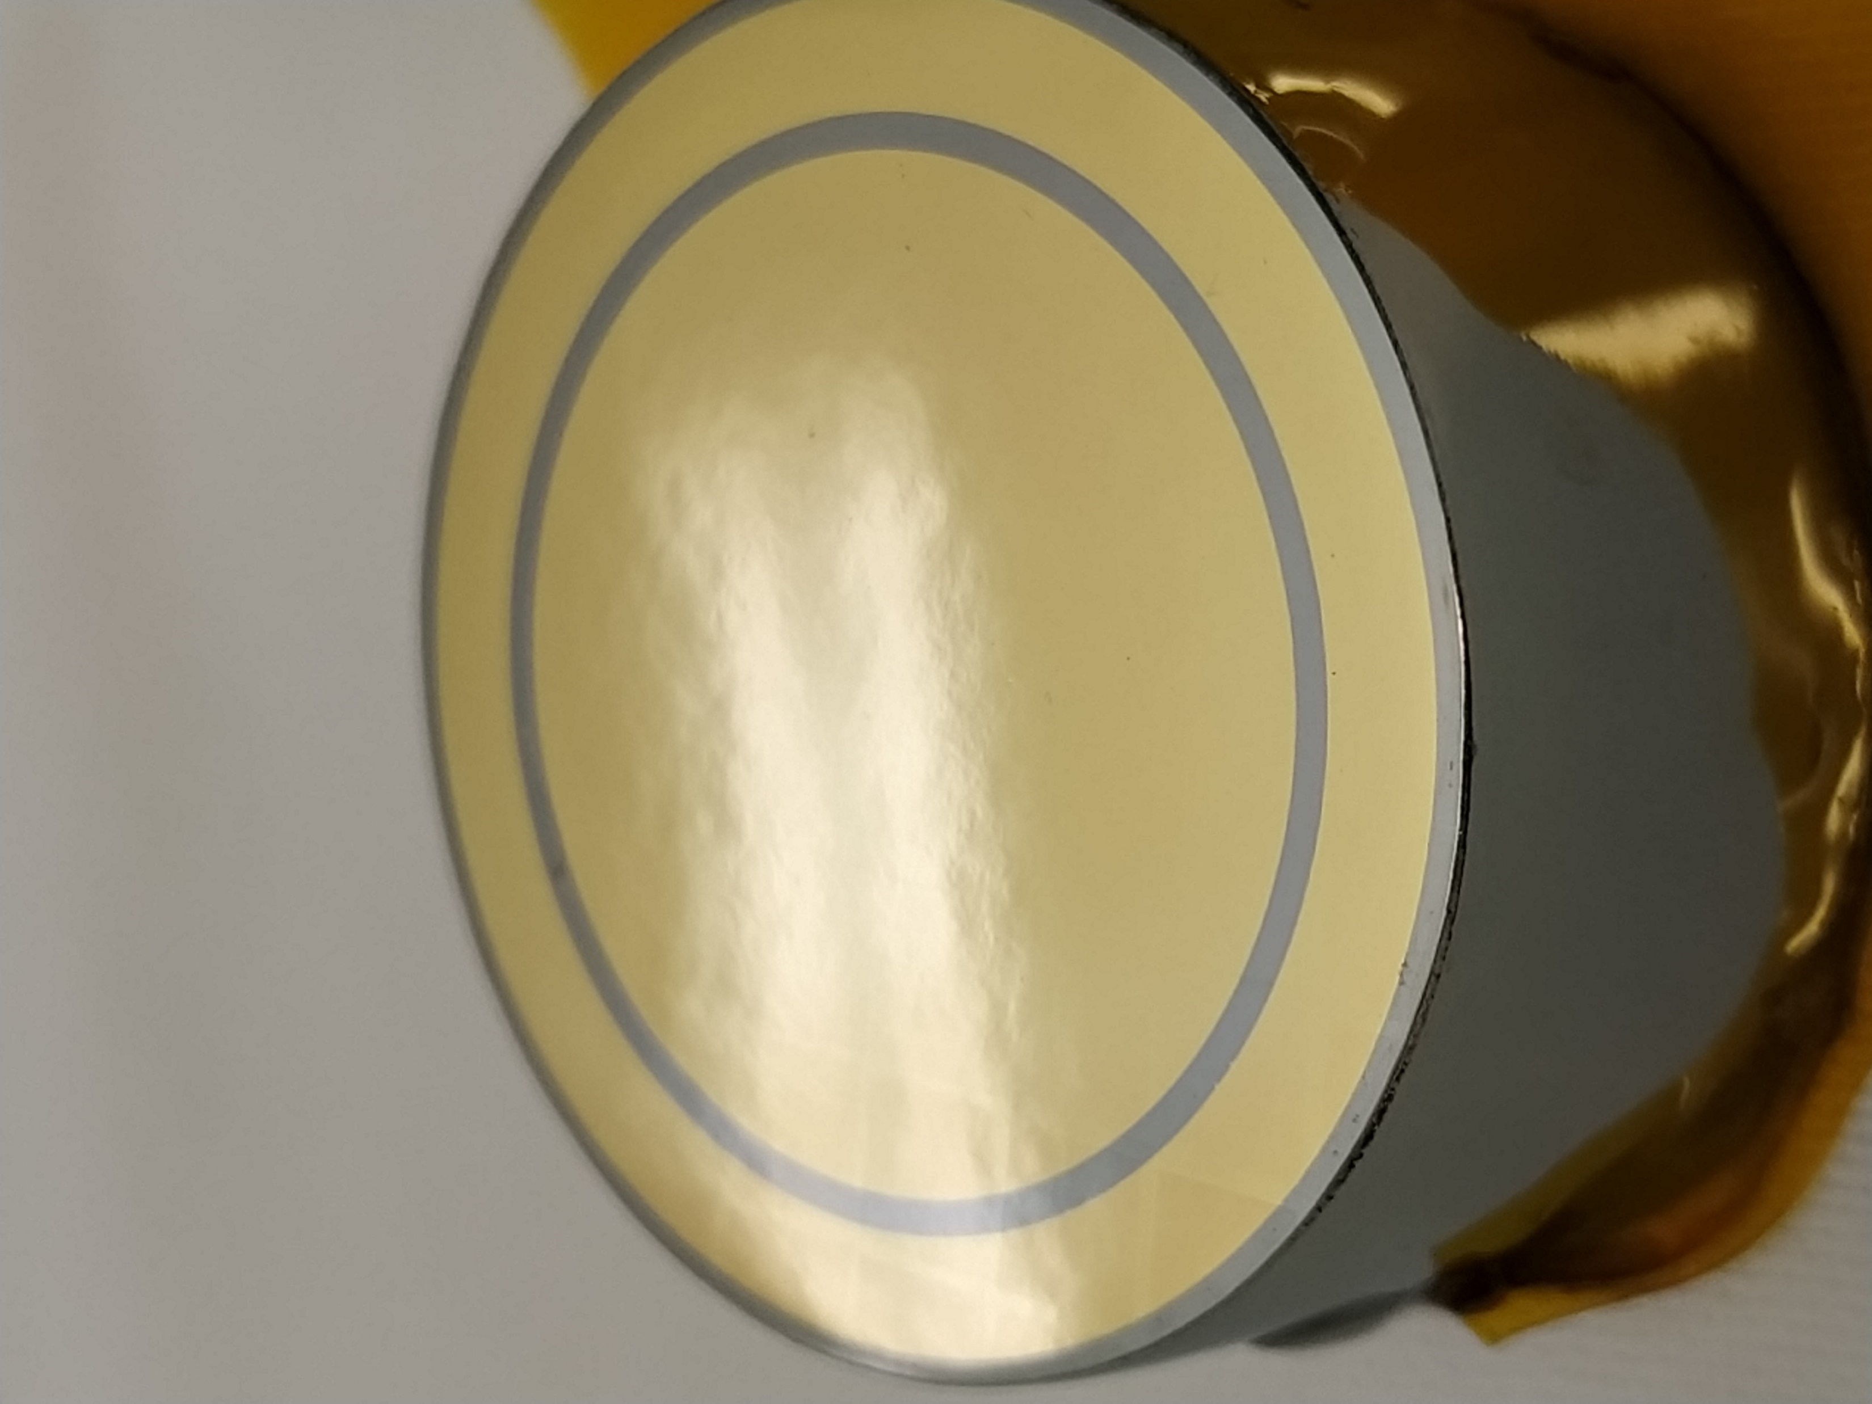
Index
Process overview
1st step: crystal polishing
2nd step: dopant deposition
3rd step: Pulsed Laser Melting
4th step: lithography
5th step: passivation
Planar detectors
CN irradiation test
Coaxial detectors
Legnaro, 16- 17 Nov 2023
Notes:
I will start with a brief process overview reviewing the main fabrication steps necessary for the production of a gamma ray detector. I will then hint some results we obtained on thin and thick planar detectors, and the promising result of the irradiation test carried out to evaluate the robustness of the detector. I’ll conclude with a brief application to coaxial detectors.

Slide 5
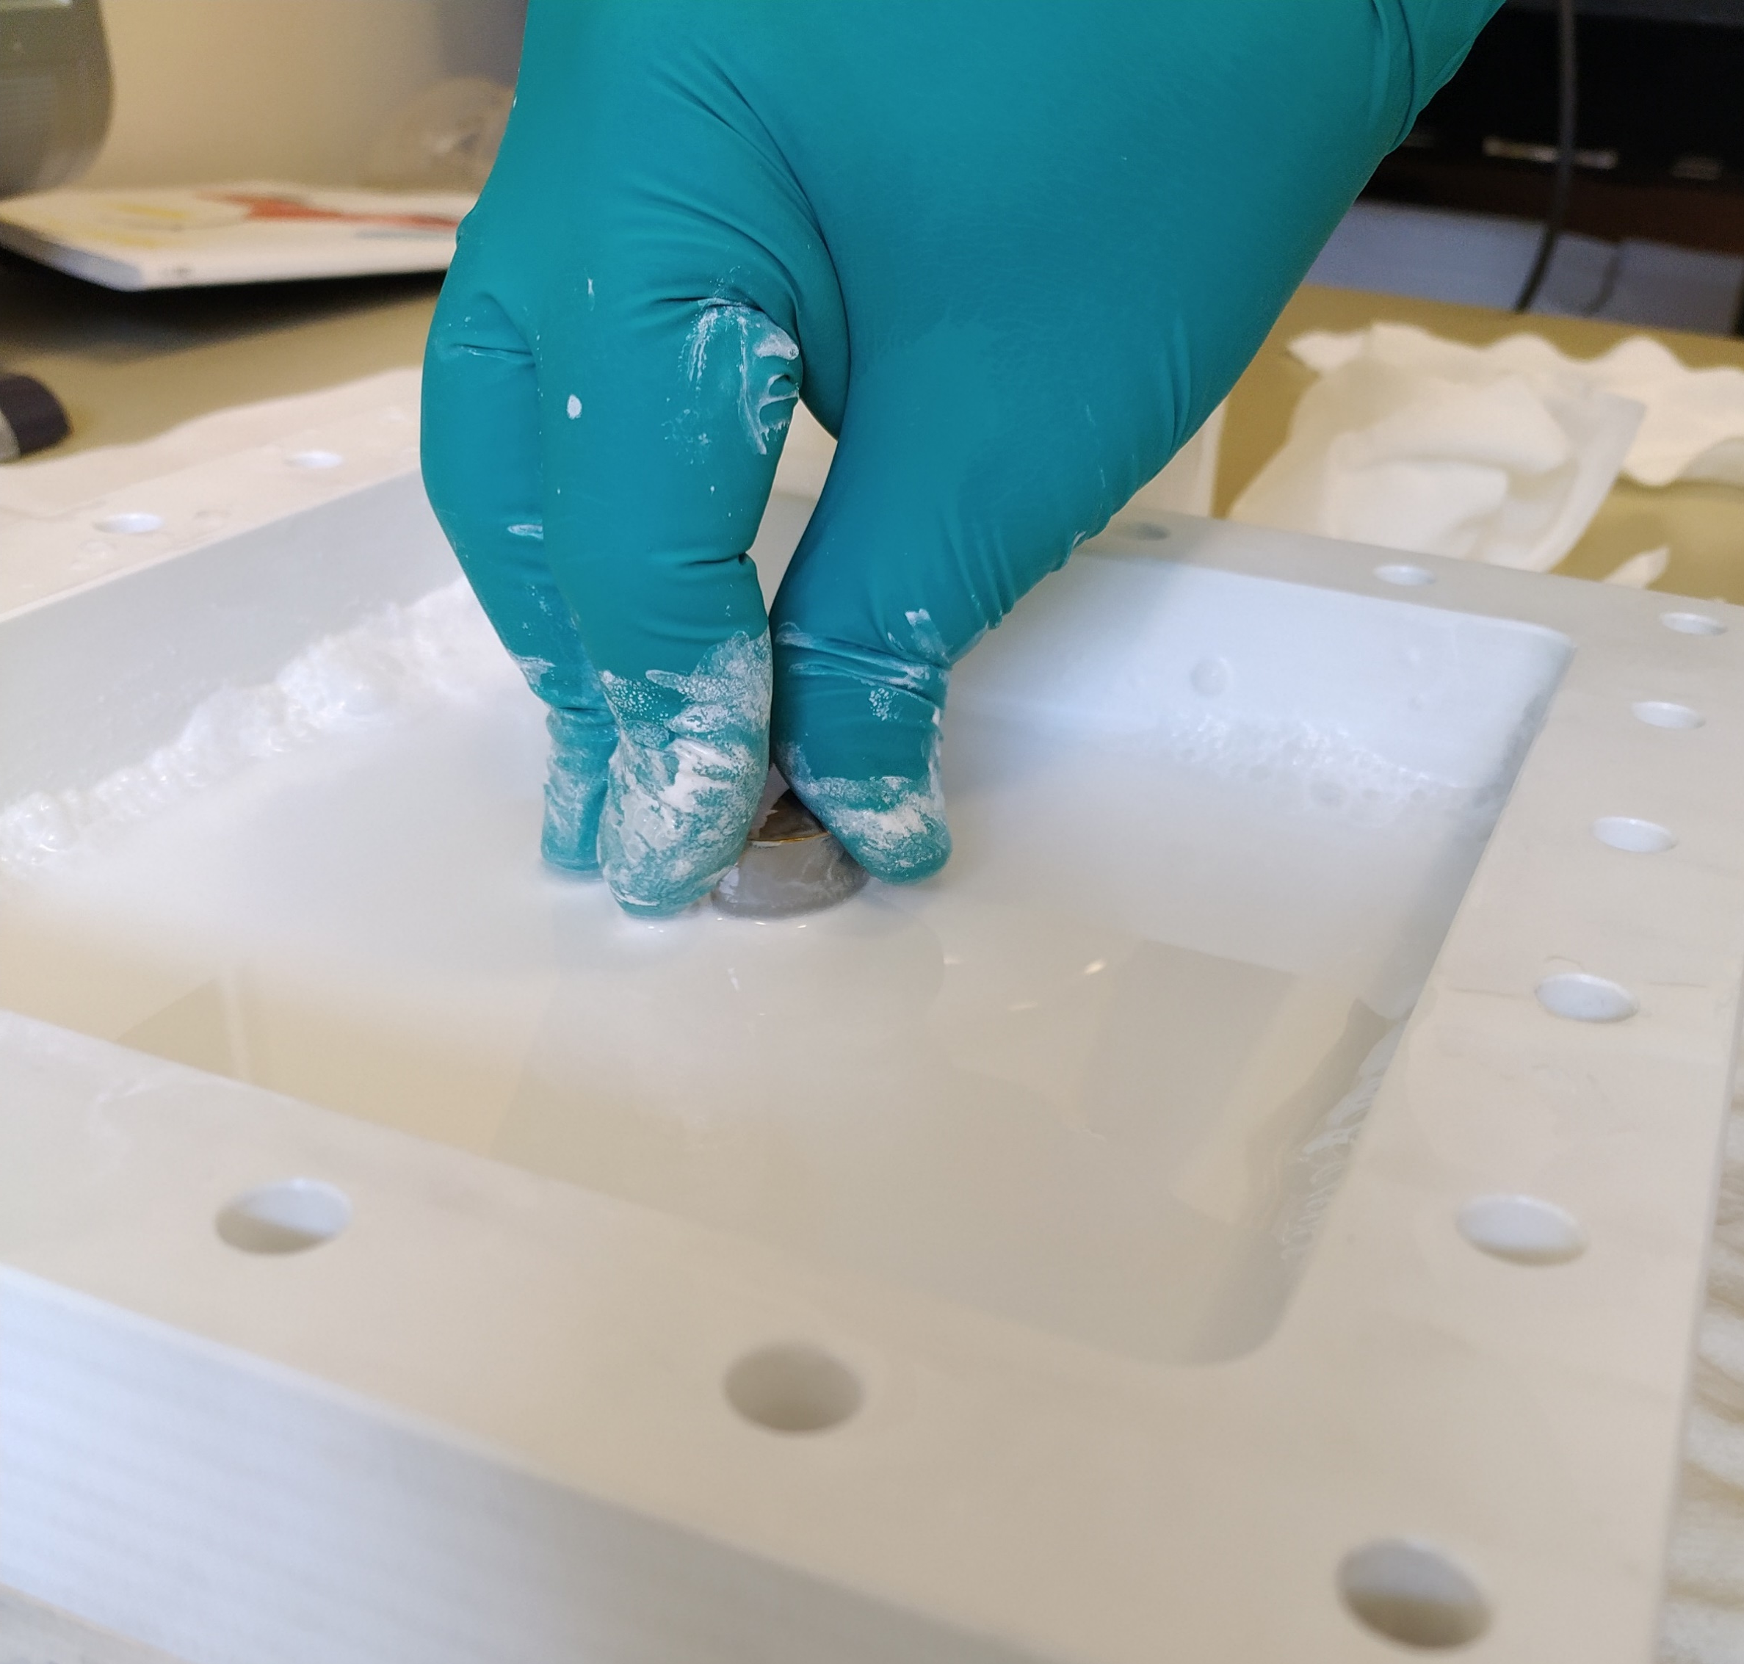
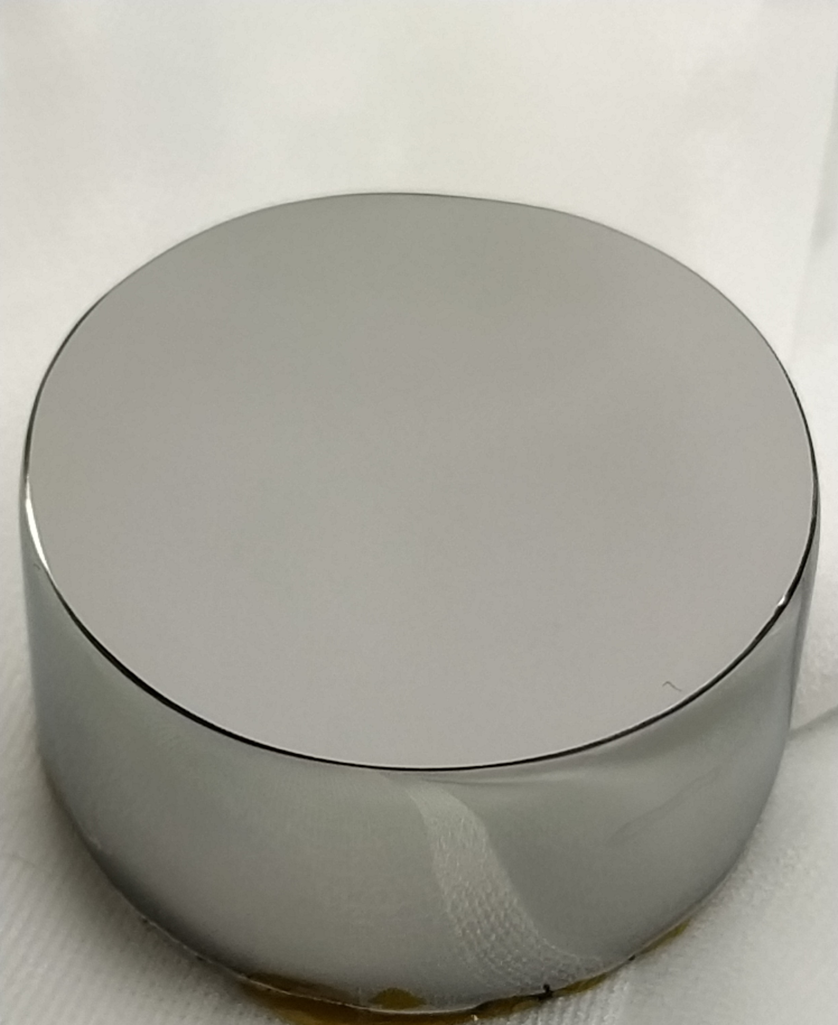
1st step: Crystal Polishing
Polished HPGe surface
Sawing damage removal via alumina grinding and final polishing via wet etching or chemical-mechanical polishing
Substep 1:
Mechanical grinding
Substep 2:
Chemical polishing
Rotating disc, H₂O₂ 1%
pH 12 with KOH
3 µm Al₂O₃ slurry
HPGe
Legnaro, 16- 17 Nov 2023
Notes:
We start the full process with a crystal polishing phase, necessary to remove sawing damages from the original crystal. The final surface is mirror like with minimum roughness.

Slide 6
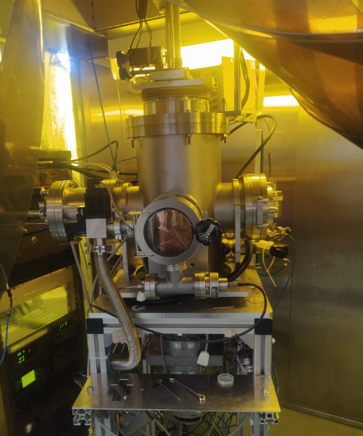
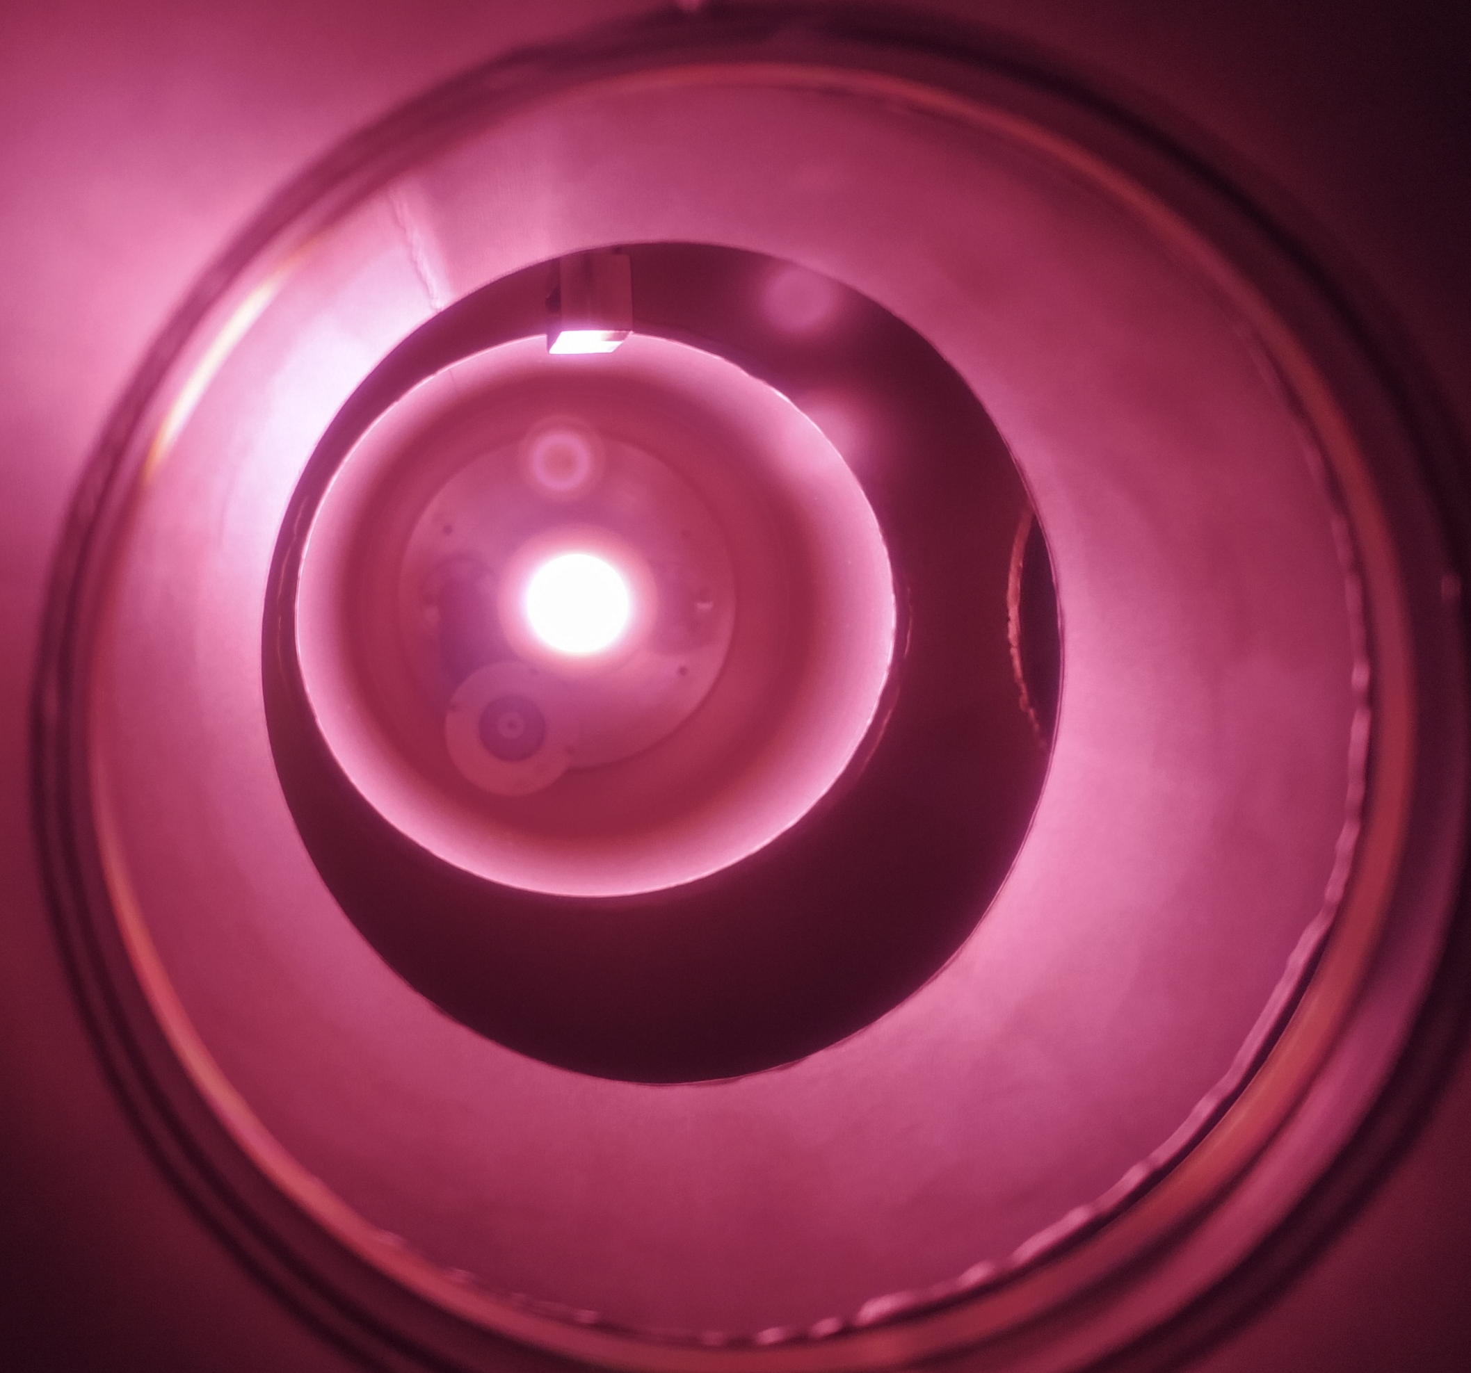
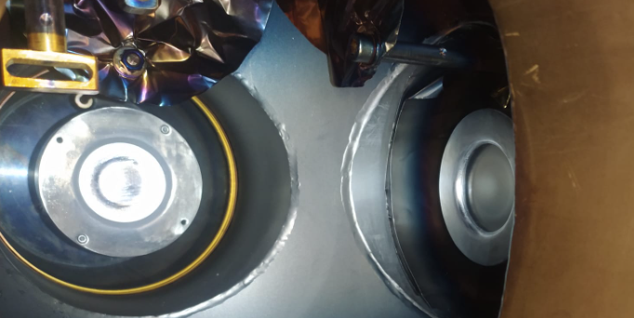
2nd step: Dopant Deposition
Dopant target
Polished HPGe surface
Sawing damage removal via alumina grinding and final polishing via wet etching or chemical-mechanical polishing
Dopant sputtering deposition
Few nm deposition of n-dopant or p-dopant in Ar plasma with ultrapure targets in vacuum (10⁻⁷ mbar)
Overpressured softbox with HEPA filters: one infinite rotational axis, two linear axes, 90° joint for sample tilting.
Sb
HPGe
Al
Ge
Legnaro, 16- 17 Nov 2023
Notes:
We then deposit a thin metallic layer of dopants atoms through magnetron sputtering. The sputtering chamber is located in an overpressured softbox and equipped with rotational and linear axis.

Slide 7
3rd step: Pulsed Laser Melting
UV pulsed laser source
Polished HPGe surface
Sawing damage removal via alumina grinding and final polishing via wet etching or chemical-mechanical polishing
Dopant sputtering deposition
Few nm deposition of n-dopant or p-dopant in Ar plasma with ultrapure targets in vacuum (10⁻⁷ mbar)
pn junction
UV pulsed laser exposure
22 ns pulses at 248 nm wavelength with 500 mj/cm2 energy density to melt 150 nm of HPGe
Melt depth
HPGe
Crystal regrowth
100 ns resolidification of germanium with dopant atoms in the crystalline structure
Legnaro, 16- 17 Nov 2023
Notes:
The sample is then irradiated with one or multiple laser impulses to obtain the melt of a thin superficial layer. The layer then regrows incorporating the dopant and obtaining a final thin doped junction with thickness of few hundred nm.

Slide 8
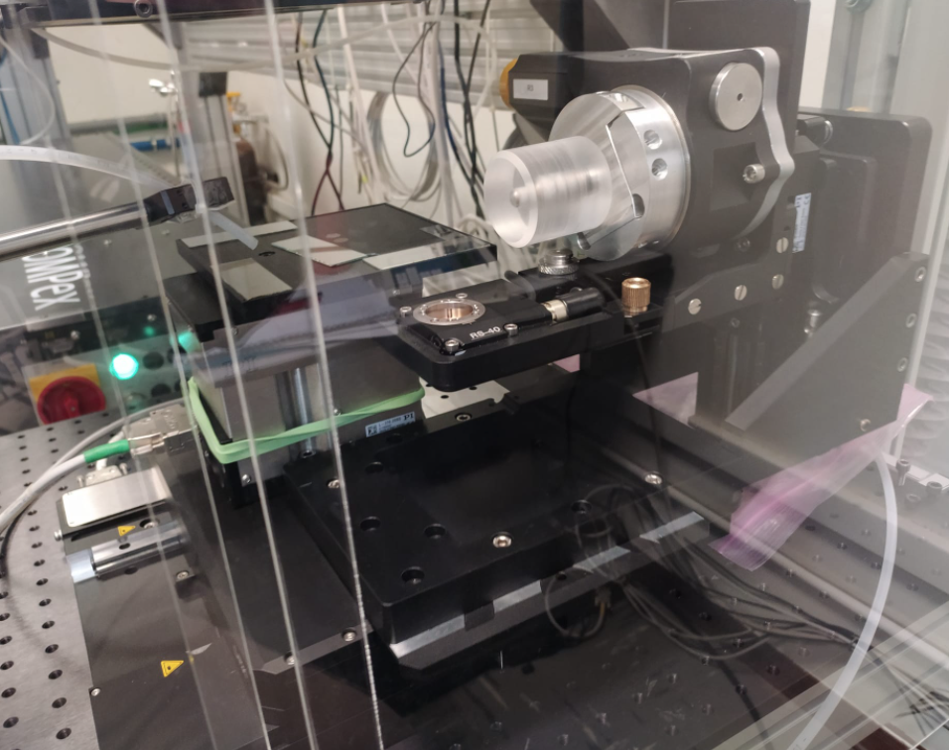
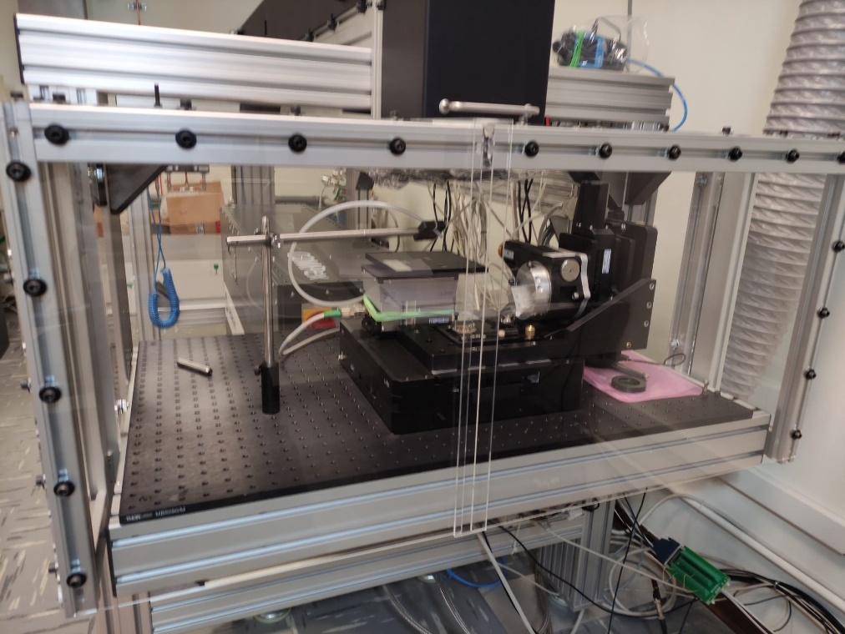
3rd step: Pulsed Laser Melting
248 nm, 22 ns pulse KrF laser (Coherent)
Laser beam
Planar samples
Rotor
Rotor
Coaxial samples
Z-axis
Z-axis
XY-axes
6 motorized DOF
Legnaro, 16- 17 Nov 2023
Notes:
The laser system used is an impulse excimer KrF laser emitting light at 248 nm, 25 ns pulse duration. The sample stage is located in an ISO 5 plexiglass box to reduce dust contamination and is equipped with linear and rotational stages for a total of 6 motorized degrees of freedom for maximum process flexibility.

Slide 9
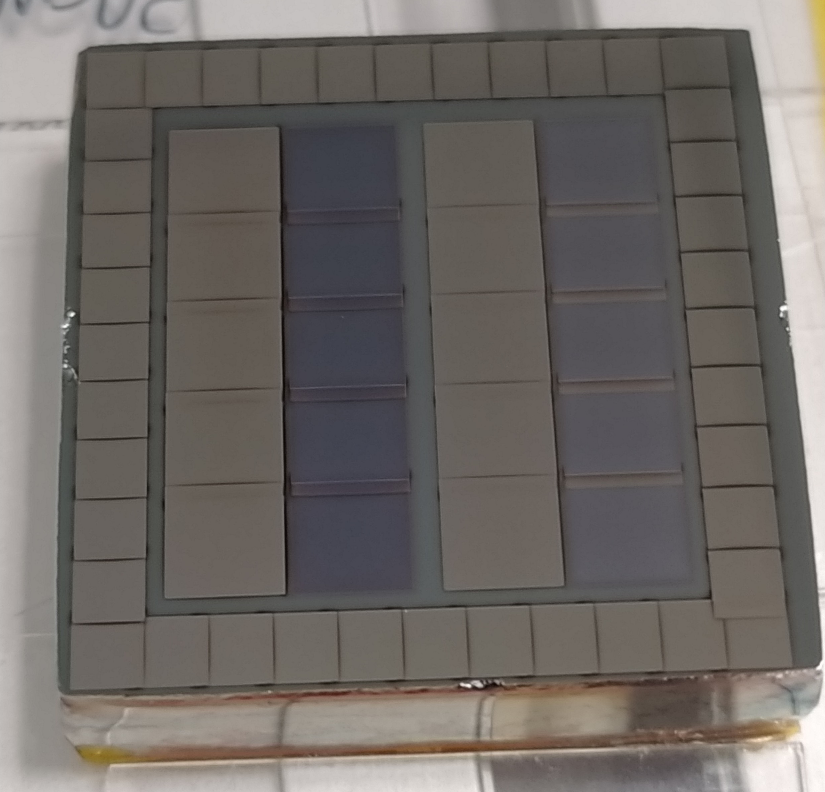
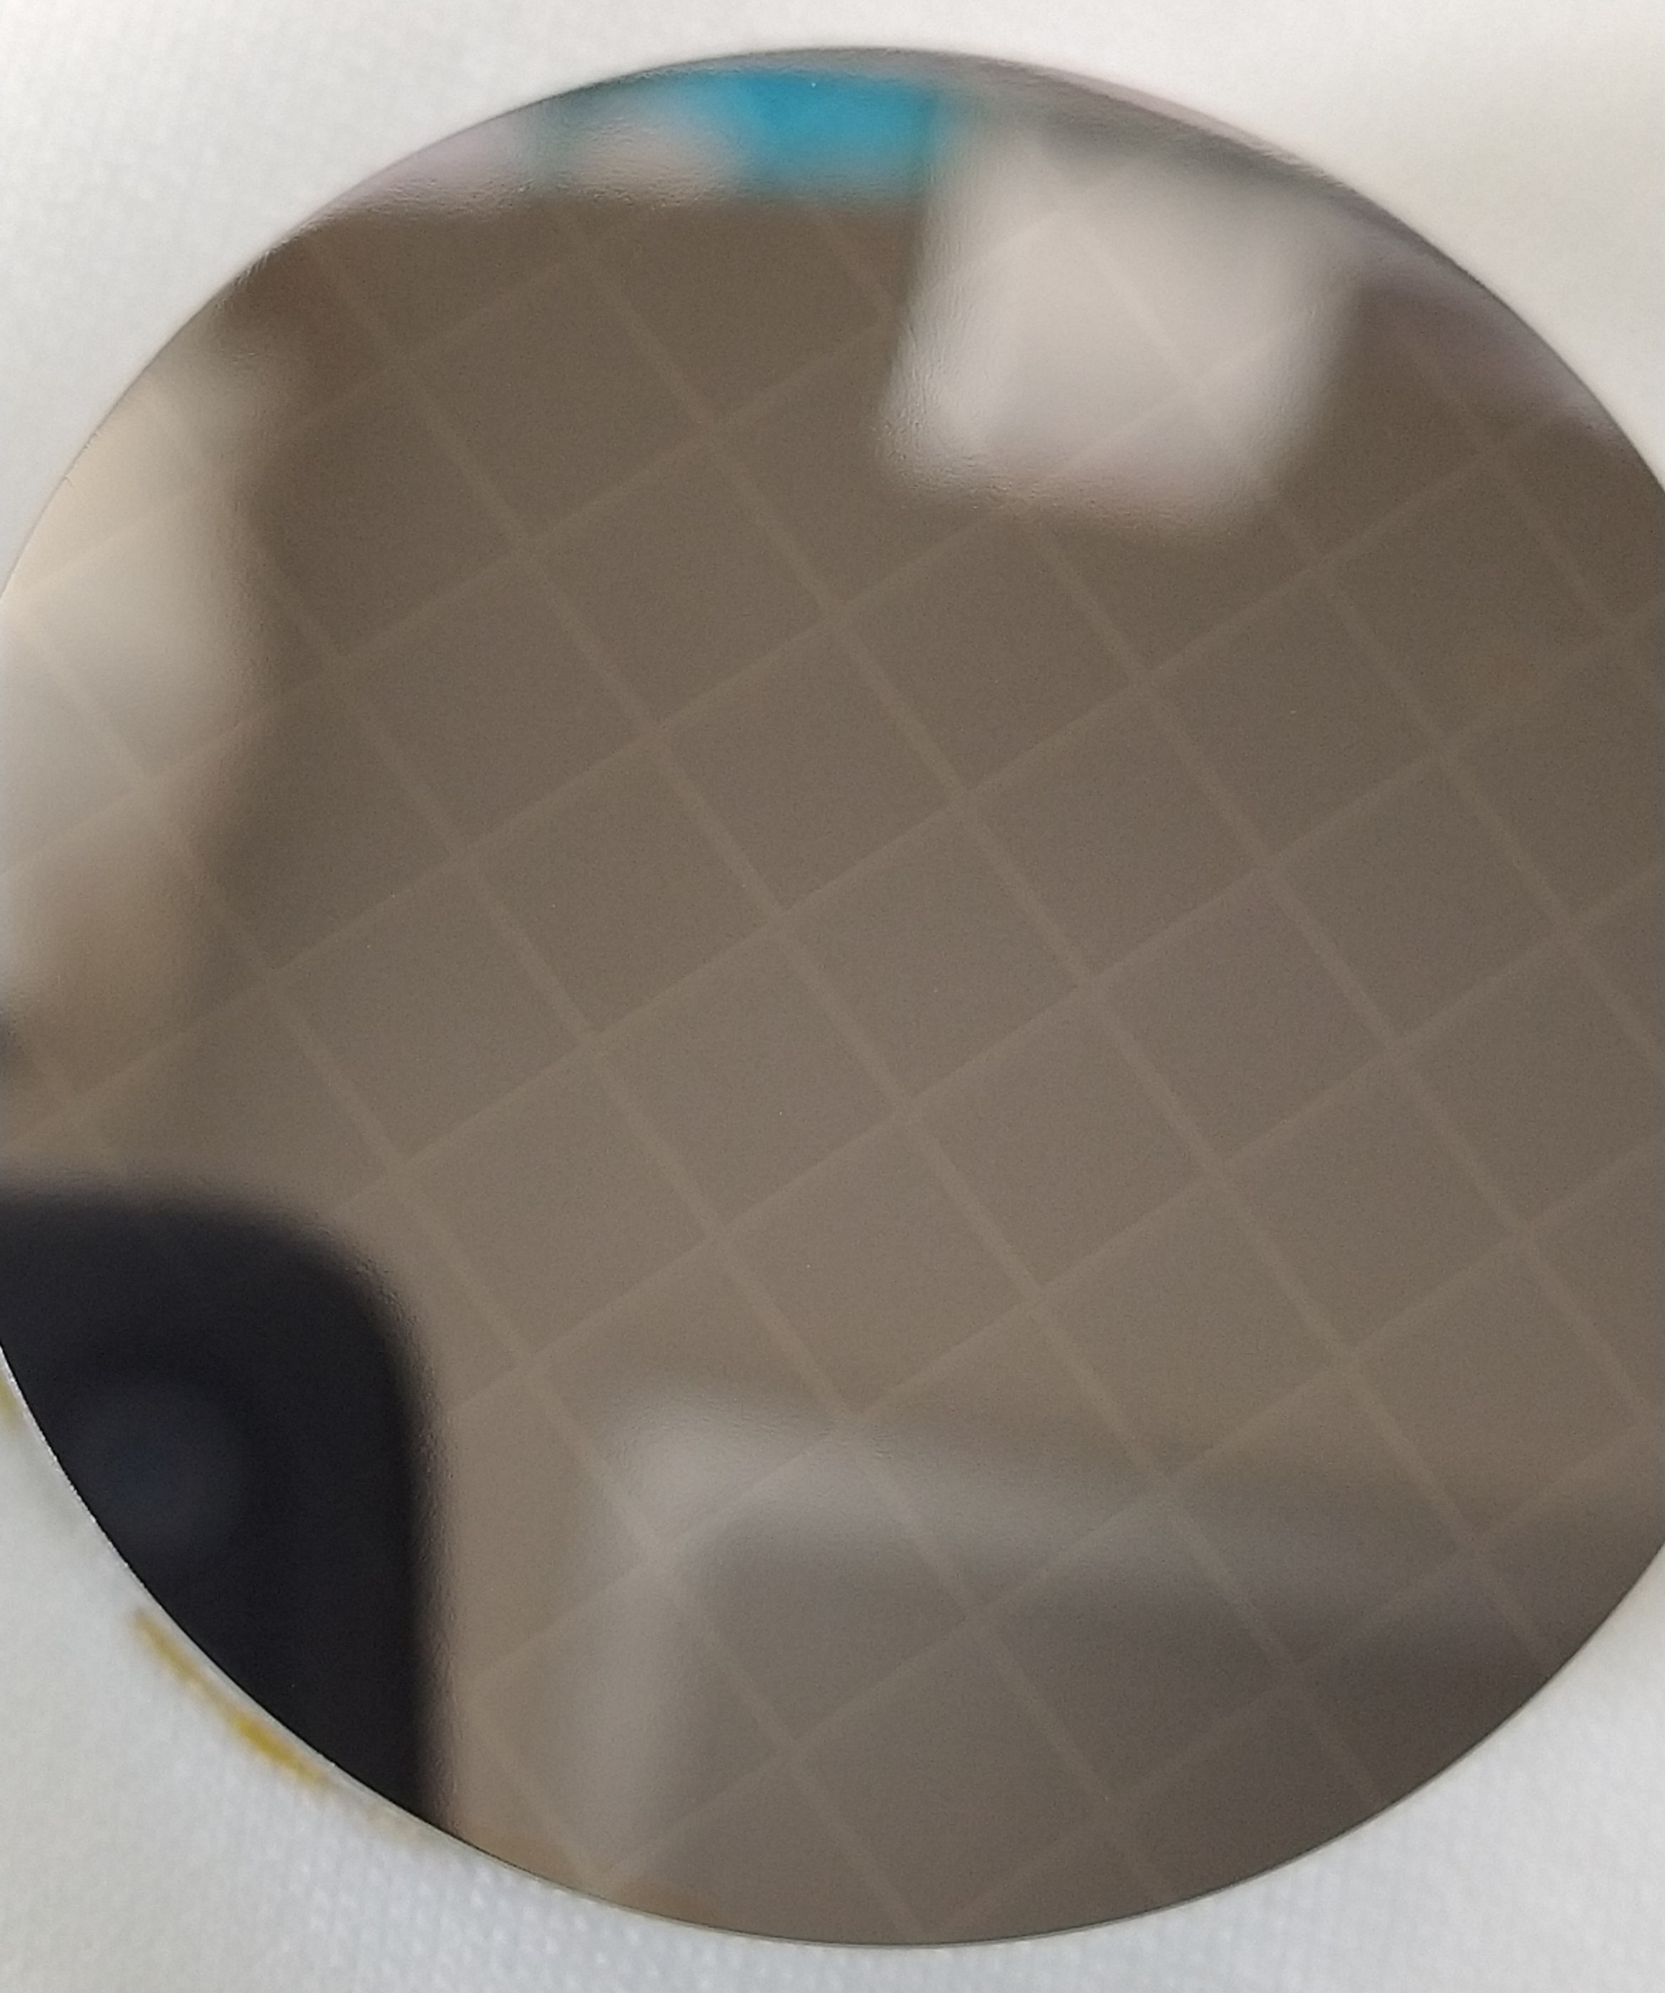
3rd step: Pulsed Laser Melting
Full area
PLM
Partial area
Same energy for every spot:
Different recipes:
Sb deposition:
no preannealing ,
500 mJ/cm² pulse
Al-Ge deposition:
100 mJ/cm² preannealing pulse + 500 mJ/cm² pulse
Different energy densities, different number of pulses, geometric flexibility, etc.
Patent WO 2021/214028 A1
Legnaro, 16- 17 Nov 2023
Notes:
We can now choose between two applications: if we treat the full area, a gold sputtering deposition is then needed to perform a photolithographic step to strip the gold for the segmentation.
Once it is stripped a strong acid attack is performed to trench the junctions and the sample is finally passivated.

Slide 10
4th and 5th step: lithography and passivation
Full area
PLM
Partial area
Au target
Au deposition
100 nm deposition of Au in Ar plasma with ultrapure target in vacuum (10⁻⁷ mbar)
Photolithography
Photoresist deposition, baking, exposure and development, followed by Au stripping and resist removal.
L=35mm, t=2mm
Intercontact gaps passivation
3:1 HNO3 : HF etching followed by chemical quenching passivation.
D=40mm, t=20mm
Legnaro, 16- 17 Nov 2023
Notes:
We can now choose between two applications: if we treat the full area, a gold sputtering deposition is then needed to perform a photolithographic step to strip the gold for the segmentation.
Once it is stripped a strong acid attack is performed to trench the junctions and the sample is finally passivated.

Slide 11
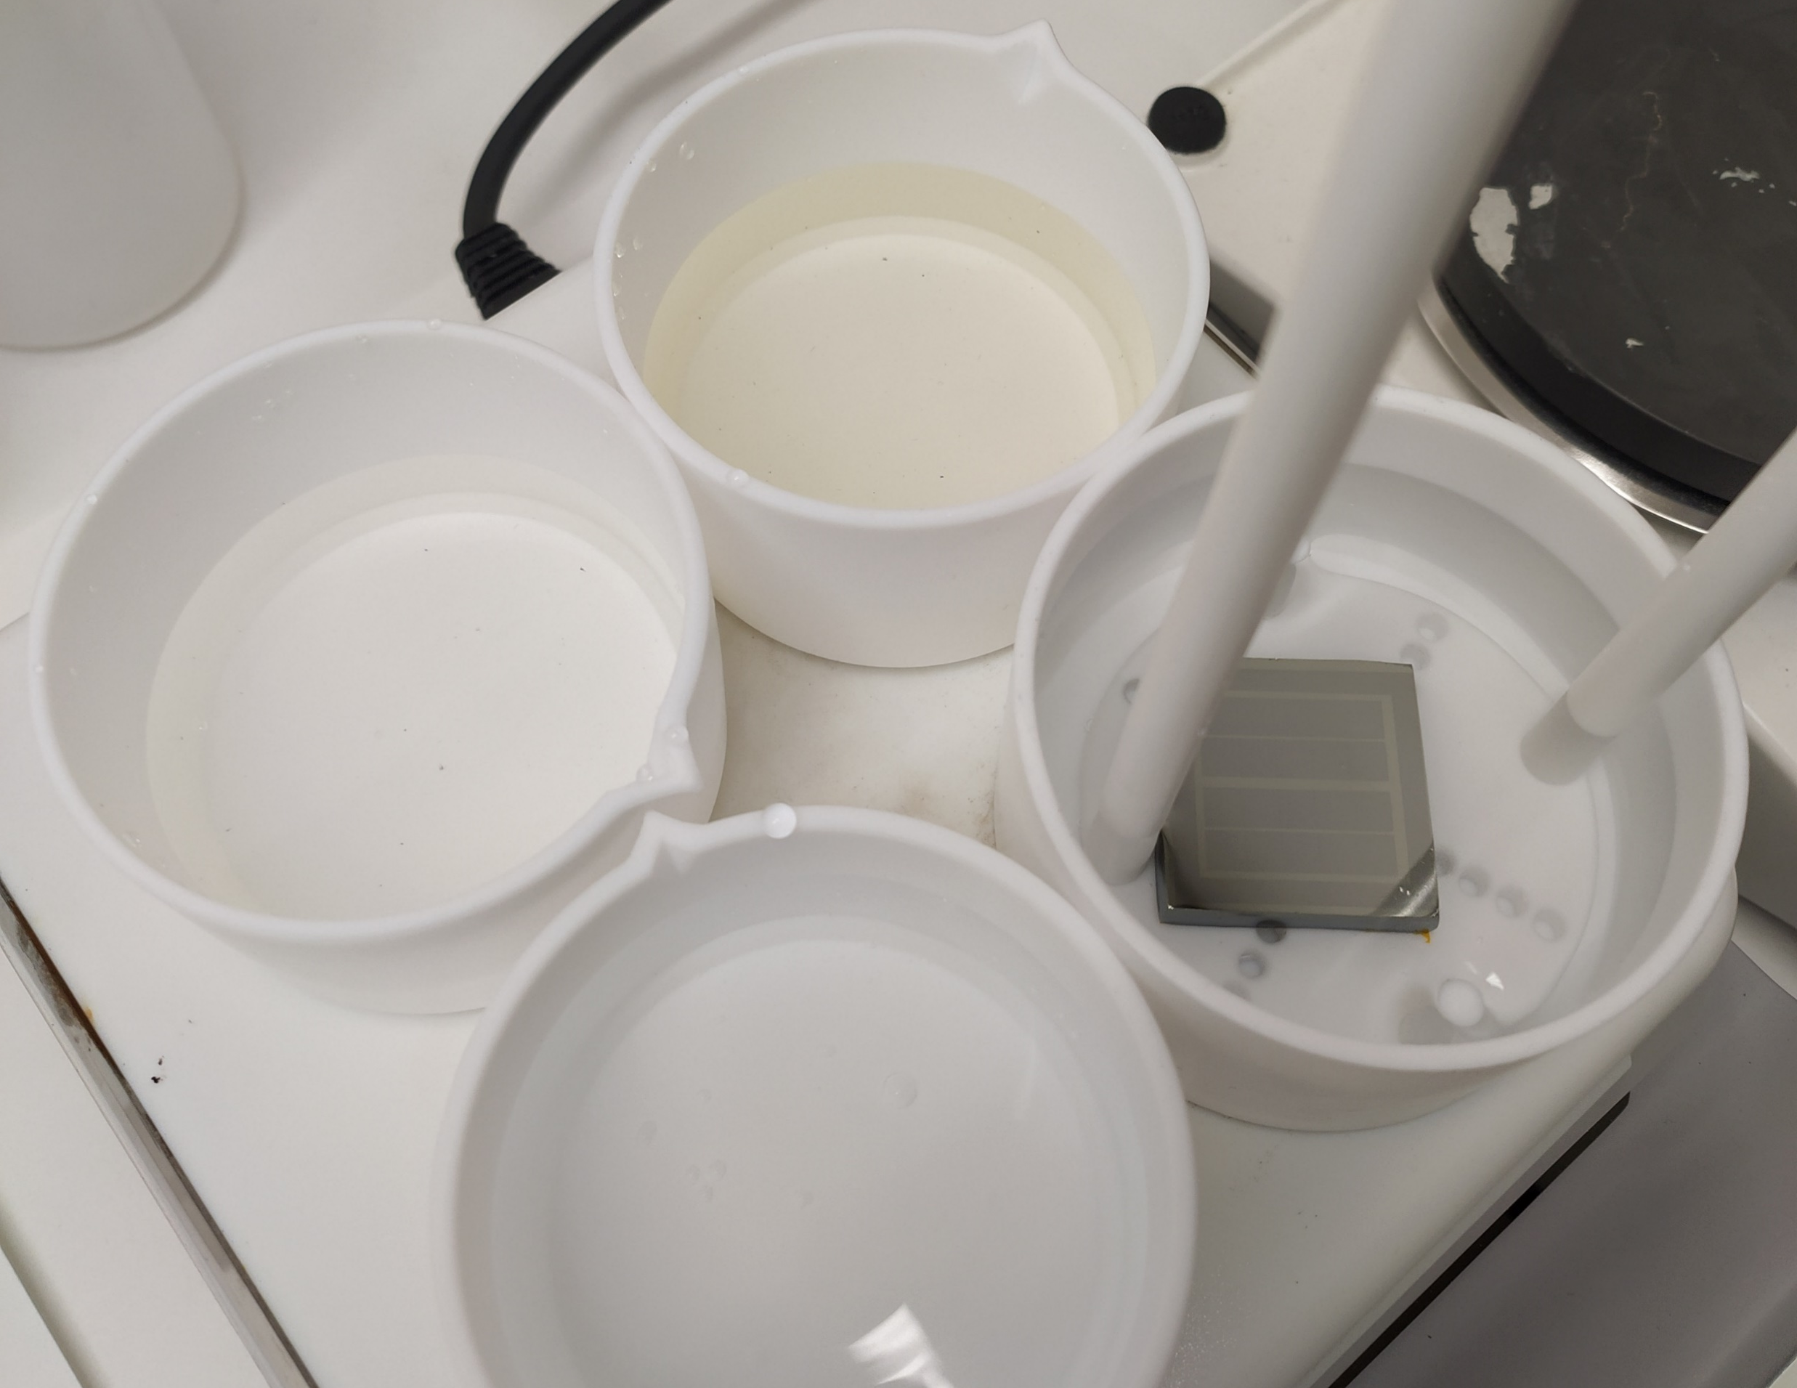
4th and 5th step: lithography and passivation
Full area
PLM
Partial area
Selective etching
Removal of untreated dopant using selective etchants to protect the near junction.
WET ETCHING
L=35mm, t=10mm
Chemical passivation
Passivation of undoped surfaces with suitable solutions.
UNDOPED
DOPED
H₂SO₄
In the case of Sb dopant:
Hot pure H₂SO₄ to remove Sb deposition
H₂O to complete the passivation
BDWater
Legnaro, 16- 17 Nov 2023
Notes:
We can also choose to draw the segmentation geometry directly with the laser, then we need to remove the untreated deposition with suitable etching agents which must preserve the junction.
We finally conclude with the surface passivation.

Slide 12
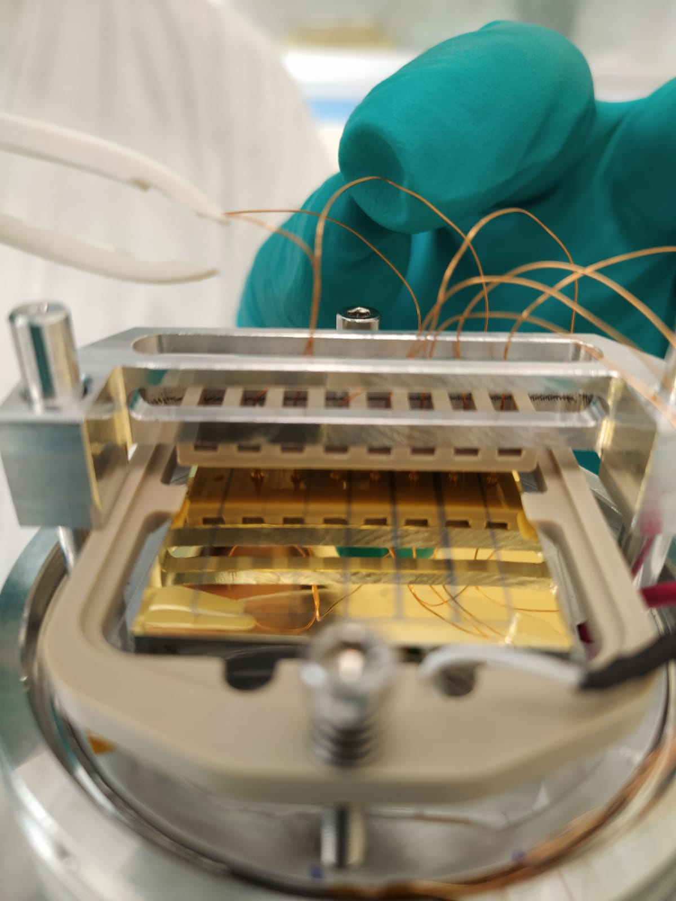
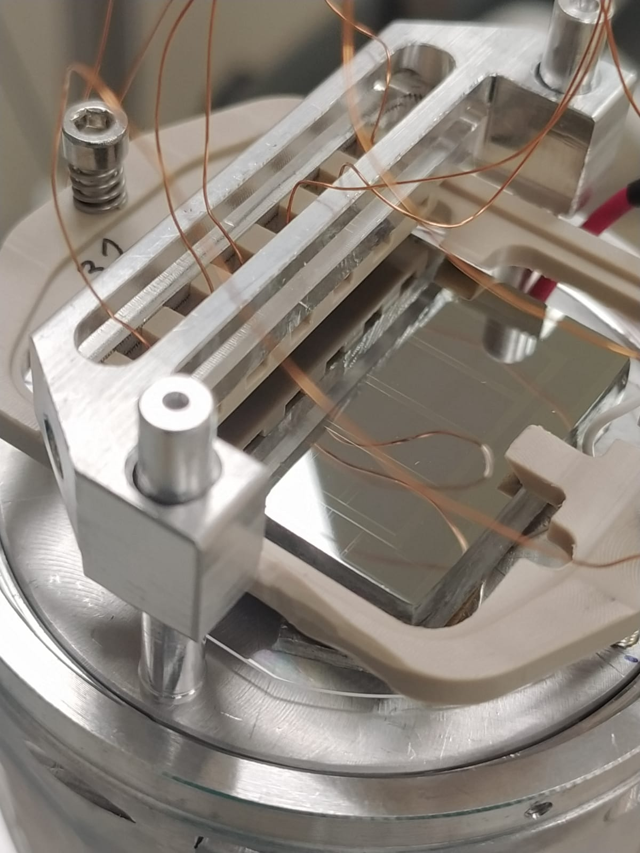
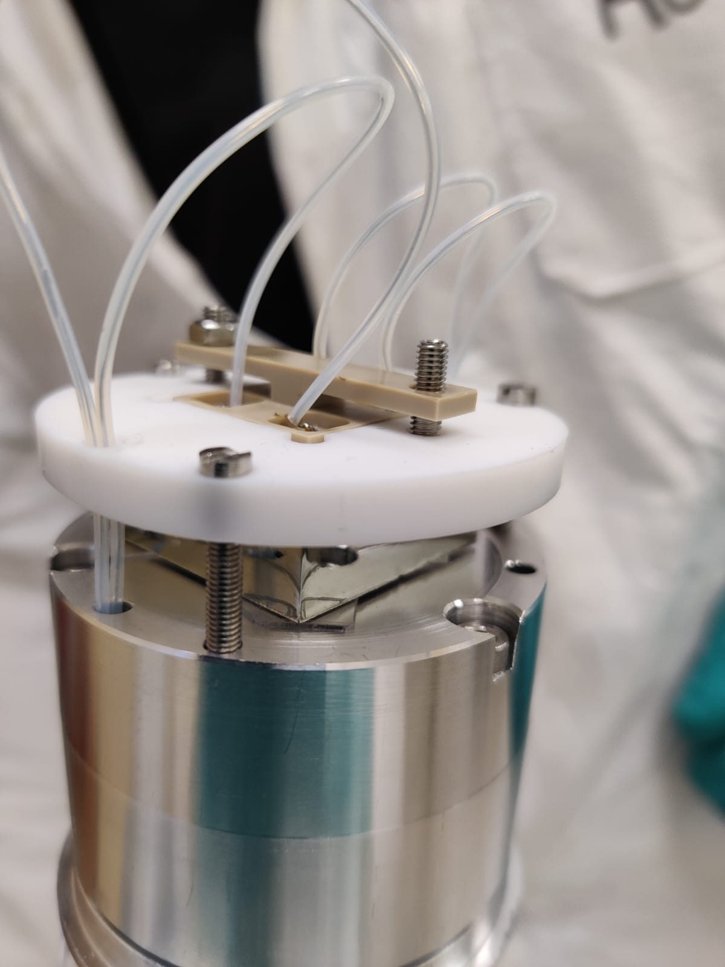
5th step: passivation
Cooling:
samples hosted in prototyped cryostats and cooled down to LN2 temperature to reduce thermal carriers: delicate electrical contacts with springs on plated and non-plated segments.
Legnaro, 16- 17 Nov 2023

Slide 13
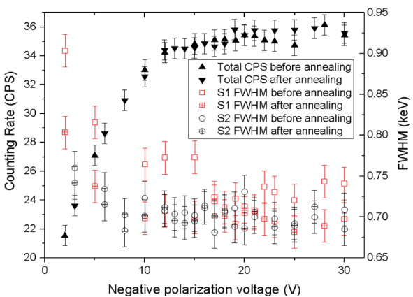
Thin planar detectors
Sb junction, p-type, L=10mm, t=2mm
Spectroscopical test:
²⁴¹Am or ¹³³Ba spectra acquisition.
S1
S2
Measured before and after recovery annealing and re-passivation to test junction stability
²⁴¹Am
Sb/p-HPGE/Al, L=35mm, t=2mm
¹³³Ba, 20V
E=80keV
FWHM=0.89keV
¹³³Ba, 20V
E=356keV
FWHM=1.19keV
GR
Before annealing
After annealing
Before annealing
After annealing
C6
C5
C4
C3
C2
C1
S. Bertoldo et al. “New method for the production of thin and stable, segmented n+ contacts in HPGe detectors”, Eur. Phys. J. A (2021) 57:177
Legnaro, 16- 17 Nov 2023
Notes:
We applied these processes on thin detectors, 2 mm thickness, fabricating one or both contact with laser annealing. We were able to reach full depletion and characterized them using Am sources, delivering very high resolution even after annealing.

Slide 14
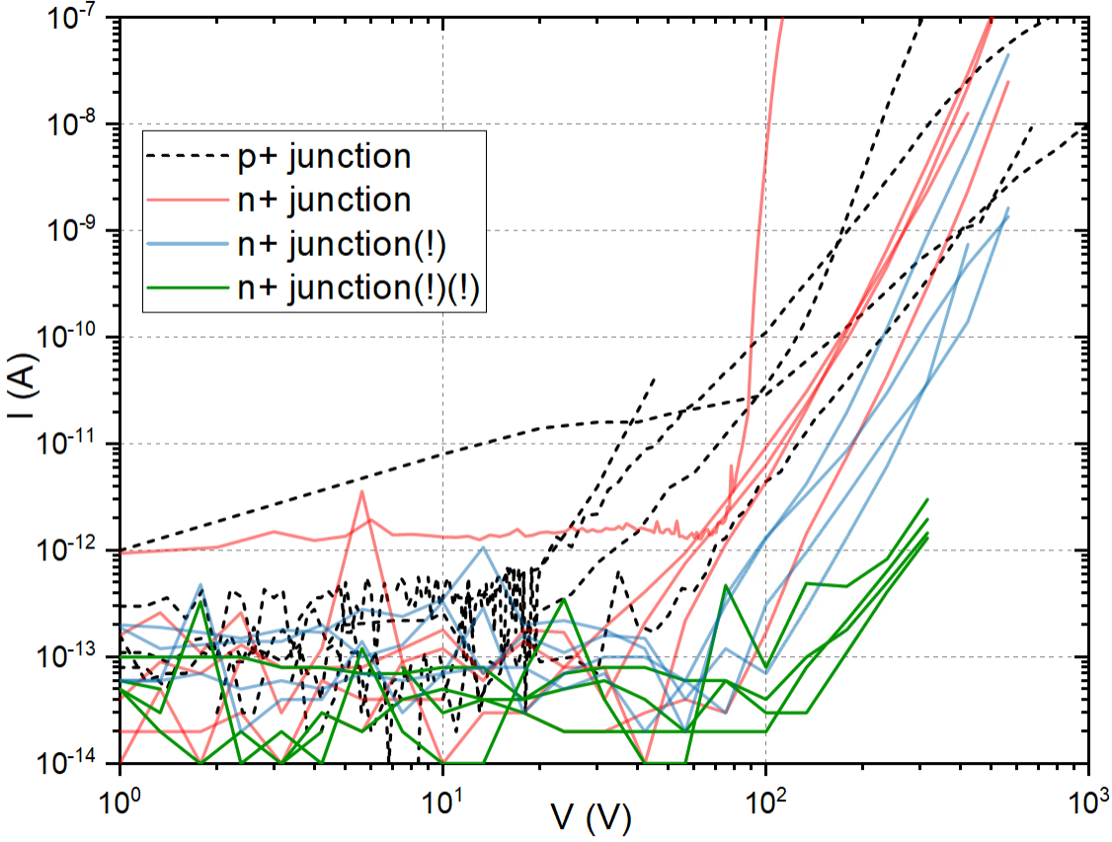
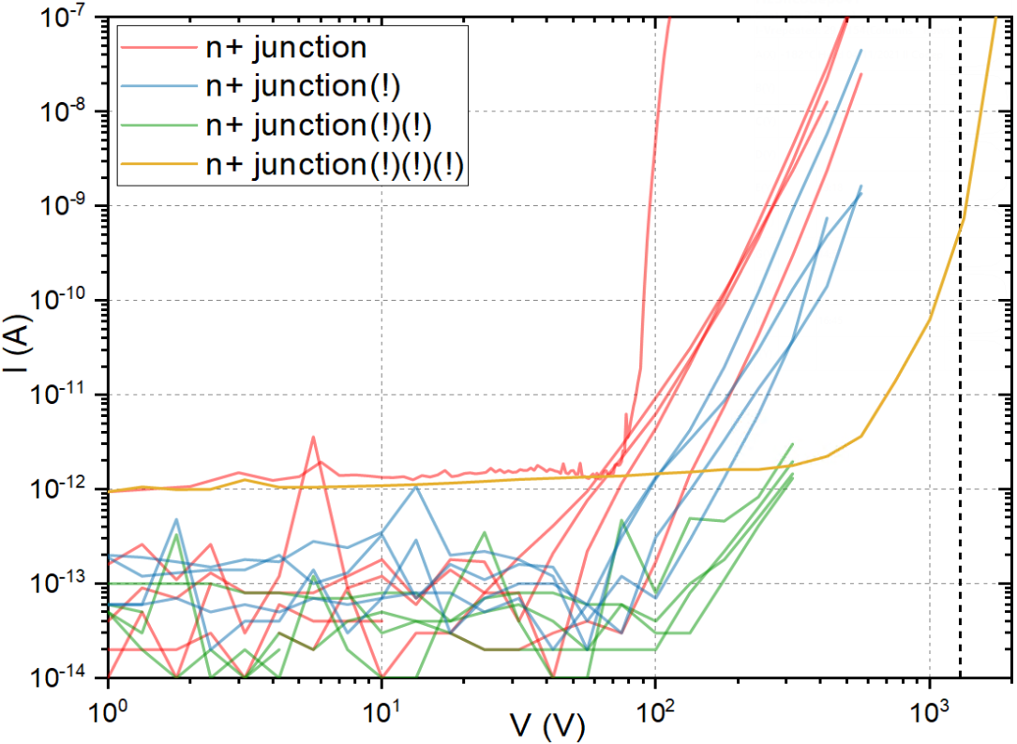
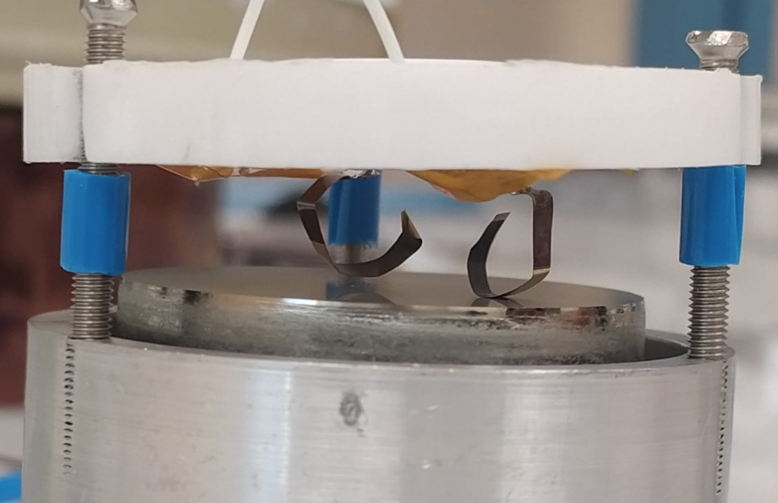
Thick planar detectors
Al/n-HPGE/Sb, D=40mm, t=20mm
Sb/p-HPGE/Al, L=35mm, t=10mm
Difficult to reach depletion voltages (600V for 1cm, 2400V for 2 cm)
Probably due to junction mechanical weakness under manipulation
Legnaro, 16- 17 Nov 2023
Notes:
We then tried to extend this technique to thicker detectors. In this case it’s proven difficult to reach depletion voltage, due to the mechanical weakness of such a thin junction. Recently we implemented soft contacts, which allowed us to extend breakdown voltage near full depletion.

Slide 15
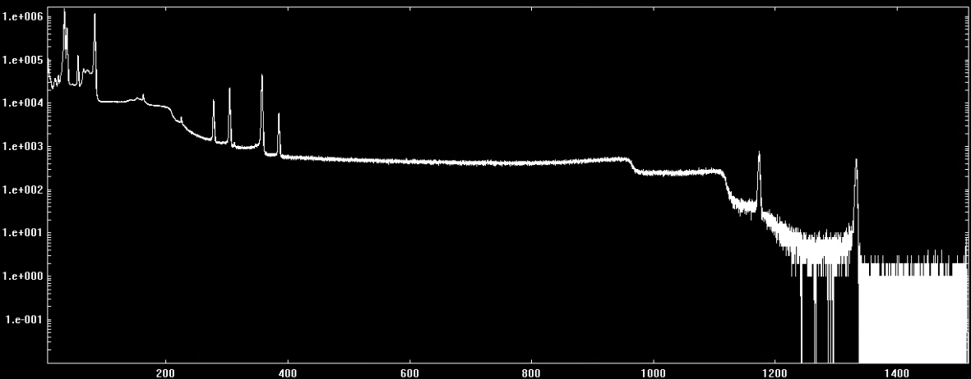
Thick planar detectors
Partially depleted guarded segment of the Sb/p-HPGe/Al detector, t=10mm:
E = 80 keV
FWHM = 1.52 keV
¹³³Ba, ⁶⁰Co
E = 1173 keV
FWHM = 2.52 keV
E = 1330 keV
FWHM = 2.67 keV
Counts
100V (61 hours)
Energy (keV)
Legnaro, 16- 17 Nov 2023
Notes:
However, undepleted detectors can still acquire spectra, with a smaller active volume and an Sb PLM junction showed good resolution on Barium and <Cobalt photopeaks

Slide 16
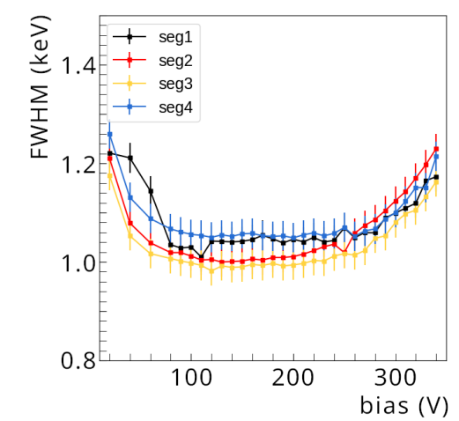
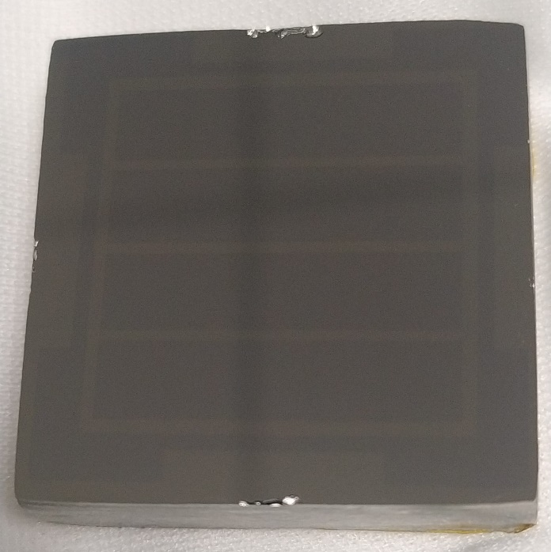
Neutron robustness: CN irradiation test
Detector prototype:
Sb/p-HPGE/Al, L=35mm, t=10mm
4 contacts + guard ring
Starting resolution:
at 80V operational bias
²⁴¹Am
E = 59,5 keV
FWHM < 1,1 keV
⁶⁰Co
E = 1332 keV
FWHM < 1,8 keV
²⁴¹Am
The prototype is irradiated with a controlled beam of fast neutrons monitoring the effect on energy resolution
Legnaro, 16- 17 Nov 2023
Notes:
To evaluate the robustness of PLM junctions against neutron irradiation, we prepared a 10mm thick prototype with Sb and Al PLM junctions. The prototype is then irradiated with a controlled fast neutron flux and the energy resolution evolution is monitored. We characterized it the initial resolution at 80V using Am and Co sources.

Slide 17
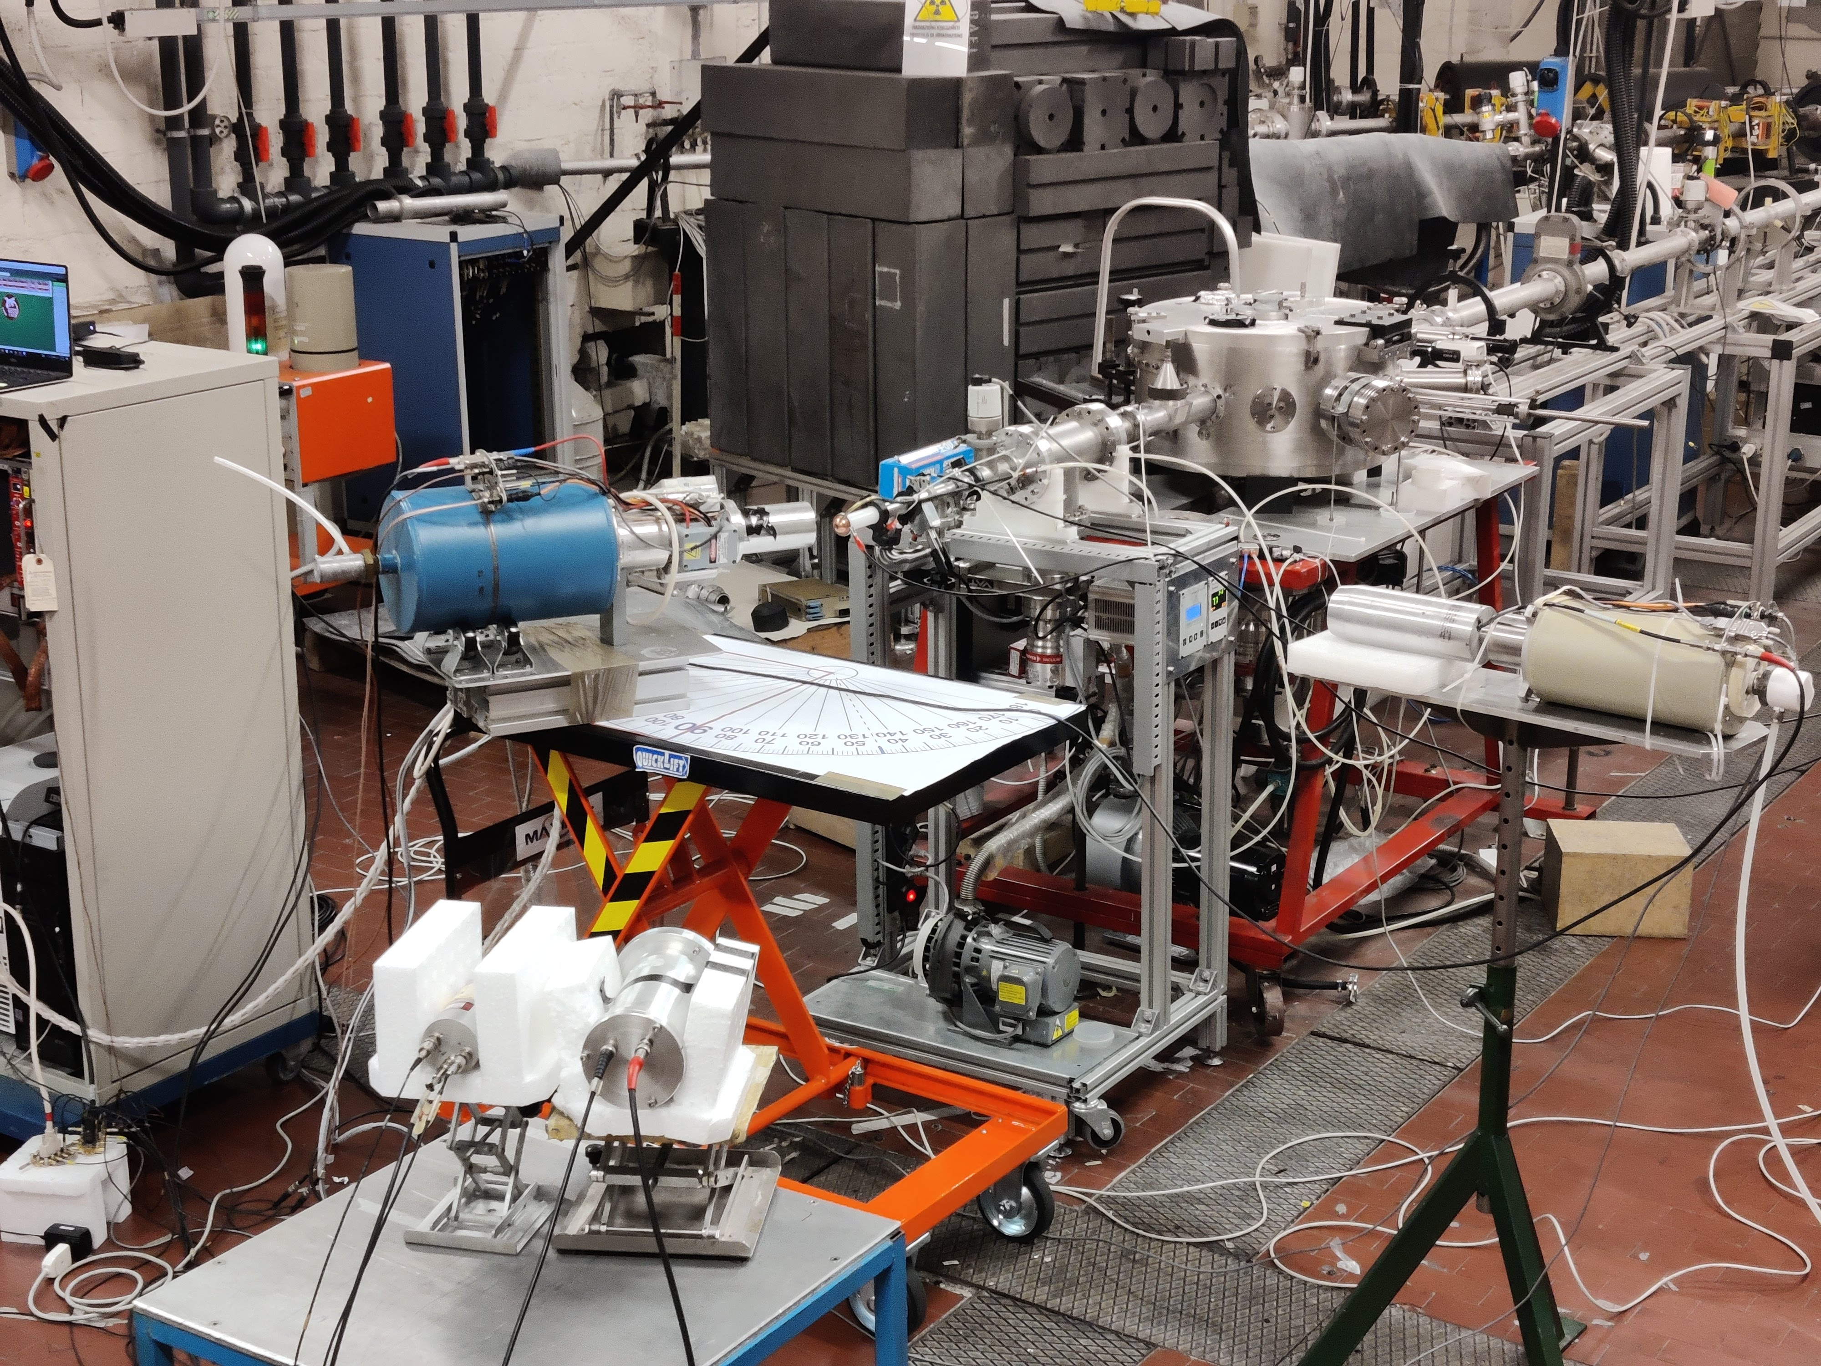
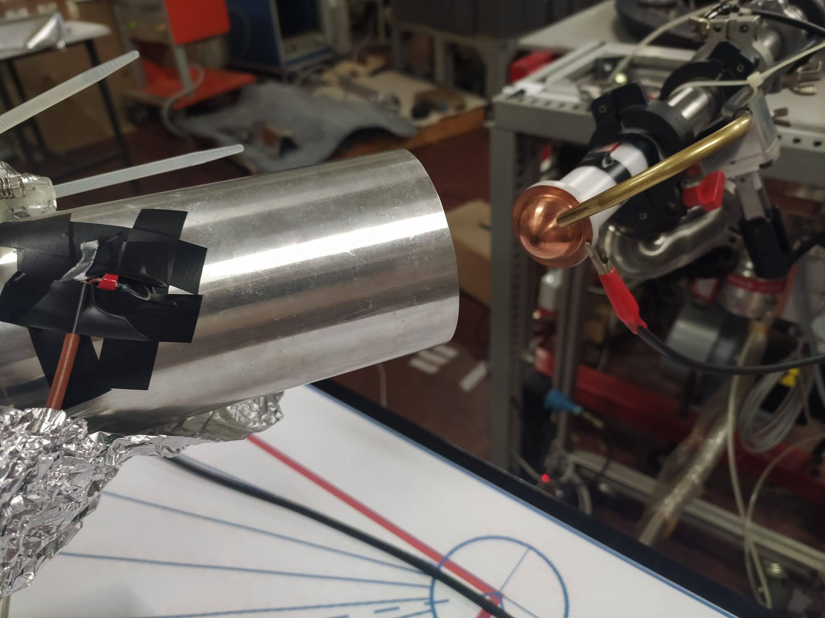
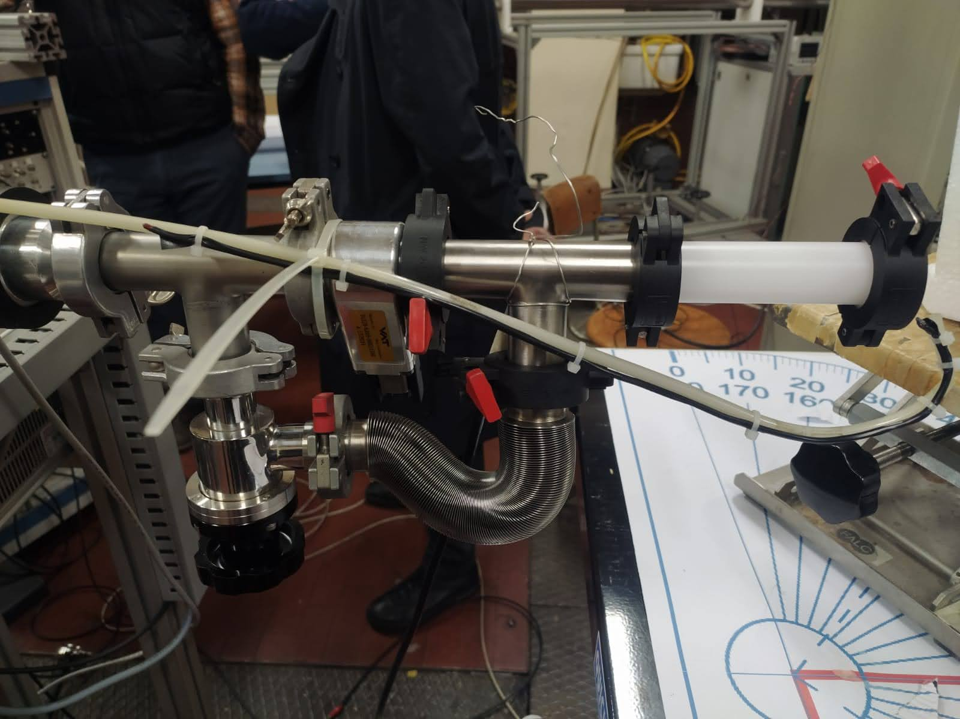
CN irradiation test: setup
N3G prototype
380nA 4MeV proton beam
⁷Li target, 100µm
Target
Beam
Reaction: ⁷Li (p,n) ⁷Be
Prototype detector is located at 30° 9.5 cm
Neutrons are directly measured with
- CLYC7 scintillators, 30° 2 m
- GASP HPGe γ detector, 90° 1 m
⁷Be + e⁻ $\underset{→}{\text{5}\text{3.3 }\text{days}}$ ⁷Li 477.6 keV
GASP
100V (61 hours)
CLYC7
Legnaro, 16- 17 Nov 2023
Notes:
The test was carried out in the CN facility here at LNL with this setup
The incoming beam is a ….. Impacting on a lithium target 100 microns thick. The target is located at the end of the beamline in a dedicated vacuum system. The reaction produces beryllium 7 and a flux of fast neutrons. Our prototype is located at…. Neutrons are directly measured using clyc scintillators….
Berillium undergoes electron capture with a half time of 53 days, reverting back to lithium7 and emitting a characteristic gamma. This radiation is monitored by another HPGe dector positioned …. And is used as a double check.

Slide 18
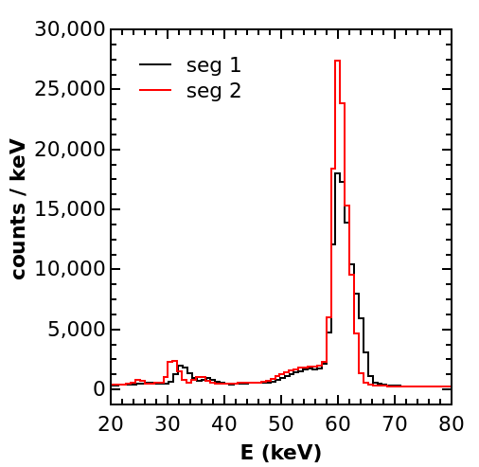
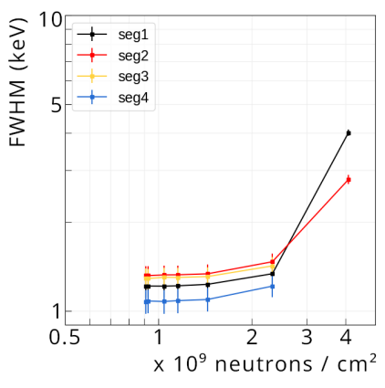
CN irradiation test: 1st run
Operational Voltage 80V
Neutron irradiation for increasing time intervals alternated to 5 min runs with ²⁴¹Am and ⁶⁰Co leads to increasing resolution worsening
²⁴¹Am
E = 59,5 keV
FWHM = 3,2 – 4,2 keV
⁶⁰Co
E = 1332 keV
Not visible!
After 4 hours of irradiation time,
≈ 4∙10⁹ neutrons/cm², detector is no longer operable
100V (61 hours)
Legnaro, 16- 17 Nov 2023
Notes:
During the first run we monitored the increasing resolution worsening alternating irradiation for increasing time intervals and 5 minute runs with Am and Co sources. After 4 hours of irradiation and a flux of….. The detector was no longer operable. The am spectra shows significant decrease in peak resolution, while co peaks are no longer measurable.

Slide 19
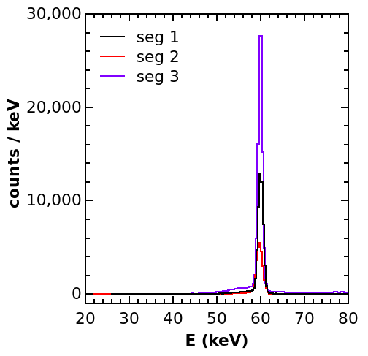
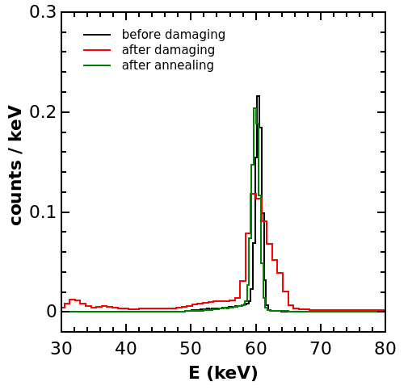
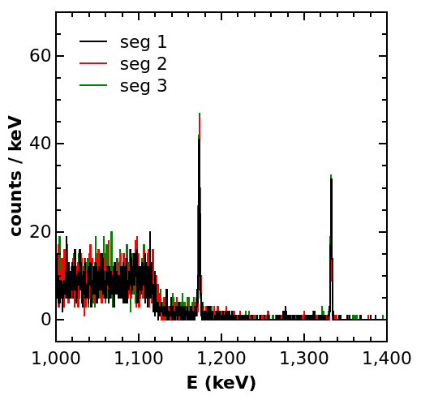
CN irradiation test: recovery
Annealing procedure: 7 days at 110° continuously pumped inside the cryostat
²⁴¹Am
E = 59,5 keV
FWHM < 1,6 keV
⁶⁰Co
E = 1332 keV
FWHM < 2 keV
Legnaro, 16- 17 Nov 2023
Notes:
We then performed an annealing cycle heating the crystal at 110deg for 7 days. We characterized the detector using the same sources as before. As we can see the FWHM of the am peak went back to the original width and the co peak is visible again, confirming the recovery of the detectors resolution.

Slide 20
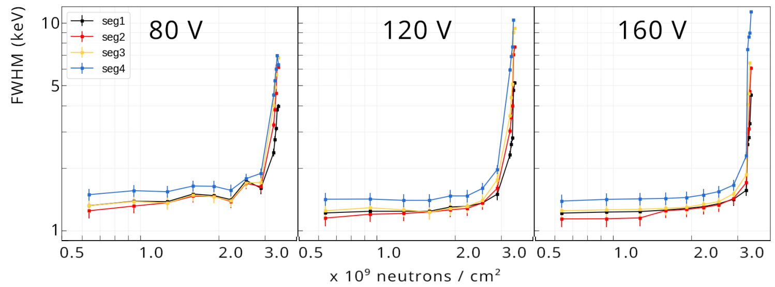
CN irradiation test: 2nd run
Operational Voltage 80-120-160V
Neutron irradiation for 20 or 2 min alternated to 5 min runs with ²⁴¹Am to better characterize resolution worsening
Drastic drop in resolution after ≈ 3∙10⁹ neutrons/cm² irradiation fluence
²⁴¹Am
E = 59,5 keV
FWHM = < 2 keV until threshold
100V (61 hours)
Legnaro, 16- 17 Nov 2023
Notes:
We then performed a second irradiation run to better characterize the resolution behavior. We alternated 20 minutes irradiation with 5 minutes runs with sources. The drop in resolution was drastic after a fluence of … confirming also the effective full recovery.
Both values are comparable with commercially available detectors, even though the geometries are much different. The role of detectors geometry and the processes involved in neutron irradiation are still under study, still this is a valuable result confirming the robustness of plm junctions.

Slide 21
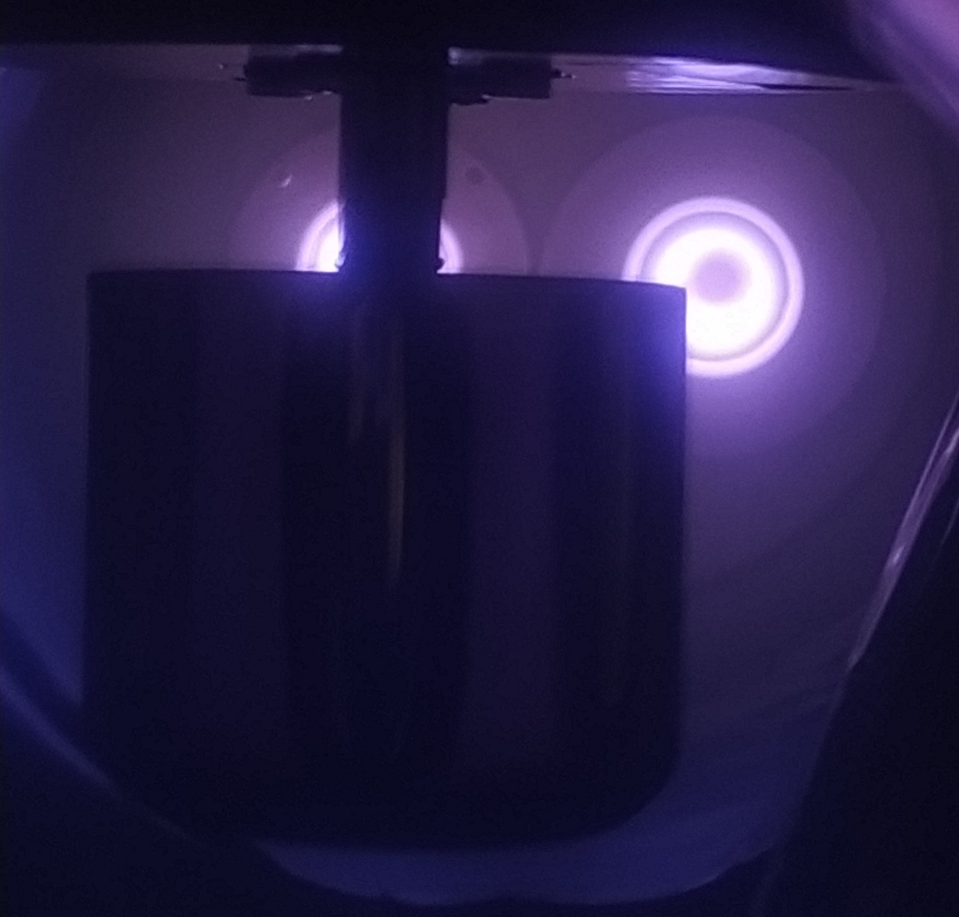
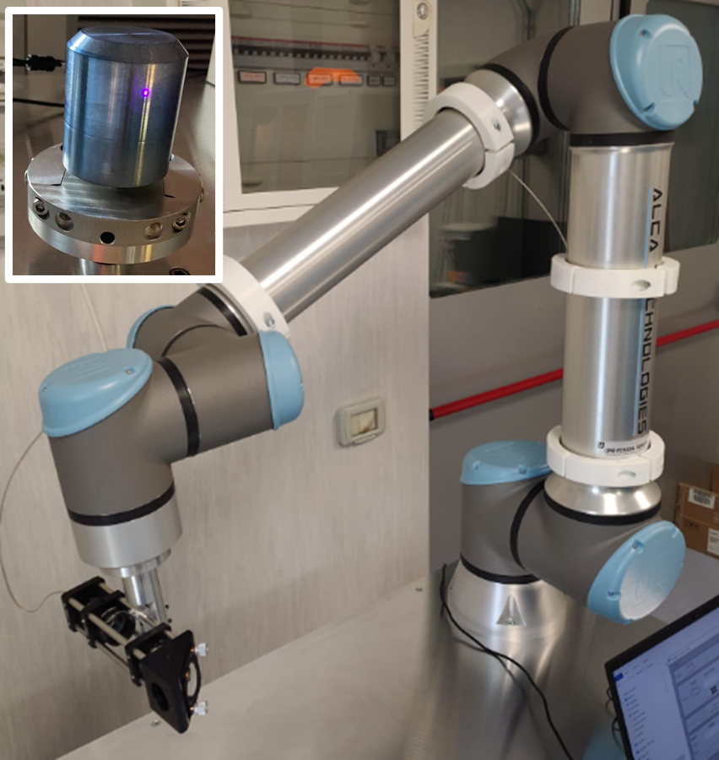
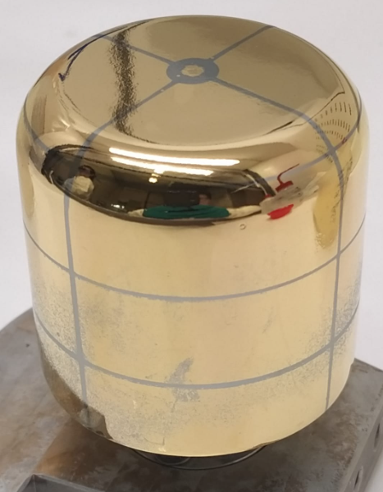
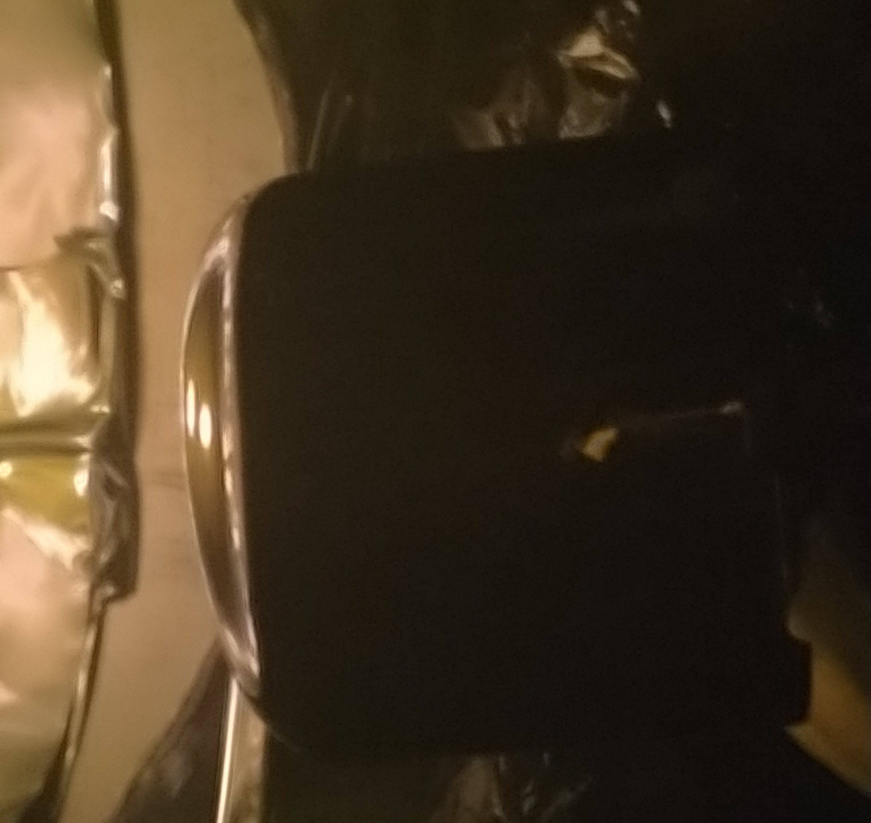
Coaxial detectors
Lateral surface rotating deposition
Al
Ge
Frontal surface static deposition
Flux
Legnaro, 16- 17 Nov 2023
Notes:
Finally a hint of how we are attempting to extend these techniques on coaxial crystals. the experimental apparatus has been upgraded to perform the sputtering depositions and the laser processes on the lateral and frontal surface of the crystal in the most homogeneus way possible. Spray coating and a robotic arm laser axposure has been implemented to perform photolithography on coaxial shapes and special soft electrical contacts has been engineered to protect the junction.. This separately tested steps will soon converge to develop a coaxial segmented germanium detector.

Slide 22
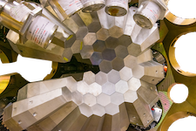
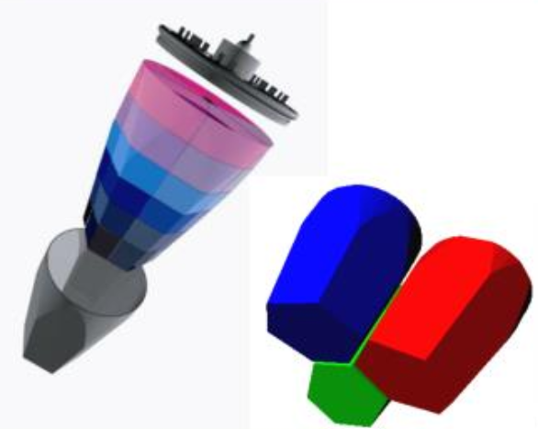
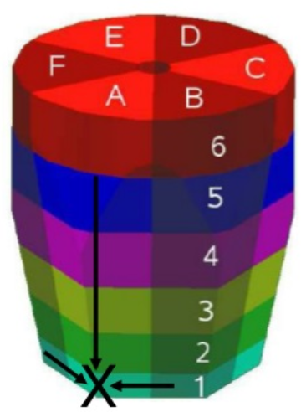
Conclusions
We developed thin and thermally stable hyperdoped n-junction using magnetron sputtering and Pulsed Laser Melting technique, which preserve bulk purity.
We tested different lithographic procedures on different planar geometries.
We produced a planar prototype and tested its robustness against fast neutrons.
Future plans
We need to investigate pressure effects on the thin junction to increase maximum reverse voltage on thick samples.
Extend this technology to coaxial shapes for future segmented gamma detectors arrays.
AGATA (Advanced GAmma Tracking Array)
Collaboration Agreement
Legnaro, 16- 17 Nov 2023
Notes:
As for the future perspectives, we need to further investigate the effects of pressure on thin junctions to extend polarization bias on thick samples.
These results are important not only for the applications on future segmented gamma detectors arrays, like agata, but are also the object of a collaboration agreement that was held with mirion as an industrial partner.

Slide 23
THANK YOU FOR YOUR ATTENTION
Legnaro, 16- 17 Nov 2023

Slide 25
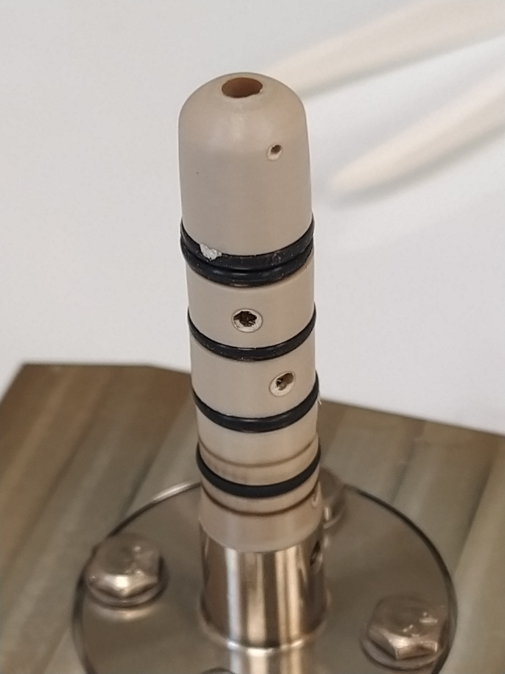
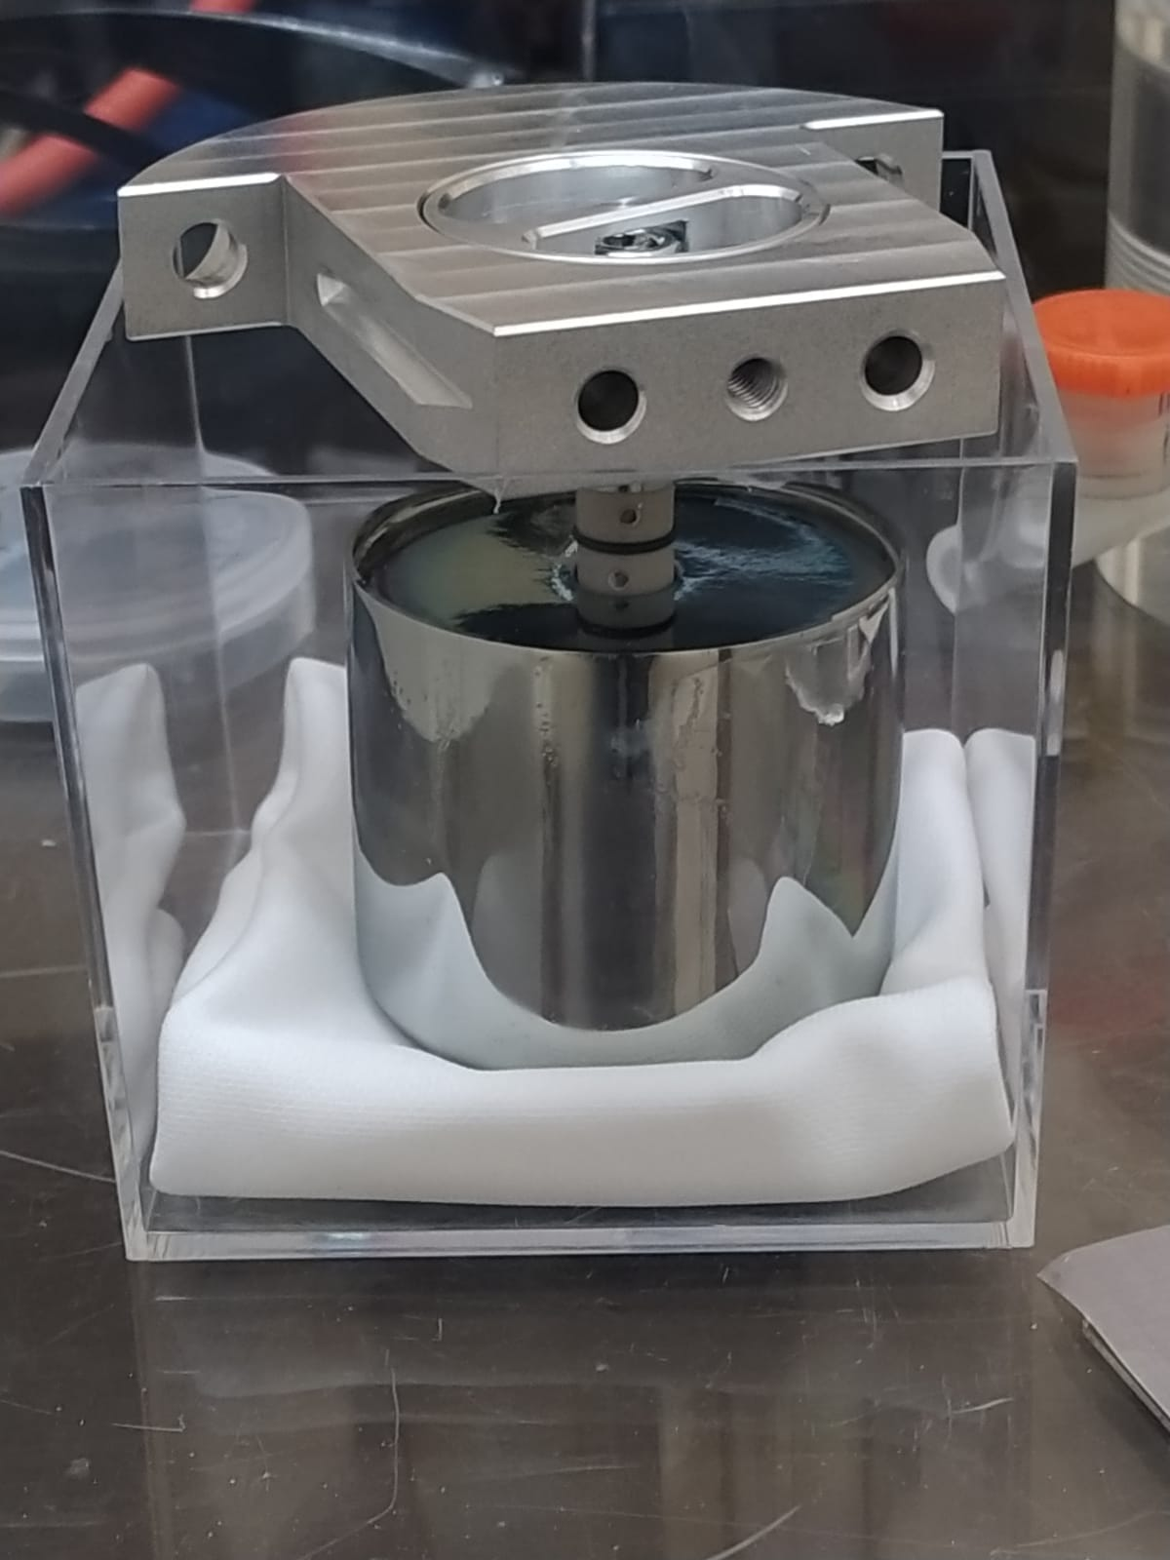
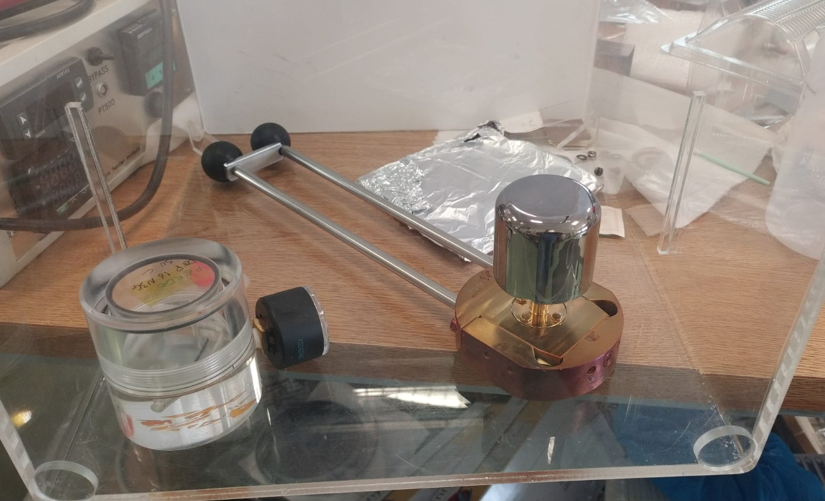
Coaxial detectors
PEEK
Handling system for etching
Handling system for deposition and PLM
VITON o-rings
Crystals must not be touched during the processes
Ar filled box
Legnaro, 16- 17 Nov 2023

Slide 26
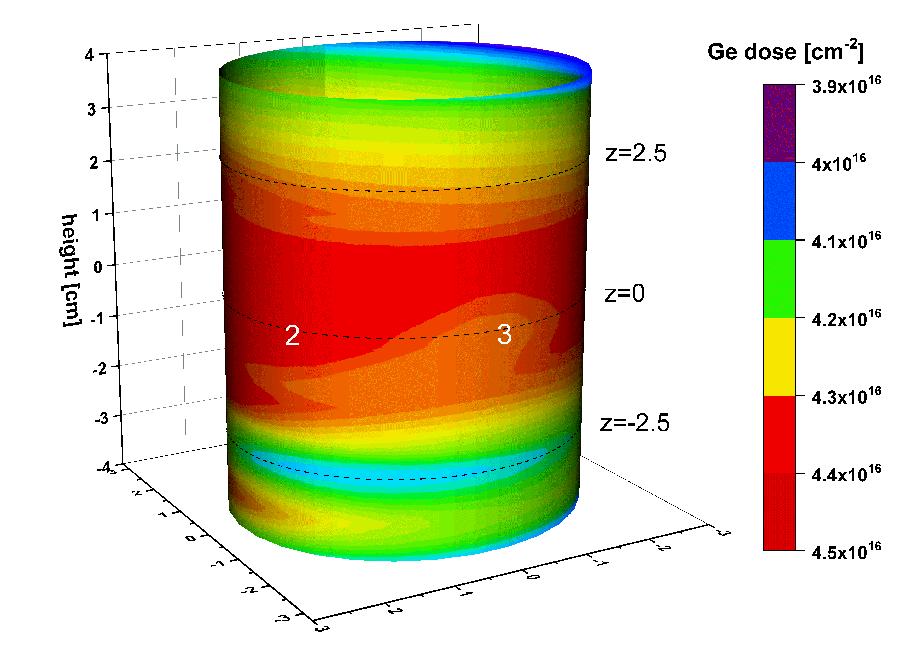
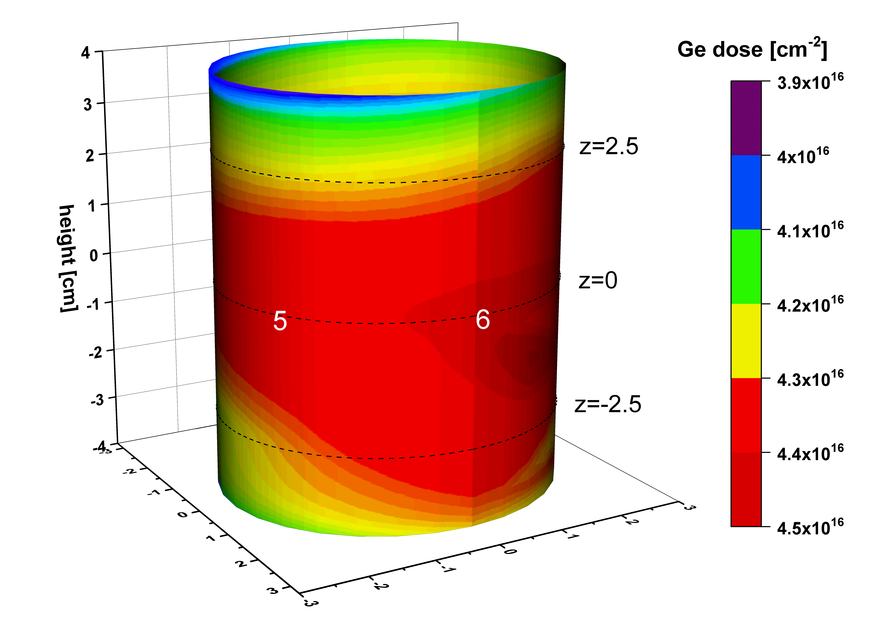
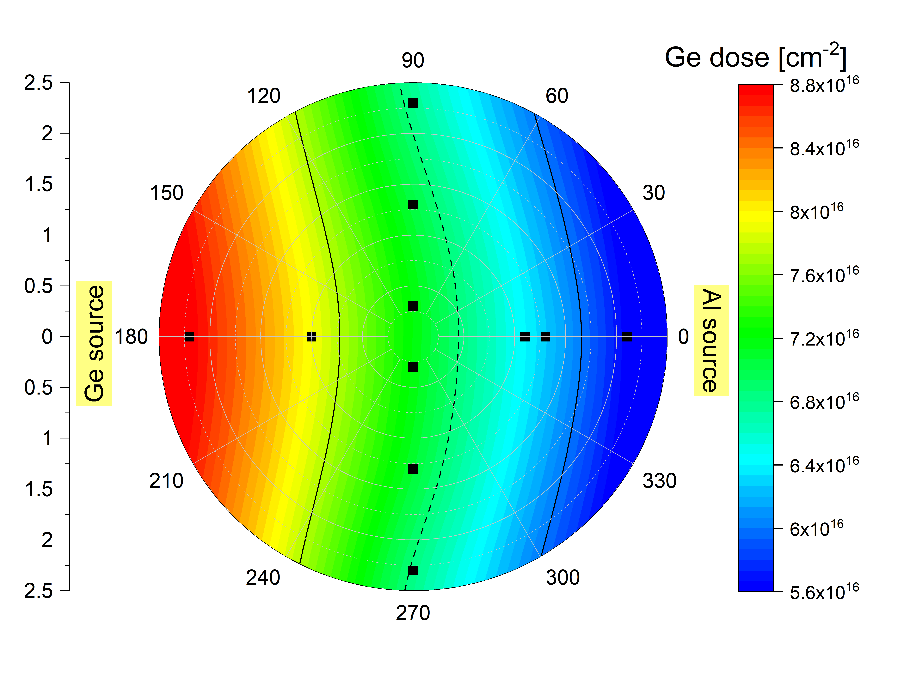
2nd step: dopant deposition
Germanium
Aluminum
Legnaro, 16- 17 Nov 2023

Slide 27
3rd step: Pulsed Laser Melting
Al CODEP (0,1 J/cm² pre-annealing) Hall dose
Al CODEP (0,1 J/cm² pre-annealing) Sheet resistance
Legnaro, 16- 17 Nov 2023

Slide 28
500 mJ/cm² no CAP
500 mJ/cm² CODEP
700 mJ/cm² CODEP
500 mJ/cm² no CAP
500 mJ/cm² CODEP
700 mJ/cm² CODEP
³²Ge
³²Ge
³²Ge
³²Ge
³²Ge
³²Ge
Legnaro, 16- 17 Nov 2023

Slide 29
Preliminary measurements
Increasing the processed surface area led to an earlier breakdown: dust reduction steps in progress.
ISO 7 box during PLM
ISO 7 softbox during sputtering
Legnaro, 16- 17 Nov 2023

Slide 30
1st step: crystal polishing
Grinding
-Grinding with 3 µm Al₂O₃ slurry to remove sawing damages: the abraded thickness depends on last process.
Polishing
-Wet etching (3:1 HNO₃ : HF) for several minutes or chemical-mechanical polishing with rotating disc rinsed with H₂O₂ 1% (pH 12 with KOH)
Grinded surface
Polished surface
Legnaro, 16- 17 Nov 2023
Notes:
The grinding step is performed moving the crystal on a glass plate submerged in a 3 micrometer alumina slurry. The acid polishing was initially used to its rapidity and consisted on a 3:1 Nitric to Hydrofluoric acid solution, but we changed to a chemical-mechanical abrasion on a rotating cloth disc using a 1% solution of H2O2 in a basic environment to promote erosion.
The time for this last process was checked with an initial trial samples through profilometry and a time between 90 minutes to 2 hours was chosen to achieve minimal roughness.

Slide 31
2nd step: dopant deposition
Source 1
Top view
Sb
Source 2
Sample
Access
Access
Sputtering deposition
Overpressured softbox with HEPA filters: one infinite rotational axis for coaxial samples,two linear axes, 90° joint for sample tilting.
n⁺ | Sb | 2 nm
n⁺ | GeP | 35 nm
p⁺ | Al (Ge cap) | 4 nm (10 nm)
Al
Ge
Legnaro, 16- 17 Nov 2023
Notes:
This is the sputtering chamber used: it is located inside a softbox and it is equipped with two linear axis and one rotational axis with a 90 degrees joint for coaxial detectors.
It is equipped with two sputtering sources and two accesses: sources are perpendicular and both pointing the center. We tested 2 nm Sb depositions or 35 nm depositions of germanium fosphide for n dopants and a patented 4 nm Al deposition capped with 10 nm of germanium to reduce ossidation.

Slide 32
3rd step: Pulsed Laser Melting
1 pulse
- - - 1 pls activation
4 pulses
- - - 4 pls activation
Al
Sb
C. Carraro, “Laser processes for HPGe gamma-ray detectors“ (Symposium L) 01 June 2023, 18:00
Legnaro, 16- 17 Nov 2023
Notes:
As Dr Carraro will explain…….., we achieved ultra high activations in Sb with a single pulse, and this level stay constant even after four pulses, which are located at the grid intersection points. With Aluminum, oxidation plays a central role and concentrations and activations are more irregular depending on several conditions, like vacuum levels durin sputtering or PLM atmosphere.

Slide 33
4th step: lithography
Full area
Partial area
Gold sputtering deposition
Lithographic process using selective etching solutions:
Hot pure H₂SO₄ for Sb deposition (preserve Sb junction)
H₂O₂ for GeP deposition (slowly etches everywhere)
Kern solutions (H₂O₂, H₃PO₄, Ethanol) for Al-Ge deposition (preserve Al junction)
Photolithographic process:
Positive resist spin coating
Softbake
Exposure through acetate mask
Development
Post-Exposure Bake
Gold stripping
Resist stripping
Trenching: strong acid attack (HNO₃ , HF)
GeP
Sb
L=10mm, t=2mm
L=35mm, t=2mm
D=40mm, t=20mm
L=35mm, t=10mm
L=35mm, t=10mm
Legnaro, 16- 17 Nov 2023
Notes:
After the laser process on the full area, we deposit a 100 nm gold layer on top of the junction and we perform a classic photolithographic process, which consists in a positive resist spin coating, softbake, exposure, development, Post exposure bake and Gold stripping in the gaps between the future segments. We then strip the resist and trench the junction using the 3:1 nitric hydrofluoric solution. This is the effect on different samples.
After the laser process on part of the surface, each non treated dopant has to be remove without damaging the junctions, and suitable acids has to be used.
Sb is removed with hot pure sulfuric acid, Diluted hydrogen peroxide etch both treated and untreated germanium phosphide, but slowly enough to save the junction. An hydrogen peroxide, posforic acid and ethanol, solution is used to remove capped Al deposits. These are the effects on planar samples with posfor and antimony.

Slide 34
5th step: passivation
Full area
Partial area
Trenching.
Quenching selective acids with suitable agents:
H₂SO₄ (Sb) → Water (Safety)
H₂O₂ (GeP) → Water (Already diluted)
Kern (Al-Ge) → Methanol
Quenching:
after the acid attack, rinse the sample in Methanol to saturate chemically active surfaces.
Methoxide-terminated Ge shows good surface insulation and stability
H₂SO₄
Native pass.
Native pass.
Water pass.
Metoh pass.
Rep. Metoh pass.
BDWater
Legnaro, 16- 17 Nov 2023
Notes:
The final step is the insulation of all the intrinsic surfaces: after the threnching between the gold plated samples an old study we performed showed that methanol rinsing right after the acid attack leads to a good passivation.
On non plated junctions, Methanol is also used after Al etchants, but water is used after already well diluted hydrogen peroxide and especially after hot pure sulfuric acid. Multiple baths are implemented to increase efficiency.

Slide 35
Thin planar detectors
Sb junction, p-type, L=10mm, t=2mm
Electrical test:
reverse I-V characteristics and resistance between contacts.
Spectroscopical test:
²⁴¹Am spectra acquisition.
Depletion V
Guard Ring
S1
S2
Measured before and after recovery annealing and re-passivation to test junction stability
S. Bertoldo et al. “New method for the production of thin and stable, segmented n+ contacts in HPGe detectors”, Eur. Phys. J. A (2021) 57:177
Legnaro, 16- 17 Nov 2023
Notes:
Processes are first tested on a 10 millimeter wide 2 mm thick detector with two segments guarded by a ring; top junction is Sb and bottom layer is B inplanted: the sample also underwent a recovery thermal annealing simulation to test thermal stability.
Through I-V reverse voltage characteristics we show the efficiency of the guard ring on surface leakage currents and the low currents of the segments well above depletion voltages.
We also acquired spectra with Am source at different voltages showing the effective depletion voltage at the maximum counting rate: the sample deliver very high resolution even after annealing.

Slide 36
Thin planar detectors
Sb/p-HPGE/Al, L=35mm, t=2mm
¹³³Ba, 20V
¹³³Ba, 20V
E=80keV
FWHM=0.89keV
E=356keV
FWHM=1.19keV
GR
Before annealing
After annealing
Before annealing
After annealing
C6
C5
C4
C3
C2
C1
⁶⁰Co gamma rays hitting C2 and inducing transient signals on neighbors segments C1 and C3: from Pulse Shape Analysis it is possible to recover the exact location of the event.
Legnaro, 16- 17 Nov 2023
Notes:
We then obtained similar results with a wider samples , 35 mm wide and 2 mm thick, but with the Sb PLM junction and the bottom Al PLM layer.
After electrical characteristics on the bottom layer we acquired spectra as before for each contact: here we show a Ba spectrum from the Al side and from one of the contacts. The number of contacts allow also to perform pulse shape analysis to reconstruct the exact event position acquiring signal shapes with a digitizer.

