Slide 1
Measurements at the SIRAD irradiation facility
Luca Silvestrin
Università di Padova, Dipartimento di Fisica e Astronomia
INFN Sezione di Padova
LNL User Meeting LNL, November 17 2023

Slide 2
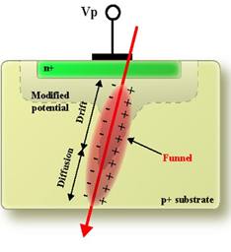
Radiation Effects in electronics
SEE - Single Event Effects
  Effect due to the passage of a single energetic ionizing particle
  Sudden large ΔE_{ionization} deposited in the “wrong” place at the “wrong” time (sensitive junction)
Ionization
TID - Total Ionizing Dose
  Small ΔE_{ionization} deposited uniformly and delivered over a long time
  Slow drift of device parameters due to charge accumulation in SiO₂
Poly
+
e
+
+
+
SiO₂
e
h
V
V
h
h
h
V
h
h
h
V
Si
-
h
-
-
-
Cumulative
DDD - Displacement (Bulk) Damage Dose
  Non-ionizing ΔE transfers to atomic nuclei (Coulomb nuclear interactions).
  Cumulative displacement damage of silicon lattice
exiting
particle
incident
particle
Frenkel pair
vacancy
interstitial
Interstitial and vacancy defect creation.

Slide 3
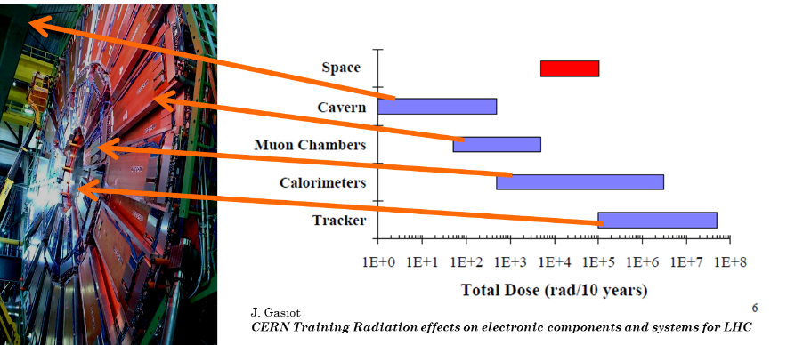
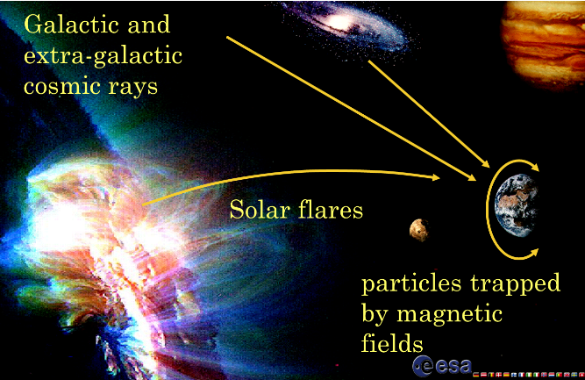
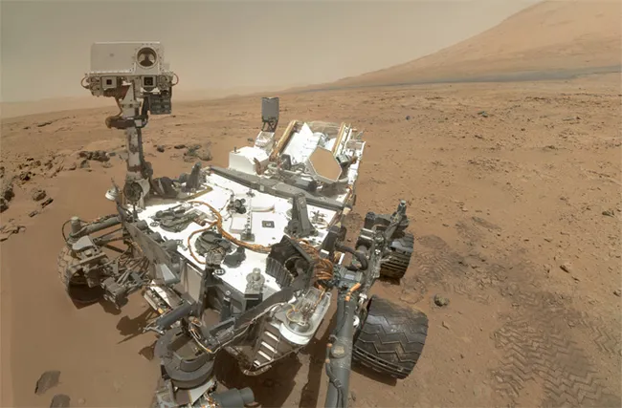

Radiation environments of interest
High Energy and Nuclear Physics Environments
Space environments
Everyday environments
NASA Curiosity rover on Mars

Slide 4
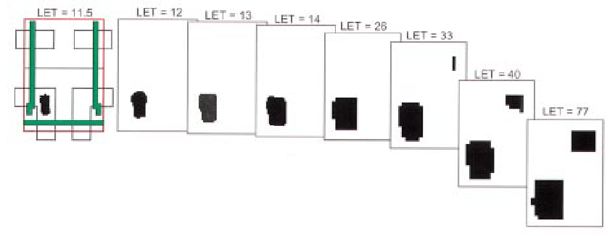
Single Event Cross section curve
Simulatio of the sensitivity to single event upset of a SRAM memory cell.
(Courtesy of prof. Barney Doyle)
Cross section curve of the ESA-SEU monitor.

Slide 5
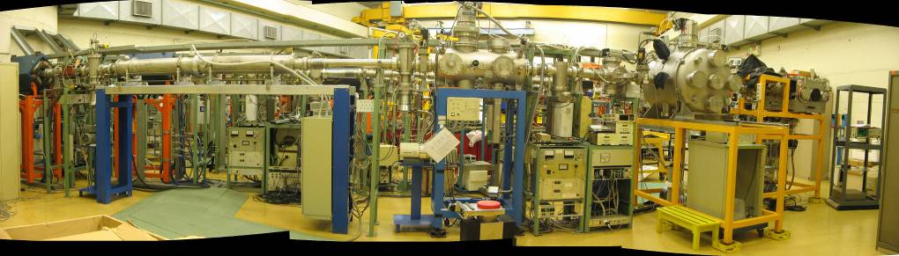
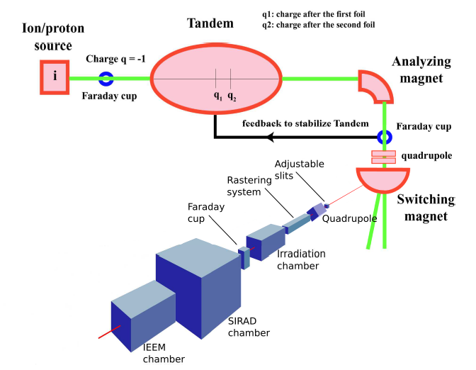
The SIRAD irradiation facility
  SEE tests with heavy ions
  DDD with protons and lithium ions
  TID with heavy ions
  Material modification with heavy ions
Beam
diagnostics

Slide 6
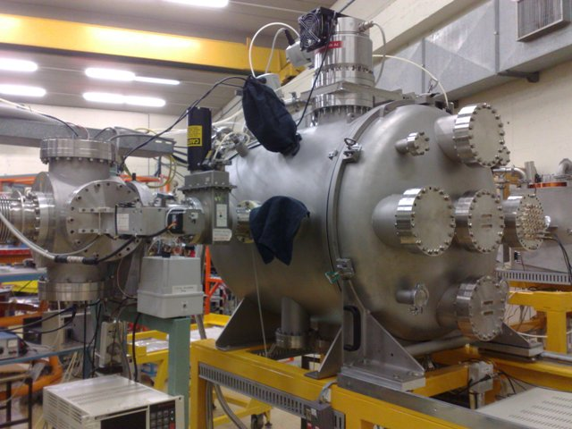
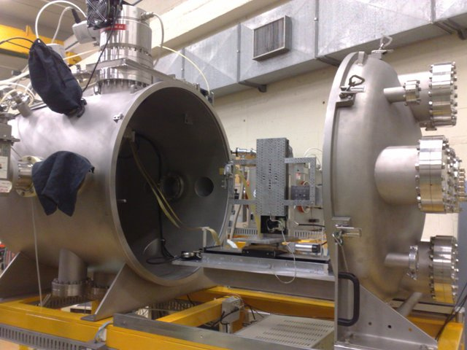
SIRAD technical characteristics
The chamber is open with the sample holder exposed
The irradiation chamber
(active since 2006)
Diameter : 80 cm
Depth: 80 cm
It is used for global SEE tests, bulk damage and TID studies

Slide 7
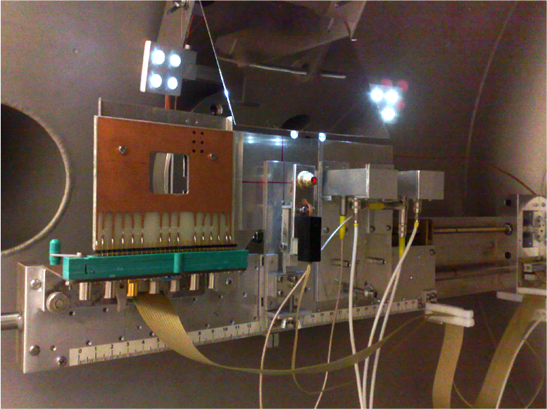
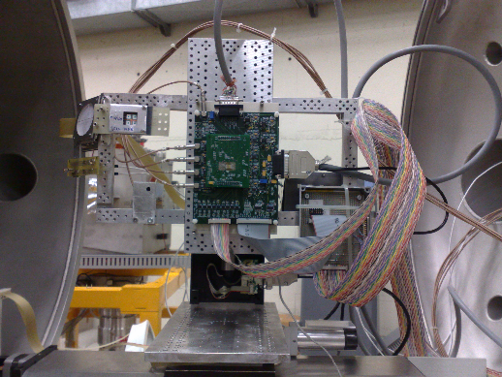
SIRAD technical characteristics
The dosimetry systems inside the irradiation chamber
Mirror of the optical inspection system
Pointing laser
Motorized sample holder
Horizontal transl. 30 cm
Vertical transl. 15 cm
Resolution 10 µm
Rotation axis vertical, +/-80º (1º steps)
Fixed PIN Silicon diodes board
http://www.youtube.com/watch?v=sKPew-nnfog
Faraday cup

Slide 8
Ion beams available at SIRAD
$$E=E_{inj}+V_{0}∙\left[1+q_{1}∙f+q_{2}∙\left(1−f\right)\right]$$
f = 0.25
Typical ions available at SIRAD serviced by the XTU-Tandem accelerator, assuming:
  Tandem voltage at 14 MV,
  the most probable charge state using two strippers.
Note: The range and surface LET are in silicon (SRIM).
The magnetic rigidity is also tabulated. The rigidity limit of SIRAD is ~ 1.6 T-m
Ion Species | Energy [MeV] | q₁ | q₂ | Rigidity [T∙m] | Range in Si [μm] | Surface LET in Si [MeV×cm²/mg]
¹H | 28 | 1 | 1 | 0.77 | 4340 | 0.02
⁷Li | 56 | 3 | 3 | 0.95 | 376 | 0.37
¹¹B | 80 | 4 | 5 | 0.86 | 185 | 1.13
¹²C | 94 | 5 | 6 | 0.81 | 164 | 1.53
¹⁶O | 108 | 6 | 7 | 0.86 | 107 | 2.95
¹⁹F | 122 | 7 | 8 | 0.87 | 95 | 3.90
²⁸Si | 157 | 8 | 11 | 0.87 | 61 | 8.58
³²S | 171 | 9 | 12 | 0.89 | 54 | 11.1
³⁵Cl | 171 | 9 | 12 | 0.93 | 50 | 12.7
⁴⁸Ti | 196 | 10 | 14 | 1.00 | 40 | 20.9
⁵¹V | 196 | 10 | 14 | 1.03 | 38 | 22.6
⁵⁸Ni | 220 | 11 | 16 | 1.02 | 37 | 29.4
⁶³Cu | 220 | 11 | 16 | 1.06 | 34 | 31.9
⁷⁴Ge | 231 | 11 | 17 | 1.11 | 33 | 36.9
⁷⁹Br | 241 | 11 | 18 | 1.10 | 33 | 41.8
¹⁰⁷Ag | 266 | 12 | 20 | 1.21 | 29 | 58.4
¹²⁷I | 276 | 12 | 21 | 1.28 | 30 | 65.4
¹⁹⁷Au | 275 | 13 | 26 | 1.52 | 26 | 79.1
1st multi-source
(¹⁹F, ³⁵Cl, ⁷⁹Br, ¹²⁷I)
2nd multi-source
(¹⁶O, ²⁸Si, ⁵⁸Ni, ¹⁰⁷Ag)

Slide 9
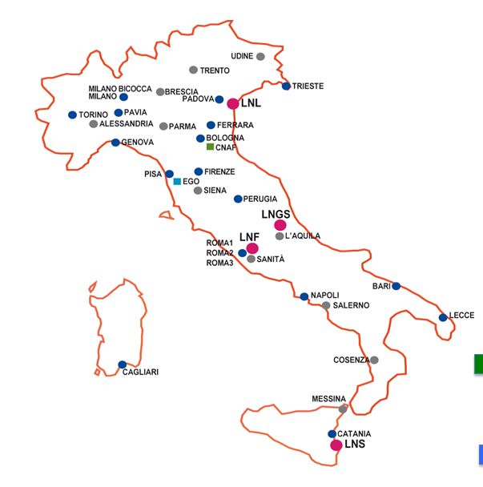
SIRAD collaboration in 2013-2023
Univ. e INFN Padova
Univ. e INFN Milano-Bicocca
Univ. e INFN Torino
Univ. e INFN Ferrara
INFN Pisa
INFN Trieste
Univ. and INFN Padiva
INFN Roma-Tor Vergata
Univ. Cassino
INAF IAPS
ENEA
CERN
EPFL
IFIN-HH
Micron Technology
ESA
NASA-JPL
Technical University of Braunschweig
CEA-LETI
STMicroelectronics
Saphyrion (Lugano)
LUGANO
CASSINO

Slide 10
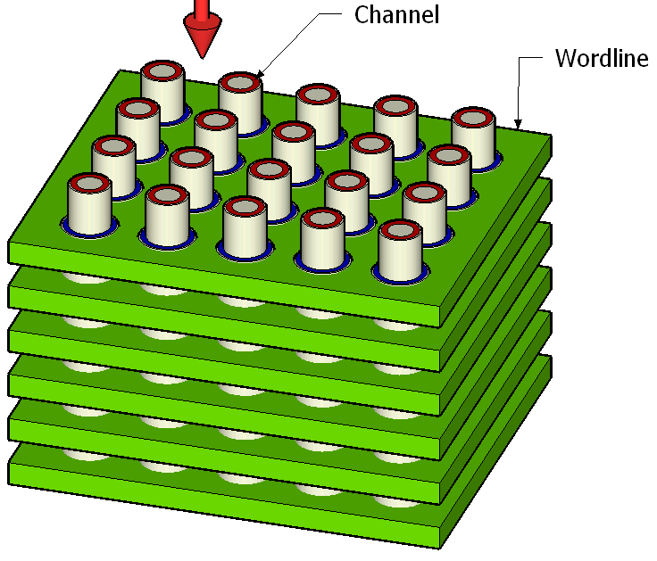
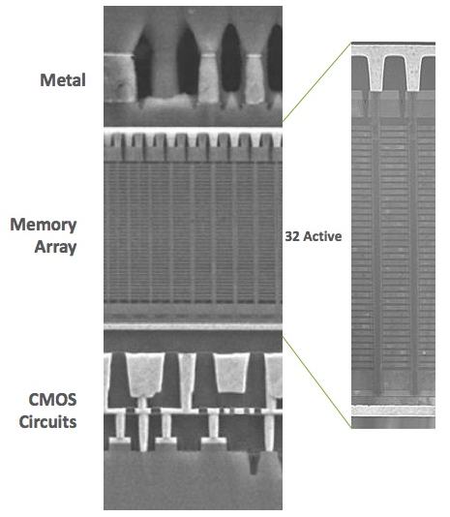
SEE tests in Non-Volatile Memories
Non-volatile memories are used in almost all electronic applications, from smartphones to servers, and from microwave ovens to cars
3D devices are the last frontier to reach ever-increasing levels of integration and capacity
Numerous irradiations performed on state-of-the art non-volatile memories, using heavy ions
32 layers (WL)
few μm
Channel
The floating gate (annulus shaped) is sandwiched between the tunnel oxide and the interpoly dielectric.
K. Parat et al., IEDM 2015
Spokepersons: Marta Bagatin and Simone Gerardin, Università and INFN Padova

Slide 11
SEE tests in Non-Volatile Memories
Particles create clusters of cells with shifted threshold voltage
Different cell technologies tested: floating gate vs charge trap
Tests at SIRAD by the UniPD Information Engineering Department were instrumental to assess the performance of 3D non-volatile memories in harsh environments
Nickel (LET 29 MeV cm²/mg) at 0°
Nickel (LET 29 MeV cm²/mg) at 30°
Spokepersons: Marta Bagatin and Simone Gerardin, Università and INFN Padova

Slide 12
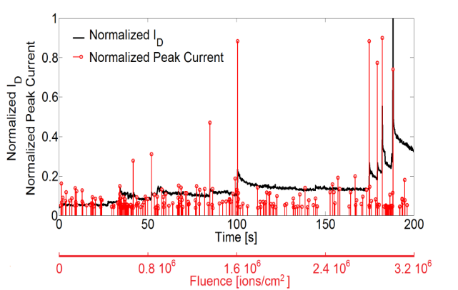
SEE tests in SiC Power Devices
Experimental Set Up
SiC power devices are the primary candidates to integrate/replace standard Si-based devices in applications where high frequencies, high operating temperatures, and reduced volumes are required.
The experimental set-up is designed to achieve the best behavior in terms of signal-to-noise ratio, allowing the measurement, during irradiation, of the gate leakage current down to the hundreds of picoamperes, range and the drain leakage current down to the nano amperes range. The circuit acquires the current pulses at both gate and drain terminals and, finally, a synchronized time base, allows us to correlate the leakage current jump to the current pulse that caused it.
A high-resolution measure of gate and drain leakage currents during irradiation.
The collection of drain and gate current pulses during each irradiation step.
A synchronized time base
Courtesy of Francesco Velardi, University of Cassino

Slide 13
SEE tests in SiC Power Devices
Main results
The failure critical voltage is related to the different penetration ranges of the bromine ions.
The plasma filament, created by the ionizing particle perturbing the electric field, forces it beyond its track. If the ion traverses the entire epitaxial layer, the simultaneous presence of a very high conduction current density and an intense electric field results in a considerable power density at the metal/epitaxy interface, leading to a thermal failure.
1.2 kV SiC Schottky diode
Thermal Burnout
The experimental data evidence three critical regions in terms of SEE sensitivity.
At very low bias voltages, the gate latent damage severely compromises the oxide integrity, reducing the maximum operating voltage to a value lower than 100V.
Starting from about V_{DS}= 350V, the sudden increase of the drain leakage current reveals progressive drain damage, injuring the drain structure.
At about V_{DS}=500V, a classical burnout takes place.
The burnout is not related to the progressive drain injury.
Ion | Energy [MeV] | Critical V_{DS} [V]
¹²⁷I | 276 | 65 – 80
⁷⁹Br | 240 | 70 – 85
⁵⁸Ni | 220 | 75 – 85
Gate Latent Damage
1.2 kV SiC Power MOSFET
Courtesy of Francesco Velardi, University of Cassino

Slide 14
Beamtime allocation (2013-2023)
Beamtime shortage
Pandemic
Tandem stop
Courtesy of prof. S. Mattiazzo - University of Padova
and O. Carletto - LNL accelerator division.

Slide 15
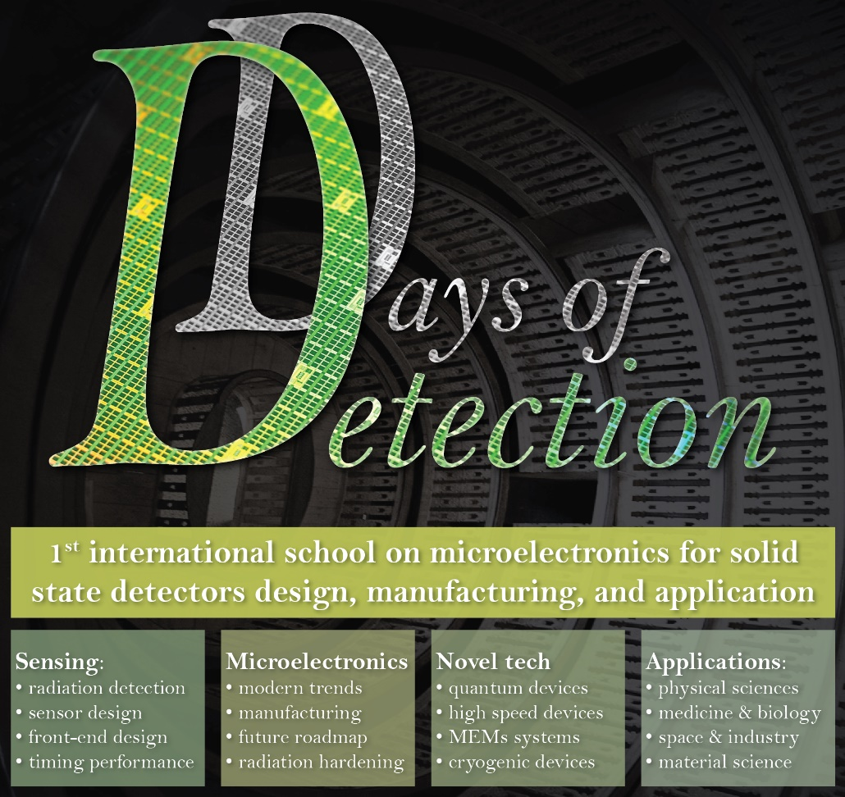
International School on detectors and radiation damage
… and its legacy
The school, will review and explain the latest advancements in solid-state sensors design and manufacturing and their applications.
October 23–25, 2023
Padova, Palazzo della Salute

Slide 16
Conclusions
SIRAD is a strategic facility for INFN, to validate electronics which has to survive in radiation harsh environments in HEP experiments;
After thirty years of activity, the SIRAD collaboration is well established and still growing.

Slide 17
The end backup slides follow

Slide 18
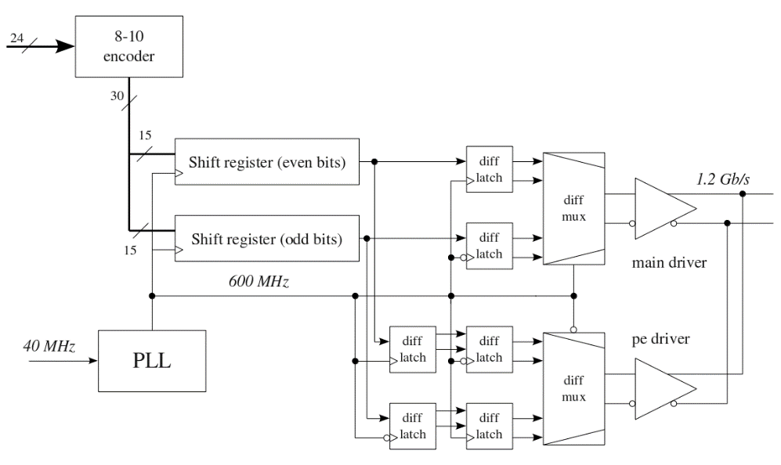
SEU Test on the ALICE ITS ALPIDE DTU
Ni 0°
Ag 0°
Si 45°
Ni 45°
Ni 20°
Ag 0°
Si 45°
Si 0°
Ni 0°
Ni 45°
Si 20°
O 45°
Data Transmission Unit (DTU) for the ALPIDE ASIC for the ALICE experiment
Data rate : 1.2 Gb/s
Input clock : 40 MHz
Double Data Rate
SEU tolerant (tested at SIRAD)
Installation ongoing
Spokeperson: Gianni Mazza, INFN Torino

Slide 19
2013-2019: space and other applications
Università di Padova – DEI (Dipartimento di Ingegneria dell’Informazione)
  SEE on non volatile Flash memories, non volatile phase change memories (PCM), non volatile resistive memories (RRAM), SRAM and flip flop in BCD technology, GaN transistors and MIM capacitors, in collaboration with Micron Technology, ESA, NASA-JPL, Technical University of Braunschweig, CEA-LETI, STMicroelectronics
IXPE (INFN Roma Tor Vergata, INFN Pisa, INAF IAPS)
  Single Event Latchup (SEL) and SEU sensitivity of the ASIC in the Gas Pixel Detector of the X-ray Imaging Polarimetry Explorer satellite mission
Università di Cassino e del Lazio Meridionale (Dipartimento di Ingegneria Elettrica e dell’Informazione)
  Single Event Effects in Power MOSFETs
ENEA
  Investigation of the effect of high fluence irradiation on the swelling and microstructural behavior of DS4 steel and on of anti corrosion coatings for high temperature operation
TERA (INFN Torino)
  SEU test of the Tera ASIC (hadron beam monitoring in cancer treatment)
See Gerardin’s talk
space
See Velardi’s talk
other

Slide 20
Beamtime allocation (2000-2019)
2013-2019

Slide 21
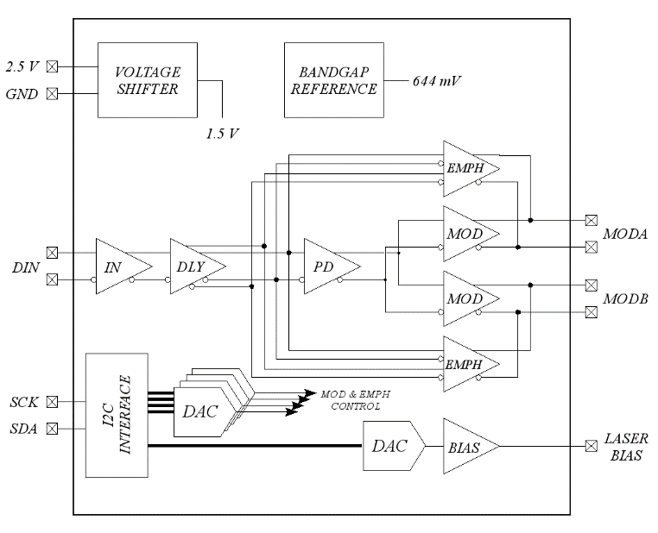
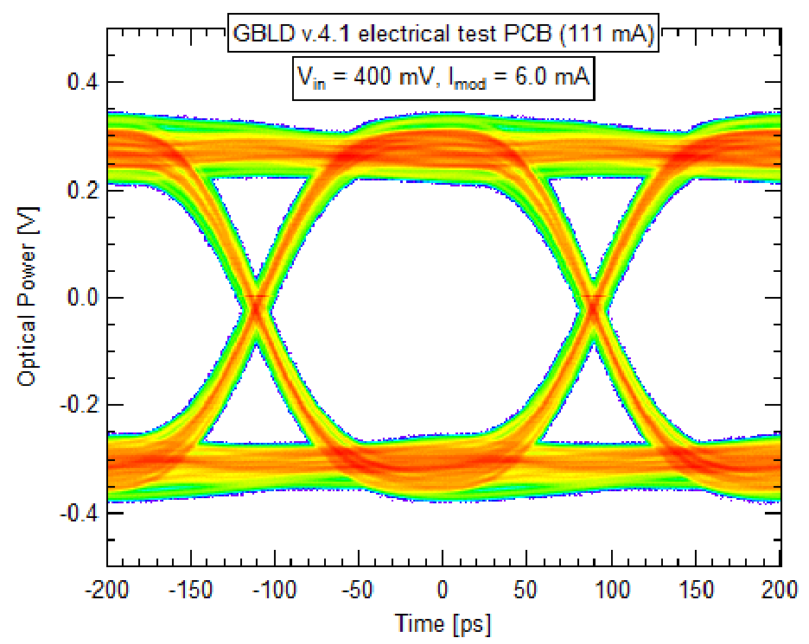
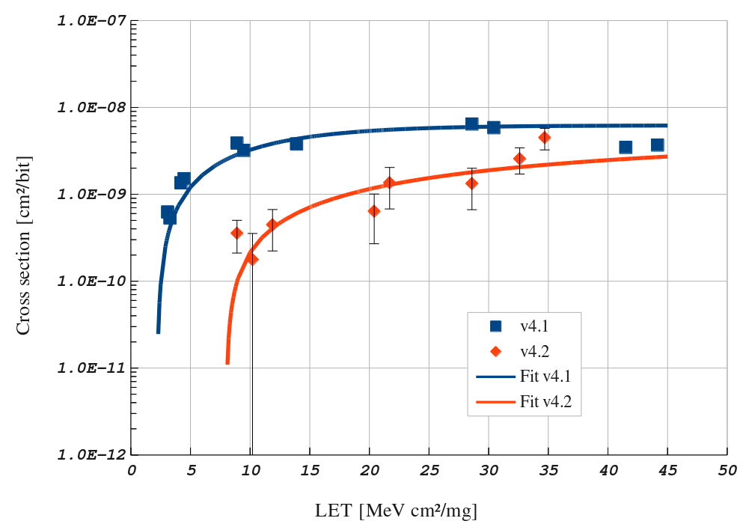
SEU Test on GBLD chip
GBLD is a radiation tolerant laser driver for the GigaBit Transceiver (GBT) project (which, in its turn, is part of the “Radiation Hard Optical Link Project” which aims at developing a radiation hard bi-directional optical link for use in the LHC upgrade programs)
Data rate : 5 Gb/s
Laser types : EE and VCSEL
Technology : CMOS 130 nm
SEU tolerant (tested at SIRAD)
~91000 chips produced
Spokeperson: Gianni Mazza, INFN Torino
Notes:
the GBT part of the “Radiation Hard Optical Link Project” which aims at developing a radiation hard bi-directional optical link for use in the LHC upgrade programs. The link targets data transmission between the on-detector and off-detector electronics serving simultaneously applications such as data acquisition, timing, trigger and experiment control. The GBT Project it self aims at the development of radiation hard chipset that will allow the implementation of such a link. The project aims also at the development of HDL code to enable FPGAs to interface directly with the links based on the GBT chip set.

Slide 22
2013-2019: HEP applications
CHIPIX65 (INFN Padova, INFN Torino, INFN Bari, INFN Pavia, INFN Pisa, INFN Milano, CERN)
  Study of Single Event Effect (SEE) on pixel readout integrated circuits in 65nm for HL-LHC upgrade
LHCb (INFN Ferrara, CERN, IFIN-HH)
  Radiation hardness tests and qualification for SEE of the read‐out electronics chain for the Upgrade of the LHCb RICH detectors at CERN and Radiation hardness (SEE) on FPGAs in the context of LHCb Upgrade
PANDA (INFN Torino)
  Single Event Upsets (SEU) in the ToPix4 ASIC for the pixel detector readout of the PANDA experiment
ALICE (INFN Padova, INFN Torino, CERN)
  Study of proton-induced bulk damage on the prototype pixel and SEU tests of the GBLD laser driver for sensors for the ALICE ITS upgrade
CMS (INFN Padova, INFN Pavia, INFN Trieste, CERN)
  TID effects on CMS muon barrel detector Electronics, bulk damage on SiPM for the CMS HCAL upgrade and SEE on RPCs (Resistive Plate Chamber) Front-End Board for the CMS Muon System at HL-LHC
SCALTECH28 (INFN Padova, INFN MI Bicocca, CERN, EPFL)
  Study of Single Event Effects (SEE) on a flip flop based shift register in a 28nm High-K CMOS technology for future HEP experiments
APOLLO (INFN Padova, INFN Roma, CERN, Cassino University, Padova University)
  SEE tests on LV Power Supplies for the next High Energy physics experiments

Slide 23
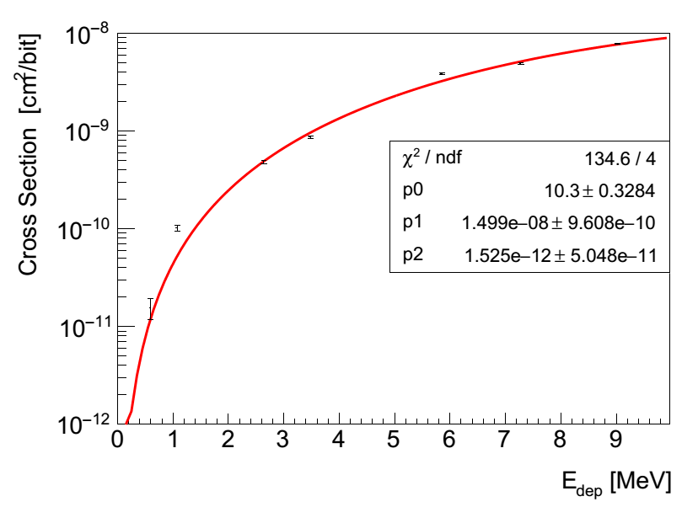
SEU Test on the PASTA chip
PASTA: custom readout circuit of silicon double-sided micro-strips of the PANDA MVD
  ASIC developed by JLU Giessen, FZ Juelich and INFN Torino
  Chip developed in 110 nm UMC technology
  Radiation tolerant circuits to Single Event Upset (SEU) effects are implemented
“Study of SEU effects in circuits developed in 110 nm CMOS technology» D. Calvo, et al. Presented at TWEPP2019
Test on the channel configuration register have been performed at SIRAD
The obtained result is adequate since the number of upsets expected in the micro-strip detector equipped with 3112 electronics readout chips, is less than 1 bit flip per hour taking into account that an evaluated particle flux of 5× 10⁴ hadrons/cm² contribute to upset effects.
Spokeperson: Daniela Calvo, INFN Torino

Slide 24
SEU Test on MZMD chip
  The MZMD chip has been designed and produced for the PHOS4BRAIN INFN Gr V experiment: PHOtonic Systems for Broad Rad HArd INterconnect
It implements two 5 Gbps drivers for Silicon-Photonics Mach Zehnder Modulators and a high-speed serializer
It is fabricated in 65 nm TSMC technology implementing RHBD techniques like Enclosed Layout, CML and double-long transistors.
Cl35
Si28
Br81
I127
Ni58
Ag109
O16
Spokeperson: Guido Magazzù, INFN Pisa

Slide 25
SEU test for LHCb RICH Detector Upgrade
Different irradiations performed in the period 2014-2018
  Heavy ions and 28 MeV protons
Radiation hardness characterization of the prototype and production versions of the CLARO ASIC (8 ch. ampl./discr. designed by INFN Ferrara/Milano-Bicocca/AGH-Krakow) and PMT glass transmittance
Tests at SIRAD were instrumental to assess the CLARO performance
Spokeperson: Massimiliano Fiorini, Università and INFN Ferrara

Slide 26
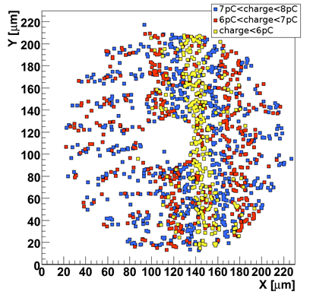
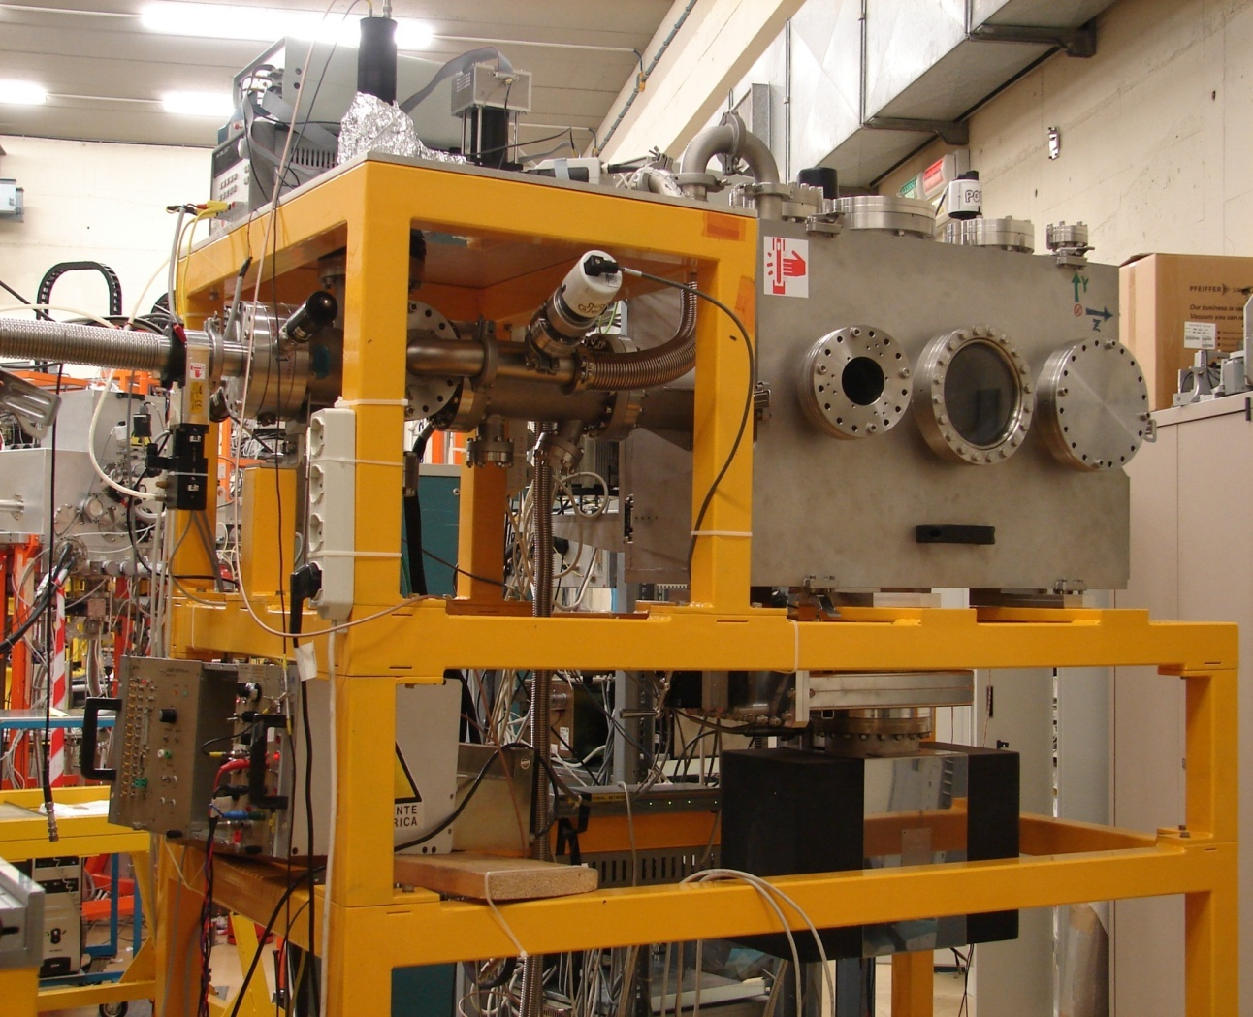
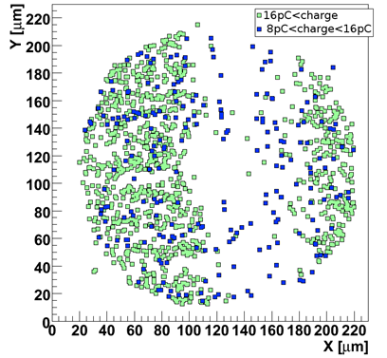
The Ion Electron Emission Microscope
Time resolved ion induced SEE-micromapping with the IEEM:
  single energetic heavy ion impact points are reconstructed with a resolution of a few microns at a rate of 1kHz over a circular area of 180 µm diameter.
power MOSFET device with 223 MeV ⁷⁹Br ions.

